Slide 1




Dementia Types and Tailored Approaches
02/13/2025
Allison Lindauer, PhD, APRN| Associate Professor
| Oregon Alzheimer’s Disease Research Center
| lindauer@ohsu.edu | Tel: 503-494-6796
Notes:
3181 SW Sam Jackson Park Road, CR-131
Tel: 503-494-6796

Slide 2


Layton Center
The Layton Aging & Alzheimer’s Disease Center at OHSU is one of 37 NIH Alzheimer’s Disease Centers in the United States and the only one of its kind in Oregon.
The Layton Center conducts studies of promising treatments, technologies for patient support, genetics, neuroimaging and pathology.
Along with research, we also provide evaluation and treatment for persons with dementia and their family members.
www.ohsu.edu/alzheimers-disease-research-center

Slide 3
Objectives
Cite common types of dementia and key features
Recognize common features of all dementias
Identify treatment strategies for each type
Notes:
Here are our learning objectives for today's presentation.

Slide 4
Why seek a diagnosis?

Slide 5
Diagnosis: "Name it to tame it"
With diagnosis
Without diagnosis
Opportunity to modify risk factors
Caregiver/family support
Emotional and spiritual support
Participate in research
Advanced care planning
Disease modifying medications
Uncertainty
Guilt
Diagnosed later (in hospital) with higher mortality
Safety
Lack of family support: "I thought it was just me being awful."

Slide 6
Key Points
Take memory concerns seriously
Seek opportunities to learn more
Thank you for being here

Slide 7
Dementia Overview

Slide 8

Dementia: An umbrella term for progressive, neurodegenerative diseases that affect memory, mood, thinking, behavior and function.

Slide 9
Criteria for Dementia
Cognitive impairment which:
Interferes with the ability to function at work or at usual activities
Represent a decline from previous levels of functioning
Not explained by delirium or major psychiatric disorder
Impairment in a minimum of two of the following domains:
Ability to acquire and remember new information (working memory)
Reasoning and handling of complex tasks, poor judgment (executive)
Visuospatial abilities
Impaired language
Personality, behavior, or comportment
McKhann et al., 2011
National Institute on Aging-Alzheimer’s Association workgroups on diagnostic guidelines for Alzheimer’s disease. Alzheimer’s and Dementia, May 2011
Notes:
Detected through a combination subjective input from patient and informants, and objective clinician assessment

Slide 10
Key Points
Take memory concerns seriously
Providing a diagnosis to a patient gives them the opportunity to modify risk factors, plan for the future, and seek treatment

Slide 11
Types of Dementia

Slide 12

Alzheimer’s Disease
Notes:
Sue Rose

Slide 13
Alzheimer’s Disease
Slow progression of memory loss
Recall on memory tests
Names of friends, family
Functional decline
Stove
Remote
Phone
Typically affects adults over 65
Behavior changes in moderate to later stages

Slide 14
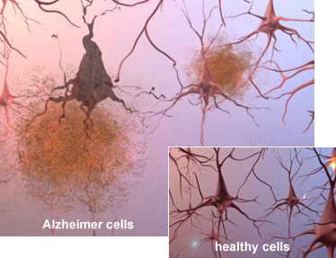
Alzheimer’s disease
In AD, plaques (abnormal
clusters of a sticky protein
called beta-amyloid) and
tangles (twisted strands
of another protein) cause
cell death.
https://www.alz.org/alzheimers-dementia/what-is-alzheimers/brain_tour_part_2

Slide 15
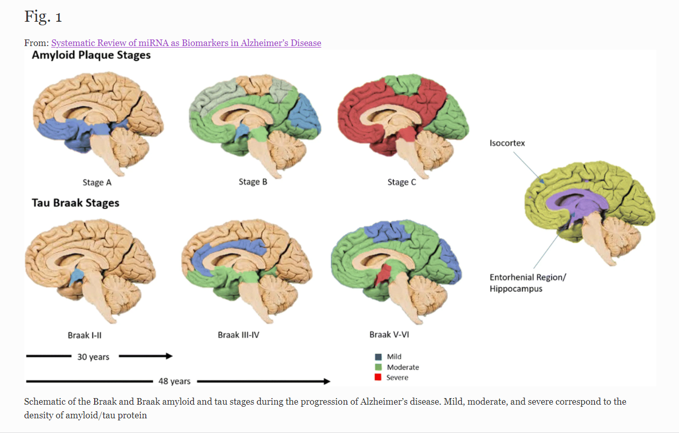
Header
http://creativecommons.org/licenses/by/4.0/
Notes:
This article is distributed under the terms of the Creative
Commons Attribution 4.0 International License (http:/ /
creativecommons.org/licenses/by/4.0/), which permits unrestricted use,
distribution, and reproduction in any medium, provided you give appropriate
credit to the original author(s) and the source, provide a link to the
Creative Commons license, and indicate if changes were made.

Slide 16

Medications for Alzheimer’s Disease:
”Slow the roll.”

Slide 17
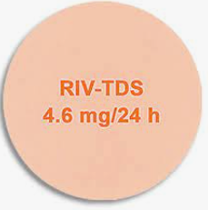


Acetylcholinesterase Inhibitors
Donepezil, rivastigmine, galantamine
Moderate evidence for improvement in cognitive function and ADLs
Various forms
Notes:
Birks, J. S. and R. J. Harvey (2018). "Donepezil for dementia due to Alzheimer's disease." Cochrane Database of Systematic Reviews(6).
- Background Alzheimer's disease is the most common cause of dementia in older people. One approach to symptomatic treatment of Alzheimer's disease is to enhance cholinergic neurotransmission in the brain by blocking the action of the enzyme responsible for the breakdown of the neurotransmitter acetylcholine. This can be done by a group of drugs known as cholinesterase inhibitors. Donepezil is a cholinesterase inhibitor. This review is an updated version of a review first published in 1998. Objectives To assess the clinical efficacy and safety of donepezil in people with mild, moderate or severe dementia due to Alzheimer's disease; to compare the efficacy and safety of different doses of donepezil; and to assess the effect of donepezil on healthcare resource use and costs. Search methods We searched Cochrane Dementia and Cognitive Improvement’s Specialized Register, MEDLINE, Embase, PsycINFO and a number of other sources on 20 May 2017 to ensure that the search was as comprehensive and up‐to‐date as possible. In addition, we contacted members of the Donepezil Study Group and Eisai Inc. Selection criteria We included all double‐blind, randomised controlled trials in which treatment with donepezil was administered to people with mild, moderate or severe dementia due to Alzheimer's disease for 12 weeks or more and its effects compared with those of placebo in a parallel group of patients, or where two different doses of donepezil were compared. Data collection and analysis One reviewer (JSB) extracted data on cognitive function, activities of daily living, behavioural symptoms, global clinical state, quality of life, adverse events, deaths and healthcare resource costs. Where appropriate and possible, we estimated pooled treatment effects. We used GRADE methods to assess the quality of the evidence for each outcome. Main results Thirty studies involving 8257 participants met the inclusion criteria of the review, of which 28 studies reported results in sufficient detail for the meta‐analyses. Most studies were of six months' duration or less. Only one small trial lasted 52 weeks. The studies tested mainly donepezil capsules at a dose of 5 mg/day or 10 mg/day. Two studies tested a slow‐release oral formulation that delivered 23 mg/day. Participants in 21 studies had mild to moderate disease, in five studies moderate to severe, and in four severe disease. Seventeen studies were industry funded or sponsored, four studies were funded independently of industry and for nine studies there was no information on source of funding. Our main analysis compared the safety and efficacy of donepezil 10 mg/day with placebo at 24 to 26 weeks of treatment. Thirteen studies contributed data from 3396 participants to this analysis. Eleven of these studies were multicentre studies. Seven studies recruited patients with mild to moderate Alzheimer's disease, two with moderate to severe, and four with severe Alzheimer's disease, with a mean age of about 75 years. Almost all evidence was of moderate quality, downgraded due to study limitations. After 26 weeks of treatment, donepezil compared with placebo was associated with better outcomes for cognitive function measured with the Alzheimer's Disease Assessment Scale‐Cognitive (ADAS‐Cog, range 0 to 70) (mean difference (MD) ‐2.67, 95% confidence interval (CI) ‐3.31 to ‐2.02, 1130 participants, 5 studies), the Mini‐Mental State Examination (MMSE) score (MD 1.05, 95% CI 0.73 to 1.37, 1757 participants, 7 studies) and the Severe Impairment Battery (SIB, range 0 to 100) (MD 5.92, 95% CI 4.53 to 7.31, 1348 participants, 5 studies). Donepezil was also associated with better function measured with the Alzheimer's Disease Cooperative Study activities of daily living score for severe Alzheimer's disease (ADCS‐ADL‐sev) (MD 1.03, 95% CI 0.21 to 1.85, 733 participants, 3 studies). A higher proportion of participants treated with donepezil experienced improvement on the clinician‐rated global impression of change scale (odds ratio (OR) 1.92, 95% CI 1.54 to 2.39, 1674 articipants, 6 studies). There was no difference between donepezil and placebo for behavioural symptoms measured by the Neuropsychiatric Inventory (NPI) (MD ‐1.62, 95% CI ‐3.43 to 0.19, 1035 participants, 4 studies) or by the Behavioural Pathology in Alzheimer's Disease (BEHAVE‐AD) scale (MD 0.4, 95% CI ‐1.28 to 2.08, 194 participants, 1 study). There was also no difference between donepezil and placebo for Quality of Life (QoL) (MD ‐2.79, 95% CI ‐8.15 to 2.56, 815 participants, 2 studies). Participants receiving donepezil were more likely to withdraw from the studies before the end of treatment (24% versus 20%, OR 1.25, 95% CI 1.05 to 1.50, 2846 participants, 12 studies) or to experience an adverse event during the studies (72% vs 65%, OR 1.59, 95% 1.31 to 1.95, 2500 participants, 10 studies). There was no evidence of a difference between donepezil and placebo for patient total healthcare resource utilisation. Three studies compared donepezil 10 mg/day to donepezil 5 mg/day over 26 weeks. The 5 mg dose was associated with slightly worse cognitive function on the ADAS‐Cog, but not on the MMSE or SIB, with slightly better QoL and with fewer adverse events and withdrawals from treatment. Two studies compared donepezil 10 mg/day to donepezil 23 mg/day. There were no differences on efficacy outcomes, but fewer participants on 10 mg/day experienced adverse events or withdrew from treatment. Authors' conclusions There is moderate‐quality evidence that people with mild, moderate or severe dementia due to Alzheimer's disease treated for periods of 12 or 24 weeks with donepezil experience small benefits in cognitive function, activities of daily living and clinician‐rated global clinical state. There is some evidence that use of donepezil is neither more nor less expensive compared with placebo when assessing total healthcare resource costs. Benefits on 23 mg/day were no greater than on 10 mg/day, and benefits on the 10 mg/day dose were marginally larger than on the 5 mg/day dose, but the rates of withdrawal and of adverse events before end of treatment were higher the higher the dose. Plain language summary Donepezil for people with dementia due to Alzheimer's disease Review question What effects (benefits or harms) does donepezil have on people with dementia due to Alzheimer's disease? Background Alzheimer's disease is the most common cause of dementia. As the disease progresses, people lose the ability to remember, communicate, think clearly and perform the activities of daily living. Their behaviour may also change. In severe Alzheimer's disease people lose the ability to care for themselves. The most commonly used treatment for Alzheimer's disease are medicines known as acetylcholinesterase inhibitors. Donepezil is one of these medicines. It is taken as a pill once a day. In Alzheimer's disease, one of the changes in the brain is a reduced number of nerve cells called cholinergic neurones. These are nerve cells that signal to other cells using a chemical called acetylcholine. Acetylcholinesterase inhibitors, such as donepezil, work by preventing acetylcholine from being broken down. This may improve the symptoms of dementia. However, acetylcholine is also found elsewhere in the body and so drugs of this type may have unwanted effects. Review methods In this review we examined evidence about benefits and harms from studies that compared donepezil, taken for at least 12 weeks, to placebo (a dummy pill), or that compared different doses of donepezil. The studies had to be double‐blind and randomised, that is, the decision whether people taking part got donepezil or placebo had to be made randomly and neither they nor the researchers should have known which treatment they were getting while the trial was going on. This was to make the comparison as unbiased, or fair, as possible. We searched for studies up to May 2017. We assessed the quality of all the studies we included. When it was sensible to do so, we analysed the results of studies together to get an overall result. Key results We included 30 studies w th 8257 participants. Most of the people in the studies had mild or moderate dementia due to Alzheimer's disease, but in nine studies they had moderate or severe dementia. Almost all of the studies lasted six months or less. The majority of the studies were known to have been funded by the manufacturer of donepezil. We found that people with Alzheimer's disease who took 10 mg of donepezil a day for six months did slightly better than people taking placebo, on scales measuring their cognitive function (e.g. thinking and remembering), how well they could manage their daily activities, and the overall impression of a trained researcher. We did not find any effect on behaviour or quality of life. People taking donepezil were more likely than those taking placebo to report side effects and to drop out of the studies. Most side effects were described as mild. Nausea, vomiting and diarrhoea were most common. Comparing 5 mg of donepezil a day with 10 mg/day, people on 5 mg had fewer side effects, but did slightly less well on cognitive function tests. A higher dose (23 mg/day) offered no advantages and was associated with more side effects. There is some evidence that use of donepezil is neither more nor less expensive than placebo when total health care costs are taken into account. Quality of the evidence In general, we thought that the quality of the evidence was moderate. The main factor reducing our confidence was concern that the results of some studies might have been biased by the way they were done. We cannot be sure that the results apply to treatment longer than six months. Conclusions After six months of treatment, there are benefits of donepezil that are large enough to measure in studies. It is associated with side effects that are mainly mild, but that may cause people to stop treatment. Being able to stabilise cognitive performance or ability to maintain activities of daily living may be important clinically. In terms of total healthcare costs the use of donepezil appears cost neutral. However, there does not appear to be an effect on quality of life. More data are still required from longer‐term clinical studies examining measures of disease progression or time to needing full time care.

Slide 18
Acetylcholinesterase Inhibitors
Increases acetylcholine in the brain
Enhances vagal tone (avoid in patients with bradycardia, conduction disorders)
Nausea, diarrhea
Pro-cholinergic (drooling, runny nose, urinary frequency)
Avoid anticholinergic meds (meds for allergies, incontinence)
Notes:
Birks, J. S. and R. J. Harvey (2018). "Donepezil for dementia due to Alzheimer's disease." Cochrane Database of Systematic Reviews(6).
- Background Alzheimer's disease is the most common cause of dementia in older people. One approach to symptomatic treatment of Alzheimer's disease is to enhance cholinergic neurotransmission in the brain by blocking the action of the enzyme responsible for the breakdown of the neurotransmitter acetylcholine. This can be done by a group of drugs known as cholinesterase inhibitors. Donepezil is a cholinesterase inhibitor. This review is an updated version of a review first published in 1998. Objectives To assess the clinical efficacy and safety of donepezil in people with mild, moderate or severe dementia due to Alzheimer's disease; to compare the efficacy and safety of different doses of donepezil; and to assess the effect of donepezil on healthcare resource use and costs. Search methods We searched Cochrane Dementia and Cognitive Improvement’s Specialized Register, MEDLINE, Embase, PsycINFO and a number of other sources on 20 May 2017 to ensure that the search was as comprehensive and up‐to‐date as possible. In addition, we contacted members of the Donepezil Study Group and Eisai Inc. Selection criteria We included all double‐blind, randomised controlled trials in which treatment with donepezil was administered to people with mild, moderate or severe dementia due to Alzheimer's disease for 12 weeks or more and its effects compared with those of placebo in a parallel group of patients, or where two different doses of donepezil were compared. Data collection and analysis One reviewer (JSB) extracted data on cognitive function, activities of daily living, behavioural symptoms, global clinical state, quality of life, adverse events, deaths and healthcare resource costs. Where appropriate and possible, we estimated pooled treatment effects. We used GRADE methods to assess the quality of the evidence for each outcome. Main results Thirty studies involving 8257 participants met the inclusion criteria of the review, of which 28 studies reported results in sufficient detail for the meta‐analyses. Most studies were of six months' duration or less. Only one small trial lasted 52 weeks. The studies tested mainly donepezil capsules at a dose of 5 mg/day or 10 mg/day. Two studies tested a slow‐release oral formulation that delivered 23 mg/day. Participants in 21 studies had mild to moderate disease, in five studies moderate to severe, and in four severe disease. Seventeen studies were industry funded or sponsored, four studies were funded independently of industry and for nine studies there was no information on source of funding. Our main analysis compared the safety and efficacy of donepezil 10 mg/day with placebo at 24 to 26 weeks of treatment. Thirteen studies contributed data from 3396 participants to this analysis. Eleven of these studies were multicentre studies. Seven studies recruited patients with mild to moderate Alzheimer's disease, two with moderate to severe, and four with severe Alzheimer's disease, with a mean age of about 75 years. Almost all evidence was of moderate quality, downgraded due to study limitations. After 26 weeks of treatment, donepezil compared with placebo was associated with better outcomes for cognitive function measured with the Alzheimer's Disease Assessment Scale‐Cognitive (ADAS‐Cog, range 0 to 70) (mean difference (MD) ‐2.67, 95% confidence interval (CI) ‐3.31 to ‐2.02, 1130 participants, 5 studies), the Mini‐Mental State Examination (MMSE) score (MD 1.05, 95% CI 0.73 to 1.37, 1757 participants, 7 studies) and the Severe Impairment Battery (SIB, range 0 to 100) (MD 5.92, 95% CI 4.53 to 7.31, 1348 participants, 5 studies). Donepezil was also associated with better function measured with the Alzheimer's Disease Cooperative Study activities of daily living score for severe Alzheimer's disease (ADCS‐ADL‐sev) (MD 1.03, 95% CI 0.21 to 1.85, 733 participants, 3 studies). A higher proportion of participants treated with donepezil experienced improvement on the clinician‐rated global impression of change scale (odds ratio (OR) 1.92, 95% CI 1.54 to 2.39, 1674 articipants, 6 studies). There was no difference between donepezil and placebo for behavioural symptoms measured by the Neuropsychiatric Inventory (NPI) (MD ‐1.62, 95% CI ‐3.43 to 0.19, 1035 participants, 4 studies) or by the Behavioural Pathology in Alzheimer's Disease (BEHAVE‐AD) scale (MD 0.4, 95% CI ‐1.28 to 2.08, 194 participants, 1 study). There was also no difference between donepezil and placebo for Quality of Life (QoL) (MD ‐2.79, 95% CI ‐8.15 to 2.56, 815 participants, 2 studies). Participants receiving donepezil were more likely to withdraw from the studies before the end of treatment (24% versus 20%, OR 1.25, 95% CI 1.05 to 1.50, 2846 participants, 12 studies) or to experience an adverse event during the studies (72% vs 65%, OR 1.59, 95% 1.31 to 1.95, 2500 participants, 10 studies). There was no evidence of a difference between donepezil and placebo for patient total healthcare resource utilisation. Three studies compared donepezil 10 mg/day to donepezil 5 mg/day over 26 weeks. The 5 mg dose was associated with slightly worse cognitive function on the ADAS‐Cog, but not on the MMSE or SIB, with slightly better QoL and with fewer adverse events and withdrawals from treatment. Two studies compared donepezil 10 mg/day to donepezil 23 mg/day. There were no differences on efficacy outcomes, but fewer participants on 10 mg/day experienced adverse events or withdrew from treatment. Authors' conclusions There is moderate‐quality evidence that people with mild, moderate or severe dementia due to Alzheimer's disease treated for periods of 12 or 24 weeks with donepezil experience small benefits in cognitive function, activities of daily living and clinician‐rated global clinical state. There is some evidence that use of donepezil is neither more nor less expensive compared with placebo when assessing total healthcare resource costs. Benefits on 23 mg/day were no greater than on 10 mg/day, and benefits on the 10 mg/day dose were marginally larger than on the 5 mg/day dose, but the rates of withdrawal and of adverse events before end of treatment were higher the higher the dose. Plain language summary Donepezil for people with dementia due to Alzheimer's disease Review question What effects (benefits or harms) does donepezil have on people with dementia due to Alzheimer's disease? Background Alzheimer's disease is the most common cause of dementia. As the disease progresses, people lose the ability to remember, communicate, think clearly and perform the activities of daily living. Their behaviour may also change. In severe Alzheimer's disease people lose the ability to care for themselves. The most commonly used treatment for Alzheimer's disease are medicines known as acetylcholinesterase inhibitors. Donepezil is one of these medicines. It is taken as a pill once a day. In Alzheimer's disease, one of the changes in the brain is a reduced number of nerve cells called cholinergic neurones. These are nerve cells that signal to other cells using a chemical called acetylcholine. Acetylcholinesterase inhibitors, such as donepezil, work by preventing acetylcholine from being broken down. This may improve the symptoms of dementia. However, acetylcholine is also found elsewhere in the body and so drugs of this type may have unwanted effects. Review methods In this review we examined evidence about benefits and harms from studies that compared donepezil, taken for at least 12 weeks, to placebo (a dummy pill), or that compared different doses of donepezil. The studies had to be double‐blind and randomised, that is, the decision whether people taking part got donepezil or placebo had to be made randomly and neither they nor the researchers should have known which treatment they were getting while the trial was going on. This was to make the comparison as unbiased, or fair, as possible. We searched for studies up to May 2017. We assessed the quality of all the studies we included. When it was sensible to do so, we analysed the results of studies together to get an overall result. Key results We included 30 studies w th 8257 participants. Most of the people in the studies had mild or moderate dementia due to Alzheimer's disease, but in nine studies they had moderate or severe dementia. Almost all of the studies lasted six months or less. The majority of the studies were known to have been funded by the manufacturer of donepezil. We found that people with Alzheimer's disease who took 10 mg of donepezil a day for six months did slightly better than people taking placebo, on scales measuring their cognitive function (e.g. thinking and remembering), how well they could manage their daily activities, and the overall impression of a trained researcher. We did not find any effect on behaviour or quality of life. People taking donepezil were more likely than those taking placebo to report side effects and to drop out of the studies. Most side effects were described as mild. Nausea, vomiting and diarrhoea were most common. Comparing 5 mg of donepezil a day with 10 mg/day, people on 5 mg had fewer side effects, but did slightly less well on cognitive function tests. A higher dose (23 mg/day) offered no advantages and was associated with more side effects. There is some evidence that use of donepezil is neither more nor less expensive than placebo when total health care costs are taken into account. Quality of the evidence In general, we thought that the quality of the evidence was moderate. The main factor reducing our confidence was concern that the results of some studies might have been biased by the way they were done. We cannot be sure that the results apply to treatment longer than six months. Conclusions After six months of treatment, there are benefits of donepezil that are large enough to measure in studies. It is associated with side effects that are mainly mild, but that may cause people to stop treatment. Being able to stabilise cognitive performance or ability to maintain activities of daily living may be important clinically. In terms of total healthcare costs the use of donepezil appears cost neutral. However, there does not appear to be an effect on quality of life. More data are still required from longer‐term clinical studies examining measures of disease progression or time to needing full time care.

Slide 19

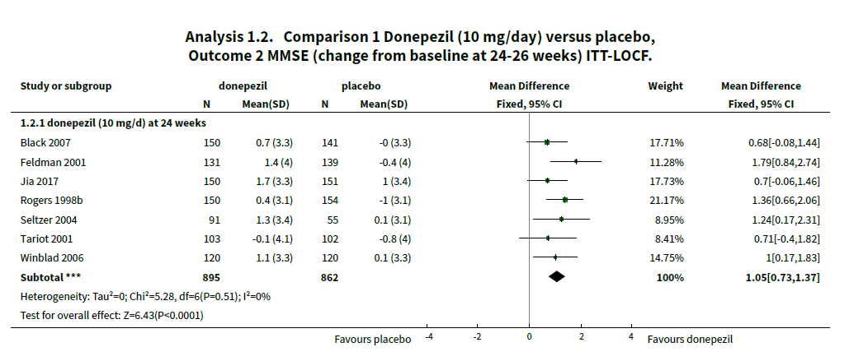
Medications for AD
Cochrane review (Birks & Harvey, 2018) found benefits for donepezil 10mg/day for cognition and daily function at 26 weeks (compared to placebo)
Notes:
Birks, J. S. and R. J. Harvey (2018). "Donepezil for dementia due to Alzheimer's disease." Cochrane Database of Systematic Reviews(6).
- Background Alzheimer's disease is the most common cause of dementia in older people. One approach to symptomatic treatment of Alzheimer's disease is to enhance cholinergic neurotransmission in the brain by blocking the action of the enzyme responsible for the breakdown of the neurotransmitter acetylcholine. This can be done by a group of drugs known as cholinesterase inhibitors. Donepezil is a cholinesterase inhibitor. This review is an updated version of a review first published in 1998. Objectives To assess the clinical efficacy and safety of donepezil in people with mild, moderate or severe dementia due to Alzheimer's disease; to compare the efficacy and safety of different doses of donepezil; and to assess the effect of donepezil on healthcare resource use and costs. Search methods We searched Cochrane Dementia and Cognitive Improvement’s Specialized Register, MEDLINE, Embase, PsycINFO and a number of other sources on 20 May 2017 to ensure that the search was as comprehensive and up‐to‐date as possible. In addition, we contacted members of the Donepezil Study Group and Eisai Inc. Selection criteria We included all double‐blind, randomised controlled trials in which treatment with donepezil was administered to people with mild, moderate or severe dementia due to Alzheimer's disease for 12 weeks or more and its effects compared with those of placebo in a parallel group of patients, or where two different doses of donepezil were compared. Data collection and analysis One reviewer (JSB) extracted data on cognitive function, activities of daily living, behavioural symptoms, global clinical state, quality of life, adverse events, deaths and healthcare resource costs. Where appropriate and possible, we estimated pooled treatment effects. We used GRADE methods to assess the quality of the evidence for each outcome. Main results Thirty studies involving 8257 participants met the inclusion criteria of the review, of which 28 studies reported results in sufficient detail for the meta‐analyses. Most studies were of six months' duration or less. Only one small trial lasted 52 weeks. The studies tested mainly donepezil capsules at a dose of 5 mg/day or 10 mg/day. Two studies tested a slow‐release oral formulation that delivered 23 mg/day. Participants in 21 studies had mild to moderate disease, in five studies moderate to severe, and in four severe disease. Seventeen studies were industry funded or sponsored, four studies were funded independently of industry and for nine studies there was no information on source of funding. Our main analysis compared the safety and efficacy of donepezil 10 mg/day with placebo at 24 to 26 weeks of treatment. Thirteen studies contributed data from 3396 participants to this analysis. Eleven of these studies were multicentre studies. Seven studies recruited patients with mild to moderate Alzheimer's disease, two with moderate to severe, and four with severe Alzheimer's disease, with a mean age of about 75 years. Almost all evidence was of moderate quality, downgraded due to study limitations. After 26 weeks of treatment, donepezil compared with placebo was associated with better outcomes for cognitive function measured with the Alzheimer's Disease Assessment Scale‐Cognitive (ADAS‐Cog, range 0 to 70) (mean difference (MD) ‐2.67, 95% confidence interval (CI) ‐3.31 to ‐2.02, 1130 participants, 5 studies), the Mini‐Mental State Examination (MMSE) score (MD 1.05, 95% CI 0.73 to 1.37, 1757 participants, 7 studies) and the Severe Impairment Battery (SIB, range 0 to 100) (MD 5.92, 95% CI 4.53 to 7.31, 1348 participants, 5 studies). Donepezil was also associated with better function measured with the Alzheimer's Disease Cooperative Study activities of daily living score for severe Alzheimer's disease (ADCS‐ADL‐sev) (MD 1.03, 95% CI 0.21 to 1.85, 733 participants, 3 studies). A higher proportion of participants treated with donepezil experienced improvement on the clinician‐rated global impression of change scale (odds ratio (OR) 1.92, 95% CI 1.54 to 2.39, 1674 articipants, 6 studies). There was no difference between donepezil and placebo for behavioural symptoms measured by the Neuropsychiatric Inventory (NPI) (MD ‐1.62, 95% CI ‐3.43 to 0.19, 1035 participants, 4 studies) or by the Behavioural Pathology in Alzheimer's Disease (BEHAVE‐AD) scale (MD 0.4, 95% CI ‐1.28 to 2.08, 194 participants, 1 study). There was also no difference between donepezil and placebo for Quality of Life (QoL) (MD ‐2.79, 95% CI ‐8.15 to 2.56, 815 participants, 2 studies). Participants receiving donepezil were more likely to withdraw from the studies before the end of treatment (24% versus 20%, OR 1.25, 95% CI 1.05 to 1.50, 2846 participants, 12 studies) or to experience an adverse event during the studies (72% vs 65%, OR 1.59, 95% 1.31 to 1.95, 2500 participants, 10 studies). There was no evidence of a difference between donepezil and placebo for patient total healthcare resource utilisation. Three studies compared donepezil 10 mg/day to donepezil 5 mg/day over 26 weeks. The 5 mg dose was associated with slightly worse cognitive function on the ADAS‐Cog, but not on the MMSE or SIB, with slightly better QoL and with fewer adverse events and withdrawals from treatment. Two studies compared donepezil 10 mg/day to donepezil 23 mg/day. There were no differences on efficacy outcomes, but fewer participants on 10 mg/day experienced adverse events or withdrew from treatment. Authors' conclusions There is moderate‐quality evidence that people with mild, moderate or severe dementia due to Alzheimer's disease treated for periods of 12 or 24 weeks with donepezil experience small benefits in cognitive function, activities of daily living and clinician‐rated global clinical state. There is some evidence that use of donepezil is neither more nor less expensive compared with placebo when assessing total healthcare resource costs. Benefits on 23 mg/day were no greater than on 10 mg/day, and benefits on the 10 mg/day dose were marginally larger than on the 5 mg/day dose, but the rates of withdrawal and of adverse events before end of treatment were higher the higher the dose. Plain language summary Donepezil for people with dementia due to Alzheimer's disease Review question What effects (benefits or harms) does donepezil have on people with dementia due to Alzheimer's disease? Background Alzheimer's disease is the most common cause of dementia. As the disease progresses, people lose the ability to remember, communicate, think clearly and perform the activities of daily living. Their behaviour may also change. In severe Alzheimer's disease people lose the ability to care for themselves. The most commonly used treatment for Alzheimer's disease are medicines known as acetylcholinesterase inhibitors. Donepezil is one of these medicines. It is taken as a pill once a day. In Alzheimer's disease, one of the changes in the brain is a reduced number of nerve cells called cholinergic neurones. These are nerve cells that signal to other cells using a chemical called acetylcholine. Acetylcholinesterase inhibitors, such as donepezil, work by preventing acetylcholine from being broken down. This may improve the symptoms of dementia. However, acetylcholine is also found elsewhere in the body and so drugs of this type may have unwanted effects. Review methods In this review we examined evidence about benefits and harms from studies that compared donepezil, taken for at least 12 weeks, to placebo (a dummy pill), or that compared different doses of donepezil. The studies had to be double‐blind and randomised, that is, the decision whether people taking part got donepezil or placebo had to be made randomly and neither they nor the researchers should have known which treatment they were getting while the trial was going on. This was to make the comparison as unbiased, or fair, as possible. We searched for studies up to May 2017. We assessed the quality of all the studies we included. When it was sensible to do so, we analysed the results of studies together to get an overall result. Key results We included 30 studies w th 8257 participants. Most of the people in the studies had mild or moderate dementia due to Alzheimer's disease, but in nine studies they had moderate or severe dementia. Almost all of the studies lasted six months or less. The majority of the studies were known to have been funded by the manufacturer of donepezil. We found that people with Alzheimer's disease who took 10 mg of donepezil a day for six months did slightly better than people taking placebo, on scales measuring their cognitive function (e.g. thinking and remembering), how well they could manage their daily activities, and the overall impression of a trained researcher. We did not find any effect on behaviour or quality of life. People taking donepezil were more likely than those taking placebo to report side effects and to drop out of the studies. Most side effects were described as mild. Nausea, vomiting and diarrhoea were most common. Comparing 5 mg of donepezil a day with 10 mg/day, people on 5 mg had fewer side effects, but did slightly less well on cognitive function tests. A higher dose (23 mg/day) offered no advantages and was associated with more side effects. There is some evidence that use of donepezil is neither more nor less expensive than placebo when total health care costs are taken into account. Quality of the evidence In general, we thought that the quality of the evidence was moderate. The main factor reducing our confidence was concern that the results of some studies might have been biased by the way they were done. We cannot be sure that the results apply to treatment longer than six months. Conclusions After six months of treatment, there are benefits of donepezil that are large enough to measure in studies. It is associated with side effects that are mainly mild, but that may cause people to stop treatment. Being able to stabilise cognitive performance or ability to maintain activities of daily living may be important clinically. In terms of total healthcare costs the use of donepezil appears cost neutral. However, there does not appear to be an effect on quality of life. More data are still required from longer‐term clinical studies examining measures of disease progression or time to needing full time care.

Slide 20
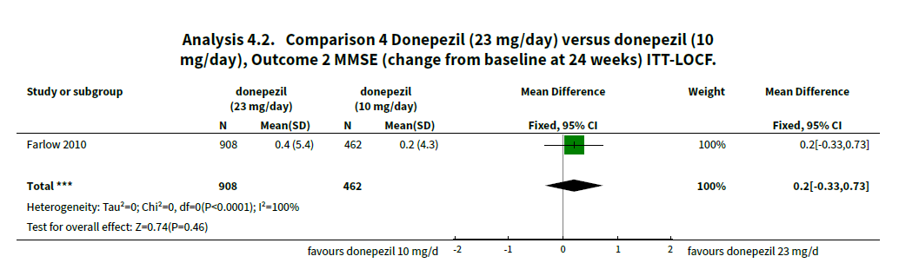
Medications for AD
Notes:
Birks, J. S. and R. J. Harvey (2018). "Donepezil for dementia due to Alzheimer's disease." Cochrane Database of Systematic Reviews(6).
- Background Alzheimer's disease is the most common cause of dementia in older people. One approach to symptomatic treatment of Alzheimer's disease is to enhance cholinergic neurotransmission in the brain by blocking the action of the enzyme responsible for the breakdown of the neurotransmitter acetylcholine. This can be done by a group of drugs known as cholinesterase inhibitors. Donepezil is a cholinesterase inhibitor. This review is an updated version of a review first published in 1998. Objectives To assess the clinical efficacy and safety of donepezil in people with mild, moderate or severe dementia due to Alzheimer's disease; to compare the efficacy and safety of different doses of donepezil; and to assess the effect of donepezil on healthcare resource use and costs. Search methods We searched Cochrane Dementia and Cognitive Improvement’s Specialized Register, MEDLINE, Embase, PsycINFO and a number of other sources on 20 May 2017 to ensure that the search was as comprehensive and up‐to‐date as possible. In addition, we contacted members of the Donepezil Study Group and Eisai Inc. Selection criteria We included all double‐blind, randomised controlled trials in which treatment with donepezil was administered to people with mild, moderate or severe dementia due to Alzheimer's disease for 12 weeks or more and its effects compared with those of placebo in a parallel group of patients, or where two different doses of donepezil were compared. Data collection and analysis One reviewer (JSB) extracted data on cognitive function, activities of daily living, behavioural symptoms, global clinical state, quality of life, adverse events, deaths and healthcare resource costs. Where appropriate and possible, we estimated pooled treatment effects. We used GRADE methods to assess the quality of the evidence for each outcome. Main results Thirty studies involving 8257 participants met the inclusion criteria of the review, of which 28 studies reported results in sufficient detail for the meta‐analyses. Most studies were of six months' duration or less. Only one small trial lasted 52 weeks. The studies tested mainly donepezil capsules at a dose of 5 mg/day or 10 mg/day. Two studies tested a slow‐release oral formulation that delivered 23 mg/day. Participants in 21 studies had mild to moderate disease, in five studies moderate to severe, and in four severe disease. Seventeen studies were industry funded or sponsored, four studies were funded independently of industry and for nine studies there was no information on source of funding. Our main analysis compared the safety and efficacy of donepezil 10 mg/day with placebo at 24 to 26 weeks of treatment. Thirteen studies contributed data from 3396 participants to this analysis. Eleven of these studies were multicentre studies. Seven studies recruited patients with mild to moderate Alzheimer's disease, two with moderate to severe, and four with severe Alzheimer's disease, with a mean age of about 75 years. Almost all evidence was of moderate quality, downgraded due to study limitations. After 26 weeks of treatment, donepezil compared with placebo was associated with better outcomes for cognitive function measured with the Alzheimer's Disease Assessment Scale‐Cognitive (ADAS‐Cog, range 0 to 70) (mean difference (MD) ‐2.67, 95% confidence interval (CI) ‐3.31 to ‐2.02, 1130 participants, 5 studies), the Mini‐Mental State Examination (MMSE) score (MD 1.05, 95% CI 0.73 to 1.37, 1757 participants, 7 studies) and the Severe Impairment Battery (SIB, range 0 to 100) (MD 5.92, 95% CI 4.53 to 7.31, 1348 participants, 5 studies). Donepezil was also associated with better function measured with the Alzheimer's Disease Cooperative Study activities of daily living score for severe Alzheimer's disease (ADCS‐ADL‐sev) (MD 1.03, 95% CI 0.21 to 1.85, 733 participants, 3 studies). A higher proportion of participants treated with donepezil experienced improvement on the clinician‐rated global impression of change scale (odds ratio (OR) 1.92, 95% CI 1.54 to 2.39, 1674 articipants, 6 studies). There was no difference between donepezil and placebo for behavioural symptoms measured by the Neuropsychiatric Inventory (NPI) (MD ‐1.62, 95% CI ‐3.43 to 0.19, 1035 participants, 4 studies) or by the Behavioural Pathology in Alzheimer's Disease (BEHAVE‐AD) scale (MD 0.4, 95% CI ‐1.28 to 2.08, 194 participants, 1 study). There was also no difference between donepezil and placebo for Quality of Life (QoL) (MD ‐2.79, 95% CI ‐8.15 to 2.56, 815 participants, 2 studies). Participants receiving donepezil were more likely to withdraw from the studies before the end of treatment (24% versus 20%, OR 1.25, 95% CI 1.05 to 1.50, 2846 participants, 12 studies) or to experience an adverse event during the studies (72% vs 65%, OR 1.59, 95% 1.31 to 1.95, 2500 participants, 10 studies). There was no evidence of a difference between donepezil and placebo for patient total healthcare resource utilisation. Three studies compared donepezil 10 mg/day to donepezil 5 mg/day over 26 weeks. The 5 mg dose was associated with slightly worse cognitive function on the ADAS‐Cog, but not on the MMSE or SIB, with slightly better QoL and with fewer adverse events and withdrawals from treatment. Two studies compared donepezil 10 mg/day to donepezil 23 mg/day. There were no differences on efficacy outcomes, but fewer participants on 10 mg/day experienced adverse events or withdrew from treatment. Authors' conclusions There is moderate‐quality evidence that people with mild, moderate or severe dementia due to Alzheimer's disease treated for periods of 12 or 24 weeks with donepezil experience small benefits in cognitive function, activities of daily living and clinician‐rated global clinical state. There is some evidence that use of donepezil is neither more nor less expensive compared with placebo when assessing total healthcare resource costs. Benefits on 23 mg/day were no greater than on 10 mg/day, and benefits on the 10 mg/day dose were marginally larger than on the 5 mg/day dose, but the rates of withdrawal and of adverse events before end of treatment were higher the higher the dose. Plain language summary Donepezil for people with dementia due to Alzheimer's disease Review question What effects (benefits or harms) does donepezil have on people with dementia due to Alzheimer's disease? Background Alzheimer's disease is the most common cause of dementia. As the disease progresses, people lose the ability to remember, communicate, think clearly and perform the activities of daily living. Their behaviour may also change. In severe Alzheimer's disease people lose the ability to care for themselves. The most commonly used treatment for Alzheimer's disease are medicines known as acetylcholinesterase inhibitors. Donepezil is one of these medicines. It is taken as a pill once a day. In Alzheimer's disease, one of the changes in the brain is a reduced number of nerve cells called cholinergic neurones. These are nerve cells that signal to other cells using a chemical called acetylcholine. Acetylcholinesterase inhibitors, such as donepezil, work by preventing acetylcholine from being broken down. This may improve the symptoms of dementia. However, acetylcholine is also found elsewhere in the body and so drugs of this type may have unwanted effects. Review methods In this review we examined evidence about benefits and harms from studies that compared donepezil, taken for at least 12 weeks, to placebo (a dummy pill), or that compared different doses of donepezil. The studies had to be double‐blind and randomised, that is, the decision whether people taking part got donepezil or placebo had to be made randomly and neither they nor the researchers should have known which treatment they were getting while the trial was going on. This was to make the comparison as unbiased, or fair, as possible. We searched for studies up to May 2017. We assessed the quality of all the studies we included. When it was sensible to do so, we analysed the results of studies together to get an overall result. Key results We included 30 studies w th 8257 participants. Most of the people in the studies had mild or moderate dementia due to Alzheimer's disease, but in nine studies they had moderate or severe dementia. Almost all of the studies lasted six months or less. The majority of the studies were known to have been funded by the manufacturer of donepezil. We found that people with Alzheimer's disease who took 10 mg of donepezil a day for six months did slightly better than people taking placebo, on scales measuring their cognitive function (e.g. thinking and remembering), how well they could manage their daily activities, and the overall impression of a trained researcher. We did not find any effect on behaviour or quality of life. People taking donepezil were more likely than those taking placebo to report side effects and to drop out of the studies. Most side effects were described as mild. Nausea, vomiting and diarrhoea were most common. Comparing 5 mg of donepezil a day with 10 mg/day, people on 5 mg had fewer side effects, but did slightly less well on cognitive function tests. A higher dose (23 mg/day) offered no advantages and was associated with more side effects. There is some evidence that use of donepezil is neither more nor less expensive than placebo when total health care costs are taken into account. Quality of the evidence In general, we thought that the quality of the evidence was moderate. The main factor reducing our confidence was concern that the results of some studies might have been biased by the way they were done. We cannot be sure that the results apply to treatment longer than six months. Conclusions After six months of treatment, there are benefits of donepezil that are large enough to measure in studies. It is associated with side effects that are mainly mild, but that may cause people to stop treatment. Being able to stabilise cognitive performance or ability to maintain activities of daily living may be important clinically. In terms of total healthcare costs the use of donepezil appears cost neutral. However, there does not appear to be an effect on quality of life. More data are still required from longer‐term clinical studies examining measures of disease progression or time to needing full time care.

Slide 21
Changing medications
 | Donepezil | Rivastigmine Patch | Galantamine
Nausea | 3-19% | 3-12% | 20.7%
Diarrhea | 5-15% | 5-7% | 7.4%
Vomiting | 3-9% | 3-10% | 10.5%

Slide 22
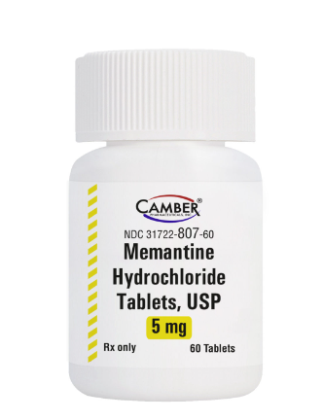
Memantine
NMDA receptor agonist
Mild benefit for those in moderate to severe stages, no benefit in mild AD
Immediate release, extended release, oral solution
Need to titrate dose up over one month until 10mg twice daily
Adjust for renal function
Notes:
Birks, J. S. and R. J. Harvey (2018). "Donepezil for dementia due to Alzheimer's disease." Cochrane Database of Systematic Reviews(6).
- Background Alzheimer's disease is the most common cause of dementia in older people. One approach to symptomatic treatment of Alzheimer's disease is to enhance cholinergic neurotransmission in the brain by blocking the action of the enzyme responsible for the breakdown of the neurotransmitter acetylcholine. This can be done by a group of drugs known as cholinesterase inhibitors. Donepezil is a cholinesterase inhibitor. This review is an updated version of a review first published in 1998. Objectives To assess the clinical efficacy and safety of donepezil in people with mild, moderate or severe dementia due to Alzheimer's disease; to compare the efficacy and safety of different doses of donepezil; and to assess the effect of donepezil on healthcare resource use and costs. Search methods We searched Cochrane Dementia and Cognitive Improvement’s Specialized Register, MEDLINE, Embase, PsycINFO and a number of other sources on 20 May 2017 to ensure that the search was as comprehensive and up‐to‐date as possible. In addition, we contacted members of the Donepezil Study Group and Eisai Inc. Selection criteria We included all double‐blind, randomised controlled trials in which treatment with donepezil was administered to people with mild, moderate or severe dementia due to Alzheimer's disease for 12 weeks or more and its effects compared with those of placebo in a parallel group of patients, or where two different doses of donepezil were compared. Data collection and analysis One reviewer (JSB) extracted data on cognitive function, activities of daily living, behavioural symptoms, global clinical state, quality of life, adverse events, deaths and healthcare resource costs. Where appropriate and possible, we estimated pooled treatment effects. We used GRADE methods to assess the quality of the evidence for each outcome. Main results Thirty studies involving 8257 participants met the inclusion criteria of the review, of which 28 studies reported results in sufficient detail for the meta‐analyses. Most studies were of six months' duration or less. Only one small trial lasted 52 weeks. The studies tested mainly donepezil capsules at a dose of 5 mg/day or 10 mg/day. Two studies tested a slow‐release oral formulation that delivered 23 mg/day. Participants in 21 studies had mild to moderate disease, in five studies moderate to severe, and in four severe disease. Seventeen studies were industry funded or sponsored, four studies were funded independently of industry and for nine studies there was no information on source of funding. Our main analysis compared the safety and efficacy of donepezil 10 mg/day with placebo at 24 to 26 weeks of treatment. Thirteen studies contributed data from 3396 participants to this analysis. Eleven of these studies were multicentre studies. Seven studies recruited patients with mild to moderate Alzheimer's disease, two with moderate to severe, and four with severe Alzheimer's disease, with a mean age of about 75 years. Almost all evidence was of moderate quality, downgraded due to study limitations. After 26 weeks of treatment, donepezil compared with placebo was associated with better outcomes for cognitive function measured with the Alzheimer's Disease Assessment Scale‐Cognitive (ADAS‐Cog, range 0 to 70) (mean difference (MD) ‐2.67, 95% confidence interval (CI) ‐3.31 to ‐2.02, 1130 participants, 5 studies), the Mini‐Mental State Examination (MMSE) score (MD 1.05, 95% CI 0.73 to 1.37, 1757 participants, 7 studies) and the Severe Impairment Battery (SIB, range 0 to 100) (MD 5.92, 95% CI 4.53 to 7.31, 1348 participants, 5 studies). Donepezil was also associated with better function measured with the Alzheimer's Disease Cooperative Study activities of daily living score for severe Alzheimer's disease (ADCS‐ADL‐sev) (MD 1.03, 95% CI 0.21 to 1.85, 733 participants, 3 studies). A higher proportion of participants treated with donepezil experienced improvement on the clinician‐rated global impression of change scale (odds ratio (OR) 1.92, 95% CI 1.54 to 2.39, 1674 articipants, 6 studies). There was no difference between donepezil and placebo for behavioural symptoms measured by the Neuropsychiatric Inventory (NPI) (MD ‐1.62, 95% CI ‐3.43 to 0.19, 1035 participants, 4 studies) or by the Behavioural Pathology in Alzheimer's Disease (BEHAVE‐AD) scale (MD 0.4, 95% CI ‐1.28 to 2.08, 194 participants, 1 study). There was also no difference between donepezil and placebo for Quality of Life (QoL) (MD ‐2.79, 95% CI ‐8.15 to 2.56, 815 participants, 2 studies). Participants receiving donepezil were more likely to withdraw from the studies before the end of treatment (24% versus 20%, OR 1.25, 95% CI 1.05 to 1.50, 2846 participants, 12 studies) or to experience an adverse event during the studies (72% vs 65%, OR 1.59, 95% 1.31 to 1.95, 2500 participants, 10 studies). There was no evidence of a difference between donepezil and placebo for patient total healthcare resource utilisation. Three studies compared donepezil 10 mg/day to donepezil 5 mg/day over 26 weeks. The 5 mg dose was associated with slightly worse cognitive function on the ADAS‐Cog, but not on the MMSE or SIB, with slightly better QoL and with fewer adverse events and withdrawals from treatment. Two studies compared donepezil 10 mg/day to donepezil 23 mg/day. There were no differences on efficacy outcomes, but fewer participants on 10 mg/day experienced adverse events or withdrew from treatment. Authors' conclusions There is moderate‐quality evidence that people with mild, moderate or severe dementia due to Alzheimer's disease treated for periods of 12 or 24 weeks with donepezil experience small benefits in cognitive function, activities of daily living and clinician‐rated global clinical state. There is some evidence that use of donepezil is neither more nor less expensive compared with placebo when assessing total healthcare resource costs. Benefits on 23 mg/day were no greater than on 10 mg/day, and benefits on the 10 mg/day dose were marginally larger than on the 5 mg/day dose, but the rates of withdrawal and of adverse events before end of treatment were higher the higher the dose. Plain language summary Donepezil for people with dementia due to Alzheimer's disease Review question What effects (benefits or harms) does donepezil have on people with dementia due to Alzheimer's disease? Background Alzheimer's disease is the most common cause of dementia. As the disease progresses, people lose the ability to remember, communicate, think clearly and perform the activities of daily living. Their behaviour may also change. In severe Alzheimer's disease people lose the ability to care for themselves. The most commonly used treatment for Alzheimer's disease are medicines known as acetylcholinesterase inhibitors. Donepezil is one of these medicines. It is taken as a pill once a day. In Alzheimer's disease, one of the changes in the brain is a reduced number of nerve cells called cholinergic neurones. These are nerve cells that signal to other cells using a chemical called acetylcholine. Acetylcholinesterase inhibitors, such as donepezil, work by preventing acetylcholine from being broken down. This may improve the symptoms of dementia. However, acetylcholine is also found elsewhere in the body and so drugs of this type may have unwanted effects. Review methods In this review we examined evidence about benefits and harms from studies that compared donepezil, taken for at least 12 weeks, to placebo (a dummy pill), or that compared different doses of donepezil. The studies had to be double‐blind and randomised, that is, the decision whether people taking part got donepezil or placebo had to be made randomly and neither they nor the researchers should have known which treatment they were getting while the trial was going on. This was to make the comparison as unbiased, or fair, as possible. We searched for studies up to May 2017. We assessed the quality of all the studies we included. When it was sensible to do so, we analysed the results of studies together to get an overall result. Key results We included 30 studies w th 8257 participants. Most of the people in the studies had mild or moderate dementia due to Alzheimer's disease, but in nine studies they had moderate or severe dementia. Almost all of the studies lasted six months or less. The majority of the studies were known to have been funded by the manufacturer of donepezil. We found that people with Alzheimer's disease who took 10 mg of donepezil a day for six months did slightly better than people taking placebo, on scales measuring their cognitive function (e.g. thinking and remembering), how well they could manage their daily activities, and the overall impression of a trained researcher. We did not find any effect on behaviour or quality of life. People taking donepezil were more likely than those taking placebo to report side effects and to drop out of the studies. Most side effects were described as mild. Nausea, vomiting and diarrhoea were most common. Comparing 5 mg of donepezil a day with 10 mg/day, people on 5 mg had fewer side effects, but did slightly less well on cognitive function tests. A higher dose (23 mg/day) offered no advantages and was associated with more side effects. There is some evidence that use of donepezil is neither more nor less expensive than placebo when total health care costs are taken into account. Quality of the evidence In general, we thought that the quality of the evidence was moderate. The main factor reducing our confidence was concern that the results of some studies might have been biased by the way they were done. We cannot be sure that the results apply to treatment longer than six months. Conclusions After six months of treatment, there are benefits of donepezil that are large enough to measure in studies. It is associated with side effects that are mainly mild, but that may cause people to stop treatment. Being able to stabilise cognitive performance or ability to maintain activities of daily living may be important clinically. In terms of total healthcare costs the use of donepezil appears cost neutral. However, there does not appear to be an effect on quality of life. More data are still required from longer‐term clinical studies examining measures of disease progression or time to needing full time care.

Slide 23
Case
77 y/o woman with moderate AD
Started donepezil a year ago (10mg daily)
Memantine started 6 months ago
Husband writes note, "She has diarrhea about 6 times a day. She is having trouble cleaning up and it's exhausting. I just wanted to let you know. Her PCP is getting labs."

Slide 24
Case
77 y/o woman with moderate AD
Started donepezil a year ago (10mg daily)
Memantine started 6 months ago
Husband writes note, "She has diarrhea about 6 times a day. She is having trouble cleaning up and it's exhausting. I just wanted to let you know. Her PCP is getting labs."
Plan
Stop donepezil
Refer to home health: OT/PT

Slide 25
Medications
Anti-amyloid Monoclonal Antibody Therapy
FDA approved July 2023
Reduces amyloid
Not a cure
“Moderately less decline on clinical measures of cognition and function than placebo at 18 months…” (Van Dyck, 2023)
Notes:
van Dyck, C. H., et al. (2023). "Lecanemab in Early Alzheimer's Disease." N Engl J Med 388(1): 9-21.
Cummings, J., et al. (2023). "Lecanemab: Appropriate Use Recommendations." J Prev Alzheimers Dis 10(3): 362-377.

Slide 26
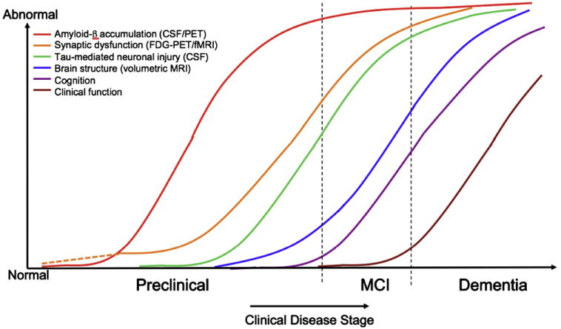
Physiologic to clinical changes
Sperling RA, Aisen PS, Beckett LA, Bennett DA, Craft S, Fagan AM, Iwatsubo T, Jack CR Jr, Kaye J, Montine TJ, Park DC, Reiman EM, Rowe CC, Siemers E, Stern Y, Yaffe K, Carrillo MC, Thies B, Morrison-Bogorad M, Wagster MV, Phelps CH. Toward defining the preclinical stages of Alzheimer's disease: recommendations from the National Institute on Aging-Alzheimer's Association workgroups on diagnostic guidelines for Alzheimer's disease. Alzheimers Dement. 2011 May;7(3):280-92. doi: 10.1016/j.jalz.2011.03.003. Epub 2011 Apr 21. PMID: 21514248; PMCID: PMC3220946.

Slide 27
Medications
Anti-amyloid Monoclonal Antibody Therapy
IV infusion every two weeks
Frequent MRIs
Covered by Medicare
$26,500/year for drug only
Notes:
van Dyck, C. H., et al. (2023). "Lecanemab in Early Alzheimer's Disease." N Engl J Med 388(1): 9-21.
Cummings, J., et al. (2023). "Lecanemab: Appropriate Use Recommendations." J Prev Alzheimers Dis 10(3): 362-377.

Slide 28
Lecanemab: Adverse Events
Infusion-related reaction (26.4%)
ARIA-E (12.6%) (Amyloid Related Imaging Abnormality)
ARIA-A (14%)
Headache (11%)
Notes:
Amyloid related Imaging Abnormality
van Dyck, C. H., et al. (2023). "Lecanemab in Early Alzheimer's Disease." N Engl J Med 388(1): 9-21.
Cummings, J., et al. (2023). "Lecanemab: Appropriate Use Recommendations." J Prev Alzheimers Dis 10(3): 362-377.

Slide 29
Amyloid Related Imaging Abnormality (ARIA)
Two forms, seen in all amyloid related Tx:
ARIA-E: focal vasogenic edema, usually resolves and asymptomatic
ARIA-H: hemorrhage with either microbleed or superficial siderosis; rare macrobleed
Rarely serious (seizures/status epi) or death reported

Slide 30
Appropriate Use Recommendations: Lecanemab
Appropriate Patients
Diagnosis | Mild Cognitive Impairment, or early AD (MMSE 22 or higher
Scans/Labs | Positive amyloid PET or CSF indicative of AD
Age | 50-90
BMI | >17 or <35
Medications | Stable dose of acetylcholinesterase inhibitors and any other medications
Care partner | Reliable, consistent
Adapted from Cummings et al., 2023
Notes:
van Dyck, C. H., et al. (2023). "Lecanemab in Early Alzheimer's Disease." N Engl J Med 388(1): 9-21.
Cummings, J., et al. (2023). "Lecanemab: Appropriate Use Recommendations." J Prev Alzheimers Dis 10(3): 362-377.
Help with support

Slide 31
Family Care
Note side effects
Manage expectations
Arrange follow up visits
Refer to the Alzheimer’s Association: www.alz.org
Patients and families can join research studies

Slide 32

Lewy Body Dementia

Slide 33

Lewy Body Dementia
Pathologic aggregations of alpha-synuclein abnormal proteins are diffused throughout other areas of the brain
Second most common neurodegenerative dementia
Notes:
McKeith, I. G., et al. (2005). "Diagnosis and management of dementia with Lewy bodies." Third report of the DLB consortium 65(12): 1863-1872.
The dementia with Lewy bodies (DLB) Consortium has revised criteria for the clinical and pathologic diagnosis of DLB incorporating new information about the core clinical features and suggesting improved methods to assess them. REM sleep behavior disorder, severe neuroleptic sensitivity, and reduced striatal dopamine transporter activity on functional neuroimaging are given greater diagnostic weighting as features suggestive of a DLB diagnosis. The 1-year rule distinguishing between DLB and Parkinson disease with dementia may be difficult to apply in clinical settings and in such cases the term most appropriate to each individual patient should be used. Generic terms such as Lewy body (LB) disease are often helpful. The authors propose a new scheme for the pathologic assessment of LBs and Lewy neurites (LN) using alpha-synuclein immunohistochemistry and semiquantitative grading of lesion density, with the pattern of regional involvement being more important than total LB count. The new criteria take into account both Lewy-related and Alzheimer disease (AD)-type pathology to allocate a probability that these are associated with the clinical DLB syndrome. Finally, the authors suggest patient management guidelines including the need for accurate diagnosis, a target symptom approach, and use of appropriate outcome measures. There is limited evidence about specific interventions but available data suggest only a partial response of motor symptoms to levodopa: severe sensitivity to typical and atypical antipsychotics in ∼50%, and improvements in attention, visual hallucinations, and sleep disorders with cholinesterase inhibitors.
Worked with Alzheimer
Lewy body dementia exists either in pure form,
or in conjunction with other brain changes,
including those typically seen in Alzheimer's
disease and Parkinson's disease.

Slide 34
LBD
Criteria for Diagnosis
Progressive dementia that interferes with normal function
Deficits in attention, executive function, visuospatial ability (memory issues not always first concern)
Fluctuations in cognition (bouncing ball)
Well-formed visual hallucinations
Parkinsonian symptoms
REM sleep disturbances

Slide 35
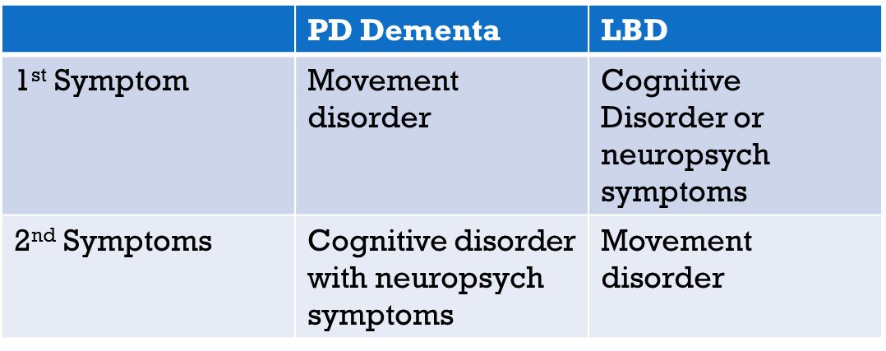
PD Dementia vs. LBD

Slide 36
Medications for LBD
Goals of treatment:
Smooth the bounce
Manage physical symptoms
Manage hallucinations

Slide 37

Lewy Body Hallucinations
Antipsychotics: ONLY if hallucinations are
distressing. Careful family decision.
Black box warning
ECG first

Slide 38
Medications for LBD
Acetylcholinesterase inhibitors
Help with hallucinations and cognition
Manage side effects
Set expectations

Slide 39
Medications for LBD
Carbidopa/levodopa
May help with stiffness, mobility
Antipsychotics
ONLY if hallucinations are distressing
Refer to Physical Therapy, Occupational Therapy

Slide 40

Case study
68 y/o man worried about his neighborhood
Soldiers on the street, threatening neighbors
Leaves door open at night so neighbors have a safe place to go

Slide 41
Case study
68 y/o man worried about his neighborhood
Soldiers on the street, threatening neighbors
Leaves door open at night so neighbors have a safe place to go
Rivastigmine patch started
Soldiers still “out there” but able to close door at night

Slide 42
Family Care
Note side effects
Manage expectations
Arrange follow up visits
Refer to the Lewy Body Dementia Association: https://www.lbda.org/

Slide 43

Vascular Dementia

Slide 44
Criteria for Vascular Dementia
The onset of the cognitive deficits is temporally related to one or more cerebrovascular events.
Onset is often abrupt with a stepwise or fluctuating course owing to multiple events, with cognitive deficits persisting beyond three months after the event.
Physical signs consistent with stroke (e.g., hemiparesis, swallowing difficulties, emotional incontinence)
Early presence of a gait disturbance
Early urinary frequency, urgency, and other urinary symptoms not explained by urologic disease
Personality and mood changes: depression or emotional incontinence
Notes:
Sachdev P, Kalaria R, O'Brien J, Skoog I, Alladi S, Black SE, Blacker D, Blazer DG, Chen C, Chui H, Ganguli M, Jellinger K, Jeste DV, Pasquier F, Paulsen J, Prins N, Rockwood K, Roman G, Scheltens P; Internationlal Society for Vascular Behavioral and Cognitive Disorders. Diagnostic criteria for vascular cognitive disorders: a VASCOG statement. Alzheimer Dis Assoc Disord. 2014 Jul-Sep;28(3):206-18. doi: 10.1097/WAD.0000000000000034. PMID: 24632990; PMCID: PMC4139434.

Slide 45
Risk Factors
HTN
Hyperlipidemia
Diabetes
Cardiac disorders
There is still no good evidence that aspirin is effective in treating patients with a diagnosis of vascular dementia.
There is increasing concern that low‐dose aspirin is associated with increased risk of hemorrhages.
Notes:
Sachdev P, Kalaria R, O'Brien J, Skoog I, Alladi S, Black SE, Blacker D, Blazer DG, Chen C, Chui H, Ganguli M, Jellinger K, Jeste DV, Pasquier F, Paulsen J, Prins N, Rockwood K, Roman G, Scheltens P; Internationlal Society for Vascular Behavioral and Cognitive Disorders. Diagnostic criteria for vascular cognitive disorders: a VASCOG statement. Alzheimer Dis Assoc Disord. 2014 Jul-Sep;28(3):206-18. doi: 10.1097/WAD.0000000000000034. PMID: 24632990; PMCID: PMC4139434.

Slide 46
Medications for vascular dementia
Control blood pressure
Manage hyperlipidemia
Acetylcholinesterase inhibitors?

Slide 47
Treating vascular dementia
Address caregiver strain
Discuss trajectory
Limit guilt
Behavioral symptom management
OT/PT/SLP

Slide 48
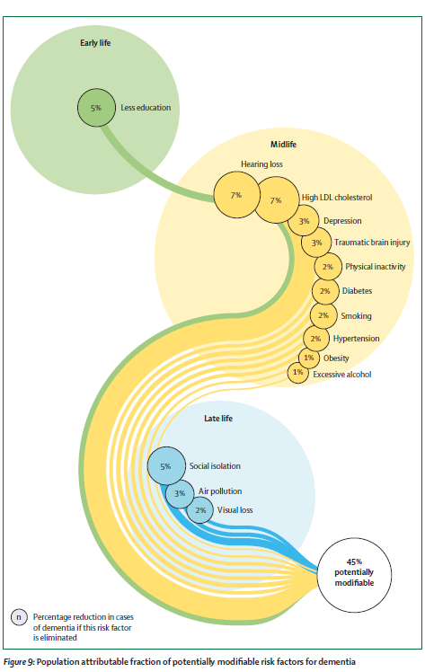
Header
45% of factors related to dementia are
potentially modifiable
Livingston, G., et al. (2024). "Dementia prevention, intervention, and care: 2024 report of the Lancet standing Commission." Lancet 404(10452): 572-628.

Slide 49
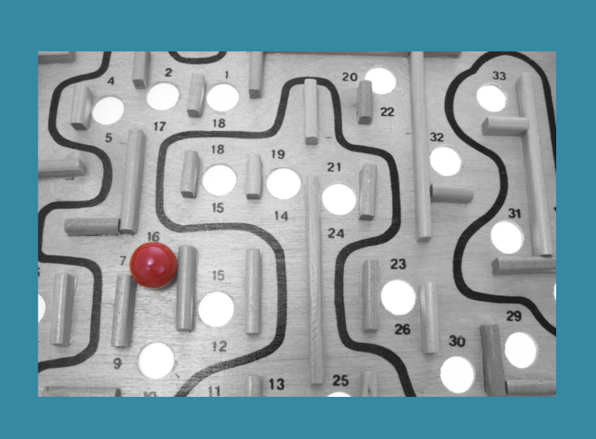
FTD

Slide 50
Frontotemporal Degeneration
FTD affects 20-30,000 individuals in the US
Second most common dementia in those under age 65
Behavioral or language
Genetic mutation in about half the cases
Mutations in microtubule-associated protein tau (MAPT), progranulin (PGRN) and chromosome 9(C9orf72)
Alzheimer’s disease
Notes:
Knopman, D. S. and R. O. Roberts (2011). "Estimating the number of persons with frontotemporal lobar degeneration in the US population." Journal of molecular neuroscience : MN 45(3): 330-335.
There are many challenges for determining the prevalence and incidence of frontotemporal lobar degenerations (FTLD). Consequently, the number of cases of behavioral variant frontotemporal dementia (bvFTD) or primary progressive aphasia (PPA) in the USA is unknown. Our objective was to derive a consensus estimate of bvFTD and PPA prevalence and thereby to estimate the total number of these syndromes in the USA. We identified five prevalence and three incidence studies of FTLD based on passive surveillance and seven studies of survival in FTLD. Data from these studies were used to estimate the number of cases of PPA or bvFTD in the USA. Because prevalence and incidence estimates outside of the 45-64-year age range were either not available or widely divergent, we used data from clinical and pathological series to estimate the proportion of FTLD cases aged <45 or >64 years. The prevalence estimates in the age categories of 45-64 years old have ranged from 15 to 22 per 100,000 person-years in studies where both bvFTD and PPA were identified. The incidence estimates for the same age group ranged from 2.7 to 4.1 per 100,000 person-years. Using a survival rate of 6 to 9 years from onset and rates from the incidence studies, a calculated prevalence estimate (prevalence = incidence × duration) was similar to the previously reported prevalence rates. We estimated that 10% of cases were less than age 45 years and 30% were 65 years and older. We estimate that there are approximately 20,000 to 30,000 cases of the cognitive syndromes of FTLD in the USA. The main threat to the accuracy of the estimates is the difficulty in diagnosing the clinical syndromes that comprise the FTLD group of disorders.
Young, J. J., et al. (2018). "Frontotemporal dementia: latest evidence and clinical implications." Therapeutic advances in psychopharmacology 8(1): 33-48.
BACKGROUND: Frontotemporal dementia (FTD) describes a cluster of neurocognitive syndromes that present with impairment of executive functioning, changes in behavior, and a decrease in language proficiency. FTD is the second most common form of dementia in those younger than 65 years and is expected to increase in prevalence as the population ages. This goal in our review is to describe advances in the understanding of neurobiological pathology, classification, assessment, and treatment of FTD syndromes. METHODS: PubMed was searched to obtain reviews and studies that pertain to advancements in genetics, neurobiology, neuroimaging, classification, and treatment of FTD syndromes. Articles were chosen with a predilection to more recent preclinical/clinical trials and systematic reviews. RESULTS: Recent reviews and trials indicate a significant advancement in the understanding of molecular and neurobiological clinical correlates to variants of FTD. Genetic and histopathologic markers have only recently been discovered in the past decade. Current therapeutic modalities are limited, with most studies reporting improvement in symptoms with nonpharmacological interventions. However, a small number of studies have reported improvement of behavioral symptoms with selective serotonin reuptake inhibitor (SSRI) treatment. Stimulants may help with disinhibition, apathy, and risk-taking behavior. Memantine and cholinesterase inhibitors have not demonstrated efficacy in ameliorating FTD symptoms. Antipsychotics have been used to treat agitation and psychosis, but safety concerns and side effect profiles limit utilization in the general FTD population. Nevertheless, recent breakthroughs in the understanding of FTD pathology have led to developments in pharmacological interventions that focus on producing treatments with autoimmune, genetic, and molecular targets. CONCLUSION: FTD is an underdiagnosed group of neurological syndromes comprising multiple variants with distinct neurobiological profiles and presentations. Recent advances suggest there is an array of potential novel therapeutic targets, although data concerning their effectiveness are still preliminary or preclinical. Further studies are required to develop pharmacological interventions, as there are currently no US Food and Drug administration approved treatments to manage FTD syndromes.

Slide 51
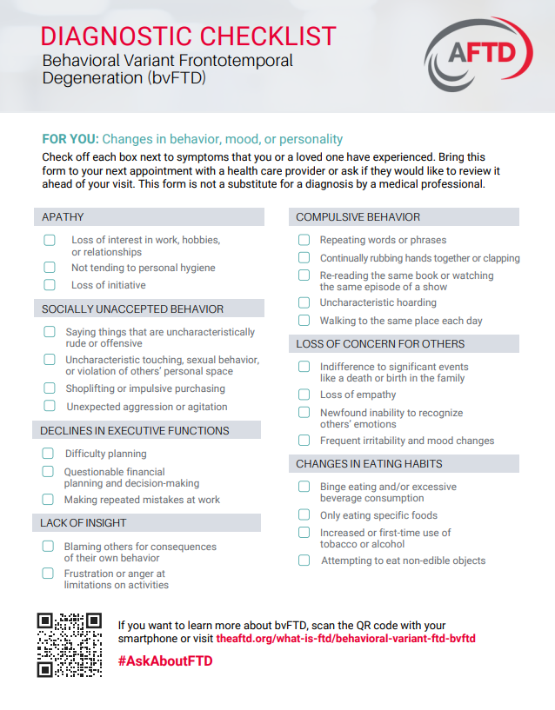
FTD-Behavioral Variant
Notes:
Rascovsky, K., et al. (2011). "Sensitivity of revised diagnostic criteria for the behavioural variant of frontotemporal dementia." Brain 134(Pt 9): 2456-2477.

Slide 52
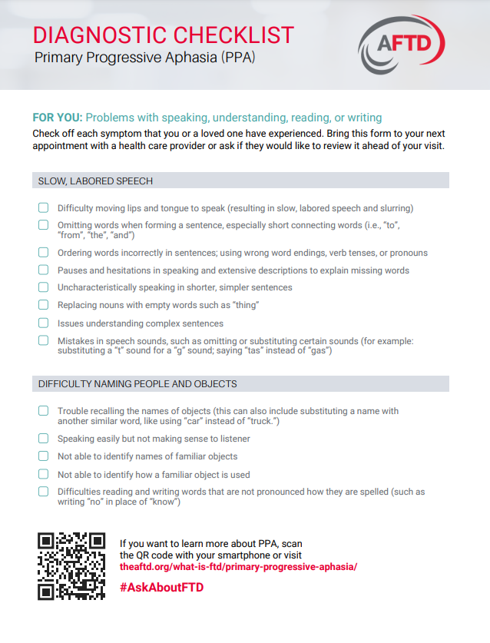
Primary Progressive Aphasia
Notes:
Rascovsky, K., et al. (2011). "Sensitivity of revised diagnostic criteria for the behavioural variant of frontotemporal dementia." Brain 134(Pt 9): 2456-2477.

Slide 53
Assessment
Young (40s, 50s) but can also be in older adults
Use standardized tools to assess (e.g., Frontal Behavioral Inventory, Milan et al., 2008)
Need imaging
Need neuropsychological evaluation
Speech therapy evaluation
Notes:
Frontal Behavioural Inventory in the differential diagnosis of dementia
G. Milan,F. Lamenza,A. Iavarone,F. Galeone,E. Lorè,C. De Falco,P. Sorrentino,A. Postiglione
First published: 04 March 2008
https://doi.org/10.1111/j.1600-0404.2007.00934.x
Citations:

Slide 54
Risk Factors
Gamogi et al., 46 subjects History of major depression (70.6%)
Familial history psychosis (64.7%)
Use of antipsychotic drugs (at recruitment) (76.5%)
Notes:
Gambogi, Leandro Boson et al. ‘Long-Term Severe Mental Disorders Preceding Behavioral Variant Frontotemporal Dementia: Frequency and Clinical Correlates in an Outpatient Sample’. 1 Jan. 2018 : 1577 – 1585.

Slide 55
PPA
PRIMARY
Impairment is prominent in a single domain (language) with relative sparing of other domains early on (e.g., memory)
PROGRESSIVE
The impairment will get worse over time
APHASIA
Affects language

Slide 56
Medications for FTD
FTD
Cholinesterase inhibitors and memantine may speed cognitive decline and worsen behaviors
Trazodone can be very helpful for hyperphagia, agitation, irritability
Citalopram: agitation, disinhibition, hypersexuality (Young, et al, 2018)
Notes:
Young, J. J., et al. (2018). "Frontotemporal dementia: latest evidence and clinical implications." Therapeutic advances in psychopharmacology 8(1): 33-48.

Slide 57
Family Care
Refer to the Association for Frontotemporal Degeneration
www.theaftd.org
Support
Research
Funding
https://www.theaftd.org/living-with-ftd/resources/comstock-grants/

Slide 58

Case Study
Donepezil is started for a man in his late 50's with young-onset Alzheimer’s dementia.
He is becoming more obsessed with mowing the lawn and family is having difficulty managing his behaviors.

Slide 59
Case Study
Donepezil is started for a man in his late 50's with young-onset Alzheimer’s dementia.
He is becoming more obsessed with mowing the lawn and family is having difficulty managing his behaviors.
Stop donepezil
Review diagnosis
Neuropsychological eval

Slide 60



Mixed

Slide 61
Key Points
If you can identify the type of dementia, you can tailor your guidance
Many people with mixed dementia
Seek support from your peers

Slide 62

Dementia Curbsides and Conversations ECHO
De-identified case-based learning
Monthly on 3rd Tuesday
February-June 2025
Noon-1:00
Virtual
Registration link: https://connect.oregonechonetwork.org/Series/Registration/1616
www.oregonechonetwork.org/
oen@ohsu.edu

Slide 63

Thank you!
Visit: IndianCountryECHO.org
Allison Lindauer, PhD, APRN
Associate Professor
Oregon Alzheimer’s Disease Research Center
3181 SW Sam Jackson Park Road, CR-131
Tel: 503-494-6796
lindauer@ohsu.edu
Notes:
Please visit our website to sign-up to join one of our many ECHO sessions. Thank you!

