Slide 1


Mental Health and Substance Use Disorders
Notes:
Thank you, my name is Trey Draude, I’m a board certified psychiatric pharmacist working in the federal bureau of prisons with a collaborative practice agreement in both substance use disorders and behavioral health. Today, we’ll be reviewing the co-occurrence of mental health or psychiatric disorders, with substance use disorders.

Slide 2
Disclaimers
"Opinions expressed in this presentation are those of the author and do not necessarily represent the opinions of the Federal Bureau of Prisons or the Department of Justice."

Slide 3
Learning Objectives
Recognize the prevalence of comorbid mental health disorders and substance use disorders (SUD).
Consider appropriate mental health screenings for patients with SUD.
Discuss treatment considerations for those with MH and SUD comorbidities.
Notes:
We’ll focus on three things by the end of this presentation. That is, to recognize the prevalence of comorbid mental health disorders and substance use disorders. Consider appropriate screening for co-occurrence among patients with psychiatric or substance use disorders. And finally discuss the impact that co-occurring disorders may have on treatment priority, or selection.
So lets dive into discussing prevalence.

Slide 4
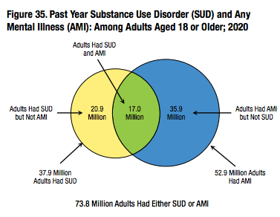
Prevalence
KRESS; 2020
NSDUH; 2020
Notes:
It may not surprise us that mental health or psychiatric illnesses can co-occur with substance use disorders, but how often might this occur.
From the data shown here in 2020, nearly half of all people who have a substance use disorder, also had a co-occurring mental illness. We’ll see today, that the risk of developing a psychiatric co-morbidity increases for those with SUD, and visa versa, having a mental health disorder increases the risk of developing a SUD.

Slide 5
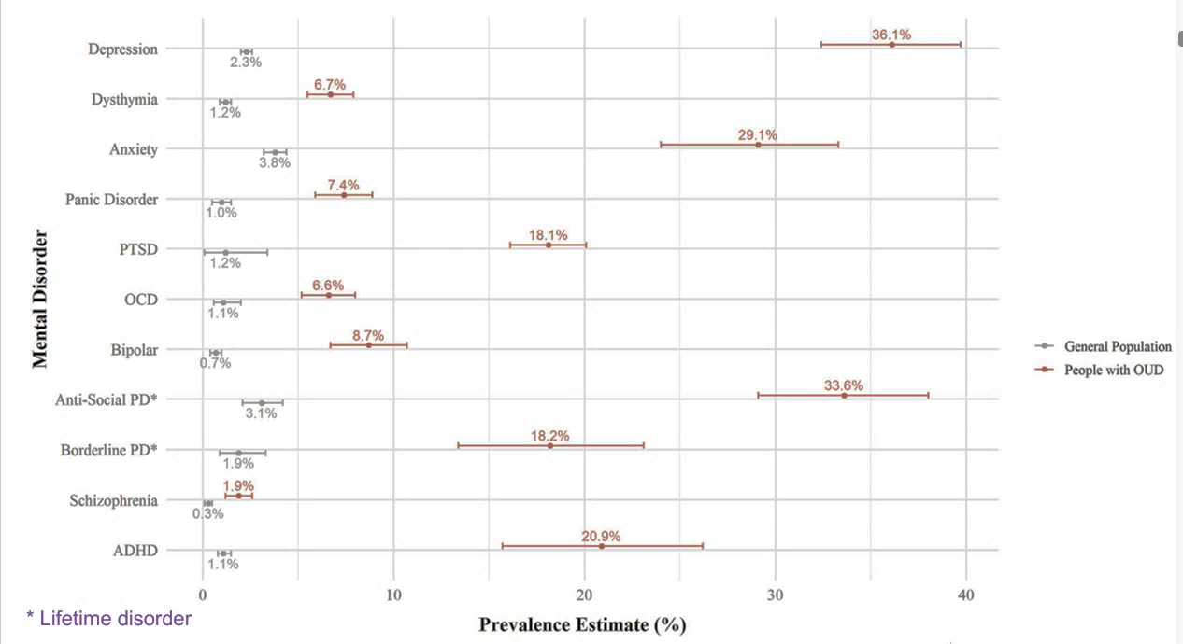
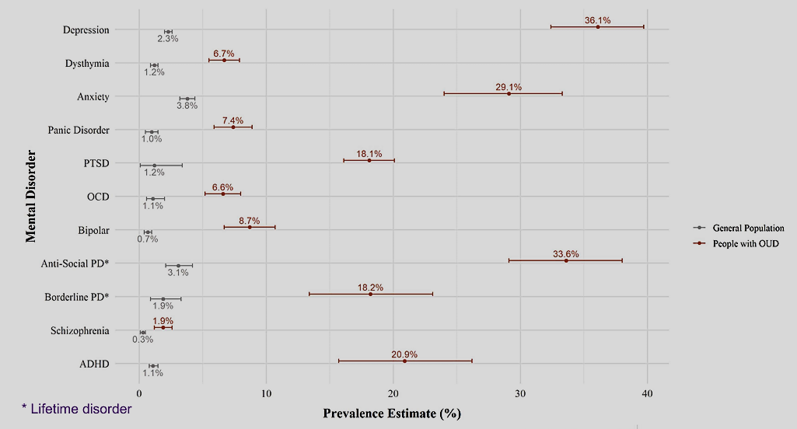

Prevalence among Opioid Use Disorder
SANTO; 2022
Notes:
As an example, the following is the estimated prevalence of the general population in gray developing the noted mental health disorder. In contrast, the orange is the estimated prevalence of developing that same disorder for people diagnosed with opioid use disorder. We can see a shocking increase in prevalence particularly with depression, anxiety, PTSD, personality disorders, and ADHD.

Slide 6
Cause of Co-Occurrence
Developmental Factors
Genetics
Environmental
Shared Risks
Brain regions involved
Stress, Trauma, Adverse Childhood Experiences (ACE)
Notes:
Why might this be? There are several overlapping developmental factors involved with both SUD and mental health disorders. Additionally, they each share similar risk, again describing how one may lead to the other in either direction.

Slide 7
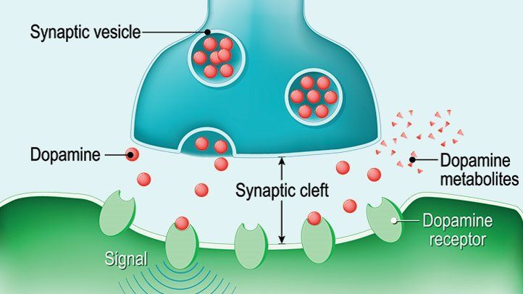
Cause of Co-Occurrence
Developmental Factors
Genetics
Environmental
Shared Risks
Brain regions involved
Stress, Trauma, Adverse Childhood Experiences (ACE)
Notes:
Starting with genetic factors, both the development of SUDs as well as nearly all psychiatric illnesses are impacted by overlapping genetic components such as the regulation of and the amount of specific neurotransmitter receptors, and how our body adapts to those neurotransmitters; dopamine, opioid, and serotonergic to name a few.

Slide 8




Cause of Co-Occurrence
Developmental Factors
Genetics
Environmental
Shared Risks
Brain regions involved
Stress, Trauma, Adverse Childhood Experiences (ACE)
Notes:
The environment also plays an overlapping role for developing both mental health and substance use disorders including socioeconomic status, access to health care, education, housing, and even the geographic location of that housing.

Slide 9
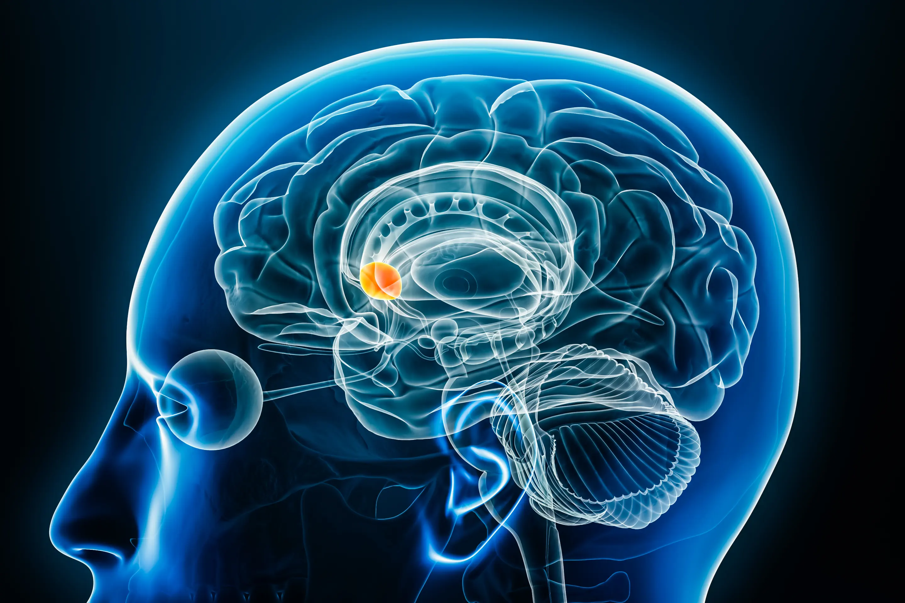
Cause of Co-Occurrence
Developmental Factors
Genetics
Environmental
Shared Risks
Brain regions involved
Stress, Trauma, Adverse Childhood Experiences (ACE)
Notes:
Similar regions of the brain are also involved in the development of either SUD or mental health disorders, including the frontal cortex, Nucleus Accumbens, and hippocampus.

Slide 10
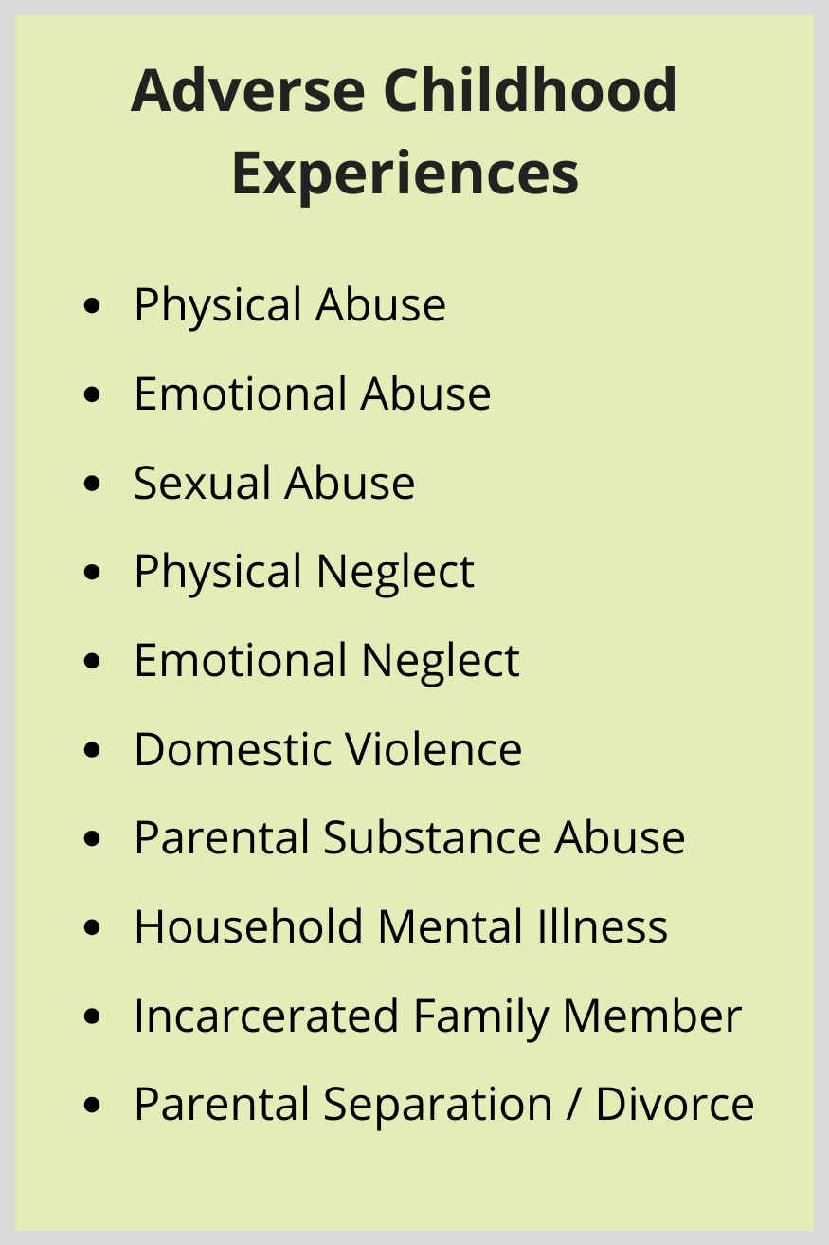
Cause of Co-Occurrence
Developmental Factors
Genetics
Environmental
Shared Risks
Brain regions involved
Stress, Trauma, Adverse Childhood Experiences (ACE)
Notes:
Stress, trauma and adverse childhood experiences, listed here, all contribute to increased risk of both disorder category.
In fact, up to 80% of patients with opioid use disorder have experienced at least one Adverse Childhood Experience. And, if an individual has experienced 5 or more ACEs, they’re up to 7-10X more likely to develop any substance use disorder.

Slide 11
Clinical implications of co-occurrence
Worser prognosis
Poorer quality of life
Increased risk for relapse
Increased risk of suicidal ideation
Less than 30% of patients are likely to receive integrated treatment for both disorders.
Jones CM, et al, 2019
Notes:
What are the clinical implications to having co-occurring disorders? Why should we look for co-occurrence, and how might it impact patient outcomes?
Patient’s tend to have a worse severity and prognosis of both disorders when co-occurring compared to those with either diagnosis alone. Increased treatment intensity is therefore likely necessary for both, with more frequent follow up, higher intensity care and increased interventions.
Risk of suicide, including ideation, planning, attempts, and completion are all increased in those with co-occurring disorders.
Furthermore, studies show that less than 30% of patients are likely to receive the integrated treatment for both disorders.

Slide 12
Polling Question
True or False;
Having a substance use disorder increases your lifetime risk of developing co-occurring psychiatric disorders.
TRUE
Notes:
Lets pause before our next learning objective for a polling question.
Excellent, and lets also remember this question would remain true if we reversed the order, having a psychiatric or mental health disorder, increases an individuals life time risk of developing a substance use disorder.

Slide 13
Polling Question
Which of the following are overlapping risk factors that contribute to the co-occurrence of SUD and MHD.
Genetics
Environmental
Areas of the brain impacted
Trauma (ACEs)
All of the above
Notes:
And one more,
Correct, all of these developmental factors and shared risk factors could contribute to co-occurrence.

Slide 14
Learning Objectives
Recognize the prevalence of comorbid mental health disorders and SUD.
Consider appropriate mental health screenings for patients with SUD.
Discuss treatment considerations for those with MH and SUD comorbidities.
Notes:
So now that we know the prevalence, possible causes, and clinic impact of co-occurrence, let’s look at how we might approach and screen patients that we may come across in clinic.

Slide 15

Case: DB
DB is a 36 yom who reports to your clinic with CC of shoulder pain and “tired all the time”.
Reports having laparoscopic surgery to repair a tear in his rotator cuff 6 months ago.
He describes “feeling useless” since the surgery; “can’t work” (construction), poor appetite, low mood, and difficulty sleeping.
He describes having been depressed before in college and again after his divorce, but “I never saw anyone for it”.
This Photo by Unknown Author is licensed under CC BY

Slide 16
Case: DB
“They gave me Percocet after the surgery, but I ran out, they really help”
Vitals today show elevated heart rate
Patient appears restless during the encounter and continues to become increasingly annoyed by “all the questions”
This Photo by Unknown Author is licensed under CC BY

Slide 17
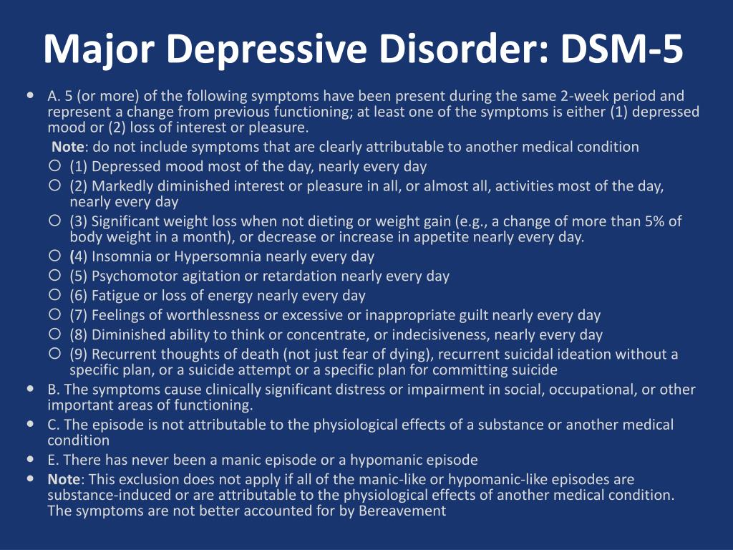
Notes:
there’s a lot to unpack with this case, and probably a lot more history to unfold, but lets take a step back and quickly review the diagnostic criteria for some of the possible differential diagnosis on the table among a possible OUD diagnosis.
Here we see the DSM criteria for major depressive disorder. We might be familiar with symptoms of depression, but lets draw out attention here (CLICK) which is an important criteria of not only major depressive disorder, but is listed on nearly all criteria including anxiety, bipolar disorder, PTSD, schizophrenia, and others.
And that is, that the symptoms present are not attributed to the effects of substances or perhaps even withdrawal from substances.

Slide 18



Independent or Secondary Disorder
Timeline
Did MH symptoms proceed substance use?
Substance use as a tool to self medicate?
Persistence
MH symptoms remain during periods of abstinence?
Past episodes not induced by substance at all.
This Photo by Unknown Author is licensed under CC BY-NC
This Photo by Unknown Author is licensed under CC BY-NC
Notes:
In many cases, it presents the age-old question.
We could easily think of a patient who experiences a significant life event such as their parents divorce, they become depressed, use substances to self medicate that depression. What do we treat? Their depression? SUD? Both? Do they have both?
Similarly we could see a patient develop an alcohol use disorder in college resulting in them quitting school, they then become depressed feeling as though they’ve failed.
What’s important is to establish is a timeline, which involves a thorough history, including a substance use history. This timeline allows us to identify when symptoms started in relation to any substance use, as well as the ongoing significance of that substance use, such as the duration and frequency.
As well, the persistence of symptoms despite abstinence, including withdrawal. Substance-induced symptoms often improve rapidly with appropriate withdrawal or SUD management.

Slide 19
Where to Start
1. Immediate safety
Suicidal Ideation
Withdrawal risk
Overdose risk
2. Treat SUD
May need to review history once abstinent
3. Evaluate for addition MHD
Shortly after induction/abstinence
4. Integrated treatment of SUD and MHD
Medically Supervised Withdrawal
Treatment for OUD, AUD, TUD
Harmful psychiatric symptoms
Notes:
With this complexity it is hard to know where to begin, especially for a patient who at this time, may not be the best historian.
CLICK
Start with the immediate safety concerns, screen for suicidal ideation, identify current substances present and possible risk of withdrawal, especially for alcohol and benzodiazepine withdrawal which can be fatal. As well as their overdose risk going forward if left untreated.

Slide 20
Case: DB
Repots misuse of previously prescribed Percocet, taking more than prescribed
Describes signs of tolerance and dependence.
“I ran out so… I started buying some”
Recently started crushing and snorting
“I even bought heroin twice last week, but it just feels so wrong so I thought I just would get back on the Percocet”
This Photo by Unknown Author is licensed under CC BY
Notes:
So getting back to DB after some additional time in clinic we discover…

Slide 21
Case: DB
Reports passive thoughts of suicide over the last month “especially after I use” but denies any history or current intention, plan, or attempt.
Last misuse of intranasal Percocet was last night, consistent with todays UDS which is positive for heroin as well
COWS today; 18 (moderate)
PHQ9: 21 (severe) (1 on Q9)
This Photo by Unknown Author is licensed under CC BY

Slide 22
DB Polling Question
What would you like to do for DB today?
Treat with an SSRI
Admit for inpatient psychiatric care based on passive thoughts of suicide
Offer treatment for OUD
Notes:
So, what would you like to do for DB today?
Exactly, so although DB may have a co-occurrence of depression, we first need to rule out any substance induced symptoms and likely get a more thorough history at a time when DB is able to share more.
For now, we want to start with his more immediate risk, which is his Opioid Use Disorder.

Slide 23
Case: DB
Inducted on buprenorphine.
Back for follow up after 2 weeks
Taking 16mg/day (8mg BID)
“I haven’t taken anything else since I saw you, so that’s good”
“I still just feel like a failure though”
This Photo by Unknown Author is licensed under CC BY

Slide 24
Where to Start
1. Immediate safety
Suicidal Ideation
Withdrawal risk
Overdose risk
2. Treat SUD
May need to review history once abstinent
3. Evaluate for addition MHD
Shortly after induction/abstinence
4. Integrated treatment of SUD and MHD
Medically Supervised Withdrawal
Treatment for OUD, AUD, TUD
Harmful psychiatric symptoms
Notes:
Lets look back on where we are.
CLICK
We addressed DBs immediate safety concern at his initial visit
CLICK
To accomplish that we initiated treatment for their diagnosed substance use disorder, OUD.
CLICK
Today, while we continue to follow up on his OUD treatment, lets also evaluate for any other mental health diagnosis that may also be indicated.

Slide 25
Screening Tools for MHD
Not an all-inclusive list
Conduct at baseline and again shortly after induction/achieving abstinence
Depression: PHQ9
Anxiety: GAD7
PTSD: PC-PTSD-5
Bipolar: CIDI-3
ADHD: ASRS
OCD: Y-BOCS
Suicidal Ideation: C-SSRS (PHQ9 also screens)
Notes:
I have listed here an example screening and in some cases diagnostic tool for specific mental health disorders. Now of course I have stated here they should be conducted at baseline and again shortly after abstinence, but I want to be clear, that doesn’t mean we should throw all these surveys and screening tools at every patient at every encounter. There are likely many we can rule out with our initial assessment. Remember, the first step is the immediate safety risk, so perhaps we might only conduct the Columbia Suicide Severity Rating Scale or C-SSRS or PHQ9 to address suicidal ideation specifically. Remember for DB he scored a 21 on the PHQ9 with a 1 for question 9 which addresses suicidal thoughts. Again by having these screening tools conducted at baseline and again after initiating SUD treatment, we can see the impact SUD treatment has on the possible underlying MHD symptoms.

Slide 26
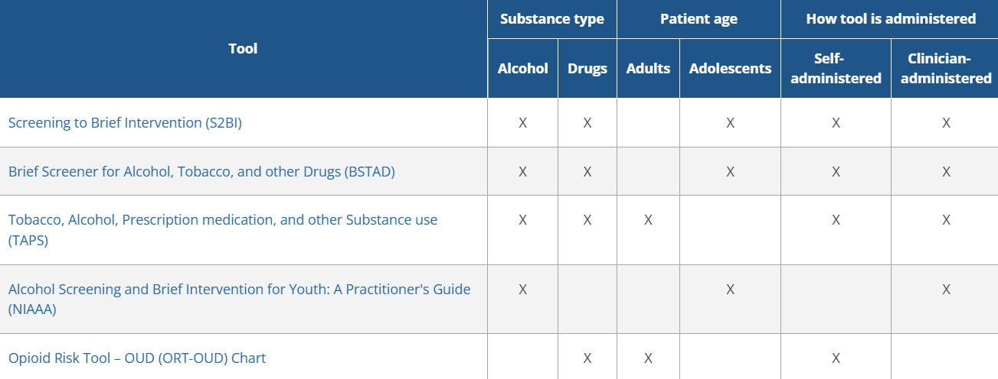
Screening Tools for SUD
https://nida.nih.gov/nidamed-medical-health-professionals/screening-tools-resources/chart-screening-tools
Notes:
Similarly, and in the reverse order, attached is a list of screenings tools that may be useful for our patients who present with a mental health disorder first, but we’re not sure if there’s any continued or underlying substance use disorder that may be impacting outcomes.
This is a chart of the National Institute on Drug Abuse with screenings tools for substance use disorders. we should always consider screening and discussion possible substance use disorders if suspected.

Slide 27
Case: DB
PHQ9; 16 (moderate-severe)
Denies suicidal thoughts
Has had a history of feeling depressed several times in his life, even before his shoulder surgery
Negative hx of mania/hypomania
Denies any other history of substance misuse other than recently with opioids
This Photo by Unknown Author is licensed under CC BY
Notes:
We’re able to get a more thorough medical history today including other medical records.

Slide 28
DB Polling Question
What would you like to do for DB today?
Offer treatment for Major Depressive Disorder
Wait until 2 months of confirmed abstinence before considering co-occurring diagnosis
Increase buprenorphine to 24mg/day
Notes:
So, what would you like to do for DB today?
Exactly, patients are all going to present in different ways, but given DBs history of depressive symptoms in the past even without prior substance use disorder and his current symptoms of depression which he has experienced in the past. It would be appropriate to offer DB treatment for MDD at this time.

Slide 29
Where to Start
1. Immediate safety
Suicidal Ideation
Withdrawal risk
Overdose risk
2. Treat SUD
May need to review history once abstinent
3. Evaluate for addition MHD
Shortly after induction/abstinence
4. Integrated treatment of SUD and MHD
Medically Supervised Withdrawal
Treatment for OUD, AUD, TUD
Harmful psychiatric symptoms
Notes:
This brings us to our fourth step, the integrated treatment of both OUD and Depression in the case of DB.
Lets move to our final objective and discuss how treatment might be impacted for co-occurring disorders.

Slide 30
Learning Objectives
Recognize the prevalence of comorbid mental health disorders and SUD.
Consider appropriate mental health screenings for patients with SUD.
Discuss treatment considerations for those with MH and SUD comorbidities.
Notes:
With that lets discuss some treatment consideration for those with co-occurring disorders.

Slide 31
Co-occurrent Treatment Overview
No one size fits all approach for every possible combination
Generally, similar to the treatment of either alone when it comes to pharmacologic selection:
Treatment history
Access
Drug-drug interactions
Notes:
For the studies conducted that look at co-occurrence for various substance use disorders, there really is no one size fits all approach.
We make treatment selection based on treatment history in terms of what’s maybe worked well in the past, their access to that treatment, and of course drug drug interactions which may play a role depending on treatment selection of the other co-occurring disorder or any other comorbidities that patient is experiencing.

Slide 32
Co-occurrent Treatment Overview
Increased monitoring
Adherence, including psychotherapy
Urine Drug Screening
Extra precaution for substances with misuse or possible misuse
Does not make them contraindicated
Integrated care > Parallel
Notes:
What we do see differently in co-occurence, as mentioned before, is that treatment is likely required to be intensified for those with co-occurring disorders; requiring increased monitoring for adherence to both their mental health and SUD treatment, perhaps an increase in follow up and/or urine drug screens, or perhaps even higher doses or augmentation with additional medications for certain co-occurring disorders.
Although not contraindicated, some treatment selections may simply require additional alert or increased screening for misuse such as other controlled substances or sedating agents with possible misuse potential to consider when selecting treatment.
Finally, an integrated approach is best; meaning a single care team or even single practitioner providing care for both disorders simultaneously, compared to two separate providers or practice settings providing care in parallel for each disorder individually.

Slide 33
Co-Occurrence and Depression
Pharmacology:
Psychotherapy:
SSRIs, SNRIs,
bupropion ER
Indicated for nicotine use disorder
off-label for ADHD
Off label, low evidence, StUD
Possible misuse, monitor
Cognitive-Behavioral Therapy (CBT)
Integrated approach
*Review risk of SI with naltrexone for OUD/AUD
Notes:
Looking more specifically, with depression our mainstay treatments again continue to be those we would consider regardless of SUD with some exceptions when it comes to bupropion. That is it may be helpful to treat both depression as well as tobacco use disorder, has off label data to support use in ADHD, and has low level, off label evidence to show reduction in stimulant misuse for those with stimulant use disorder. However, that being said, it’s pharmacologic properties are similar to that of amphetamines and clinical experience has noted it’s potential for misuse.
Additionally, for patients with depression and OUD or AUD, considering the risk of naltrexone or Vivitrol’s risk of increased suicidal ideation should be reviewed with the patient prior to treatment selection.

Slide 34
Co-Occurrence and Anxiety
Pharmacology:
Psychotherapy:
SSRIs, SNRIs
Buspirone
AVOID: benzodiazepines
Cognitive-Behavioral Therapy (CBT)
Integrated approach
Notes:
Regarding anxiety, the main take away here is being extra vigilant or even avoiding benzodiazepines as a controlled substance for those with a known history of substance use disorders and anxiety. Again, some circumstances may warrant short term use, but this should be justified and weighed heavily. Chronic use of benzodiazepines for anxiety type disorders is generally not recommended.

Slide 35
Co-Occurrence and PTSD
Pharmacology:
Psychotherapy:
SSRIs, SNRIs
Consider prazosin for nightmares
AVOID: benzodiazepines
CBT
Seeking Safety
Cognitive Processing Therapy
Exposure Therapy
Notes:
For PTSD our SSRIs remain our most well studied treatment for PTSD for those with co-occurring SUD. Prazosin can be considered to treat nightmares, and benzodiazepines should be avoided for the treatment of PTSD, which would be the case regardless of a confirmed co-occurring substance use disorder.
For psychotherapy, again many options exist, one specifically is a form of CBT called seeking safety which focusses on both trauma but also substance use components in each session.

Slide 36
Co-Occurrence and Bipolar
Pharmacology:
Psychotherapy:
Mood stabilizers
Quetiapine
Evidence of misuse
Monitor
Psychoeducation
CBT
Notes:
With bipolar disorder, many of our mood stabilizers may cause sedation or have a risk of misuse, most notably quetiapine, an antipsychotic. however, treatment for bipolar disorder should not be avoided if effective for this reason alone. We can always increase monitoring and or screen for misuse at frequent follow up if a concern exists.

Slide 37
Co-Occurrence and Schizophrenia
Pharmacology:
Psychotherapy:
Antipsychotic agents
Consider LAIs if able to improve adherence
CBT
Social Skills Training
Notes:
A similar consideration should be taken for psychiatric illness such as schizophrenia regarding extra consideration for antipsychotics that may have sedating properties. Consideration for long acting injectables may assist in improving or ensuring adherence to treatment if agreeable by the patient.

Slide 38
Co-Occurrence and ADHD
Pharmacology:
Psychotherapy:
Nonstimulant agents
Atomoxetine
Stimulant agents
Methylphenidate ER
Monitor closely
CBT
Family Therapy
Notes:
Finally, for ADHD, some of our mainstay treatments are stimulants.
Stimulants are not contraindicated for patients with ADHD who have co-occurring SUD and in many cases the substance misuse itself is like from untreated ADHD in the first place.
Adolescents with ADHD for example are at more risk of developing stimulant use disorder from untreated ADHD than they are from being prescribed a stimulant to treat ADHD in the first place.
If stimulants are most appropriate, using extended release formulizations for those with co-occurring SUD can reduce risk of misuse.

Slide 39
Questions?
Kress, Christine Bazik et al. The Prevalence of Comorbidities and Substance Use. Disorder. Nursing Clinics, Volume 58, Issue 2, 141 – 151.
Santo, T. et al. Prevalence of mental disorders among people with opioid use disorder: A systematic review and meta-analysis. Drug and Alcohol DependenceVolume 238, 1 September 2022, 10955
https://nida.nih.gov/nidamed-medical-health-professionals/screening-tools-resources/chart-screening-tools
https://pcssnow.org/courses/psychiatric-comorbidities-diagnosis-and-treatment-of-comorbid-psychiatric-disorders-and-opioid-use-disorders/
https://pcssnow.org/courses/substance-use-disorders-in-adolescents-with-psychiatric-comorbidity-when-to-screen-and-how-to-treat/
https://pcssnow.org/courses/the-connection-between-mental-health-and-opioid-use-disorder-2/
https://pcssnow.org/courses/15-managing-common-psychiatric-conditions-in-primary-care/
https://pcssnow.org/courses/suicide-and-opioids-intersections-and-opportunities-for-prevention/
https://pcssnow.org/courses/dual-diagnoses-of-youth-substance-use-disorders-and-depression-the-nature-of-the-association-and-treatment-implications/
Notes:
That was a lot of ground to cover in a short amount of time, I hope you all learned something, and I’m happy to answer any questions anyone may have!

