Slide 1
Advance Directives for EMS Clinicians
Shelby Parker, MD, EMT-P February 4, 2025 Indian Country EMS ECHO

Slide 2
What is an advance directive?
Living will
Durable power of attorney
MOLST/POLST form
Notes:
Introduction
What are Advanced Directives?
Legal documents that outline a patient's wishes regarding medical care in situations where they cannot communicate for themselves.
Examples: Living wills, durable power of attorney for healthcare, and POLST forms.
Importance for EMS Clinicians:
EMS is often the first point of contact for patients in emergencies.
Knowing how to interpret and respect these directives is crucial for providing patient-centered care and avoiding legal complications.

Slide 3
Living Will
Specifies the type of medical treatments a patient does or does not want (i.e. life-sustaining measures, ventilators, feeding tubes)
Notes:
Key Concepts
What are Advanced Directives?
Living Will: Specifies the type of medical treatments a patient does or does not want (e.g., life-sustaining measures, ventilators, or feeding tubes).
Durable Power of Attorney for Healthcare: Appoints a healthcare proxy to make medical decisions on the patient’s behalf.
POLST: Physician Orders for Life-Sustaining Treatment, which are actionable medical orders, often more specific than living wills, for EMS to follow.

Slide 4
Durable Power of Attorney (POA)
Appoints a healthcare proxy to make medical decisions on the patient’s behalf
Notes:
Key Concepts
What are Advanced Directives?
Living Will: Specifies the type of medical treatments a patient does or does not want (e.g., life-sustaining measures, ventilators, or feeding tubes).
Durable Power of Attorney for Healthcare: Appoints a healthcare proxy to make medical decisions on the patient’s behalf.
POLST: Physician Orders for Life-Sustaining Treatment, which are actionable medical orders, often more specific than living wills, for EMS to follow.

Slide 5
MOLST/POLST Form
Medical or Physician Orders for Life-Sustaining Treatment: actionable medical orders for EMS to follow, often more specific than living wills
Notes:
Key Concepts
What are Advanced Directives?
Living Will: Specifies the type of medical treatments a patient does or does not want (e.g., life-sustaining measures, ventilators, or feeding tubes).
Durable Power of Attorney for Healthcare: Appoints a healthcare proxy to make medical decisions on the patient’s behalf.
POLST: Physician Orders for Life-Sustaining Treatment, which are actionable medical orders, often more specific than living wills, for EMS to follow.

Slide 6
DNR/DNI
DNR (Do Not Resuscitate): Indicates that a patient does not want CPR or advanced cardiac life support if their heart stops
DNI (Do Not Intubate): Indicates that a patient does not want to be intubated or placed on a mechanical ventilator
Notes:
Key Concepts
DNR/DNI:
Do Not Resuscitate (DNR): A directive that specifies no CPR or advanced cardiac life support if the patient’s heart stops.
Do Not Intubate (DNI): Indicates the patient does not want to be intubated or placed on a mechanical ventilator.
Role of EMS:
Recognize the limits of these orders in the prehospital setting.
Follow state laws and medical protocols.

Slide 7
New Mexico State Laws
Recognizes NM MOST form (a type of POLST) as well as standard DNR/DNI orders
Must be signed by licensed provider to be valid (i.e. MD, DO, NP, PA)
Allows DNR identification via official forms, bracelets or necklaces
Good Samaritan laws protect EMS clinicians acting in good faith when honoring these directives
Notes:
New Mexico Legislation
State-Specific Laws:
New Mexico recognizes POLST forms and standard DNR/DNI orders.
A POLST form must be signed by a licensed provider (e.g., MD, DO, NP, PA) to be valid.
Verbal DNR orders from a physician can be honored if verified through dispatch or medical control.
DNR Identification:
New Mexico allows DNR identification via official forms, bracelets, or necklaces.
Legal Protections:
Good Samaritan laws protect EMS providers acting in good faith when honoring these directives.

Slide 8
New Mexico State Laws
Uniform Health-Care Decisions Act (UHCDA): provides individuals the right to make decisions regarding their own healthcare, including execution of advance directives
Allows for designation of healthcare proxy and creation of living wills
Notes:
A. Legal Framework
Uniform Health-Care Decisions Act (UHCDA):
New Mexico has adopted the UHCDA, which provides individuals the right to make decisions regarding their own healthcare, including the execution of advance directives.
This act allows for the designation of a healthcare decision-maker through a durable power of attorney and the creation of living wills.
B. EMS Do Not Resuscitate (DNR) Orders
Definition:
An EMS DNR order is a directive that instructs emergency medical services personnel not to perform resuscitative measures in the event of a patient's cardiac or respiratory arrest.
Execution:
Must be executed by a physician, advanced practice nurse, or physician assistant, with the informed consent of the patient or their authorized healthcare decision-maker.
The order should be documented on a form approved by the New Mexico Department of Health's EMS Bureau.
Identification:
Patients may choose to wear an approved EMS DNR bracelet or necklace to indicate the existence of the order.
Revocation:
An EMS DNR order can be revoked at any time by the patient or their authorized healthcare decision-maker, either orally or by destroying the DNR document.
C. Medical Orders for Scope of Treatment (MOST)
Purpose:
The MOST form is designed to translate a patient's preferences into actionable medical orders, particularly concerning life-sustaining treatments.
Execution:
Must be signed by the patient (or their authorized healthcare decision-maker) and a physician, advanced practice nurse, or physician assistant.
Scope:
Covers decisions regarding resuscitation, medical interventions, antibiotics, and artificially administered nutrition.
Review and Revocation:
The MOST form should be reviewed periodically and can be revoked or revised by the patient or their authorized healthcare decision-maker at any time.
D. EMS Personnel Responsibilities
Verification:
Upon encountering a patient, EMS personnel should verify the presence of an EMS DNR order or MOST form.
Acceptable forms of verification include the physical document or approved identification jewelry.
Actions:
If a valid EMS DNR order is present, EMS personnel should withhold resuscitative measures such as chest compressions, intubation, defibrillation, and administration of cardiac medications.
Comfort measures, including oxygen administration, suctioning, and pain management, should still be provided as needed.
Uncertainty:
In cases where the validity of a DNR order or MOST form is in question, EMS personnel are advised to initiate resuscitation and contact medical control for guidance.
E. Legal Protections
Good Faith Compliance:
EMS personnel who, in good faith, comply with a valid EMS DNR order or MOST form are protected under New Mexico law from civil or criminal liability.
Documentation:
It's essential for EMS personnel to document the presence and specifics of any advance directives encountered during patient care.
F. Resources
New Mexico Department of Health EMS Bureau:
Provides approved forms and additional guidance on EMS DNR orders and MOST forms.
Training:
EMS agencies are encouraged to provide regular training on the recognition and implementation of advance directives in accordance with New Mexico law.

Slide 9
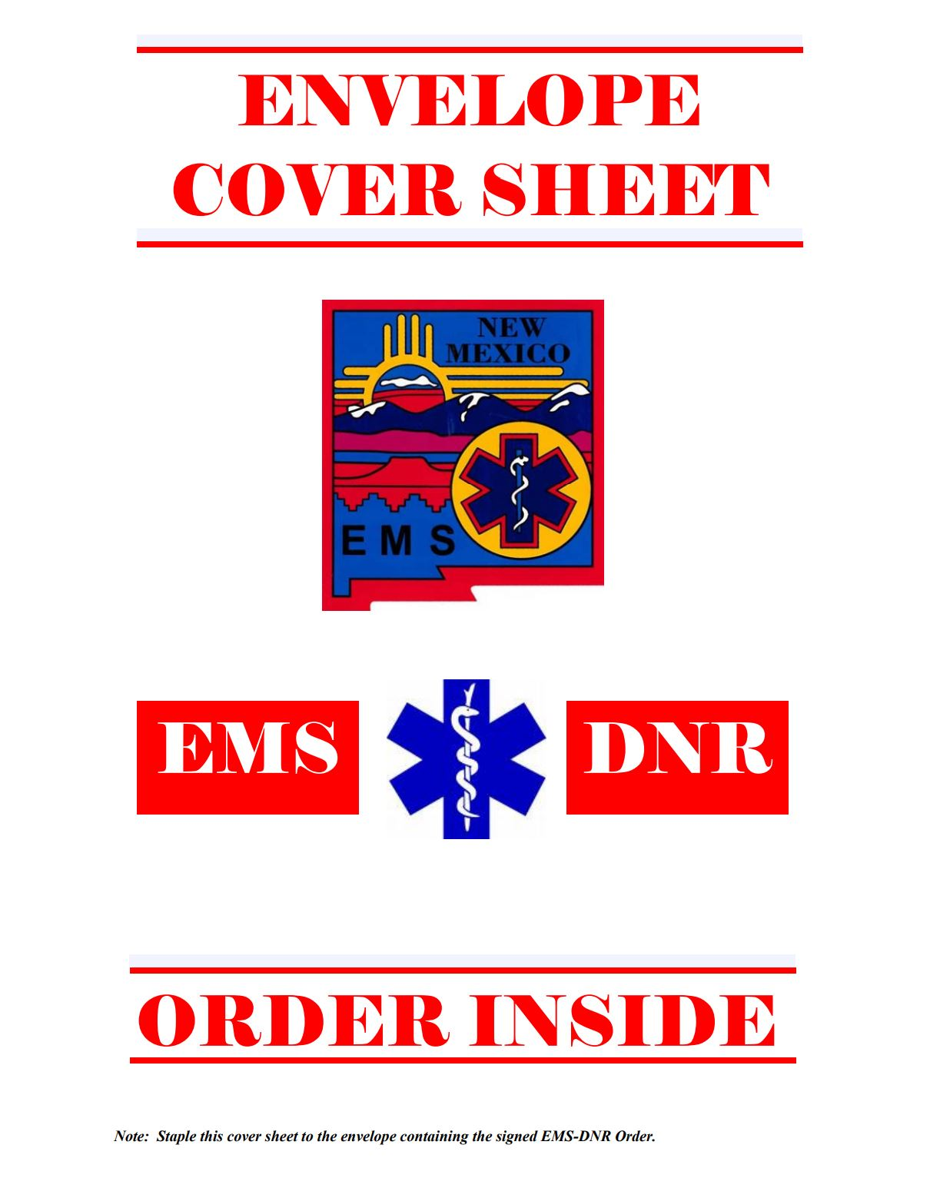
EMS DNR
Directive that instructs EMS clinicians not to perform resuscitative measures in the event of cardiac or respiratory arrest
Must be executed by a physician, NP or PA with patient’s informed consent (or that of their POA)
Should be documented on approved NM DOH EMS Bureau form
May be revoked at any time by patient or healthcare proxy
Notes:
B. EMS Do Not Resuscitate (DNR) Orders
Definition:
An EMS DNR order is a directive that instructs emergency medical services personnel not to perform resuscitative measures in the event of a patient's cardiac or respiratory arrest.
Execution:
Must be executed by a physician, advanced practice nurse, or physician assistant, with the informed consent of the patient or their authorized healthcare decision-maker.
The order should be documented on a form approved by the New Mexico Department of Health's EMS Bureau.
Identification:
Patients may choose to wear an approved EMS DNR bracelet or necklace to indicate the existence of the order.
Revocation:
An EMS DNR order can be revoked at any time by the patient or their authorized healthcare decision-maker, either orally or by destroying the DNR document.

Slide 10
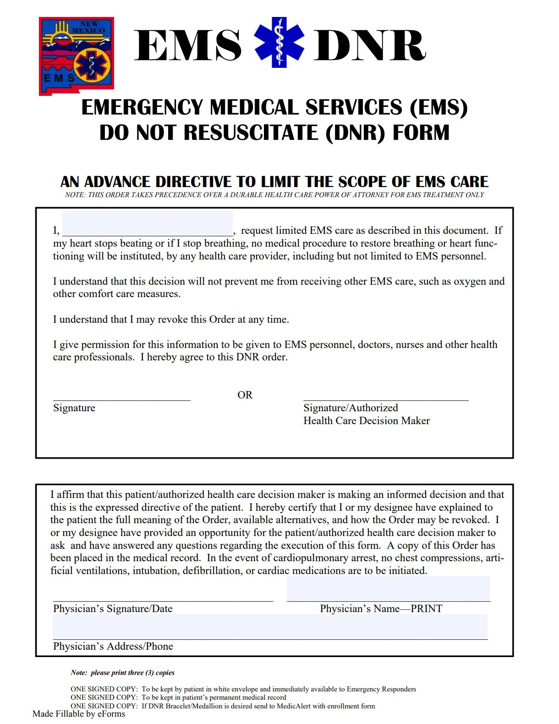
Notes:
B. EMS Do Not Resuscitate (DNR) Orders
Definition:
An EMS DNR order is a directive that instructs emergency medical services personnel not to perform resuscitative measures in the event of a patient's cardiac or respiratory arrest.
Execution:
Must be executed by a physician, advanced practice nurse, or physician assistant, with the informed consent of the patient or their authorized healthcare decision-maker.
The order should be documented on a form approved by the New Mexico Department of Health's EMS Bureau.
Identification:
Patients may choose to wear an approved EMS DNR bracelet or necklace to indicate the existence of the order.
Revocation:
An EMS DNR order can be revoked at any time by the patient or their authorized healthcare decision-maker, either orally or by destroying the DNR document.

Slide 11
DNR ≠ Do Not Treat

Slide 12
MOST Form
Medical Orders for Scope of Treatment: New Mexico-specific form of POLST that translates a patient’s preferences into actionable medical orders, particularly concerning life-sustaining treatments
Resuscitation
Medical interventions
Antibiotics
Artificially administered nutrition
Notes:
C. Medical Orders for Scope of Treatment (MOST)
Purpose:
The MOST form is designed to translate a patient's preferences into actionable medical orders, particularly concerning life-sustaining treatments.
Execution:
Must be signed by the patient (or their authorized healthcare decision-maker) and a physician, advanced practice nurse, or physician assistant.
Scope:
Covers decisions regarding resuscitation, medical interventions, antibiotics, and artificially administered nutrition.
Review and Revocation:
The MOST form should be reviewed periodically and can be revoked or revised by the patient or their authorized healthcare decision-maker at any time.

Slide 13
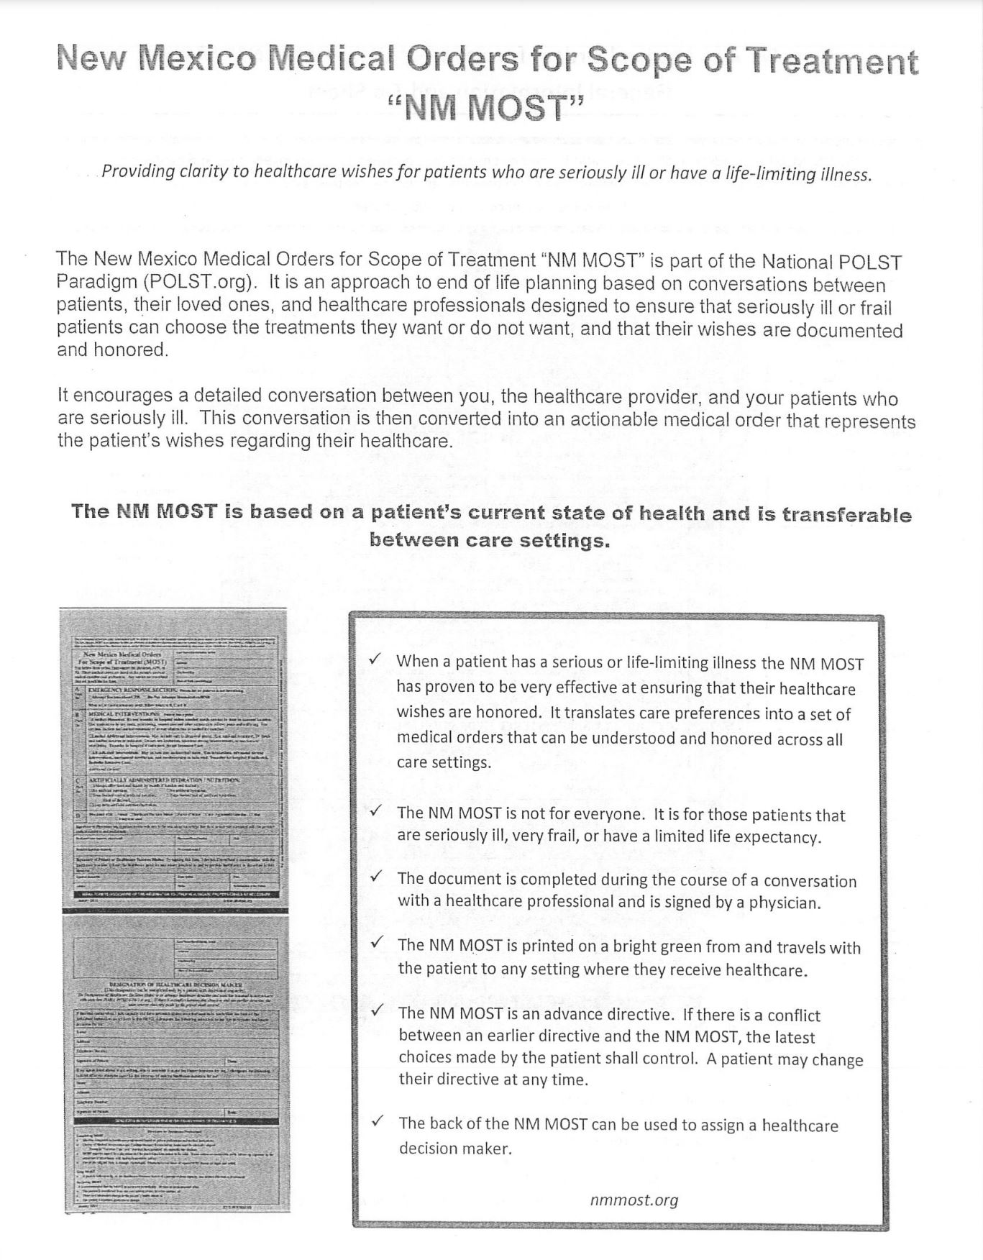
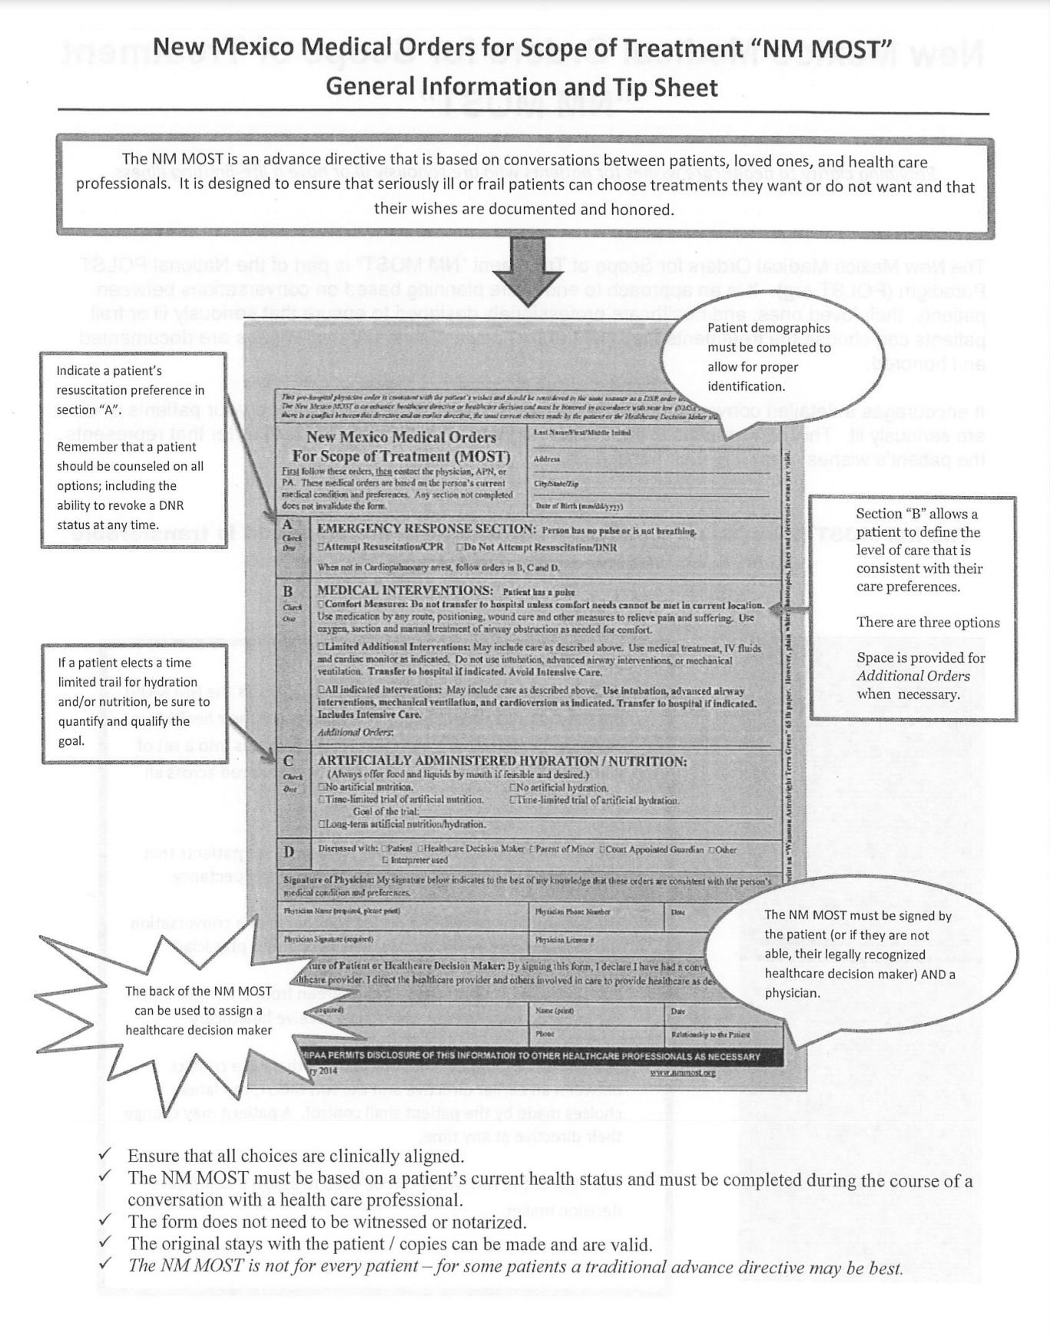
Notes:
C. Medical Orders for Scope of Treatment (MOST)
Purpose:
The MOST form is designed to translate a patient's preferences into actionable medical orders, particularly concerning life-sustaining treatments.
Execution:
Must be signed by the patient (or their authorized healthcare decision-maker) and a physician, advanced practice nurse, or physician assistant.
Scope:
Covers decisions regarding resuscitation, medical interventions, antibiotics, and artificially administered nutrition.
Review and Revocation:
The MOST form should be reviewed periodically and can be revoked or revised by the patient or their authorized healthcare decision-maker at any time.

Slide 14
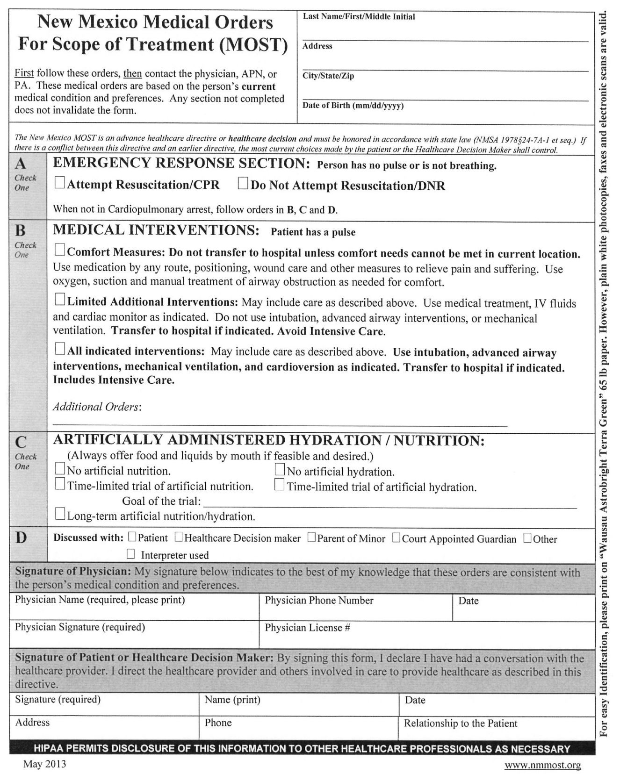
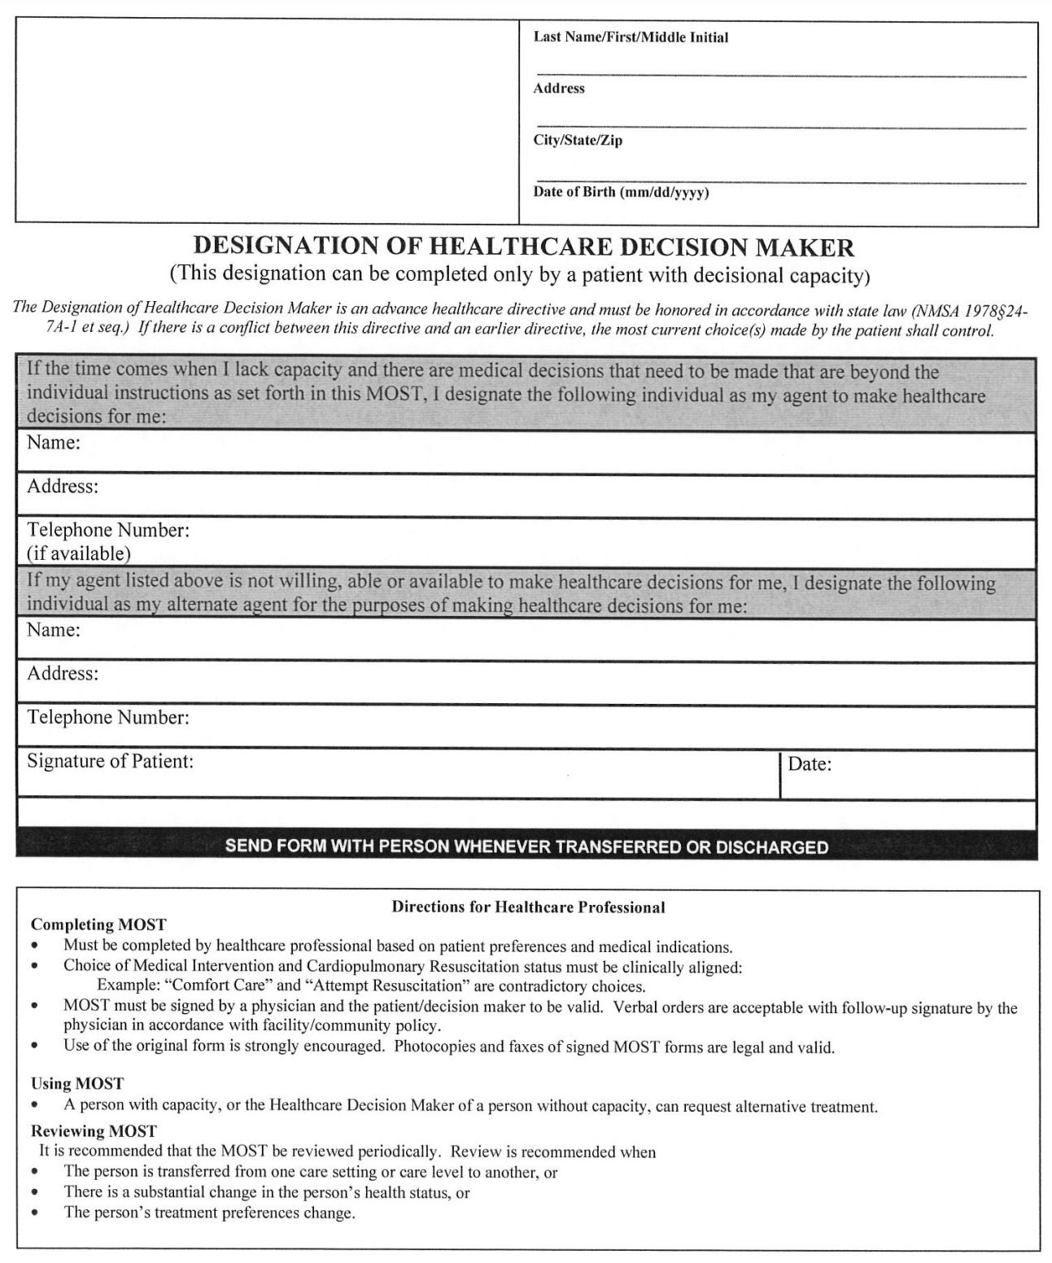
Notes:
C. Medical Orders for Scope of Treatment (MOST)
Purpose:
The MOST form is designed to translate a patient's preferences into actionable medical orders, particularly concerning life-sustaining treatments.
Execution:
Must be signed by the patient (or their authorized healthcare decision-maker) and a physician, advanced practice nurse, or physician assistant.
Scope:
Covers decisions regarding resuscitation, medical interventions, antibiotics, and artificially administered nutrition.
Review and Revocation:
The MOST form should be reviewed periodically and can be revoked or revised by the patient or their authorized healthcare decision-maker at any time.

Slide 15
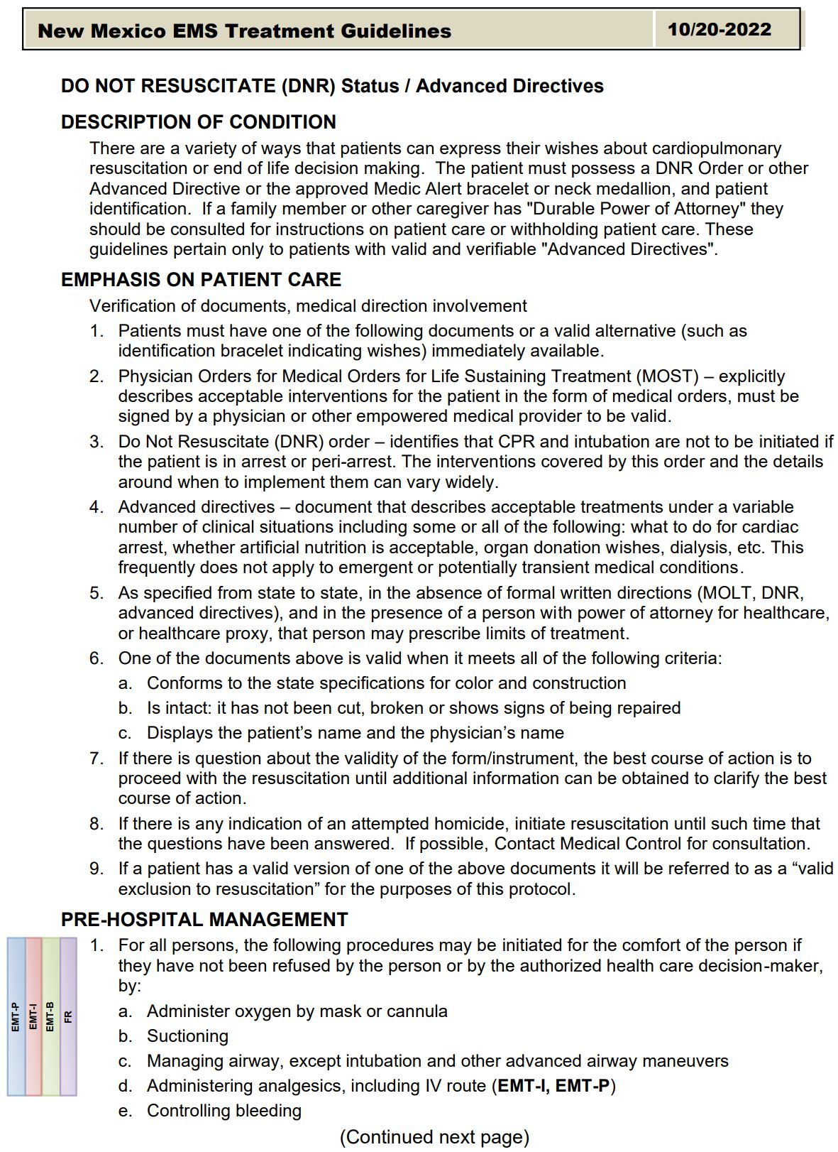
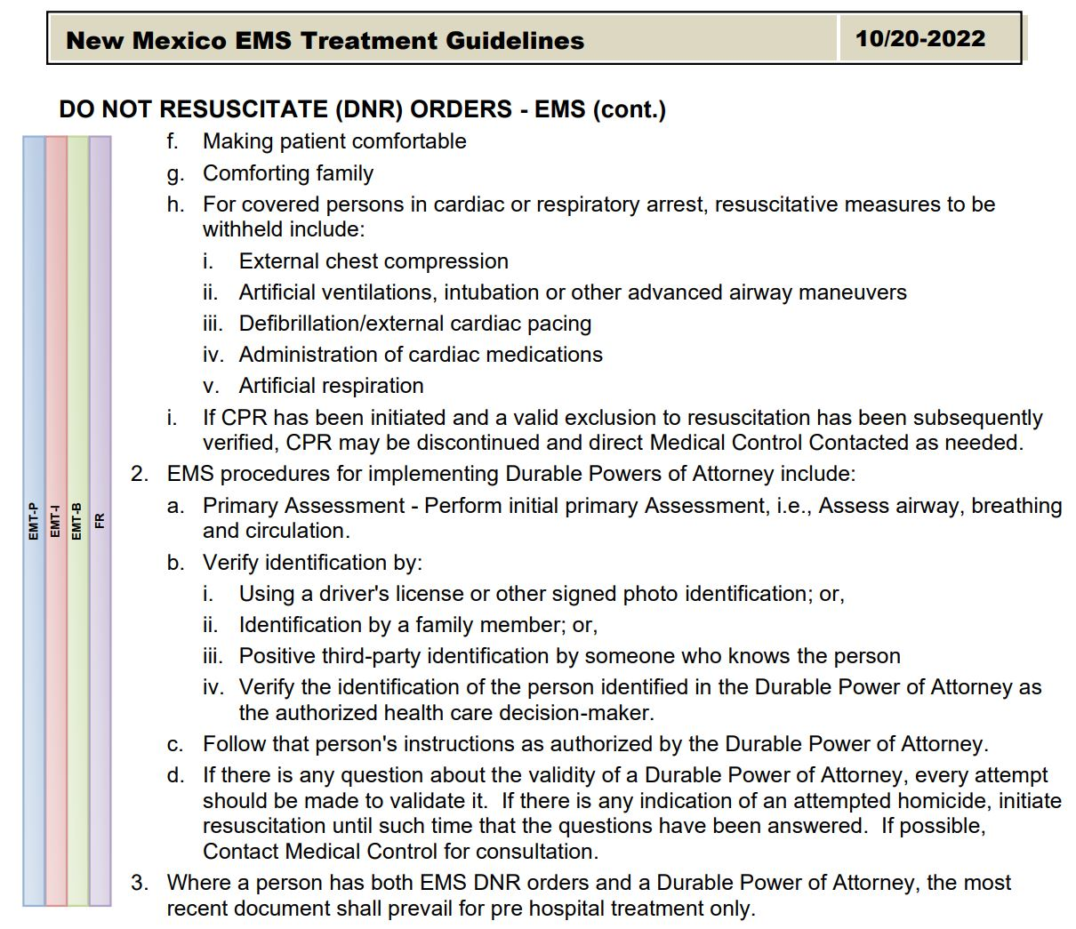

Slide 16
What is my job as an EMS clinician?
Verify presence of EMS DNR, MOST or POLST form and/or approved identification jewelry
Ensure documents are valid and applicable to current situation
If present, withhold resuscitative measures including chest compressions, intubation, defibrillation, administration of cardiac medications, etc.
If appropriate, provide comfort measures including oxygen, suctioning, and pain management
Notes:
D. EMS Personnel Responsibilities
Verification:
Upon encountering a patient, EMS personnel should verify the presence of an EMS DNR order or MOST form.
Acceptable forms of verification include the physical document or approved identification jewelry.
Ensure documents are valid and applicable to the current situation.
When in doubt, contact medical control for guidance.
Actions:
If a valid EMS DNR order is present, EMS personnel should withhold resuscitative measures such as chest compressions, intubation, defibrillation, and administration of cardiac medications.
Comfort measures, including oxygen administration, suctioning, and pain management, should still be provided as needed.
Uncertainty:
In cases where the validity of a DNR order or MOST form is in question, EMS personnel are advised to initiate resuscitation and contact medical control for guidance.

Slide 17

CALL YOUR MEDICAL DIRECTION!

Slide 18
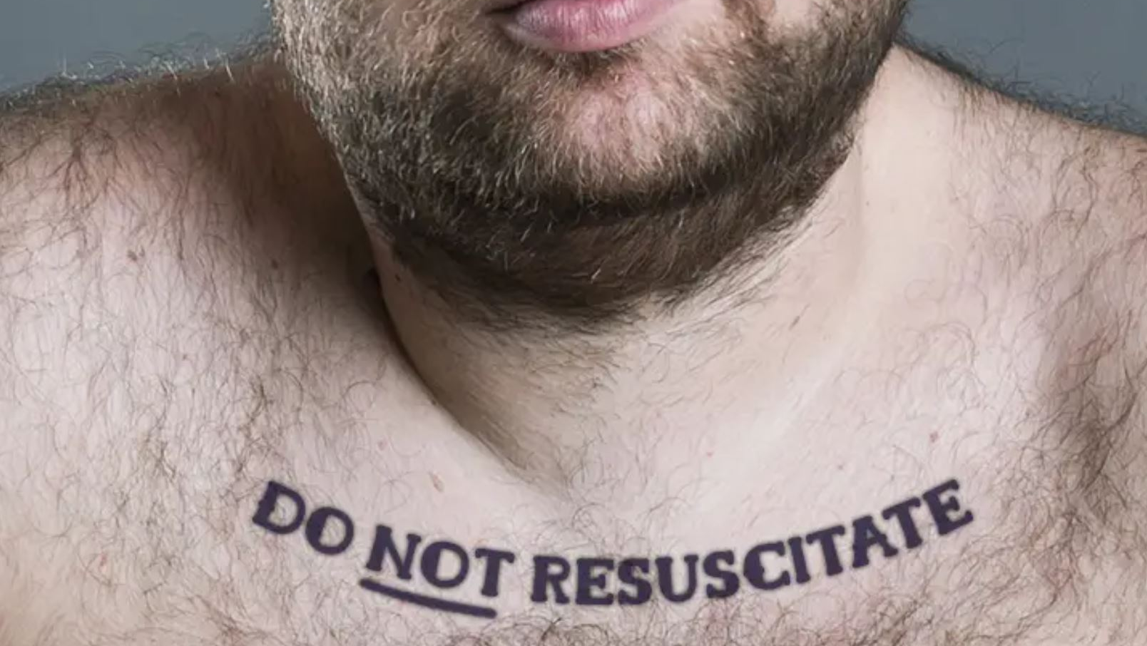
Notes:
In New Mexico, as in most states, a tattoo indicating "Do Not Resuscitate" (DNR) is not legally recognized as a valid DNR order.
Tattoos lack the necessary components of a legally binding DNR order, such as the patient's full name, address, phone number, and the signature of the attending physician.
Moreover, tattoos are not easily alterable, which poses challenges since patients have the right to revoke a DNR at any time.
Given these factors, EMS personnel and healthcare providers should not rely on DNR tattoos when making critical decisions. Instead, they should look for official documentation or approved medical identification that clearly outlines the patient's end-of-life care preferences.
In the absence of valid documentation, standard resuscitation protocols should be followed, and medical control should be consulted for further guidance. EMS1.COMIt's essential for individuals to communicate their end-of-life wishes through legally recognized means, such as completing the appropriate DNR forms and discussing their preferences with healthcare providers and family members.

Slide 19

Notes:
What if a family member verbally confirms that patient would not want resuscitation?
In situations where a patient is in cardiac arrest and the official DNR or MOST documentation is not immediately available, EMS personnel are instructed to initiate standard resuscitation procedures.
Family members may verbally inform EMS personnel of the patient's advance directives; however, without the requisite documentation, EMS is generally obligated to proceed with life-saving measures.
EMS personnel are advised to ask family members or others present to locate the EMS DNR order; if the order is located, they can then proceed according to the directives.
If the order is not found, resuscitation efforts should continue, and medical control should be contacted for further consultation.

Slide 20
Legal Protections
Good Faith Compliance: EMS clinicians are protected against civil or criminal liability
Documentation: critical to document presence and specifics of advance directives encountered during patient care
Notes:
E. Legal Protections
Good Faith Compliance:
EMS personnel who, in good faith, comply with a valid EMS DNR order or MOST form are protected under New Mexico law from civil or criminal liability.
Documentation:
It's essential for EMS personnel to document the presence and specifics of any advance directives encountered during patient care.

Slide 21
What if the patient is awake?
Advance directives only apply when patient is incapacitated.
If patient is conscious and competent, they can change their decision.
Notes:
Recognizing and Handling Documentation
EMS Considerations:
Remember: Advanced directives only apply when the patient is incapacitated. If they are conscious and competent, they can change their decision.

Slide 22
Communication
Difficult Conversations:
With families: “I understand this is a very difficult time. Let’s review what your loved one wanted.”
With patients: “I see you have a DNR form. Let’s talk about what that means and how I can respect your wishes today.”
Navigating Disagreements:
Stay focused on patient’s wishes as outlined in the documentation.
Involve medical control early if family members challenge the directive or provide conflicting information.
Notes:
Communication Skills
Having Difficult Conversations:
With Families:
Approach with empathy and patience. Example: “I understand this is a very difficult time. Let’s review what your loved one wanted.”
Acknowledge their emotions and answer their questions clearly.
With Patients:
Respect their autonomy and affirm their decisions.
Example: “I see you have a DNR order. Let’s talk about what that means and how I can respect your wishes today.”
Navigating Disagreements:
Stay calm and focused on the patient’s wishes as outlined in the documentation.
Involve medical control if family members challenge the directive or provide conflicting information.
Scenario Example:
A family member demands resuscitation for a patient wearing a DNR bracelet. Practice steps to de-escalate while adhering to protocols.

Slide 23


Slide 24
Scenario #1
You arrive to find a patient in cardiac arrest with a signed DNR form.
Notes:
Case Studies
Case Study 1: Valid DNR Order
Scenario: EMS arrives to find a patient in cardiac arrest with a signed DNR form.
Response: Verify documentation, confirm with medical control if needed, and provide comfort care without initiating CPR.

Slide 25
Scenario #2
A patient in severe respiratory distress has a POLST form refusing intubation, but the family insists on advanced measures.
Notes:
Case Studies
Case Study 2: Conflicting Information
Scenario: A patient has a POLST form refusing intubation, but the family insists on advanced measures.
Response: Prioritize the POLST form as a legally binding document and consult medical control to address the family’s concerns.

Slide 26
Scenario #3
You arrive to find a patient in cardiac arrest and the family states that the patient has a DNR, but no paperwork or identifiers are present.
Notes:
Case Studies
Case Study 3: Missing Documentation
Scenario: Family states the patient has a DNR, but no paperwork or identifiers are present.
Response: Treat the patient per standard protocols while contacting medical control for further instructions.

Slide 27
Key Takeaways
Advance directives guide EMS clinicians in respecting patients’ autonomy.
Understanding state laws and documentation ensures ethical and legal compliance.
Empathy and communication are vital when navigating challenging scenarios.
Notes:
Conclusion
Key Takeaways:
Advanced directives guide EMS clinicians in respecting patient autonomy.
Understanding state laws and documentation ensures ethical and legal compliance.
Empathy and communication are vital when navigating these challenging scenarios.

Slide 28
To-Do Items
Review your agency’s protocols and stay updated on state laws regarding advance directives
Important Websites:
EMS DNR
NM MOST Form
NM State EMS Guidelines
End of Life Options NM
Notes:
Final Note:
Encourage attendees to review their agency’s protocols and stay updated on state laws regarding advanced directives.
Provide resources, such as links to POLST forms, state guidelines, and continuing education opportunities.

Slide 29

Thank You! Questions?
shelbyparkermd@gmail.com
Sky City, Acoma Pueblo, New Mexico

