Slide 1
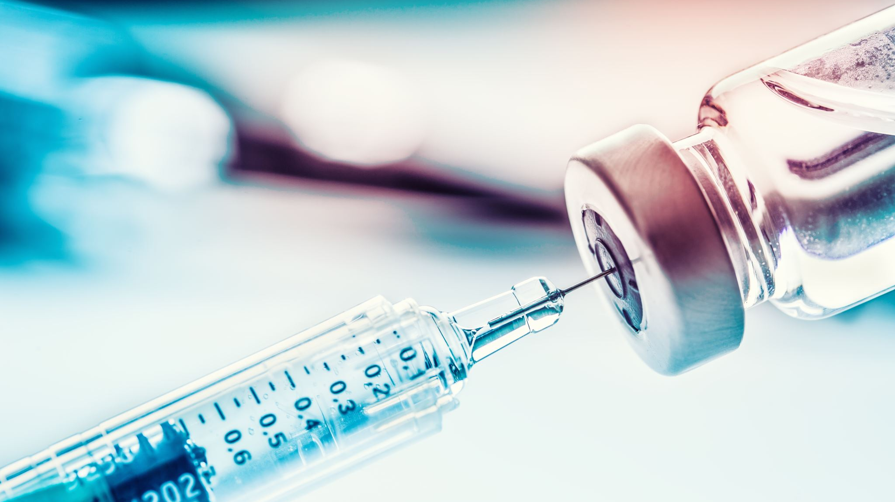
Once-Weekly Basal Insulin: Advances, Challenges, and Practical Applications
May (Annamay) Fry, Pharm.D., B.S. PGY-1 Pharmacy Resident Yakama Indian Health Clinic Toppenish, Washington

Slide 2
Once-Weekly Basal Icodec: Pharmacokinetic Profile
Long-acting basal insulin analog that bind to insulin receptors and facilitates glucose uptake into cells - lowering blood glucose levels
Exhibits prolonged duration of action, lasting up to 7 days, w/flat, sustained blood glucose lowering effect
By binding w/serum albumin, insulin becomes protected from rapid degradation & clearance
Absorbed slowly - miniPEG-γGlu linked-1, 20-icosanedioic acid (C20) at position LysB29 results in stronger (reversible) binding w/serum albumin
Notes:
Insulin icodec pen injector
U-700 formulation w/10 U increments
Insulin naïve pts starting dose of 70 U subQ = 10 U daily
Weekly injection volume in equivalent to daily injection volume

Slide 3
Once-Weekly Basal Efsitora Alfa: Pharmacokinetic Profile
Long-acting basal insulin analog providing continuous 17-day coverage (low peak to trough ratio 1.14 or <15% insulin variation)
Once-weekly subQ - simplifies dosing & improves patient adherence
Slow, predictable absorption - sustained glycemic control, allowing for tailored dosing & minimizing blood glucose fluctuations
Modified fusion protein combining a novel single-chain insulin variant w/human IgG Fc domain
Comparison w/Degludec in both T1DM & T2DM demonstrate similar glycemic control outcomes but varied weight & hypoglycemia profiles based on industry studies
Notes:
Eli Lilly, 2024 phase 3 trials
Offers convenient & effective long-term glycemic management

Slide 4
Basal Insulin Comparisons
Feature | Icodec (Awiqli) | Degludec (Tresiba) | Efsitora Alfa
Duration of Action | Plasma half-life > 8 days; requires further clarification for precise duration | Long-acting insulin analog w/duration up to 42 hours and predictable absorption | Plasma half-life > 17 days; requires further clarification for precise duration
Absorption Rate | Slow & relatively predictable, but individual variations exist | Predictable absorption | Slow & predictable; minimizes fluctuations
Onset of Action | Gradual, several hours post-injection | Gradual, minimizing hypoglycemia | Gradual; prevents rapid glucose drops
Peak Effect | Minimal peak effect; consistent glucose lowering | Minimal, ensuring consistent glycemic control | Minimal; consistent blood glucose profile
Glycemic Control | Sustained and predictable control for T1DM & T2DM | Sustained control, minimizing fluctuations | Sustained 17-day control; simplifies management
Side Effect Profile | Hypoglycemia (dose dependent), injection site reactions, rare allergic reactions | Injection-site reactions, hypoglycemia (dose dependent), rare hypersensitivity | Hypoglycemia (dose dependent), injection site reactions, rare allergic reactions
Notes:
Difference in estimated mean body weight change from baseline was not statistically significant when comparing icodec with degludec
Novo, Novo, Lilly - Manufactors

Slide 5
Why use once weekly basal insulin formulations?
Convenient Weekly Dosing
Up and Coming
Clinical Trial Data
Pharmacist-Led Comprehensive Review
Notes:
Simplified insulin regimen for better adherence. Supporting efficacy and safety in diabetes management. Understanding Icodec's role in diabetes care.

Slide 6
Binding & Glucose Uptake
Long-acting analog, administered subQ once weekly
Insulin binds to insulin receptors on cells, facilitating glucose uptake & utilization, lowering blood glucose levels
Extends blood glucose control through binding w/serum albumin
Prolonged MOA achieved through controlled release mechanism - ensures consistent supply of insulin over course of the week
With each weekly injection, the pool of albumin-bound basal insulin gradually increases, until steady state is reached after 3 - 4 weeks when the full glucose-lowering effect is achieved (basal Icodec)
Reduced action at insulin receptor - contributes to decreasing rate of degradation & clearance in the body

Slide 7
Slow Absorption & Prolonged Action
Ensures stable glycemic control w/minimal fluctuations throughout the week
Extended action minimizes need for frequent injections, improving pt convenience & adherence to the prescribed regimen
Slow absorption rate primarily attributed to the specific formulation and delivery system of Icodec - gradual release of insulin into bloodstream
Prolonged duration of action is crucial for maintaining consistent glycemic control, especially for patients requiring long-term insulin therapy
Gradual absorption ensures steady-state insulin levels, achieved after approximately 4 weeks w/o loading dose

Slide 8
ONWARDS Studies
ONWARDS 3: Studied pts w/T2DM, who have not previously been treated with insulin, comparing icodec to once-daily degludec (non-inferior)
ONWARDS 1: Studied pts w/T2DM who have not previously been treated with insulin, comparing icodec to once-daily glargine U100 (non-inferior)
ONWARDS 2: Studied pts w/T2DM who have previously been treated with basal insulin, comparing icodec to once-daily degludec (non-inferior)
ONWARDS 4: Studied pts w/T2DM, who have previously been treated with insulin, comparing icodec to once-daily glargine U100 (non-inferior)
ONWARDS 6: Studied pts w/T1DM, comparing icodec to once-daily degludec & insulin aspart (non-inferior)
Notes:
Novo Nordisk

Slide 9
Clinical Efficacy: ONWARDS 3 Trial Findings
Insulin-naive T2DM pts treated with OADs +/- GLP-1 RA, adults (aged ≥18 yrs), and hemoglobin (HbA1c) < 7.0 – 11.0%
01
Participants received either once-weekly basal insulin (Icodec) or a degludec, & primary endpoint assessed the change in HbA1c after 26 weeks
02
HbA1c Reduction:
-1.57% HbA1c w/Icodec
-1.36% HbA1c w/Degludec
03
Further details regarding trial's methodology, including patient stratification & statistical analysis, are available in the complete study report
04

Slide 10
ONWARDS 3: Fasting Plasma Glucose
Improvements in fasting plasma glucose (FPG) levels
Effectively controls blood glucose levels not only on average throughout the day but also specifically after an overnight fast
Supports effectiveness in managing blood glucose and contributing to overall metabolic control

Slide 11
ONWARDS 3 –Secondary Endpoint
Clinically significant or severe hypoglycemia
NOT significantly different between treatment groups at week 31
Insulin icodec: 0.31
Insulin degludec: 0.15
(events/pt year of exposure)
Require further investigation but suggest a broad range of effects beyond glycemic control

Slide 12
ONWARDS 6: Overview
26-week open-label, treat to target trial, assessed efficacy & safety of once-weekly basal insulin (Icodec) in pts w/T1DM currently prescribed basal/bolus regimens
Adults (aged ≥18 yrs) treated w/insulin analogue regimens for at least 1 yr w/glycated hemoglobin (HbA1c) < 10.0%
Once-weekly basal insulin demonstrated non-inferiority in reducing mean HbA1c from baseline

Slide 13
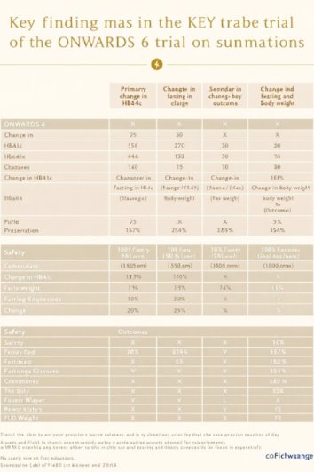
ONWARDS 6: Findings
Compared Icodec w/Degludec & Aspart
HbA1c Reduction vs Baseline --> 7.4%
FPG decreased --> 2.1%
Modest reduction in weight gain compared to Degludec --> 2.5%
Findings indicate reduction in weight gain rather than absolute weight loss

Slide 14
ONWARDS 6: Glycemic Control
Shown to effectively lower blood glucose levels w/in first few weeks of treatment
Early & rapid improvement in glycemic control
Clinically significant or severe hypoglycemia were significantly higher with icodec insulin at week 26
Insulin icodec: 19.93
Insulin degludec: 10.37
(events/pt year of exposure)

Slide 15
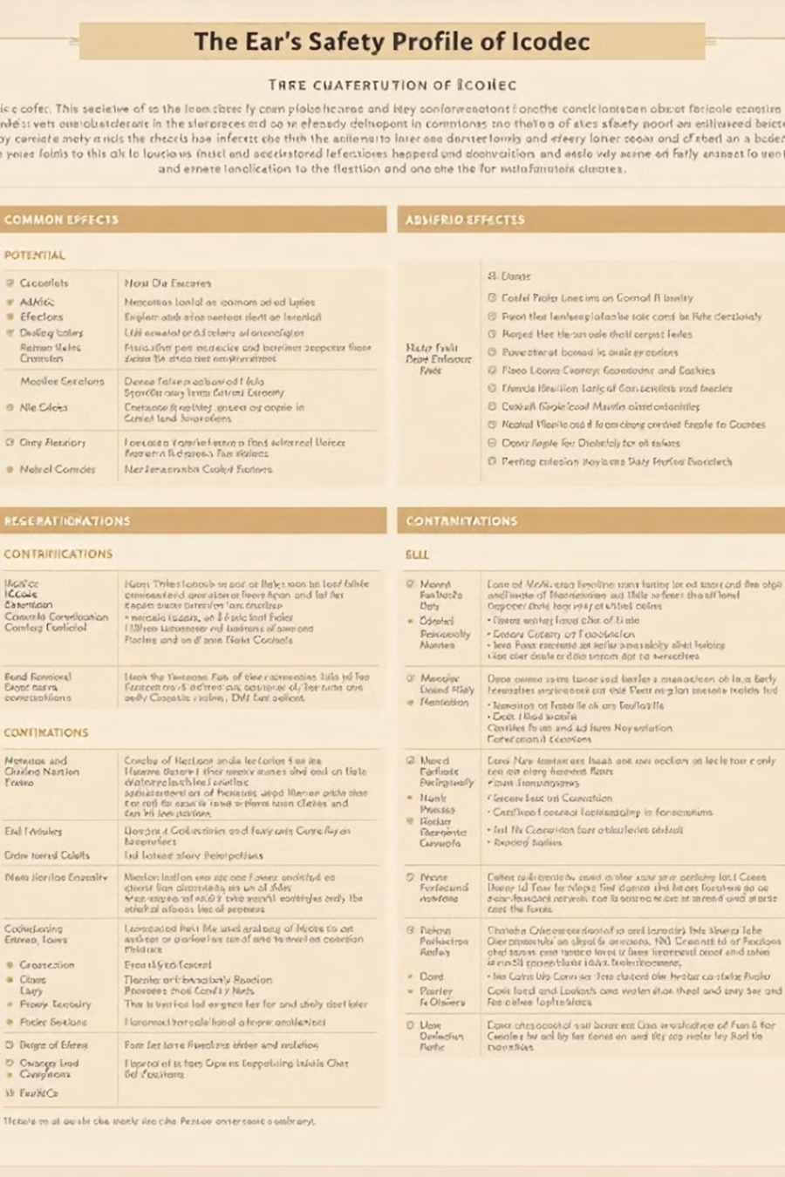
ONWARDS 6: Safety Profile & AEs
Generally favorable safety profile w/ low incidence of serious AEs
Most common: mild & transient injection site reactions
Others: hypoglycemia & weight gain
Events were typically manageable & could be minimized w/appropriate patient education & dose adjustments
CIs: pts w/known hypersensitivity to insulin or any of its excipients. NOT recommended for pts w/DKA history

Slide 16
QWINT-2 Trial
T2DM patients
01
Compare efficacy & safety of once-weekly basal insulin (Efsitora) to daily basal insulin
02
HbA1c reduction: Similar between once-weekly basal insulin (Efsitora) & daily basal insulins (Non-Inferior)
03
Modest reduction in weight gain with once-weekly basal insulin (Efsitora)
04
Comparable rates of hypoglycemia & adverse events
05
14.03 Efsitora Alfa
11.59 Degludec
(estimated rates of bg <54 mg/dL through week 52)
06
Notes:
Eli Lilly

Slide 17
QWINT-5 Trial
T1DM patients
Assess weekly once-weekly basal insulin (Efsitora) efficacy versus daily basal insulins (degludec)
HbA1c control: Non-inferior performance by once-weekly basal insulin
(-0.53% vs -0.59%)
Higher rates of combined level 2 or level 3 hypoglycemia w/greater incidence of severe hypoglycemia in participants
Data might suggest the need for additional evaluation of once-weekly basal insulin (efsitora) dose initiation & optimization in pts w/T1DM
14.03 Efsitora Alfa
11.59 Degludec
(estimated rates of bg <54 mg/dL through week 52)
Notes:
Eli Lilly

Slide 18
Weekly Basal Insulin vs. Degludec Key Findings
Comparable HbA1c reduction between weekly basal insulin & Degludec
Longer half-life (~8-17 days w/single subQ injection depending on insulin) suggests potential for improved adherence
Similar or higher risk of hypoglycemia observed in some trials
Some studies show equal or greater weight gain compared to Degludec
Once-weekly basal demonstrated comparable efficacy in T2DM pts but requires further studies in T1DM populations

Slide 19
Advantages to Established Basal Insulin Formulations
Convenient once-weekly dosing schedule
Potentially beneficial for pts struggling w/adherence to daily insulin regimens
Demonstrated comparable efficacy to other long-acting insulins in clinical trials
Potential to reduce burden of frequent injections

Slide 20
Disadvantages to Established Basal Insulin Formulations
Associated w/slightly higher risk of hypoglycemia compared to other insulin formulations
Uncertainty remains regarding to dose adjustments or transitions from insulin types
Uncertainty remains regarding cost-effectiveness & payer adoption

Slide 21
Practical Considerations for Clinical Use
Thorough patient education needed
Instructed on proper injection technique, dose adjustments, and the importance of blood glucose monitoring
Initial dose of once weekly basal insulin formulations should be individualized based on pt factors such as HbA1c, fasting glucose levels, and prior insulin experience
Regular monitoring and dose adjustments are necessary to achieve optimal glycemic control
Hypoglycemic monitoring is crucial, especially during initial treatment phase
Pts should be instructed on the s/sx of hypoglycemia & appropriate management strategies

Slide 22
Practical Considerations Continued
Weekly insulin titration differs significantly from daily basal insulin adjustments
If pt is hospitalized, insulin needs may change rapidly, requiring conversion to daily insulin regimens
Adjustments should be based on glucose trends, patient-specific factors, and careful monitoring
Surgery & Procedures: Still undetermined best approach; some endocrinologists suggest glucose-containing beverages and IV fluids and avoid overbasalization
Weekly insulins may benefit pts w/adherence challenges or those unable to self-inject frequently

Slide 23
Potential Titration Recommendations for Icodec
Once weekly dose (Icodec) of 70 units is approximately equivalent to 10 units of once-daily basal insulin
Adjustments typically made weekly based on fasting/pre-breakfast SMBG levels - recommended titration involves modifying dose by ± 20 units to achieve target fasting glucose level
Insulin Icodec reaches steady-state concentration after approximately four weeks - dose adjustments should be made cautiously to avoid hypoglycemia or hyperglycemia
Notes:
Insulin icodec pen injector
U-700 formulation w/10 U increments
Insulin naïve pts starting dose of 70 U subQ = 10 U daily
Weekly injection volume in equivalent to daily injection volume

Slide 24
Potential Titration Recommendations for Efsitora Alfa
Once weekly dose (Efsitora Alfa) was titrated across four fixed doses at four-week intervals, as needed for blood glucose control
Specific dosing adjustments were based on fasting glucose targets & clinical judgment
For individuals requiring mealtime insulin, such as insulin lispro, doses were adjusted based on glucose readings, hypoglycemia data, & other clinical factors - although dosing recommendations provided, adjustments could be made at any time based on the investigator's clinical judgment
Notes:
First dose (500 U/ml) LD of 300 U, second week dose of 100 U. Average at 52 weeks was 314.7 units/week
Eli Lilly, phase 3 clinical trials

Slide 25
Incorporation into Diabetes Management Strategies
Lifestyle modifications: diet, exercise, & weight management
Therapy should be integrated into a comprehensive diabetes care plan that includes these essential components
In some cases, once weekly basal insulin formulations may be used in combination w/other medications, such as metformin or SGLT-2i
Careful monitoring of blood glucose levels and appropriate dose adjustments are essential when using combination therapies
Pt education & empowerment are essential for successful diabetes management
Pts should be actively involved in their care, participating in decision-making and actively managing their condition
Notes:
Would weekly insulins help your patients achieve better adherence and outcomes? Which patients might benefit most? – Discussion Question

Slide 26
Conclusion & Key Takeaways
Once weekly basal insulin formulations could potentially represent overall non-inferiority in insulin therapy
Offers convenient once-weekly dosing w/efficacy & favorable safety profile
Could be effectively incorporated into diabetes management & provides valuable tool for achieving & maintaining glycemic control
Further research is ongoing to explore the full potential of once weekly basal insulin formulations & to evaluate its long-term effects in a wider range of pts w/T2DM
Insulin Icodec (Awiqli®) approved in EU, Canada, Australia, & Japan for T1DM & T2DM treatment. In China for T2DM treatment
FDA Endocrinologic and Metabolic Drugs Advisory Committee determined data available was not sufficient to conclude on a positive benefit-risk in T1DM (T2DM not discussed)

Slide 27
References
American Diabetes Association. "Standards of Medical Care in Diabetes—2025." Diabetes Care, vol. 48, no. 1, 2025, pp. S1-S195.
Lingvay, Ildiko, et al. "Once-Weekly Insulin Icodec vs Once-Daily Insulin Degludec in Adults with Insulin-Naive Type 2 Diabetes: The ONWARDS 3 Randomized Clinical Trial." JAMA, vol. 330, no. 3, 2023, pp. 228–237. DOI:10.1001/jama.2023.11313.
Manufacturer data for Tresiba (insulin degludec).
Manufacturer data for Efsitora Alfa.
Novo Nordisk. "ONWARDS Trial Results for Insulin Icodec." Clinical Trials Reports, vol. 8, no. 3, 2024, pp. 123-132.
Billings, Lucy K., et al. "Comparison of Weekly Icodec with Daily Insulin Degludec in Type 2 Diabetes." The Lancet Diabetes & Endocrinology, vol. 10, no. 12, 2024, pp. 875-884.
ENDO Panel Discussion. "Insights on Weekly Insulins: Challenges and Opportunities." Presented at ENDO 2024, 10 June 2024.
Lilly Pharmaceuticals. "Efsitora Clinical Trial Data: T1D and T2D Findings." 2024.
Rosenstock, Julio, et al. "Once-Weekly Insulin for Type 2 Diabetes Without Previous Insulin Treatment." The New England Journal of Medicine, vol. 383, no. 22, 2020, pp. 2107–2116. DOI:10.1056/NEJMoa202247.
Russell-Jones, David, et al. "Once-Weekly Insulin Icodec vs Once-Daily Insulin Degludec as Part of a Basal-Bolus Regimen in Individuals with Type 1 Diabetes (ONWARDS 6): A Phase 3a, Randomised, Open-Label, Treat-to-Target Trial." The Lancet, vol. 402, no. 10390, 2023, pp. 1636–1647. DOI:10.1016/S0140-6736(23)02179-7.
Novo Nordisk. ONWARDS Phase 3 Trials Infographic. Novo Nordisk, June 2023. Accessed January 14, 2025. https://www.novonordisk.com/content/nncorp/global/en/news-and-media/news-and-ir-materials/news-details.html?id=127304.
SpringerLink. "Insulin Icodec: A Weekly Basal Insulin Option." Springer Nature, 2024. Accessed January 14, 2025. https://link.springer.com/article/10.1007/s13300-024-01600-y.
MDPI. "Pharmacokinetics and Titration of Insulin Icodec." Biomedicines, vol. 12, no. 8, 2024. Accessed January 14, 2025. https://www.mdpi.com/2227-9059/12/8/1852.
Lilly Investor News. "First Fixed-Dose Study on Insulin Efsitora Alfa." Eli Lilly and Company, 2024. Accessed January 14, 2025. https://investor.lilly.com/news-releases/news-release-details/first-its-kind-fixed-dose-study-once-weekly-insulin-efsitora.

