Slide 1
Ophthalmic (EYE) Complaints and emergencies
C. Mateo Garcia, MD

Slide 2
Eye Anatomy
Orbit
Sclera
Cornea
Conjunctiva
Lacrimal glands
Anterior chamber
Aqueous humor
Iris
Pupils
Lens
Retina
Vitreous humor
Notes:
The eye is a globe measuring approximately 3 centimeters in diameter. Each globe sits within a pyramid-shaped recess within the skull called the orbit. Thin bone forms the walls of each orbit. Within the orbit, numerous long, thin muscles are attached to the surface of the globe and anchored to the orbital walls. These muscles rotate the globe, and it is the fine coordination of this movement within both orbits that allows for the complex act of visual tracking.
The sclera is a tough, fibrous coat that envelops most of the globe. It forms the “white” of the visible portion of the eye. The colored iris in the center of the anterior globe is coated by the cornea, a transparent sheet of tissue that is extremely susceptible to scratches or the embedding of small foreign bodies. It is also quite sensitive—even the smallest corneal abrasion causes extreme pain, tearing, and sensitivity to light (photophobia) in the affected eye. The conjunctiva is a thin covering that extends from the inner aspects of the upper and lower eyelids and across the exposed portion of the sclera. It does not cover the cornea. Moistening of the conjunctiva with tears secreted by the lacrimal glands lubricates the surface of the eye and allows the eyelids to glide smoothly over the globe’s surface.
Behind the cornea lies the anterior chamber, a space filled with circulating intraocular fluid called the aqueous humor. The posterior wall of the anterior chamber is formed by the iris, a colored ring of thin muscle. Contraction or relaxation of the musculature of the iris dilates or constricts the pupil, the central opening of the iris through which light enters the globe itself. The lens is situated immediately posterior to the pupil. Subtle changes in the shape of the lens focuses entering light upon the retina, a thin sheet of richly vascularized and highly specialized nerve tissue that adheres to the posterior inner wall of the globe. The retina converts light images into neural transmissions interpreted as sight by the brain.
Pressure within the globe is maintained by a careful balance in the volume of aqueous humor circulating within the anterior chamber and the more gelatinous fluid known as vitreous humor that fills the eyeball itself. The integrity of the retina depends upon the maintenance of proper intraocular pressure (IOP) within a specific range. A sudden loss of IOP, such as might occur when the globe has been punctured or ruptured, can deform the globe and separate the retina from its attachment to the posterior wall of the globe, which may result in blindness. Conversely, sudden rises in IOP can disrupt the retina or, over time, compromise its blood flow, causing ischemic damage to this delicate nerve tissue.
Numerous conditions cause acute eye pain or compromise vision. Most important among these are chemical exposure, trauma, and certain medical conditions such as acute glaucoma or sudden compromise of the vascular supply to the eye.

Slide 3
Eye

Slide 4
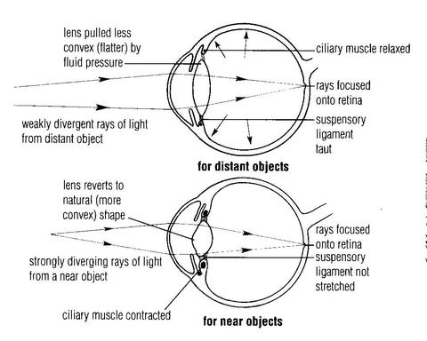
Normal Lens function

Slide 5
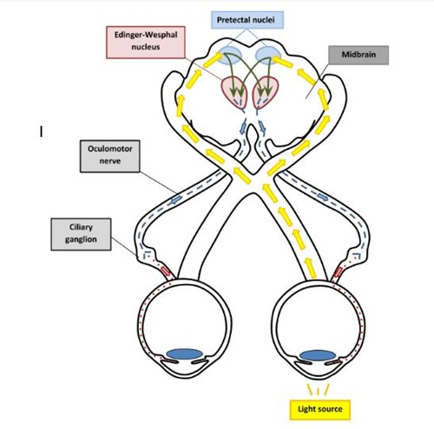
Pupillary light reflex
No ocular cortex involved
Midbrain based
Where would there be problems that would affect this reflex?

Slide 6
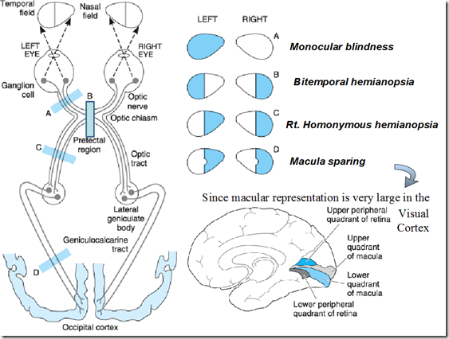
Optic Nerve and Brain

Slide 7
Eye
Specific problems:
Foreign bodies
Trauma
Blunt
Penetration of eyeball
Iritis
Exposures
Glaucoma
Notes:
Blunt: resulting orbital blow out, entrapment, exopthalmos
Penetrating: foreign bodies, globe rupture,
Exposures: Acid, base

Slide 8
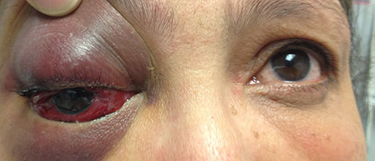
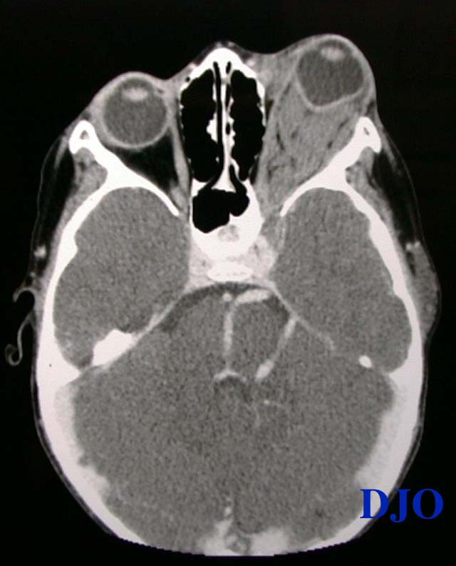
Retrobulbar hematoma

Slide 9
Eye complaints
Management
Leave foreign bodies in
Be aware of possible globe rupture
Treatment
Irrigate exposures copiously
Appropriate pain management
Transport
Think about intracranial causes

Slide 10
Eye Case 1
63 yo female with history of dm, calls with acute onset right eye decreased vision and pain
Reports occurred right when walking into movie theater
Meds: metformin
VSS patient very uncomfortable
Right pupil 4 mm, sluggish, cloudy cornea, left eye unremarkable

Slide 11
Questions
Differential diagnosis (name 2)
Diagnosis
Basic pathophysiology
Notes:
Glaucoma, trauma, temporal arteritis, optic neuritis (painful vision loss) retinal detachment, CRAO, CRVO, vitreous hemorrhage, amaurosis fugax (painless)
Glaucoma (steamy cornea, acute painful vision loss, increased iop)
Increased IOP, trabecular meshwork blocked usually by lip of iris at time of attempted pupillary dilation so aqueous humor can’t leave

Slide 12
Eye Case 2
33 yo male car mechanic worker got splashed sulfuric acid when car battery exploded
Reports severe eye pain, occurred approximately 5 minutes ago
Otherwise healthy
VSS
Right eye with erythema, difficult to evaluate 2/2 pain

Slide 13
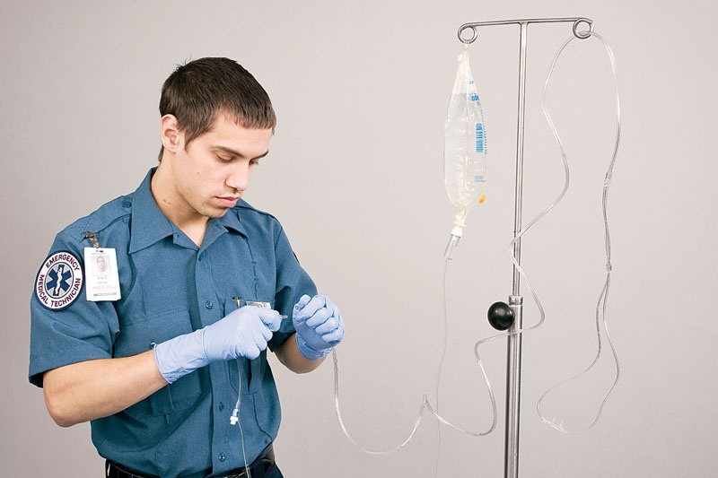
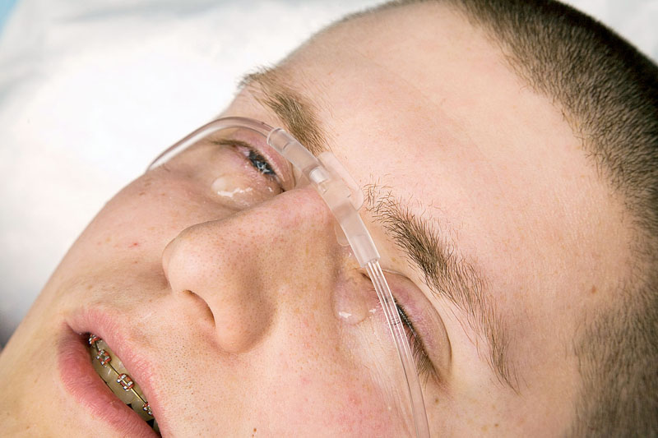
Questions
What is the immediate treatment?
What type of exposure is more damaging acid or base?
Why?
Notes:
irrigate!!! Morgan lens, nasal cannula
Base, so gather as much info as possible about what type of exposure.
Liquefactive necrosis, allows penetration of cornea, to trabecula, iris, pupil within 5-15 min depending on the type of base (usually ph >11.5)

Slide 14
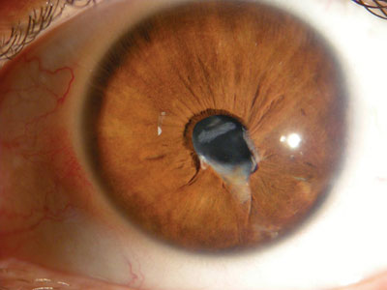
Eye case 3
45 yo male construction worker was at the job site and felt something fly into his eye, not wearing safety glasses, coworker was grinding metal nearby.

Slide 15
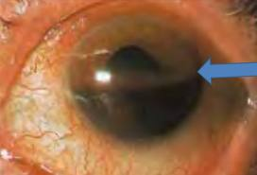
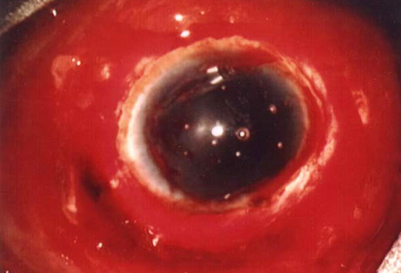
Questions
Diagnosis
Treatment
Notes:
Irregular pupil suggestive of globe rupture even though trauma not not impressive
Don’t put pressure on globe, can cover with end of cup to protect during transport etc, provide pain control
You can also see hyphema with globe rupture and with just plain trauma, other associated symptoms of globe rupture include subconjunctival hemorrhage, chemosis

Slide 16
Eye exam

Slide 17
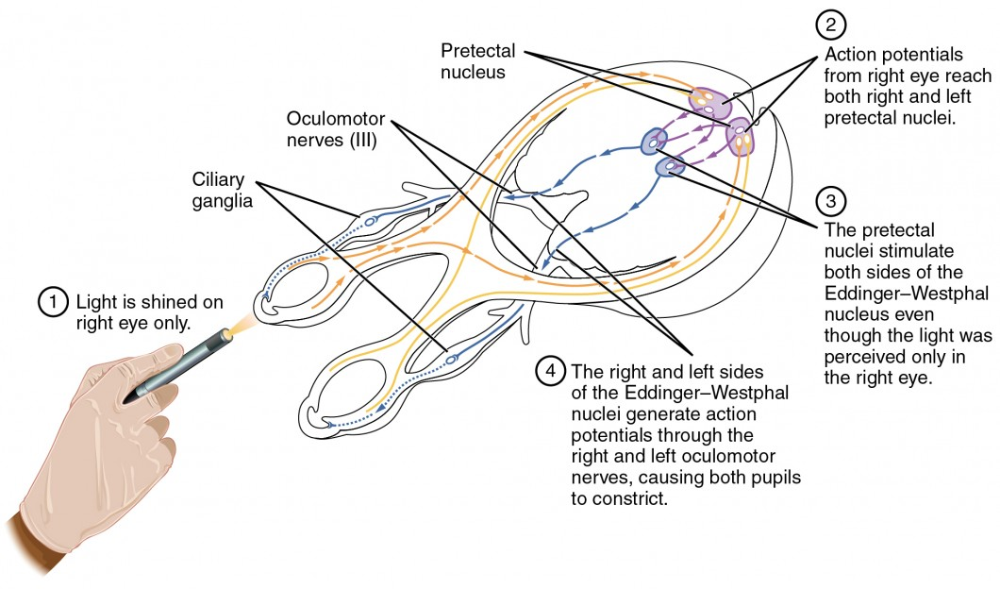
Pupillary reflexes

Slide 18
Case
Dispatch: confusion
Scene: ophthalmology office
Size up: patient sitting in office chair, confused. Ophthalmologist says he knows the patient has DM
What do you want to do first?

Slide 19
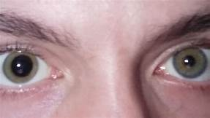
On exam

Slide 20
Badness that causes this
Ischemic stroke
Intracranial hemorrhage with subsequent elevation of ICP
hemorrhagic stroke
Epidural
Subdural
Mass

Slide 21
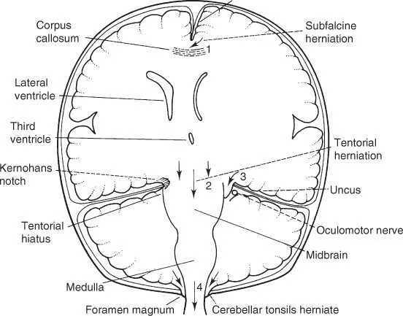
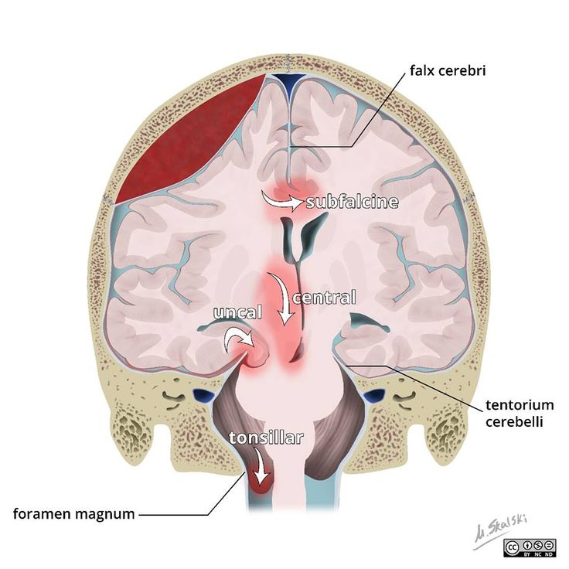

Slide 22
In your awake patient…
Physiologic anisocoria
Mydriatic drugs: atropine, cyclopentolate, phenylephrine (nosebleed?)
compressive lesion to oculomotor nerve
ocular prosthesis
traumatic iritis

Slide 23
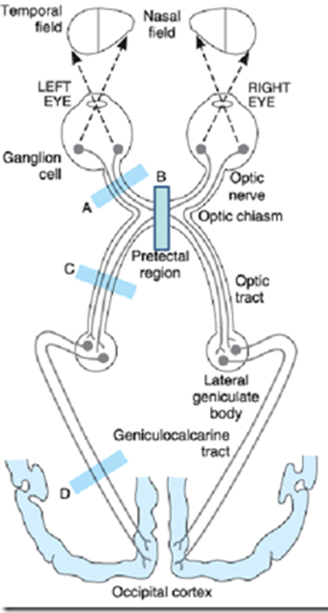
Where is the problem?

Slide 24
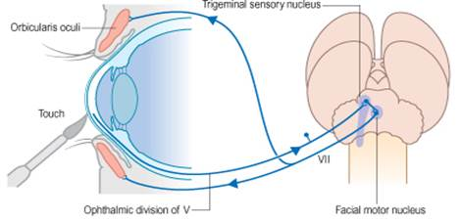
Corneal reflex

Slide 25
Eye case 3
45 yo male construction worker was at the job site and felt something fly into his eye, not wearing safety glasses, coworker was grinding metal nearby.

Slide 26
Questions
Diagnosis
Treatment
Notes:
Irregular pupil suggestive of globe rupture even though trauma not not impressive
Don’t put pressure on globe, can cover with end of cup to protect during transport etc, provide pain control
You can also see hyphema with globe rupture and with just plain trauma, other associated symptoms of globe rupture include subconjunctival hemorrhage, chemosis

