Slide 1
Managing Alcohol Withdrawal in Ambulatory Care
James J. Gasper, PharmD, BCPP
National Clinician Consultation Center
Substance Use Warmline
University of California, San Francisco
at Zuckerberg San Francisco General Hospital
San Francisco, CA
January 21, 2025
Notes:
2nd most commonly used psychoactive drug, lifetime prevalence for AUD (mild-severe) is 30%, 3rd leading cause of death in the U.S.
50% of alcohol dependent patients develop AWS
AUD related deaths much higher in native communities and rural areas
Withdrawal
- results in generalized excitability,
-Etoh enhances GABA, inhibits NMDA and upregulates, excess NE from desensitization of alpha 2 autoreceptors and conversion from DA

Slide 2
Goals for Discussion
Focus on the large number of patients at low to moderate risk of alcohol withdrawal who present for treatment in ambulatory care settings
Address the gaps in the care continuum for treating alcohol withdrawal
Identify patients who can be managed for alcohol withdrawal in non-hospital settings and identify patients to advocate for higher level of care placement
Develop pharmacotherapy and placement treatment plan for alcohol withdrawal management

Slide 3
Why Treat Alcohol Withdrawal
High dose/prolonged Alcohol Exposure
Physical Dependence
Kindling
sensitization
Interruption of Alcohol Intake
Cessation of use
Decrease in amount/frequency
Withdrawal
Notes:
KOR MOR LC
Psychopharmacology (Berl)
. 2010 Jun;210(2):121-35.
doi: 10.1007/s00213-010-1825-8. Epub 2010 Mar 30.
The role of the dynorphin-kappa opioid system in the reinforcing effects of drugs of abuse

Slide 4
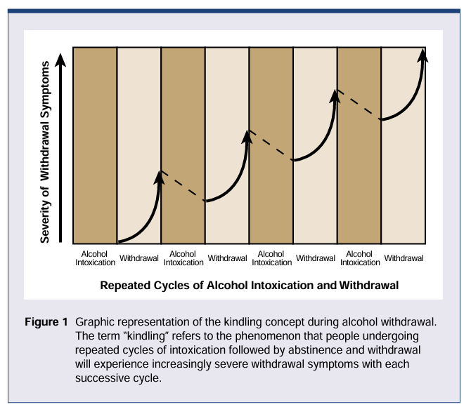
Why Treat Alcohol Withdrawal
Repeated exposure and withdrawal cycles may be most important predictor of severity
Becker H. Alcohol Health Res World. 1998;22(1):25–33

Slide 5
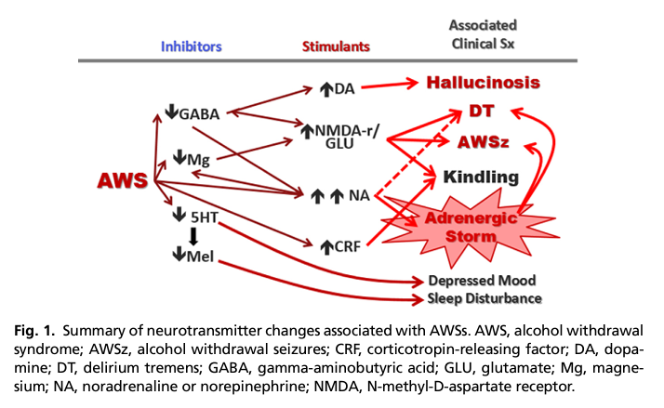
Pathophysiology of Alcohol Withdrawal
Maldonado J. Crit Care Clin 2017;559-599

Slide 6
Presentation Timeline of Alcohol Withdrawal Symptoms
After last use or decrease in intake:
6-12 hours
Sweating
Tremor
Anxiety
Agitation
Insomnia
Headaches
Nausea/vomiting
12-24 hours
Alcoholic Hallucinosis
24-48 hours
Seizures
48-96 hours
Delirium Tremens
  Sweating
  Agitation
  Hallucinations
  Disorientation
  Tachycardia
  Hypertension
  Fever
Karavolis ZA. AAPP Pharmacist Toolkit: Alcohol and Benzodiazepine Withdrawal Management [Internet]. Lincoln, NE: American Association of Psychiatric Pharmacists, 2024. [revised 2024 Oct 21].
Available from https://aapp.org/guideline/alcohol-benzo-withdrawal.

Slide 7
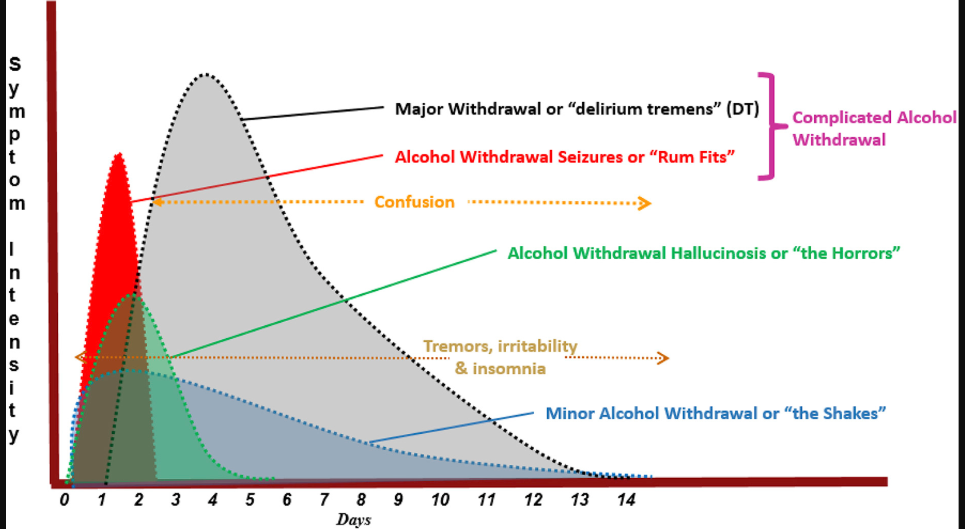
Maldonado J. Critical Care Clinics 2017;33:559-599
Notes:
80% of alcohol dependent patients experience uncomplicated withdrawal and will recover without complications within 5-7 days
95% of seizures occur from 7-38 hours

Slide 8
Where Do We Start: General Criteria for Outpatient Management
Upon presentation the patient reports a goal of discontinuing alcohol intake (or substantially cutting back)
Patient has no/remote history of severe alcohol withdrawal episodes
Medical and psychiatric comorbidity are relatively stable

Slide 9
Who Should be Managed at a Higher Level of Care
Current Presentation
  CIWA-Ar score > 18 or any evidence of alcohol hallucinosis, seizure activity, or clouded sensorium
  Significant vital sign or laboratory abnormalities
History of severe withdrawal
  DTs, alcohol hallucinosis, or other serious complications
  Withdrawal seizures in previous 6 months
  Inability to present sober OR minimal impairment at BAC >0.15 OR daily consumption of >15 drinks
Concurrent conditions
  Concurrent seizure disorder
  Use of other CNS depressants
  Unstable medical or psychiatric conditions
  Decompensated liver disease ( INR >1.5, ascites, esophageal varicies, hepatorenal syndrome, SBP, encephalopathy)
Other considerations
  Inability to safely store take-home medication
  Lack of any sober social supports

Slide 10
Assessment of Alcohol Intake
Alcohol Use Disorder
+
Physical Dependence
How much and how long
Containers not drinks
Days, months, years
Duration of alcohol-free period
Between binges
Throughout day
Level of impairment at BAC

Slide 11
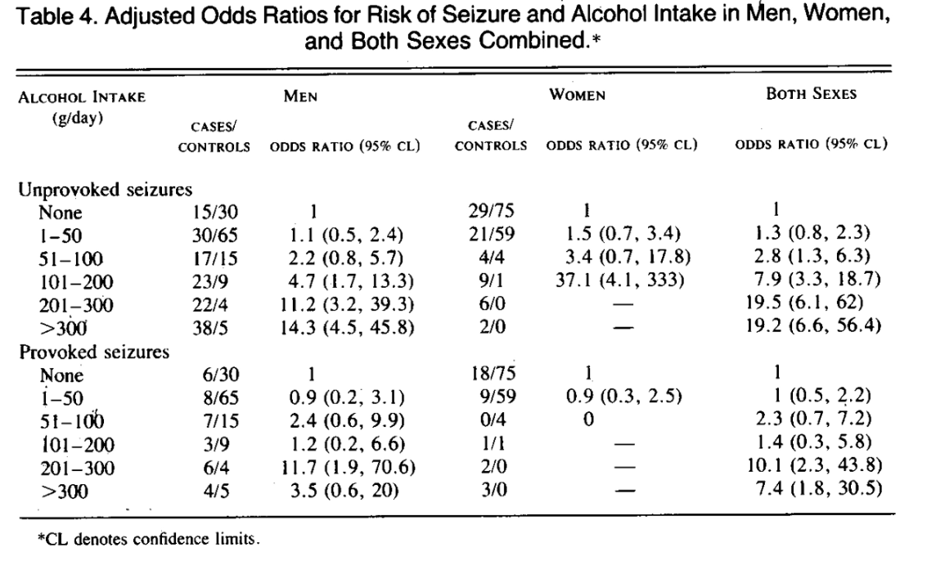
Alcohol Intake and Risk of Seizures
Intake(g/d) Drinks
1-50 <4
51-100 4-7
101-200 7-14
201-300 14-21
>300 >21
Stephen K.C. Ng et al. N Engl J Med 1988;319:666-673
Notes:
5-15%

Slide 12
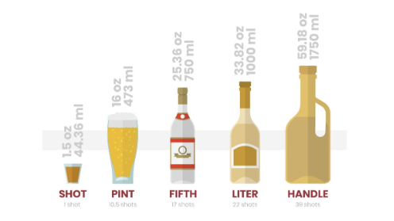
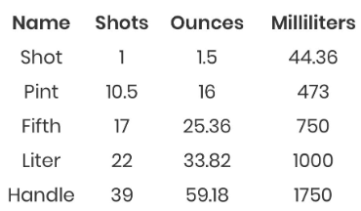
Patient Reports and Treatment Considerations
1 pint of vodka after work most days
2 cases of beer on weekends
1 shot whiskey/hr while awake
2 bottles of wine starting at lunch time
BAC 0.2% with no impairment
3 cans of Four Loko throughout day
Notes:
Four loko = ~24oz can, 12-14% alcohol = “blackout in a can” 5-5.5 drinks each
Risk of seizures increases with amount of alcohol consumed

Slide 13
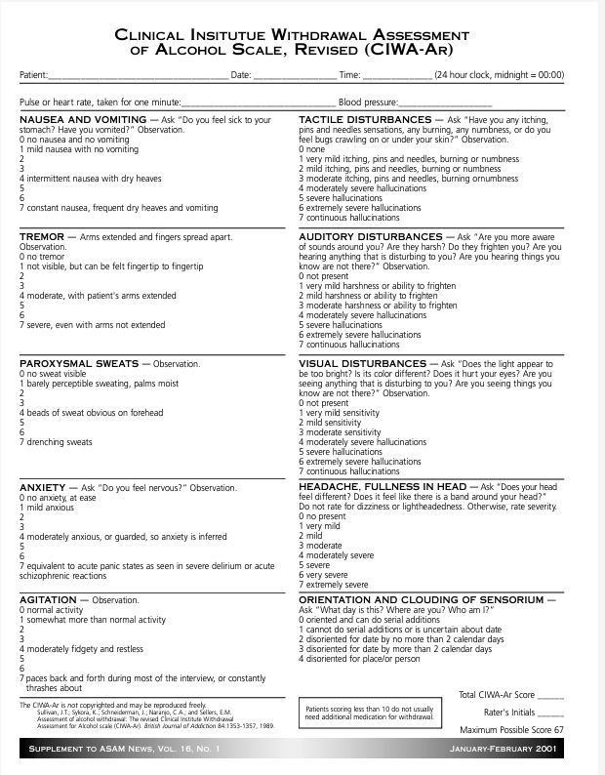
Clinical Institute Withdrawal Assessment- Alcohol revised (CIWA-Ar) and Assessment of Withdrawal Symptoms
Agitation 0-7
Anxiety 0-7
Auditory disturbances 0-7
Clouding of Sensorium 0-4
Headache 0-7
Nausea/vomiting 0-7
Paroxysmal sweats 0-7
Tactile disturbances 0-7
Tremor 0-7
Visual disturbances 0-7
CIWA-Ar: Mild <8, Moderate 8-15, Severe > 15
Sullivan JT et al. Br J Addict. 1989 Nov;84(11):1353-7
Notes:
CIWA 18 item
CIWA-A 15 item was shortened to 10 item CIWA-Ar
Pulse and blood pressure did not correlate with severity of withdrawal thus not scored only recorded

Slide 14
CIWA-Ar and Risk of Severe Withdrawal
Score >15 and not treated = 3.72 RR for severe alcohol withdrawal syndrome
*Some with low scores or adequate treatment can still develop severe withdrawal
Foy A et al. Alcohol Clin Exp Res. 1988 Jun;12(3):360-4

Slide 15
Prediction of Alcohol Withdrawal Severity Scale (PAWSS)
Systematic review to determine clinical factors associated with alcohol withdrawal syndrome
Developed a 10 item scale, each item scored 0 or 1
Tested for psychometric reliability in a pilot study (any many subsequent evaluations)
Determined that a score ≥4 highly predictive of moderate to severe alcohol withdrawal
Designed for medical settings NOT for outpatient management decisions
Maldonado J et al. Alcohol 2014; 48:375-90

Slide 16
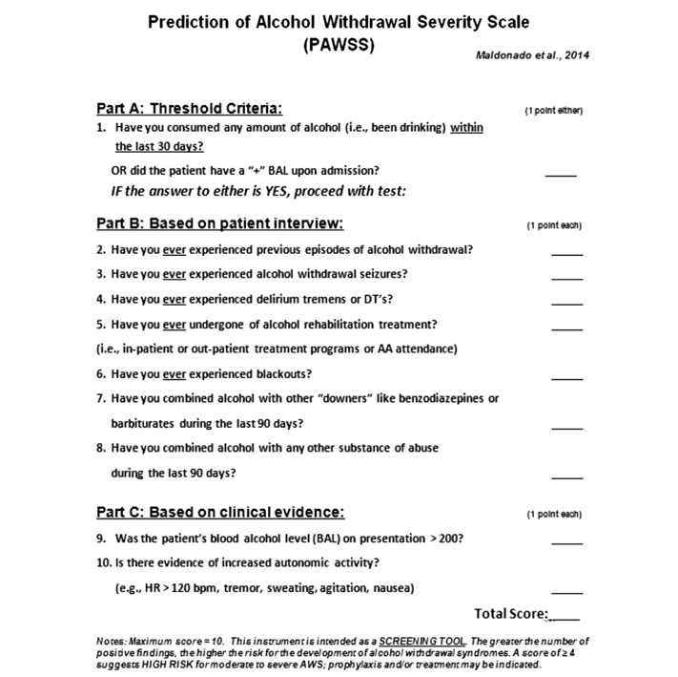
Any alcohol or + BAC
Hx of withdrawal
Blackouts or combined with other drugs
Vitals and BAC >0.2

Slide 17
Risk Stratification for Ambulatory Management
Low Risk
History of mild withdrawal symptoms
Less than 10 drinks per day and CIWA less than 10
Moderate Risk
History of moderate withdrawal symptoms
10-15 drinks per day or CIWA-Ar 11-18
Medications for Alcohol Use Disorder Guideline: San Francisco Health Network Behavioral Health Services
Medication Use Improvement Committee 11/02/2023

Slide 18
Treatment Approach: Low Risk
Low Risk
Adequate Liver Function Impaired Liver Function
Day 1 Chlordiazepoxide 25-50mg po Q6H Lorazepam 1-2mg po Q6H
Day 2 Chlordiazepoxide 25-50mg po Q6H Lorazepam 1-2mg po Q6H
Day 3 Chlordiazepoxide 25mg po Q6H Lorazepam 1mg po Q6H
Day 4 Chlordiazepoxide 25mg po Q8H Lorazepam 1mg po Q8H
Day 5 Chlordiazepoxide 25mg po Q12H Lorazepam 0.5-1mg po Q12H
Medications for Alcohol Use Disorder Guideline: San Francisco Health Network Behavioral Health Services
Medication Use Improvement Committee 11/02/2023

Slide 19
Treatment Approach: Moderate Risk
Moderate Risk
Adequate Liver Function Impaired Liver Function
Day 1 Chlordiazepoxide 75-100mg po Q6H Lorazepam 2-3mg po Q6H
Day 2 Chlordiazepoxide 75-100mg po Q6H Lorazepam 2-3mg po Q6H
Day 3 Chlordiazepoxide 50-75mg po Q6H Lorazepam 2mg po Q6H
Day 4 Chlordiazepoxide 25-50mg po Q8H Lorazepam 1-2mg po Q8H
Day 5 Chlordiazepoxide 25mg po Q8H Lorazepam 0.5-1mg po Q8H
Day 6 Chlordiazepoxide 25mg po Q12H Lorazepam 0.5mg po Q12H
Medications for Alcohol Use Disorder Guideline: San Francisco Health Network Behavioral Health Services
Medication Use Improvement Committee 11/02/2023

Slide 20
Non-Benzodiazepines/Adjunctive treatments
Gabapentin
  Many small studies including low-risk outpatients, some findings suggest lower risk of drinking and better tolerability vs benzodiazepines
  Starting doses 1200-2400mg/day split BID-TID tapered over 6-7days
Carbamazepine
  Demonstrated efficacy in 9 controlled trials, with similar response to benzodiazepines
  Dosing 800mg/day tapered over 7 days
Oxcarbazepine
  Limited data, fewer adverse effects/drug interactions vs CBZ
Valproate
  6 studies, faster resolution of symptoms, less use of rescue benzodiazepines
Alpha-2 agonists
  Clonidine most studied with 7 small trials, effective against many symptoms of withdrawal including anxiety, irritability, agitation
Modesto-Lowe V et al. Cleveland Clinic Journal of Medicine 2019;86:815-882
Barrons R, Roberts N. J Clin Pharm Ther 2010;35:153-167
Maldonado J. Critical Care Clinics 2017;33:559-599
Notes:
- Generally for not for severe withdrawal symptoms
CBZ is superior to placebo92 and non-BZDP hypnotic agents, such as clomethaizole93 and barbiturates,94 in suppressing all aspects of AWS. Nine randomized, controlled studies (n 5 800) have demonstrated the effectiveness of CBZ in alcohol detoxification, compared with BZDP (Table 3).91,93–105 CBZ-treated subjects had an overall better response to treatment (ie, were calmer, less irritable, and less dysphoric)92,96; experienced superior and faster relief of symptoms, including anxiety, fear, and hallucinations96,106; had shortened duration of DTs94,99,107; and decreased incidence of AWS-seizures.99,101,106,107 CBZ was found particularly useful in outpatient detoxification because it enabled the alcoholic to return to work more quickly92,108 and had greater efficacy than BZDP in preventing post-treatment relapses to drinking.91 Data suggest CBZ may be useful in the treatment of alcohol dependence and the reduction of cravings and recidivism.91,109–111 Furthermore, it has a strong antikindling effect and lacks any misuse potential.108 CBZiswell-tolerated, rapidly absorbed after oral administration, and its metabolism is largely unaffected by liver damage.112,113 There were no significant cardiovascular or hepatotoxic effects noted, and no adverse interactions when used with ethanol.114 Reports suggest that CBZ improves sleep without rapid eye movement (REM)suppression.106 Potential side effects include pruritus without rash (18.9%),91 followed by dizziness, ataxia, headache, somnolence, dry mouth, orthostatic hypotension, vertigo, nausea, and vomiting (in up to 10% of patients).115 A major concern is the risk of agranulocytosis or aplastic anemia, both potentially lethal conditions, occurring in less than 0.01%.116 This was not reported in any of the studies cited.

Slide 21
When to Move to a Higher level of Care
• Agitation/severe tremor has not resolved despite having received multiple doses of medication
First intervention maybe higher dose/more frequent dosing depending on tolerability
• More severe signs or symptoms develop such as persistent vomiting, marked agitation,
hallucinations, confusion, or seizure
• Existing medical or psychiatric condition worsens
• Patient appears over-sedated or returns to alcohol use
• Syncope, unstable vital signs
Karavolis ZA. AAPP Pharmacist Toolkit: Alcohol and Benzodiazepine Withdrawal Management [Internet]. Lincoln, NE: American Association of Psychiatric Pharmacists, 2024. [revised 2024 Oct 21]. Available from https://aapp.org/guideline/alcohol-benzo-withdrawal.

Slide 22
Best Practices and Considerations
All patients should be started on thiamine, folate, and a MVI
Patients should be seen daily for first 72 hours and dispensed only a 24 hour supply at a time
  Check CIWA-Ar and BAC
  Evaluate social supports and living situation
  Obtain laboratory work
Maintenance pharmacotherapy should be initiated along with the detoxification protocol
May use observed disulfiram during detoxification for appropriate patients

Slide 23
Putting it All Together
Identify patients at risk for mild to moderate withdrawal symptoms
Determine patient’s motivation for stopping drinking
Discuss maintenance pharmacotherapy options and detoxification regimen
Coordinate follow-up visits, home support, and begin process for necessary labs
Identify higher levels of care available and appropriateness for patient if outpatient management isn’t safe or not effective

Slide 24



The National Clinician Consultation Center is a free telephone advice service for clinicians, by clinicians.
Go to nccc.ucsf.edu for more information.
HIV/AIDS Warmline
800-933-3413
HIV treatment, ARV management, complications, and co-morbidities
Perinatal HIV Hotline
888-448-8765
Pregnancy, breastfeeding and HIV
Hepatitis C Warmline
844-HEP-INFO/
844-437-4636
HCV testing, staging, monitoring, treatment
Substance Use
Warmline
855-300-3595
Substance use evaluation and management
PrEPline
855-HIV-PrEP
HIV Pre-exposure prophylaxis
PEPline
888-448-4911
Occupational & non-occupational exposure management
This National Clinician Consultation Center program is supported by the Health Resources and Services Administration (HRSA) of the U.S. Department of Health and Human Services (HHS) as part of an award totaling $2,633,756 with 0% financed with non-governmental sources.
The content in this presentation are those of the author(s) and do not necessarily represent the official views of, nor an endorsement, by HRSA, HHS, or the U.S. Government. For more information, please visit HRSA.gov.

