Slide 1
Indian Health Service
Post Acute Withdrawal Syndrome
CDR Teresa Grund r.Ph MSCas bcps bcpp
CDR Samantha Gustafson Pharmd. BCACP
Recovery care team, Red lake Ihs, MN
12/17/2024

Slide 2
Disclosures
None
2

Slide 3
Objectives
Summarize post acute withdrawal syndrome (PAWS)
Identify possible causes, warning signs, duration, and coping strategies
Summarize the recent literature on PAWS

Slide 4
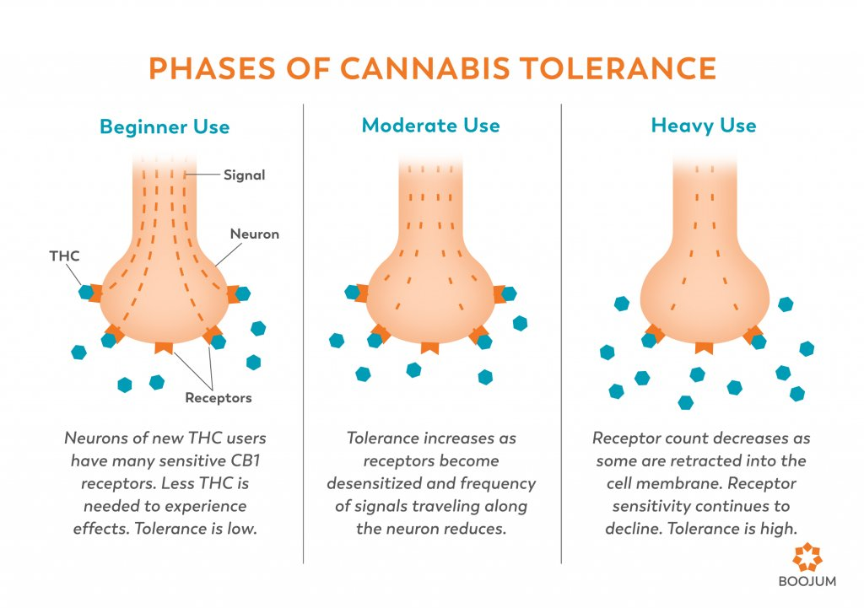
Neurobiology of Addiction

Slide 5
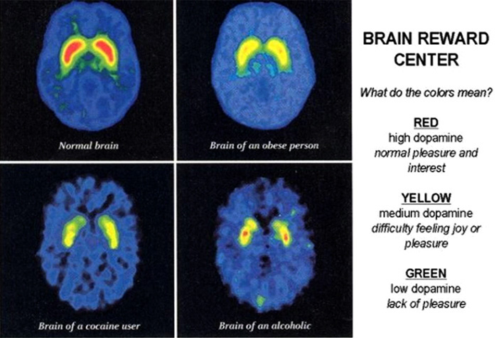
Neurobiology of Addiction
The Journal of Neuroscience, 21(23):9414-9418. 2001

Slide 6
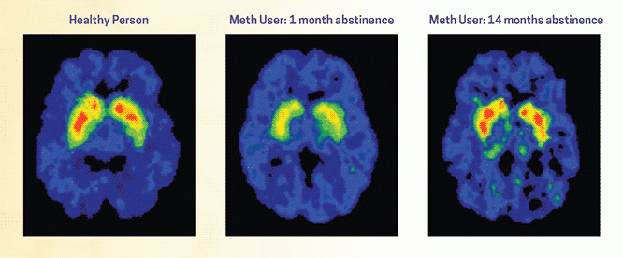
Neurobiology of Addiction

Slide 7
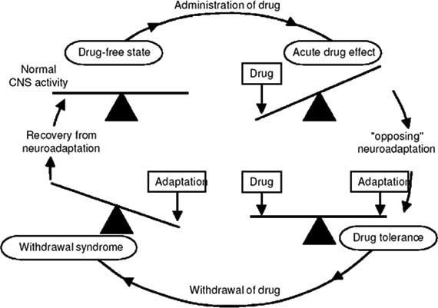
Neuronal Adaption
Substance use/Abuse
Dependence
Tolerance
Addiction
Relapse
Withdrawal

Slide 8
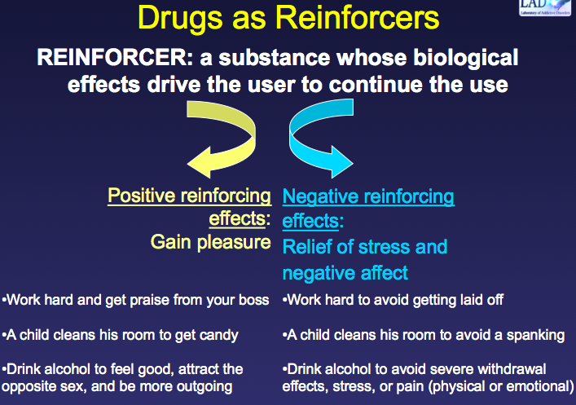
Neurobiology of Addiction

Slide 9

Alcohol Use Disorder Case
Notes:
Insert patient case where patient was stabilized on suboxone dose but still struggling with anxiety/irritability. Started on NRT for tobacco cessation and status improved dramatically.

Slide 10
Alcohol Use Disorder Case
38 yo male. First drink age 12. Drinking 1 liter of vodka per day for 3 years up until 6 months ago.
Pick up for DUI. Incarcerated for 3 month then Residental treatment for 45 days. Graduated 2 weeks ago. No meds prescribed during treatment. Center emphasized true recovery i.e no medications for AUD
Complains of sleep issues and wicked anxiety.
Notes:
Insert patient case where patient was stabilized on suboxone dose but still struggling with anxiety/irritability. Started on NRT for tobacco cessation and status improved dramatically.

Slide 11
Questions
What other information do you need from this patient?
What recommendations do you have.
  Therapy
  Medications
  Nothing
  Both

Slide 12
Withdrawal
“The onset of a predictable constellation of signs and symptoms following the abrupt discontinuation of, or rapid reduction in, the dose of a psychoactive substance “
American Society of Addiction Medicine (ASAM)

Slide 13
Acute Withdrawal
Physical withdrawal symptoms
Immediately after the cessation/dose reduction of abused/addictive substances
Reversible
Transient
Last 1-8 weeks
  Substance
  Elimination have life

Slide 14
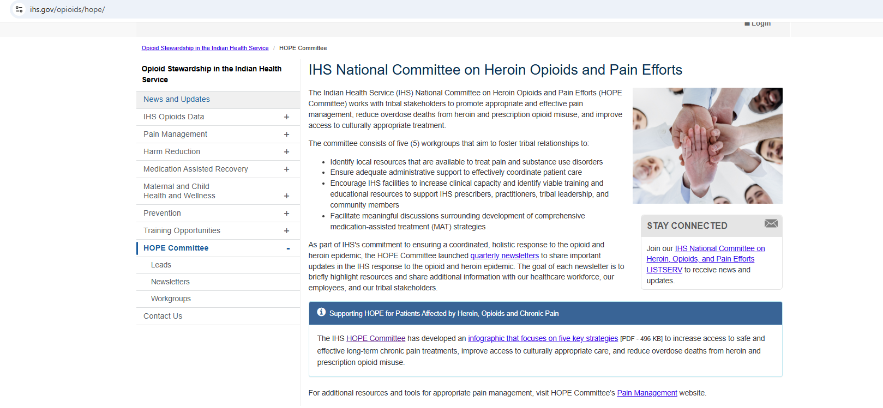
Educational Outreach Program

Slide 15
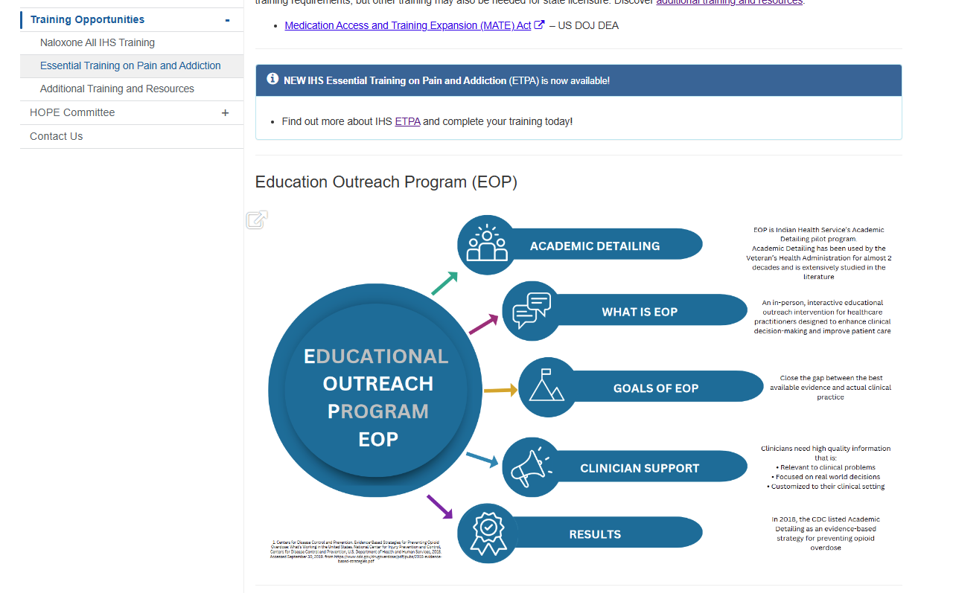
Educational Outreach Program

Slide 16
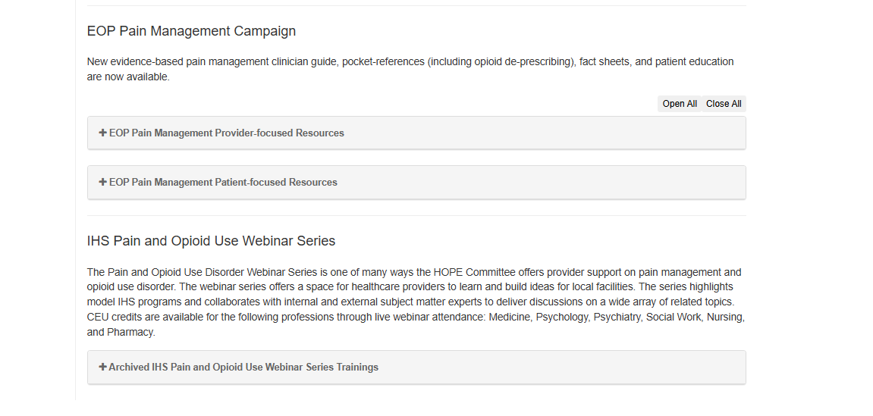
Educational Outreach Program

Slide 17
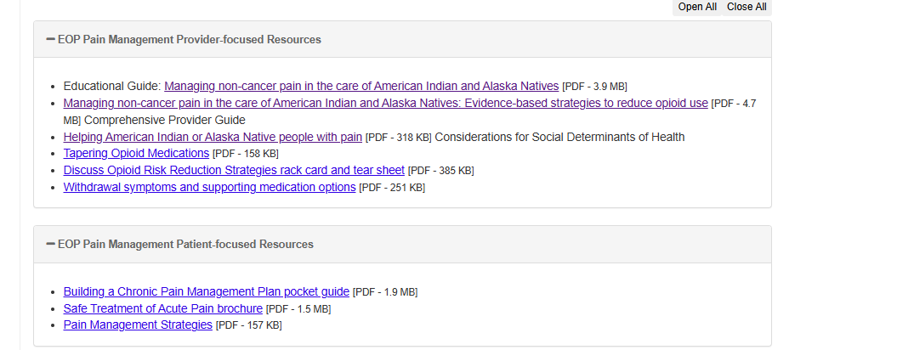
Educational Outreach Program

Slide 18
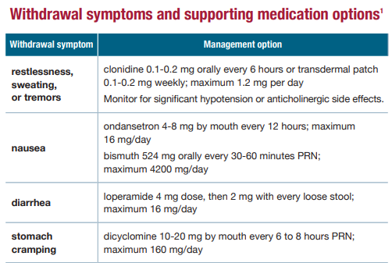
Educational Outreach Program

Slide 19
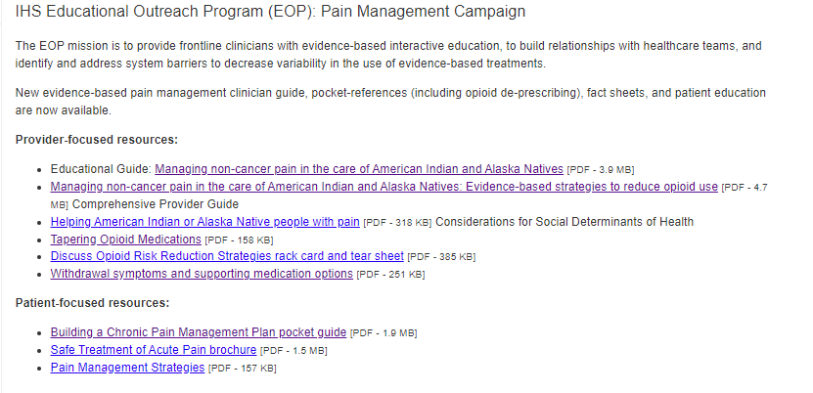
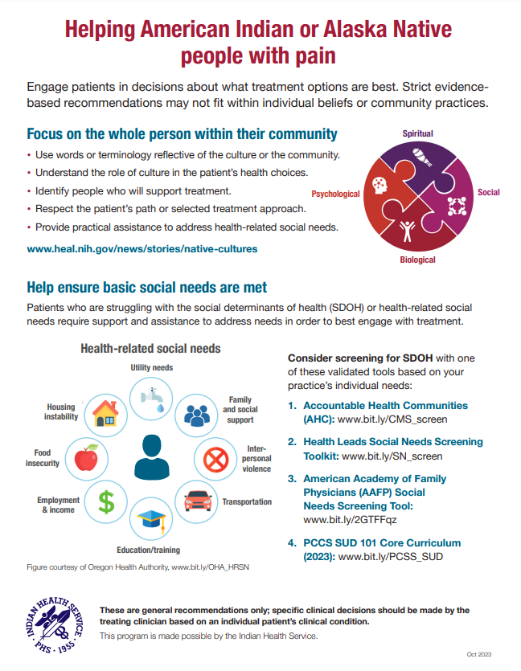
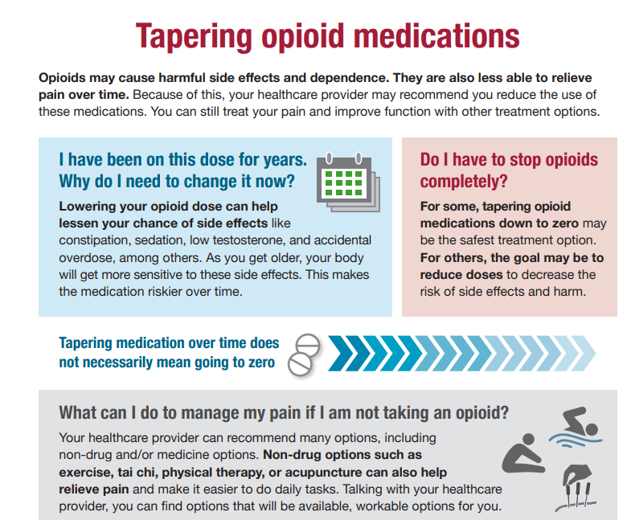
Educational Outreach Program

Slide 20
Post Acute Withdrawal Syndrome (PAWS)
No diagnostic criteria
  Satel SL, Kosten TR, Schuckit MA, Fischman MW. Should protracted withdrawal from drugs be included in DSM-IV? Am J Psychiatry. 1993 May;150(5):695-704. doi: 10.1176/ajp.150.5.695. PMID: 8097618
Symptoms lasting well past the known timeframe for acute withdrawal
No proper name
  protracted withdrawal syndrome
  protracted abstinence syndrome
  persistent/chronic withdrawal
  persistent post-withdrawal disorder
  prolonged withdrawal syndrome
  extended withdrawal
  late withdrawal
  long-term withdrawal
  post-use syndrome
  sobriety-based symptoms
  subacute withdrawal syndrome

Slide 21
Risk Factors for PAWS
Pattern of substance abuse
Duration of the addiction
Intensity of the drug use
Genetics
Physiology
Psychological makeup
Existence of other physical or psychological conditions

Slide 22
Acute Withdrawal vs PAWS
 | Timing | Symptoms | Areas Involved
Acute Withdrawal | Days to week | Rebound symptoms | Body healing
Post Acute Withdrawal | 6 months to 2 years |  | Brain recalibrating
Notes:
For the brain to produce endorphins and dopamine normally

Slide 23
Common Drugs with PAWS
Alcohol
Benzodiazepines
Antidepressants
Opioids
Antipsychotics
Other substances suggested
  Marijuana
  Psychostimulants
  Anabolic Steroids

Slide 24
General Themes in PAWS Literature
Multiple classes of medications reviewed (SSRIs, SNRIs, TCAs, antipsychotics, etc.)
Studies often discuss a variety of 3 types of withdrawal symptoms:
  New—typically similar across all classes of meds during withdrawal
    Nausea, headaches, sleep issues
  Rebound—short duration, transient, reversible
    Thought to represent return to primary symptoms at greater intensity than experienced pre-treatment
  Persistent post-withdrawal –long duration, severe, potentially irreversible
    May resemble rebound primary symptom, primary disorder symptoms at greater intensity, new symptoms not previously present
    Last > 6 weeks
Nearly all studies note that there isn’t a lot of data available to support conclusions

Slide 25
Alcohol
Most studied
Symptoms of PAWS include:
  Cravings
  Sleep disorders
  Anhedonia
  Negative affect
    These all occur after resolution of acute and early withdrawal
    May last 3-6 months or more (vs 2-3 days with acute and 2-3 weeks with early withdrawal
Symptoms related to changes of gamma-aminobutyric acid (GABA) and N-methyl-d-aspartate (NMDA) systems
  Naltrexone, nalmefene, and disulfiram may not be able to suppress the symptoms of PAWS
Pharmacologic management of PAWS may reduce risk of returning to use
  Medications that counterbalance NMDA up-regulation and GABA down-regulation could considered to improve patient outcomes
Notes:
This study was a systematic lit review from major scientific databases.
Anticonvulsants impacting GABA pathway have shown some benefit (carbamazepine, topiramate).

Slide 26
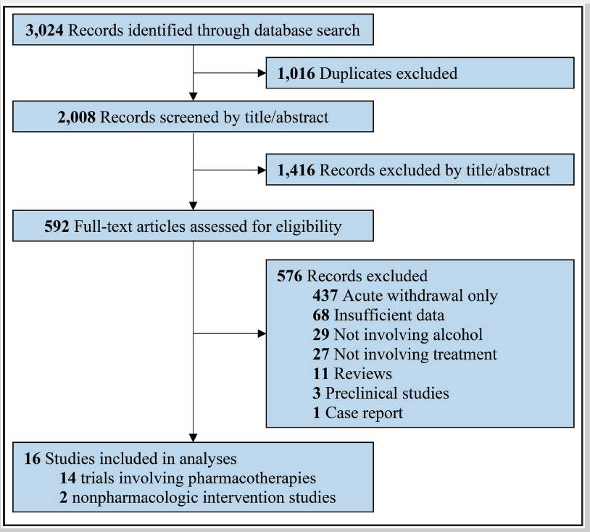
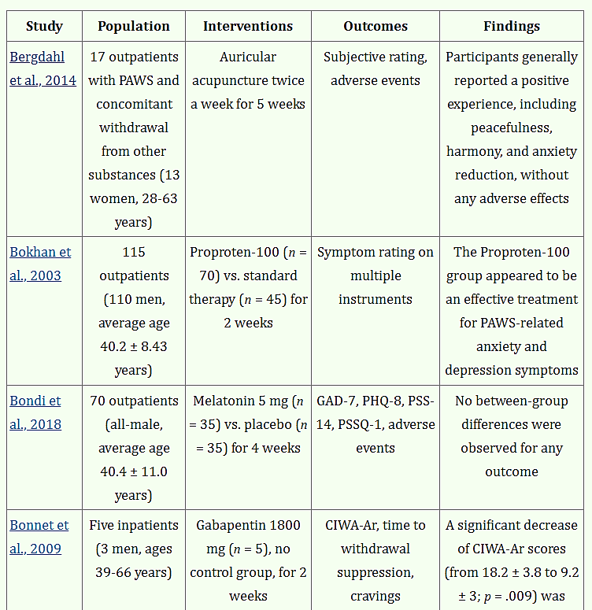
Study Information

Slide 27
Alcohol
Gabapentinoids may improve anxiety, sleep disturbances, and negative affect
  Gabapentin and pregabalin
    Pregabalin may be of higher risk for misuse due to quicker absorption and higher potency
Acamprosate
  Studies report this was well tolerated, improved cravings and relapses, and reduced PAWS symptom severity
Anticonvulsants
  Carbamazepine showed efficacy in reduced alcohol intake and improved mood
  High-dose oxcarbazepine provided higher rates of abstinence that low dose and naltrexone in one study
No data showing benefit from sleep-promoting medications with exception of trazodone
***Few robust, placebo-controlled trials published***
Level of evidence low for treatment efficacy.
Notes:
Trazodone not recommended for many other sleep issues but is appropriate in substance use disorders

Slide 28
Benzodiazepines
Benzodiazepine-Induced Neurological Dysfunction (BIND)
  Refers to a variety of symptoms that persist months to years after discontinuing benzodiazepines
    May include:
      Anxiety
      Insomnia
      Nausea
      Sweating
      Tremors
      Muscle pain
Often assumed symptoms are related to the condition indicating benzodiazepine treatment

Slide 29
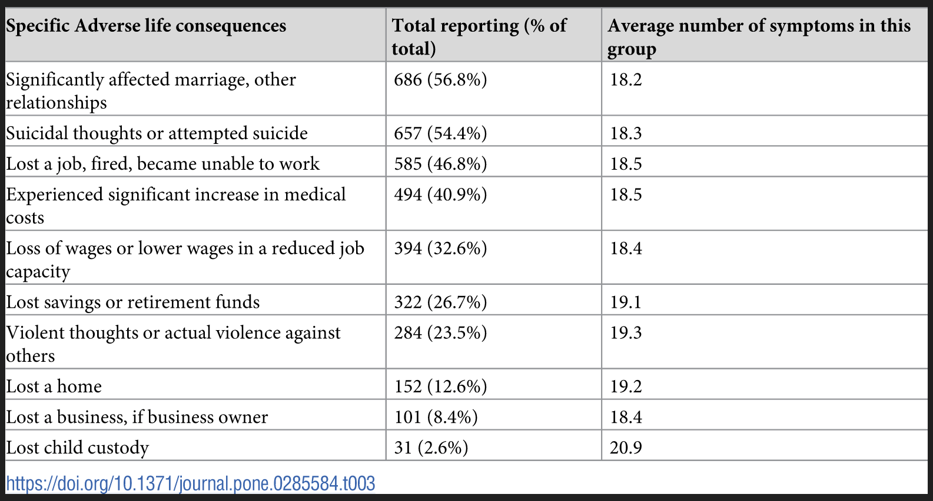
BIND—Adverse Life Consequences
Notes:
Over 90% of respondents attributed one or more general adverse life consequences to benzodiazepine use.

Slide 30
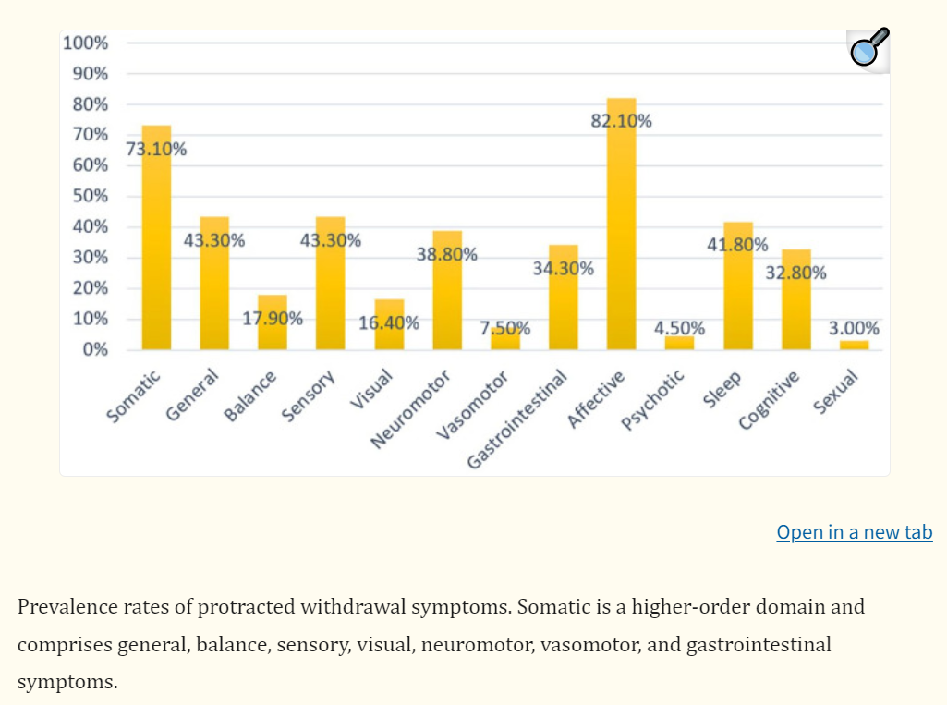
Antidepressants
Acute withdrawal is typically 1-8 weeks after medication discontinuation
PAWS can last months to years after discontinuation
  Mechanism: neuropsychological changes after prolonged drug exposure
    Includes receptor downregulation and desensitization, often explained as physical tolerance
  Symptoms may be improved from pharmacologic management, reinstating the antidepressant, natural recovery

Slide 31
Opioids
May last weeks up to 9 months after last use
Symptoms may include:
  Anxiety
  Depression
  Fatigue
  Insomnia
  Executive dysfunction
Study done to examine functional brain abnormalities that occur/change/persist over time after opioid use
  Limitations include small sample size, difficulty recruiting OUD patients in recovery due to high risk of returning to use
  Longitudinal studies needed to establish whether reward sensitivity recovers, or to determine whether recovery of PVS function might serve as a potential biomarker of when OUD patients may be able to discontinue medication for OUD.
  Primary goal should be to employ strategies to reduce risk of harm from overdose after periods of abstinence

Slide 32
Antipsychotics
Rebound and persistent post-withdrawal symptoms include two primary disorders
  Tardive dyskinesia (first and second generation antipsychotics)
  Supersensitivity psychosis (second generation antipsychotics)
Extended duration for discontinuation may reduce PAWS symptoms but may not prohibit occurrence of new symptoms
Use of adjunctive long half-life medications, such as long-acting injectables and antiseizure meds, may have benefit in treatment of withdrawal symptoms
Lamotigine, valproic acid, carbamazepine, phenytoin suggested for supersensitivty psychosis
Clozapine and risperidone for palliative treatment
Quetiapine suggested as adjustive therapy at max 150mg/d to avoid rebound symptoms

Slide 33
Example Patient Cases
Notes:
Insert patient case where patient was stabilized on suboxone dose but still struggling with anxiety/irritability. Started on NRT for tobacco cessation and status improved dramatically.

Slide 34
Alcohol Use Disorder Case
38 yo male. First drink age 12. Drinking 1 liter of vodka per day for 3 years up until 6 months ago.
Pick up for DUI ->incarcerated for 3 month -> residental treatment for 45 days-> graduated 2 weeks ago. No meds prescribed during treatment. Center emphasized true recovery i.e no medications for AUD
Complains of sleep issues and wicked anxiety.
Notes:
Insert patient case where patient was stabilized on suboxone dose but still struggling with anxiety/irritability. Started on NRT for tobacco cessation and status improved dramatically.

Slide 35
Questions
What other information do you need from this patient?
What recommendations do you have?
  Therapy
  Medications
  Nothing
  Both

Slide 36
Opioid Use Disorder Case
40yo female with 10+ year history of opioid use. Meth and fentanyl were daily substance of choice until incarcerated. Also smoked one pack of cigarettes per day.
Started on naltrexone while in detention center but was discontinued due to dizziness and fainting (resolved upon discontinuation). Reports lack of motivation, decreased appetite, loss of interest, cravings.
Started on suboxone, which initially improved cravings. Later cravings returned even while taking suboxone 24mg/6mg daily, which significantly increased anxiety and negatively impacted sleep.

Slide 37
Questions
What recommendations do you have?
  Increase suboxone dose
  Change suboxone to buprenorphine
  Add gabapentin to current meds
  Add nicotine replacement products to current meds

Slide 38
Summary
Post Acute Withdrawal Syndrome can occur due to a variety of substances
  Products used recreationally and for treatment of various disorders
Difficult to diagnose due to lack of DSM criteria to do so
  Symptoms often mimic other disease states which allow for easier diagnosis
May last months to years after last use of substance or medication
Using medications with longer half-lives may reduce risk of withdrawal symptoms
Employing adjunctive medications to treat PAWS may support success in recovery
Harm reduction is key!
Listening to patients and treating their symptoms may reduce risk of returning to use.
Notes:
Some of the meds we use to treat PAWS may also have their own PAWS symptoms when stopping.

Slide 39

Closeout
39

