Slide 1




Driving Evaluation
December 12, 2024
Emily Morgan, MD
Sarah Foidel, OTR/L, OTD

Slide 2

We do not have anything to disclose

Slide 3
Objectives
Describe when to screen for driver safety
Demonstrate how to screen for driver safety
Describe when to send DMV forms vs. refer to OT
Demonstrate how to report or refer for evaluation
Notes:
Here are our learning objectives for today's presentation.

Slide 4

Driving during the Lifespan
By 2050 drivers >65 years old = 25% of the US driving population
Notes:
Suvi notes:
Look how many dirvers on the road. This is relevant and important

Slide 5
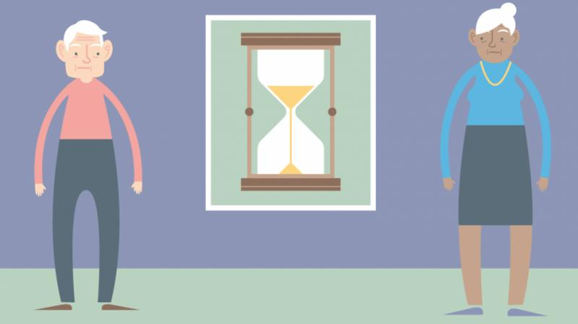
Driving during the lifespan
Life expectancy exceeds driving fitness expectancy in the US
~6 yrs for men
~10 yrs for women
Most older adults need to retire from driving in their lifetime
Notes:
This is a universale xperience. If you are lucky to live long enough, you will have to retire from driving at som epoint
Normamlize it
We need to plan for it

Slide 6
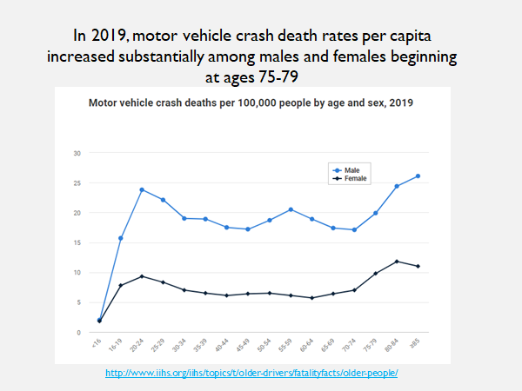
Notes:
Looks at MVA by age and sex
Haha—women are NOT worse drivers :), men line is always higher
Two spikes 16-19, undev frontal lobes
Then around 75, higher 85 (higher than teenagers). Driving at older ages IS a higher risk activity
Middle spike for men? Mid life crisis, buying convertible

Slide 7
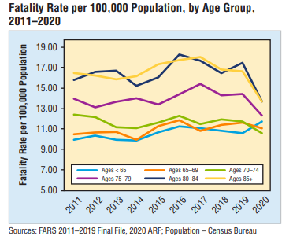

Slide 8
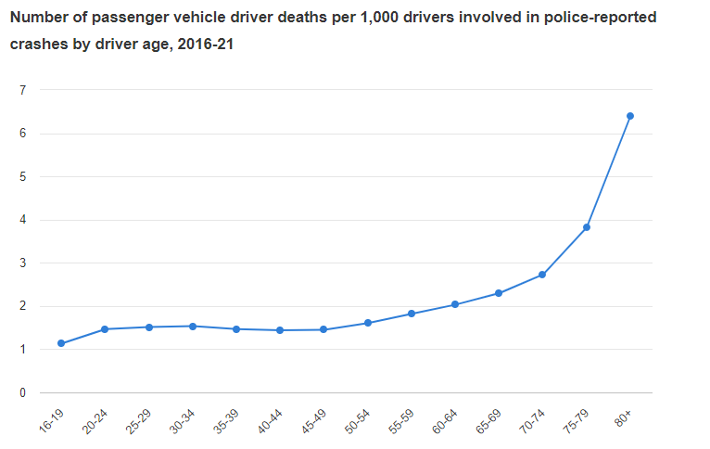
https://www.iihs.org/topics/older-drivers

Slide 9
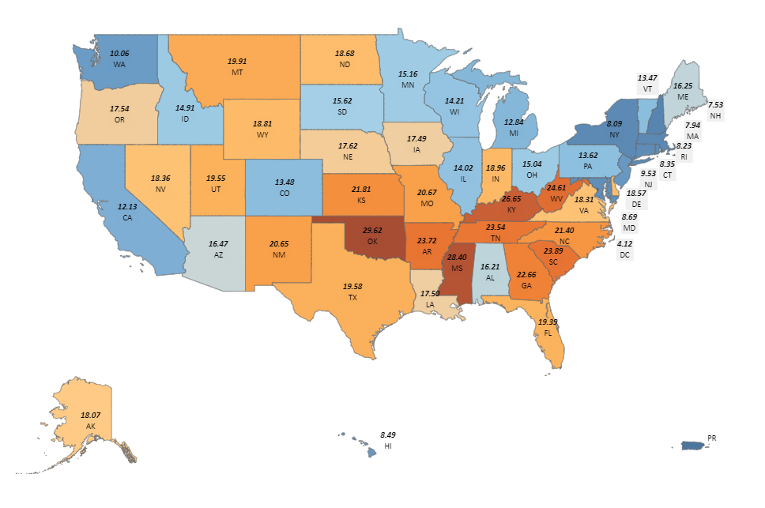
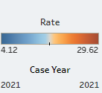

Slide 10
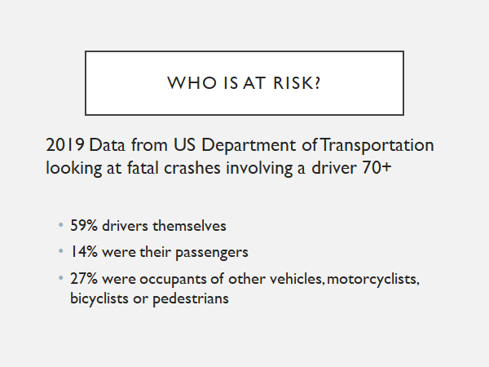
Notes:
We retire from driving to keep YOU safe (pt), their loved ones (partners, grandkids, friends) and other people (public health? Innocnent public)
THERE ARE STATES THAT YOU HAVE TO TEST FOR YOUR LICENSE AFTER AGE 75, OR MANDATORY REPORTED STATES (OR IS THIS)

Slide 11
Why is this my job?
Studies looking at self-rated driving ability show that older drivers tend to score themselves higher on ability as their skills decline.⁹
However, most older adults agree that if a primary care provider advised them to stop driving they would do so.¹¹
Given this dichotomy between driving perception and ability, it is clearly within the role of primary care providers to assess and counsel older drivers
Notes:
Doesn't the DMV do this? Not in OREGON. We are not a state that requires you to retest after a certain age.
People tend to score themselves at higher ability—we have lack of insight about declining abilities.
Most people would stop if PCP recommended it
Therfore, even though it is hard to have the conversation we need to take this role seriously and assess/recommend

Slide 12
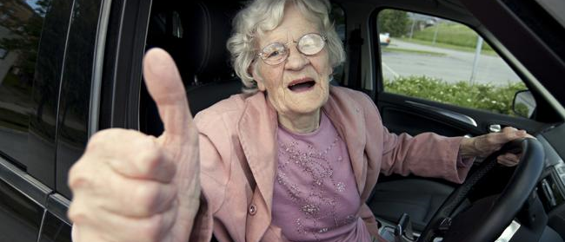
Driving = independence
Notes:
The push back is that driving does equal independence for a lot of people
But, even though it isn't an easy task, it is so important and the consequences of bad driving are hard to live with as well (fatal, vs financial, vs fender bender)

Slide 13

WHEN?
When is the right time to assess for driver safety?
Notes:
Just read slide

Slide 14

Driving is a complex task
Visual acuity and perception
Cognitive abilities: executive function and multitasking
Neuromuscular function
Notes:
When thinking about the red flags, think about all the body systems required to drive safely

Slide 15

Five Triggers for driver screening

Slide 16




5 Triggers for Driver Screening
Changes in vision
Changes in gait, neuro or MSK exam
Changes in memory or cognition
High risk medications

Slide 17

Triggers for driver screening
Driving Concerns
Notes:
Is a family member bringing up concerns—pulled aside in hallway, my chart message before hand...
If a family member OR patient has a concern, take it seriously.
There is good data to show that one of the most reliable red flag findings is someone bringing up concerns about driving

Slide 18

HOW? Five Domains to Assess
This Photo by Unknown author is licensed under CC BY-NC-ND.

Slide 19

Toolbox
There is no single validated screening tool to assess driving safety and thus evaluation requires a multifaceted approach
Notes:
Unfirtunately, no single vadliated tool, so we have to take a multifacted approach

Slide 20

Vision

Slide 21
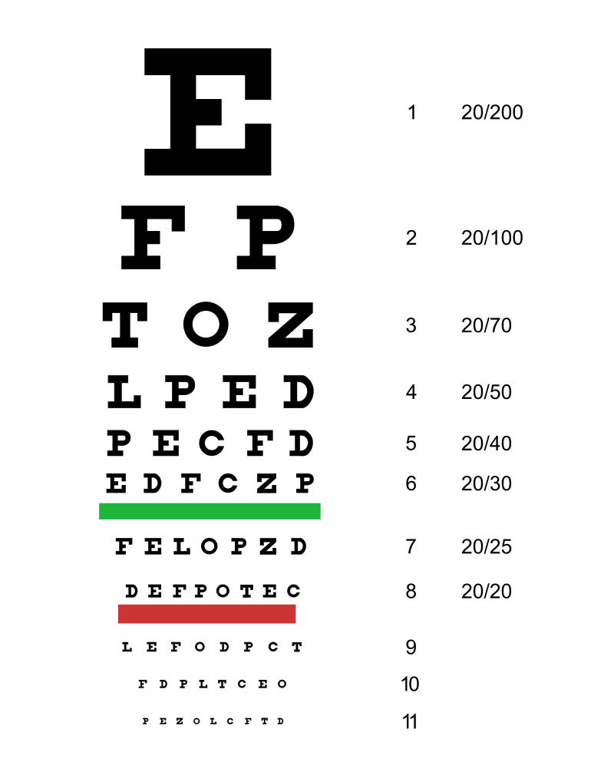
"Snellen chart" by Jeff Dahl - Own work by uploader, Based on the public domain document: [1]. Licensed under CC BY-SA 3.0 via Commons https://commons.wikimedia.org/wiki/File:Snellen_chart.svg#/media/File:Snellen_chart.svg
Notes:
What do you think the cut off is in OR for drriving impairement
20/70 in the best eye (you could have a wrose eye)
This is pretty poor vision
There are snellen charts in clinic

Slide 22
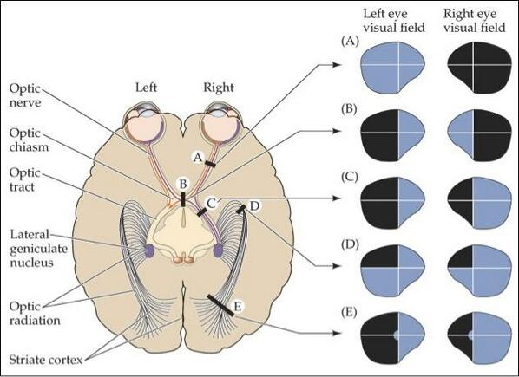
www.psychologyus.com450
Notes:
Visiual fields are so important.
Maybe you are comfortable with VF exams in the office
Be more aware of this if hx of stroke

Slide 23
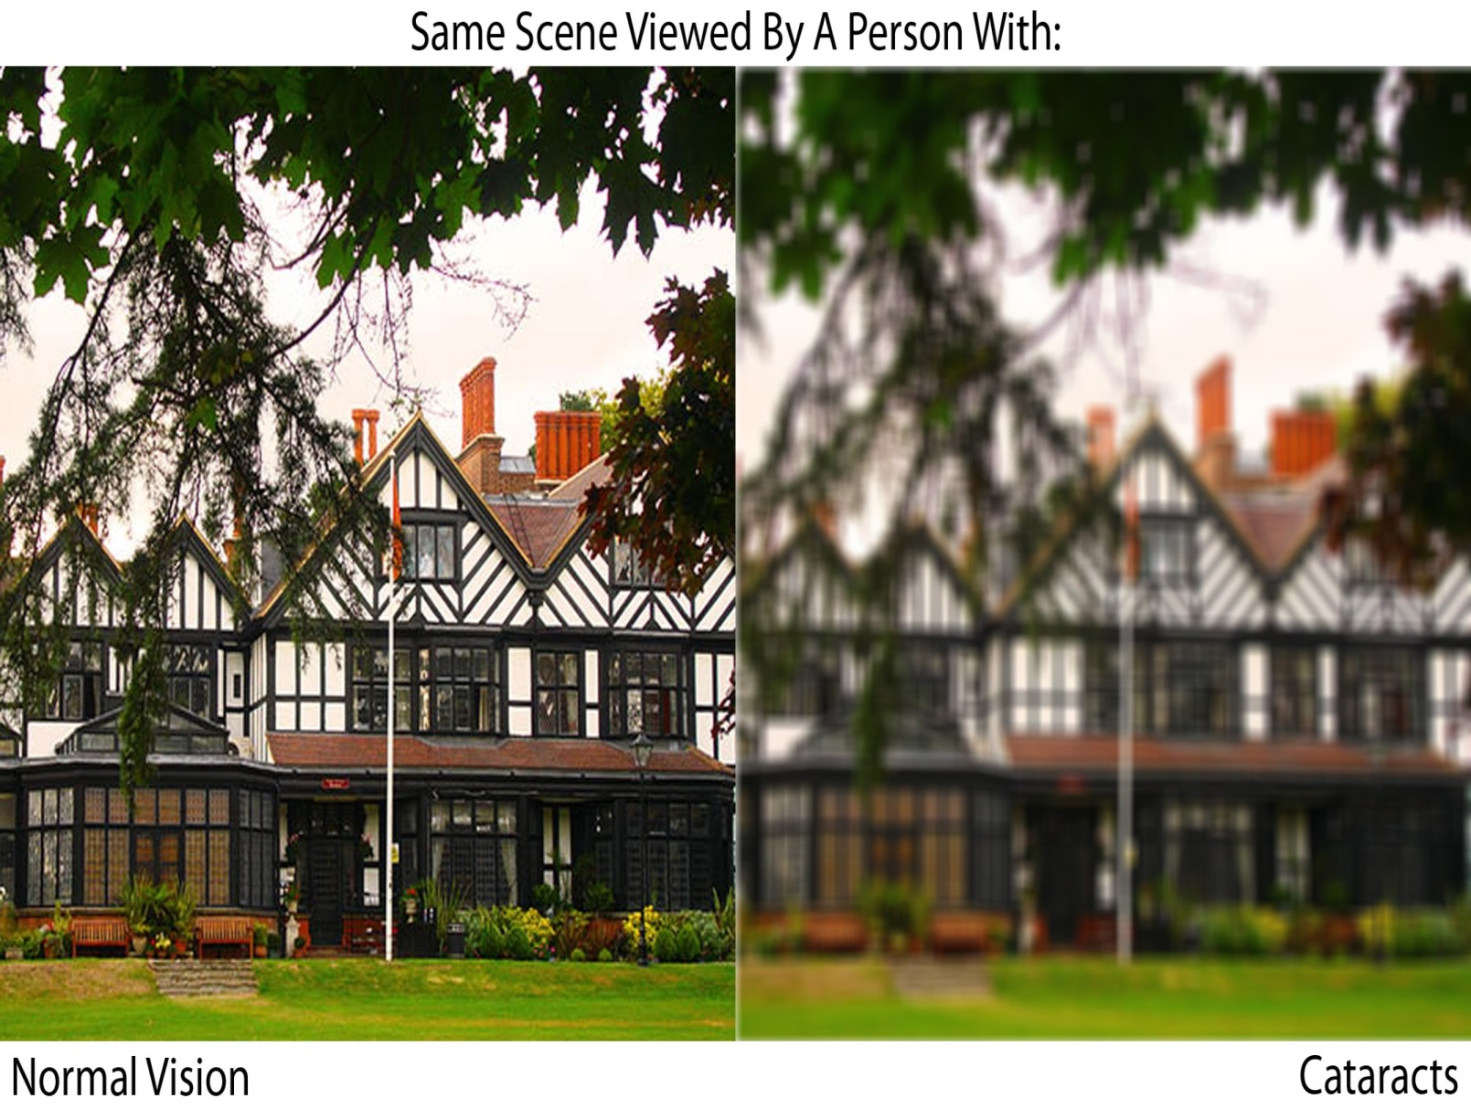
http://www.krishnavision.com/
Notes:
Cataracts—if both eyes, the world is pretty blurry
Add about how easy surgery can be

Slide 24
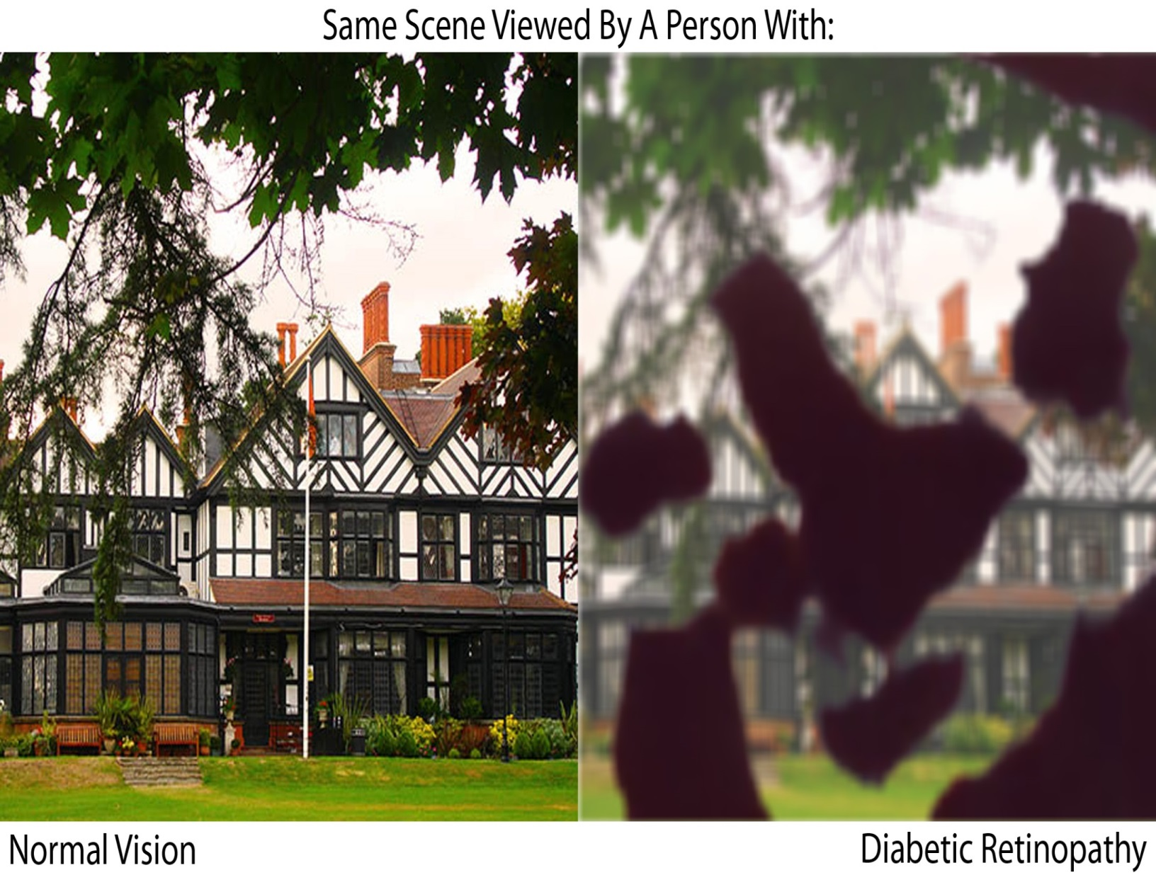
http://www.krishnavision.com/
Notes:
All over the place holes in your vision combined with blurry vision
This is not a safe driver

Slide 25
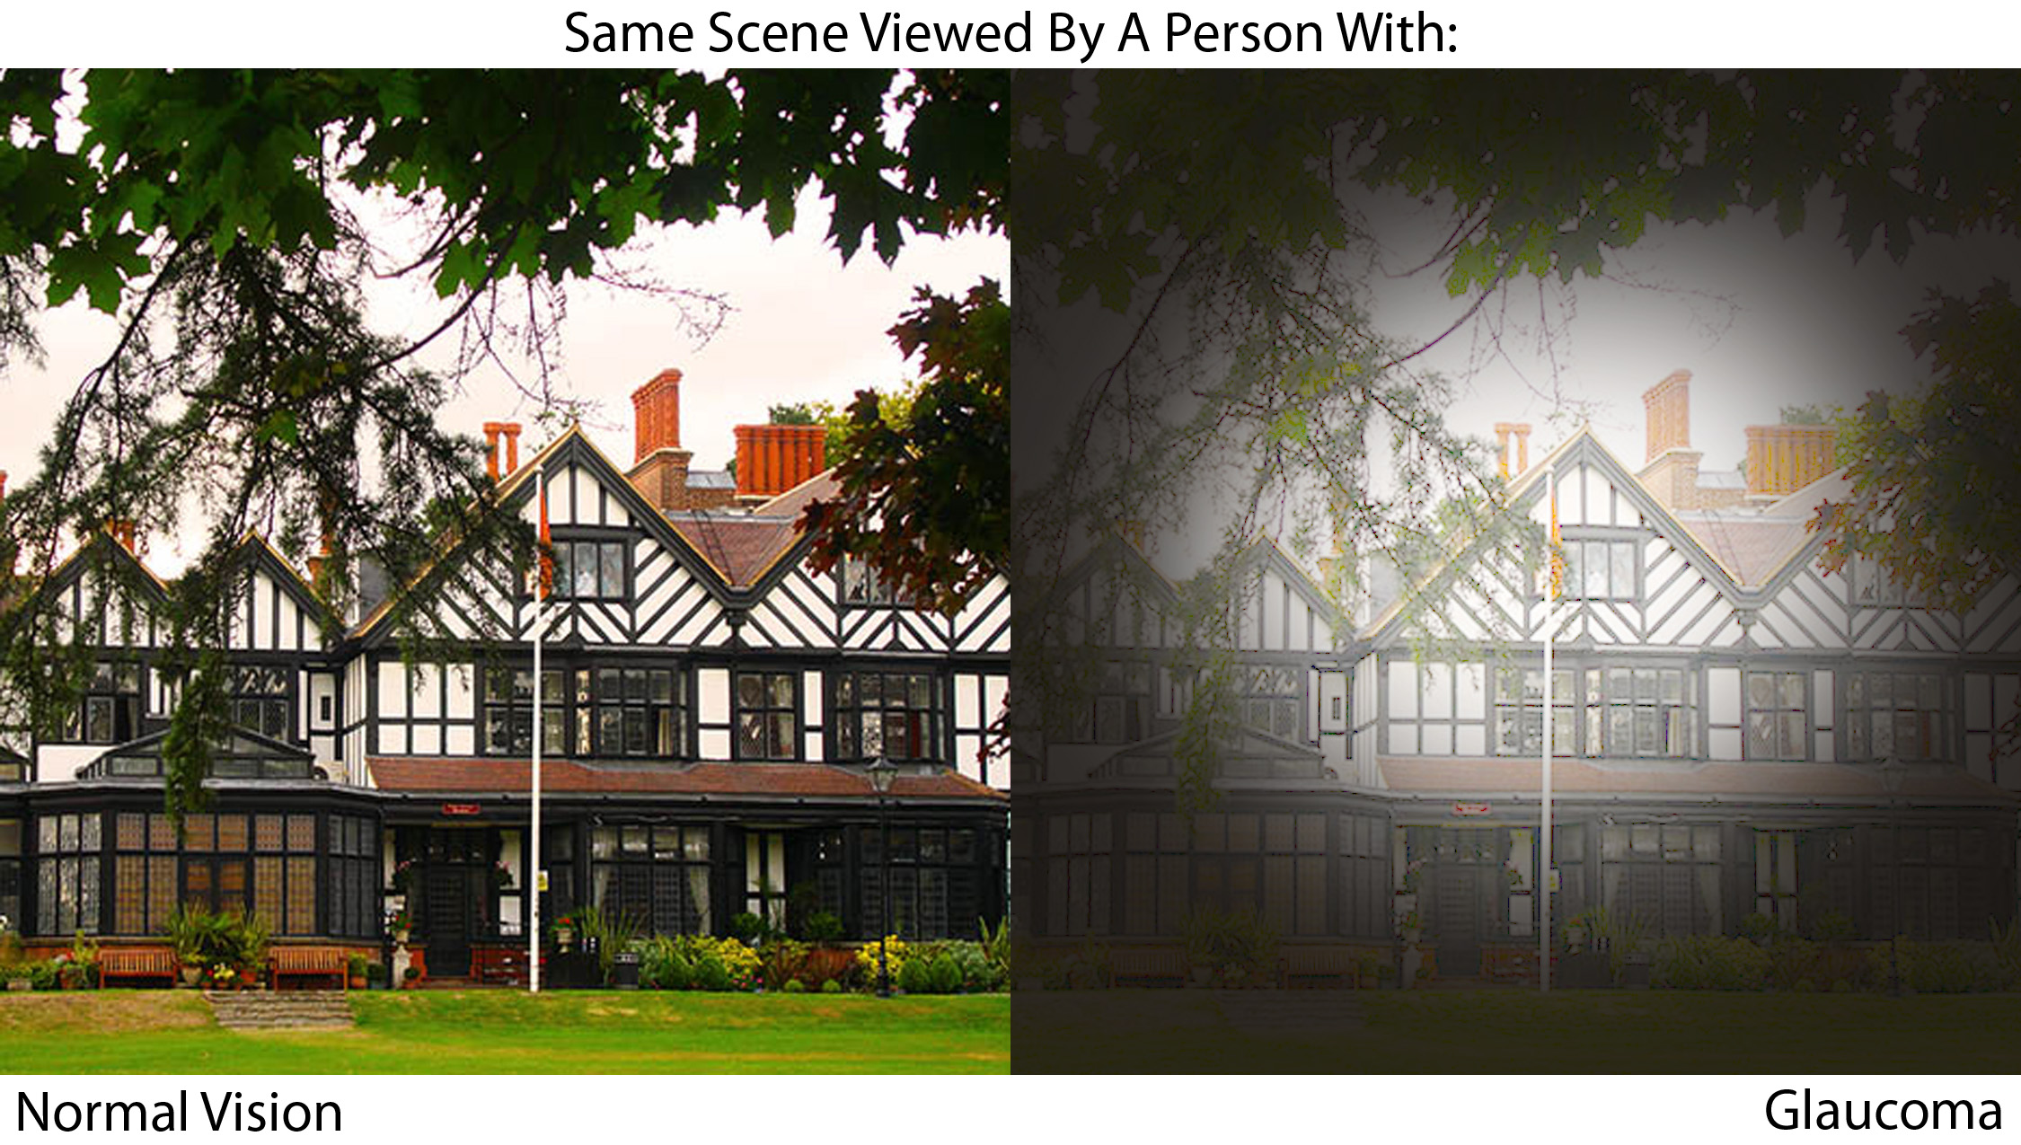
http://www.krishnavision.com/
Notes:
Glacucoma, central preserved but you lose peripheral vision.
So turning is hard—you can't actually see all the way to their field of vision (ped, biker, turning car), changing lanes...
The data does support that intersections are the greatest place where fatal accidents occur in older adults

Slide 26
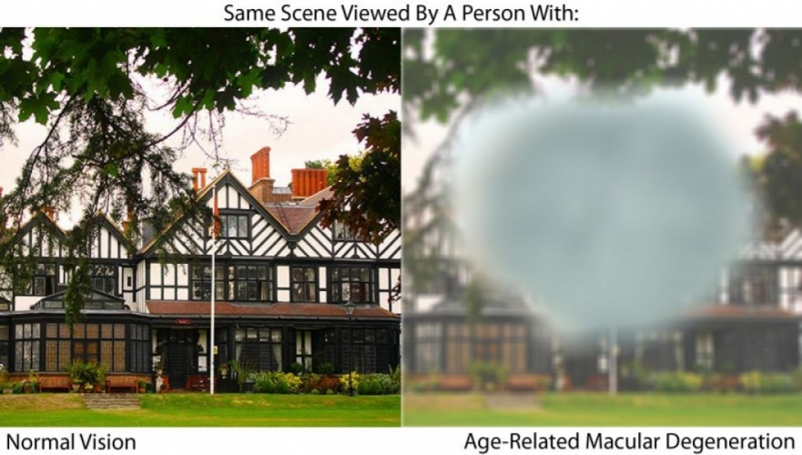
http://www.krishnavision.com/
Notes:
Hole in central vision with ARMD
The brain doesn't really allow the person to recognize the hole, it sorts of fills it in. So the pt doesn't really realize that they are missing information.
There could be a whole vehical or person in that hole but they don't realize it is here

Slide 27
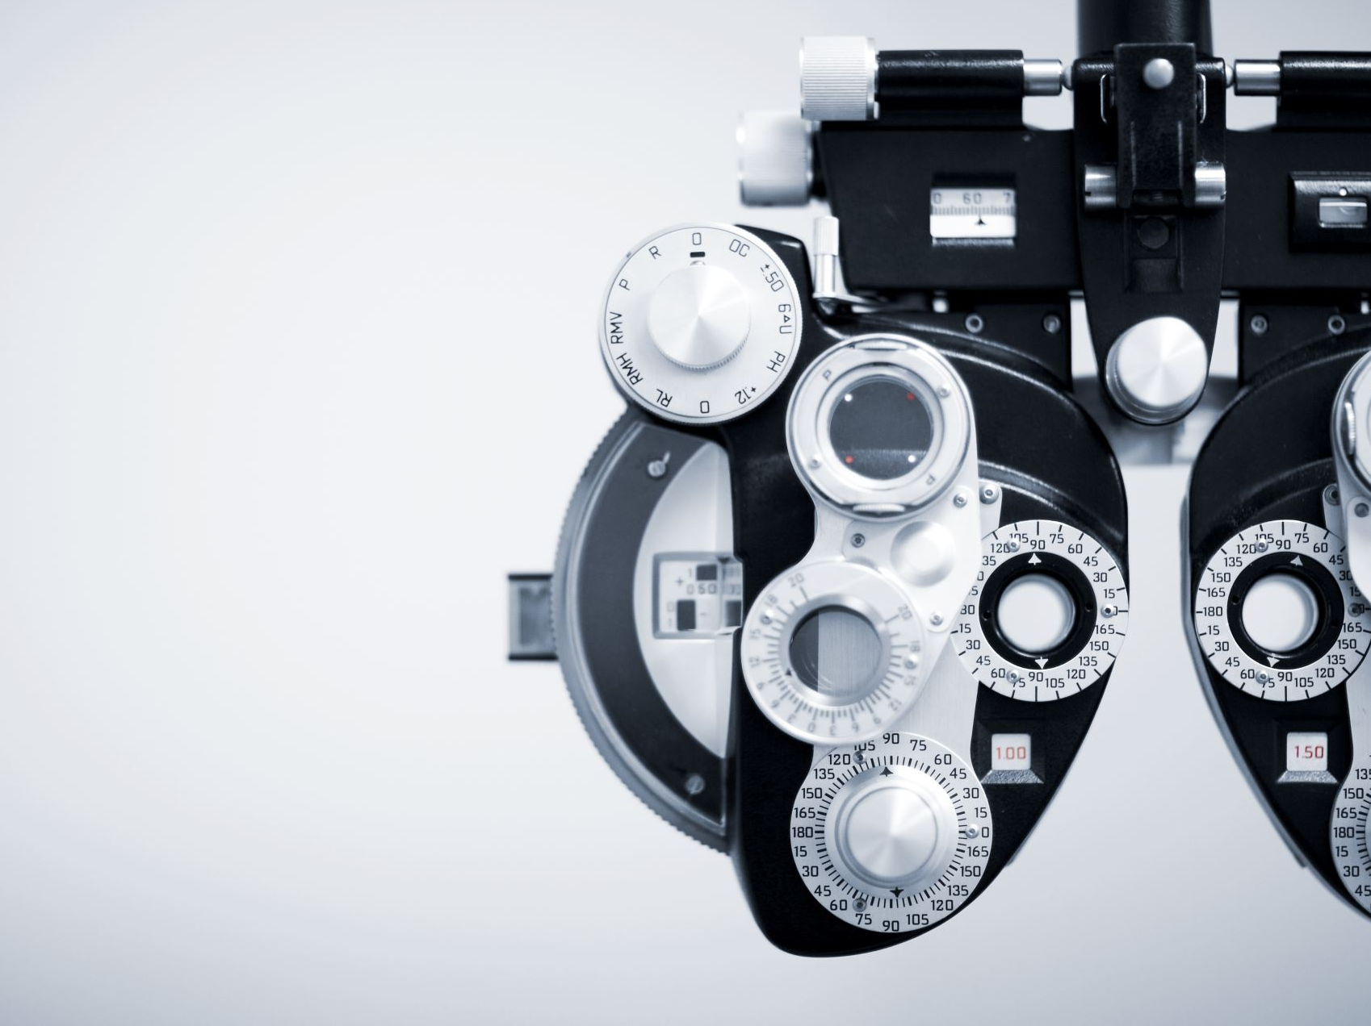
Vision
Refer to ophthalmology specifically for drivers evaluation
Notes:
Yes optho reiviews these thing but they may not, often don't, comment on ability to drive
You need to specifically ask for this

Slide 28
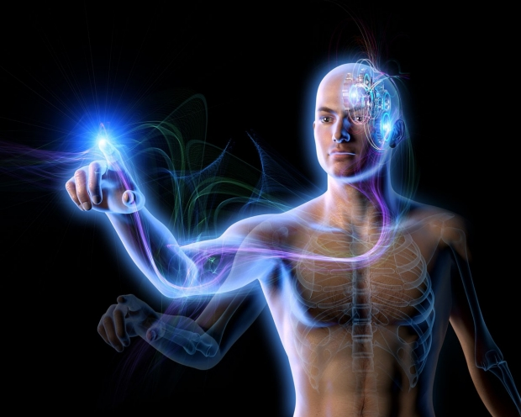
Neuromuscular function
History of falls is associated with motor vehicle accidents in which older drivers were at fault.³⁶
Driving impairment is associated with inability to reach above the shoulder, impaired knee flexion, neck ROM, and inability to walk for more than one block.^{37,38}
Notes:
A hx of falls is statistically sig associated with likelihood of accidents (MVAs)
Red flags:
Shoulder stenosis, decreased cervical ROM, knee ROM, can't walk more than a block (these are associated with driving impairement)

Slide 29
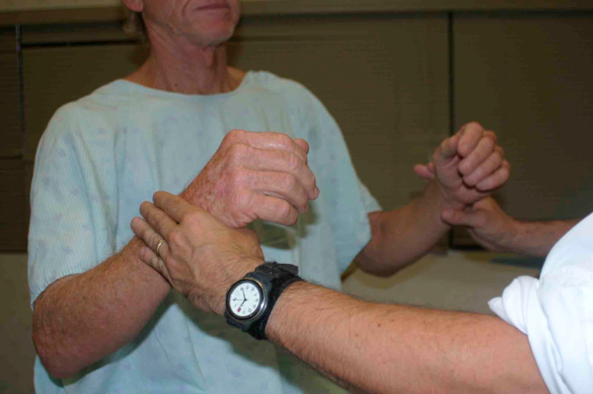
Neuromuscular function
Neuro/MSK exams
Weakness
Flexibility
Peripheral neuropathy
Motor coordination
Notes:
Need to feel pedal
Motor—PD, MS

Slide 30
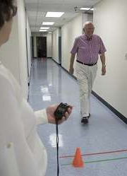
Rapid pace walk test
In a recent review, it was shown that the timed up and go (TUG) was not a reliable indicator of driving ability,³⁹ however the rapid pace walk test is associated with driving ability.¹⁷
20 feet (10 feet up and back) using any assistive device they normally use.
>9 seconds is associated with driving impairment.⁴⁰
Notes:
Wish it was the TUG cause we use this for falls/STEADI and GAC but unfortunately the TUG is not a reliable indicator of driving ability
The rapid pace walk test was reliable. not hard to do. It's like a double TUG. No chair. Normal pace 20 ft.

Slide 31
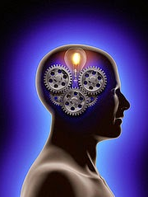
Cognition
This Photo by Unknown author is licensed under CC BY-SA-NC.

Slide 32

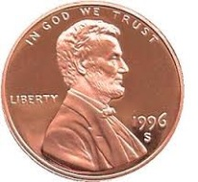

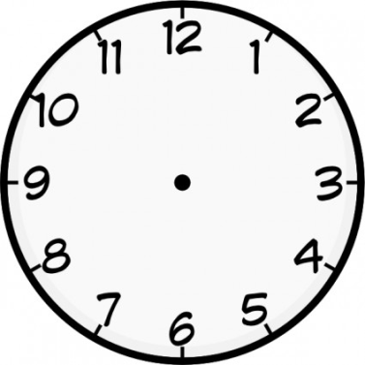
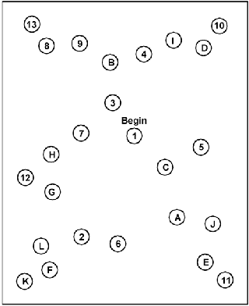
Mini Cog
3 item recall
Clock draw
Executive function testing:
trails B test
Notes:
Hard to find time in busy office visit so if you don't have time for full Moca or SLUMS
Clock draw is most Sn and Sp for ability to drive
Reason is that it measures EF, the part of brain we need most ot safely drive
So if they cannot do a coplmete clock draw, they are at high risk for driving
The second test is trails B
It is pretty easy to administer
Can they do it? Errors? Take too long?
MoCA has both so it test more brain domans involved in driving

Slide 33
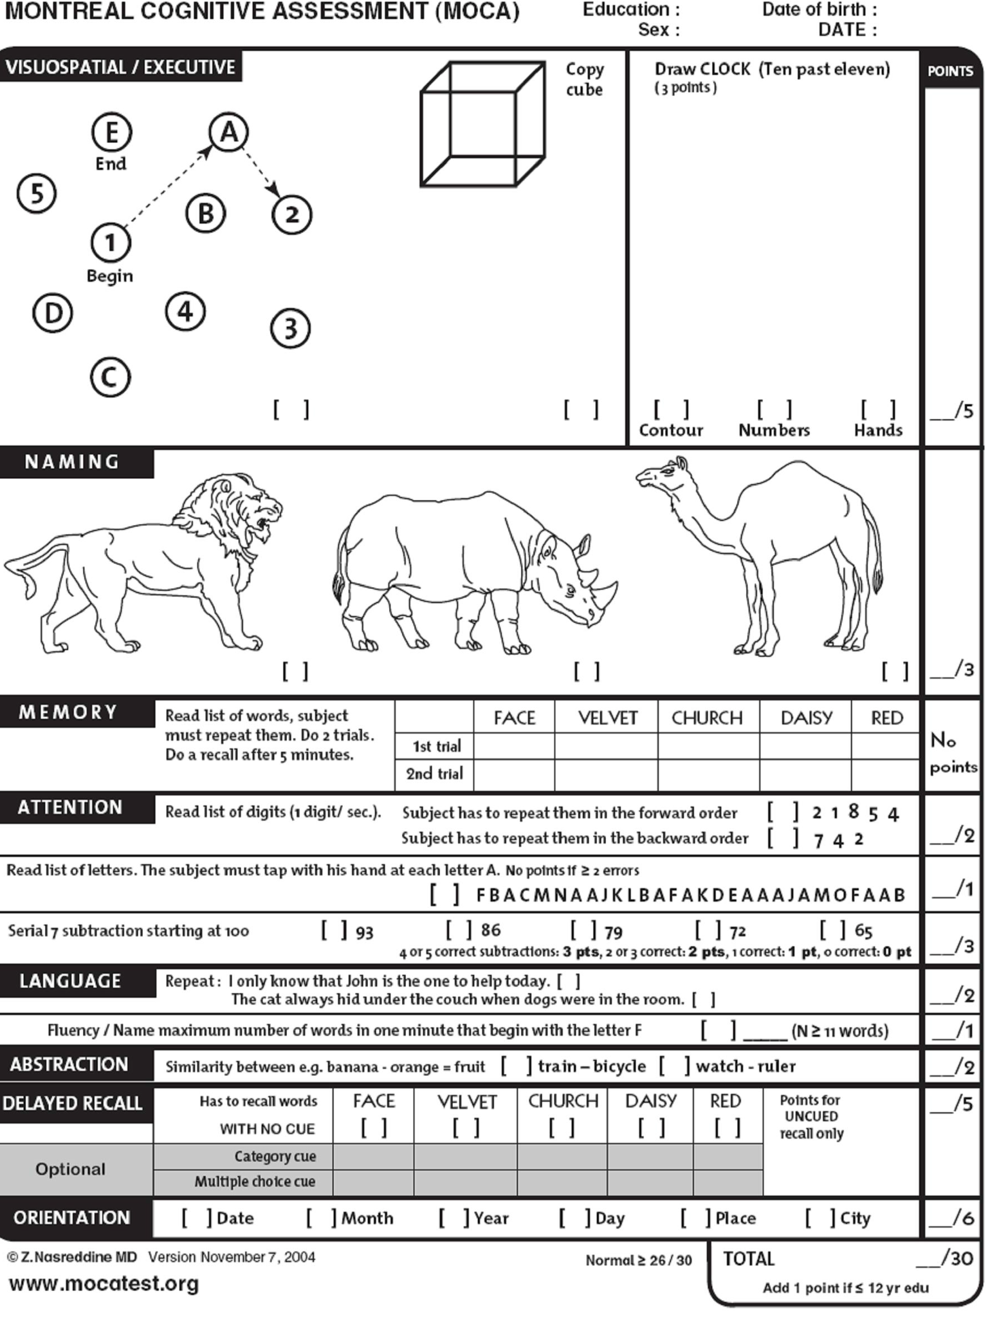

MoCA
Attention
Judgement
Reaction Time
Planning and sequencing
Impulsivity
Visuospatial
Memory
Notes:
All of these starred things are required for driving
MoCA well studied in context of ability to drive.
Those with a MoCA score of 18/30 or less are likely unsafe to drive (75% sensitivity, 94% specificity).
So, if you give a MoCA and clock is off and trails B is off, right there you can take away ability to drive "no longer safe".
Or regardless of clock/trails, if score <18 you can also say unfit to drive
What about SLUMS?
It hasn't been validated for ability to drive.
It does have clock draw, but not planning/sequencing or trails component
Moca now proprietary like MMSE
Training is high quality, inexpensive, I was reimbursed for CME. Some health systems get batched deals

Slide 34
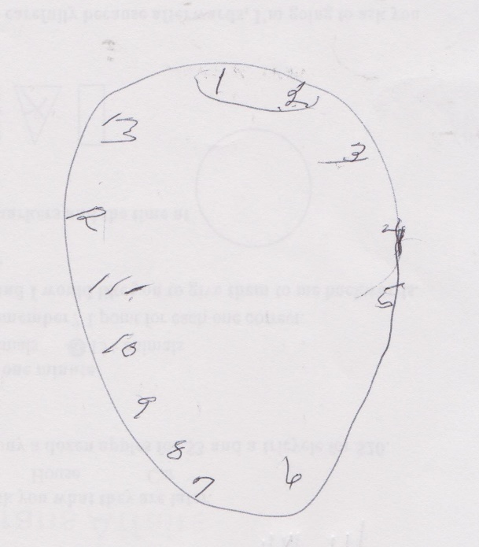
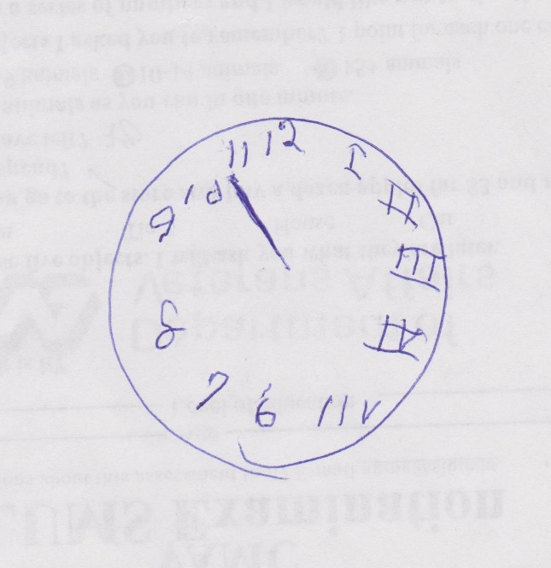
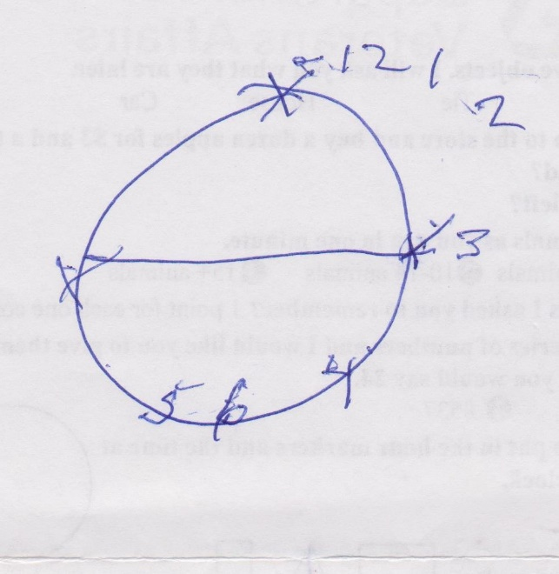
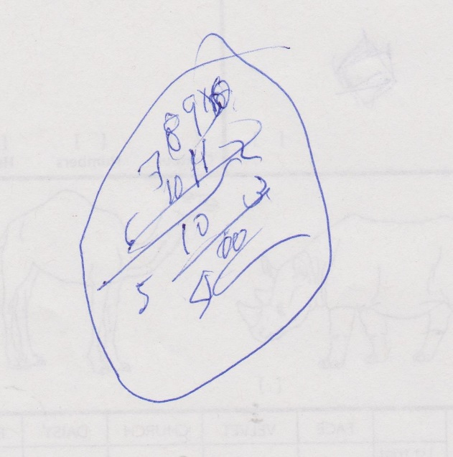
Notes:
Examples of abnormal clocks

Slide 35

SUBSTANCES: MEDICATIONS ALCOHOL DRUGS
Notes:
Highlight high risk meds??

Slide 36
Alcohol use
2014 Data from the National Survey on Drug Use and Health Report 4.1% of drivers over the age of 65 drove under the influence of alcohol in the preceding year.
That is roughly the same percentage as drivers aged 16-17 years old.¹⁵
Older adults are at even greater risk due to increased rates of drug interactions, decreased alcohol metabolism, and underlying cognitive impairment^{.16}
Notes:
We often forget to ask older adults about etoh (if and how much they are drinking) but....
4%. (small number but still relevant) drive under influence
This is the SAME as 16 and 17 yo!! And we known from prior slides that older drivers are having more fatalities/MVAs
Higher risk because of drug interactions, decreased etoh metabolism and they often do have underying cog impairement

Slide 37
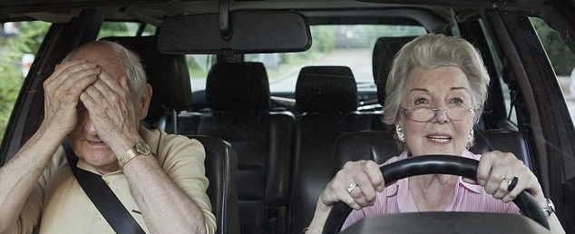
Driving concerns
Does the patient limit their driving?
Has family expressed concerns?
Notes:
I only drive to church or the grocery store. No driving at night. Don't drive out of state
We know from studies that if they have already started to limit driving they are at high risk. This means it is time to evaluate
I do ask if family has expressed concerns? Have kids asked you to stop driving? Do people prefer to not drive with you?

Slide 38
Mandatory reporting to DMV or referral???

Slide 39

Provider responsibility
Providers should know local reporting laws and should feel comfortable counseling their patients on driving cessation and alternative transportation strategies

Slide 40
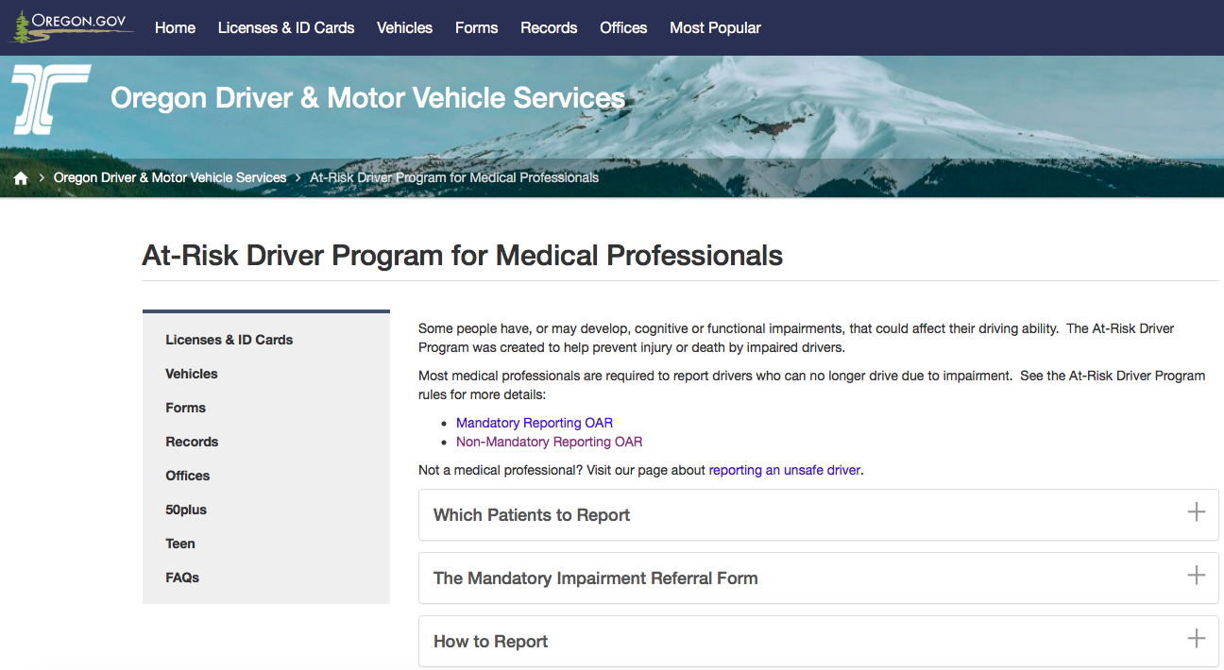

http://www.oregon.gov/ODOT/DMV/pages/at-risk_program_index.aspx
http://www.oregon.gov/ODOT/DMV/pages/at-risk_program_index.aspx

Slide 41
Mandatory reporter laws
Report
Severe
Uncontrollable
Permanent
Refer
Mild
Potentially controllable
Potentially reversible
Notes:
(California, Delaware, Nevada, New Jersey, Oregon, and Pennsylvania)

Slide 42
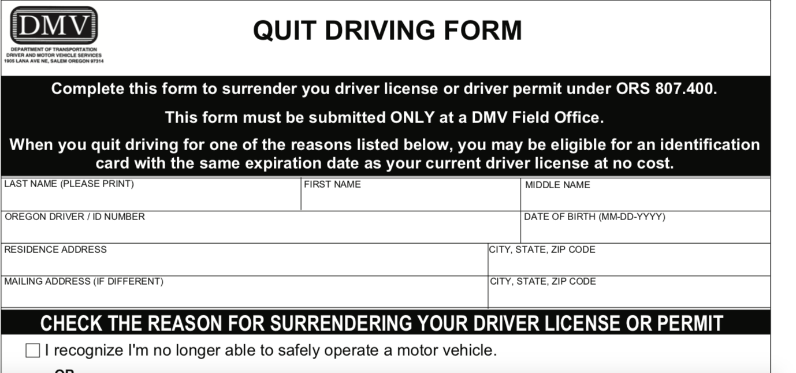
Voluntary Retirement
ODOT
http://www.oregon.gov/ODOT/DMV/pages/at-risk_program_index.aspx

Slide 43
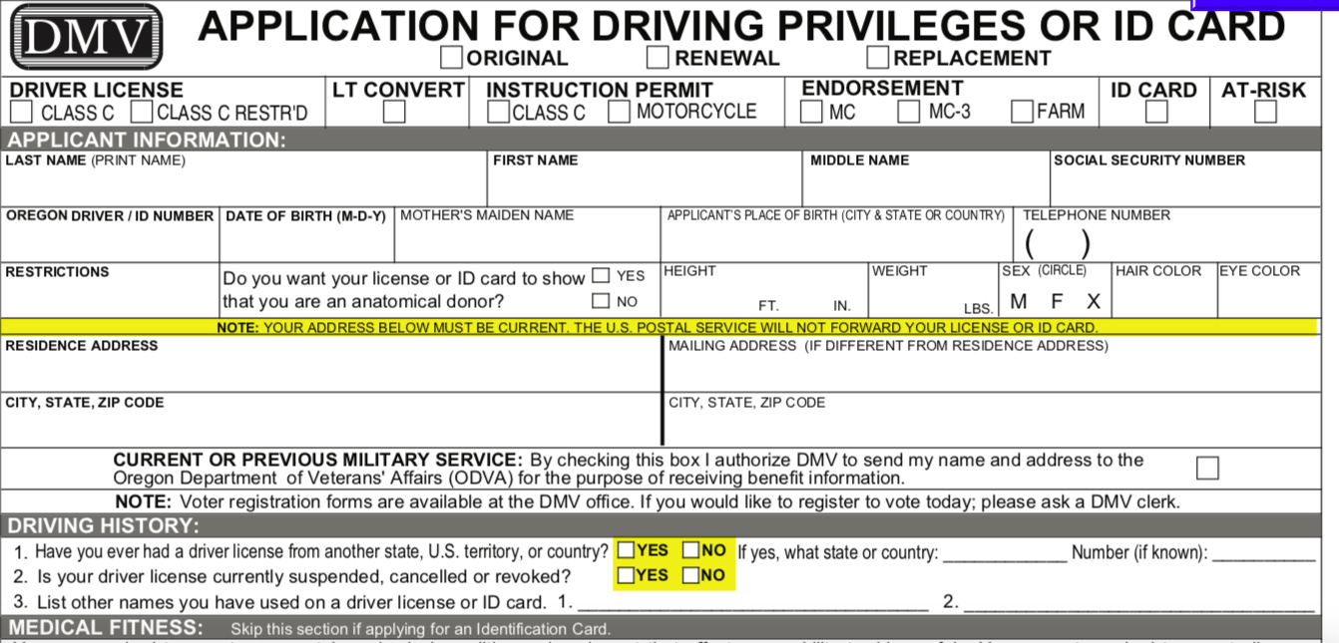
Apply for ID card when surrendering license

Slide 44

Drivers Ed
When starting through an intersection and you see an ambulance behind you, you must
a. stop in the intersection and allow the ambulance to go around.
b. pull to the right in the intersection and stop.
c. drive through the intersection, pull to the right and stop

Slide 45
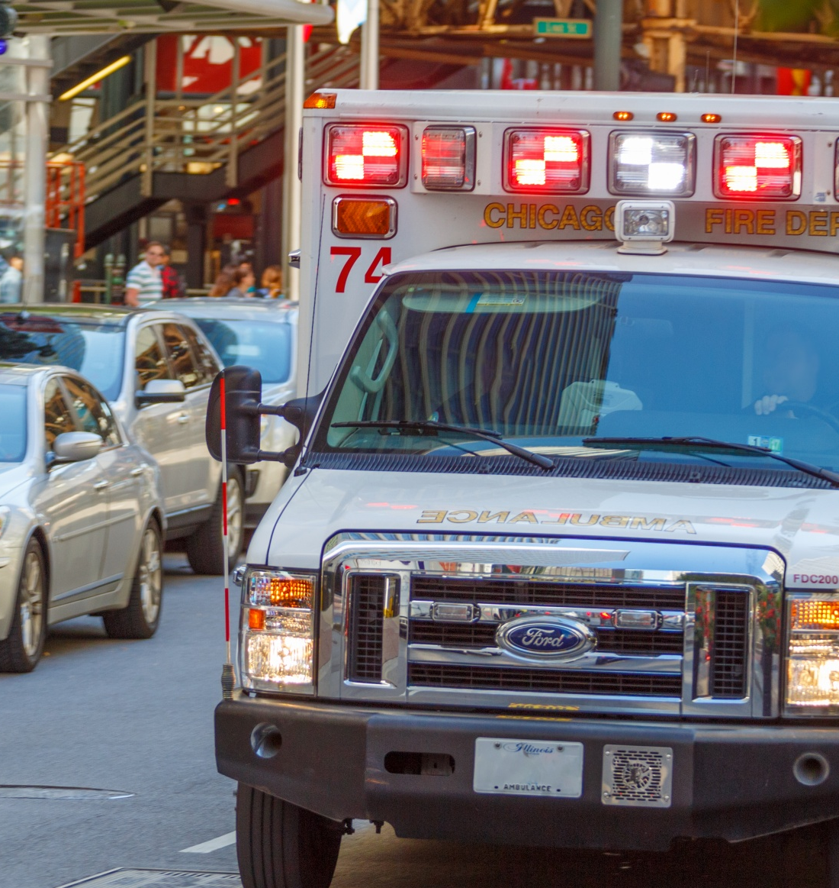
Drivers Ed
Correct Answer
c. drive through the intersection, pull to the right and stop

Slide 46

Referral

Slide 47

DMV Reporting
This Photo by Unknown author is licensed under CC BY-SA.

Slide 48
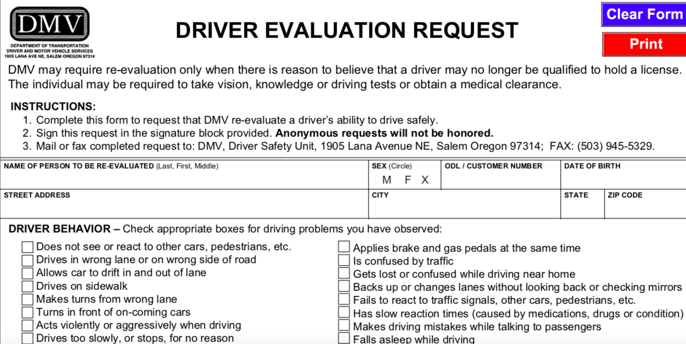
Refer for Re-test if deficits are not severe and uncontrollable

Slide 49
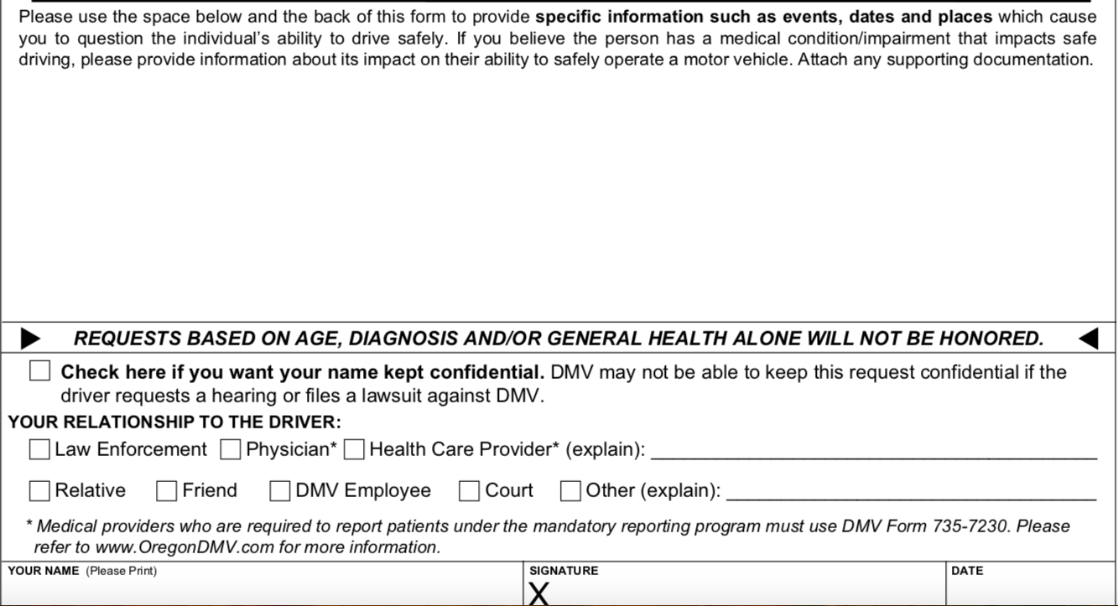
Driver re-evaluation request

Slide 50
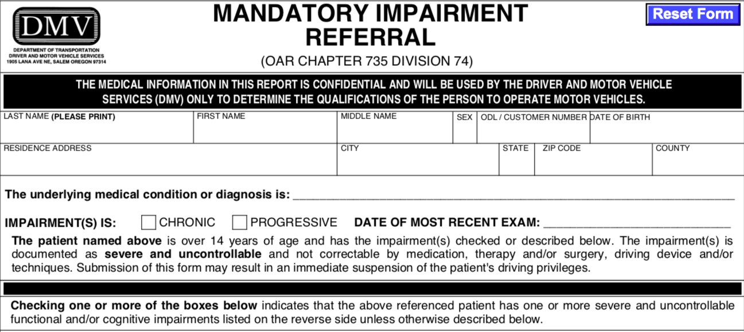
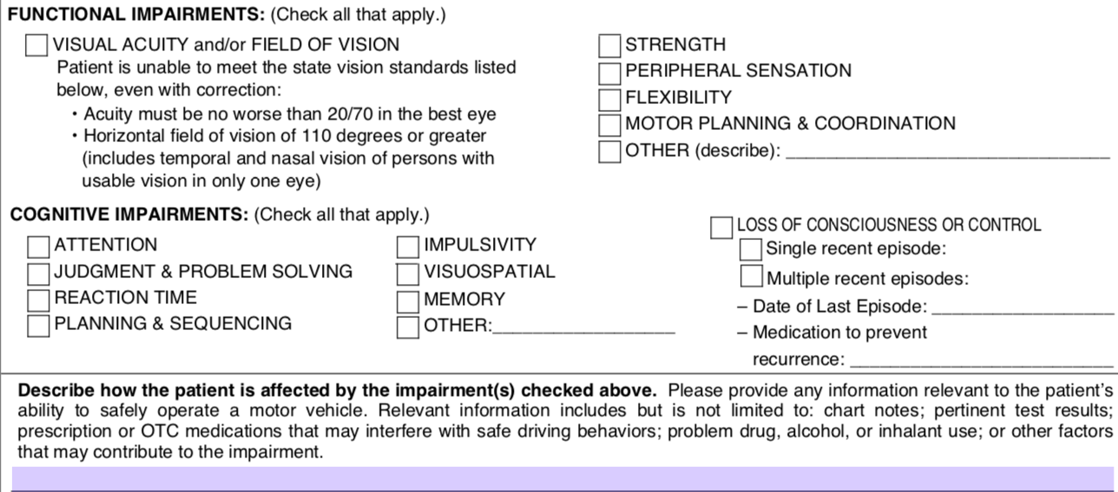

Slide 51
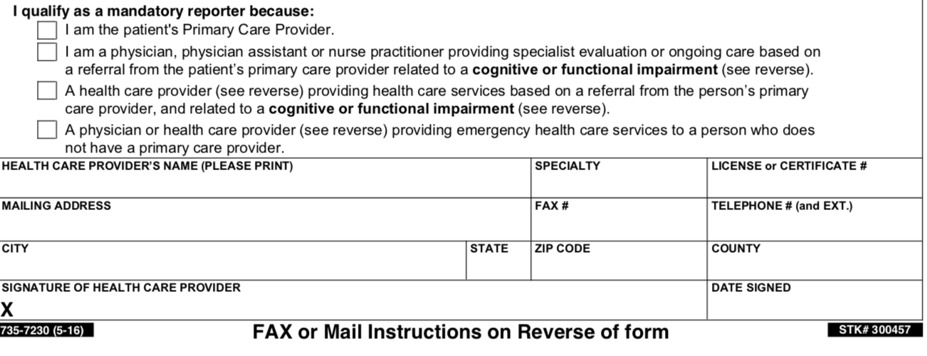
**You MUST report even if the patient
voluntarily retires from driving**

Slide 52



Slide 53
Other resources
Aging and Disability Services offices http://www.oregon.gov/dhs/spwpd/pages/offices.aspx#top
AAA Senior Driving Resources https://exchange.aaa.com/saftey/seniordriver-safety-mobility/
AARP Driving Safety Resources https://www.aarp.org/auto/driversafety/driving-assessment/
Association of Driver Rehabilitation Specialists
https://www.aded.net
Older Adult Driver Initiative https://www.planfortheroadahead.com
The Hartford Center: Driving Safety
https://www.thehartford.com/resources/mature-market-excellence/driving-safety

Slide 54
Driver assessment workflow
VISION
FUNCTION
COGNITION
SUBSTANCES
DRIVING CONCERNS
Identify
Vision – acuity and peripheral vision
Cognition – clock draw and Trails B
Neuromuscular function – gait speed, strength, flexibility
Assess
Mild, controllable, reversible deficits = referral to DRS/CDRS
Severe, uncontrollable, not reversible deficits = driving cessation
Refer or Revoke

Slide 55
References
American Automobile Association. Senior Driving: understand mind and body changes 2017. Available at: http://seniordriving.aaa.com/understanding-mind-body-changes/reaction-time. Accessed April 23, 2017.
Bernard JA, Seidler RD. Moving forward: Age effects on the cerebellum underlie cognitive and motor declines, Neuroscience and Biobehavioral Reviews 2014;42:193-207.
Boisgontier MP. Motor aging results from cerebellar neuron death. Trends in Neurosciences 2015;38:127-128.
Clark BC, Taylor JL. Age-Related Changes in Motor Cortical Properties and Voluntary Activation of Skeletal Muscle. Current Aging Science 2011;4(3):192-199.
Chen, KB, Xu X, Lin JH, Radwin RG. Evaluation of older driver head functional range of motion using portable immersive virtual reality. Exp Gerontol 2015;70;150–156.
Der G, Deary IJ. Age and sex differences in reaction time in adulthood: results from the United Kingdom Health and Lifestyle Survey. Psychol Aging 2006;21:62–73.
Huisingh C, McGwin G, Orman KA, Owsley C. Frequent falling and motor vehicle collision involvement in older drivers. J Am Geriatr Soc 2014;62:123–129.
Hu Hu PS, Trumble DA, Foley DJ, et al. Crash risks of older drivers: a panel data analysis. Accid Anal Prev 1998;30:569–581.
Marottoli RA, Wagner DR, Cooney LM, Tinetti ME. Predictors of Crashes and Moving Violations Among Elderly Drivers. Annals of Internal Medicine 1994;121:842–846.
Mielenz TJ, Durbin LL, Cisewski JA, Guralnik JM, Li G. Select physical performance measures and driving outcomes in older adults. Inj Epidemiol 2017;4(1):14.
Staplin L, Gish KW, Wagner EK. MaryPODS revisited: updated crash analysis and implications for screening program implementation. J Safety Res 2003;34:389-397.

Slide 56
References
National Center for Injury Prevention and Control. 2015. Web-based Injury Statistics Query and Reporting System (WISQARS), 2014 fatal injury data. Atlanta, GA: Centers for Disease Control and Prevention. Available at: http://www.cdc.gov/injury/wisqars/index.html. Accessed April 10, 2017.
Foley DJ, Heimovitz HK, Guralnik JM, Brock DB. Driving Life Expectancy of Persons Aged 70 Years and Older in the United States. American Journal of Public Health. 2002;92(8):1284-1289.
Traffic Safety Facts 2013. A Compilation of Motor Vehicle Crash Data from the Fatality Analysis Reporting System and the General Estimates System National Highway Traffic Safety Administration National Center for Statistics and Analysis U.S. Department of Transportation Washington, DC. Available at: https://crashstats.nhtsa.dot.gov/Api/Public/ViewPublication/812139. Accessed March 18, 2017.
Anstey KJ, Wood J, Lord S, Walker JG. Cognitive, sensory and physical factors enabling driving safety in older adults. Clin Psychol Rev 2005;25:45–65.
Cicchino, J.B. Why have fatality rates among older drivers declined? The relative contributions of changes in survivability and crash involvement. Accident Analysis and Prevention 2015;83:67-73.
Fonda SJ, Wallace RB, Herzog AR. Changes in driving patterns and worsening depressive symptoms among older adults. J Gerontol Ser B: Psychol. Sci Soc Sci 2001;56:343–351.
Marottoli RA, Ostfeld AM, Merrill SS, Perlman GD, Foley DJ, Cooney LM. Driving cessation and changes in mileage driven among elderly individuals. J Gerontol Soc Sci. 1993;48:255–260.
Liddle J, Gustafsson L, Mitchell G, Pachana N. A Difficult Journey: Reflections on Driving and Driving Cessation From a Team of Clinical Researchers. Gerontologist 2017; 57 (1):82-88.
Freund B, Colgrove LA, Burke BL, McLeod R. Self-rated driving performance among elderly drivers referred for driving evaluation. Accid Anal Prev. 2005 Jul; 37(4):613-8.
Choi M, Mezuk B, Rebok G. Voluntary and involuntary driving cessation in later life. Journal of Gerontological Social Work 2012;55(4):367-376.
Betz M, Schwartz R, Valley M, Lowenstein S. Older adult opinions about driving cessation: a role for advanced driving directives. Journal of Primary Care and Community Health 2012; 3(3):150-154.
Physician’s Guide to Assessing and Counseling Older Drivers. Second Edition 2010. Available at: https://www.nhtsa.gov/staticfiles/nti/older_drivers/pdf/811298.pdf. Accessed April 30, 2017.
Clinician's Guide to Assessing and Counseling Older Drivers. Third Edition 2015: An Update of the Physician's Guide to Assessing and Counseling Older Drivers. Available at: https://www.nhtsa.gov/.../nti/older_drivers/.../812228_CliniciansGuideToOlderDrivers.pdf. Accessed April 30, 2017.
Older Drivers: license renewal procedures. Insurance Institute for Highway Safety 2013. Available at: http://www.iihs.org/iihs/topics/laws/olderdrivers?topicName=older-drivers. Accessed March 12, 2017.
Lipari R, Hughes A, Bose J. Driving Under the Influence of Alcohol and Illicit Drugs. The CBHSQ Report. Rockville (MD): Substance Abuse and Mental Health ServicesAdministration (US); 2016. Available at: https://www.ncbi.nlm.nih.gov/books/NBK424784/. Accessed March 12, 2017.

Slide 57
References
Barry KL and Blow FC. Drinking Across the Lifespan: Focus on Older Adults. Alcohol Research: Current Reviews 2016;38(1):115-120.
Dickerson AE, Meuel DB, Ridenour CD, Cooper K. Assessment tools predicting fitness to drive in older adults: A systematic review. American Journal of Occupational Therapy 2014;68(6):670–680.
Desapriya E, Subzwari S, Fujiwara T, Pike I. Conventional vision screening tests and older driver motor vehicle crash prevention. International Journal of Injury Control and Safety Promotion 2008;15(2):124-6.
West CG, Gildengorin G, Haegerstrom-Portnoy G, Lott LA, Schneck ME, Brabyn JA. Vision and driving self-restriction in older adults. Journal of American Geriatric Society 2003;51:1348-55.
Cicchino, JB. Critical older driver error in a national sample of serious U.S. crashes. Accident Analysis and Prevention 2015;(80):211-219.
Asimakopulos J, Boychuck Z, Sondergaard D, et al. Assessing executive function in relation to fitness to drive: A review of tools and their ability to predict safe driving. Aust Occup Ther J. 2012; 59:402–427.
Reuter-Lorenz G, Cabeza R, Dennis N. Frontal Lobes and Aging: Deterioration and Compensation. In: Principles of Frontal Lobe Function. Oxford, UK: Oxford University Press; 2013.
Costello MC, Madden DJ, Mitroff SR, Whiting WL. Age-related decline of visual processing components in change detection. Psychol Aging 2010;25:356-368.
Vanlaar W, McKiernan A, McAteer H, Robertson R, Mayhew D, Carr D, Brown S, Holmes E. A Meta-Analysis of Cognitive Screening Tools for Drivers Aged 80 and Over. Traffic Injury Research Foundation, Ottawa, Ontario 2014. Available at: http://tirf.ca/wpcontent/uploads/2017/01/MTO_cognitive_meta_6.pdf. Accessed on April 23, 2017.
Seong-Youl C, Jae-Shin L, A-Young S. Cognitive test to forecast unsafe driving in older drivers: meta-analysis. NeuroRehabilitation 2014;35(4):771-8.
Papndonatos GD, Ott BR, Barco PP, Carr DB. Clinical Utility of the Trail-Making Test as a predictor of driving performance in older adults. J Am Geriatr Soc 2015;63(11):2358-64.
Karthaus, M and Falkenstein, M. Functional Changes and Driving Performance in Older Drivers: Assessment and Interventions. Geriatrics 2016; 1(2):12.
Hollis AM, Duncanson H, Kapust LR, Xi PM, O’Connor MG. Validity of the Mini-Mental State Examination and the Montreal Cognitive Assessment in the prediction of driving test outcome. J Am Geriatr Soc 2015;63:988–992.
Cameron D, Zucchero-Sarracini C, Rozmovits L, Naglie G, Herrmann N, Molnar F, Rapoport M. Development of a decision-making tool for reporting drivers with mild dementia and mild cognitive impairment to transportation administrators. International Psychogeriatrics 2017;1-13.

