Slide 1
Trauma rounds: Blunt cardiac trauma
PREPARED BY aleezay Haider, pgy-4
General Surgery resident

Slide 2
Objective
By the end of this presentation, participants will understand:
Identification of BCI
Diagnosis of BCI
Management of BCI
Diagnosis and management of pericardial tamponade

Slide 3
What is blunt cardiac injury (BCI)?
Injury sustained due to blunt trauma to the heart
Diagnosis difficult given variety of manifestations and absence of gold standard for diagnosis
Present in 20% of all blunt thoracic trauma patients
Incidence as high as 76% in severe thoracic injury or multiple injuries
Myocardial contusion is the most reported BCI
Right sided cardiac injury more common than left
Septal, coronary artery, and valve injuries rare
Notes:
Clinical studies looking at BCI in chest and abdominal trauma report incidences significantly lower than in autopsy series. This may suggest either that subtler forms of cardiac injury are underdetected when symptoms are minimal, or that many patients with significant BCI die in the field from cardiac or associated traumatic injury.

Slide 4
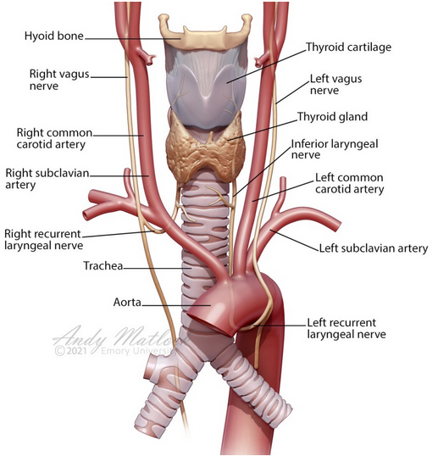
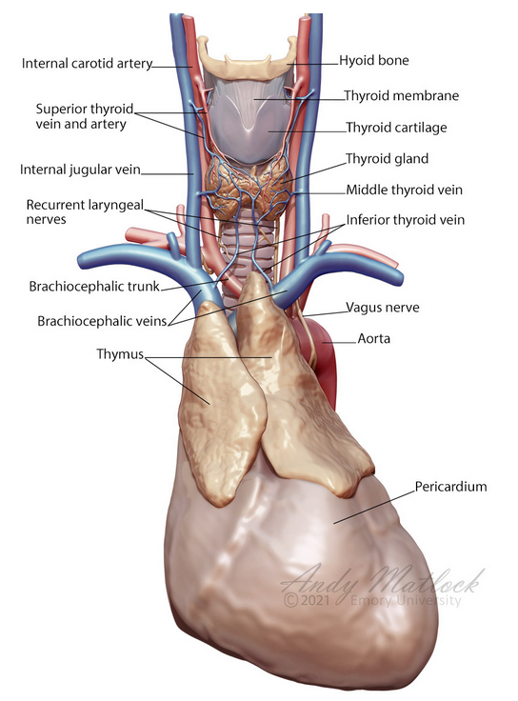
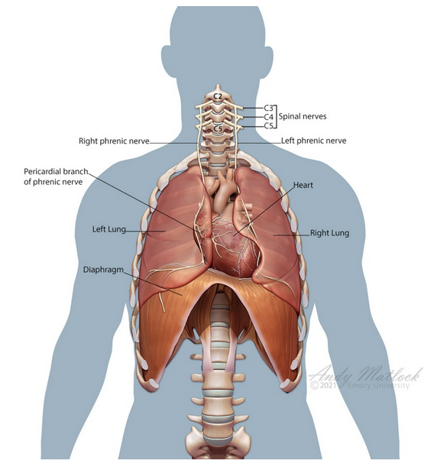
Anatomical Considerations
Notes:
Blunt cardiac trauma commonly leads to the following injuries:
Free septal rupture
Free wall rupture
Coronary artery thrombosis
Cardiac failure
Injury to the myocardial conduction system (dysrhythmias)
Rupture of the chordae tendineae or papillary muscles
Low-pressure structures of the heart, including the vena cava and right atrium, are the first to be compressed by increasing intrapericardial pressure.
The location of the left phrenic and vagus nerves in relation to the pericardial sac is significant. The pericardial sac is a thin, fibrous membrane composed of two layers (visceral and parietal pericardium). Between these two layers is a potential space that may contain up to 30 mL of free fluid in a physiologically normal individual.
The phrenic nerve runs cephalad to caudal along the lateral aspect of the pericardium.
The vagus nerve is located posterior to the pericardial sac and the lung root. The recurrent laryngeal nerve passes under the aortic arch.

Slide 5
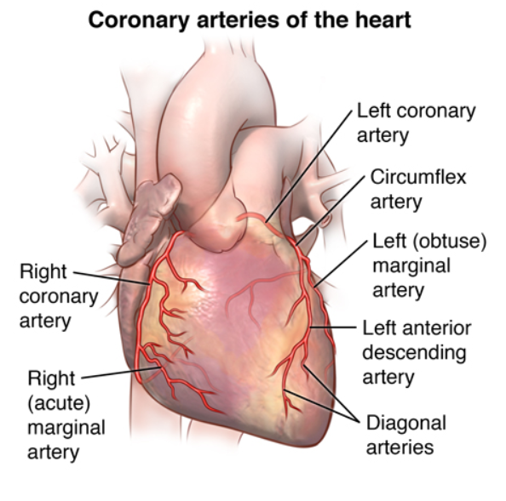

Slide 6
Physiology and Mechanism
Direct transmission of intrathoracic pressure
Hydraulic force transmission to abdomen or extremity vein
Decelerating force between fixed and mobile areas results in aortocaval tears
Direct force can cause myocardial contusion
Cardiac penetration from rib and sternal fractures
Cardiac strangulation from pericardial tear and herniation of cardiac apex
Notes:
Hydraulic force transmission to the right atrium. The distribution of injury among the different heart chambers relates to the anterior positioning of the right-sided chambers in the chest.
Right ventricular injury and right atrial injury are more common
Cardiac strangulation: Compression resulting from blunt trauma causes laceration of the pericardium in both the diaphragm and pleural surface.
Laceration usually occurs parallel to the phrenic nerve and leads to cardiac herniation.

Slide 7
Cardiac Tamponade Physiology
First phase: pericardial pressure increases, decreases ventricular diastolic filling, reduces subendocardial blood flow, tachycardia
Second phase: compromised diastolic filling, stroke volume, coronary perfusion occurs, which leads to anxiety, diaphoresis, and pallor
Third phase: compensatory mechanisms fail; loss of coronary perfusion, cardiac arrest
Notes:
Pericardial pressure increases, which decreases ventricular diastolic filling and reduces subendocardial blood flow, leading to tachycardia
Second phase. Compromised diastolic filling, stroke volume, and coronary perfusion occurs, which leads to anxiety, diaphoresis, and pallor
Third phase. All compensatory mechanisms fail; there is a loss of coronary perfusion that leads to cardiac arrest

Slide 8
Physiology and Mechanism
Significant force required since heart is encompassed by sternum and ribs
Often part of multi-system trauma and other thoracic injuries
Direct blow to the chest (MVC, pedestrian vs. automobile, fall, crush injuries, assault, sports)
Severe abdominal compression (IVC compression > increase in venous return > increase in intracardiac pressure > chamber rupture)
Myocardial contusion: most common, most innocuous involving direct injury to the muscle of the heart (EKG changes, cardiac enzyme elevation)
Notes:
rib fracture, sternal fracture, pneumothorax, hemothorax, and pulmonary contusion. BCI should be highly suspected when these other injuries are presents

Slide 9
Physiology and Mechanism
Coronary artery injury
Valve, chordae tendinae, papillary muscle injury
Pericardial rupture
Myocardial contusion involving LAD
Intimal disruption, thrombosis
MI, arrythmia, VF, ventricular rupture
Compressive force of blood during contraction
Aortic valve most involved
New murmur, thrill, LV dysfunction, shock
Both direct impact and abdominal compression
Herniation of heart, torsing of great vessels
Cardiac arrest death

Slide 10
Diagnosis and Evaluation
Asymptomatic, chest pain, shock
Positional hypotension: hallmark symptom of cardiac herniation
CXR
EKG: no pathognomonic EKG changes that can diagnose BCI
Cardiac enzymes
TTE/TEE
Coronary angiography: gold standard for coronary artery dissection (LAD, left main coronary artery)
FAST: pericardial window to look for pericardial fluid, high risk of false negatives
Pericardiocentesis: high false-positive, negative rates, iatrogenic cardiac injury, temporizing measure for tamponade
Notes:
Must be distinguished from other causes of hypotension such as tension pneumothorax, neurogenic and hypovolemic shock
Cardiac herniation through the pericardium presents as low cardiac output due to impaired venous return. Positional hypotension is the hallmark symptom.
EKG: sinus tachycardia (most common), T wave and ST segment changes, sinus bradycardia, atrioventricular conduction defects, right bundle branch block, atrial fibrillation, PVCs, ventricular tachycardia, and ventricular fibrillation
Cardiac enzymes: Assessment of cardiac enzymes in conjunction with ECG can aid in the diagnosis of blunt cardiac injury.
Elevated cardiac enzymes (eg, troponin T) with ECG changes suggest cardiac injury but are not diagnostic of this given the potential confounding factors that could also cause elevation of these enzymes.

Slide 11
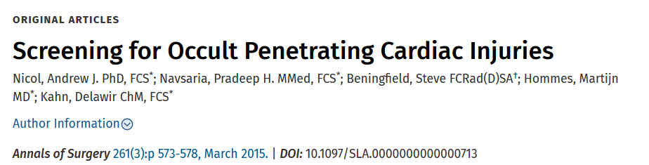
When: 2001-2009
Where: Groote Schuur Trauma Center
Who: patients presenting with penetrating chest wound and possible cardiac injury, hemodynamically stable, had no indication for emergency surgery, and had an US scan followed by subxiphoid pericardial window exploration
Results: sensitivity of US in detecting hemopericardium was 86.7%, with a positive predictive value of 77%, 18 false-negatives, 11 of those had an associated hemothorax, 6 had pneumopericardium
Conclusion: 2 main factors that limit the screening are the presence of a hemothorax and air in the pericardial sac

Slide 12
Tamponade
Muffled heart sounds
Pulsus Paradoxus
Tension Pneumothorax
Unilateral absent breath sounds
Hemorrhagic Shock
Equal breath sounds
JVD
Low BP

Slide 13
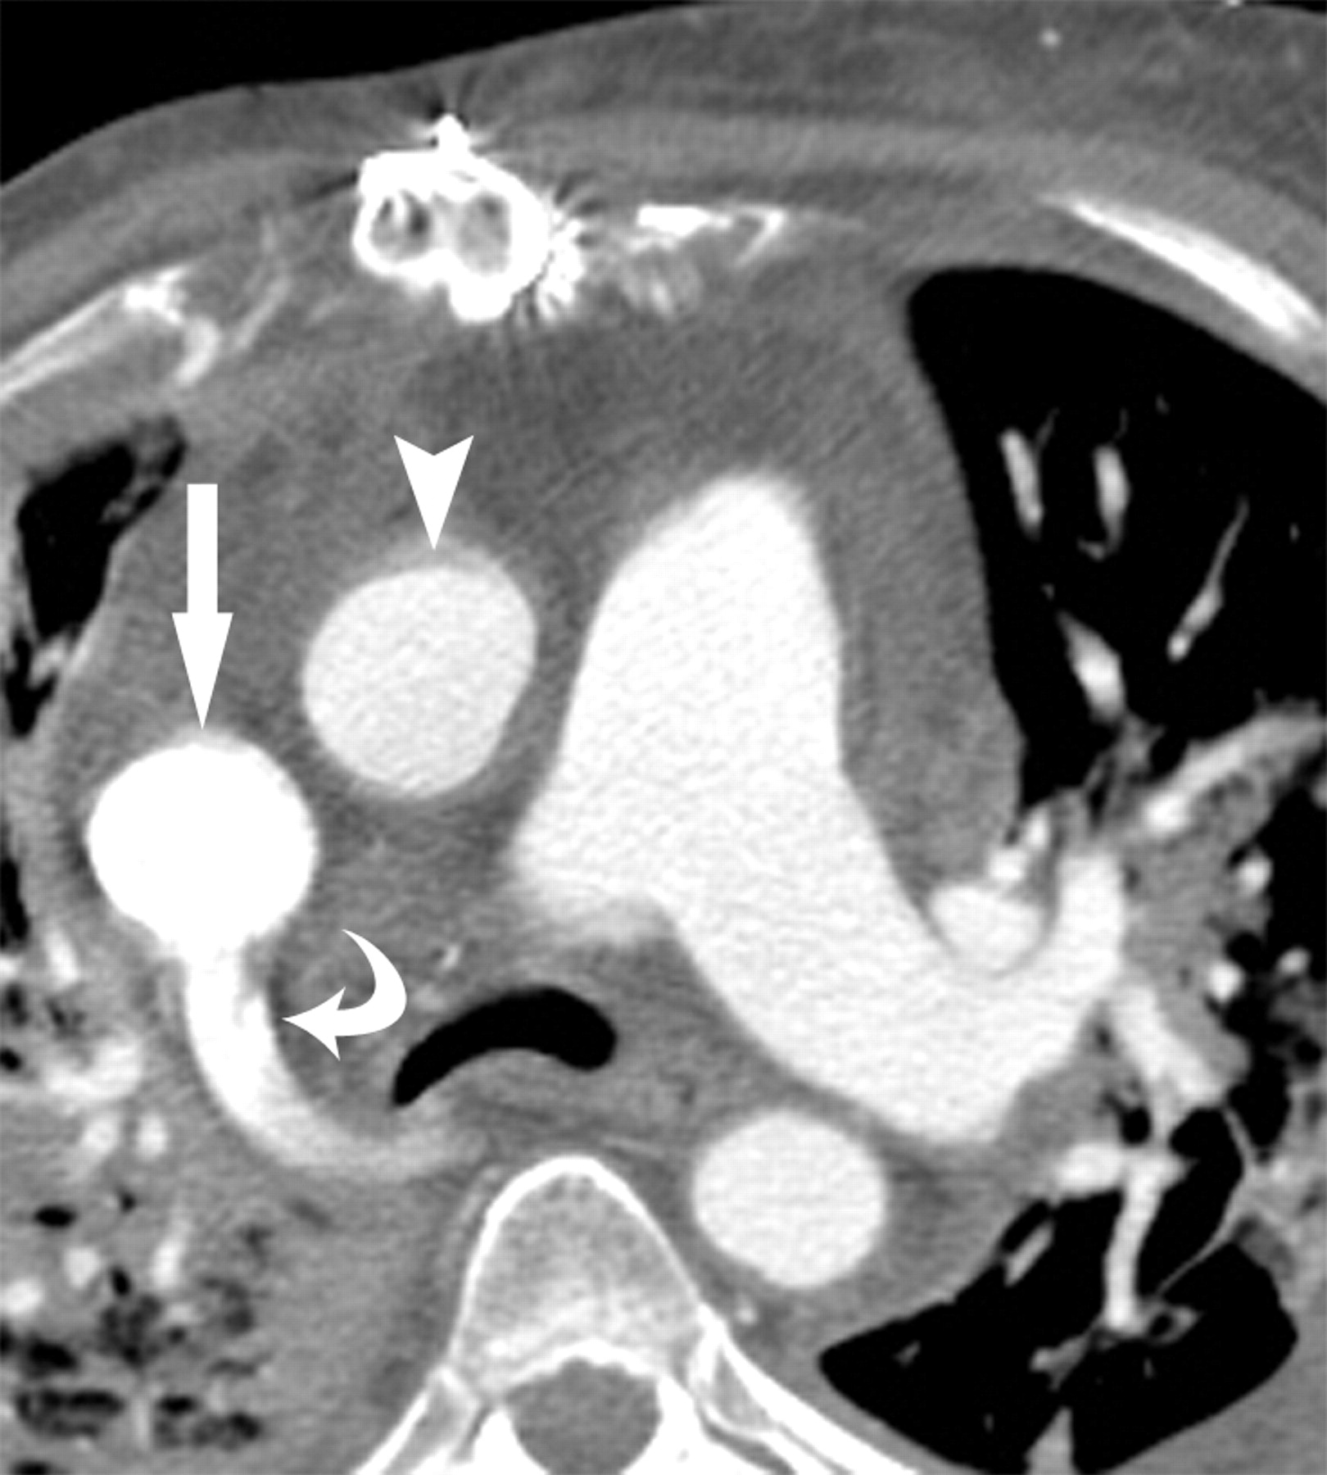
Are CT scans useful?
Do not use in patients with a cardiac tamponade
If used for patients for other reasons, sensitive modality to detect pericardial effusion
Notes:
Axial contrast-enhanced CT image obtained inferior to the aortic arch shows an abnormally dilated superior vena cava (straight arrow) with a diameter similar to that of the adjacent aorta (arrowhead). There is also reflux of contrast material within the azygos vein (curved arrow).

Slide 14
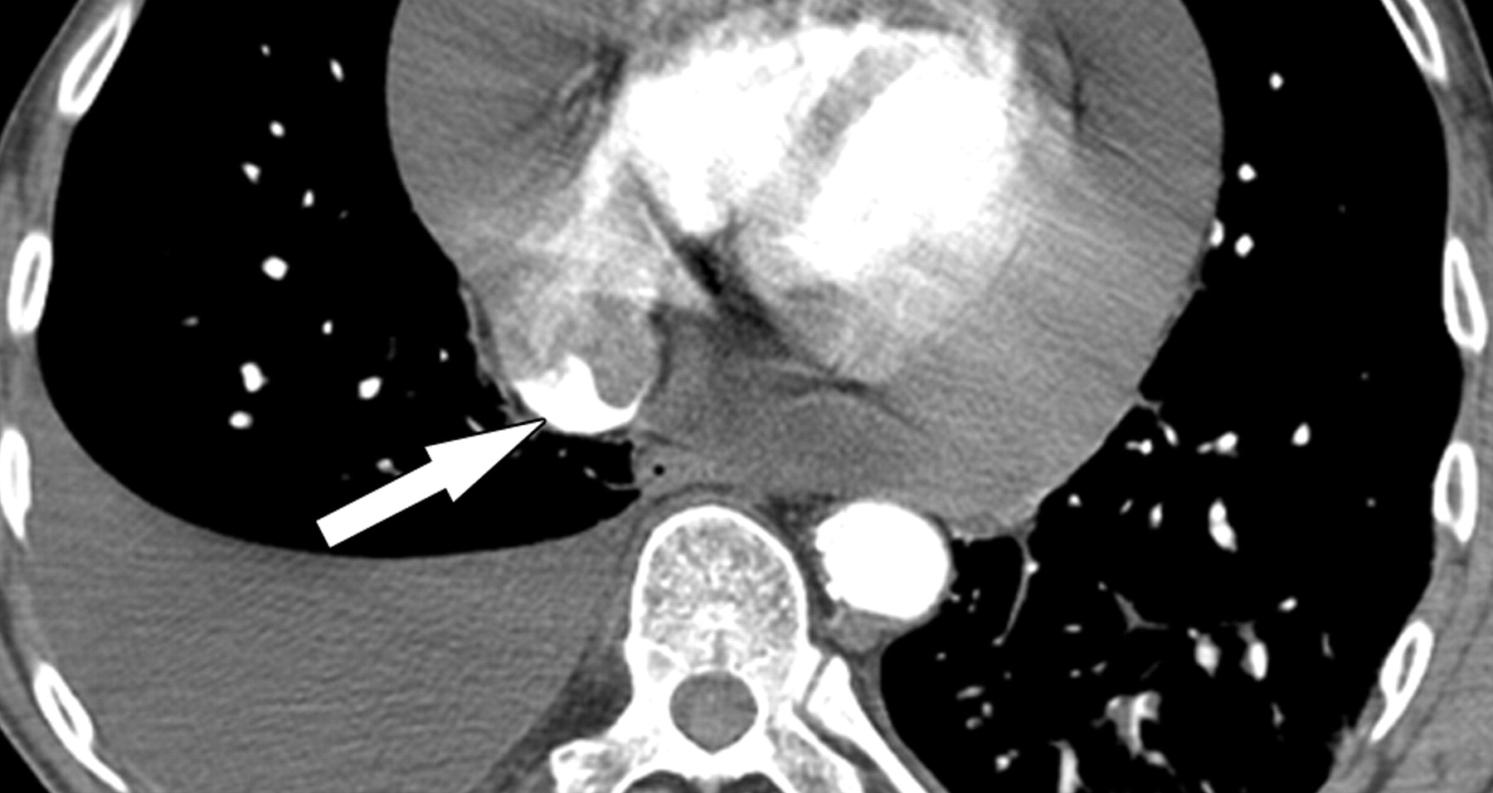
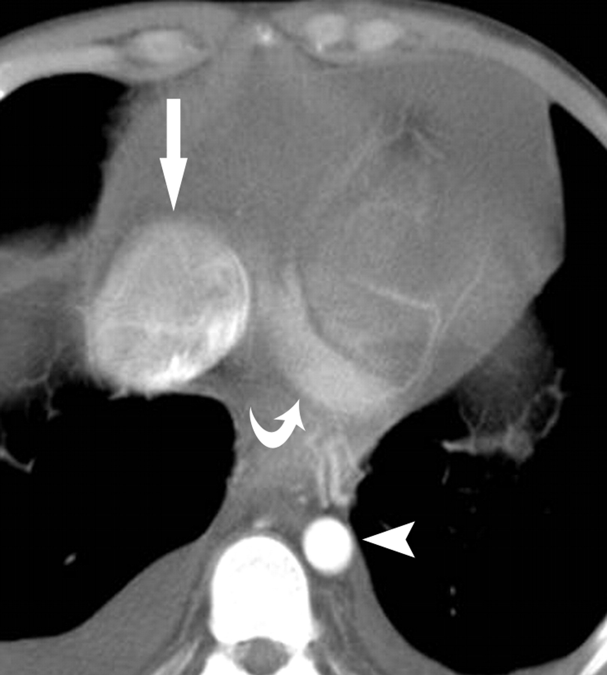
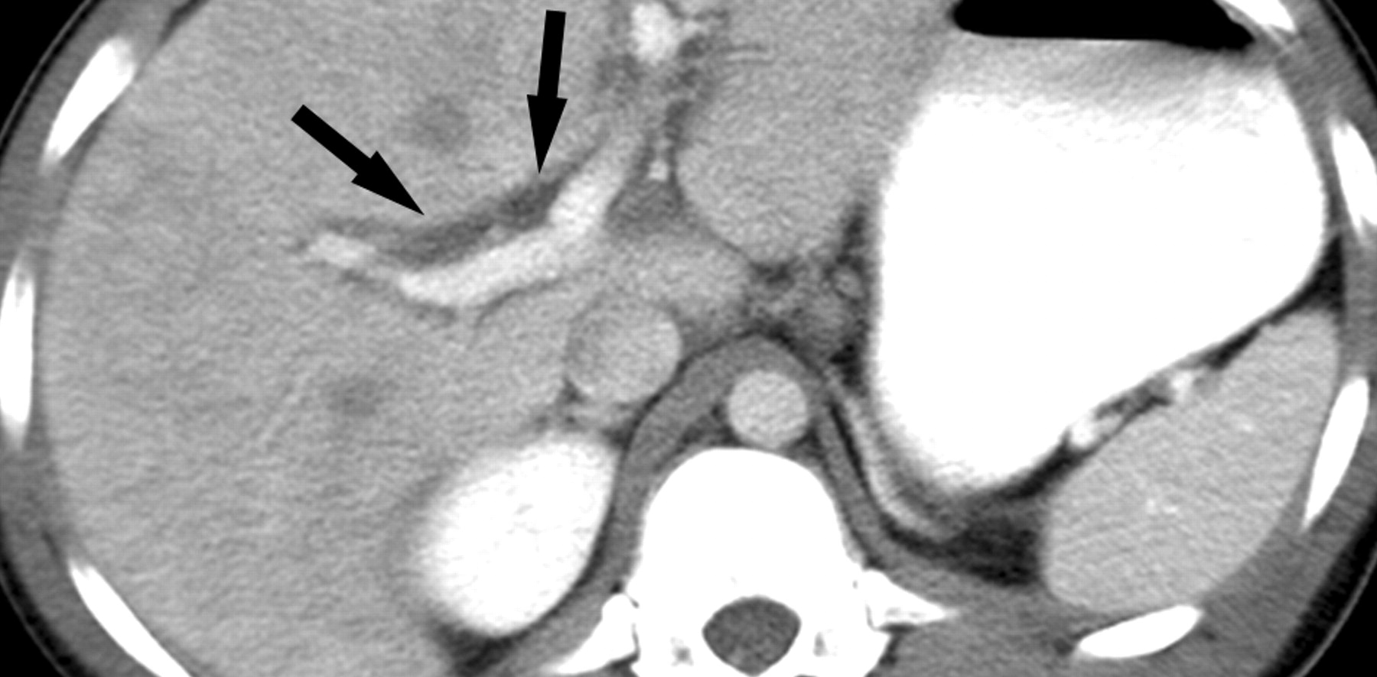
Notes:
Axial CT image shows a large pericardial effusion with a compressed small heart and reflux of contrast material into the IVC (arrow). A moderate-sized right pleural effusion and very small left pleural effusion are also seen. The patient had clinical and hemodynamic findings consistent with pericardial tamponade.
Contrast-enhanced CT image of the upper abdomen shows periportal fluid (arrows) due to distended periportal lymphatic vessels.
Contrast-enhanced CT image of the chest shows an abnormally dilated IVC (straight arrow) with a diameter greater than twice that of the adjacent abdominal aorta (arrowhead). The coronary sinus (curved arrow) also appears prominent.

Slide 15
AAST Injury Spectrum
Grade I
Minor EKG changes: non-specific ST or T wave changes, PACs, PVCs, sinus tachycardia
Grade II
Grade III
Multifocal ventricular contractions
Blunt valve or coronary artery involvement with cardiac failure
Heart block or ischemic changes without cardiac failure
Septal rupture, pulmonary or tricuspid incompetence, papillary muscle dysfunction, or distal coronary artery occlusion without cardiac failure
Blunt pericardial laceration with cardiac herniation
Grade IV
Aortic or mitral incompetence
Right ventricle, right or left atrium involvement
Grade V
Proximal coronary artery occlusion
Left ventricular perforation
Grade VI
Blunt avulsion of the heart

Slide 16
EAST Guidelines
Level 1
Level 2
Level 3
Admission EKG in all patients with concern for BCI
Continuous cardiac monitoring for 24-48 hours only if EKG abnormal (compare to prior EKG)
EKG and troponin normal, BCI ruled out
If unstable or persistent arrythmia, obtain TTE/TEE
Sternal fracture alone does not warrant monitoring
CK levels, nuclear medicine not useful
Elderly patients with cardiac disease, unstable patients, patients with abnormal admission EKG can undergo surgery if monitored
Troponin measured routinely and monitored serially if elevated
MRI or CT to differentiate between AMI and BCI in trauma patients to see if anticoagulation or catheterization required
Notes:
Establishing the Recommendations
Level 1
The recommendation is convincingly justifiable based on the available scientific information alone. This recommendation is usually based on Class I data; however, strong Class II evidence may form the basis for a Level 1 recommendation, especially if the issue does not lend itself to testing in a randomized format. Conversely, low-quality or contradictory Class I data may not be able to support a Level 1 recommendation.
Level 2
The recommendation is reasonably justifiable by available scientific evidence and strongly supported by expert opinion. This recommendation is usually supported by Class II data or a preponderance of Class III evidence.
Level 3
The recommendation is supported by available data, but adequate scientific evidence is lacking. This recommendation is generally supported by Class III data. This type of recommendation is useful for educational purposes and in guiding future clinical research.

Slide 17
Management
Non-operative
Optimize cardiac function if dysrhythmia or new heart failure
Monitoring without surgical or medical intervention if stable without structural injury
Surgical
For patients with structural cardiac abnormalities
Cardiac rupture: median sternotomy for repair
Clamshell thoracotomy for trauma resuscitation
Pericardial decompression

Slide 18
Pericardiocentesis
Landmarks
  Xiphoid process
  Left shoulder
Approach
  Subxiphoid: angle between xiphoid process and the left costal margin
  Parasternal: adjacent to sternum, 4th or 5th intercostal space left of sternum
  Apical: 1 cm outside point of maximal impulse within intercostal space
Technique
  45 degrees starting from left of xiphoid aiming to left shoulder
  Insert needle till fluid aspirated, cardiac pulsation felt or EKG change noted
  Aspirate should not form clot; if clots concern for intracardiac aspiration or cardiac puncture
  Negative aspirate not diagnostic and not definitive treatment

Slide 19
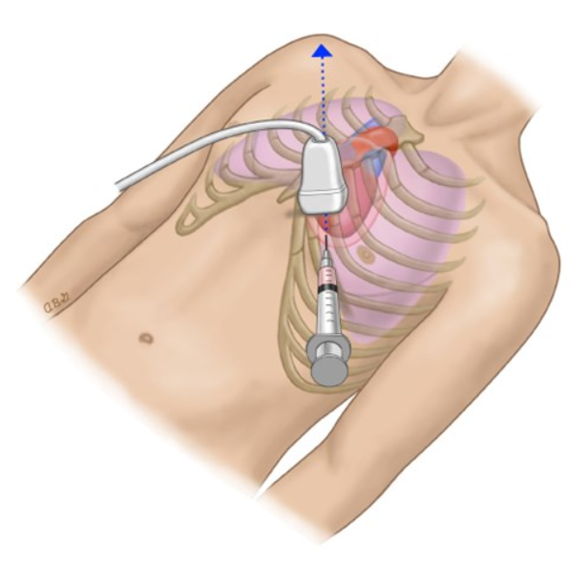
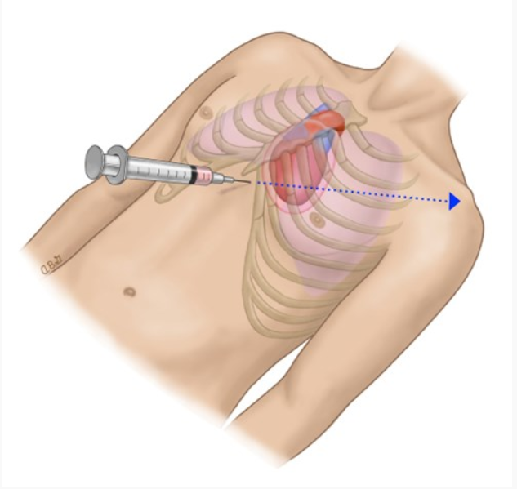
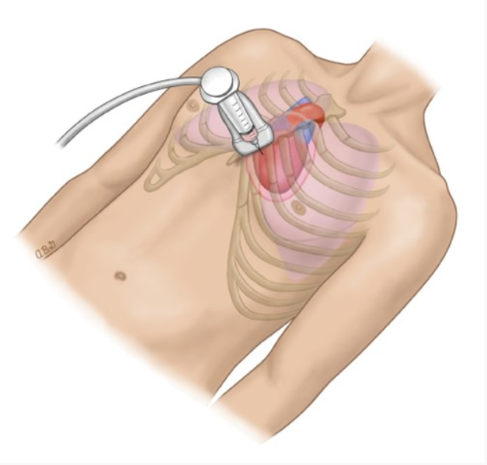
https://www.surgicalcore.org/videoplayer/510000172

Slide 20
References
Clancy, Keith MD; Velopulos, Catherine MD; Bilaniuk, Jaroslaw W. MD; Collier, Bryan DO; Crowley, William MD; Kurek, Stanley DO; Lui, Felix MD; Nayduch, Donna RN; Sangosanya, Ayodele MD; Tucker, Brian DO; Haut, Elliott R. MD. Screening for blunt cardiac injury: An Eastern Association for the Surgery of Trauma practice management guideline. Journal of Trauma and Acute Care Surgery 73(5):p S301-S306, November 2012. | DOI: 10.1097/TA.0b013e318270193a
Schultz JM, Trunkey DD. Blunt cardiac injury. Crit Care Clin. 2004; 20(1):57-70.
Mattox KL, Flint LM, Carrico CJ et al. Blunt Cardiac Injury. J Trauma 1992; 33:649-650
Roy-Shapira A, Levi I, Khoda J. Sternal Fractures: a red flag or a red herring? J Trauma 1994; 37:59-61
Pasquale MD et al. Practice Management Guidelines for Screening of Blunt Cardiac Injury. Eastern Association for the Surgery of Trauma 1998
Asensio J A et al. Trauma to the Heart in Trauma, 6th edition, Feliciano DV, Mattox KL, Moore EE, Macgraw Hill, New York 2008
Nicol AJ, Navsaria PH, Beningfield S, Hommes M, Kahn D. Screening for occult penetrating cardiac injuries. Ann Surg. 2015;261(3):573-578. doi:10.1097/SLA.0000000000000713
Restrepo CS, Lemos DF, Lemos JA, et al. Imaging findings in cardiac tamponade with emphasis on CT. Radiographics. 2007;27(6):1595-1610. doi:10.1148/rg.276065002
SCORE Module Cardiac Injury, Jasmina Ehab, MD, Sneha Bhat, MD
https://handbook.bcehs.ca/clinical-practice-guidelines/pr-clinical-procedure-guide/pr44-pericardiocentesis/

Slide 21

Questions

