Slide 1

Talking with Parents & Guardians About Vaccines
Presented by: <Name>
Date: 00/00/00
Notes:
Welcome! Thank you for joining us today. As an educator, we know that you receive many questions from parents and guardians about a variety of topics. Since the COVID-19 pandemic impacted our community and the world, one of the topics educators are often asked about are vaccines. This presentation is designed to share useful strategies you can use when speaking with parents and guardians about vaccines. Since you are a trusted resource for families in our community, you have the power to positively influence the health and well-being of others.

Slide 2

Your Presenter
<Your full name here>
<Your title here>
<Email or additional info here>
Notes:
[use for 1 presenter, host or contact]
[Introduce yourself]
Speaker recommendation: You can add your headshot onto this slide by doing the following:
1) Click the “Insert” button on the toolbox above.
2) Then, click the “Pictures” button and select “This Device.”
3) A pop-up box with access to the folders on your computer will open. Look for the image you’d like to add.
4) Once you select the image, it should come up on the slide. Use your mouse to move and place the image over the “HEADSHOT HERE” place holder. That’s it!

Slide 3
Your presenters
<Your full name here>
<Your title here>
<Email or additional info here>
<Your full name here>
<Your title here>
<Email or additional info here>
Notes:
[use for 2 presenters, hosts or contacts]
[Introduce yourself and your co-presenter]
Speaker recommendation: You can add your headshots onto this slide by doing the following:
1) Click the “Insert” button on the toolbox above.
2) Then, click the “Pictures” button and select “This Device.”
3) A pop-up box with access to the folders on your computer will open. Look for the image you’d like to add.
4) Once you select the image, it should come up on the slide. Use your mouse to move and place the image over the “HEADSHOT HERE” place holder. That’s it!

Slide 4

Meet the team
<First and last name>
<First and last name>
<First and last name>
<title>
<email>
<title>
<email>
<title>
<email>
Notes:
[use for 3 presenters, hosts or contact]
[Introduce yourself and your co-presenters]
Speaker recommendation: You can add your headshots onto this slide by doing the following:
1) Click the “Insert” button on the toolbox above.
2U Then, click the “Pictures” button and select “This Device.”
3) A pop-up box with access to the folders on your computer will open. Look for the image you’d like to add.
4) Once you select the image, it should come up on the slide. Use your mouse to move and place the image over the “HEADSHOT HERE” place holder. That’s it!

Slide 5

Agenda
Influence educators have
Vaccine basics
Conversational tips
Accurate sources of information
Responding to FAQs
When to refer to others
Notes:
During this presentation, we will discuss your ability as an educator to positively influence the health of your students and their families. We will then go through a brief overview of vaccine basics. We will share conversational tips on how to talk to parents and guardians about vaccines. Then, we will highlight accurate sources of information you can refer others to. We will discuss frequently asked questions parents and guardians have about vaccines. Lastly, we will discuss when to refer questions to others.

Slide 6

Educators are Influencers
Notes:
Before we discuss some basic information about vaccines, let’s briefly talk about what we mean when we say, “educators are influencers.”

Slide 7
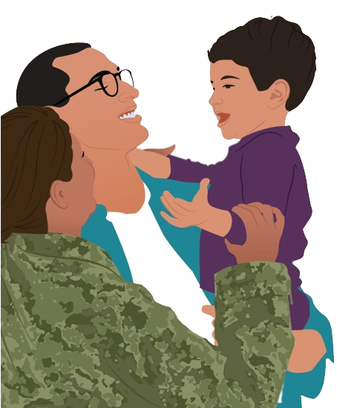

Trusted Relationships
As an educator, you:
Establish relationships with families
Interact with families daily
Are a trusted source of information
Notes:
Unlike doctors and other health providers, as an educator, you interact with parents, guardians, and children daily throughout the school year. These relationships make you a trusted source of information. So, when parents and guardians ask questions about vaccines, it’s important to be prepared, because you have the unique opportunity to promote healthy behaviors among your students’ parents and their guardians. Ultimately, the information you share with students and their parents and guardians can impact the whole community.

Slide 8
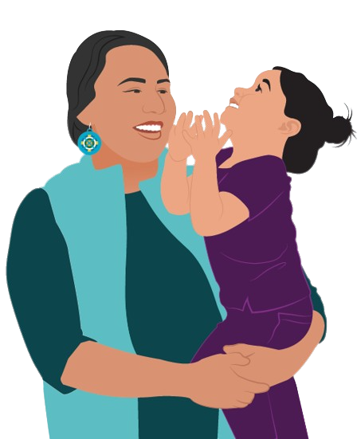
Trusted Relationships
As an educator, you MAY BE A LINK TO:
Good sources of community health information
Available local health services
Teachings for keeping children healthy
Notes:
You have an important role in our community. Oftentimes, your role as an educator goes beyond the classroom, and community members see you as leaders and may turn to you for advice. As such, you may be a link to good sources of community health information, available local health services, and teachings for keeping children healthy.

Slide 9
Vaccine
Basics
Notes:
But what if you don’t know a ton about how vaccines work or why they are important? Next, we will share some vaccine basics to help you respond to common questions you may be asked about vaccines.

Slide 10

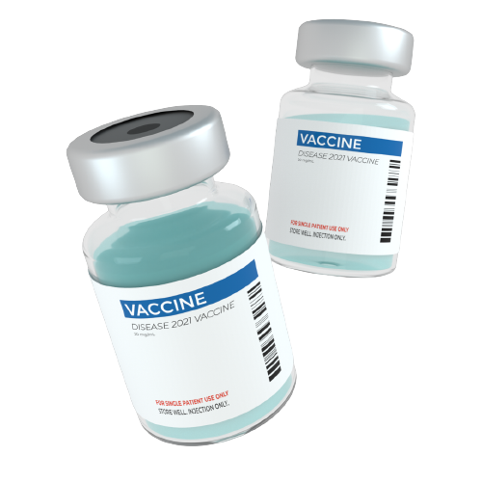
Vaccine Basics
How Vaccines work
We all have warrior cells (antibodies) that stand guard and attack diseases
Vaccines help our warrior cells see and fight disease
Vaccines make it less likely that we’ll get sick
Vaccines reduce the seriousness of illness if you do get sick
Notes:
Within our bodies, each of us has warrior cells (antibodies) that stand guard and attack diseases. Vaccines help our warrior cells see and fight disease. For example, when we get the flu shot, the ingredients in the shot tell our warrior cells how to recognize and fight the flu. That is why if you get a flu shot, you are less likely to get sick with the flu. Getting vaccinated can also reduce the seriousness of illness if you happen to get sick.

Slide 11

Vaccine Basics
Vaccine ingredients
Vaccines contain some natural ingredients that are common in the foods we eat, including:
  Sugars
  Proteins
Vaccine ingredients teach your body how to protect itself
Notes:
Vaccines contain some natural ingredients that are common in the foods we eat, including sugars and proteins. Vaccine ingredients teach your body how to protect itself by calling upon your body’s defense systems. For example, some vaccine ingredients make your warrior cells stronger and better able to respond to an attack.

Slide 12
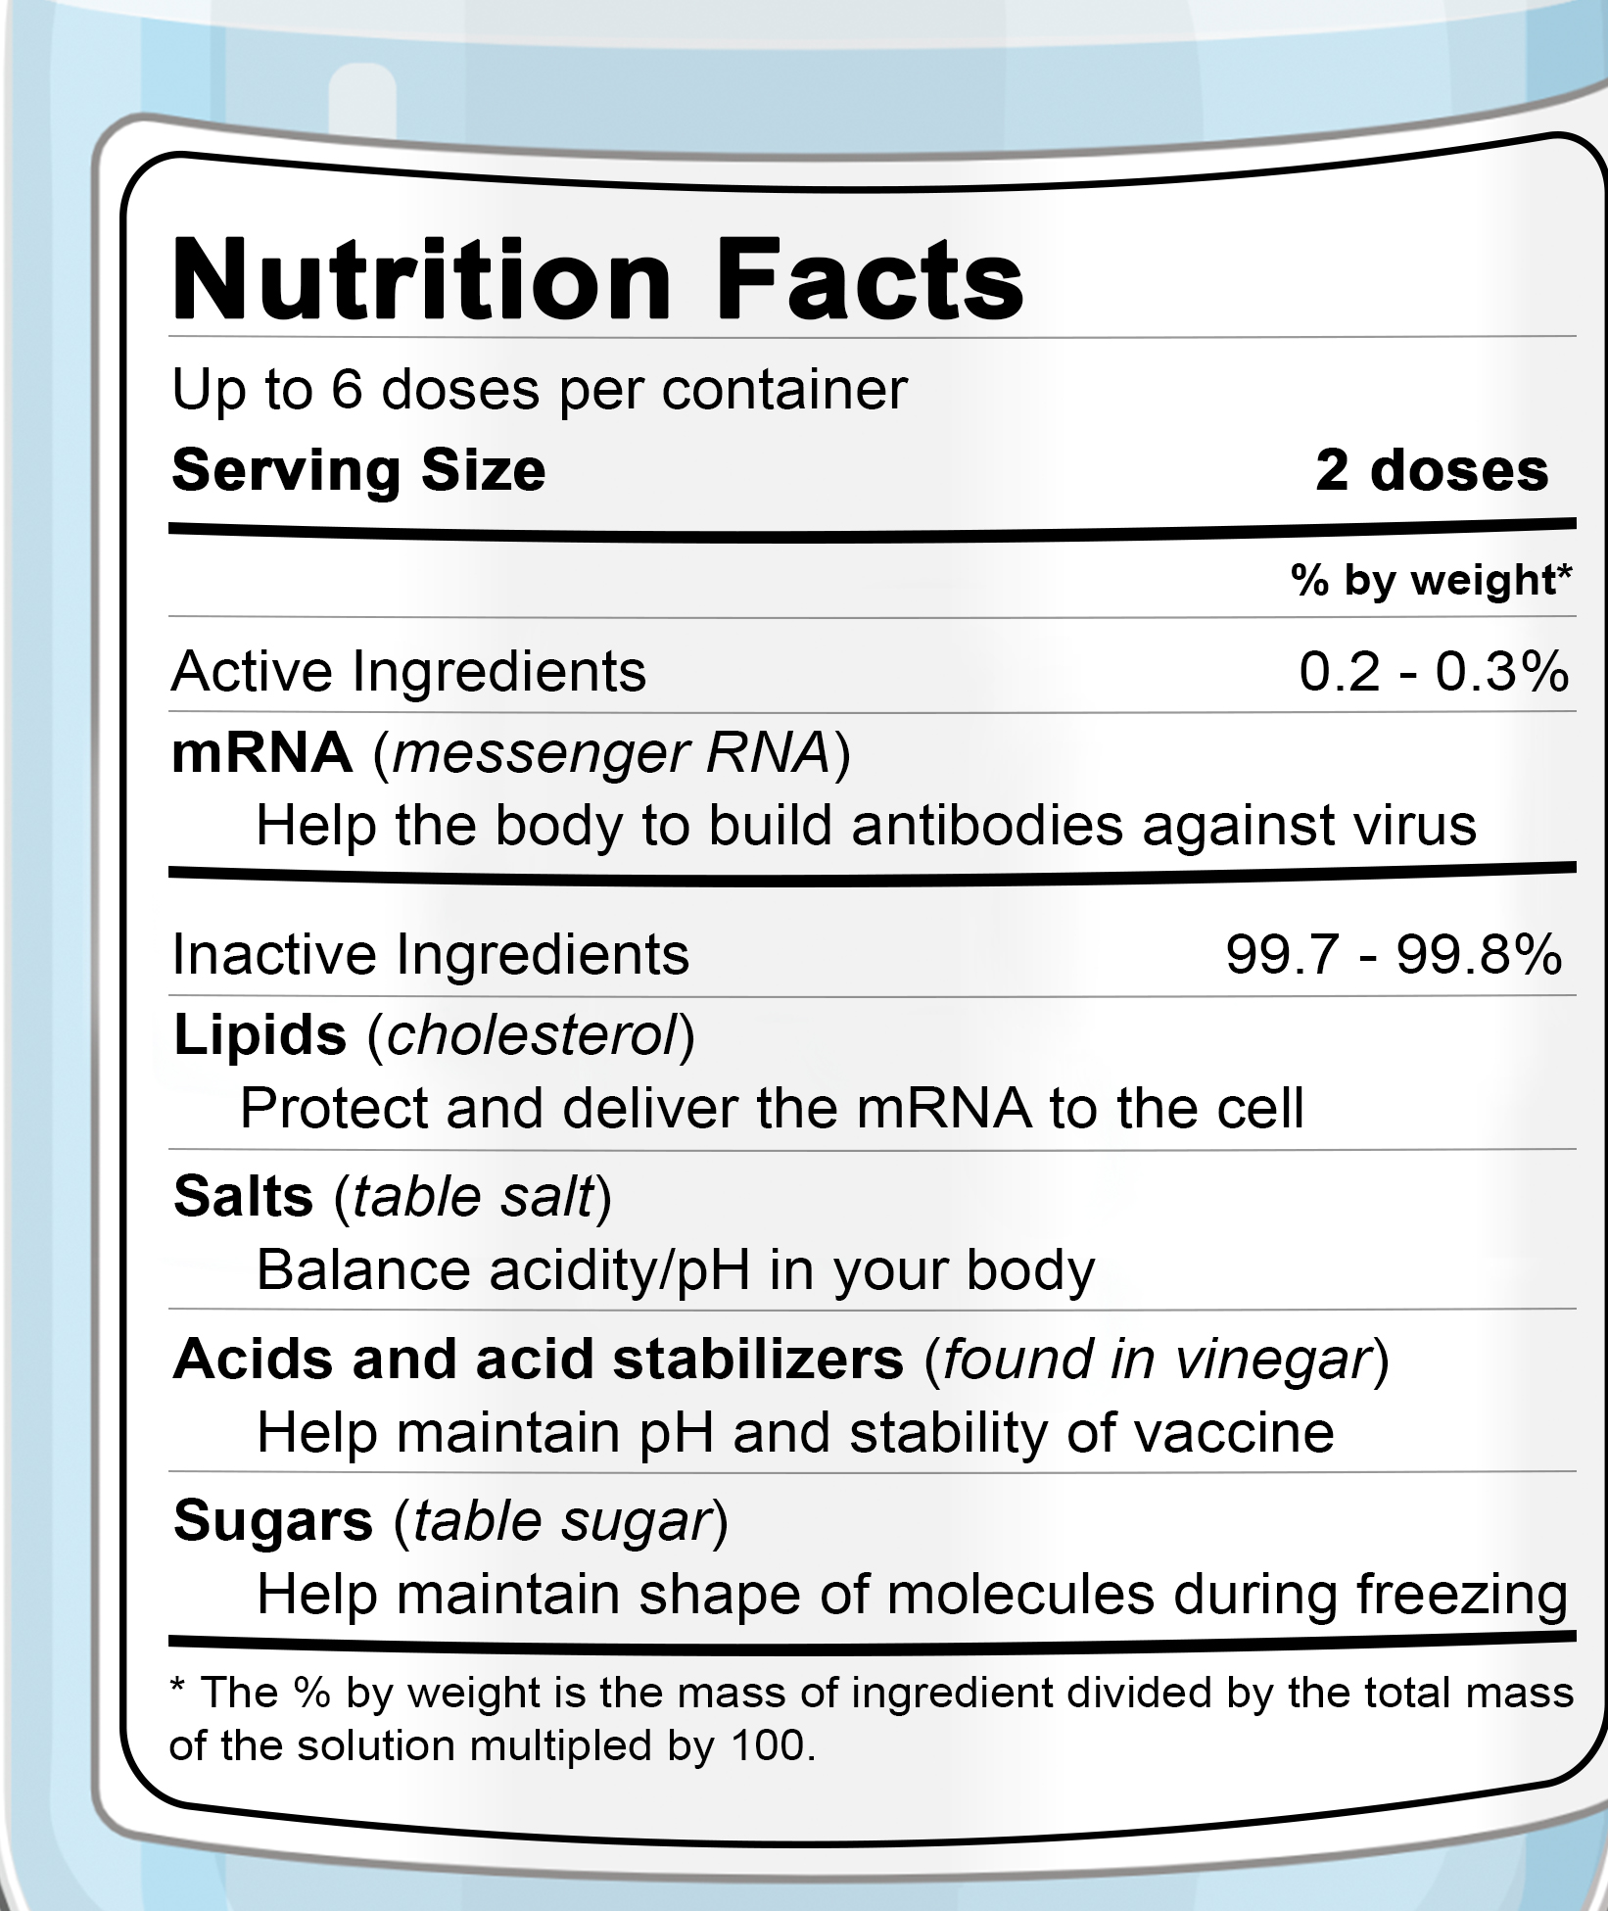
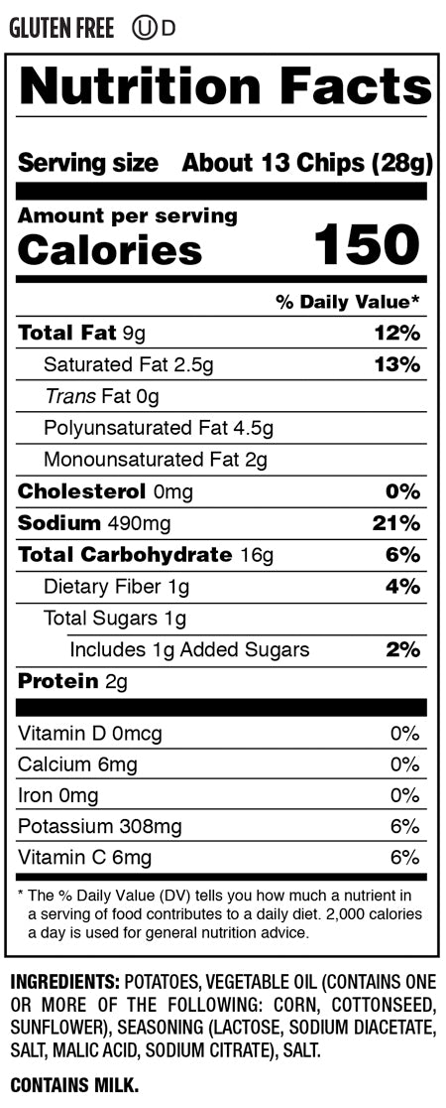
Vaccine Basics
mRNA Vaccine
Salt & Vinegar Chips
Notes:
For example, the label on the left shows the ingredients in an mRNA vaccine, like the COVID-19 vaccine. The food label on the right shows what is in salt and vinegar chips. In looking at these two, we can see that the ingredients in a vaccine and a bag of chips are pretty similar, as they both contain fats, salt, acid, stabilizers, and sugars.

Slide 13

Vaccine Basics
Vaccine Testing
Each vaccine goes through many rounds of safety tests
  “Is the vaccine safe?”
  “How does the body react to it?”
Testing helps us learn about side effects
Notes:
In addition to having ingredients that are common in the foods we eat, each vaccine goes through many rounds of safety tests, which may take years and thousands of volunteers. During vaccine testing, important questions are considered, like “Is the vaccine safe?” and “How does the body react to it?” This testing process also helps us learn about any possible vaccine side effects.

Slide 14

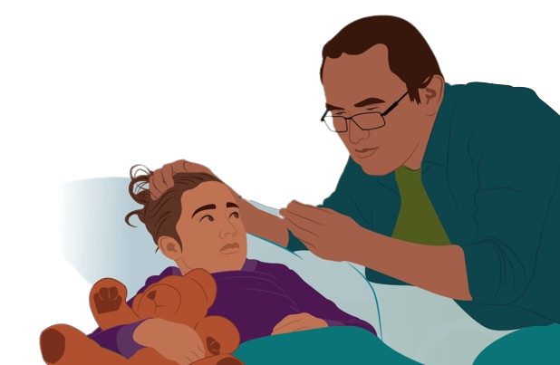
Vaccine Basics
Vaccine Side effects
Most vaccines have mild side effects that go away in a few days, like:
Mild vaccine side effects do not mean you are “sick with the disease”
  Soreness
  Fever
  Headache
  Muscle aches
Notes:
Most vaccines have mild side effects that go away in a few days, like soreness, fever, headache, and muscle aches. Mild side effects are a good sign that your warrior cells are preparing to recognize and fight disease.
Sometimes people make the mistake of thinking that having mild vaccine side effects means that they are “getting sick with the disease.” This is not true. Vaccines do not make you sick with the disease you are getting vaccinated against.

Slide 15
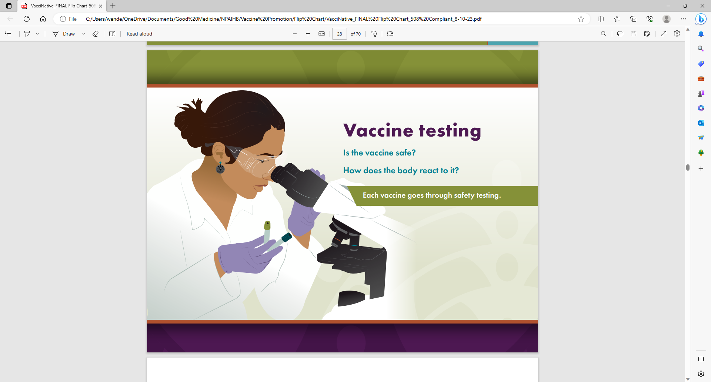
Vaccine Basics
Vaccine Approval
Vaccines are approved after:
  They are found to be safe and effective
  Common side effects are shown to be mild
Vaccines are monitored even after they are approved
Notes:
Vaccines are only approved for public use after they go through thousands of hours of testing and are found to be safe and effective. Any common side effects must be mild.
After approval, some vaccines may have rare but potentially serious side effects. That is why we continue to monitor vaccines even after they are approved.

Slide 16

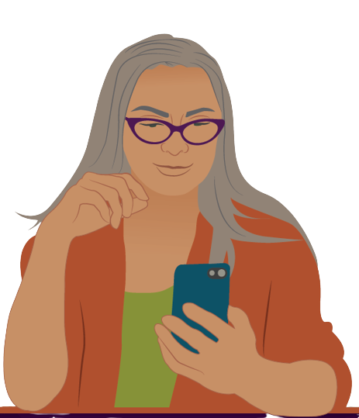
Vaccine Basics
Vaccine monitoring
Everyday people who got the vaccine can share how it made them feel
Monitoring helps to quickly identify any vaccine risks and take action
www.VAERS.hhs.gov
Notes:
After a vaccine is approved, everyday people who got the vaccine can share how it made them feel. This monitoring helps to quickly identify any vaccine risks and take action.
The Vaccine Adverse Event Reporting System, also known was VAERS, monitors the safety of vaccines. If you experience anything beyond common side effects from a vaccine, you should report your experience to www.VAERS.hhs.gov.

Slide 17


Vaccine Basics
Why vaccines are important
During pregnancy and breast/chestfeeding, our warrior cells pass on knowledge to the unborn baby
This protection starts to fade weeks to months after birth
Notes:
When we get a vaccine during pregnancy or when breast/chestfeeding, our warrior cells pass knowledge about how to recognize and fight certain illnesses to the baby. However, this protection starts to fade weeks and months after birth.

Slide 18
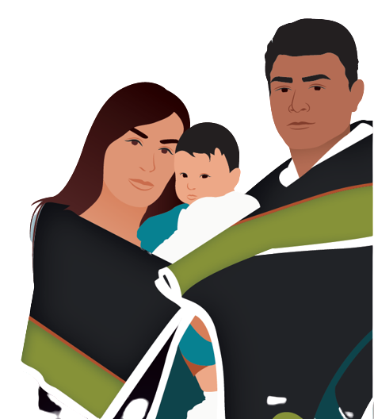
Vaccine Basics
Why vaccines are important
That’s why vaccinating children according to the recommended vaccine schedule is important
This helps ensure children are protected before they come in contact with potentially life-threatening diseases
Notes:
That's why vaccinating children according to the recommended vaccine schedule created by the Centers for Disease Control and Prevention (CDC) is important. Doing so helps ensure that children are protected before they come in contact with potentially life-threatening diseases.

Slide 19
Conversational tips
Notes:
We now understand the basics of vaccines. But, as an educator, how can you talk to parents about vaccines? You might feel nervous about having this conversation or believe that you don’t have enough knowledge. But don’t worry! We’re going to provide some conversational tips you can use when talking to parents and guardians about vaccines.

Slide 20

Conversation tips
When talking with a parent or guardian who has questions or concerns about vaccines:
Show empathy and understanding
Ask for permission to share information
Respond with facts about vaccination
Share accurate sources of information
Share your reasons for getting vaccinated
Help them take the next step
Notes:
As a trusted source of information, you can play a role in parents’ and guardians’ decision to vaccinate their children. When talking to parents or guardians who have questions or concerns about vaccines, show empathy and understanding. Then, ask for permission to share information. Respond with facts about vaccination and share your reasons for getting vaccinated. If you have a child, share your reasons for getting your child vaccinated. Lastly, help them take the next step to vaccinate their child.

Slide 21

Show empathy and understanding
Listen without judgement
  Be calm and open
  Use positive body language
  Be respectful
  Don’t interrupt
Notes:
You can show empathy and understanding by listening to parents and guardians without judgment. When they state their concerns or support their stance with inaccurate information, actively listen to them. Make sure you’re calm, open, and ready to listen. Throughout your conversation, use positive body language. This means not rolling your eyes or crossing your arms. Even if you disagree with them or have different thoughts or feelings, treat their thoughts and feelings with respect. Don’t interrupt them. Let the other person finish talking before you talk.

Slide 22

Show empathy and understanding
Acknowledge their emotions, so they know they’ve been heard
You can say:
“It sounds like your concerns about vaccines, especially for your child, are causing stress. I completely understand.”
“It’s understandable you feel that way.”
Notes:
Acknowledging their emotions so they know they’ve been heard goes a long way. You can say phrases like: “It sounds like your concerns about vaccines, especially for your child, are causing stress. I completely understand” and “It’s understandable you feel that way.”

Slide 23

What can you say to show someone empathy even if you may not agree with what they are saying?
Notes:
What can you say to show someone empathy even if you may not agree with what they are saying?
Speaker recommendation: A word cloud can be imbedded in the slides. Participants’ responses will appear on the screen as they submit them. You can create a word cloud using PollEverywhere.com/Word-Cloud.

Slide 24

Ask For Permission to Share Information
Once you understand their questions or concerns, ask if you can share information about vaccines
If they say “no” | If they say “yes”
Do not push. Respect their decision and let them know you are there for them if they want to discuss vaccines in the future. | Share accurate sources of information.
Notes:
Once you understand their questions or concerns, ask if you can share information about vaccines. If they say “no,” do not push. Respect their decision and let them know you are there for them in the future if they want to discuss vaccines. If they say “yes,” share accurate sources of information.

Slide 25

Respond with facts
Get accurate facts about vaccination:
VacciNative
www.IndianCountryECHO.org/VacciNative
Native Boost
www.NPAIHB.org/Native-Boost
CDC
Tribal Epi Centers
Tribal clinics
Health providers
Local health dept
Notes:
Encourage them to talk to their health providers about their questions and concerns. Also, consider sharing these online resources. Two sources of Native-specific vaccine information are VacciNative and Native Boost. At the end of this presentation, we’ll have QR codes you can scan to access these and other sources of accurate information.

Slide 26

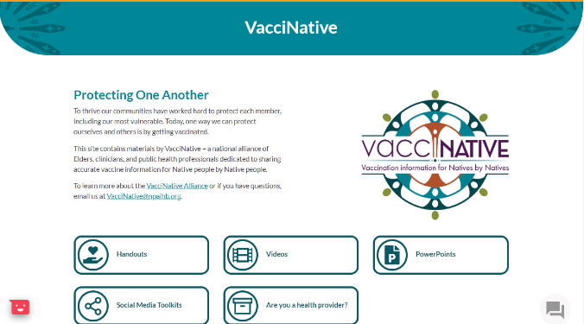
Share accurate sources of information
NPAIHB.org/Native-Boost
IndianCountryECHO.org/VacciNative
Notes:
Both Native Boost and VacciNative have webpages that contain materials designed for American Indian and Alaska Native people. These materials include: (move to next slide).

Slide 27


Share accurate sources of information
NPAIHB.org/Native-Boost
Notes:
guides and booklets,

Slide 28
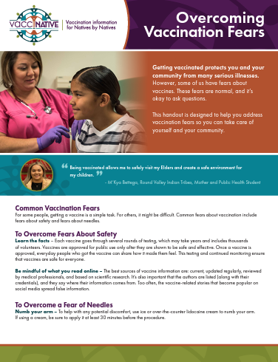
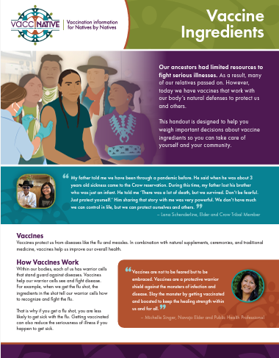
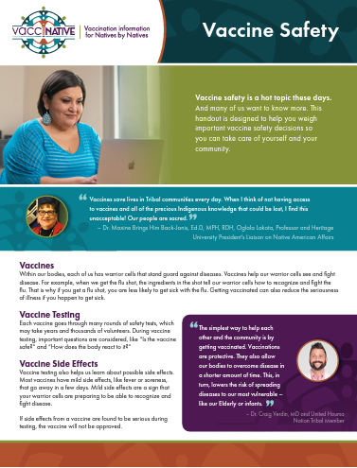
Share accurate sources of information
IndianCountryECHO.org/VacciNative
Notes:
handouts,

Slide 29
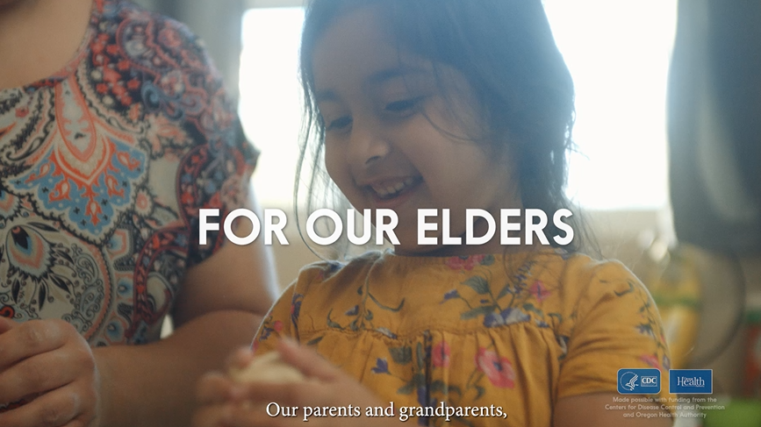
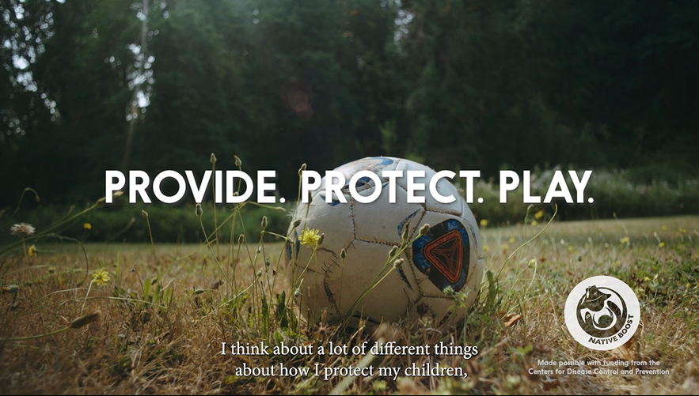
Share accurate sources of information
NPAIHB.org/Native-Boost
Notes:
and videos…

Slide 30
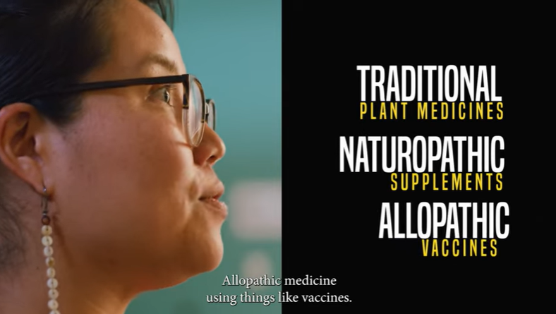
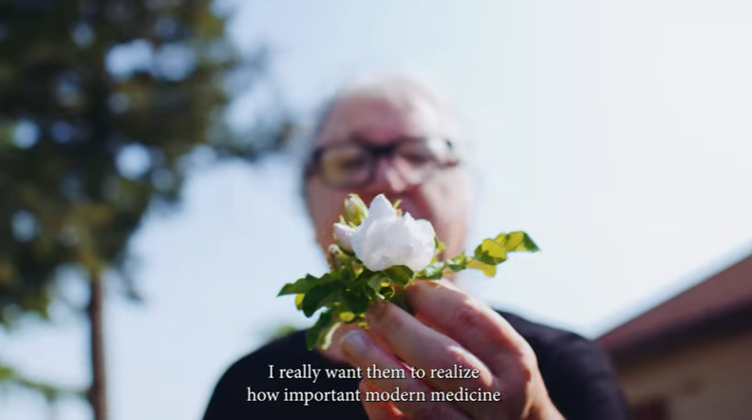
Share accurate sources of information
IndianCountryECHO.org/VacciNative

Slide 31
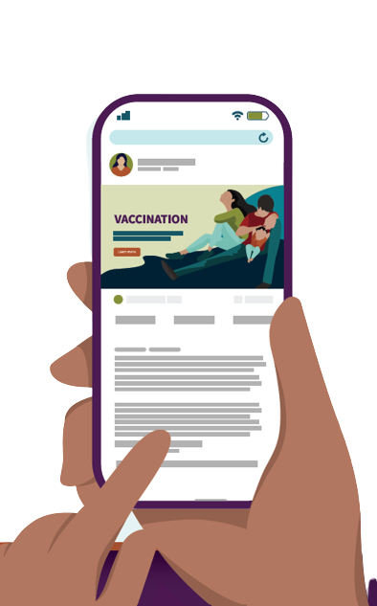
Share accurate sources of information
Accurate sources of information:
  Local or Tribal health department
  Health providers
  Indian Health Service
  The Centers for Disease Control and Prevention
Notes:
Other accurate sources of information include your local or Tribal health department, health providers, like doctors, nurses, and pharmacists, the Indian Health Service, and the Centers for Disease Control and Prevention.

Slide 32
Share your reasons for getting vaccinated
Use phrases like…
“By vaccinating them, I feel secure they are protected against many diseases my ancestors did not survive.”
“I get my child vaccinated because I want to protect them and future generations.”
“Protecting them means protecting our culture and community.”
Notes:
After offering sources of accurate information, consider sharing your reasons for staying up to date on your vaccines and your child’s vaccines. This lets parents and guardians know that you are not asking something of them that you would not do yourself. It can also help them find their reasons to get their child vaccinated. Try using phrases like “I get my child vaccinated because I want to protect them and future generations.” “By vaccinating them, I feel secure that they are protected against many diseases my ancestors did not survive.” and “Protecting them means protecting our culture and community.”

Slide 33
Share your reasons for getting vaccinated
Use phrases like…
“I have no worry that I will get sick or make others sick, especially my grandparents and friends who don’t have strong immune systems.”
“I can comfortably spend time with friends and family because I’m vaccinated.”
Notes:
If you don’t have a child but get vaccinated yourself, you can say “I can comfortably spend time with friends and family because I’m vaccinated.” And “I have no worry that that I will get sick or make others sick, especially my grandparents and friends who don’t have strong immune systems.”

Slide 34
Help them take the next step
Once a parent or guardian decides to vaccinate their child, help them take the next step by:
Offering a list of local places that provide vaccines to infants and children
Directing them to vaccines.gov, a site where they can search for nearby vaccine providers
Encouraging them to talk to their health provider
Notes:
Once a parent or guardian decides to vaccinate their child, help them take the next step. This may include offering a list of local places that provide vaccines to infants and children, directing them to vaccines.gov, a site where they can search for nearby vaccine providers, and encouraging them to talk to their health provider.

Slide 35
Responding to frequently asked questions
Notes:
Now that we’ve discussed some conversational tips you can use, let’s learn about frequently asked questions parents and guardians have about vaccines and how you can respond to them.

Slide 36
Responding to FAQs
Why are vaccines so important?
You can say…
Vaccines protect your child from serious, and sometimes deadly, diseases
Some of these diseases are:
  Polio
  Chickenpox
  Whooping cough
Notes:
A parent or guardians might ask you “Why are vaccines so important?” When asked this, you can say: “Vaccines protect your child from serious, and sometimes deadly, diseases. Some of these diseases are: polio, chickenpox, and whooping cough.”

Slide 37
Responding to FAQs
Are these diseases very serious?
You can say…
Yes, these diseases are very serious
For ex, measles kills hundreds, sometimes thousands, of people a year
Some diseases can have lifelong health impacts
However, these diseases are vaccine-preventable
Notes:
If asked, “Are these diseases very serious?” you can say: “Yes, these diseases are very serious. For example, measles kills hundreds, sometimes thousands, of people a year. Some diseases like chicken pox, polio, and meningitis can have lifelong health impacts. However, these diseases are vaccine-preventable.”

Slide 38
Responding to FAQs
Are vaccines safe?
You can say…
Yes, vaccines are safe
There is a system in place to test vaccine safety
Millions of children have received vaccines
Serious reactions are rare
Vaccine side effects are often mild
Notes:
You might be asked “Are vaccines safe?”, to which you can say: “Yes, vaccines are safe. There is a system in place to test vaccine safety. Millions of children have received vaccines. Serious reactions are rare, and vaccine side effects are often mild.”

Slide 39
Responding to FAQs
Why are vaccines given at such a young age?
You can say…
vaccination during pregnancy and breast/chestfeeding offers protection to the baby but protection wanes during baby’s first few months
Newborns are at increased risk of infection
Vaccines at a young age help prevent serious diseases
Notes:
If a parent or guardian asks: “Why are vaccines given at such a young age?”, offer a simple explanation by saying: “Getting vaccinated during pregnancy and breast/chestfeeding offers protection to the baby. This protection wanes during the first few months of life. Newborns are at increased risk of infection. Vaccines at a young age help prevent serious diseases.”

Slide 40
Responding to FAQs
Isn’t it expensive to get all these vaccines?
You can say…
No, shots don’t have to be expensive
Contact your local health department or clinic
Reach out to the Indian Health Service Vaccines For Children (VFC) Program or to your Tribal clinic
Notes:
If asked “Isn’t it expensive to get all these vaccines?”, you can say: “No, shots don’t have to be expensive. Contact your local health department or clinic.” When they contact the local health department or clinic, they can receive more information about the cost of vaccines. Some clinics or local pharmacies, like Walgreens, offer free vaccination. Let them know this. In addition, refer them to the Indian Health Service VFC or their tribal clinic. These services can provide free vaccines to eligible kids under 18, including those who are uninsured, underinsured, Medicaid-eligible, and American Indian or Alaska Native.

Slide 41
Responding to FAQs
Why should I vaccinate my child?
You can say…
Vaccination protects your child against serious diseases
Diseases can be deadly without vaccination
Your child can participate in fun activities when vaccinated, without the worrying about serious illness
Notes:
When asked “Why should I vaccinate my child?”, you can say: “Vaccination protects your child against serious diseases. Diseases can be deadly without vaccination. Your child can participate in fun activities when vaccinated, without worrying about serious illness.”

Slide 42
Are there any other questions you’ve been asked about vaccination?
Notes:
Are there any other questions you’ve been asked about vaccination?
Speaker recommendation: A word cloud can be imbedded in the slides. Participants’ responses will appear on the screen as they submit them. You can create a word cloud using PollEverywhere.com/Word-Cloud.

Slide 43
When Asked a Question You Are Unsure Of
Notes:
You might get asked questions that you don’t know the response to. This is completely okay! Here’s what to do when you’re asked a question about vaccines that you’re not sure how to answer or you think is outside of your scope.

Slide 44

When you’re unsure
When Asked a Question You Don’t Know the answer to
You can say…
Unfortunately, I don’t have that answer for you
I highly recommend you contact your health provider
You can also talk to the school nurse
Notes:
When asked a question you don’t know the answer to, be honest and let the parent or guardian know that you don’t have the answer. You can say “Unfortunately, I don’t have that answer for you.” Then, point them in the direction of someone who definitely will have the answer for them, like their health provider, by saying “I highly recommend you contact your health provider.” and “You can also talk to nurse _________.” If they would like to be connected, help arrange the conversation.

Slide 45
Any questions?
Notes:
Does anyone have any questions about what we’ve discussed today? Was anything unclear?

Slide 46
For More Information
Notes:
Thank you for the time you’ve spent listening to this presentation. If you’d like more information about what we’ve discussed today or training on this, you can…

Slide 47


For more information
For more vaccine information
Visit
NPAIHB.org/Native-Boost
IndianCountryECHO.org/VacciNative
Notes:
visit the Native Boost and VacciNative websites by scanning their respective QR codes on the screen or by visiting their websites at www.NPAIHB.org/Native-Boost and www.IndianCountryECHO.org/VacciNative. For easy access, save these URLs in your website browser bookmarks.

Slide 48



For more information
For more vaccine information
Visit
TribalEpiCenters.org
IHS.gov
CDC.gov
Notes:
To obtain additional information about vaccines, visit the national Tribal Epidemiology Center website, the Indian Health Service website, and the Centers for Disease Control and Prevention website by scanning their respective QR codes or by entering their URLs into your search browser.

Slide 49

Thank You!
Notes:
Thank you for the time you’ve spent listening to this presentation!

Slide 50
Your Presenter
<Your full name here>
<Your title here>
<Email or additional info here>
Notes:
If you’d like a copy of this presentation or have any additional questions about what we’ve talked about today, please feel free to contact me/us via email.
Speaker recommendation: You can add your headshot onto this slide by doing the following:
1) Click the “Insert” button on the toolbox above.
2) Then, click the “Pictures” button and select “This Device.”
3) A pop-up box with access to the folders on your computer will open. Look for the image you’d like to add.
4) Once you select the image, it should come up on the slide. Use your mouse to move and place the image over the “HEADSHOT HERE” place holder. That’s it!

Slide 51


