Slide 1
ECHO Diabetes
Case Discussion
November 7, 2024
Carol Greenlee MD

Slide 2
Clinical Question
“How to assist with BG control and eating habits.”
  31-year-old female with ADHD, Autism Spectrum Disorder (ASD), Chronic Depression, Mild Intellectual Disability (ID)
    Pt struggles with impulsivity and binge eating cycles, choosing large portions.
      Verbalizes desire to lose weight and control BG, but difficulty day to day.
    Mother very supportive but struggles with how to best help.
    Issues with CGM sensor staying on….

Slide 3
Selecting Medication/Treatments for Diabetes
Efficacy (how well they lower the blood glucose)
  “Therapeutic Heterogeneity” – not everything works the same for everyone
  “Precision Medicine” – matching treatments to the individual’s genetic makeup and other characteristics
Benefits vs Risks/Harms
  Added benefits such as reducing CVD risk, preserving renal function, preventing HF, reversing fatty liver/MASLD, weight reduction
    The ADA, EASD, American College of Physicians T2D guidelines recommend choosing a medication that offers additional benefits beyond just glucose lowering over one that only reduces glucose
  Effects on co-existing conditions
    Heart failure/fluid balance (SGLT2i meds improve; TZD meds worsen)
    Osteoporosis (increased fracture risk with TZD)
    Liver disease (reduced Hepato-Cellular Carcinoma (HCC) with metformin, improved MASLD with GLP1 RA and pioglitazone and ~ SGLT2i))
    Gallbladder issues (caution with GLP1 RA meds)
    Gout (reduced by SGLT2i meds)
    Other – Autism Spectrum Disorder (ASD)
How does diabetes affect ASD
How does ASD affect diabetes
How does treatment of ASD affect diabetes
How does treatment of diabetes affect ASD

Slide 4
Autism spectrum disorders (ASD)
Autism spectrum disorders (ASD) are a group of complex neurodevelopmental disorders characterized by impairments in social interaction and communications, as well as restricted and repetitive behaviors
The etiology of ASD remains unclear
  Both genetic and environmental factors are thought to play a role
  Among diverse factors, maternal conditions during pre-pregnancy or pregnancy are increasingly being recognized as potential risk factors for ASD.
  Women who are obese or have diabetes while pregnant are more likely to have children with autism.
    Some increased risk of ASD also seen with paternal obesity & diabetes
Notes:
Lai, M. C., Lombardo, M. V. & Baron-Cohen, S. Autism. Lancet (London, England) 383, 896–910, 10.1016/s0140-6736(13)61539-1 (2014).
https://jamanetwork.com/journals/jamapediatrics/fullarticle/2800779

Slide 5
Maternal Body Mass Index and Risk of Autism Spectrum Disorders in Offspring: A Meta-analysis. Sci Rep 6, 34248 (2016). Wang, Y., Tang, S., Xu, S. et al.
ASD is one of the most common and severe neurodevelopmental disorders which is lifelong.
  It not only significantly impacts upon the individuals, but also has long-term implications for their families, as well as for the provision of education and habilitative services.
It is therefore crucial to identify related risk factors and to prevent ASD in the primary step.
Along with the nearly doubled world’s obesity rate between 1980 and 2008, the prevalence of ASD has also been increasing rapidly during the same period.
While elevated awareness and updated diagnostic criteria of ASD might contribute to its increased prevalence, it is possible that the obesity epidemic may also play a role, which is supported by the results of our meta-analysis.
Notes:
https://www.nature.com/articles/srep34248#Sec1

Slide 6
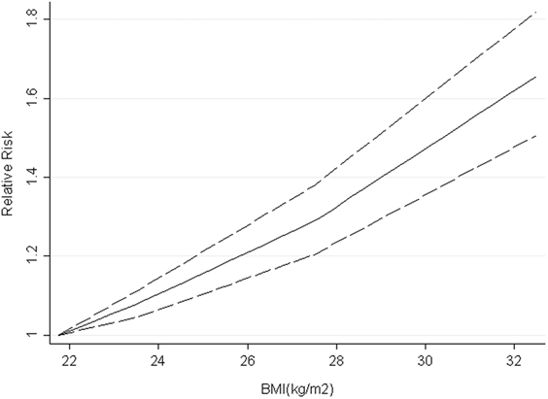
Maternal Body Mass Index and Risk of Autism Spectrum Disorders in Offspring: A Meta-analysis. Sci Rep 6, 34248 (2016). Wang, Y., Tang, S., Xu, S. et al.
Compared with children whose mothers were at normal weight, children born to overweight and obese mothers have a 28% and 36% higher risk of developing ASD, respectively.
  Maternal underweight was not associated with increased ASD risk.
A linear dose-response relationship was found, with the risk of ASD increasing by 16% for each 5 kg/m2 increment in maternal BMI compared with that of normal weight.
Notes:
https://www.nature.com/articles/srep34248#Sec1

Slide 7
Multiple observational studies have reported that maternal diabetes is associated with an increased risk of neuro-developmental disorders (NDDs) in offspring…
Xu G , Jing J , Bowers K , Liu B , Bao W. Maternal diabetes and the risk of autism spectrum disorders in the offspring: a systematic review and meta-analysis. J Autism Dev Disord 2014;44
Xiang AH , Wang X , Martinez MP et al. Maternal gestational diabetes mellitus, type 1 diabetes, and type 2 diabetes during pregnancy and risk of ADHD in offspring. Diabetes Care 2018;41:2502–08.
Xiang AH , Wang X , Martinez MP , Page K , Buchanan TA , Feldman RK. Maternal type 1 diabetes and risk of autism in offspring. JAMA 2018;3
Xiang AH , Wang X , Martinez MP et al. Association of maternal diabetes with autism in offspring. JAMA 2015;313:1425–34.
Ji J , Chen T , Sundquist J , Sundquist K. Type 1 diabetes in parents and risk of attention deficit/hyperactivity disorder in offspring: a population-based study in Sweden. Diabetes Care 2018;41:770–74.
Mann JR , Pan C , Rao GA , McDermott S , Hardin JW. Children born to diabetic mothers may be more likely to have intellectual disability. Matern Child Health J 2013;
Leonard H , N de K , Bourke J , Bower C. Maternal health in pregnancy and intellectual disability in the offspring: a population-based study. Ann Epidemiol 2006;16:448–54.
Wan H , Zhang C , Li H , Luan S , Liu C. Association of maternal diabetes with autism spectrum disorders in offspring: a systemic review and meta-analysis. Medicine (Baltimore) 2018;97:e9438.
Burstyn I , Sithole F , Zwaigenbaum L. Autism spectrum disorders, maternal characteristics and obstetric complications among singletons born in Alberta, Canada. Chronic Dis Inj Can 2010;30:125–34.
Dodds L , Fell DB , Shea S , Armson BA , Allen AC , Bryson S. The role of prenatal, obstetric and neonatal factors in the development of autism. J Autism Dev Disord 2011;41:891–902.
Bytoft B , Knorr S , Vlachova Z et al. Assessment of attention deficits in adolescent offspring exposed to maternal type 1 diabetes. PloS One 2017;12:e0169308
Piven J , Simon J , Chase GA et al. The etiology of autism: pre-, peri- and neonatal factors. J Am Acad Child Adolesc Psychiatry 1993;32:1256–63.

Slide 8
Association of maternal diabetes with neurodevelopmental disorders: autism spectrum disorders, attention-deficit/hyperactivity disorder and intellectual disability. International Journal of Epidemiology, Volume 50, Issue 2, April 2021, Pages 459–474. Shuyun Chen, Sixian Zhao, et al
Autism spectrum disorders (ASD), intellectual disability (ID) and attention-deficit/hyperactivity disorder (ADHD) are common neurodevelopmental disorders (NDDs) with lifelong impacts on affected children and their families.
  The co-occurrence of ASD, ADHD and ID is more common than would be expected by chance.
  Clinically, the co-occurrence of NDDs indicates more severe impairment, different needs and poorer prognoses of the affected children compared with children with a single NDD diagnosis.
In this large population-based cohort study (Swedish National Registry), we found that exposure to maternal diabetes was associated with an increased risk of ASD, ID and ADHD in offspring.
Exposure to T2DM was associated with a greater risk of all three NDDs in offspring compared with T1DM and GDM.

Slide 9
Obesity has emerged as an important comorbidity associated with autism
Centers for Disease Control found that nearly a third of children with autism are severely overweight, compared to 13 percent of typically developing children
Hill AP, Zuckerman KE, Fombonne E. Obesity and Autism. Pediatrics. 2015 Dec;136(6):1051-61. doi: 10.1542/peds.2015-1437. Epub 2015 Nov 2. PMID: 26527551; PMCID: PMC4657601.
  the prevalence of unhealthy weight is significantly greater among children with ASD compared with the general population, with differences present as early as ages 2 to 5 years.
Shedlock K﻿, Susi A﻿, Gorman GH﻿, Hisle-Gorman E﻿, Erdie-Lalena CR﻿, Nylund CM﻿. Autism spectrum disorders and metabolic complications of obesity. ﻿ J Pediatr. 2016;178:183-187.e1
  Children with ASD had significantly greater odds of having obesity (OR 1.85; 95% CI 1.78-1.92), & having obesity-related disorders, and being prescribed a medication when they had these diseases, suggesting they may have more severe disease. In children with ASD, mood stabilizers, antipsychotics, antiepileptic drugs, and selective serotonin reuptake inhibitors were associated with obesity, suggesting that obesity in children with ASD may be partially iatrogenic.
Li YJ﻿, Xie XN﻿, Lei X﻿, Li YM﻿, Lei X﻿. Global prevalence of obesity, overweight and underweight in children, adolescents and adults with autism spectrum disorder, attention-deficit hyperactivity disorder: a systematic review and meta-analysis. ﻿ Obes Rev. 2020;21(12):e13123.
  The worrisome epidemic of obesity and overweight in individuals with ASD, ADHD highlighted the need for weight management.
Kahathuduwa CN﻿, West BD﻿, Blume J﻿, Dharavath N﻿, Moustaid-Moussa N﻿, Mastergeorge A﻿. The risk of overweight and obesity in children with autism spectrum disorders: a systematic review and meta-analysis. ﻿ Obes Rev. 2019;20(12):1667-1679.
  Children with ASD had a 41.1% greater risk of development of obesity.

Slide 10
Risk of Developing Type 2 Diabetes in Adolescents and Young Adults With Autism Spectrum Disorder: A Nationwide Longitudinal Study. Diabetes Care. 2016 May;39(5):788-93. Mu-Hong Chen, et al
Results: Adolescents (HR 2.71 [95% CI 1.64-4.48]) and young adults (HR 5.31 [95% CI 2.85-9.90]) with ASD had a higher risk of developing type 2 DM than those without ASD, after adjustment for demographic data, atypical antipsychotics use, and medical comorbidities.
Any use of atypical antipsychotics were associated with a higher likelihood of subsequent type 2 DM.
  Short-term (HR 1.97 [95% CI 1.20-3.23]) and long-term (HR 1.64 [95% CI 1.02-2.63])
Conclusions: Adolescents and young adults with ASD were more likely to develop type 2 DM during the follow-up.
In addition, those with ASD using atypical antipsychotics exhibited a high risk.

Slide 11
https://www.thetransmitter.org/spectrum/autism-may-share-risk-factors-with-diabetes/
Analysis/Discussion of the Diabetes Care article:
  People with autism were more likely to be obese, and any individuals[with ASD] who were obese were about 3.5 times more likely to develop type 2 diabetes than those at a healthy weight.
  People with autism were also more likely than controls to be taking atypical antipsychotics, a class of drugs that includes risperidone and aripiprazole, which are used to treat behavioral problems in children with autism.
    The drugs have been linked to weight gain, and the new study suggests that individuals [with ASD] who take them as much as double their risk of type 2 diabetes.

Slide 12
Association Between Autism Spectrum Disorders and Cardiometabolic Diseases.
A Systematic Review and Meta-analysis https://jamanetwork.com/journals/jamapediatrics/fullarticle/2800779
Individuals with autism seem to be at a greater associated risk of developing:
  DM by 57.3%
    type 1 DM by 64.1% (likely due to increased risk of autoimmune disease in autism)
    type 2 DM by 146.7% (often early development of T2D)
  Dyslipidemia by 69.4%
    Individuals with autism had low HDL and high triglyceride levels compared with individuals without autism.
  Atherosclerotic heart disease by 45.9%.
Impact on quality of life & life expectancy
Notes:
https://jamanetwork.com/journals/jamapediatrics/fullarticle/2800779

Slide 13
Diabetes Medications & ASD
“Repurposed” – trials using diabetes medications to treat ASD in subjects
without co-existing diabetes
Provides us some idea if the medications we use to treat diabetes might help
or exacerbate ASD symptoms

Slide 14
GLP1 RA medications and ASD
Animal studies:
Exenatide, a GLP-1 analog, has healing effects on LPS-induced autism model: Inflammation, oxidative stress, gliosis, cerebral GABA, and serotonin interactions https://onlinelibrary.wiley.com/doi/abs/10.1002/jdn.10056
Semaglutide ameliorated autism-like behaviors and DNA repair efficiency in male BTBR mice by recovering DNA repair gene expression https://www.sciencedirect.com/science/article/abs/pii/S0278584624001593

Slide 15
Beneficial Effects of GLP-1 Agonist in a Male With Compulsive Food-Related Behavior Associated With Autism
Front Psychiatry. 2019 Mar 1;10:97. Anna Järvinen et al.
Abstract: Individuals with autism spectrum disorder (ASD) frequently display intensely repetitive, restricted thoughts, and behaviors. These behaviors have similarities to compulsions and/or obsessions in obsessive compulsive disorder (OCD) and are primarily treated with behaviourally-based interventions and serotonin uptake inhibitors (SSRIs). Due to the lack of treatment responses in many cases, however, new treatments are being sought.
Here we report beneficial effects of treatment with liraglutide, a glucagon-like peptide-1 (GLP-1) analog, on severe obsessive food craving, binge eating, weight gain, and behavioral problems in an adolescent male with infantile autism and moderate intellectual impairment. Liraglutide treatment reduced weight and unwanted behavior seemingly by preventing food-related repetitive thoughts and compulsions.
Our report provides clinical evidence that GLP-1 signaling pathway may represent a novel target for treating food-related behavioral problems and aggressive behavior in ASD.
Notes:
https://pmc.ncbi.nlm.nih.gov/articles/PMC6405420/#abstract1

Slide 16
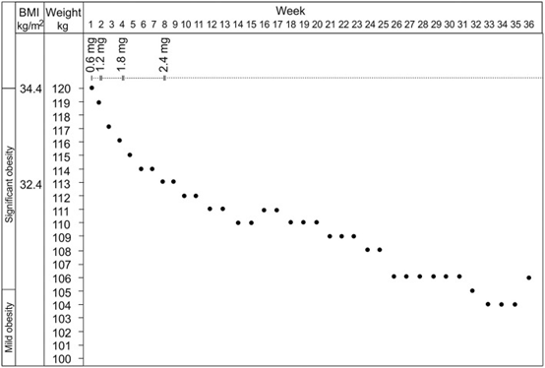
Beneficial Effects of GLP-1 Agonist in a Male With Compulsive Food-Related Behavior Associated With Autism
Front Psychiatry. 2019 Mar 1;10:97. Anna Järvinen et al.
Treatment with liraglutide was initiated with a dose of 0.6 mg/day and being gradually increased to 2.4 mg/day during the following 8 weeks. Immediate positive response was observed in the patient's food-related behavior manifesting as drastically subsided obsessive food-related thoughts, craving for food, and compulsive eating. After first week of treatment, a clear reduction in patient's body weight was seen (Figure 1).
  Also obsessions, compulsions and behavioral problems not related to food, including aggressive behavior, decreased in a significant way at home.
No adverse side effects of liraglutide were observed in our patient case.
Figure 1

Slide 17
Metformin Alleviates Autistic-Like Behaviors Elicited by High-Fat Diet Consumption and Modulates the Crosstalk Between Serotonin and Gut Microbiota in Mice.
Behav Neurol. 2022 Feb 17;2022:6711160. Deng W, Ke H, Wang S, Li Z, Li S, Lv P, Li F, Chen Y.
https://pmc.ncbi.nlm.nih.gov/articles/PMC8872653/
HFD Exacerbates Repetitive Behaviors and Metformin Alleviates Them
  Marble burying and self-grooming tests were used to measure repetitive and stereotyped behaviors.
  The HFD-fed mice displayed higher levels of marble-burying and self-grooming behavior than the ND-fed mice (Figures 2(a) and 2(b), p < 0.05).
Metformin administration significantly reversed this increase in both tests.
  Together, these results indicate that HFD aggravates repetitive behaviors, and metformin alleviates them.
Notes:
https://pmc.ncbi.nlm.nih.gov/articles/PMC8872653/

Slide 18
“Diabetes drug may help symptoms of autism associated condition”
Scientists have found that metformin improves sociability and reduces symptomatic behaviours in adult mice with a form of Fragile X syndrome and, if clinical trials prove successful, that metformin could be repurposed as a therapy for Fragile X syndrome within a few years.
  Fragile X syndrome is caused by inherited defects in a gene called FMR1, which leads to excess protein production in the brain. This results in the breakdown of connections between brain cells, leading to changes in behaviour.
  The team led by the University of Edinburgh and McGill University in Canada looked at the effects of metformin on mice that lack the FMR1 gene. These mice usually have symptoms consistent with Fragile X syndrome – they exhibit repetitive behaviours such as increased grooming and do not socialise with other mice.
“Metformin has been extensively used as a therapy for type 2 diabetes for more than 30 years, and its safety and tolerability are well documented. Our study suggests the drug could be a novel therapeutic for Fragile X syndrome, a common type of autism. We next plan to investigate whether metformin offers any benefits for other types of autism.”
Dr. Christos Gkogkas, Chancellor’s Fellow, Patrick Wild Centre for Research into Autism
Notes:
https://biomedical-sciences.ed.ac.uk/news/archives/2017/diabetes-drug-help-symptoms-of-autism-condition

Slide 19
What about SGLT2i medications?
SGLT2 proteins are present in the Central Nervous System (CNS)
  Pharmacol Res. 2022 Feb:176:106062. Cognitive impairment and type 2 diabetes mellitus: Focus of SGLT2 inhibitors treatment. Maria Rosaria Rizzo et al.
Sodium-glucose cotransporters 2 (SGLT2) are widely found in various brain regions, such as the hippocampus, cerebellum, and blood-brain barrier (BBB).
  This makes them a potential target in treating many central nervous system disorders & SGLT2i are being extensively studied for potency in preventing or protecting against certain neurological diseases.
  Three main mechanisms that link SGLT2 inhibitors with cognitive function are that SGLT2i
    reduces reactive oxygen species (ROS)
    lessens leakage of BBB and
    decreases microglia burden and acetylcholinesterase levels.
    Jasleen B, Vishal GK, Sameera M, Fahad M, Brendan O, Deion S, Pemminati S. Sodium-Glucose Cotransporter 2 (SGLT2) Inhibitors: Benefits Versus Risk. Cureus. 2023 Jan 18;15

Slide 20
Repurposing SGLT2 Inhibitors for Neurological Disorders: A Focus on the Autism Spectrum Disorder.
Molecules. 2022 Oct 23;27(21):7174. Nakhal MM, Aburuz S, Sadek B, Akour A.
Autism spectrum disorder (ASD) is a neurodevelopmental disorder with a substantially increasing incidence rate. It is characterized by repetitive behavior, learning difficulties, deficits in social communication, and interactions.
Numerous medications, dietary supplements, and behavioral treatments have been recommended for the management of this condition, however, there is no cure yet.
Recent studies have examined the therapeutic potential of the sodium-glucose cotransporter 2 (SGLT2) inhibitors in neurodevelopmental diseases, based on their proved antioxidant and anti-inflammatory effects and ability to cross the blood-brain barrier
SGLT2 inhibitors have the potential to improve ASD patients’ behavioral and brain disruptions by increasing the cerebral brain derived neurotrophic factor and reducing the cerebral oxidative stress, including elevated the GSH and catalase activity, reduced MDA, amyloid levels, plaque density, and acetylcholinesterase

Slide 21
Challenges with treating ASD
Interview with Michael Tranfaglia, medical director and chief scientific officer at the FRAXA Research Foundation:
“One drug or treatment will not help 100% of individuals with ASD.
  Because of this, there has been a reluctance by most of the larger pharmaceutical companies to go into the ASD treatment space.”
“The heterogeneity of the condition poses another challenge.”
  FOR EXAMPLE: Selective serotonin reuptake inhibitors (SSRIs) have been tested for ASD, but the results were “very disappointing” for this reason.
    “It was really hard to show that [SSRIs] worked in autism because we got a whole mixed bag of results.”
    There were subgroups of patients who appeared to have a “dramatically positive response,” while others got worse, and still others had no response at all.
Notes:
https://www.biospace.com/as-autism-cases-rise-biopharma-springs-into-action

Slide 22
Autism-related eating challenges to keep in mind
A strong need for routine is common with autism.
  It can make it more difficult to break out of unhealthy patterns of eating or inactivity.
Autism often involves sensory issues and oral-motor weaknesses. Both can contribute to a highly selective diet.
  Such diets tend to consist primarily of processed foods high in fat and carbohydrates, rather than healthier and less caloric fruits and vegetables.
  Over the years, such a diet commonly leads to weight gain.
Many people affected by autism experience what we call hyperphagia. This is an intense desire to eat that goes beyond true hunger.
  Similar to Prader Willi Syndrome (PWS)
  Given unchecked access to food, someone with hyperphagia may eat almost constantly -As the amount of time the adolescent or young adult spends unsupervised tends to increase, unchecked overeating may likewise increase.
With ADHD – some patients forget to eat then overeat/binge

Slide 23
Advice from The PWS Association
Handout: “People with Prader Willi syndrome can avoid obesity”
Why are people with PWS at high risk of obesity?
  Excessive drive to eat (hyperphagia) that results from genetic abnormalities and starts at a young age
  Lifelong impaired satiety of hypothalamic origin
  Self-control of food intake is not possible without external support
  Lower than normal energy requirements and low muscle mass
How can families and caregivers manage the risks?
  Accept that people with PWS need special and ongoing support with food
  Collaborate with the person with PWS when planning environmental controls
  Provide nutritionally balanced menus that take account of reduced energy needs
  Avoid sugary drinks and foods that are high in calories and low in nutrients
  Provide a food secure environment where food is not freely available to prevent excessive energy intake and reduce temptation
  Support regular physical activity, which is key to good health and fitness*
  Engage people with PWS in regular, purposeful activities to use energy and distract from the desire to eat
  Ensure all caregivers understand PWS and are consistent around access to food and opportunities to obtain food
What is likely if food is not managed?
  Extreme obesity and a reduced lifespan
  Health problems resulting from obesity, including disordered sleep and cardiovascular diseases
  Increased behavioural problems
  Reduced capacity to engage in activities
  Challenges with social engagement and family life
What is possible if food is well-managed?
  Good health and a longer lifespan
  Enhanced self-esteem, wellbeing and happiness
  A social life and community involvement
  Reduced thoughts about food
External controls aren’t cruel,
They are caring
Notes:
Avoid obesity leaflet

Slide 24
Advice to Parents/Caregivers for PWS
Starvation Syndrome
To understand the importance of this drive to eat, try to look at PWS as a ‘starvation’ syndrome (behaving as if you were starving) rather than an over-eating one.
  Because of the dysfunction in the hypothalamus, there is no on/off mechanism that tells the brain, “I’ve eaten enough”. What happens instead is that the brain keeps telling the body, “you’re starving, you need food”, and the drive to find food overrides everything else.
  When food is seen it is a great temptation, difficult or impossible to resist.
  [In ASD, some food behavior seems to be due to repetitive thoughts & compulsion, not hunger]
Good Support and Management
Without support and good management, severe obesity will arise early on and can, within a few years, becoming life-threatening.
Added to this is an inability to reason between right and wrong when it comes to food-seeking, and you have the makings of some serious behavioral challenges
  You cannot demand that the person behaves as if he/she did not have PWS. And no one with PWS sets out to create such difficult and painful situations.
Management also means locks on pantries, fridges, food cupboards – or only have food in a kitchen where you can lock the door.
  Although this might seem antiquated and unfair, it is incredibly helpful to the person with PWS to know that food is secure and is not a temptation to them. Some children even remind the parents that they have to lock the kitchen.

Slide 25
Summary
How does Diabetes affect ASD
  Maternal obesity &/or T2D appear to increase the occurrence of neurodevelopmental disorders (ASD, ADHD & ID) in offspring, including co-occurrence of all 3 NDDs.
How does ASD affect diabetes
  People with ASD have higher incidence of obesity & T2D – even at a young age
How does treatment of ASD affect diabetes
  Mood stabilizers, antipsychotics, antiepileptic drugs, and selective serotonin reuptake inhibitors were associated with obesity in children with ASD
    Individuals with ASD and Obesity are more likely to develop T2D
  Any use of atypical antipsychotics were associated with a higher likelihood of subsequent type 2 DM.
How does treatment of diabetes affect ASD
  Diabetes medications being tested/show improvement in some forms of autism
    GLP1 RA
    Metformin
    SGLT2i
Eating behaviors may be driven by something other than or beyond hunger
  External controls are critical – optimize “routines” for health

Slide 26
Advice to Parents/Caregivers for PWS
Try to encourage exercise at all times –
  Even hidden exercise, such as hanging out the clothes, window-shopping, parking further away in the supermarket parking lot, climbing the stairs, helping push the supermarket trolley, it is all better than nothing.
  For adults: walking after each meal for 20-30 min is a good way to get the body and calorie burning activated
    [Establish as a routine??]

Slide 27
Considerations for our Case Patient
How to assist with BG control and eating habits.
  Current diabetes meds:
    Tirzepatide 5 mg weekly
    Metformin 500 mg BID
    Lantus 30u QD
Mother very supportive but struggles with how to best help.
Issues with CGM sensor staying on.
Please share your input, insight & experiences

Slide 28
Considerations for our Case Patient
Some of my thoughts for consideration:
Continue to titrate up the Tirzepatide – maybe higher dose will help behavior as well as glucose levels and appetite (CVD protection)
Continue Metformin 500 mg BID – consider titrating up once stable on tirzepatide
Consider adding SGLT2 – should help reduce glucose spikes with binging & cardiac benefits / reduce hyperfiltration associated with obesity & hyperglycemia
  Concern is Genital Mycotic Infection - ? Establish preventive habits at onset
All 3 associated with weight loss & possible benefit to ASD

Slide 29
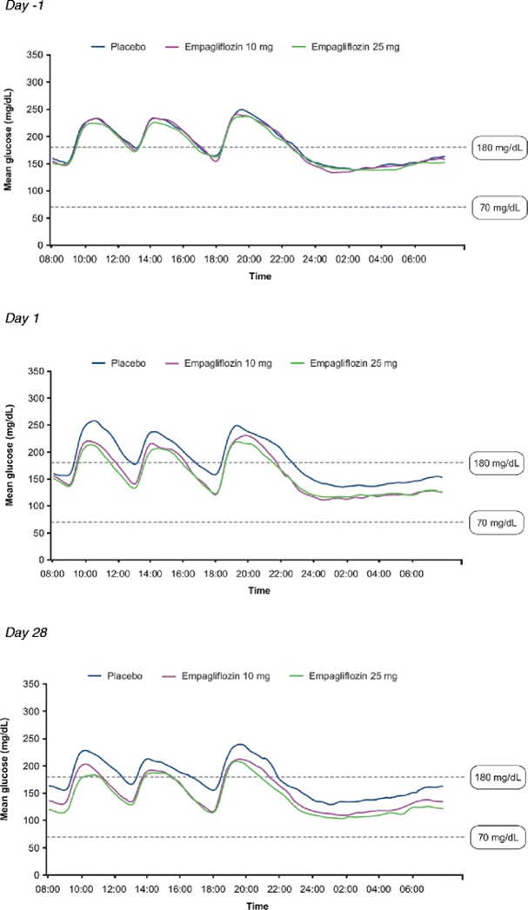
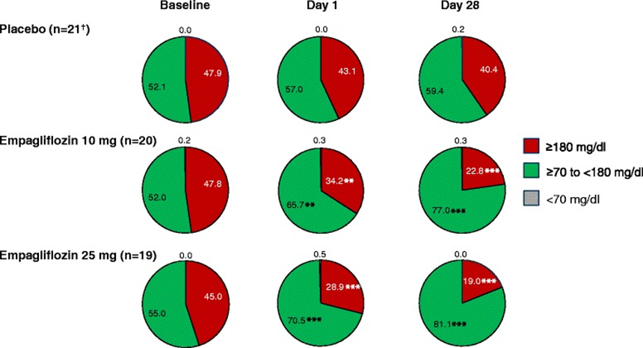
Effect of empagliflozin monotherapy on postprandial glucose and 24-hour glucose variability in Japanese patients with type 2 diabetes mellitus: a randomized, double-blind, placebo-controlled, 4-week study - PMC
Significant reductions from baseline in AUC1-4h for PPG were observed after acute and sub-chronic treatment with empagliflozin, with 80–90% of the reduction in AUC1-4h for PPG already achieved at day 1.
CGM Data
Notes:
Effect of empagliflozin monotherapy on postprandial glucose and 24-hour glucose variability in Japanese patients with type 2 diabetes mellitus: a randomized, double-blind, placebo-controlled, 4-week study - PMC

Slide 30
Considerations for our Case Patient
Continue to titrate up the Tirzepatide – maybe higher dose will help behavior as well as glucose levels and appetite (CVD protection)
Continue Metformin 500 mg BID – consider titrating up once stable on tirzepatide
Consider adding SGLT2 – should help reduce glucose spikes with binging & cardiac benefits / reduce hyperfiltration associated with obesity & hyperglycemia
  Concern is Genital Mycotic Infection - ? Establish preventive habits at onset
All 3 associated with weight loss & possible benefit to ASD
Caution with Lantus 30u QD – need to taper as increase tirzepatide & add SGLT2i
  Avoid hypoglycemia – CGM data would be very helpful
Mother very supportive but struggles with how to best help.
  Reassure mother that external controls are required – patient unable to do on her own
    Maybe share some of the support info developed for PWS with parents
  Established “pattern” with fast food (vs home) more challenging – works in fast food
Issues with CGM sensor staying on.
Please share your input, insight & experiences

Slide 32
Association of maternal diabetes with neurodevelopmental disorders: autism spectrum disorders, attention-deficit/hyperactivity disorder and intellectual disability. International Journal of Epidemiology, Volume 50, Issue 2, April 2021, Pages 459–474. Shuyun Chen, Sixian Zhao, et al
Abstract: Background -Maternal diabetes has been associated with a risk of neurodevelopmental disorders (NDDs) in offspring, though the common co-occurrence of autism spectrum disorders (ASD), attention-deficit/hyperactivity disorder (ADHD) and intellectual disability (ID) is rarely considered, nor is the potential for confounding by shared familial factors (e.g. genetics).
Methods
This population-based cohort study used data from Psychiatry Sweden, a linkage of Swedish national registers, to follow 2 369 680 individuals born from 1987 to 2010. We used population-averaged logit models to examine the association between exposure to maternal type 1 diabetes mellitus (T1DM), pre-gestational type 2 diabetes mellitus (T2DM) or gestational diabetes mellitus (GDM), and odds of NDDs in offspring. Subgroup analysis was then performed to investigate the timings of GDM diagnosis during pregnancy and its effect on the odds of NDDs in offspring. We compared these results to models considering paternal lifetime T1DM and T2DM as exposures.
Results
Overall, 45 678 individuals (1.93%) were diagnosed with ASD, 20 823 (0.88%) with ID and 102 018 (4.31%) with ADHD. All types of maternal diabetes were associated with odds of NDDs, with T2DM most strongly associated with any diagnosis of ASD (odds ratioadjusted 1.37, 95% confidence interval 1.03–1.84), ID (2.09, 1.53–2.87) and ADHD (1.43, 1.16–1.77). Considering common co-morbid groups, the associations were strongest between maternal diabetes and diagnostic combinations that included ID. Paternal T1DM and T2DM diagnoses were also associated with offspring NDDs, but these associations were weaker than those with maternal diabetes. Diagnosis of GDM between 27 and 30 weeks of gestation was generally associated with the greatest risk of NDDs in offspring, with the strongest associations for outcomes that included ID.
Conclusion
The association of maternal diabetes with NDDs in offspring varies depending on the co-morbid presentation of the NDDs, with the greatest odds associated with outcomes that included ID. Results of paternal-comparison studies suggest that the above associations are likely to be partly confounded by shared familial factors, such as genetic liability.
Notes:
https://doi.org/10.1093/ije/dyaa212

Slide 33
https://pubmed.ncbi.nlm.nih.gov/27006513/ https://diabetesjournals.org/care/article/39/5/788/30599/Risk-of-Developing-Type-2-Diabetes-in-Adolescents
Diabetes Care. 2016 May;39(5):788-93. doi: 10.2337/dc15-1807. Epub 2016 Mar 22.
Risk of Developing Type 2 Diabetes in Adolescents and Young Adults With Autism Spectrum Disorder: A Nationwide Longitudinal Study
Mu-Hong Chen 1,

Slide 34
Maternal Body Mass Index and Risk of Autism Spectrum Disorders in Offspring: A Meta-analysis. Sci Rep 6, 34248 (2016). Wang, Y., Tang, S., Xu, S. et al.
Compared with children whose mothers were at normal weight, children born to overweight and obese mothers have a 28% and 36% higher risk of developing ASD, respectively.
  Maternal underweight was not associated with increased ASD risk.
A linear dose-response relationship was found, with the risk of ASD increasing by 16% for each 5 kg/m2 increment in maternal BMI compared with that of normal weight.
ASD is one of the most common and severe neurodevelopmental disorders which is lifelong. It not only significantly impacts upon the individuals, but also has long-term implications for their families, as well as for the provision of education and habilitative services. It is therefore crucial to identify related risk factors and to prevent ASD in the primary step.
Along with the nearly doubled world’s obesity rate between 1980 and 2008, the prevalence of ASD has also been increasing rapidly during the same period. While elevated awareness and updated diagnostic criteria of ASD might contribute to its increased prevalence, it is possible that the obesity epidemic may also play a role, which is supported by the results of our meta-analysis.
Notes:
https://www.nature.com/articles/srep34248#Sec1

