Slide 1
Here’s the Scoop with Bupe: Analgesia
Gary Houchard, PharmD
Palliative Clinical Pharmacy specialist
The Ohio State University James Cancer Hospital

Slide 2
Objectives
Discuss the potential role of buprenorphine for analgesia
Compare buprenorphine to full agonist opioids in terms of its risks and benefits for analgesia
Evaluate patient candidacy for pain management with buprenorphine

Slide 3
Disclosures
This presentation will include discussion of the off-label use of medications.

Slide 4
The Ohio State University - Formulary
Pain | Opioid Dependence
Intravenous Buprenex® | Sublingual Suboxone®, Subutex®
Transdermal Butrans® | Subcutaneous Sublocade®, Brixadi®
Buccal Belbuca®

Slide 5
The Ohio State University - Formulary
Pain | Opioid Dependence
Intravenous Buprenex® 2.4 mg | Sublingual Suboxone®, Subutex® 32 mg
Transdermal Butrans® 0.48 mg | Subcutaneous Sublocade®, Brixadi® 10 mg, 4.5 mg
Buccal Belbuca® 1.8 mg

Slide 6
History
1981 Intravenous buprenorphine FDA approved for moderate/severe pain
2002 SL buprenorphine FDA approved for opioid addiction
2015 Buccal buprenorphine FDA approved for moderate/severe pain
2010 Transdermal buprenorphine FDA approved for moderate/severe pain

Slide 7
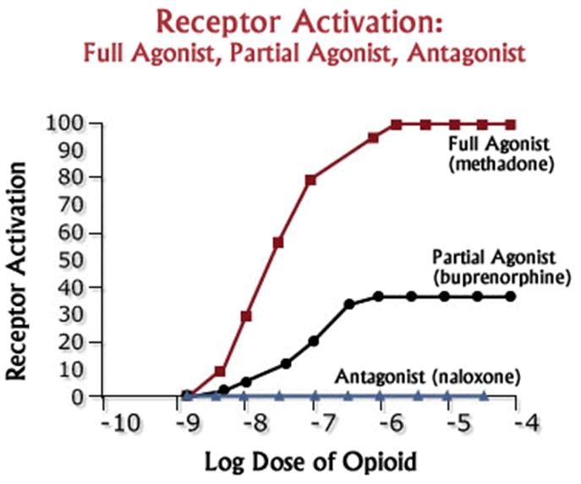
Unique Pharmacology
μ receptor partial agonist
Lower adverse effect profile
𝜅 receptor antagonist
Reverse/limit hyperalgesia
Sodium channel blockade
Potential neuropathic pain benefit
Strong μ binding affinity
Displacement of μ agonists
High lipophilicity
>20-hour elimination half-life for most formulations
Prommer. Am J Hosp Palliat Med. 32.8 (2015): 881-889.
Butler. Scan J Pain 4.3 (2013): 148-152.
Leffler, et al. J Am S Anesthesiol. 116.6 (2012): 1335-1346.
Notes:
Sufentanil: stronger binding affinity; effect still attenuated by buprenorphine
Sodium channel blockade: enhances and prolongs peripheral nerve blocks; local anesthetic properties
Neuropathic pain: randomized controlled trials with transdermal buprenorphine supporting benefit for diabetic peripheral neuropathy;

Slide 8
Adverse Effect Profile

Slide 9
Respiratory Depression
Analgesia
Respiratory Response
Dahan, et al. Br J Anaesth. 2006;96(5):627-632.
Notes:
IV buprenorphine at increasing doses showed significant increase in analgesia, but non-significant increase in respiratory depression
Appropriate use of buprenorphine is typically not associated with overdose deaths; overdose deaths are almost always associated with inappropriate use (e.g. IVDA) or use in combination with other sedating drugs such as benzos

Slide 10
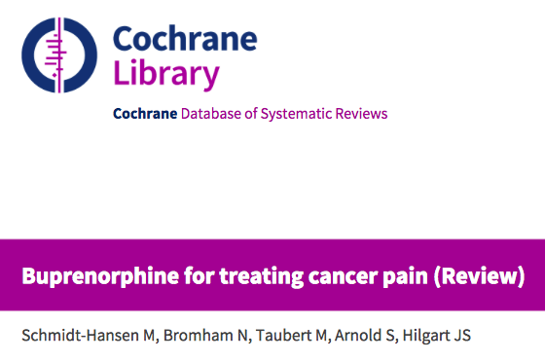
19 randomized controlled trials (1421 patients)
“Generally, the studies showed that buprenorphine is an effective strong pain relief medicine that in some cases may be slightly better than other strong pain relief medicines.”
Schmidt-Hansen M, et al. Cochrane Database Syst Rev. 2015;2015(3):CD009596.
Notes:
Published 2018
Use of buprenorphine specifically for treatment of cancer-related pain

Slide 11


Expert narrative review
“A comparison of efficacy and safety data from studies of buprenorphine and conventional opioids suggests that buprenorphine may be a better-tolerated treatment option for many patients that provides similar or superior analgesia. Our benefit-risk assessment in this narrative review suggests that health care providers should consider that buprenorphine may be an appropriate alternative for pain management over other opioids.”
Hale, et al. J Pain Res. 2021;14:1359-1369.
Notes:
Published 2018
Use of buprenorphine specifically for treatment of cancer-related pain

Slide 12

Expert opinion
“The overall consensus of the panel was that buprenorphine is a unique Schedule III opioid with favorable pharmacologic properties and a safety profile that may be desirable for chronic pain management.”
Webster, et al. Pain Med. 2020;21(4):714-723.
Notes:
Published 2018
Use of buprenorphine specifically for treatment of cancer-related pain

Slide 13
Additional Benefits
Preferred opioid in renal dysfunction
Preferred opioid in hepatic dysfunction
50% dose reduction for ”severe” dysfunction
Naloxone NOT recommended
DEA schedule 3
Convenient routes of administration
Abuse deterrent formulations?

Slide 14

Buprenorphine/Naloxone
“If you are already on buprenorphine, IVing Suboxone will not put you into withdrawal… There is no functional reason why naloxone is in Suboxone, and for all intensive purposes, Suboxone and Subutex are the same thing – both can be used with any route of administration.”
Notes:
Current cash price (GoodRX):
Suboxone 8mg/2mg tablets x 60 - $180
Subutex 8mg x 60 - $90

Slide 15

This Photo by Unknown Author is licensed under CC BY-NC-ND

Slide 16
Partial Agonist
+
High Binding Affinity (Displacement)
=
Precipitated Withdrawal
*Dose Dependent*

Slide 17
Precipitated Withdrawal

Slide 18
Precipitated Withdrawal

Slide 19
Precipitated Withdrawal

Slide 20
Buprenorphine Ideal Patient Populations
Moderate-Severe Cancer-Related Pain Requiring Opioids
Opioid Naive
Respiratory Compromise
Sensitivity to Full Agonist Opioids
History of Opioid Use Disorder or Misuse

Slide 21
Pain Management Principles
Generally not recommended for non-malignant pain
Extremely low risk of precipitating withdrawal with pain formulations
More frequent administration when compared to opioid use disorder
IV buprenorphine is sole short-acting formulation
CAN be used in conjunction with full agonist opioids
Equianalgesic conversions are widely variable in the literature
Potential mechanisms for neuropathic pain treatment
Conflicting evidence for efficacy
Low concentration in urine – false negatives on urine drug screens
Less euphorigenic – poor perceived efficacy with rotation from full agonists

Slide 22
Dose Dependent Receptor Occupancy
Greenwald. Neuropsychopharmacology 28.11 (2003): 2000-2009.

Slide 23
Dose Dependent Receptor Occupancy
2 mg: 27-48%
16 mg: 78-92%
32 mg: 84-98%
Greenwald. Neuropsychopharmacology 28.11 (2003): 2000-2009.

Slide 24
Dosing Strategy By Indication
Baseline Chronic Pain

Slide 25
Dosing – Opioid Use Disorder
Opioid “Toxicity”
Baseline Chronic Pain

Slide 26
Dosing – Pain
Opioid “Toxicity”
Baseline Chronic Pain

Slide 27
Rotation from Full Agonist Opioids
Patient reports of poor efficacy after rotation
Classical conditioning -euphoria/analgesia

Slide 28
Unclear Equianalgesic Conversions
Multiple mechanisms of action with wide interpatient variability
Partial agonist
Kappa receptor antagonist
Sodium channel blockade
For sublingual/buccal formulations, administration-dependent bioavailability

Slide 29
Adopted with permission from Kyle Quirk, PharmD – “Buprenorphine ’21”
OME = Oral Morphine Equivalents

Slide 30
Pharmacokinetics
Formulation | Bioavailability | Onset | Peak | Duration | Steady State | Average Wholesale Price (per dosing unit)
Transdermal (Butrans®) | ~15% | ~24 hours | 2-3 days | 7 days May have end of dose effect around day 5-6 | 3-4 days | $61.37-164.67
Intravenous (Buprenex®) | 100% | ~5-10 minutes | ~30 minutes | 6-8 hours | 6 hours | $14.77-$18.20
Buccal (Belbuca®) | ~45-65% | ~2-3 hours | 2.5-3 hours | 12 hours | 2.5 days | $8.56-$21.10
Sublingual (Subutex® or Suboxone®) | 30-50% | ~1.5-2 hours | 30-60 minutes | 6-8 hours | 3-5 days | $0.37-$18.46
Buprenorphine and naloxone. Lexi-drugs online. UpToDate, Inc. 2024.
Buprenorphine. Lexi-drugs online. UpToDate, Inc. 2024.

Slide 31
Transdermal Buprenorphine
7-day transdermal patch
Dosing limited to 20 mcg/hr in the United States due to QT prolongation
Transtec® patches available in 35, 52.5, and 70 mcg/hr in Europe
Local site reactions are the most common reported adverse effect
Can consider a different manufacturer
Topical Flonase prior to patch application
Butrans [package insert]. Stamford, CT: Purdue; 2023.

Slide 32
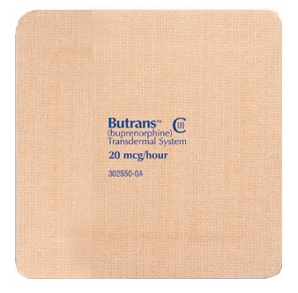
Transdermal Buprenorphine
Prior daily dose of opioid analgesic | Initial Butrans dose
Less than 30 mg MEDD | 5 mcg/hr patch
30-80 mg MEDD | 10 mcg/hr patch
>80 mg MEDD | Consider alternate analgesic
Taper to 30 morphine equivalent daily dose prior to initiation recommended
Necessary?
MEDD = Morphine Equivalent Daily Dose
This Photo by Unknown Author is licensed under CC BY-SA-NC
Butrans [package insert]. Stamford, CT: Purdue; 2023.

Slide 33
Buccal Buprenorphine
Twice daily buccal film
Available in 75, 150, 300, 450, 600, 750, and 900 mcg films
Generally lower patient satisfaction compared to Butrans
Patient-reported adhesion problems
Avoid food and beverages until fully dissolved (~30 minutes)
Brand name – reduced coverage/higher copay
Concern for dental carries – swish with water after dissolution
Caution in mucositis – 1.75-2x absorption
Belbuca [package insert]. Stoughton, MA: Collegium; 2023.

Slide 34
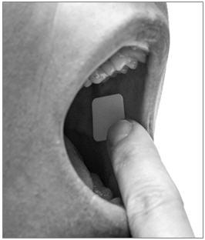
Buccal Buprenorphine
Prior daily dose of opioid analgesic | Initial Belbuca dose
Less than 30 mg MEDD | 75 mcg once daily or every 12 hours
30-89 mg MEDD | 150 mcg every 12 hours
90-160 mg MEDD | 300 mcg every 12 hours
>160 mg MEDD | Consider alternate analgesic
Taper to 30 mg morphine equivalent daily dose prior to initiation recommended
MEDD = Morphine Equivalent Daily Dose
Belbuca [package insert]. Stoughton, MA: Collegium; 2023.

Slide 35
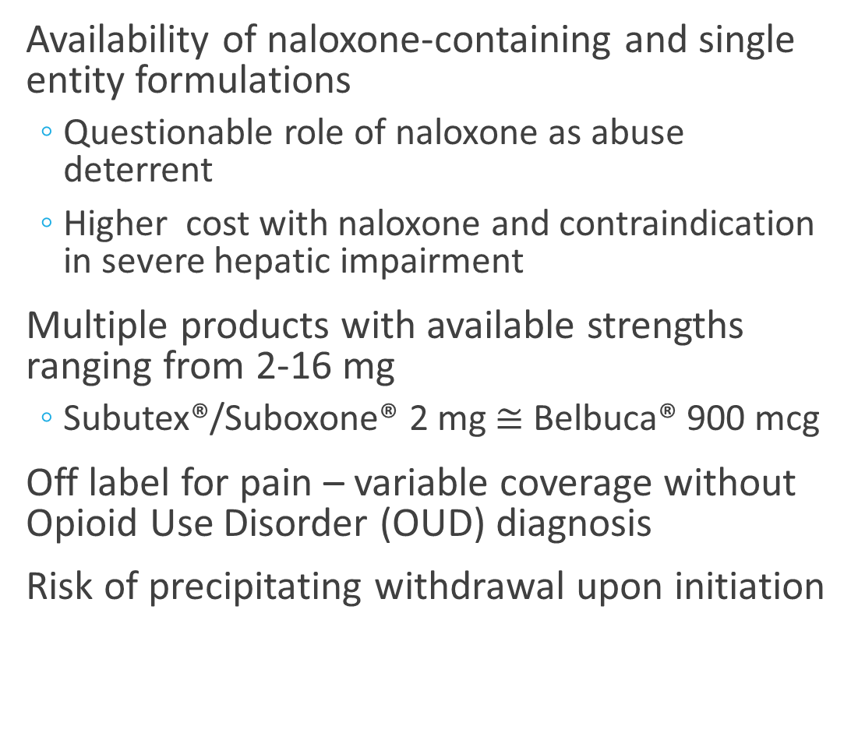
Sublingual Buprenorphine
Availability of naloxone-containing and single entity formulations
Questionable role of naloxone as abuse deterrent
Higher cost with naloxone and contraindication in severe hepatic impairment
Multiple products with available strengths ranging from 2-16 mg
Subutex®/Suboxone® 2 mg $≅$ Belbuca® 900 mcg
Off label for pain – variable coverage without Opioid Use Disorder (OUD) diagnosis
Risk of precipitating withdrawal upon initiation
Suboxone [package insert]. North Chesterfield, VA: Indivior; 2023.

Slide 36
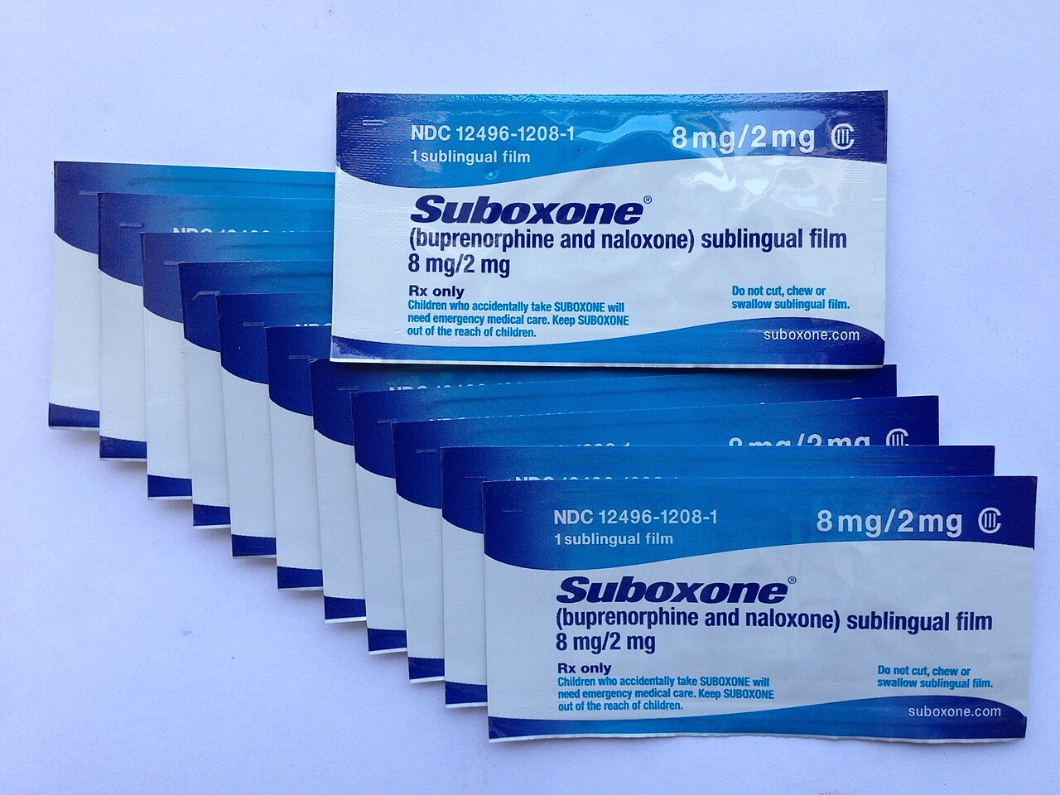
Sublingual Buprenorphine
Misuse/diversion is common
TID or QID dosing recommended for pain
Concern for dental carries – swish with water after dissolution
This Photo by Unknown Author is licensed under CC BY-SA
Suboxone [package insert]. North Chesterfield, VA: Indivior; 2023.

Slide 37
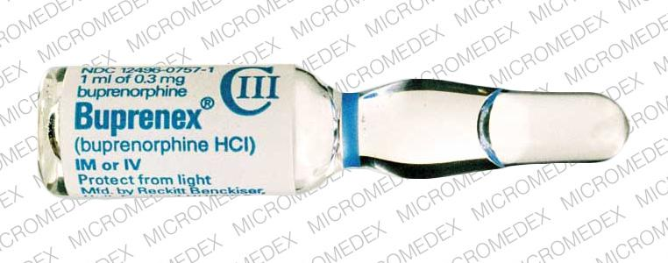
Intravenous Buprenorphine
Available as 0.3 mg/mL vials
Sole buprenorphine formulation indicated for acute pain
Recommended dosing 0.3-0.6 mg every 6-8 hours
Lower doses commonly used for highly opioid-sensitive patients e.g. 0.09 mg
Improved tolerability compared to full agonist opioids
Elimination half-life ~2.2 hours
Comparatively longer onset of action – peak effect at ~1 hour
Buprenex [package insert]. Malvern, PA: Endo; 2024.
This Photo by Unknown Author is licensed under CC BY-SA-NC

Slide 38
OUD Patients – Acute Pain Management
Optimize non-opioid analgesics
For SL products, split into TID or QID dosing e.g. 8 mg BID -> 4 mg QID
Consider IV buprenorphine if available
If full agonist opioids are required, DO NOT stop buprenorphine
Shared decision making with patient regarding risks and benefits
Consider hydromorphone for breakthrough pain
Ensure appropriate opioid-tolerant dosing
Buprenorphine 8 mg Q12h ~ 480 mg MEDD
Greenwald. Neuropsychopharmacology 28.11 (2003): 2000-2009.

Slide 39
Final Thoughts
Safest opioid in terms of overdose risk and adverse effect profile
High tolerability in opioid-sensitive patients
Formulations for pain may be inadequate for patients with high opioid requirements – can consider off-label OUD formulations
Risk of precipitated withdrawal is very low for any buprenorphine product indicated for pain

Slide 40
References
Prommer E. Buprenorphine for cancer pain: is it ready for prime time?. Am J Hosp Palliat Care. 2015;32(8):881-889.
Butler S. Buprenorphine-Clinically useful but often misunderstood. Scand J Pain. 2013;4(3):148-152. Published 2013 Jul 1.
Leffler A, Frank G, Kistner K, et al. Local anesthetic-like inhibition of voltage-gated Na(+) channels by the partial μ-opioid receptor agonist buprenorphine. Anesthesiology. 2012;116(6):1335-1346.
Dahan, A., et al. "Buprenorphine induces ceiling in respiratory depression but not in analgesia." BJA: British Journal of Anaesthesia 96.5 (2006): 627-632.
Schmidt-Hansen, Mia et al. “Buprenorphine for treating cancer pain.” The Cochrane database of systematic reviews vol. 2015,3 CD009596. 31 Mar. 2015, doi:10.1002/14651858.CD009596.pub4
Hale, Martin, Mark Garofoli, and Robert B. Raffa. "Benefit-Risk Analysis of Buprenorphine for Pain Management." Journal of Pain Research 14 (2021): 1359.
Webster L, Gudin J, Raffa RB, et al. Understanding Buprenorphine for Use in Chronic Pain: Expert Opinion. Pain Med. 2020;21(4):714-723.
Greenwald, Mark K et al. “Effects of buprenorphine maintenance dose on mu-opioid receptor availability, plasma concentrations, and antagonist blockade in heroin-dependent volunteers.” Neuropsychopharmacology : official publication of the American College of Neuropsychopharmacology vol. 28,11 (2003): 2000-9. doi:10.1038/sj.npp.1300251
Buprenorphine and naloxone. Lexi-drugs online. UpToDate, Inc. 2024.
Buprenorphine. Lexi-drugs online. UpToDate, Inc. 2024.
Butrans [package insert]. Stamford, CT: Purdue; 2023.
Belbuca [package insert]. Stoughton, MA: Collegium; 2023.
Suboxone [package insert]. North Chesterfield, VA: Indivior; 2023.
Buprenex [package insert]. Malvern, PA: Endo; 2024.

Slide 41
Questions?

