Slide 1
Communications

Slide 2


Objectives
Review general principles of good communication
Discuss a general structure for Online medical direction report
Review a general structure for patient handoffs

Slide 3
We do a lot of communicating
Handing patients off to other crews
Radio Reports
Medical Direction Consults
Routine ED hand offs
Critical “front room” hand offs to whole teams
and more

Slide 4

What we wish: on the phone, to the next crew, at hand off

Slide 5

It frequently feels more like this…

Slide 6

Please draw a picture of yourself riding a bike
Notes:
Hook: before we get started, we would like you to take the paper that is at your seat and the pens and draw what is described on the slide
Have people draw and then show pictures
Point is without extra context (usually through communication) we have different mental models

Slide 7
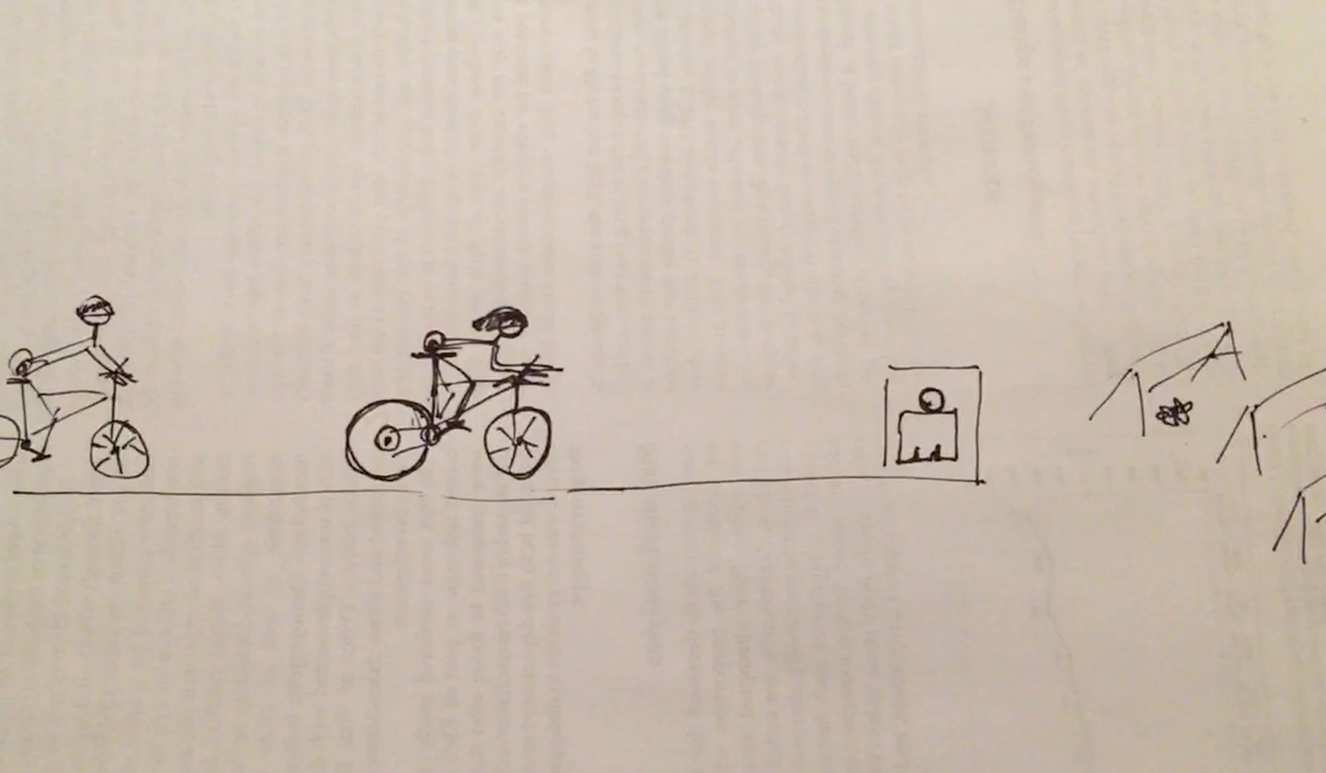
Example 1

Slide 8
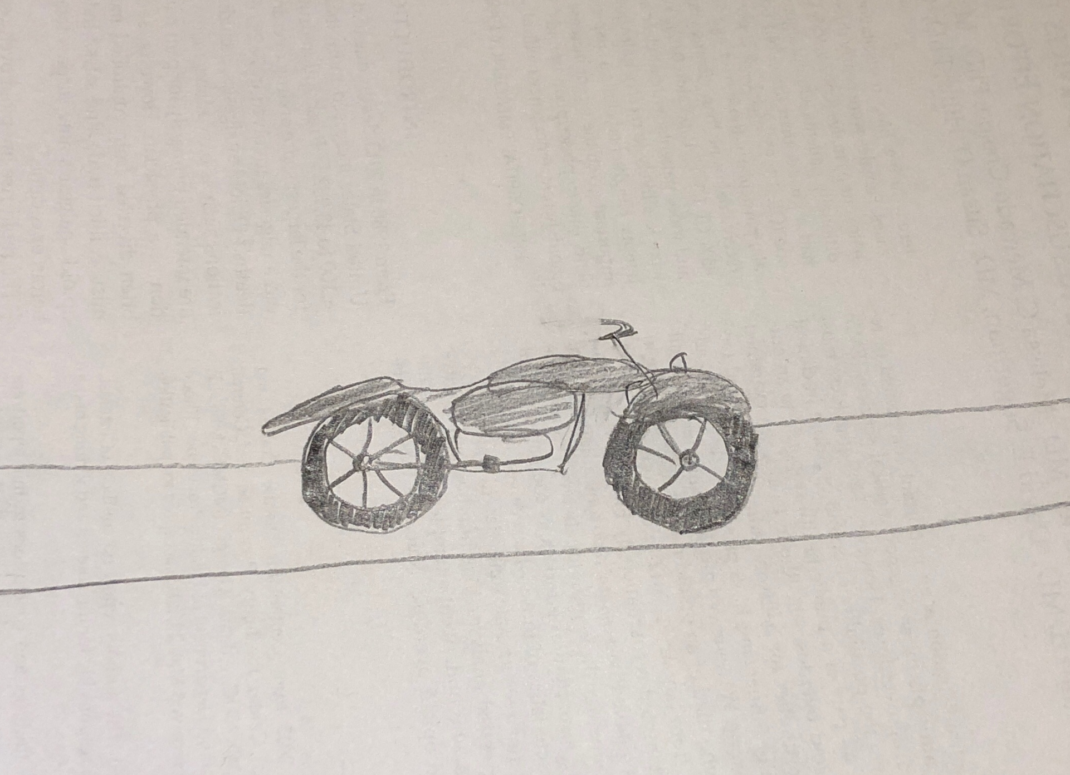
Example 2

Slide 9
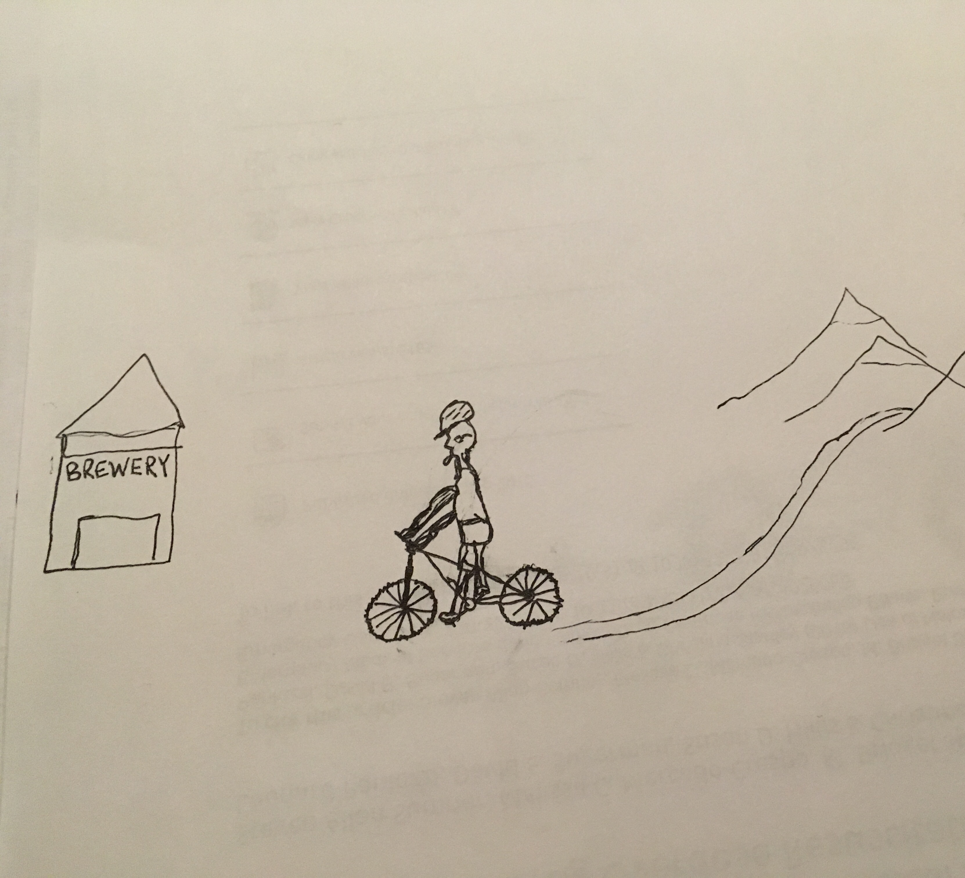
Example 3

Slide 10
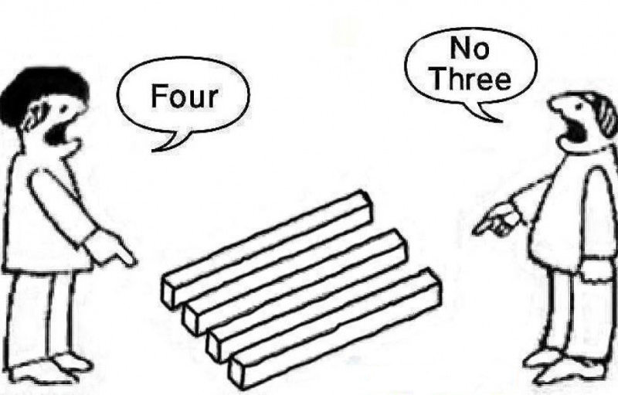
Shared Mental Model
Notes:
This is a relatable problem - we’ve all felt we’ve been trying to describe the same thing before with confusion

Slide 11
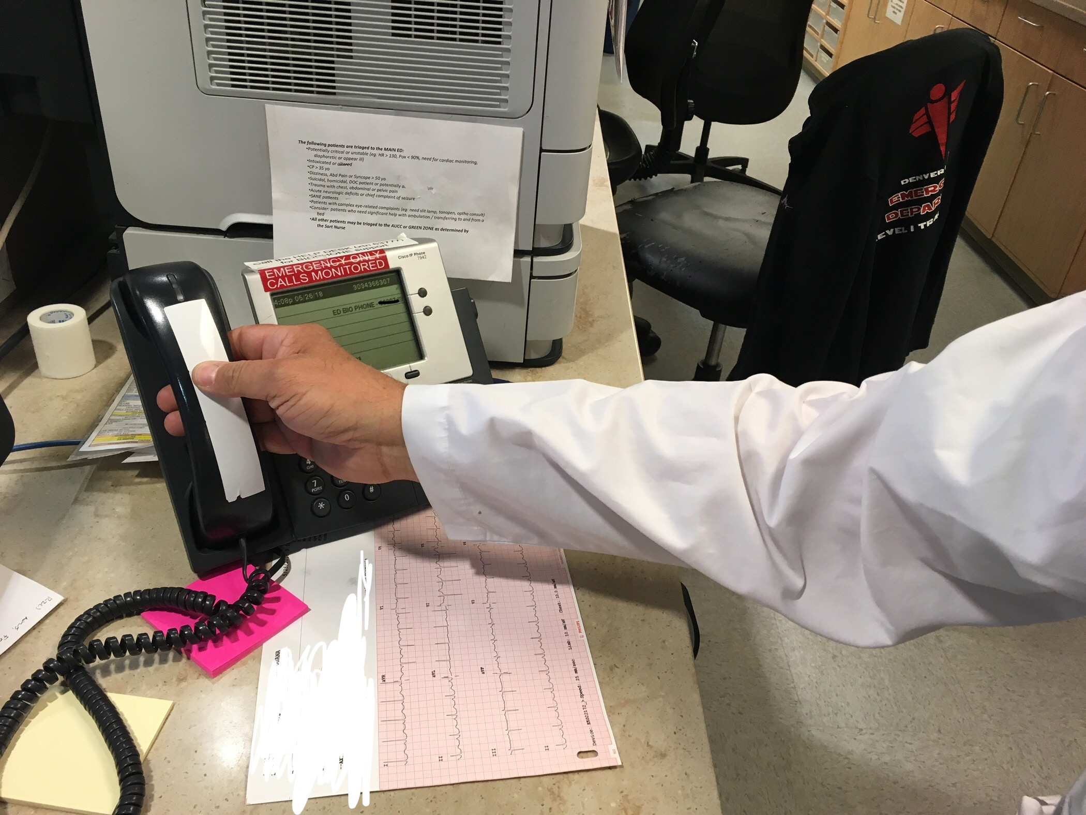
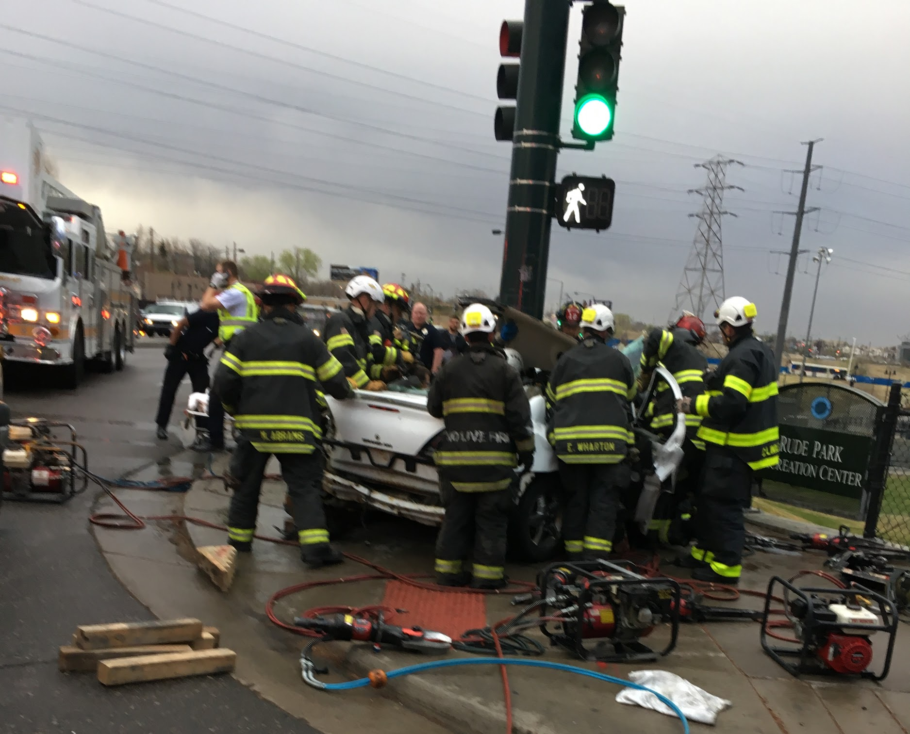
Different Views of the Same Patient

Slide 12
Why
Everyone on the same page benefits the patient
Improved communication improves interprofessional relationships
Notes:
Why shared mental model is important
Improved communication, collaboration
Improves care

Slide 13

How do we get there?
Choose your words (and tone)
Listen
Seek to understand

Slide 14

Choose your words: Preventing problems
Notes:
Choose your words-- how we can prevent problems
Prep your listener
Avoid jargon
Watch your tone

Slide 15

Choose your words
Prepare your listener
“ I’m ______ I’m an (level provider)
I’m calling for …” OR
“are you ready for report?”
Notes:
At the beginning of the call, state who you are and why you are calling. This should identify your agency, name, your level of service should probably be implied, AND WHAT YOU’RE ABOUT TO ASK FOR.
It’s okay to say, I need a consult and maybe something else which prepares the listener for a longer, more complicated phone call.
Provides verbal cues and context -- “this is really confusing…”, “this is a weird call”, “this is a really complicated refusal…” == “please listen closely”

Slide 16
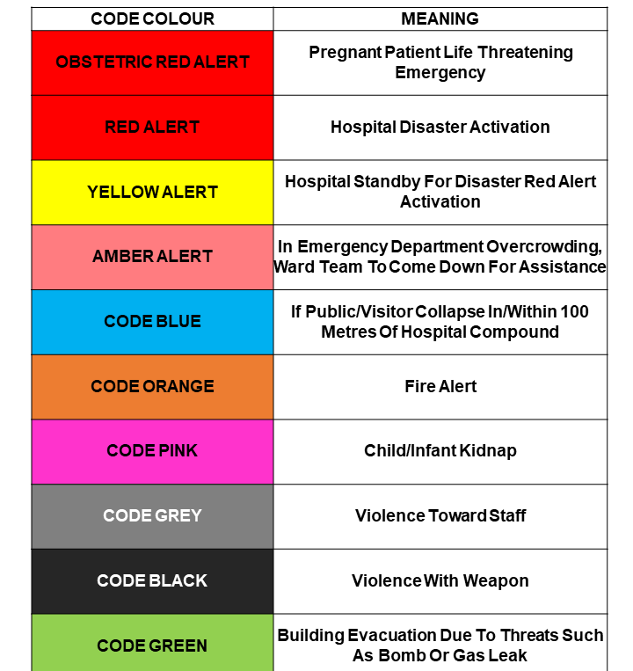

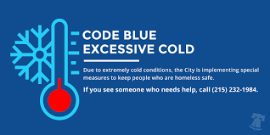
Choose your words
Avoid Jargon
Notes:
Ambiguous terms: bus
Codes: “Ten to 5 with 2 auto-peds with Cinderella sign” [diner order]
Abbreviations: “Dope.”
Homonyms: You, U, Frog protection?

Slide 17

Choose your words
Be aware of tone
Perception is reality
Questioning care ≠ you are doing the wrong thing
Notes:
Perception is reality -- you would read the same text differently if it was in each of those text bubbles
Tone, body language
Nobody wants to patronize anybody
Fine line to question a course of care without impugning it
“Did you give narcan” vs. “Why did you give Narcan” changing the tone makes this a question to “..., you idiot.”

Slide 18
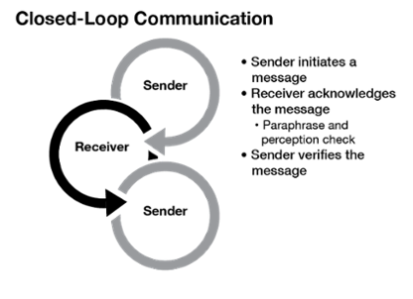
Choose your words
Close the loop
Important stuff should be read back
- med doses
- med routes
- important details
Erin Federer. Coria Communications, 2017
Notes:
Does not have to be lengthy; could just be a bullet point summary of what you heard
Make sure everyone’s starting with the same information
Allows the sender opportunity to verify that the message has been correctly received or to correct any errors
Important stuff: medication dosages, destinations, anything that will keep you awake at night
https://www.coria.com/blog/project-management/closingthelooponcommunication

Slide 19
Listening: how we can be the problem
Notes:
Distracted listening-- how we contribute to the problem
We spend a lot of time learning how to listen to patients but very little time learning how to listen to one another

Slide 20
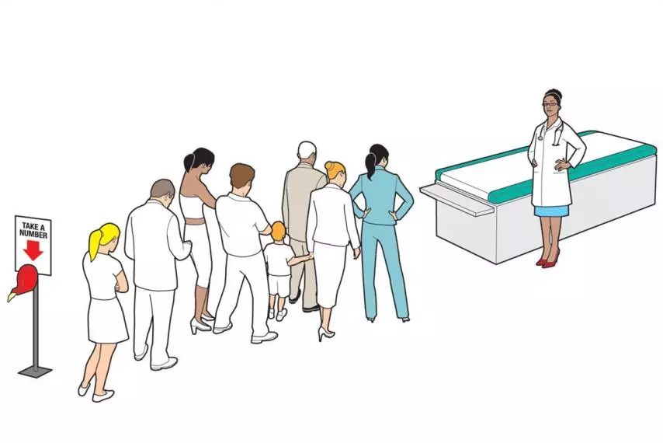
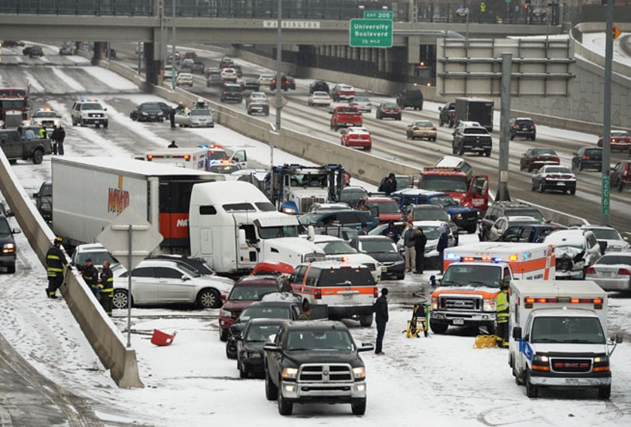
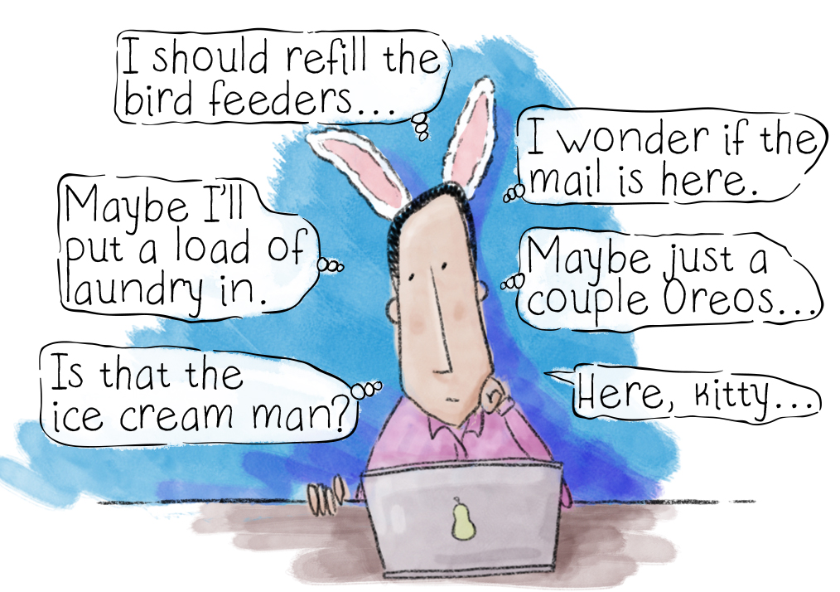
We are distracted
Newsweek BY SHANNON BROWNLEE ON 4/16/12 AT 12:00 AM
BY KEVANJATT | JULY 29, 2013 · 8:03 AM
Notes:
Whether you find yourself on scene with a patient, in the back of an ambulance or in the emergency department answering the phone, you are distracted.
Distractions come in the form of, Interruptions, patient clinical changes, what your bring to work
How we manage our distractions...
Nature of our work
In the same way we have to get away from this as much as possible to talk to a patient etc, don’t why would we listen in a similar way?
-- where/when do you answer the phone, make the call?
--

Slide 21
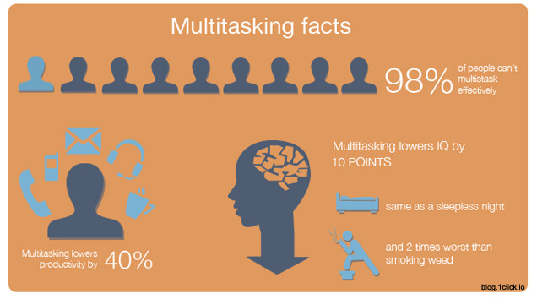
Multitasking
Is it even possible?
Multitasking vs. task switching
Tipping point
Implications to prehospital communications
Notes:
We think we are listening:
I’m going to _____ while I listen
In studies, about 70% of important information from hand off is recorded in Hospital record- BMJ review
To be possible at least one of the tasks must not require any thought- writing what you hear
Task switching is what most of us do. Switch from listening to putting in orders then back
At some point when we do multiple things some tasks start to get dropped and then take longer than they should-- sometimes this is okay,

Slide 22

“Most people do not listen with the intent to understand; they listen with the intent to reply.”
- Stephen covey

Slide 23
Seek to understand: Solving problems
Notes:
Seek to understand-- how we solve the problems once they start

Slide 24
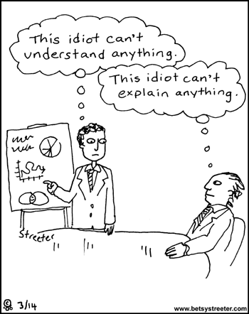
Before you decide they are an idiot...
What am I missing?
Confirmation bias
Anchoring
Did I actually listen?

Slide 25
Have a structure
Organize your thoughts

Slide 26


You are calling a Shop about a problem with your car
What information will be helpful to include?
What information is not helpful?
What will make the conversation frustrating?
What will impact the information you are able to provide?
What would be markers of success for your call?

Slide 27

1. Take a second to Collect your thoughts

Slide 28

2. What type of communication is this?
Hand off a patient to another crew/ED
Call for a consult/intervention
Call for a patient refusal
Setting up a hospital
Critical patient handoff in ED

Slide 29
3. Based on communication type, what needs to be conveyed?
Hand off a patient to another crew/ED
  What you know and have done
Call for a consult/intervention
  Why you need what you are calling about
Call for a patient refusal
  What the patient is refusing and that they can make that decision
Set up a hospital
  What do they need to know to get ready
Critical patient handoff in ED
  Brief highlights to illustrate what is critical and what you have done

Slide 30
4. Based on the patient in front of me what needs to be conveyed?
If they are sick- what illustrates that best?
Is there something abnormal on exam or evaluation you need to highlight?
Is there an “alert” of some variety you need to communicate?
Did you intervene on something?
Other specifically relevant?

Slide 31
5. Have a fall back Structure- every time
I’m _______ (prepare your listener) with agency _____
What you are about to do: I’m calling for/ I’m coming with/ Ready for report?…
I have a: Demos- age, gender
Communicate the most important stuff based on the objective of your call
Vitals
Add the other stuff if indicated
Questions: you can’t and shouldn’t try to anticipate all the things

Slide 32
When receiving Information
Get undistracted
Don’t take report until everybody is ready
Listen
Don’t re-distract yourself
Clarifying questions without interruptions
Closed loop communication

Slide 33
In Summary
Shared mental models are important to establish but sometimes hard to achieve
Listen
Choose your words (and tone)
Seek to understand
Have a Structure

Slide 34
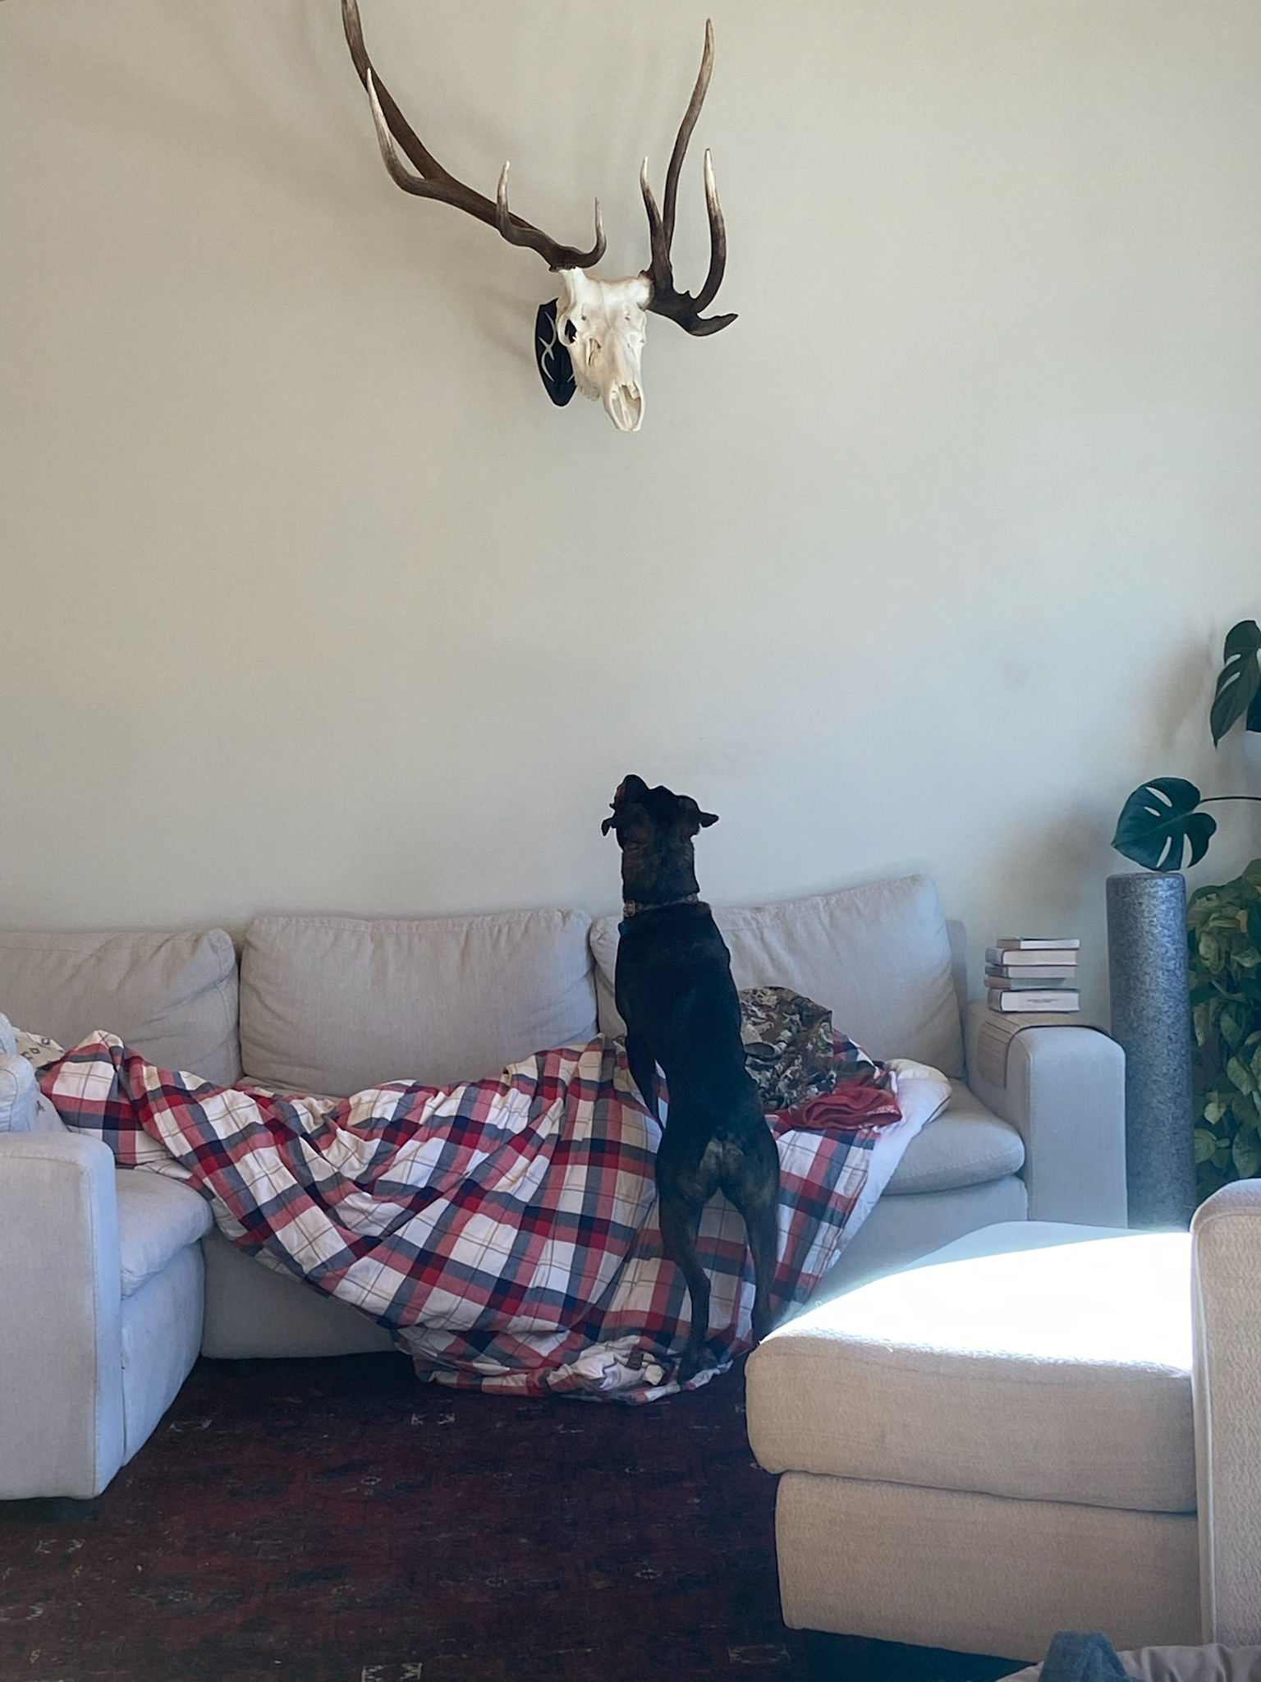
Questions?

