Slide 1
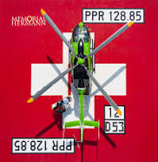

Trauma Airway Management
Christopher T. Stephens, MD, FAEMS
Professor
Anesthesiology
Emergency Medicine
McGovern Medical School
Chief, Trauma Anesthesiology
Memorial Hermann Hospital - TMC

Slide 2
Financial Disclosures
I have nothing to disclose

Slide 3

Question to ponder…….
So why paralytics and a bougie ???

Slide 4
Remember…….
**Every trauma airway is a difficult airway until proven otherwise……**

Slide 5
Famous quotes I have heard from experienced
EM / trauma providers……
“I always use a straight Miller blade”
“I was taught to pre-load the bougie”
“I only use a bougie if it’s a difficult airway”
“I can’t remember the last time I used a bougie”
“I’ve never missed a tube”
“Using a video laryngoscope is cheating”

Slide 6
Overview
Definition of RSI / DSI
Physiological Considerations of RSI / DSI
Pharmacological Considerations of RSI / DSI
Initial airway management – back to basics!
Checklists
Video
Case Reviews
Discussion

Slide 7
National Definition Confusion
Rapid Sequence Intubation (RSI)
  Use of a rapid acting neuromuscular blocking agent to facilitate intubation of the trachea
  Delayed Sequence Intubation (DSI)
  -Use of a rapid acting neuromuscular blocking agent to facilitate intubation of the trachea

Slide 8
Drug Facilitated Intubation (DFI)
  Use of a rapid acting neuromuscular blocking agent to facilitate intubation of the trachea

Slide 9
Physiology of Intubation…..
Goals? Type of injury/illness – Signs of Shock?
How much reserve do they have? (rapid desaturation)
Intrathoracic pressure – negative/positive What is the difference?
**You control their physiology once you take over the airway!!!!**

Slide 10
RSI / DSI Considerations
Cardiopulmonary reserve??
Signs of shock? Vitals?
Signs of tension PTX?
Drug choices?
Doses?
Volume resuscitation?
Physiological management after procedure

Slide 11
RSI / DSI Pharmacology
What are your goals?
What is current physiology?
Shock dosing of sedatives?
Paralytic only?

Slide 12
Optimizing the Patient
Basic airway skills!
Supplemental oxygen
Pre-oxygenation / de-nitrogenation
Positioning
Monitoring – ECG, SpO2, ETCO2, BP
Fluid bolus?
Blood?
Push dose pressors?
Why is pre-load important?

Slide 13
Preparing to RSI / DSI
How to set yourself up for success!

Slide 14
RSI / DSI Checklist
Why a RSI / DSI Checklist?

Slide 15
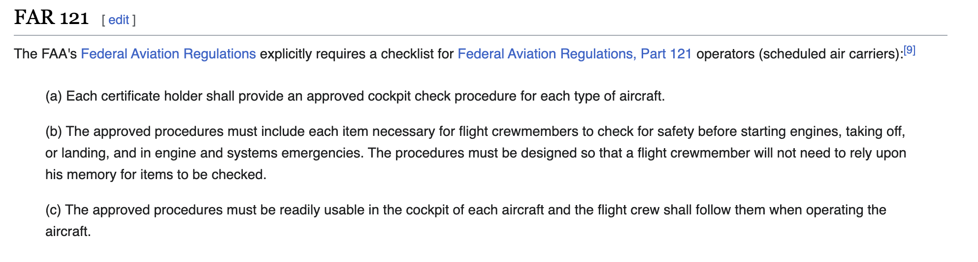
History of the FAA Check List
The concept of a pre-flight checklist was first introduced by engineers and management at the Boeing Company after the 1935 crash of the prototype Boeing B-17, then known as the Model 299. The pilots had forgotten to disengage the gust locks, which are devices that stop control surfaces from moving in the wind when parked, before take-off

Slide 16
Drug-facilitated Intubation Checklist
Patient Optimization / Pre-Oxygenation – basic oxygenation / ventilation
Continuous monitoring (SpO2, ETCO2, BP, HR, ECG)
Airway equipment out and ready:
  OPA/NPA, NRB/NC O2, BVM, iGel/SGA, ETTs, bougie, 10 cc syringe, video laryngoscope, backup laryngoscope, suction, surgical airway supplies per local guidelines

Slide 17
Checklist Con’t
Drugs drawn up and labeled (sedative, paralytic, push dose pressor)
Adequate IV/IO access (ensure patent line)
Hard Stop – all roles assigned, double check everyone is ready, equipment functioning
Rapidly administer and flush RSI sedative and/or rocuronium (this is the rapid part of RSI)
60 second timer (can gently BVM-assist patient while waiting to ensure adequate oxygenation - use 2-hand technique) **high dose rocuronium requires 60 second onset to ensure ideal intubating conditions**

Slide 18
Checklist Con’t
Perform laryngoscopy
Suction oropharynx as needed
Place bougie first, leave blade in place during procedure!
Assistant loads ETT over bougie
All hands off bougie during intubation!
Airway operator removes own bougie
Check cm depth of ETT at teeth or gums (female 20 or 21; males 23 or 24)
Confirm tube placement
Cycle BP without delay!
Secure ETT
**Push dose pressor ready**

Slide 19
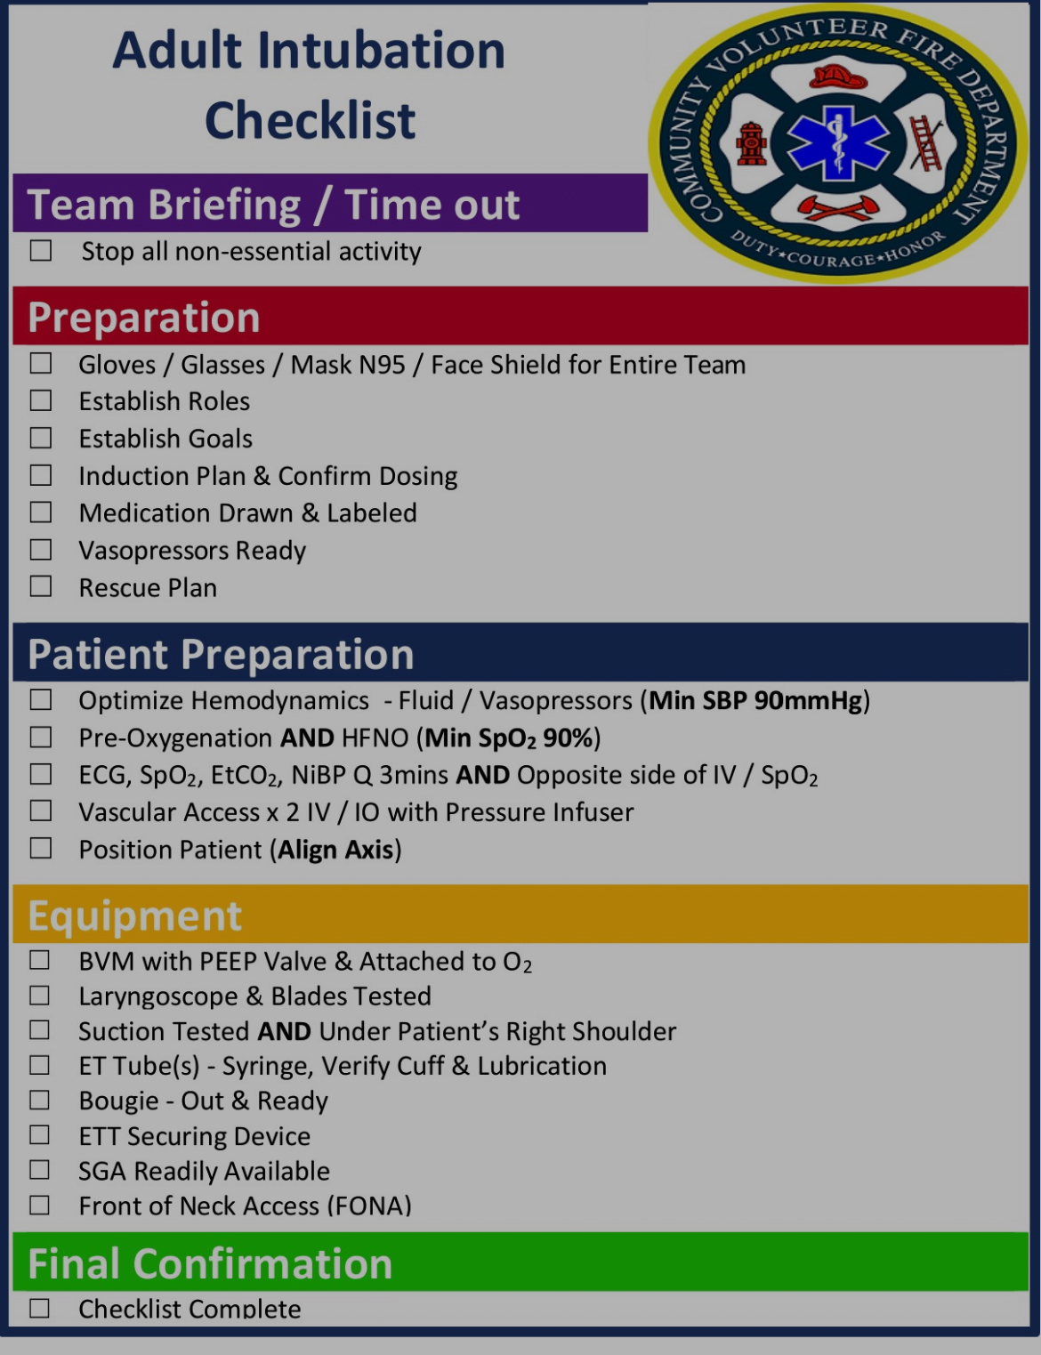

Slide 20
The Intubation Procedure
Wait 60 seconds for the Rocuronium to actually do its job and relax the patient!!
(you can gently assist with BVM oxygenation while waiting for drug to work)
Slow, deliberate laryngoscopy……slow down!
This is NOT a rapid / rushed procedure

Slide 21
RSI / DSI Myths
Must have O2 Sats above (91,92, 94, 95%) before intubating…
  ** V/Q mismatch can prevent this for hours to days!! **
Must wait 3 minutes for pre-oxygenation before intubating….
Must wait for 3 minutes after ketamine/etomidate before pushing roc…
The entire drug facilitated intubation procedure is rapid sequence…
Sedative only intubation works just as well (you can avoid paralytics by using high dose sedatives!)

Slide 22
RSI / DSI Pearls of Wisdom
Optimize Patient! (fluids/blood, push dose pressors)
Double check all assigned roles (pit-crew approach like cardiac arrest)
Double check all equipment out, ready, and functional
**Discuss drug selection and doses with each other and agree on plan**
Continuous monitoring throughout procedure
Immediate BP after intubation

Slide 23
Case Reviews
Shock Dose Ketamine / Rocuronium Intubation
Rocuronium only Intubation

Slide 24
Shock Dose Ketamine
76 y/o male respiratory distress sitting in bed assisted care living facility
History of recent cough
Lethargic
Unable to speak in sentences
Rhonchi breath sounds
Foley catheter in place with dark urine noted

Slide 25
Case Review (Shock dose ketamine)
Time | AVPU | BP | Pulse | RR | SPO2 | ETCO2 | GCS
11:04 | Voice | 89/59 | 126 | 32 | 77% | 11 | 3+2 +4 = 9
11:07 | Voice | 80/49 A | 105 | 23 | 91% | 11 | 9
11:10 | Voice | 94/33 | 125 | 20 | 95% | 15 | 9
11:17 | Pain | 88/55 | 132 | 7 | 90% | 5 | 8
11:18 | Unresponsive | 65/47 | 61 | 12 | 94 Ox | 33 | 1 + 1 + 1 = 3
Time | Treatment | Description
11:04 | Oxygen | 15 L NRB
11:05 | 12 lead
11:05 | IV | 20 g Hand
11:07 | IVF bolus | 500 cc
11:08 | Norepi Push | 10 mcg
11:13 | Norepi Push | 20 mcg
11:17 | Pre-O2 | BVM
11:18 | Ketamine | 25 mg
11:18 | Rocuronium | 100 mg
11:19 | Intubation | 7.0; at 25 cm

Slide 26
Case Review (Shock dose ketamine con’t)
Time | AVPU | BP | Pulse | RR | SPO2 | ETCO2 | GCS
11:21 | U | 127/77 | 123 | 14 | 96% | 24 | 3
11:23 | U | 67/46 | 114 | 14 | 96% | 23 | 3
11:25 | U | 150/85 | 125 | 20 | 95% | 35 | 9
Arr hosp | U | 123/75 | 1110 | 14 | 96% | 32 | 8
Time | Treatment | Description
11:23 | Norepi | 20 mcg
11:25 | Norepi drip | 10 mcg/min
 |  | 20 g Hand
11:27 | IVF bolus | 500 cc
 |  | 10 mcg

Slide 27
Rocuronium Only Intubation
55 y/o unrestrained male MVC entrapment
Extricated
GCS 3
BP 96/50
HR 100
NRB O2 with 95% saturation

Slide 28
Loaded in ambulance
Lacerations to face and head
Abdominal distention with bruising noted
Pupils sluggish on exam

Slide 29
Case Review (Roc only)
Time | AVPU | BP | Pulse | RR | SPO2 | ETCO2 | GCS
04:35 | Unresponsive | 96/60 | 106 | 24 | 95 |  | 1+1+1=3
04:39 | Unresponsive | 90/50 A | 98 | 22 | 95 |  | 1+1+1=3
04:42 | Unresponsive | 103/68 | 102 | 24 | 95 |  | 1+1+1=3
04:47 | Unresponsive | 130/79 | 101 | 16 | 96 | 38 | 1+1+1=3
04:49 | Unresponsive | 133/88 | 99 | 16 | 100 | 46 | 1+1+1=3
04:52 | Unresponsive | 125/76 | 103 | 18 | 100
04:55 | Unresponsive | 120/64 | 106 | 24 | 100 | 46 | 1+1+1=3
Time | Treatment | Description
04:38 | IO | Humeral head
04:39 | WB | Whole Blood
04:35 | O2 | NRB 15 LPM
04:45 | Rocuronium | 100 mg IV
04:46 | Intubation | VL / bougie
04:50 | CaCl | 1 gm
04:52 | TXA
04:54 | Fentanyl | 50 mcg
 |  | LF transported to TMC

Slide 30
Airway Conclusions
Have a plan and designate roles (Physicians, nurses, techs)
Have RSI / DSI checklist ready (Think like Pilots)
Prioritize treatments (resuscitate before / after airway secured)
Reassess, Reassess, Reassess – continuous monitoring (frequent BP measurements cycle every 1-3 minutes); A-line preferred

Slide 31
So where has this led us?
How do we correct the coagulopathy of trauma?
What studies have been done?
Where is the future headed?

Slide 32
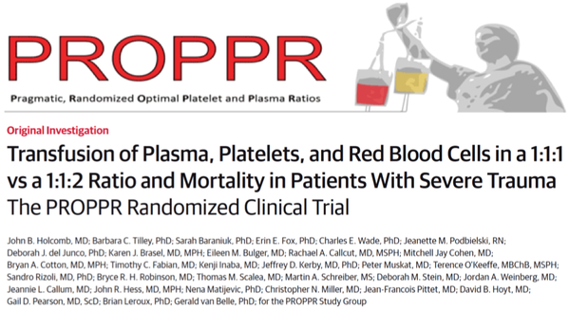

Slide 33
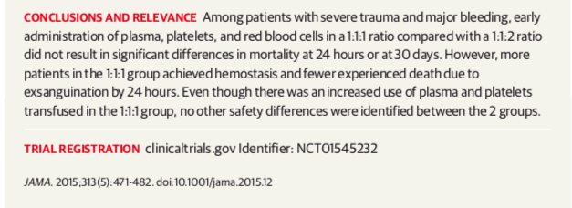

Slide 34
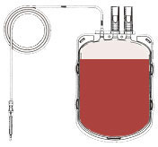
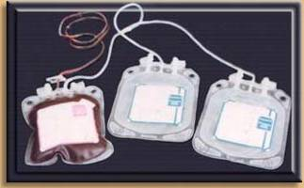
Component Therapy vs What we bleed
Plt
5.5x10¹⁰
50 mL
PRBC
Hct 55%
335 mL
FFP
80%
275 mL
500 mL
Hct: 38-44%
Plt: 150-400K
Coags: 100%
So Component Therapy Gives You
1U PRBC + 1U PLT + 1U FFP
  Hct 29%
  Plt 87K
  Coag activity 65%
  550 mg fibrinogen
600 mg Fibrinogen
Armand & Hess, Transfusion Med. Rev., 2003

Slide 35
Potentially Preventable Injury Mortality
Of the injured who will die, 50% die before they reach a hospital
Uncontrolled hemorrhage or MOF-related shock is the cause of death in about 40% of deaths
About 20% of hemorrhagic deaths appear to have been potentially preventable
  How many of these 20% were delayed in ED?
Notes:
Trauma deaths are frequently divided into 3 peaks: a very early peak (usually occurring in the field) due to severe CNS injury or massive hemorrhage such as catastrophic injury to the great vessels; a second peak in the first 24 hours of hospitalization that is most frequently due to failed hemorrhage control and coagulopathy; and a late peak which is generally due to multilple organ failure (MOF) and infection. Hemorrhage is generally the most common preventable cause of death in trauma patients.

Slide 36
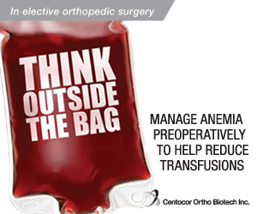
At UT Houston, we started our
whole blood program in 2016
Initially placed on Life Flight
Helicopters and in Trauma Bays
Success with early definitive
hemostatic resuscitation
(trend of overall fewer products given)
The Debate continues on which fluid is best for trauma resuscitation and early pre-operative resuscitation - **WHOLE BLOOD**

Slide 37
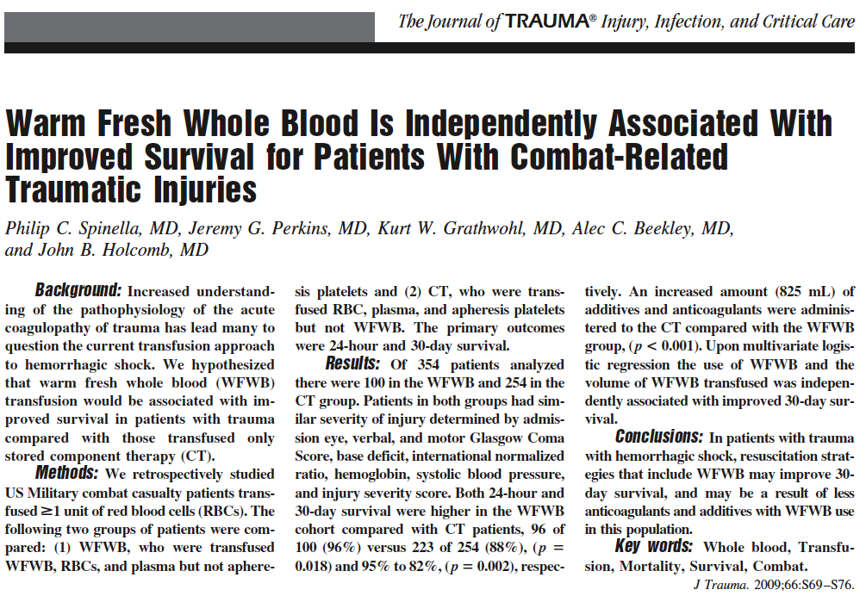
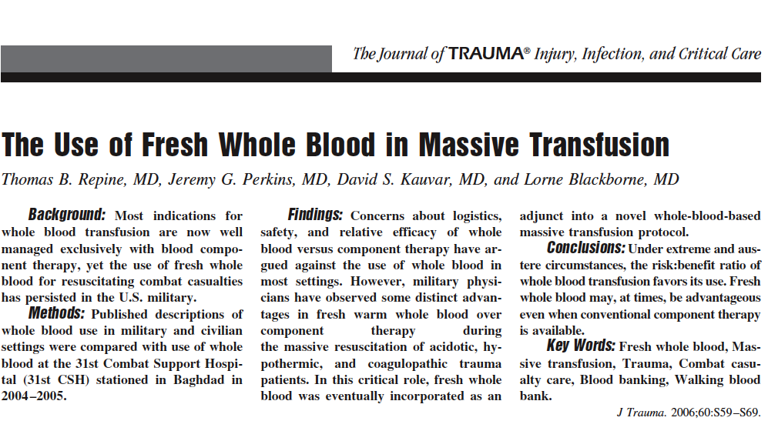
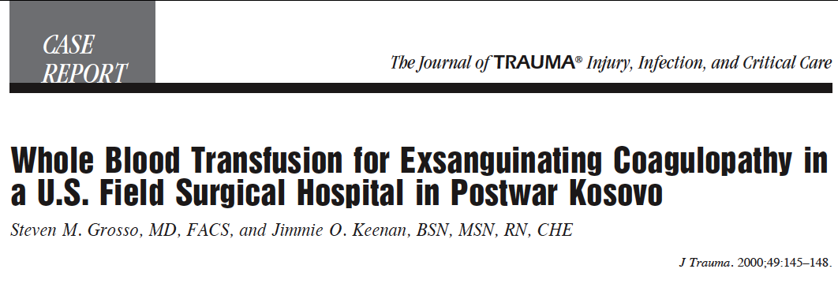

Slide 38
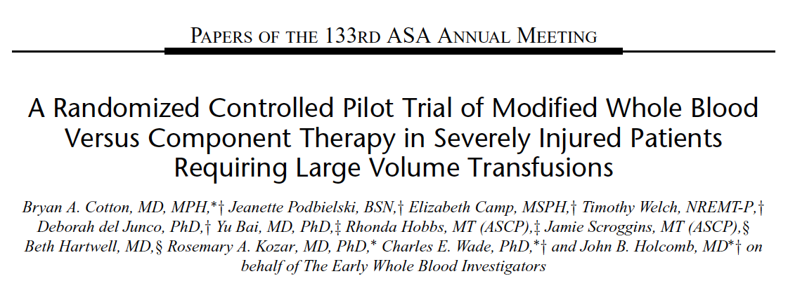

Slide 39
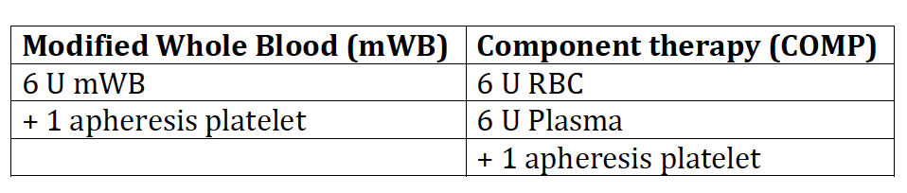
Methods- Randomization

Slide 40
Methods- Outcomes and definitions
Primary outcome: 24-hour product use
Secondary outcome: 24-hour and 30-day mortality

Slide 41
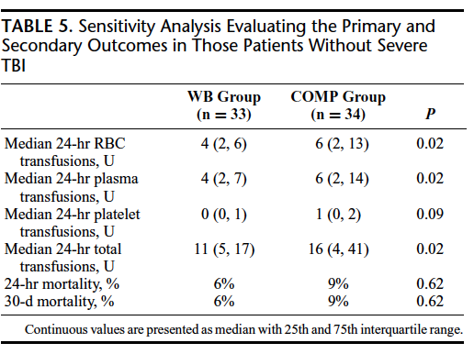

Slide 42
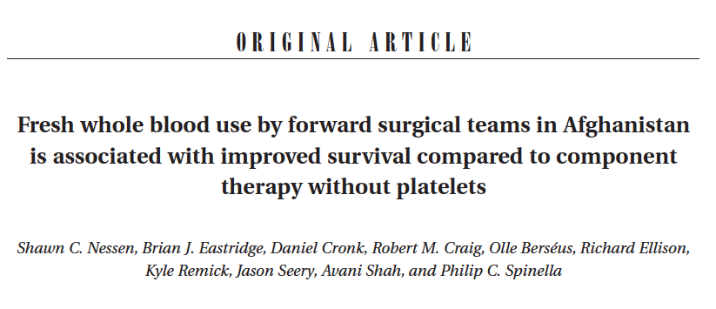

Slide 43
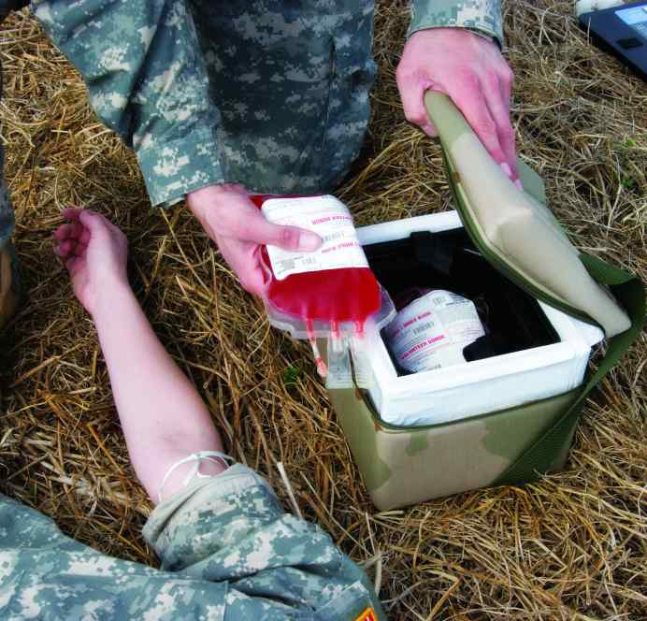
Golden Hour
Containers

Slide 44
Whole Blood Transfusion at MHH
Logistically simpler to provide rapidly to patients with life-threatening bleeding.
11/01/17: Trauma team at MHH-TMC began using low-titer Type O whole blood in trauma resuscitation.
Two (2) units on each helicopter and four (4) in the ED/Trauma Bay/Trauma OR cooler.

Slide 45
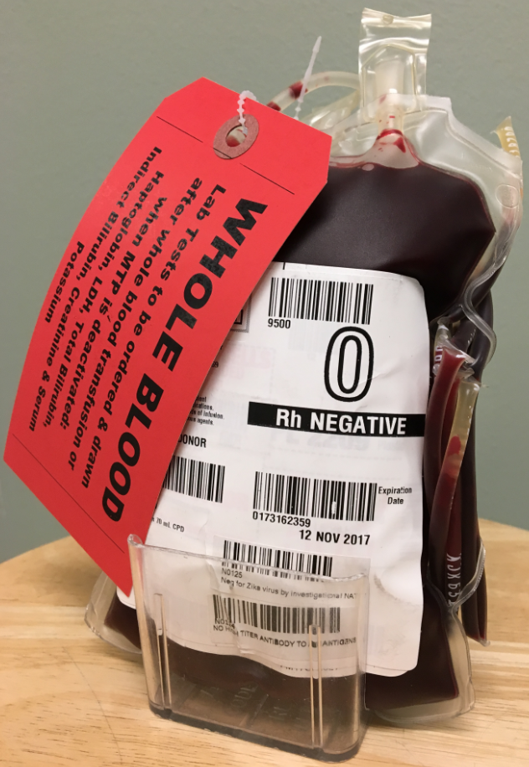

Slide 46
Goals of Resuscitation
Airway, Breathing, Circulation
Restore adequate intravascular volume
Restore clotting factors and platelets
Maintain lower MAP adequate to perfuse vital organs
Maintain adequate urine output
Correct acid-base abnormalities

Slide 47
UTSA and SAMMC
Started Pre-hospital Whole Blood program 2013
OB Physician experts consulted regarding low-titer O positive WB for females of child- bearing age….
It was supported for life-saving!

Slide 48
Pre-hospital
Ground and Air Medical – capabilities
        RSI
        eFAST (ultrasound on board)
        Whole Blood
        Fluid Warmer
        Speed
        Direct admit to OR

Slide 49
Summary
Whole blood is a safe, feasible alternative
Superior hemostatic profile
Less donor exposures per transfusion

Slide 50
christopher.stephens@uth.tmc.edu
QUESTIONS?

