Slide 1
Use of HCV Direct-Acting Antivirals in Patients with Swallowing Difficulties: Focus on Epclusa® and Mavyret®
Jessica Orizu, PharmD Candidate 2025
November 6th, 2024

Slide 2

Outline
Background and Overview
Significance
Epclusa® Information
Mavyret® Information
Manufacturers’ Recommendations
Clinical Studies and Case Reports
National Liver Entities’ Guidelines
My Recommendations

Slide 3
Overview
  Chronic hepatitis C (HCV) impacts around 70 million people worldwide and can lead to severe liver complications, including cirrhosis and hepatocellular carcinoma.
  In 2021, the CDC identified 107,540 new chronic HCV diagnoses across the U.S. The age group with the newest cases was 30-39, followed by individuals aged 60 and older.
  Direct Acting Antivirals of Focus: Epclusa® (sofosbuvir/velpatasvir) and Mavyret®
  (glecaprevir/pibrentasvir) have shown over 95% cure rates in HCV across multiple genotypes.
  Although DAAs have transformed HCV therapy with high cure rates and minimal side effects, there is limited data on DAA use in patients who require tablet manipulation due to conditions like dysphagia.
HCV Epidemiology in the United States. Hepatitis C Online. January 2, 2024. https://www.hepatitisc.uw.edu/go/screening-diagnosis/epidemiology-us/core-concept/all.
Whelchel K, Zuckerman AD, Koren DE, Derrick C, Bouchard J, Chastain CA. Crushing and Splitting Direct-Acting Antivirals for Hepatitis C Virus Treatment: A Case Series and Literature Review. Open forum infectious diseases. 2021;8(11):ofab525.
Notes:
According to data from the 2017-2020 NHANES survey, an estimated 2.2 million individuals in the United States were HCV RNA positive during this period. Over half of those living with HCV are aged 55 or older, with the highest prevalence (2.4%) observed among individuals aged 55-64.

Slide 4
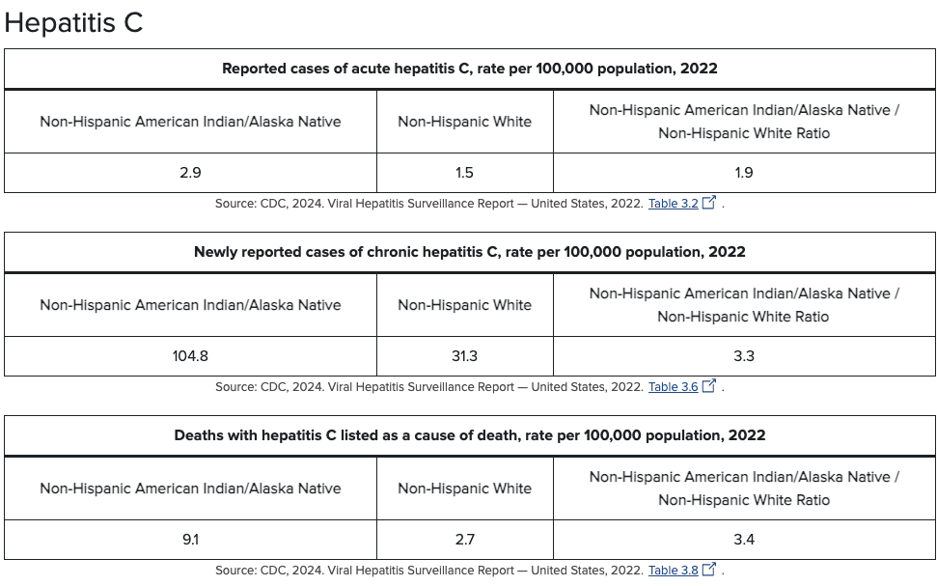
Overview
HCV Stats in AI/AN Population
Hepatitis and American Indians/Alaska natives. U.S. Department of Health and Human Services. October 29, 2024. Accessed November 4, 2024.

Slide 5
Significance
Prevalence of Swallowing Difficulties
(15-20%)
Impact on Adherence
Maximizing Clinical Outcomes
Notes:
Prevalence of Swallowing Difficulties: Approximately 15% -20% of older adults report dysphagia; with an increased risk in adults with debilitating conditions.
Impact on Adherence: Swallowing issues can compromise adherence to treatment. Poor adherence in HCV therapy can lead to reduced sustained virologic response (SVR), increasing the risk of viral resistance and treatment failure.
Maximizing Clinical Outcomes: Non-adherence or altered administration methods (like crushing tablets) can lead to suboptimal drug absorption, potentially reducing the effectiveness of HCV therapies. Studying the effects ensures the treatment’s efficacy remains high even in modified forms.

Slide 6
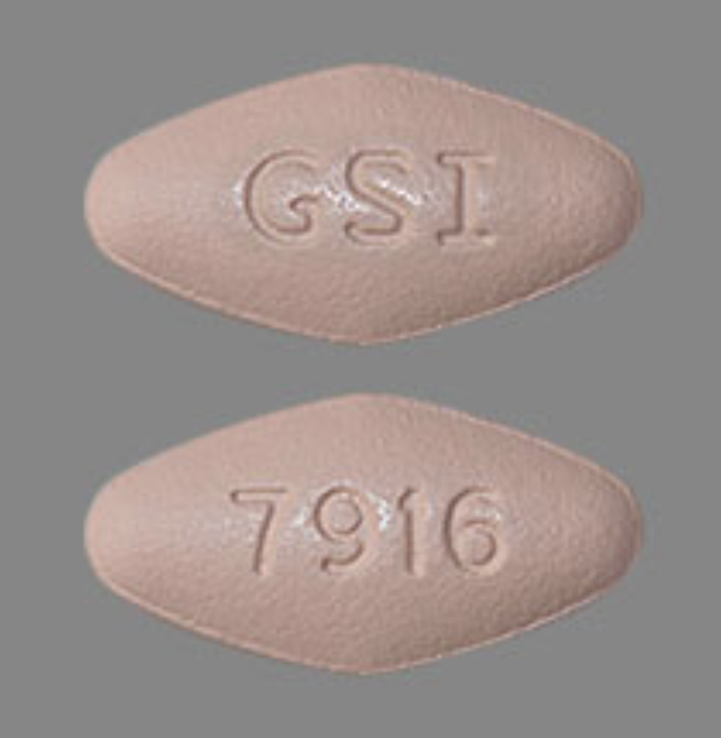
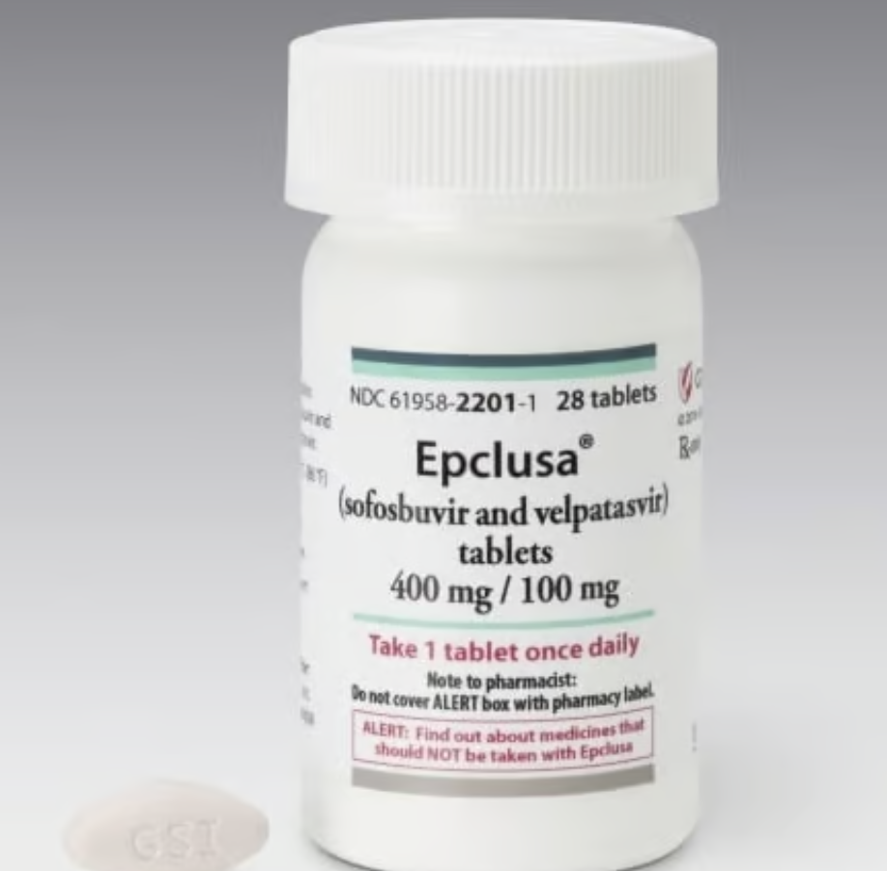
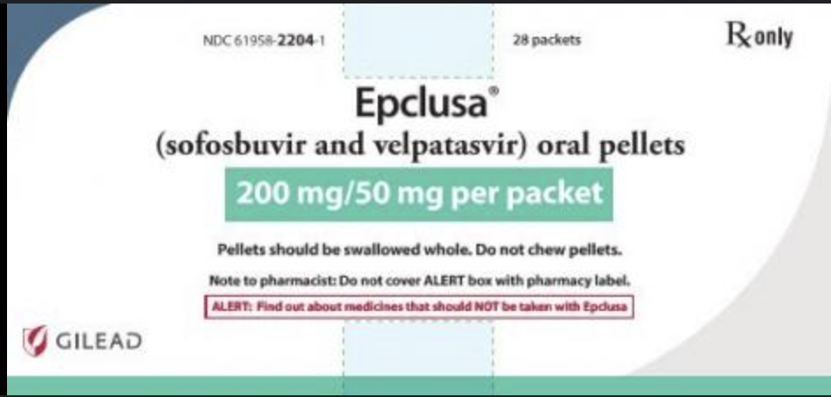
Epclusa®
Composition: Epclusa contains sofosbuvir a hepatitis C virus (HCV) nucleotide analog NS5B polymerase inhibitor, and velpatasvir, an HCV NS5A inhibitor, and targets multiple HCV genotypes.
Indications: the treatment of adult patients and pediatric patients 3 years of age and older with chronic HCV genotype 1, 2, 3, 4, 5 or 6 infections:
  Without cirrhosis or with compensated cirrhosis
  HCV/HIV-1 coinfection
  With decompensated cirrhosis for use in combination with ribavirin
Gilead Sciences Inc, EPCLUSA® (sofosbuvir and velpatasvir) tablets, for oral use. US Prescribing Information. Foster City, CA.

Slide 7
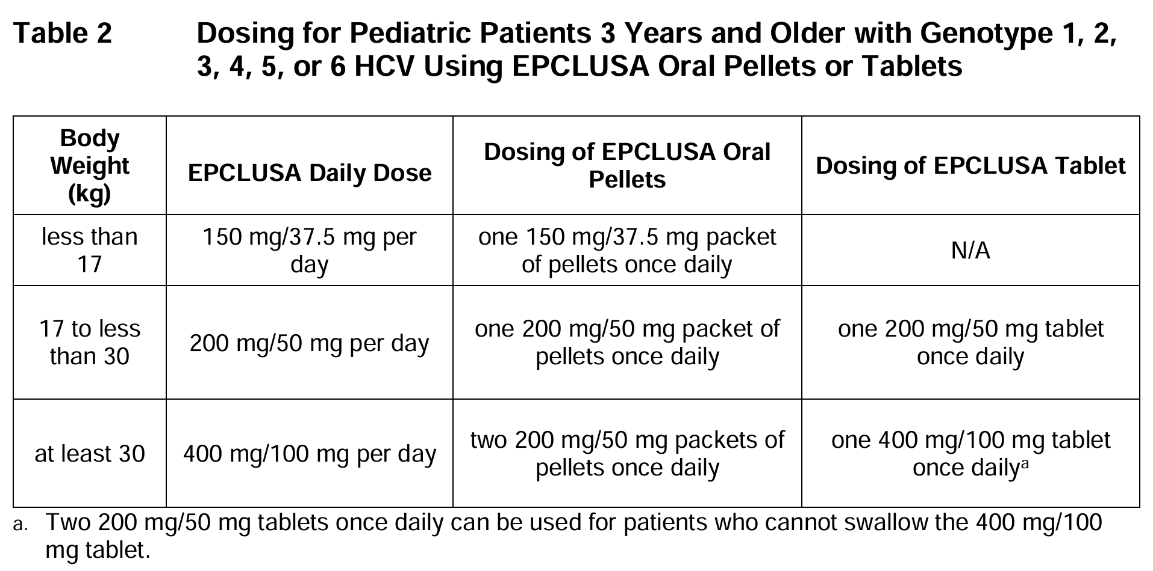
Epclusa®
Tablets: One tablet (400 mg of sofosbuvir and 100 mg of velpatasvir) taken orally once daily with or without food.
Oral pellets: once daily with or without food. In pediatric patients less than 6 years of age, administer the oral pellets with food to increase tolerability.
Administration: There is no information in the SOF/VEL product labeling about the crushing or splitting of SOF/VEL tablets. Oral pellets should not be chewed to avoid a bitter aftertaste.
Dosing: 12-week regimen
Gilead Sciences Inc, EPCLUSA® (sofosbuvir and velpatasvir) tablets, for oral use. US Prescribing Information. Foster City, CA.
Notes:
Make the admin part stand out

Slide 8
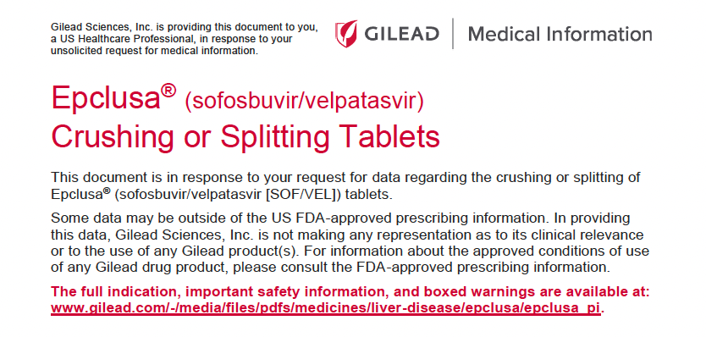
“There are no Gilead studies evaluating the efficacy, safety, and PK parameters of a disintegrated, crushed, or split SOF/VEL tablet versus the whole tablet in a randomized controlled trial.”

Slide 9
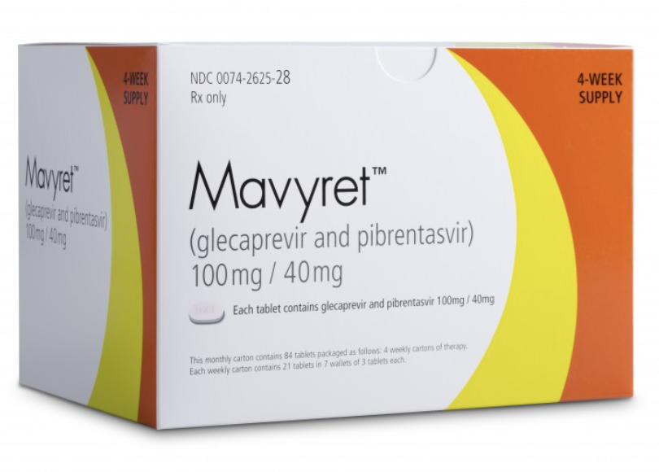
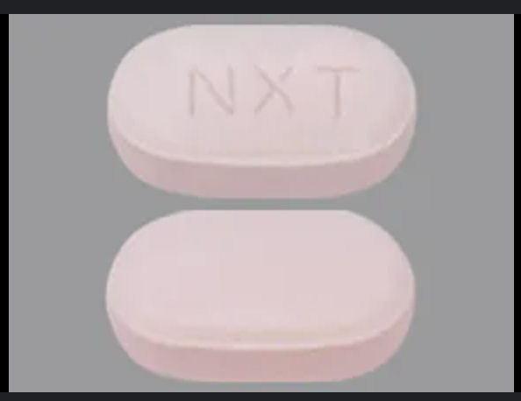
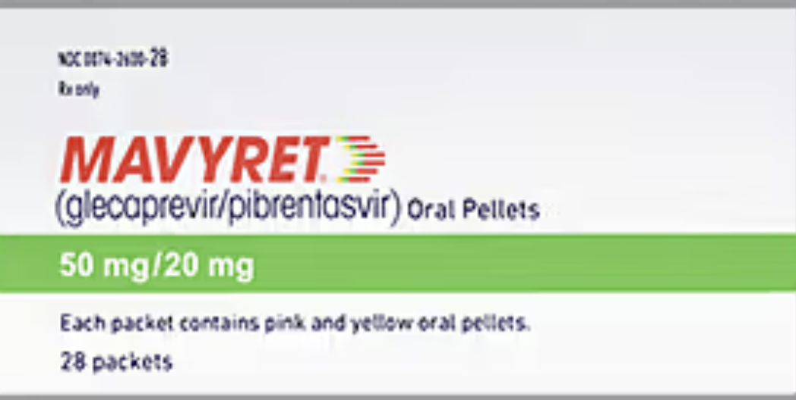
Mavyret®
Composition: Mavyret combines glecaprevir, a hepatitis C virus (HCV) NS3/4A protease inhibitor, and pibrentasvir, an HCV NS5A inhibitor effective against HCV genotypes 1-6.
Indications: the treatment of adult patients and pediatric patients 3 years of age and older with chronic HCV genotype 1, 2, 3, 4, 5 or 6 infections:
  Without cirrhosis or with compensated cirrhosis
  HCV genotype 1 infection, who previously have been treated with a regimen containing an HCV NS5A inhibitor or an NS3/4A protease inhibitor, but not both.
AbbVie Inc. MAVYRET® (glecaprevir and pibrentasvir) tablets, for oral use. US Prescribing Information. North Chicago, IL. Revised October 2023.

Slide 10
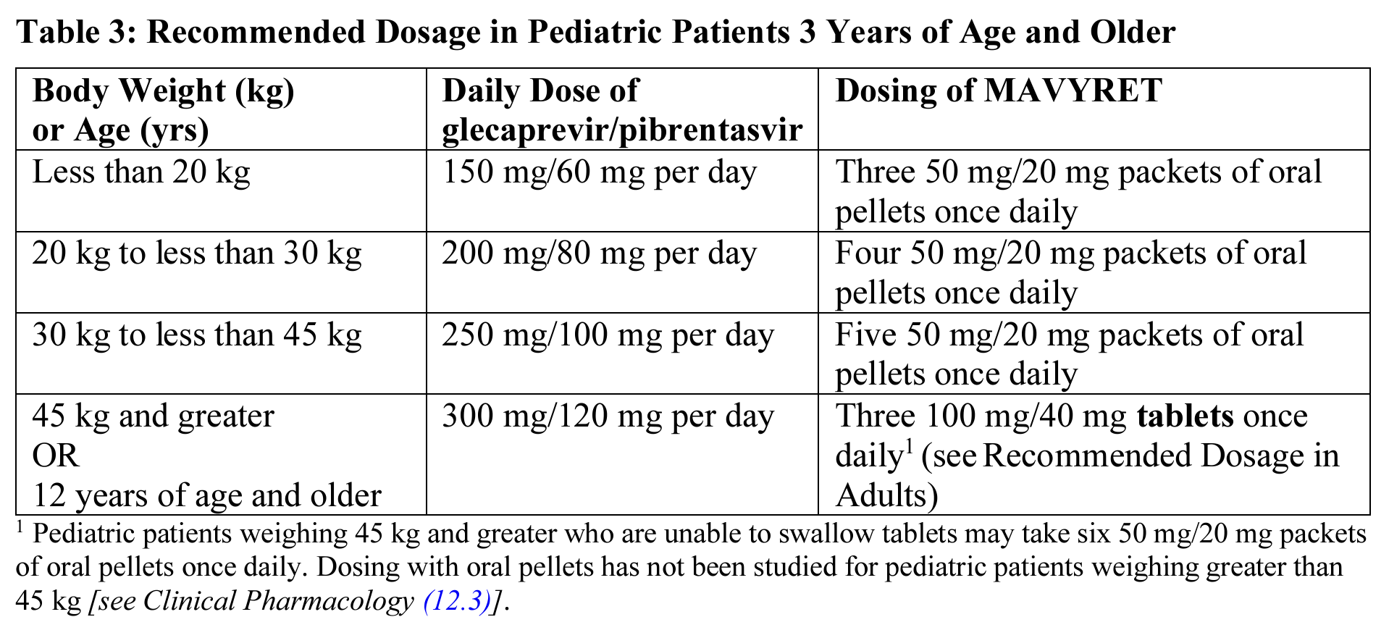
Mavyret®
Dosing: 8-week regimen except in specific patient populations.
Tablets: Three tablets (glecaprevir 300 mg and pibrentasvir 120 mg) taken orally once daily with food.
Oral pellets: Recommended dose by the product labeling with soft food.
Pediatric patients aged 3-12 are dosed by weight.
Administration: There is no information in the product labeling about the crushing or splitting of tablets. Oral pellets should not be chewed or crushed.
AbbVie Inc. MAVYRET® (glecaprevir and pibrentasvir) tablets, for oral use. US Prescribing Information. North Chicago, IL. Revised October 2023.
Notes:
Remember to say that unfortunately could not reach Abbvie (manufacturers of Mavyret for specific recommendations, resources or data)

Slide 11
CLINICAL TRIALS
Notes:
It is important to note that these are not studies performed by manufacturers of these drugs.

Slide 12
DONATE HCV TRIAL
This clinical trial, explored the viability of heart and lung transplants from HCV-positive donors into HCV-negative recipients, using Epclusa as a preemptive antiviral therapy.
Despite this modified administration, 35 patients achieved SVR12 and SVR24. No treatment-related adverse events were reported, highlighting both the efficacy and safety of crushed Epclusa under these conditions​
For patients with swallowing difficulties, the tablets were crushed, mixed with saline, and administered via alternative routes, including orogastric, nasogastric (NG), and percutaneous endoscopic gastrostomy (PEG) tubes.
Population: 44 transplant recipients (36 lung and 8 heart transplants) from HCV-infected donors.
Treatment Protocol: Epclusa (400 mg sofosbuvir and 100 mg velpatasvir) was given once daily for 4 weeks.
Woolley AE, Singh SK, Goldberg HJ, et al. Heart and Lung Transplants from HCV-Infected Donors to Uninfected Recipients. N Engl J Med. 2019;380(17):1606-1617. https://www.ncbi.nlm.nih.gov/pubmed/30946553
Notes:
A single-center, open-label pilot study at Brigham and Women’s Hospital in Boston
Administration began within hours post-transplant to block viral replication, simulating post-exposure prophylaxis rather than treatment for established HCV infection. A total of 42 of the 44 transplant recipients (95%) had a detectable hepatitis C viral load immediately after transplantation. This regimen was not associated with any identifiable toxic effects, and 100% adherence to the treatment was achieved. This short 4-week course of treatment was probably successful because this situation is analogous to postexposure prophylaxis rather than treatment of established infection (in which 8 to 12 weeks of treatment are administered in patients with typically higher viral loads)
Why only 35? The trial was designed with a "stopping boundary" for efficacy, a pre-set point at which, if crossed, the trial could be considered successful enough to stop early. In February 2018, this boundary was reached, as the first 13 patients with six months of follow-up showed a SVR. By February 2018, 35 patients had been enrolled, and the outcomes for these patients are presented. The trial continued to enroll more patients to deepen understanding and confirm the initial promising results, ensuring the findings were robust and applicable across a larger population.
This was most often required in the immediate post-transplant period for at least the first 2 doses of SOF/VEL prior to extubation.

Slide 13
CASE SERIES

Slide 14
CASE SERIES 1
A Case Series of Safety and Efficacy of Crushed Sofosbuvir/Velpatasvir in Hepatitis C Infected Patients
Study Methods
  Data were gathered from 13 U.S. medical centers, with providers submitting deidentified records for patients treated with crushed Epclusa.
Results
  Participants: 19 patients (11 female, 8 male); predominantly White (11), followed by Hispanic (4), Black (3), and other (1).
  HCV Genotypes: GTs were 1 (11 patients) and 3 (8 patients).
  Fibrosis Scores: Available for 15 patients, ranging from F0 (minimal fibrosis) to F4 (severe fibrosis).
  Administration: Patients received crushed Epclusa orally, via NG tube, PEG tube, or J-tube, with solvents such as soda, juice, and water.
Efficacy: 100% of patients with end-of-treatment data had an undetectable viral load, and 95% achieved SVR12.
Safety: No patients reported on-treatment adverse events, and no therapy discontinuations occurred.
Joshi S, Cohen M, Katz R, et al. A Case Series of Safety and Efficacy of Crushed Sofosbuvir/Velpatasvir in Hepatitis C Infected Patients [Poster]. Paper presented at: American Association for the Study of Liver Diseases (AASLD): The Liver Meeting Digital Experience; 12-15 November 2021.
Notes:
Background
This case series, presented at the AASLD 2021 Liver Meeting, addresses the lack of safety and efficacy data for patients who require crushed Epclusa due to swallowing difficulties.
The study demonstrated high cure rates (SVR12) and no significant safety concerns for HCV patients receiving crushed Epclusa. Even with predictors of treatment failure (e.g., genotype 3, dose interruptions, and surgical history), patients achieved effective viral suppression, suggesting crushed Epclusa is a viable option when standard administration is not possible.
8 patients received crushed oral SOF/VEL (1 dissolved in soda, 6 dissolved in other and 1 none), 3 patients received crushed SOF/VEL via NG tube (1 in juice and 2 in water). 7 patients received dosing via PEG-tube (1 mixed in soda, 2 in water, and 4 in other). 1 received dosing via J tube mixed in water.
16 patients received 84 consecutive days of therapy. 3 patients had dose interruptions but completed the full course of therapy.

Slide 15
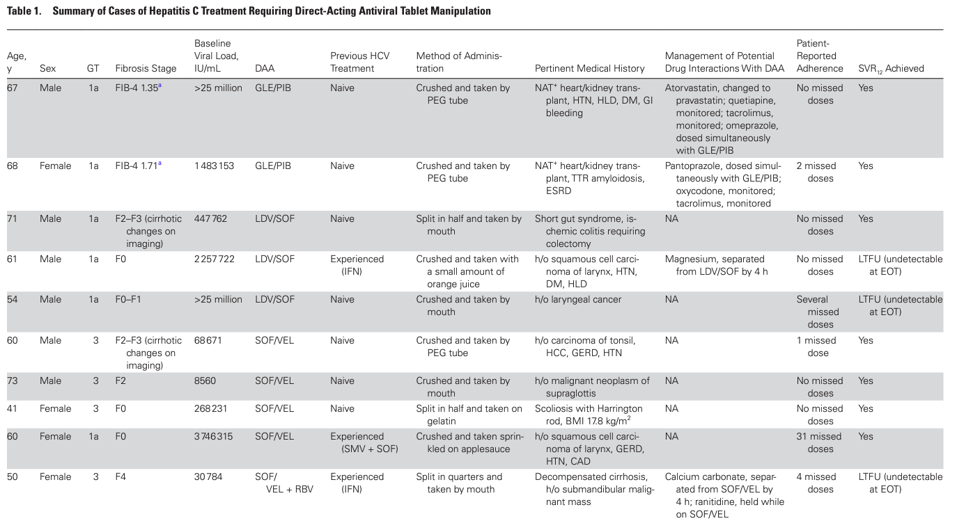
CASE SERIES 2: Tablet Manipulation of DAAs for HCV Treatment
LTFU = lost to follow up
EOT = end of treatment
Whelchel K, Zuckerman AD, Koren DE, Derrick C, Bouchard J, Chastain CA. Crushing and Splitting Direct-Acting Antivirals for Hepatitis C Virus Treatment: A Case Series and Literature Review. Open forum infectious diseases. 2021;8(11):ofab525.
Notes:
retrospective case series of patients prescribed DAA therapy requiring tablet manipulation from January 2013 to December 2019 at Vanderbilt University Medical Center, Temple University or the University of South Carolina
Methods:
Participants: 10 patients were included, with a median age of 61 years; 60% were male, 50% were Black, and the other half were White.
HCV Genotypes and Treatments: The most common genotype was 1a. Patients received sofosbuvir/velpatasvir (50%), ledipasvir/sofosbuvir (30%), or glecaprevir/pibrentasvir (20%). 70% of the patients had tablets crushed, while the remainder had tablets split.
70% of the patients had tablets crushed, while the remainder had tablets split.
All patients were prescribed 12 weeks of DAA therapy and had undetectable HCV viral loads by day 56 on treatment.

Slide 16
CASE SERIES 2: Tablet Manipulation of DAAs for HCV Treatment
Reasons for manipulation included dysphagia due to cancer or anatomical changes, short gut syndrome, and post-transplant intubation. Patients received 12 weeks of treatment, and adherence was monitored.
Outcomes:
  Efficacy: All patients achieved undetectable viral loads within 56 days of treatment initiation, with a median time to viral suppression of 33 days. Those with follow-up data achieved SVR12.
  Adverse Events: No severe adverse events were reported, though four patients noted an unpleasant taste.
Whelchel K, Zuckerman AD, Koren DE, Derrick C, Bouchard J, Chastain CA. Crushing and Splitting Direct-Acting Antivirals for Hepatitis C Virus Treatment: A Case Series and Literature Review. Open forum infectious diseases. 2021;8(11):ofab525.
Notes:
This study, published in Open Forum Infectious Diseases, presents the largest and most comprehensive case series on tablet manipulation of DAAs for HCV treatment, providing insights into the safety and efficacy of crushed or split DAA use in patients unable to swallow tablets. The study reviewed cases of patients prescribed DAA therapies, including Epclusa, who required tablet manipulation from 2013 to 2019. Data was collected on demographics, HCV genotype, treatment methods, and outcomes.
Adherence was generally high, with most patients completing treatment with four or fewer missed doses.

Slide 17
CASE REPORTS

Slide 18
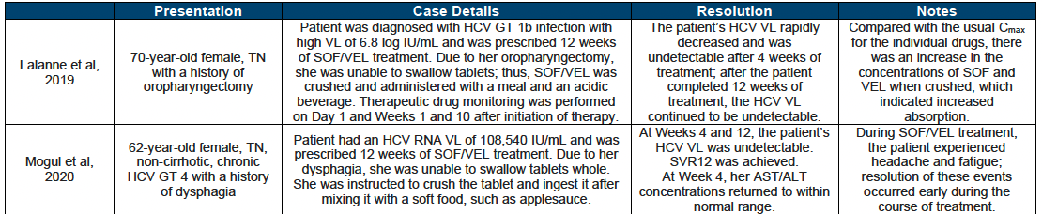
Summary of Case Reports of Patients Receiving Crushed SOF/VEL
Lalanne S, Jezequel C, Tron C, et al. TDM-Guided Crushed Sofosbuvir-Velpatasvir Treatment: A Case Study [Accepted]. Ther Drug Monit. 2019. https://www.ncbi.nlm.nih.gov/pubmed/31809407
Mogul A, Teixeira E, McAuliffe L, Promrat K, Zullo AR. Effectiveness of Crushed Sofosbuvir-Velpatasvir in a Patient with Dysphagia. Am J Health Syst Pharm. 2020. https://www.ncbi.nlm.nih.gov/pubmed/31930300

Slide 19
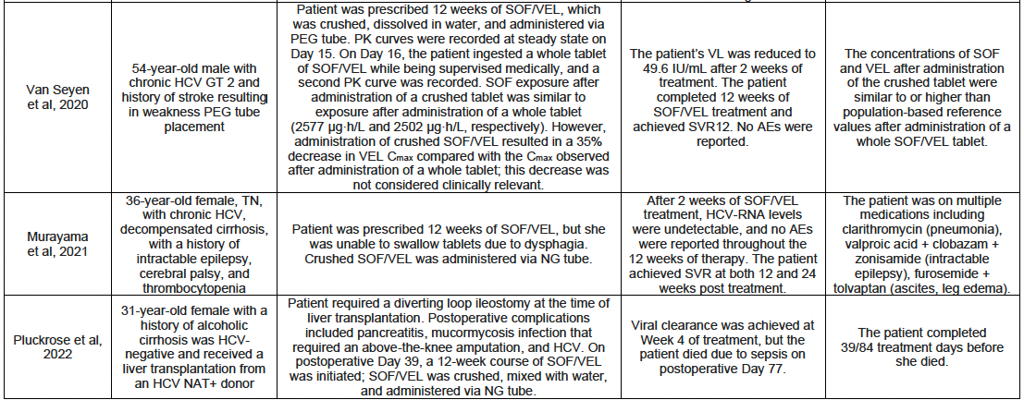
Summary of Case Reports of Patients Receiving Crushed SOF/VEL
Van Seyen M, Samson AD, Cullen L, et al. Crushed Application of Sofosbuvir and Velpatasvir in a Patient with Swallowing Disorder [Journal Pre-Proof]. Int J Antimicrob Agents. 2020.
https://www.ncbi.nlm.nih.gov/pubmed/32156618
Murayama A, Tajiri K, Kanegane C, Murakami J, Hayashi Y, Yasuda I. Successful Treatment with Crushed Sofosbuvir/Velpatasvir of a Patient with Decompensated Cirrhosis C and Thrombocytopenia. Case Rep Gastroenterol. 2021;15(2):729-735.
Pluckrose DM, Szczepanik A, Bova SE, Freedman SR. Hepatitis C viral clearance with coadministration of crushed sofosbuvir/velpatasvir and high-dose pantoprazole after liver transplantation [Accepted Manuscript]. Am J Health Syst Pharm. 2022.https://www.ncbi.nlm.nih.gov/pubmed/35675479

Slide 20


National Liver Entities’ Guidelines
The AASLD/EASL guidelines do not provide specific recommendations on the use of HCV antivirals in patients with swallowing difficulties.

Slide 21
My Recommendations
Tablet Manipulation Not Recommended by Manufacturers
  Both Gilead and AbbVie do not recommend crushing or splitting tablets due to insufficient pharmacokinetic, safety, and efficacy data.
Case-by-Case Consideration
  In the absence of specific guidelines for patients with swallowing difficulties, tablet manipulation should be evaluated on a case-by-case basis.
Oral Pellet Alternative
  While oral pellets may serve as an alternative for those with swallowing difficulties, this option may increase pill burden and cost, potentially impacting adherence.
Data Gap in AI/AN Population
  There is a lack of published data on the efficacy of tablet manipulation in the American Indian/Alaska Native (AI/AN) population.
Notes:
Case by Case: some positive data exists, and this is happening clinically.
Oral Pellet: Although pellets of commonly prescribed HCV DAAs are now approved for pediatric use, these are unlikely to be used in the real-world adult population as multiple packets (ranging from 2 to 6) would be needed to constitute an adult dose, which may exceed the costs of standard tablets and prove a barrier during the insurance authorization process
Data Gap:. “maybe something that ECHO could consider publishing in the future via case report or series?” I recommend the ECHO organization consider a case series within their health systems to address this gap

Slide 22
References
Hepatitis and American Indians/Alaska natives. U.S. Department of Health and Human Services. October 29, 2024. Accessed November 4, 2024.
Gilead Sciences Inc, EPCLUSA® (sofosbuvir and velpatasvir) tablets, for oral use. US Prescribing Information. Foster City, CA
AbbVie Inc. MAVYRET® (glecaprevir and pibrentasvir) tablets, for oral use. US Prescribing Information. North Chicago, IL. Revised October 2023.
Woolley AE, Singh SK, Goldberg HJ, et al. Heart and Lung Transplants from HCV-Infected Donors to Uninfected Recipients [Supplementary Appendix]. N Engl J Med. 2019;380(17):1606-1617. https://www.ncbi.nlm.nih.gov/pubmed/30946553
Joshi S, Cohen M, Katz R, et al. A Case Series of Safety and Efficacy of Crushed Sofosbuvir/Velpatasvir in Hepatitis C Infected Patients [Poster]. Paper presented at: American Association for the Study of Liver Diseases (AASLD): The Liver Meeting Digital Experience; 12-15 November, 2021.
Whelchel K, Zuckerman AD, Koren DE, Derrick C, Bouchard J, Chastain CA. Crushing and Splitting Direct-Acting Antivirals for Hepatitis C Virus Treatment: A Case Series and Literature Review. Open forum infectious diseases. 2021;8(11):ofab525.
Lalanne S, Jezequel C, Tron C, et al. TDM-Guided Crushed Sofosbuvir-Velpatasvir Treatment: A Case Study [Accepted]. Ther Drug Monit. 2019. https://www.ncbi.nlm.nih.gov/pubmed/31809407
Mogul A, Teixeira E, McAuliffe L, Promrat K, Zullo AR. Effectiveness of Crushed Sofosbuvir -Velpatasvir in a Patient with Dysphagia. Am J Health Syst Pharm. 2020. https://www.ncbi.nlm.nih.gov/pubmed/31930300
Van Seyen M, Samson AD, Cullen L, et al. Crushed Application of Sofosbuvir and Velpatasvir in a Patient with Swallowing Disorder [Journal Pre-Proof]. Int J Antimicrob Agents. 2020. https://www.ncbi.nlm.nih.gov/pubmed/32156618
Murayama A, Tajiri K, Kanegane C, Murakami J, Hayashi Y, Yasuda I. Successful Treatment with Crushed Sofosbuvir/Velpatasvir of a Patient with Decompensated Cirrhosis C and Thrombocytopenia. Case Rep Gastroenterol. 2021;15(2):729-735.
Pluckrose DM, Szczepanik A, Bova SE, Freedman SR. Hepatitis C viral clearance with coadministration of crushed sofosbuvir/velpatasvir and high-dose pantoprazole after liver transplantation [Accepted Manuscript]. Am J Health Syst Pharm. 2022. https://www.ncbi.nlm.nih.gov/pubmed/35675479

Slide 23
THANK YOU!!!!
Jessica Orizu, PharmD Candidate 2025
cjorizu@umich.edu
Acknowledgement
CDR Nicholas Cushman, PharmD, MHA, BCACP
Indian Country ECHO

