Slide 1
Ketamine and Esketamine
A review of evidence and current uses in psychiatry
For NPAIHB Indian Country Substance Use Disorders (SUD) ECHO
September 5, 2024
Lucas M Dunklee, MD

Slide 2
Disclosures
No disclosures to report
Janssen Pharmaceuticals has been of occasional assistance, but provides no incentives or compensation to UNM psychiatric providers

Slide 3
About Dr. Dunklee
Outpatient psychiatrist with ABPN board certification in adult general psychiatry
Assistant Professor at UNM, promotion pending to Associate Professor
Mix of clinical and education work
Advanced psychopharmacology
Psychodynamic psychotherapy
Esketamine treatment
Electroconvulsive therapy

Slide 4
Goals and Objectives
Today’s Goal:
To increase understanding of ketamine related treatments including their place in the treatment of treatment resistant depression (TRD) and the risks and knowledge gaps in this field.
Objectives:
At the end of today’s presentation participants will:
Have a basic understanding of the theorized mechanisms behind ketamine’s therapeutic action.
Appreciate some of the risks and complexities involved in ketamine treatments.
Have an improved understanding of when to encourage/discourage referrals for ketamine treatments.

Slide 5
What is ketamine?
Ketamine is a dissociative anesthetic, with some hallucinogenic effects.
Approved for anesthetic use in the 1970
Commonly used to induce unconsciousness (surgery) or sedation for procedures or severe pain
Generic ketamine (Ketalar) is a racemic mixture of 2 enantiomers

Slide 6
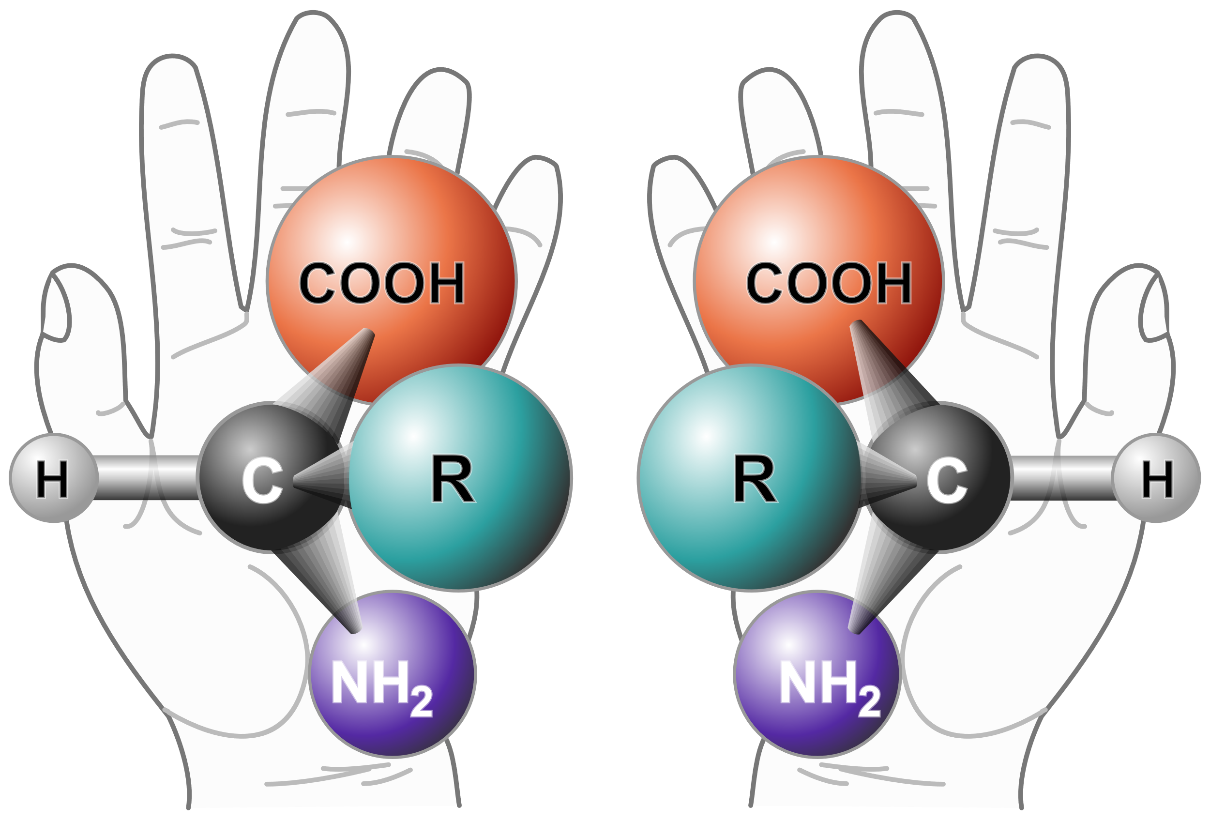
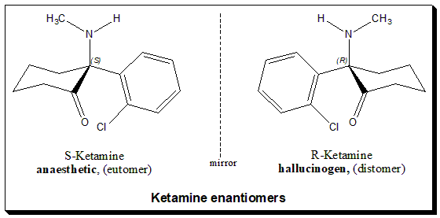
Entantiomers – mirror image molecules

Slide 7
Ketamine for depression
First formal studies of ketamine for depression around 2000
Dramatic and rapid antidepressant effect
Not a durable antidepressant response
Response lasted much longer than the “high”
Studies of repeated dosing began in 2010s
Demonstrated success in prolonging response
Optimum initial frequency found to be 2x per week
Taper programs developed based largely on ECT

Slide 8
Proposed mechanisms of action (Molecular)
1. Opioid agonism
Not a narcotic
Concurrent naltrexone blocks response
Street abuse has been well documented
2. N-methyl-D-aspartate (NMDA) receptor antagonism
Appealing, but why does memantine not work?
3. Alpha-amino-3-hydroxy-5-methyl-4-isoxazole propionic acid (AMPA) receptor
Ketamine (or metabolites) may activate AMPA and increase glutamate activation
Blocking AMPA seems to block majority of response

Slide 9
Proposed mechanisms of action (Connectivity)
Activation of the anterior cingulate cortex
Increased connectivity between the insula and default mode network

Slide 10
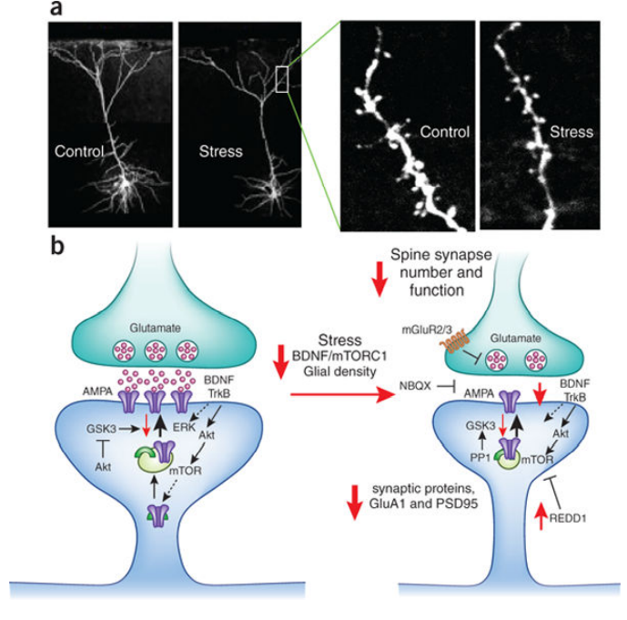
Proposed mechanisms of action (Neuroplasticity)
By unknown mechanisms, ketamine seems to upregulate networks that lead to an upregulation of BDNF tone.
This results in increased branching of dendrites
May correct for neuronal pruning that occurs in trauma/stress/depression
Broadly referred to as increased neuroplasticity

Slide 11
Esketamine at UNM

Slide 12
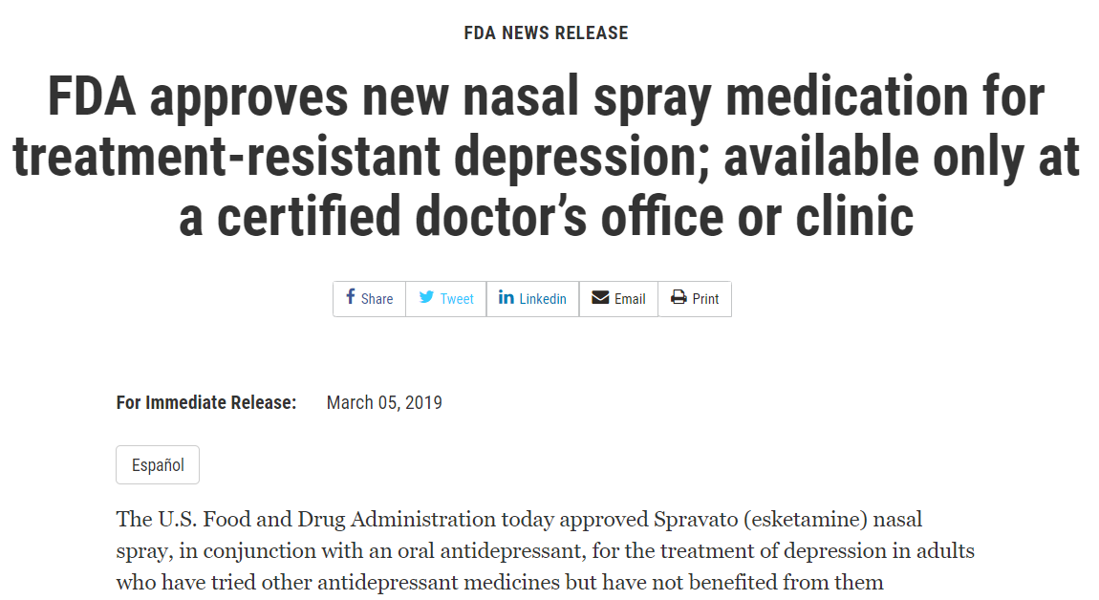

Slide 13
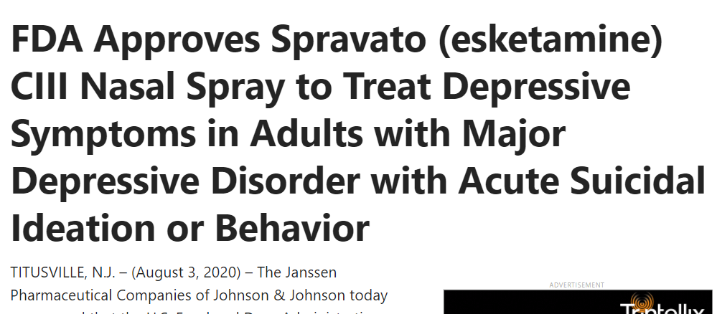

Slide 14
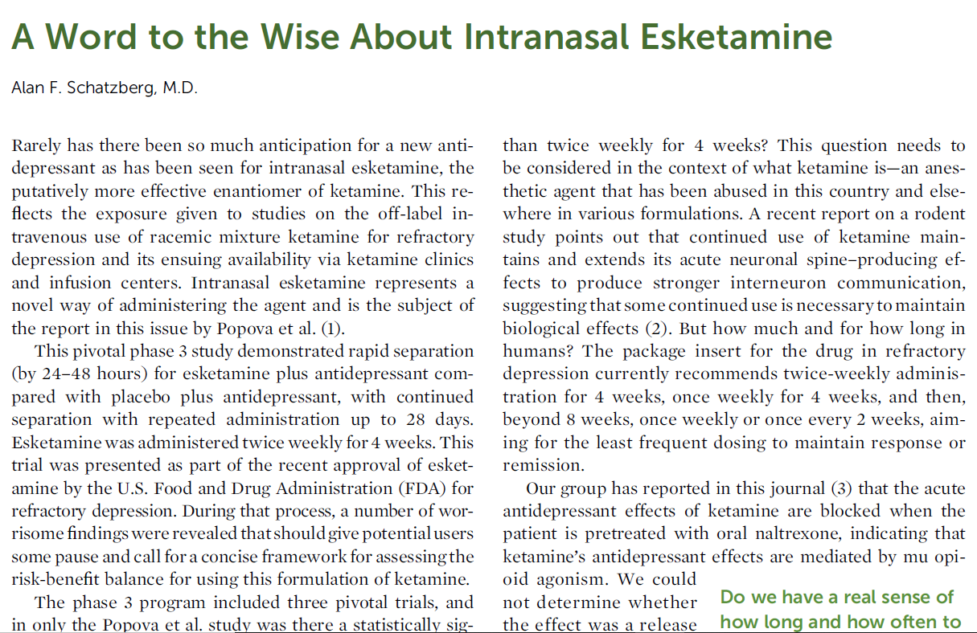

Slide 15
What is Treatment Resistant Depression? (TRD)
A prolonged state of meeting criteria for major depressive episode (MDE)
Episode fails to respond to at least 2 medication trials of adequate dose and duration
DOSE = varies with medication (ex: 40mg fluoxetine)
DURATION = roughly 6 weeks at above dose
In practice, usually more med trials
For insurance purposes even more med trials
One company required at least 3 different MAO-I trials

Slide 16
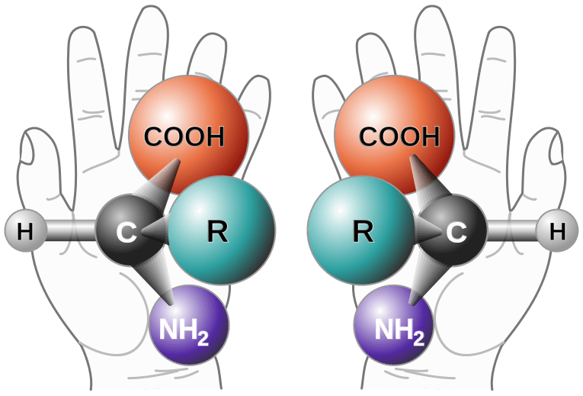
What is intranasal esketamine? (Spravato)
Ketamine = anesthetic for veterinary medicine, army medics
Ketamine can also be abused
(mild dissociative experience up to K hole)
Generic ketamine has been used in IV infusion as an off label treatment for >10 years (not FDA approved)
Janssen developed esketamine (S-enantiomer) to be delivered via intranasal spray
FDA approval 2019
Patented
Expensive

Slide 17
How does it work?
We don’t know (for sure)
Downstream effects upregulate BDNF
May enhance neuroplasticity
Neuroplasticity = the brain’s receptiveness to change
As a result, esketamine probably helps other treatments work better
Studies of esketamine have focused on it’s use alongside a newly initiated oral antidepressant

Slide 18
What is it not?
Not a miracle cure for depression
My best guesses as to response rates:
Non-response: 20%
Full remission: 20%
Partial response: 60%
Not a substitute for standard treatments
Most patients with TRD will require lifetime antidepressant treatment
Should be used together with medication and psychotherapy

Slide 19
Esketamine pros and cons (versus IV ketamine)
Advantages
Disadvantages
Lack of long term data
May be less powerful?
Still requires significant time in office
Complications of REMS requirement
Out of pocket cost can vary widely ($10 to $450 per treatment)
FDA approved
May be covered by insurance
No IV access required
May be less expensive for patient

Slide 20
Patient experience
Evaluation visit – verify TRD diagnosis and discuss esketamine
Treatment planning:
Concurrent antidepressant medication
Concurrent psychotherapy
Esketamine is probably best used to help other treatments work better

Slide 21
Patient experience
REMS registration, designed to manage:
Risks of sedation and dissociation
Avoid abuse and misuse of SPRAVATO
SPRAVATO® is intended for use only in a certified Healthcare Setting.
Treatment administered under direct observation of a healthcare provider
Patients are required to be monitored by a healthcare provider for at least 2 hours
SPRAVATO® must never be dispensed directly to a patient for home use.

Slide 22
Patient experience
Treatment days:
Patient arrives and registers
Assessed by nurse and provider (vital signs, depression rating scale)
Nurse and patient pickup up medication from pharmacy
Patient administers nasal spray with nursing supervision
Room darkened, relaxing music if desired
Patient experiences dissociative/sedating effects for 30 to 90 minutes
Monitoring lasts 2 hours to ensure resolution of symptoms
Patient discharged when ready and cleared by provider

Slide 23
Patient experience
After discharge:
Must have a trusted ride home
Preferably supervision overnight
May not drive until after a good night’s sleep

Slide 24
Patient experience
Induction Phase:
4 weeks, 2 treatments each week (8 treatments total)
This is considered an adequate trial
Continuation/Taper Phase:
1x weekly
Every 2 weeks
Every 4 weeks
Discontinue?
Maintenance
Some patients treated ongoing every 1 to 4 weeks

Slide 25
What is it like?
“Ineffable”
Dream-like and detached
Relaxed and happy
Confused and nauseated
Altered perception of time and space
Detached from body
Anxious
Dizzy, unsteady
Trapped in a “K hole”

Slide 26
Possible side effects
Dissociation and sedation (expected)
Blood pressure spike
Nausea
Vertigo
Imbalance
Anxiety/Panic
Suicidality
Urinary tract infections or bladder irritability
Seizure risk?

Slide 27
Patient – X
Patient X is 65 years old and has struggled with chronic social anxiety disorder and multiple depressive episodes.
Current episode has lasted 3 years, varying between moderate to severe, with no response to fluoxetine, escitalopram, paroxetine, venlafaxine, duloxetine, nortriptyline, clomipramine, and tranylcypromine. Esketamine treatment was arranged with concurrent trial of fluoxetine, which seemed to have provided the greatest past benefit.
X noticed no improvement initially, but partner remarked on behavior change at treatment 5, and X endorsed improvement of depressive symptoms at treatment 7.
Improvement continued through cautious taper treatments over 8 months, along with increase of fluoxetine dose to 80mg.
Esketamine was ultimately discontinued, and X has remained in full remission for 18 months. Fluoxetine 80mg was continued.

Slide 28
Patient – Y
Patient Y is 40 years old with a traumatic childhood and has long-standing struggles with self-esteem and chronic depression.
A long list of medication trials have yielded little improvement in depression symptoms
Y had difficulties with insurance coverage leaving a high remaining copay, but ultimately opted to try esketamine during a period of worsening suicidal ideation
Y’s first treatment was powerful but helpful; Y described “I feel like my ego is dying” but felt able to treat self with more kindness, and suicidality improved dramatically.
2nd treatment with esketamine was very intense. Y felt unable to move their body, asking “am I dying?”As medication wore off, Y experienced vivid memories of demeaning childhood treatment and felt very anxious.
Y has discontinued esketamine and continues to struggle with depression and varying degrees of suicidal thinking despite aggressive medication management and psychotherapy

Slide 29
Patient Z
Z was 45 with a history of recurrent major depressive episodes, with current episode severe and failing to respond to numerous adequate med trials. At the time of initial evaluation Z felt very guilty, was no longer working or functioning well as a parent.
At Z’s initial treatments with esketamine produced mild dissociation and sedation, but pronounced vertigo with nausea and vomiting.
Medications for nausea were used frequenty during treatments to the point where Z was able to increase from low to high dose treatment.
Z experienced gradual reduction of depressive symptoms from severe to mild range, with greatest improvements in suicidality, self-esteem, and motivation.
Z continues with symptoms of mild depression, but has returned to work part-time while continuing regular esketamine treatments every 3 weeks.
Z continues to work with a psychiatrist and psychotherapist in hopes of reaching full remission.

Slide 30
Challenges
Ketamine
Not FDA approved, but increasingly available as an off-label treatment
Increasingly available from under-trained providers, for inappropriate diagnoses, or at inappropriate doses or frequencies
Esketamine
FDA approved but REMS is restrictive
Off-label prescribing is not possible
Resource intensive, expensive

Slide 31
References
Berman RM, Cappiello A, Anand A, et al. Antidepressant effects of ketamine in depressed patients. Biol Psychiatry 2000;47(4):351–4.
Zanos P, Gould TD. Mechanisms of ketamine action as an antidepressant. Mol Psychiatry. 2018 Apr;23(4):801-811. doi: 10.1038/mp.2017.255. Epub 2018 Mar 13. PMID: 29532791; PMCID: PMC5999402.
Feeney A, Papakostas GI. Pharmacotherapy: Ketamine and Esketamine. Psychiatr Clin North Am. 2023 Jun;46(2):277-290. doi: 10.1016/j.psc.2023.02.003. Epub 2023 Mar 10. PMID: 37149345.
Goldfine CE, Tom JJ, Im DD, Yudkoff B, Anand A, Taylor JJ, Chai PR, Suzuki J. The therapeutic use and efficacy of ketamine in alcohol use disorder and alcohol withdrawal syndrome: a scoping review. Front Psychiatry. 2023 Apr 27;14:1141836. doi: 10.3389/fpsyt.2023.1141836. PMID: 37181899; PMCID: PMC10172666.
Singh JB, Fedgchin M, Daly EJ, De Boer P, Cooper K, Lim P, Pinter C, Murrough JW, Sanacora G, Shelton RC, Kurian B, Winokur A, Fava M, Manji H, Drevets WC, Van Nueten L. A Double-Blind, Randomized, Placebo-Controlled, Dose-Frequency Study of Intravenous Ketamine in Patients With Treatment-Resistant Depression. Am J Psychiatry. 2016 Aug 1;173(8):816-26. doi: 10.1176/appi.ajp.2016.16010037. Epub 2016 Apr 8. PMID: 27056608.
Sanacora G, Frye MA, McDonald W, Mathew SJ, Turner MS, Schatzberg AF, Summergrad P, Nemeroff CB; American Psychiatric Association (APA) Council of Research Task Force on Novel Biomarkers and Treatments. A Consensus Statement on the Use of Ketamine in the Treatment of Mood Disorders. JAMA Psychiatry. 2017 Apr 1;74(4):399-405. doi: 10.1001/jamapsychiatry.2017.0080. PMID: 28249076.

