Slide 1
tRACHEal Injuries
roXANN Lerma, MD mph
9/11/2024

Slide 2
Conflicts of Interest
None

Slide 3
Objectives
1. Be able to identify traumatic tracheal injuries.
2. Understand different diagnostic modalities to assess tracheal injuries.
3. Implement ways in repairing traumatic tracheal and esophageal injuries.

Slide 4
History of Present Illness
35 year old female presented after reported inflicted stab to the anterior neck.
Vital signs on presentation: HR: 150s, BP: 116/59, O2, 90% on 10L non-rebreather at the moment of the patient’s arrival to the emergency room
On arrival reported:
Hoarse voice and muffled
No crepitus felt on exam
She was intubated in ED for poor oxygenation and concerning for possible tracheal injury. On exam, she had three lacerations to anterior neck with the inferior laceration violating platysma. CXR showed no pneumothorax.
Patient was stable, oxygenating well on ventilator

Slide 5
Imaging
Notes:
He has crepitus on exam and on CT scan, he has a diffuse subcutaneous emphysema.

Slide 6
Intervention
OPERATION PERFORMED:
1. Anterior neck dissection.
2. Bronchoscopy.
3. Esophagogastroscopy.
Anterior collar incision approximately 2 centimeters above the manubrial notch, dissecting through the platysma and down to the level of the strap muscles.
The strap muscles were split bluntly.
Using 3-0 PDS suture in a running fashion the esophagus was closed primarily. Interrupted 3-0 Vicryl sutures were then used to reinforce the repair with Lembert sutures.
Debriding nonviable and jagged tissue, the laceration was repaired using 3-0 PDS suture in interrupted fashion for an airtight closure. To reinforce the repair and isolate the esophagus from the trachea, the sternal head of the sternocleidomastoid was transected using LigaSure, the muscle mobilized, and then secured using 3-0 vicryl suture with u-stitches to connective tissue between the esophagus and the trachea.
Using 3-0 PDS suture in a running fashion, the tracheal injury was reapproximated, ensuring to take submucosal round full-thickness bites through the tracheal rings.
Notes:
There was an anterior and posterior component of the tracheal laceration which was connected by 3 mm of normal tissue.
Anterior and posterior laceration to the trachea, involving approximately 1/2 the circumference of the trachea and involving membranous portion of trachea.
EGD noted a 1.4cm laceration to the esophagus creating a traumatic tracheo-esophageal fistula

Slide 7
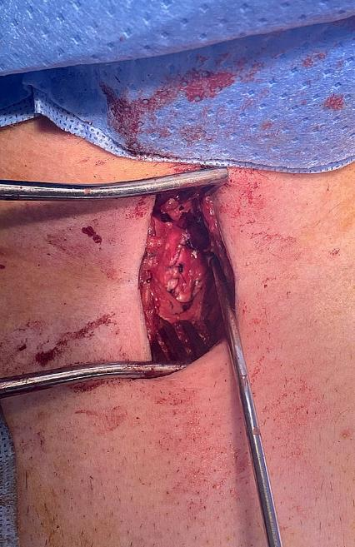

Slide 8
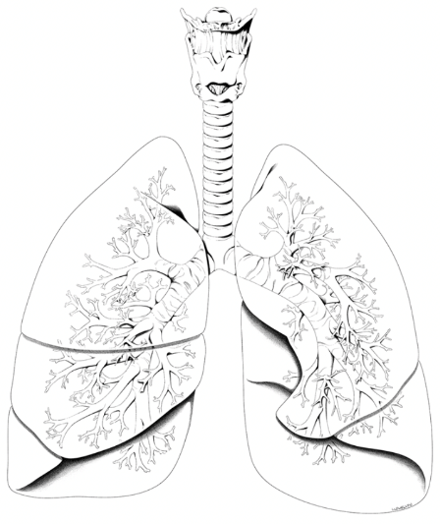
Background
Tracheobronchial injuries can occur anywhere along the larynx, trachea, primary carina, mainstem bronchi to where they divide into lobar or secondary bronchi
Incidence of 2-3% among all patients with cervical/thoracic trauma
Lower traumatic airways portend poorer prognosis which reflects a combination of timely recognition, severity and accessibility
TBIs also result from iatrogenic injury during intubation or surgical procedures, although not the focus of this presentation.

Slide 9
Penetrating
Cervical injuries represent 75% and 84% of all TBIs
Penetrating injuries more common with relative incidences of 4.5%
Penetrating injury to cervical trachea more common due to the exposed location
Stab injury tend to cause punctures or linear lacerations
Ballistic injury results in greater amount of tissue loss

Slide 10
Blunt
Blunt TBI less common, incidence between 0.5% and 2%
80% of TBI from blunt injury die on scene, variable mortality rates among survivors 20-40%
Tend to occur more commonly intra-thoracic at the level of the carina and mainstem bronchi within 2.5 cm of the carina about 62-75% of cases
Injuries can be linear (18%), transverse (75%) either partial or complete as well as combined injures that include cartilage fracture, dislocation, airway avulsions and tears.

Slide 11
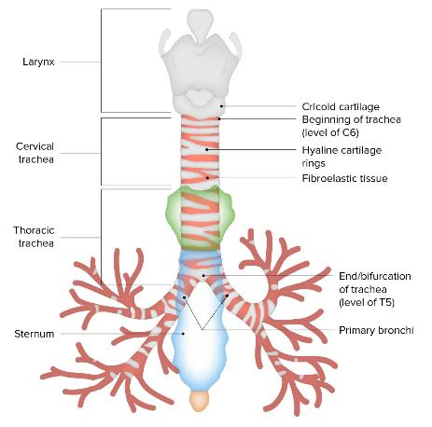
Blunt
Mechanism of injury at distal tree:
High velocity A-P crush injuries to the chest wall can cause abrupt displacement of intrathoracic contents and result in injury due to lateral traction by the mobile lungs on the immobile tree
Crush injury to the airway between sternum and vertebral column causing an abrupt increase in airway pressure which with a closed glottis can rupture the airway usually membrano-cartilaginous junctions or between rings
Decel injuries that result in shear stress along tethered points like the cricoid and carina

Slide 12
Blunt
Mechanism of injury at the cervical trachea:
Combined decel and neck hyperextension followed by blunt anterior compressive force, with either mechanism sufficient enough to cause injury
Thyroid and cricoid cartilage most prone to fractures, lacerations usually occurring below the 4th tracheal ring at the junction of the membranous and cartilaginous elements

Slide 13
Clinical Presentation
Soft Signs | Hard Signs
Further diagnostic testing | Operative exploration
Voice changes | Stridor
Dysphonia | Air moving through wound
Aphonia | Subcutaneous emphysema
Cough | Hemoptysis
Hoarseness | Mediastinal emphysema
 | Hamman’s crunch
Notes:
Can range from subtle symptoms to severe airway obstruction, tension pneumothorax

Slide 14
Clinical Presentation
Between 25-33% of cervical airway injuries are asymptomatic upon initial evaluation and become more symptomatic over the next 24 to 48 hours
Thoracic airway injuries more significantly affect lung mechanics and are most symptomatic with respect to oxygenation and ventilation
Pneumothorax present in up to 70% of cases
Subcutaneous emphysema is present in 35 to 85% of cases
Pneumothorax that persists and does not resolve with tube thoracostomy
Patient that experiences worsening hypoxia with the chest tube to suction rather than water seal
Overinflated endotracheal cuff greater than upper limit of 25 mm in men, 21 mm in women

Slide 15
Diagnostic Modalities
CXR
CT
Bronchoscopy
Laryngoscopy
EGD
Esophagram

Slide 16
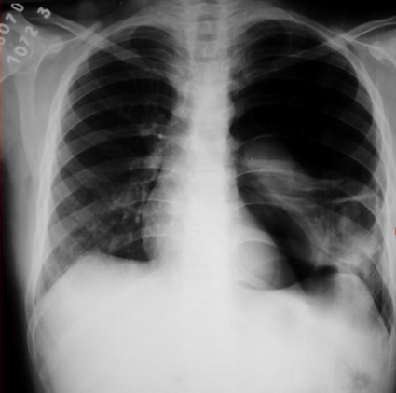
CXR
Abnormal in up to 90% of patients
PTX
Pneumomediastinum
Subq Emphysema
Fallen lung sign
https://epos.myesr.org/posterimage/esr/ecr2014/121234/mediagallery/541316
Notes:
Associated wit ptx, but away from hilum, towards diaphragm and posteriorly, mainstem bronchial fracture

Slide 17
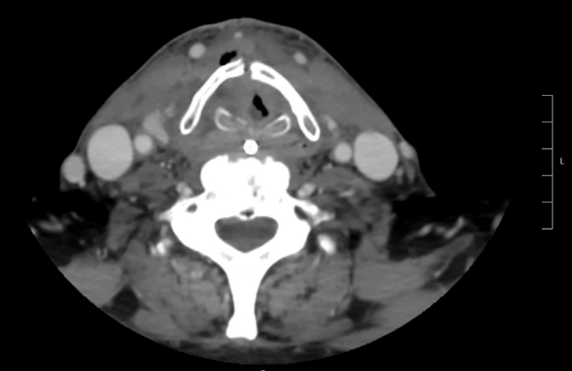
CT
Can delineate laryngeal trauma, the airway, and associated injury as well as establish trajectory in penetrating injury
Bronchial step offs
Fluid within the airway
Pneumomediastinum
Pneumopericardium
Pneumothorax
Abnormal elevation of the hyoid bone superior to C3
Notes:
Displaced fracture of the thyroid cartilage and cricoid, with associated air within the soft tissues. This patient also had numerous other comminuted and displaced fractures of the trachea, including displaced fractures of the hyoid bone and arytenoid cartilage. The tracheal rings were not discretely visualized, and the airway appeared effaced. Pneumomediastinum was also noted. CT, computed tomography.

Slide 18
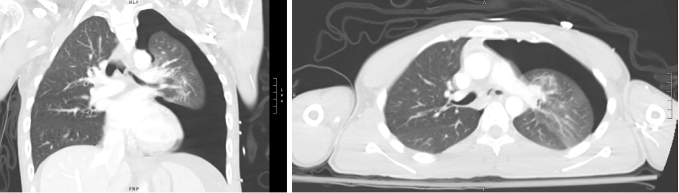
Notes:
Curvilinear endoluminal filling defect within left mainstem bronchus with associated bronchial wall step-off, concerning for left mainstem bronchial injury. Moderate to large left-sided pneumothorax. CT, computed tomography; CAP, chest, abdomen and pelvis.

Slide 19
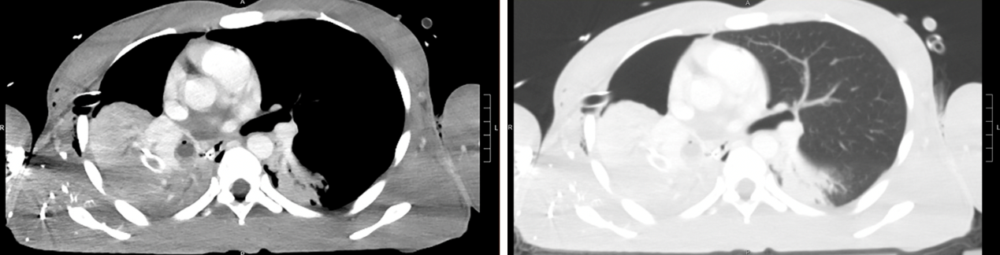
Notes:
Large right pneumothorax with complete collapse of the right lung and rightward shift of the mediastinum. Fluid within the right mainstem bronchus and distal airways is suggestive of hemorrhage

Slide 20
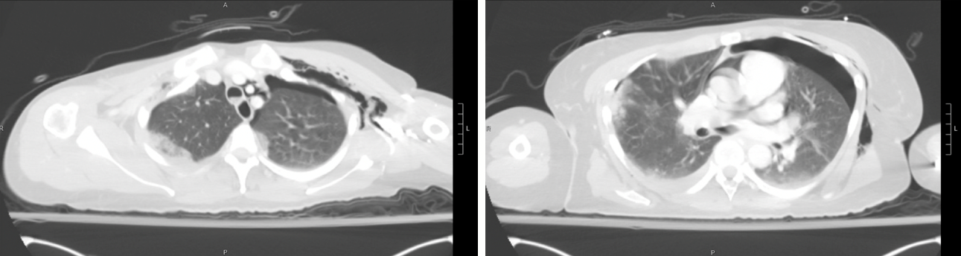
Notes:
Gas seen around the trachea and right mainstem bronchus, suggestive of a tracheal injury. Extensive pneumomediastinum extending into the superior neck. CT, computed tomography; CAP, chest, abdomen and pelvis.

Slide 21
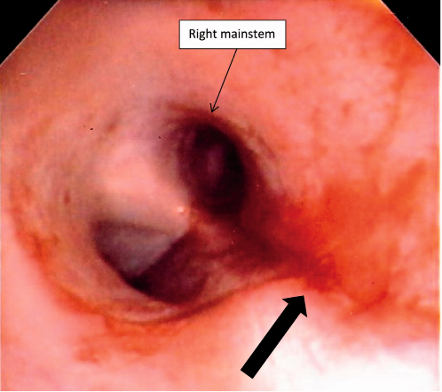
Bronchoscopy, EGD, Esophagram
Bronch is gold standard
Can make definitive diagnosis especially for injury not well defined on imaging
Awake intubation over a flexible fiberoptic bronchoscope allows direct visualization of injury minimizes potential to further disrupt airway
May need to withdraw endotracheal tube to visualize a more proximal injury, should only be performed in OR, over a bronchoscope to maintain access
Should rule out concomitant esophageal injury with EGD and esophagram
Each modality in isolation has up to 20% false negative rate, combined sensitivity is nearly 100%
O’Connor JV. Tracheal injury. Trauma. 2016;18(2):155-158. doi:10.1177/1460408615594389

Slide 22
Anatomy
Segmental blood supply from inferior thyroid artery, internal thoracic artery, bronchial artery
The tracheoesophageal branches of the inferior thyroid arteries bring blood to the cervical trachea from the right and left thyrocervical trunks that branch off the subclavian arteries
Thoracic trachea and carina receive blood from the bronchial arteries arising directly from the aorta
Anastomotic arcades run along the trachea at 3 and 9 o’clock
Limits circumferential tracheal dissection to no more than 1–2 cm on either side of a tracheal anastomosis due to the risk of devascularization and ischemia with larger dissections.
The origin of the left recurrent laryngeal nerve occurs distal to the aortic arch when it then dives and courses posteromedially just lateral to the ligamentum arteriosum, at which point it recurs and ascends toward the cricoid cartilage within the left tracheoesophageal groove.
The right recurrent laryngeal nerve branches off the right vagus nerve just distal to the right subclavian artery when its course then dives posteromedially under the origin of the right subclavian where it recurs and ascends toward the cricoid cartilage in the right tracheoesophageal groove.

Slide 23
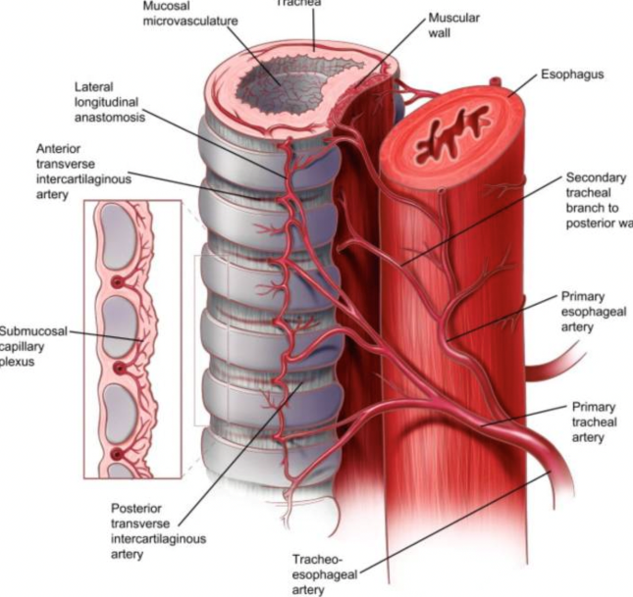

Slide 24
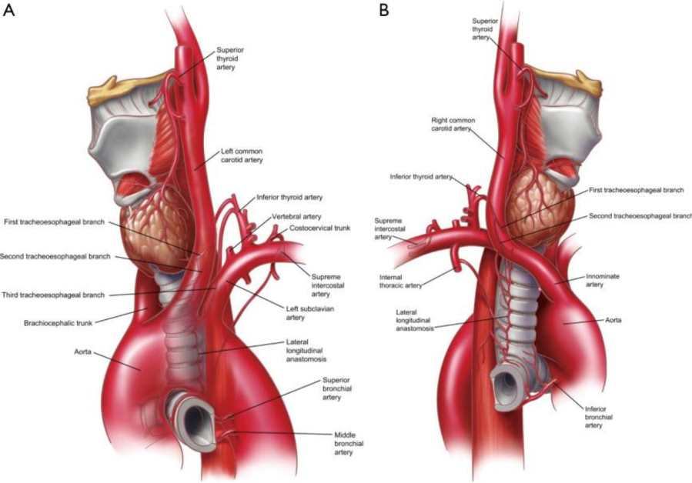

Slide 25
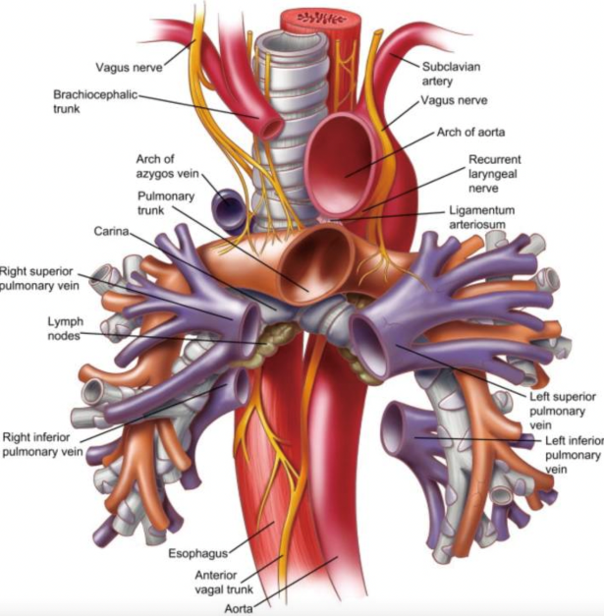

Slide 26
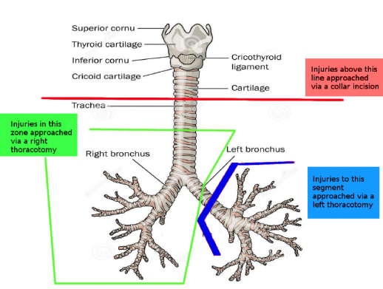
Operative
Proximal 1/3 to 2/3 of trachea
Cervical collar incision
Distal half, R mainstem
R posterolateral thoracotomy
L distal mainstem
L posterolateral thoracotomy
Bibas BJ, Cardoso PFG, Minamoto H, Pêgo-Fernandes PM. Surgery for intrathoracic tracheoesophageal and bronchoesophageal fistula. Ann Transl Med. 2018 Jun;6(11):210. doi: 10.21037/atm.2018.05.25. PMID: 30023373; PMCID: PMC6035972.

Slide 27
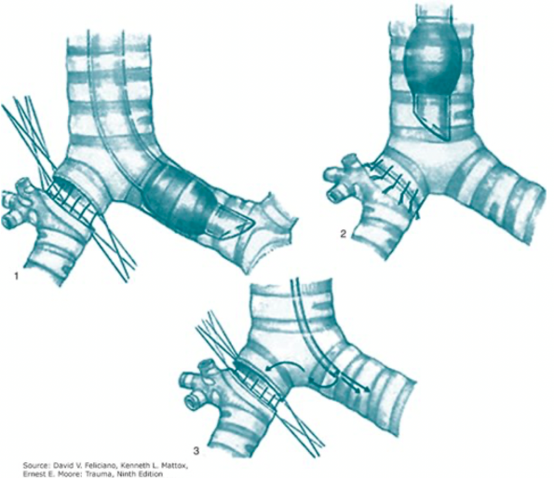
Operative
Must debride aggressively to healthy tissue
Absorbable monofilament suture in simple interrupted transverse fashion, exteriorize the knot
Posterior membranous trachea may be repaired with interrupted or running absorbable suture, can also consider a soft tissue flap for extensive posterior injuries
Lower tidal volumes, brief periods of apnea allow for precise suture placement

Slide 28
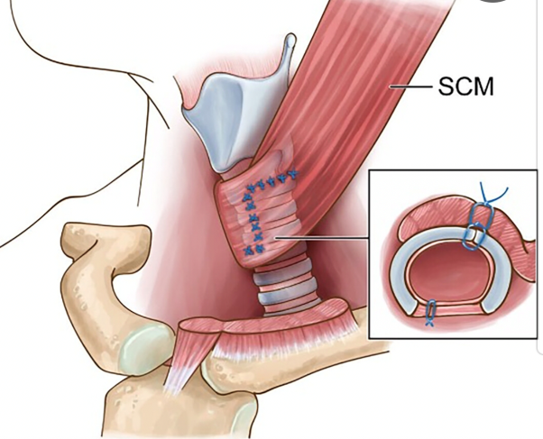
Operative
With concomitant esophageal injury:
identify extent of esophageal mucosal injury with longitudinal myotomy
primary repair over a bougie with interrupted 4-0 absorbable suture
muscularis reapproximated with a running or interrupted 3-0 nonabsorbable suture
Must perform interposition buttress with strap muscles/SCM in neck or intercostal muscle in chest.
Place drain, no drain for isolated tracheal injuries
Shaari, Diana, Eric Dowling, and Mark L. Urken. "How I Do It: Sternocleidomastoid Flap Augmentation of Tracheal Repair After Resection for Invasive Thyroid Cancer." The Laryngoscope (2023).

Slide 29
Outcomes
Mortality range from 0-40%, mostly due to associated injury
Long term complications, leaks, TEF, fistulization to vessels
Granulation with stenosis, abnormal phonation, vocal cord paralysis
Laryngeal injuries

Slide 30
References
Antonescu, Ioana, Vishnu R. Mani, and Suresh Agarwal. "Traumatic injuries to the trachea and bronchi: a narrative review." Mediastinum 6 (2022).
Mulholland, Michael W., et al. Operative techniques in surgery. Lippincott Williams & Wilkins, 2014.
DuBose, Joseph J., et al. "Trachea, Bronchi, and Esophagus." Trauma, 9e Eds. David V. Feliciano, et al. McGraw Hill, 2020, https://accesssurgery.mhmedical.com/content.aspx?bookid=2952&sectionid=249120015.
Grewal, Harpreet Singh, et al. "Treatment of tracheobronchial injuries: a contemporary review." Chest 155.3 (2019): 595-604.
Furlow PW, Mathisen DJ. Surgical anatomy of the trachea. Ann Cardiothorac Surg. 2018 Mar;7(2):255-260. doi: 10.21037/acs.2018.03.01. PMID: 29707503; PMCID: PMC5900092.

