Slide 1
dStigmatizing Diabetes
Matthew Garza
August 8, 2024

Slide 2
Disclosures
No personal disclosures
The diaTribe Foundation and the dStigmatize program have received funding from Abbott, AstraZeneca, BI-Lilly, Genentech, Insulet, Lilly, and One Drop for the dStigmatize Program.

Slide 3


Who are we?
The diaTribe Foundation: We’re a small nonprofit focused on helping people with diabetes through education and advocacy.
We have three main programs:
diaTribe Learn - www.diatribe.org
dStigmatize - www.dstigmatize.org
Time in Range Coalition - www.TimeinRange.org
Matthew Garza
dStigmatize Director

Slide 4
What will we be covering?
Diabetes Stigma and Diabetes Distress
What are they?
How are they related?
What is their impact on people with diabetes?
What can we do to address diabetes stigma and distress?
Bringing an End to Diabetes Stigma – An International Consensus
The dStigmatize Resource Library
Tackling complex conversations in the clinic
Q&A

Slide 5
Diabetes Stigma and Diabetes Distress

Slide 6
ADDRESSING DIABETES STIGMA IS AN ESSENTIAL MISSING ELEMENT OF EFFECTIVE DIABETES CARE

Slide 7
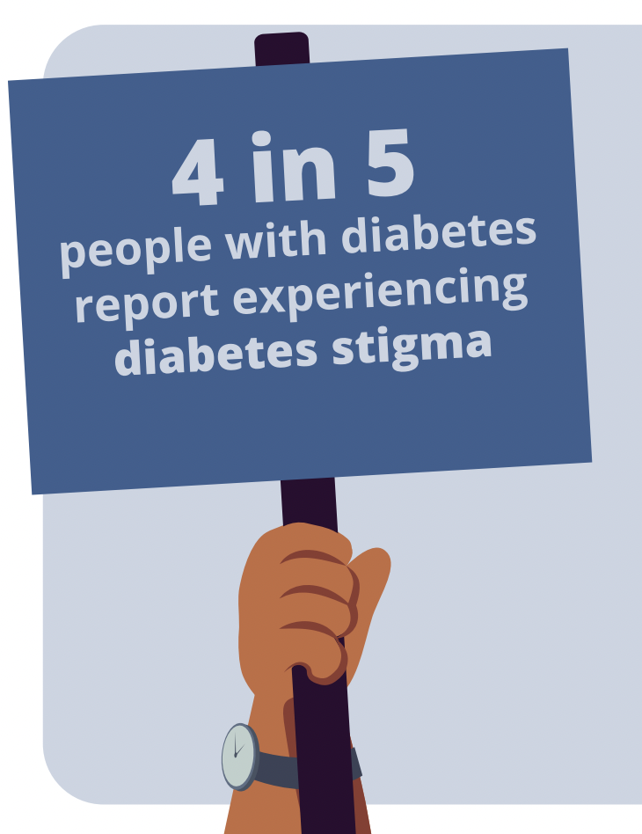
What is diabetes stigma?
Diabetes stigma refers to negative social judgments, stereotypes, and prejudices about diabetes, or about a person due to their diabetes.
Diabetes stigma becomes discrimination when it is used in unfair or prejudicial treatment towards a person with diabetes.

Slide 8
What is diabetes distress?
Diabetes distress refers to the emotional distress that results specifically from the demands of the condition itself, such as the relentless daily self-management required.
Diabetes distress is not the same thing as clinical anxiety or depression.
1 in 5
people with diabetes report severe levels of diabetes distress

Slide 9







What does diabetes stigma look like?
Interactions with others
Internalized stigma
In the media
In the diabetes community
In health settings
In our language
In employment/education

Slide 10
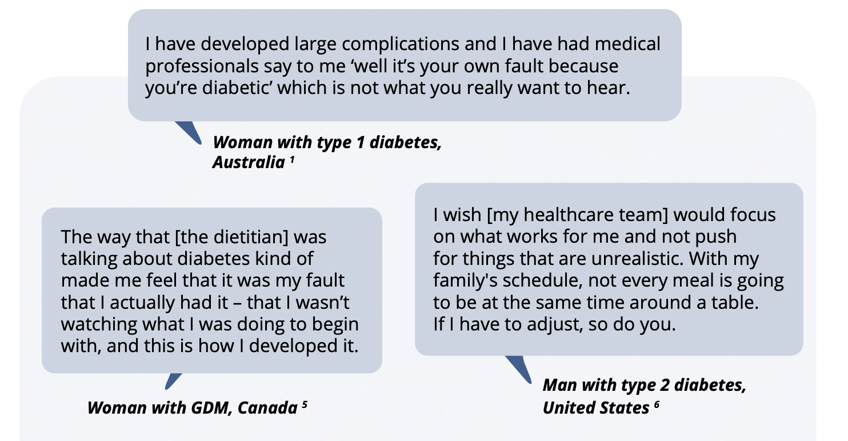

Slide 11
How are diabetes distress and stigma related?
Diabetes Stigma
The overwhelming and stressful nature of diabetes management can exacerbate feelings of judgment, shame and isolation.
Negative impact on:
Mental health
Physical health
Social health
Healthcare engagement and trust
Self-care behaviors
When people feel alone, isolated, and judged it can heighten the burden of diabetes self-management.
Diabetes Distress

Slide 12
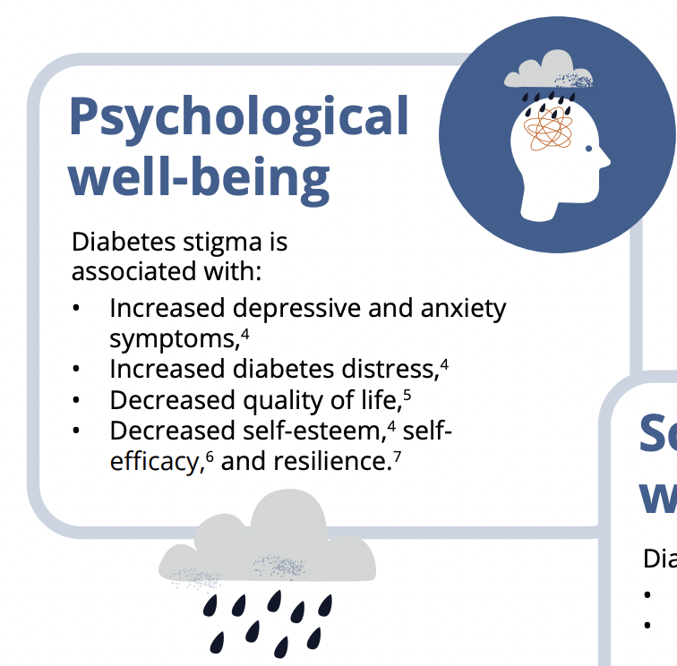
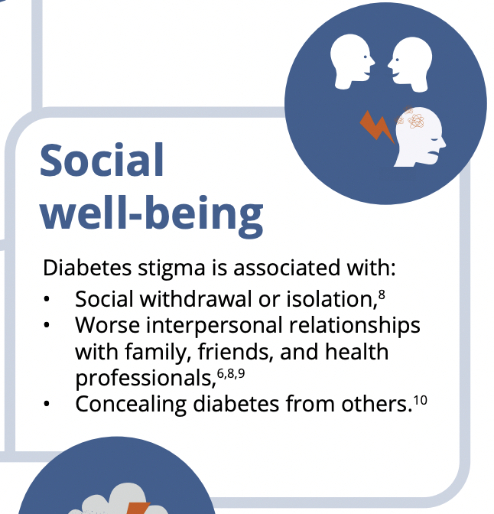
How does diabetes stigma affect people?

Slide 13
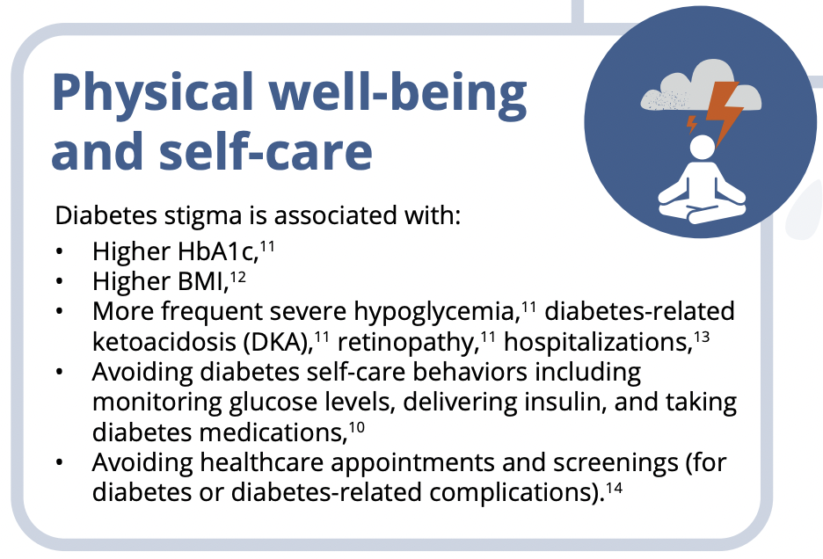
How does diabetes stigma affect people?

Slide 14

How does diabetes distress affect people?
Self-care
Diabetes distress has been associated with:
Higher HbA1c,
Avoiding diabetes self-care behaviors such as monitoring glucose levels, delivering insulin, taking other diabetes medications, and less optimal eating and exercise habits,
Reduced health-related quality of life,
Reduced self-efficacy,
Reduced healthcare engagement.

Slide 15
Bringing an End to Diabetes Stigma
An International Consensus

Slide 16
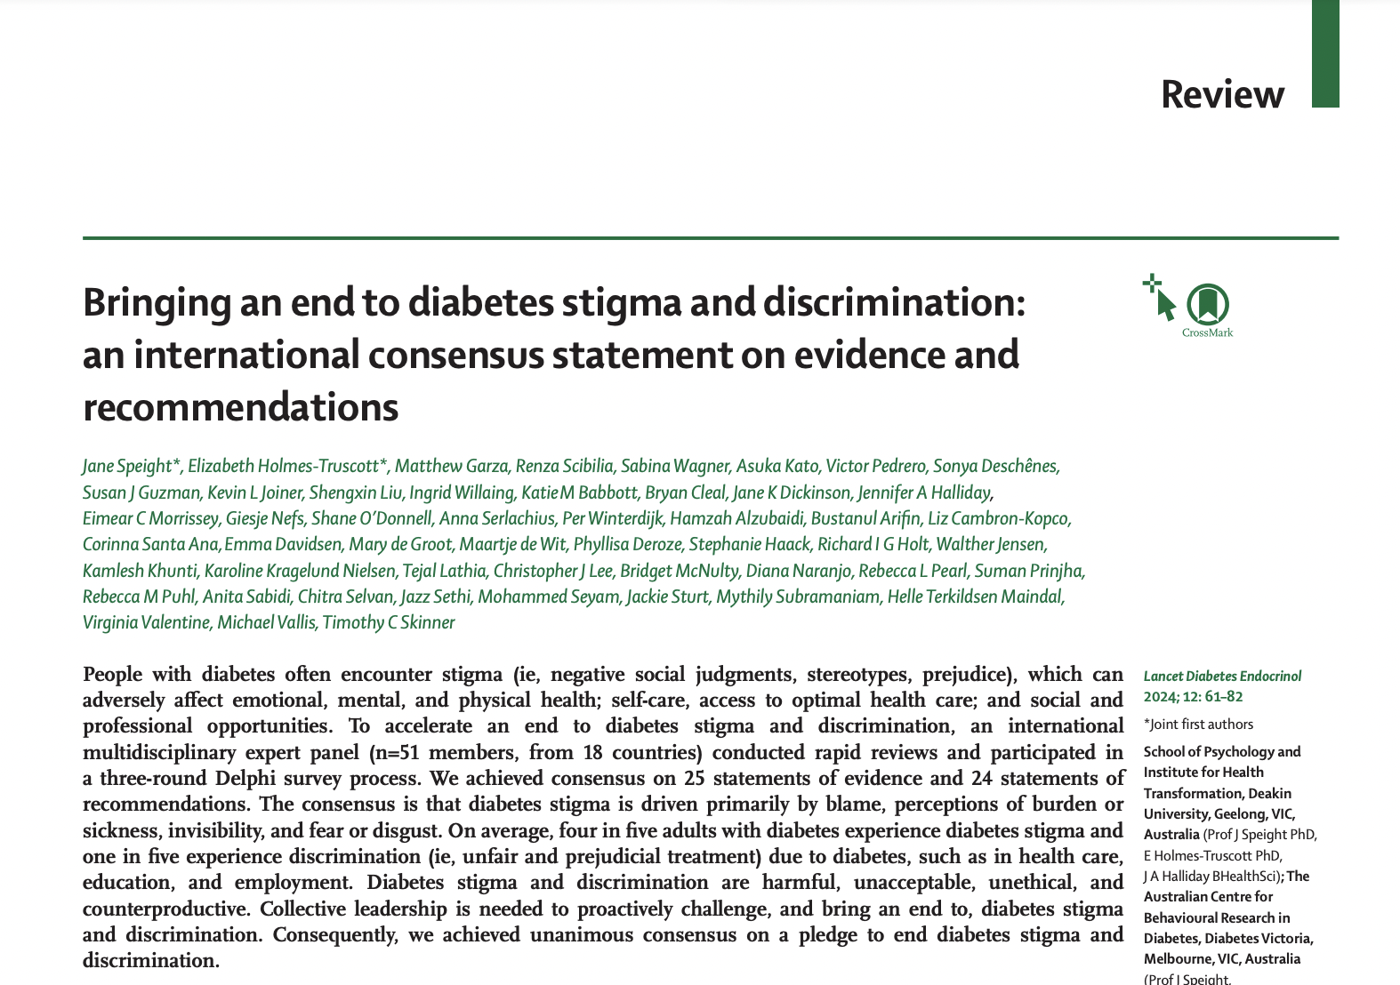
Achieving consensus
51 expert panelists
Rapid Systematic Search / Evidence Summary
Consensus (3 rounds, Delphi-like survey)
Statements of Evidence
Recommendations
Pledge
Published in Lancet D&E

Slide 17
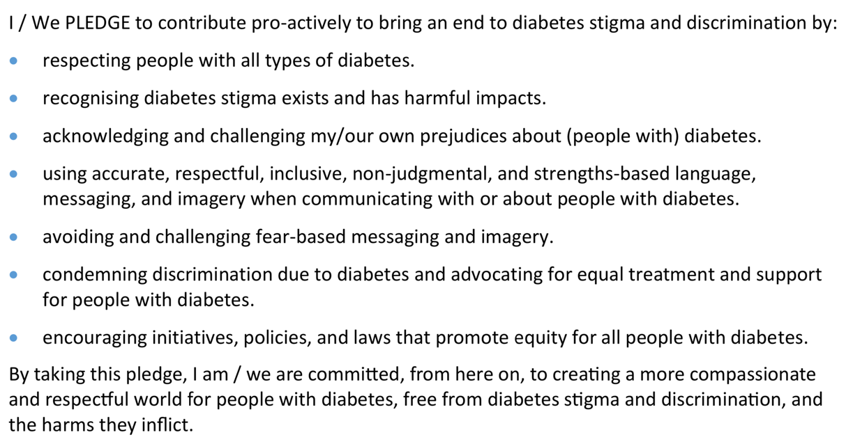
The Pledge to End Diabetes Stigma

Slide 18



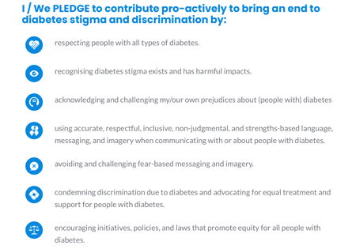


The Pledge to End Diabetes Stigma
The Pledge has received
2630+ Individual endorsements
300+ Organizational endorsements
People in over 100 countries have signed on!
Learn more at EndDiabetesStigma.org and share on social media using #EndDiabetesStigma

Slide 19
The dStigmatize Resource Library

Slide 20
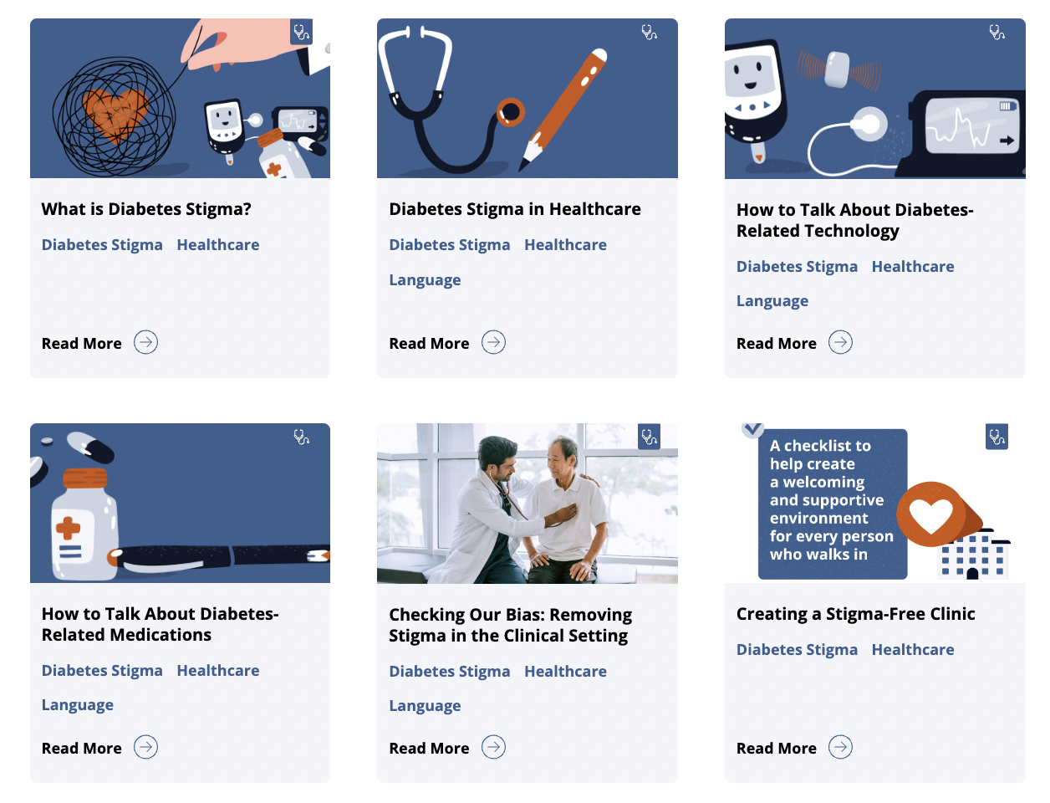
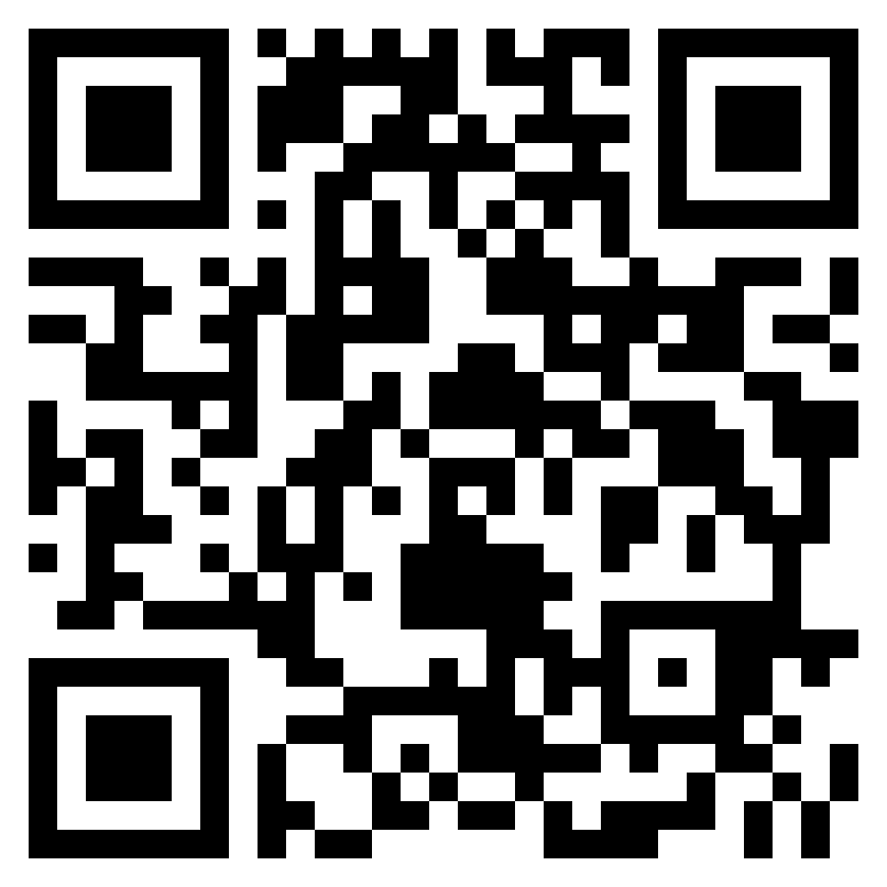
dStigmatize
Resource Library:

Slide 21
Tackling Complex Conversations in the Clinic

Slide 22

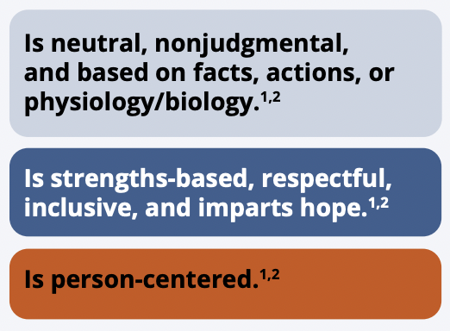

Language Matters
Choose to use language that is:

Slide 23

Discussing Diabetes-Related Medications
Be mindful of the stigma associated with insulin use.
Avoid using overly technical language or language commonly used in electronic health records in conversations with people with diabetes.
Emphasize that medications are just one tool in a person’s toolbox.

Slide 24

Discussing Diabetes Devices and Technology
Ask lots of questions, be an active listener, and share in the decision-making.
Avoid “gatekeeping” certain devices or diabetes-related technology.
Acknowledge the psychosocial impact of using diabetes-related technology.

Slide 25
Discussing Diabetes-Related Complications
Be aware that certain complications can be particularly scary: eye complications, neuropathy and amputation, and kidney complications.
Avoid using fear or scare tactics to motivate behavior changes.
Enter conversations with respect, hope, and positivity. Often, people are looking for simple explanations and clear directions that highlight collaboration.

Slide 26
Q&A

Slide 27
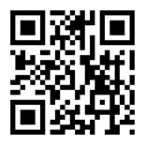
Join the growing movement – It’s easy!
We are creating a culture of compassion that helps people with diabetes live well with a serious but manageable condition.
Contact me: matthew.garza@diaTribe.org
Take the Pledge to End Diabetes Stigma
EndDiabetesStigma.org
Visit the dStigmatize Resource Library
dStigmatize.org/resources

Slide 28
References
Speight, J., Holmes-Truscott, E., Garza, M., Scibilia, R., Wagner, S., Kato, A., ... & Skinner, T. C. (2024). Bringing an end to diabetes stigma and discrimination: an international consensus statement on evidence and recommendations. The Lancet Diabetes & Endocrinology, 12(1), 61-82.
Schabert, J., Browne, J. L., Mosely, K., & Speight, J. (2013). Social stigma in diabetes. The Patient-Patient-Centered Outcomes Research, 6(1), 1-10.
Speight J, Holmes-Truscott E, Scibilia R, Black T (2021). Diabetes: Stigma, blame and shame. Diabetes Australia, Canberra.
Browne, J. L., Ventura, A., Mosely, K., & Speight, J. (2014). 'I'm not a druggie, I'm just a diabetic': a qualitative study of stigma from the perspective of adults with type 1 diabetes. BMJ open, 4(7), e005625.
Speight, J., Skinner, T. C., Dunning, T., Black, T., Kilov, G., Lee, C., ... & Johnson, G. (2021). Our language matters: Improving communication with and about people with diabetes. A position statement by Diabetes Australia. Diabetes Research and Clinical Practice, 173, 108655.
Dickinson, J. K., Guzman, S. J., Maryniuk, M. D., O’Brian, C. A., Kadohiro, J. K., Jackson, R. A., ... & Funnell, M. M. (2017). The use of language in diabetes care and education. Diabetes Care, 40(12), 1790-1799.
Skinner, T. C., Joensen, L., & Parkin, T. (2020). Twenty‐five years of diabetes distress research. Diabetic Medicine, 37(3), 393-400.
Dennick K, Sturt J, et al. High rates of elevated diabetes distress in research populations: a systematic review and meta-analysis. International Diabetes Nursing. 2015;12(3):93-107

