Slide 1

Sick not Sick
C. Mateo Garcia, MD
UNM EMS Consortium

Slide 2
Objectives
Appreciate signs of “the Critically Sick” patients (easier)
Discuss and gain appreciation that Patients don’t always immediately reveal the truth of whether or not they are “critically sick” (harder)
Learn about obvious signs of illness we must detect
Think about the less obvious signs and what to do in those situations.

Slide 3

Why does this skill matter?

Slide 4
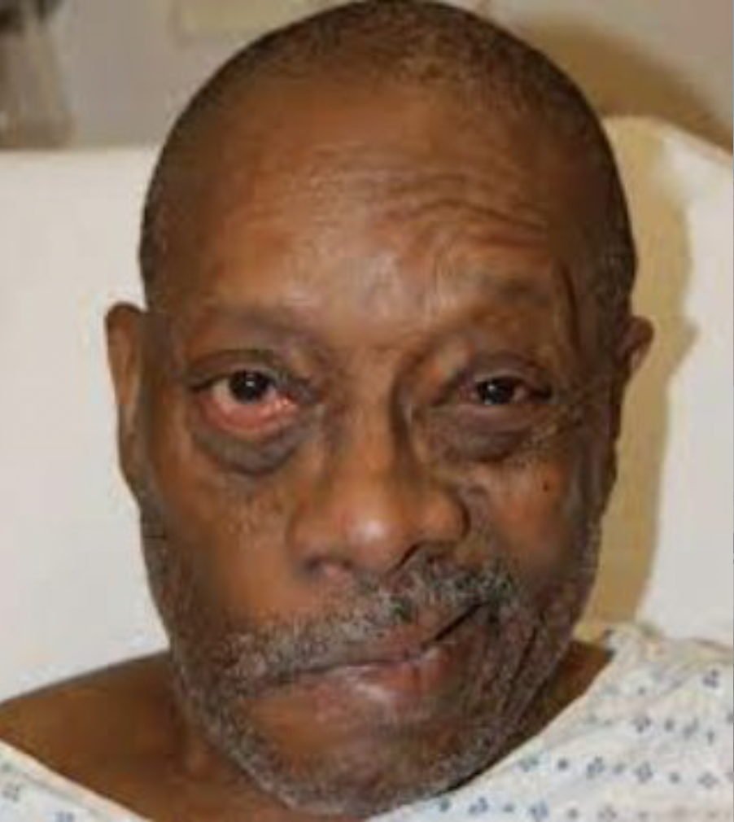
Sick vs Less Sick

Slide 5
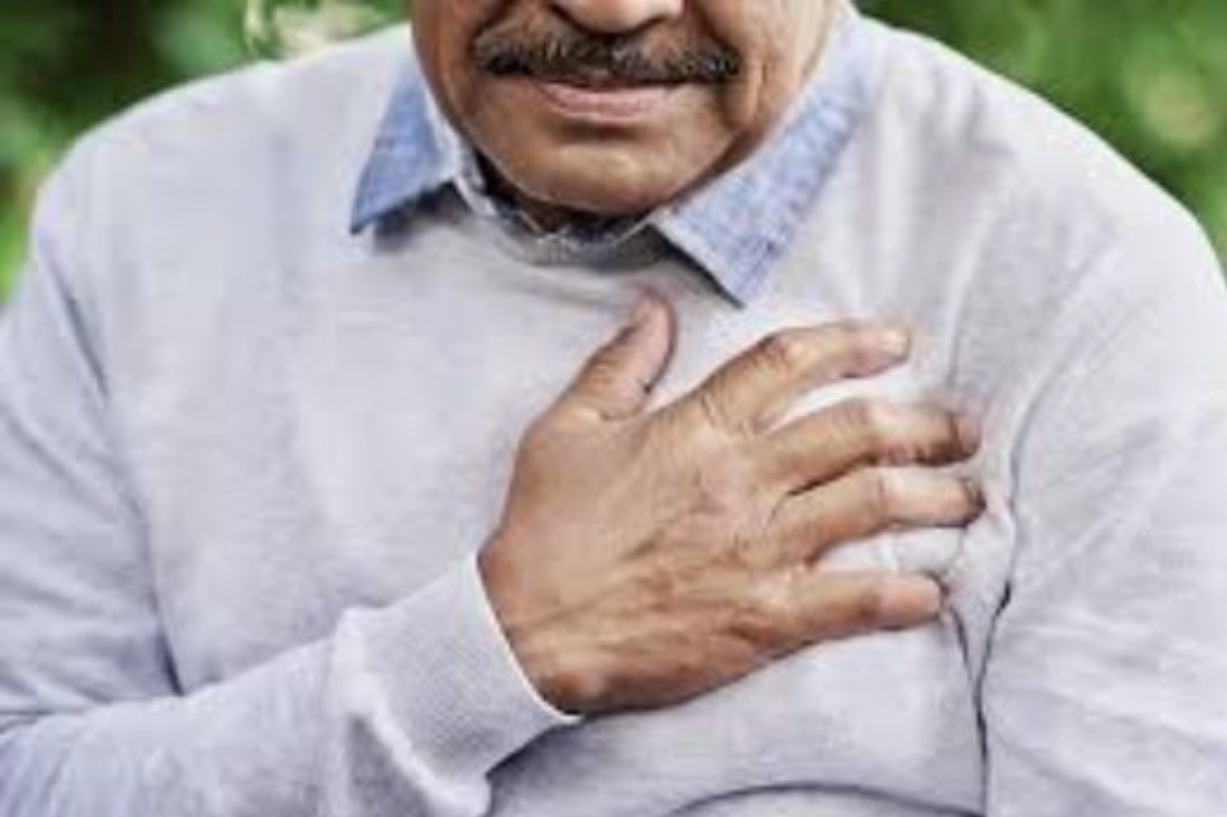
Sick vs Less Sick

Slide 6
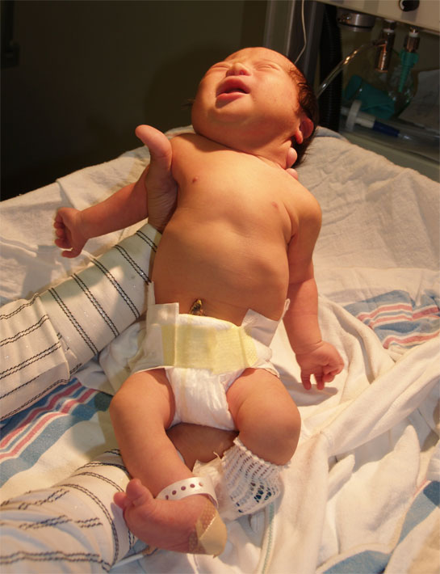
Sick vs Less Sick

Slide 7
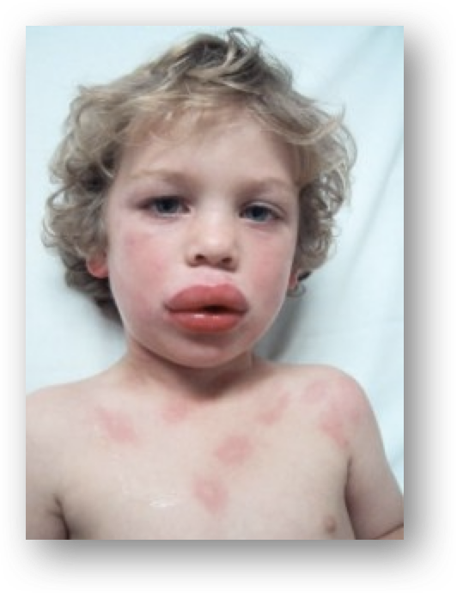
Sick vs Less Sick

Slide 8
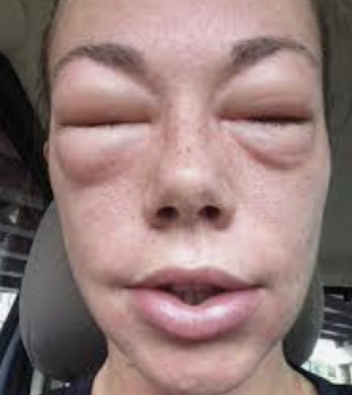
Sick vs Less Sick

Slide 9
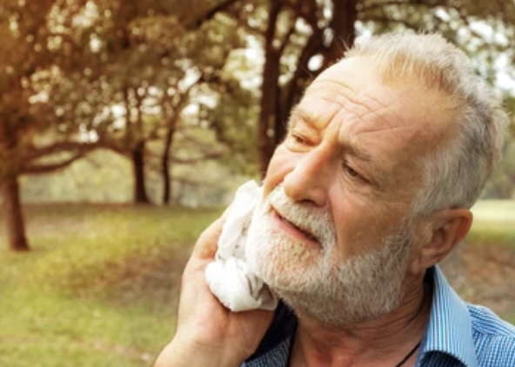
Sick vs Less Sick

Slide 10
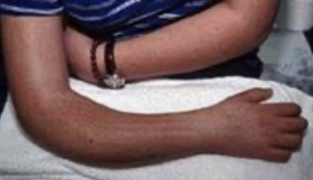
Sick vs Less Sick

Slide 11
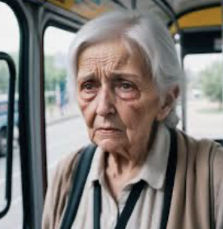
Sick vs Less Sick

Slide 12
Time sensitive situations
● Uncontrolled bleeding
● Confused, lethargic, disoriented, or unresponsive
● Unable to complete a sentence without catching breath
● Other breathing difficulties
● Severe pain or distress
● Stroke-like symptoms
○ Off balance, trouble seeing, trouble speaking or slurred words, face droop,
one-sided numbness or weakness
● Chest pain over age 35
● Suicidal statements
● At your discretion if patient appears to need immediate evaluation

Slide 13
We should assume every patient is or has potential to become sick. Then let evidence prove to us they are less likely to be critically ill.

Slide 14

So how do we do that?

Slide 15

Vital signs are vital.

Slide 16
What are your vital signs?
Appearance – This is only used to Rule in critical illness, cannot rule out!
Airway (can they talk or phonate, any weird noises?)
Oxygen saturation
Breathing (respiratory rate, depth, effort, accessory muscle use
Oxygen saturation
Heart Rate (Pulse, EKG- rate, Rhythm, ST elevation)
Blood Pressure (High, Low, Normal- What does this mean)
Capnography
Mentation

Slide 17
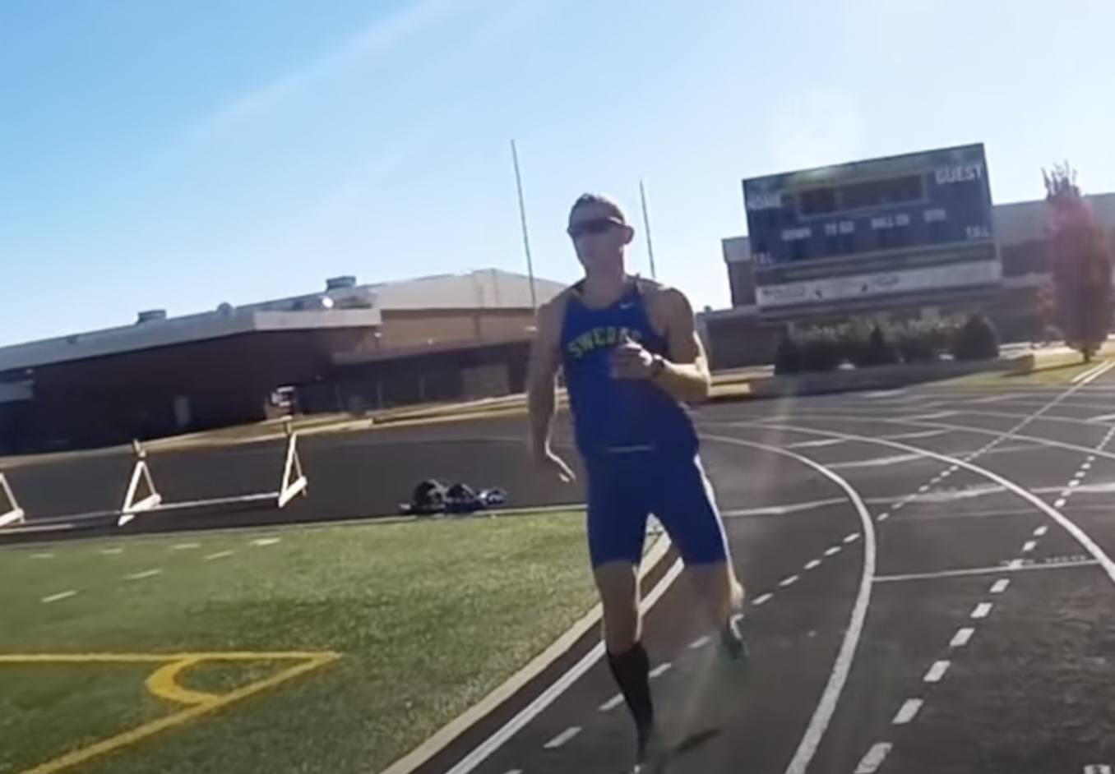
A set of vital signs

Slide 18
Guinness World record holder Aaron Yoder

Slide 19
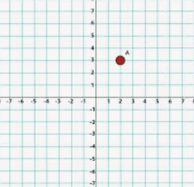

Single vs multiple sets of vital signs

Slide 20

One set of vitals is a snapshot in time but is incomplete.

Slide 21
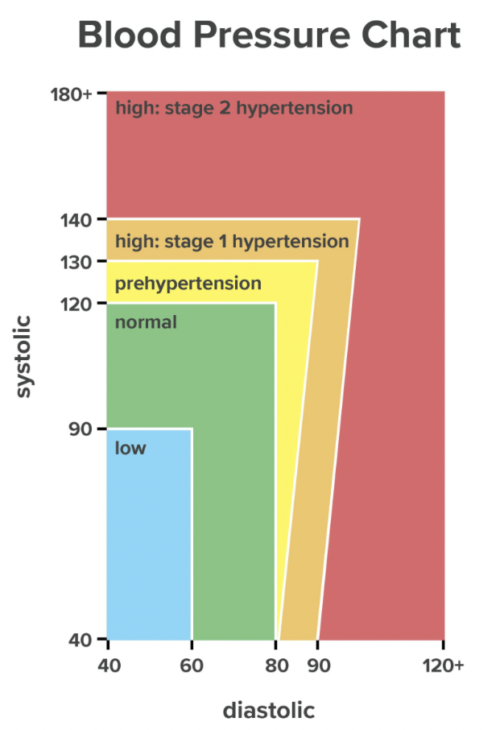
Normal Blood Pressure Range?

Slide 22
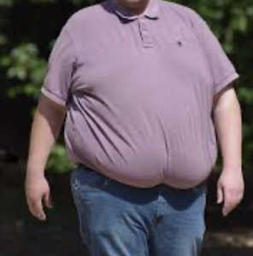
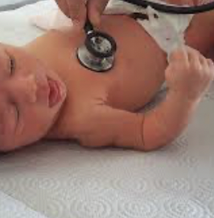
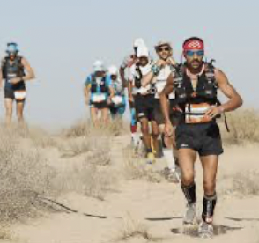
Normal only matters in appropriate context

Slide 23

Shock Index

Slide 24
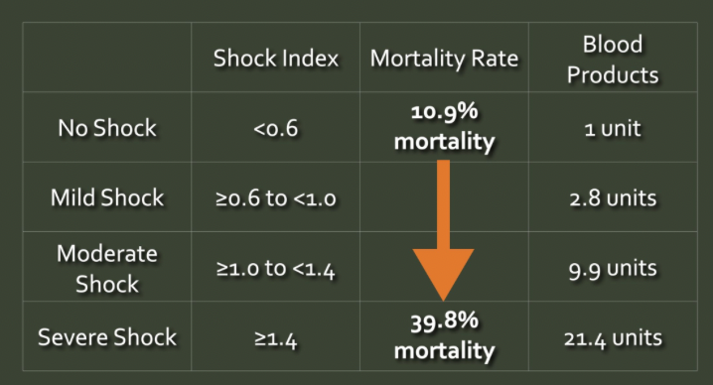
Shock Index

Slide 25
Sick Vital signs
Hypoxic
Tachypnea/bradypnea
Tachycardia/bradycardia
Hypotensive/hypertensive
Febrile
Diaphoresis

Slide 26
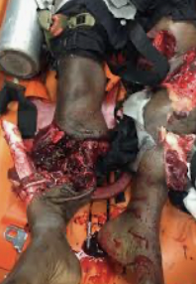
CAse: Sick not Sick? What else would you like?

Slide 27

What Questions may I answer

