Slide 1
HEADER
The Language of Addiction
Jasen Christensen, DO
Associate Professor of Psychiatry
Co-Medical Director, alcoholECHO
jachristensen@salud.unm.edu
Karla Thornton, MD, MPH
Professor, Division of Infectious Diseases
Senior Associate Director, Project ECHO
kthornton@salud.unm.edu

Slide 2
Disclosures
No conflicts of interest to disclose

Slide 3
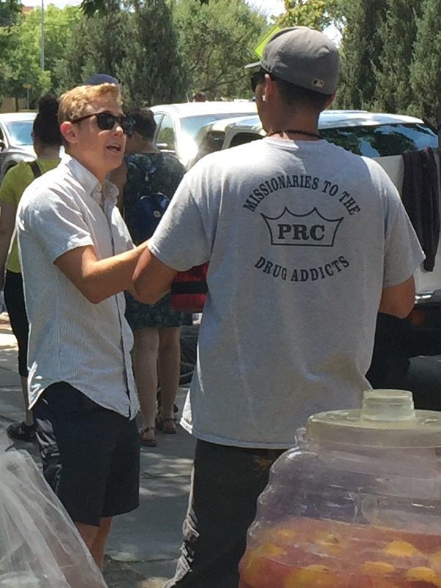
Learning Objectives
Recognize the importance of using non-stigmatizing language for substance use
Recognize the terminology related to substance use recommended by the ONDCP

Slide 4
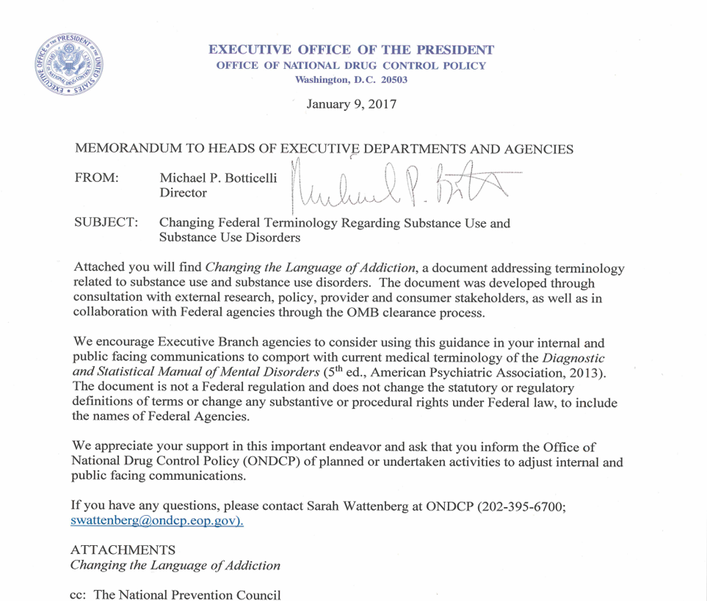
Office of National Drug Control Policy: Changing the Language of Addiction

Slide 5

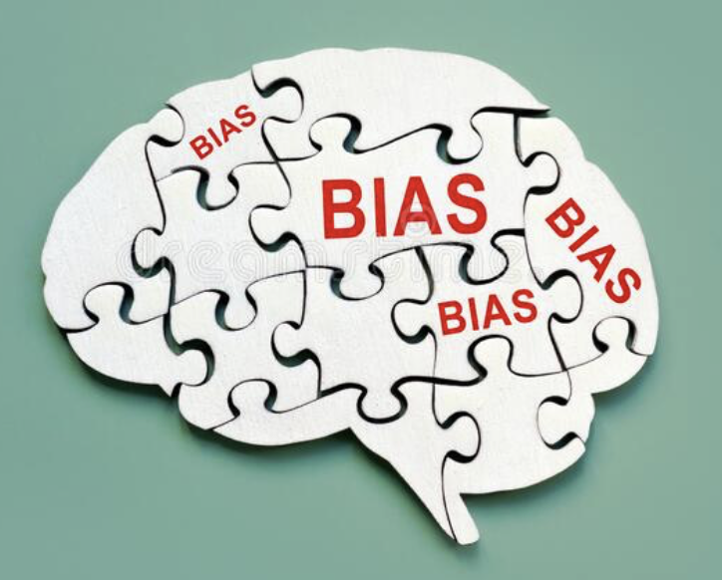
Language Drives Our Biases
Use of “substance abuser” compared to “substance use disorder”
“substance abuser” evoked more agreement that the individual was personally responsible and punitive measures should be taken
Even among highly trained mental health professionals!
Kelly, John F., and Cassandra M. Westerhoff. "Does it matter how we refer to individuals with substance-related conditions? A randomized study of two commonly used terms." International Journal of Drug Policy 21.3 (2010): 202-207.

Slide 6
Our Biases Drive Language
Review of 546,309 notes for 30,000 patients
Stigmatizing language was more likely to be used with:
males than females
older patients than younger patients
white patients than asian or hispanic patients
Weiner S, Lo E-C, et al. The Incidence and Disparities in Use of Stigmatizing Language in Clinical Notes for Patients With Substance Use Disorder. Journal of Addiction Medicine, March 2023

Slide 7
Dignity Relates to Stigmatizing Language
“…to reduce stigma, policies must ensure that all personnel preserve the dignity of patients with SUDs, beginning with communication standards that avoid stigmatizing language.”
- Nora Volkow (Director of NIDA) & Jerome Adams (Former Surgeon General)
Adams J, Volkow N. Ethical Imperatives to Overcome Stigma Against People With Substance Use Disorders. AMA Journal of Ethics. Policy Forum. 2022:22(8)

Slide 8
Background – Substance Use
Substance use imposes a devastating health and emotional burden on individuals, families, and communities
21.2 million Americans 12 or older have a SUD
More Americans die every year from drug overdoses than in motor vehicle crashes
The crisis of Opioid Use Disorder claims 130 lives per day
89% of individuals in need of treatment for a SUD do not receive treatment
Substance Abuse and Mental Health Services Administration. (2019). Key substance use and mental health indicators in the United States: Results from the 2018 National Survey on Drug Use and Health (HHS Publication No. PEP19-5068, NSDUH Series H-54). Rockville, MD: Center for Behavioral Health Statistics and Quality, Substance Abuse and Mental Health Services Administration. Retrieved from https://www.samhsa.gov/data/
US Department of Health and Human Services. What is the US opioid epidemic? https://www.hhs.gov/opioids/about-the-epidemic/index.html. Reviewed September 4, 2019. Accessed April 21, 2020.

Slide 9
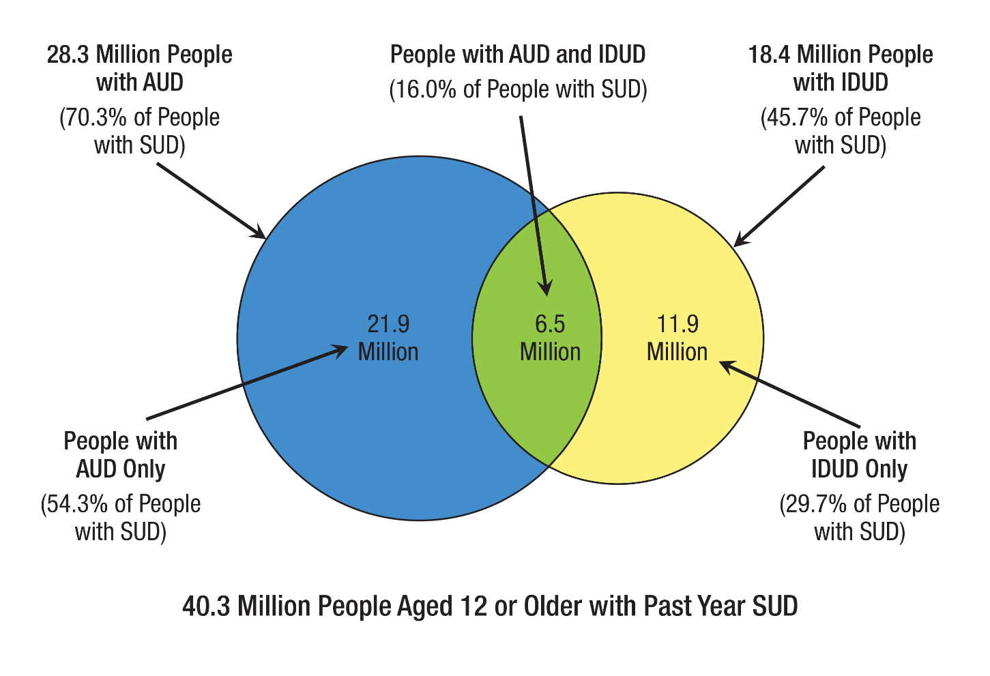
Substance Use Disorder (Alcohol Use Disorder and Illicit Drug Use Disorder) in the Past Year
https://www.samhsa.gov/data/release/2020-national-survey-drug-use-and-health-nsduh-releases

Slide 10
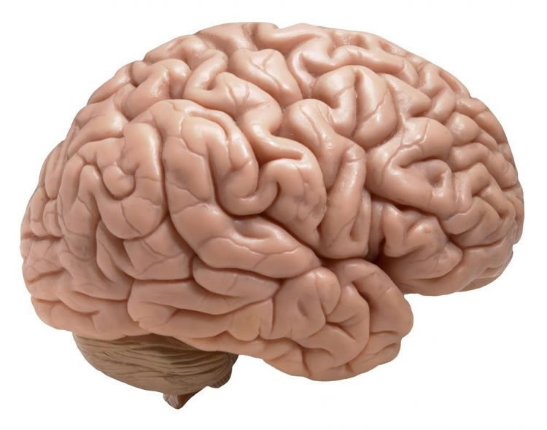
Background – the Brain
Substance Use Disorder (SUD) is a chronic brain disorder
Addictive substances can lead to dramatic changes in brain function
Changes in brain reduce a person’s ability to control their substance use
People can and do recover

Slide 11
Background – Stigma
What is stigma?
When a person or group experiences prejudice or discrimination in society because of a particular characteristic
May be intentional or unintentional, but the outcome is the same
​Examples of stigma toward people who use drugs:
Criminalization of substance use
Being called a “junkie,” “addict,” etc.​
Being denied care in emergency departments, primary care, or pharmacies​

Slide 12
Background – Stigma
People with SUD are viewed more negatively than people with physical or psychiatric disabilities
The terminology often used can suggest that SUD is the result of a personal or moral failing/choice
The term “abuse” is highly associated with negative judgments and punishment
Even trained clinicians are likely to assign blame when someone is called a “substance abuser” rather than a “person with a SUD”
Kelly JF, Westerhoff CM. Does it matter how we refer to individuals with substance-related conditions? A randomized study of two commonly used terms. Int J Drug Policy. 2010 May;21(3):202-7. doi: 10.1016/j.drugpo.2009.10.010. Epub 2009 Dec 14. PMID: 20005692.

Slide 13
Substance Use Disorder
Diagnostic and Statistical Manual of Mental Disorders (DSM-5) replaced categories of substance “abuse” and “dependence” with single classification of “substance use disorder”
Terms such as “drug habit” inaccurately imply that a person is choosing to use substances or can choose to stop

Slide 14
Person with a Substance Use Disorder
Person-first language is the accepted standard for discussing people with disabilities and/or chronic medical conditions:
“A person diagnosed with Alcohol Use Disorder”
“A patient wrestling with Opioid Use Disorder”
Use of the terms “abuse” and “abuser” negatively affects perceptions and judgments about people with SUD
Terms such as “addict” and “alcoholic” can have similar effects

Slide 15
Person in Recovery
Various terms used to label the substance using status of people “clean” and “dirty”
Alternatives:
Instead of “clean”
“negative” (for a toxicology screen)
“not currently using substances” (for a person)
Instead of “dirty”
“positive” (for a toxicology screen)
“currently using substances” (for a person)
“Person in recovery” refers to an individual who is stopping or reducing substance use to a safer level, and reflects a process of change

Slide 16
Medication for Opioid Use Disorder (MOUD)
Terms “replacement” and “substitution” imply medications “substitute” one drug or “one addiction” for another - this is a misconception
Medications used in treatment for opioid addiction do not result in a “high,” they help to reduce opioid cravings and withdrawal
“Medication-assisted treatment” (MAT) implies shorter-term treatment and that medications are an ‘assistance’ rather than a stand-alone treatment.
Preferred term: Medication for Opioid Use Disorder (MOUD) or Medication for Substance Use Disorder, Alcohol Use Disorder, etc.

Slide 17


Why change our language?
Reflects our conscious & unconscious biases
Affects our actions and interactions with others
Slide Courtesy of Erin Madden, PhD, MPH

Slide 18
Why change our language?
Stigmatizing language has downstream effects
Affects treatment and other healthcare
Access to services
Adherence to treatments
Affects how the larger community sees people who use drugs
Employment
Housing
Other services
Slide Courtesy of Erin Madden, PhD, MPH

Slide 19

Evidence of language importance for people who use drugs
Across 134 studies,¹⁰ people who feel discriminated against are more likely to report:
Stress
Unhealthy behaviors
Worse physical and mental health outcomes
Slide Courtesy of Erin Madden, PhD, MPH
Notes:
Pascoe EA, Smart Richman L. Perceived discrimination and health: a meta-analytic review. Psychol Bull. 2009 Jul;135(4):531-54. doi: 10.1037/a0016059. PMID: 19586161; PMCID: PMC2747726.

Slide 20
Summary
Language matters!
Preferred terminology:
Substance Use Disorder
Person with a Substance Use Disorder
Person in Recovery
MOUD (Medication for Opiate Use Disorder
Medication for a Substance Use Disorder, Alcohol Use Disorder, etc.

Slide 21
References
https://obamawhitehouse.archives.gov/blog/2017/01/13/changing-language-addiction
Center for Behavioral Health Statistics and Quality. (2016). 2015 National Survey on Drug Use and Health: detailed tables—prevalence estimates, standard errors, p values, and sample sizes. Substance Abuse and Mental Health Services Administration, Rockville, MD.
Centers for Disease Control and Prevention, National Center for Health Statistics. Multiple Cause of Death, 1999- 2015 on CDC WONDER Online Database, released 2016. Extracted by ONDCP from http://wonder.cdc.gov/mcd-icd10.html on December 8, 2016.
Corrigan, P.W., Kuwabara, SA., O’Shaughnessy, J. (2009). The public stigma of mental illness and drug addiction: findings from a stratified random sample. Journal of Social Work. (9)(2): 139-147.
Barry, C.L., McGinty, E.E., Pescosolido, B.A., Goldman, H.H. (2014). Stigma, discrimination, treatment, effectiveness, and policy: public views about drug addiction and mental illness. Psychiatric Services. (65)(10): 1269-1272.
Kelly, J.F., Westerhoff, C.M. (2010). Does it matter how we refer to individuals with substance-related conditions? A randomized study of two commonly used terms. International Journal of Drug Policy. 21(3):202-7.
Pascoe EA, Smart Richman L. Perceived discrimination and health: a meta-analytic review. Psychol Bull. 2009 Jul;135(4):531-54. doi: 10.1037/a0016059. PMID: 19586161; PMCID: PMC2747726.
van Boekel, L.C., Brouwers, E.P.M., van Weeghel, J., Garretsen, H.F.L. (2013). Stigma among health professionals towards patients with substance use disorders and its consequences for healthcare delivery: Systematic review. Drug and Alcohol Dependence. 131: 23-35.
American Society of Addiction Medicine. Patients with addiction need treatment – not stigma. Retrieved December 3, 2016 from http://www.asam.org/magazine/read/article/2015/12/15/patients-with-a-substanceuse-disorder-need-treatment---not-stigma.
International Society of Addiction Journal Editors. (2015). Addiction terminology statement. Retrieved November 4, 2016 from http://www.parint.org/isajewebsite/terminology.htm.
American Psychological Association. Guidelines for nonhandicapping language in APA journals (n.d.). Retrieved December 15, 2015 from http://www.apastyle.org/manual/related/nonhandicappinglanguage.aspx.
American Psychiatric Association (2013). Diagnostic and statistical manual of mental disorders (5th ed.). Washington, D.C.
American Society of Addiction Medicine. (2015). The ASAM national practice guideline for the use of medications in the treatment of addiction involving opioid use disorder.

