Slide 1
Indian Country ECHO Grand Rounds Rheumatoid Arthritis: Introduction to Diagnosis and Management
September 23, 2024
Wendy Grant MD

Slide 2
RA: Intro to Diagnosis and Management
I have no financial disclosures

Slide 3
RA: Intro to Diagnosis and Management
Agenda
RA: epidemiology, pathogenesis, clinical spectrum
RA in Indian Country
Diagnosis of RA
General treatment principles/initial therapy
Case presentation
Description of the Rheumatoid Arthritis ECHO curriculum

Slide 4
Poll questions
Approximately how many patients with RA do you have under your care? (0; 1-5; 5-10; > 10)
How comfortable do you feel diagnosing someone with RA without the input of a rheumatologist? (not at all, somewhat, reasonably, very)
How comfortable do you feel starting someone on DMARD therapy without consultation from a rheumatologist? (not at all, somewhat, reasonably, very)
How long do your patients (with RA or any rheumatologic condition) wait to see a rheumatologist? (1-3 months; 3-6 months; > 6 months)

Slide 5
Rheumatoid Arthritis: the basics
RA is a systemic autoimmune disease characterized primarily by a symmetric inflammatory polyarthritis
The US prevalence is 0.5-1%, with some populations having significantly higher rates of disease
Women:men 3:1
Age of onset: 30-50 most common
1st degree relative confers 3X higher odds
2nd degree relative confers 2X higher odds

Slide 6
Extra-Articular Manifestations of RA

Slide 7
Rheumatoid Arthritis: the basics
Pathogenesis
Likely a combination of genetic and environmental factors
Genetics:
HLA-DRB1 genes are most closely associated with RA
Environmental:
smoking (strongest known environmental RF for RA)
chronic mucosal inflammation (periodontitis) and possibly gut dysbiosis are potential RF
others: silica/other inhalants, sugary drinks, obesity, pollution
2 copies of the HLA-DRB1 gene + smoking = RR of 21

Slide 8
RA: Intro to Diagnosis and Management
RA: epidemiology, pathogenesis, clinical spectrum
RA in Indian Country
Diagnosis of RA
General treatment principles/initial management
Case presentation
Description of the Rheumatoid Arthritis ECHO curriculum

Slide 9
RA Epidemiology among American Indians/Alaska Natives
Tlingit 2.4% (1991)
1.3% male
3.5% female
Yakima (1973)
N/A male
3.4% female
Boyer et al. Rheumatic Diseases in Alaskan Indians of the Southeast Coast. JRheum1991;18:1477-84
Beasley et al. High prevalence of rheumatoid arthritis in Yakima Indians. Arth Rheum 1973; 16:743-8

Slide 10
RA Epidemiology among American Indians/Alaska Natives
Pima (1989)
3.2% male
7.0% female
Chippewa (1981,1983)
4.8% male
8.2 % female
DelPuente et al. High incidence and prevalence of rheumatoid arthritis in Pima Indians. Am J Epidemiol 1989; 129: 1170-8Harvey et al. Rheumatoid arthritis in a Chippewa Band. Arthritis Rheum 1981; 24: 717-21

Slide 11
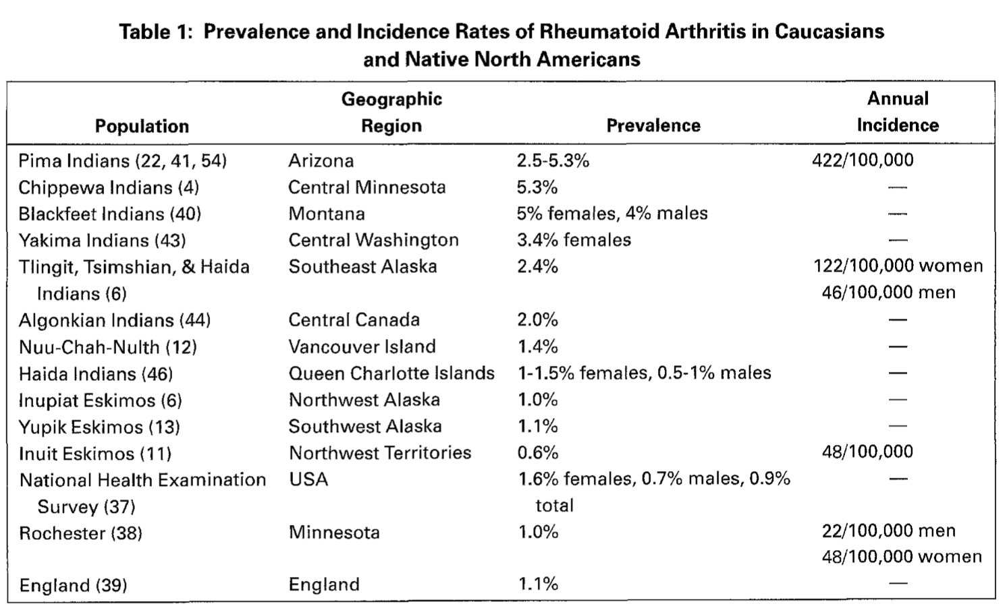
RA Epidemiology Among American Indians/Alaska Natives
Peschken CA, Esdaile JM. Seminars in Arthritis and Rheum 1999;28:368–391.
Notes:
Estimated I&P 2-3x that of Anglo populations

Slide 12
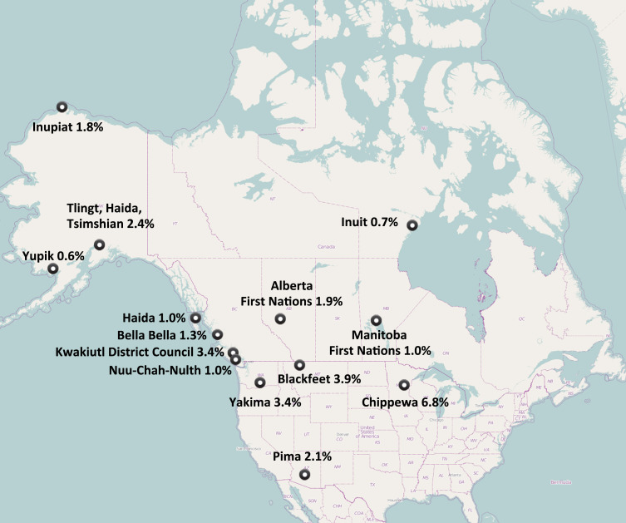
RA in Native American populations
RA in Native American populations

Slide 13
RA Epidemiology among American Indians/Alaska Natives
2010 study comparing NAN patients (Cree, Ojibway, Metis, Sioux, Dakota) to white patients with RA
20 years of follow up
In the NAN group:
Younger age of onset
Higher rate of RF positivity
Higher rate of ANA positivity
Higher lifetime number of DMARDs
More frequent combination therapy
More frequent prednisone use
Peschken et al. Rheumatoid arthritis in a North American Native population: longitudinal followup and comparison with a white population. JRheum 2010; 37: 1589-95

Slide 14
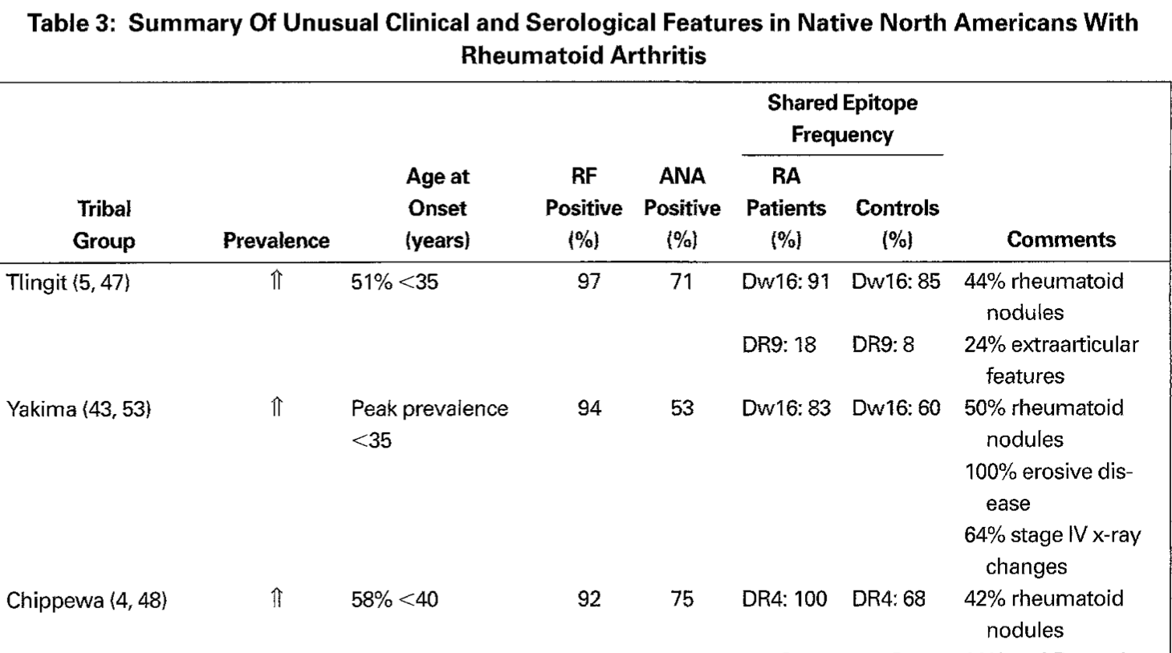
Peschken CA, Esdaile JM. Seminars in Arthritis and Rheum 1999;28:368–391.

Slide 15
RA: Intro to Diagnosis and Management
RA: epidemiology, pathogenesis, clinical spectrum
RA in Indian Country
Diagnosis of RA
Principles of treatment/initial management
Case presentation
Description of the Rheumatoid Arthritis ECHO curriculum

Slide 16
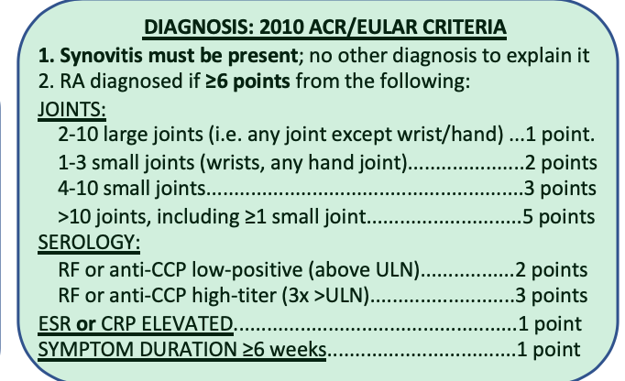

Slide 17
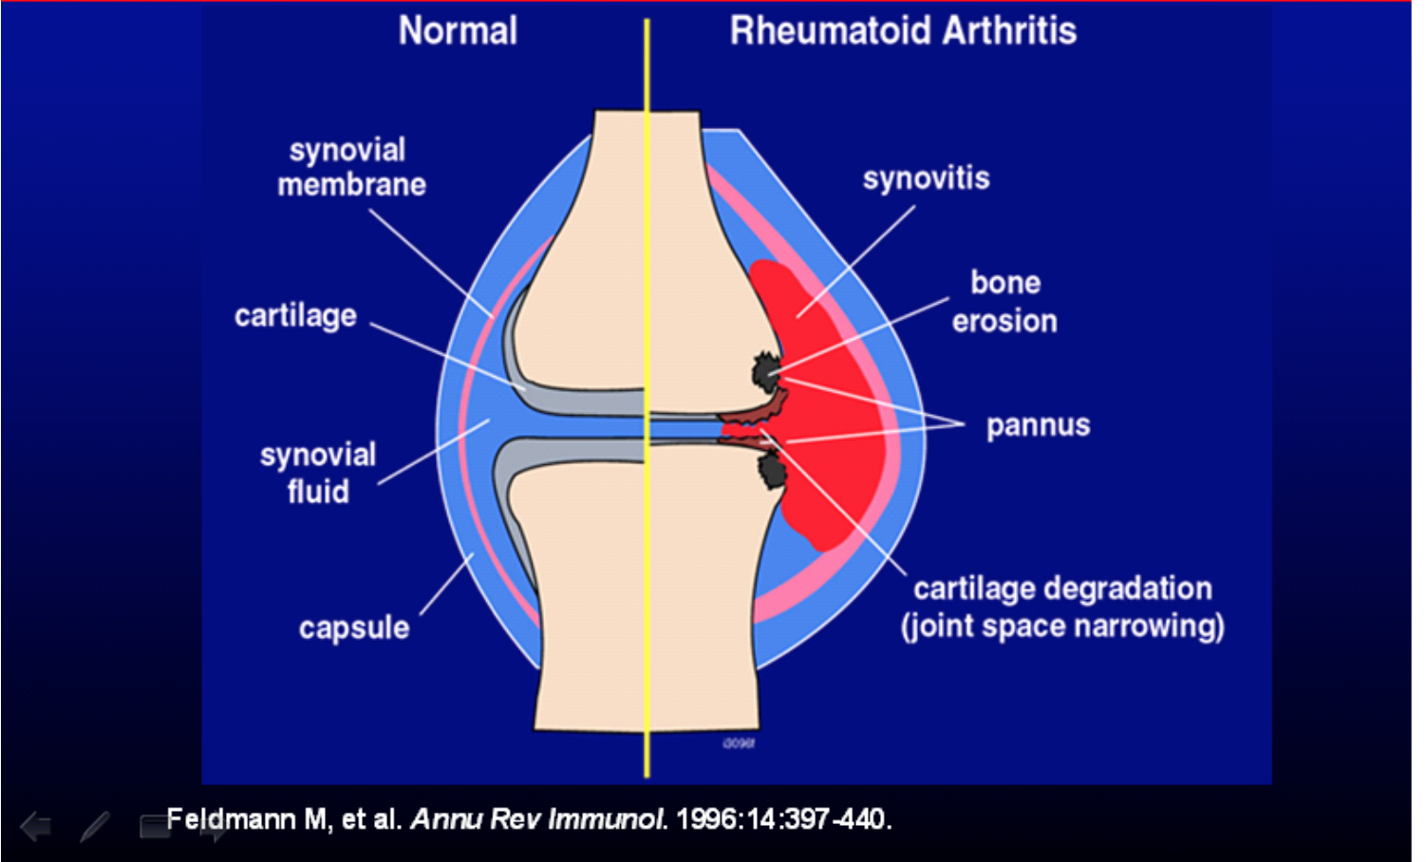
Synovitis

Slide 18
Hallmarks of synovitis
History
Stiffness
Swelling
+/- warmth
Improvement with movement/NSAIDs
Exacerbated by inactivity (morning stiffness > one hour)
Exam
Swelling
“bounciness” to palpation

Slide 20
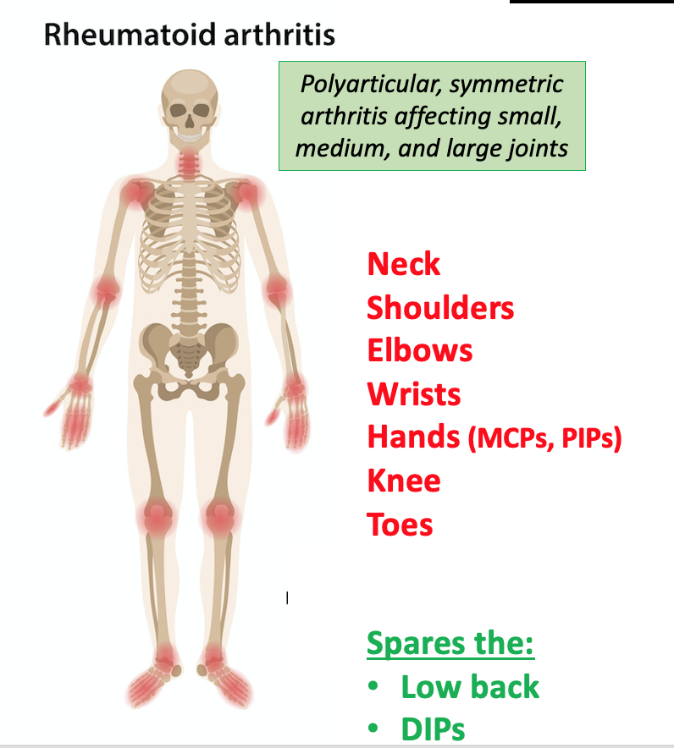
Joint distribution in RA

Slide 22
Rheumatoid Factor and CCP ab
RF and CCP (cyclic citrullinated peptide) should always be ordered together
RF is 70-80% sensitive, 75% specific for RA
CCP (cyclic citrullinated peptide) ab is 80% sensitive, > 95% specific
A positive RF can be seen in multiple other settings (other rheumatologic disease, chronic infection including Hep C, healthy individuals)
RF and CCP are used in diagnosis of RA but generally do not correlate with disease activity, so not helpful to follow over time
High titers tend to correlate with severity of disease

Slide 23
RF and CCP in rheumatoid arthritis
Be suspicious!

Slide 25
Diagnosis: Exceptions
Very early RA
< 6 weeks, but high CCP/RF, typical joint distribution and no other reasonable explanation
Very late RA
No ongoing inflammation (normal CRP/ESR); no active synovitis, but joint erosions/deformities consistent with RA

Slide 26
Scenario #1
34 year old woman
2-3 months joint pain, stiffness in hands, feet, wrists
Better with movement, NSAIDs; worse in the morning or after inactivity
Exam: swelling and tenderness of both wrists, left index and third finger PIP joints
RF negative
CCP > 250 (< 20)
CRP 15 (< 10)

Slide 27
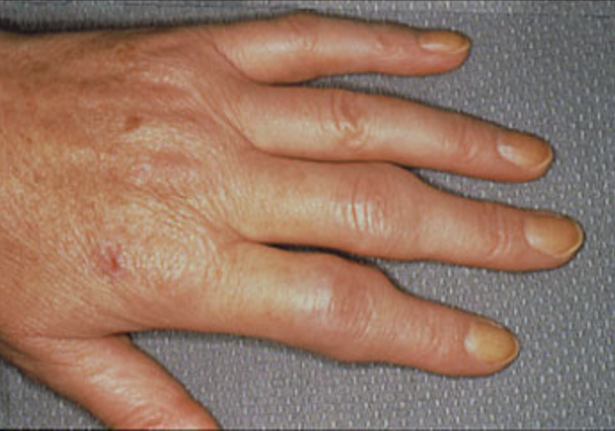

Slide 28
Poll Question
Does this person have RA?
Yes
No
Maybe

Slide 29
Scenario #1
34 year old woman
2-3 months joint pain, stiffness in hands, feet, wrists 1 point
Exam: swelling and tenderness of both wrists, 3 points
left index and third PIP joints
RF negative 0 points
CCP > 250 (normal < 20) 3 points
CRP 15 1 point
This person has rheumatoid arthritis

Slide 30
Scenario #2
68 year old woman
10 years of joint pain and stiffness in the hands, gradually progressive
Stiffness in hands in the mornings x 15-20 minutes
Relief from NSAIDs; worse with use
Exam: enlarged PIP and DIP joints; decreased flexion; no direct tenderness
RF 34 (normal < 14)
CCP negative
Normal CRP

Slide 31
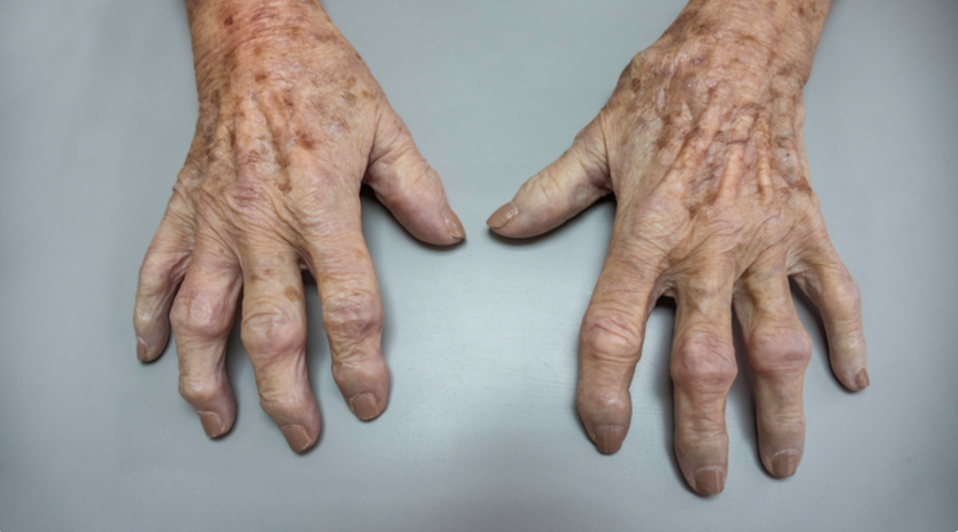

Slide 32
Poll Question
Does this person have RA?
Yes
No
Maybe

Slide 33
Scenario #2
68 year old woman
10 years of joint pain in the hands 1 point
Exam: enlarged PIP and DIP joints; decreased flexion 0 points
no synovitis
RF 34 2 points
CCP negative 0 points
Normal CRP 0 points
This person has osteoarthritis

Slide 34


Osteoarthritis in the hands
Normal wrists
Normal MCP joints
Bouchard’s nodes
Heberden’s nodes

Slide 35
Scenario #3
55 year old woman
3 months of pain/stiffness in hands
Worse in AM; 30 minutes morning stiffness; better with NSAIDs
Exam: tenderness in several PIP joints; no swollen joints; full grip
RF negative
CCP 50 (normal < 20)
CRP 12 (normal < 10)

Slide 36
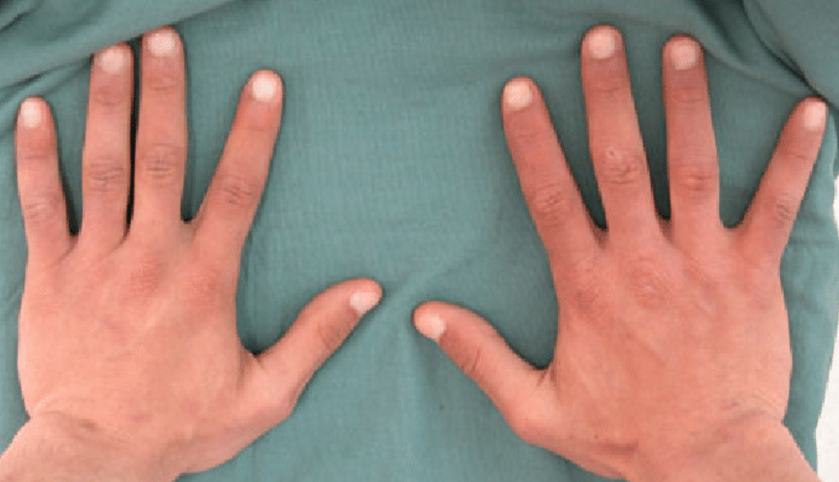

Slide 37
Poll Question
Does this person have RA?
Yes
No
Maybe

Slide 38
Scenario #3
55 year old woman
3 months of pain in hands 1 point
Exam: tender joints; no obvious synovitis 0 points
RF negative
CCP 50 (normal < 20) 2 points
CRP 12 (normal < 10) 1 point
This person does not meet the criteria for RA, but should be followed closely

Slide 39
RA: Intro to Diagnosis and Management
RA: epidemiology, pathogenesis, clinical spectrum
RA in Indian Country
Diagnosis of RA
Principles of treatment/initial therapy
Case presentation
Description of the Rheumatoid Arthritis ECHO curriculum

Slide 40
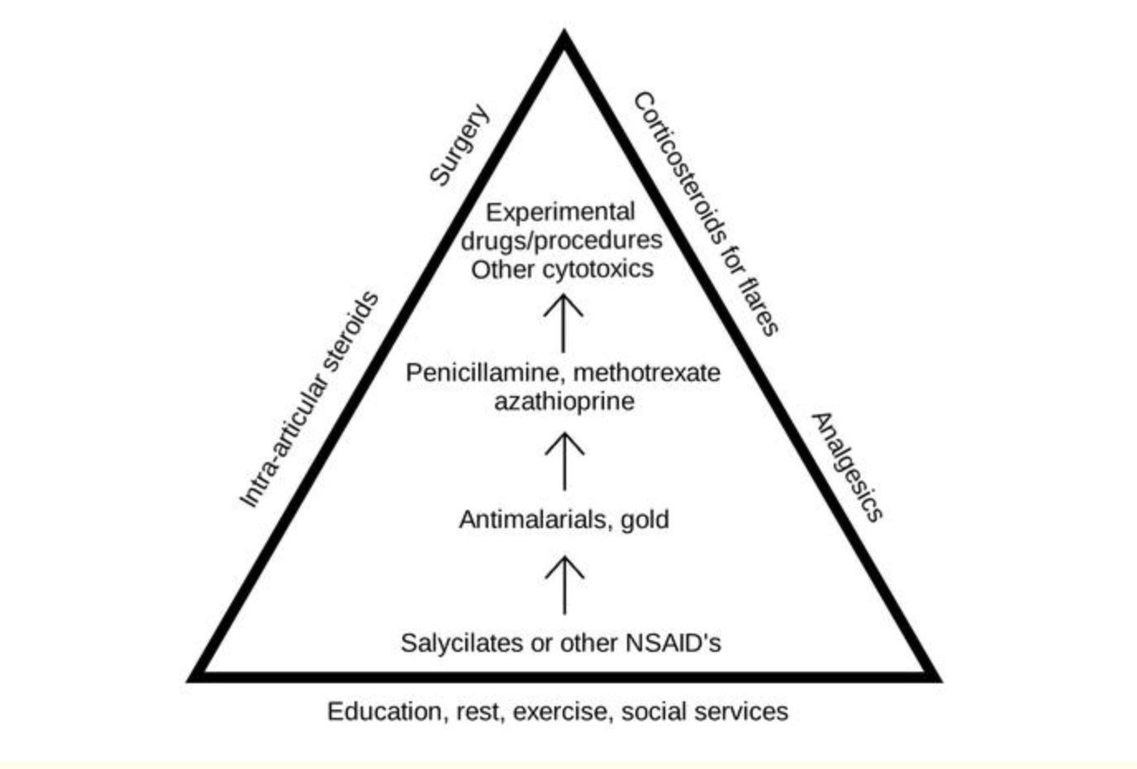
Principles of Treatment The old “pyramid approach”

Slide 41
Current approach to treatment of RA
Early initiation of treatment with disease modifying anti-rheumatic drugs (DMARDs) is critical to slow disease progression and prevent irreversible damage and disability
“Treat to target” approach: titrate/change DMARDs until patient achieves low disease activity
There are now more than 20 FDA-approved medications for the treatment of RA!
NSAIDS and glucocorticoids are helpful adjuncts to treatment, particularly early on, but are not disease modifying agents
Glucocorticoids should be used in the lowest dose possible for the shortest duration possible
Opioids are not effective treatment for RA and should be avoided

Slide 42
Terminology: DMARDs Disease Modifying Anti-Rheumatic Drugs
“Conventional DMARDs”:
Methotrexate, Hydroxychloroquine, Sulfasalazine, Leflunomide
“Biologic/Targeted DMARDs”:
TNF inhibitors: etanercept/Enbrel (SQ), adalimumab/Humira (SQ), infliximab/Remicade (IV), certolizumab, golimumab
Others: abatacept (T cell costimulatory inhibitor), rituximab (anti-CD20), tocilizumab/sarilumab (IL-6 inhibitors), tofacitinib/upadacitinib (JAK inhibitors)

Slide 43
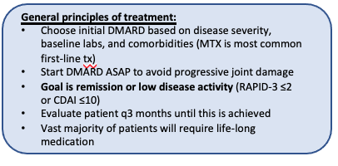
”Treat to Target” Approach

Slide 44
Contraindications to Methotrexate
Chronic liver disease
GFR < 30/hemodialysis
Severe COPD or other chronic lung disease (risk of methotrexate pneumonitis)
Untreated LTBI (can use MTX after initiation of LTBI treatment)
Potential for conception/lactation

Slide 45
RA: Intro to Diagnosis and Management
RA: epidemiology, pathogenesis, clinical spectrum
RA in Indian Country
Diagnosis of RA
Principles of treatment/initial therapy
Case presentation
Description of Rheumatoid Arthritis ECHO curriculum

Slide 46
Case presentation
22 year old Navajo woman, college student with 1 year of joint pain, initially intermittent, now daily
Affected joints: hands, feet, knees, elbows; more right-sided than left
Swelling in hands, feet
Symptoms are better with Advil, hot shower, activity
Worse in the mornings and after sitting (knees)
Not able to do her usual running for exercise
Sometimes hard to get to class on time in the mornings

Slide 47
Case presentation
College student
No tobacco, alcohol, drug use
Exercises regularly when able
Not sexually active currently
Great aunt with RA
No medications aside from OTC NSAIDs
Prior LARC but d/c secondary to arthritis sx
No allergies

Slide 48
Case presentation
Pertinent review of systems positives and negatives:
Const: no fevers, chills, weight loss; + fatigue
HEENT: no sicca symptoms; no oral ulcers
Resp: no dyspnea or cough
CV: no chest pain or palpitations
Skin: no rash or photosensitivity; no Raynaud’s phenomenon
Neuro: no h/a, dizziness, paresthesia
Lymph: no adenopathy

Slide 49
Case presentation
EXAM
Swelling/tenderness at the MCP joints of the right > left hand
Swelling/tenderness/pain with ROM of both wrists
Swelling/tenderness of the right foot MTP joints
Stiff with ROM of the knees, ankles, elbows.
Small effusion right knee

Slide 50
Case presentation
LAB DATA
RF 100 (CCP not done)
ANA 1:320; SSA 2.0
HLA B27 +
ESR 33 (< 20)
CRP 10.1 (< 3)
CBC, CMP without abnormalities
TSH normal
No imaging

Slide 51
Poll Question
What is the diagnosis?
RA
Sjogren’s syndrome
Lupus
Reactive arthritis
Fibromyalgia

Slide 52
Case presentation
Using the diagnostic criteria
Synovitis in > 10 joints, including 1 small joint 5 points
High titer RF 3 points
Elevated inflammatory markers 1 point
Duration > 6 weeks 1 point

Slide 53
Case presentation
But what about the ANA of 1:320 and positive SSA?
30% of RA patients have a positive ANA
Higher in some AI/NA populations
SSA is very low positive; no sicca symptoms

Slide 54
Case presentation
What about the positive HLA B27? Why not a spondyloarthritis?
High rate of HLA B27 positivity in Navajo population (40%) so not a very helpful test
Pattern of involvement (symmetric, small joints) more c/w RA
No associated sx (psoriasis, uveitis)

Slide 55
Poll Question
What would be your first-choice medication regimen for this patient?
Methotrexate
Hydroxychloroquine
Sulfasalazine
Combination therapy (MTX + HCQ + SSZ)
TNF inhibitor (or other biologic)

Slide 56
Poll Question
Methotrexate contraindicated; no contraception
Hydroxychloroquine safe, but not likely to control disease
Sulfasalazine ditto
Combination therapy (MTX + HCQ + SSZ) contains methotrexate
TNF inhibitor most likely to get disease under control

Slide 57
RA: Intro to Diagnosis and Management
RA is more common among Native American populations
Early diagnosis and treatment is critical in preserving function and preventing joint damage
RF and CCP should always be ordered in tandem
Treat to target approach is recommended, with goal of remission or low disease activity
First choice of therapy is usually methotrexate, with some important exceptions

Slide 58

DIAGNOSIS & MANAGEMENT OF RHEUMATOID ARTHRITIS
DIAGNOSIS: 2010 ACR/EULAR CRITERIA
1. Synovitis must be present; no other diagnosis to explain it
2. RA diagnosed if ≥6 points from the following:
JOINTS: 2-10 large joints (i.e. any joint except wrist/hand) ...1 point.
1-3 small joints (wrists, any hand joint).....................2 points
4-10 small joints.........................................................3 points
>10 joints, including ≥1 small joint............................5 points
SEROLOGY: RF or anti-CCP low-positive (above ULN).................2 points
RF or anti-CCP high-titer (3x >ULN)..........................3 points
ESR or CRP ELEVATED...................................................1 point
SYMPTOM DURATION ≥6 weeks..................................1 point
Initial visit checklist:
LABWORK: RF, CCP, CBC, CMP, ESR, CRP, PPD or Quantiferon, HBV sAg/sAb/cAb, HCV Ab
IMAGING: bilateral hand and foot xrays (to establish baseline and screen for alternate diagnoses)
MEDS: consider scheduled NSAIDs vs. prednisone 5-10mg daily (temporary measure until patient is stable on DMARD therapy)
Pneumovax/Prevnar, flu shot, Shingrix, HBV vaccine, COVID19 vaccine as early as possible.
If TB screen positive (and active TB has been ruled out), start LTBI treatment at least 1 week before starting methotrexate
Schedule follow-up to review labs/xrays and discuss DMARD initiation
General principles of treatment:
Choose initial DMARD based on disease severity, baseline labs, and comorbidities (MTX is most common first-line tx)
Start DMARD ASAP to avoid progressive joint damage
Goal is remission or low disease activity (RAPID-3 ≤2 or CDAI ≤10)
Evaluate patient q3 months until this is achieved
Vast majority of patients will require life-long medication
VERY MILD RA
ALL of the following: <5 joints involved, no extra-articular disease, minimal limitation in joint function, RAPID-3 ≤2 or CDAI ≤10.
less common
common
MODERATE or SEVERE RA
ANY of the following: >5 joints involved, extra-articular disease, erosions on baseline x- rays, function limited, RAPID-3 >2 or CDAI >10
1st line for most RA patients
HYDROXYCHLOROQUINE 200-400mg PO daily [max dose 5mg/kg]
* May reduce risk of diabetes and improve lipids * Well-tolerated, safe in pregnancy * Retinal exam at baseline and q1yr
METHOTREXATE
10mg PO qWEEK x 4 weeks, then check labs. If no side effects and labs stable then increase to 20mg PO qWEEK. Recheck labs after 4 weeks.
If RA activity still mod-high after 3 months: switch to 25mg subcutaneous qWEEK
MTX monitoring:
* CBC, liver panel, Cr q3months once the dose is stable * Must take with folic acid 1mg daily (increase to 2mg daily if mild side effects)
If not tolerating MTX, might consider:
LEFLUNOMIDE 10mg PO daily x 6 weeks, then check labs. If tolerating, increase to 20mg PO daily * Diarrhea in 20% * Labs and contraindications same as for MTX (see page 2); Avoid in women of childbearing age: risk of birth defects up to 2 years after cessation!
OR
After 3 months, if moderate or high disease activity
SULFASALAZINE 500mg BID x 1 week → 1000mg BID * Better efficacy than hydroxychloroquine, but more likely to cause GI upset * Monitor WBC q2 months
*
After 3 months, if moderate or high disease activity
preferred
When to use prednisone in RA?
Prednisone 5-10mg daily may be considered initially (<3 months, while waiting for DMARD to take effect), but should be avoided as chronic therapy whenever possible, due to long term side effects.
“TRIPLE THERAPY”
Methotrexate + Sulfasalazine + Hydroxychloroquine
Large pill burden makes adherence challenging
Lower infectious risk compared to TNFi
Can be considered in patients who strongly prefer pills over injections
TNF-INHIBITOR
Adalimumab (Humira) 40mg SC q2weeks
or Etanercept (Enbrel) 50mg SC qweek
or Certolizumab pegol (Cimzia) 200mg SC q2weeks
* Ideally, give TNFi AND weekly methotrexate
* Adalimumab and Etanercept are more readily available
* Certolizumab is specifically preferred in pregnancy
Originally developed by: Sara K. Tedeschi, MD¹; Paul Dellaripa, MD¹; Anneliese Flynn, MD²; Michael Weinblatt, MD¹; ¹Brigham and Women’s Hospital, Division of Rheumatology, ²Northern Navajo Medical Center
Updated in 2021 by: Jennifer Mandal, MD³; Wendy Grant, MD⁴; Mary Margaretten, MD³; John McDougall, MD5; 3UCSF Division of Rheumatology, ⁴Centura Health Rheumatology, Durango, CO; ⁵Northern Navajo Medical Center-Shiprock
If still not controlled, discuss second-line biologic options with a rheumatologist

Slide 59
Conventional DMARD Safety & Monitoring:
Typical Timeline for Starting Methotrexate:
Methotrexate:
Contraindicated in: pregnancy, breastfeeding, chronic liver disease, heavy alcohol use, CKD stage 4/5
Caution in: CKD 3 (decrease dose)
Side effects: GI upset, oral ulcers, transaminitis (if AST/ALT <2x ULN: ok to monitor; >2x ULN: reduce dose or discontinue), infections, cytopenias, macrocytosis, pneumonitis (very rare)
Pearls: Dosed once WEEKLY. Splitting the oral dose (half in AM, half in PM) or switching to SQ formulation can improve absorption/efficacy. Always prescribe along with folic acid 1-5mg daily. In case of overdose: IV leucovorin.
Monitoring: CBC, Cr, LFTs q 3 months
Hydroxychloroquine:
Caution in: advanced renal impairment (decrease dose)
Side effects: Retinal toxicity (risk increases with duration of therapy), GI upset, skin hyperpigmentation. Rare myopathy, rare cardiotoxicity (avoid with known QT prolongation).
Pearls: Not immunosuppressive. Safe in pregnancy/breastfeeding.
Monitoring: Annual retinal exam (q6 months after >10 years on therapy). No lab monitoring required.
Sulfasalazine:
Side effects: GI upset, hepatotoxicity, leukopenia, hemolytic anemia (higher risk in G6PD deficiency)
Diagnose w/ RA
Assess disease activity → high
Labs: CBC, CMP, HBV, HCV, Quant Gold, CXR, baseline hand/foot xrays
Ask open-ended questions to check if pt is taking MTX correctly
Side effects?
Labs: CBC, LFTs, Cr → if reassuring, increase MTX to 20mg weekly
Assess RA activity
Side effects?
Labs: CBC, LFTs, Cr
1 month
1 month
1 month
1 month
3 months
MTX med counseling
Discuss birth control, alcohol use, plan for lab monitoring
Start MTX 10mg weekly + folic acid 1mg daily
Assess RA activity
Side effects?
Labs: CBC, LFTs, Cr
Continue to assess RA activity and check labs q 3 months
Pregnancy & Breastfeeding:
Safe | Contraindicated | Insufficient/Limited Data
Hydroxychloroquine, Sulfasalazine, TNFi (certolizumab has most data) | Methotrexate, Leflunomide | Abatacept, IL-6 inhibitors, Rituximab, JAK inhibitors
Overview of Biologic DMARDs for RA:
Generic | Trade | Class | Administration | Frequency | Pearls
Etanercept Adalimumab Golimumab Certolizumab Infliximab | Enbrel Humira Simponi Cimzia Remicade | TNF inhibitor | SQ SQ SQ SQ IV | Weekly Q 14 days Monthly Monthly Q 4-8 weeks | Typically used as first-line biologic therapy. Often try 2 different TNFi before moving on to another class. Avoid in class III/IV CHF, SLE-overlap, demyelinating disease.
Abatacept | Orencia | Costim blocker | SQ/IV | Weekly/monthly | Pro: Fewer infectious complications. Con: Longer time to efficacy
Tocilizumab Sarilumab | Actemra Kevzara | IL-6 inhibitor | SQ/IV SQ/IV | Weekly/monthly Weekly/monthly | Pro: Well-tolerated Con: Can cause hyperlipidemia, intestinal perforation
Rituximab | Rituxan | Anti-CD20 | IV | 2 IV doses every 6 months | Pros: May help RA-ILD, q6 month dosing can help with compliance, lowest risk of activating TB. Cons: B cell depletion = high risk of severe COVID, poor response to vaccines.
Tofacitinib Baricitinib Upadacitinib | Xeljanz Olumient Rinvoq | JAK inhibitor | PO PO PO | Daily or BID Daily Daily | Pro: Oral Con: high rate of zoster, increased risk of CVE/VTE in at-risk patients

Slide 60
Overview of Project RAE (Rheumatoid Arthritis ECHO)
The purpose of Project RAE is to provide education and support to primary care providers, enabling them to diagnose RA and initiate treatment among their patients
The format is a 10 -12 week program with didactics and case discussions

