Slide 1
The Month in Virology
August 21, 2024
Jorge Mera, MD

Slide 2
Outline
COVID-19 updates
Mpox
HIV prevention
Avian Flu in the US
Parvovirus B19

Slide 3
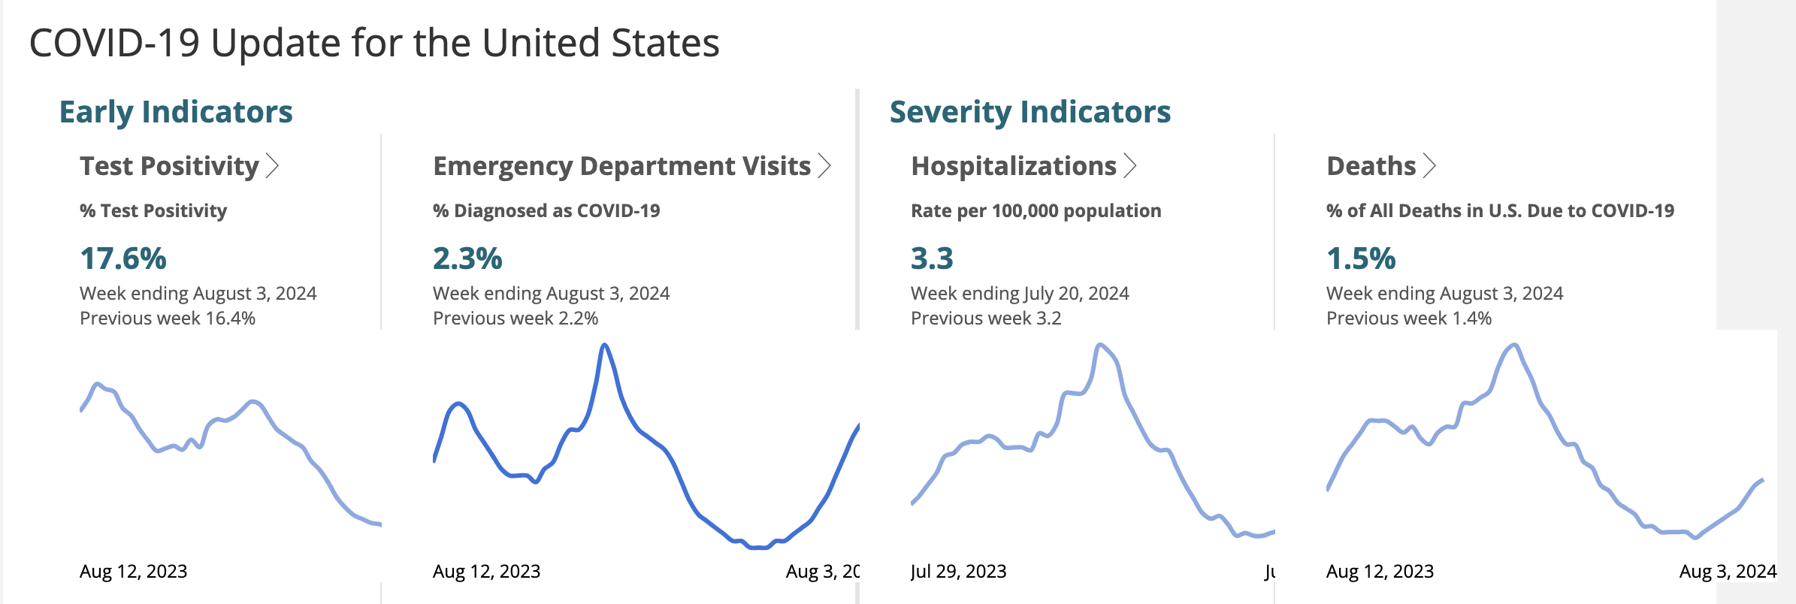

Slide 4
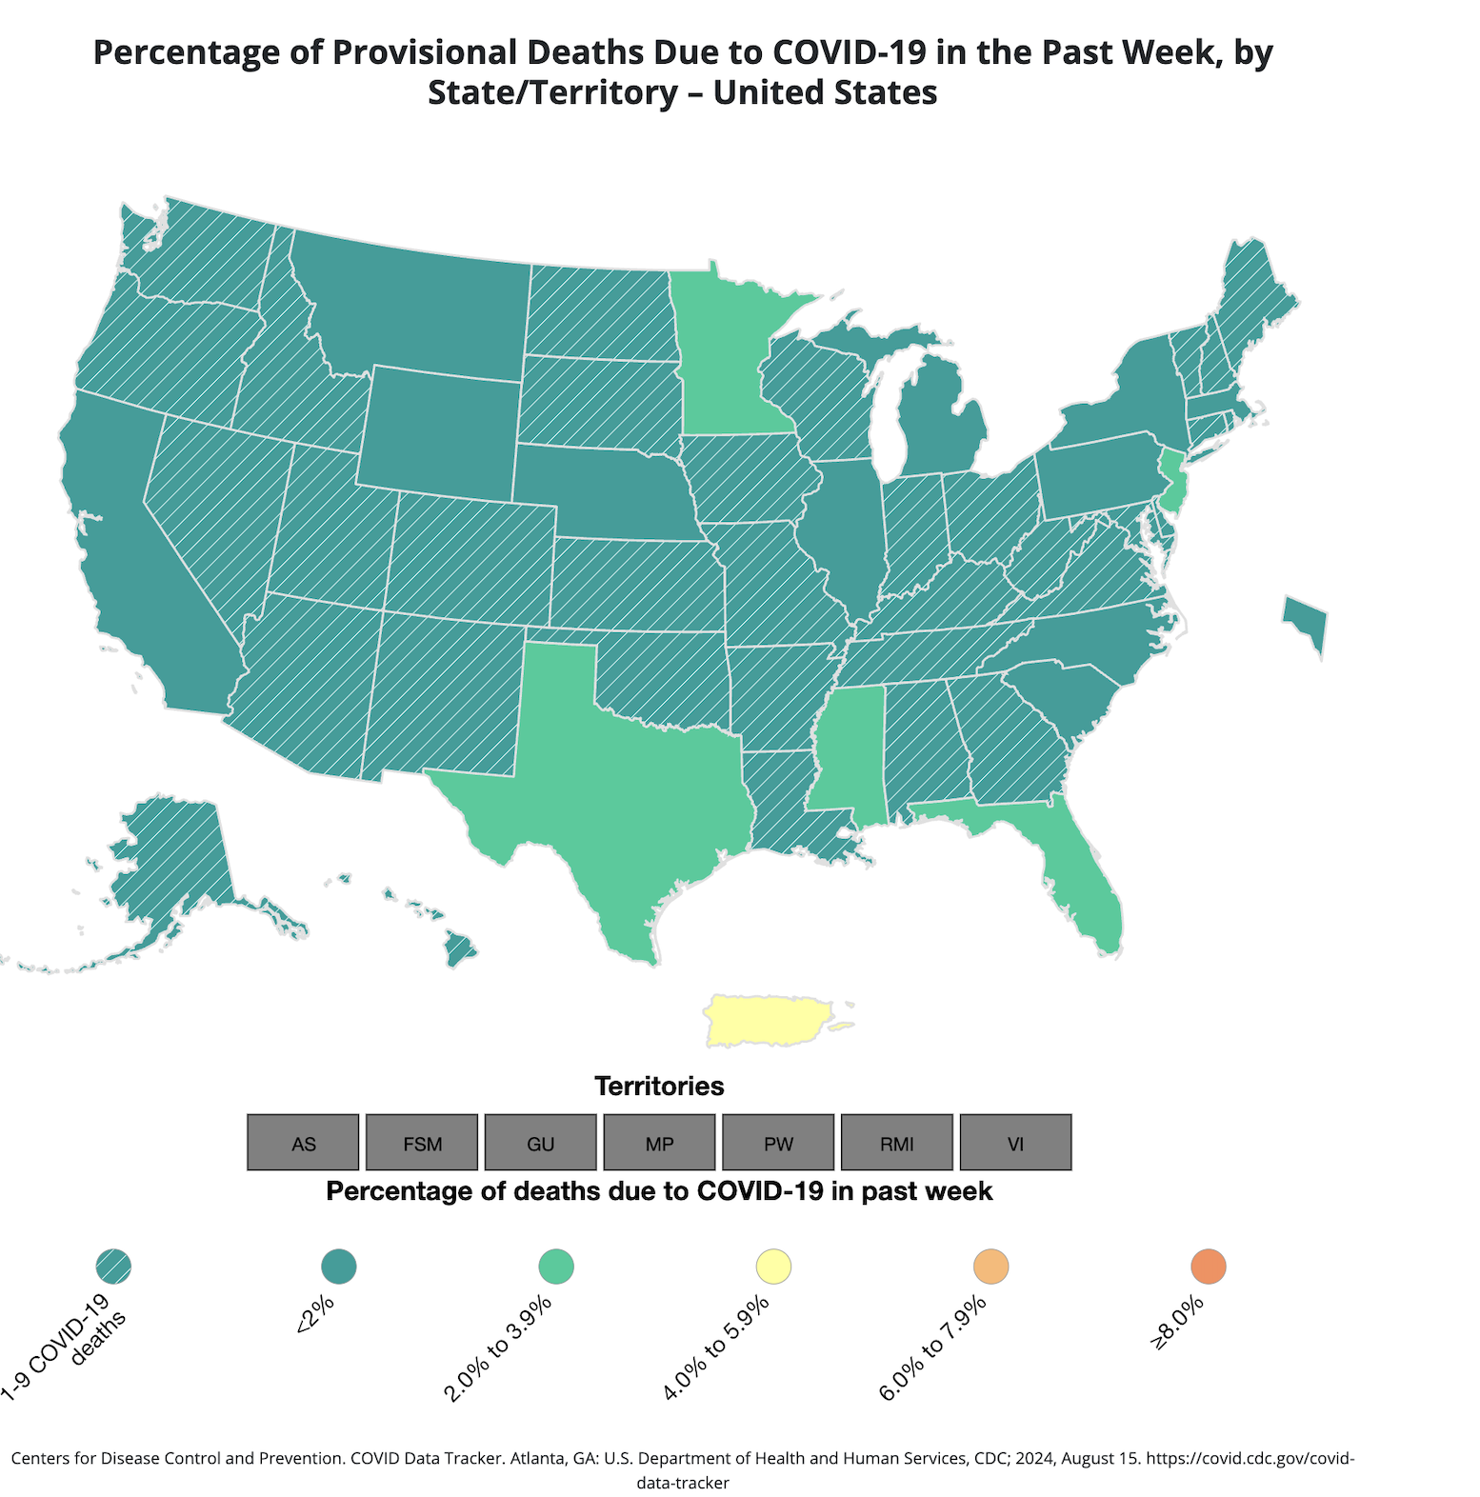

Slide 5
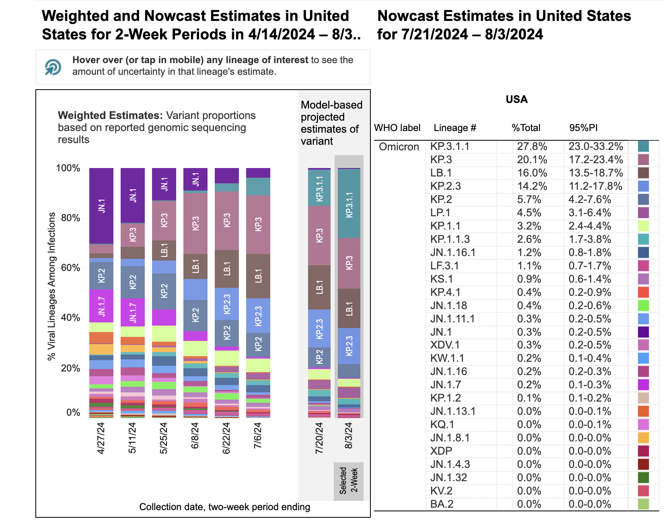

Slide 6
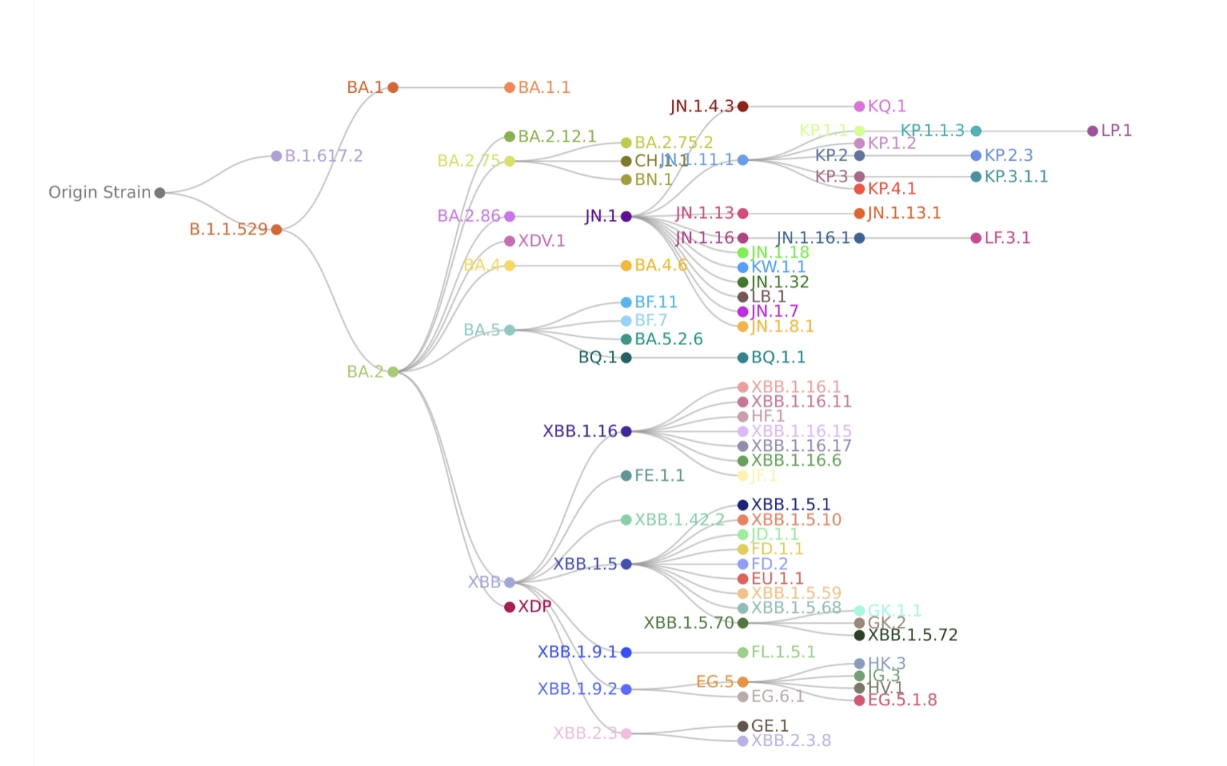
Evolution of COVID-19 Variants

Slide 7
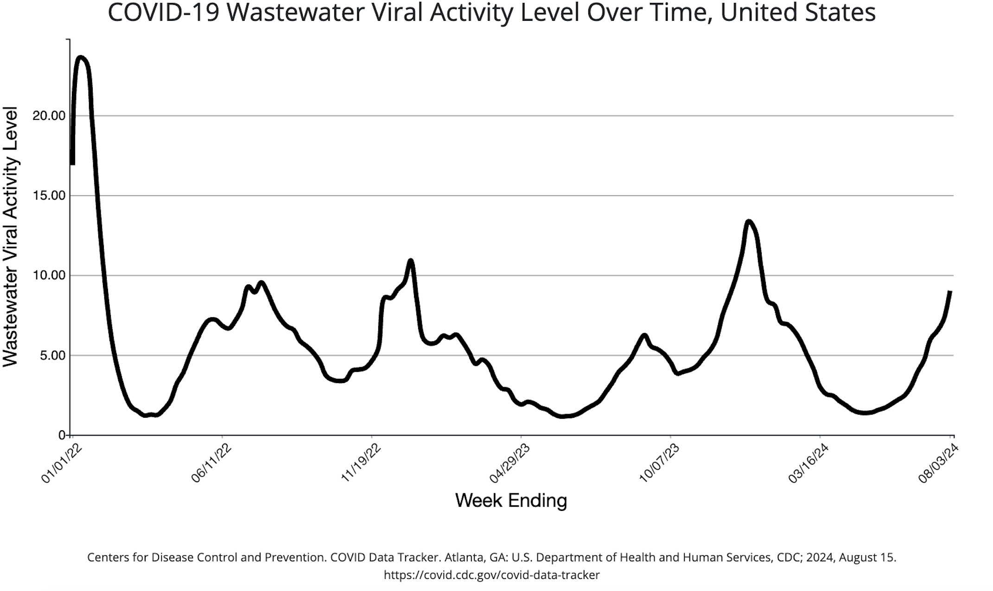

Slide 8
Incidence of diabetes after SARS-CoV-2 infection in England and the implications of COVID-19 vaccination: a retrospective cohort study of 16 million people
Background
Studies show that the incidence of type 2 diabetes increases after a diagnosis of COVID-19 but evidence is not conclusive
The effects of the COVID-19 vaccine on this association, or the effect on other diabetes subtypes, are not clear
Aims
This study aimed to investigate the association between COVID-19 and incidence of type 2, type 1, gestational and non-specific diabetes, and
The effect of COVID- 19 vaccination, up to 52 weeks after diagnosis.
Kurt Taylor*, Sophie Eastwood*, Venexia Walker*, Genevieve Cezard, Rochelle Knight, Marwa Al Arab, Yinghui Wei, Elsie M F Horne, Lucy Teece, Harriet Forbes, Alex Walker, Louis Fisher, Jon Massey , Lisa E M Hopcroft, Tom Palmer, Jose Cuitun Coronado, Samantha Ip, Simon Davy, Iain Dillingham, Caroline Morton, Felix Greaves, John Macleod, Ben Goldacre, Angela Wood, Nishi Chaturvedi†, Jonathan A C Sterne†, Rachel Denholm†, on behalf of the Longitudinal Health and Wellbeing and Data and Connectivity UK COVID-19 National Core Studies, CONVALESCENCE study, and the OpenSAFELY collaborative

Slide 9
METHODS
Retrospective cohort study done in England
Incident diabetes following COVID-19 investigated in:
Pre-vaccination, vaccinated, and unvaccinated cohort
Inclusion criteria
People alive and aged between 18 years and 110 years
Registered with a general practitioner at least 6 months before baseline
Exclusion criteria
Those with a previous COVID-19 diagnosis
Diabetes incidence after COVID-19 diagnosis was compared to:
Incidence before or in the absence of COVID-19 and up to 102 weeks after diagnosis.
Kurt Taylor*, Sophie Eastwood*, Venexia Walker*, Genevieve Cezard, Rochelle Knight, Marwa Al Arab, Yinghui Wei, Elsie M F Horne, Lucy Teece, Harriet Forbes, Alex Walker, Louis Fisher, Jon Massey , Lisa E M Hopcroft, Tom Palmer, Jose Cuitun Coronado, Samantha Ip, Simon Davy, Iain Dillingham, Caroline Morton, Felix Greaves, John Macleod, Ben Goldacre, Angela Wood, Nishi Chaturvedi†, Jonathan A C Sterne†, Rachel Denholm†, on behalf of the Longitudinal Health and Wellbeing and Data and Connectivity UK COVID-19 National Core Studies, CONVALESCENCE study, and the OpenSAFELY collaborative

Slide 10
RESULTS
Cohorts:
Pre vaccination: 16 669 943 people (Jan 1, 2020–Dec 14, 2021),
Vaccination: 12 279 669 people (June 1–Dec 14, 2021).
Unvacinated:3076 953 people June 1–Dec 14, 2021).
Findings:
Results were stratified by COVID-19 severity (hospitalized or non-hospitalized) and diabetes type
In the pre-vaccination cohort, aHRs for the incidence of type 2 diabetes after COVID-19 (compared with before or in the absence of diagnosis) declined from 4·30 in weeks 1–4 to 1·24 in weeks 53–102.
aHRs were higher in unvaccinated people 8·76 than in vaccinated people 1·66 in weeks 1–4 and in patients hospitalized with COVID-19 (pre-vaccination cohort 28·3 [26·2–30·5]) in weeks 1–4 declining to 2·04 in weeks 53–102 than in those who were not hospitalized (1·95 [1·78 in weeks 1–4 declining to 1·11 in weeks 53–102).
Type 2 diabetes persisted for 4 months after COVID-19 in around 60% of those diagnosed. Patterns were similar for type 1 diabetes, although excess incidence did not persist beyond 1 year after a COVID-19 diagnosis.
Kurt Taylor*, Sophie Eastwood*, Venexia Walker*, Genevieve Cezard, Rochelle Knight, Marwa Al Arab, Yinghui Wei, Elsie M F Horne, Lucy Teece, Harriet Forbes, Alex Walker, Louis Fisher, Jon Massey , Lisa E M Hopcroft, Tom Palmer, Jose Cuitun Coronado, Samantha Ip, Simon Davy, Iain Dillingham, Caroline Morton, Felix Greaves, John Macleod, Ben Goldacre, Angela Wood, Nishi Chaturvedi†, Jonathan A C Sterne†, Rachel Denholm†, on behalf of the Longitudinal Health and Wellbeing and Data and Connectivity UK COVID-19 National Core Studies, CONVALESCENCE study, and the OpenSAFELY collaborative

Slide 11
INTERPRETATION
Elevated incidence of type 2 diabetes after COVID-19 is greater, and persists for longer, in people who were hospitalized with COVID-19 than in those who were not, and is markedly less apparent in people who have been vaccinated against COVID-19.
Testing for type 2 diabetes after severe COVID-19 and the promotion of vaccination are important tools in addressing this public health problem.
Kurt Taylor*, Sophie Eastwood*, Venexia Walker*, Genevieve Cezard, Rochelle Knight, Marwa Al Arab, Yinghui Wei, Elsie M F Horne, Lucy Teece, Harriet Forbes, Alex Walker, Louis Fisher, Jon Massey , Lisa E M Hopcroft, Tom Palmer, Jose Cuitun Coronado, Samantha Ip, Simon Davy, Iain Dillingham, Caroline Morton, Felix Greaves, John Macleod, Ben Goldacre, Angela Wood, Nishi Chaturvedi†, Jonathan A C Sterne†, Rachel Denholm†, on behalf of the Longitudinal Health and Wellbeing and Data and Connectivity UK COVID-19 National Core Studies, CONVALESCENCE study, and the OpenSAFELY collaborative

Slide 12
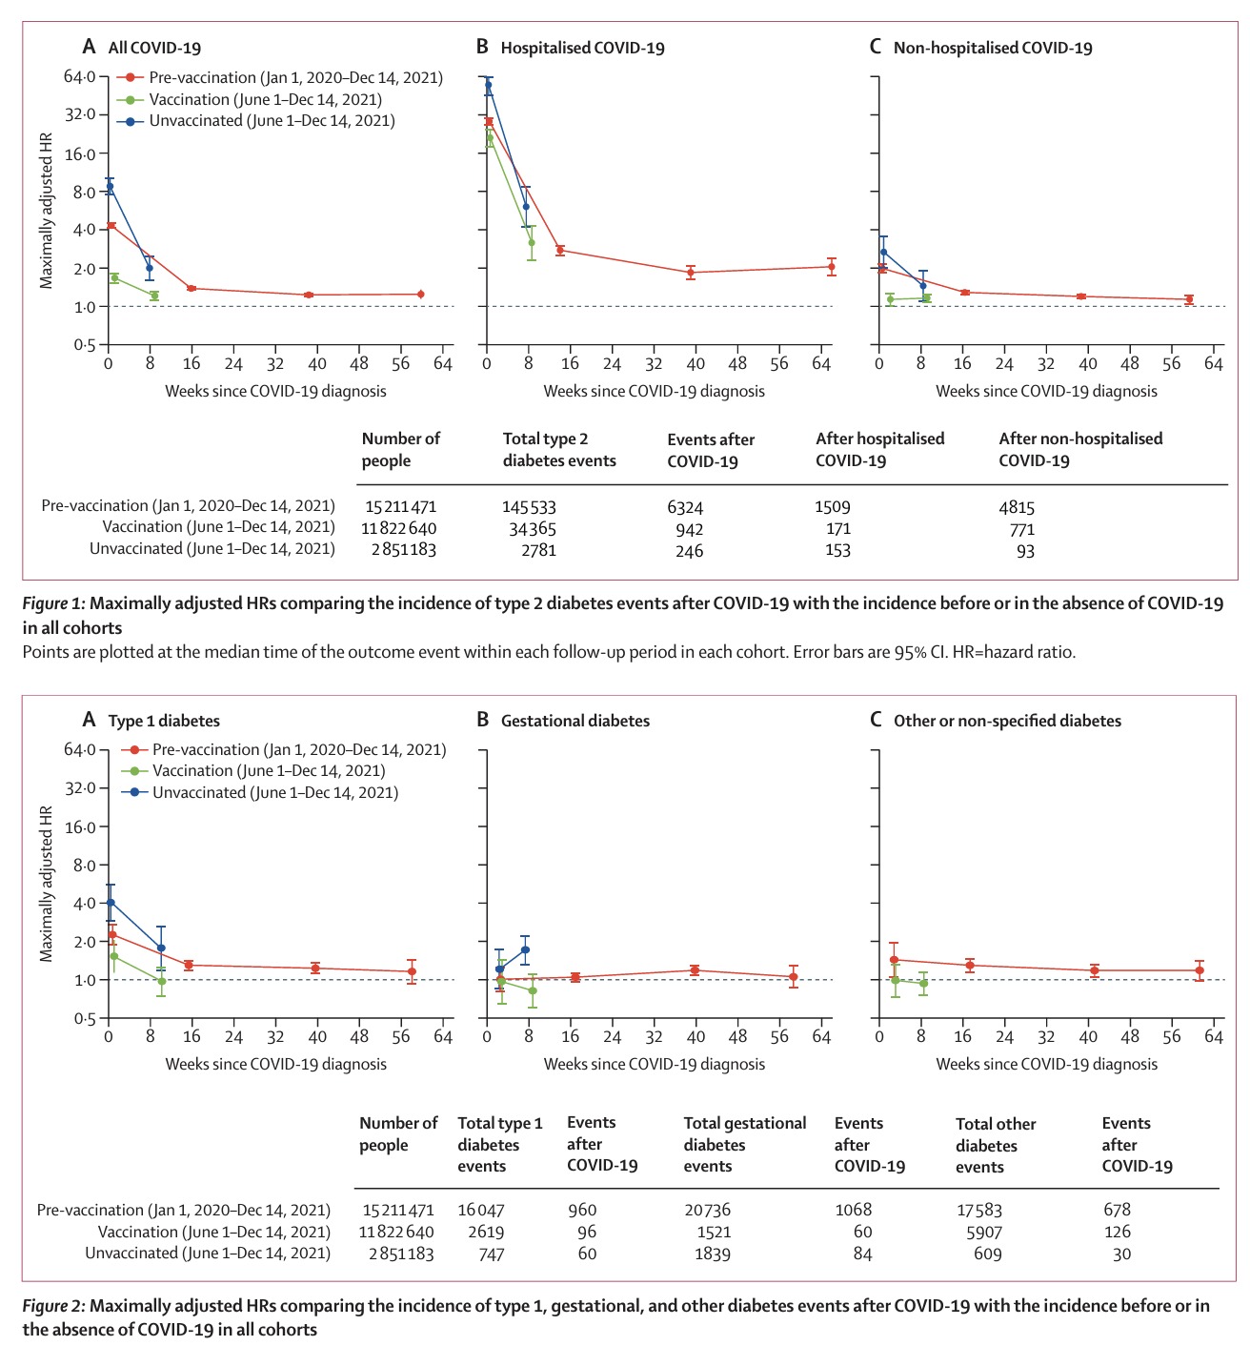
Incidence of diabetes after SARS-CoV-2 infection in England and the implications of COVID-19 vaccination: a retrospective cohort study of 16 million people

Slide 13
Fatal SARS-CoV-2 Infection among Children, Japan, January–September 2022
Objective
To determine the characteristics of pediatric patients 0–19 years of age who died after onset of SARS-CoV-2 infection in Japan during 1/1–9/30, 2022
Methods
Multiple sources reviewed
62 cases identified
Detailed information from medical records and death certificates collected, and conducted interviews
Emerging Infectious Diseases • www.cdc.gov/eid • Vol. 30, No. 8, August 2024

Slide 14
Fatal SARS-CoV-2 Infection among Children, Japan, January–September 2022: RESULTS
Patients evaluated
53 patients with detailed information and 46 patients with internal causes of death
Demographics:
15% were <1 year of age, 59% had no underlying disease, and 88% eligible for vaccination were unvaccinated.
Clinical presentation:
Non respiratory symptoms were more common than respiratory symptoms.
Out-of-hospital cardiac arrest affected 46% of patients,
Time from symptom onset to death was <7 days for 77%.
Main suspected causes of death were:
Central nervous system abnormalities (35%) and cardiac abnormalities (20%).
We recommend careful follow-up of pediatric patients after SARS-CoV-2 infection during the first week after symptom onset, regardless of underlying diseases.
Emerging Infectious Diseases • www.cdc.gov/eid • Vol. 30, No. 8, August 2024

Slide 15
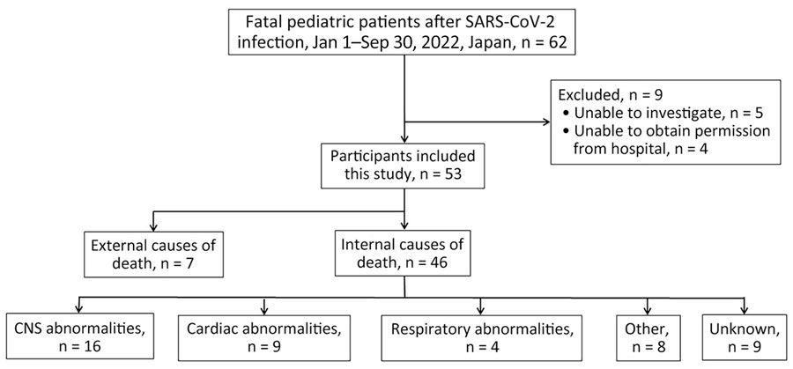
Fatal SARS-CoV-2 Infection among Children, Japan, January–September 2022
Patient selection in study of fatal SARS-CoV-2 infection among children, Japan, January–September 2022. CNS, central nervous system.
Mitsushima S, Yahata Y, Tsuchihashi Y, Ikenoue C, Fukusumi M, Otake S, et al. Fatal SARS-CoV-2 Infection among Children, Japan, January–September 2022. Emerg Infect Dis. 2024;30(8):1589-1598. https://doi.org/10.3201/eid3008.240031

Slide 16
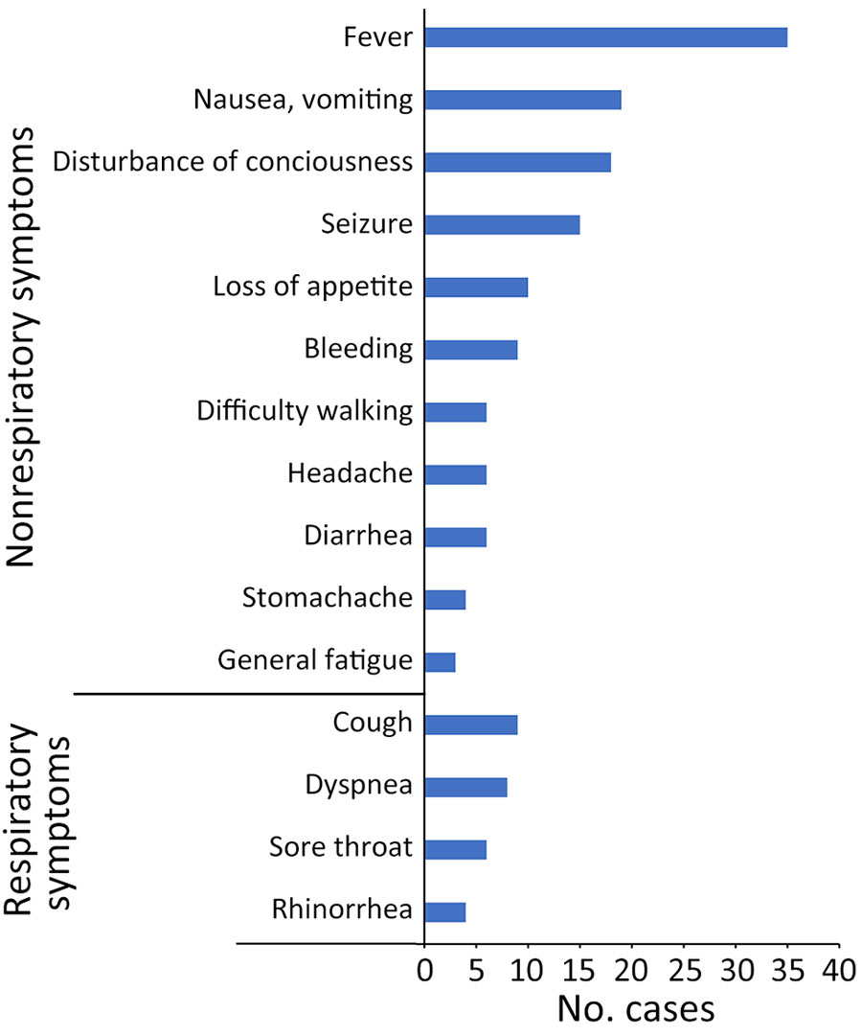
Fatal SARS-CoV-2 Infection among Children, Japan, January–September 2022
Distribution of symptoms before admission or death in outpatient settings in study of fatal SARS-CoV-2 infection among children, Japan, January–September 2022 (n = 46). Data account for multiple symptoms in some patients.
Mitsushima S, Yahata Y, Tsuchihashi Y, Ikenoue C, Fukusumi M, Otake S, et al. Fatal SARS-CoV-2 Infection among Children, Japan, January–September 2022. Emerg Infect Dis. 2024;30(8):1589-1598. https://doi.org/10.3201/eid3008.240031

Slide 17
COVID-19 Vaccine Side Effects and Long-Term Neutralizing Antibody Response: A Prospective Cohort Study
Background:
Concern about side effects is a common reason for SARS-CoV-2 vaccine hesitancy.
Objective:
To determine whether short-term side effects of SARS-CoV-2 messenger RNA (mRNA) vaccination are associated with subsequent neutralizing antibody (nAB) response.
Design:
Prospective cohort study.
Setting:
San Francisco Bay Area.
Participants:
Adults who had not been vaccinated against or exposed to SARS-CoV-2, who then received 2 doses of either BNT162b2 or mRNA-1273.
Measurements:
Serum nAB titer at 1 month and 6 months after the second vaccine dose. Daily symptom surveys and objective biometric measurements at each dose.
Annals of Internal Medicine • Vol. 177 No. 7 • July 2024 893 https://doi.org/10.7326/M23-2956

Slide 18
COVID-19 Vaccine Side Effects and Long-Term Neutralizing Antibody Response: A Prospective Cohort Study
Results:
363 participants included in symptom-related analyses (65.6% female; mean age, 52.4 years [SD, 11.9])
147 included in biometric-related analyses (66.0% female; mean age, 58.8 years [SD, 5.3]).
Chills, tiredness, feeling unwell, and headache after the second dose were each associated with 1.4 to 1.6 fold higher nAB at 1 and 6 months after vaccination.
Symptom count and vaccination-induced change in skin temperature and heart rate were all positively associated with nAB across both follow-up time points.
Each 1 °C increase in skin temperature after dose 2 was associated with 1.8 fold higher nAB 1 month later and 3.1 fold higher nAB 6 months later.
Annals of Internal Medicine • Vol. 177 No. 7 • July 2024 893 https://doi.org/10.7326/M23-2956

Slide 19
COVID-19 Vaccine Side Effects and Long-Term Neutralizing Antibody Response: A Prospective Cohort Study
Limitations:
The study was conducted in 2021 in people receiving the primary vaccine series, making generalizability to people with prior SARS-CoV-2 vaccination or exposure unclear.
Whether the observed associations would also apply for neutralizing activity against non-ancestral SARS-CoV-2 strains is also unknown.
Conclusion:
Convergent self-report and objective biometric findings indicate that short-term systemic side effects of SARS-CoV-2 mRNA vaccination are associated with greater long-lasting nAB responses.
This may be relevant in addressing negative attitudes toward vaccine side effects, which are a barrier to vaccine uptake.
Annals of Internal Medicine • Vol. 177 No. 7 • July 2024 893 https://doi.org/10.7326/M23-2956

Slide 20
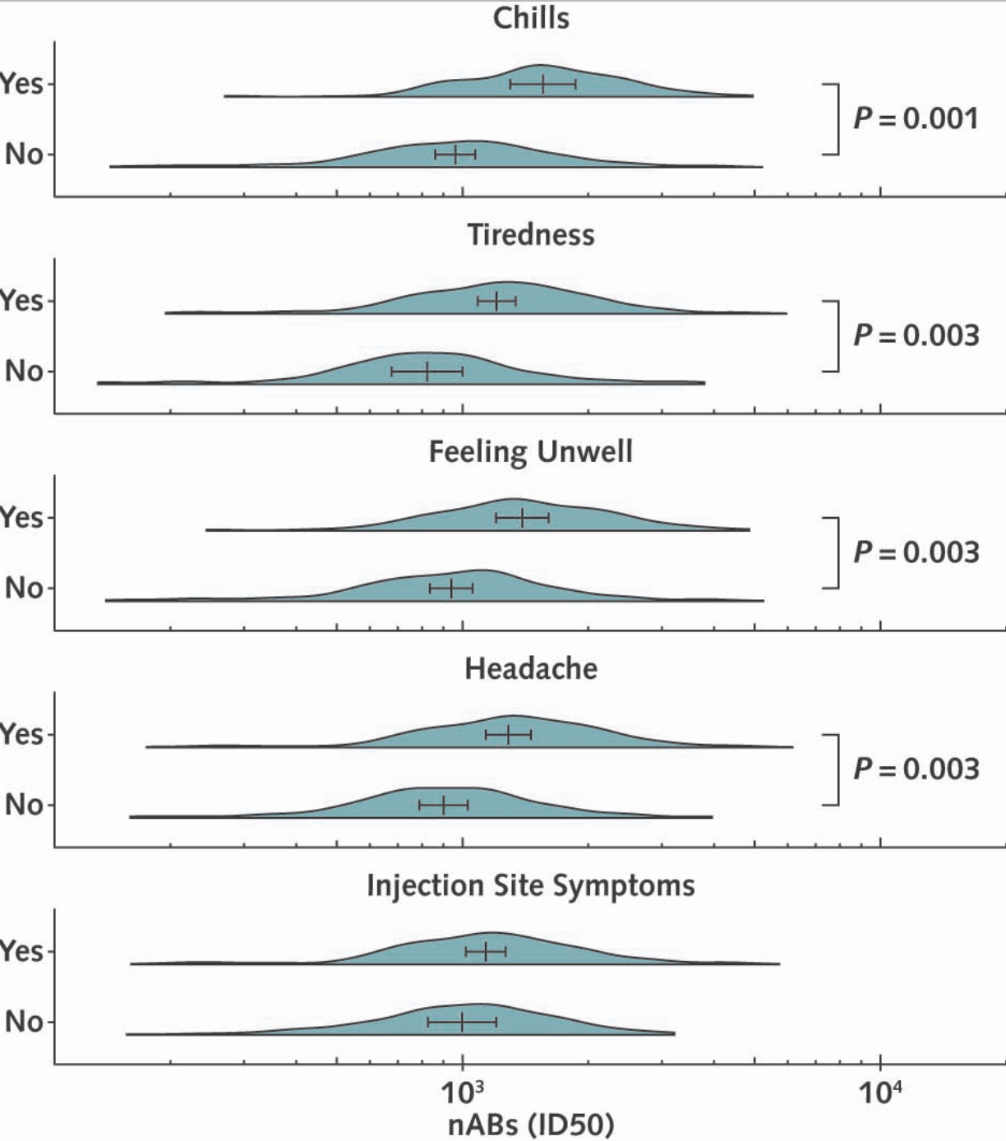
Association between symptoms after the second vaccine dose and subsequent nAB levels.
Each of 13 symptoms after each vaccine dose was individually tested as a predictor of nAB levels at 1 month and 6 months later in multivariable mixed-effects models.
The nAB titer was expressed as the ID50. After correcting for multiple comparisons, 4 symptoms remained statistically significant predictors of nABs, all only when measured at dose 2: chills, tiredness, feeling unwell, and headache. Injection site symptoms are included in the figure for comparison. Density plots are provided, and vertical bars represent the marginal means ± 95% CIs. No interaction terms between a symptom and vaccine or outcome time point were statistically significant; therefore, presented marginal means represent the average effect across both vaccines and both outcome time points. ID50 = inhibitory dose 50; nAB = neutralizing antibody.
Annals of Internal Medicine • Vol. 177 No. 7 • July 2024 893 https://doi.org/10.7326/M23-2956

Slide 21
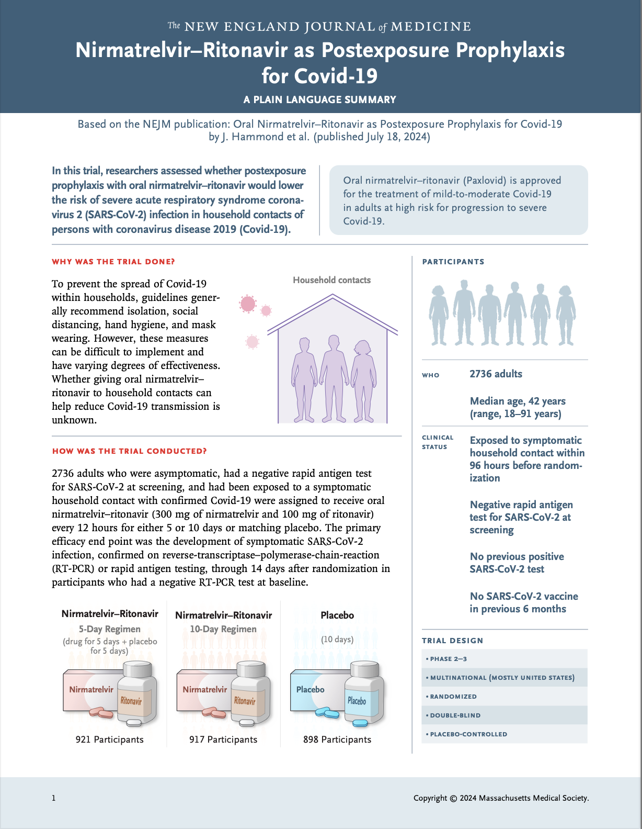
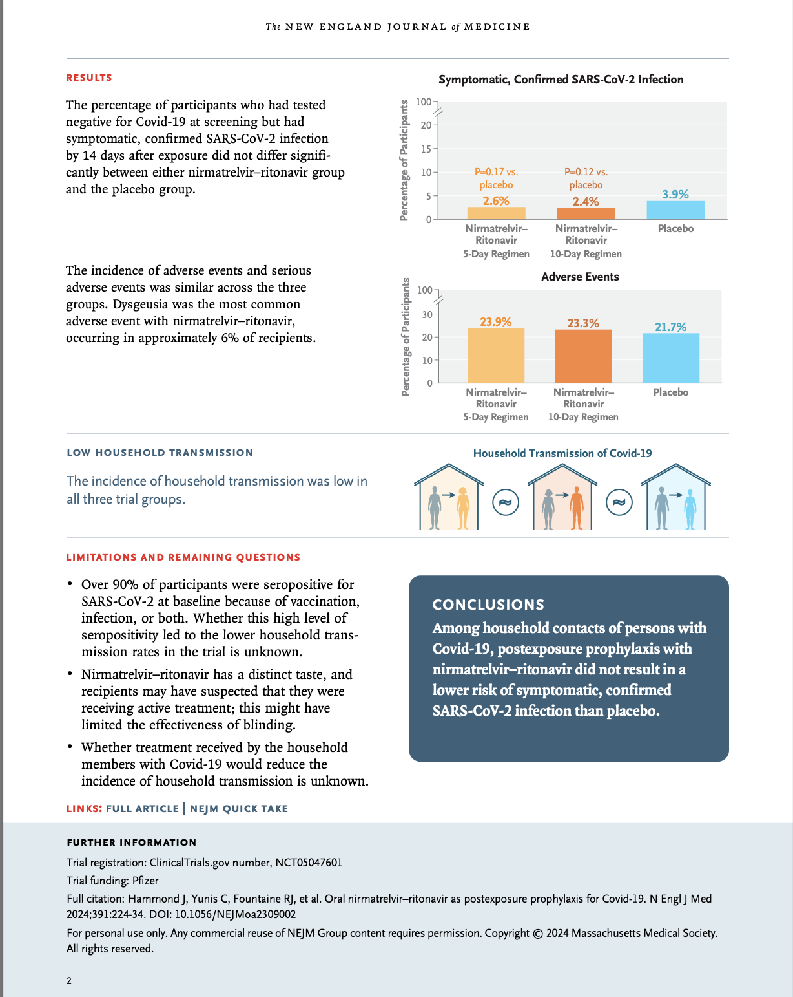

Slide 22
COVID-19 Updates What's going on with the variants?
SARS-CoV-2 KP.1, KP.2, KP.3 (Flirt Variants) accounted for most infections in the United States as of the first week of August.
The Flirt variants have escaped immunity up to five- to tenfold, compared to the XBB variant contained in last fall’s booster.
The surge is occurring probably due to a:
Greater transmissibility
Partial escape from immunity
Waning immunity from previous vaccinations and infections

Slide 23
COVID-19 Updates What's going on with the clinical impact?
ED visits and hospitalizations due to COVID-19 have increased
Deaths remained far below the weekly rates during previous surges
With 340 reported during the week ending Aug. 3, compared with 2,578 weekly deaths during the last COVID-19 peak, in January 2024, and nearly 26,000 weekly deaths at the height of the pandemic in the United States, in January 2021.

Slide 24
COVID-19 Updates What is going on with vaccines?
After vaccination with the 2023-2024 vaccines (XBB.1.5 variant)
Vaccine effectiveness peaked four weeks after vaccination and then gradually waned
Protection is for about 3-4 months
As of May, only 22.5% of adults received the updated 2023-24 vaccine
Hospitalizations and deaths have probably risen only slightly
Because immunocompetent individuals have previously been vaccinated or infected or both.

Slide 25
COVID-19 Updates: Recommendations
The advisory committee recommended
That the FDA authorize vaccines targeting the JN.1 lineage rather than KP.2
But, the FDA’s final decision was a preference for KP.2-targeted vaccines, while also allowing Novavax to proceed with the JN.1-targeted vaccine.
The CDC recommends that people in high-risk categories
Get a second dose of vaccine at least four months after their last booster
Get the updated 2024-2025 vaccine once it is available.

Slide 26
COVID-19 Updates
What is going on with masks?
Specially useful in high-risk environments.
Specially when the virus is surging
Specially indoors and crowded conditions
What is going on with isolation?
According to CDC guidelines you can resume normal activity if your symptoms have improved for 24 hours and you haven’t had a fever in 24 hours without taking a fever suppressant, but you should continue to take extra precautions, like masking, for an additional five days.
What is going on with treatment?
Those in high-risk groups (people 65 and older or anyone over age 12 with a condition that is a risk factor for severe COVID, including diabetes, asthma, heart disease, obesity, or pregnancy) still benefit from an antiviral
It must be started within five to seven days of developing symptoms.

Slide 27
COVID-19 Updates: What is new in the horizon?
There may be annual updated COVID-19 vaccines
Similar to seasonal flu shots
Moderna is testing a combination COVID-19 and flu shot.
A nasal vaccine is also being developed.
COVID-19 is not as dangerous as before
But it is still deadly for some, especially young children, the elderly, and the immunocompromised
It still carries the risk of long COVID

Slide 28
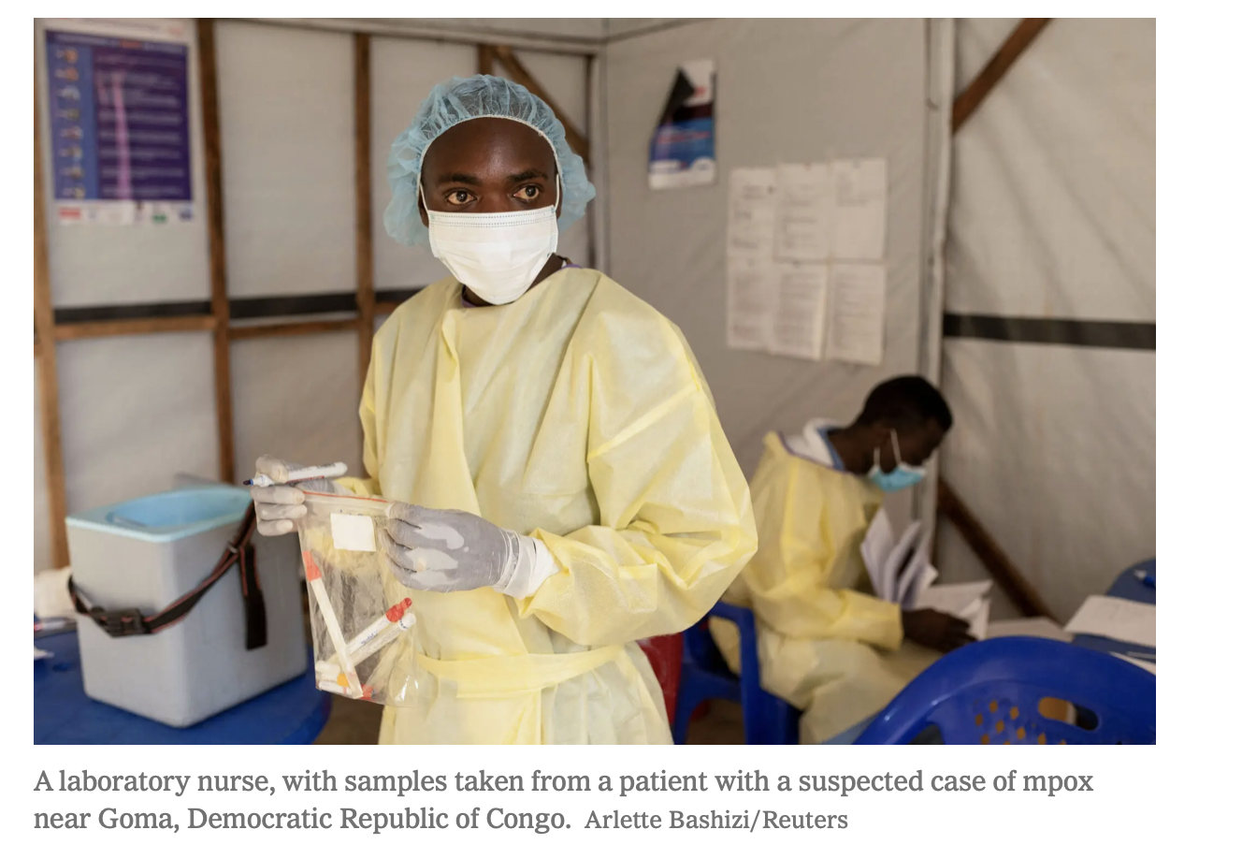
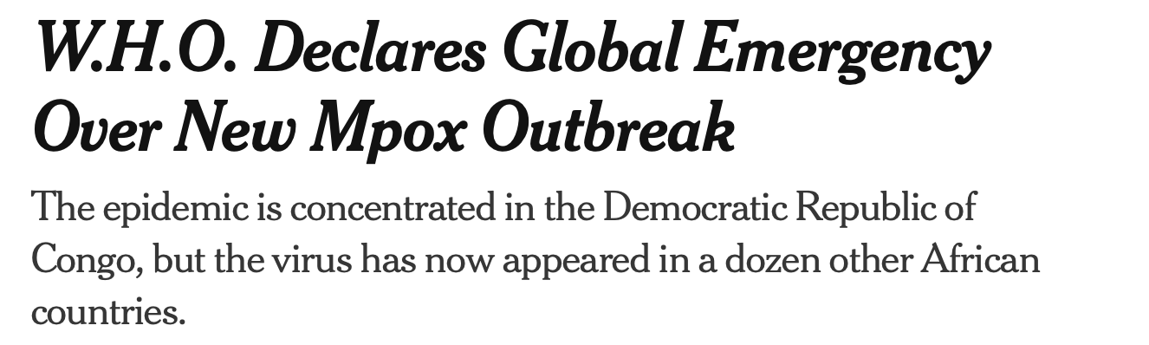
New York Times
“This is the second time in three years that the W.H.O. has designated an mpox epidemic as a global emergency. It previously did so in July 2022. That outbreak went on to affect nearly 100,000 people, primarily gay and bisexual men, in 116 countries, and killed about 200 people.
“ Since the beginning of this year, the Democratic Republic of Congo alone has reported 15,600 mpox cases and 537 deaths. Those most at risk include women and children under 15”
“The detection and rapid spread of a new clade of mpox in eastern D.R.C., its detection in neighboring countries that had not previously reported mpox, and the potential for further spread within Africa and beyond is very worrying,” said Dr. Tedros Adhanom Ghebreyesus, the W.H.O.’s director general.

Slide 29
Twice-Yearly Lenacapavir or Daily F/TAF for HIV Prevention in Cisgender Women
BACKGROUND
There are gaps in uptake of, adherence to, and persistence in the use of preexposure prophylaxis for human immunodeficiency virus (HIV) prevention among cisgender women.
METHODS
A phase 3, double-blind, randomized, controlled trial involving adolescent girls and young women in South Africa and Uganda.
Participants were assigned in a 2:2:1 ratio to receive subcutaneous lenacapavir every 26 weeks, daily F/TAF, or daily oral F/TDF (active control)
All participants also received the alternate subcutaneous or oral placebo.
The efficacy of lenacapavir and F/TAF were assessed by comparing:
The incidence of HIV infection with the estimated background incidence in the screened population and evaluated relative efficacy as compared with F/TDF.
Published July 24, 2024. DOI: 10.1056/NEJMoa2407001

Slide 30
Twice-Yearly Lenacapavir or Daily F/TAF for HIV Prevention in Cisgender Women: Results
Among 5338 participants initially HIV-negative, 55 incident HIV infections were observed:
0 infections among 2134 participants in the lenacapavir group (0 per 100 person-years)
39 infections among 2136 participants in the F/TAF group (2.02 per 100 person-years)
16 infections among 1068 participants in the F/TDF group (1.69 per 100 person-years).
Background HIV incidence (8094 participants) was 2.41 per 100 person-years
HIV incidence with lenacapavir was significantly lower compared to other groups than background HIV incidence and than HIV incidence with F/TDF
Published July 24, 2024. DOI: 10.1056/NEJMoa2407001

Slide 31
Twice-Yearly Lenacapavir or Daily F/TAF for HIV Prevention in Cisgender Women: Results
HIV incidence with F/TAF did not differ significantly from background HIV incidence, HIV incidence with F/TAF and F/TDF were similar
Adherence to F/TAF and F/TDF was low
No safety concerns were found.
Injection-site reactions were more common in the lenacapavir group (68.8%) than in the placebo injection group (F/TAF and F/TDF combined) (34.9%);
4 participants in the lenacapavir group (0.2%) discontinued the trial regimen owing to injection-site reactions.
Published July 24, 2024. DOI: 10.1056/NEJMoa2407001

Slide 32
Twice-Yearly Lenacapavir or Daily F/TAF for HIV Prevention in Cisgender Women: Conclusions
No participants receiving twice-yearly lenacapavir acquired HIV infection.
HIV incidence with lenacapavir was significantly lower than background HIV incidence and HIV incidence with F/TDF.
Published July 24, 2024. DOI: 10.1056/NEJMoa2407001

Slide 33
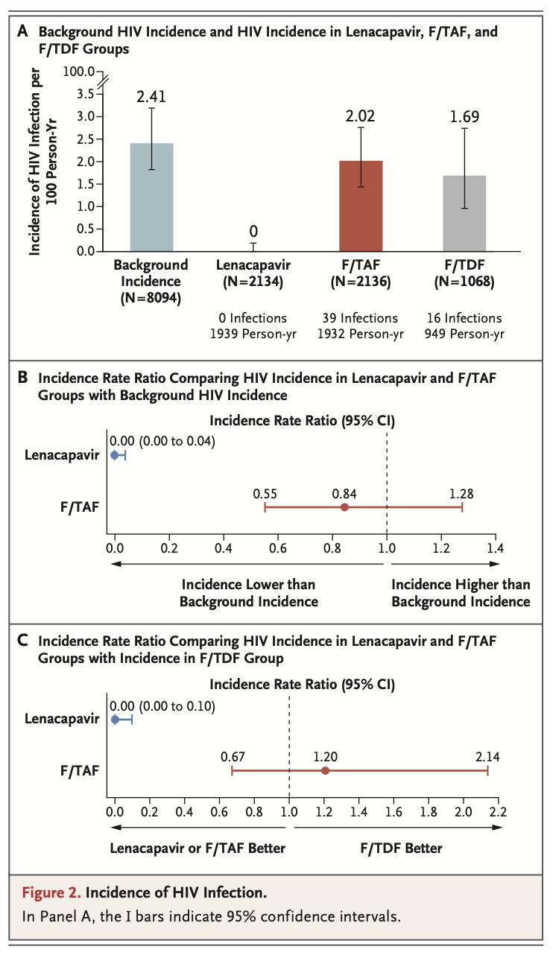
Twice-Yearly Lenacapavir or Daily F/TAF for HIV Prevention in Cisgender Women
Published July 24, 2024. DOI: 10.1056/NEJMoa2407001

Slide 34
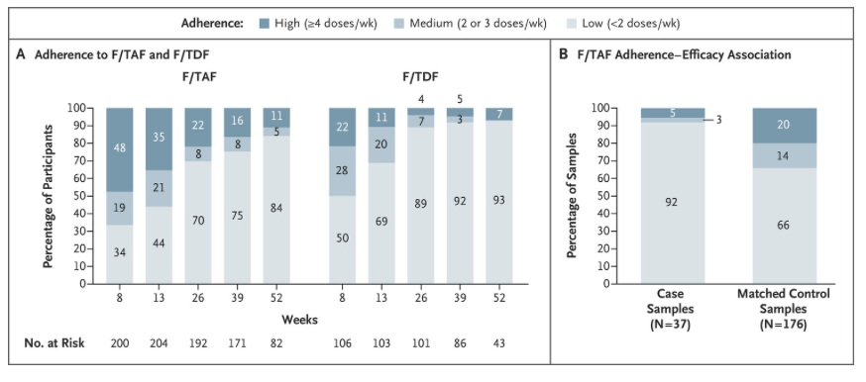
Twice-Yearly Lenacapavir or Daily F/TAF for HIV Prevention in Cisgender Women
Adherence was assessed on the basis of tenofovir diphosphate levels in red cells in dried-blood-spot samples from all trial visits from a randomly preselected 10% of participants in the F/TAF and F/TDF groups (Panel A). To assess the association between adherence and HIV prevention efficacy in the F/TAF group, a matched case–control analysis was conducted (Panel B). Case participants were defined as participants who had acquired HIV infection; up to five controls were selected, matched on the basis of trial site and VOICE risk score for acquisition of HIV infection.31 Each of 37 case participants contributed 1 sample. A trial participant could serve as a con- trol for more than 1 case participant; 159 participants contributed 176 samples to be used as matched controls. Tenofovir diphosphate levels in dried-blood-spot samples were measured from the HIV diagnosis visit (for case participants) or time-matched visit (for controls). Percentages may not total 100 because of rounding.

Slide 35
CDC Confirms Three Human Cases highly pathogenic avian influenza (HPAI) A(H5) Among Colorado Poultry Workers
Occurred in a poultry farm in workers in direct contact with infected poultry
At a commercial egg layer operation that had reported an outbreak of H5 bird flu among poultry.
All three people had mild illness and were offered oseltamivir, for treatment.
The total number of human cases associated with the current poultry outbreaks in Colorado is 9, and 13 in the US since April 2024
Prior to 2024, the only human case of H5N1 in the US was in Colorado in April 2022.
CDC deployed a bilingual team in response to ongoing poultry outbreaks
CDC’s current assessment is that the risk to the general public from H5N1 remains low.
CDC’s recommendations related to H5 virus have not changed at this time.
For immediate release: July 25, 2024 http://www.cdc.gov/media

Slide 36
Highly pathogenic avian influenza (HPAI) A(H5) CDC Recommendations
People should avoid unprotected exposures to sick or dead animals
Including wild birds, poultry, other domesticated birds, and other wild or domesticated animals (including cows).
People should also avoid unprotected exposures to animal feces, bedding, unpasteurized milk, or materials that have been touched by, or close to, birds or other animals with suspected or confirmed A(H5N1) virus.
CDC has interim recommendations for prevention, monitoring, and public health investigations of A(H5N1) virus infections in people.
CDC also has updated recommendations for worker protection and use of PPE.
Following these recommendations is central to reducing a person’s risk and containing the overall public health risk.
For immediate release: July 25, 2024 http://www.cdc.gov/media

Slide 37
Parvovirus B 19 Alert
Parvovirus B19 is a seasonal respiratory virus
That is transmitted through respiratory droplets by people with symptomatic or asymptomatic infection.
In early 2024, unusually high numbers of cases of parvovirus B19 observed in Europe
In the US there is no routine surveillance, and it is not a notifiable condition.
Distributed via the CDC Health Alert Network August 13, 2024, 2:30 PM ET

Slide 38
Parvovirus B 19 Alert
Recently, CDC has received reports indicating increased parvovirus B19 activity in the US
Increased test positivity for parvovirus B19 in clinical specimens and pooled plasma from a large commercial laboratory, and reports of clusters of parvovirus B19-associated complications among pregnant people and people with sickle cell disease.
The proportion of people with IgM antibodies, increased among all ages from <3% during 2022–2024 to 10% in June 2024; the greatest increase was observed among children aged 5–9 years, from 15% during 2022–2024 to 40% in June 2024.
Among plasma donors, the prevalence of pooled samples with parvovirus B19 DNA >10⁴ IU/mL increased from 1.5% in December 2023 to 19.9% in June 2024.
Distributed via the CDC Health Alert Network August 13, 2024, 2:30 PM ET

Slide 39
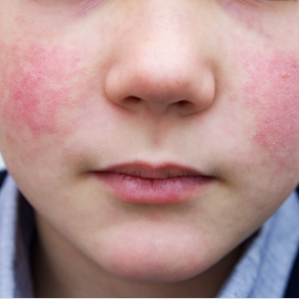
Parvovirus B-19
Parvovirus B19 infection is usually mild in people who are otherwise healthy.
Common symptoms include "slapped cheek" rash in children, and joint pains in adults.
Complications can occur among people with underlying blood disorders or weakened immune system.
Infection early during pregnancy can cause a slight increase in the risk of a miscarriage.
https://www.cdc.gov/parvovirus-b19/about/index.html

Slide 40
Parvovirus-19
Incubation and infectious periods
Associated with viral shedding and replication
By the time symptoms of rash and/or arthropathy emerge, infected individuals are no longer infectious.
Clinical presentation:
Erythema infectiosum
Arthropathy
Transient aplastic crisis
Fetal infection
Pure red blood cell aplasia in immunocompromised individuals.
Transmission occurs 5 to 10 days after exposure and usually lasts approximately 5 days.
Notes:
Clinical presentation may be from benign to life threatening, depending on age, hematologic and immunologic status.

Slide 41
Parvovirus B19 Syndromes
Erythema infectiosum
Mild febrile illness characterized by the malar rash (slapped cheeks rash) that spreads over over the trunk and extremities
Also known as Fifth Disease (or Erythema Infectiosum).
This rash typically appears a few days after the fever or flu-like symptoms. It is more common in children than adults.
The rash may be itchy. It usually goes away in 7 to 10 days but can recur for several weeks.
Acute arthritis with or without a rash
Usually in adult women
Joint symptoms are usually symmetric and most frequently involve the small joints of the hands, wrists, knees, and feet.
The joint pain usually lasts 1 to 3 weeks but can last for months or longer. It usually resolves.

Slide 42
Parvovirus B19 Syndromes
Transient aplastic crisis:
Only in patients with baseline hematological disorders (sickle cell,iron deficiency anemia, etc). \
Hemoglobin usually drops 30 percent.
Pure red cell aplasia and severe chronic anemia
Only in immunosuppressed patients, such as transplant recipients or individuals with HIV
Due tonlack of neutralizing antibody responses against the virus.
Fetal complications in pregnancy that include
Miscarriage, intrauterine fetal death, and/or non-immune hydrops fetalis.

Slide 43
Parvovirus Diagnosis
In immunocompetent children with the classic malar rash
Clinical diagnosis, serology not needed
If needed diagnosis is confirmed with a parvovirus B19-specific IgM antibody.
In patients with transient aplastic crisis or chronic pure red cell aplasia
Parvovirus B19 DNA through NAAT.
Ig M can be used but a negative titer does not rule it out

Slide 44
Questions?

