Slide 1
Strategies, Best Practices, and Vaccine Education/Resources for the AI/AN Community
August 27, 2024
Notes:
Check fonts and colors

Slide 2
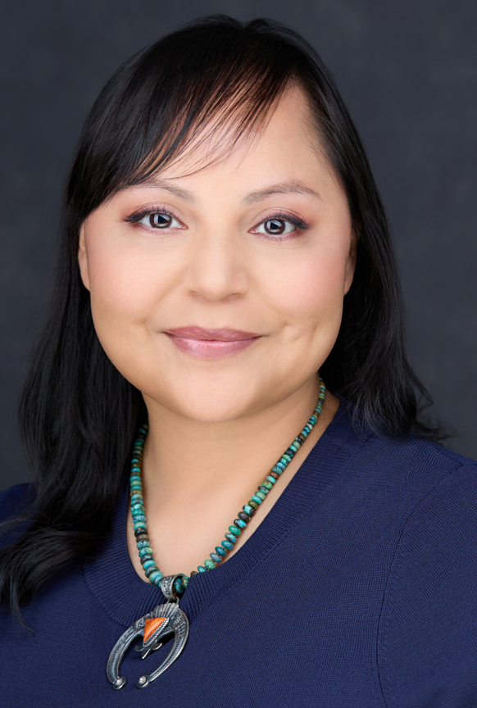
Welcome
Chelsea Kettering, DrPH, MPH (Navajo)
Associate Scientist
Johns Hopkins Center for Indigenous Health

Slide 3

OBJECTIVES
Understand strategies and best practices associated with increasing vaccine uptake among American Indian/Alaska Native (AI/AN) communities
Understand how culturally competent messaging from trusted sources can increase vaccine uptake
Review vaccine education and resources that are currently available

Slide 4
Vaccine hesitancy changes over time
New information and perceptions/fears can drive vaccine attitudes
  Social media drivers
  Political drivers
  New diseases
We must understand sources of distrust for AI/AN populations
  Colonization and historical trauma
  Past unethical research with Native Nations
  Ongoing systemic racism and disparities
Notes:
There are numerous channels and drivers of vaccine information and misinformation to date.
COVID-19 pandemic introduced new vaccines for the virus and its variants that generated distrust among AI/AN communities which stemmed from historical trauma and mistrust of the healthcare system (Gonzalez & Stewart, 2023, https://link.springer.com/article/10.1007/s10865-023-00443-5).

Slide 5
Vaccine hesitancy can turn into vaccine confidence OR vaccine refusal
Providers (MDs, RNs, Midwives, MAs, Pharmacists, CHRs, etc.) have a critical role of communicating with patients to turn vaccine hesitancy into vaccine confidence
Vaccine confidence
Vaccine concerns or questions
STOP
Vaccine refusal

Slide 6
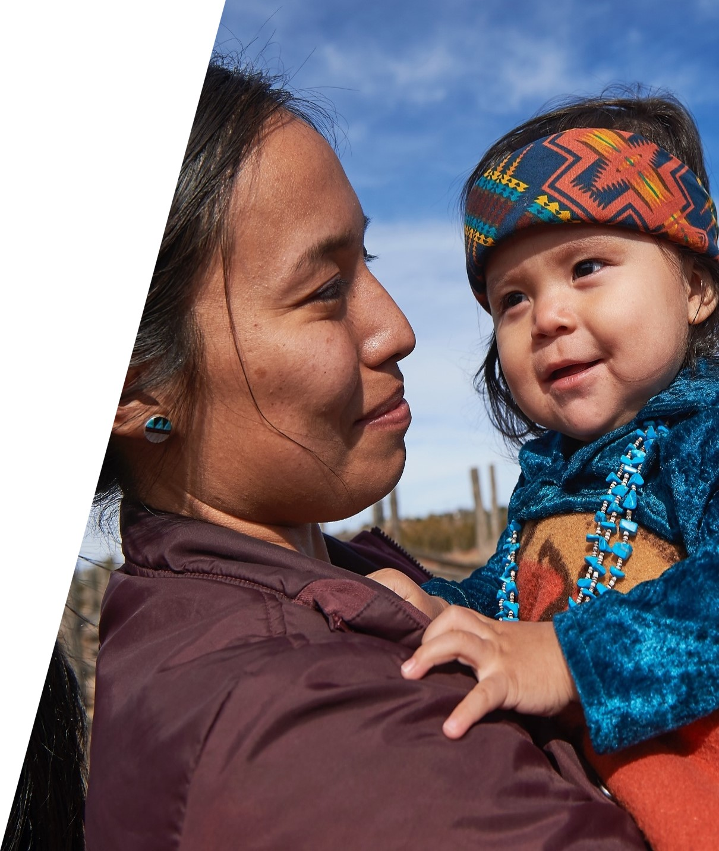
Best Practices for Improving Vaccine Uptake
Patient screening at each visit
Standing orders
  Standing orders are the most consistently effective means for increasing vaccination rates and reducing missed opportunities for vaccination.
Reminder letters/phone calls
Strong provider recommendation
  Presumptive recommendation
Improved access
  Extended vaccine clinic hours
  Outreach/drive through events in the community
Notes:
-patient screening assigned to a team member
-standing orders – most consistently effective – logistics:
-patients/community members have expressed this in advisory boards – these can be helpful
-providers: not only knowledgeable about disease prevention and side effects, mindfulness on how its presented (presumptive recommendation). In recent CAB, community member talked about this – made her question if this was what she should be getting (positive).
-community members and patients perspective on improved access

Slide 7
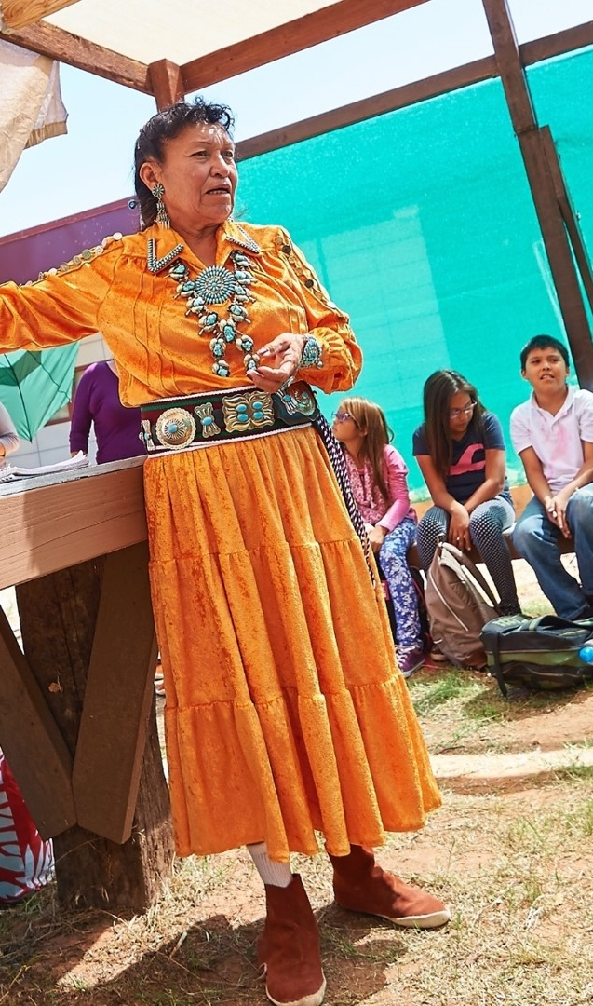
How should we communicate about vaccines?
Trust: Communicate to build, maintain, and restore trust between patients and providers; be present in the community, be consistent, and practice humility
  This includes communication regarding side effects
Announce early: Proactive communication so patients know what to expect (e.g., early in pregnancy, 2 week well child appointment)
Transparency: Maintaining trust requires ongoing transparency including timely and complete information
Listening: Understanding public risk perceptions, views, and concerns is critical to effective communication
  Work with the community to promote messaging and communication strategies that come from and are led by them
World Health Organization Outbreak Communication Planning Guide, 2008
Notes:
https://www.ncoa.org/article/how-culturally-competent-strategies-are-boosting-vaccine-uptake-among-urban-native-elders
Community-centered approach from trusted sources by culturally sensitive care. Moreover, indigenous populations uphold community/cultural values through care and protection of elders, youth, and children; cultural preservation for the future.
In recent research, listening sessions were conducted for the COVID-19 Vaccine Confidence Project where professionals provided information to community members about vaccine information while addressing safety concerns and otherwise.
The use of trusted messengers (e.g., tribal leaders, AI/AN health professionals, and tribal elders) to provide information about vaccines can be beneficial. In recent research to reach unvaccinated, the University of Maryland Baltimore collaborated with I.H.S. and UIHOs to promote vaccines.

Slide 8
How should we communicate to increase trust?
Don’t correct misperceptions: The instinctive response to vaccine-related misinformation is to provide correct information, but this can backfire – called the boomerang effect.
Focus on the disease: Pivot the conversation to the disease itself
Use nudges/defaults: apply presumptive communication
Build trust through empathy
Notes:
Community-centered approach
Understand risk perceptions of vaccinations
Trusted messengers
Partnerships with respected organizations

Slide 9
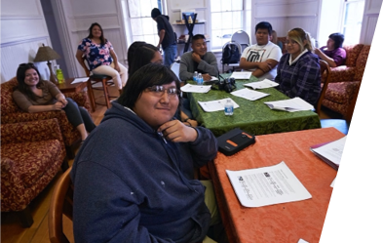
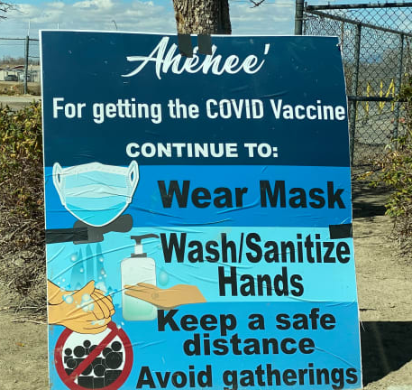
Vaccine messaging campaigns
Youth-led campaigns – “Protect our elders”
VacciNative – vaccine ingredients, vaccine basics, side effects, overcoming vaccine fears, symptoms, etc.
Culturally specific and linguistic messaging – reproduction of CDC messaging into the local Indigenous language
Notes:
During the COVID-19 pandemic, there was significant focus on protecting the community, particularly the youth and elder populations. (https://publichealth.jhu.edu/2021/keys-to-the-navajo-nations-covid-19-vaccination-success). “Youth are the future, and elders are the keepers of the past and keepers of the codes, the culture, and the traditions” – Dr. Allison Barlow
VacciNative, a project by the NPAIHB, has been developed to provide a comprehensive overview of vaccine information (Vaccination Information for Natives by Natives). Consisting of handouts, social media toolkits, PPTs, videos, and more – this resource is valuable as it provides relevant and up-to-date information in a culturally significant manner.
Translating existing messaging from verifiable sources (e.g., WHO, CDC, NIH, etc.) into the local Indigenous language – working with traditional healers, tribal leaders, and individuals that are fluent in the language; generating images and illustrations that are significant to the community (ex: Navajo – social distancing “keep two sheep apart”, wash hands “nila’taanigis”)
Image sources: JHCIH (top), https://encrypted-tbn0.gstatic.com/images?q=tbn:ANd9GcSm0xU9dcfSiZ0QL3yFCN5WQD9zz8CBNpdRvg&s (bottom).
___
New slide idea: What have we learned?
Incentives (sustainability) - rural [gas cards] vs urban communities. Studies have shown incentives increase vaccination, but falls off unless sustained.
People think differently about different vaccines – prioritization needed
Strategies – providing information on what to expect on vaccines.

Slide 10
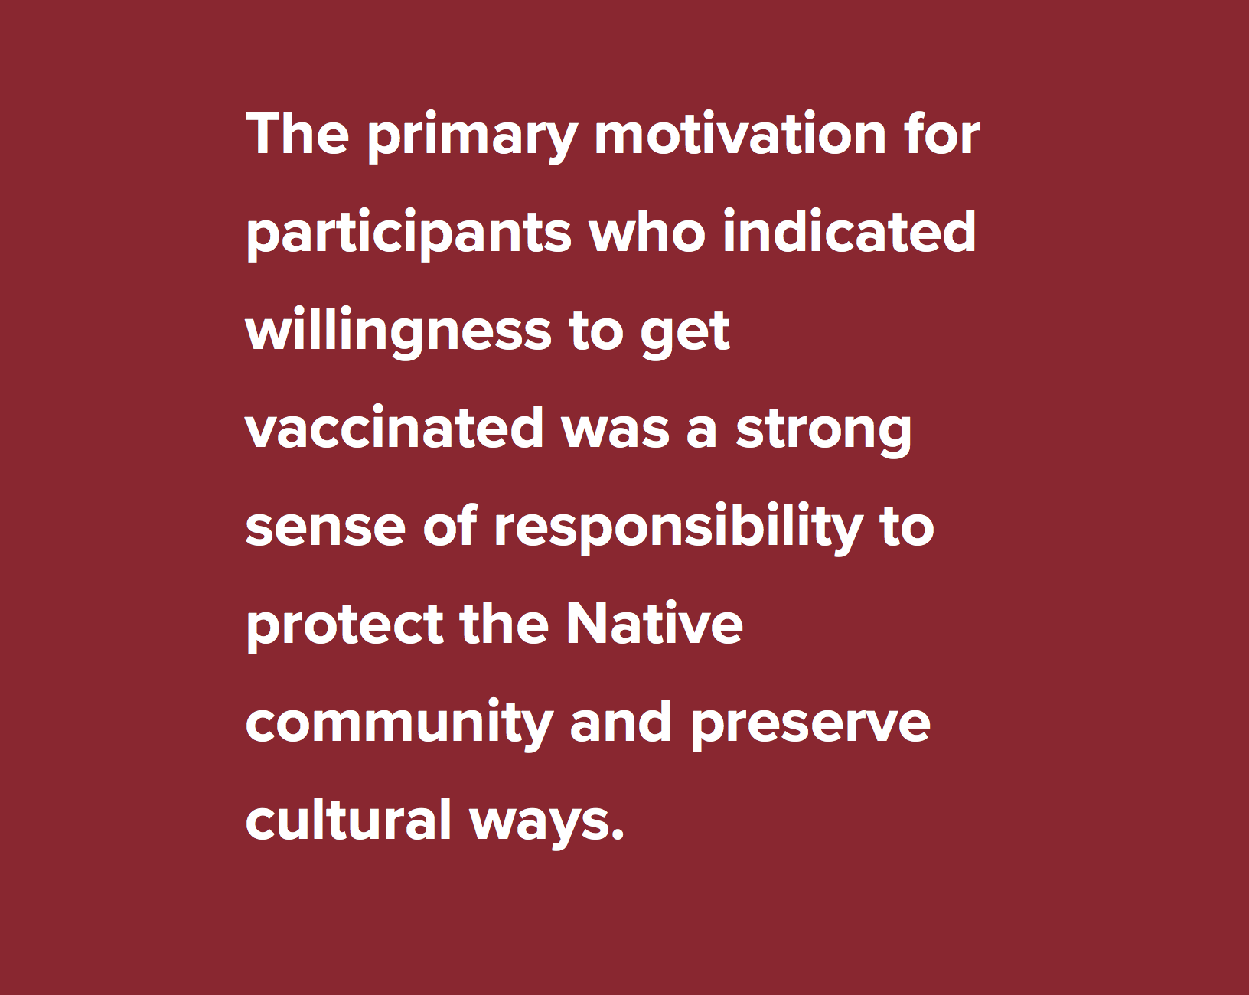
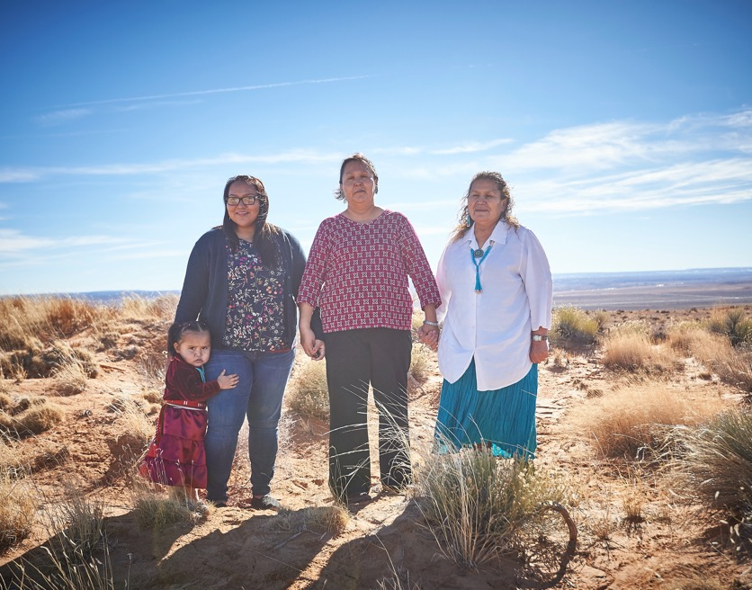
Appeal to community values and aspirational norms
Source: https://www.uihi.org/projects/strengthening-vaccine-efforts-in-indian-country/
Notes:
During COVID-19 pandemic, survey/research found primary motivation was strong sense of responsibility (source here)

Slide 11
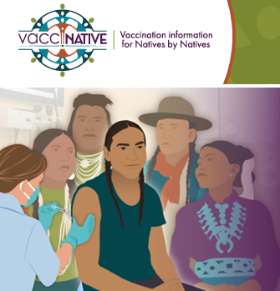
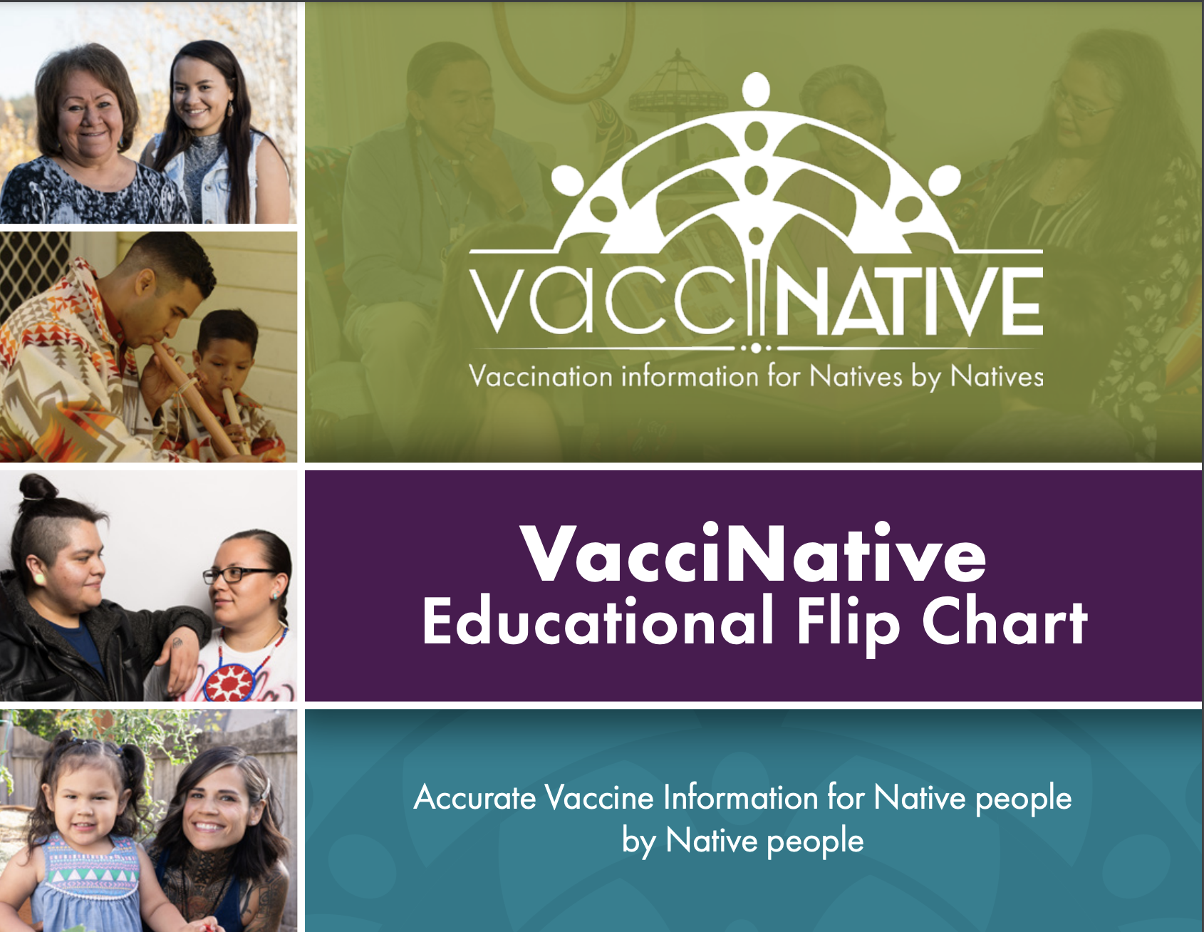
VacciNative
Flip charts
Videos
PowerPoints
Social Media toolkits
https://www.indiancountryecho.org/vaccinative/

Slide 12
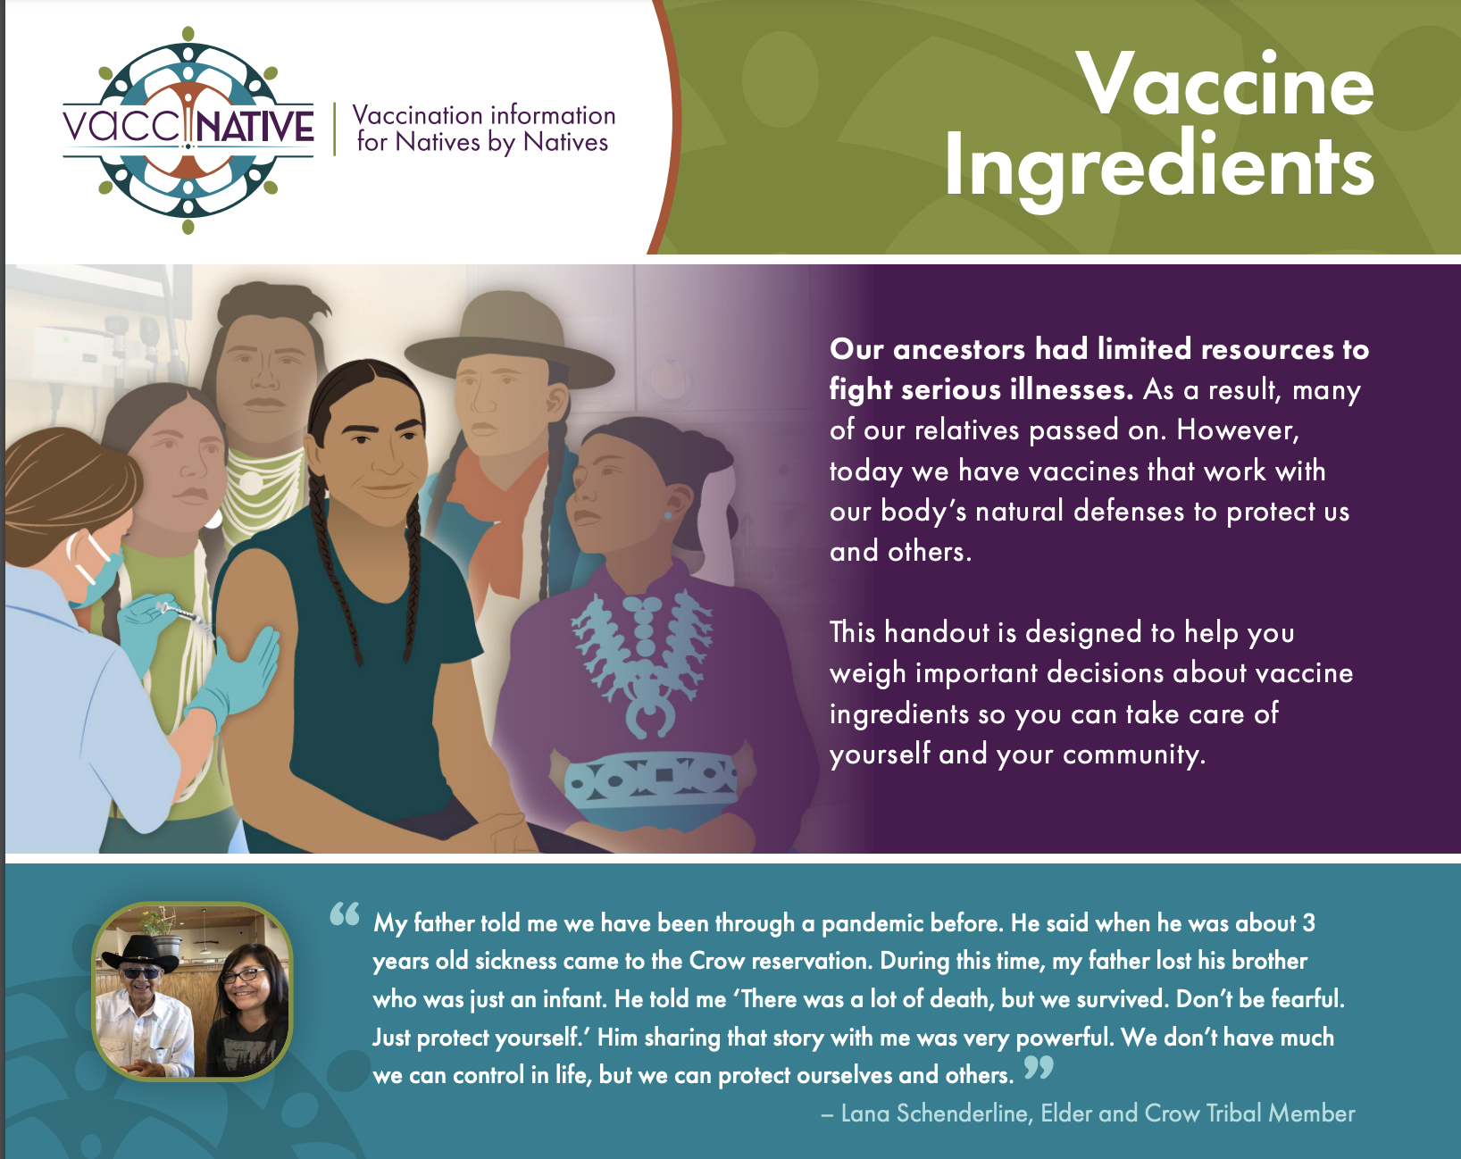
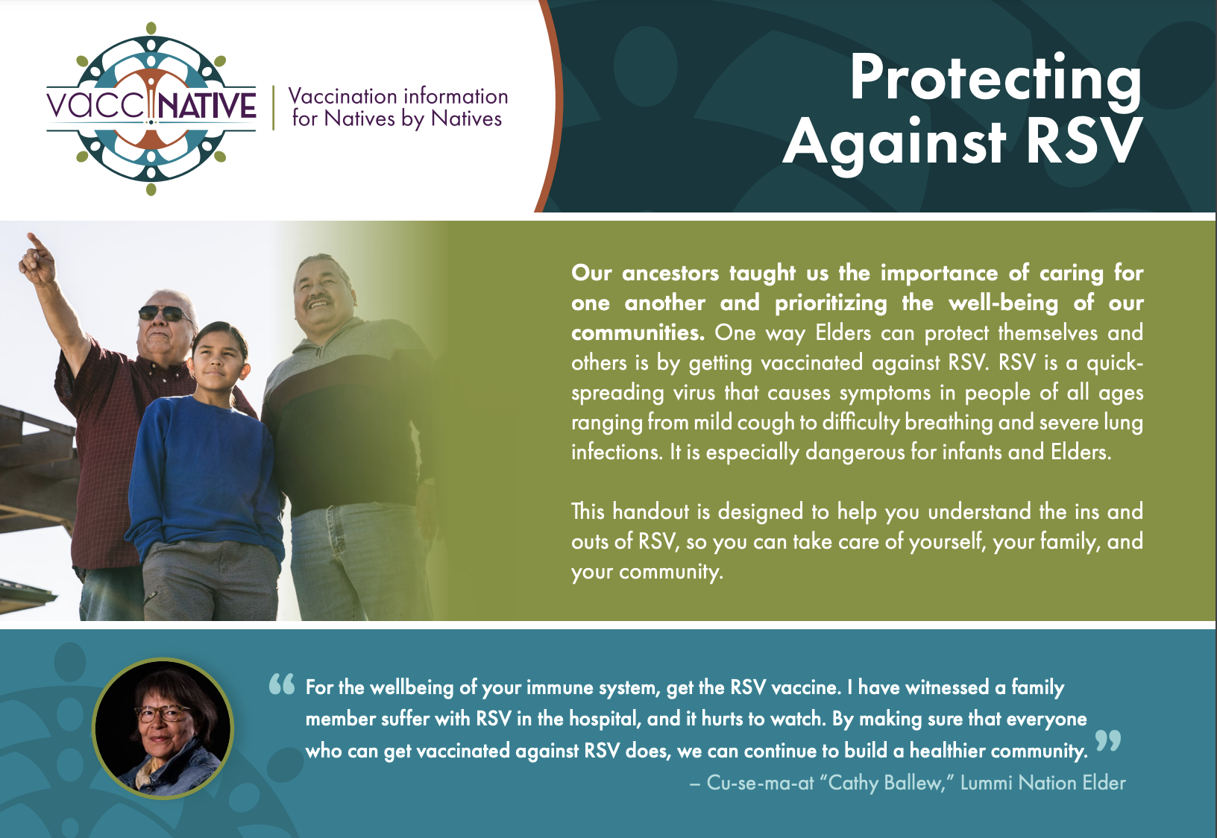
https://www.indiancountryecho.org/vaccinative/

Slide 13
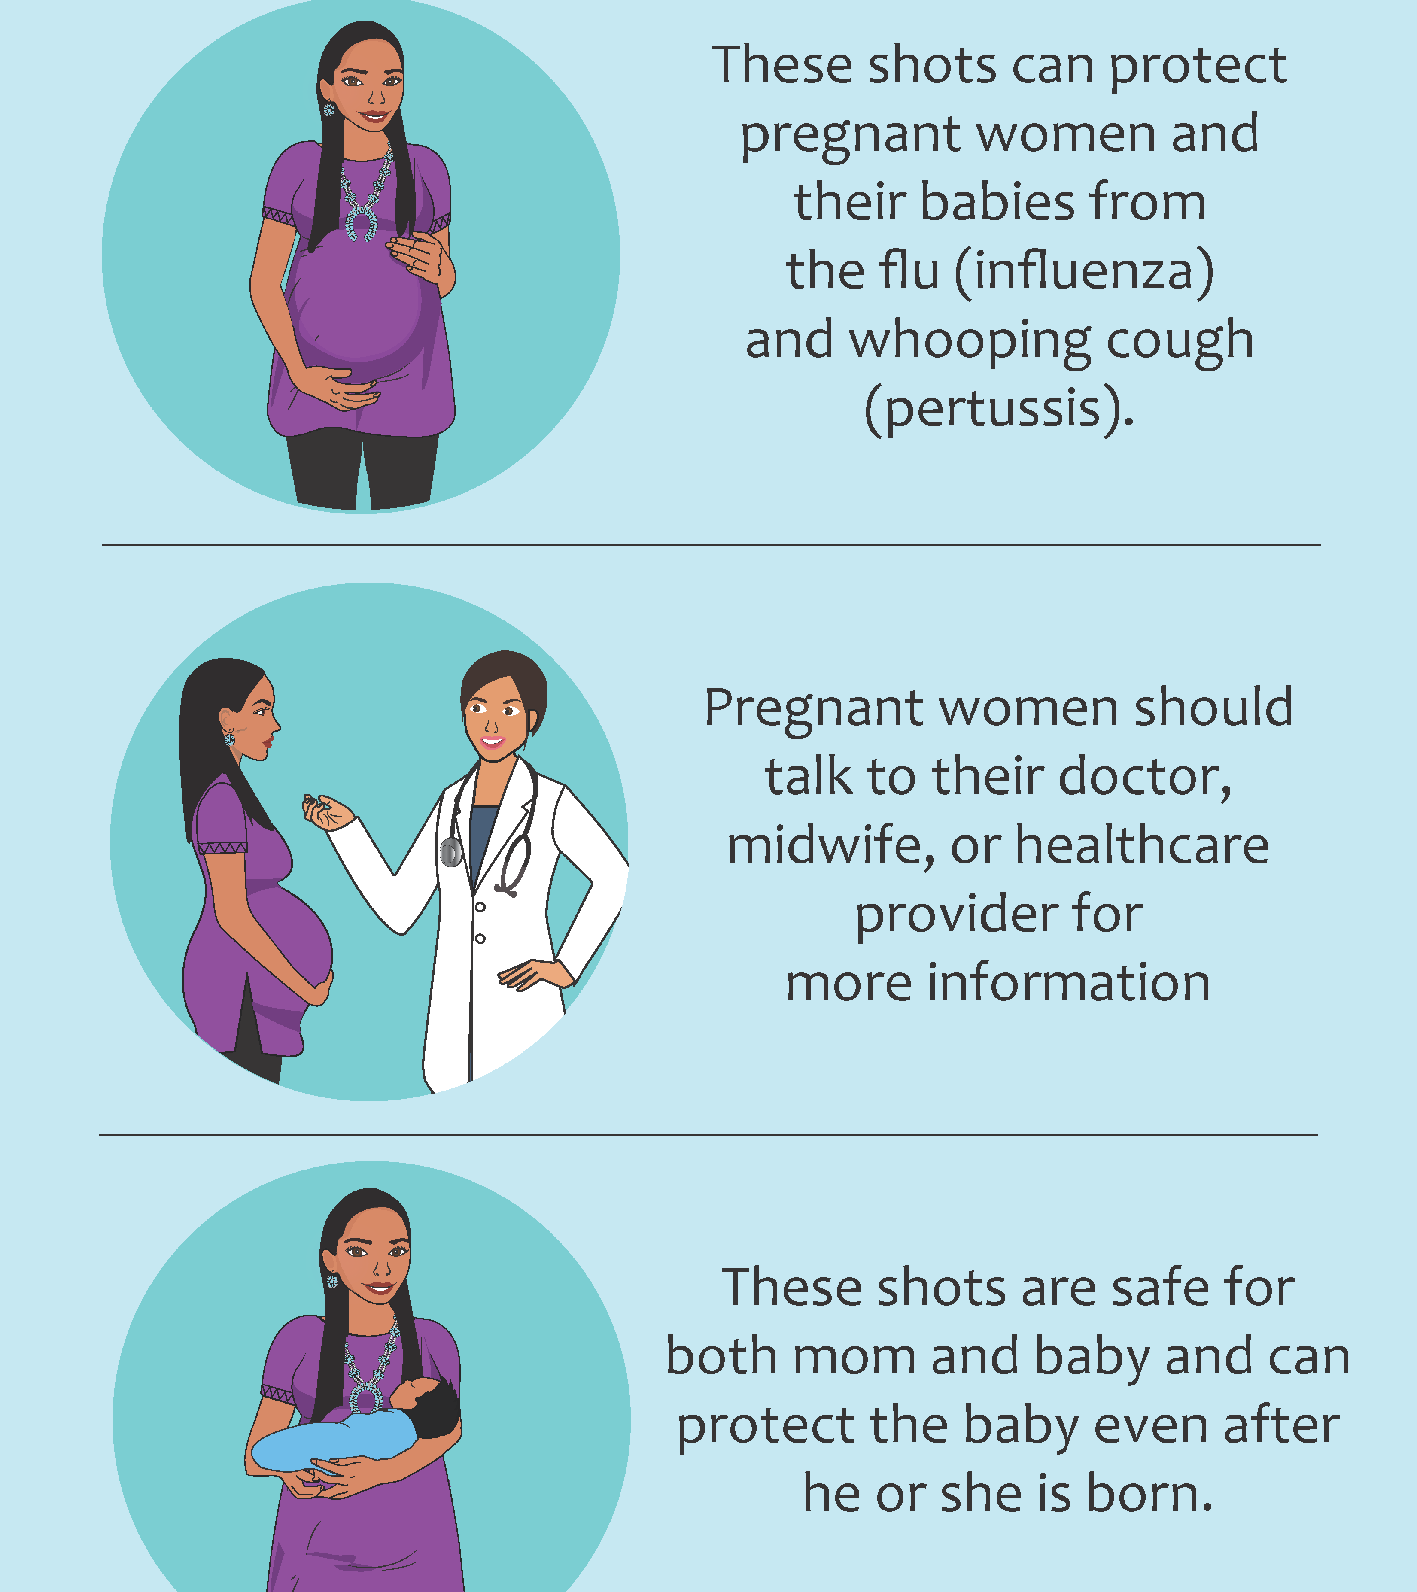
Evaluating Maternal Immunization
Despite coverage that is higher than the national average, a large proportion of AI/AN women in the Southwest US still had questions and concerns about maternal immunization.
While only a minority of providers (15%) expressed concerns about administering vaccines in pregnancy, this highlights an important audience for outreach and education.
Mobile phone-based communication appears to be both feasible and highly desirable among both patients and provider; women expressed interest in an informational app for pregnancy-related information.
https://cih.jhu.edu/programs/evaluating-maternal-immunization-study/
Notes:
CIH survey completed with Navajo and White Mountain Apache among pregnant women and women of childbearing age (and their providers)
Providers remain knowledgeable and confident about vaccinations and recommendations
Findings – women interested in receiving phone reminders/information

Slide 14
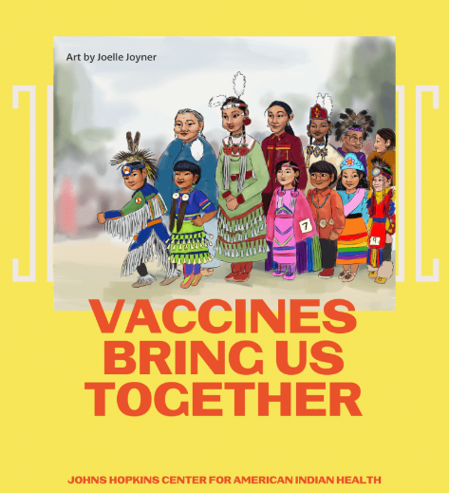
Resources
Standing orders
  https://www.immunize.org/wp-content/uploads/catg.d/p3066.pdf
Center for Indigenous Health Resource Library
  https://cih.jhu.edu/knowledge-center/resources/
VacciNative
  https://www.indiancountryecho.org/vaccinative/
U.S. Centers for Disease Control and Prevention
  https://www.cdc.gov/vaccines/index.html

Slide 15
References
Baker HA, Klunk A, Calac AJ, Livermont T, Bell S. Improving Indian Health Service Vaccination Campaigns Across the Full Spectrum of Age, Clinical, and Public Health Settings. Am J Public Health. 2023 Aug;113(8):849-851. doi: 10.2105/AJPH.2023.307349. PMID: 37406265; PMCID: PMC10323853.
Cataldi, J.R., Kerns, M.E., O’Leary, S.T. (2020). Evidence-based strategies to increase vaccination uptake: a review. Current Opinion Pediatrics, 32, 151-159. doi:10.1097/MOP.0000000000000843
Ellenwood, R., Boyd, A. D., & Higheagle Strong, Z. (2023). Communication and Perspectives About COVID-19 and Vaccinations Among Native Americans. Science Communication, 45(2), 172-194. https://doi.org/10.1177/10755470221151184
Evaluating maternal immunization study. Johns Hopkins Center for Indigenous Health. (2023, March 16). https://cih.jhu.edu/programs/evaluating-maternal-immunization-study
Gonzalez, V.M., Stewart, T.J. (2024). COVID-19 Vaccine hesitancy among American Indian and Alaska Native college students: the roles of discrimination, historical trauma, and healthcare system distrust. Journal of Behavioral Medicine, 47, 123-124. doi:10.1007/s10865-023-00443-5
Immunize (2023, May 29). Using Standing Orders for Administering Vaccines: What You Should Know. https://www.immunize.org/wp-content/uploads/catg.d/p3066.pdf
Tan, L.J. (2018). A review of the key factors to improve immunization coverage rates: What can the clinician do? Vaccine, 36, 5373-5378. http://dx.doi.org/10.1016/j.vaccine.2017.07.050
VacciNative. (2024). Indian Country ECHO. https://www.indiancountryecho.org/vaccinative/
Vaccines and Immunizations. (2024, August 10). U.S. Centers for Disease Control and Prevention. https://www.cdc.gov/vaccines/index.html
Vafiadis, D. (2024, April 25). How Culturally Competent Strategies are Boosting Vaccine Uptake Among Urban Native Elders. National Council on Aging. https://www.ncoa.org/article/how-culturally-competent-strategies-are-boosting-vaccine-uptake-among-urban-native-elders

