Slide 1


Implementation of Pharmacy-Based MOUD Clinic
Karly Westra, PharmD
Quentin N. Burdick Memorial Health Care Facility

Slide 2
Agenda
1
2
3
4
5
Background
Implementation
Challenges & Opportunities
Data
Case
Presentations

Slide 3
Objectives
Understand process of establishing an MOUD (medications for opioid use disorder) clinic
Evaluate challenges and successes of implementing a new MOUD clinic
Review patient cases and discuss treatment options

Slide 4
Background

Slide 5
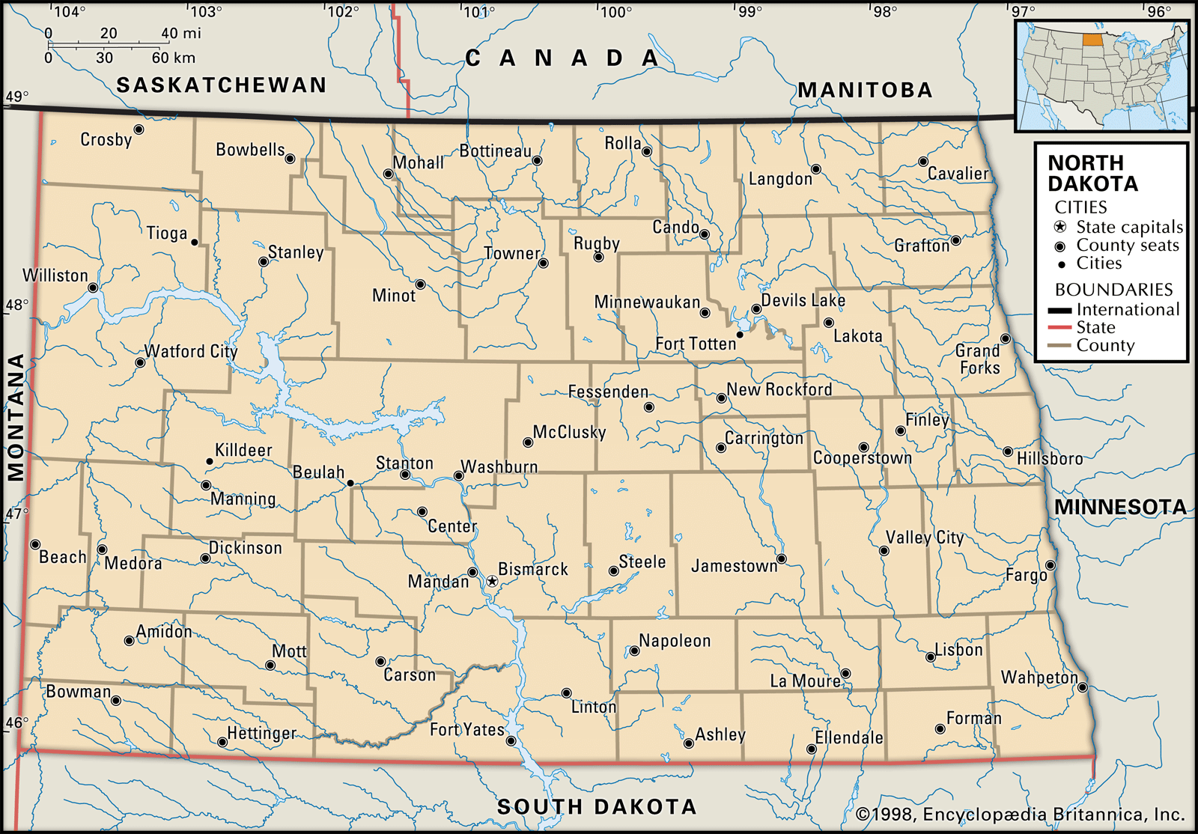
Background
July 2023
Turtle Mountain Band of Chippewa Tribe has over 20,000 enrolled members
One in-house primary care provider seeing patients for MOUD/SUD
For patients that have insurance, there are providers at outside facilities 35-50 miles away who provide MOUD services

Slide 6
Implementation

Slide 7
Implementation Timeline
July:
Updating Collaborative Practice Agreement
November:
EHR Updated Templates
February:
Community Partners
August: Licensing and Credentialing
December:
Improved UDS Lab

Slide 8
Updating CPA
Utilized existing Collaborative Practice Agreement (CPA) but added the following language:
Referral into clinic: Facility staff or patient self-referrals are sufficient for evaluation and consideration.
Diagnose Substance Disorder (SUD) and withdrawal utilizing the Diagnostic and Statistical Manual of Mental Disorders Fifth Edition (DSM 5) and the Clinical Opioid Withdrawal Score (COWS)
Initiate, modify, or discontinue non-controlled and controlled substances for substance use disorders, including Opioid Use Disorders and opioid withdrawal after diagnosis by pharmacist or provider utilizing current standards of medical practice and guidelines. Initiate, modify, or discontinue therapy for SUD related conditions, when determined by the pharmacist that such conditions are caused by Substance use or withdrawal, such as insomnia, anxiety, Nausea/Vomiting, constipation, diarrhea, depression, etc. Controlled prescriptions will be written under the credentialed pharmacists’ name and individual DEA number.

Slide 9
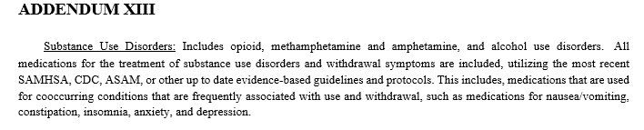
Updating CPA (Cont.)

Slide 10
Implementation Timeline
July:
Updating Collaborative Practice Agreement
November:
EHR Updated Templates
February:
Community Partners
August: Licensing and Credentialing
December:
Improved UDS Lab

Slide 11
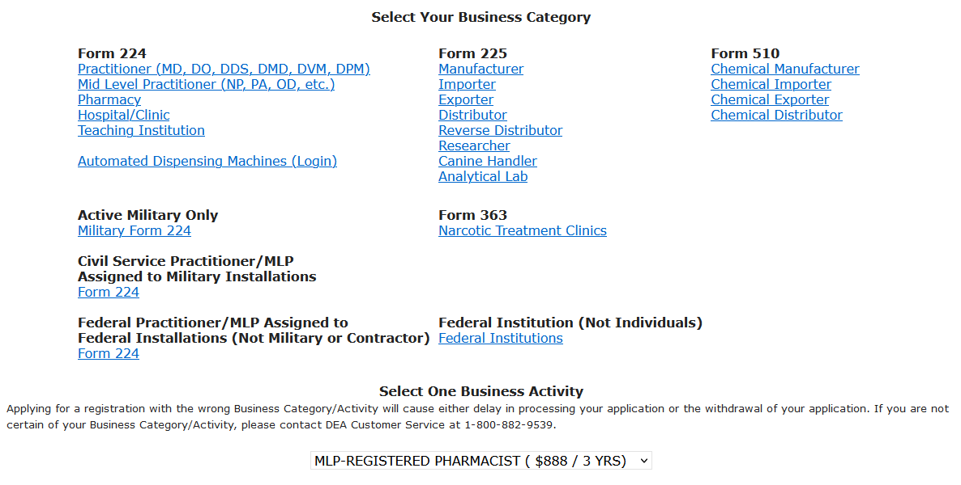
DEA Licensing

Slide 12
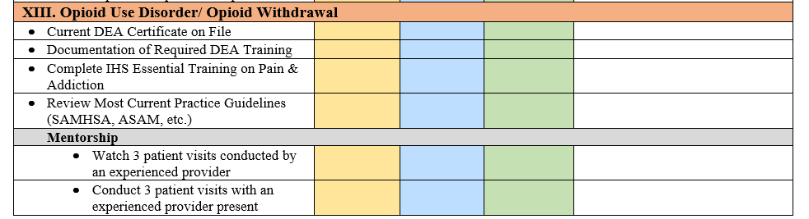
PharmD Credentialling Criteria

Slide 13
Implementation Timeline
July:
Updating Collaborative Practice Agreement
November:
EHR Updated Templates
February:
Community Partners
August: Licensing and Credentialing
December:
Improved UDS Lab

Slide 14
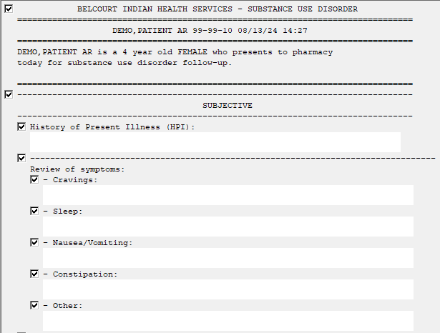
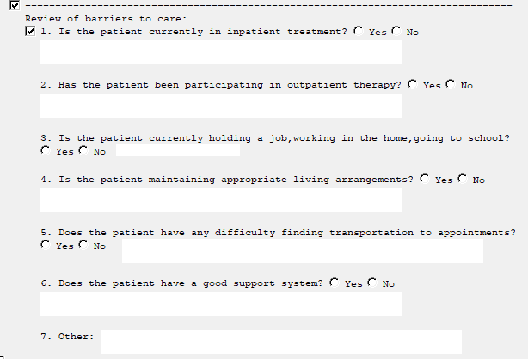

Slide 15
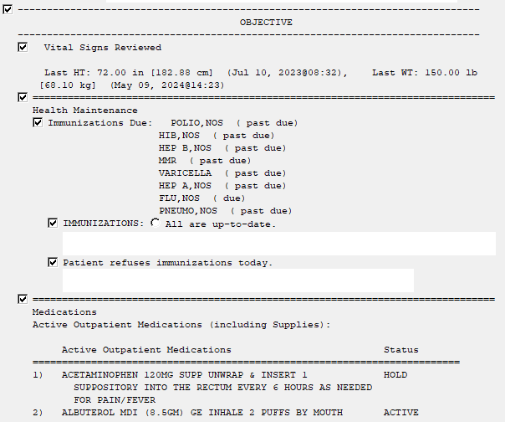
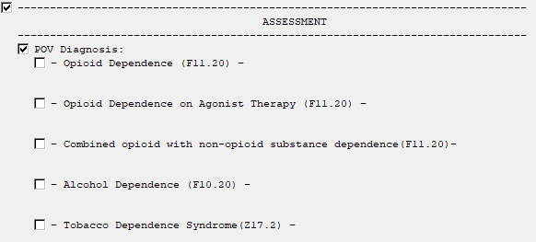

Slide 16
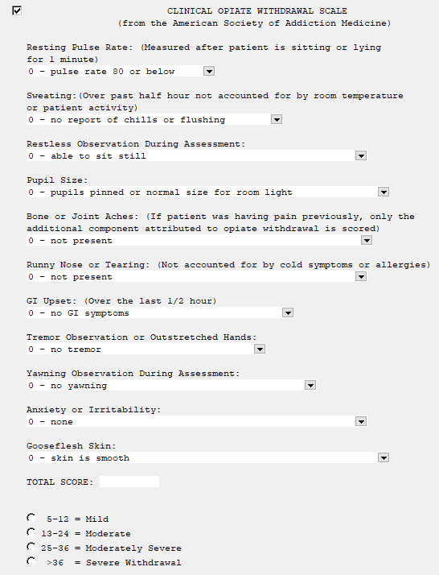
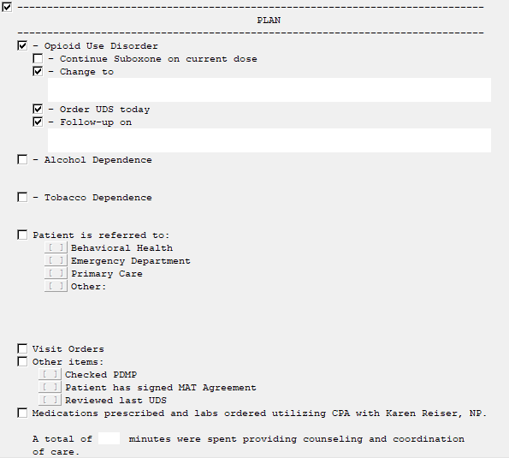

Slide 17
Implementation Timeline
July:
Updating Collaborative Practice Agreement
November:
EHR Updated Templates
February:
Community Partners
August: Licensing and Credentialing
December:
Improved UDS Lab

Slide 18
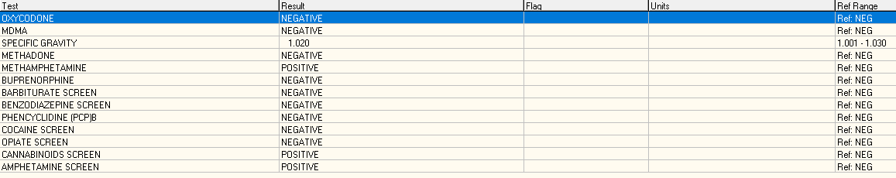
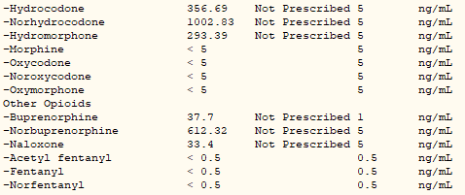

Slide 19
Implementation Timeline
July:
Updating Collaborative Practice Agreement
November:
EHR Updated Templates
February:
Community Partners
August: Licensing and Credentialing
December:
Improved UDS Lab

Slide 20
Community Partners
Reaching out to local treatment center personnel:
  Educate about services provided and how to enroll patients into clinic
  Gather resources to refer patients to treatment centers and outpatient counseling
  Identify further community needs and help distribute Naloxone

Slide 21
Billing
Private Insurance – dependent on individual insurance if they will pay for prescriptions and visits written/conducted by pharmacists
Medicaid – acknowledges PharmD’s as providers and will pay for prescriptions and visits if the pharmacist is enrolled in Medicaid with their NPI number (for controlled substances – DEA number on file) → Billable MTM codes
No Insurance– Suboxone/Sublocade is standard of care for MOUD.

Slide 22
Challenges & Opportunities

Slide 23





Challenges
DEA Licensing for Pharmacists
Unknown process for obtaining DEA licenses for pharmacists. Worked with Executive Director of ND Board of Pharmacy.
Lack of Access to PCP for MOUD
Obtained DEA licenses to write prescriptions under pharmacist names. Continued education on management of MOUD
Low Experience and Few Mentors
Utilize the Clinician-to-Clinician Substance Use Warmline to connect with experts for recommendations for management
Urine Drug Screen (UDS)
Previous lab provided a positive/negative result (no quantity or metabolites) and did not include fentanyl
Staffing
Only two credentialled pharmacists – limited access to care on outside business hours or when we are on leave

Slide 24
Opportunities –
Increased Access to Care
August 2023 – 4 pharmacy MOUD visits (2 patients)
July 2024 – 25 pharmacy MOUD visits (17 patients)
Greater than 60 patients referred to internal and community behavioral health services since the beginning of clinic
~ 70% of patients still engaged in care

Slide 25


Questions?

Slide 26
Case Presentations

Slide 27

Case #1
26-year-old Female presenting at 30 weeks gestation. She reports that she relapsed mid-pregnancy with fentanyl.
How is suboxone used in late-term pregnancy?

Slide 28

Case #2
33-year-old Male presenting due to history of substance use. He was found to have spinal abscess (pain was masked due to fentanyl use).
How do we treat pain in a patient with an indication for opioid pain reliever and history of SUD?

Slide 29

Thank you!
Karly.Westra@ihs.gov
Quentin N. Burdick Memorial Health Care Facility

