Slide 1
Harm Reduction in Alaska
Maya Bowers, NCPRSS, PSPII
Venus Staten
Hannah Gumlickpuk, MPH

Slide 2
What is Harm Reduction?
Harm reduction acknowledges that drugs are widely available in our society. It encompasses the understanding that traditional law enforcement approaches or those that require complete abstinence do not decrease demand, use, or negative health consequences of substance use.
Harm reduction is exactly what it sounds like: reducing the harm associated with using drugs through a variety of public health interventions. But the concept relies on more than these tools and begins, at the most fundamental level, with recognizing that all people deserve safety and dignity. It does not treat drug use as a moral failing.
-Johns Hopkins School of Public Health, 2022

Slide 3

710 3rd Avenue, Fairbanks, Alaska
www.interioraids.org
Syringe Access Program
Medication Assisted Treatment
Financial Assistance and Case Management for Persons Living with HIV/AIDS

Slide 4
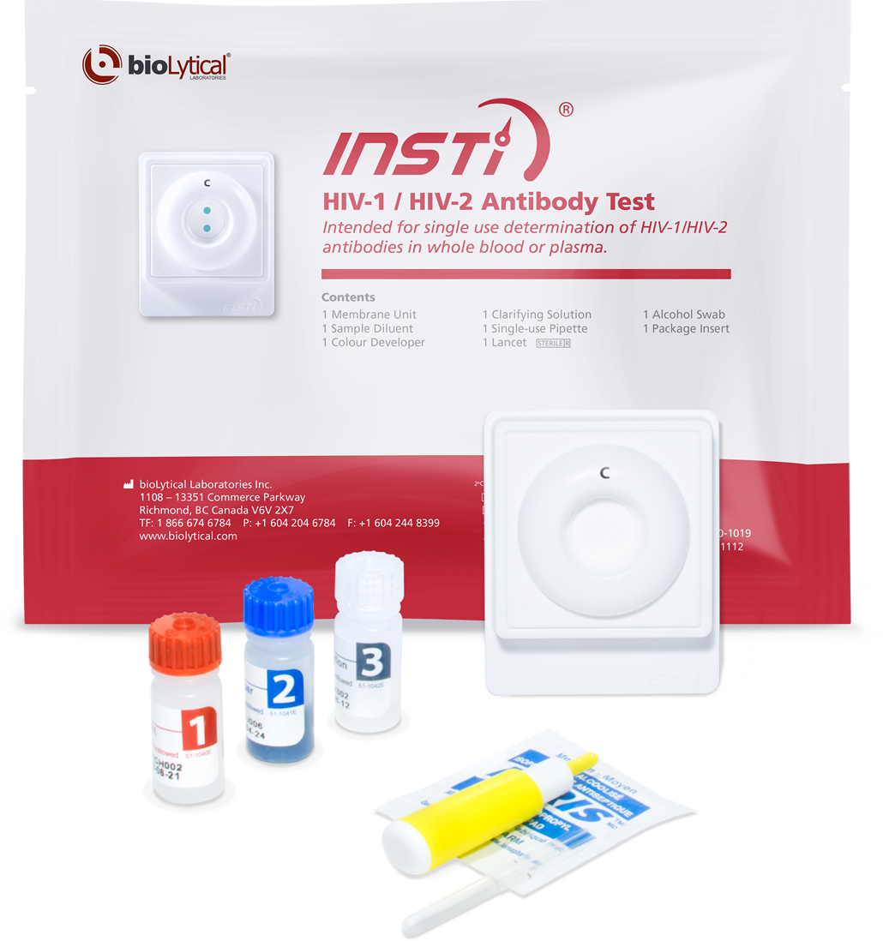
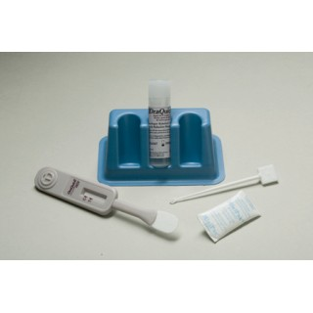
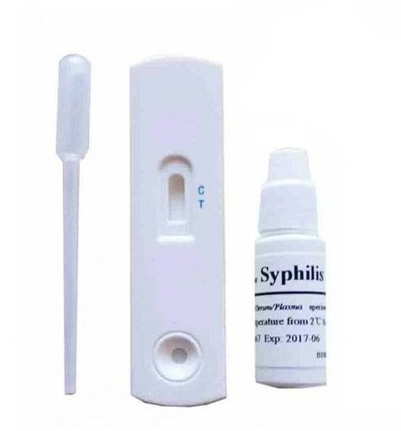
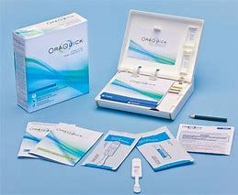
Rapid Testing
Additional Referrals for Testing, Treatment, & Prevention Medications to:
Public Health
Chief Andrew Isaac Health Center
Tanana Valley Clinic
Interior Community Health Center
iknowmine.org
Identity Health Clinic
Veterans Administration
1 minute HIV Tests
20 minute HIV & HCV tests
10 minute Syphilis Tests
20 minute HIV at home tests

Slide 5
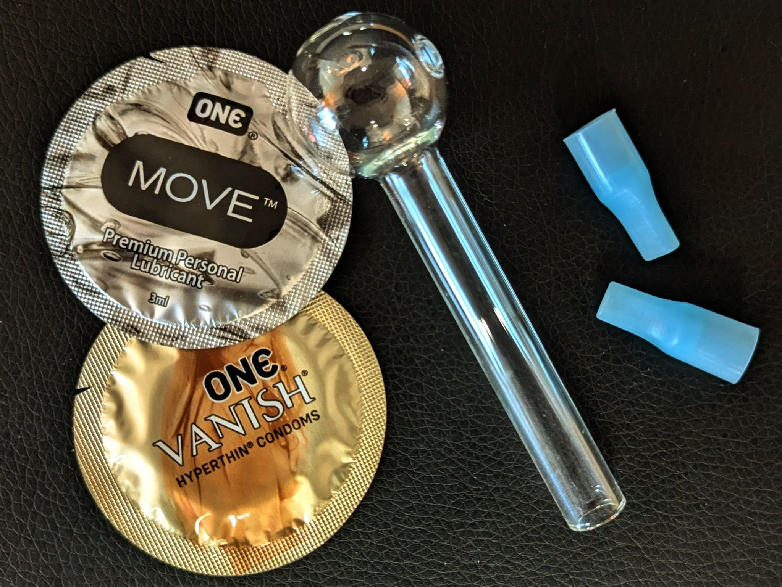
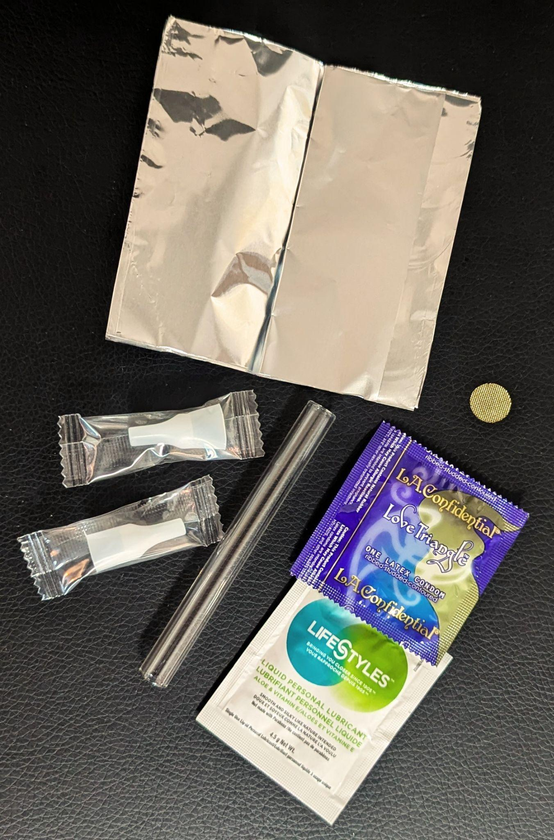
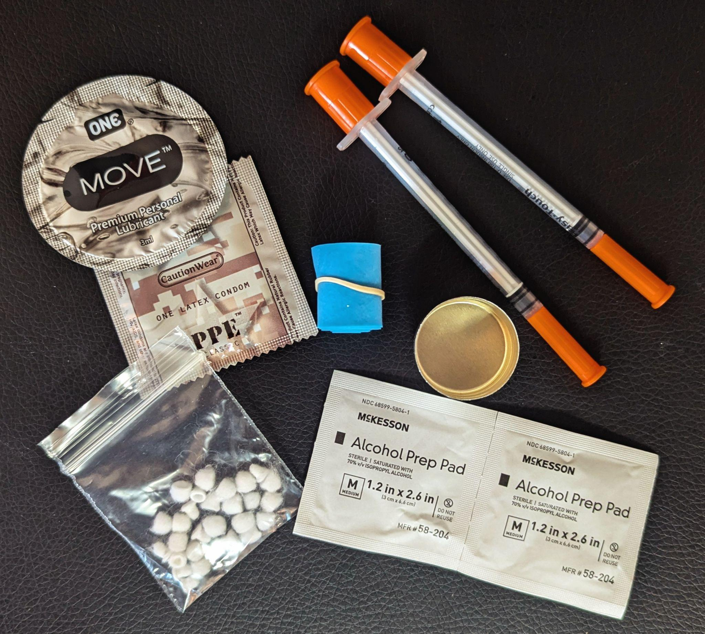
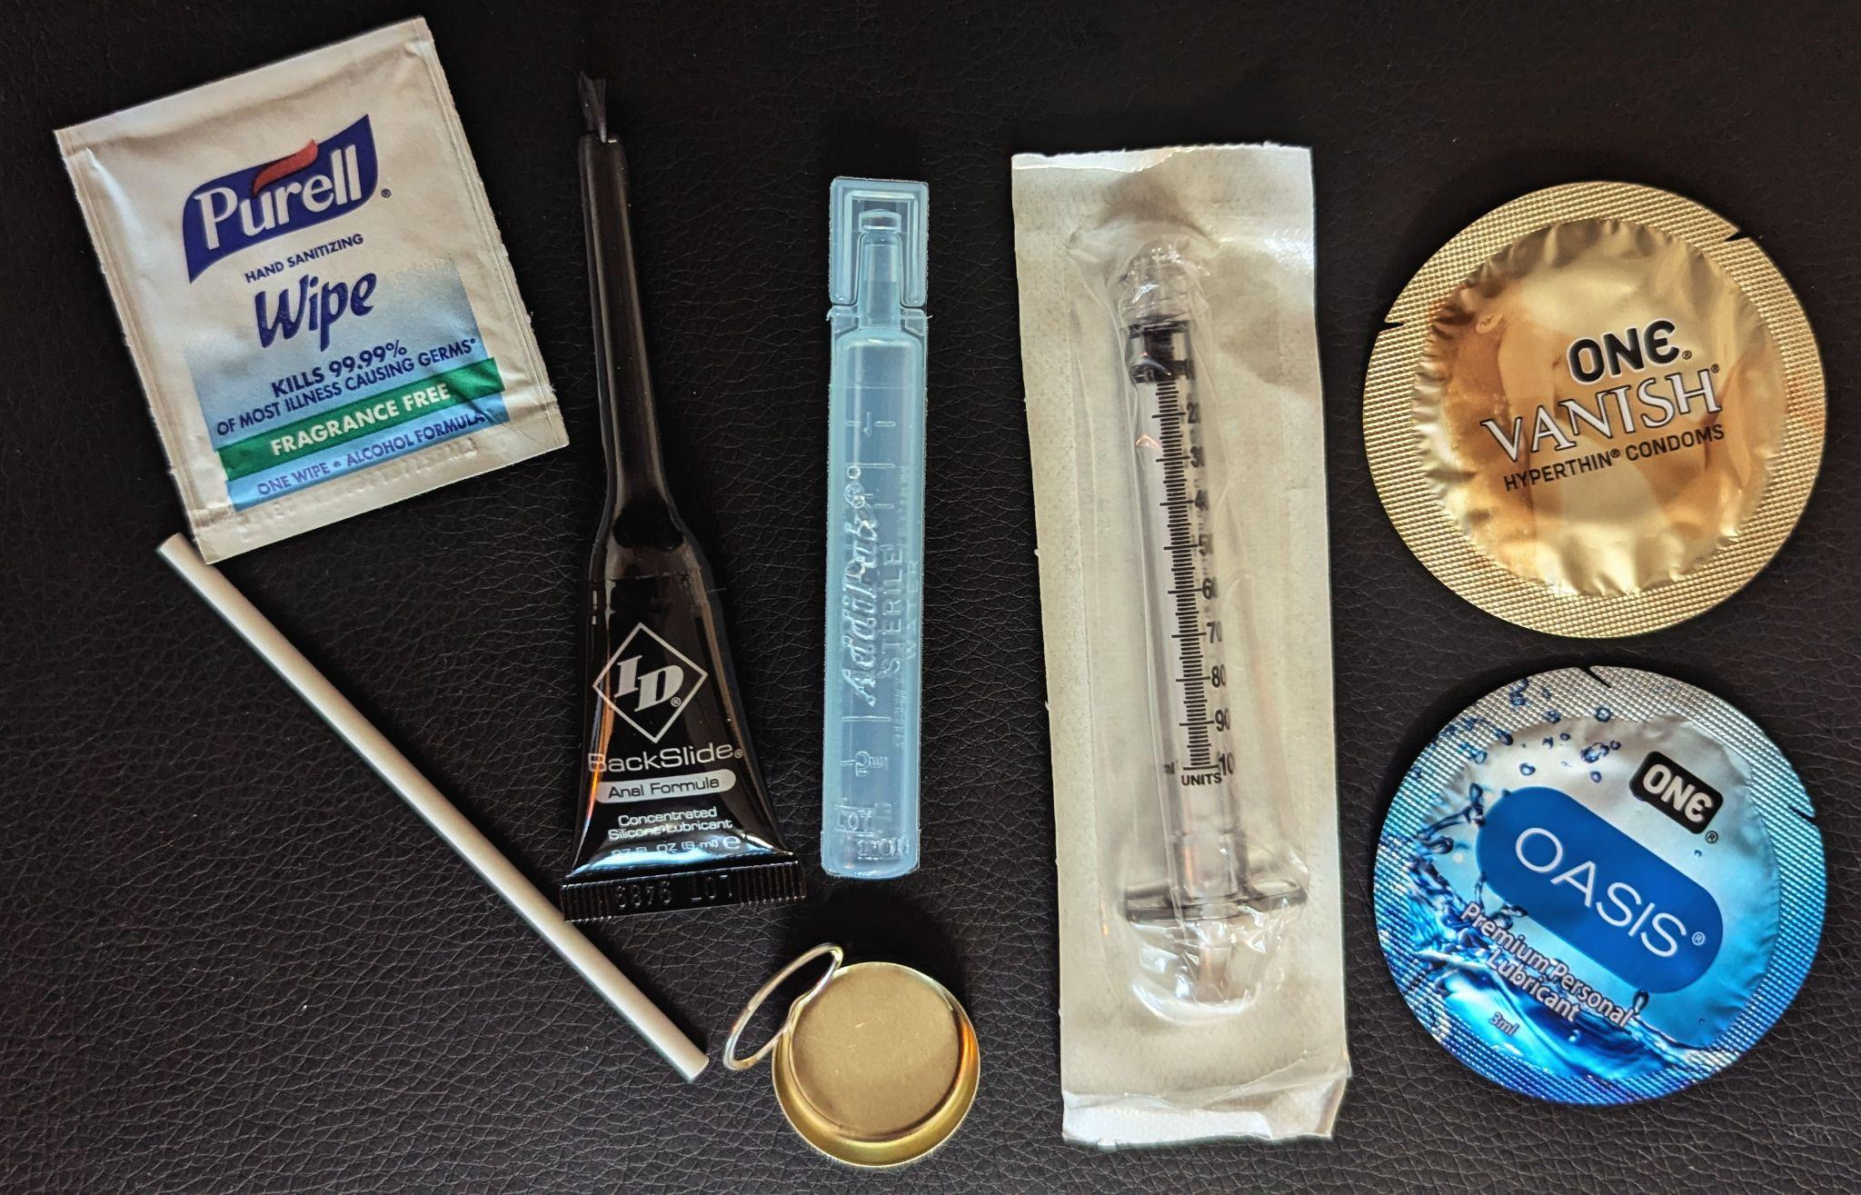
Safer Drug Use Supplies
Smoking Supplies
Injection Supplies
Booty Bumping Supplies
Snorting Supplies

Slide 6
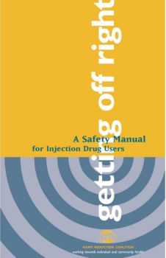
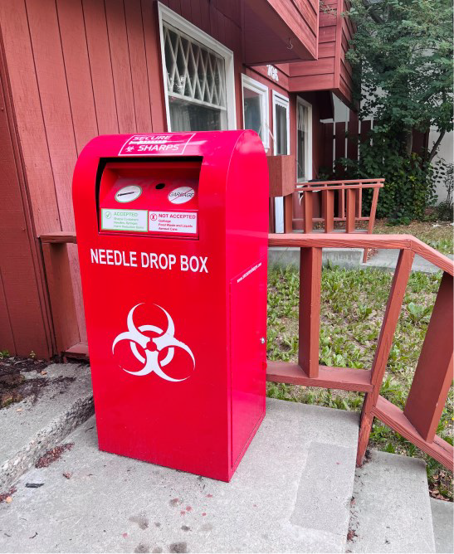
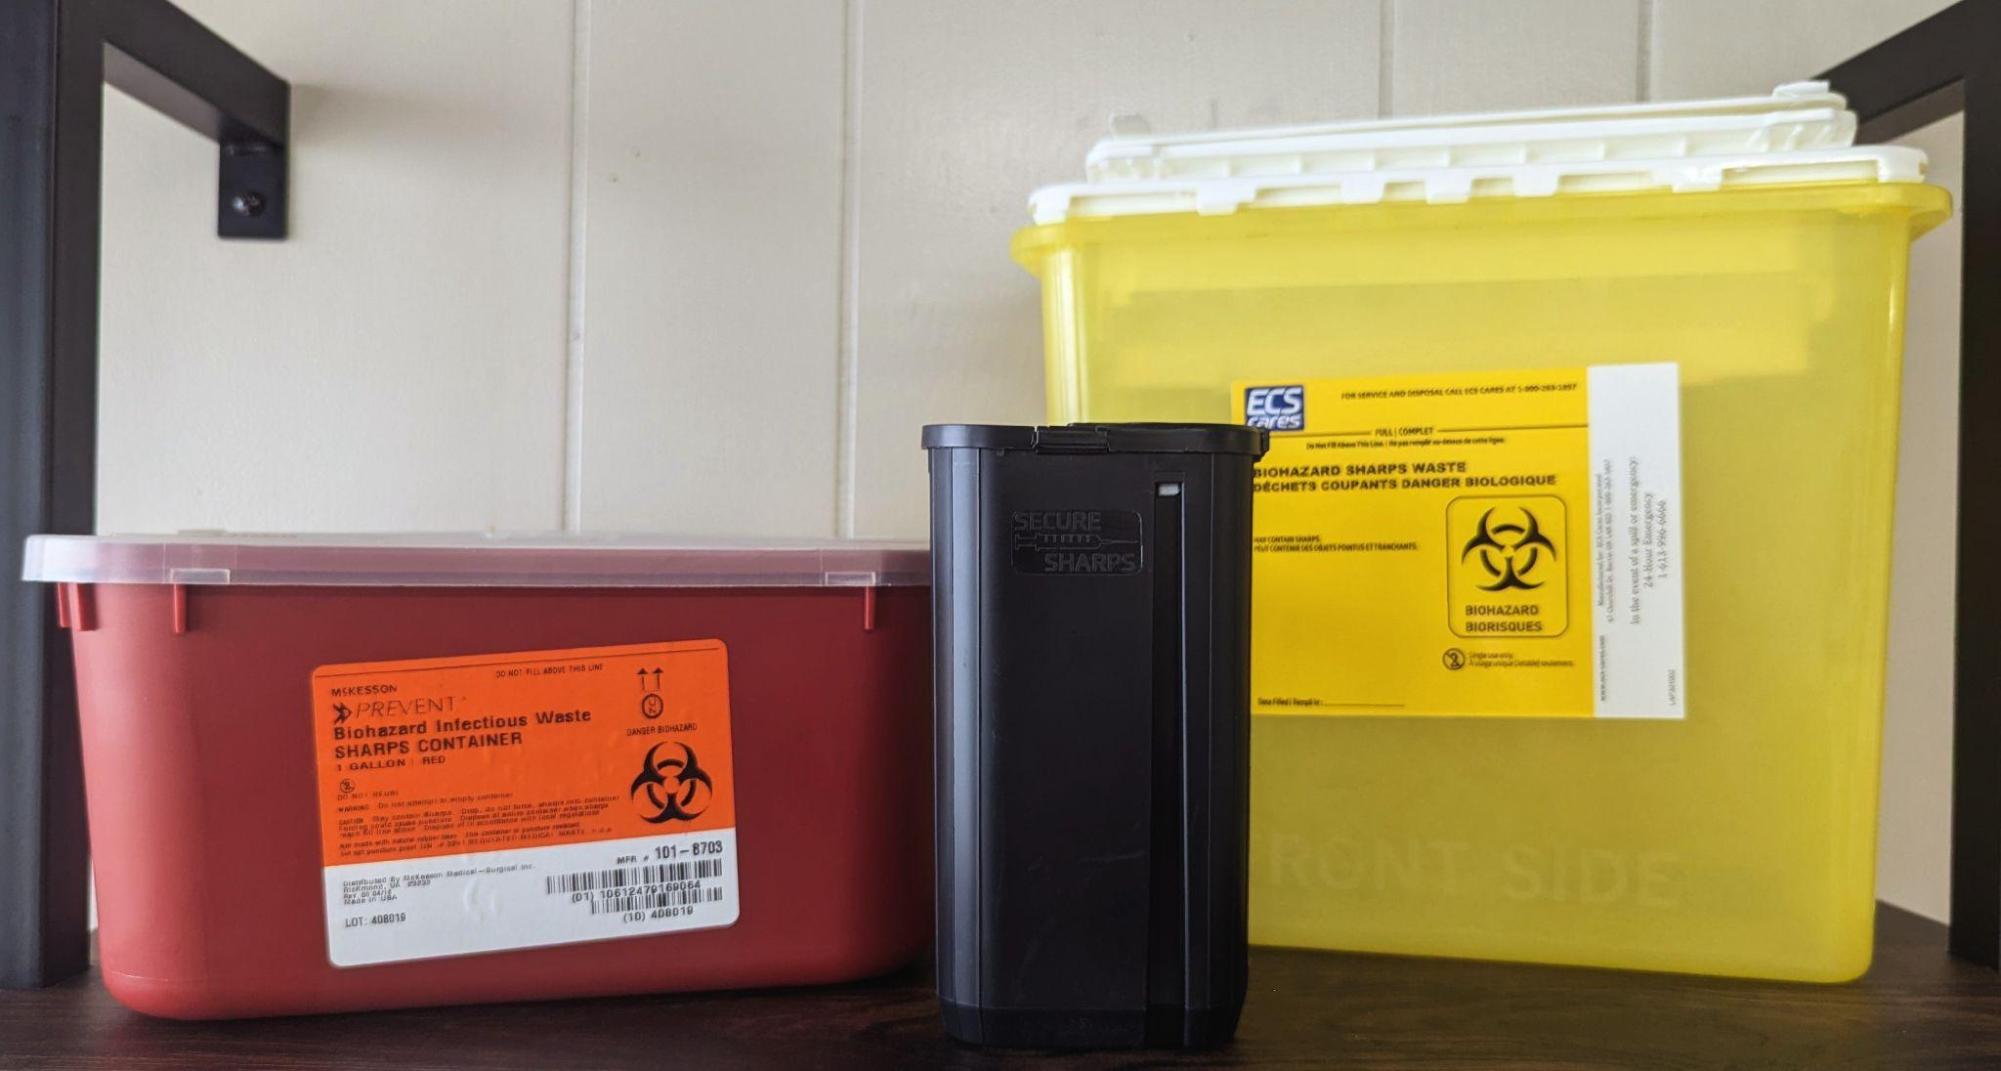
Safer Use Supplies
Sharps Containers
24/7 Sharps Disposal
Safety Manual for Injection Drug Users
Wound Care Kits

Slide 7
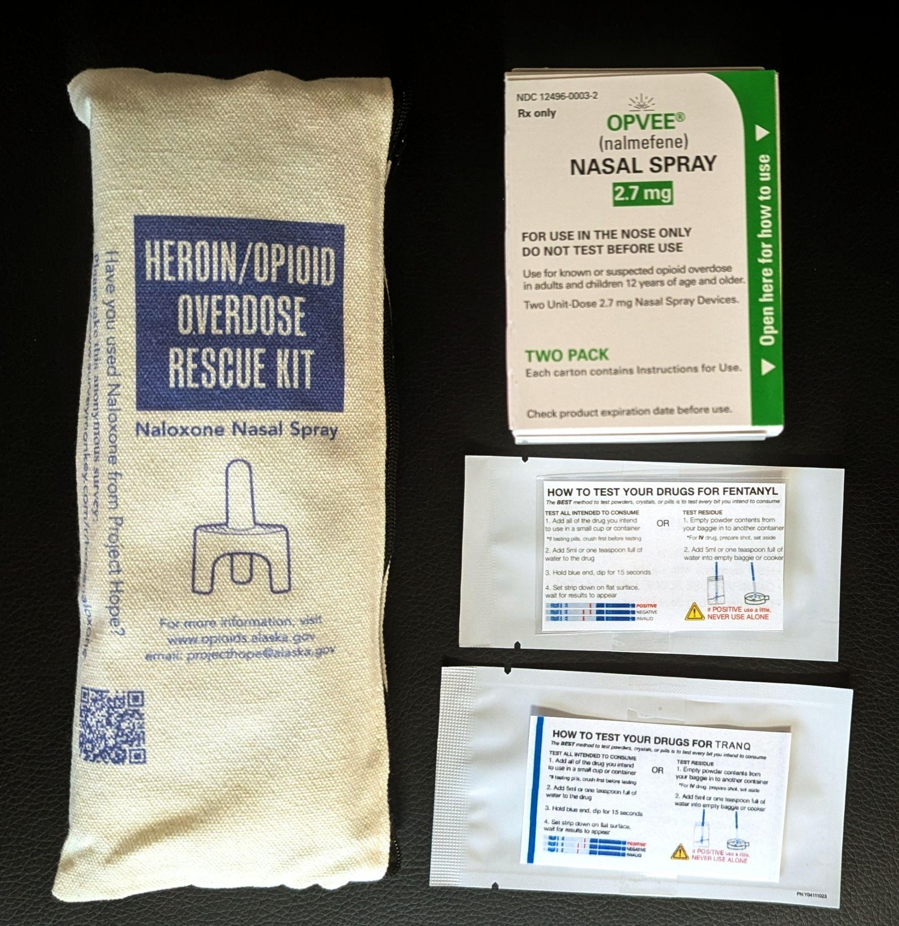
Overdose Prevention
Naloxone
Opvee
Fentanyl Testing Strips
Xylazine Testing Strips

Slide 8
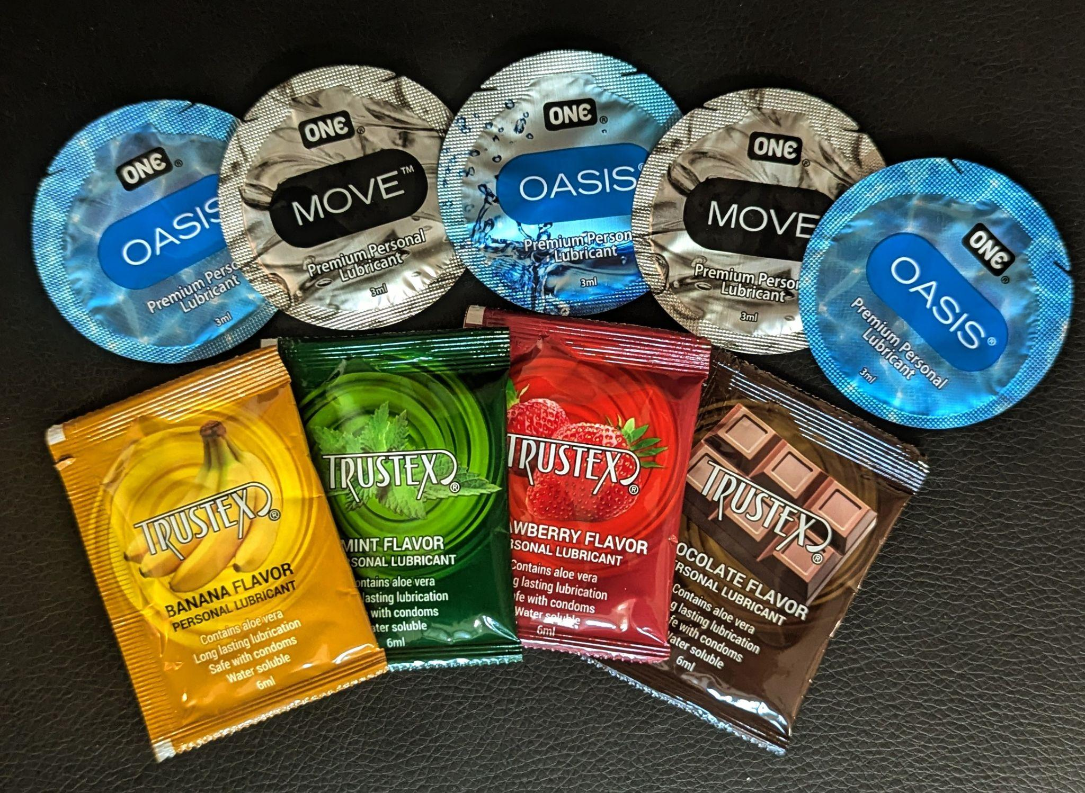
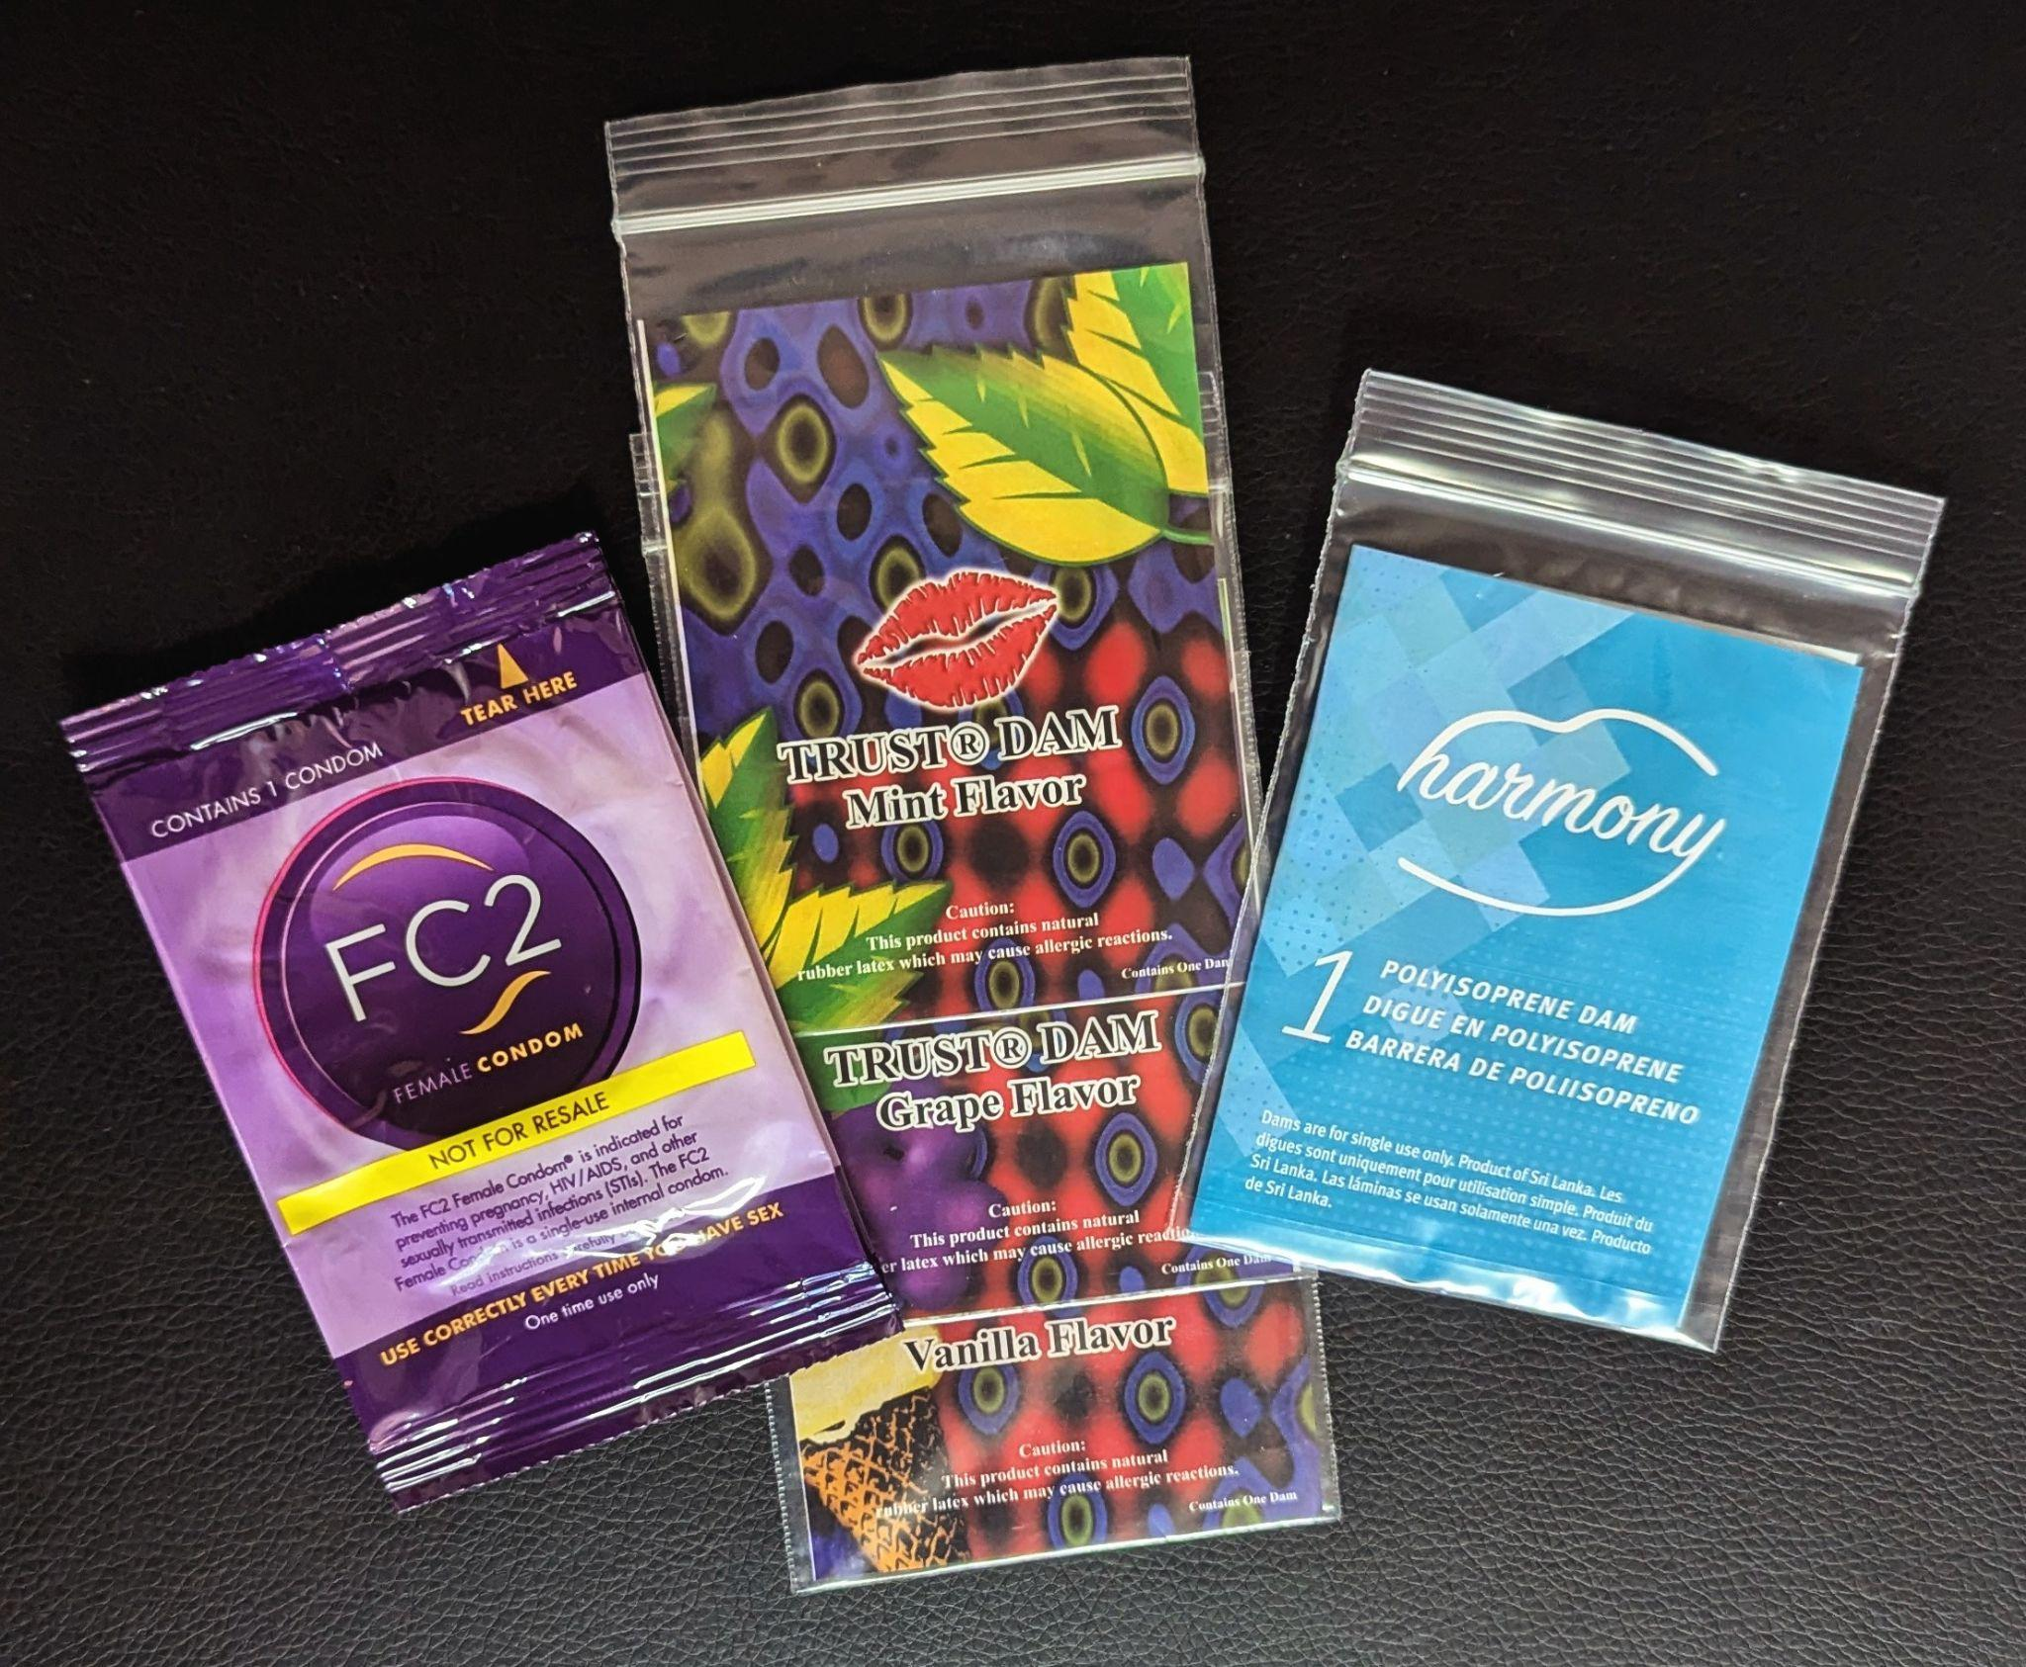
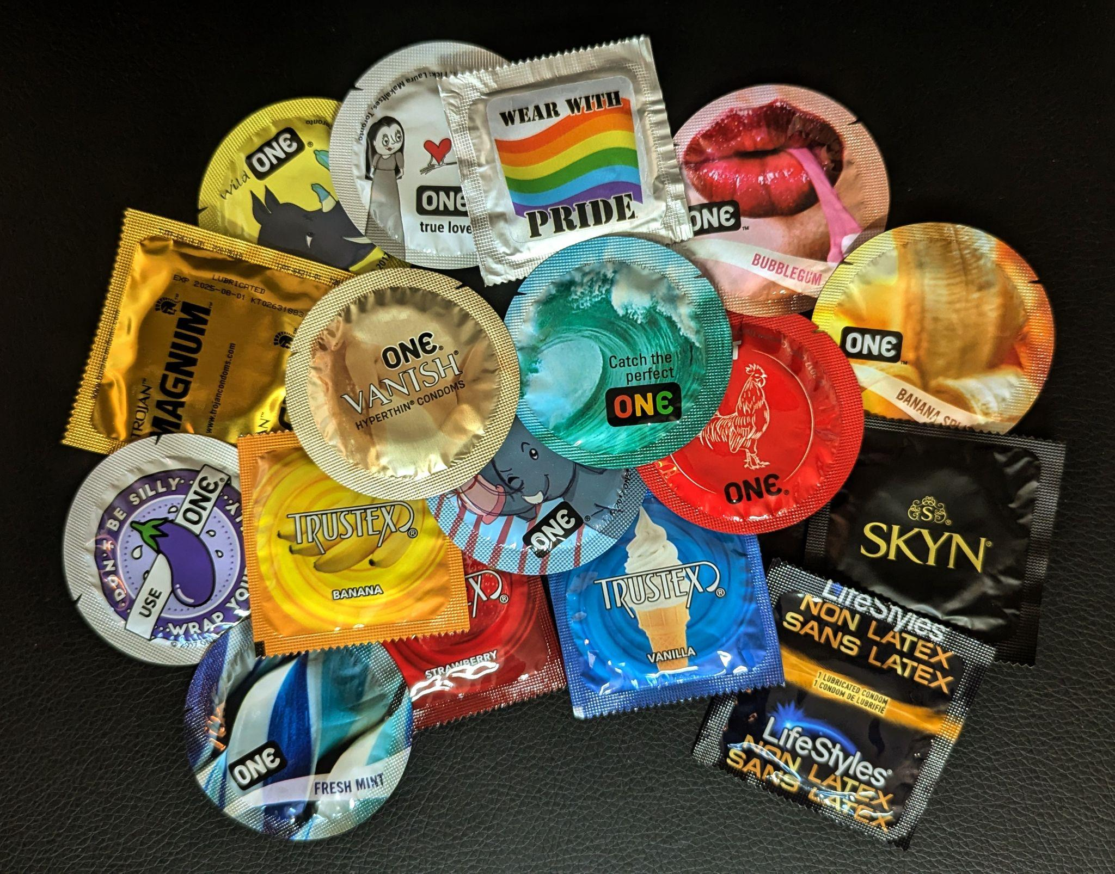
Safer Sex Supplies
Lubricant
Internal Condoms
Dental Dams
External Condoms
Latex and non latex options available

Slide 9
Community Education
Ralph Perdue Center
Women and Childrens Center for Inner Healing
Red Cross
FNSBSD Middle & High Schools
Rescue Mission
University of Alaska Fairbanks
Lions Clubs
Chamber of Commerce
Presbyterian Hospitality House

Slide 10

Alaskan AIDS Assistance Association (Four A’s)
1057 W. Fireweed Lane Suite 102.
Anchorage, AK 99503
WWW.alaskanAIDS.org
Four A’s Syringe Access Program
(FASAP)

Slide 11
FASAP timeline
FASAP started in May 2007.
Four A’s started offering Mobile Health Unit services in July 2017.
Four A’s expanded to the Mat-Su Valley through the Mobile Unit in 2018.
In 2019 FASAP distributed over 1 million syringes and took in over 1 million used syringes.
In 2022 Four A’s expanded our Juneau office services to include 1.0 FTE for Harm Reduction services.
April 2023, Four A’s expanded to a full time office in the Mat-Su Valley, with 2-staff.
November 2023, FASAP Mat-Su/Juneau started offering non-injection supplies.
March 2024 Anchorage FASAP converted to a needs-based distribution model and added non-injection supplies.

Slide 12
What FASAP Does…
Utilizes the concept of Harm Reduction to reduce the negative impacts of drug use.
Provides sterile syringes and supplies to injection and non-injection drug users.
Provides overdose response kits (Narcan) and overdose prevention and education.
Offers education to participants from Peer staff that have lived experience.
How to reduce the risk of getting a bloodborne illness such as HIV or HCV.
How to access health care before a medical condition becomes emergent.
Referrals to food banks, housing, mental health and Substance Use treatment.
Referrals to Medication Assisted Treatment or Detox.
A non-stigmatizing safe place and someone that will listen without judgement.

Slide 13
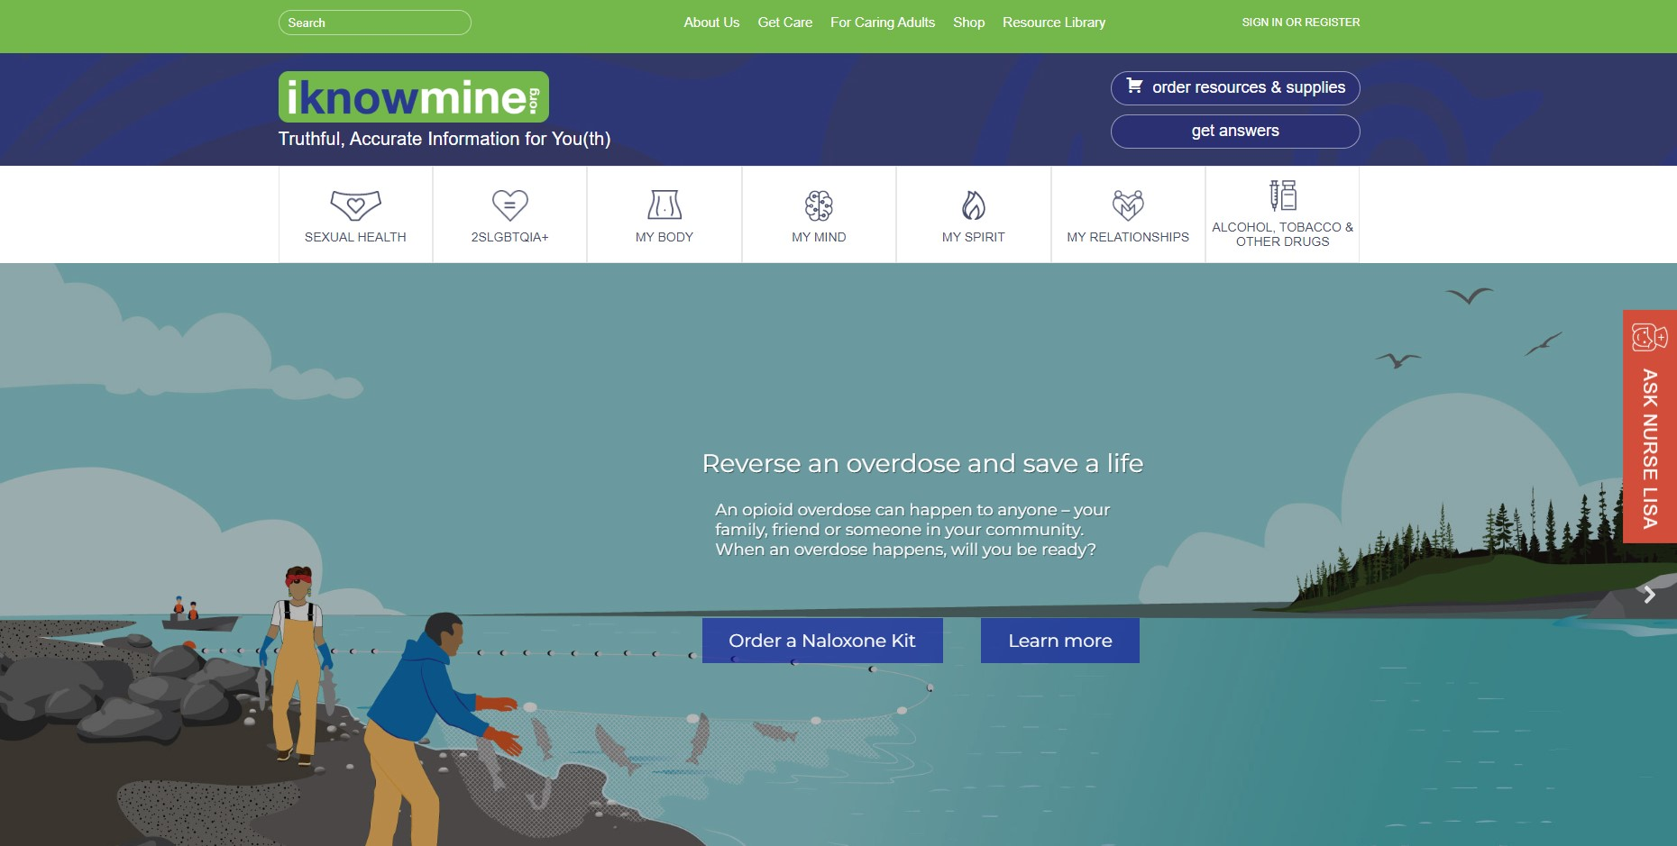
iKnowMine.org home page
Notes:
Hannah
IKM: https://www.iknowmine.org/
At ANTHC, we are located in the Wellness and Prevention Department, and provide public health services for HIV and STD prevention. We provide training, technical assistance to our partners across the state, as well as engage in community-based programming and outreach.
All of our programming is supplemented with a resource we manage, called iKnowMine.org.
iKnowMine is a website where people throughout the state of Alaska can go to for free resources and education related to health and wellness from a holistic standpoint.
This website is built on the foundation of partnerships across different programs, and it’s intended to provide easier access to resources and education to both individuals and those doing community-based outreach. We do prioritize Alaska Native people and Tribal organizations, but all services offered through iKnowMine is accessible to everyone within the state of AK.
There are a lot of features, services and resources provided through the site, and we’ll only go over a few of them today.
Through IKM:
•People can access articles covering bodily health in different areas, from sexual health to relationships to substance use and more.
•People can also contact us through an ‘Ask Nurse Lisa’ feature in order to ask a real-life nurse a sexual health-related question and receive a response within a few days.
•People can also order safer sex and safer substance use supplies for free, shipping included. And supplies are mailed discreetly statewide.

Slide 14

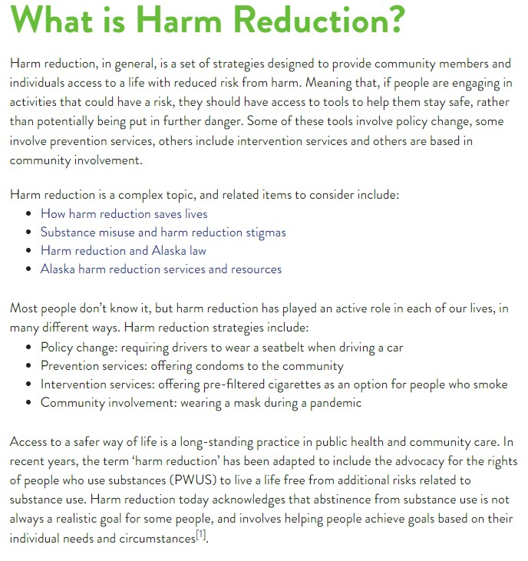
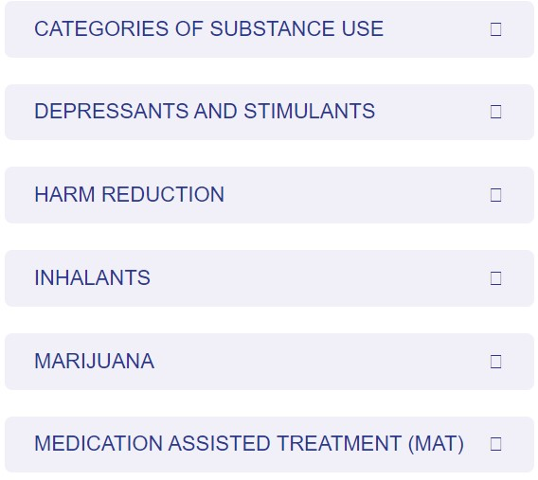

Articles: Alcohol, Tobacco and Other Drugs
Notes:
Hannah
IKM: https://www.iknowmine.org/
Here’s an example of some of our educational material available on the website. This is just a snippet of what’s in the Alcohol, Tobacco and Other Drugs tab for our harm reduction page.

Slide 15
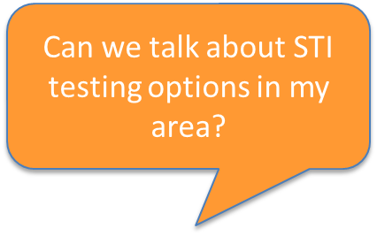

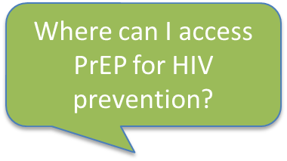
Ask Nurse Lisa
Ask a sexual health question online
Prevention strategies
Testing and treatment options
Review local resources across the state
Responses are:
Medically accurate
Non-judgmental
Confidential
Quick
Free
Prefer to chat? Call Nurse Lisa at: 877-334-8762
Notes:
Hannah
Ask Nurse Lisa: https://www.iknowmine.org/ask-nurse-lisa/
Included is a program called Ask Nurse Lisa, where people can ask a sexual health related question, and receive a real-life response from the ANTHC EIS HIV clinical team.
This is accessible on every page through the red Ask Nurse Lisa button.
People across the state are welcome to ask any questions related to sexual health, which can cover things like:
STI or HIV prevention strategies
Testing and treatment options
Review local resources
Responses are:
Medically accurate
Non-judgmental
Confidential
Quick, responses are typically back to the person same-day or within a few days at the latest
Free
Please note that we are mandatory reporters; This is not an emergency or urgent care line, any questions submitted will receive a response in a few days.

Slide 16
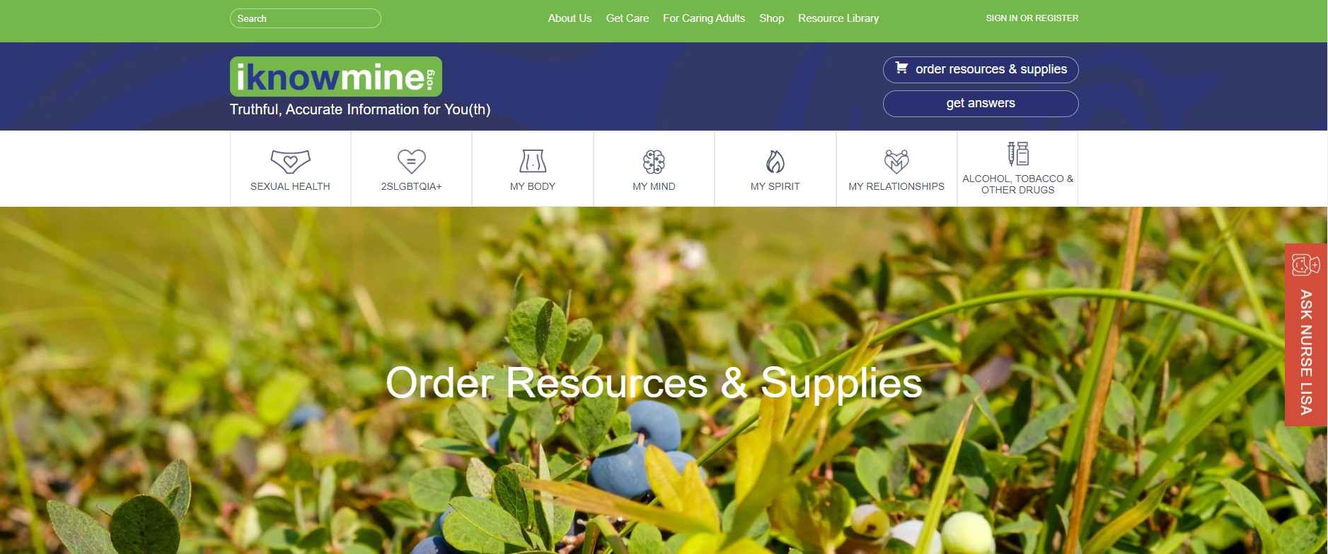


iKnowMine.org store home page
Notes:
Hannah
Individuals, Tribal organizations and nonprofits based in Alaska are also able to order and receive free hands-on resources and educational materials through iKnowMine’s store as well. The store is accessible from every page through the ‘Order resources and supplies button’ up in the top right corner.

Slide 17
iKnowMine.org Store Resources
Individuals
Condoms, latex & non-latex
Dental Dams, latex & non-latex
HIV Self-Test Kit
I Want The Kit: STI self-swab
Safer Injection Kit
Opioid Overdose Response Kit
Safe Medicine Disposal Systems
Educational materials
DVDs, lesson plans, toolkits, etc.
Organizations
Educational Materials
DVDs
lesson plans
Toolkits, etc.
Community awareness tools
Posters
Brochures
Palm cards, etc.
Condoms, etc.
Notes:
Hannah

Slide 18
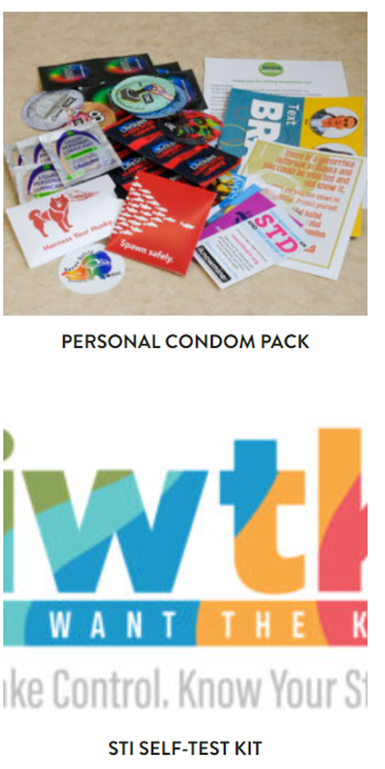
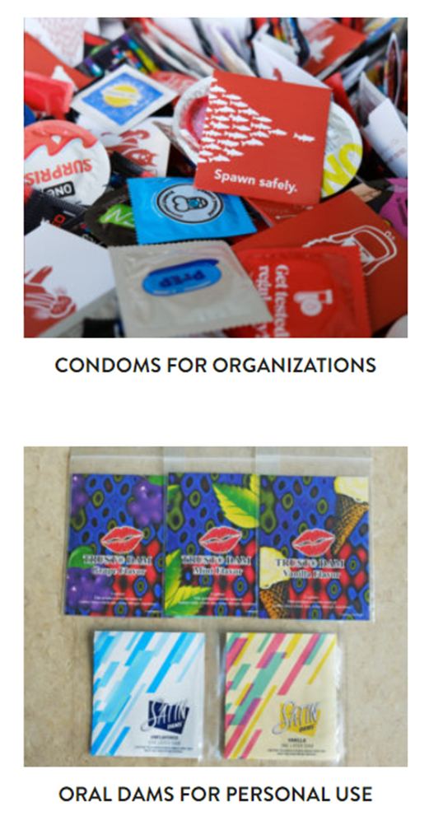
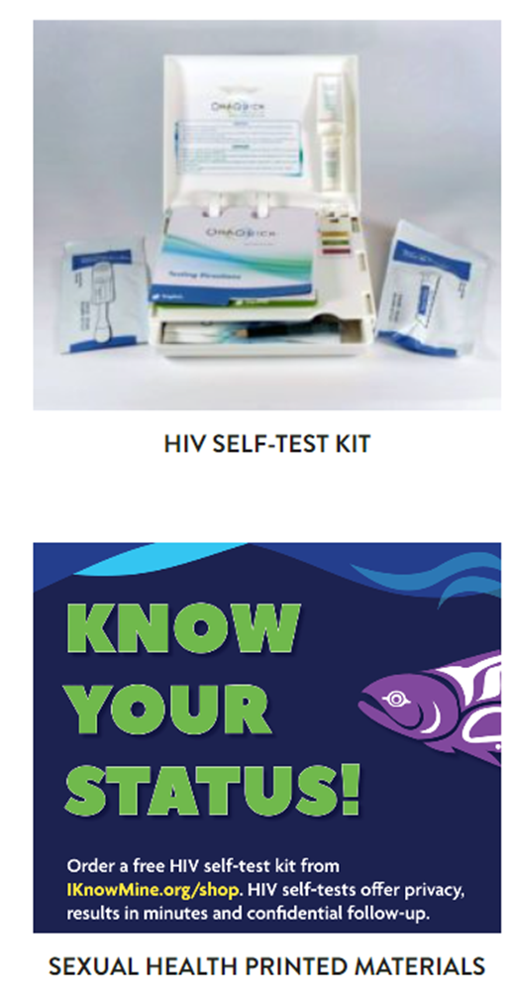
Sexual Health & Wellness
Click for more supplies!
Posters
Brochures
DVDs
Internal Condoms
Dental Dams
And more!
Notes:
Hannah
There are two sections to the store, the first is sexual health and wellness.

Slide 19
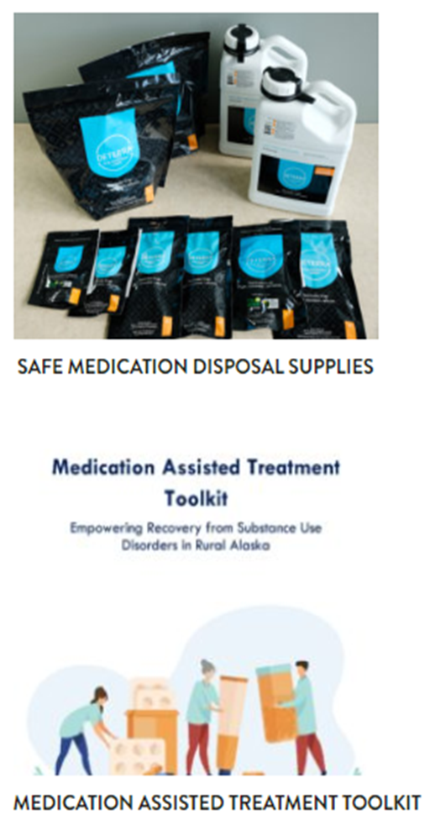
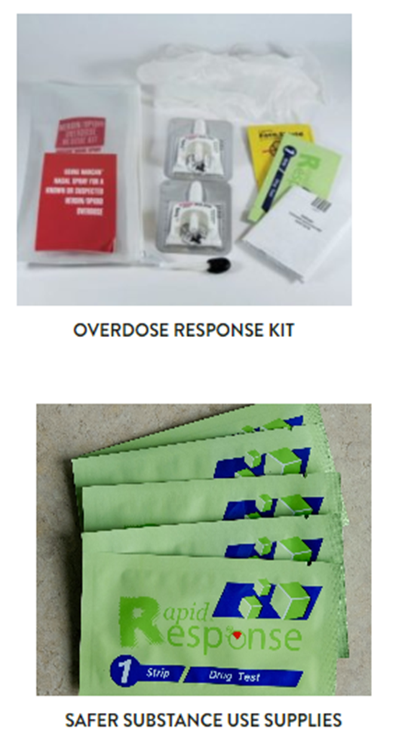
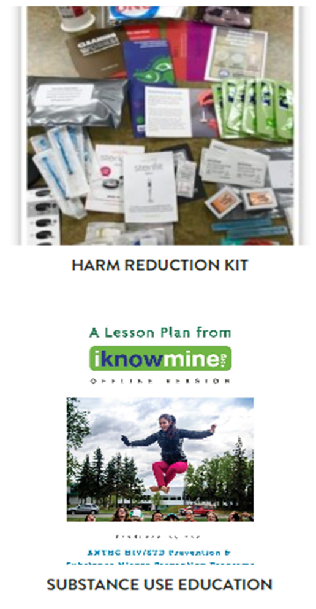
Safer Substance Use
Click for more supplies!
Posters
Brochures
DVDs
Safer Injection
Fentanyl & Xylazine Test strips
And more!
Notes:
Hannah
The second section is Safer Substance Use supplies. This is where you’ll find the safer injection/harm reduction kits, bags to dispose of unused or unwanted medications, naloxone kits, fentanyl and xylazine testing strips and more.

Slide 20
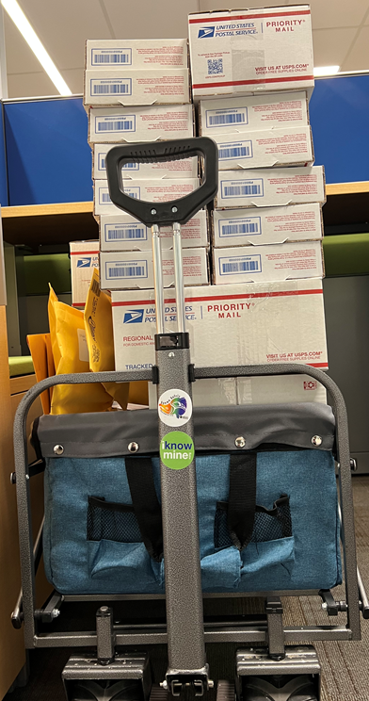
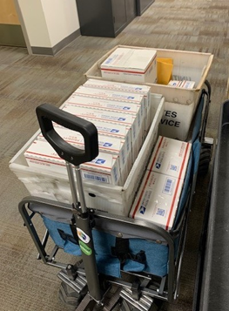
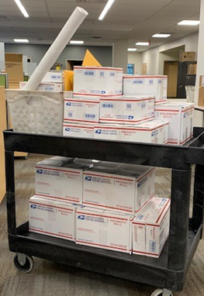
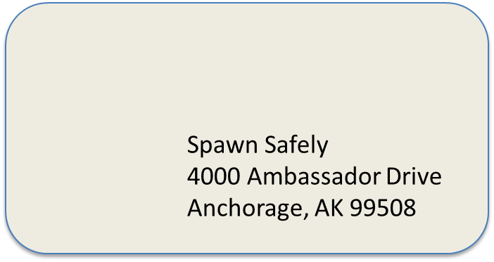
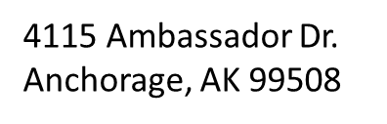
Mail-outs
Packages shipped out within 1 week
Mail is discreet
Trainings provided if needed
Notes:
Hannah
Mail sent out from iKnowMine staff is sent priority so that they’ll arrive within a week. Mail is also sent out discreetly, where the packages themselves do not indicate the contents. The photos here are real-life examples of some mail-outs that we’ve done in the past.
The return label is a generic ANTHC address. So if someone were to look at it, there’s no way to truly know that it’s from the HIV/STD prevention program. And if the package is unclaimed, it gets sent right back to our staff.
If someone else were to open the package, whether for USPS inspection or someone at home, there’s a card inside with contact information and it says that if they think it was mistakenly sent to them to contact us. So it gives clients an out if for example a parent were to open their package and there’s condoms inside.
If there are any trainings required, we’ll make sure that there’s an accessible way to get them. For example - to receive naloxone kits it’s a requirement from the state to receive a training on opioid recognition and response. So we have an online training that does that that everyone who orders a kit has to complete in order to receive a kit.

Slide 21

iKnowMine.org
4115 Ambassador Drive
Anchorage, Alaska
www.iKnowMine.org
iKnowMine@anthc.org
Statewide Harm Reduction Technical Assistance
Trainings, presentations and outreach
Free resources for community distribution
Link clients to local HIV and STI testing options
Technical assistance for community outreach or resource finding
Notes:
Hannah
ANTHC Wellness and Prevention Program: https://anthc.org/what-we-do/wellness/
iKnowMine.org: www.iknowmine.org
----------------------

Slide 22
What Does Harm Reduction Accomplish?
Connect individuals to overdose education, counseling, and referral to treatment for infectious diseases and substance use disorders.
Distribute opioid overdose reversal medications (e.g., naloxone) to individuals at risk of overdose, or to those who are likely to respond to an overdose.
Lessen harms associated with drug use and related behaviors that increase the risk of infectious diseases, including HIV, viral hepatitis, and bacterial and fungal infections.
Reduce infectious disease transmission among people who use drugs (including those who inject drugs) by equipping them with sterile supplies, accurate information and facilitating referrals to resources.
Reduce overdose deaths, promote linkages to care, facilitate co-location of services as part of a comprehensive, integrated approach.
Reduce stigma associated with substance use and co-occurring disorders.
Promote a philosophy of hope and healing ― by employing people with living and lived experience in leadership and in the planning, implementation, and evaluation of services. People with lived experience can also model for their peers what meaningful change can look like in their lives.
Build community and increase protective factors ― for people who use drugs and their families.
-Substance Abuse and Mental Health Services Administration (SAMHSA)

Slide 23
References
What is harm reduction?. Johns Hopkins Bloomberg School of Public Health. (n.d.). https://publichealth.jhu.edu/2022/what-is-harm-reduction
Harm reduction. SAMHSA. (n.d.). https://www.samhsa.gov/find-help/harm-reduction

Slide 24
Contact Information
Maya Bowers- Interior AIDS Association
Fairbanks, Alaska
907-452-4222 Ext. 116
maya@interioraids.org
Venus Staten - Alaskan AIDS Assistance Association
Juneau* Wasilla* Anchorage, Alaska
907-263-2050
vstaten@alaskanaids.org
ANTHC - iKnowMine
Anchorage, Alaska
907-729-3970
iKnowMine@anthc.org

