Slide 1


Vaccinations and Pregnancy
Prevention, Education, and Outreach for Indigenous Communities
Indian Country Care and Access for Pregnant People ECHO Virtual Clinic August 27, 2024
LCDR Abby Petrulis, PharmD, MS, BCPS
Clinical Pharmacist, Chair of Pharmacists Expanding Vaccine Access Workgroup

Slide 2
Disclosures
Abby Petrulis has no relevant financial relationship(s) with ineligible companies to disclose.
This presentation does not reflect the view of the United States federal government, the Indian Health Service or the United States Public Health Service.

Slide 3

Planning for Pregnancy
Discussions with women of childbearing age – even if not currently planning for pregnancy
Titers!
  Measles, Mumps, Rubella
  Varicella
  Hepatitis B
HPV
Tdap/Td
  At 10 yr intervals
Pneumococcal disease

Slide 4

Necessary Intrapartum Vaccinations
Always:
  Tdap (each pregnancy, 27-36 weeks)
  Hepatitis B (IF non-immune), Engerix-B only approved product
Seasonal
  RSV
    32-36 weeks, between the months of September-June
    If not administered or out of range, baby should get nirsevimab
    Current recommendation – once per lifetime, not pregnancy – though expecting this to potentially change
  Influenza – annually regardless of pregnancy status
  COVID-19 – annually regardless of pregnancy status

Slide 5
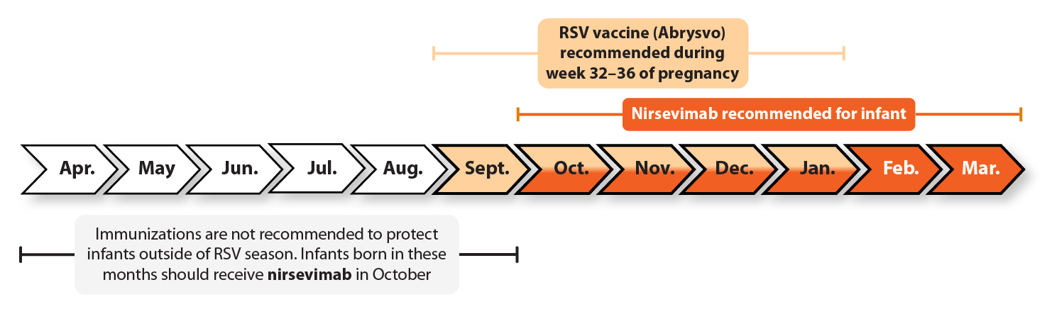
Seasonality of RSV vaccine
**AI/AN children may receive nirsevimab for both their first and second RSV seasons, classified in high risk criteria

Slide 6
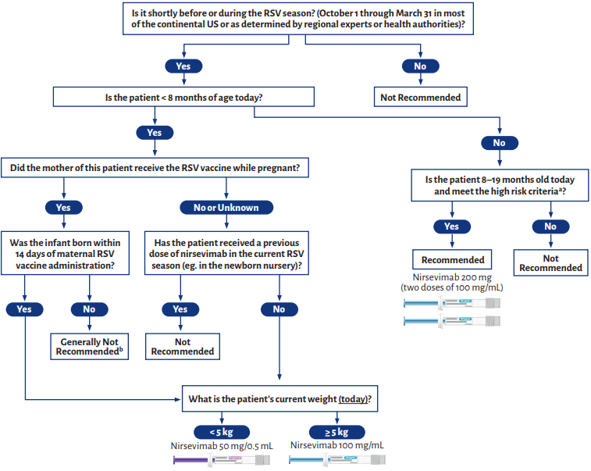

Nirsevimab Administration Visual Guide
one dose in each thigh
Reference: 2023-2024 AAP Nirsevimab Administration Visual Guide. Archived, previously available at: https://downloads.aap.org/AAP/PDF/Nirsevemab-Visual-Guide.pdf

Slide 7

Allowable Intrapartum Vaccinations
Not routinely recommended, but permitted if patient is at risk:
Hepatitis A
  Local outbreak – can also be used as post-exposure prophylaxis
Haemophilus influenzae type b
  Asplenia
Meningitis ACWY, Meningitis B
  Asplenia
  Congregate living such as dorms

Slide 8
What if…
My patient inadvertently receives these vaccines during pregnancy?
  HPV
  MMR
  Varicella
  Zoster
  Non-approved HBV (Heplisav, Pre-Hevbrio)
Reporting: I-STAR, Pregnancy Registry for individual product
However, generally considered not a hazard to the pregnancy and we do not need to do pregnancy tests prior to administration of these vaccines

Slide 9
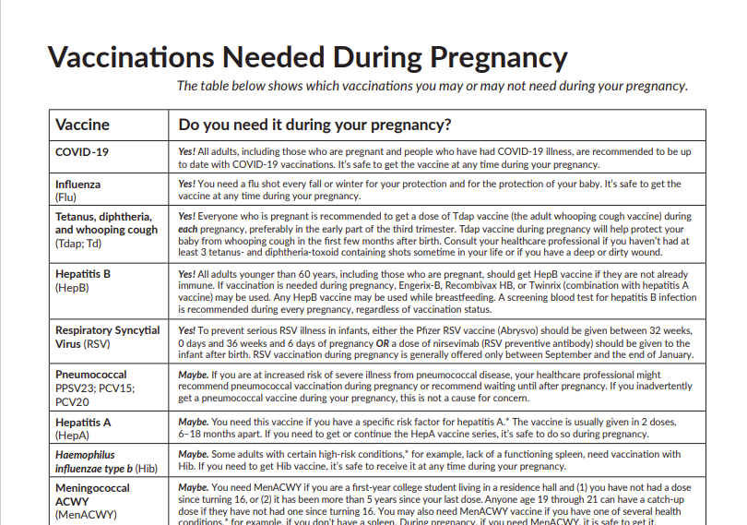
Resources
Vaccinations Needed During Pregnancy (immunize.org)

Slide 10
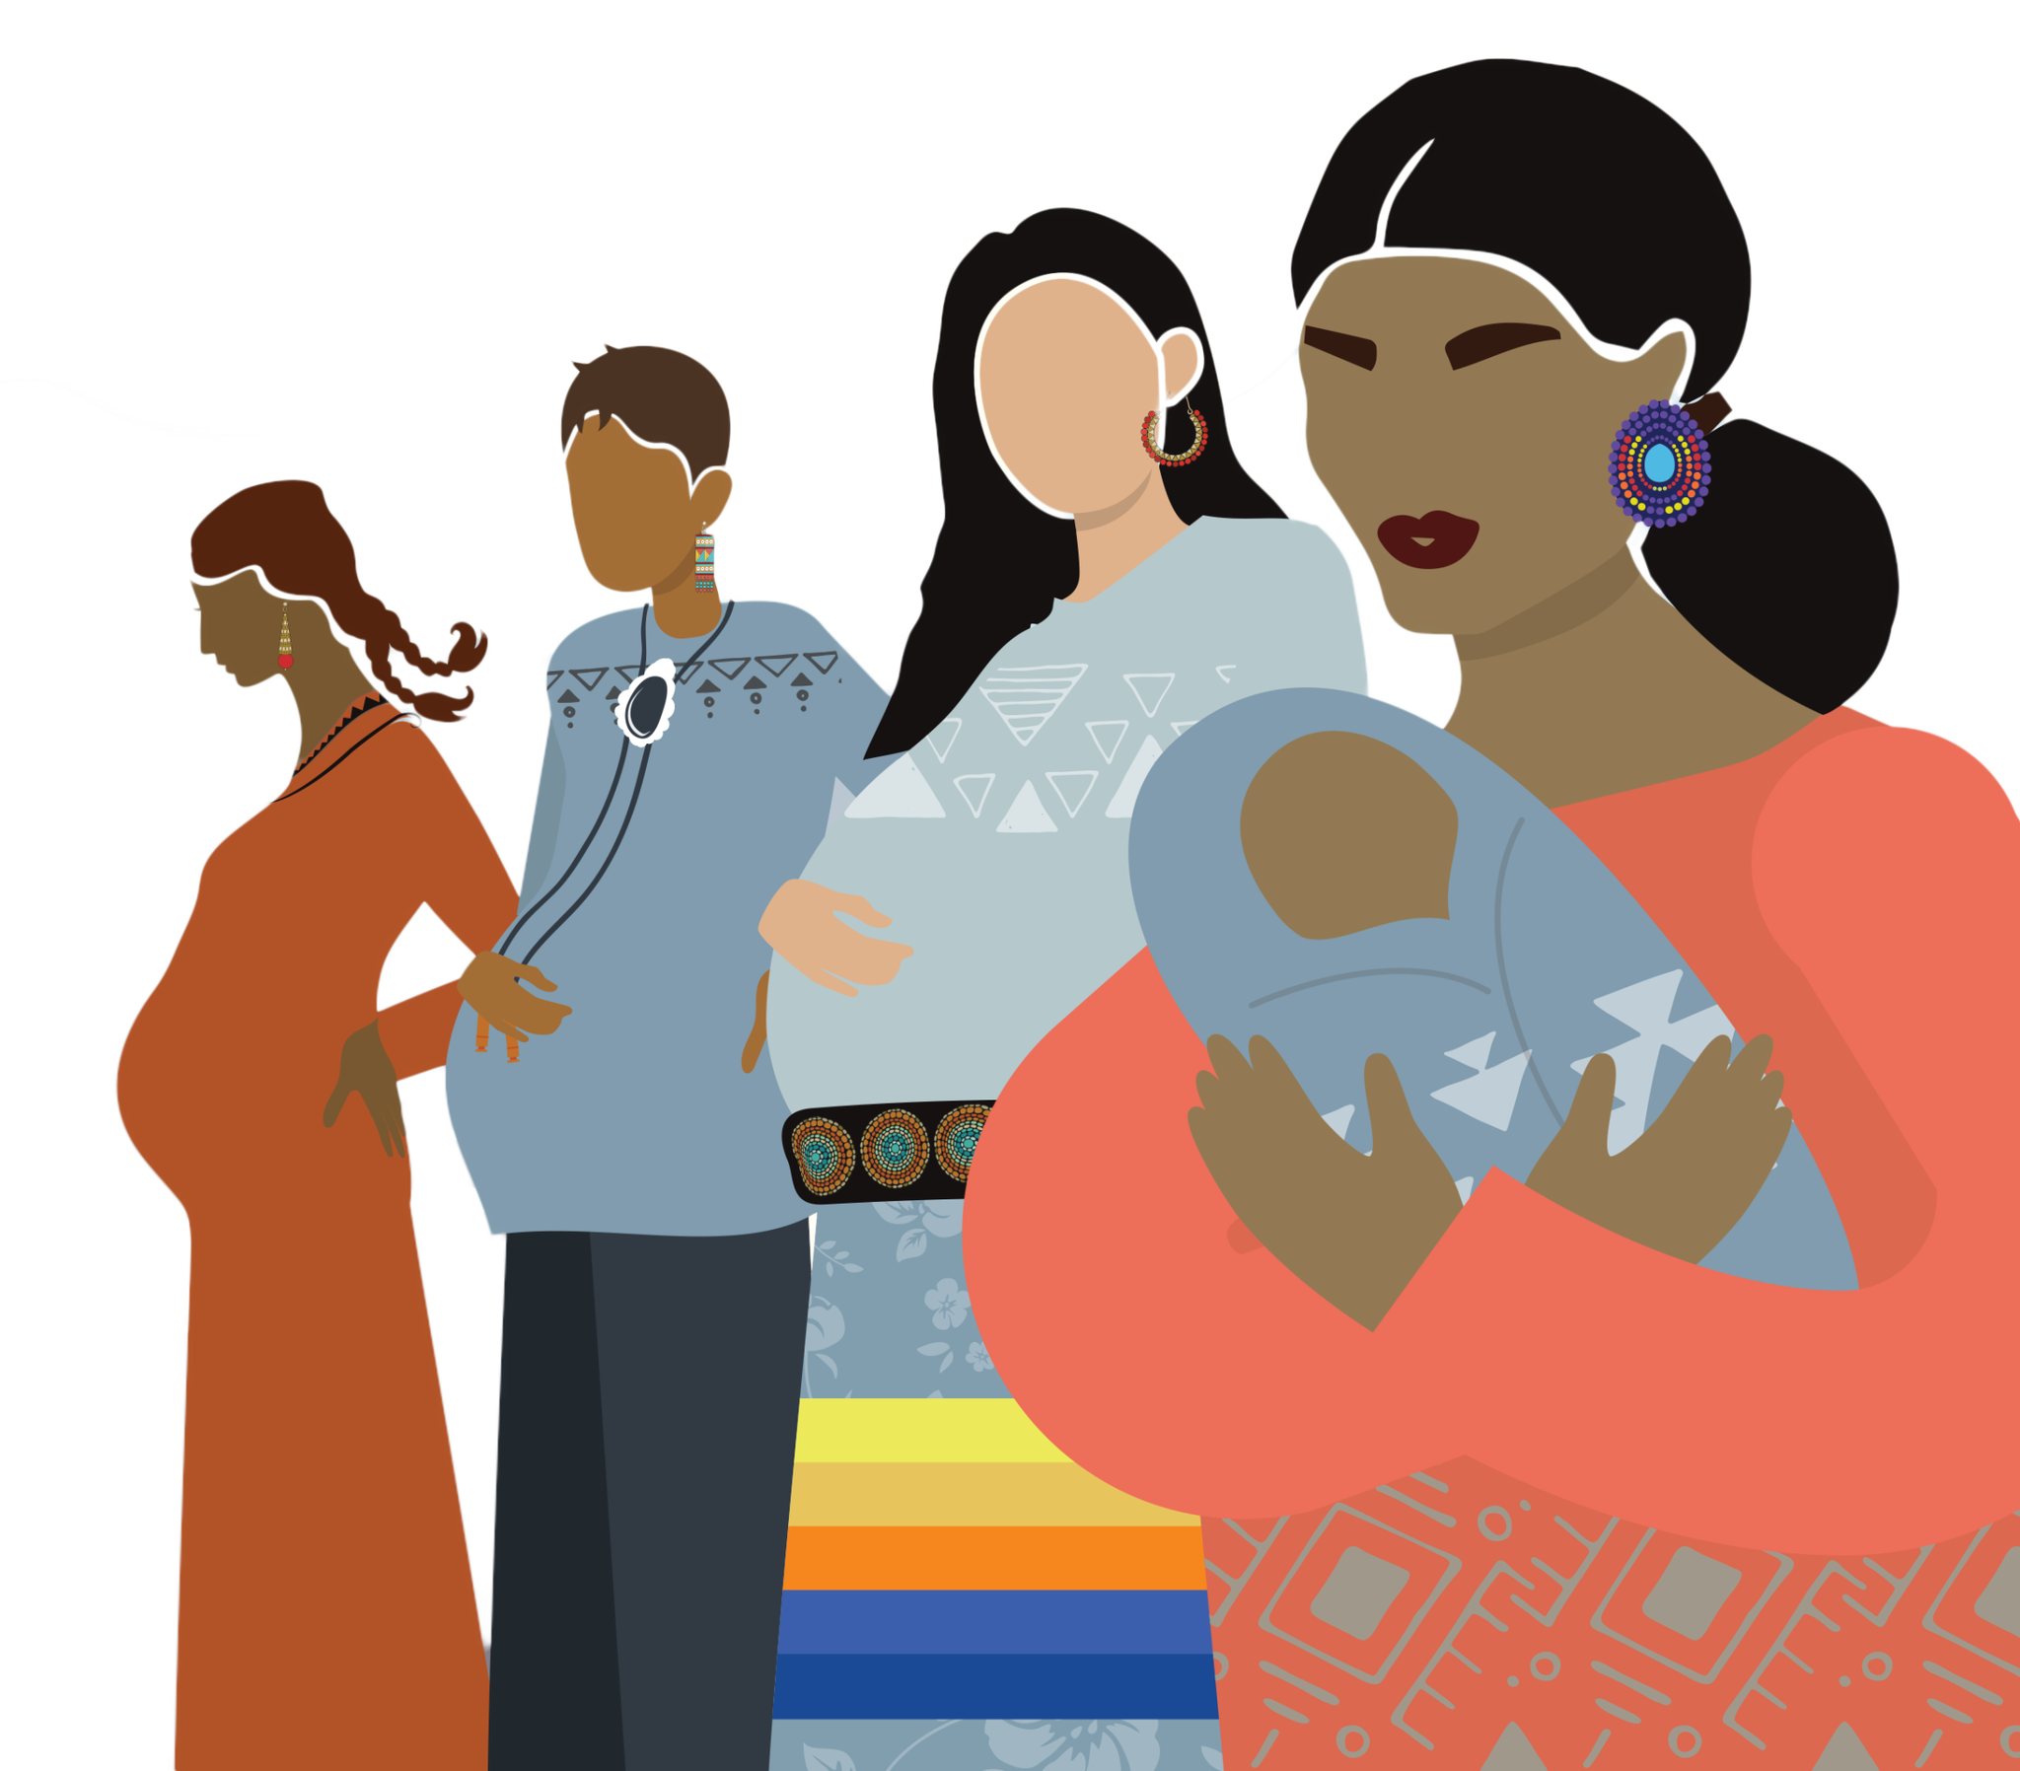
Postpartum and Family Vaccinations
  Tdap/Td – every 10 years
    If missed during pregnancy window 27-36 weeks, and last Td/Tdap within 10 years, would not administer postpartum – opportunity missed
  Influenza – annually regardless of pregnancy status
  COVID-19 – annually regardless of pregnancy status
  Generally breastfeeding is not a concern for vaccinations

Slide 11
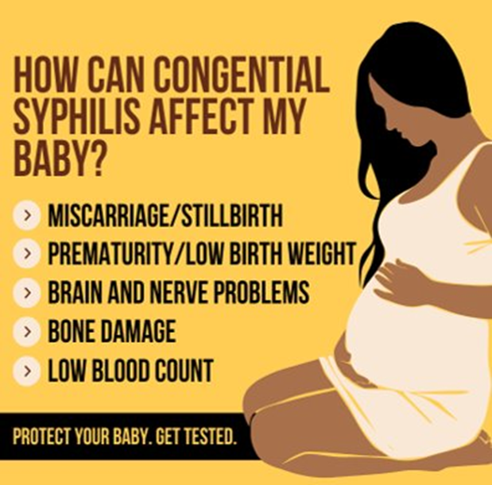
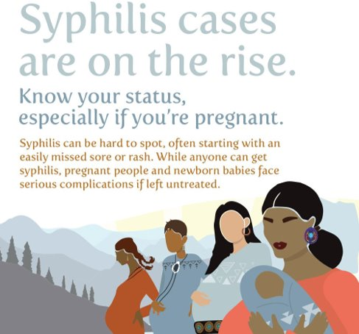
Additional public health screenings

Slide 12
Discussion
1. What projects are you planning to focus on this fall for vaccines?
2. How is your practice currently documenting prenatal visits?
3. What vaccines are your communities most open to receiving during pregnancy?
4. What vaccines do you find as the most challenging for acceptance during pregnancy?

Slide 13
Workflow Suggestions
  Add vaccine education to new pregnancy folders
  Resources for clinic based on visit timing
    12 wk, 16 wk, etc
    Pre-pregnancy and contraceptive visits
  Train triaging staff/nursing on immunization
  If vaccines are declined, “what specifically concerns you about these vaccines?” can open up discussion about vaccine while still maintaining trust

Slide 14
Documentation Suggestions
Immunization forecaster will work for pre-pregnancy vaccines, but not intrapartum
Reminder dialogs (“alarm clock”) also not likely
Add into note templates for standardized visits
If using one template for all visits regardless of week, add header on vaccines that separates out by recommendation.
Could also be added to pre-pregnancy visits
Immunization Review: Stage of pregnancy
Planning for Pregnancy
Third trimester
Tdap
Seasonal RSV, COVID, flu
First and Second trimester
Hep B, status of MMR titers, syphilis (?)

Slide 15
Thank you! abigail.petrulis@ihs.gov
Indian Country Care and Access for Pregnant People ECHO Virtual Clinic August 27, 2024
LCDR Abby Petrulis, PharmD, MS, BCPS
Clinical Pharmacist, Chair of Pharmacists Expanding Vaccine Access Workgroup

Slide 16
References and Resources
1. About Vaccines and Pregnancy | Pregnancy & Vaccines | CDC
2. Vaccine Safety for Moms-To-Be | Pregnancy & Vaccines | CDC
3. Pregnancy and Vaccines | Vaccine Safety | CDC
Clinical Resources: Pregnancy and Vaccines | Immunize.org

