Slide 1





Slide 2
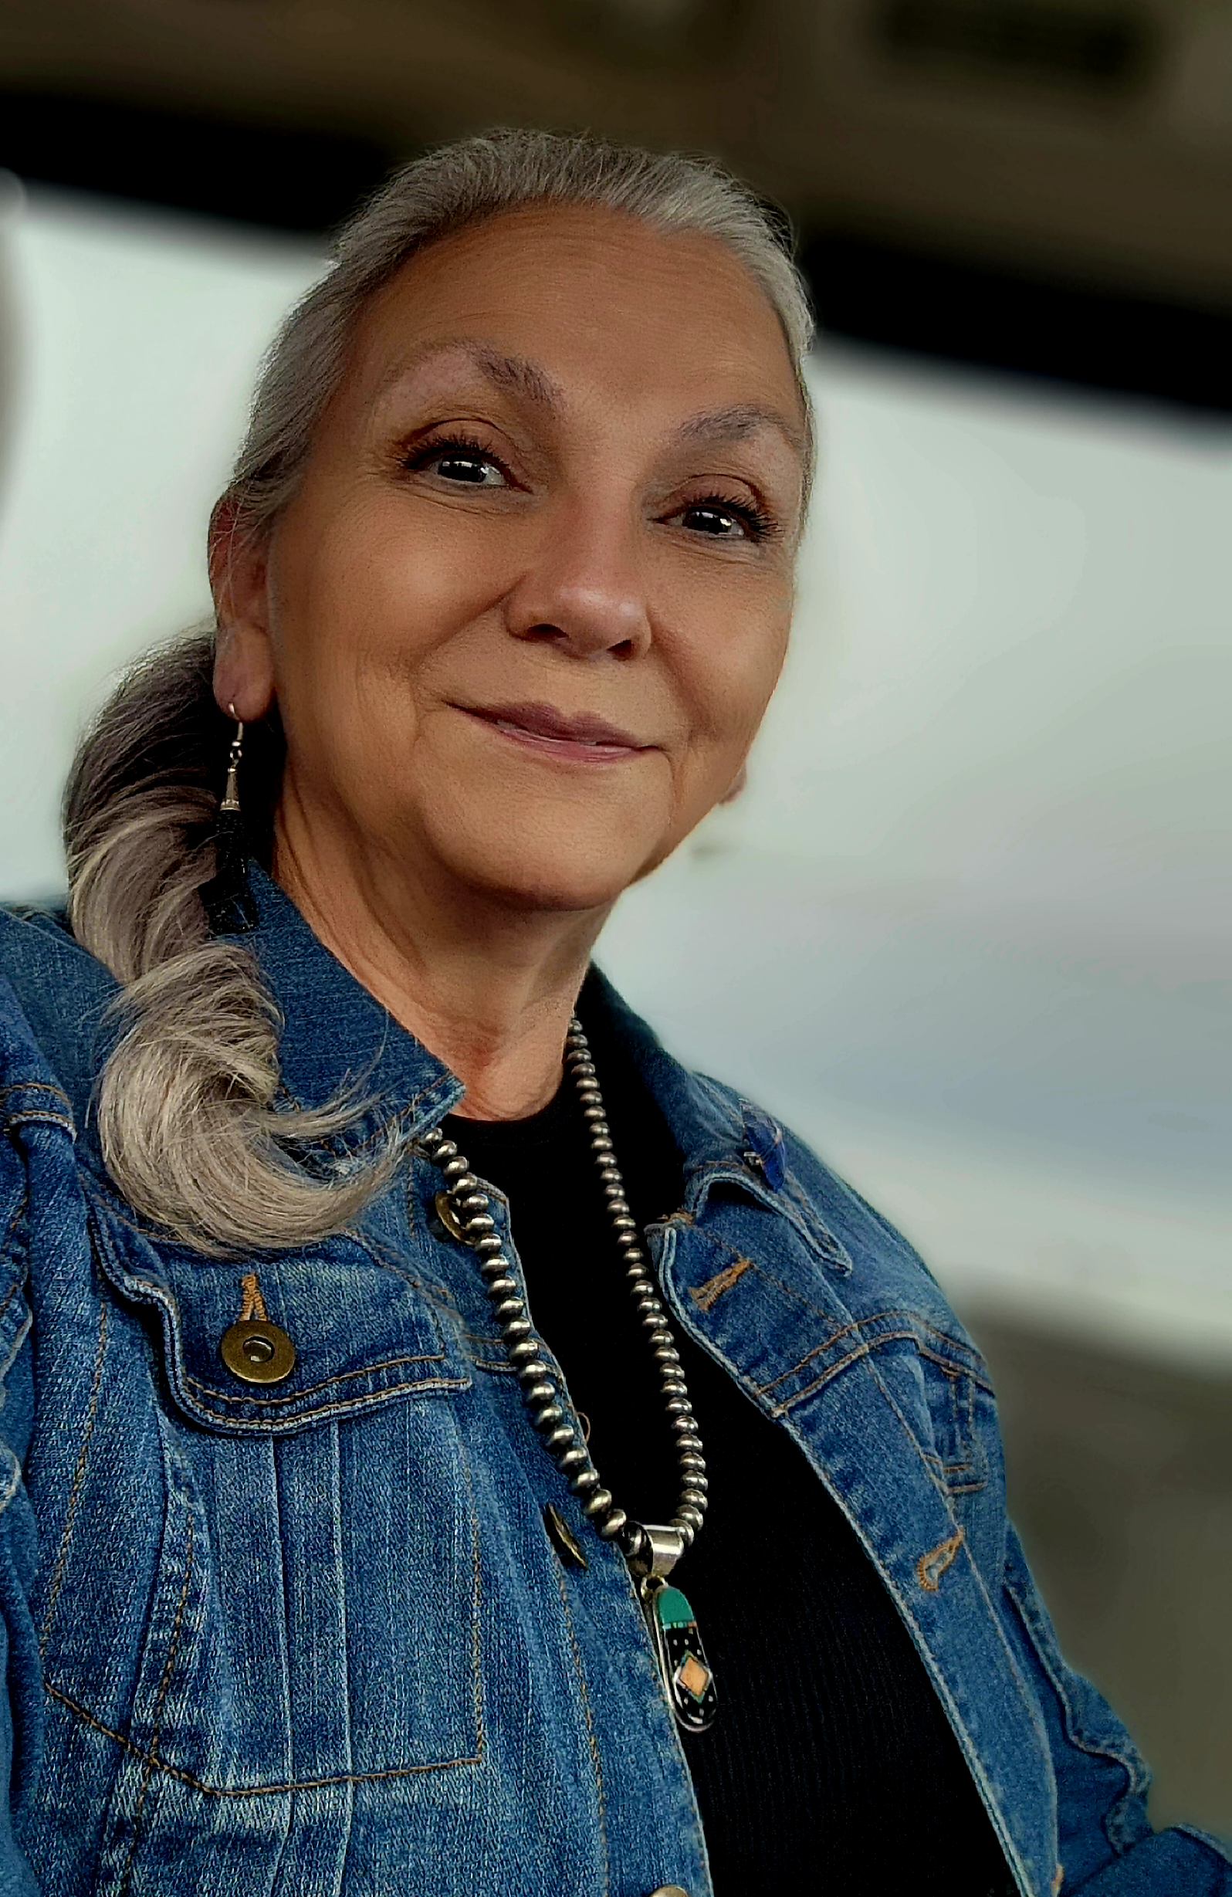
Pamela Aguilar, CHR/LPN
Indian Health Service
Headquarters CHR Program
pamela.aguilar@ihs.gov
405-365-0237

Slide 3


Slide 4
Objectives
Understand history and role of CHR
Describe services CHRs for patients
List services to provide on home visit
Explain importance of documentation
Understand basic time management
Know importance of self care

Slide 5

1968

Slide 6
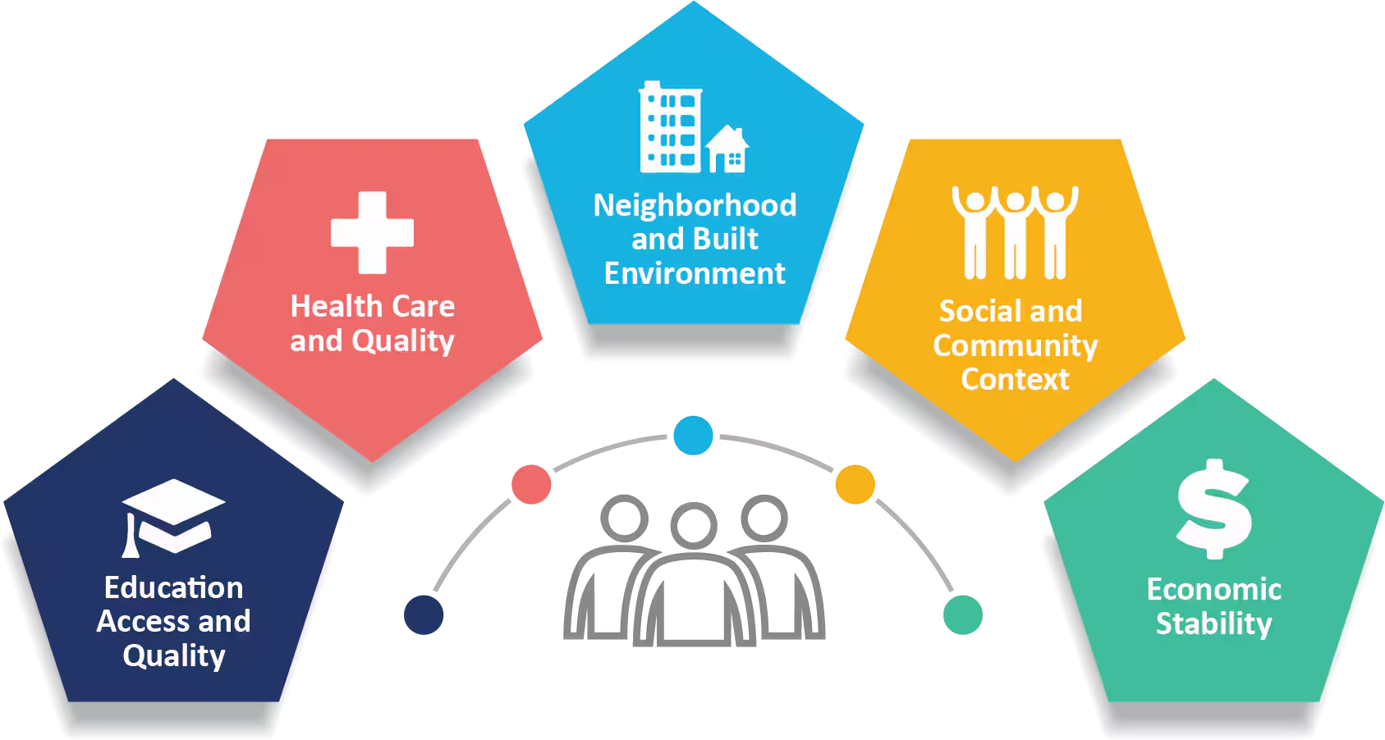
Social Determinates of Health

Slide 7
About CHR Programs
The CHR Program is based on the concept that indigenous community members, trained in the basic skills of health care provision, disease control, and prevention, are best able to gain community acceptance and make use of limited health care and socio-economic resources.

Slide 8
About CHR Programs
The CHR program’s aims to provide quality health promotion and disease prevention services to American Indian and Alaska Natives through the use of well-trained CHRs, who are integrated into and partner with the patient’s health care team.

Slide 9
Mission
Community Health Representatives provide outreach, education, informal counseling, social support, patient-centered care, and advocacy services that improve the health and wellness of American Indian and Alaska Native people.

Slide 10
Vision
Good health and wellness for all American Indian and Alaska Native individuals, families, and communities.

Slide 11
The CHR Strategic Plan details how the National CHR Program will achieve its vision by focusing on five priority areas:
1. Advocacy and Awareness
2. Partnerships
3. Sustainability
4. Workforce Strengthening
5. Data Systems

Slide 12
CHR Role
CHRs bridge the gap in communities they serve and encourage ownership and involvement of the patient in their health and well being
CHRs provide a crucial link between their communities and resources, such as health care and socio-economic issues

Slide 13
Define a Home Visit
Providing care and health services to patients and their families in their home. It allows the CHR to assess home environments and provide patient care, education and support.

Slide 14
Purpose of Home Visit
The purpose of home visits includes health promotion disease prevention, health education, and assessment

Slide 15
Patient Wellness Handout
Demographic information
Allergies
Meds/refills
Immunization needs
Additional services needed
Health goals

Slide 16
Personal Safety
Use internal warning system
Be mindful of surroundings
Keep in touch with office
Emergency numbers on speed dial
Set boundaries/limits
Recognize signs of substance abuse
Do not give out personal information
Use privacy settings on social media
Notes:
This is not intended to be an all encompassing training for personal safety, but some basic principals of safety. ASK SOMEONE TO READ

Slide 17
Home Visit Outline
Monitor patient (health and meds)
Emotional support
BP
Pulse
Resp
Health ed
Monitor environment for safety

Slide 18
CHR Patient Services
Monitor patient
Patient care
Health education
Environmental services
Case find/Screening
Case management
Interpret/translate
Home maker services
Emergency care
Transportation

Slide 19
Monitor Patient
Check on the patient to ensure proper health care is maintained and provided as needed.

Slide 20
Patient Care
Providing services directly to a patient

Slide 21
Vital Signs
BP
P
R

Slide 22
Health Education
Educating the pt on their health problems or prevention

Slide 23
Environmental Services
Assessing the home for variety of environmental services that are intended to prevent injury or disease.

Slide 24
Case find/screen
Screening is done to find, discover or detect.
Notes:
Conducting interviews/surveys to identify individual or household risk factors for disease, such as environmental health home safety surveys, socio-economic issues, etc.
• Discovering or locating a new patient.
• Having a first visit with a patient.

Slide 25
Case Management
For any activity that results in a patient obtaining services.
Notes:
Establishing the responsibilities of each person involved in the patient’s care.
• Serving as a patient advocate by arranging appointments, filing complaints for the patient, helping the patient to fill out forms or applications, planning for follow- up services. For example, therapy and otherwise helping with medical assistance benefits (Medicare/Medicaid) applications, assisting the patient in obtaining basic needs of living healthy.
• Arranging transportation by explaining bus schedules, or arranging for other means of transportation, except in cases of emergency transports (see Emergency Care).
• Obtaining or working with documents such as patient demographic information,
emergency contacts, list of medications, etc. that are related to managing the patient’s care. Arranging for traditional Tribal Ceremonial Services for a sick patient.
• Checking the condition of crutches, wheelchairs, eyeglasses, hearing aids, and other health equipment to ensure that they are properly working.
• Documenting referrals received or made by the CHR.

Slide 26
Referrals to or by CHR
Referrals provide a picture of how the CHR program coordinates with other community resources and uses available resources.

Slide 27
Interpret/Translate
Interpret, translate, or clarify information for the pt.
Explaining in layman’s terms or the preferred language of the patient to other health care providers and vice versa.

Slide 28
Homemaker Services
Assisting a patient with household duties. Not intended to be provided to pt long term.

Slide 29
Emergency Care
Providing emergency care services

Slide 30
Transportation
Transportation is provided to a patient for health-related services.

Slide 31
Time Management
Set weekly goals
Create a schedule
Prioritize task
Focus on one task at a time
Review your schedule at end of day
Notes:
Home visiting requires time management skills. Getting work done, meeting deadlines, and being productive 100% of the time is difficult for everyone. It’s even harder if you struggle with time management. Luckily, there are several ways you can improve your time management skills.
Set weekly goals
Write down everything you would like to accomplish. Review your list and prioritize what absolutely has to get done that week, such as a task with a looming deadline. Setting specific goals helps keep you motivated and will make you feel extra accomplished when you’ve achieved everything you set out to do. Create a daily schedule to organize visits
2. Create a schedule and Prioritize task
You may not follow your schedule exactly, as life can sometimes surprise you with how long a task will take. Regardless, a schedule is a great guideline for keeping you on track to reach your weekly goals.
3. Focus on one task at a time
It’s hard to get things done when you’re doing too many things at once. As you cross things off your to-do list, keep your mind focused on the task at hand. Shut out thoughts about your other responsibilities, and avoid going back and forth between unrelated duties. It’s much more efficient to tackle one responsibility at a time
4. Review your schedule at end of day
take note of what you completed as well as what still needs to get done. Cross off the tasks you finished and make a new to-do list for the next day, starting with what you didn’t accomplish. Making time for this extra step each night helps you celebrate what you achieved while keeping your goals for the next day in mind. It can also help you get a better idea of what tasks take the most time.

Slide 32
Time Management
Make a schedule base on:
  Assigned area/ pts prevent duplication of services
  Pt needs
  Clustering

Slide 33
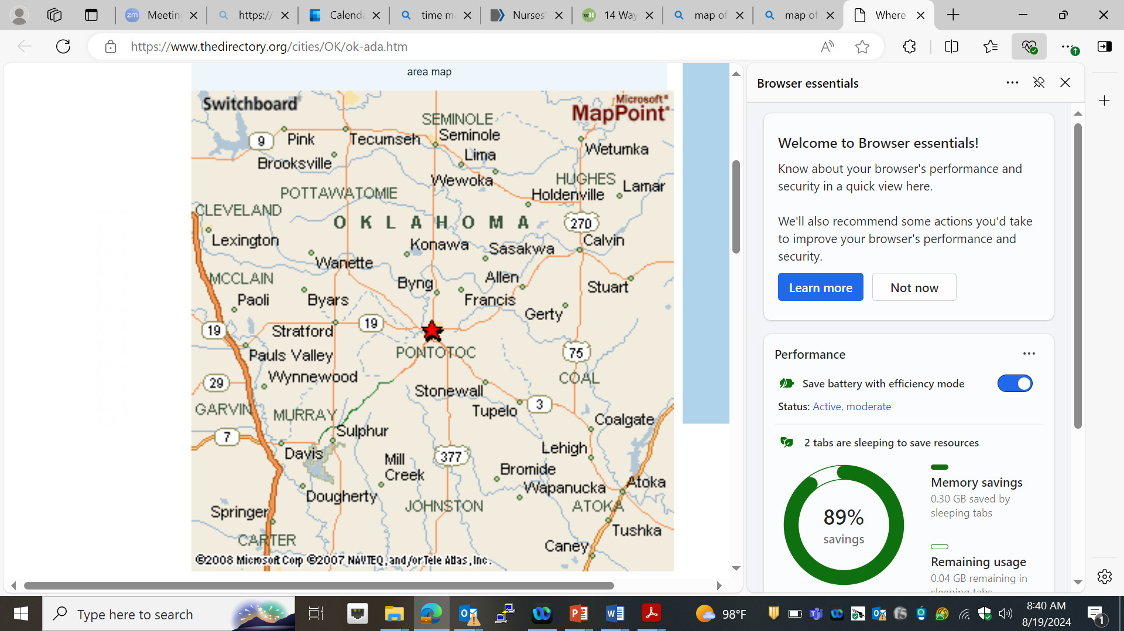
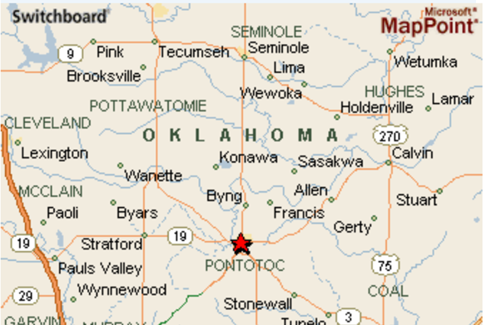

Slide 34
Time Management
Be prepared
  Check PWH
  Bring equipment
  Documentation
  Health education
Time spent during visit
  1. Quantity of time vs Quality

Slide 35
Patient Care vs Paper Work
Balance
Budget
Legal document
Complete during/after visit
Accuracy
Not documented- didn’t happen

Slide 36
Documentation
Document during visit or immediately after instead of taking notes then transferring to CHR PCC at later time.

Slide 37

Busy as a bee!

Slide 38
Self Care
“It refers to anything that you do to keep yourself healthy – physically, mentally, and spiritually.
If you don’t practice self-care regularly, you’re risking your well-being and inviting burnout.” Dr. Matt Glowiak

Slide 39
Self Care
Eat healthy
Exercise
Take breaks/lunch
Set boundaries
Learn to say no
Get a hobby
Make time to relax
Cultural activities

Slide 40
Self Care
“It means giving ourselves the same grace, compassion and care that we give to others.” Kristen Suleman
“Caring for myself is not self-indulgence it is self-preservation.” Audre Lorde

Slide 41
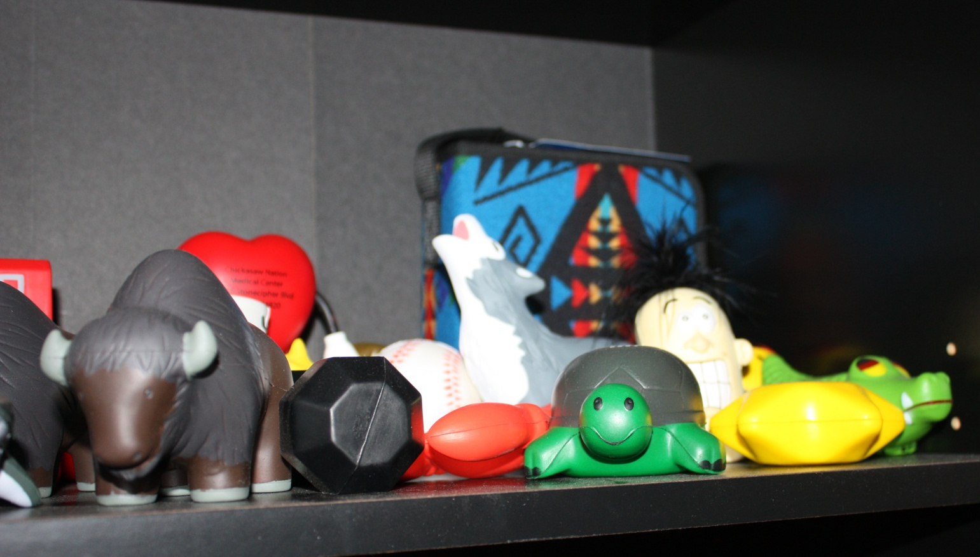
Stress Ball Collection

Slide 42
Summary
Prepare for visits
Make a schedule
Don’t duplicate services
Know your pts needs
Cluster your visits
Have required equipment, forms, applications, health education
Make a schedule
Know patient
Logistics
Have equipment/documents etc.

Slide 43
Summary
Provide minimum of 7 services
Monitor patient
Provide emotional support
Take BP
Take P
Take R
Provide health education
Monitor environment for safety

Slide 44
Summary
Provide additional services if needed
Case management/referrals
Case find/ Screen
Interpret/translate
Home maker services
Emergency care
Transport

Slide 45
Summary
Time management plays a major role in successful home visits
Self care is important

Slide 46
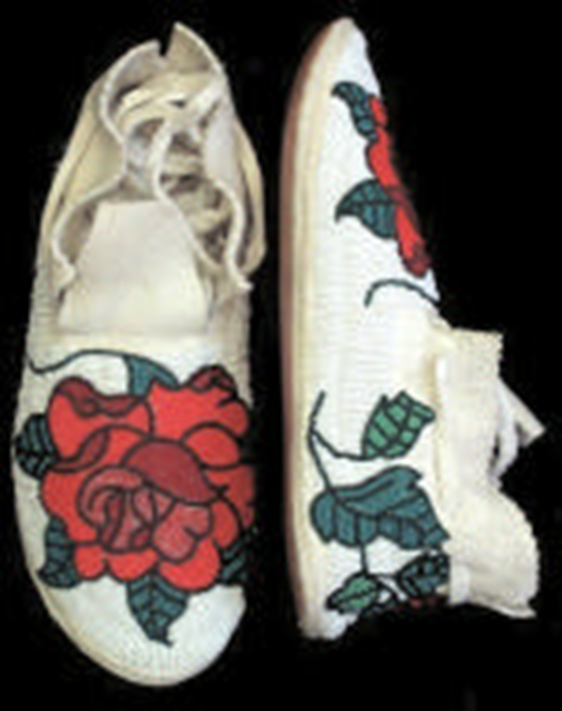
Walk a mile in our shoes

Slide 47

CHRs keep going and going and going…
Notes:
.

Slide 48
CHR
Committed to helping Tribal community members reach the highest attainable standard of health by addressing physical, mental, social, environmental and spiritual health through advocacy and education.
Honor and respect the customs and traditions of Tribal communities to build purposeful relationships that promote cultural awareness and understanding and facilitate access to essential health and human services.
Relentless pursuit of excellence and self-improvement to increase skills and ability to provide quality health services and promote wellness in Tribal communities

Slide 49

Thank you!

