Slide 1

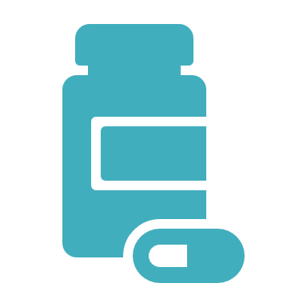
Treatment of Alcohol and Stimulant Use Disorders in Primary Care
Anchorage Syndemic Training, September 2024
Sarah Spencer DO, FASAM

Slide 2
Objectives
Describe 3 FDA approved medications to treat alcohol use disorder
Describe an evidence-based treatment for stimulant use disorder
Explain the utility of low-threshold, harm reduction based care in reducing morbidity and mortality in patients with SUDs

Slide 3
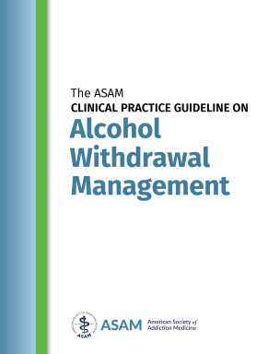
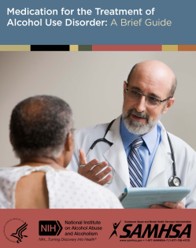
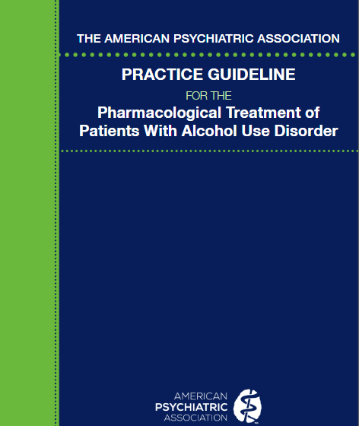
NATIONAL PRACTICE GUIDELINES

Slide 4
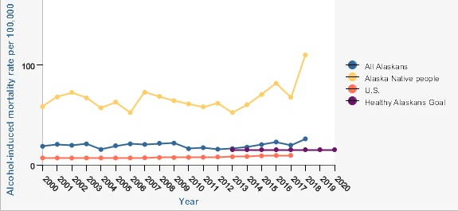
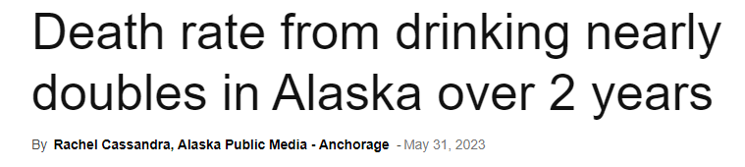
Alaska Native people at 110.3 per 100,000 had rates of alcohol-induced mortality that were 8 times higher than those experienced by non-Hispanic whites at 13.0 per 100,000 in 2018

Slide 5
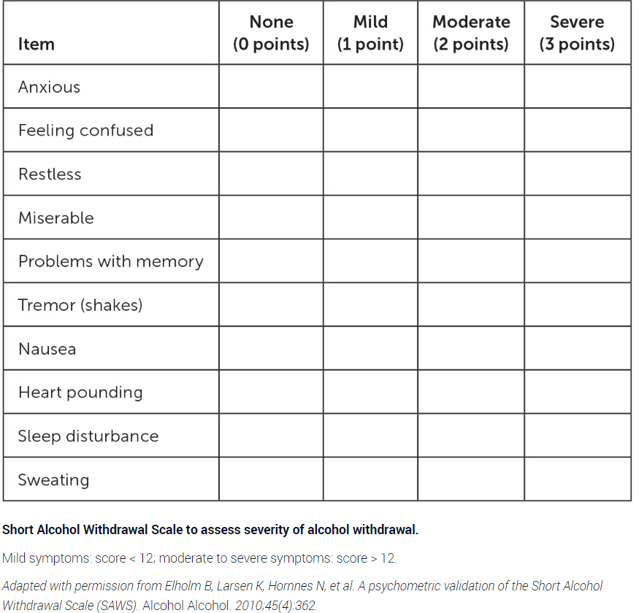
Short Alcohol Withdrawal Scale

Slide 6
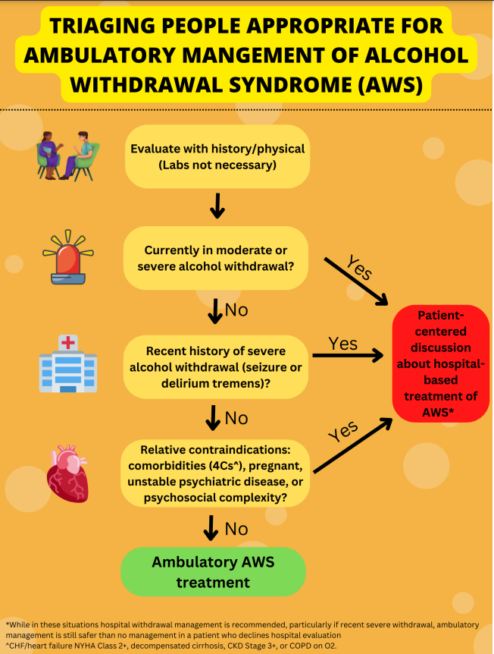
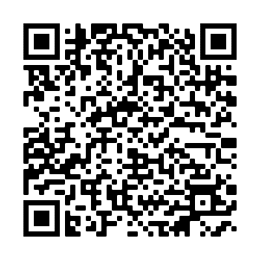
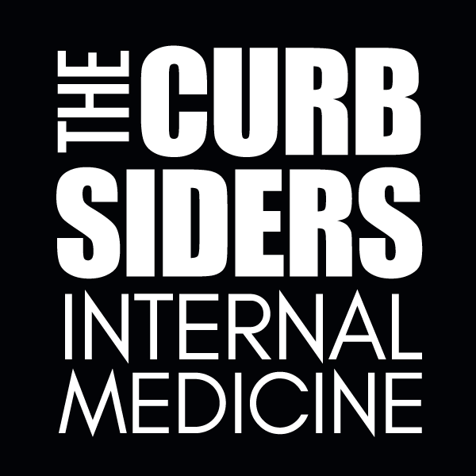
Harm Reduction Tip:
Some patients may decline to go to the hospital for AWS management, and for those certain individuals, it may be safer to trial supervised ambulatory withdrawal than receive no medical care at all.

Slide 7
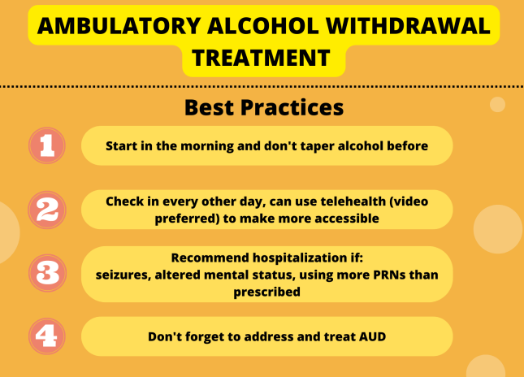

Slide 8
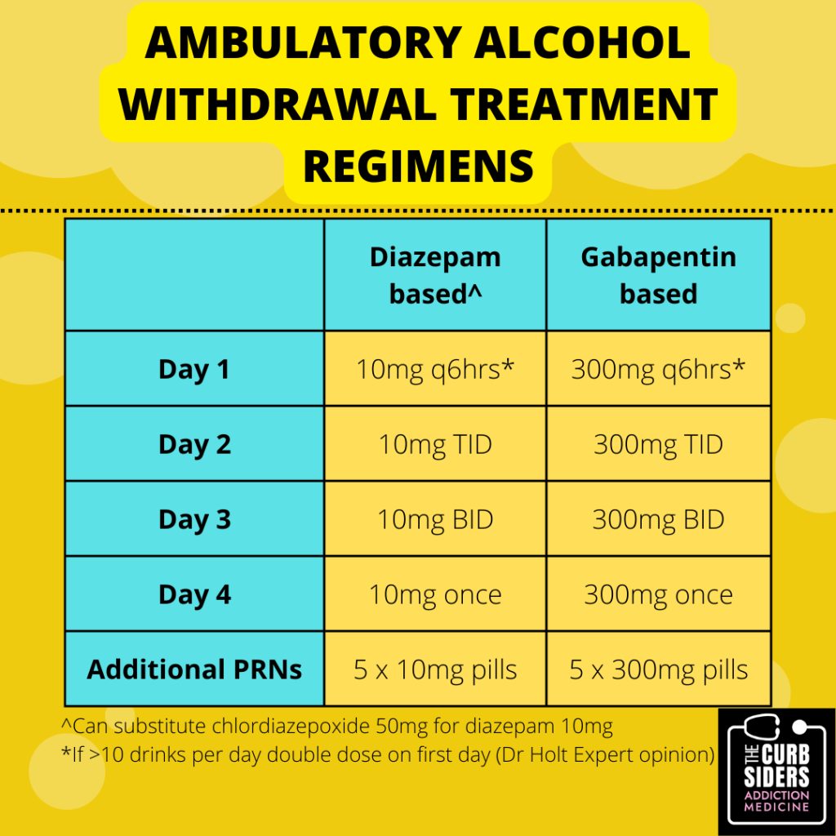
AMBULATORY ALCOHOL WITHDRAWAL REGIMENS
Amato, Cochrane 2010
Holbrook, CMAJ 1999
Mayo-Smith, JAMA 1997
Leung, Ann Pharmacother, 2015
Curbsiders Addiction Medicine, Episode 2
Notes:
SH
Carbamazepine fixed dose starting at 800 mg/day tapered over 4, 7, 9, or 12 days; symptom-triggered dosing (≤1200 mg/day)

Slide 9
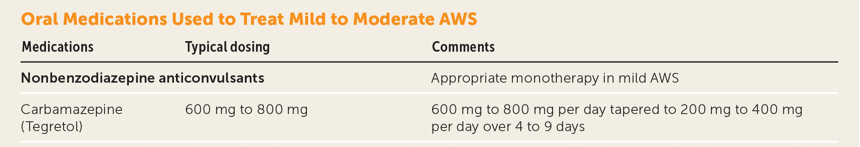
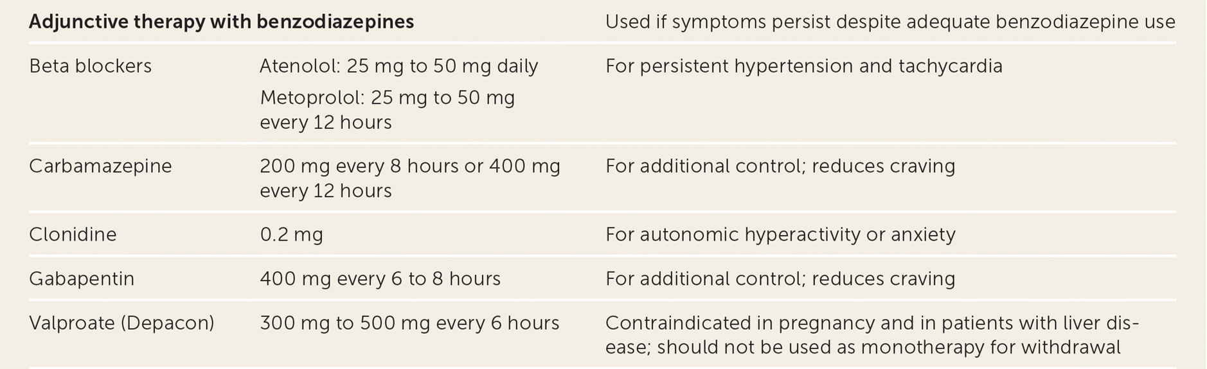
https://www.aafp.org/pubs/afp/issues/2021/0900/p253.html

Slide 10
Outpatient Phenobarbital
In a Level 2-WM ambulatory setting, phenobarbital monotherapy, managed by a clinician
experienced with its use, is appropriate for patients with a contraindication for benzodiazepine use who are experiencing moderate or severe alcohol withdrawal or who are at risk of developing severe or complicated alcohol withdrawal o complication of alcohol withdrawal. Discussion. There is disagreement in the literature regarding the appropriateness of phenobarbital in ambulatory settings, due to the risk of toxicity when used in combination with alcohol or in high doses. In general, phenobarbital should only be used by clinicians experienced with its use in settings that offer close monitoring. Phenobarbital may cause respiratory depression and over-sedation and its narrow therapeutic window makes it challenging to dose correctly compared to other medications used to treat alcohol withdrawal. As with benzodiazepines, effects on the central nervous system are exacerbated when other CNS depressants such as alcohol are also used.
The ASAM Clinical Practice Guideline on Alcohol Withdrawal Management

Slide 11
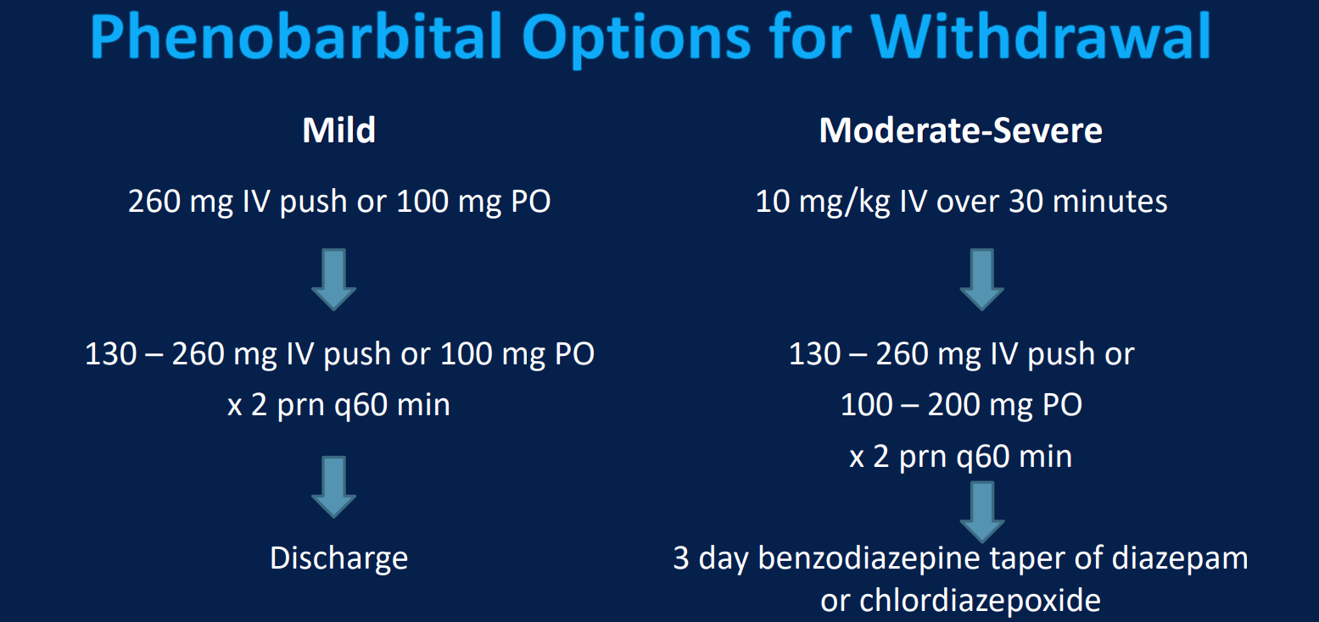
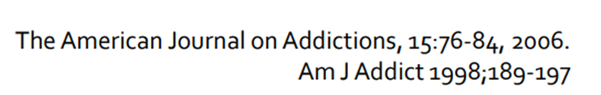
Mild: Oral Taper 60mg qid day1, 60 mg tid day 2, 60 mg bid day 3, 30 mg bid day 4

Slide 12
Medications for Alcohol Use Disorder (AUD) treatment
1st /2nd Line
Naltrexone or Acamprosate
3rd Line
Disulfiram
Off label /adjunctive
Gabapentin, Topiramate, Baclofen, Suvorexant, Ondansetron

Slide 13
Naltrexone
Mu receptor antagonist, interrupts the reward pathways in the brain
Dosing 50-100 mg po daily, or 380 mg IM monthly
Hold for LFT >5 times normal, OK in cirrhosis as long as compensated and no acute failure
Nausea is most common side effect (also watch for depression)
Off Label use: dosed prn prior to anticipated drinking episode

Slide 14
The utility of naltrexone is the ability of the drug to reduce cravings for alcohol and to result in a reduction in the amount of alcohol consumed per sitting.
Using naltrexone alone does not generally result in abstinence from alcohol
Naltrexone does not block the intoxicating effects of alcohol or cause unpleasant side effects when patients drink

Slide 15
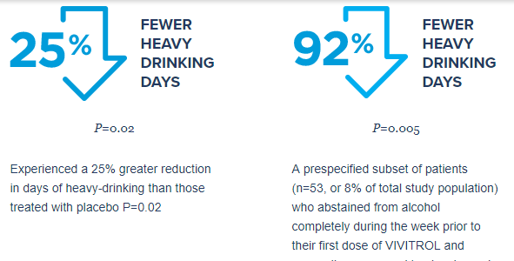
XR Naltrexone (Vivitrol)
0.2 heavy-drinking days on Naltrexone vs 2.5 heavy-drinking days on placebo
The same results were not seen in the subset of patients (n=571, or 92% of the total study population) who were actively drinking at the time of starting Rx

Slide 16
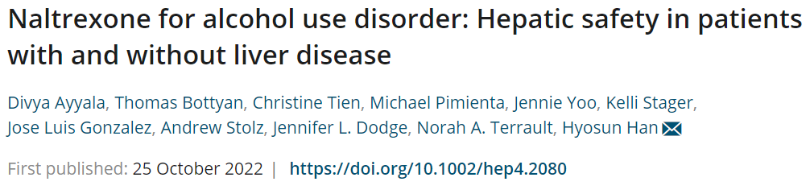
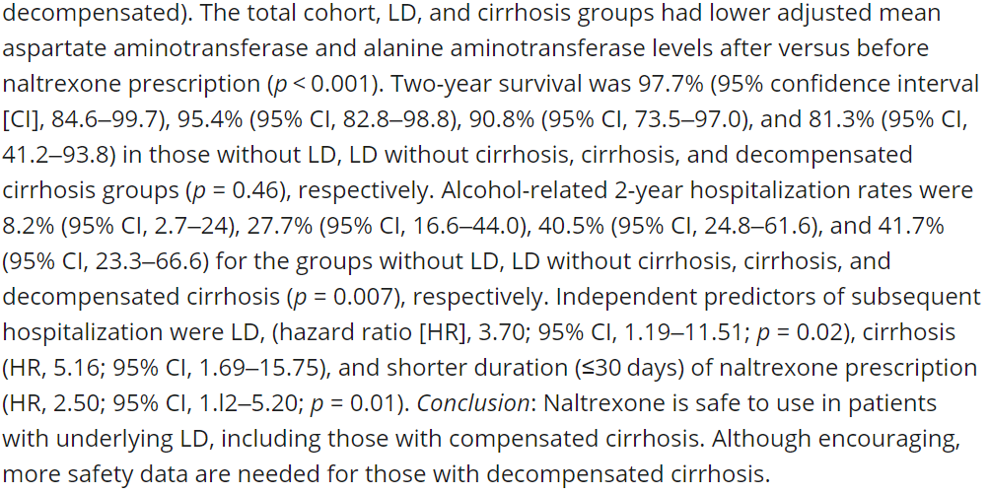
https://aasldpubs.onlinelibrary.wiley.com/doi/10.1002/hep4.2080
Naltrexone likely safe in compensated cirrhosis

Slide 17
ACAMPROSATE
Modulates overactive GABA activity that occurs with alcohol cessation (more effective if patient has stopped drinking)
May be particularly helpful in patients whose cravings are triggered by anxiety symptoms, can help with insomnia
Dose 333 mg 2 pills TID → compliance difficulties
Renal dosing: for CrCl 30-50 cut reduce dose by half
avoid in CrCl <30
Most common side effect is diarrhea (in early treatment)
No significant drug-drug interactions, safe in Liver Dz

Slide 18
Acamprosate was shown only to support abstinence; it did not influence alcohol consumption after the first drink. When the efficacy profiles of the two drugs were compared, acamprosate was found to be more effective in preventing a lapse, whereas naltrexone was better in preventing a lapse from becoming a relapse. (Rosner 2018)
Acamprosate had a significantly larger effect size than naltrexone on the maintenance of abstinence, and naltrexone had a larger effect size than acamprosate on the reduction of heavy drinking and craving. For naltrexone, requiring abstinence before the trial was associated with larger effect sizes for abstinence maintenance and reduced heavy drinking compared with placebo. For acamprosate, detoxification before medication administration was associated with better abstinence outcomes compared with placebo. (Maisel 2013)

Slide 19
DISULFIRAM
Enforces abstinence through accumulation in acetaldehyde inducing unpleasant side effects if alcohol is consumed (nausea, vomiting, flushing, tachycardia, hypertension)
Dose 250-500 mg po qd
Many drug-drug interactions (benzos, warfarin, metronidazole, rifampin)
Consider avoiding in patients with severe CAD/autonomic dysfunction and severe liver dz
Monitor for worsening neuropathy and liver dysfunction (rare)

Slide 20
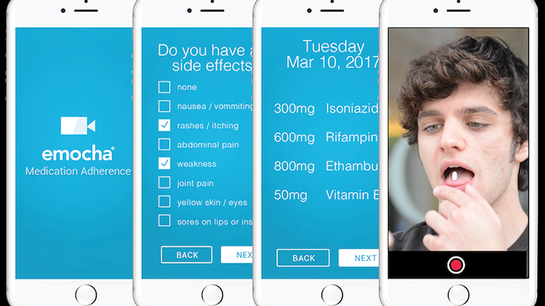
DISULFIRAM
Limited evidence for efficacy (poor compliance)
Establish plan for directly observed therapy (family member or App)
Monitor for signs of return to use

Slide 21
Off-Label MAT for AUD
Topiramate: GABA mediated neuronal inhibition, start at 25 mg/d, increase by 25-50 mg weekly to 300 mg/d,
Gabapentin: balances GABA/glutamate dysregulation, 600 mg tid, also for withdrawal management
Baclofen: GABA receptor antagonist, 5mg tid, titrate to 20 mg tid, preferred in cirrhosis
Ondansetron: serotonin receptor type 3 antagonist, 0.2 mg bid
Suvorexant: dual orexin receptor antagonist, for co-morbid AUD and insomnia

Slide 22
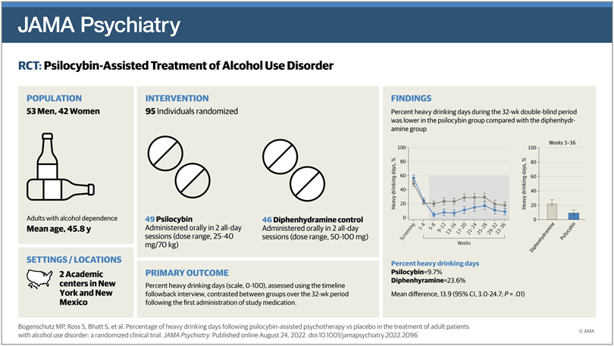

Slide 23
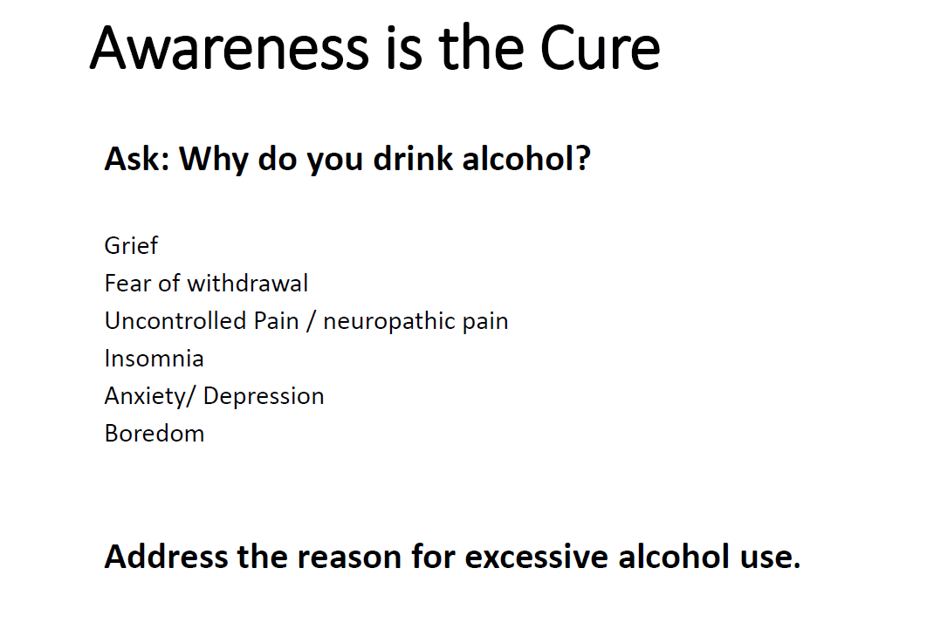

Slide 24
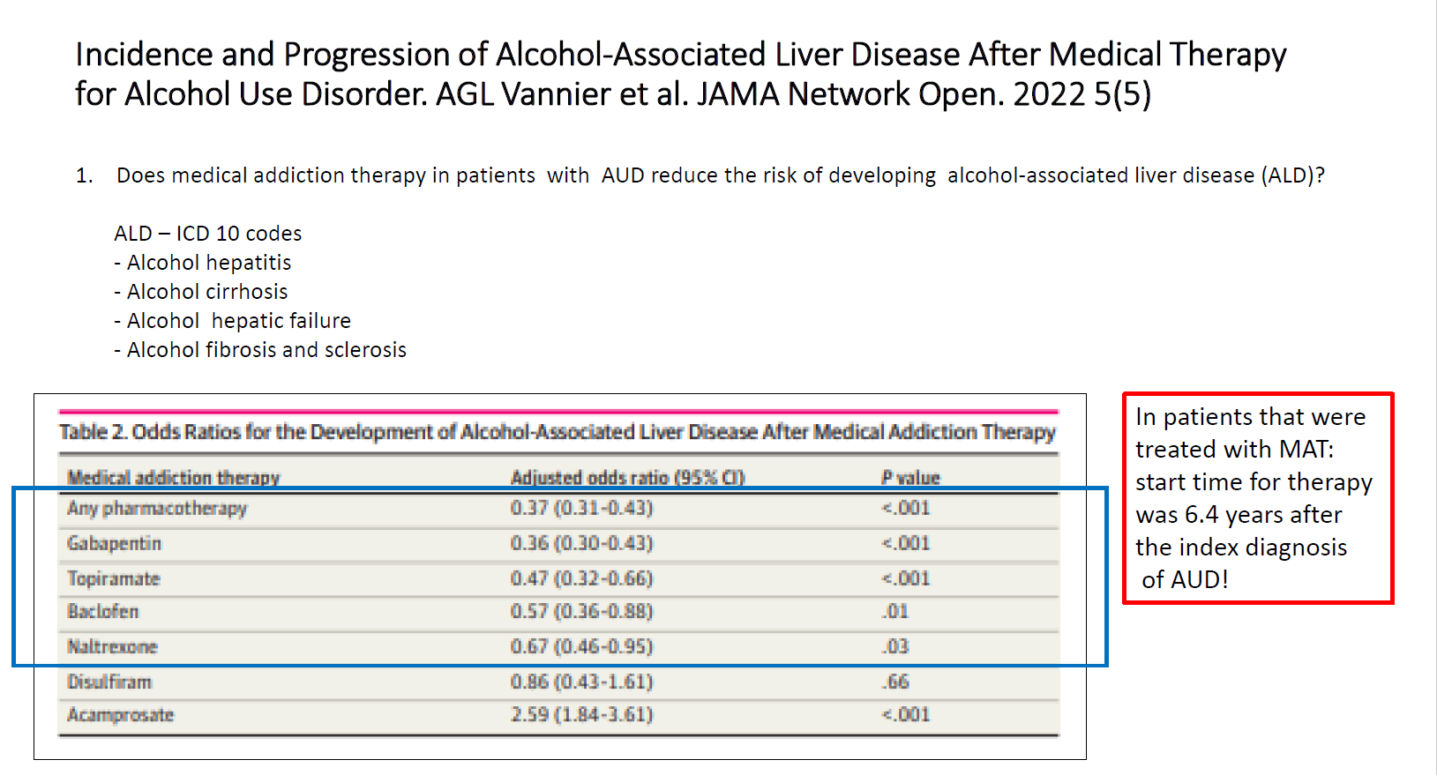
https://pubmed.ncbi.nlm.nih.gov/35594048/

Slide 25
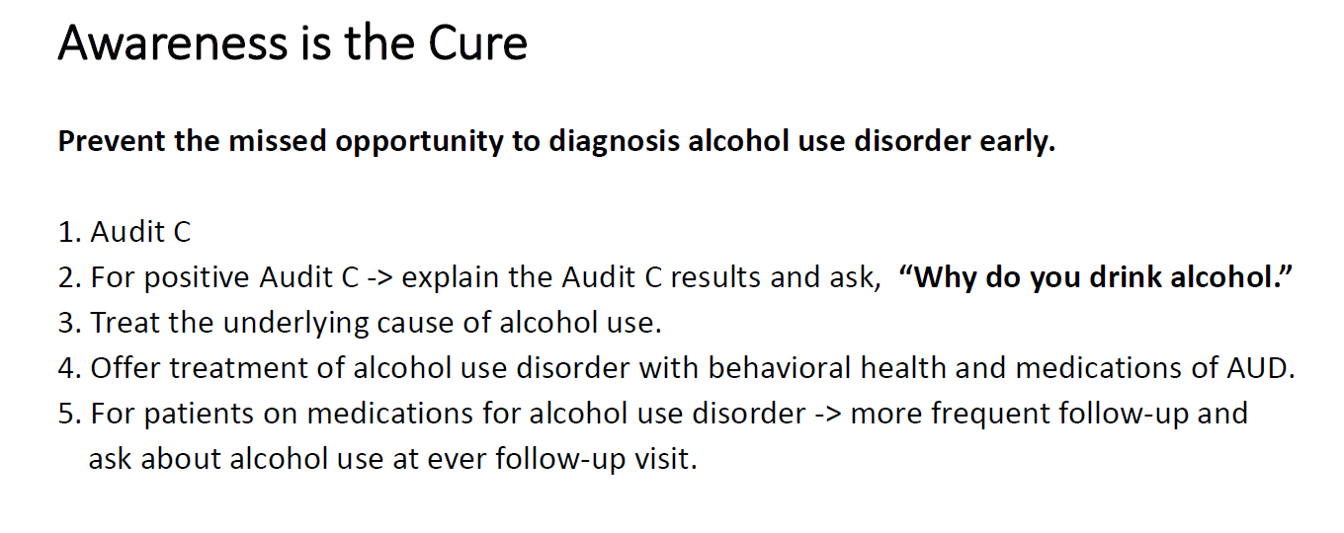

Slide 26
Stimulant Use Disorder

Slide 27
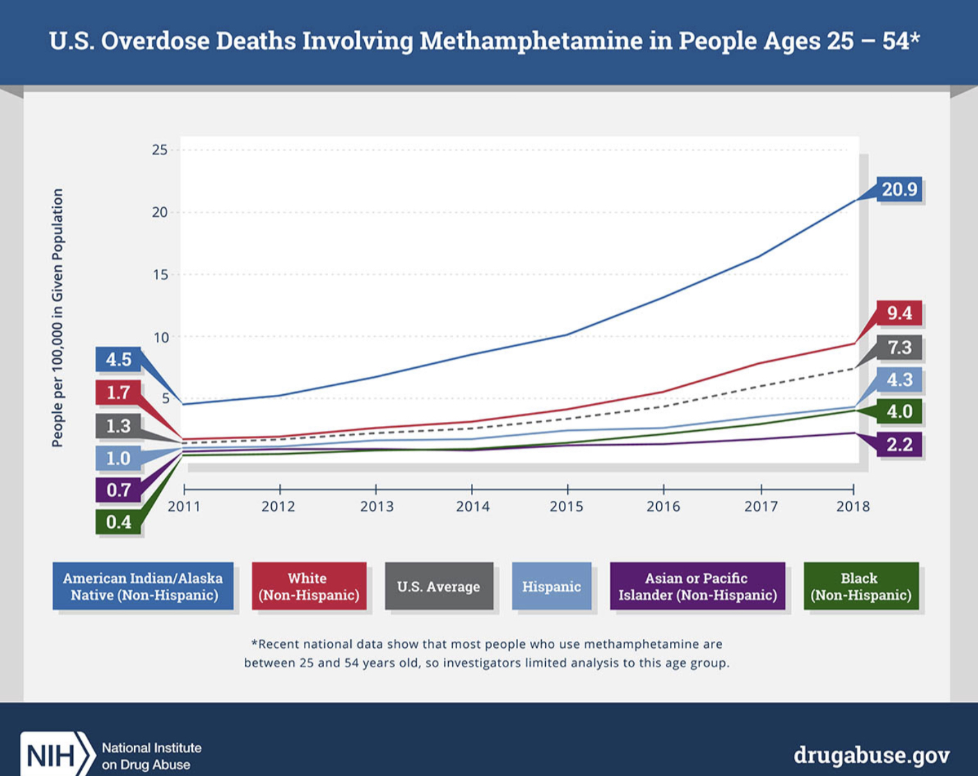
Alaskan Natives and American Indians have experienced the greatest
increase in Methamphetamine overdoses

Slide 28
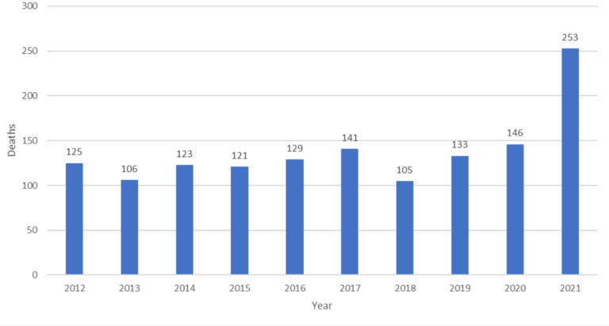
Alaskan Natives
OD rate 77/110K
White
OD rate 28/100K
Meth OD up 150%
Fentanyl OD up 150%
Overdose deaths in Alaska rose by 75% in 2021, highest increase nationwide
https://health.alaska.gov/dph/VitalStats/Documents/PDFs/DrugOverdoseMortalityUpdate_2021.pdf
Notes:
Last year Alaska had the largest increase in overdose death rate of any state nationwide, up 75% in 2021, and the overdose death rate in Alaskan natives is nearly 3 times higher than in white Alaskans. Methamphetamine and Fentanyl related overdoses were both up 150%. Evidence based treatment for stimulant use disorders, such as contingency management, is scare in rural areas and within the IHS system.

Slide 29
Use of stimulants with opioids has been increasing nationwide
Past month methamphetamine use by people who use heroin
9.0% to 44.0%
from 2015-2019
Strickland et al, The continued rise of methamphetamine use among people who use heroin in the United States. Drug Alcohol Depend. 2021
Notes:
The use of stimulants with opioids has been increasing dramatically nationwide, quadrupling over the past 5 years to nearly half of people reporting co-morbid use in the past month

Slide 30
NTC Community Clinic
Notes:
The percentage of patients using methamphetamines with opioids on admission has tripled over the past 5 years, up from 25 to 75%

Slide 31
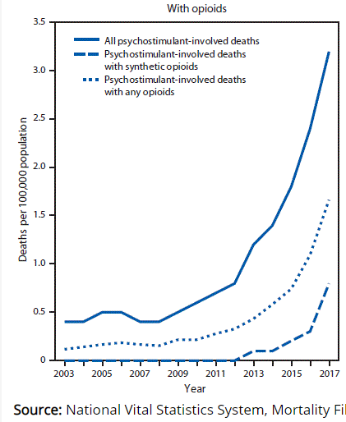
Roughly ½ of methamphetamine overdoses involve opioids
Injecting meth with opioids “goof-balling” is 3X more likely to result in overdose than injecting opioids alone
Notes:
Methamphetamine related deaths quadrupled in the past 5 years, and we know that the use of methamphetamine with fentanyl greatly increases overdose risk, as the respiratory depression effects of fentanyl combine synergistically with the negative cardiovascular effects of stimulants, and over half of the stimulant related deaths nationwide also involve fentanyl

Slide 32
Methamphetamine and Opioid Co-Ingestion – What are the Issues?
A synergistic effect occurs when using meth and an opioid together (i.e., the result of using both is greater than either alone)
The stimulant effect counterbalances the depressant effect, thus increasing overdose risk (respiratory depression AND cardiac arrest)
The most potent effect seems to be in the first 90 minutes of co-ingestion
Notes:
People generally use two substance together because one offsets the effects of the other (e.g., using depressants after a stimulant helps to make the uncomfortable agitation from stimulants go away), or because they prefer the combined effect over the effect of either substance alone. Researchers have noted that when co-ingested, methamphetamine and opioids produce a synergistic effect, meaning that together they produce an effect that is better and/or different than can be achieved with either substance alone. Qualitative data indicates that the combination of methamphetamine and opioids produces a “roller coaster” high that was seen as more pleasurable than the effect of either drug alone. People also reported that they could use methamphetamine as a substitute for opioids when not available, and that the effects of the drugs balanced each other, allowing them to function more normally (Ellis, Kasper, & Cicero, 2018). Tian and colleagues (2017) also noted that the combination of methamphetamine and heroin may be more neurotoxic than either substance alone.
When taken together, the simulant effect from methamphetamine and the depressant effect of the opioids counterbalance either other, making both feel more pleasant. However, a person may not be able to recognize that they have overused one or both of the substances, thereby increasing the risk of overdose from respiratory suppression (opioids) and/or from cardiac arrest (methamphetamine). This risk seems most pronounced during the first 90 minutes of taking both substances.
REFERENCES:
Ellis, M. S., Kasper, Z. A., & Cicero, T. J. (2018). Twin epidemics: The surging rise of methamphetamine use in chronic opioid users. Drug and Alcohol Dependence, 193, 14–20.
Tian, X., Ru, Q., Xiong, Q., Yue, K., Chen, L., Ma, B., … Li, C. (2017). Neurotoxicity induced by methamphetamine-heroin combination in PC12 cells. Neuroscience letters, 647, 1–7.
Meacham, M. C., Strathdee, S. A., Rangel, G., Armenta, R. F., Gaines, T. L., & Garfein, R. S. (2016). Prevalence and correlates of heroin-methamphetamine co-injection among persons who inject drugs in San Diego, California, and Tijuana, Baja California, Mexico. J. Stud. Alcohol Drugs, 77, 774–781.
Trujillo, K. A., Smith, M. L., & Guaderrama, M. M. (2011). Powerful behavioral interactions between methamphetamine and morphine. Pharmacology, Biochemistry, and Behavior, 99, 451–458.

Slide 33
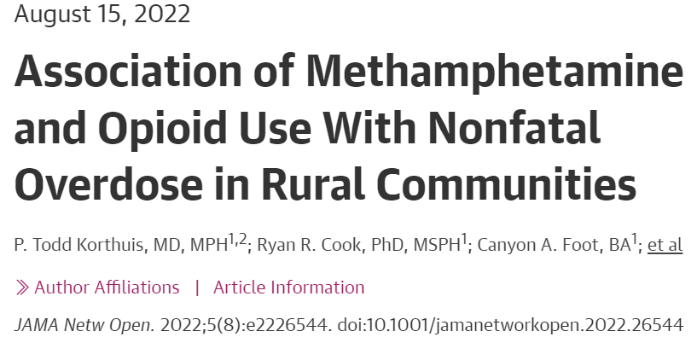
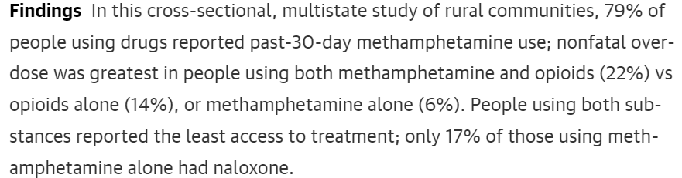

Slide 34
Why do people use stimulants with opioids?
To prolong the effects of fentanyl
To counteract the negative effects of opioids (reduce the chance of “nodding out”)
To foster energy and enhance euphoria
https://www.sciencedirect.com/science/article/abs/pii/S0955395922002079
Notes:
Since it’s so dangerous, it’s important to ask why do people prefer to use these drugs together? A study released this summer complies information from interviews conducted with people who use these drugs together to ask about their motivations. 3 common themes emerged: to prolong the effects of fentanyl, to counteract the negative effects of opioids, and to foster energy and enhance euphoria. So given the increasing potency of the fentanyl contaminated opioid supply, we can see why people would be motivated to add stimulants to the mix to improve their experience.

Slide 35
Why do people start using psychostimulants
Work more
Weight loss
Better sex
Escape
Stay awake
Replace drug
Energy
Experiment
Friends use
For fun
Get high
Motivations vary slightly by gender
Brecht 2004
Drugabuse.gov 2004
Moustafa, Parkes, Fitzgerald, et al., 2021
Dr. Fagan UNC
Notes:
Turning our attention back to psychostimulants….. Why do people use them… Dr. Brecht out of UCLA did a study in 2004 looking at reasons for methamphetamine use for example and found that the primary reasons for initial use are pretty typical – a good number of people use them for fun or to get high while others use them for arousal – they increase energy, increase wakefulness, etc..
Work more: more males
Weight loss: more female
Better sex: more males
Replace drug: more males
Escape: more females
Stay awake: more females
Experiment: more males
Energy: more females
Friends use: more females
For fun: more females
Get high: more females, but fairly even
Citations
Mary-Lynn Brecht, Ann O'Brien, Christina von Mayrhauser, M.Douglas Anglin, Methamphetamine use behaviors and gender differences, Addictive Behaviors,Volume 29, Issue 1, 2004, Pages 89-106, ISSN 0306-4603,
https://doi.org/10.1016/S0306-4603(03)00082-0.
Abuse NI on D. Sex and Gender Differences in Substance Use. National Institute on Drug Abuse. Published --. Accessed May 19, 2021. https://www.drugabuse.gov/publications/research-reports/substance-use-in-women/sex-gender-differences-in-substance-use
Moustafa AA, Parkes D, Fitzgerald L, et al. The relationship between childhood trauma, early-life stress, and alcohol and drug use, abuse, and addiction: An integrative review. Curr Psychol. 2021;40(2):579-584. doi:10.1007/s12144-018-9973-9

Slide 36
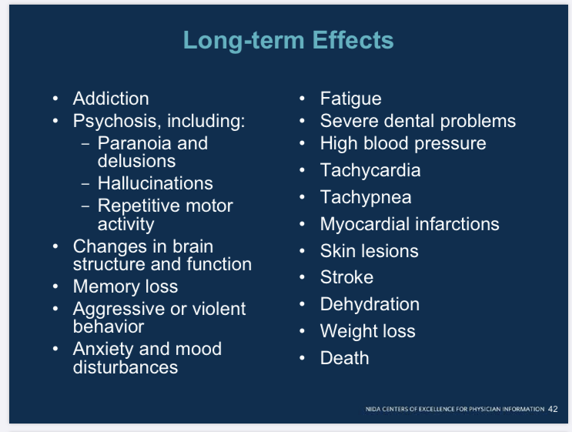

Slide 37
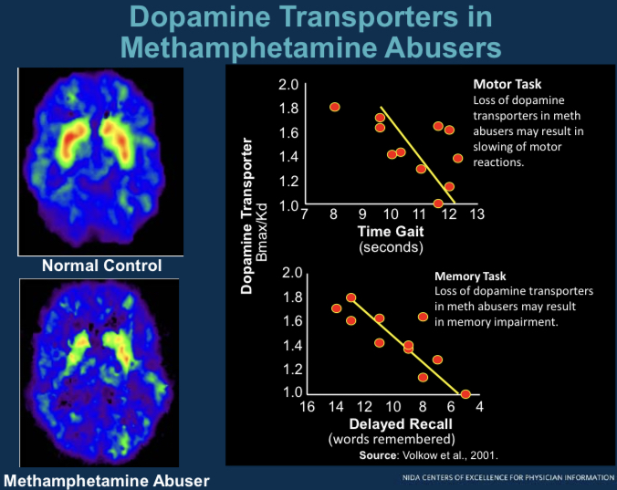
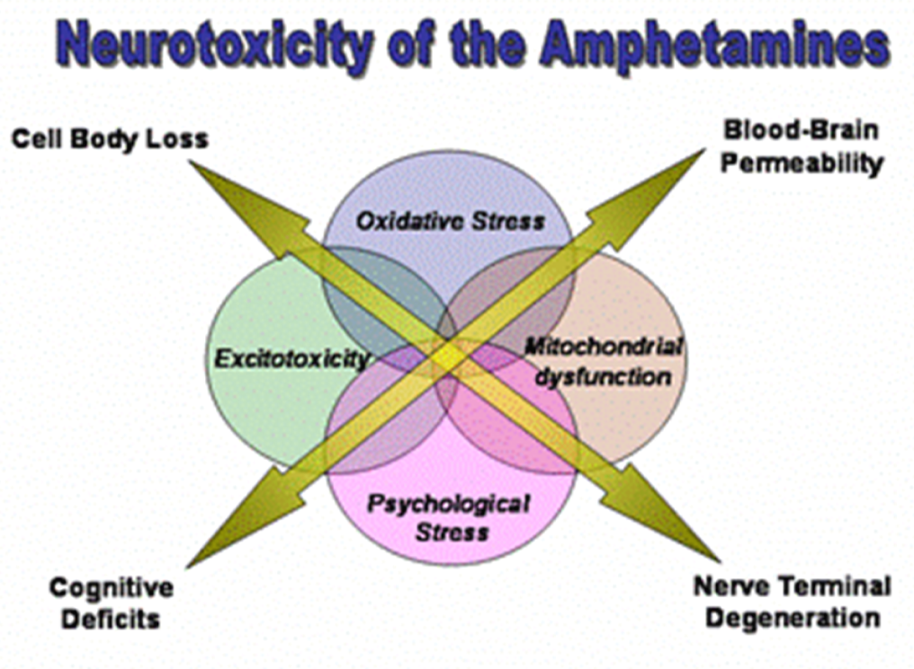

Slide 38
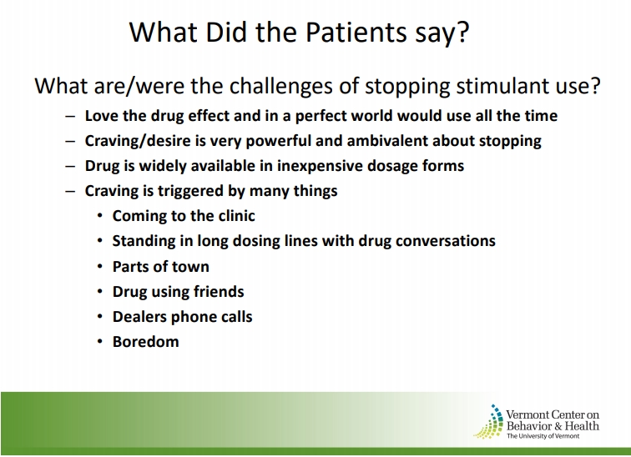
Dr. Rick Rawson

Slide 39
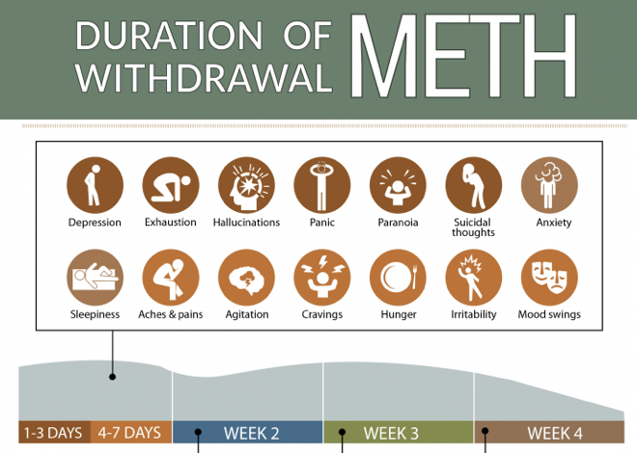

Slide 40
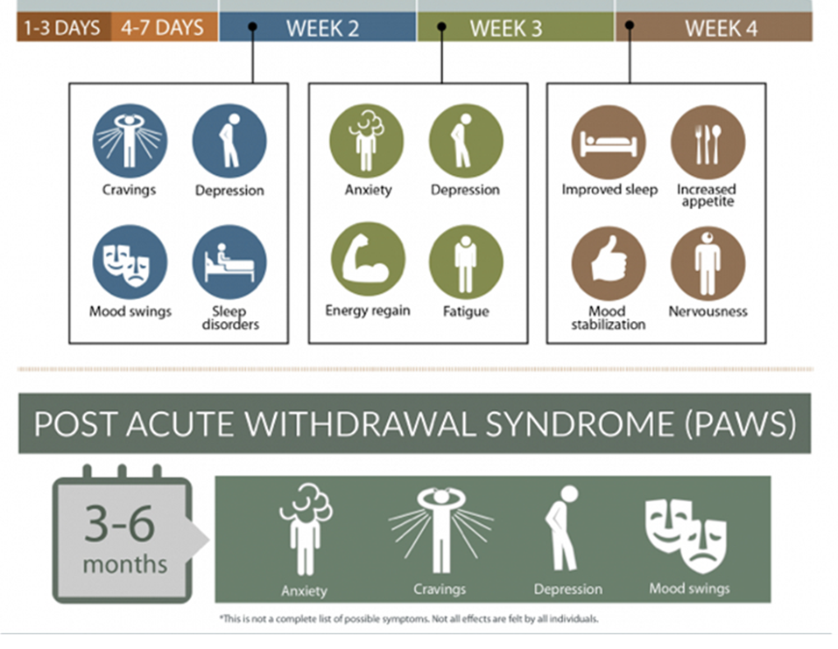

Slide 41
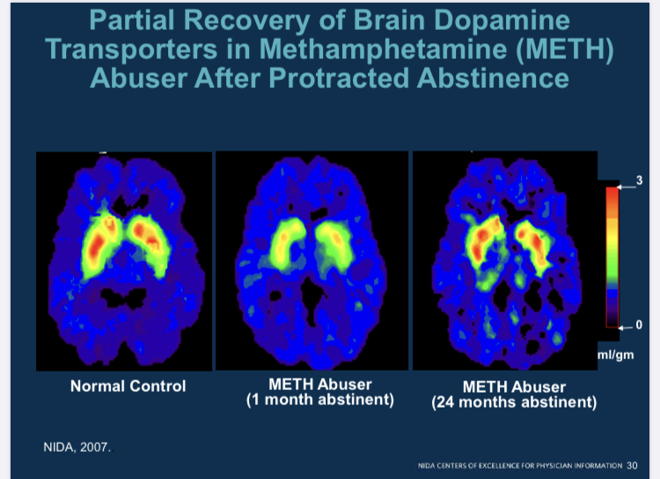

Slide 42
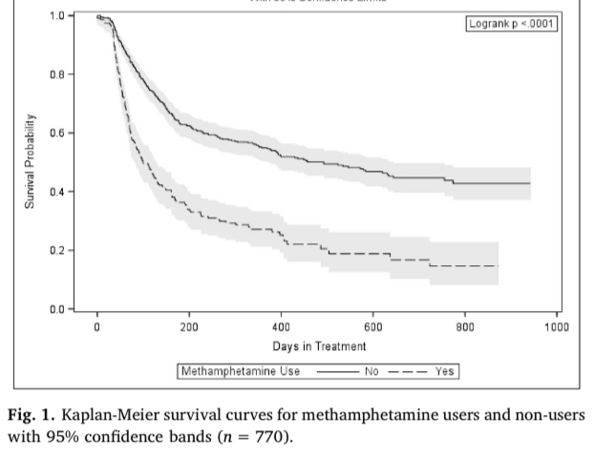
People who use meth may have poorer retention in MOUD programs
But those who stay in treatment may reduce their use
https://www.journalofsubstanceabusetreatment.com/article/S0740-5472(19)30250-8/fulltext
Notes:
Unfortunately, several studies have suggested that patients who use methamphetamine with opioids tend to drop out of buprenorphine treatment at rates up twice as high that as patients who don’t use meth. Studies have also revealed that patients who use both drugs have reduced access to treatment, because they were not accepted in treatment programs, or discharged involuntarily due to issues like ongoing drug use or difficulty keeping appointment. Because traditional systems of care are not accessible or accommodating for patients with severe SUD or those who are actively using drugs, this population isn’t getting the lifesaving care they need.

Slide 43
Harm Reduction Based Low Threshold Care
(Our clinic’s approach)
Don’t discharge patients for ongoing drug use
Create patient centered care plans
Flexible walk-in/same day/tele-med appointments
Co-located/tele-behavioral health/digital apps
Motivational interviewing
Peer support (via text)
Treatment of co-morbid medical/MH issues
Contingency Management
Notes:
Low-threshold care programs can be structured in many ways and can offer a variety of services, but they all operate on the philosophy of meeting patients where they are at to create patient centered care plans based on the patients' goals, and not discharging patients for ongoing drug use. We offer as much flexibility as possible in scheduling, with availability of walk-in appointments for medication injections and telemedicine appointments when needed. We offer optional behavioral health support and peer support via telemedicine, texting and digital apps. Gas cards, funded by out tribal opioid response grant, helps our patients living in rural areas to reduce transportation barriers and get to their appointments. Evidence based treatment for stimulant use disorder, such as contingency management, is scarce in rural areas and within the IHS system nationwide. Rural and tribal clinics often rely on federal grant funding to operate their SUD treatment programs, which has traditionally severely limited the use of grants to fund contingency management programs. There has been a promising trend towards availability of funds for contingency management, and we are hopeful that the state and tribes will utilize upcoming opioid settlement funds for this purpose and SAMSHA will liberalize its contingency management allowance for its grants to provide evidence-based amounts, NOT limited to $75/year.

Slide 44
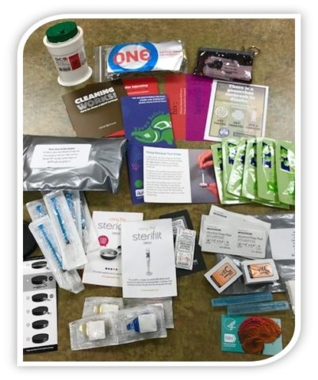
Harm Reduction Based Low Threshold Care (continued)
Assistance with transportation
Assistance with filling out applications for treatment or social services
Contraception
Rapid Hep C/HIV testing
Hep C treatment/ PREP for active users
Naloxone kits
Injection and smoking supplies
Fentanyl test strips
Notes:
Case management support is very helpful, as well as treating co-morbid medical and mental health problems during visits. We treat Hepatitis C in patients who are still actively using drugs. The Alaska Native Tribal Health Consortium offers Alaskan native clinics and patients free mail-order harm reduction kits through iknowmine.org that we keep in stock to hand out as needed, as well as free naloxone from the State Project HOPE.

Slide 45
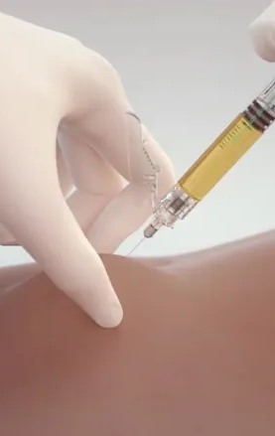
Low Threshold XR-BUP
Given regardless of active drug/alcohol use
No required drug testing
Flexible schedule
Walk-in appointments for injections
Single day SL-BUP induction for tolerant patients
Flexible dose
SL supplementation available
Available in pregnancy (2nd/3rd trimester)
Primary care/harm reduction services
Notes:
There are several ways to reduce barriers to accessing XRBUP. We never withhold injections due to active drug or alcohol use and don’t require drug testing. We offer walk-in appointments for injections when possible, and off-label flexible schedules for induction and maintenance injections, with same-day medication starts available for opioid tolerant patients rather than the standard 7-day induction. We offer supplemental SLBUP as needed in early treatment to treat uncontrolled cravings and offer XRBUP to pregnant patients with severe SUDs who are in their 2nd and 3rd trimesters and in whom the benefits outweigh the risks.

Slide 46
The treatment modality with the most evidence for efficacy for stimulant use disorder is
Contingency Management

Slide 47

What is Contingency Management?
The most effective behavioral health intervention to treat substance use disorders, but also the least utilized.
Provides immediate rewards for meeting goals
Negative UDS
Coming to appointments
Getting monthly medication injections
Attending counseling
Example: Gift cards = $100/month

Slide 48
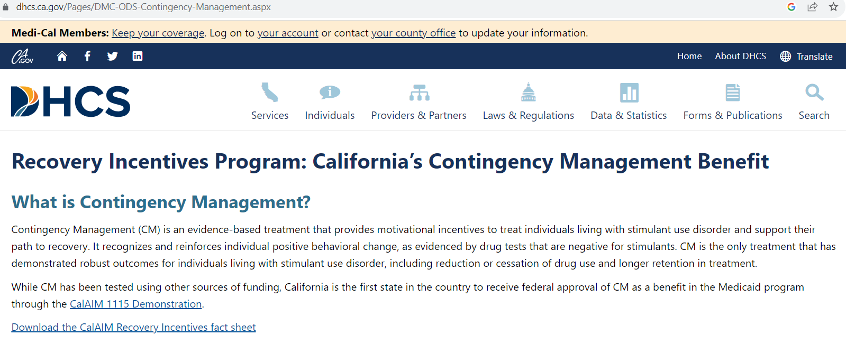
Contingency Management = Providing rewards for meeting treatment goals
Gold standard treatment for stimulant use disorder
Alaska should apply for this 1115 waiver!!!
Can also be funded by Opioid Settlement Funds

Slide 49
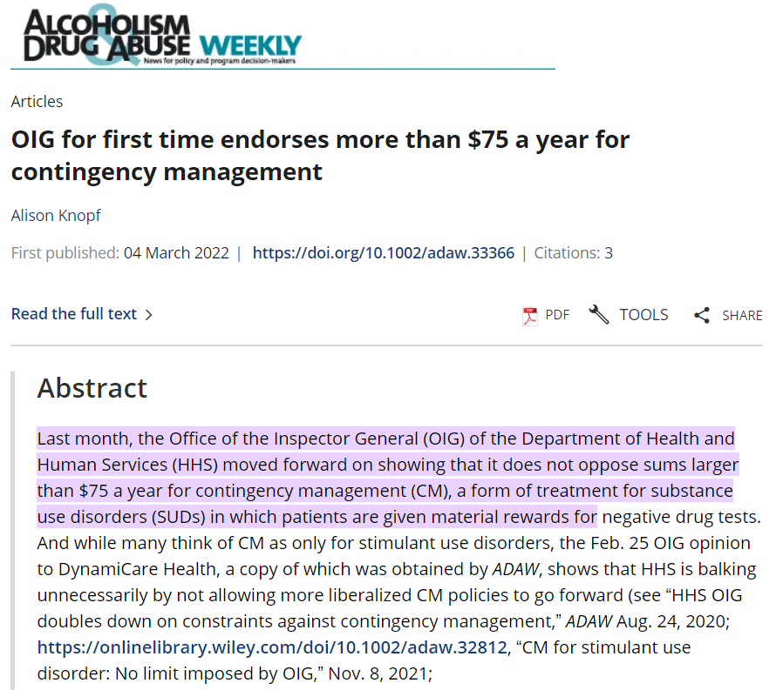
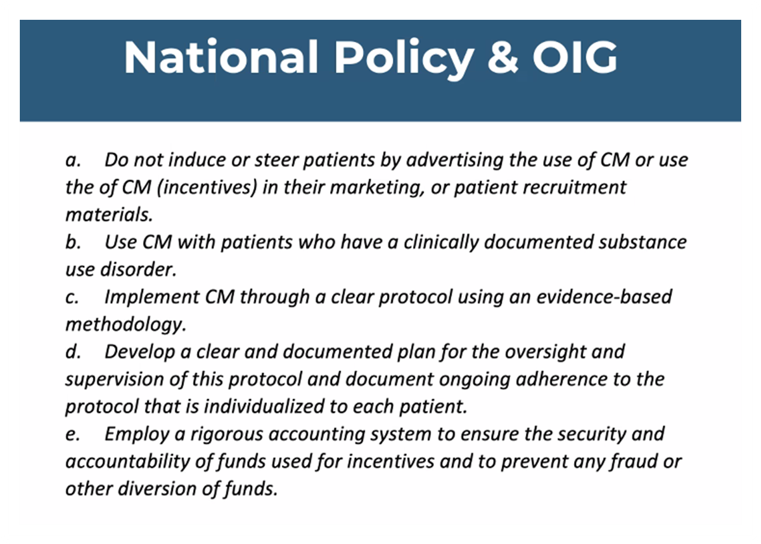
CM programs must have P&P that include OIG guardrails

Slide 50
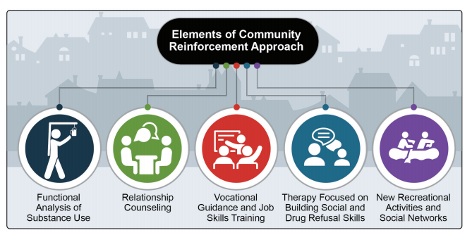
Community Reinforcement Approach (CRA) isa combination of behavioral strategies that address the role of environmental contingencies in encouraging or discouraging drug use and attempts to rearrange these contingencies so that a non-drug using lifestyle is more rewarding than a using one.

Slide 51
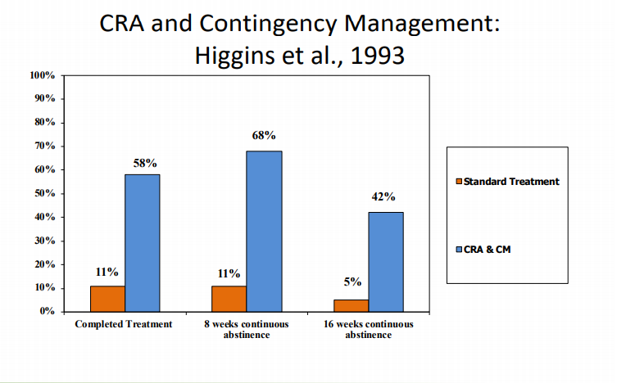

Slide 52
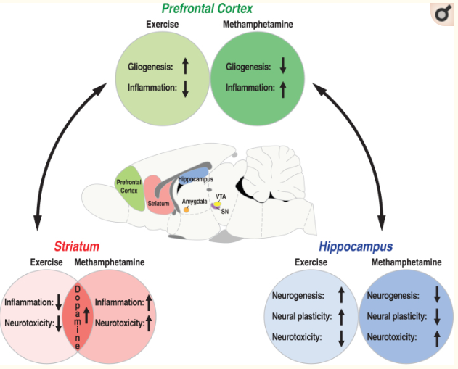
Exercise can help brains heal from stimulant toxicity

Slide 53
No FDA approved meds to treat stimulant use disorders
Bupropion and Naltrexone in Methamphetamine Use Disorder
January 14, 2021 N Engl J Med 2021; 384:140-153 DOI: 10.1056/NEJMoa2020214
IM Naltrexone 380 mg every 3 weeks, plus bupropion 450 mg/day
Around 10-15% of patient able to show abstinence
Mirtazapine for Methamphetamine dependence in MSM
Colfax 2011
Mirtazapine 30 mg/day reduced UDS +meth by 20%
Even without great medication compliance
Contingency Management is the most effective treatment for stimulant use dz

Slide 54
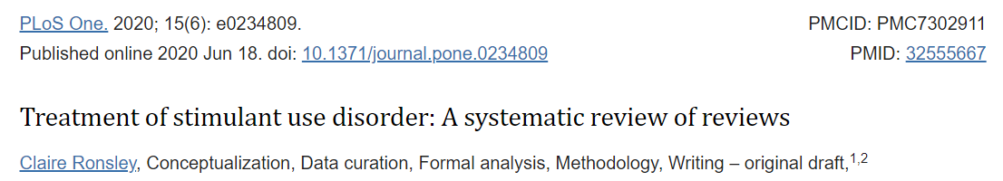

Slide 55
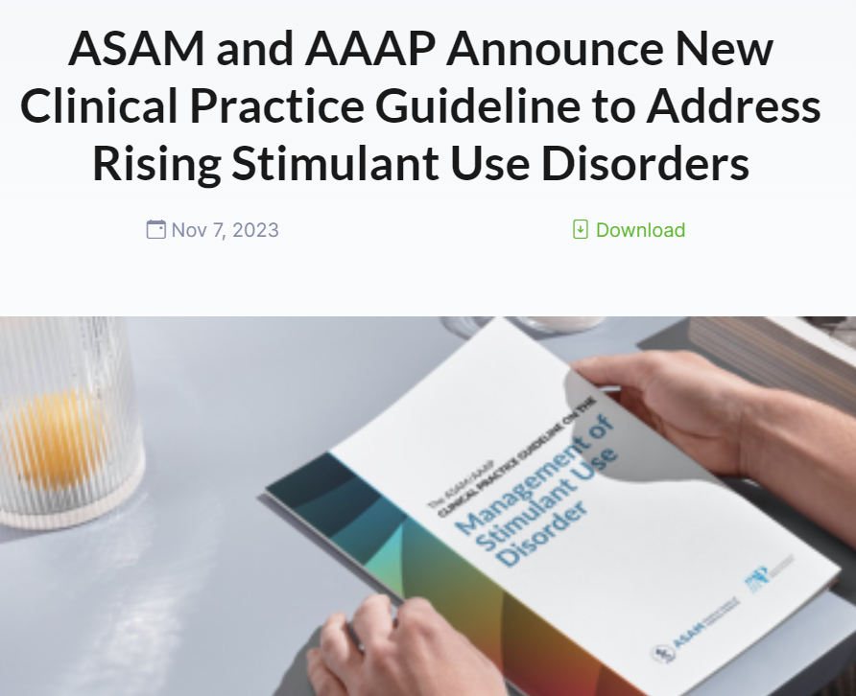
Contingency Management is #1
Board certified providers may consider Rx stimulants in select patients with close monitoring
https://downloads.asam.org/sitefinity-production-blobs/docs/default-source/quality-science/stud_guideline_document_final.pdf?sfvrsn=71094b38_1

Slide 56
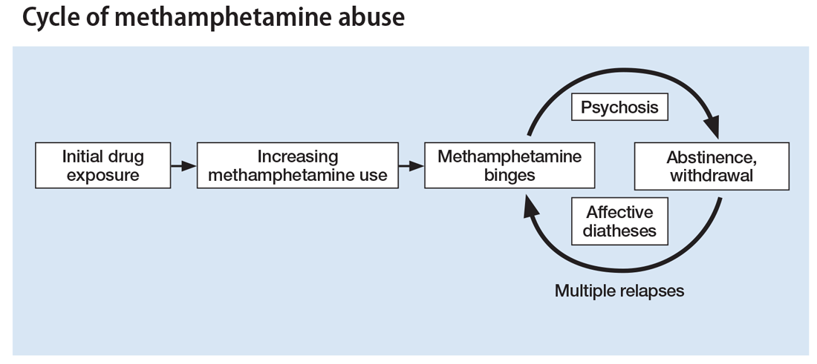
Its important to treat withdrawal symptoms to reduce cravings and improve quality of life
Provide non-narcotic medications and behavioral health support for:
Depression
Anxiety
Insomnia
Pain
Thought disorders

Slide 57
ASK ABOUT ANXIETY AND DEPRESSION
Treat with non-narcotic medications that may address comorbid conditions
Mirtazapine helps sleep and appetite
Avoid Benzos → try buspirone instead
Consider treating physiological w/d sxs that mimic anxiety with prn clonidine, hydroxyzine, propranolol

Slide 58
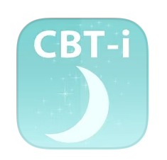
Ask About Sleep
Make a differential diagnosis to determine whether a client’s sleep problems likely stem from protracted withdrawal or are the result of other causes.
Educate clients about good sleep habits: adopting a regular sleep routine (getting up at the same time daily), exercising early in the day, minimizing caffeine intake, eating well, and avoiding late afternoon naps.
Utilize non-narcotic meds, consider co-treating comorbid pain/mood disorders: eg TCAs, mirtazapine, trazodone, doxepin, quetiapine (all off label), low-dose melatonin
Test for sleep apnea (may be central vs obstructive)
CBTI (free VA app)
The Substance Abuse and Mental Health Services
Administration’s (SAMHSA’s) Center for Substance Abuse Treatment (CSAT) is developing a Substance Abuse in Brief Fact Sheet on sleep problems

Slide 59
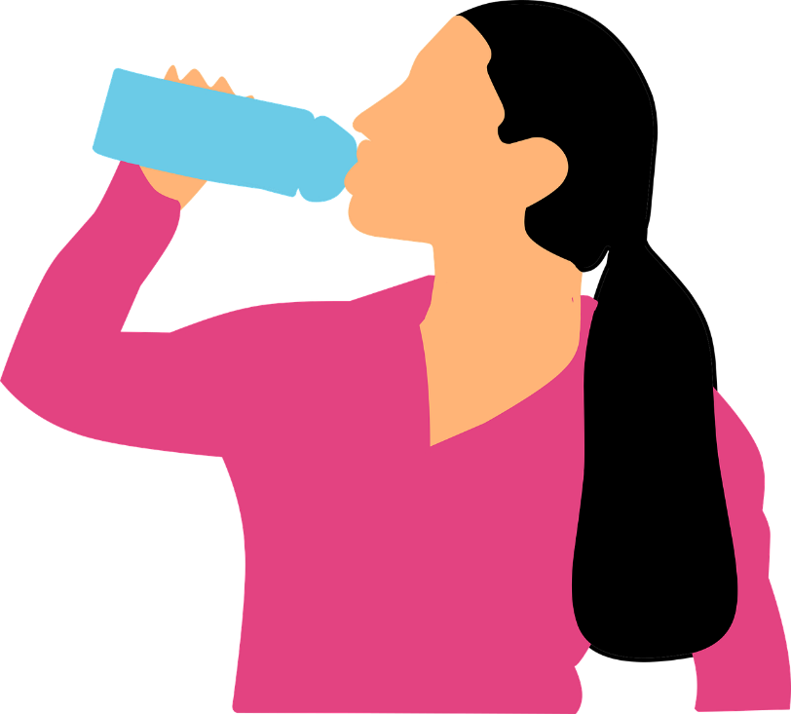
Harm Reduction for Psychostimulant Use
Overamping prevention (Eat, Hydrate, Sleep)
Treatment for co-occurring substance use disorders (ex: OUD)
Naloxone education and distribution
Exercise
Dental hygiene supplies
Syringe services programs, safer injection supplies
Smoking supplies
Fentanyl test strips
Never use alone, Test doses
Safe sexual practices, condoms, lube
Hep C treatment
Vearrier L. 2019
Notes:
These interventions encourage safer use, and connections to care, and have consistently been found to be the most effective way to reduce overdose and risks of HIV and Hepatitis C when designed with community and participant involvement.
They also reduce crime in a cost-effective manner.
Citations:
Vearrier L. The value of harm reduction for injection drug use: A clinical and public health ethics analysis. Dis Mon. 2019 May;65(5):119-141. doi: 10.1016/j.disamonth.2018.12.002. Epub 2018 Dec 29. PMID: 30600096.
Images:
Public Domain Vectors. Medical Syringe Icon Vector Clip Art. https://publicdomainvectors.org/en/free-clipart/Medical-syringe-icon-vector-clip-art/28666.html Published 21 June 2015. Accessed November 18, 2019. Public Domain.
Public Domain Vectors. Pink Condom Package. https://publicdomainvectors.org/en/free-clipart/Pink-condom-package/80690.html Published 23 January 2019. Accessed November 18, 2019. Public Domain.
Soupeurfaive. Français : Témoin de Ceinture de Sécurité Non Bouclée. December 10, 2012. Own work. https://commons.wikimedia.org/wiki/File:Seat_belt.png. Public domain.
Pixabay. Drinking Water Woman Bottle. https://pixabay.com/vectors/drinking-water-woman-bottle-2704297/. Accessed May 19, 2021. Public domain.
Pills - drawn on google slides

Slide 60


Slide 61



https://www.harmreductionactioncenter.org/new-page

Slide 62



Slide 63

NARCAN RX
Every patient who receives a prescription for opioids, a new MAT patient, a family member or someone who knows someone who knows uses opioids should be provided a Narcan® kit.
The best way to make Narcan® kits available- hand them out to people who use. They can be the best first responders.
Even stimulant users who don’t use opioids need a Narcan kit due to fentanyl contamination

Slide 64
What are Some Treatment Implications for Methamphetamine and Opioid Co-Ingestion?
Make sure you have sufficient naloxone kits available for overdoses
Because of the interaction effect, it may require more than one dose to counteract the effects of meth and heroin
Combine medication for opioid use disorder with contingency management for meth
It may be better to use buprenorphine rather than methadone, since methadone and meth would still have a potent interaction (for people who relapse on meth during treatment)
Exercise may help to reduce methamphetamine use and reduce depression and anxiety symptoms
Notes:
With increasing rates of fentanyl mixed into samples of methamphetamine (and cocaine), people who use stimulants are at much higher risk for overdose death due to their lack of tolerance for opioids. People who use stimulants should be educated about the dangers of fentanyl and offered naloxone kits to have on hand in case of opioid overdose. This slide features a few additional practical treatment implications to consider.

