Slide 1
Starting an Effective Model to End the Syndemic at Cass Lake IHS
Whitney Dickson, PharmD, BCPS
9.11.24
Notes:
Increase the availability of accessible and sustainable community-centered health systems
Harm Reduction and syphilis

Slide 2
Learning Objectives
Understand the need for hepatitis c and harm reduction services
Summarize the steps taken to end the syndemic at a local level

Slide 3
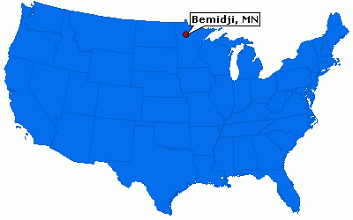
About Cass Lake IHS
Located in Northern Minnesota
Outpatient Ambulatory Care Clinic
  3 physicians
  6 nurse practitioners
Active user population of ~12,000 clients
Pharmacy also serves 4 area tribal clinics
Services provided
  24/7 emergency department
  Same Day Clinic
  Dental
  Pharmacy
  Lab
  Radiology
  Physical Therapy
  Podiatry
Cass Lake, MN

Slide 4
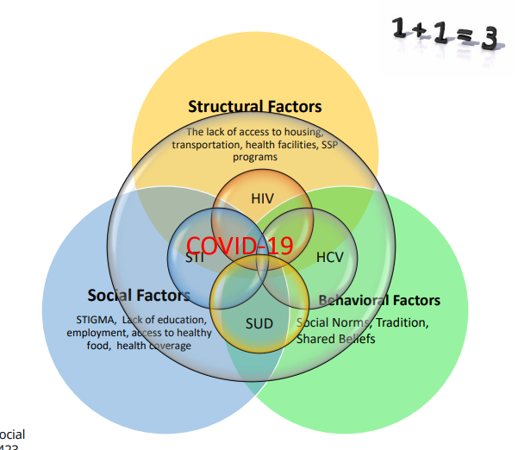
Ending the Syndemic

Slide 5
Getting Started
Hepatitis C

Slide 6
Hepatitis C Background
More people dying of HCV than all other 60 nationally notifiable infectious diseases combined
Minnesota is one of the states that had >200% increase in HCV cases from 2007-2012
Today over 80% of new HCV transmission occurs in people who inject drugs
AI/AN are the most affected compared to other races or ethnicities
Notes:
Notifiable diseases: HIV, TB, HEP B,

Slide 7
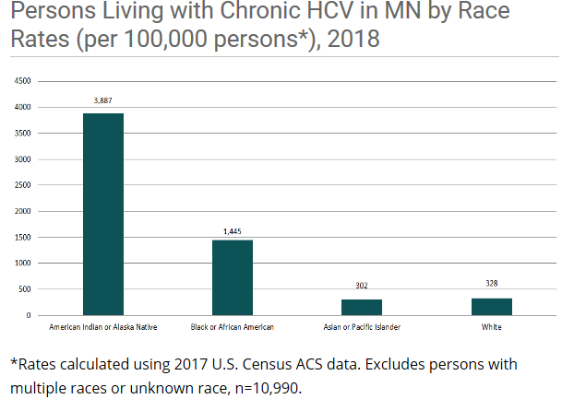
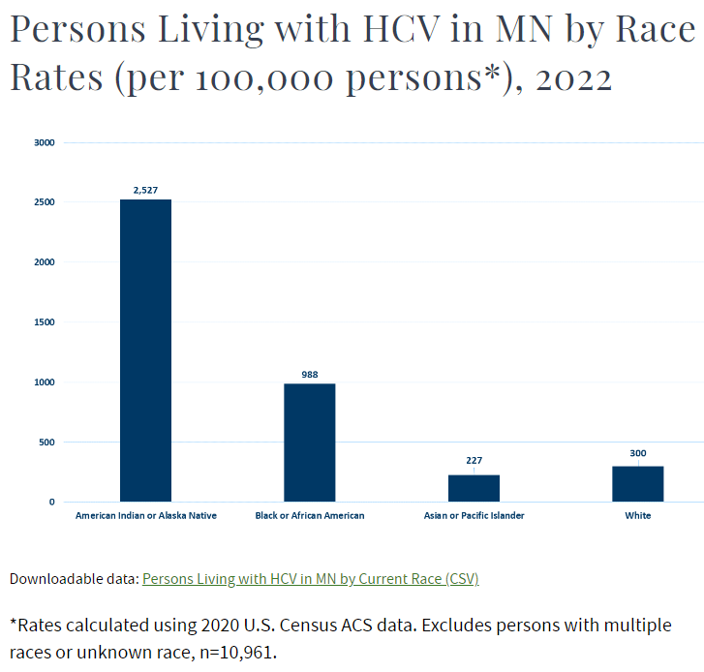
HCV in Minnesota
MN Department of Health
Notes:
Rates calculated using 2017 US Census ACS Data. Excludes persons with multiple races or unknown race n=10990

Slide 8
Previous HCV Treatment Process
Referred to outside specialist
  Typically Bemidji, Duluth, Fargo (range from 30 min-2.5 hours away)
  No further screening/testing done here after Ab/RNA positive
  Often patients referred with only Ab + (Not detectable RNA)
  Patients screened positive and lost to follow up
  Unclear what percentage of patients received care/completed treatment
  Paid for by patient’s insurance or purchased referred care
  Restrictions on substance use prior to treatment
  No medications filled at our pharmacy

Slide 9
Pharmacist Run HCV Clinic
Patient with + HCV antibody and HCV RNA detectable
Referral to pharmacist
Initial pharmacy visit
  Assess readiness/appropriateness for treatment
  If ready/willing to be treated order required labs
Presentation to project ECHO if needed
Initiate prior authorization or Patient Assistance
Start treatment
Pharmacist monitoring/follow up throughout treatment and SVR
SVR Counseling
  Risk of reinfection
  Necessary follow up (ex. Cirrhotic patients still require ultrasounds and monitoring for HCC)
Notes:
Billing through MTM CPT codes
Meds ordered under primary providers name
Use

Slide 10
Pharmacist Collaborative Practice Agreement
1 pharmacist
Collaborative Practice Agreement in place
  Allows for treatment based on most recent guidelines
Flexibility for appointments
  Can schedule appointments
  Walk-in
Collaborate with local treatment programs

Slide 11
Risk Factors for Hepatitis C at Cass Lake IHS
11.5%
4%
6%
10.5%
78%
90%
Notes:
Other- Blood transfusion, tattoo, partner +
Last 20- 19 out of 20 identified IVDU-95%

Slide 12
Need for Local Harm Reduction Services

Slide 13
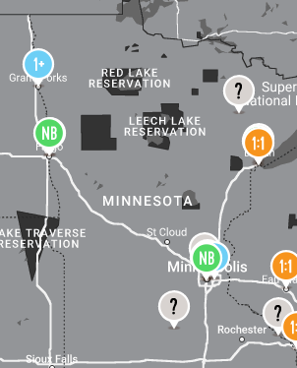
Need for Syringe Services
MN Pharmacy Syringe Access
  Pharmacies can voluntarily participate
  Individual pharmacist may decide
  Limit of 10 syringes
  Can not display syringes for purchase
  Can not advertise availability of syringes
SEP Locations : NASEN Directory- north American syringe exchange network
https://www.nasen.org/map/
https://www.health.state.mn.us/
Notes:
SEP Locations : NASEN Directory- north American syringe exchange network
https://www.nasen.org/map/
Sharps containers broken into

Slide 14
Need for Syringe Services
ER visits for STI testing
  Need for quick and easy access to testing outside of the ER
Association between our syphilis cases and substance use
Increase in ER overdose visits
  Need for additional access to naloxone
Patients accessing ER for services not empaneled with primary care provider

Slide 15
Getting Started - People
Meetings with Tribal counterparts
  What services we can both provide
  What gaps can we fill for each other
  Meeting with Tribal Police Department
Pharmacy leadership and staff buy in
  Survey staff
Presentation to medical staff
Word of mouth advertising
  One Facebook post after ~ 3 months

Slide 16
Getting Started- Education
Gathered resources for patients
  Mental Health
  Substance use
  Patient education
    Safer injection
    Numbers for clinic appointments
    Sharps disposal in Minnesota
Education for pharmacy staff (ongoing)
  Background presentation given
  Invited NPAIHB staff to present and answer questions
  Emailed resources on harm reduction
    Rationale behind items provided
Notes:
Educated myself first

Slide 17
Getting Started- Supplies
Created list of supplies needed
Compared pricing from different sources
Created NASEN account
Majority of items the pharmacy already offered or the facility orders for other departments
Identified funding source
Resources
  NPAIHB
  National Harm Reduction Coalition
  NASEN
  NASTAD
Notes:
List of supplies can be overwhelming, can select a few items, reach out to other programs for best practice

Slide 18
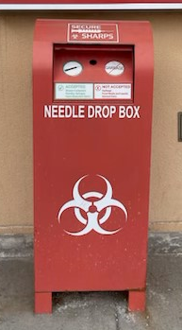
Harm Reduction at CLIHS
Within CLIHS pharmacy provides harm reduction services which include
  Syringe services
  Sharps containers/syringe disposal
  Naloxone
  STI testing
  Condom distribution
  Xylazine/fentanyl test strips
  Education on safer use
  Resources for mental health and addiction

Slide 19
Harm Reduction at CLIHS
Patients complete a voluntary intake form
  Provided a participant card with an ID number
  Encounter is not documented in medical record
    Naloxone prescription and STI testing is entered in EHR, but not linked to harm reduction visit
Pharmacist or student pharmacist provides information on what is available
  Handouts on safer use and mental health and addiction resources
  Participant can request items they would like
Return visit participants can show their participant card to request services or ask to speak with a pharmacist
Pharmacy tracks visits based on ID number

Slide 20
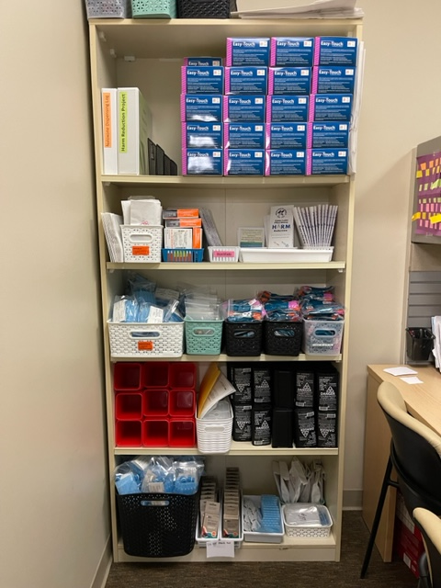
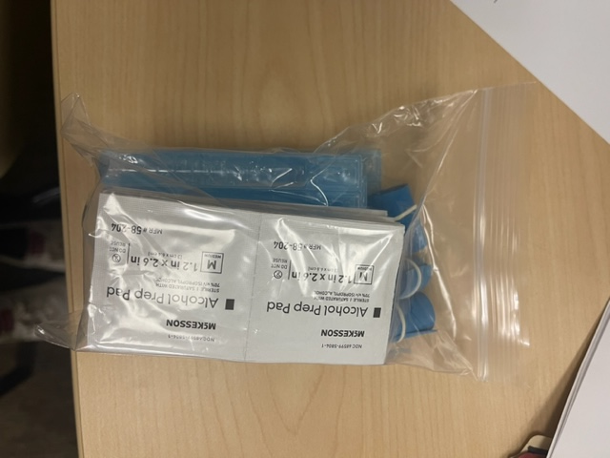
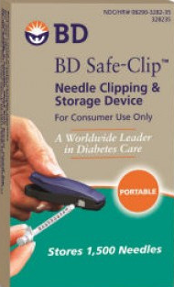
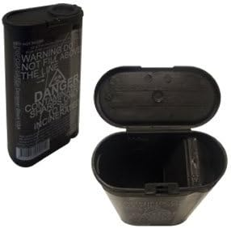
Harm Reduction Supplies

Slide 21
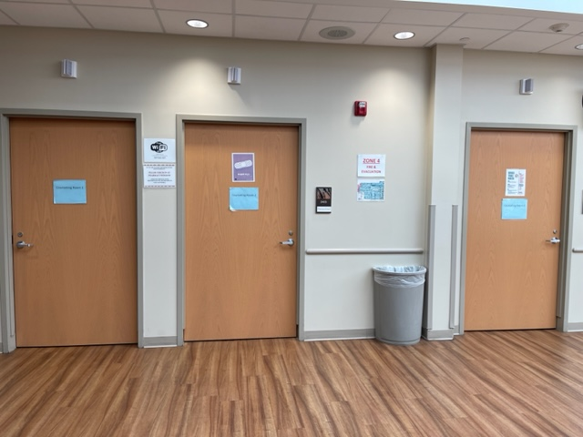
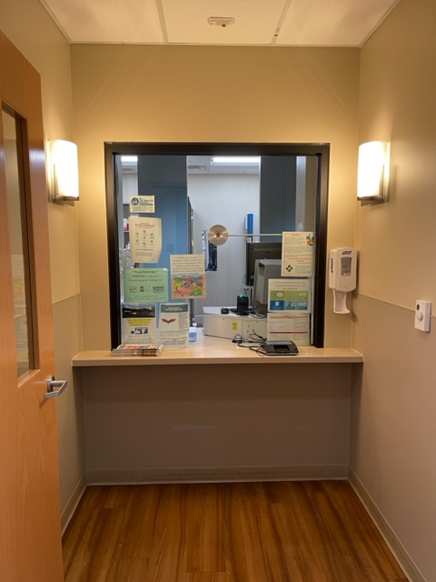
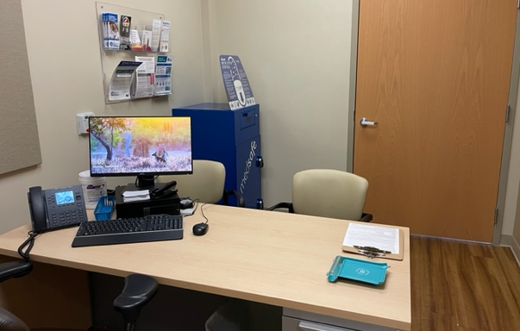

Slide 22
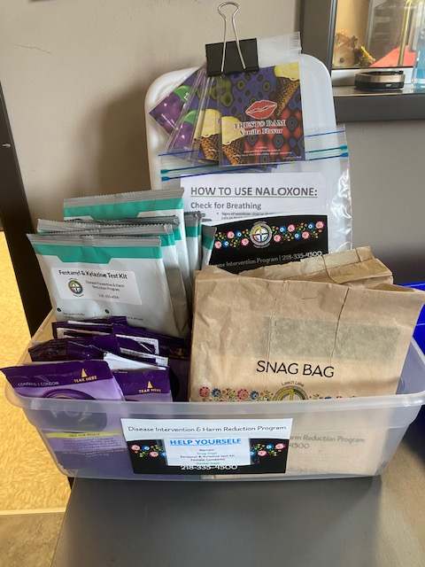
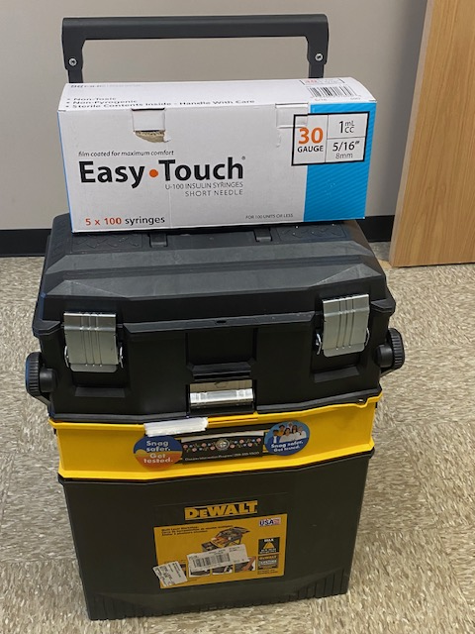
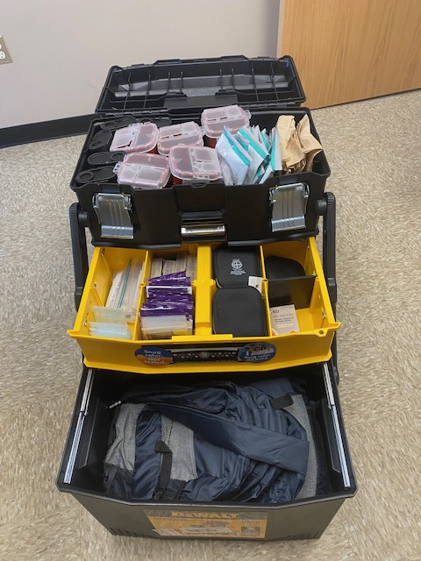
Supplies available in Tribal Clinics
New Community Wellness and Recovery Navigator Program
  Independent Tribal program

Slide 23
Participant Demographics
First participant 10/24/22
Currently have 146 participants
Median age: 36
  Age range: 21-68
  71 participants with no primary care provider (70%)
>850 visits
~40,000 syringes, 1,100 naloxone doses, and 2,200 condoms provided
Notes:
Sharps- 310
Clipper-69
Injection Kit-515
Cooker kits-128

Slide 24
What Works Well
People know where to find us
  Consistent hours
  Consistent location
Always a pharmacist available
  10 pharmacists and typically 1-2 students
Private space
  Same space used for all pharmacy services
Lab available during harm reduction program hours
Ability to test and treat for STIs/HCV within the pharmacy
Same Day clinic and ER on site if needed

Slide 25
What Could Be Better
Multiple staff might be a disadvantage
How do we engage more with patients
Input from people with lived experience
Offer rapid testing
Remove barriers for HCV treatment
  Medicaid, reimbursement limits
Could offer additional supplies
Offer PrEP and doxy PEP more universally

Slide 26
Pharmacy STI Standing Order
STI Order Set “Bundle” | STI Treatment
Syphilis | Chlamydia
HIV | Gonorrhea
HCV | Syphilis
CT/GC | Trichomoniasis
Trichomonas
Pregnancy
HBV (Surface Ab, Surface Ag, Core Ab)
Allows any pharmacist to order STI testing and appropriate treatment

Slide 27
STI Testing first 7 months
STD panel ordered at 8 visits (6 patients)
  3 positive HCV
  3 reactive RPR
    1 late latent case in need of treatment
    2 with history of treated syphilis
7 participants with known HCV in need of treatment
35 participants
Notes:
~35 participants
7000 syringes
130 visits

Slide 28
Pharmacy Based Incentive Program
Implemented July 10th 2023
$10 incentive card offered for STI testing
  Testing ordered under pharmacy standing order
  No STI testing within the last 3 months
Second $10 incentive card offered for notification of results or if treatment needed
  Treatment ordered under pharmacy standing order
No advertising done
Do not have to be part of harm reduction program

Slide 29
Pharmacy Based Incentive Program
In the first 5 months 196 incentive cards given out
101 STI bundles completed
  33 not part of harm reduction program
Positive results– 44 positives in 40 patients
  Syphilis cases
  Hepatitis C
  Chlamydia
  Gonorrhea
  Trichomoniasis
  Pregnancy
9 positives were outside of harm reduction program
Notes:
Within first week 20 people- 15 positives
21 with known HCV (27%)
Start 7/10/23-11/14/23
9 HCV patients- finished tx, on tx, or meds approved waiting to start

Slide 30
Benefits of Incentives
Identified and treated multiple positive infections in patients that may not have sought care otherwise
Helped establish pharmacy as a trusted resource
Patients returned to request STI testing even if not eligible for another card
Allowed for education on STI testing and prevention
Opportunity for referral to primary care for additional services

Slide 31
Alternate Ways to Reach Patients
Tribal Disease Intervention Specialist Consult
  Utilized if unable to reach patient by phone
  Consult placed in EHR
  Can assist with getting patient into clinic, obtaining labs, or providing treatment
Follow up Flag
  Placed and removed by one pharmacist
  Only used as a last resort if patient unable to be contacted after multiple attempts
  Education needed for staff to ensure action when patient presents
  Need to proactively remove flag as soon as action is taken
Internal pharmacy communication
  Notes in harm reduction binder
  Notes in Scriptpro (pharmacy based dispensing system)

Slide 32
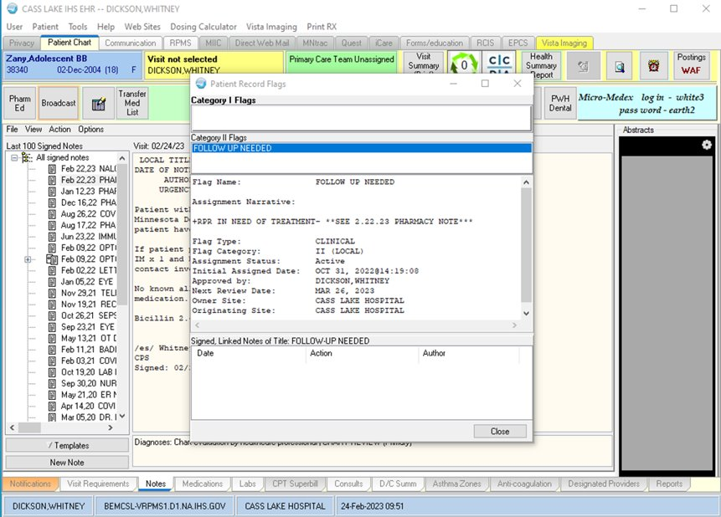

Slide 33
Syphilis Case Management
Notification of results
Health Department Partnerships
Tribal Partnerships
  Field Treatment
  DIS
Incentives
Documentation
Community Education

Slide 34
Other Policies/Standing Orders
Pharmacist privileges through collaborative practice agreement for HIV and HCV
STI Partner Treatment
  Expedited Partner Therapy
  Treatment of non-eligible partners
Naloxone standing order
  Allows pharmacy to order for any patient
Naloxone standing order for community members or first responders
Lab Express Testing
  Allows patient to go directly to lab to request STI testing
  Pharmacist follows up on results
    Contacts patients
    Orders treatment
Vaccination Standing order

Slide 35
Opportunities for Growth
Community engagement
  Homeless shelters
  Opioid Treatment Program
  Powwows
Talk about your program
Ask questions about other programs or services in your area

Slide 36
Key Takeaways
It is ok to start small
  Growth provides an opportunity for education/conversation
Be flexible
Alternate forms of communication are needed
You don’t have to be an expert
We are always learning

Slide 37
Resources
Materials for Syringe Services Programs: A Guide for Staff & Volunteers | NASTAD
Safer Drug Use Technique | Bevel Up (bvlup.com)
National Harm Reduction TA Center
NASEN | North America Syringe Exchange Network: NASEN Directory

Slide 38
Questions?

