Slide 1

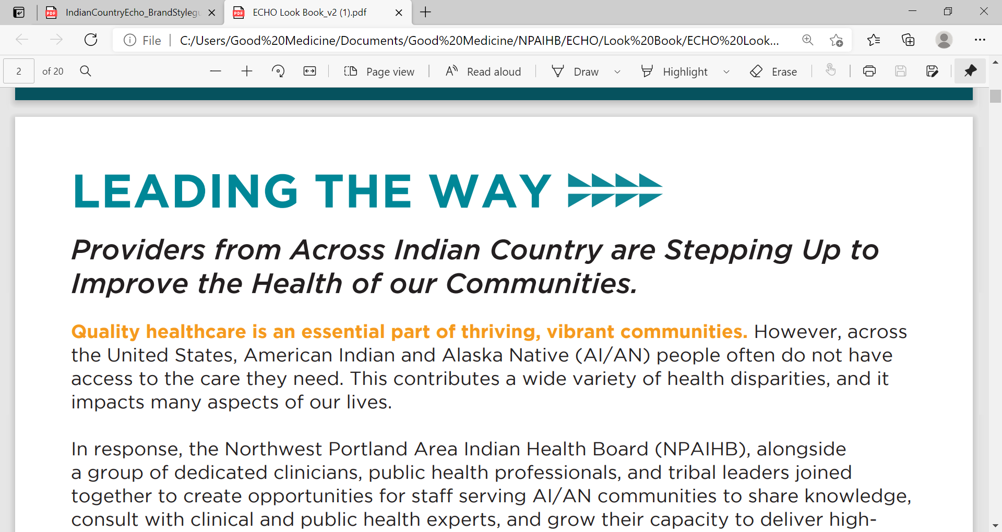
Addressing National Increases in
Adult and Congenital Syphilis
Melanie Taylor, MD, MPH
CAPT, USPHS
Volunteer, Indian Health Service
Assignee Arizona Dept of Health Services.
Assignee Maricopa County Dept of Health Services
CDC Medical Epidemiologist, Division of HIV Prevention
mdt7@cdc.gov
Notes:
Thank you all for joining this seminar. I am going to share Best Practices for and challenges to delivering a coordinated syphilis response at a community level.
I am presenting on behalf of the Indian Health Service describing approaches for American Indian Alaska Native People at risk for syphilis. I will be integrating opportunities to address substance abuse through a syndemic approach.

Slide 2
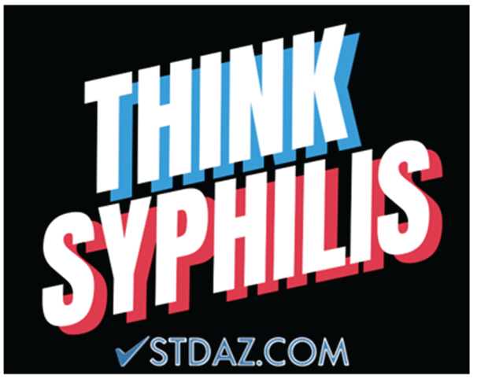
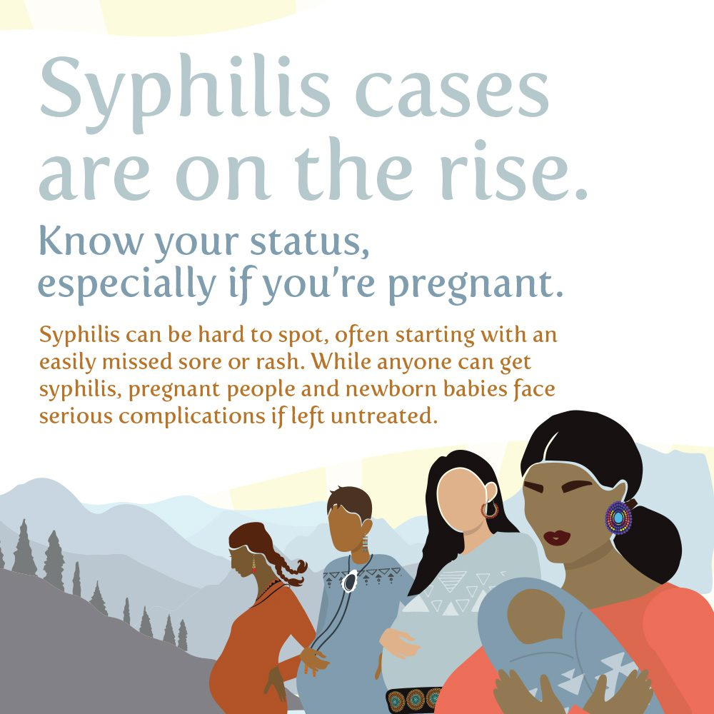
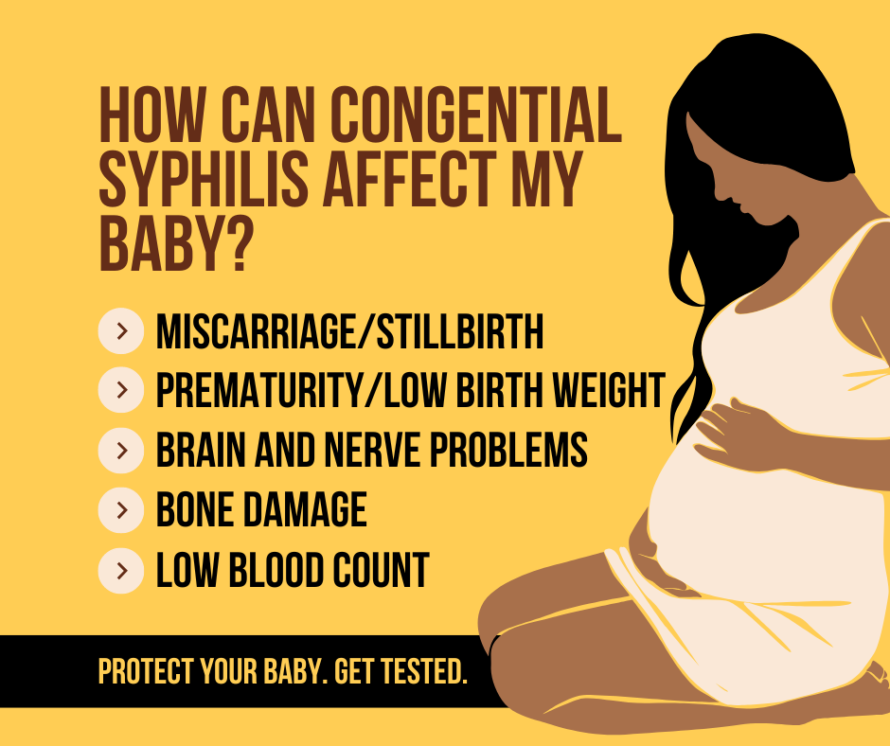
Think Syphilis

Slide 3
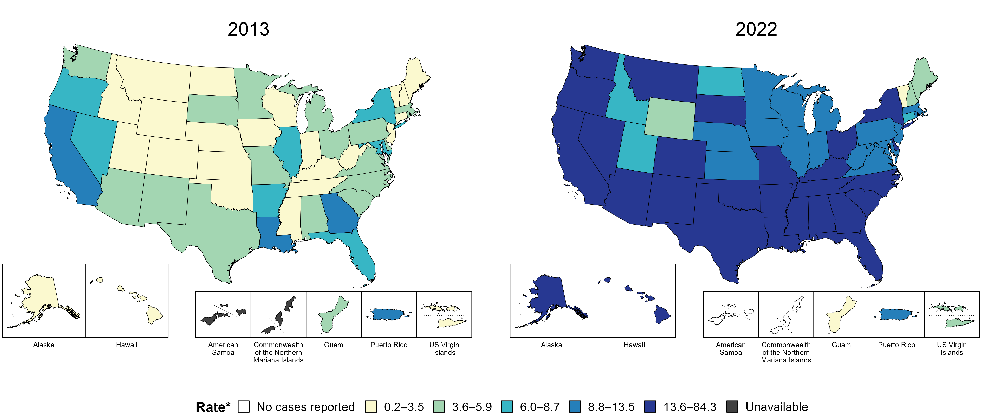
Primary and Secondary Syphilis — Rates of Reported Cases by Jurisdiction, United States and Territories, 2013 and 2022
* Per 100,000
https://www.cdc.gov/std/statistics/2022/figures.htm
Notes:
In 2013, three states, the District of Columbia (DC), and one US territory (9.3% of areas with available data) had a rate of reported primary and secondary syphilis greater than or equal to 8.8 cases per 100,000 population. This increased to 42 states, DC, and one US territory (78.6% of areas with available data) in 2022.
American Samoa and the Commonwealth of the Northern Mariana Islands began reporting data on primary and secondary syphilis cases to CDC in 2018; data are not available for those areas prior to that year.
This report includes data from years that coincide with the COVID-19 pandemic, which introduced uncertainty and difficulty in interpreting STI surveillance data. See Impact of COVID-19 on STIs for more information.
See Technical Notes (https://www.cdc.gov/std/statistics/2022/technical-notes.htm) for information on syphilis case reporting and on interpreting reported rates in US territories.
Data for all figures are available at https://www.cdc.gov/std/statistics/2022/data.zip. The file “PS Syphilis - Rates by Jurisdiction (US and Terr 2013 and 2022).xlsx” contains the data for the figure presented on this slide.

Slide 4
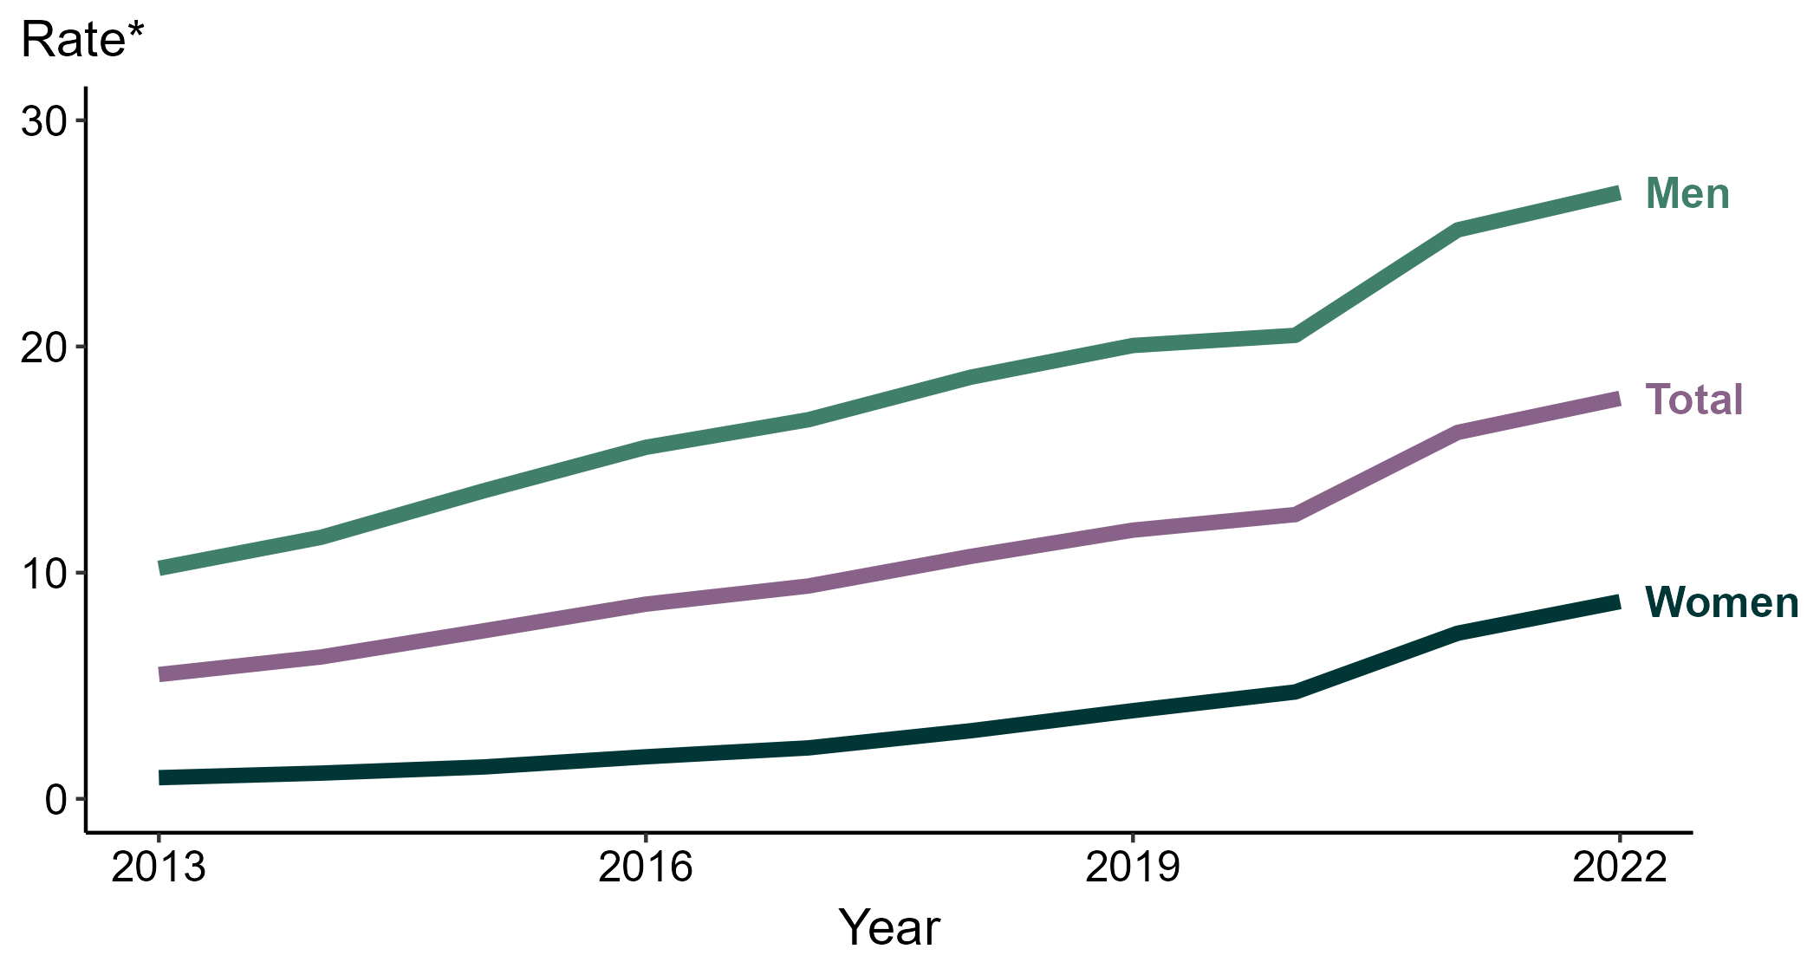
Primary and Secondary Syphilis — Rates of Reported Cases by Sex, United States, 2013–2022
* Per 100,000
https://www.cdc.gov/std/statistics/2022/figures.htm
Notes:
During 2021 to 2022, the rate of reported primary and secondary syphilis among women increased 19.2% (from 7.3 to 8.7 per 100,000) and the rate among men increased 6.3% (from 25.2 to 26.8 per 100,000).
Over the last five years, the rate of reported primary and secondary syphilis among women increased 190.0% (from 3.0 to 8.7 per 100,000) and the rate among men increased 44.1% (from 18.6 to 26.8 per 100,000). Over the last 10 years, the rate among women increased 866.7% (from 0.9 to 8.7 per 100,000) and the rate among men increased 162.7% (from 10.2 to 26.8 per 100,000).
This report includes data from years that coincide with the COVID-19 pandemic, which introduced uncertainty and difficulty in interpreting STI surveillance data. See Impact of COVID-19 on STIs for more information.
See Technical Notes (https://www.cdc.gov/std/statistics/2022/technical-notes.htm) for information on syphilis case reporting. Table A1 (https://www.cdc.gov/std/statistics/2022/tables/a1.htm) provides information on unknown, missing, or invalid values of select variables.
Data for all figures are available at https://www.cdc.gov/std/statistics/2022/data.zip. The file “PS Syphilis - Rates by Sex (US 2013-2022).xlsx” contains the data for the figure presented on this slide.

Slide 5
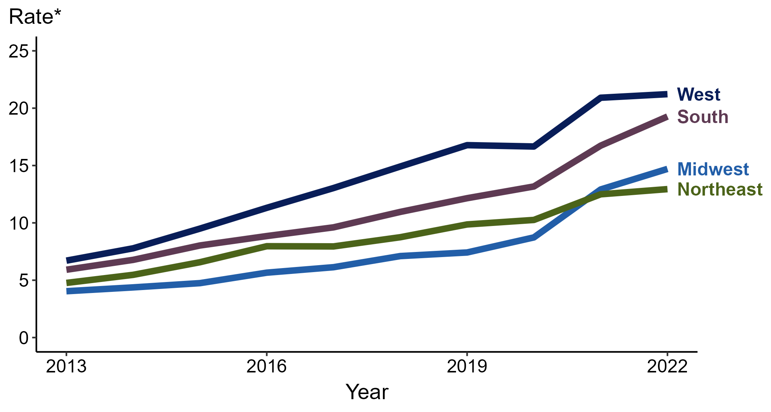
Primary and Secondary Syphilis — Rates of Reported Cases by Region, United States, 2013–2022
* Per 100,000
https://www.cdc.gov/std/statistics/2022/figures.htm
Notes:
In 2022, the West had the highest rate of reported primary and secondary (P&S) syphilis (21.2 cases per 100,000; 1.4% increase from 2021), followed by the South (19.3 cases per 100,000; 15.6% increase from 2021), the Midwest (14.7 cases per 100,000; 14.0% increase from 2021), and the Northeast (12.9 cases per 100,000; 3.2% increase from 2021).
The Midwest had the greatest five-year increase in rates of reported cases of P&S syphilis (7.1 to 14.7 per 100,000; 107.0% increase from 2018). The Midwest also had the greatest 10-year increase in rates of reported cases of P&S syphilis (4.0 to 14.7 per 100,000; 267.5% increase from 2013).
This report includes data from years that coincide with the COVID-19 pandemic, which introduced uncertainty and difficulty in interpreting STI surveillance data. See Impact of COVID-19 on STIs for more information.
See Technical Notes (https://www.cdc.gov/std/statistics/2022/technical-notes.htm) for information on syphilis case reporting.
Data for all figures are available at https://www.cdc.gov/std/statistics/2022/data.zip. The file “PS Syphilis - Rates by Region (US 2013-2022).xlsx” contains the data for the figure presented on this slide.

Slide 6
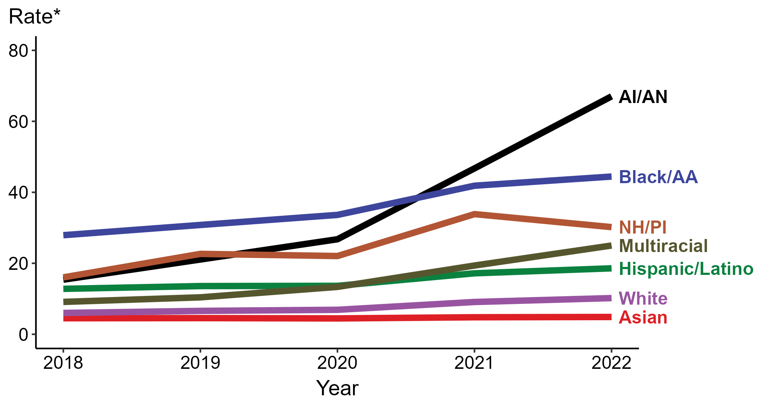
Primary and Secondary Syphilis — Rates of Reported Cases by Race/Hispanic Ethnicity, United States, 2018–2022
* Per 100,000
ACRONYMS: AI/AN = American Indian or Alaska Native; Black/AA = Black or African American; NH/PI = Native Hawaiian or other Pacific Islander
https://www.cdc.gov/std/statistics/2022/figures.htm
Notes:
In 2022, the highest rate of reported primary and secondary syphilis cases per 100,000 persons was among non-Hispanic American Indian or Alaska Native persons (67.0), followed by non-Hispanic Black or African American persons (44.4).
During 2021 to 2022, the greatest increase in rate of reported primary and secondary syphilis cases per 100,000 persons was among non-Hispanic American Indian or Alaska Native persons (46.7 to 67.0; 43.5% increase). Non-Hispanic American Indian or Alaska Native persons also had the greatest five-year increase in rate of reported primary and secondary syphilis (15.4 to 67.0; 335.1% increase from 2018).
During 2021 to 2022, the only decrease in rate of reported primary and secondary syphilis cases per 100,000 persons was among non-Hispanic Native Hawaiian or other Pacific Islander persons (33.9 to 30.2; 10.9% decrease). There were no decreases in the rate of reported primary and secondary syphilis among any race or Hispanic ethnicity group during 2018 to 2022.
This report includes data from years that coincide with the COVID-19 pandemic, which introduced uncertainty and difficulty in interpreting STI surveillance data. See Impact of COVID-19 on STIs for more information.
See Technical Notes (https://www.cdc.gov/std/statistics/2022/technical-notes.htm) for information on syphilis case reporting, race/Hispanic ethnicity categorization, and reporting of race/Hispanic ethnicity for STI cases. Table A1 (https://www.cdc.gov/std/statistics/2022/tables/a1.htm) provides information on unknown, missing, or invalid values of select variables.
Data for all figures are available at https://www.cdc.gov/std/statistics/2022/data.zip. The file “PS Syphilis - Rates by Race Hispanic Ethnicity (US 2018-2022).xlsx” contains the data for the figure presented on this slide.

Slide 7
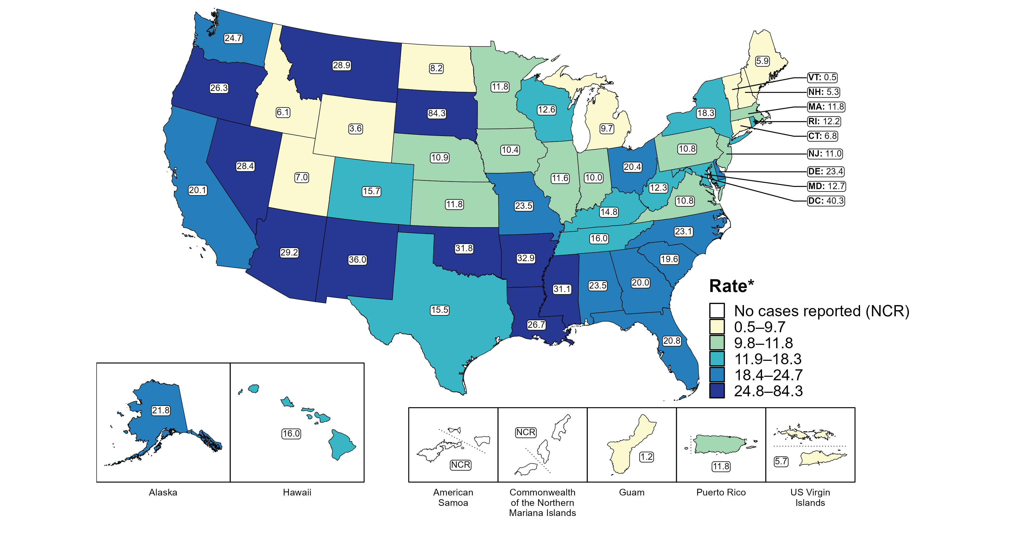
Primary and Secondary Syphilis — Rates of Reported Cases by Jurisdiction, United States and Territories, 2022
* Per 100,000
https://www.cdc.gov/std/statistics/2022/figures.htm
Notes:
In 2022, rates of reported primary and secondary (P&S) syphilis ranged by state from 0.5 cases per 100,000 population in Vermont to 84.3 cases per 100,000 population in South Dakota. The rate of reported P&S syphilis in the District of Columbia was 40.3 per 100,000 population.
Among US territories reporting any cases, rates of reported P&S syphilis ranged from 1.2 cases per 100,000 population in Guam to 11.8 cases per 100,000 population in Puerto Rico. No cases of P&S syphilis were reported in American Samoa and the Commonwealth of the Northern Mariana Islands.
This report includes data from years that coincide with the COVID-19 pandemic, which introduced uncertainty and difficulty in interpreting STI surveillance data. See Impact of COVID-19 on STIs for more information.
See Technical Notes (https://www.cdc.gov/std/statistics/2022/technical-notes.htm) for information on syphilis case reporting and on interpreting reported rates in US territories.
Data for all figures are available at https://www.cdc.gov/std/statistics/2022/data.zip. The file “PS Syphilis - Rates by Jurisdiction (US and Terr 2022).xlsx” contains the data for the figure presented on this slide.

Slide 8
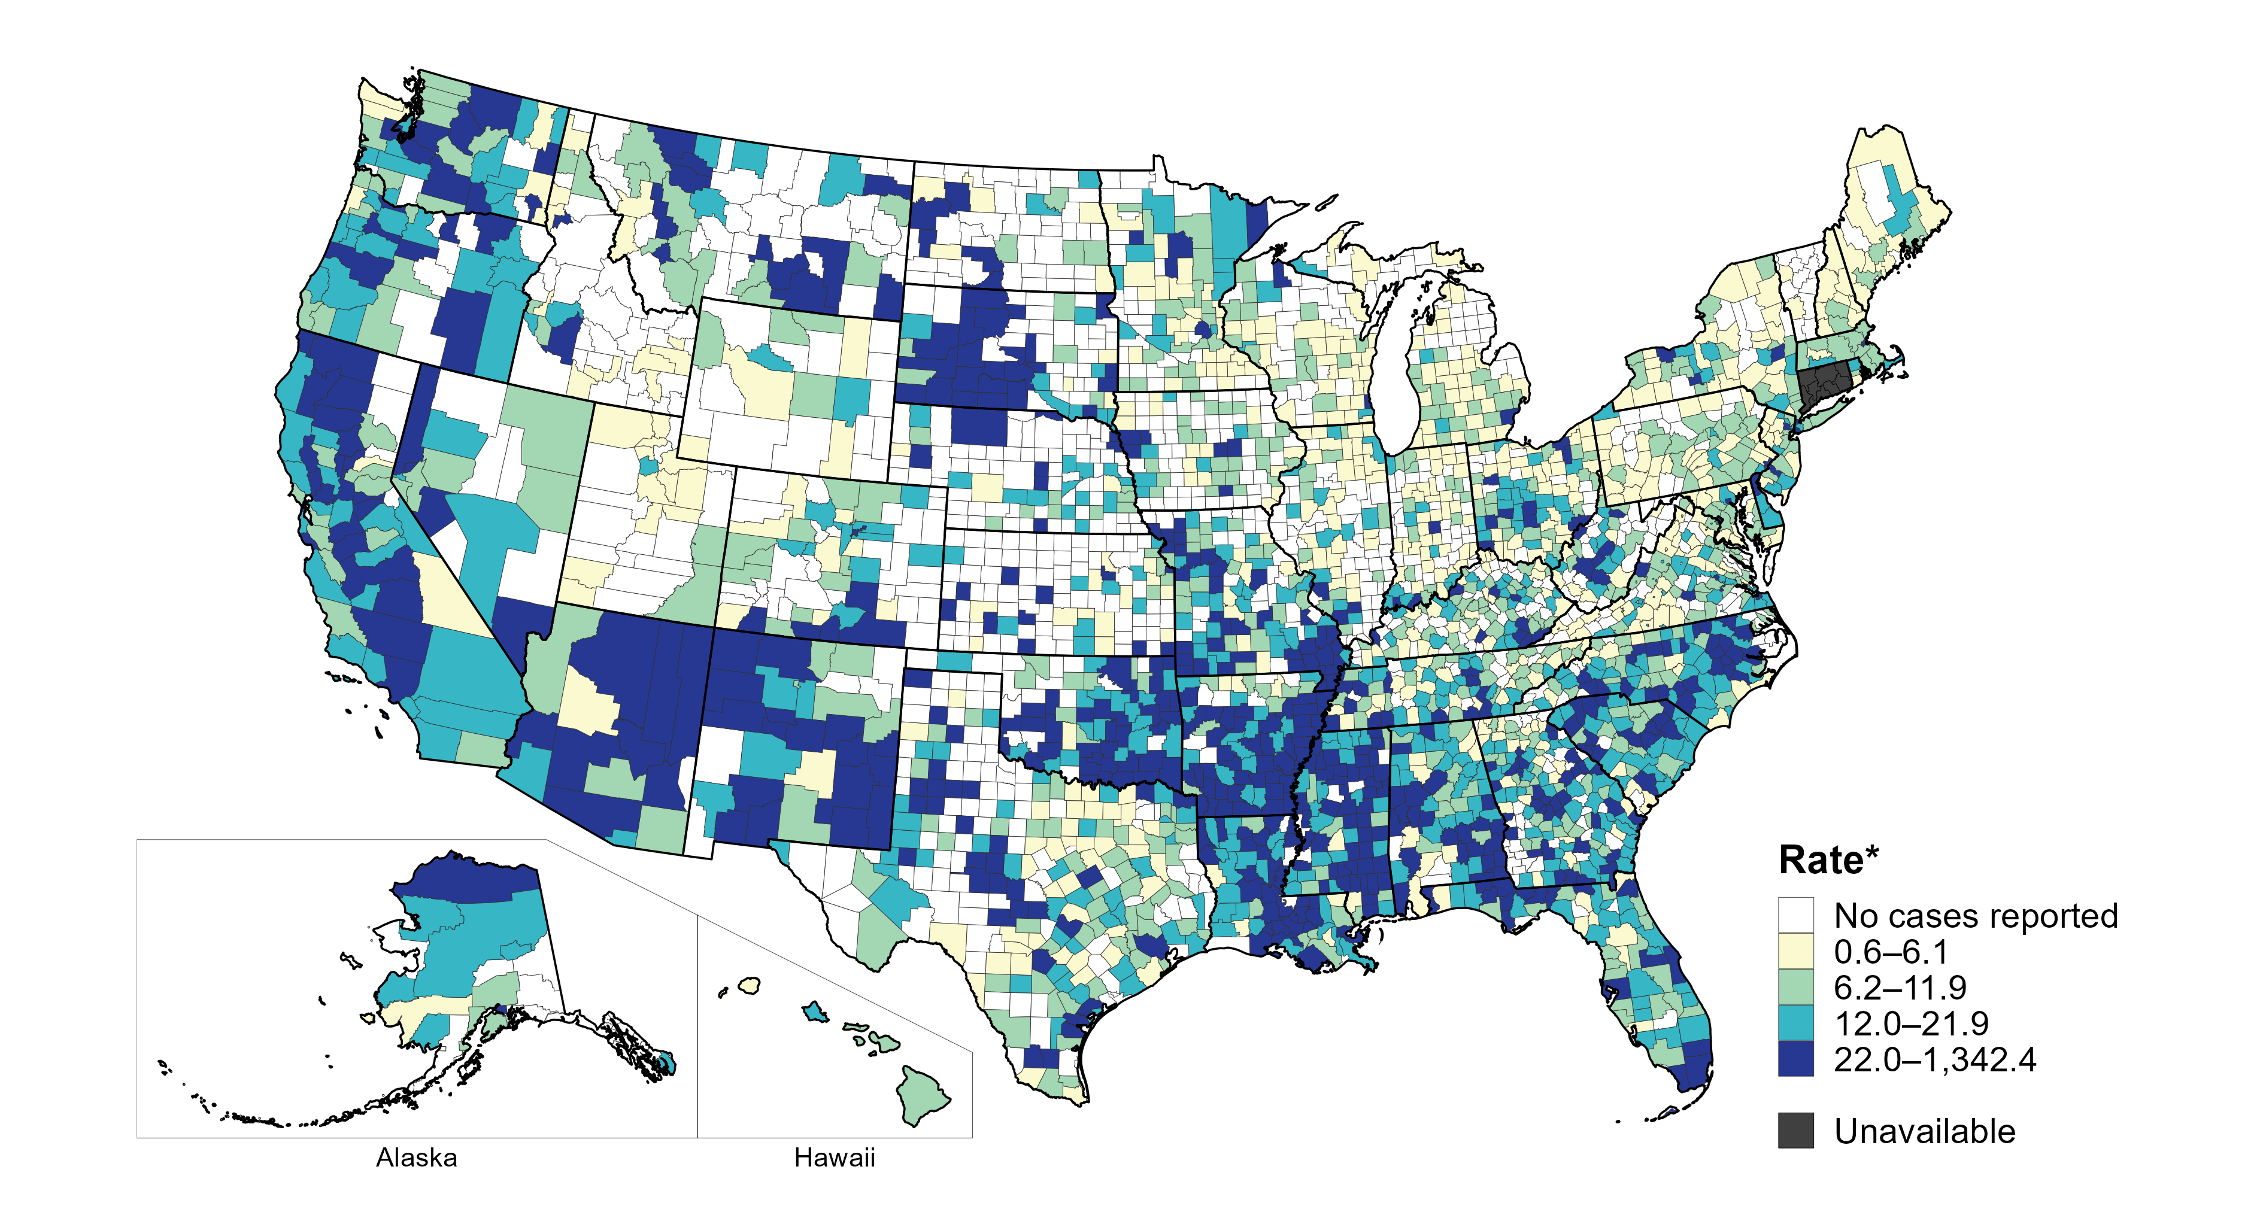
Primary and Secondary Syphilis — Rates of Reported Cases by County, United States, 2022
* Per 100,000
Notes:
In 2022, 70% of counties and county equivalents with available data in the United States reported at least one case of primary and secondary syphilis. Out of 3,135 counties and county equivalents with available data, 70 (2%) reported half of all cases of primary and secondary syphilis.
In 2022, Connecticut adopted nine planning regions as county-equivalent geographic units; as STI case notification data were not available in the new county-equivalent units for 2022, data for Connecticut have been suppressed for this figure.
This report includes data from years that coincide with the COVID-19 pandemic, which introduced uncertainty and difficulty in interpreting STI surveillance data. See Impact of COVID-19 on STIs for more information.
See Technical Notes (https://www.cdc.gov/std/statistics/2022/technical-notes.htm) for information on syphilis case reporting. Table A1 (https://www.cdc.gov/std/statistics/2022/tables/a1.htm) provides information on unknown, missing, or invalid values of select variables.
Data for all figures are available at https://www.cdc.gov/std/statistics/2022/data.zip. The file “PS Syphilis - Rates by County (US 2022).xlsx” contains the data for the figure presented on this slide.

Slide 9
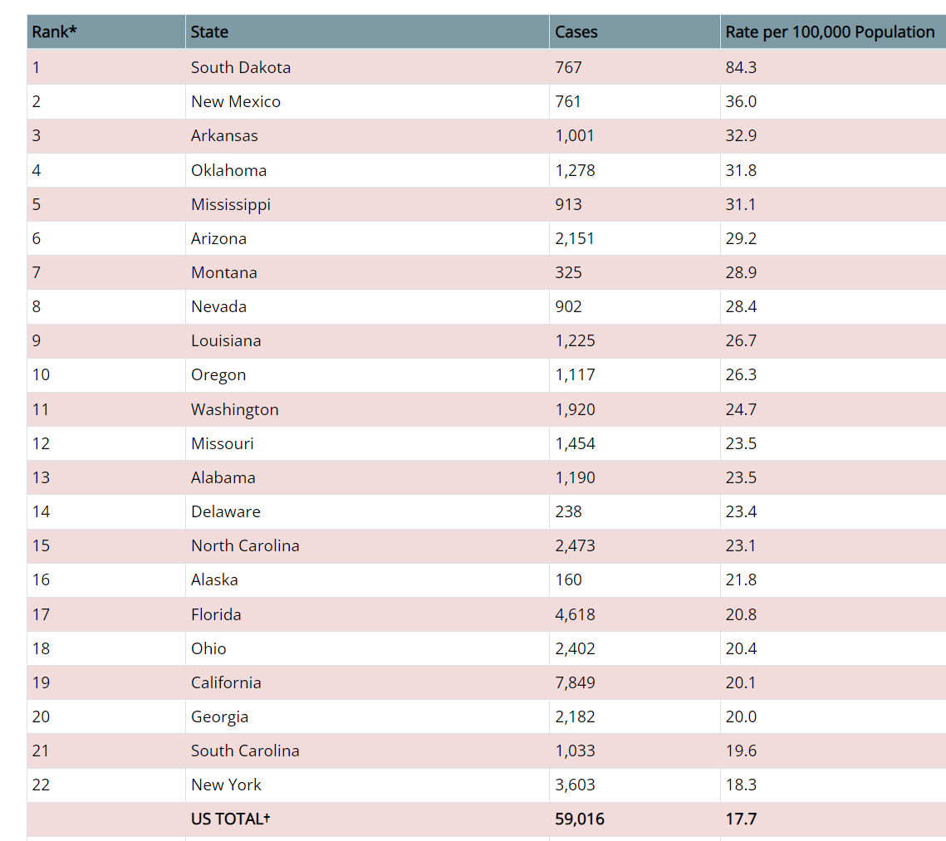
Primary and Secondary Syphilis — Reported Cases and Rates by State,
United States, 2022
https://www.cdc.gov/std/statistics/2022/tables/21.htm

Slide 10
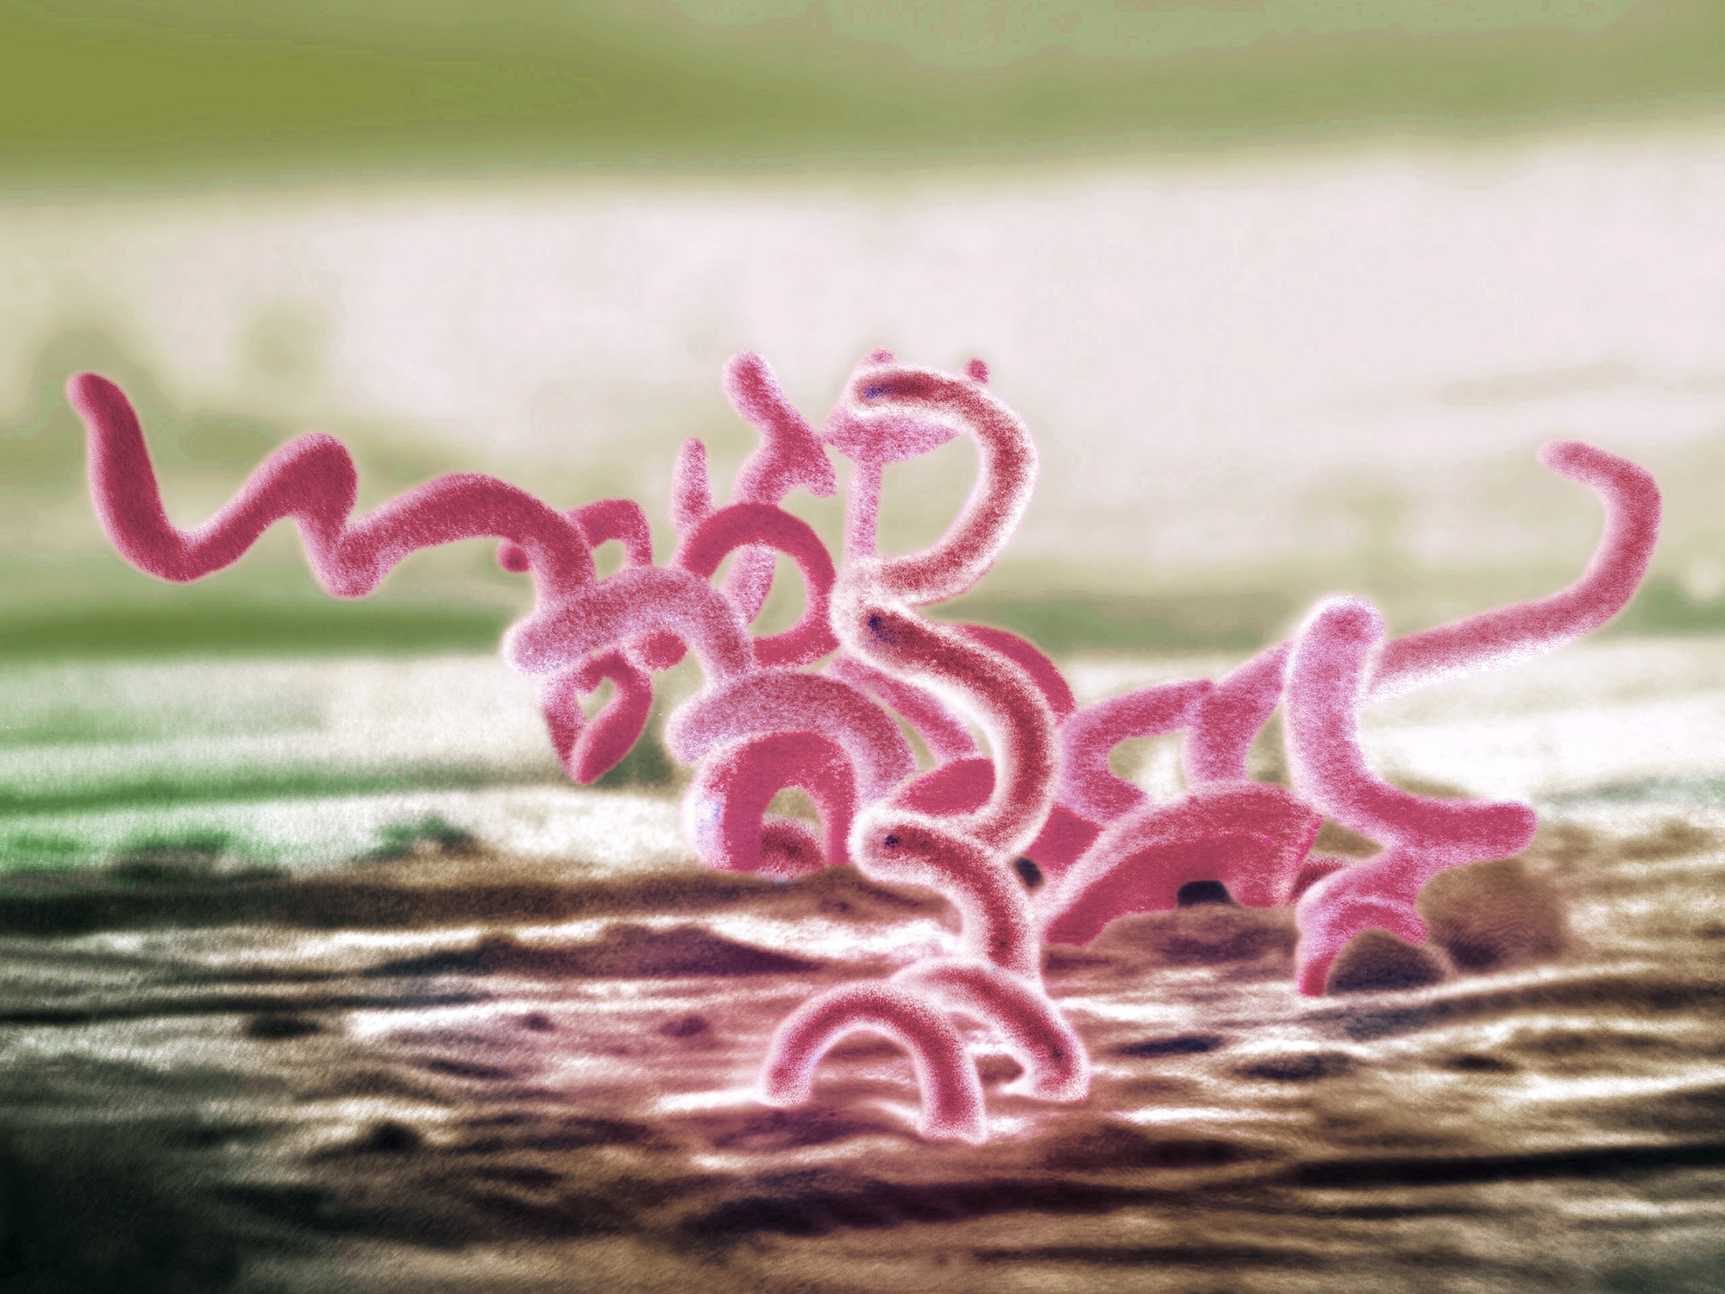
Syphilis
Treponema pallidum
Sexual, vertical, and horizontal transmission
Curable with penicillin
4 stages
  Primary
  Secondary
  Early (non-primary, non-secondary)
  Unknown duration or late
Notes:
Horizontal transmission is rare but can occur from blood transfusion or organ transplantation “Prior to the standard practice of using gloves by healthcare providers, there were reports of extragenital syphilitic lesions on the fingers and in the nose of physicians.^{12,39} In addition, the transmission of syphilis via human bite in both sexual and non-sexual circumstances has been reported,^{13–15} as well as transmission via mouth-to-mouth feeding of infants with pre-chewed food from infected relatives”
Stoltey JE, Cohen SE. Syphilis transmission: a review of the current evidence. Sex Health. 2015;12(2):103-109. doi:10.1071/SH14174
Tertiary syphilis is no longer consider a stage of syphilis rather the clinical signs are called “late”

Slide 11
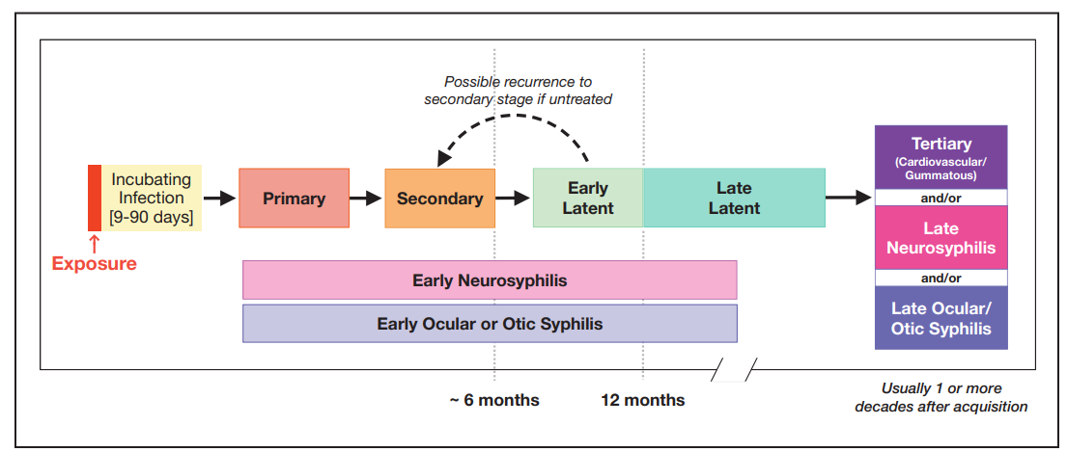
Natural History of Untreated Syphilis Infection
Transmission to fetus during pregnancy
The Diagnosis, Management and Prevention of Syphilis An Update and Review. New York City Department of Health and Mental Hygiene Bureau of
Sexually Transmitted Infections and the New York City STD Prevention Training Center . May 2019. https://www.nycptc.org/x/Syphilis_Monograph_2019_NYC_PTC_NYC_DOHMH.pdf

Slide 12
Case Definitions: Primary Syphilis
Clinical Description
Characterized by one or more ulcerative lesions (e.g. chancre), which might differ in clinical appearance.
Classic Presentation
Single painless ulcer or chancre at the site of infection
Atypical Presentation
Multiple, atypical, or painful lesions at the site of infection
Vaginal
Tongue
Penile
https://www.cdc.gov/std/syphilis/images.htm and https://www.cdc.gov/std/statistics/2019/case-definitions.htm
Notes:
Case Definitions in Effect During 2019 (cdc.gov)
“Syphilis, primary
Clinical description
A stage of infection with Treponema pallidum characterized by one or more ulcerative lesions (e.g., chancre), which might differ considerably in clinical appearance.
Laboratory criteria for diagnosis
Confirmatory:
Demonstration of T. pallidum by darkfield microscopy in a clinical specimen that was not obtained from the oropharynx and is not potentially contaminated by stool, OR
Demonstration of T. pallidum by polymerase chain reaction (PCR) or equivalent direct molecular methods in any clinical specimen.
Supportive:
A reactive nontreponemal serologic test (Venereal Disease Research Laboratory [VDRL], rapid plasma reagin [RPR], or equivalent serologic methods), OR
A reactive treponemal serologic test (T. pallidum particle agglutination [TP-PA], enzyme immunoassay [EIA], chemiluminescence immunoassay [CIA], or equivalent serologic methods).*
* These treponemal tests supersede older testing technologies, including microhemagglutination assay for antibody to T. pallidum [MHA-TP].
Case classification
Probable: a case that meets the clinical description of primary syphilis and the supportive laboratory criteria.
Confirmed: a case that meets the clinical description of primary syphilis and the supportive confirmatory criteria.”

Slide 13
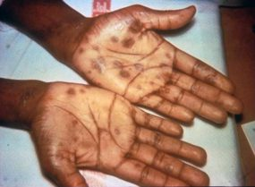
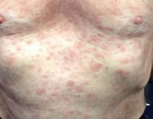
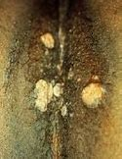
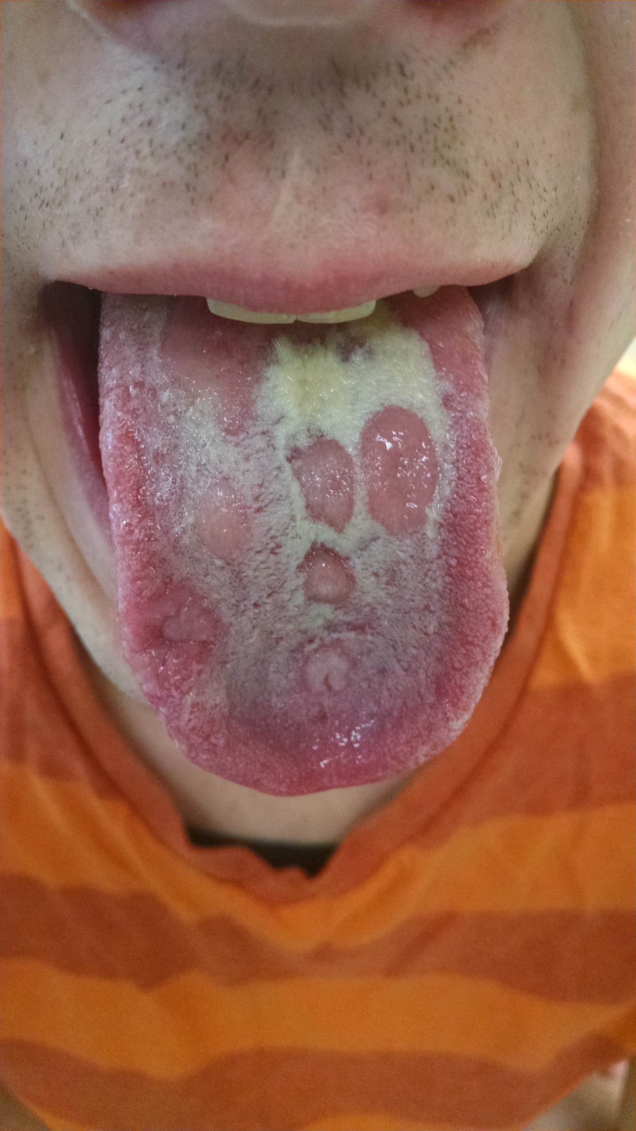
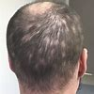
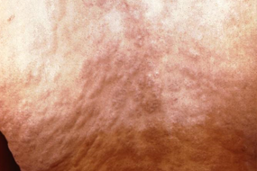
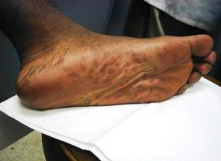
Case Definitions: Secondary Syphilis
Clinical Description
Characterized by localized or diffuse mucocutaneous lesions (e.g., rash – such as non-pruritic macular, maculopapular, papular, or pustular lesions), often with generalized lymphadenopathy. Other signs can include mucous patches, condyloma lata, and alopecia. The primary ulcerative lesion may still be present.
Torso/back rash
Palmar/plantar rash
Condyloma lata
Alopecia
Mucous patches
https://www.cdc.gov/std/syphilis/images.htm
https://www.cdc.gov/std/statistics/2019/case-definitions.htm
Notes:
Case Definitions in Effect During 2019 (cdc.gov)
“A stage of infection caused by T. pallidum characterized by localized or diffuse mucocutaneous lesions (e.g., rash – such as non-pruritic macular, maculopapular, papular, or pustular lesions), often with generalized lymphadenopathy. Other symptoms can include mucous patches, condyloma lata, and alopecia. The primary ulcerative lesion may still be present. Because of the wide array of symptoms and signs possibly indicating secondary syphilis, serologic tests for syphilis and a physical examination are crucial to determining if a case should be classified as secondary syphilis.
Laboratory criteria for diagnosis
Confirmatory:
Demonstration of T. pallidum by darkfield microscopy in a clinical specimen that was not obtained from the oropharynx and is not potentially contaminated by stool, OR
Demonstration of T. pallidum by polymerase chain reaction (PCR) or equivalent direct molecular methods in any clinical specimen.
Supportive:
A reactive nontreponemal serologic test (VDRL, RPR, or equivalent serologic methods), AND
A reactive treponemal serologic test (TP-PA, EIA, CIA, or equivalent serologic methods).”

Slide 14
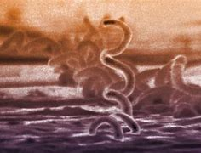
Case Definitions: Early (non-primary non-secondary)
Clinical Description
Stage of infection caused by T. pallidum in which initial infection has occurred within the previous 12 months, but there are no current signs or symptoms of primary or secondary syphilis.
Less than 12 months duration by (1) interval from prior negative syphilis test (or 4-fold titer increase) OR (2) report of symptoms consistent with syphilis within prior 12 months OR (3) sexual contact with a known case (or sexual debut) within prior 12 months
https://www.cdc.gov/std/statistics/2019/case-definitions.htm)
Notes:
Case Definitions in Effect During 2019 (cdc.gov)
“Case classification
Probable: a person with no clinical signs or symptoms of primary or secondary syphilis who has one of the following:
No prior history of syphilis, AND a current reactive nontreponemal test (e.g., VDRL, RPR, or equivalent serologic methods), AND a current reactive treponemal test (e.g., TP-PA, EIA, CIA, or equivalent serologic methods), OR
A prior history of syphilis and meets the supportive laboratory criteria.
AND evidence of having acquired the infection within the previous 12 months based on one or more of the following criteria:
Documented seroconversion or fourfold or greater increase in titer of a nontreponemal test during the previous 12 months, unless there is evidence that this increase was not sustained for >2 weeks
Documented seroconversion of a treponemal test during the previous 12 months
A history of symptoms consistent with primary or secondary syphilis during the previous 12 months
Meets epidemiologic criteria.
Epidemiological criteria:
A history of sexual exposure to a partner within the previous 12 months who had primary, secondary, or early non-primary non-secondary syphilis (documented independently as duration <12 months).
Only sexual contact (sexual debut) was within the previous 12 months.”

Slide 15
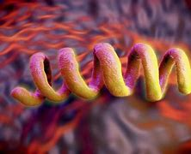
Case Definitions: Unknown duration or late
Clinical Description
Stage of infection caused by T. pallidum in which initial infection has occurred >12 months previously or in which there is insufficient evidence to conclude that infection was acquired during the previous 12 months.
Unknown or greater than 12 months duration by: (1) interval from prior negative syphilis test (or 4-fold titer increase) OR (2) report of symptoms consistent with syphilis occurring > 12 months ago OR (3) sexual contact with a known case > 12 months ago (4) Neurologic, ocular, otic signs without evidence of acquiring infection in prior 12 months.
Notes:
Case Definitions in Effect During 2019 (cdc.gov)
“Syphilis, unknown duration or late
Clinical description
A stage of infection caused by T. pallidum in which initial infection has occurred >12 months previously or in which there is insufficient evidence to conclude that infection was acquired during the previous 12 months.
Case classification
Probable: a person with no clinical signs or symptoms of primary or secondary syphilis who meets one of the following sets of criteria:
No prior history of syphilis, and a current reactive nontreponemal test (e.g., VDRL, RPR, or equivalent serologic methods), and a current reactive treponemal test (e.g., TP-PA, EIA, CIA, or equivalent serologic methods), OR
A prior history of syphilis, and a current nontreponemal test titer demonstrating fourfold or greater increase from the last nontreponemal test titer, unless there is evidence that this increase was not sustained for >2 weeks, OR
Clinical signs or symptoms and laboratory results that meet the likely or verified criteria for neurologic, ocular, otic, or late clinical manifestations syphilis (see below)
AND who has no evidence of having acquired the disease within the preceding 12 months (see Syphilis, early non-primary non-secondary).
Comments: Although cases of syphilis of unknown duration are grouped together with late syphilis for the purposes of surveillance, the conservative clinical and public health responses to these cases will differ when there is uncertainty about the duration of infection. When faced with uncertainty, clinicians should act conservatively and treat unknown duration syphilis as if it were late infection, with three doses of benzathine penicillin. In contrast, the most conservative approach for STD control programs would be to manage cases of syphilis of unknown duration as early non-primary non-secondary infections and search for partners who may have been recently infected. Because this would not be feasible for most STD control programs, programs should consider prioritizing cases of syphilis of unknown duration with higher nontreponemal titers (e.g., 1:32 or higher) for investigation and partner services. Although nontreponemal titers cannot reliably distinguish between early infection (<12 months duration) and late infection (>12 months duration), nontreponemal titers usually are higher early in the course of syphilis infection.

Slide 16

Best Practice: Indian Health Service (I H S)
Syphilis Screening Recommendations
The Indian Health Service recommends universal 3 time-point syphilis screening during pregnancy/delivery
At the first prenatal visit
In the beginning of the third trimester
At delivery
*Pregnant people using drugs often avoid pre-natal care due to fear of punitive measures. Emergency Departments/Urgent Care settings are critical partners in providing testing and treatment.
The Indian Health Service recommends universal screening for syphilis among persons ages 13 and older
“Annual syphilis testing for persons aged 13 and older to eliminate syphilis transmission by early case recognition”.
“Turn on the annual EHR reminder at all sites to facilitate testing for two years or until incidence rates decrease locally to baseline”
Expand screening in emergency/urgent care settings
Stop-Syphilis-Letter-2-15-24.pdf (indiancountryecho.org)
Notes:
In recognition of high rates of congenital syphilis among AI/AN, I H S recommends expanded universal 3 timepoint screening for syphilis in pregnancy and universal syphilis screening annually for persons 13 and older. This includes expanded screening in emergency departments and urgent care clinics where persons using substances may seek healthcare. .
The IHS Chief Medical Officer writes to Tribal Leaders and Urban Indian Organization Leaders to share an update on efforts by the Agency to address the syphilis epidemic in Indian Country. Updated Feb 2024

Slide 17

Best Practice: Provide “Express” STI Testing
Express STI services refer to triage-based STI testing without needing an appointment or full clinical exam.
Express STI services:
1. increase clinic capacity and
2. reduce the time to treatment.
https://www.indiancountryecho.org/resources/sample-toolkit-for-express-sti-resources/
Notes:
To overcome barriers of limited patient access to care, and limited clinical staff resources. Express testing allows for “walk up” testing without an appointment and without a clinical exam. . This expedited care model facilitates ‘on-demand’ STI which may be more accessible to persons using substances.

Slide 18
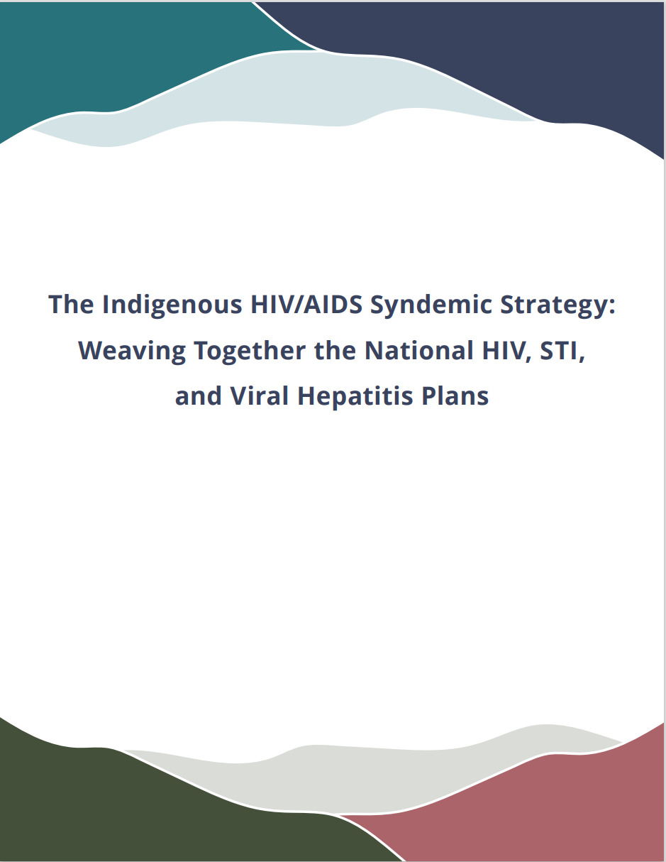
Overlapping Epidemics:
“Syndemic” Bundle for Screening
Indian Health Service “Syndemic Bundle”
Syphilis screening test with reflex RPR and TPPA
HIV serology (with documentation of consent if required in the local state jurisdiction)
Screening for gonorrhea and chlamydia at three sites: Urine, Pharynx, Rectum
Screening for hepatitis B and C
Pregnancy test
Stop-Syphilis-Letter-2-15-24.pdf (indiancountryecho.org)
https://www.indiancountryecho.org/indigenous-hiv-aids-syndemic-strategy/
Notes:
Alongside syphilis screening and in alignment with the National Syndemic Strategy for HIV, STI and Hepatitis., I H S recognizes the syndemic overlap of substance abuse along with other sexually transmitted conditions and thus uses a syndemic bundle approach to screening which includes pregnancy screening alongwith the STIs listed here.

Slide 19
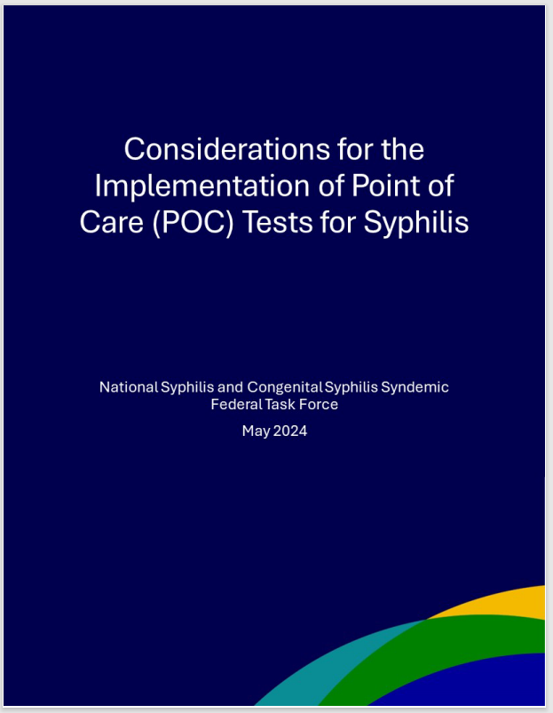
Where? In general, POC tests should be used where syphilis rates are high
Who? individuals who access health care infrequently and have difficulty with follow-up visits
How? POC tests generally can be conducted by trained non-clinical staff or clinicians within And outside clinical settings. Clinical staff can evaluate patients with positive POC test results and provide treatment at the same visit.
Why? In some settings and for some populations, the rapid results from a positive POC test create an opportunity to treat syphilis during the same visit
What else? POC tests should not be used in those previously diagnosed with syphilis.
https://www.hhs.gov/sites/default/files/nscss-considerations-for-the-implementation-of-syphilis-poc-tests.pdf

Slide 20
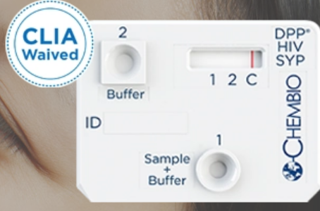
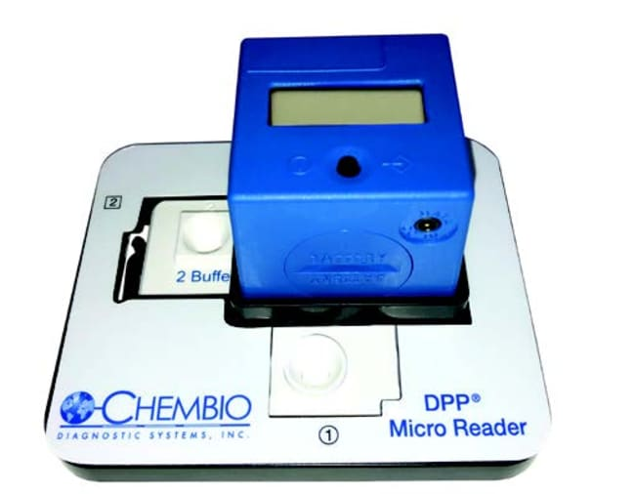
Rapid syphilis testing
Chembio
FDA-approved and CLIA-waived rapid dual HIV/syphilis test
Treponemal test component for syphilis
Sensitivity: >99% for HIV and >94% for T. pallidum
Sample volume: 10 μl
15-minute results for dual rapid test
Objective results using handheld
digital reader (DPP® Micro Reader)
DPP® HIV Syphilis USA – Chembio Diagnostics, Inc.

Slide 21
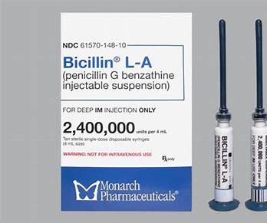
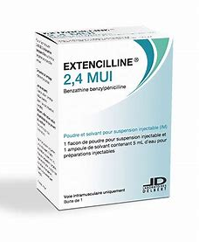
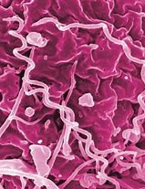
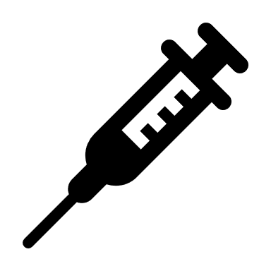
Secure the Supply of Benzathine Penicillin
https://www.cdc.gov/std/treatment-guidelines/default.htm
Notes:
Foundational to the syphilis response nationally is treatment with benzathine penicillin., the only recommended treatment for pregnant women. The national shortage of benzathine penicillin has affected the public health response to curbing the syphilis increases in the United States. The Indian Health Service has ensured that an adequate supply of benzathine penicillin is available for tribal members receiving care through I H S and tribal health facilities.

Slide 22
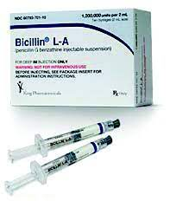
Treatment of syphilis in pregnant women
Stage
Primary | Secondary | Early non-primary, non secondary | Late Latent/ or Unknown Duration | Neurosyphilis, ocular syphilis and otic syphilis
Benzathine penicillin 2.4 million units IM in a single dose | Benzathine penicillin 2.4 million units IM in a single dose | Benzathine penicillin 2.4 million units IM in a single dose | Benzathine penicillin 2.4 million units total administered as 3 doses of 2.4 million units IM each at 1-week intervals | Aqueous crystalline penicillin G 18-24 million units per day, administered as 3-4 million units by IV every 4 hours or continuous infusion for 10-14 days Alternative: procaine penicillin G 2.4 million units IM 1x/day PLUS probenecid 500 mg orally 4x/day, both for 10-14 days
* Doxycycline is an alternative oral treatment for syphilis in Non-pregnant patients
https://www.cdc.gov/std/treatment-guidelines/default.htm

Slide 23
Penicillin Allergy
Patients often are incorrectly labeled as allergic to penicillin
  Evaluate what symptoms were experienced by patients with reported penicillin allergy
Penicillin allergy causing anaphylaxis is rare
  In studies that have incorporated penicillin skin testing and graded oral challenge among persons with reported penicillin allergy, the true rates of allergy are low, ranging from 1.5% to 6.1%.
Allergies wane over time:
  Approximately 80% of patients with a true IgE-mediated allergic reaction to penicillin have lost the sensitivity after 10 years
Desensitization is recommended for pregnant women diagnosed with syphilis followed by treatment with penicillin.
https://www.cdc.gov/std/treatment-guidelines/STI-Guidelines-2021.pdf .

Slide 24
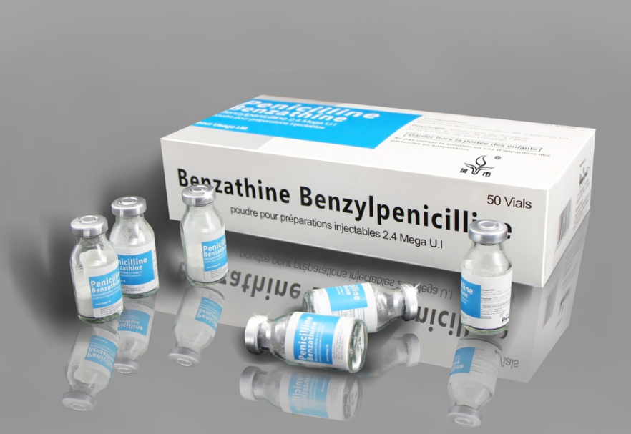
Field treatment with benzathine penicillin
Field treatment (non-clinical facility based) can be offered under standing orders and administered by nursing staff for patients with or exposed to syphilis who cannot access care at a facility due to:
    Pregnancy
    Substance use
    Transportation difficulties
    Childcare
    Privacy concerns
    Mental health issues
PHN Syphilis Field-Based Treatment Policy - Indian Country ECHO
Notes:
Providing injections of penicillin outside of clinical settings can ensure adequate treatment for patients with substance use disorder including those who are pregnant. Field treatment for syphilis using benzathine penicillin can overcome barriers related to transportation and privacy. Public Health Nurses and other medical providers within I H S can perform field injections of penicillin to facilitate adequate and complete treatment for syphilis.

Slide 25
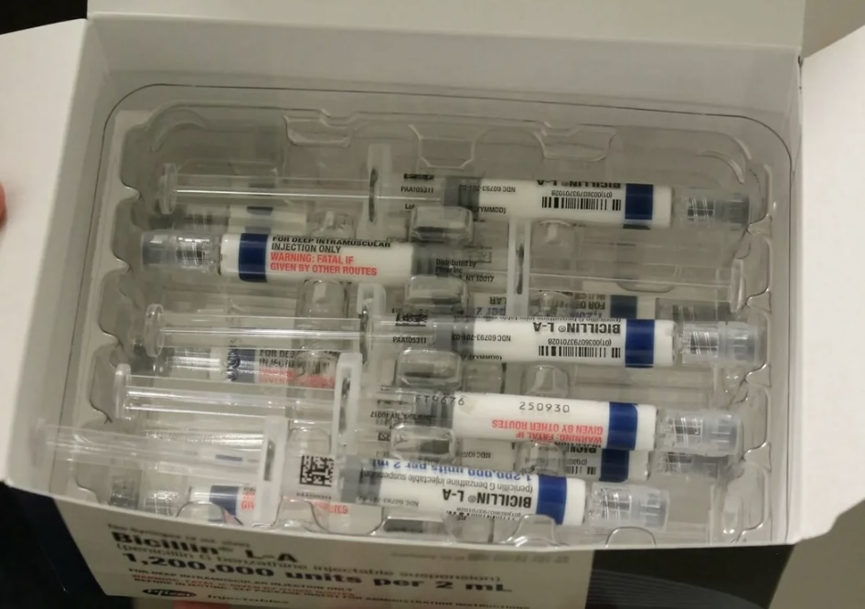
Presumptive treatment with
benzathine penicillin
Presumptive treatment prior to receiving syphilis test results is recommended:
    For patients with symptoms consistent with syphilis
    For sexual contacts to syphilis cases
    For patients testing positive using rapid testing prior to confirmatory results*
https://www.indiancountryecho.org/wp-content/uploads/2023/07/Stop-Syphilis-Letter-6-29-23.pdf
*Vital Signs: Missed Opportunities for Preventing Congenital Syphilis — United States, 2022 | MMWR (cdc.gov)
https://www.hhs.gov/sites/default/files/nscss-considerations-for-the-implementation-of-syphilis-poc-tests.pdf
Notes:
Providing penicillin treatment “presumptively” prior to being tested can expedite therapy and reduce loss to followup, inadequate treatment, and community transmission. It is recommended by I H S and CDC for patients with syphilis symptoms, sexual contacts, and for patients testing positive for syphilis using a rapid test. This is also a valuable option for syphilis patients using substances who may be unable or unwilling to attend clinical services.
I H S

Slide 26
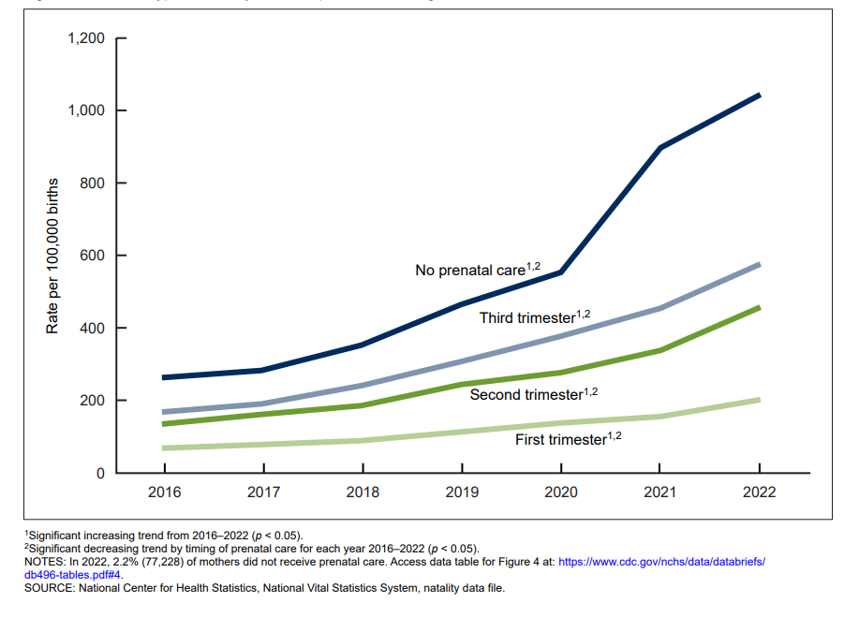
Maternal syphilis rate, by trimester prenatal care began: United States, 2016–2022

Slide 27
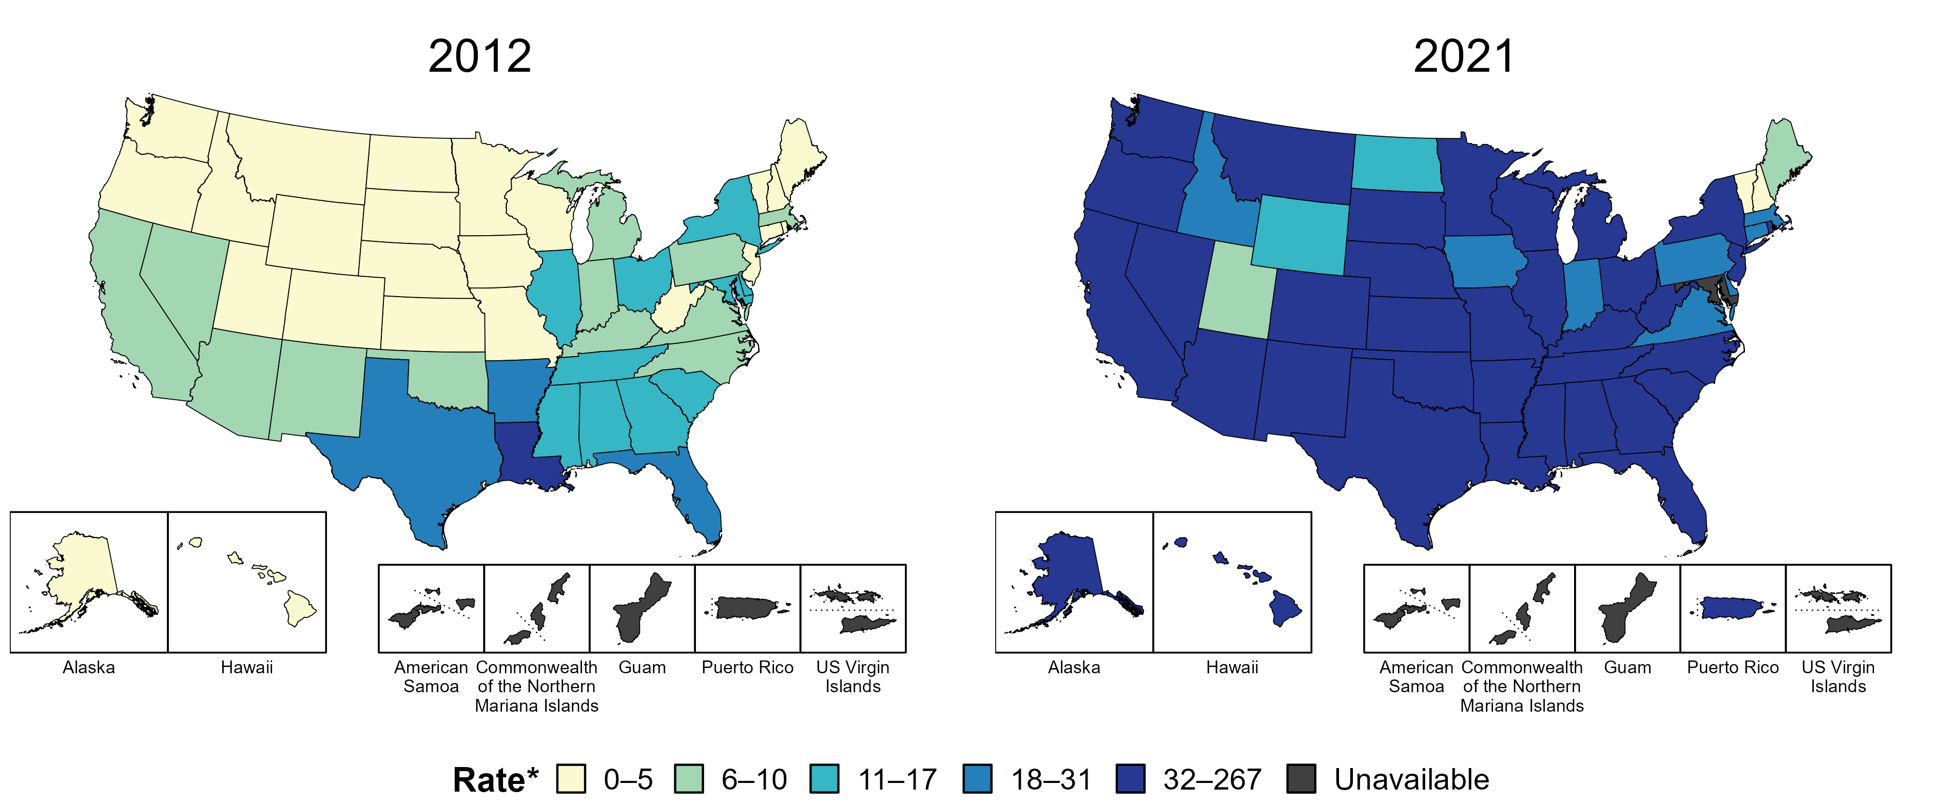
Syphilis (All Stages) — Rates of Reported Cases Among Women Aged 15–44 Years by State, United States and Territories, 2012 and 2021
* Per 100,000
https://www.cdc.gov/std/statistics/2021/figures.htm
Notes:
In 2012, four states and the District of Columbia (DC; 9.8% of areas with available data) had a rate of reported syphilis (all stages) greater than or equal to 18 cases per 100,000 women aged 15 to 44 years. This increased to 43 states, DC, and one US territory (88.2% of areas with available data) in 2021.
Data on reported cases of syphilis other than primary and secondary syphilis are not available by age and sex for American Samoa, the Commonwealth of the Northern Mariana Islands, Guam, and the US Virgin Islands. Additionally, population estimates by age and sex were not available in all territories in both years. Due to a network security incident in December 2021, the Maryland Department of Health could not finalize their 2021 STD case notification data. 2021 data from Maryland have been suppressed for this figure; however, they are included in national and regional case counts and rates displayed in other figures.
The COVID-19 pandemic has introduced uncertainty and difficulty in interpreting STD data collected during 2020 and 2021. See Impact of COVID-19 on STDs (https://www.cdc.gov/std/statistics/2021/impact.htm) for more information.
See Technical Notes (https://www.cdc.gov/std/statistics/2021/technical-notes.htm) for information on syphilis case reporting and on interpreting reported rates in US territories.
Data points are available at https://www.cdc.gov/std/statistics/2021/data.zip.

Slide 28
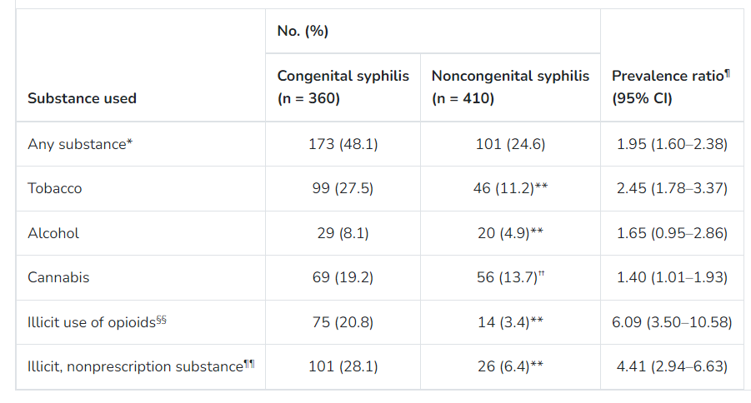
Substance Use Among Persons with Syphilis During Pregnancy— Arizona and Georgia, 2018–2021
Substance Use Among Persons with Syphilis During Pregnancy — Arizona and Georgia, 2018–2021 | MMWR (cdc.gov)

Slide 29
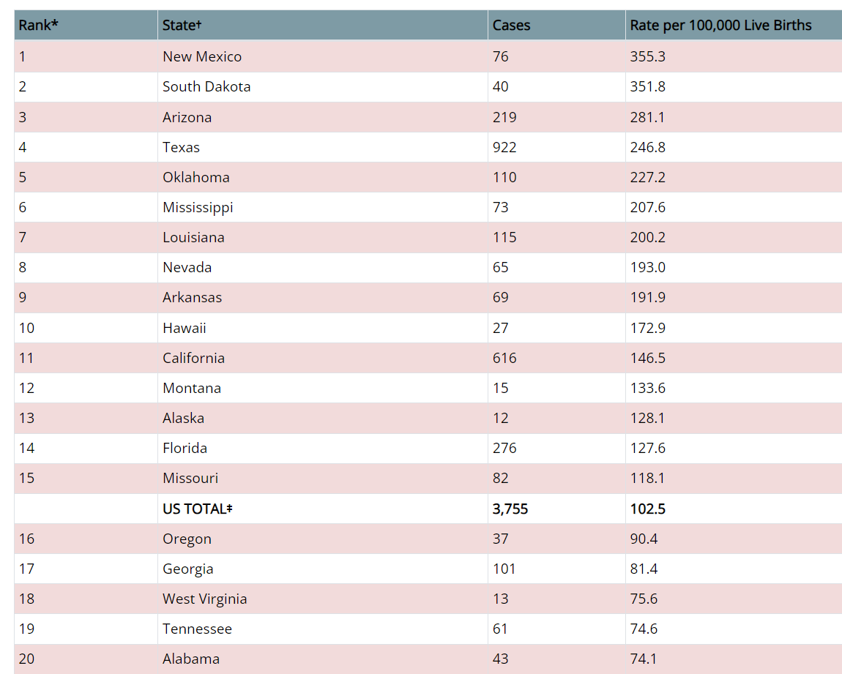
Congenital Syphilis — Reported Cases and Rates of Reported Cases by State, Ranked by Rates, United States, 2022
https://www.cdc.gov/std/statistics/2022/tables/31.htm

Slide 30
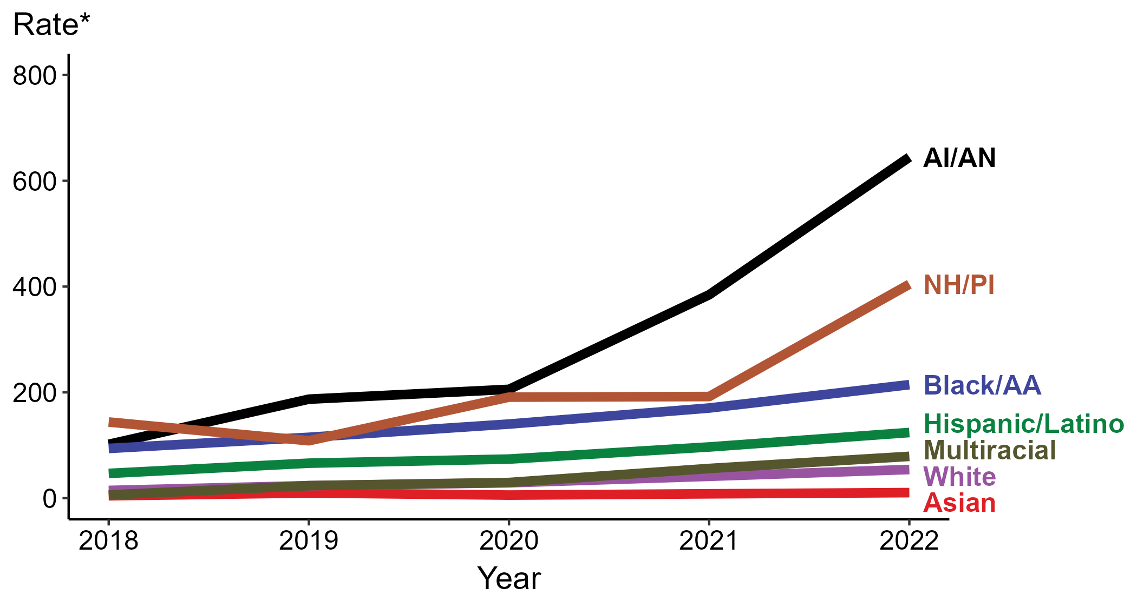
Congenital Syphilis — Rates of Reported Cases by Year of Birth, Race/Hispanic Ethnicity of Mother, United States, 2018–2022
* Per 100,000 live births
ACRONYMS: AI/AN = American Indian or Alaska Native; Black/AA = Black or African American; NH/PI = Native Hawaiian or other Pacific Islander
https://www.cdc.gov/std/statistics/2022/figures.htm
Notes:
In 2022, there were a total of 3,755 cases of congenital syphilis reported for a rate of 102.5 per 100,000 live births.
In 2022, the highest rate of reported cases of congenital syphilis per 100,000 live births was among mothers who were non-Hispanic American Indian or Alaska Native (644.7), followed by mothers who were non-Hispanic Native Hawaiian or other Pacific Islander (404.4).
During 2021 to 2022, the greatest increase in rate of reported cases of congenital syphilis per 100,000 live births was among mothers who were non-Hispanic Native Hawaiian or other Pacific Islander (192.1 to 404.4; 110.5% increase). Mothers who were non-Hispanic and of multiple races had the greatest five-year increase in rate of congenital syphilis (5.9 to 79.0; 1,239.0% increase from 2018).
There were no decreases in the rate of reported cases of congenital syphilis per 100,000 live births among any race or Hispanic ethnicity group during 2021 to 2022. There were also no decreases in the rate of congenital syphilis among any race or Hispanic ethnicity group during 2018 to 2022.
This report includes data from years that coincide with the COVID-19 pandemic, which introduced uncertainty and difficulty in interpreting STI surveillance data. See Impact of COVID-19 on STIs for more information.
See Technical Notes (https://www.cdc.gov/std/statistics/2022/technical-notes.htm) for information on syphilis case reporting, race/Hispanic ethnicity categorization, and reporting of race/Hispanic ethnicity for STI cases.
Data for all figures are available at https://www.cdc.gov/std/statistics/2022/data.zip. The file “CS - Rates by Race Hispanic Ethnicity of Mother (US 2022).xlsx” contains the data for the figure presented on this slide.

Slide 31
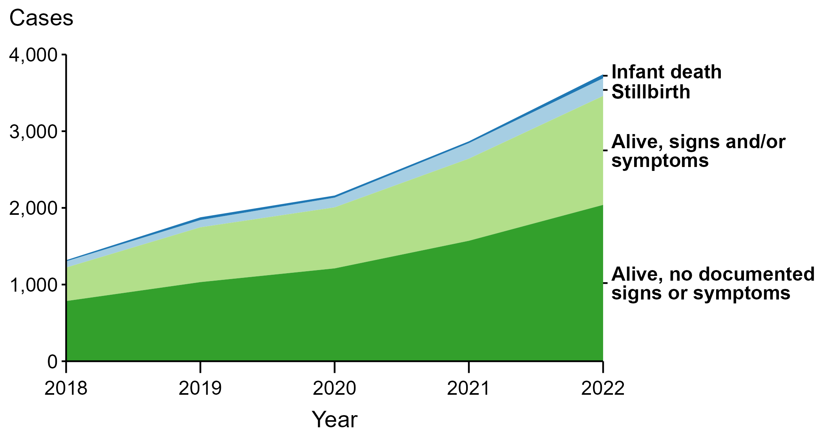
Congenital Syphilis — Reported Cases by Vital Status and Clinical Signs and Symptoms* of Infection, United States, 2018–2022
* Infants with signs and/or symptoms of congenital syphilis have documentation of at least one of the following: long bone changes consistent with congenital syphilis, snuffles, condylomata lata, syphilitic skin rash, pseudoparalysis, hepatosplenomegaly, edema, jaundice due to syphilitic hepatitis, reactive CSF-VDRL, elevated CSF WBC or protein values, or evidence of direct detection of T. pallidum.
NOTE: Of the 11,999 congenital syphilis cases reported during 2018 to 2022, 33 (0.3%) did not have sufficient information to be categorized.
https://www.cdc.gov/std/statistics/2022/figures.htm
Notes:
In 2022, there were a total of 3,755 cases of congenital syphilis reported for a rate of 102.5 per 100,000 live births.
In 2022, 51 congenital syphilis cases (1.4%) were infant deaths, 231 cases (6.2%) were stillbirths, 1,421 cases (37.8%) were born alive with congenital syphilis-related signs or symptoms, 2,039 cases (54.3%) were born alive with no documented congenital syphilis-related signs or symptoms, and 13 cases (0.3%) were missing information on vital status.
In 2022, there were 282 congenital syphilis-related deaths (231 stillbirths and 51 infant deaths), an increase of 24.8% from 2021 (226 in 2021 to 282 in 2022) and an increase of 193.8% from 2018 (96 in 2018 to 282 in 2022).
The number of infants reported with congenital syphilis who were born alive with congenital syphilis-related signs and symptoms increased 32.7% from 2021 to 2022 (1,071 in 2021 to 1,421 in 2022) and increased 225.2% from 2018 to 2022 (437 in 2018 to 1,421 in 2022).
This report includes data from years that coincide with the COVID-19 pandemic, which introduced uncertainty and difficulty in interpreting STI surveillance data. See Impact of COVID-19 on STIs for more information.
See Technical Notes (https://www.cdc.gov/std/statistics/2022/technical-notes.htm) for information on syphilis case reporting.
Data for all figures are available at https://www.cdc.gov/std/statistics/2022/data.zip. The file “CS - Cases by Vital Status and Clinical Signs and Symptoms (US 2018-2022).xlsx” contains the data for the figure presented on this slide.

Slide 32
Scenario 1: Confirmed, proven or highly probable congenital syphilis | Scenario 2: Possible congenital syphilis | Scenario 3: Congenital syphilis less likely | Scenario 4: Congenital syphilis unlikely
Neonate with: a physical exam consistent with CS serum quantitative nontreponemal serology 4-fold greater than mother’s or a positive darkfield or PCR test of placenta, body fluids or positive silver stain of placenta or cord | Neonate with a normal physical exam and a serum quantitative nontreponemal serologic titer equal to or < 4-fold of the maternal titer at delivery and one of the following: • The mother was not treated, was inadequately treated, or has no documentation of treatment. • The mother was treated with erythromycin, or a regimen not recommended in these guidelines • The mother received recommended regimen, but treatment was initiated <30 days before delivery. | Neonate with a normal physical examination and a serum quantitative nontreponemal serologic titer equal or <4-fold of the maternal titer at delivery and both of the following are true: • The mother was treated during pregnancy, treatment was appropriate for the infection stage, and the treatment regimen was initiated ≥30 days before delivery. • The mother has no evidence of reinfection or relapse | Neonate with: a normal physical exam serum quantitative nontreponemal serology equal to or less than 4-fold mother’s at delivery and Mother’s treatment was adequate before pregnancy Mother’s nontreponemal titer remained low and stable before and during pregnancy and at delivery
Evaluation: CSF with VDRL, cell ct, protein, CBC/diff, long bone radiographs, neurologic eval (eye, auditory, imaging) | CSF analysis for VDRL, cell count, and protein** CBC, differential, long-bone radiographs | No evaluation is recommended | No evaluation is recommended
Treatment: Aqueous crystalline penicillin G 100,000–150,000 units/kg/body wt./day, administered as 50,000 units/kg body wt./dose IV q 12 hours during the first 7 days of life and q 8 hours thereafter for a total of 10 days OR Procaine penicillin G 50,000 units/kg body weight/dose IM in a single daily dose for 10 days | Treatment: Aqueous crystalline penicillin G 100,000–150,000 units/kg/body wt./day, administered as 50,000 units/kg body wt./dose IV q 12 hours during the first 7 days of life and q 8 hours thereafter for a total of 10 days OR Procaine penicillin G 50,000 units/kg body weight/dose IM in a single daily dose for 10 days OR Benzathine penicillin 50,000 units/kg body wt. single IM injection | Treatment: Benzathine penicillin G 50,000 units/kg body weight/dose IM in a single dose * Another approach involves not treating the newborn if follow-up is certain but providing close serologic follow-up every 2–3 months for 6 months for infants whose mothers’ nontreponemal titers decreased at least fourfold after therapy for early syphilis or remained stable for low titer, latent syphilis (VDRL <1:2 or RPR <1:4). | No treatment recommended Benzathine penicillin 50,000 units/kg body weight as a single IM injection might be considered, if follow-up is uncertain and the neonate has a reactive nontreponemal test. Neonates should be followed serologically to ensure the nontreponemal test returns to negative
https://www.cdc.gov/std/treatment-guidelines/default.htm

Slide 33
Scenario 1: Confirmed, Proven or Highly Probable Congenital Syphilis
Definition: (1) Infant with an abnormal physical examination that is consistent with congenital syphilis; OR (2) serum quantitative nontreponemal serologic titer that is fourfold (or greater) higher than the mother’s titer at delivery OR (3)a positive darkfield test OR PCR of placenta, cord, lesions, or body fluids OR (4) a positive silver stain of the placenta/cord. (regardless of maternal treatment history)
Evaluation:
CSF with VDRL, cell count, protein, CBC/diff, long bone radiographs, neurologic eval (eye, auditory, imaging) Other tests as clinically indicated (e.g., chest radiograph, liver function tests, neuroimaging, ophthalmologic examination, and auditory brain stem response)
Treatment:
Aqueous crystalline penicillin G 100,000–150,000 units/kg/body wt./day, administered as 50,000 units/kg body wt./dose IV q 12 hours during the first 7 days of life and q 8 hours thereafter for a total of 10 days
https://www.cdc.gov/std/treatment-guidelines/STI-Guidelines-2021.pdf

Slide 34
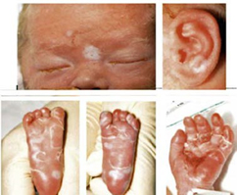
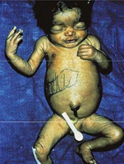
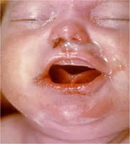
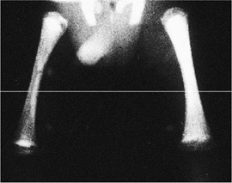
Clinical Manifestations of Congenital Syphilis (CS)
Approximately 40%–60% of infected infants have >1 of the following: hepatosplenomegaly, rash, generalized lymphadenopathy, skeletal abnormality, or nasal discharge
Centers for Disease Control and Prevention. Congenital syphilis case definition. https://www.cdc.gov/std/statistics/2022/case-definitions.htm
World Health Organization. Birth defects surveillance: A manual for programme managers, 2nd Edition. December 2020. https://www.who.int/publications/i/item/9789240015395
Principles and practices of Pediatric Infectious Diseases. 6th Edition. 2018. Edited by: Sarah S. Long. ISBN. 978-0-323-75608-2
Red Book: 2024–2027 Report of the Committee on Infectious Diseases (33rd Edition)

Slide 35
Clinical Manifestations of Early Congenital Syphilis
Enlarged liver and spleen with abnormal alkaline phosphatase
Bone abnormalities, Lesions include metaphysitis, periostitis, and osteitis.
Pneumonia (pneumonia alba)
Anemia (up to 75%), Hydrops fetalis is typically fatal.
Elevated WBC (50%) with significant monocytosis.
Skin manifestations: maculopapular desquamating rash (palms and soles) , petechial lesions (from thrombocytopenia) , vesiculobullous lesions that rupture (Pemphigus syphiliticus)
Generalized lymphadenopathy
Abnormal CSF in ~50% of symptomatic congenitally infected infants and in up to 10% of asymptomatic infants. Diagnosed by positive CSF VDRL test result or with abnormal elevation of CSF white blood cell (WBC) count or protein levels. Neurologic symptoms are rare
Clear nasal discharge. Rhinitis, or “snuffles,” (containing many spirochetes), mucosal erosion can cause bleeding.
Nephrotic syndrome (rare) is caused by immune complex disease, not treponemal invasion.
Principles and practices of Pediatric Infectious Diseases. 6th Edition. 2018. ISBN. 978-0-323-75608-2

Slide 36
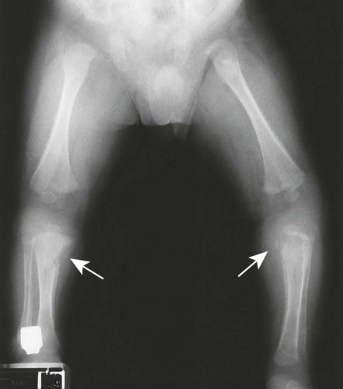
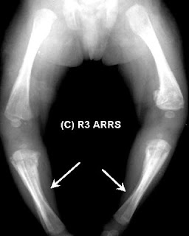
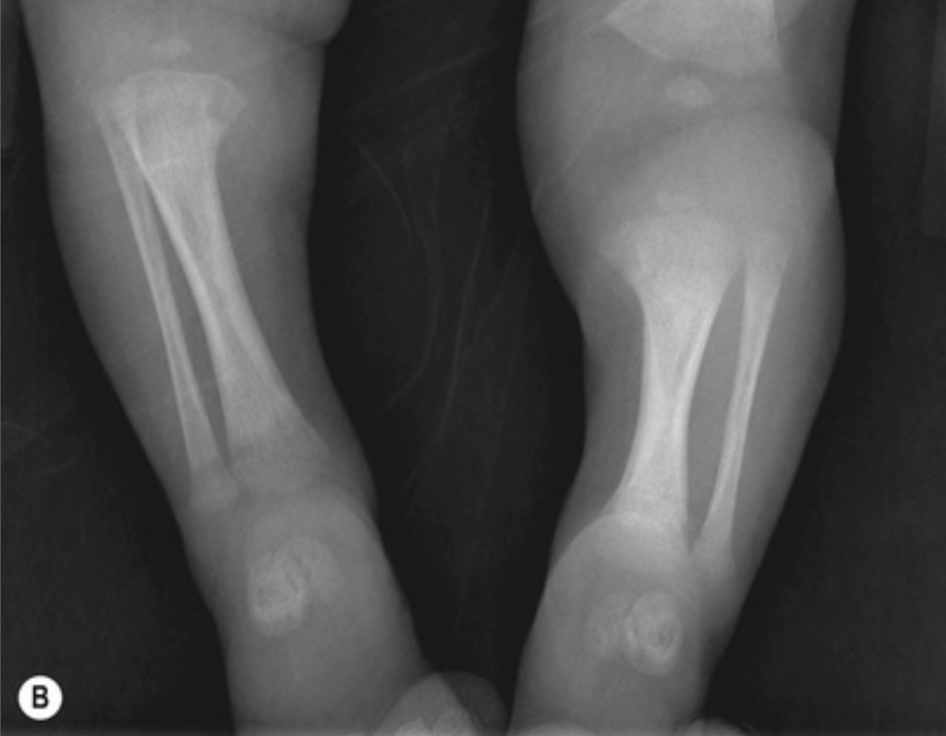
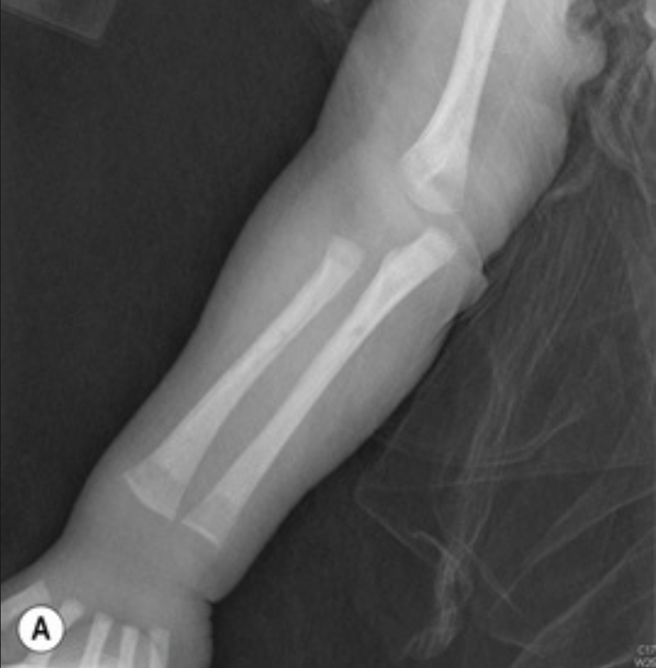
Radiographic abnormalities in 95% of symptomatic and up to 20% of asymptomatic infants
  Lesions include metaphysitis, periostitis, and osteitis.
  Findings are symmetric and involve multiple long bones; the lower extremities are almost always affected.
  Metaphyseal lesions (osteochondritis) vary from punctate lucencies to more destructive changes, are seen earlier than periostitis.
  Wimberger sign (“cat bite”) describes osteitis and destruction of the proximal medial tibial metaphysis
  Lesions can be painful, resulting in pseudoparalysis of the affected limb (pseudoparalysis of Parrot).
  Periostitis appears radiographically as multiple layers of periosteal new bone formation.
Principles and practices of Pediatric Infectious Diseases. 6th Edition. 2018. Edited by: Sarah S. Long. ISBN. 978-0-323-75608-2

Slide 37
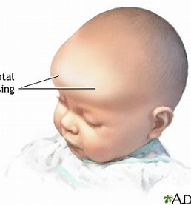
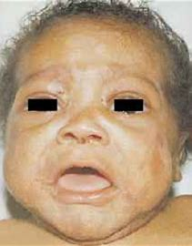
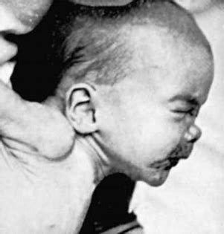




Clinical Manifestations of Late Congenital Syphilis in patients >2 years of age
Bone malformations (frontal bossing, saddle nose and saber shins),
Teeth (Hutchinson peg-shaped, notched central incisors and mulberry multi-cusped first molars),
skin (rhagades, or linear scars, fanning out from the corner of the mouth)
Interstitial keratitis
Eighth nerve deafness result from longstanding chronic inflammation.
Symmetric, chronic painless swelling of the knees (Clutton joints)
Asymptomatic neurosyphilis is more common in than is symptomatic disease.
Pathologic nervous system deficits including mental, motor, and sensory deficits, similar to those seen in acquired tertiary disease.

Slide 38
Scenario 2: Possible Congenital Syphilis
Definition: Any neonate who has a normal physical examination and a serum quantitative nontreponemal serologic titer equal to or less than fourfold of the maternal titer at delivery (e.g., maternal titer = 1:8, neonatal titer ≤1:16) AND one of the following:
(1) The mother was not treated, was inadequately treated, or has no documentation of having received treatment.
(2) The mother was treated with erythromycin or a non penicillin G regimen other than those recommended in these guidelines.
(3) The mother received the recommended regimen but treatment was initiated <30 days before delivery.
Evaluation:
CSF with VDRL, cell count, protein, CBC/diff, long bone radiographs, neurologic eval (eye, auditory, imaging)
Treatment:
Aqueous crystalline penicillin G 100,000–150,000 units/kg/body wt./day, administered as 50,000 units/kg body wt./dose IV q 12 hours during the first 7 days of life and q 8 hours thereafter for a total of 10 days OR Benzathine penicillin G 50,000 units/kg body weight/dose IM in a single dose
https://www.cdc.gov/std/treatment-guidelines/STI-Guidelines-2021.pdf

Slide 39
Scenario 3: Congenital Syphilis Less Likely
Definition: Any neonate who has a normal physical examination and a serum quantitative nontreponemal serologic titer equal or less than fourfold higher than the maternal titer at delivery and both of the following are true:
(1)The mother was treated during pregnancy, treatment was appropriate for the infection stage, and the treatment regimen was initiated ≥30 days before delivery. AND
(2) The mother has no evidence of reinfection or relapse.
Evaluation:
No evaluation is recommended.
Treatment:
Benzathine penicillin G 50,000 units/kg body weight/dose IM in a single dose
Another approach involves not treating the newborn if follow-up is certain but providing close serologic follow-up every 2–3 months for 6 months for infants whose mothers’ nontreponemal titers decreased at least fourfold after therapy for early syphilis or remained stable for lowtiter, latent syphilis (e.g., VDRL <1:2 or RPR <1:4).
https://www.cdc.gov/std/treatment-guidelines/STI-Guidelines-2021.pdf

Slide 40
Scenario 3: Congenital Syphilis Less Likely
Definition: Any neonate who has a normal physical examination and a serum quantitative nontreponemal serologic titer equal or less than fourfold higher than the maternal titer at delivery and both of the following are true:
(1)The mother was treated during pregnancy, treatment was appropriate for the infection stage, and the treatment regimen was initiated ≥30 days before delivery. AND
(2) The mother has no evidence of reinfection or relapse.
Evaluation:
No evaluation is recommended.
Treatment:
Benzathine penicillin G 50,000 units/kg body weight/dose IM in a single dose
Another approach involves not treating the newborn if follow-up is certain but providing close serologic follow-up every 2–3 months for 6 months for infants whose mothers’ nontreponemal titers decreased at least fourfold after therapy for early syphilis or remained stable for lowtiter, latent syphilis (e.g., VDRL <1:2 or RPR <1:4).
https://www.cdc.gov/std/treatment-guidelines/STI-Guidelines-2021.pdf

Slide 41
Scenario 4: Congenital Syphilis Unlikely
Definition: Any neonate who has a normal physical examination and a serum quantitative nontreponemal serologic titer equal to or less than fourfold of the maternal titer at delivery and both of the following are true:
(1)The mother’s treatment was adequate before pregnancy.
(2) The mother’s nontreponemal serologic titer remained low and stable (i.e., serofast) before and during pregnancy and at delivery (e.g., VDRL ≤1:2 or RPR ≤1:4).
Evaluation:
No evaluation is recommended.
Treatment:
No treatment is required. However, any neonate with reactive nontreponemal tests should be followed serologically to ensure the nontreponemal test returns to negative
Benzathine penicillin G 50,000 units/kg body weight as a single IM injection might be considered, particularly if follow-up is uncertain and the neonate has a reactive nontreponemal test.
https://www.cdc.gov/std/treatment-guidelines/STI-Guidelines-2021.pdf

Slide 42
Infant Followup
(1) All neonates with reactive nontreponemal tests should receive thorough follow-up examinations and serologic testing (i.e., RPR or VDRL) every 2–3 months until the test becomes nonreactive.
(2) For a neonate who was not treated because congenital syphilis was considered less likely or unlikely, nontreponemal antibody titers should decrease by age 3 months and be nonreactive by age 6 months, indicating that the reactive test result was caused by passive transfer of maternal IgG antibody.
At age 6 months, if the nontreponemal test is nonreactive, no further evaluation or treatment is needed;
If the nontreponemal test is still reactive, the infant is likely infected and should be treated.
(4) Treated neonates who exhibit persistent nontreponemal test titers by age 6–12 months should be reevaluated through CSF examination and managed in consultation with an expert. Retreatment with a 10-day course of a penicillin G regimen might be indicated.
(5) Neonates with a negative nontreponemal test at birth and whose mothers were seroreactive at delivery should be retested at age 3 months to rule out serologically negative incubating congenital syphilis at the time of birth.
https://www.cdc.gov/std/treatment-guidelines/STI-Guidelines-2021.pdf

Slide 43
Syphilitic Stillbirth
Clinical case definition
A fetal death that occurs after a 20-week gestation OR in which the fetus weighs >500g AND the mother had untreated or inadequately treated* syphilis at delivery.
* Adequate treatment is defined as completion of a penicillin-based regimen, in accordance with CDC treatment guidelines, appropriate for stage of infection, initiated 30 or more days before delivery.
Comments: For reporting purposes, congenital syphilis includes:
cases of congenitally acquired syphilis among infants and children
syphilitic stillbirths
https://www.cdc.gov/std/statistics/2019/case-definitions.htm)

Slide 44
Congenital Syphilis Case Classification for Disease Reporting
Confirmed: Demonstration of Treponema pallidum in any infant body fluid or discharge, umbilical cord, autopsy, or placenta by darkfield, immunohistochemistry, staining, or other molecular testing (PCR) OR
Probable: An infant whose mother had untreated or inadequately treated* syphilis at delivery, regardless of signs in the infant OR
An infant or child who has a reactive non-treponemal test for syphilis (Venereal Disease Research Laboratory [VDRL], rapid plasma reagin [RPR], or equivalent serologic methods) AND any one of the following:
  Any evidence of congenital syphilis on physical examination
  Any evidence of congenital syphilis on radiographs of long bones
  A reactive cerebrospinal fluid (CSF) venereal disease research laboratory test (VDRL) test
  In a non-traumatic lumbar puncture, an elevated CSF leukocyte (white blood cell, WBC) count or protein (without other cause):
    Suggested parameters for abnormal CSF WBC and protein values:
    During the first 30 days of life, a CSF WBC count of >15 WBC/mm3 or a CSF protein >120 mg/dl is abnormal.
    After the first 30 days of life, a CSF WBC count of >5 WBC/mm3 or a CSF protein >40 mg/dl, regardless of CSF serology. The treating clinician should be consulted to interpret the CSF values for the specific patient.
*Adequate treatment is defined as completion of a penicillin-based regimen, in accordance with CDC treatment guidelines, appropriate for stage of infection, initiated 30 or more days before delivery.
STI Case Definitions in Effect During 2022 (cdc.gov)/
https://www.cdc.gov/std/statistics/2022/case-definitions.htm

Slide 45

Adult and Infant Case Management
Addressing Congenital Syphilis includes:
Prioritize data sharing across public health partners.
Close communication with state, county and tribal health departments.
Support for additional community-level healthcare staff performing contact tracing for syphilis, employed through tribal, state, or county health departments.
Dedicated facility-level case managers that track adult, pregnant, and infant patients with syphilis to ensure linkage to treatment and partner services
Notes:
Each partner can play a valuable and complementary role to diagnose, stage and treat cases, identify sexual contacts, and disrupt transmission within sexual networks
The PH entity that is performing partner services/contact tracing needs the clinical and locating information of the case to locate and perform case investigation, referral for treatment, and contact tracing.

Slide 46


Case Investigation and Contact Tracing
Importance of identifying and referring sexual contacts/partners to syphilis cases for presumptive treatment to stop community-level transmission
Partner services is an effective method to identify undiagnosed cases of syphilis and other STIs. It has a higher yield than screening.
Notes:
I cannot stress enough the Importance of contact tracing as a top level best practice for syphilis control. This public health practice is the most effective way to identify undiagnosed syphilis at a community level specifically…. identifying and referring sexual contacts/partners to syphilis cases for presumptive treatment to stop community-level transmission
Halting community level transmission is critical to stop outbreaks. Consistent and frequent communication with the clinical service unit to the state, county and/or tribal Disease Intervention Specialists (DIS) is important to relay case information to facilitate sexual partner identification and referral to care.

Slide 47





Remove Barriers
Notes:
Underlying increasing rates of congenital syphilis among American Indian /Alaska Native people are associated social and behavioral risks as well as medical care access.. Further, the criminalization of substance abuse during pregnancy can be a barrier to pregnant patients’ seeking prenatal care due to fear of reprisal such as charges of child abuse, reckless endangerment and the involvement of child protective services influencing custody of an infant at delivery. This is a special risk for AI/AN pregnant women who fall under tribal law as well as state and federal laws. In addition, Due to clinical staff shortages OB/GYN services frequently do not meet the demand for prenatal care and women may need to seek care through other care facilities far from their homes. Finally limited or lack of data sharing from states to sovereign tribal nations hinder tribal public health responses to communicable disease increases, in this case syphilis.
As a success , one tribal nation has removed tribal laws criminalizing substance use in pregnancy in one tribal area. As another success, several tribal areas have obtained the rights to state data access in order deliver a coordinated public health response to syphilis .

Slide 48

Patient Incentives
Evidence based intervention in TB, MAT, Diabetes for testing and adherence to care, being piloted for syphilis testing events and treatment
    Priority populations (pregnancy, substance use)
    Partners/Contacts treated
Of programs using incentives in IHS, an internal survey found:
    90% would recommend their use
    100% said they would continue to use incentives
Notes:
Patient incentives in the forms of gift cards as an example have shown promise for testing and treatment for other infectious conditions and substance abuse treatment. These are being piloted with good response for syphilis.
Gift cards available. protocols are used to log use with a response such as 'criteria and inventory management are largely a local decision, most sites are tracking via ledgers.' One site has submitted data on impact

Slide 49
Educate the Community
www.StopSyphilis.org
Notes:
Finally, educating the community on the occurrence of syphilis in their communities and risks associated with untreated infection and mother to child transmission are an integral part of a community-level syphilis response. Educational campaigns can be linked to testing and treatment services.

Slide 50
Provider Education Resources
Educate Providers
CDC STD Treatment Guidelines: https://www.cdc.gov/std/treatment-guidelines/default.htm
CDC STD Surveillance: https://www.cdc.gov/std/statistics/2022/default.htm
Indian Country Infectious Disease ECHO: www.IndianCountryECHO.org
CDC STD Prevention Training Centers: https://www.cdc.gov/std/training/default.htm
University of Washington STD CME sessions: https://www.std.uw.edu/
California Prevention Training Center Online: https://www.stdhivtraining.org/online_courses.html
Johns Hopkins STD Prevention Training: https://www.stdpreventiontraining.com/
New York City STD/HIV Prevention Training Center: https://www.nycptc.org/

Slide 51

Build an Effective Response
Notes:
In summary I will leave you with this slide. A matrix or path of sorts with high level challenges and building blocks for a best practices using multi-partnership response specifically for syphilis. This includes reimagining and expanding an in-person public health workforce for disease control. Community engagement and education are critical elements for success.
Note at the top that for congenital syphilis prevention we need to recognize social determinants of health such as poverty and access to healthcare AND remove barriers to prenatal care through support of de-criminalization of drug use in pregnancy and providing care and treatment for substance use disorder. These can increase women’s access and uptake of prenatal care that includes screening and treatment for syphilis to prevent congenital syphilis. Thank you for the opportunity to present today..

Slide 52
Think Syphilis
MDT7@cdc.gov

Slide 53

Serologic Diagnosis of Syphilis
CDC Laboratory Recommendations for Syphilis Testing, United States, 2024 | MMWR

Slide 54

Serologic Diagnosis of Syphilis

Slide 55

Prozone phenomena
CDC Laboratory Recommendations for Syphilis Testing, United States, 2024 | MMWR

Slide 56

Expected serologic response after treatment
CDC Laboratory Recommendations for Syphilis Testing, United States, 2024 | MMWR
Adapted from Peeling RW, Mabey D, Kamb ML, Chen X-S, Radolf JD, Benzaken AS. Syphilis. Nat Rev Dis Primers 2017;3:17073.

Slide 57
Who should be screened for syphilis?
US Preventive Services Task Force Grade A Recommendations
“The USPSTF recommends early screening for syphilis infection in all pregnant women”.
All pregnant women are at risk. All pregnant women should be tested for syphilis as early as possible when they first present to care. If a woman has not received prenatal care prior to delivery, she should be tested at the time she presents for delivery.
“The USPSTF continues to recommend screening for syphilis in nonpregnant persons who are at increased risk for infection”.
Population: Asymptomatic, nonpregnant adolescents and adults who are at increased risk for syphilis infection

Slide 58

DoxyPEP: Doxycycline cannot be used in Pregnancy!
Take 1 dose of Doxycycline 200mg
< 72 hours after condomless sex
Prevention of chlamydia, gonorrhea, and syphilis
Who should receive DoxyPEP?
    Men who have sex with men (MSM)/Trans Women (TGW) on HIV PrEP or living with HIV
    If not on HIV PrEP, MSM/TGW with history of STIs within the past 12 months, sex work, chemsex (sex under the influence of drugs)
    Guidelines for the Use of Doxycycline Post-Exposure Prophylaxis for Bacterial STI Prevention (cdc.gov)

