Slide 1


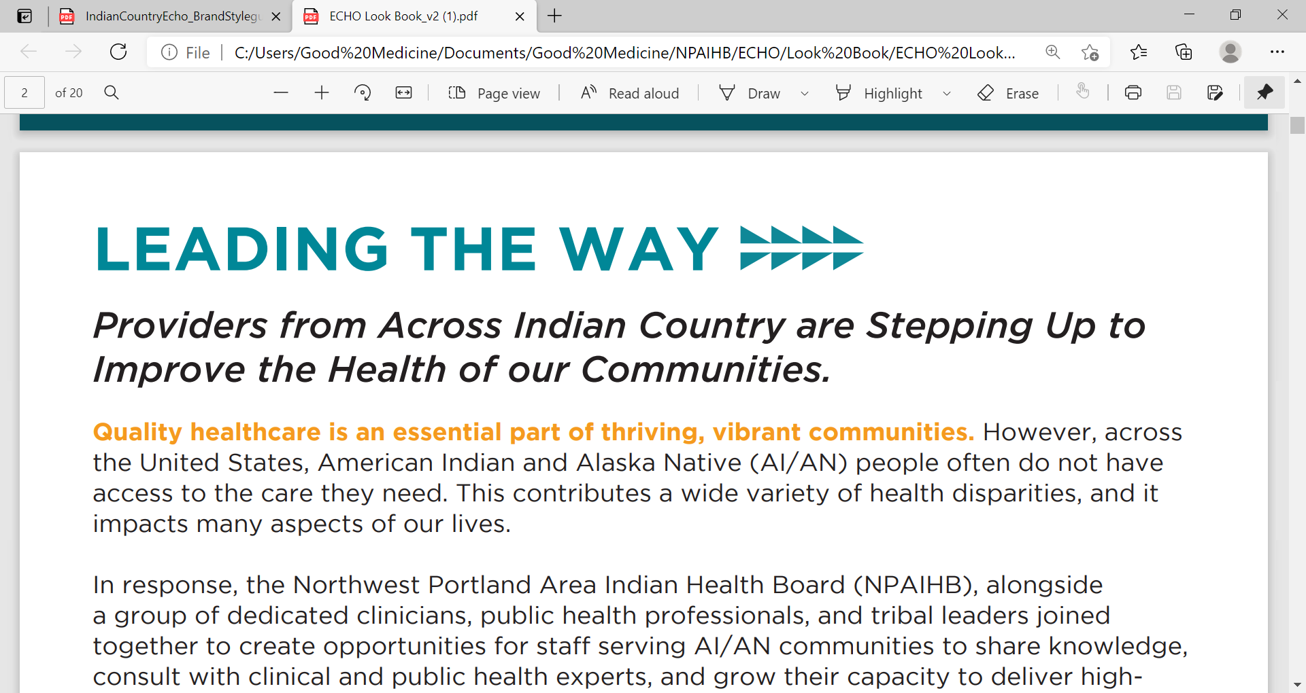
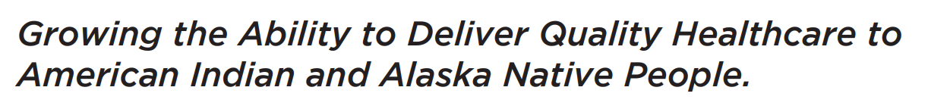
Ending the Syndemic (SUD/HCV/HIV/STI) at Your Tribe or Facility
July 26,2024
Jorge Mera | MD, Infectious Disease Specialist | ECHO Clinic Director | Northwest Portland Area Indian Health Board

Slide 2
Learning Objectives
Participants will be able to explain the concept of a Syndemic
Participants will recognize the impact of the opioid epidemic in relation to the HIV and HCV epidemics
Participants will be able to describe interventions to mitigate the HIV/STI/SUD/HCV syndemic at a Macro, Micro and individual level
Notes:
,

Slide 3
Outline
Syndemic concepts
Clinical case
The SUD | HCV | HIV | STI syndemic in Indian Country
Interventions to mitigate the syndemic:
  Societal (Macro), health system (micro), health professional (individual)
Conclusions
Notes:
,

Slide 4

Syndemic
  Core principles:
  Clustering of two or more conditions in a specific population
  Their synergism in producing excess burden of disease in a population
  Precipitation and propagation by large scale behavioral, structural and social forces
Structural Factors
Behavioral Factors
Social Factors
Lack of access to housing, transportation, health facilities, SSP, etc.
Stigma, lack of education, employment, healthy food, health coverage, etc.
Social norms, traditions, shared beliefs, etc.
HIV
HCV
SUD
STI
Singer, M. and Clair, S. (2003), Syndemics and Public Health: Reconceptualizing Disease in Bio‐Social Context. Medical Anthropology Quarterly, 17: 423-441. https://doi.org/10.1525/maq.2003.17.4.423
HIV: Human Immunodeficiency Virus
HCV: Hepatitis C virus
SUD: Substance Use Disorder

Slide 5
HIV Syndemic Outcomes
HIV 14%
Syphilis 1%
Gonorrhea 2%
Chlamydia 2%
LTBI 2%
Active TB 1%
HCV 4%
HBV 4%
Viral suppression rates by number of co-infections
Syndemics are associated with poorer HIV health outcomes among PLWHA
Significant “dose-response relationship” between the number of co-infections and mean VLs
In addition to numbers of co-infections, particular demographic subgroups, and certain geo-clusters were also
associated with poorer health outcomes, underscoring the need to address multiple conditions in tandem in an I
integrated health system
Chu PL, Santos GM, Vu A et al. Journal of the International AIDS Society 2012. 15:102-103

Slide 6
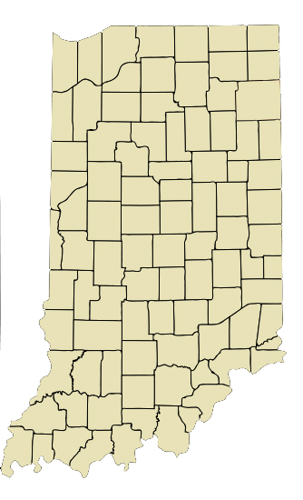
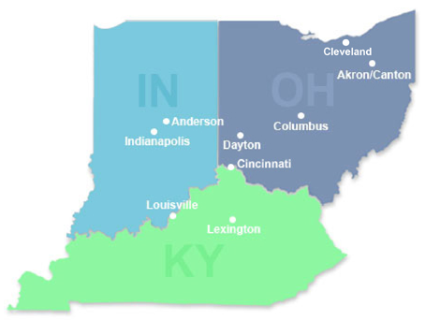
Indiana HIV/HCV/SUD Outbreak
From 2004-2013
In late 2014
By mid-January 2015
< 5 HIV infections reported annually in Austin, Indiana
3 new HIV diagnoses in Austin IN, 2 of them had shared needles
Through contact tracing ISHD identified 8 more new infections
As of June 14, 2015:
170 new HIV infections and 115 co-infected with HCV in a Community of 4200 people
All epidemiologically linked to Austin, IN
Infections were recent and from a single HIV strain
The source of infection: Injection of the opioid oxymorphone (semi-synthetic opioid analgesic)
Scott County: Among the state’s 92 counties,
ranked 92nd in a variety of health and
social indicators, including life expectancy

Slide 7
Indiana HIV/HCV Outbreak:
Syndemic Risk Factors in Scott County
High poverty (19.0%)
Unemployment (8.9%)
Few affected persons were employed or insured
Education
Low educational attainment (21.3% no high school)
Little HIV awareness in the general population
Unaware of transmission risks and treatment benefits
No routine HIV education in schools (abstinence only)
Ranked lowest in the State for health indicators and life expectancy
SSP program not permitted by state law
No outpatient HIV/HCV care available
Limited addiction services, including MAT

Slide 8
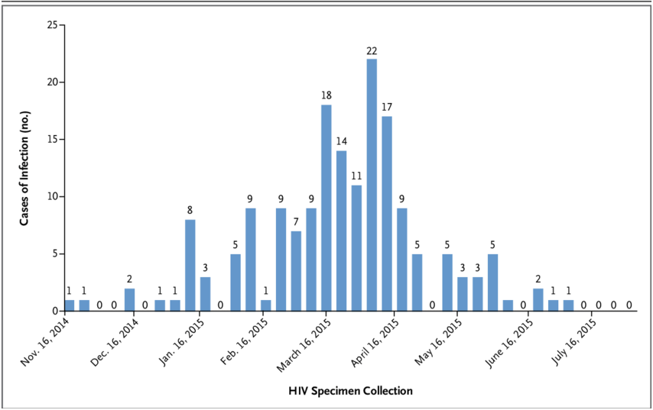
Indiana HIV/HCV Outbreak:
How Was the Outbreak Controlled?
SSP Authorized
One stop shop
  Behavioral health treatment
  HCV/HIV/MAT treatment provided
SSP emergency authorization

Slide 9

Syndemic
Linkage to Care
Screening
Quality of Care
HCV/HIV/STI
SUD Behavior Risk
Harm Reduction Strategies
Access to Care
Poverty
Domestic Violence
Mental Illness
Historical Trauma*
Cultural
Disconnection
Incarceration
others
Prevention
*Maria Yellow Horse Brave Heart Journal of Psychoactive Drugs Vol. 35, Iss. 1, 2003

Slide 10
Outline
Syndemic concepts
Clinical case
The SUD | HCV | HIV | STI syndemic in Indian Country
Interventions to mitigate the syndemic:
  Societal (Macro), health system (micro), health professional (individual)
Conclusions
Notes:
,

Slide 11
Clinical Case:
A 20 yo cis-gender female who has sex with cis-gender males, presents for a pregnancy test only
Reports oral and vaginal sex without protective barrier 3 weeks ago
2 partners over the past 6 months
Denies recent drug use, but reports injecting heroin 3 months ago, unstable housing and transportation, does not have regular access to phone
No current signs or symptoms, and doesn’t recollect any in the past year
Never tested for HIV
Office Tests
Agrees to rapid HIV/Syphilis test in office when offered incentive
HIV: non-reactive
Rapid pregnancy test: Positive
Last gonorrhea/chlamydia (urine only) and RPR tests were 11 months ago, all negative
Syphilis (treponemal antibody): reactive

Slide 12
What are the recommended next steps? (Check all that apply)
No further testing necessary, as initial reason for the visit (pregnancy testing) already completed
Draw serum HIV, test for gonorrhea and chlamydia in the urine and throat
Draw RPR, wait for results (~1 week) to determine treatment
Draw RPR and immediately administer 2.4 MU IM injection of benzathine penicillin for early latent stage syphilis
Draw RPR and immediately administer 2.4 MU IM injection of benzathine penicillin weekly x 3 weeks (total 7.2 MU) for late latent stage syphilis

Slide 13
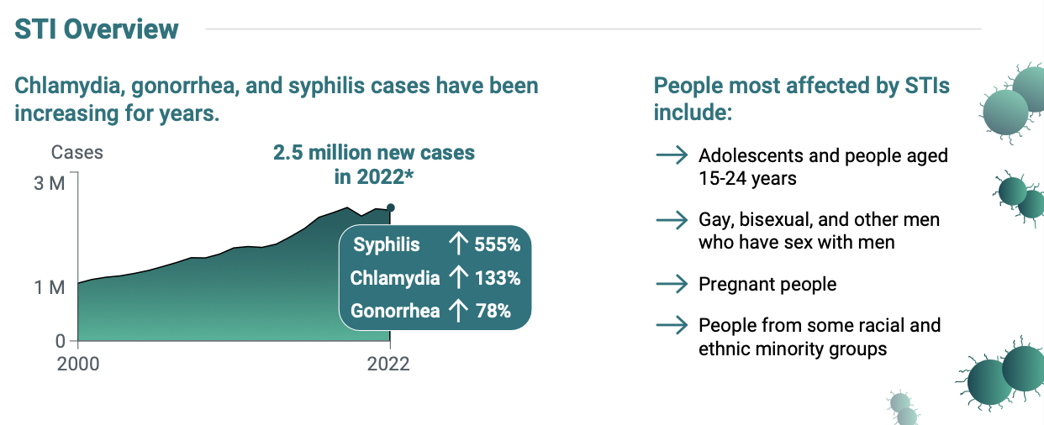

Slide 14
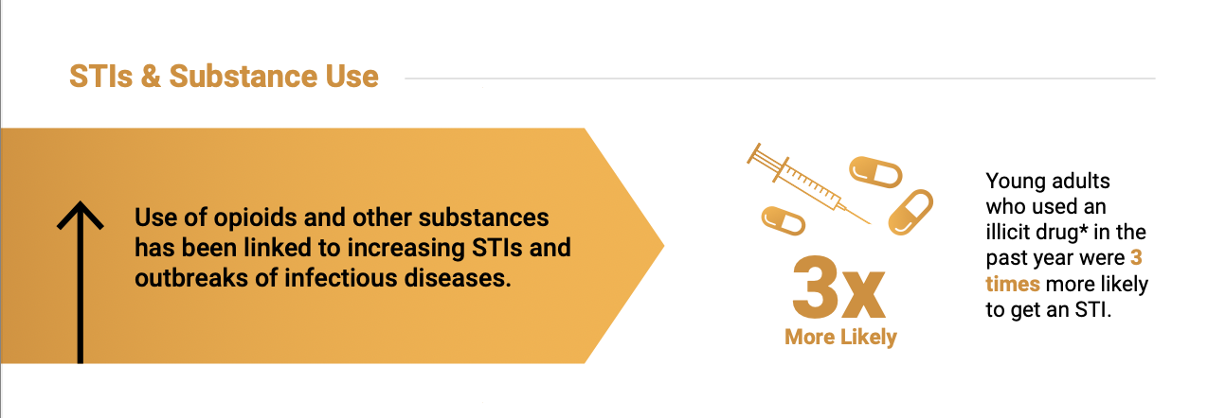

Slide 15
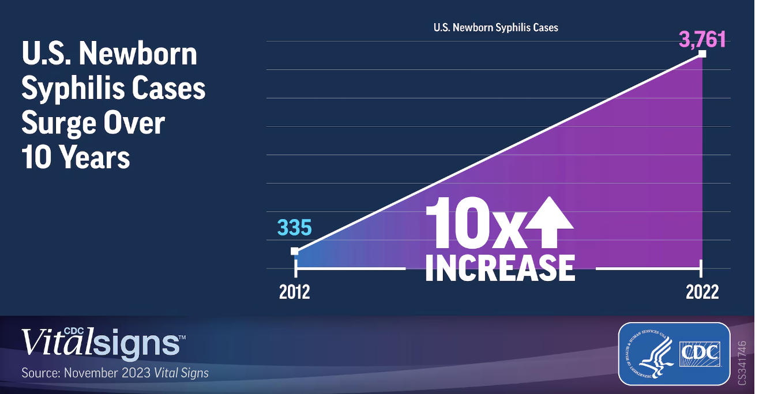
U.S. Syphilis Cases in Newborns Continue to Increase: A 10-Times Increase Over a Decade
https://www.cdc.gov/media/releases/2023/s1107-newborn-syphilis.html

Slide 16
Increased Methamphetamine, Injection Drug, and Heroin Use Among Women and Heterosexual Men with Primary and Secondary Syphilis — United States, 2013–2017.
Among women and MSW with P&S syphilis
Reported use of methamphetamine, injection drugs, and heroin more than doubled during 2013–2017.
In 2017, women with P&S syphilis
16.6% used methamphetamine
10.5% used injection drugs
5.8% used heroin during the preceding 12 months.
MMWR / February 15, 2019 / 68(6);144–148

Slide 17
Substance Use Among Persons with Syphilis During Pregnancy — Arizona and Georgia, 2018–2021
What is already known about this topic?
Substance use prevalence has increased among women with syphilis; however, its association with congenital syphilis is less clear.
What is added by this report?
During 2018–2021, the prevalence of substance use among persons with syphilis during pregnancy in Arizona and Georgia was nearly twice as high among those with a congenital syphilis pregnancy outcome (48.1%) as among those without this outcome (24.6%).
What are the implications for public health practice?
The need for syphilis screening and treatment should be addressed at every health care encounter during pregnancy, especially among persons using substances.
Approximately one half of persons who used substances during pregnancy and had a congenital syphilis pregnancy outcome had late or no prenatal care.
Carlson JM, Tannis A, Woodworth KR, et al. Substance Use Among Persons with Syphilis During Pregnancy — Arizona and Georgia, 2018–2021. MMWR Morb Mortal Wkly Rep 2023;72:63–67. DOI: http://dx.doi.org/10.15585/mmwr.mm7203a3

Slide 18
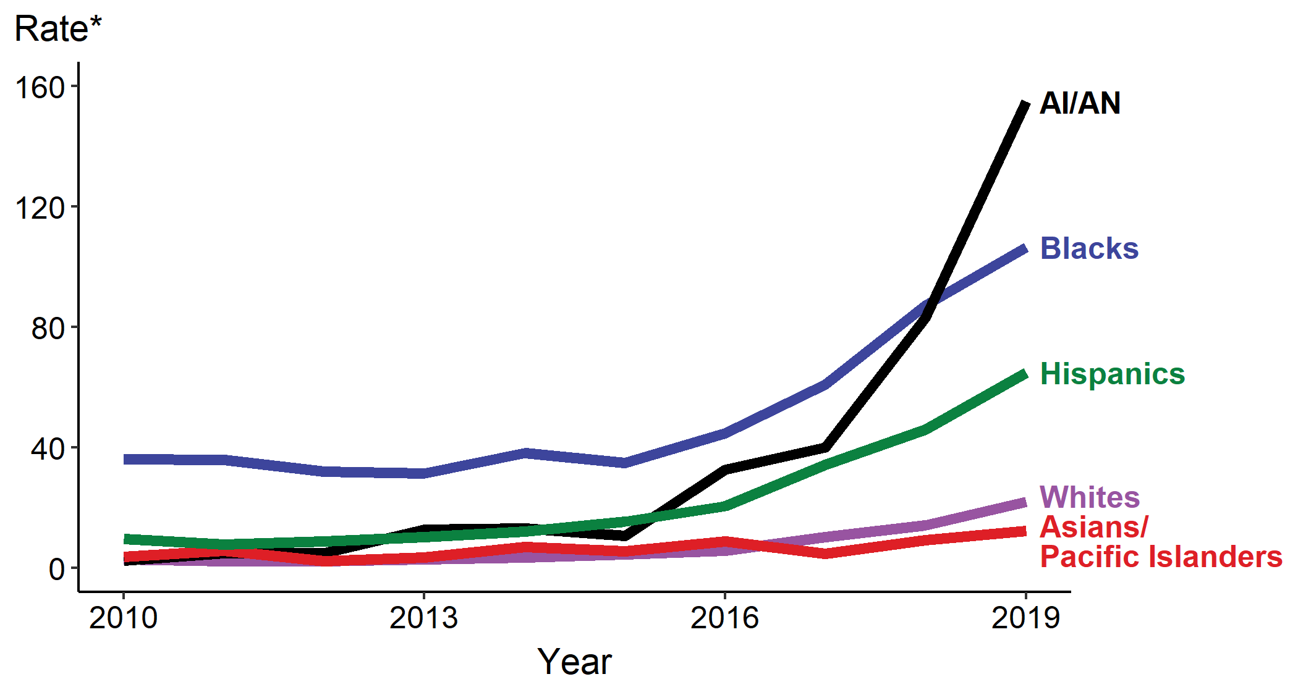
Congenital Syphilis — Rates of Reported Cases by Year of Ethnicity of Mother, United States, 2010–2019
https://www.cdc.gov/std/statistics/2019/overview.htm#Syphilis
Notes:
,

Slide 19
HHS Announces Department Actions to Slow Surging Syphilis Epidemic
Emphasizing the role of HCW in primary care, emergency departments, community health, correctional and drug treatment programs
Most syphilis cases were diagnosed outside of STD clinics in 2022
Comparable to rates from the pre-penicillin era
For every 155 AI/AN births in 2022, there was one congenital syphilis case.
Primary, secondary and congenital syphilis rates are highest in AI/AN
HHS IMMEDIATE RELEASE REPORT. January 30, 2024
Notes:
,

Slide 20
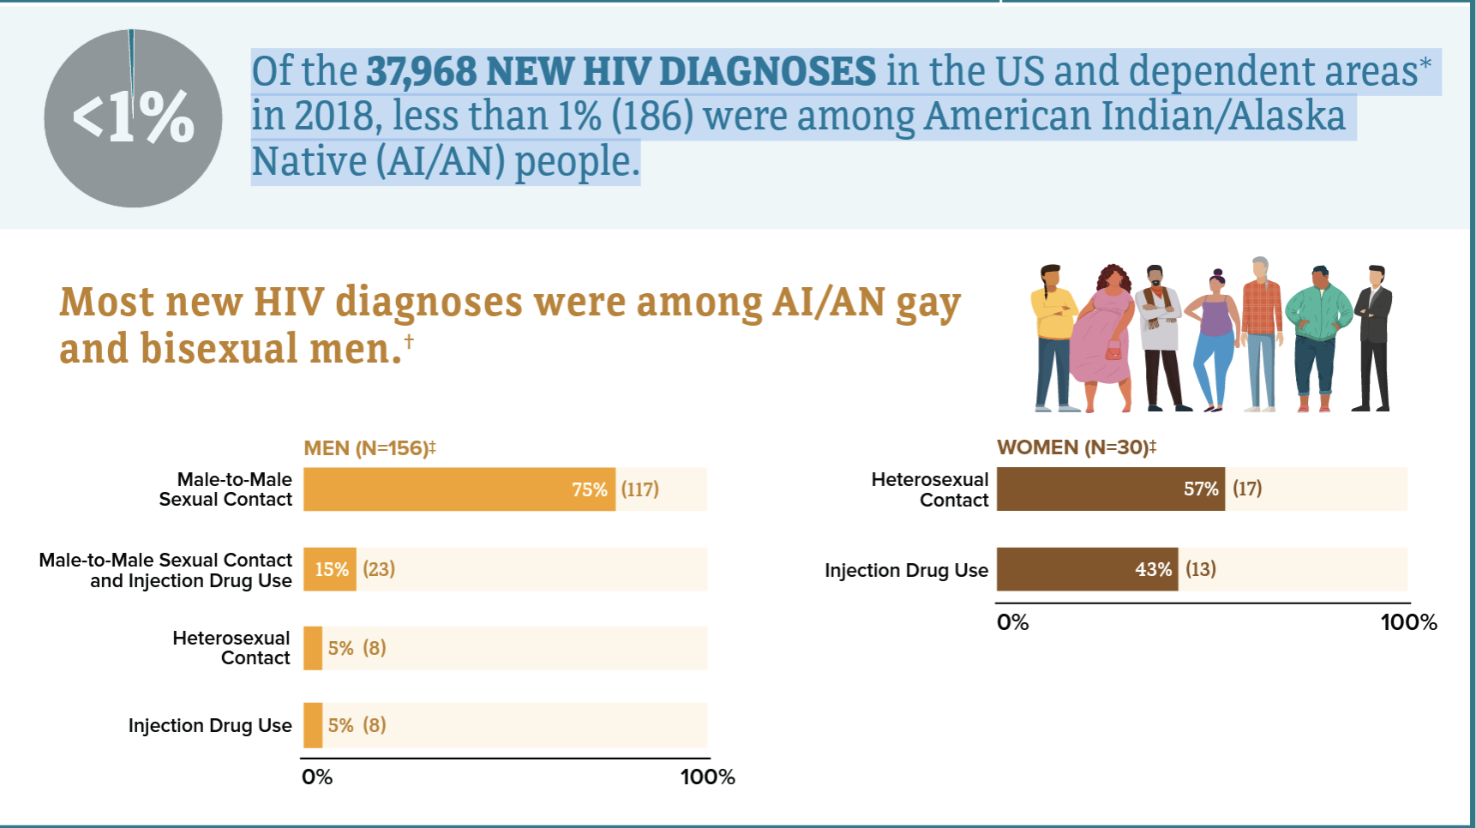
HIV in American Indian/Alaska Native Populations
In the U.S. in 2018, both male and female AI/AN had the highest percent of estimated diagnoses of HIV infection attributed to injection drug use, compared with all races/ethnicities.
Among men, 15% (23) of new HIV diagnoses were attributed to injection drug use, and 11% (21) were attributed to both male-to-male sex and injection drug use.
Among women, 43% (13) of new HIV diagnoses were attributed to injection drug use.

Slide 21
American Indian/Alaska Native (AI/AN)
HCV Statistics in the United States
HCV disproportionately affects AI/AN^{1,2}
The AI/AN HCV mortality rate is 10.8 deaths per 100,000, compared to 4.5 per 100,000 nationally.
From 2015 to 2016, incidence rates of acute HCV among AI/ANs rose from 1.8 to 3.1 cases per 100,000.
Rates of chronic liver disease and cirrhosis deaths are 2.3 times higher among AI/ANs than Whites.
Centers for Disease Control and Prevention. Surveillance for Viral Hepatitis: United States, 2016. Retrieved from https://www.cdc.gov/hepatitis/statistics/2016surveillance/commentary.htm
Center for Disease Control and Prevention. Deaths: Final Data for 2014. http://www.cdc.gov/nchs/data/nvsr/nvsr65/nvsr65_04.pdf
US Census Bureau. https://www.census.gov/www. Accessed Nov 2, 2019

Slide 22
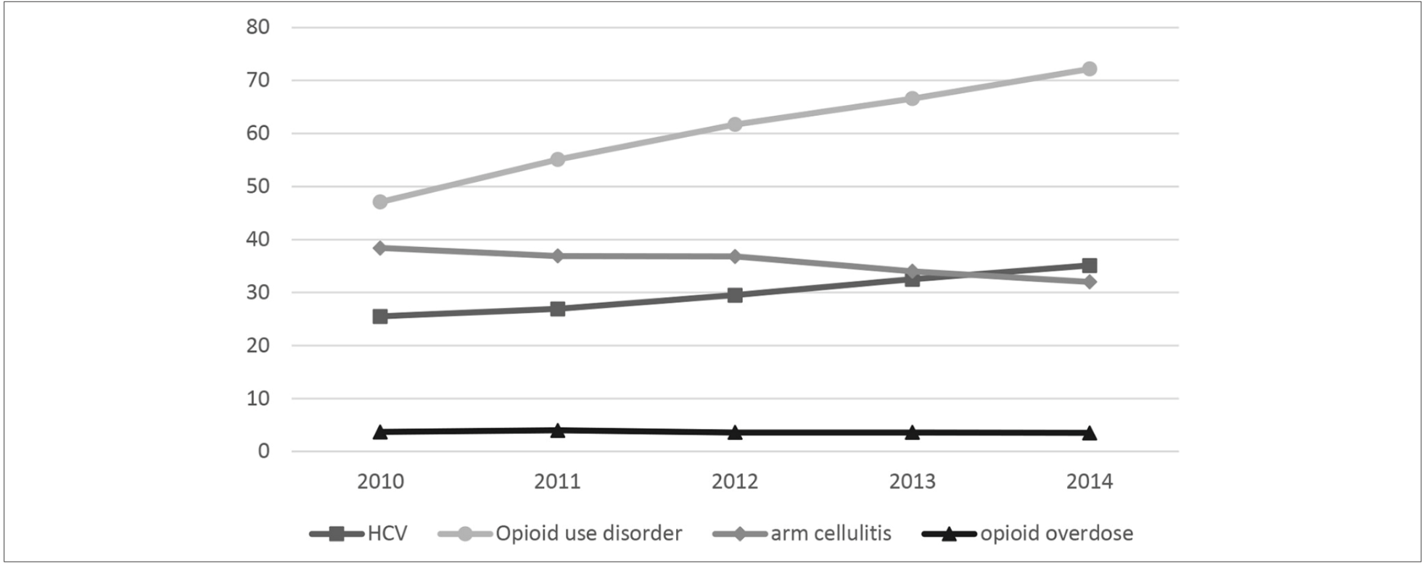
Trends in Indicators of Injection Drug Use, Indian Health Service, 2010-2014: A Study of Health Care Encounter Data
Overall national annual rates (per 10 000 adults) of diagnoses among American Indian/Alaska Native persons for hepatitis C virus (HCV) infection, opioid use disorder, arm cellulitis and abscess, and opioid-related overdose, Indian Health Service, 2010-2014. Rates of diagnoses represent 1 health care encounter per person per year. Data for HCV infections are for adults aged 18-35; all other data are for adults aged ≥18. Arm cellulitis was counted only among adults with no diabetes on or before the health care encounter for arm cellulitis visit (since 2001). Data source: National Patient Information Reporting System.
Evans ME, Person M, Reilley B, Leston J,. Public Health Rep. 2020 Jul/Aug;135(4):461-471.
Notes:
,

Slide 23
HIV, HCV, STIs, Drug Use Among AI/AN
AI/AN had the highest percent of estimated diagnoses of HIV infection attributed to injection drug use
Syphilis rates including congenital syphilis are rapidly increasing
  Exacerbates HIV transmission
Drug use is increasing nationwide and in Indian Country
AI/AN have greatest rates of new HCV diagnoses
  Over 2x national rate of HCV-related mortality
  Rates are decreasing with greater availability of treatment

Slide 24
Outline
Syndemic concepts
Clinical case
The SUD | HCV | HIV | STI syndemic in Indian Country
Interventions to mitigate the syndemic:
  Societal (Macro), health system (micro), health professional (individual)
Conclusions
Notes:
,

Slide 25
What can we do to mitigate the syndemic?
as a primary care health worker?
(Individual)
as health system Leadership?
(Micro)
As a Society
(Macro)

Slide 26

Actions to Address the Syndemic Among People Who Inject Drugs as a Primary Care Health Care Worker
Screening patients for SUDs and mental health disorders
Testing patients and their sexual or drug-injection partners for HIV, HCV, and STIs
  With appropriate pre and post-test counseling
Offering immediate treatment according to established guidelines for patients who test positive
Threading the Needle — How to Stop the HIV Outbreak in Rural Indiana Steffanie A. Strathdee, Ph.D., and Chris Beyrer, M.D., M.P.H. NEJM 373;5 nejm.org July 30, 2015

Slide 27
Actions to Address the Syndemics Among People Who Inject Drugs as a Primary Care Health Care Worker
Providing Hep B vaccinations
Providing naloxone to opioid users and their families/partners
Acquiring training to provide opioid agonist therapy
Supporting injection-drug users by providing sterile syringes or referring them to syringe service programs

Slide 28
What can the Healthcare Worker do for Mr. S?
Medication Assisted Treatment
PREP for PWUDs
HCV/HIV Testing and Treatment
Naloxone, Syringe Service Programs, and Safer Injection Practices
Mental Health Services
“Using trauma terminology implies that the individual is responsible for the response, rather than the broader systemic force caused by the state’s abuse of power”
Linklater, R. (2014). Decolonizing trauma work : Indigenous stories and strategies. Black Point, Nova Scotia: Fernwood Publishing.

Slide 29
What can the Health Care system (Leadership)
do for to Mitigate the Syndemic (Micro level)
Recognize
the problem and embrace it as a syndemic
Develop
SUD/HCV/HIV/STI policies
Enforce Policies
Encourage, facilitate and motivate SUD, HCV, HIV and STI screening and treatment
Allow provider time
Create
Performance-based outcomes around SUD/HCV/HIV/STI
For training and participation in these activities
“Using trauma terminology implies that the individual is responsible for the response, rather than the broader systemic force caused by the state’s abuse of power”
Linklater, R. (2014). Decolonizing trauma work : Indigenous stories and strategies. Black Point, Nova Scotia: Fernwood Publishing.

Slide 30
What Can Society Do To Mitigate the Syndemic (Macro level)?
Decrease Injection Drug Use a make it safer
  Make SSP available
  Easy access to MAT
  Easy access to behavioral health
Eliminate social and structural determinants of injection drug use
  Poverty (Decrease the economic inequality gap)
  Housing
  Lack of education
  Racism
  Stigma
  Mass incarceration (Reform drug laws)
Addressing the root of the problem is critical for the elimination of present SUD/HCV/HIV/STI syndemic and the prevention of future ones
A coordinated approach between society, government, public health will be needed
“Using trauma terminology implies that the individual is responsible for the response, rather than the broader systemic force caused by the state’s abuse of power”
Linklater, R. (2014). Decolonizing trauma work : Indigenous stories and strategies. Black Point, Nova Scotia: Fernwood Publishing.

Slide 31
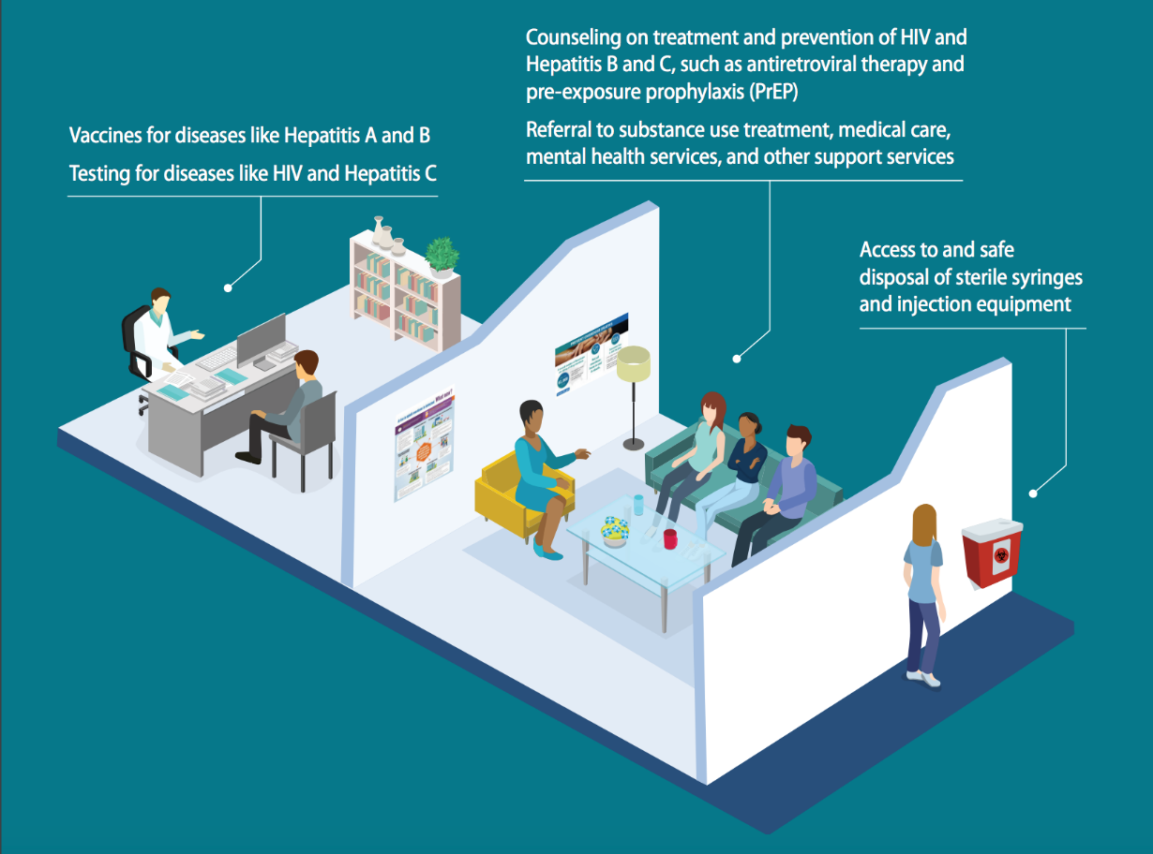
Syringe Services Programs
SSPs adapt to local needs by providing comprehensive support services, such as ways to get treatment, medicines to prevent overdoses, and tools to prevent HIV and viral hepatitis. Many support services may be operated in partnership with federal government funding¹
Combined use of OST and high coverage of NSP was associated with a 74% risk reduction in HCV acquisition ²
1. HIV.gov: Syringe Serviece Programs. https://www.hiv.gov/federal-response/policies-issues/syringe-services-programs

Slide 32
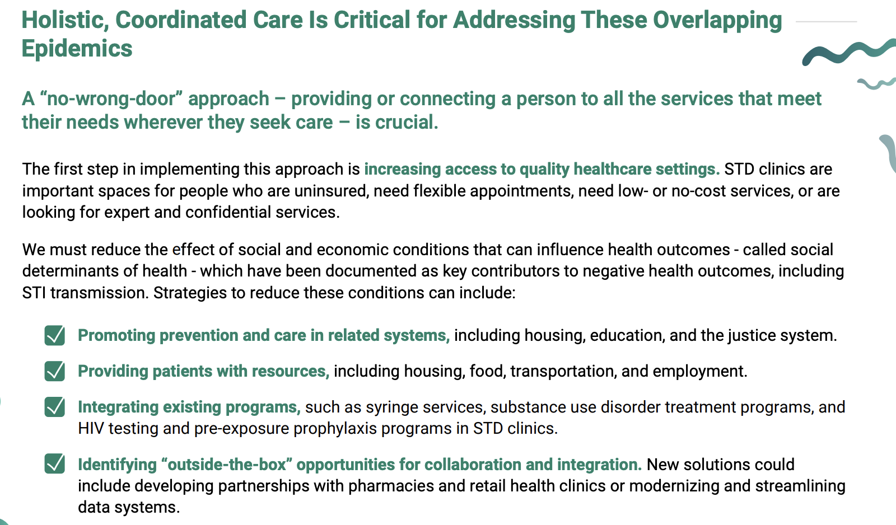
”No-Wrong Door Approach”
https://www.cdc.gov/std/statistics/2019/syndemic-infographic.pdf

Slide 33
Clinical Case:
A 20 yo cis-gender female who has sex with cis-gender males, presents for a pregnancy test only
Reports oral and vaginal sex without protective barrier 3 weeks ago
2 partners over the past 6 months
Denies recent drug use, but reports injecting heroin 3 months ago, unstable housing and transportation, does not have regular access to phone
No current signs or symptoms, and doesn’t recollect any in the past year
Never tested for HIV
Office Tests
Agrees to rapid HIV/Syphilis test in office when offered incentive
HIV: non-reactive
Rapid pregnancy test: Positive
Last gonorrhea/chlamydia (urine only) and RPR tests were 11 months ago, all negative
Syphilis (treponemal antibody): reactive

Slide 34
What are the recommended next steps? (Check all that apply)
No further testing necessary, as initial reason for the visit (pregnancy testing) already completed
Draw serum HIV, test for gonorrhea and chlamydia in the urine and throat
Draw RPR, wait for results (~1 week) to determine treatment
Draw RPR and immediately administer 2.4 MU IM injection of benzathine penicillin for early latent stage syphilis
Draw RPR and immediately administer 2.4 MU IM injection of benzathine penicillin weekly x 3 weeks (total 7.2 MU) for late latent stage syphilis
Notes:
B. Serum HIV recommended since last sexual encounter was only 3 weeks ago and rapid HIV antibody test has a window period that can exceed 3 weeks. GC/CT testing at all anatomical sites recommended (urine + throat)
D. Immediate treatment indicated as patient reports unstable housing and inconsistent access to transportation and phone. Significant likelihood that clinic would not be able to contact patient easily for recall. Only 1 injection needed since last RPR was within 1 year.

Slide 35
What else would you recommend
SUD counseling and treatment
HIV counseling and PrEP
HCV screening
Social services intervention for housing and transportation

Slide 36
Conclusions
Ending the syndemic will require a multipronged approach
SUD services should be integrated into primary care – barriers for harm reduction should be removed
The efficacy of PrEP and HIV treatment has been established – access for the most vulnerable is critical
Syphilis is taking a toll in AI/AN communities – zero tolerance for congenital syphilis should be the standard

Slide 37
References
Singer, M. and Clair, S. (2003), Syndemics and Public Health: Reconceptualizing Disease in Bio‐Social Context. Medical Anthropology Quarterly, 17: 423-441. https://doi.org/10.1525/maq.2003.17.4.423
Chu PL, Santos GM, Vu A et al. Journal of the International AIDS Society 2012. 15:102-103
Community Outbreak of HIV Infection Linked to Injection Drug Use of Oxymorphone — Indiana, 2015 MMWR May 1, 2015 / 64(16):443-444
US Census Bureau. https://www.census.gov/www. Accessed March 22, 2021
Evans ME, Person M, Reilley B, et al. Trends in Indicators of Injection Drug Use, Indian Health Service, 2010-2014 : A Study of Health Care Encounter Data. Public Health Rep. 2020 Jul/Aug;135(4):461-471. doi: 10.1177/0033354920937284. Epub 2020 Jul 7. PMID: 32633599; PMCID: PMC7383762.
Viral Hepatitis Surveillance Report 2018 — Hepatitis C https://www.cdc.gov/hepatitis/statistics/2018surveillance/HepC.htm
Melkonian SC, Jim MA, Haverkamp D, et al. Disparities in Cancer Incidence and Trends among American Indians and Alaska Natives in the United States, 2010-2015. Cancer Epidemiol Biomarkers Prev. 2019;28(10):1604-1611. doi:10.1158/1055-9965.EPI-19-0288
National Center for HIV/AIDS, Viral Hepatitis, STD, and TB Prevention Division of HIV/AIDS Prevention. https://www.cdc.gov/hiv/group/racialethnic/aian/index.html

Slide 38
References
Sordo L, Barrio G, Bravo M J, Indave B I, Degenhardt L, Wiessing L et al. Mortality risk during and after opioid substitution treatment: systematic review and meta-analysis of cohort studies BMJ 2017; 357 :j1550 doi:10.1136/bmj.j1550
Haffajee RL, Lin LA, Bohnert ASB, Goldstick JE. Characteristics of US Counties With High Opioid Overdose Mortality and Low Capacity to Deliver Medications for Opioid Use Disorder. JAMA Netw Open. 2019;2(6):e196373. doi:10.1001/jamanetworkopen.2019.6373
Reilley B, Haberling DL, Person M, Leston J, Iralu J, Haverkate R, Siddiqi AE. Assessing New Diagnoses of HIV Among American Indian/Alaska Natives Served by the Indian Health Service, 2005-2014. Public Health Rep. 2018 Mar/Apr;133(2):163-168. doi: 10.1177/0033354917753118. Epub 2018 Mar 8. PMID: 29517957; PMCID: PMC5871137.
Lauren Canary, Susan Hariri, Cecily Campbell, et al., Geographic Disparities in Access to Syringe Services Programs Among Young Persons With Hepatitis C Virus Infection in the United States, Clinical Infectious Diseases, Volume 65, Issue 3, 1 August 2017, Pages 514–517
Paquette CE, Pollini RA. Injection drug use, HIV/HCV, and related services in nonurban areas of the United States: A systematic review. Drug Alcohol Depend. 2018 Jul 1;188:239-250. doi: 10.1016/j.drugalcdep.2018.03.049. Epub 2018 May 8. PMID: 29787966; PMCID: PMC5999584.
Jon E. Zibbell, Alice K. Asher, Rajiv C. Patel, et al. Increases in Acute Hepatitis C Virus Infection Related to a Growing Opioid Epidemic and Associated Injection Drug Use, United States, 2004 to 2014. J Public Health. 2018 Feb; 108(2): 175–181.

Slide 39
Questions?
Thank You

