Slide 1


Pediatric Vehicular Heatstroke
Olivia Whiting-Tovar, BA, CPST
Native CARS Highway Safety Specialist, NPAIHB
Tammie Scott, BS, CPSTI
Idaho Tribal CPS Liaison, WEAVE-NW Health Educator/Evaluation Specialist, NPAIHB
Tam Lutz (Lummi Nation) , MPH, MHA, CPST
Population and Public Health Director at the Lummi Nation
Notes:
Hello,
My name is Olivia Whiting-Tovar, I am a member of the Oglala Sioux Tribe in SW South Dakota
I am a certified Child Passenger Safety Technician and the Native CARS Highway Safety Specialist here at the board
Another person that provides expertise to the Injury Prevention programs here is Tammie Scott. Tammie is a certified Child Passenger Safety Technician Instructor, based in SE Idaho, she also serves as the Idaho Tribal Child Passenger Safety Liaison supporting tribal Car Seat Technicians and events throughout Idaho.
And then Tam Lutz of the Lummi Nation, is the former MCH Programs Director here at the health board, but she has since returned to work for her tribe as the Population and Public Health Director. We were very sad to see her go but glad she is following her dream of serving her tribe.
And I will be sharing information about Pediatric Vehicular Heatstroke today.

Slide 2

Climate crisis drives heat wave
Heat waves expanding across the south this week
Triple digit temperatures and extreme humidity impact millions
Night time temps not cooling down enough to offer reprieve
Record breaking consecutive days of record or near record high night time temps
Urban concrete/asphalt “islands” absorb more heat than area with parks, rivers and tree lined street, when temps are supposed to cool down that retained heat is release back into the air
Night time is a critical time to relieve the stress on our bodies from being overheated during the day
Notes:
Now that is summer here, we are able to get a first hand look at the rising temperatures nationwide.
There are heat waves expanding across the south this week
Temperatures as high as the triple digits and extreme humidity impacting millions of folks
And the night time temperatures are not cooling down enough to offer reprieve
There are record breaking consecutive days of record or near record high night time temperatures
Urban concrete/asphalt “islands” absorb more heat than area with parks, rivers, and tree lined streets, when temperatures are supposed to cool down that retained heat is released back into the air
Night time is a critical time to relieve the stress on our bodies from being overheated during the day

Slide 3
Northwest Heat Wave Soars Earlier
800 people died in Oregon, Washington and British Columbia during the heat dome weather event in late June and early July 2021
Oregon passed law for all new residential construction as of April 2024 to have one room with air conditioning
Portland, OR responded with installing portable heat/cooling pump units in lower income housing
Notes:
From January through May of this year, North America has had its highest temperatures to date, at 2.38 degrees Fahrenheit above average
In Portland alone, May 2024 was 3 degrees Fahrenheit higher when compared to May 2023
800 people died in Oregon, Washington, and British Columbia during the heat dome weather event in late June and early July 2021
Oregon passed a law for all new residential construction as of April 2024 to have one room with air conditioning
Here in Portland, landlords had responded with installing portable heat/cooling pump units in lower income housing

Slide 4
Notes:
This graph demonstrates how heat-related emergency department visits spike from April to about October here in Oregon.
We can see that the highest spike was in Summer 2021

Slide 5
Transportation & Safety Orgs Prioritize Pediatric Vehicular Heatstroke
National institutes and organizations prioritize the prevention of heat stroke in vehicles
Focus on children, our most vulnerable, who are at higher risk of dying from heat stroke after being left or trapped in vehicles
All hot car deaths are preventable
nsc.org/heatstroke
noheatstroke.org
cpsboard.org/heatstroke
nhtsa.gov/campaign/heatstroke
Notes:
Here are a few transportation and safety organizations that prioritize pediatric vehicular heatstroke prevention
These resources focus on children, our most vulnerable, who are at higher rick of dying from heat stroke after being left or trapped in vehicles
A major takeaway from all of these resources is that: All hot car deaths are preventable

Slide 6
Pediatric Vehicular Heatstroke (PVH)
About 38 children die each year from PVH.
Nationally 8 PVH deaths have occurred as of 6/12/23
PVH is the leading cause of death in vehicles (excluding crashes) for those 14 and younger.
Whether participating is summer activities or beginning school routines, research shows that tragedy can strike among anyone
Important for parents, caregiver, providers, community member to be vigilant about dangers of children in hot cars
KidsAndCars.org and NoHeatStroke.org
Vaidyanathan A, Malilay J, Schramm P, Saha S. Heat-Related Deaths — United States, 2004–2018. MMWR Morb Mortal Wkly Rep 2020;69:729–734. DOI: http://dx.doi.org/10.15585/mmwr.mm6924a1external icon
Notes:
Pediatric vehicular heatstroke (PVH) is the leading cause of death for non-crash vehicular deaths among children in the United States.
Heatstroke can be an all-season threat in some parts of the country
It is important for parents and others remain vigilant about the ongoing dangers of children (and our pets) from dying in hot cars
In the hustle and bustle of summer activities, parents and caregivers need to be extra mindful of their children’s whereabouts. And they need to keep vehicles locked in the garage or driveway, and the keys out of children’s reach.

Slide 7
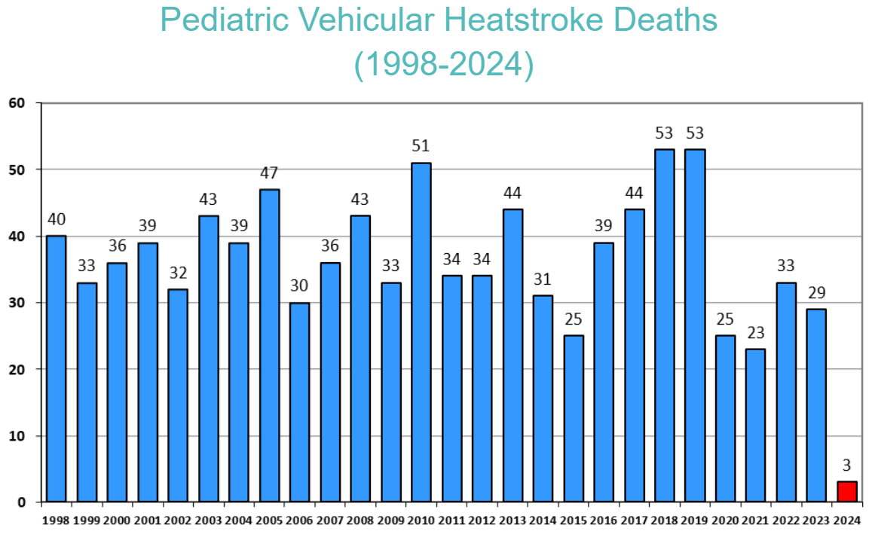
Source: Jan Null, CCM, Department of Meteorology and Climate Science, San Jose State University, http://noheatstroke.org (last updated 4/3/23)
Notes:
For 26 years, safety advocates have tracked child deaths caused by pediatric vehicular heatstroke. On average, one child dies from heatstroke nearly every 10 days in the United States from being left in a car or crawling into an unlocked vehicle. What is most tragic is that every single one of these deaths could have been prevented. The U.S Department of Transportation's National Highway Traffic Safety Administration (NHTSA) is working with the National Weather Service to urge parents and caregivers to learn about and share critical information about the dangers of leaving children alone in hot cars. Share this lifesaving message with everyone you know: Look Before You Lock. For the most recent data on vehicular heatstroke, visit
noheatstroke.org
In 2018 and 2019, we saw a record number of hot car deaths — 53 children died each year — the most in at least 25 years, according to NoHeatstroke.org

Slide 8
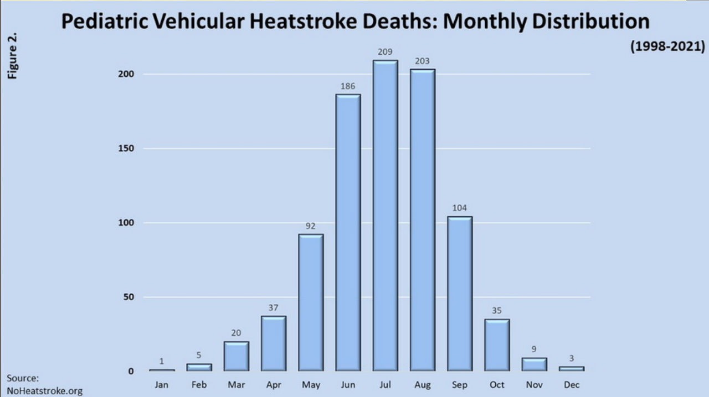
Notes:
U.S. Pediatric Vehicular Heatstroke deaths have occurred in each month of the year, but the majority of cases happen in the summer months (Jun-Aug).
We must always stay vigilant

Slide 9
How does this happen?
An examination of media reports about the 938 pediatric vehicular heatstroke deaths for a 25-year period (1998 through 2022)
Notes:
Since 1998, the majority (52.6%) of these tragedies occur when a child is “forgotten” by a parent or caregiver and left in a hot car, and more than half (58%) occur at a home. A busy parent or caregiver may unintentionally forget that a quiet or sleeping child, who may also be facing the back of the car, is in the back of the vehicle.
The children that have died from vehicular heatstroke in the United States (1998-2022) have ranged in age from 5 days to 14 years. More than half of the deaths (54%) are children under 2 years of age

Slide 10
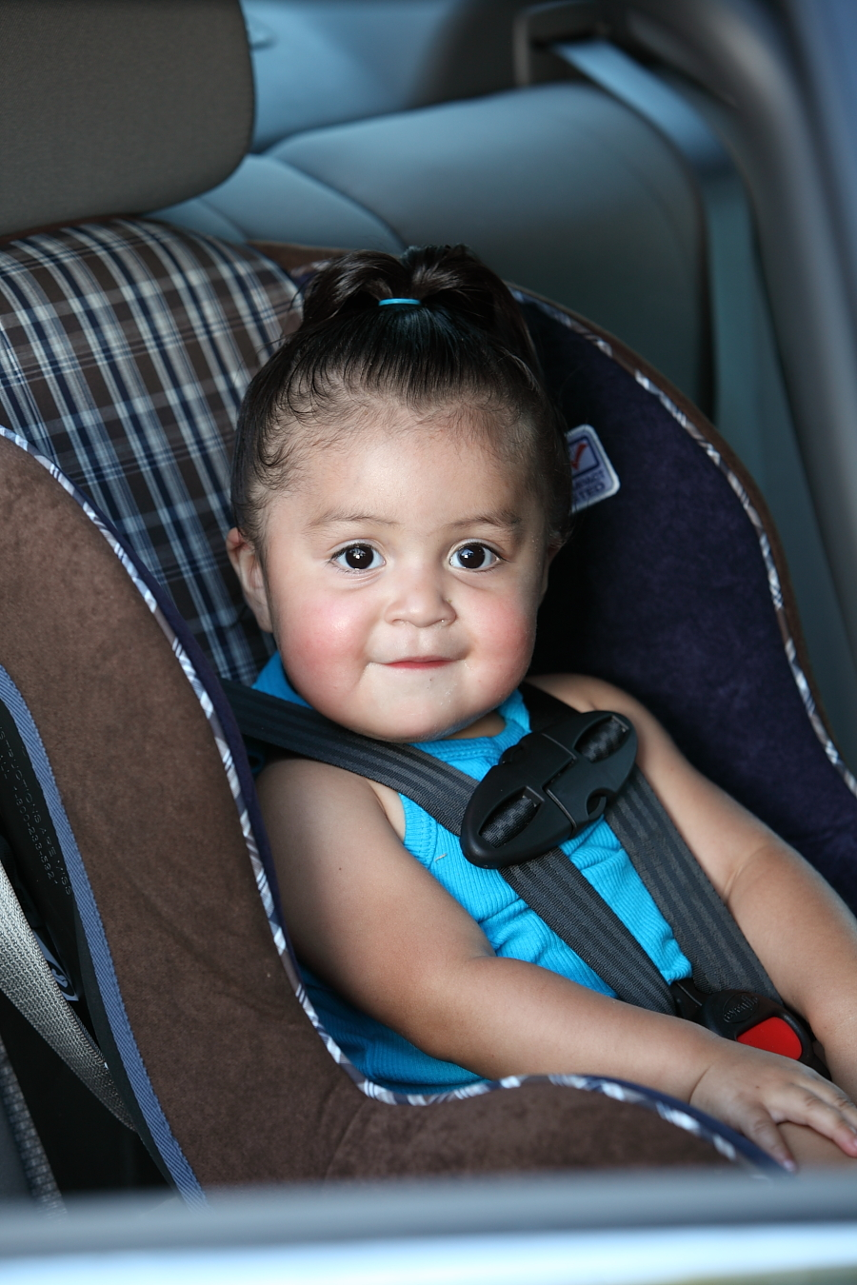
Vulnerability of Children in Hot Cars
A child’s body temperature rises 3 to 5 times faster than an adult’s
Heatstroke begins when the core body temperature reaches about 104 degrees
A child can die when their body temperature reaches 107 degrees.
Notes:
Vehicular heatstroke occurs when a child dies due to being left – intentionally or unintentionally – in a hot car. A child's body can overheat three to five times faster than an adult's body, making them highly susceptible to the condition
When a child is left in a vehicle, that child's temperature can rise quickly — and the situation can quickly become dangerous.

Slide 11
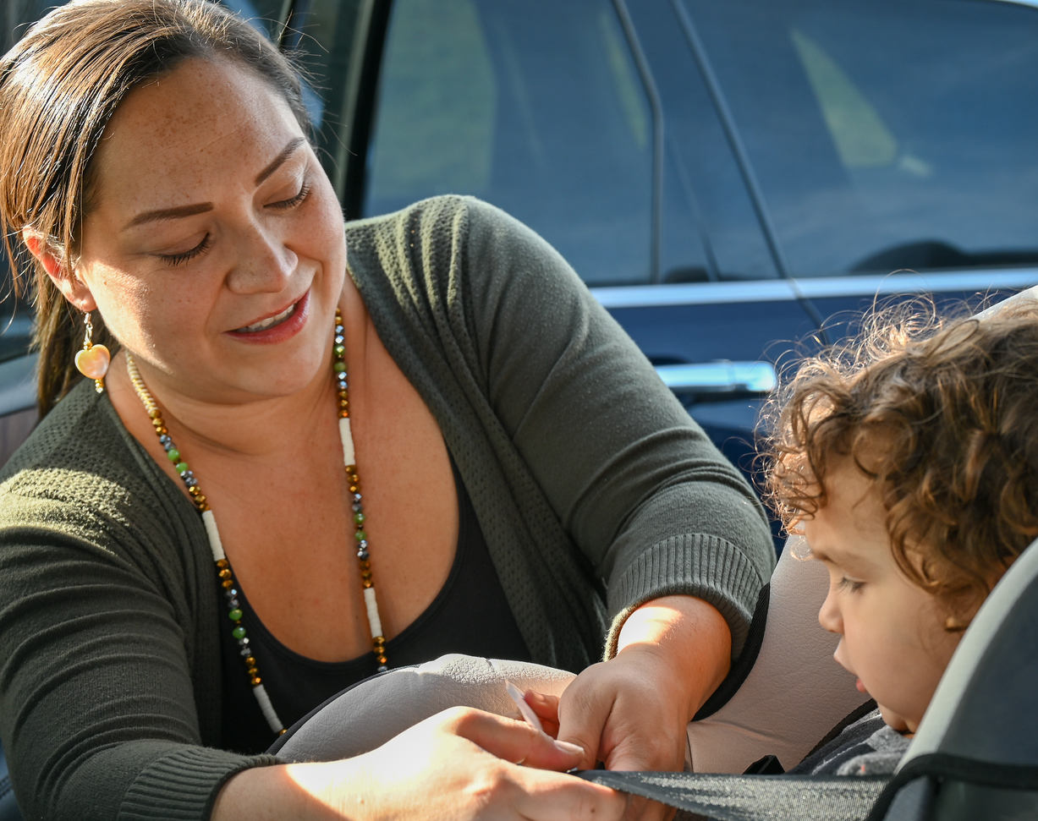
It Doesn’t Take a Heat Wave
Even on mild days, the temperature in a car can rise by 19 degrees in only 10 minutes and cracking the window doesn’t help.
Notes:
Heat stroke has occurred when as low as 57 degrees
Heatstroke occurs when the body is unable to cool itself quickly enough. Young children are particularly at risk. A child’s body heats up three to five times faster than an adult’s. When a child’s internal temperature reaches 104 degrees, major organs begin to shut down, and when the temperature reaches 107 degrees, the child can die.
Even on mild days, the temperature in a car can rise by 19 degrees in only 10 minutes and cracking the window doesn’t help.

Slide 12

So what can we do?
Notes:
So what can we do?
Well I will share a really good resource from National Safety Council that not only is a great educational resource but also outlines strategies for everyone including
Parents
Providers
Community Members

Slide 13


National Safety Council Toolkit on Vehicular Heat Stroke
https://training.nsc.org/hot-cars/
Notes:
This is a Toolkit on Vehicular Heat Stroke and it was created in 2018 by collaboration with the NSC & the National Weather C

Slide 14
Parents preventing vehicular heatstroke
Set your audible GPS on your phone or car to your child’s childcare destination
While important to focus on the road when driving, talk to your child along the way
Even if your child is not old enough say out loud to child where you are going on that trip especially if it deviates from your routine
Set your cell phone alarm for your expected destination add a label on your alarm setting
One child is secured, place your phone, purse, your left shoe, lap tap next to car seat, something that you will need at your destination
Notes:
1. Never leave a child in a vehicle unattended for any length of time. Rolling windows down or parking in the shade does little to change the interior temperature of the vehicle.
2. Make it a habit to check your entire vehicle — especially the back seat — before locking the doors and walking away.
3. Ask your childcare provider to call if your child doesn’t show up for care as expected.
4. Place a personal item like a purse or briefcase in the back seat, as another reminder to look before you lock. Write a note or place a stuffed animal in the passenger's seat to remind you that a child is in the back seat.
5. Store car keys out of a child's reach and teach children that a vehicle is not a play area.

Slide 15
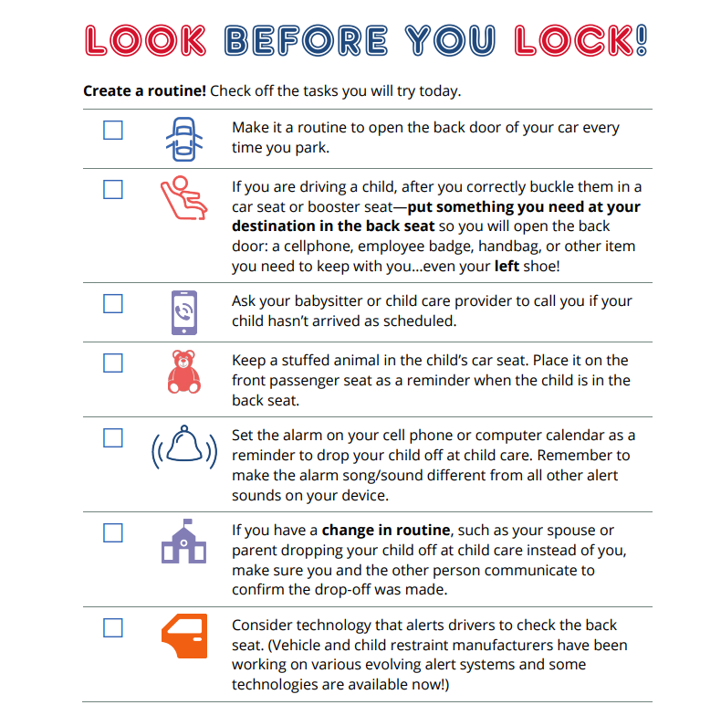
Notes:
The new technology is called Cabin Awareness. It's designed to use radar to save lives and prevent heatstroke deaths inside cars, not just from babies left in car seats, unattended children who climbed into cars unnoticed
Used radar to detect heart beat or breathing

Slide 16
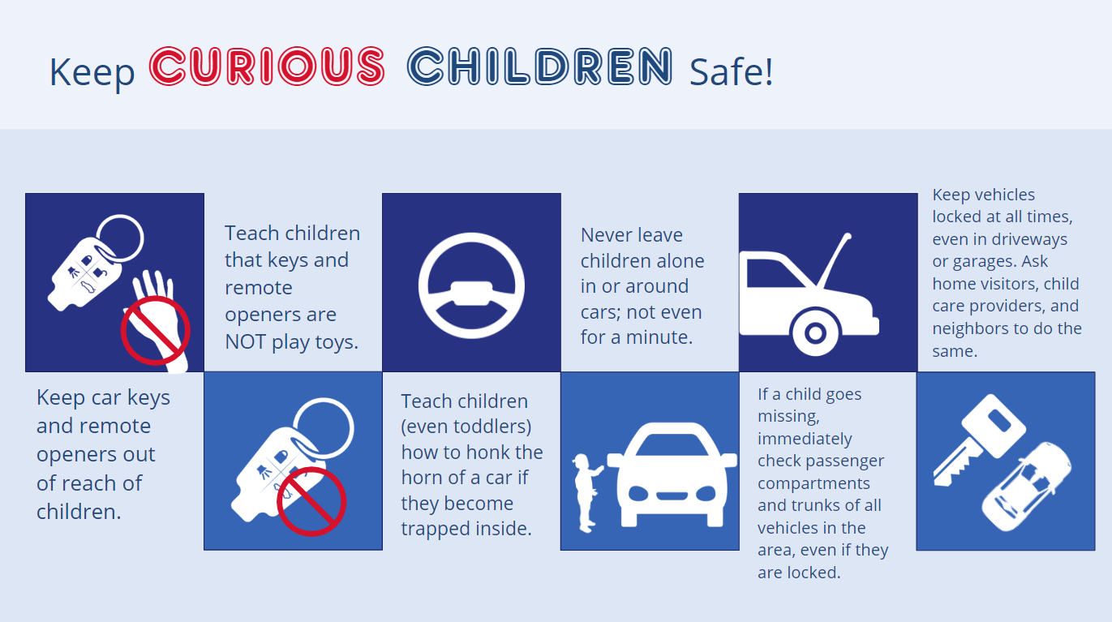

Slide 17
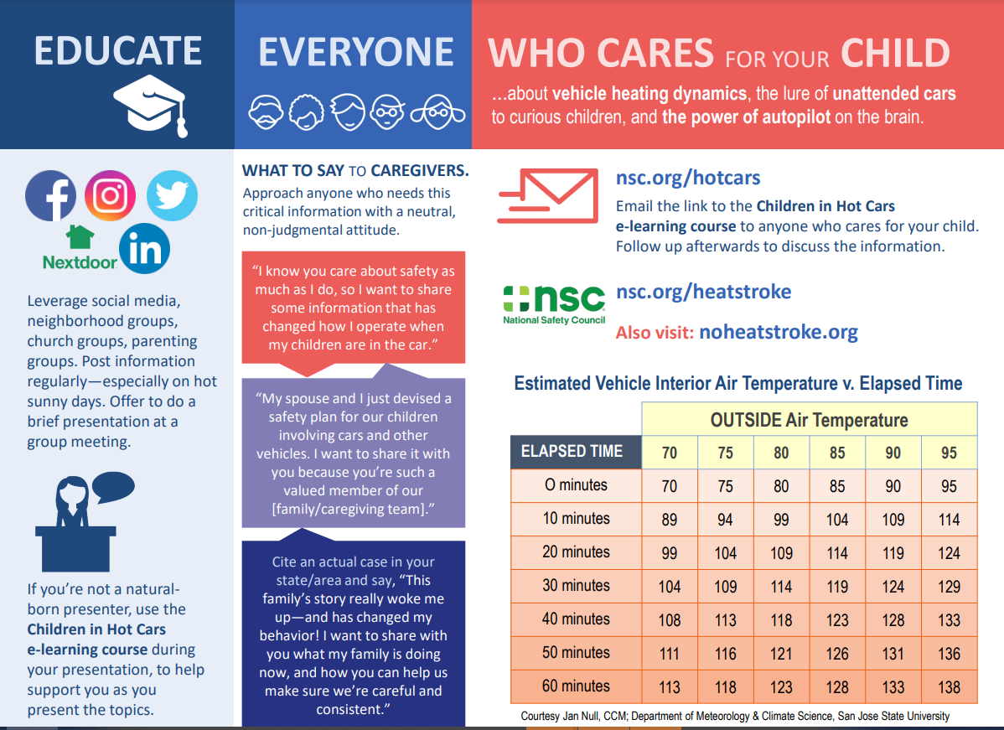

Slide 18
Pediatric Vehicular Heat Stroke Resources
nsc.org/hotcars
nsc.org/heatstroke
noheatstroke.org
cpsboard.org/heatstroke
nhtsa.gov/campaign/heatstroke

Slide 19
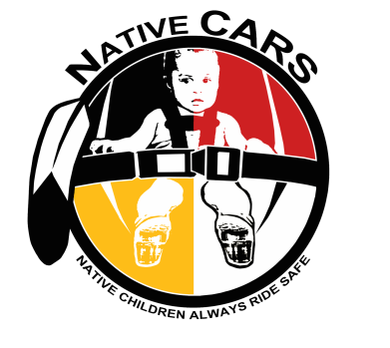
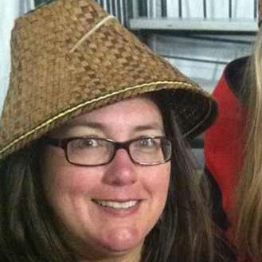
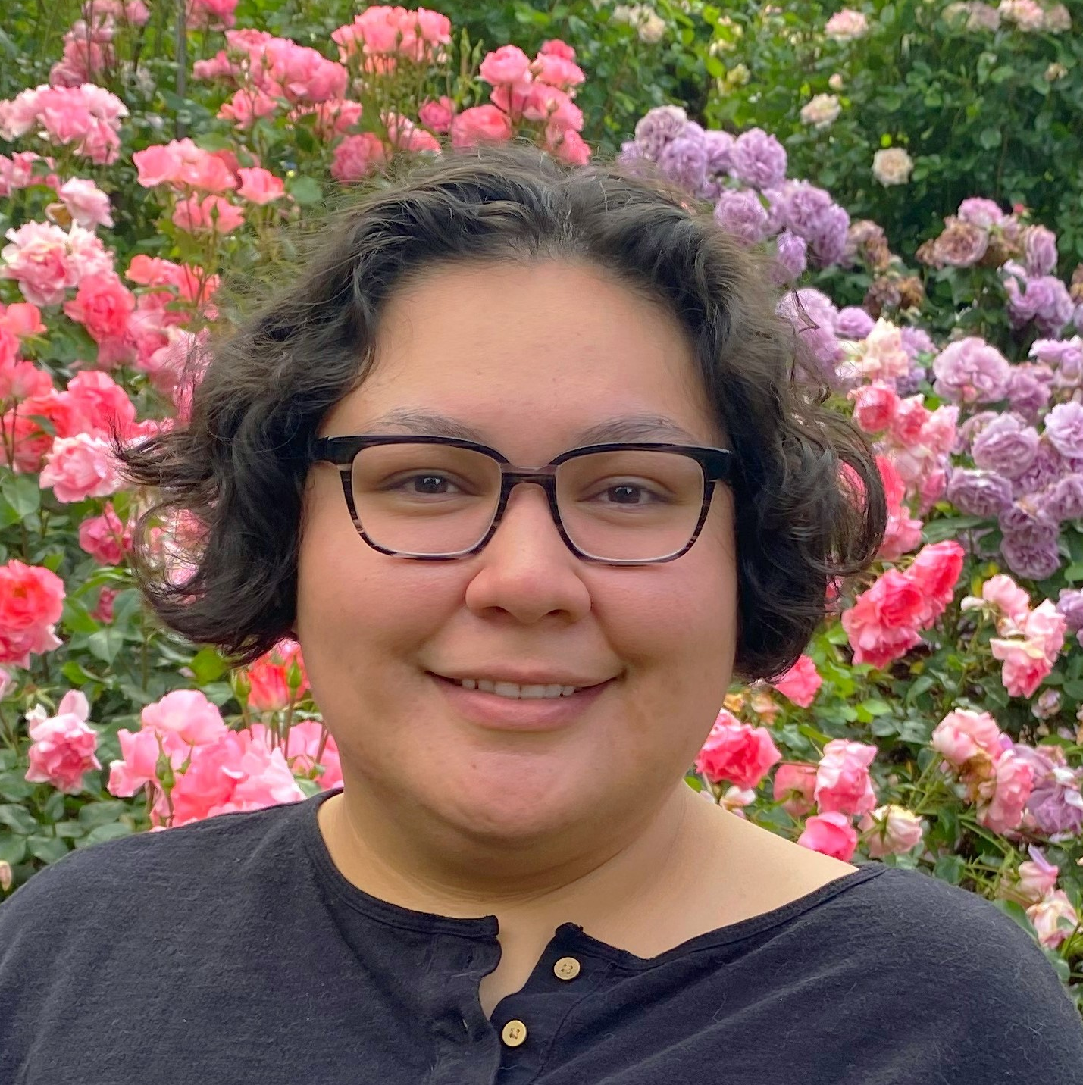

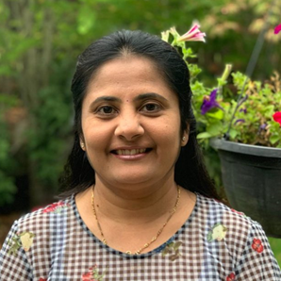
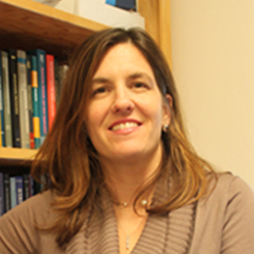
Native CARS/TIPCAP Team
Tam Lutz,
Maternal Child Health Programs Director/ Native CARS Co-PI, CPST
Olivia Whiting-Tovar,
Native CARS TIPCAP Project Coordinator, CPST
Nicole Smith,
NW Tribal Epidemiology Center Senior Biostatistician
Meena Patil,
NW Tribal Epidemiology Center Biostatistician
Jodi Lapidus,
Professor OHSU-PSU School of Public Health/ Native CARS Co-PI
Project Period January 2021 to December 2025
Grant No. D261IHS0202-01-00
Funder NIH, NIMHD
Tribal Injury Prevention Cooperative Agreement Program
Project Period January 2021 to December 2025
Grant No. D261IHS0202-01-00
Funder DHHS, IHS
Notes:
Here is the Native CARS TIPCAP Team
Tam Lutz; the Maternal Child Health Programs Director, a Native CARS Co-Principle Investigator, and CPST,
Myself, Olivia Whiting-Tovar; the Native CARS TIPCAP Project Coordinator and CPST,
Nicole Smith; the Senior Biostatistician at the NW Tribal Epidemiology Center,
Meena Patil; a Biostatistician at the NW Tribal Epidemiology Center and,
Jodi Lapidus; a Professor at the OHSU-PSU School of Public Health and the other Native CARS Co-Principle Investigator

Slide 20
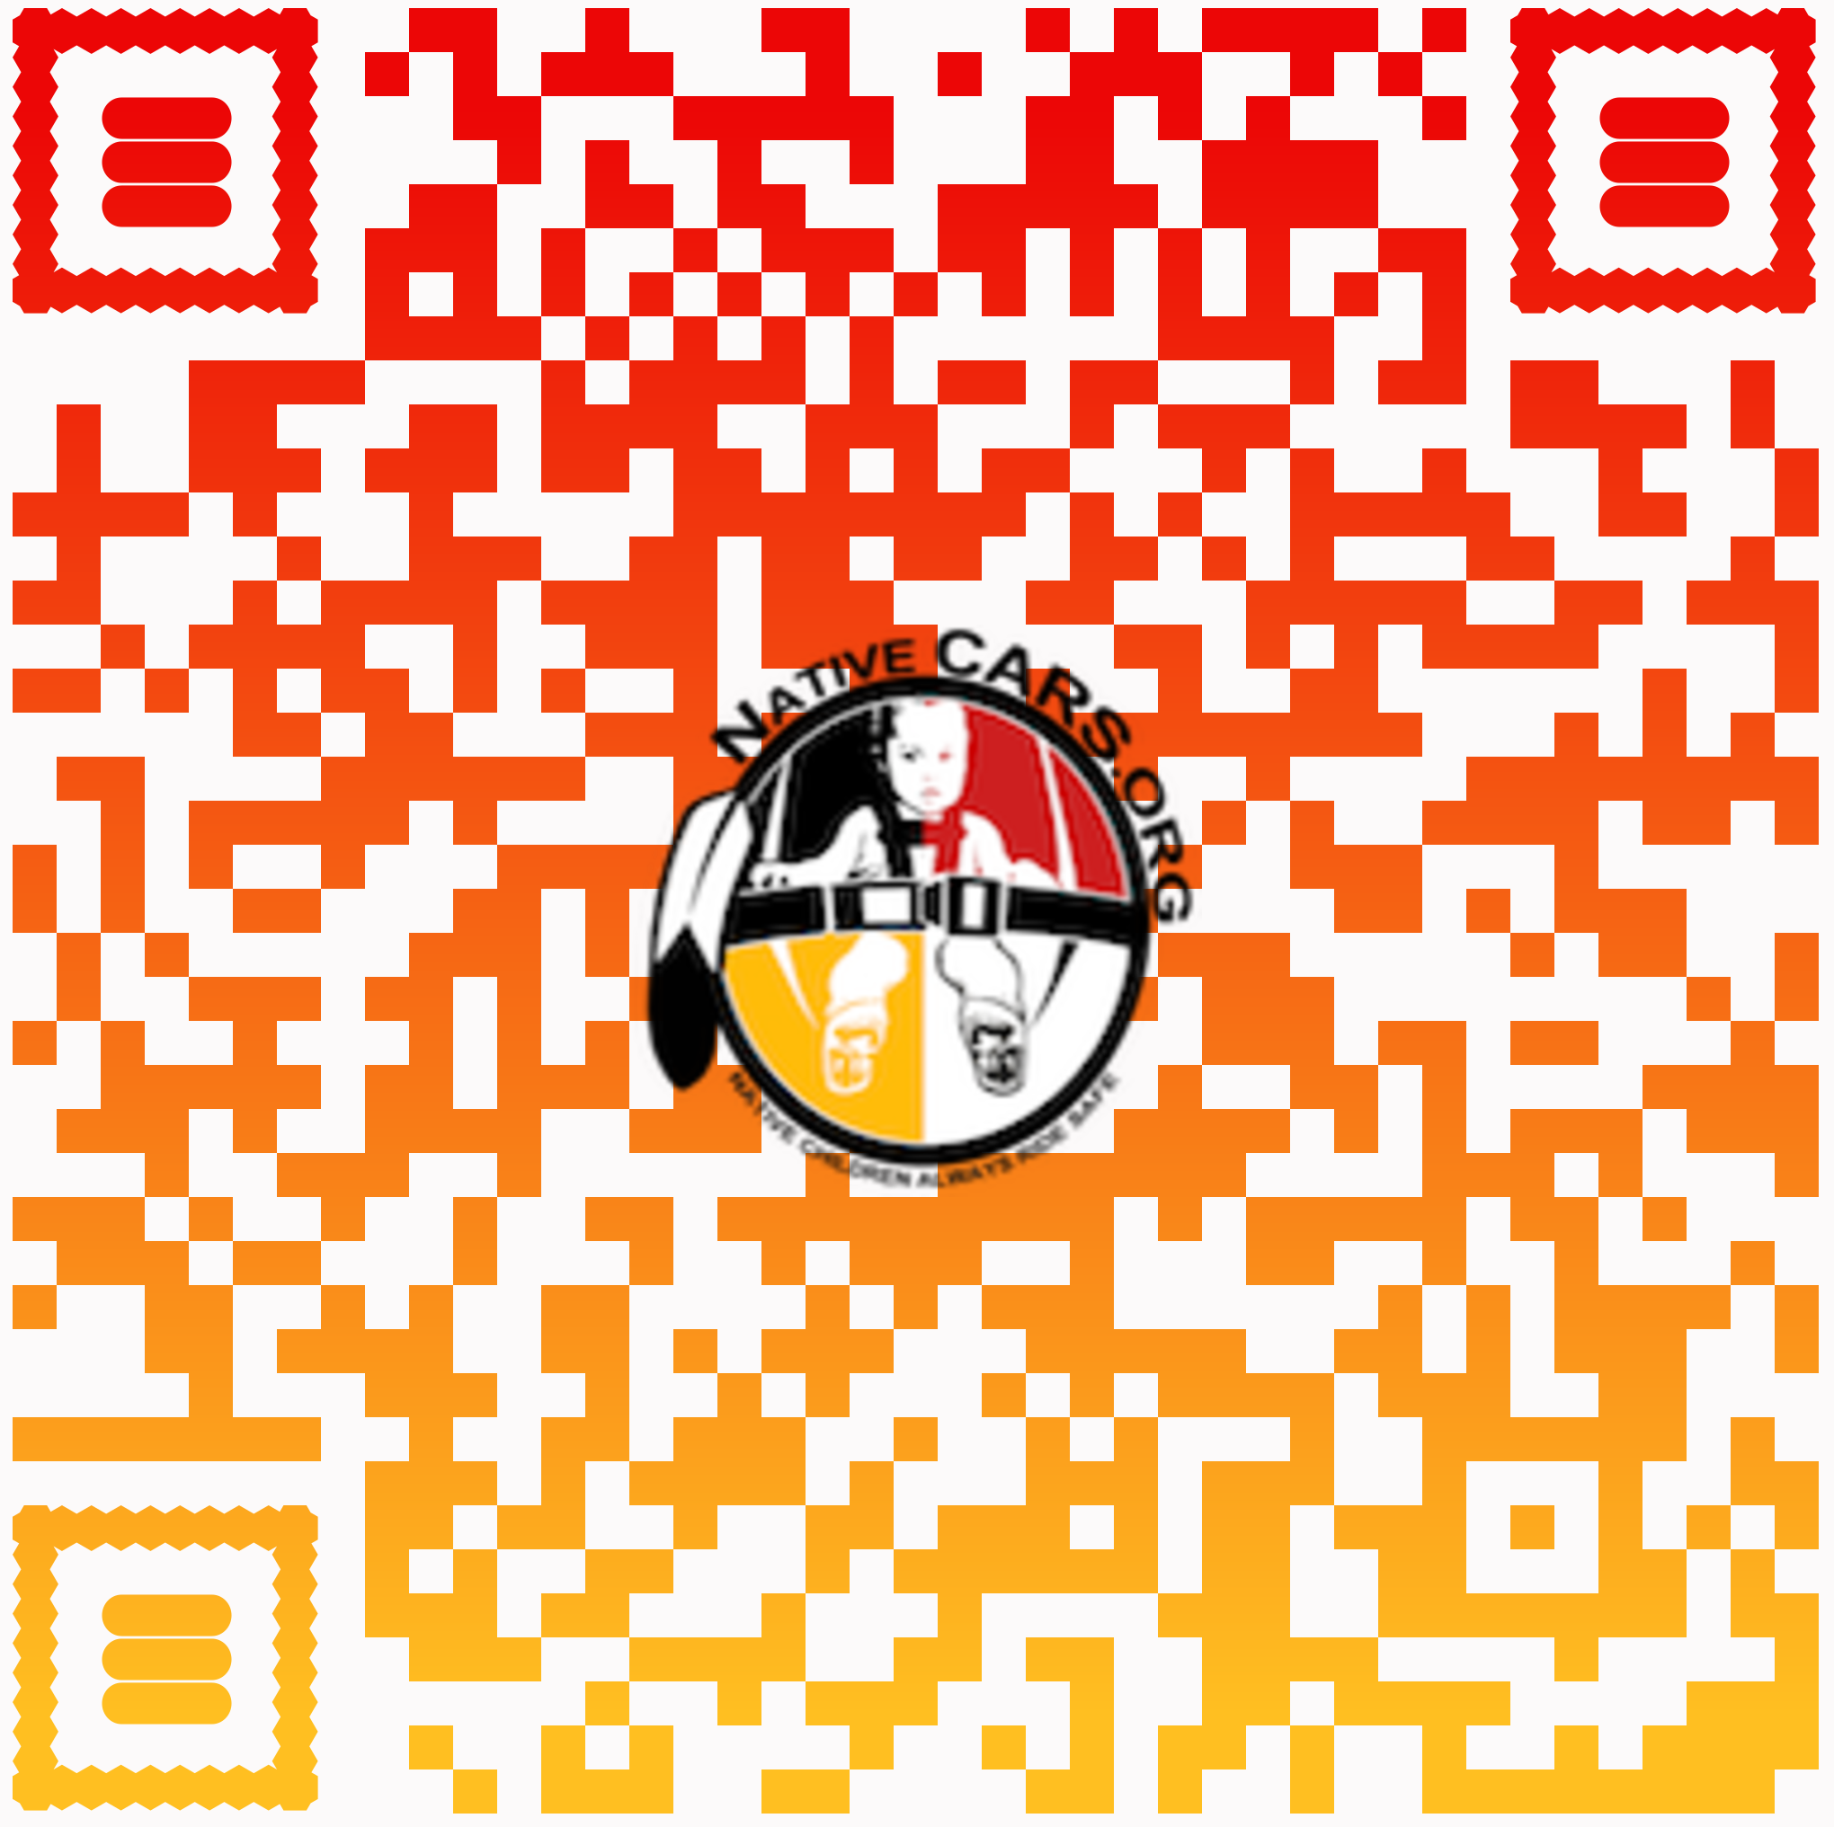
Native CARS TIPCAP Overview
Coalition
Sign up using the QR Code
We meet every quarter month (January, April, July, October)
Pedestrian Safety
New injury prevention activity
Child Passenger Safety
Well established and practiced activity
NativeCARS.org
Notes:
I wanted to start off with adding a plug for folks to join the Native CARS TIPCAP Coalition!
You can use the QR Code or this link to join: https://lp.constantcontactpages.com/su/6xgRwuZ
The coalition is an open group discussing and addressing motor vehicle injury prevention topics and trainings needs.
We meet every quarter month, and we are going to meet toward the end of July or early August; my schedule is filling up this month. But I always share meeting updates in advance, so you will always be in the know.
I will outline the injury prevention focus areas of which Native CARS TIPCAP is concentrating on in this slide and I’ll go more in-depth in the next few slides.
The first is:
Pedestrian Safety
Which is a newer prevention focus for the project that we are trying to get our foot in the door, if you will, as we are seeking northwest Tribal partners interested in working on this topic with us
So if you are interested in working together to address pedestrian safety concerns within your community, please reach out to me
The second injury focus is:
Child Passenger Safety
Which we have much more practice in because I kind of picked up where the Native Children Always Ride Safe Project left off in regards to Tribal contacts and we hold similar activities
I also assist with maintaining and updating the Native CARS Atlas, where there are 12 learning modules to understand the process in which Native CARS took to implement community interventions to increase car seat use within 6 Native CARS original partner Tribes
And you can access those resources at NativeCARS.org

Slide 21
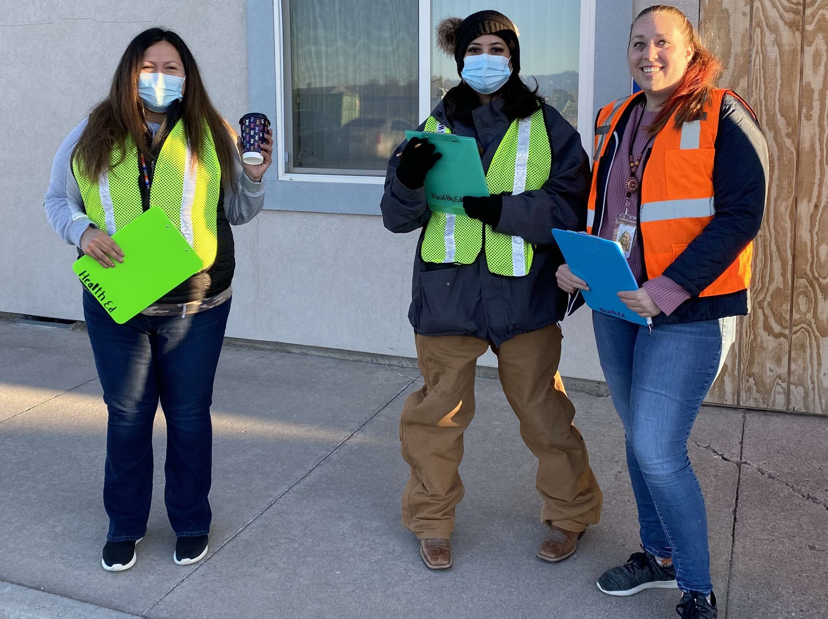
Pedestrian Safety Partnership Offerings
Pedestrian Safety
Community Pedestrian Safety Evaluations
Tribal community StoryMap creation activity
To bring awareness to high traffic injury area with pictures, videos, and stories
Community Walk Audit Activities
To assess areas with high pedestrian and motor vehicle interaction; popular intersections
Notes:
Alright, now that we know Native CARS TIPCAP provides partnership to northwest Tribes for activities focused on Child Passenger Safety and Pedestrian Safety
I will talk about our pedestrian safety partnership offerings now:
Community Pedestrian Safety Evaluations, which is a Tribal community StoryMap creation activity
Where we highlight and bring awareness to high traffic-related injury areas within Tribal communities through pictures, videos, and of course stories
Community Walk Audit Activities; where we would assess the accessibility and walkability of locations in which there is high pedestrian and motor vehicle interaction, such as popular intersections in communities
With the information collected, we can assist with creating plans to address the safety concerns that are found during either of the assessments
And we are definitely ready to go and very determined when it comes to this injury focus

Slide 22
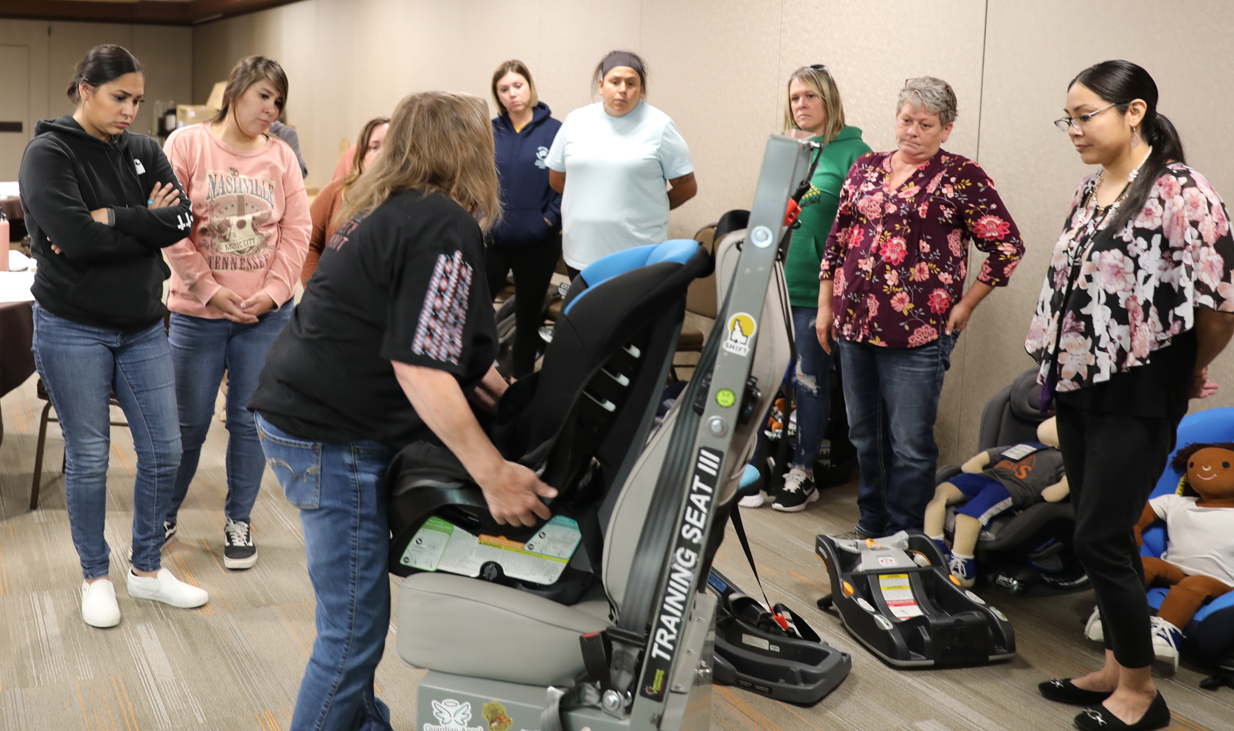
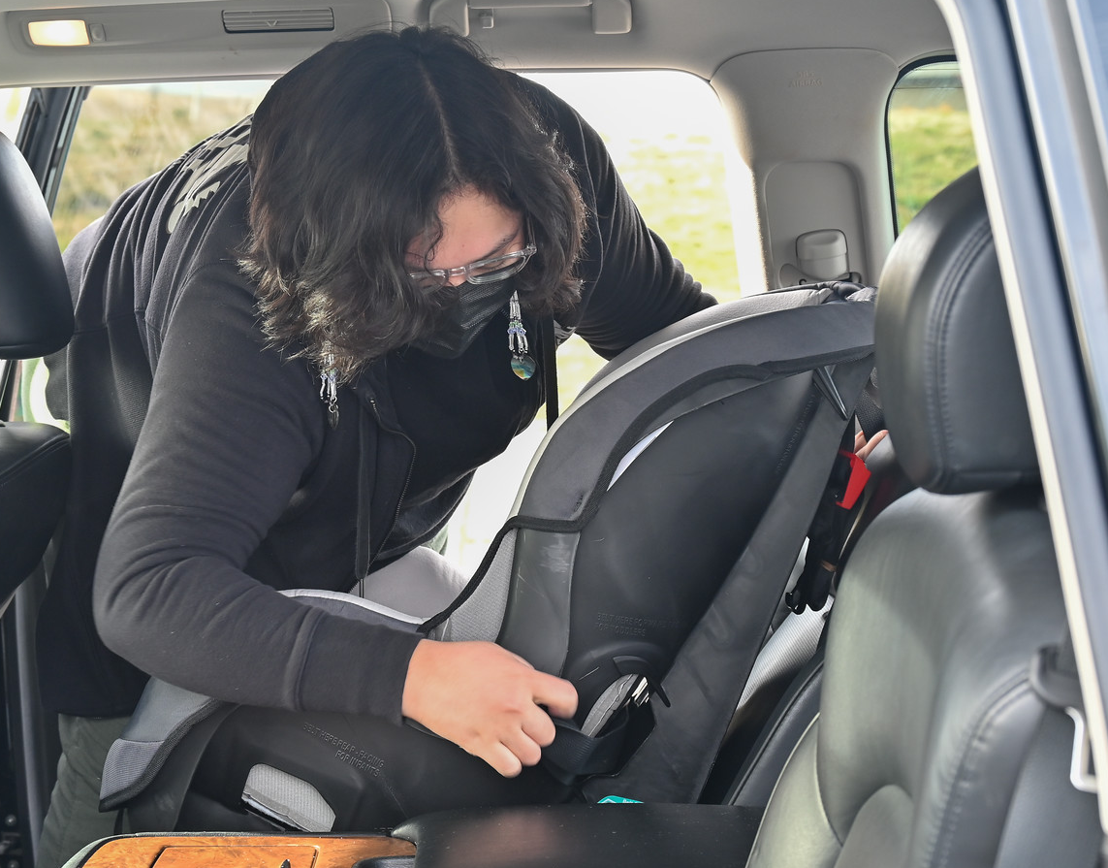
Child Passenger Safety Partnership Offerings
Child Passenger Safety
Tribal Community Specific Child and Driver Restraint Use Data Collection
Data is applicable to the BIA Indian Hwy Safety Occupant Protection Grant
Child Passenger Safety Seat Check and Distribution Events
Car seat fittings, car seat resources can be distributed
Child Passenger Safety Trainings and Courses
Child Passenger Safety Technician Certification Course
Safe Native American Passengers (SNAP) Trainings (NOT a certification training)
Notes:
And here I will talk about our Child Passenger Safety initiatives that we offer partnership for:
Tribal community specific child and driver restraint use data collection
The data collected is applicable to the BIA Indian Highway Safety Occupant Protection Grant, which closes at the same time every year – the 1st of May
This grant provides numerous resources for child passenger safety seats and training funds
We definitely encourage all our Tribal partners to apply for this grant as it is not competitive, so as long as Tribes fill in the application they will most likely get funded because BIA really is seeking to get Tribal car seat programs funds - and if you need assistance, they will work with you
But we are also willing to provide assist in any way we can
Child passenger safety seat check and distribution events
Where we work with Tribal families to provide appropriate car seats and check the seats that families already have to discuss any safety concerns or questions they may have
Child Passenger Safety Trainings and Courses
One course we provide at least once a year is a Child Passenger Safety Technician Certification Course; which we held one last week where 13 Tribal serving Technicians became certified
This course is 3 to 4 days long with written and practical tests. It does take a bit of commitment to go through the course but it is definitely worth the work when you get to provide your newfound skills to Tribal families
A training we offer is the Safe Native American Passengers Training or SNAP Training
It is a 2-4 hour long training covering child passenger safety seat use best practices
It is NOT a training for certification - I just wanted to make that clear
It is more focused on educating and working with Tribal caregivers to gain confidence and skills around proper child passenger safety seat use practices to ensure their children are always riding safe

Slide 23

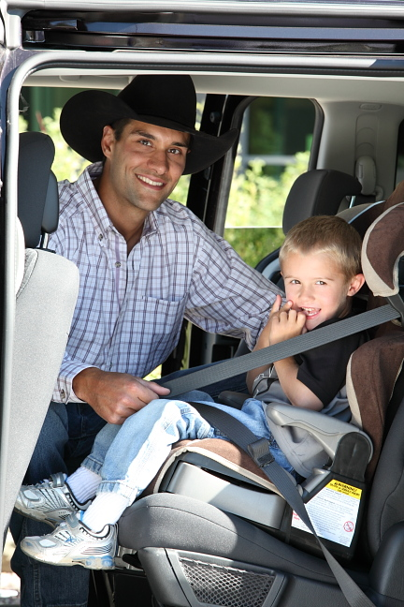
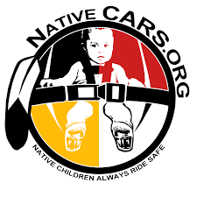


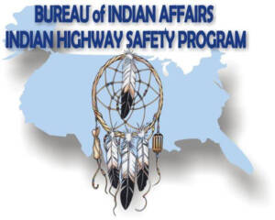
Importance and Role of Child Passenger Safety Technician in Tribal Communities
MV injuries are the leading cause of PREVENTABLE death among children in the US.
Always buckling children in the appropriate car seat will reduce serious injury by up to 80%.
Factors and impacts to having CPST in native communities
Socioeconomic impact
Rural communities
Access to resources
New parents/uninformed of need for CPS
Why it is important to maintain certification
Maintain resources for community
More expensive and time consuming to retake CPST class than recertify
National Certification and network of contacts and resources

Slide 24
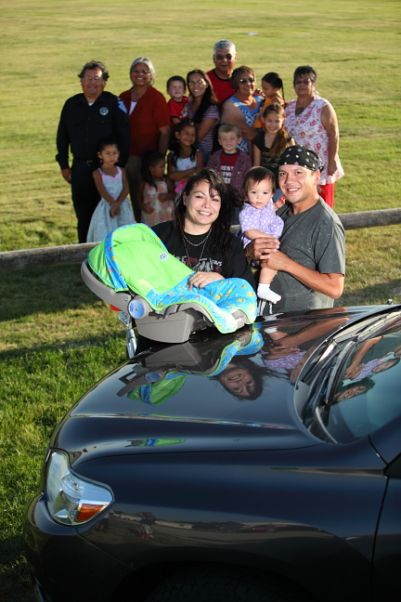
Contact Us
Tam Lutz
tlutz@npaihb.org
971-322-6385
Olivia Whiting-Tovar
owhiting@npaihb.org
Notes:
We are open to partnering with all northwest Tribes to work on Child Passenger Safety or Pedestrian Safety initiatives, so please do not hesitate to reach out with any questions or comments.

