Slide 1



Motivational Interviewing with Youth and Families
DATE: July 16, 2024 PRESENTED BY: Diana Latorre, LCSW, CADC III
Notes:
Hi everyone. I am Diana Latorre and I am a LCSW and CADCIII. I am currently the clinical director of Haven Counseling Collective and I am also a dual diagnosis provider with Iris Telehealth. I’ve spent the past 15 years working with adolescents with mental health and substance use disorders in various settings and levels of care including residential, IOP, PHP, and outpatient counseling services. While working with teens and families can be challenging, they are some of the most inspiring and rewarding people I have worked with. Today, I’m excited to be presenting to you on Motivational Interviewing with Youth and Families.

Slide 2
Disclosures
I have no disclosures.
Notes:
I have no disclosures.

Slide 3
Learning Objectives
Understand why Motivational Interviewing works for teens and families
Learn/ review basic skills of Motivational Interviewing to use with youth
Learn how to utilize and equip parents/ caregivers/ family with motivational interviewing skills and resources
Notes:
My hope is that you will walk away from today’s presentation with an
Understanding about why Motivational Interviewing works for teens and families
Learn/ review basic skills of Motivational Interviewing with youth and families
Learn how to utilize and equip parents/ caregivers/ family with motivational interviewing skills and resources

Slide 4

Why Motivational Interviewing?
“I just smoke weed. It’s natural. It’s from the earth.” – Teen
“My parents are so controlling… they don’t understand I’m going to find a way to do what I want anyway.”- Teen
“They think it’s just weed, but they’re going to end up in jail… living on the streets… it’s a gateway drug…” – Parent
“If they’re not doing what I want, I’m going to kick them out…”- Parent
“I’ve done everything I can possibly think of… and nothing has worked.” – Parent
“My parents said I need a new provider because I’m still smoking weed.”- Teen
Notes:
“If they’re not doing what I want, I’m going to kick them out…”- Parent
“My parents are so controlling… they don’t understand I’m going to find a way to do what I want anyway.”- Teen
“They think it’s just weed, but they’re going to end up in jail… living on the streets… it’s a gateway drug…” – Parent
“My parents said I need a new provider because I’m still smoking weed.”- Teen
“I just smoke weed. It’s natural. It’s from the earth.” – Teen
“I’ve done everything I can possibly think of… and nothing has worked.” – Parent
Why MI with youth and families?
These are quotes I have heard often in the years I’ve worked with youth and families dealing with substance use issues. When you are working with youth, you are often not just working with them, but with their entire system of support including parents, teachers, probations officers or other providers. And every person may have a very different idea about what the problem is and what needs to change.

Slide 5
Why Motivational Interviewing with Youth?
A core principle of Motivational Interviewing is that individuals are more likely to accept and act on decisions that they voice themselves.
Notes:
A core principle of MI is that individuals are more likely to accept and act on decisions that they voice themselves.
This core principle of motivational interviewing is what makes it so effective with youth. A normal stage of adolescent development is individuation from their family of origin; in other words, developing their own sense of identity, purpose, and place in the world. Therefore, it is normal for teens to rebel from their families and authority figures. But what happens when a teen has multiple systems of authority telling them what they should do? Naturally, they push back and rebel. Motivational Interviewing leans into an adolescent’s natural tendency to want to explore themselves and their own sense of power.
Research has shown positive effects of using Motivational Interviewing with adolescents including:
-improved healthy behaviors such as reduced risky sexual behaviors, increased exercise, and healthy diet
-increased likelihood to follow up with outpatient appointments after an inpatient stay
-decreased substance use

Slide 6
The Efficacy of Using Motivational Interviewing with Youth
MI has been found to work well in treating substance use issues, which was the original intent of its creators (Burke et al., 2003).
MI is proven effective in reducing substance abuse among adolescents (Barnett et al., 2012).
Providing a brief MI intervention is a viable approach to working with high-risk teens to decrease substance use (D’Amico et al., 2008).
MI has been found to reduce risky behavior (Lundahl & Burke, 2009) and increase healthy behaviors among teens (Cushing et al., 2014).

Slide 7
The Efficacy of Using Motivational Interviewing with Youth
Further, the positive effects of motivational interviewing on teenagers appear to maintain themselves over time (Jensen et al., 2011).
MI appears to have value as an adjunct treatment for certain psychological disorders that may have stalled due to teen resistance (Randall & McNeil, 2017).
Motivational Interviewing techniques for substance abuse are transferable to other situations and conditions, both psychological and physical.

Slide 8
What is Motivational Interviewing?
“Motivational interviewing is a way of being with a client, not just a set of techniques for doing counseling.”
—William R. Miller and Stephen Rollnick, authors of “Motivational Interviewing: Helping People Change”
Notes:
What is Motivational Interviewing?
“Motivational interviewing is a way of being with a client, not just a set of techniques for doing counseling.”
Motivational Interviewing is now utilized in conjunction with other therapeutic modalities and now used in health, social services, criminal justice, and education setting across a variety of situations.

Slide 9
Here is Miller and Rollnick’s official definition of Motivational Interviewing:
“Motivational Interviewing is a collaborative, goal-oriented style of communication with particular attention to the language of change. It is designed to strengthen personal motivation for and commitment to a specific goal by eliciting and exploring the person’s own reasons for change within an atmosphere of acceptance and compassion.”
Notes:
Here is Miller and Rollnick’s official definition of Motivational Interviewing:
“Motivational Interviewing is a collaborative, goal-oriented style of communication with particular attention to the language of change. It is designed to strengthen personal motivation for and commitment to a specific goal by eliciting and exploring the person’s own reasons for change within an atmosphere of acceptance and compassion.”

Slide 10
History & Development of Motivational Interviewing
Developed in 1980’s by clinical psychologists William R. Miller and Stephen Rollnick to support patients with substance use disorders
Motivational Interviewing is a combination of three theoretical models of therapy:
  1. teen-Centered Therapy
  2. Self-Determination Theory
  3. Transtheoretical Model (TTM) of behavior change

Slide 11
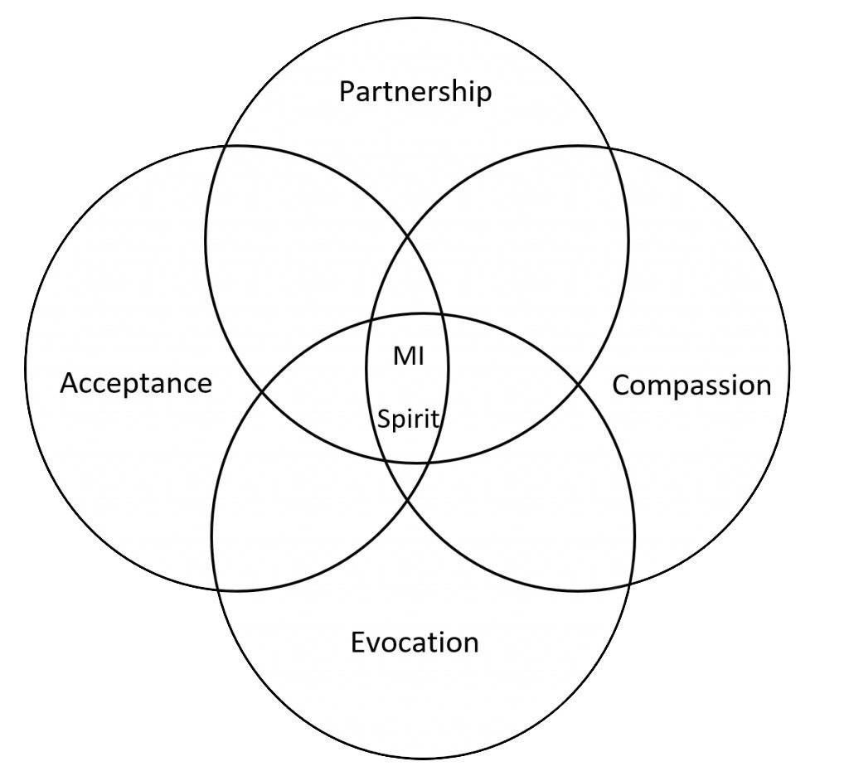
And thus, the Motivational Interviewing Spirit was born…

Slide 12
ACE
A = Autonomy: Only the teen has the power to change their lives.
C = Collaboration: teen and provider work together, rather than the provider giving advice.
E = Evocation: The provider evokes and elicits reasons for the teen to make a change.

Slide 13
Basic Motivational Interviewing Skills
Show empathy
Develop discrepancies
Build self-efficacy
Notes:
I have broken down some of the main motivational interviewing skills into three steps which I will go into more depth with.
Show empathy.
Develop discrepancies.
Build self-efficacy.

Slide 14
“OARS” Four micro skills
Open-ended questions
Draws out information
Self-reflection
Tell their own story
Affirm
Validates
Appreciation & positive regard
Self-efficacy
Reflective listening
Respect & acceptance
Trust
Collaborative
Supportive without agreeing
Summarize
Highlights important aspects
Sets goals and next steps
Notes:
The acronym OARS stands for the four main techniques for demonstrating empathy in Motivational Interviewing conversations: Open-ended questions, affirming statements, reflective listening, and summarizing statements.
By using OARS, teens are invited to be with us exactly as they are in their readiness to change, and from there we can build a safe and collaborative relationship for them to explore change.

Slide 15
Closed ended vs. Open ended
As you hear these examples, imagine you are a teen and notice the difference in how you might receive and respond to each kind of question…
CLOSED QUESTIONS | OPEN QUESTIONS
“Do you agree that it would be a good idea for you to cut back on your vaping?” | “What do you think about the possibility of cutting back on your vaping?”
“When do you plan to quit drinking?” | “What do you think you want to do about your drinking?”
“How many siblings do you have?” | “Tell me about your family.”
Notes:
Open-ended questions help to draw out information from teenagers who might not usually talk much. They encourage teens to reflect on their lives, their thoughts, and their actions. And they give young people a chance to tell their story.
As you hear these examples, imagine you are a teen and notice the difference in how you might receive and respond to each kind of question…
“Do you agree that it would be a good idea for you to cut back on your vaping?”
“What do you think about the possibility of cutting back on your vaping?”
“When do you plan to quit drinking?”
“What do you think you want to do about your drinking?”
“How many siblings do you have?”
“Tell me about your family.”

Slide 16
Affirming statements
When affirming:
Emphasize teen strengths, past successes, and efforts to take steps, however small, to accomplish change goals.
Do not confuse with praise, which can sometimes be a roadblock to effective listening.
Frame your affirming statements with “you” instead of “I.”
  For example, instead of saying “I am proud of you,” which focuses more on you than on the teen, try “You have worked really hard to get to where you are now in your life,” which demonstrates your appreciation, but keeps the focus on the teen.
Notes:
In motivational interviewing, providers affirm teenagers by validating their experience. They optimistically promote the teen’s self-efficacy—their power to change their own lives. Plus, affirming includes emphasizing past experiences that demonstrated the teen’s strengths and ability to accomplish goals.
When affirming it’s important to emphasize a teen’s strengths, past successes, and efforts to take steps, however small, to accomplish change goals.
Do not confuse this type of feedback with praise, which can sometimes be a roadblock to effective listening and sound patronizing to some teens.
Frame your affirming statements with “you” instead of “I.” For example, instead of saying “I am proud of you,” which focuses more on you than on the teen, try “You have worked really hard to get to where you are now in your life,” which demonstrates your appreciation, but keeps the focus on the teen.

Slide 17
Affirming statements
Examples of affirming statements:
“You took a big step in talking about your drinking today.”
“You got discouraged last week but kept going to your practices. You are persistent.”
“Although things didn’t turn out the way you hoped, you tried really hard, and that means a lot.”
“That’s a good idea for how you can avoid situations where you might be tempted to drink.”
Notes:
These are some examples of what affirming statements might sound like…
“You took a big step in talking about your drinking today.”
“You got discouraged last week but kept going to your practices. You are persistent.”
“Although things didn’t turn out the way you hoped, you tried really hard, and that means a lot.”
“That’s a good idea for how you can avoid situations where you might be tempted to drink.”

Slide 18
It’s Not About the Nail
https://youtu.be/-4EDhdAHrOg?si=eZDTXndjiE-2HdJy
Notes:
I have a short video before we segway to the next slide on reflective listening.

Slide 19
Reflective Listening
A higher ratio of reflections to questions consistently predicts positive teen outcomes (Romano & Peters, 2016).
Notes:
Do not underestimate the power of reflective listening when working with teens!
In reflective listening, the provider is genuinely interested in what the teen has to say. After the teen shares, the provider repeats what they said, rephrasing it and reflecting the emotions.
It is recommended to follow open questions with at least one reflective listening response—but preferably two or three responses—before asking another question. Research has shown a higher ratio of reflections to questions consistently predicts positive teen outcomes (Romano & Peters, 2016).

Slide 20
Reflective Listening Responses
Statement | Reflection
“My mom keeps lecturing me about my smoking.” | “Your mom is putting pressure on you about your smoking.”
“I’d like to quit smoking weed so it doesn’t make my memory worse.” | “You’re afraid that your memory will get worse if you continue smoking cannabis.”
“I’d like to quit smoking weed because I read that cannabis can make memory worse and I don’t want that to affect my grades.” | “You’re worried your grades will get worse if you continue smoking cannabis.”
“I know I should give up smoking weed, but life is so boring without it.” | “Giving up smoking weed would be hard, and you recognize that it’s time to stop.”
“I think my smoking is just not a problem for me.” | “There are absolutely no negative consequences of using cannabis.”
Notes:
These are some examples of reflective listening responses ranging from simple to more complex:
“My mom keeps lecturing me about my smoking.”
“Your mom is putting pressure on you about your smoking.”
“I’d like to quit smoking weed so it doesn’t make my memory worse.”
“You’re afraid that your memory will get worse if you continue smoking cannabis.”
“I’d like to quit smoking weed because I read that cannabis can make memory worse and I don’t want that to affect my grades.”
“You’re worried your grades will get worse if you continue smoking cannabis.”
“I know I should give up smoking weed, but life is so boring without it.”
“Giving up smoking weed would be hard, and you recognize that it’s time to stop.”
“I think my smoking is just not a problem for me.”
“There are absolutely no negative consequences of using cannabis.”

Slide 21
Summarizing statements
Reinforce key statements of movement toward change.
Teens hear change talk once when they make a statement, twice when the provider reflects it, and again when the provider summarizes the discussion.
Example, “So it sounds like you’ve noticed your memory is getting worse and your worried your cannabis use is impacting it. You’re considering quitting cannabis because you don’t want your grades to be impacted. I know you really want to graduate high school on time because you’ve talked about that before.”
Notes:
By using summarizing statements, providers can recap what has been said, highlight important aspects, and prepare the teen to move forward in the planning process. Moreover, they support the teen in setting goals and next steps.
Summaries reinforce key statements of movement toward change. Teens hear change talk once when they make a statement, twice when the provider reflects it, and again when the provider summarizes the discussion.
Example, “So it sounds like you’ve noticed your memory is getting worse and your worried your cannabis use is impacting it. You’re considering quitting cannabis because you don’t want your grades to be impacted. I know you really want to graduate high school on time because you’ve talked about that before.”

Slide 22
Recognizing and Reinforcing Change Talk
Focuses on a WILLINGNESS to change
Rather than on FEARS or avoidance
Notes:
After you’ve used open ended questions, shown empathy with reflective listening, and affirming statements and built a collaborative relationship with the teen, the next step is to develop discrepancies between the status quo and the changes the teen would like to see.
William Miller and Stephen Rollnick, who developed MI, emphasized the importance of focusing on the willingness of teens to change, rather than on their fears or what they would like to avoid. Thus, the goal of MI is to foster a teen’s predisposition toward change. To assess teens’ openness to change, Miller and Rollnick pinpointed what they called “change talk.” Specifically, they define change talk as “any self-expressed language that is an argument for change.”

Slide 23
Reinforce change talk with double sided reflections
Example:
Double-sided | “I know I should give up smoking weed, but life is so boring without it.” | “Giving up smoking weed would be hard, and you recognize that it’s time to stop.” | Resolves ambivalence. Acknowledges sustain talk and emphasizes change talk. | Use “and” to join two reflections. Start with sustain talk reflection and end with change talk reflection.
Notes:
Double sided reflections are a great way to develop discrepancies between keeping the status quo and what the teen wants to be different. It can help resolve any ambivalence the teen expresses, and it can help the conversation move forward to the planning and self-efficacy stage.
For example,
“I know I should give up smoking weed, but life is so boring without it.”
“Giving up weed would be hard, and you recognize that it’s time to stop.”

Slide 24
5 Key Ideas About Change
Change occurs naturally.
Moreover, change is influenced by the interactions between people.
Expressing empathy is a means of effecting change.
The best predictor of change is confidence, on the part of the teen or provider, that the teen will change.
teens who say they are motivated to change are more likely to actually change.

Slide 25
Four Strategies to Reduce Ambivalence to Change
Engaging
Show the teen the disadvantages of staying the same.
Use OARS to establish rapport and explore ambivalence.
Focusing
Encourage the teen to envision the benefits of change.
Develop a mutually agreed upon agenda that promotes change and identify a specific target behavior.
Evoking
Demonstrate optimism that change is possible. Elicit teens’ motivations for change.
Planning
Support patients in their intention to change.
Help the teen develop a change plan that is acceptable, accessible, and appropriate.

Slide 26
Engaging
Use OARS to establish rapport
“Roll with Discord (Resistance)”

Slide 27
Roll with Discord (Resistance)
Describes resistance
Behavior that reflects dissonance & tension
Our job to manage discord
Reflects the teen’s perception
Notes:
As we continue a conversation about change or ambivalence to change, an important skill to keep in mind is to “Roll with Discord or what was formally called Resistance.”
Discord is a relatively new term to describe teen resistance in the therapeutic process. The term discord is a more strengths based and collaborative approach to what we normally understand as resistance.
Discord is understood to be a behavior that reflects dissonance or a tension between the provider and the teen. It is the provider’s job to manage discord to maintain the therapeutic alliance. Discord reflects the teen’s perception of how the counseling process is going.

Slide 28
Approaches to Discord
Shifting focus
“Tell me more about…”
Affirming autonomy
“No matter what anyone thinks, you have control over yourself and get to decide what you want to do about it.”
Apology
“You know, it seems like those suggestions were not helpful. Sorry about that.”
Notes:
These are some Approaches to Discord:
Shifting focus is a way of responding to discord by redirecting attention and discussion to a less contentious topic or perspective. “Tell me more about…”
Affirming autonomy shows acceptance and confirms the teen’s irrevocable right to self-determination and choice. “No matter what anyone thinks, you have control over yourself, and you get to decide what you want to do about it.”
Making an Apology is a way of responding to discord by taking partial responsibility. “You know, it seems like those suggestions were not helpful. Sorry about that.”

Slide 29

Focusing
Once you’ve engaged the teen, the next step is to find a direction for the conversation and the counseling process as a whole.
Once you and the teen agree on a general direction, focus on a specific behavior the teen is ready to discuss.

Slide 30
An example of focusing:
Clinician: “Ana, you mentioned you’re concerned about your marijuana use. What are some of your main concerns about your use?
teen: “Well, I’ve been vaping it pretty much every day throughout the school day and I’ve noticed that I’m forgetting things more quickly, I can’t focus at all in class and even forgetting what I’m talking about mid-sentence… I don’t want it to affect my grades and my ability to graduate on time this year.”
Clinician: “So you’re worried your marijuana use is affecting your grades and maybe even your ability to graduate on time. What do you think you’d like to change about the marijuana use?
teen: “I think I need to stop smoking completely for a while so I can get my focus and memory back.”
Clinician: “So it sounds like you want to want to stop using marijuana for a while. Let’s explore that.”

Slide 31

Evocation
Evoking elicits teen motivations for change. It shapes conversations in ways that encourage teens, not providers, to argue for change. Evoking is the core of MI and differentiates it from other counseling methods (Miller & Rollnick, 2013).

Slide 32
Evocative questions include exploring desire, ability, reasons, and need (DARN)
Desire questions explore what teens want or wish for in life.
What do you want from therapy?
How much would you like to drink?
Tell me what you wish were different.
Ability questions explore what teens can and are able to do.
What do you think you could do to… ?
How likely are you to be able to… ?
What ideas do you have to change how much you’re… ?
How confident are you that you could… ?
Reason questions explore why teens want to change.
Why do you want to… ?
What’s the problem with continuing with how things are?
Tell me your top three reasons for…
Need questions explore the teen’s urgency for change.
What needs to occur for you to… ?
How urgently does… feel to you?
What do you think needs to change?

Slide 33
Using the importance ruler
An imaginary scale ranging from 0 to 10 can be used to explore the teen’s level of perceived importance for change. It involves the use of two questions, and the second question is meant to elicit change talk and assist the teen to identify why change is important.
“On a scale from 0 to 10, where 0 indicates not at all important and 10 indicates the most important thing for me right now, how important is it for you to… ?”
“And why are you at a… and not a (lower number)?”
Notes:
There are a few tools that I keep in my toolbox to help set the stage for Motivational Interviewing and the three steps of showing empathy, developing discrepancy, and then helping the teen to build self-efficacy.
One of my go-to tools is the importance ruler.
The importance ruler is an imaginary scale ranging from 0 to 10 and can be used to explore the teen’s level of perceived importance for change. It involves the use of two questions, and the second question is meant to elicit change talk and assist the teen to identify why change is important.
It sounds like, “On a scale from 0 to 10, where 0 indicates not at all important and 10 indicates the most important thing for me right now, how important is it for you stop using cannabis?”
“And why are you at a 6 and not a 2?

Slide 34
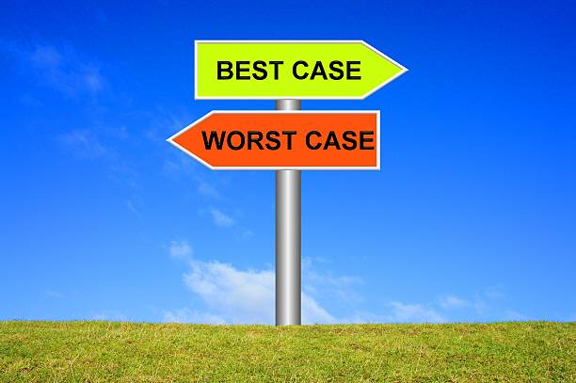
Querying extremes
Exploring the teen’s worst- and best-case scenarios
“What can happen in the long run if you continue as you are (keep using and not informing your parents?”
“What worries you the most about your parents finding out about your use?”
“What would it look like if you were able to talk to your parents about your use?”
“What would be the best-case scenario if you told your parents about your use?”
Notes:
Exploring the teen’s worst- and best-case scenarios can elicit change talk.
I like to use these types of questions when talking with teens about involving their parents in the changes they are making on their substance use. The teen’s responses can give useful information about the relationship dynamics they have with their parent and some of the challenges that come up in their communication with their parent. It can also help me prepare for how to approach their parent to be able to receive and respond in a conducive way. It can also give an opening to talk to the teen about how I can support them in addressing the challenges they have with their parent by providing them information about how I work with parents to educate them about substance use and learning how to improve their communication and problem-solving skills. Or, how family counseling can help them in general.
Some examples of what querying extremes sound like are:
“What can happen in the long run if you continue as you are (keep using and not informing your parents?”
“What worries you the most about your parents finding out about your use?”
“What would it look like if you were able to talk to your parents about your use?”
“What would be the best-case scenario if you told your parents about your use?”

Slide 35
Looking back and looking forward
Looking back:
“What was your life like before you started using every day?”
“How has your cannabis use changed your relationship with your family?”
“Tell me about when things were going well. What changed?”
Looking forward:
“How would you want things to be different a year from now?”
“Tell me, if you didn’t have any need or desire to use cannabis, how would your interactions with your family change?”
“How would you like things to be five years from now?”
Notes:
I love using the tool, looking back, and looking forward, with youth because for them, a sense of time is so different than with adults. They can experience so much change within themselves in six months or a year because of the amount of growth and development they experience at that age, and it is amazing to reflect with them on the changes they see. I also love exploring the future with them because sometimes they have difficulty imagining what that can look like. Remember, their prefrontal cortexes are still developing. Thinking about the future with youth often instills a sense of hope for many of them because they are in the transition to becoming young adults and have more independence. I like to remind youth I work with that they do not choose the family or family circumstance they are born into, especially if their family situations are difficult, and once they are adults, they will have the opportunity to have more choices for how they want their lives to be.
Looking back questions might sound like :
“What was your life like before you started using every day?”
“How has your cannabis use changed your relationship with your family?”
“Tell me about when things were going well. What changed?”
Looking forward questions might sound like:
“How would you want things to be different a year from now?”
“Tell me, if you didn’t have any need or desire to use cannabis, how would your interactions with your family change?”
“How would you like things to be five years from now?”

Slide 36
Exploring goals and values
Exploring the discrepancy between the teen’s current behaviors and the things that they value can elicit change talk.
“I can hear that graduating high school and going to college are really important to you. How does smoking weed impact your school?”
Notes:
Exploring the discrepancy between the teen’s current behaviors and the things that they value can elicit change talk. Assisting teens to identify that their behavior is inconsistent with what they find meaningful can enhance their motivation for change.
All of these motivational interviewing tools to elicit change talk are not just useful in individual work with teens but are also useful with parents and in family work. When I work with teens and their parents, it can feel extremely tense when they are on opposites ends of what they think needs to change or happen, but when I use for example, querying extremes, looking back, or looking forward, or exploring goals or values, most of the time, parents and their teens share similar goals for the teen. Both teens and their parents want them to grow into healthy, autonomous adults. They usually agree that they don’t want the teen to become a 30-year-old living in their parent’s basements. And so, the next part of the conversation with them is, ok, now how do we work together to make sure that doesn’t happen?

Slide 37

Building self-efficacy
Explore options that are still attractive to the teen
Talk about how people in similar situations have successfully changed their behavior
Education
Support teens in developing achievable small steps towards change
**Addiction Neuroscience 101: https://youtu.be/bwZcPwlRRcc?si=MojNvj5vu-_WTFok
Notes:
Building self-efficacy is the third step in the Motivational Interviewing process.
Many teens do not have a well-developed sense of self-efficacy and find it difficult to believe that they can begin or maintain behavioral change. Improving self-efficacy requires eliciting and supporting hope, optimism, and the feasibility of accomplishing change. This requires you to recognize the teen's strengths and bring these to the forefront whenever possible. Unless a teen believes change is possible, the perceived discrepancy between the desire for change and feelings of hopelessness about accomplishing change is likely to result in rationalizations or denial in order to reduce discomfort. Because self-efficacy is a critical component of behavior change, it is crucial that you as the provider also believe in your teens' capacity to reach their goals.
Discussing treatment or change options that might still be attractive to teens is usually helpful, even though they may have dropped out of other treatment programs or returned to substance use after a period of being substance free. It is also helpful to talk about how persons in similar situations have successfully changed their behavior. Other teens can serve as role models and offer encouragement, for example, recovery mentors, peer support specialists, or sponsors. Nonetheless, teens must ultimately come to believe that change is their responsibility, and that long-term success begins with a single step forward.
Education can increase teens' sense of self-efficacy. Credible, understandable, and accurate information helps teens understand how substance use progresses to abuse or dependency. Making the biology of addiction and the medical effects of substance use relevant to the teens' experience may alleviate shame and guilt and instill hope that recovery can be achieved by using appropriate methods and tools. A process that initially feels overwhelming and hopeless can be broken down into achievable small steps toward recovery.
I remember facilitating a group for teens in substance use treatment and showing an educational video from YouTube that explained the impact of substance use on dopamine levels in the brain compared to other pleasurable activities. For example, it showed how MDMA produced a dopamine level of lets say ten thousand compared to a dopamine level of eating the best meal of your life of lets say 100. The teens were able to understand why using certain substances was so appealing and difficult to avoid and helped to externalize a lot of the shame they experienced when they had recurrences of use. We were able to use the information to experiment with alternative pleasurable activities by measuring their dopamine levels before and after an activity to see which ones they could incorporate into their recovery plans (playing on a playground, playing volleyball, doing art, karaoke etc.).
I also showed the video to a parent group and received a lot of positive feedback about how helpful it was for them to understand why substance use is so attractive to their teens. It brought more empathy to how difficult it is for their teens to avoid using substance. The parents also showed more buy-in and a commitment to supporting their teens in accessing other pleasurable activities.

Slide 38

Strengthening Commitment to Change
Usually, people express an intention to make a change before they make a firm commitment to taking action.
You can evoke the teen’s intention to take action by asking open questions:
  “What are you willing to do this week?”
“What specific steps are you ready to take?”
Exploring any ambivalence teens have about change goals or specific elements of change plans.
Reinforcing change talk through reflective listening.
Inviting teens to state their commitment to their close or supportive friends.
Asking teens to self-monitor by recording progress toward change goals (e.g., with a smoking log).
Exploring, with teens’ consent, whether supportive significant others or family members can help with medication adherence or other activities that reinforce commitment (e.g., getting to NA meetings).

Slide 39
The Invitation to Change (ITC) &
Community Reinforcement and Family Therapy (CRAFT) Approach
CRAFT works to influence the loved one’s behavior by changing the way family interacts with them.
CRAFT shows parents how to positively and incrementally reinforce abstinence or steps toward change. It recognizes family members as powerful collaborators in this process.
ITC also includes key elements of Motivational Interviewing (MI), to create a respectful, empathic environment that invites change instead of demanding it.
Notes:
As we know, we often cannot work with teens without some collaboration and work with their parents, caregivers, or other family members. The most common question I hear from parents or caregivers is, “What do I do?! My teen is…. And I’ve done everything I possible can but nothing works!” When we know that Motivational interviewing works with adolescents to make healthy changes, why not equip parents with the same tools?
Parents are often confused and overwhelmed by what to do because we hear conflicting advice like “don’t be co-dependent! You have to show tough love! Detach! Don’t enable them!” But for parents/ caregivers it’s not so simple. There are parent and family resources and groups that incorporate motivational interviewing skills and approaches so they can develop a collaborative relationship with their teen and young adult and honors the teens need for autonomy and self-exploration.
I often utilize the same OARS skills with parents to build a collaborative partnership with them and emphasize any shared goals or values they have with their teen. I like to use the Looking back, looking forward tool with them by asking parents, “How would you like your relationship to be with your teen 20 years from now? How would you want your teen to describe how you helped them through this time in their life if you were to ask 20 years from now?” This nicely segways into an introduction to some of the parent resources and support groups that incorporate MI.
Two approaches utilizing MI for parents and caregivers are Invitation to Change and Community Reinforcement and Family Training (CRAFT).
ITC includes all the components of Community Reinforcement and Family Training (CRAFT), and is a behavioral and motivational treatment for families of people with substance problems developed by Dr. Robert J. Meyers and Dr. Jane Ellen Smith. CRAFT has been studied extensively in randomized controlled trials and has been found to be more effective than traditional approaches such as Al-Anon and interventions. CRAFT teaches families and friends effective strategies for helping their loved one change and improving their own wellbeing. CRAFT works to influence the loved one’s behavior by changing the way family interacts with them.
CRAFT shows parents how to positively and incrementally reinforce abstinence or steps toward change. It recognizes family members as powerful collaborators in this process.
ITC also includes key elements of Motivational Interviewing (MI), to create a respectful, empathic environment that invites change instead of demanding it.

Slide 40
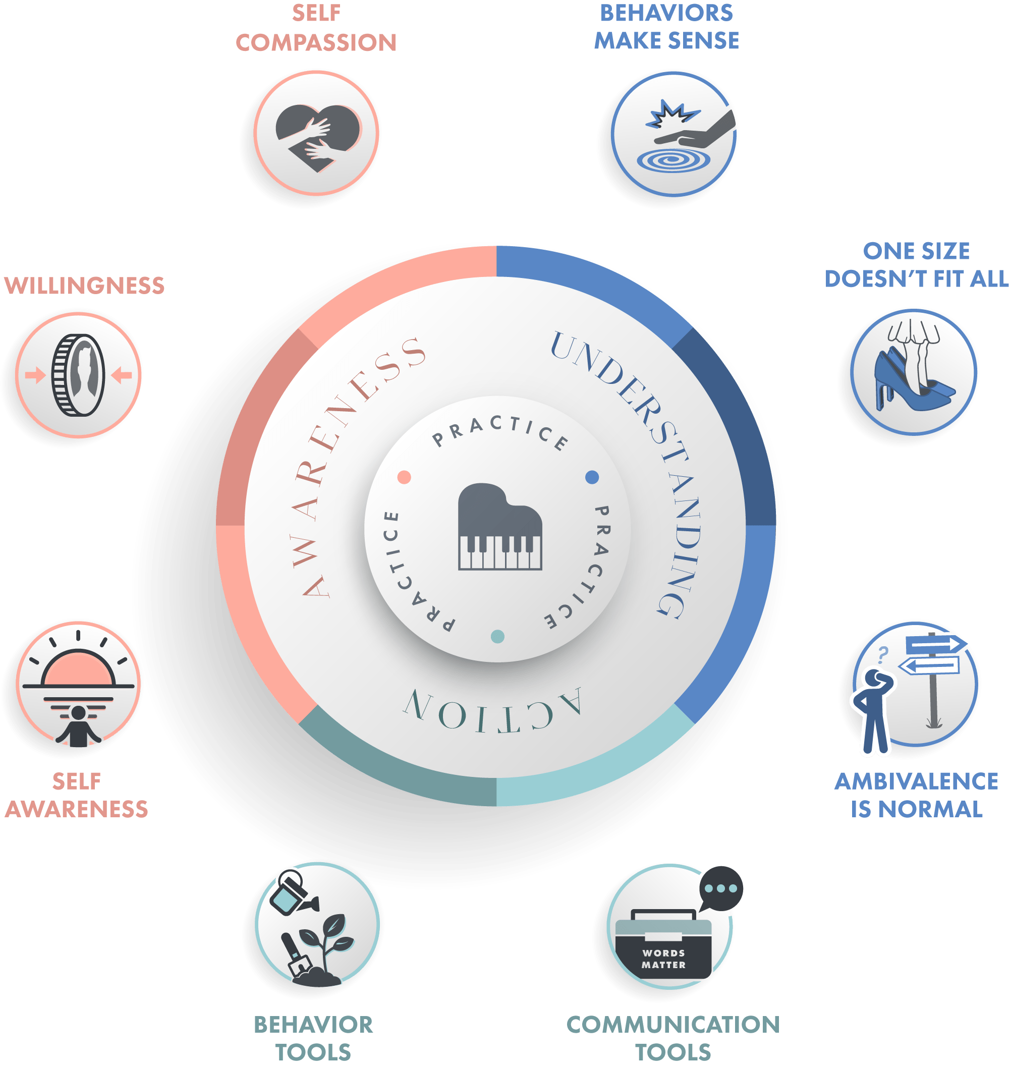
https://cmcffc.org/approach/invitation-to-change
Notes:
This image is the Invitation to Change wheel from the Center for Motivation and Change (CMC) website. Each part of the wheel illustrates a new approach for parents/ caregivers to help their teen through understanding, awareness and action. Some of the key approaches in ITC are:
BEHAVIORS MAKE SENSE
Even though parents may not see it now, a loved one’s behaviors make sense in some way. People use substances because they get something out of it that’s important to them. It’s not because they’re “crazy” or “bad”—it’s because the behavior is serving a purpose. That is what keeps them going back, even as the costs pile up. While parents don’t have to agree with or like their reasons for using, understanding those reasons will help them be more effective in helping promote change.
ONE SIZE DOES NOT FIT ALL
Parents learn their teen has very specific reasons why their behavior makes sense to them, and their reasons are different from the next person’s. There are also many paths to change. Understanding that one size does not fit all will help their teen find a way to change that works for them, and help parents find what they need as well.
AMBIVALENCE IS NORMAL
Since their teen’s substance use makes sense to them in some way, when they try to give up those behaviors they will naturally feel ambivalent and sometimes go back to those old ways. Change is an ongoing process, and how a parent responds to ambivalence can help move things along or set things back.
The Helping with Awareness section of the wheel also has three parts. As a parent tries to help, it’s likely they will have pain, anger, fear, and upset. It’s likely they will also have personal values of love, hope, and a desire to be connected to their teen.
A parent’s self-awareness, which includes awareness of one's thoughts, feelings, body sensations, and reactions, along with connection to one's values, will matter a lot as they try to use the skills in ITC. With self-awareness, parents can see that their values and their pain are two sides of the same coin, and they can learn to work with both (i.e., picking up the whole coin).
Since helping is not a pain-free process, the willingness section will help parents find ways to accept this struggle instead of shutting down, withdrawing, or getting angry. Willingness helps parents allow for the vulnerability that comes with caring.
ITC helps bring self-compassion to parents’ pain and the change process. Improved self-compassion will help move away from self-blame and shame and tend to yourself better. This way, parents can bring kindness and care to the learning (and stumbling) that comes with making changes in behavior, for their teen and for themselves. Plus, taking care of themselves will invite their teen to do the same.
The Helping with Action section has two parts: communication tools, or how we talk, and behavior tools, or how we act as we try to help.
How we talk can be the difference between starting the change process and stalling out. When things are rough, it’s normal to want to yell, lecture, or shut down—but it’s not likely that anything positive will come from these interactions. By learning communication skills parents can speak with their teen in collaborative ways that open them up to the possibility of changing, and that increase the connection between them instead of creating distance.
How we act also matters for encouraging behaviors we want and discouraging ones we don’t want. In the behavior tools section, parents will learn that recognizing and rewarding positive change invites it to happen more, while allowing naturally occurring consequences and setting respectful limits makes negative behavior less likely to happen.
Finally, at the center of the wheel is practice, practice, practice, because behavior changes when you change behaviors.

Slide 41
Video from CMC: foundation for change
https://youtu.be/WU9VefjfSpo
More videos can be found at https://cmcffc.org/resources/why-i-have-hope
Notes:
This video is from CMC: foundation for change, a website that provides trainings, resources and tools for providers and families to learn Invitation to Change (ITC) skills. The video clip shows a parent reflecting on how learning ITC skills has altered her approach towards her teen’s behaviors and helped her find hope in the small steps towards change.

Slide 42
ITC and CRAFT Resources for Parents & Families
SMART Recovery Family & Friends SMART Recovery Family & Friends | Addiction Help for Family Members - SMART Recovery
Family Services • The Center for Motivation & Change (motivationandchange.com)
Invitation to Change for Family & Friends free online group ITC Group (ONLINE) — Cordelia Kraus
Sisu Healing Partners: https://www.sisuhealingpartners.com
  provide mental health and substance use coaching, interventions, family coaching and sober transports.
Allies in Recovery:
  This program is currently $59 for 6 months. They provide CRAFT-based video modules as well as an online community. They are available at alliesinrecovery.net
Based on the Invitation to Change®, the 20-Minute Guide contains practical ideas and exercises to help you help your loved one through the process of change. Home - The 20 Minute Guide
Notes:
This is a list of ITC and CRAFT based resources and groups both on-line and in-person. There are quite a few free parent groups all over the country.
There's also a link to a free workbook for parents to learn basic ITC skills, called the 20-minute guide from the center for motivation and change.

Slide 43
Motivational Interviewing for Adolescent Substance Use Video
https://youtu.be/K-zJme3RTzM?si=BPxbwY-PkfFRhSZi
Notes:
Video
https://www.youtube.com/watch?v=K-zJme3RTzM
This clip models the OARS (open ended questions, affirming, reflection, and summarizing) skills from Motivational Interviewing.

Slide 44
Motivational Interviewing Training Resources
Welcome to the Motivational Interviewing Website! | Motivational Interviewing Network of Trainers (MINT)
Motivational Interviewing Free Resources | Psychwire
Motivational Interviewing Toolkit - IRETA
Notes:
If you would like to learn more about MI skills, these are a few helpful links.

Slide 45
Thank You
Email: diana.b.latorre@gmail.com

