Slide 1
Building the Primary care SUD Team:
Taking it to the next level!
Jim Morrill, MD, PhD
Lori Hooley, RN, CARN
Ryan K. O’Brien, Recovery Coach
MGH Charlestown Community Health Center

Slide 2
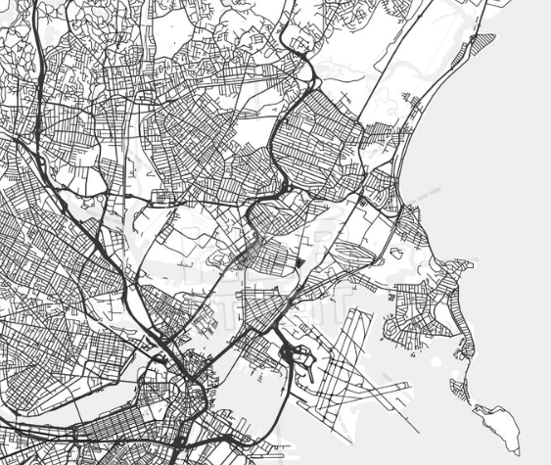
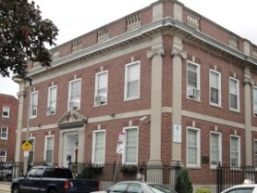
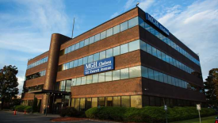
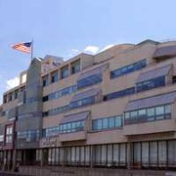
The mgh Health center system
Other key community sites:
North End Health Center, 1971
MGH Everett Family Care, 1997
MGH Back Bay, 1998
MGH Revere Broadway, 2000
NEW Health Charlestown, 2015
1965: Geiger and Gibson establish the first modern CHCs
1968: Charlestown Health Center established
1972: Chelsea Health Center
1972: Revere Health Center
1965
1970
1975
1980
1985
1990
1995
2000
2005
2010
2015

Slide 3
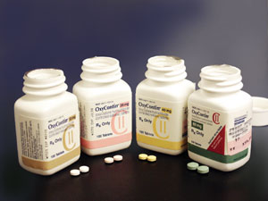
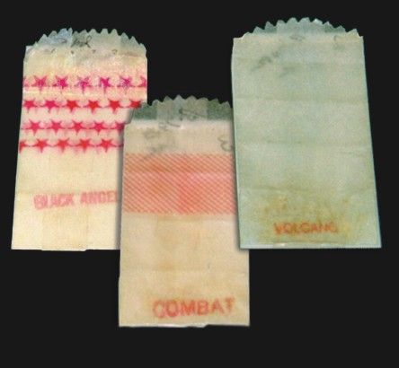
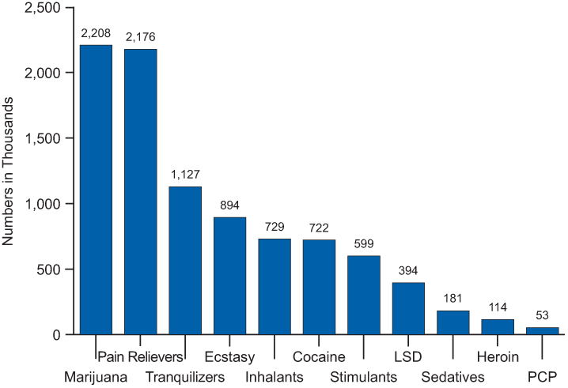
Toll of opioid use in Charlestown in the early 2000s
Acute Effects
Overdose
Violence / trauma
Subacute Effects
Soft tissue infection
Endocarditis
Losses / legal issues
Intranasal → IV
First-initiated substances
Tentative → Compulsive
Chronic Effects
Chronic viral hepatitis
HIV infection
Malnutrition
Incarceration
Homelessness
Source: SAMHSA, National Survey on Drug Use and Health, 2010.

Slide 4
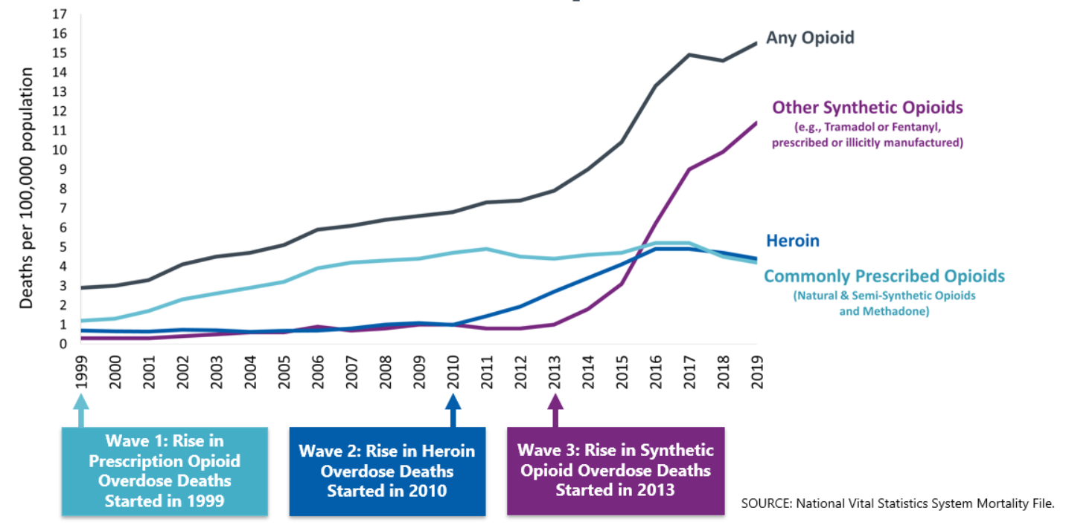
Changes in prescribed Opioid Use in Commercially Insured U.S. Adults

Slide 5
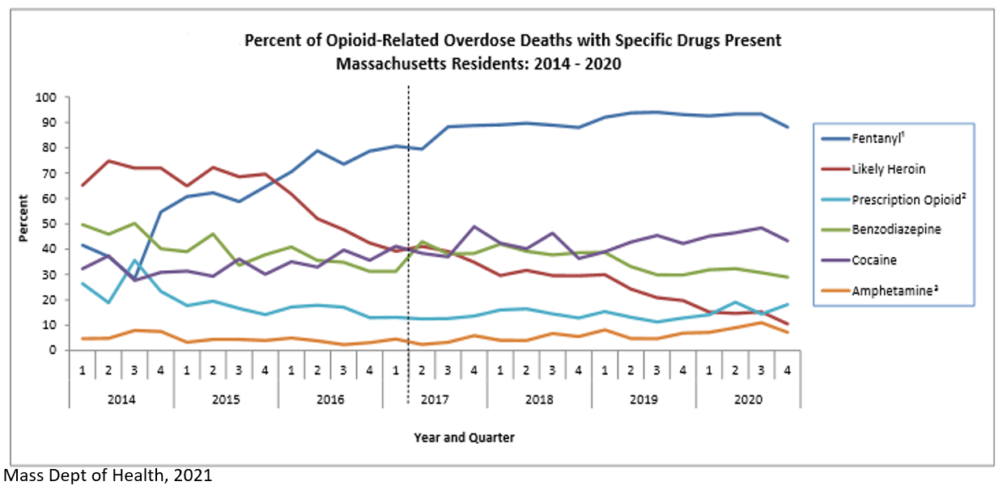

Slide 6
2003–Suboxone treatment begins at MGH; one of the first two prescribers is at MGH Charlestown
2005– Three PCP Suboxone providers at MGH Charlestown, managing ~60-90 patients
2012-2014– MGH invests in a new SUD Initiative:
  Inpatient Addiction Consult Team
  Bridge Clinic
  Outpatient / community-based care: Counseling expertise, Risk Rounds, Office Based Addiction Treatment (OBAT) Nursing, Recovery Coaching / Peer Support
2015– Eight PCP Suboxone providers, 160 pts
2016– Lori Hooley RN recruited to serve full-time as MGH Charlestown’s first OBAT Nurse; full time Recovery Coach role initiated
2019– 15 Suboxone providers, 335 pts
Evolution of Addiction Treatment at MGH and MGH Charlestown
Lori Hooley RN with Recovery Coach Efrain Lozada in 2017

Slide 7
“Macro” Teams: MGH SUD Initiative
Inpatient Addiction Consult Team (ACT)
Withdrawal management
Engagement
Peer Support
Medication for SUD
Connection to care
Activated Practices / Health Centers
Multidisciplinary SUD Care
Primary Care
Ongoing Behavioral Health care
Bridge Clinic
Post-hospital management
Low-threshold / walk-in model
Rapid Behavioral Health access
Connection to care (including primary care)
Management of SDOH

Slide 8
“Micro” Teams: Embedded in every site!
Addiction Medicine
Nursing
The
Patient!
Recovery Coaching
Behavioral Health

Slide 9
Why Recovery Coaching?
Notes:
Lori and I are here today to let you know why nurses are uniquely suited to help optimize the care of patients with substance use disorders.
…………………………………
So why are nurses uniquely suited to work with this patient population?
………………………………
The entirety of nursing school in our humble opinion can be reduced to down to 2 take aways

Slide 10
Why Nursing?
Notes:
Lori and I are here today to let you know why nurses are uniquely suited to help optimize the care of patients with substance use disorders.
…………………………………
So why are nurses uniquely suited to work with this patient population?
………………………………
The entirety of nursing school in our humble opinion can be reduced to down to 2 take aways

Slide 11

What is an OBAT Nurse?
Specialized Nursing role, first defined in Boston within the OBOT-B (Office-Based Opioid Treatment– Buprenorphine) program at Boston Medical Center (led by Colleen Labelle MSN, RN-BC, CARN), then rolled out state-wide
Nurse-driven addiction visits, w/ supervision by prescribing MD, who performs initial Assessment/Diagnosis
Care management model, with a multidisciplinary team-based approach and a close connection to Behavioral Health and Peer Support
Also: leadership role as a stigma-fighting spokesperson and educator within the practice!

Slide 12

What has OBAT Nursing brought to MGH
Increased access to addiction care
New, more robust levels of care
The therapeutic approach of the Nursing discipline– allowing a “new space” in which to engage with patients
Increased standardization of treatment, with improved quality and safety of care
More effective wraparound care– with group visits and co-location with / warm handoffs to Peer Support and Behavioral Health
Increased comfort level among prescribers
Decreased fear and stigma within the clinic!

Slide 13
Case Example: Thomas M.
42 yo M with depression, pediatric kidney cancer s/p nephrectomy, mild chronic kidney disease, sleep apnea, and FH opioid use disorder (sister).
History of unsupervised oxycodone use from age 18-25
First initiated buprenorphine treatment in 2003; was seeing a for-profit provider and left treatment due to cost, then resumed oxycodone use
In early 30s, self-transitioned from oxycodone to unsupervised buprenorphine and began using unsupervised benzodiazepines (up to 3 mg of clonazepam and 3 mg of alprazolam per day)
Divulged use to PCP in 8.2018 and initiated on Suboxone at 8/2 mg QD
Began weekly follow-up with OBAT RN in 9.2018
Warm handoff to Recovery Coach in 10.2018, and initiated behavioral health care and weekly SUD group later that month
Continues to do well and remains sober at 6 years in care w/ his Health Center treatment team and managing family, financial, legal, and relationship stress.

Slide 14
Thank You!!
Questions / Reflections?

