Slide 1
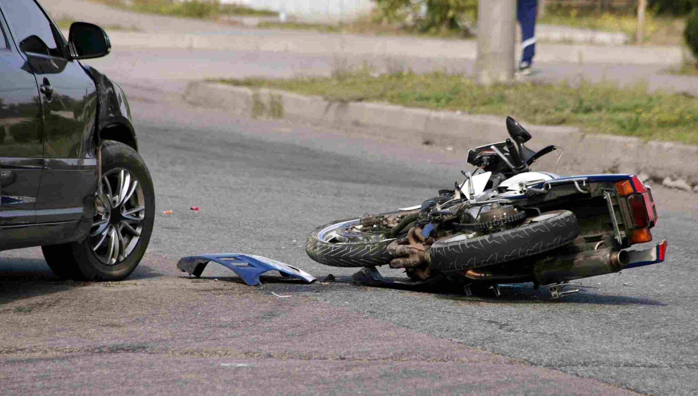
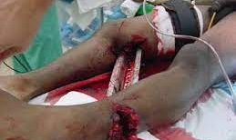
Patient Management Considerations In Blunt and Penetrating Trauma
Kimberly Pruett, MD
University of New Mexico
EMS Consortium

Slide 2

Trauma Is A Time Sensitive Emergency

Slide 3

Bleeding Is What Kills Trauma Patients

Slide 4


5 Liters of Blood In The Average Adult

Slide 5
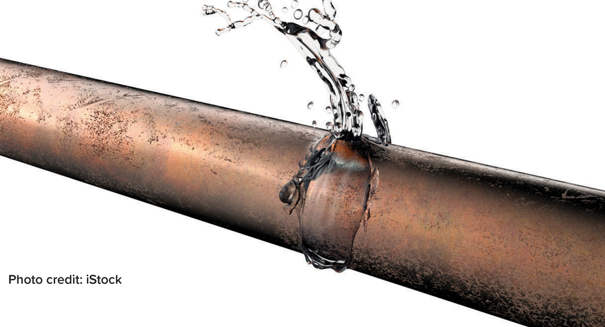
It Takes About 3-5 Minutes To Bleed To Death

Slide 6
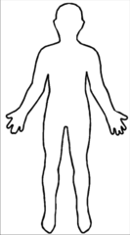



5 Places to Bleed to Death
Chest
Abdomen
Pelvis
Femur
The Street

Slide 7

Recognizing Sick Trauma

Slide 8

What Signs And Symptoms Suggest A Sick Trauma Patient?

Slide 9

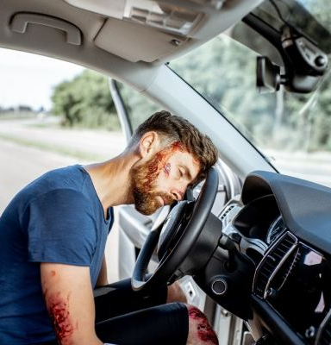


Clues You Can See

Slide 10

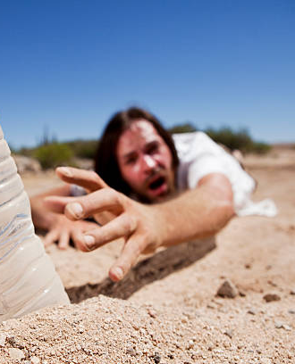
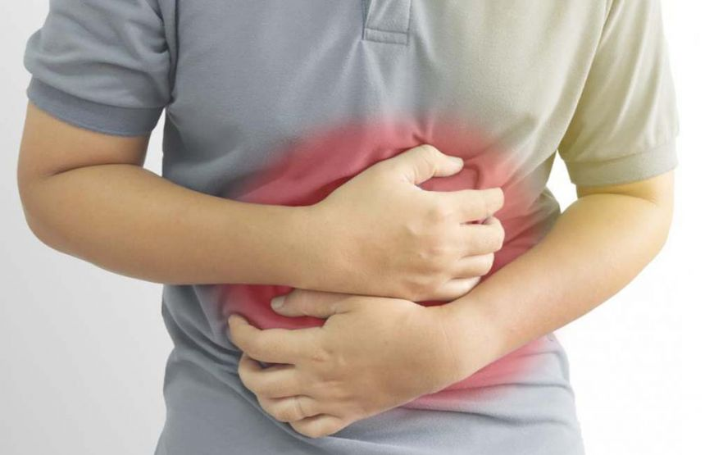
Clues They Tell You

Slide 11

Be careful with elderly and peds!

Slide 12


Primary Survey

Slide 13

Control Bleeding
Treat Hypoxia

Slide 14

Vital Signs Are Vital
Continually Re-Assess Them

Slide 15
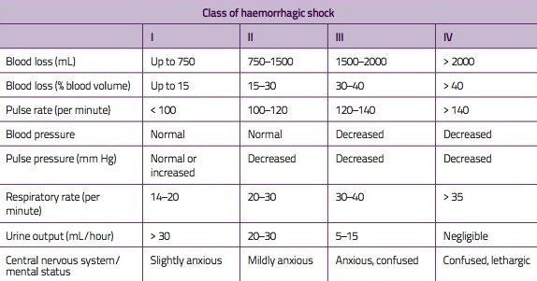
Stages of Shock
Is there a radial pulse?
https://lifeinthefastlane.com/wp-content/uploads/2011/06/Class-of-haemorrhagic-shock-JPEG2.jpg

Slide 16

Sick Trauma Patient:
You have a small hospital 15 minutes away or a helicopter that will arrive in 45 minutes

Slide 17

DO NOT Waste Time

Slide 18
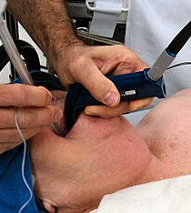
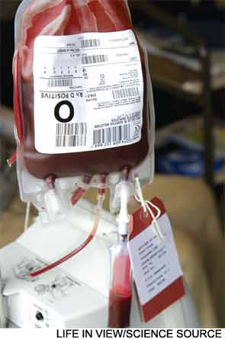
How Can My Small Hospital Help?

Slide 19

DO NOT Wait on scene for a helicopter!!

Slide 20
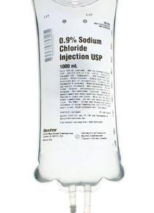
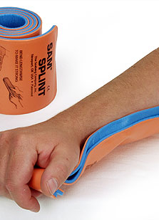

ENROUTE: Secondary Survey
IV access, splint injuries, treat pain, keep them warm

Slide 21
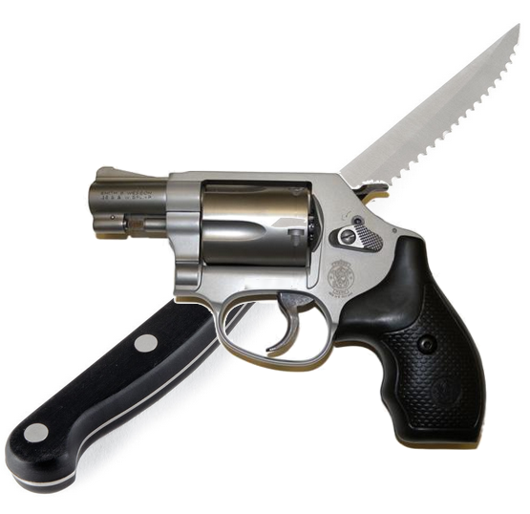
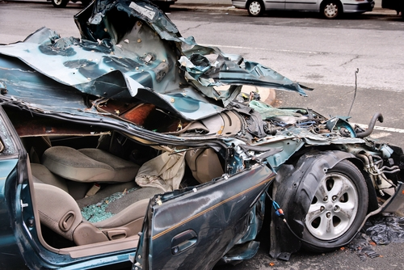
Two Types Of Severe Trauma
Blunt
Penetrating

Slide 22
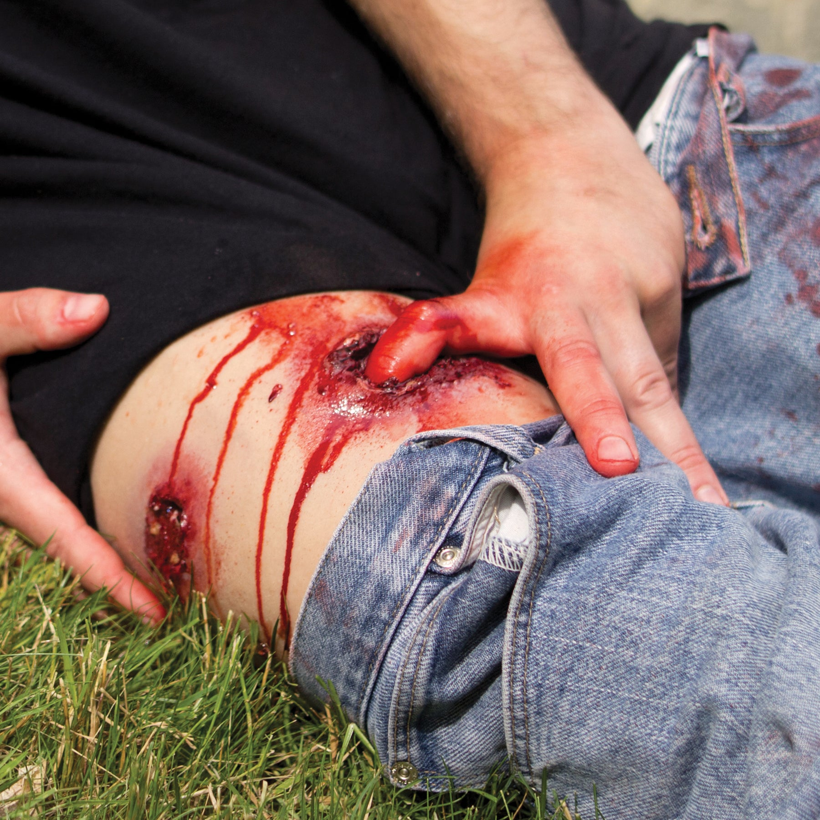
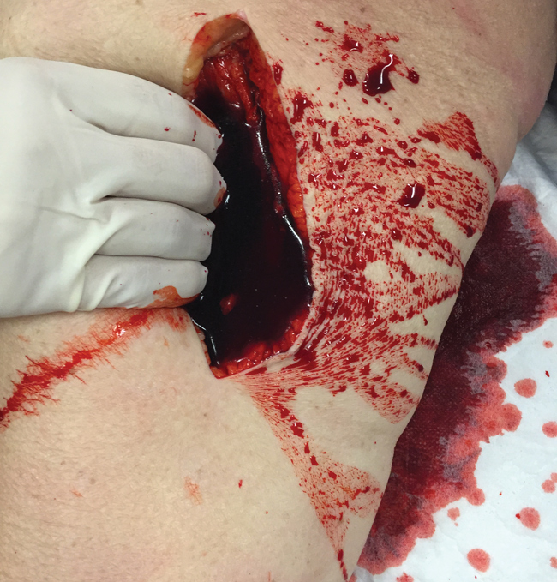
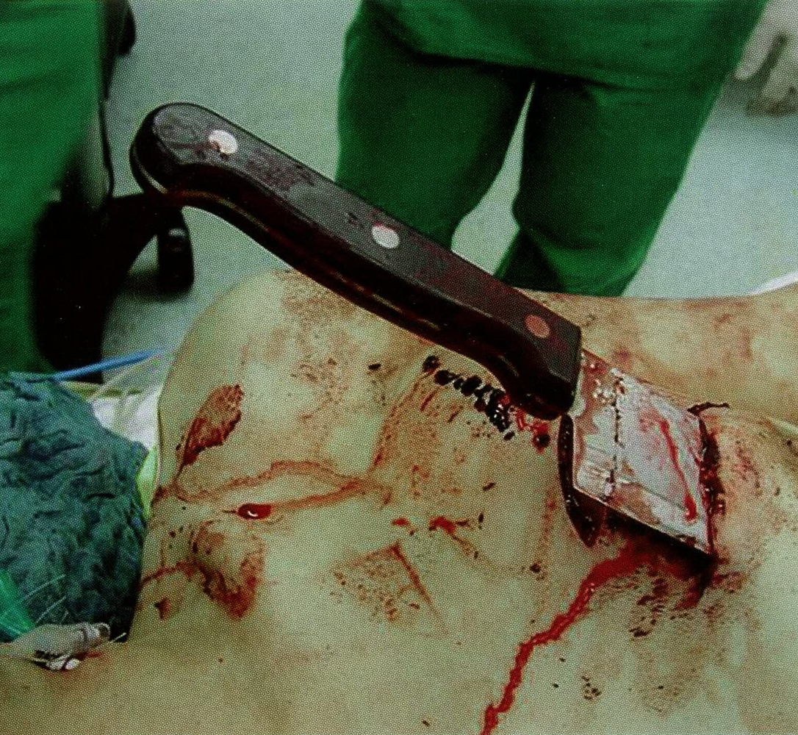
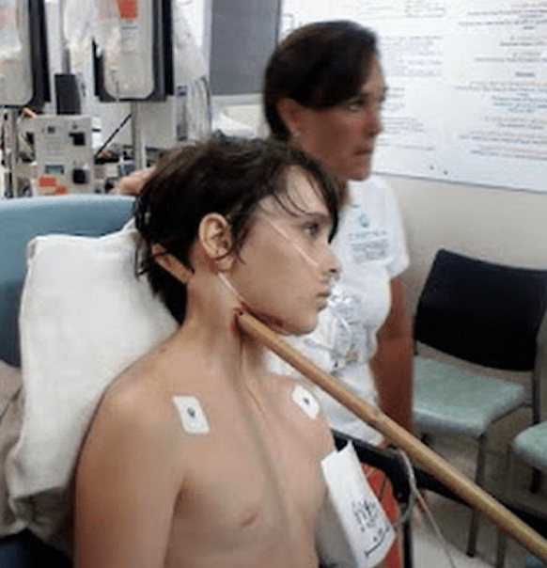
Penetrating Trauma

Slide 23
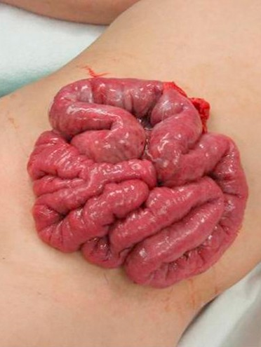
Evisceration
Don’t try to replace contents
Cover with moist dressing
  Normal saline guaze
Keep patient calm
  Don’t increase intra-abdominal pressure
  Treat pain

Slide 24

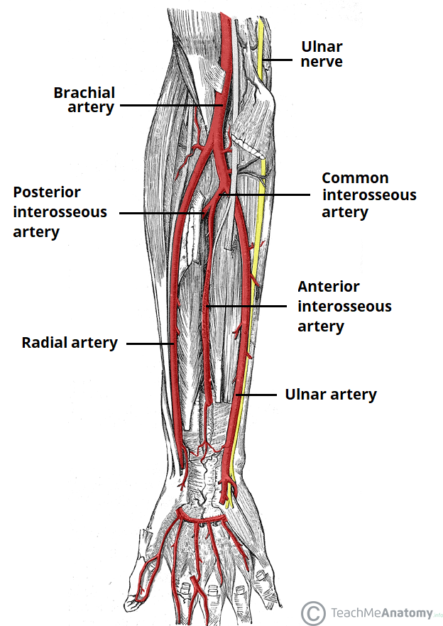
Always Consider Underlying Tissues

Slide 25
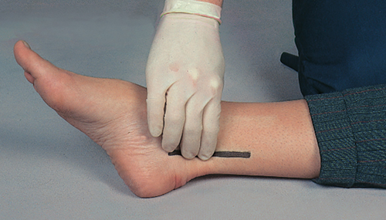
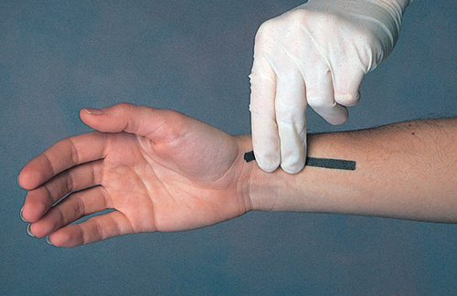
Check Distal Pulse, Movement, and Sensation In The Injured Extremity

Slide 26
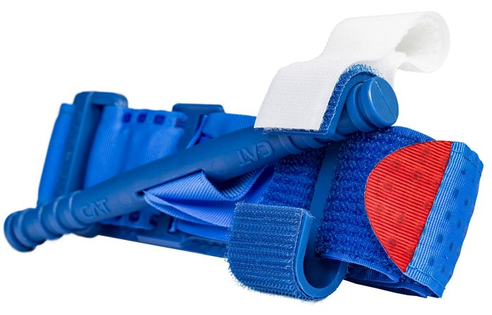
Tourniquets Are Safe and Effective
35% of pre-hospital trauma deaths are a result of hemorrhage

Slide 27


Blunt Trauma
Hollow organs
rupture
Solid organs bleed

Slide 28

Blunt Abdominal Trauma Accounts for 15-20% of Trauma Deaths

Slide 29
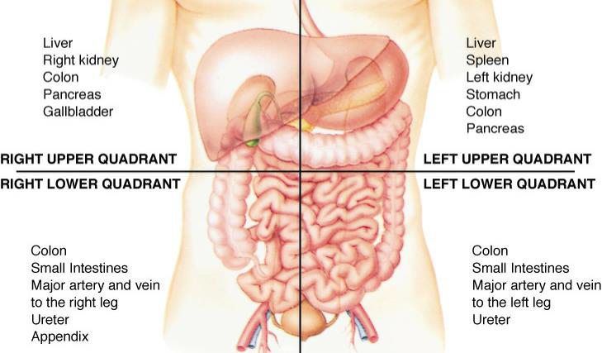
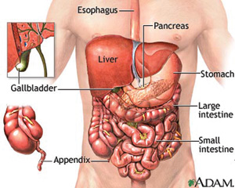
Anatomy Review

Slide 30
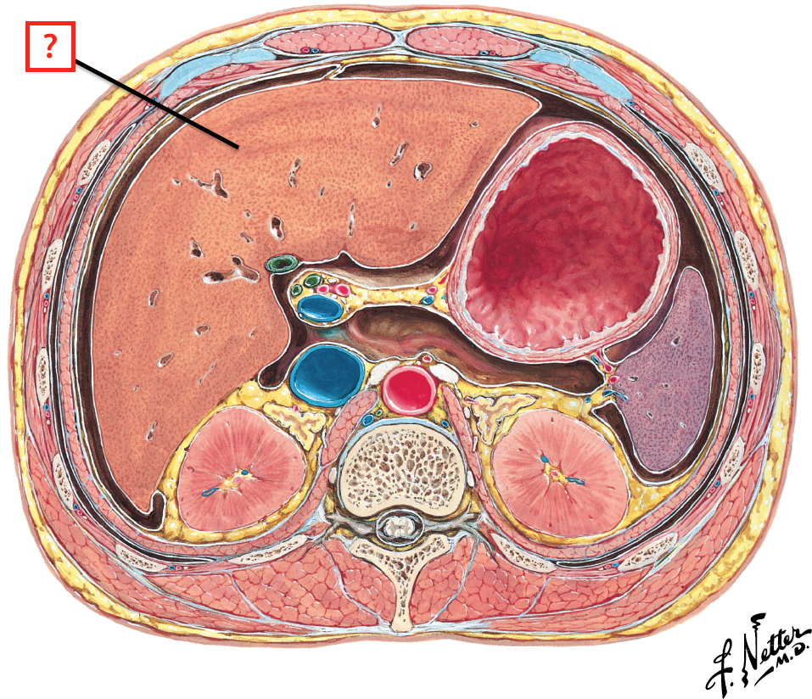
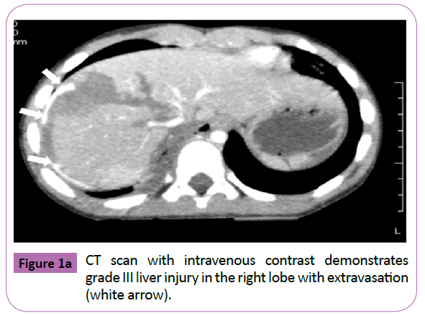
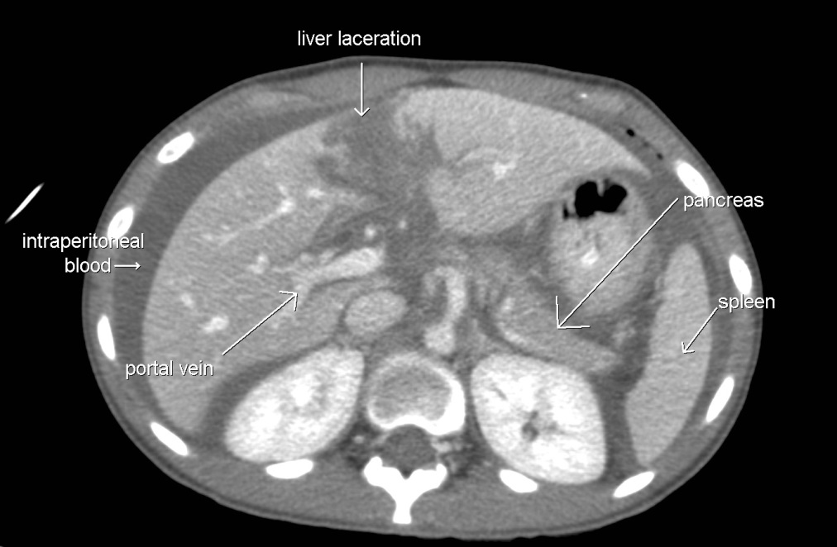
Liver
Stomach
Spleen
Kidney
Spine
Kidney

Slide 31
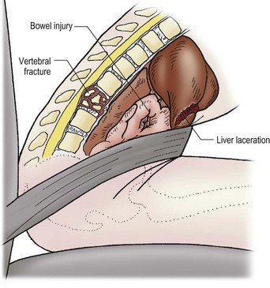
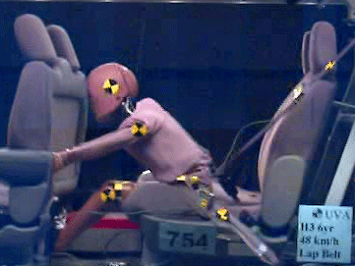
Most common cause of severe abdominal injury involves motor vehicles
Compression, shearing, acceleration/deceleration forces

Slide 32
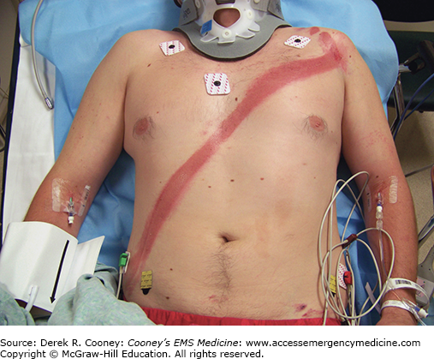
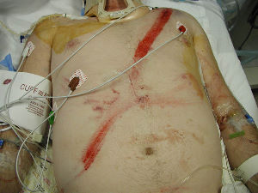
Clues To Serious Injury
Pain, tenderness, distension, bruising

Slide 33
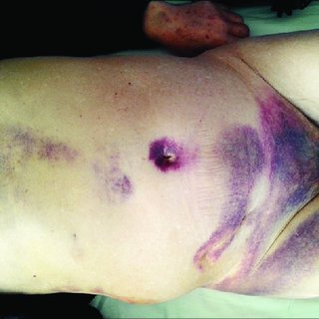
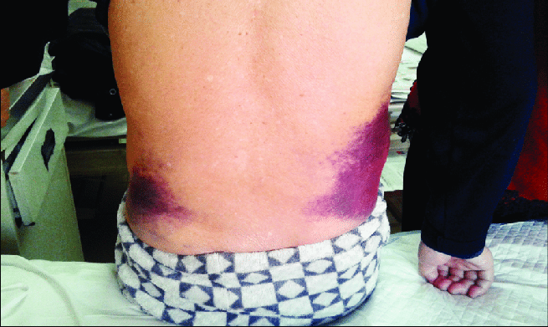
Retroperitoneal Injury?
Pancreatic and duodenal injuries occur from rapid deceleration or handle bar injuries
Cullen Sign:
Periumbilical
Grey Turner Sign:
Flank

Slide 34
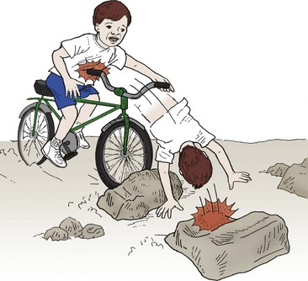
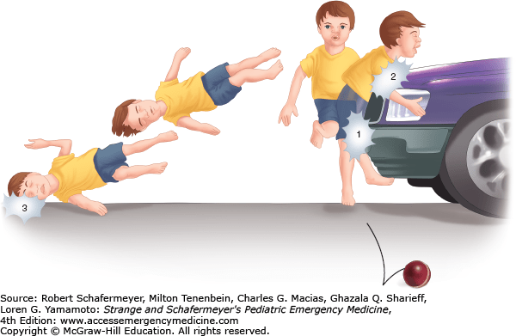
Common Serious Pediatric Injury Patterns

Slide 35
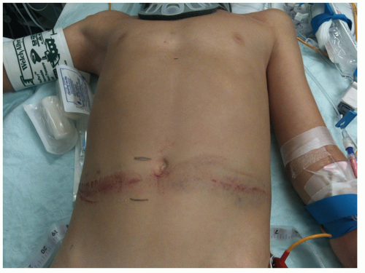
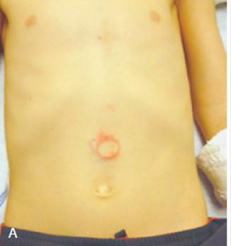
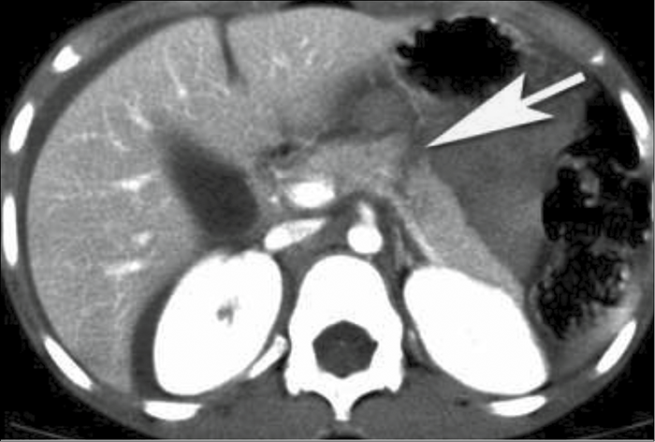
Pediatric Considerations
Very susceptible to abdominal injury
Compliant bones, larger organs, less fat protection
Can lose 45% of blood volume and only be tachycardic

Slide 36
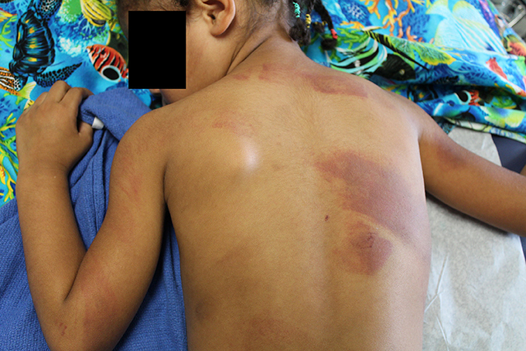
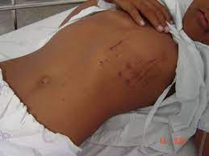
Pediatric Chest Trauma
Pulmonary Contusions
Pneumothorax
Rib fractures
Cardiac contusion
Cardiac Tamponade

Slide 37
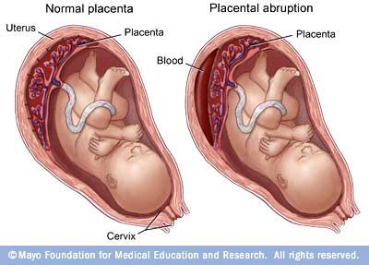
Abdominal Trauma In A Pregnant Patient
Placental Abruption
Can be delayed up to 48 hours, most common cause of fetal death

Slide 38
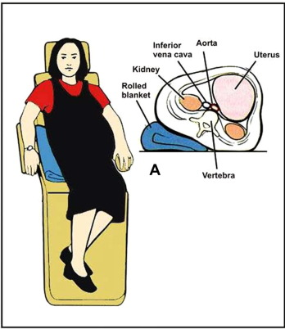
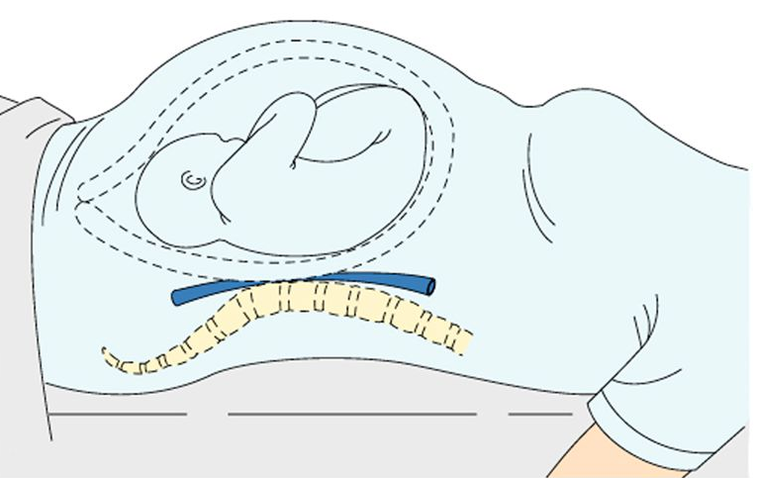
Transporting a Pregnant Patient
Beware of IVC compression
Tilt Patient To Her Left
For Transport

Slide 39
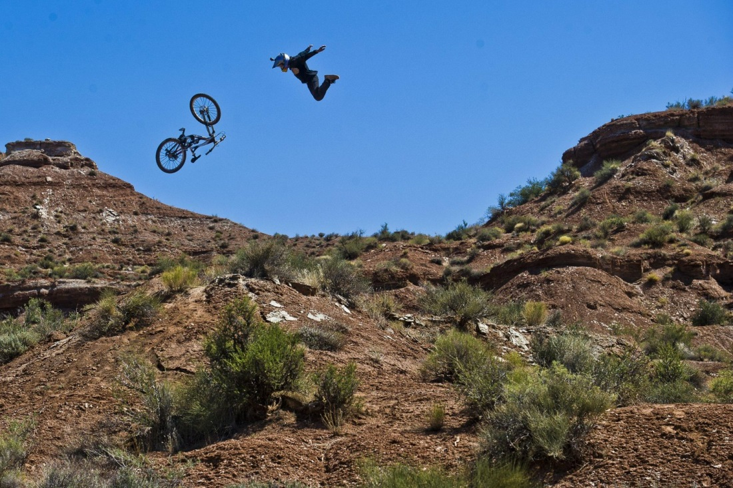
Falls
Severity of injury determined by distance, landing surface, and angle of impact

Slide 40

Strongly Consider Cervical Collar For Elderly Patients that Fall
Neuro exam, mental status, and neck pain should drive your decision

Slide 41

Head Injury Complications
Vomiting
Seizures
Combativeness
C-spine injuries
Protect The Airway!

Slide 42
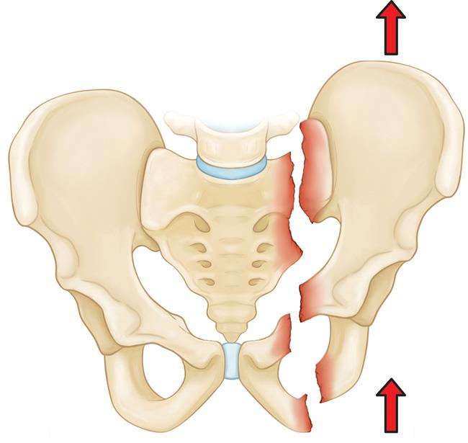
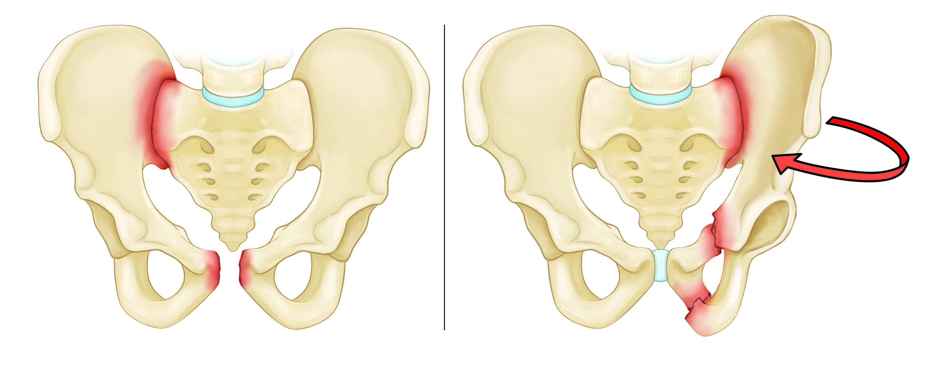
Types Of Pelvic Fractures
Anterior-Posterior
Compression
Lateral
Compression
Vertical Shear

Slide 43
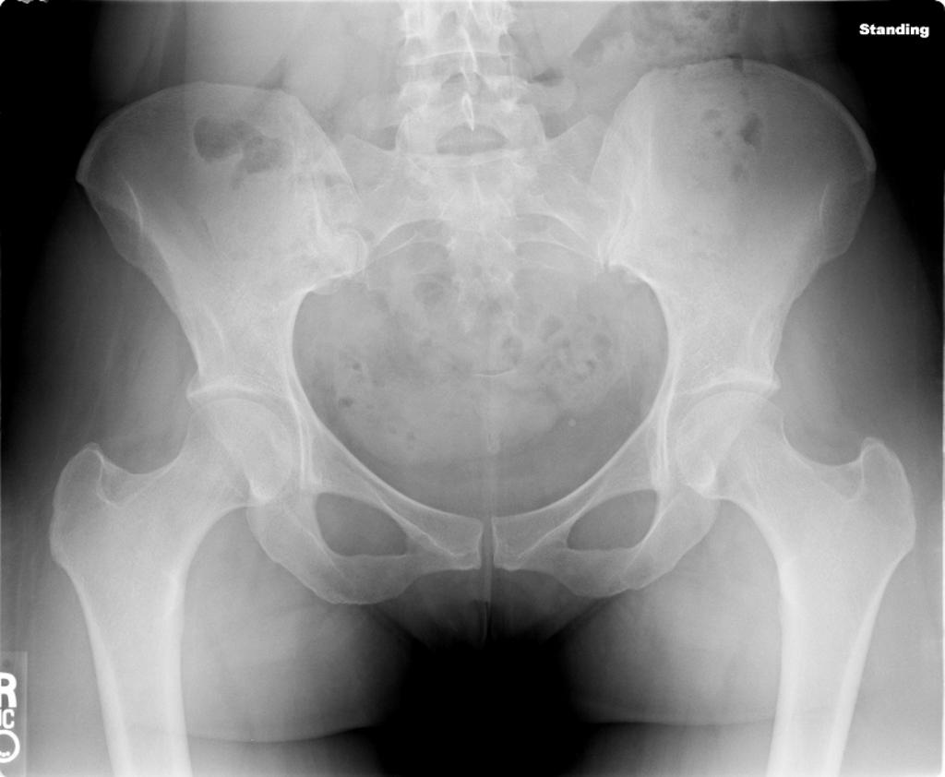
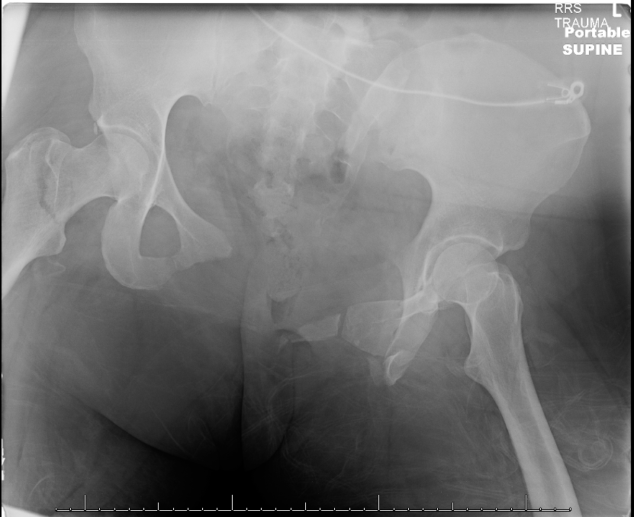
Open Book Pelvic Fractures
Normal
Open Book

Slide 44
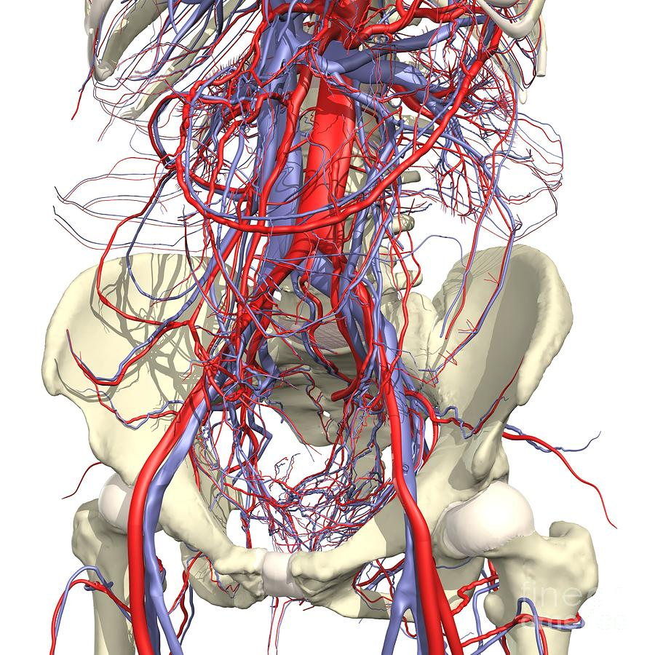
The Pelvis Is VERY Vascular!

Slide 45

Pelvic Binders = Tourniquet For Pelvis

Slide 46

Treatments
X-ABCs
Quick Transport Decision
En Route:
  Prevent hypoxia
  Prevent hypothermia
  IV access and Permissive Hypotension
Consider pelvic binder
Repeat vitals and monitor

Slide 47

TXA For Patient’s In Shock With Bleeding You Cannot Control?

Slide 48


