Slide 1

Dermatologic Emergencies
Steven T. Chen, MD MPH MS-HPEd
Assistant Professor, Harvard Medical School
Attending in Dermatology and Internal Medicine
Associate Program Director, Harvard Dermatology Residency Program
Subspecialty Core Educator, MGH Internal Medicine Training Program
@DrStevenTChen
Notes:
Questions on slides: 14, 39, 47, 56, 80

Slide 2
Disclosures/Conflicts of Interest
I have received honoraria from Pfizer for serving on an advisory board for digital media.
Many of the treatments/medications discussed today are in the setting of off-label usage.

Slide 3
Objectives for this session
Evaluate and a new potentially severe cutaneous eruption in the hospitalized patient.
Understand the salient clinical features to avoid missing a severe rash, such as SJS/TEN, DRESS, AGEP, purpura fulminans, etc.
Formulate a framework for when dermatology consultation may be necessary or advised.
Analyze available patient characteristics and data to identify culprit drugs when faced with an adverse skin reaction to medication.

Slide 4

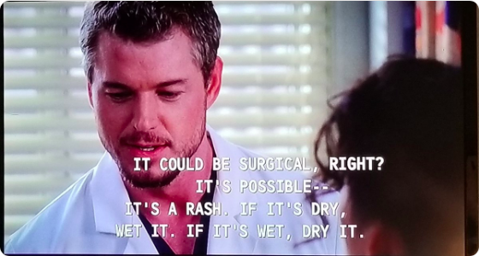
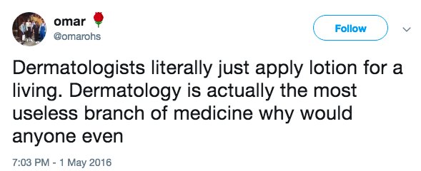
What do you think of when you hear dermatology?

Slide 5
The Merits/Truths of Dermatology
One of the few organ systems in which you can actually see disease
Easily tested and biopsied for analysis (for patient care and for research)
A large immunologic organ
The skin doesn’t lie!
Start with the physical exam, and then take a pertinent history
Difficult to generate a differential unless you know what the diagnoses are

Slide 6
Some Review on Morphology
Macule – flat, <1 cm
Patch – flat, >1 cm
Papule – raised, <1 cm
Plaque – raised, > 1 cm
Vesicle – fluid filled, <1 cm
Bulla – fluid filled, >1 cm
Pustule – pus filled
Nodule
Tumor
Wheals
“Maculopapular”

Slide 7

A different approach
Red Flags
Painful
Target lesions
Mucosal involvement
Systemic involvement
Certain blisters/bullae
Erythroderma
A rash in an immunosuppressed patient

Slide 8
Case 1
Case One

Slide 9
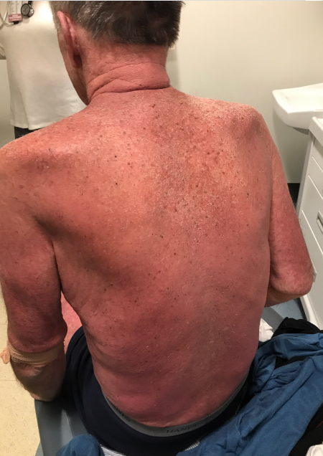

Slide 10
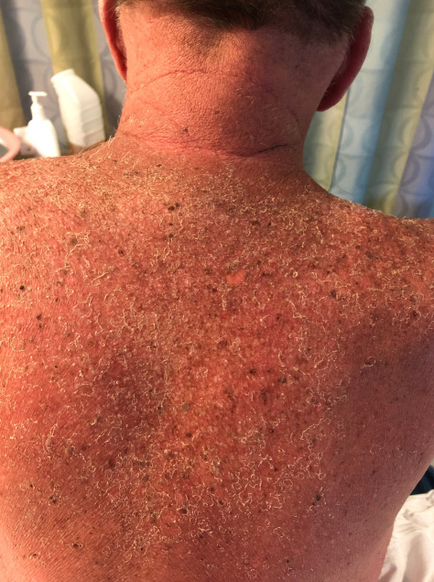
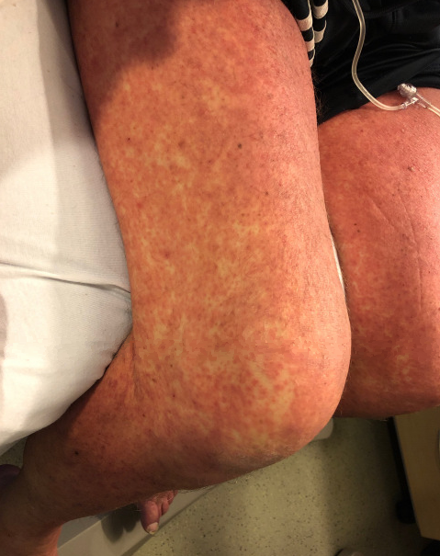
HD 2

Slide 11
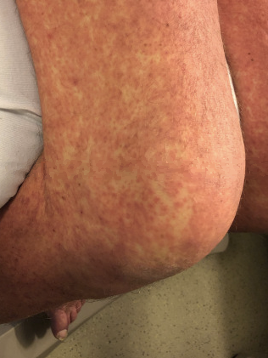
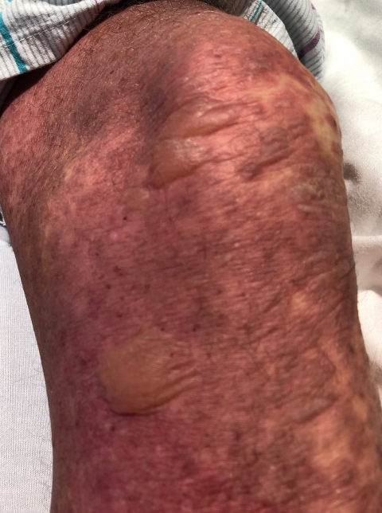
HD 2 → HD 3

Slide 12
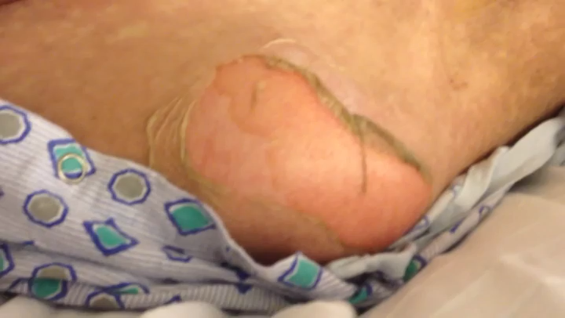
Nikolsky Sign
https://www.youtube.com/watch?v=xj5svjANaIE

Slide 13
Patient History
65M with follicular lymphoma on bendamustine and rituximab who was started on trimethoprim/sulfamethoxasole for PCP prophylaxis.
Has been on trimethoprim/sulfamethoxasole for 2 weeks. Presented to clinic with subjective fevers, myalgias, and skin eruption as pictured.

Slide 14
Stevens Johnson Syndrome
Macular, atypical targetoid lesions with duskiness, mucosal involvement/sloughing, and positive Nikolsky with <10% BSA epidermal detachment or pending detachment. Conjunctival injection and hemorrhagic lips are common.
>30% - Toxic Epidermal Necrolysis
10-30% - SJS-TEN overlap syndrome
Chen ST, Velez NF, Saavedra AP. Adverse Cutaneous Drug Reactions. Ch 145, Principles and Practice of Hospital Medicine, 2nd ed.

Slide 15
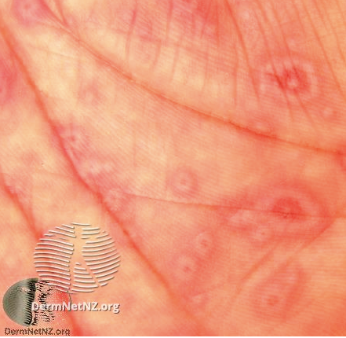
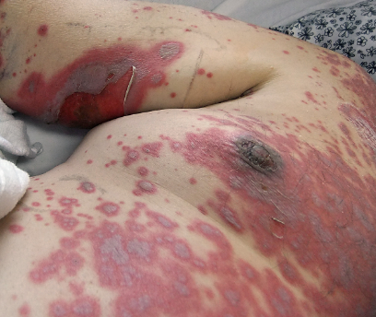

Target versus targetoid
https://my.clevelandclinic.org/health/diseases/17656-stevens-johnson-syndrome

Slide 16
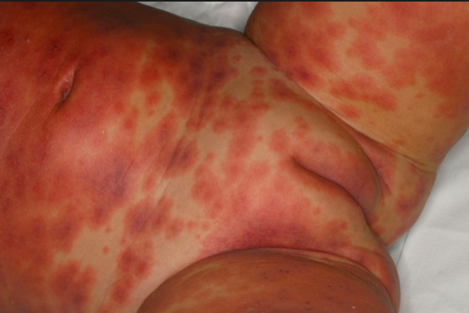
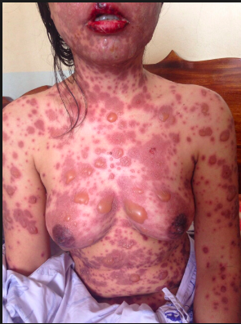
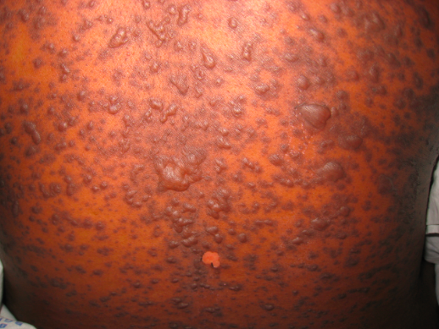
https://app.figure1.com/rd/images/578387610d39995a44b253f7
https://adc.bmj.com/content/98/12/998
https://www.infectiousdiseaseadvisor.com/infectious-diseases/stevens-johnson-syndrometoxic-epidermal-necrolysis/article/610572/
https://cdemcurriculum.files.wordpress.com/2015/09/ten.png

Slide 17
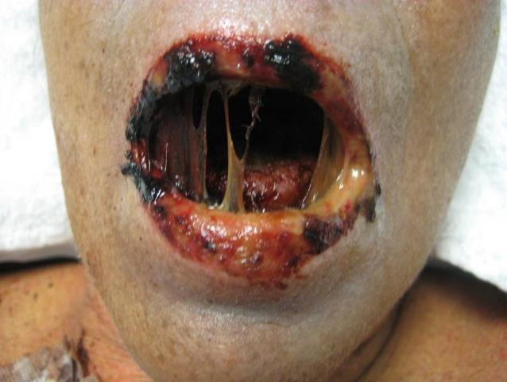
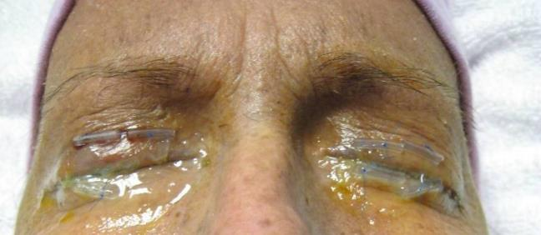
Courtesy of Dr. Art Saavedra
Notes:
17

Slide 18
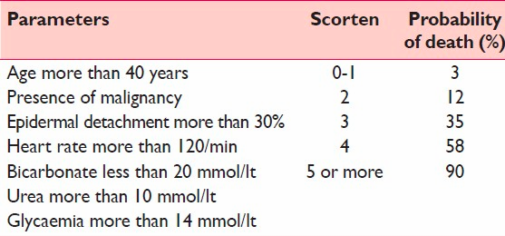
Prognostication can be attempted with SCORTEN
Bastuji-Garin S, et al. SCORTEN: a severity-of-illness score for toxic epidermal necrolysis. J Invest Dermatol. 2000 Aug;115(2):149-53.

Slide 19
SJS/TEN
First large study in an American cohort published in 2018.
Trimethoprim/sulfamethoxasole was the most common culprit
Overall survival was better than predicted than SCORTEN
Prognosis worsened drastically with BSA > 40%
No convincing data regarding treatment options
Overall, the study is largely exploratory and hypothesis generating.
Micheletti et al. Stevens-Johnson Syndrome/Toxic Epidermal Necrolysis: A Multicenter Retrospective Study of 377 Adult Patients from the United States
Journal of Invest Dermatol. Nov 2018, 138:11, 2315–2321.

Slide 20
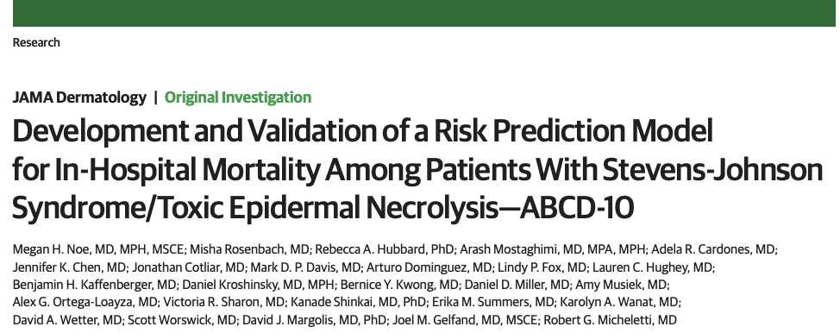
SCORTEN updated → ABCD-10

Slide 21
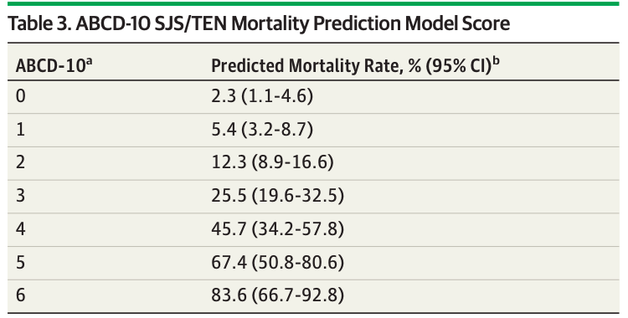
ABCD-10
Age > 50 1 pt
Bicarb < 20 mmol/L 1 pt
Cancer (active) 2 pts
Dialysis 3 pts
10% BSA 1 pt

Slide 22
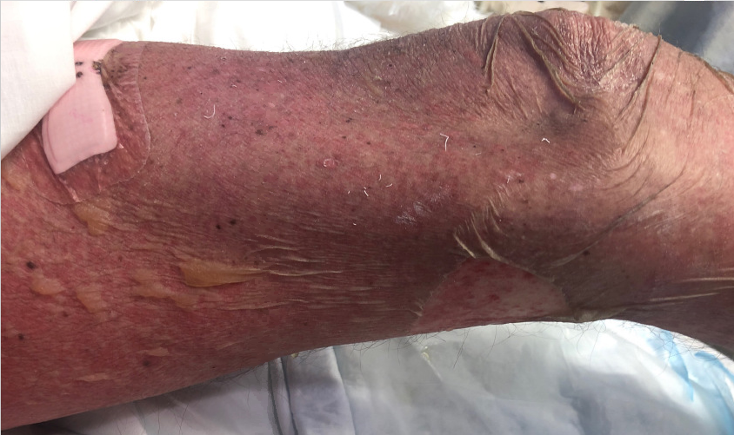
After 4 days:

Slide 23
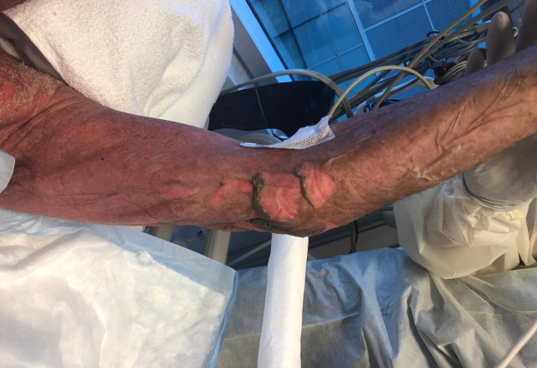
Progression to TEN

Slide 24
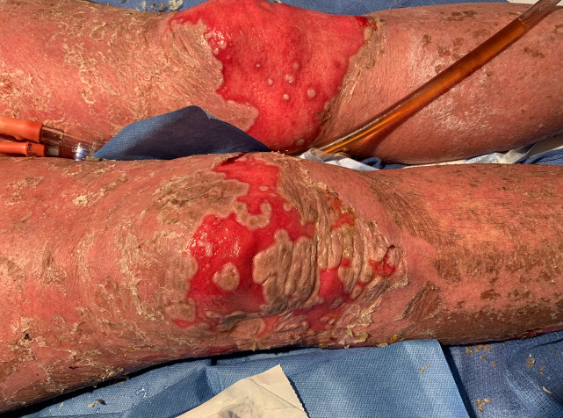
3 weeks later…

Slide 25
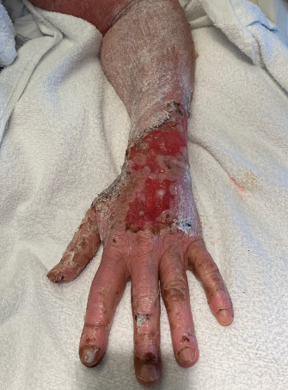

Slide 26
A word on treatment
Discontinuation of offending agent (4-21 days prior to rash)
Antibiotics, Antiepileptics, NSAIDs most common
Good wound care without debridement
Antibiotics only if necessary (sepsis given open skin)
Consider Ophthalmology, GYN/Urology consult
Dermatology can guide possible therapy to halt progression
Etanercept
Cyclosporine
Intravenous Immunoglobulin + Steroids

Slide 27
What else is in the differential?
Stevens Johnson Syndrome/Toxic Epidermal Necrolysis
Acute Stage IV GVHD
Pemphigus vulgaris
Staph Scalded Skin Syndrome

Slide 28
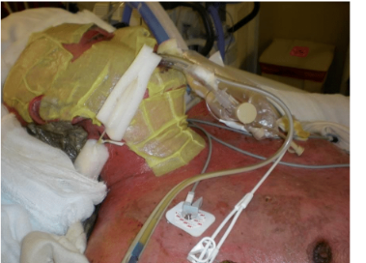
Stage IV GVHD
Clinically very difficult to distinguish
Patient’s history most helpful (medications and ?BMT)

Slide 29

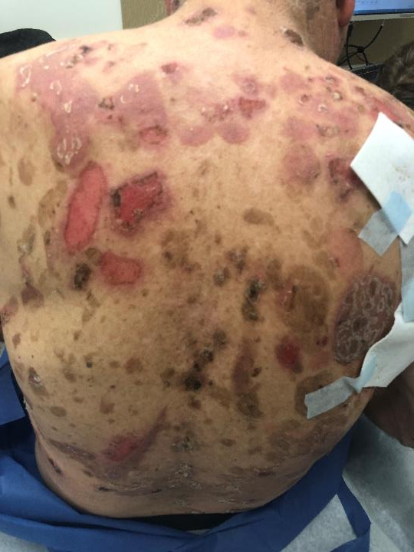
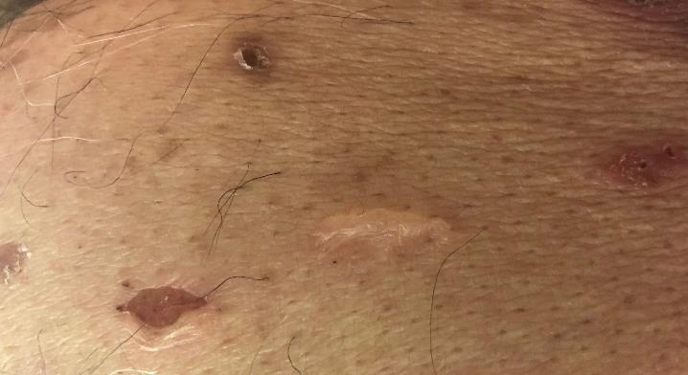
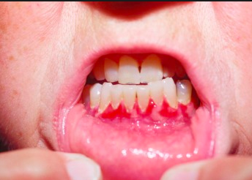
Pemphigus Vulgaris
Also + Nikolsky
No targetoid lesions
No duskiness (meaning no cell death)
Systemically not ill
More commonly gingiva involved, NOT lips

Slide 30
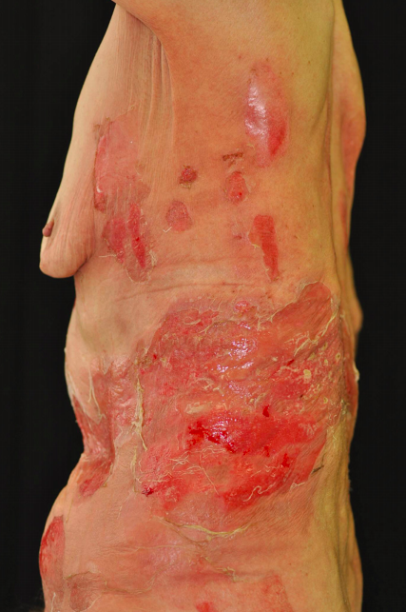
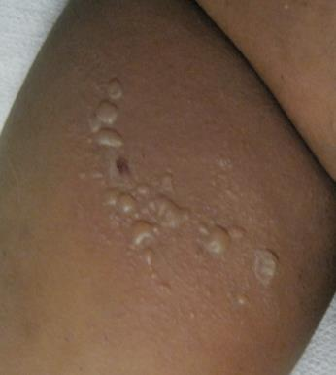
Staphlococcal Scalded Skin Syndrome
From bloodborne staph toxin that causes cleavage of Desmoglein, protein that holds skin together.
Desquamation is more superficial than SJS/TEN.
Skin is not as painful.
Adult patients should have renal failure!
Jelly Roll!
http://www.odermatol.com/odermatology/32013/22.SSSS-OishiT.pdf

Slide 31
Let’s Compare
 | SJS/TEN | EM | Pemphigus | S IV GVHD | SSSS
Morphology | Targetoid, dusky, and flat (macule) | Target, and raised (papule) | Less inflammatory, no duskiness | Dusky, macular or papular | Erythema/ superficial sloughing
Nikolsky | + | - | + | + | +
Skin Pain | ++ | +/- | + | ++ | +/-
Important history | New drug | Recent infection | n/a | BMT | ?exposure and AKI/CKD
Treatment location | Inpatient management | Usually observation | Outpatient management | ICU Level care | Inpatient management

Slide 32
Case 1
Case Two

Slide 33
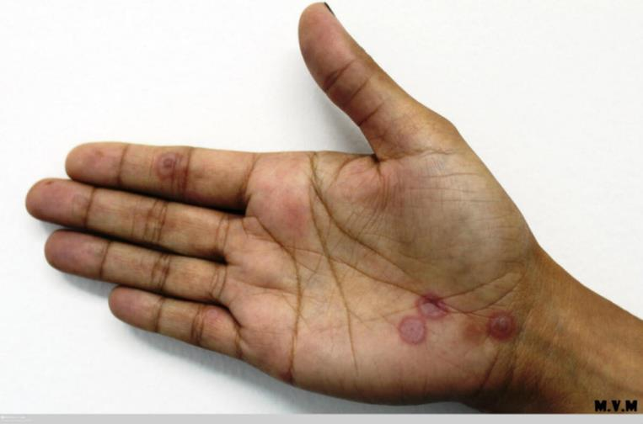
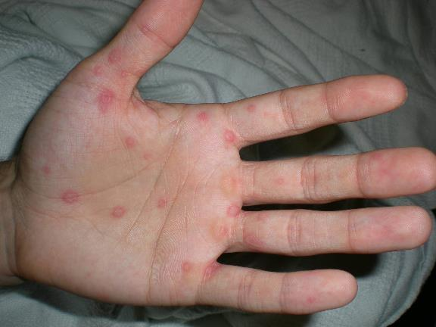
https://www.pcds.org.uk/clinical-guidance/erythema-multiforme

Slide 34
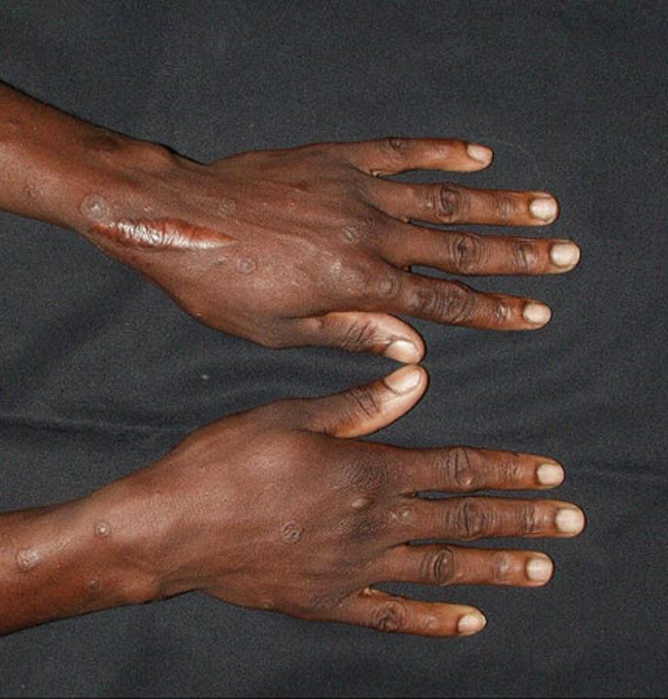
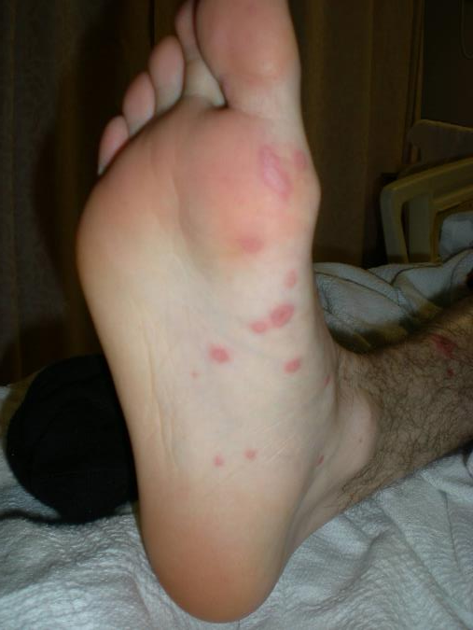
https://www.pcds.org.uk/clinical-guidance/erythema-multiforme

Slide 35
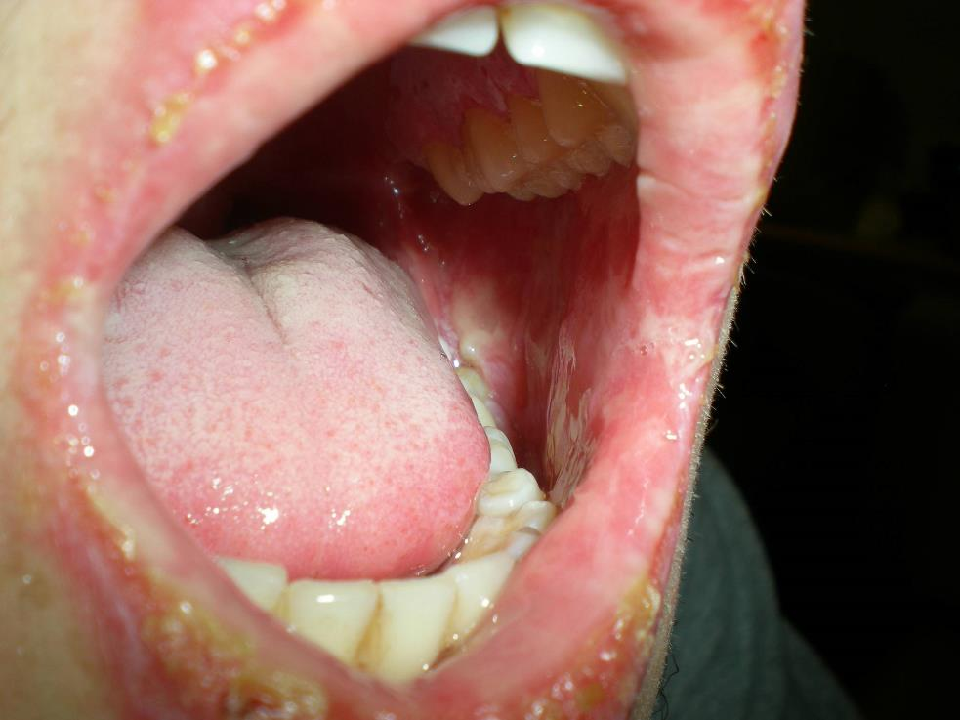

Slide 36
History
21M with recent URI and sudden onset of painful rash. Also has mouth erosions causing difficulty eating/swallowing.
No new drugs.

Slide 37
Erythema Multiforme
Usually triggered by infection (90%)
Typical targets on the palms/soles, +/- mucosal involvement
Treat for underlying infection (HSV, mycoplasma) and systemic steroids for symptomatic relief
?spectrum with SJS/TEN

Slide 38
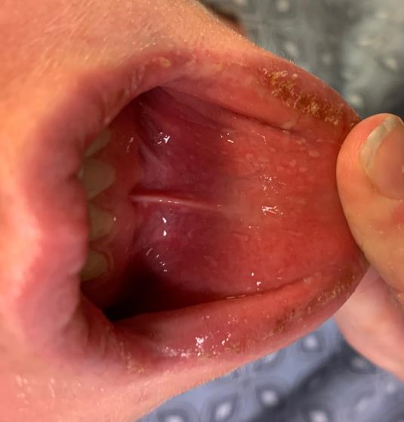
Why is it not Hand Foot Mouth Syndrome?
Typical HFMS should be vesicular, not target lesions.
In HFMS, oral erosions should be focal lesions (not diffuse sloughing).
Atypical HFMS can mimic erythema multiforme.
Ultimately, supportive care is never wrong for either!

Slide 39
EM-Minor
EM-Major
SJS
TEN

Slide 40
Case 4
Case Three

Slide 41
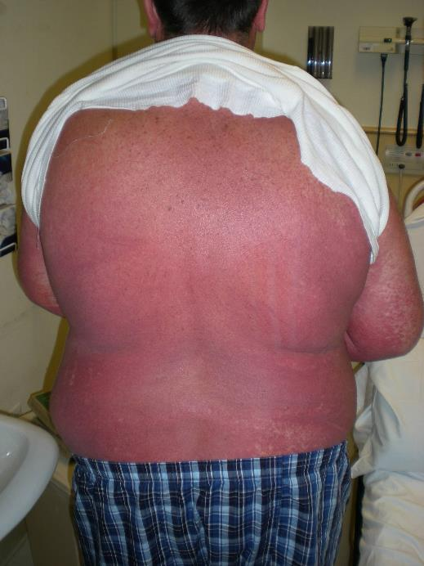
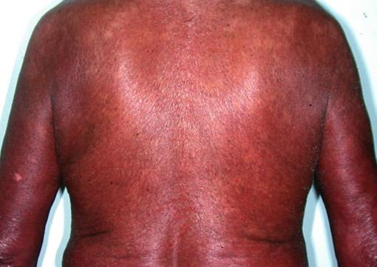

Slide 42
History
55M with recent hospitalization for MSSA bacteremia, started on vancomycin at admission, but switched to nafcillin 5 weeks ago. Rash started yesterday.
Patient reports feeling swollen, especially in the face. Also feels “sick” with muscle and joint aches.
Admitted overnight.

Slide 43
Drug Rash with Eosinophilia and Systemic Symptoms
Usually from antiepileptics, antibiotics, antivirals
HIV patients: “Never” go “back”
Starts 2-6 weeks after first exposure to drug
Mortality rate is 10%
Hepatotoxicity and cardiac toxicity are top two causes of death
Some cases thought to be from reactivation of HHV-6

Slide 44
Drug Rash with Eosinophilia and Systemic Symptoms
Drug rash WITH systemic involvement
Check labs (CBC with diff, LFTs, BUN/Cr)
Worry about eosinophilia, cytopenias, atypical lymphocytes
Palpate lymph nodes and check for hepatosplenomegaly
ROS: arthralgia, edema, fever
Can have hypotension
If chest pain or hemodynamic instability: EKG, cardiac enzymes and consider TTE
If difficult case, can consider HHV-6
Steroids are mainstay of treatment
Bowel edema, so IV steroids commonly used

Slide 45
DRESS Treatment
Steroid taper usually requires longer course (starting at 1 mg/kg)
Other options exist (IVIG, Cyclosporine, etc)
Outpatient follow-up in dermatology
TSH to be checked 2-3 months later
Autoimmune thyroiditis

Slide 46
Diagnosing DRESS
DRESS is a clinical diagnosis. A biopsy doesn’t help other than indicate possible drug rash.
Regiscar scoring system can be used to help differentiate between: Unlikely, possible, probable, and definite DRESS.

Slide 47
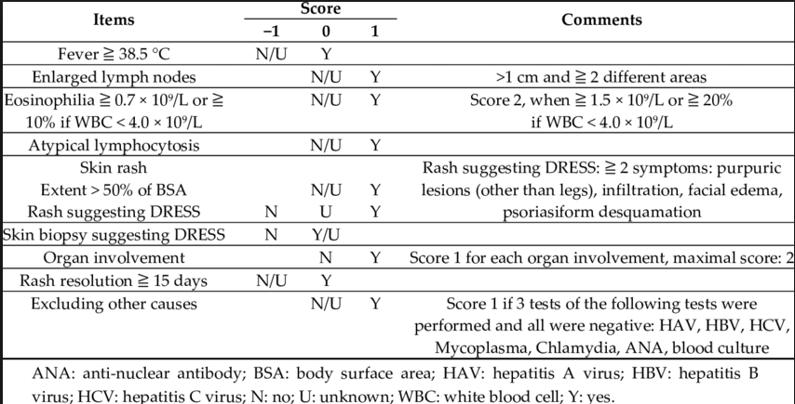
Regiscar
You don’t need a rash or eosinophilia to have DRESS!

Slide 48
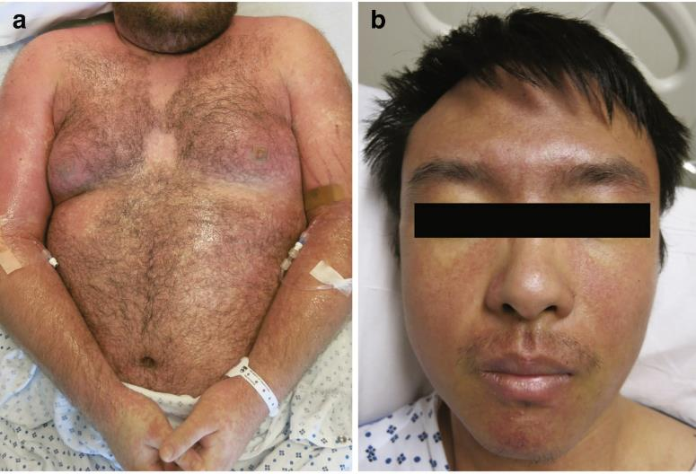
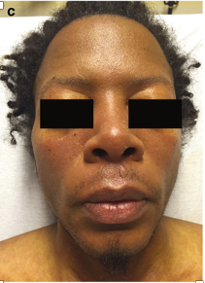
https://link.springer.com/chapter/10.1007/978-3-319-18449-4_6

Slide 49
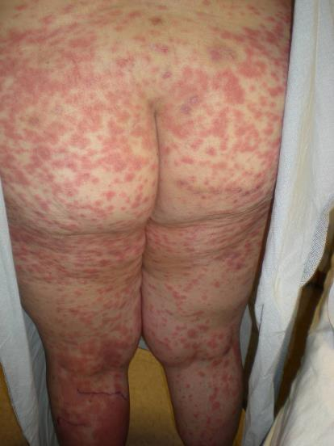
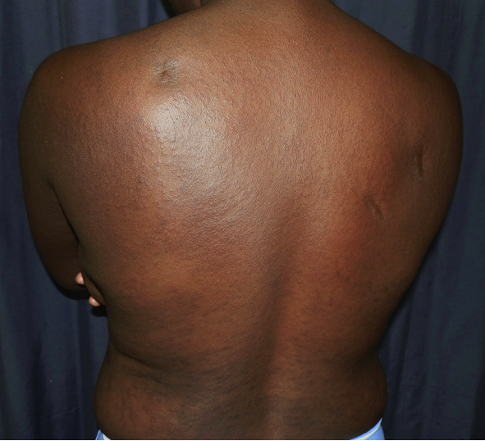
An Exanthematous Drug Rash (morbilliform)
https://docksci.com/queue/clinical-presentations-of-severe-cutaneous-drug-reactions-in-hiv-infected-africa_5af06c15d64ab21c4baadf54.html

Slide 50
If you see a patient with morbilliform drug, which drug is it?
RASH
Consult
Time course is important
Make a drug chart!!
 | 10/1 | 10/2 | 10/3 | 10/4 | 10/5 | 10/6 | 10/7 | 10/8 | 10/9 | 10/10 | 10/11 | 10/12
Vanc |  |  |  |  | x | x | x | x | x | x | x | X
Cefep | x | x | x | x | x | x | x | x | x | x
Levo |  |  |  |  |  |  |  | x | x | x | x | x
Phenytoin |  |  |  |  |  | x | x | x | x | x | x | x
nsaids | x |  |  |  |  |  |  | x |  |  | X
Based on the above chart, what is the most likely culprit?
Vancomycin
Cefepime
Levofloxacin
Phenytoin
NSAIDs

Slide 51
If you see a patient with morbilliform drug, which drug is it?
RASH
Consult
Time course is important
Make a drug chart!!
 | 10/1 | 10/2 | 10/3 | 10/4 | 10/5 | 10/6 | 10/7 | 10/8 | 10/9 | 10/10 | 10/11 | 10/12
Vanc |  |  |  |  | x | x | x | x | x | x | x | X
Cefep | x | x | x | x | x | x | x | x | x | x
Levo |  |  |  |  |  |  |  | x | x | x | x | x
Phenytoin |  |  |  |  |  | x | x | x | x | x | x | x
nsaids | x |  |  |  |  |  |  | x |  |  | X
Based on the above chart, what is the most likely culprit?
Vancomycin
Cefepime
Levofloxacin
Phenytoin
NSAIDs

Slide 52
Approximate time courses
1 wk 2 wks 3 wks 4 wks 5 wks 6 wks
Drug initiation
Exanthematous
SJS/TEN
DRESS
AGEP
Urticaria/
Anaphylaxis

Slide 53
What is AGEP?
Acute Generalized Exanthematous Pustulosis
Occurs 1-2 days after exposure to drug
Only need one exposure
(Don’t forget about peri-operative antibiotics)
Treatment is topical or systemic steroids if necessary

Slide 54
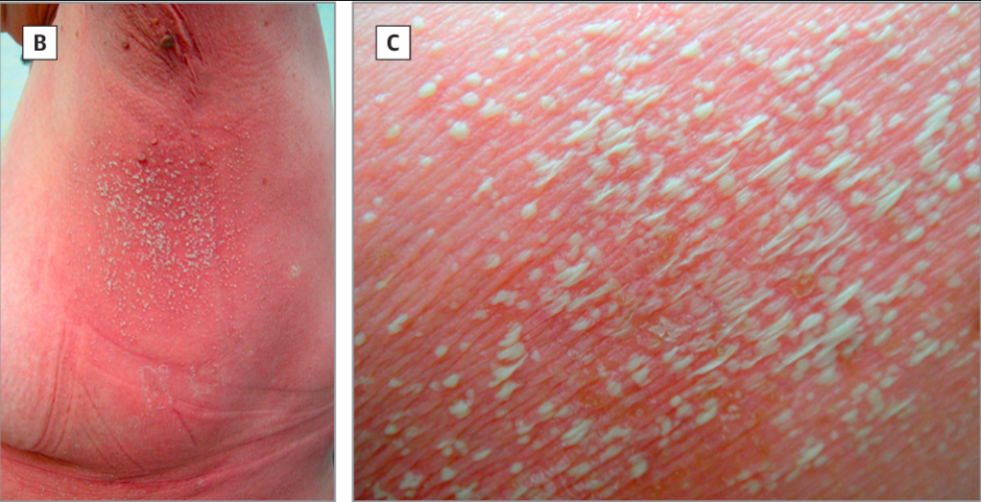
https://jamanetwork.com/data/journals/derm/933272/dcr140032f1.png

Slide 55
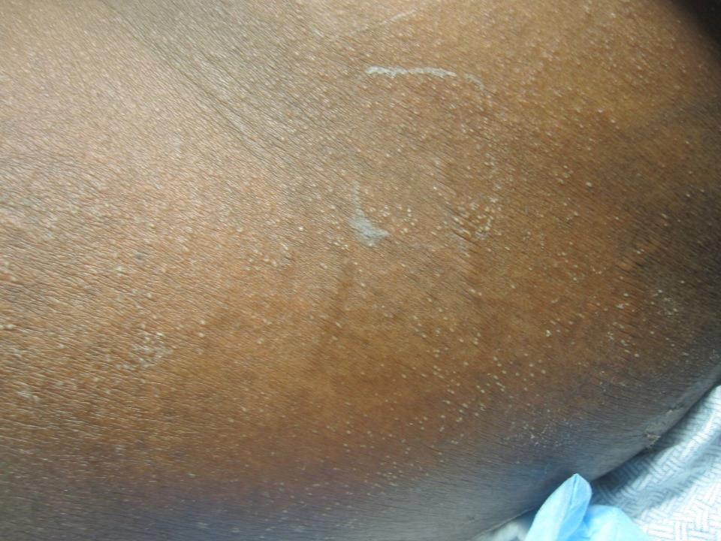

Slide 56
Case 5
Case Four

Slide 57
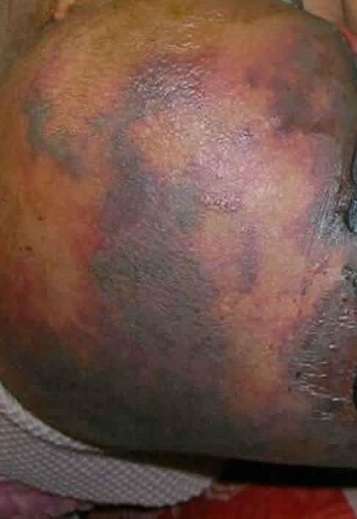
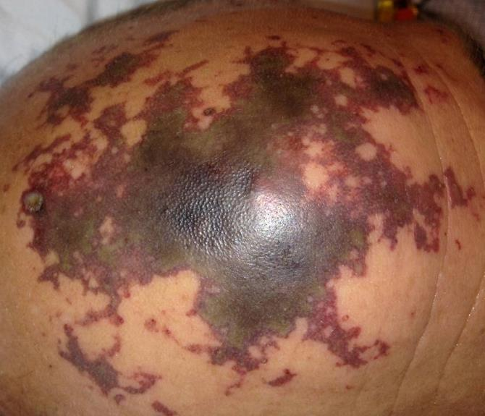
https://healthjade.net/purpura-fulminans/
Notes:
2nd photo from https://healthjade.net/purpura-fulminans/

Slide 58
Look at all those angular and stellate edges!

Slide 59
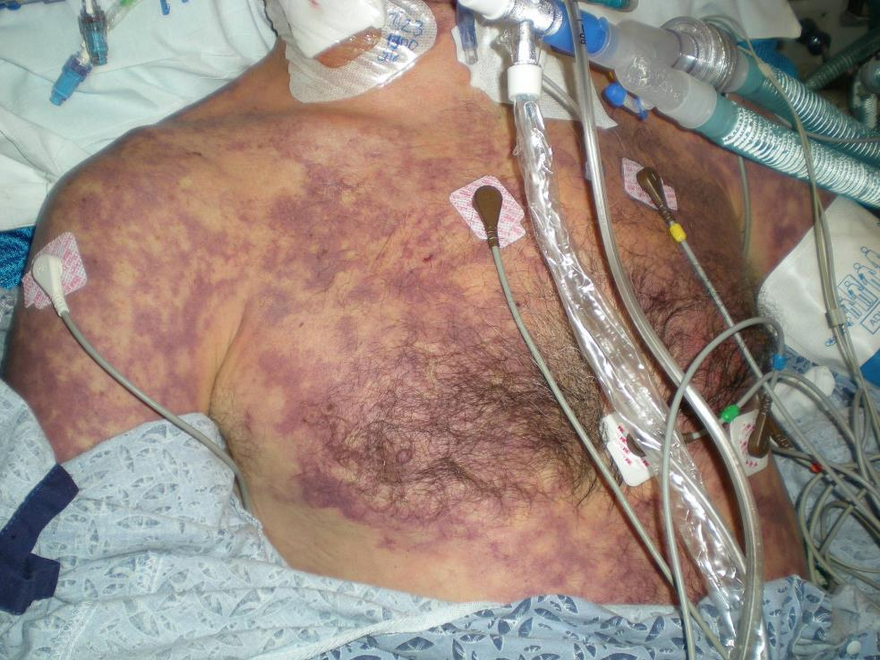

Slide 60
HPI
44M who walked into the ED with flu-like symptoms and headache. Was bitten by his dog the day prior.
Rash developed suddenly while patient was getting a CT scan.

Slide 61
Purpura Fulminans
Microvascular occlusion in skin with platelet-fibrin thrombi
No inflammation seen on biopsy (purely vascular)
“DIC in the skin”
A true emergency!

Slide 62
Differential Diagnosis
Purpura Fulminans Differential
Infection
Bacterial – Staph, Strep, encapsulated organisms
Viral (VZV, CMV)
Tick-borne illness (Rickettsial, babesia)
Malaria
Catastrophic antiphospholipid syndrome
Protein C/S deficiency (in pediatric population)

Slide 63
History continued
What other historical questions might you ask the patient or family?
History of splenectomy
Increased risk of encapsulated organism sepsis
Meningococcus
Pneumococcus
Hemophilus Influenza
Capnocytophaga
History of dogbites
Immunization history
Travel

Slide 64
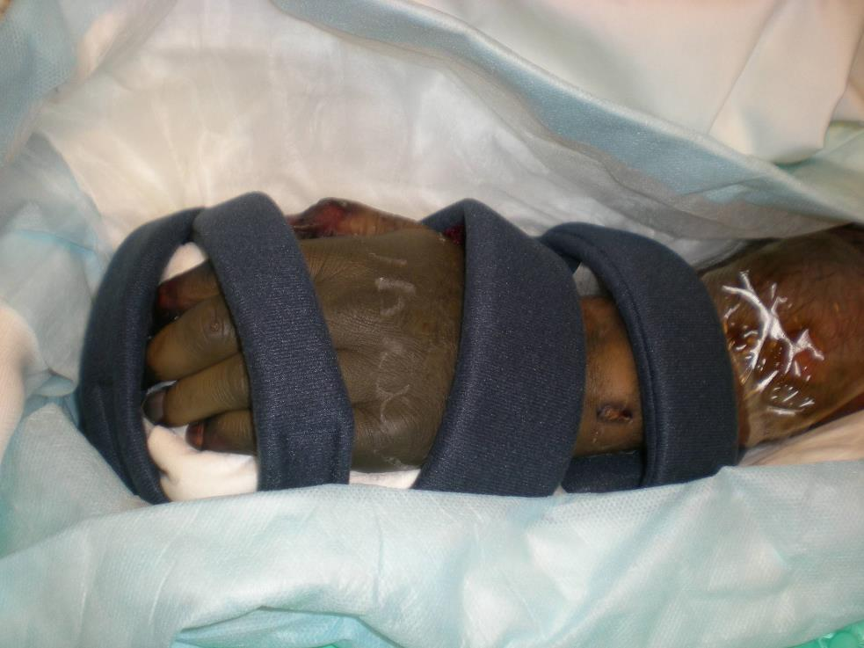

Slide 65
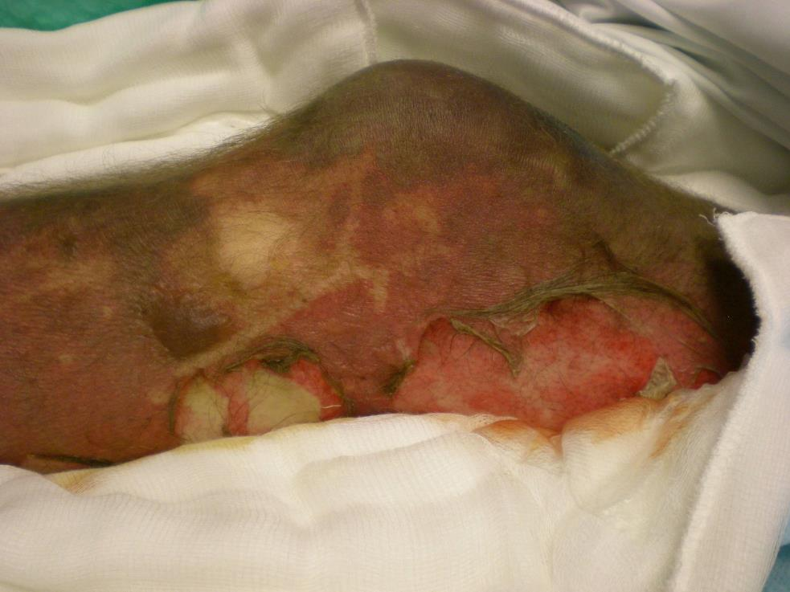

Slide 66
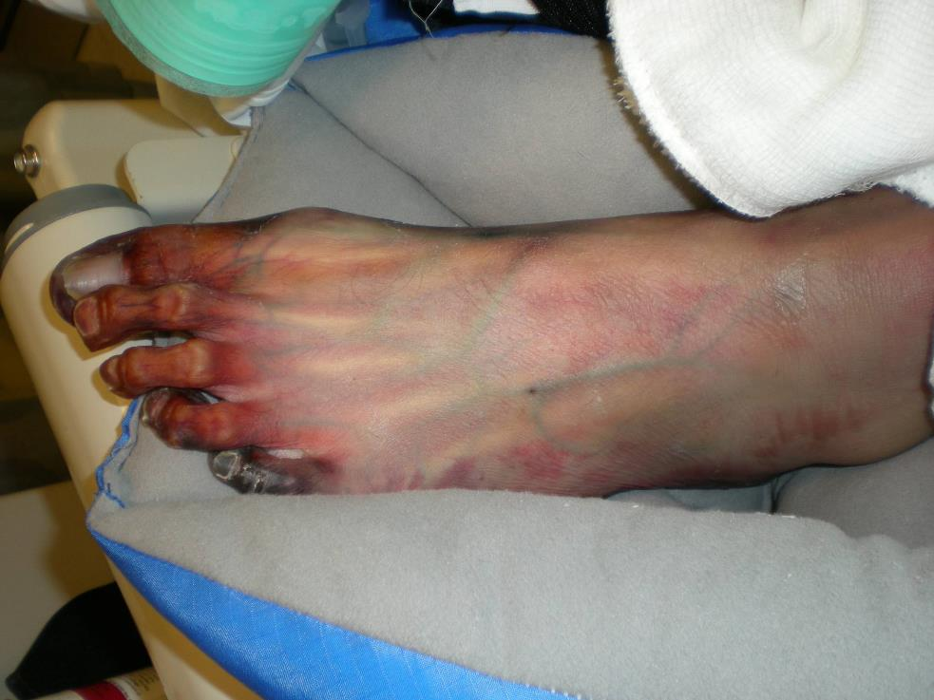

Slide 67
Continued hospital course
Blood Cultures – grew Capnocytophaga canimorsus
We recommended supportive wound care to minimize shearing of necrosed skin
Patient continued to have refractory shock to multiple pressors, with need for amputation of all four limbs.
Family members decided to make patient CMO. Patient passed away ~ 72 hours after onset of symptoms.

Slide 68
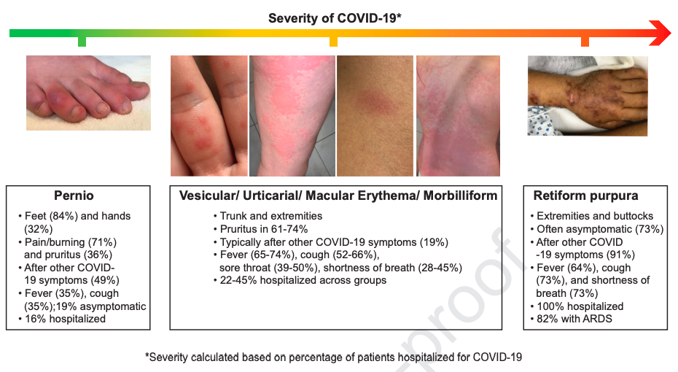
A brief detour on COVID-19
In the inpatient population, the critically ill tend to show sequela of thrombotic processes.
Freeman et al, JAAD June 30, 2020.

Slide 69
Case Five

Slide 70


Slide 71
HPI
72F with recent lap→ open cholecystectomy, with nonhealing ulcers. Ulcers are exquisitely tender.
What is the most likely diagnosis?
Before you answer, let’s do a full skin exam and see if there are any other clues….

Slide 72

On the left shin:

Slide 73
Pyoderma Gangrenosum
A neutrophilic dermatosis
Pyoderma Gangrenosum
Sweets Syndrome
Behcet’s Syndrome
Pathergy is a hallmark of these diseases
Need to stop debridement!!
Usually a diagnosis of exclusion
Treatment requires immunosuppression

Slide 74
How do you mitigate risk of infection
Often, we will perform a biopsy for both H+E and tissue culture, to rule out infectious processes.
Co-administration of immunosuppressant and antibiotics is a reasonable option to start, with further adjustment based on clinical course.
Dosing usually starting at equivalent of prednisone 1mg/kg
What if the patient requires another surgical procedure?
What if a patient with a h/o PG requires a surgical procedure?
Discuss with surgeon but may need some steroid or CsA.
Expectant management may be reasonable.
Xia et al, JAAD, 2/2018.

Slide 76



Slide 77


Another example of early effect of immunosuppression
Started on Prednisone 60 mg PO QD

Slide 78

https://www.cidjournal.com/article/S0738-081X(17)30126-8/pdf

Slide 79


Slide 80
Mini case 6

Slide 81
HPI
Critically ill ICU patient with sudden onset of new necrotic eschars.
https://europepmc.org/article/pmc/5266152

Slide 82

Ecthyma Gangrenosum
Necrotic ulcerating nodules/plaques (often in the anogenital region) from hematogenous spread of GNRs (usually), most classically pseudomonas.
Because of pathophysiologic mechanism, can be retiform as well.
Blood cultures and empiric broad spectrum antibiotics.

Slide 83
Take home points
Time course is critical to identify culprit drugs. Each eruption has its own “window.”
Beware of the dangerous rashes and red flags
Painful skin
Systemic involvement
Immunosuppressed patient
Target lesions and positive Nikolsky on exam
Always feel free to call a dermatology consultant if you need help.

Slide 84
Thank you!
@DrStevenTChen

