Slide 1
Use of Thrombolytics with STEMI
emRIC ECHO
June 17, 2024

Slide 2
Presenters
Dr. Dan Schnorr: EM Medical Director at San Carlos Apache Healthcare in Arizona
Dr. Randall Ellis: EM physician at San Carlos Apache Healthcare and member of the IHS EM Chief Clinical Consultant Core Group
Dr. Steve Humphrey: Cardiologist, former faculty at University of South Carolina with extensive experience teaching cardiology in Niger, Nicaragua, Ecuador, Tanzania, and Uganda

Slide 3
Objectives
Know thrombolytic agents available for use in STEMI and mechanisms
Know indications for thrombolytic use in STEMI
Know absolute and relative contraindications for thrombolytics
Understand post-thrombolytic care
Understand reperfusion rhythms
Understand possible complications and management

Slide 4
Case #1
CC: 62M via BLS “not feeling well, high blood pressure”
HPI:
  CP x 2 hours, onset on waking, radiates to back
  No fevers, chills, cough
PMH: DMII, HTN, HLD, CAD, MI s/p stent
Meds: ASA, Plavix, Lisinopril taken 1 hour PTA
PE: BP 195/106, O2:98, HR:118, RR:20, T:98.1

Slide 5
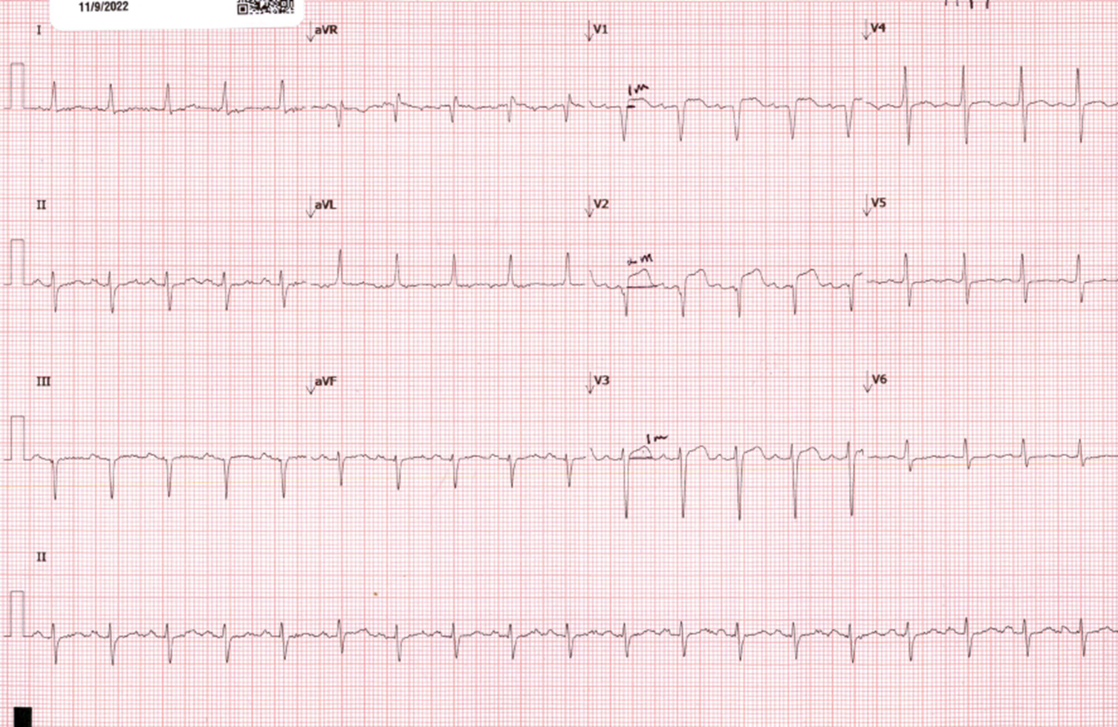
Case #1: ECG #1

Slide 6
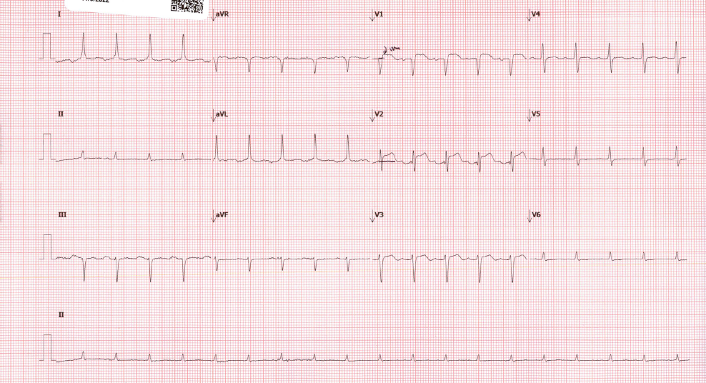
Case #1: ECG #2

Slide 7
Case #1
1702 ED arrival
1712 1st ECG shows STEMI
1723 Air Ambulance #1 declines due to weather
1728 Air Ambulance #2 declines due to weather
1731 ASA 324 mg given
1735 CTA: No dissection, No PE
1738 Accepted at Tucson Medical Center, Trop 0.52, BNP 2400, INR wnl
1805 2nd ECG done
1807 Air Ambulance #3 reports both units are on flights
1837 TPA started
2010 TPA completed
2205 Patient leaves ED in ground ambulance for a 2+ hour transport

Slide 8
Case #2
67-year-old male presented with chest pain and SOB
Stable vital signs
ECG shows an inferior STEMI
Snowing outside, helicopters were grounded, and the ground transport was going to be greater than 2 hours

Slide 9
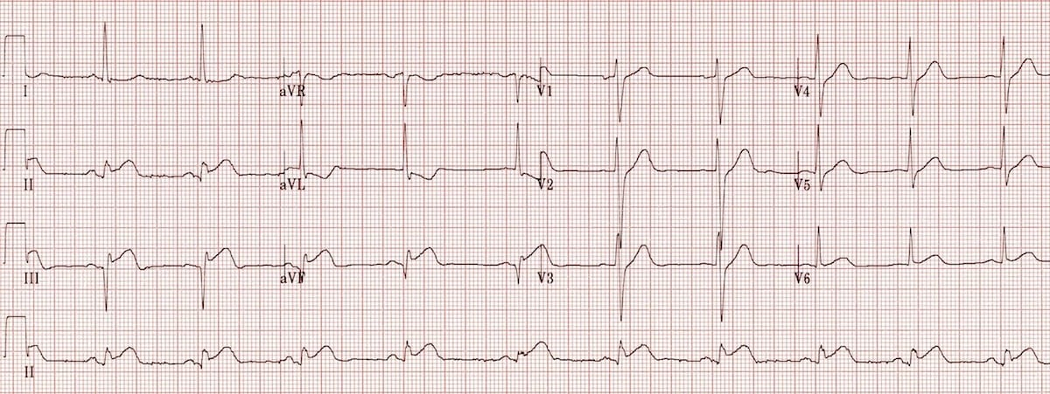
Case #2

Slide 10
Case #2
Patient given TPA while arrangements made for transfer
About halfway through TPA infusion, patient started to complain of a persistent headache
TPA was immediately stopped, and patient sent to CT

Slide 11
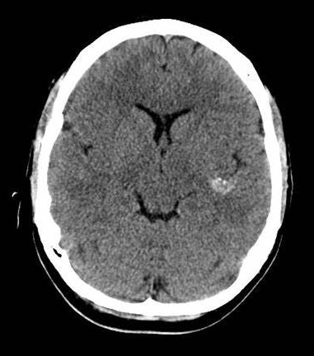
Case #2

Slide 12
Case #2
TPA stopped, avoided any further antiplatelet or anticoagulants
Elevated head of bed to 30 degrees
Consulted cardiology and neurosurgery
Kept SBP less than 140 per recommendations of neurosurgeon
ECG showed improvement suggesting reperfusion
Patient’s neuro status remained stable. Patient was transferred and did well. Returned to normal neuro status.

Slide 13
Thrombolytics Available for Use in STEMI
AGENT | DOSAGE
Tenecteplase (TNK) | Weight: • <60 kg: 30 mg IV bolus • 60-69 kg: 35 mg IV bolus • 70-79 kg: 40 mg IV bolus • 80-89 kg: 45 mg IV bolus • ≥90 kg: 50 mg IV bolus
Reteplase (rPA) | • 2 IV boluses of 10 units given 30 min apart
Alteplase (tPA) | Weight ≤67 kg: • First: 15 mg IV bolus • Second: 0.75 mg/kg IV over 30 min (max 50 mg) • Third: 0.5 mg/kg IV over 60 min (max 35 mg) Weight >67 kg: • First: 15 mg IV bolus • Second: 50 mg IV over 30 min • Third: 35 mg IV over 60 min
Streptokinase | • 1.5 million units IV over 60 min

Slide 14
Mechanism of Action
A thrombus is made from a complex process
TNK, Alteplase, and Reteplase are fibrin specific in breaking down a thrombus
Often called fibrinolytic agents
Thrombolysis and fibrinolysis are interchangeable terms with these meds
They activate fibrin-bound plasminogen to convert to plasmin
Plasmin breaks fibrin into fibrin degradation products
These meds will cause fibrin to break down throughout the body

Slide 15
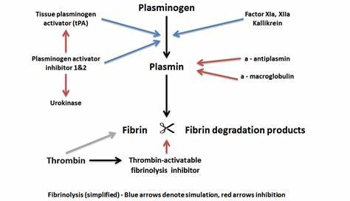
Mechanism of Action

Slide 16
Indications for Thrombolytic Use in STEMI
STEMI on an ECG
ED presentation to a cath lab will exceed 120 minutes
Symptom duration <12 hours or
Symptom duration 12-24 hours AND evidence of ongoing ischemia and large area of myocardium is at risk or hemodynamic instability
Goal is to start the thrombolytic within 60 minutes

Slide 17
Absolute Contraindications
Any history of intracranial hemorrhage
Ischemic stroke within 3 months
Intracranial neoplasm or structural cerebral vascular lesion
Suspected aortic dissection
Active internal bleeding
Significant head/face trauma in last 3 months

Slide 18
Relative Contraindications
Severe hypertension of SBP > 180 mmHg, or DBP > 110 mmHg
Any history of ischemic stroke
Major trauma in past 2-4 weeks
Non-compressible vascular puncture
Pregnancy
Active peptic ulcer
Use of anticoagulants or a bleeding diathesis

Slide 19
Post-Thrombolytic
Care

Slide 20
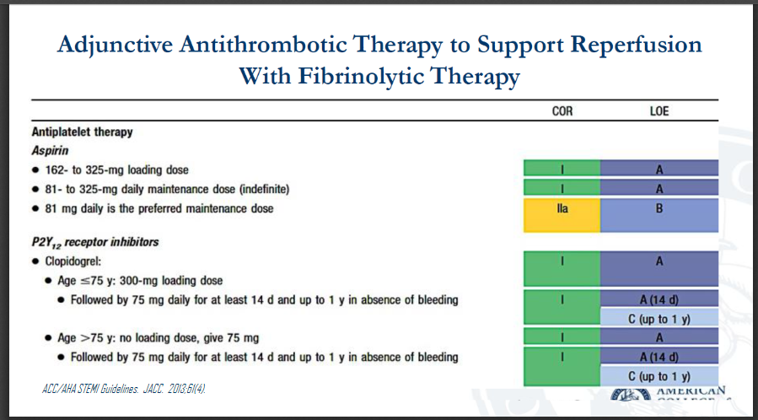

Slide 21
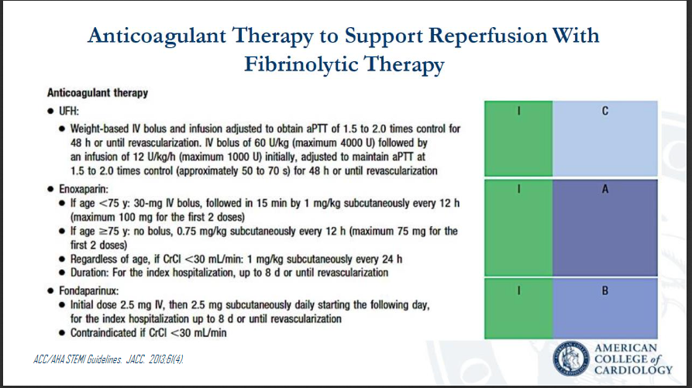

Slide 22
Arrhythmias Associated
with
Coronary Reperfusion

Slide 23
What are Reperfusion Arrhythmias?
Ventricular or occasionally atrial arrhythmias occurring within 6 hours of start of thrombolysis
Occur frequently and repetitively
Are highly specific but poorly sensitive for recanalization of the obstructed artery
They are a sign of significant reperfusion injury

Slide 24
Mechanisms of Reperfusion Arrhythmias
Consequence of complex cellular and humoral reactions
Key role to free oxygen radicals, calcium, thrombin, platelet activating factor and angiotensin II and others
Enhanced automaticity and triggered activity due to after-depolarizations more common than reentrant phenomena
Don’t forget the role of electrolyte abnormalities including especially K+, Mg++, Ca++

Slide 25
Incidence of Commonly Observed
Reperfusion Arrhythmias
Accelerated Idioventricular Rhythm (AIVR) 40 – 45 %
Sinus bradycardia 25 – 30%
Non-sustained Ventricular Tachycardia 20 – 25 %
Sustained Ventricular Tachycardia, Ventricular Fibrillation, Polymorphic Ventricular Tachycardia, Heart Block 5 -10%

Slide 26
Accelerated Idioventricular Rhythm (AIVR)
Regular rhythm of ventricular complexes
QRS duration > 120 msec.
Rate 50 – 110 beats per minute (less than 50 bpm is ventricular escape, greater than 110 bpm is Vtach)
Fusion and capture beats

Slide 27
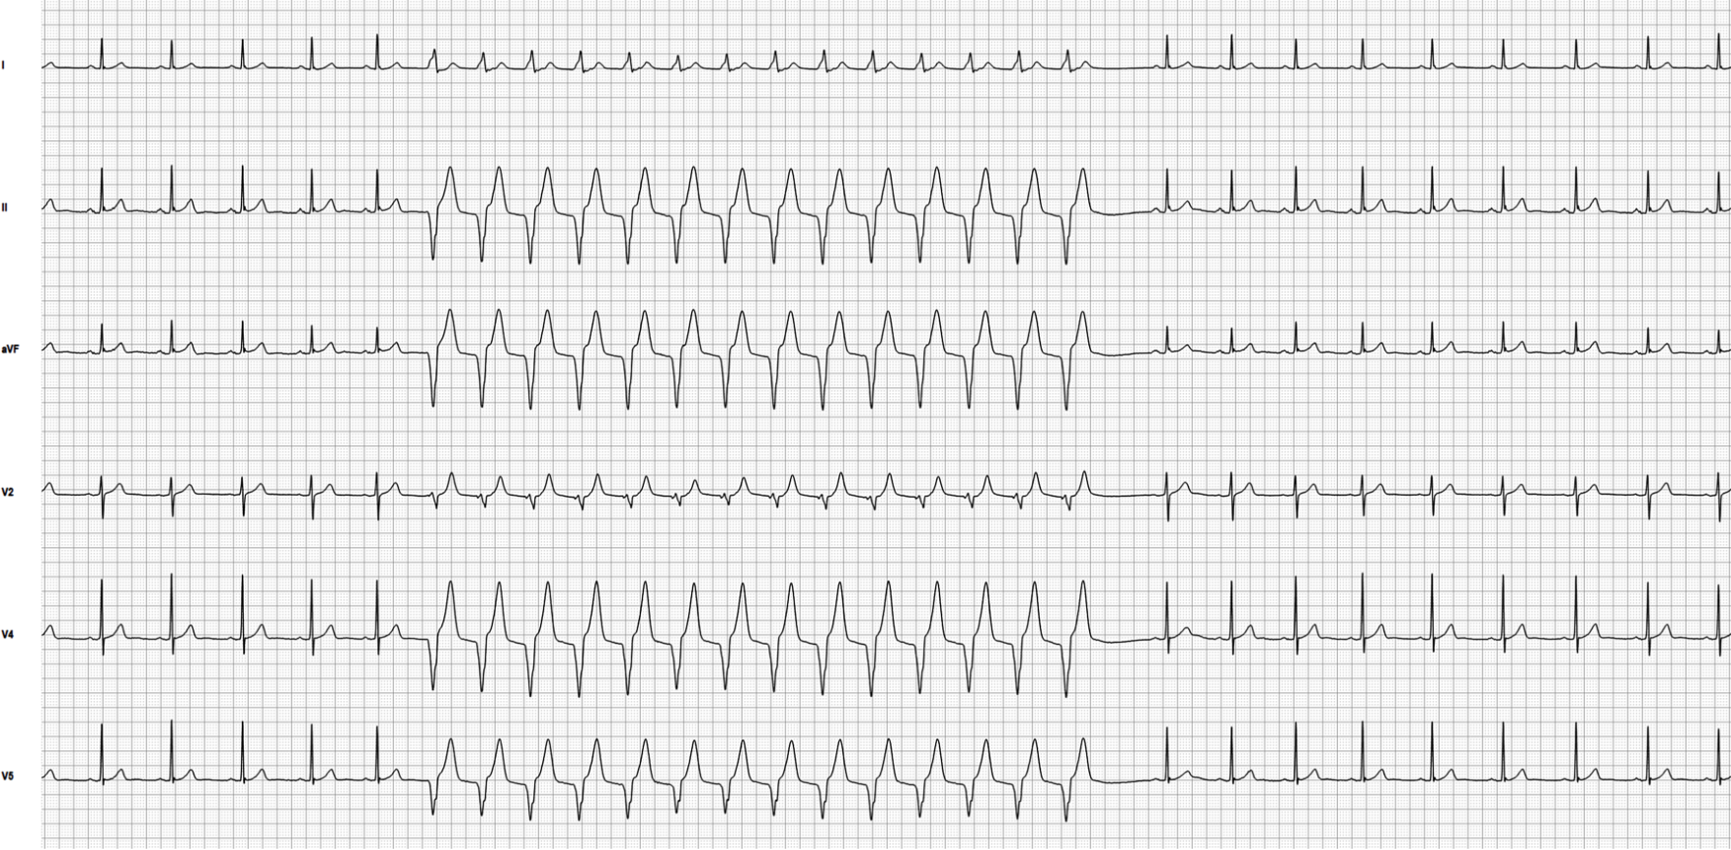
AIVR at rate 90
Sinus rhythm at rate 68

Slide 28
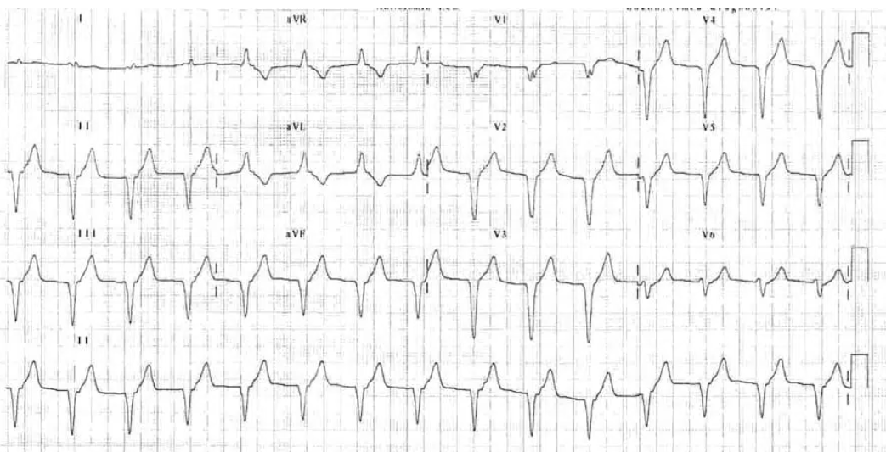
AIVR
Rate 90 BPM and regular
QRS > 120 msec.
Ventricular origin
No fusion beats

Slide 29
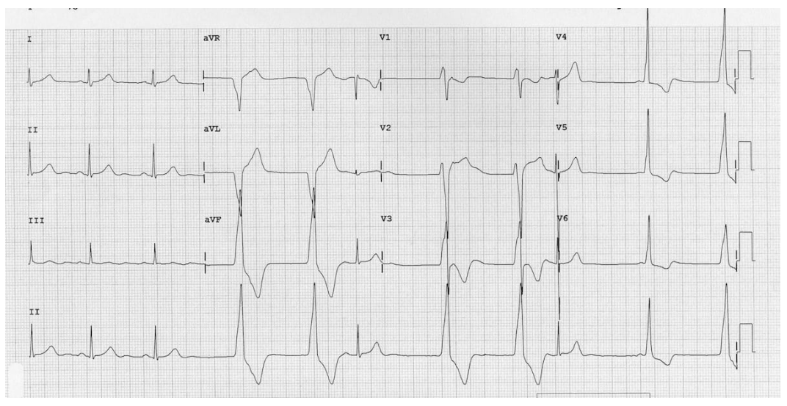
AIVR (isorhythmic)
with sinus capture beats (S)
and fusion beats (F)
S
S
F

Slide 30
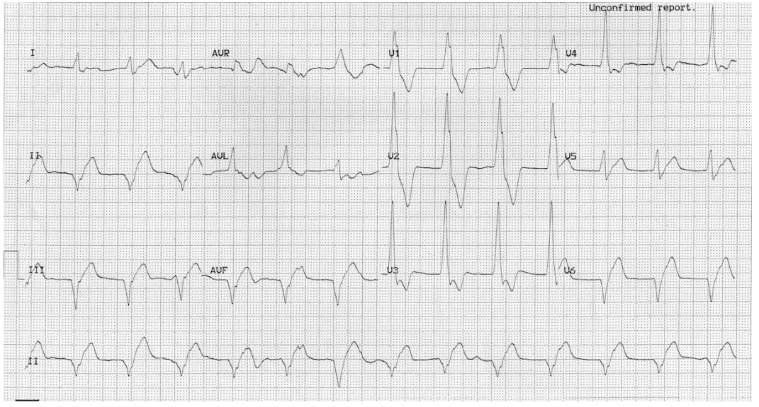
AIVR
Rate 78 bpm
AV dissociation with dissociated
P wave (P)
P

Slide 31
AIVR
AIVR is almost always a self-limited rhythm
It is usually associated with hemodynamic stability
It should be observed and not treated!
Treatment with drugs such as procainamide, lidocaine, and amiodarone may result in asystole

Slide 32
Sinus Bradycardia
Most often seen in association with inferior STEMI
May be associated with various degrees of AV block
May reflect sinus node ischemia or the Bezold-Jarisch reflex
B-J reflex is vagally mediated and often associated with marked hypotension
Responds to atropine if hemodynamic instability

Slide 33
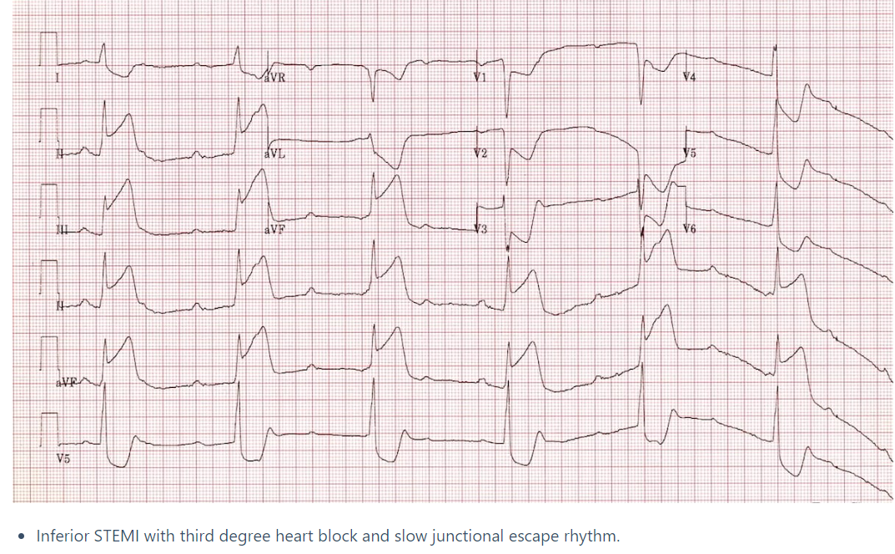

Slide 34
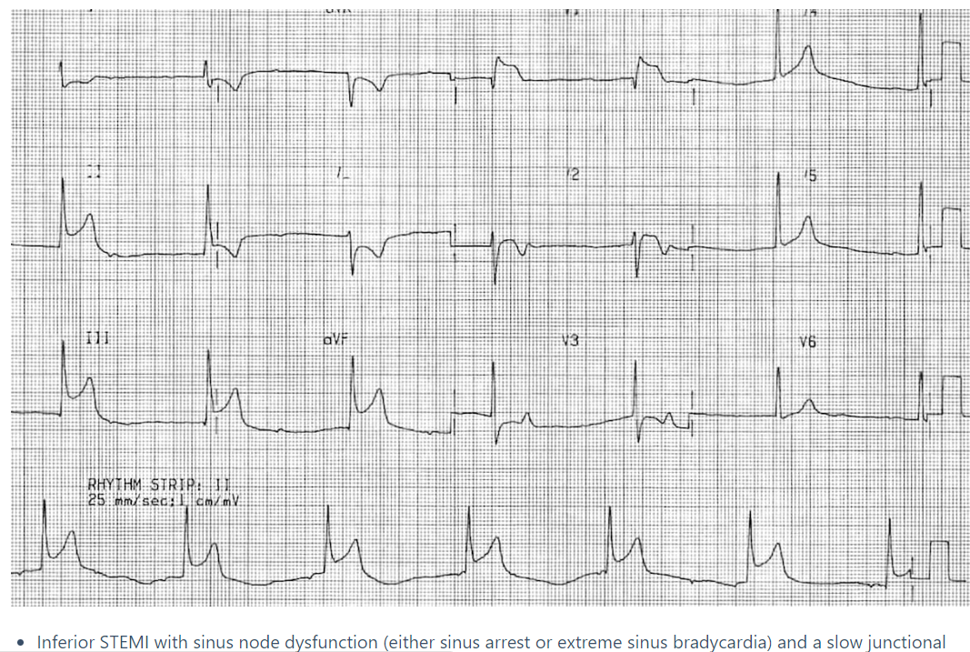
Sinus Bradycardia
P
P
P

Slide 35
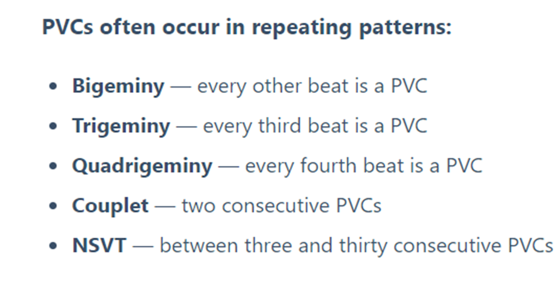
PVC’s and Non-sustained VT

Slide 36
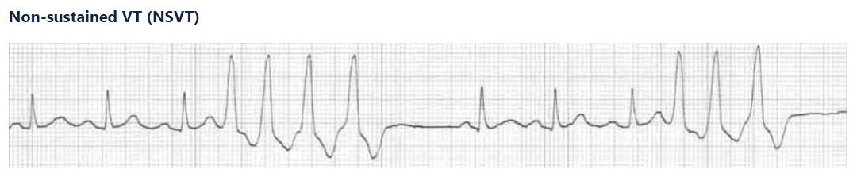

Slide 37
Non-sustained ventricular tachycardia should be observed only
There is no role for “prophylactic” antiarrhythmic therapy

Slide 38
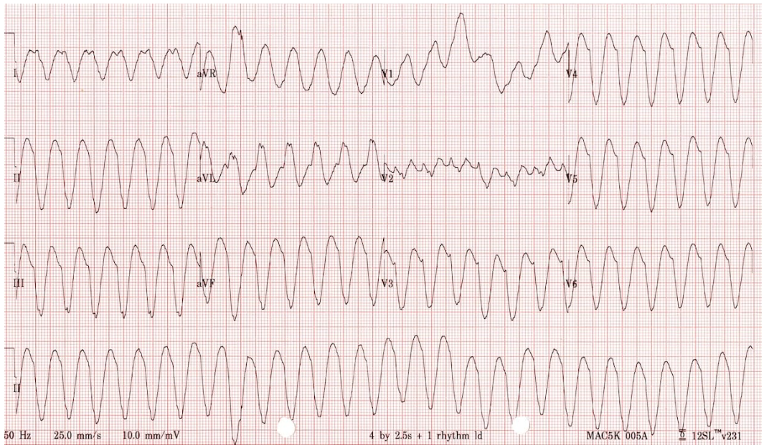
Monomorphic Ventricular Tachycardia

Slide 39
Although monomorphic ventricular tachycardia may be seen after the start of thrombolytic agents, it is not a typical reperfusion arrhythmia
It may be managed according to usual protocols depending on hemodynamic stability.
Electrical cardioversion, if elected, should be synchronized
Procainamide or amiodarone may be used
Amiodarone: 50 mg IV over 10 mins. then 1mg/min. over 6 hours

Slide 40
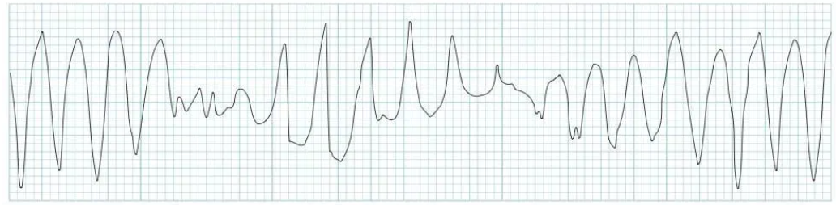
Polymorphic Ventricular Tachycardia
Is this polymorphic ventricular tachycardia or Torsades de Pointes?

Slide 41
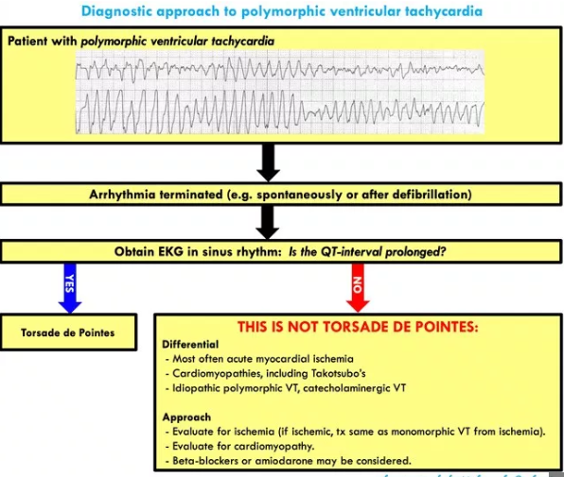

Slide 42
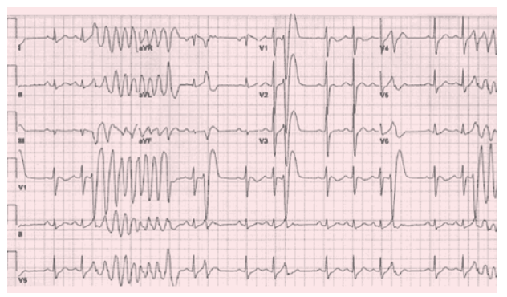
Polymorphic Ventricular Tachycardia
Normal QTc

Slide 43
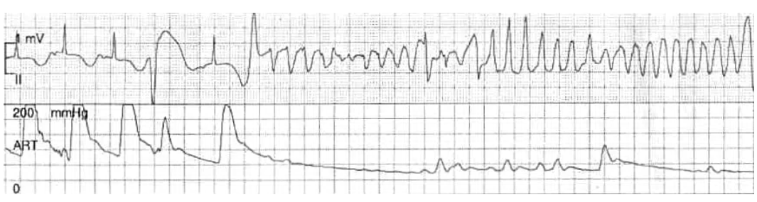
Torsades de Pointes
(a subset of polymorphic VT)
Prolonged QTc

Slide 44
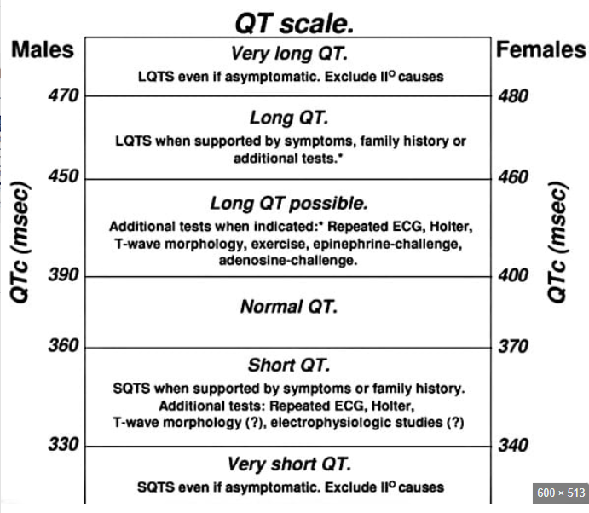
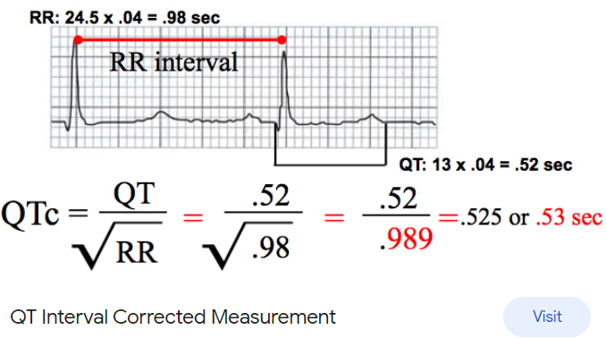
Calculation of Corrected QT interval (QTc)
Method 1.
Method 2.
Most ECG machines calculate it for you…look in the intervals section

Slide 45
In the management of polymorphic VT, measurement of the QTc once the patient is in sinus rhythm (spontaneously or post electrical cardioversion) is the key.
If the QTc is prolonged it is Torsades de Pointes and should be managed with magnesium 2 gm. IV push and antiarrhythmic drugs avoided
If the QTc is normal it can be managed as you would ischemic sustained VT, preferably with amiodarone

Slide 46
Heart block, even if it occurs post thrombolysis, should be managed according to
standard protocols
Thanks for your attention!

Slide 47
Complications
Bleeding (intracranial, GI, GU, retroperitoneal, puncture sites)
Allergic reaction
Distal embolization (if there is an unknown thrombus somewhere)

Slide 48
Managing Severe Bleeding
Stop thrombolytic, anti-platelet agents, and anticoagulants
Pressure on a venipuncture site or hematoma
Immediate head CT if concern about intracranial hemorrhage

Slide 49
Managing Severe Intracranial or GI Bleeding
Paucity of evidence for what to do for intracranial hemorrhage or severe GI bleeding
AHA recommends giving 10 units of Cryoprecipitate to raise the fibrinogen level
Could consider Fresh Frozen Plasma (FFP) if you do not have cryoprecipitate
AHA recommends Protamine to reverse Heparin
AHA recommends platelet transfusion if thrombocytopenic or antiplatelets given

Slide 50
Take Home Points
PCI is the best intervention for STEMI if it can be done within 120 minutes
Thrombolytics do have an 80-85% reperfusion rate
In many rural areas, if you cannot fly the patient, thrombolytics should be considered early. In some rural areas thrombolytics may always be the first choice because flight times will always exceed 120 minutes
The sooner you start the thrombolytic, the better. They should be started within 60 minutes of ED arrival if they will be used.

Slide 51
Take Home Points
TNK (if available) should be your first choice for thrombolytic in STEMI
Avoid IM injections, arterial punctures and placing central lines unless absolutely necessary for care at your facility
Do not wait for biomarkers to initiate transfer and thrombolysis (if indicated) in a STEMI patients
Do not treat reperfusion rhythms! This may kill the patient!

Slide 52
Take Home Points
Doses of thrombolytics given for STEMI and stroke are DIFFERENT!
Make sure you are giving the correct dose!

Slide 53
References
Assessment of the Safety and Efficacy of a New Thrombolytic (ASSENT-2) Investigators. Single-bolus tenecteplase compared with front-loaded alteplase in acute myocardial infarction: the ASSENT-2 double-blind randomized trial. Lancet. 1999;354:716-722.
Yaghi S, Willey JZ, et al. Treatment and Outcome of Hemorrhagic Transformation After Intravenous Alteplase in Acute Ischemic Stroke: A Scientific Statement for Healthcare Professionals. American Heart Association/American Stroke Association. Stroke. 2017.
Krittanawong C, Hahn J, Kayani W, Jneig H. Fibrinolytic Therapy in Patients with Acute ST-elevation Myocardial Infarction. Interv Cardiol Clin 2021 Jul; 10(3): 381-390.
Bhatt D, Lopes R, Harrington R. Diagnosis and Treatment of Acute Coronary Syndromes: A Review. JAMA 2022 Feb 15; 327(7): 662-675.
Gunlu S, Demir M. Comparison of Tenecteplase versus Alteplase in STEMI Patients Treated with Ticagrelor: A cross-sectional study. Am J Emerg Med 2022 Aug; 58: 52-56.

Slide 54
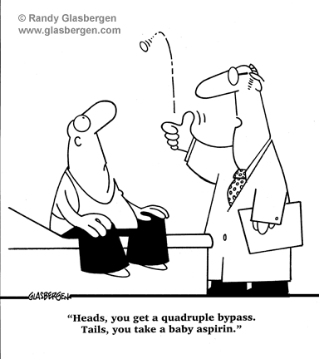

Slide 55


