Slide 1
Rodeo Injuries
C. Mateo Garcia

Slide 3
Epidemiology
Results: A total of 2305 injuries from 139,098 competitor exposures (CEs) were reported, demonstrating overall injury density of 16.6 injuries per 1000 CEs (95% confidence interval, 0.016-0.017) and overall risk of injury of 1.69%.
Rough stock riders accounted for 88.7% of all injuries.
Bull riders, bareback riders, and saddle bronc riders demonstrated injury densities of 48.2, 41.1, and 23.2 injuries per 1000 CEs, respectively.
Most injuries (62.9%) were sustained by collisions with the ground or animal or being stomped on by the animal.
Contusions, sprains, and concussions were the most frequent injury types (23.1%, 13.6%, and 11.6%, respectively). Neurological components, knees, and shoulders were the most injured body parts (13.4%, 11.1%, and 11.0%, respectively). Most injuries (36.8%) occurred during or immediately after the dismount.
Conclusions: Rough stock events have the greatest risk of injury in professional rodeo, whereas steer wrestling has the greatest risk of injury for timed event athletes. Medical professionals should use these findings to implement prevention programming where possible.

Slide 4
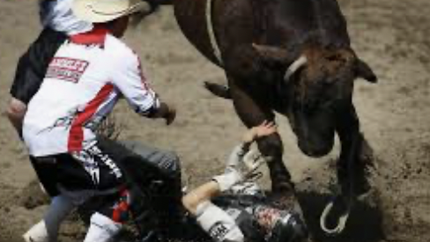
Concussion

Slide 5
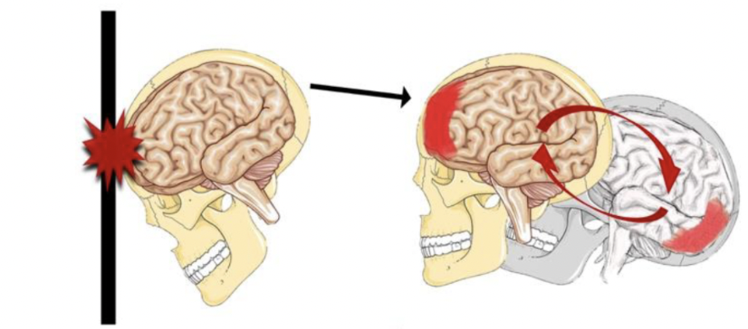
Concussion

Slide 6
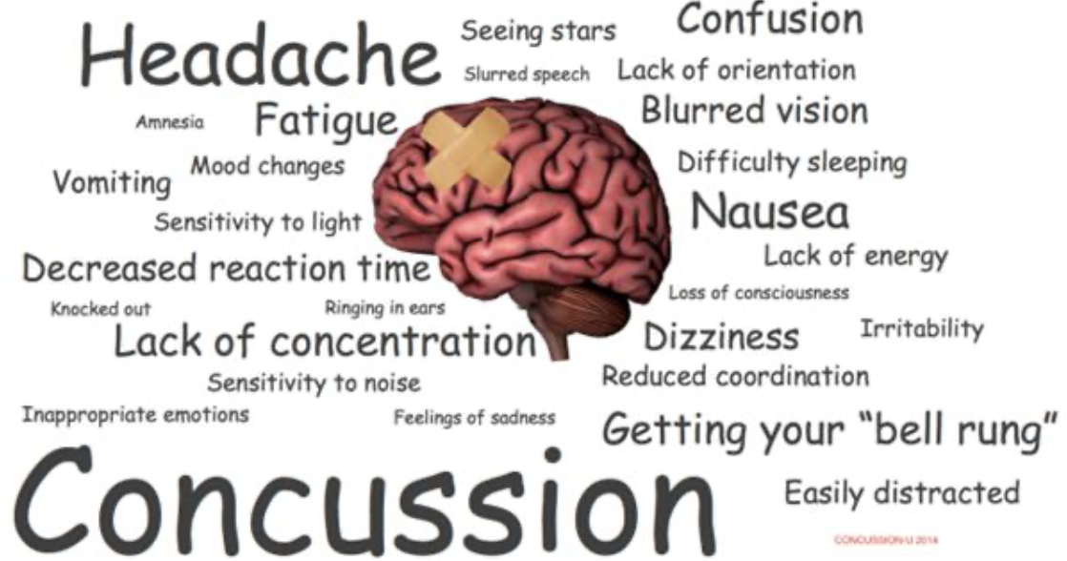
Symptoms

Slide 7
Treatment
ABC’s
NSAIDs
Anti-emetics
Hydration
Transport and possibly neurologic imaging
Track/Trend GCS
Post concussive education and supportive care

Slide 8
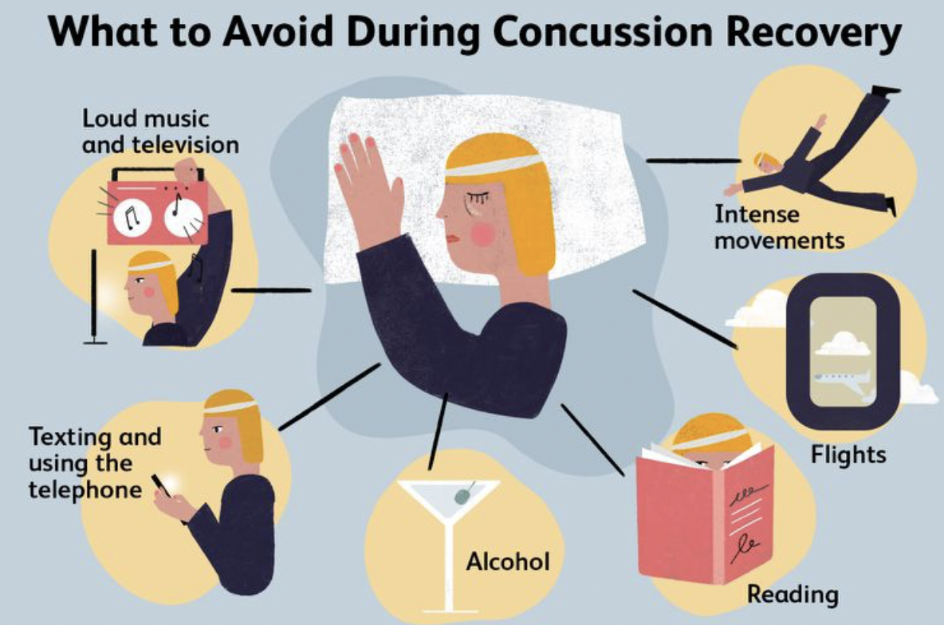

Slide 9
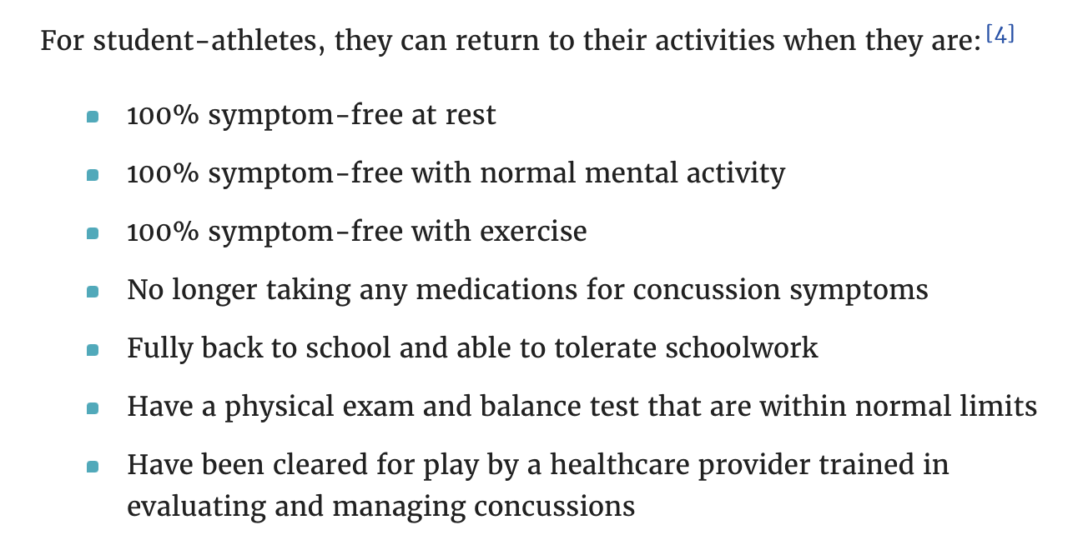
Concussion Clearance

Slide 10
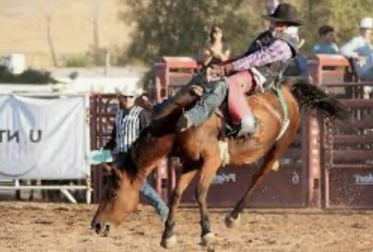
Degloving and Amputations

Slide 11
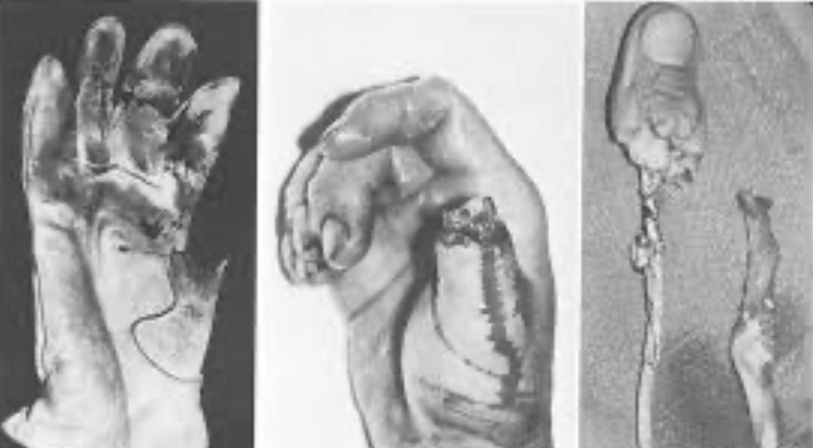
Degloving and avulsion injuries

Slide 12
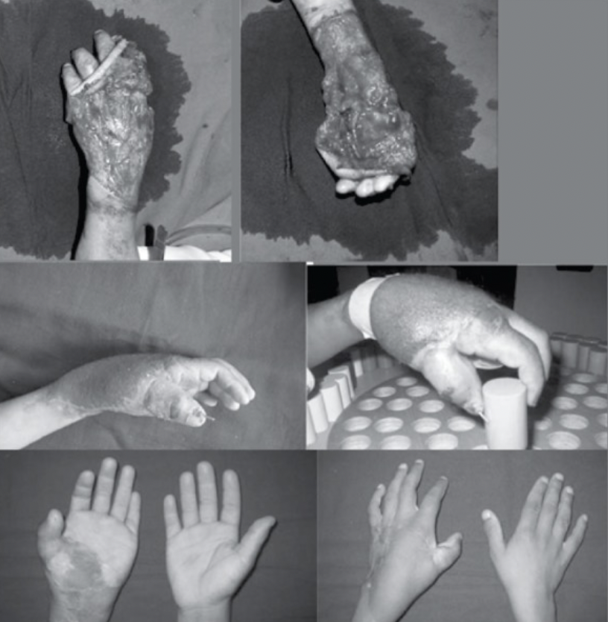

Slide 13
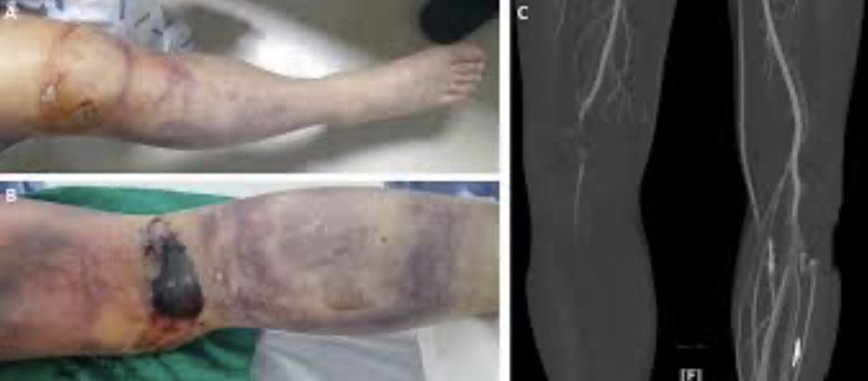

Slide 14
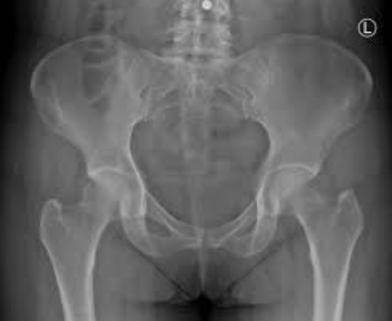
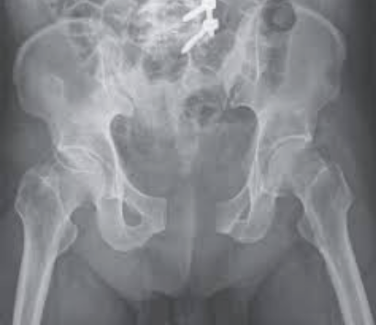
Open Book Pelvic fracture
Notes:
Pelvis Fractures: Always consider other internal injuries in association with a pelvic fracture. Typically, massive forces have been applied to cause such an injury. Spinal injuries are common in pelvis fractures; therefore, you should consider using a backboard to immobilize the patient. Various commercially available pelvic binders are available to splint these types of fractures (see Figure 3). Such devices are used to limit lateral movement of an unstable pelvis. You may also consider (when local protocol allows) using a pneumatic anti-shock garment (PASG) to immobilize the pelvis.

Slide 15
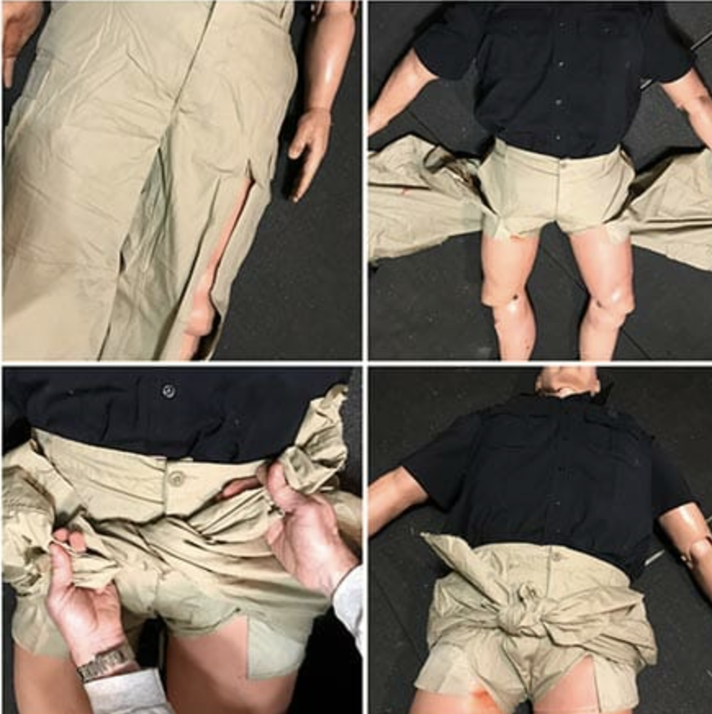
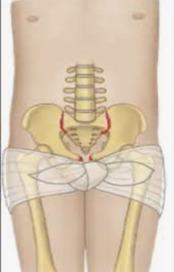
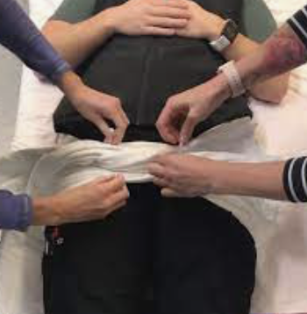
Improvised Pelvic Binder

Slide 16
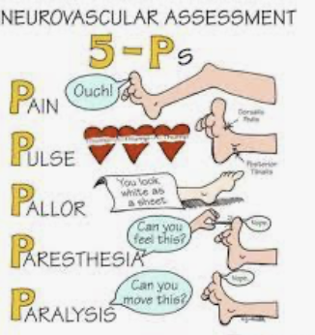
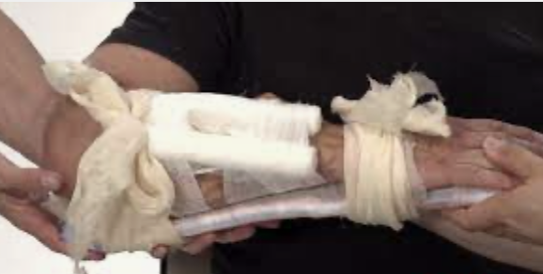
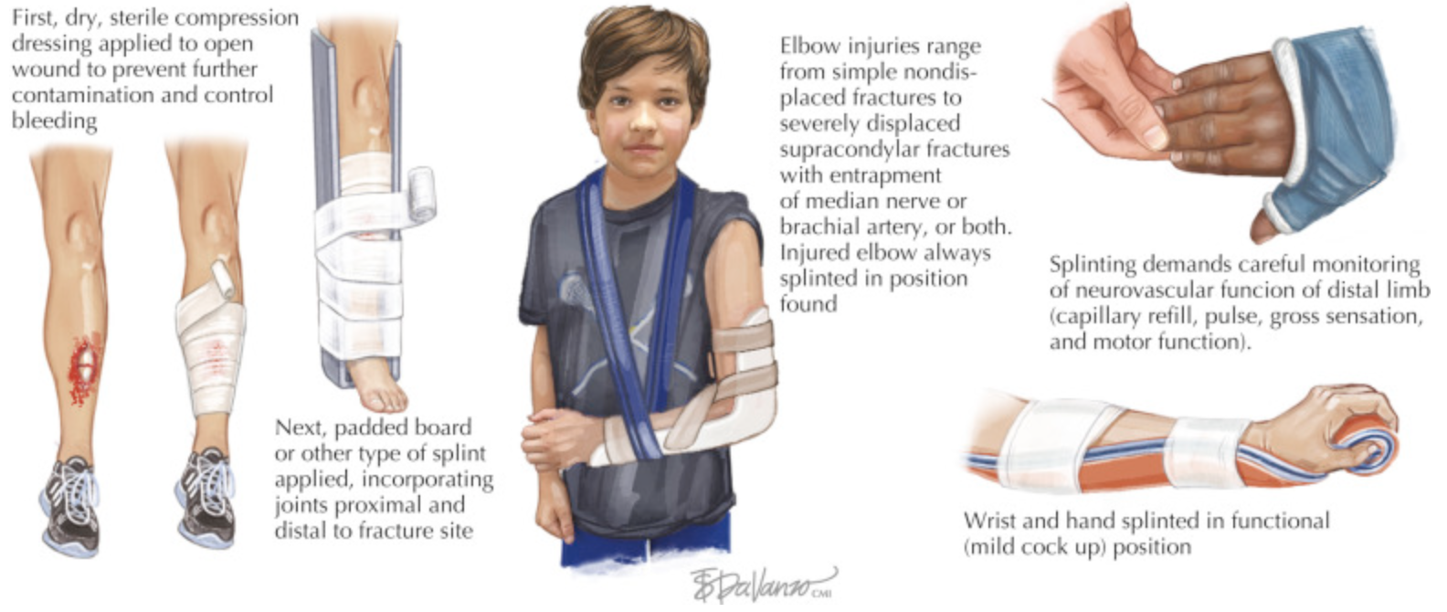
Assessment → Stabilization/Splinting → Re-Assessment

Slide 17
Assessment
1. Pain: Does the patient have pain in the injured area? Is the area sensitive to palpation (pain on palpation), or is the pain increased with movement?
2. Pallor: Is the injured area, or the area distal to the injury, pale, which would indicate compromised circulation?
3. Paresthesia: Does the patient complain of numbness/tingling or pins and needles in the affected extremity? These findings can indicate neurologic compromise.
4. Pulses: Are distal pulses present or lost?
5. Paralysis: Can the patient move the affected extremity?

Slide 18
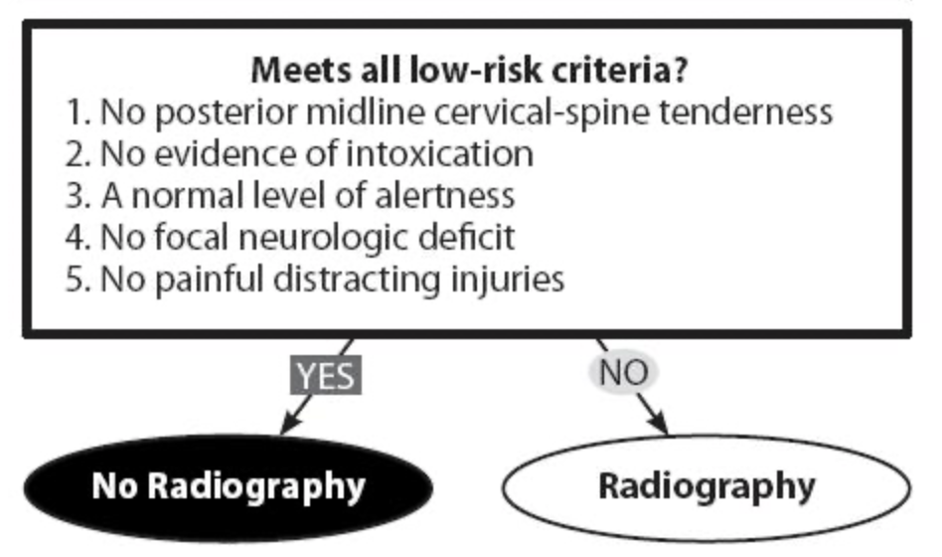
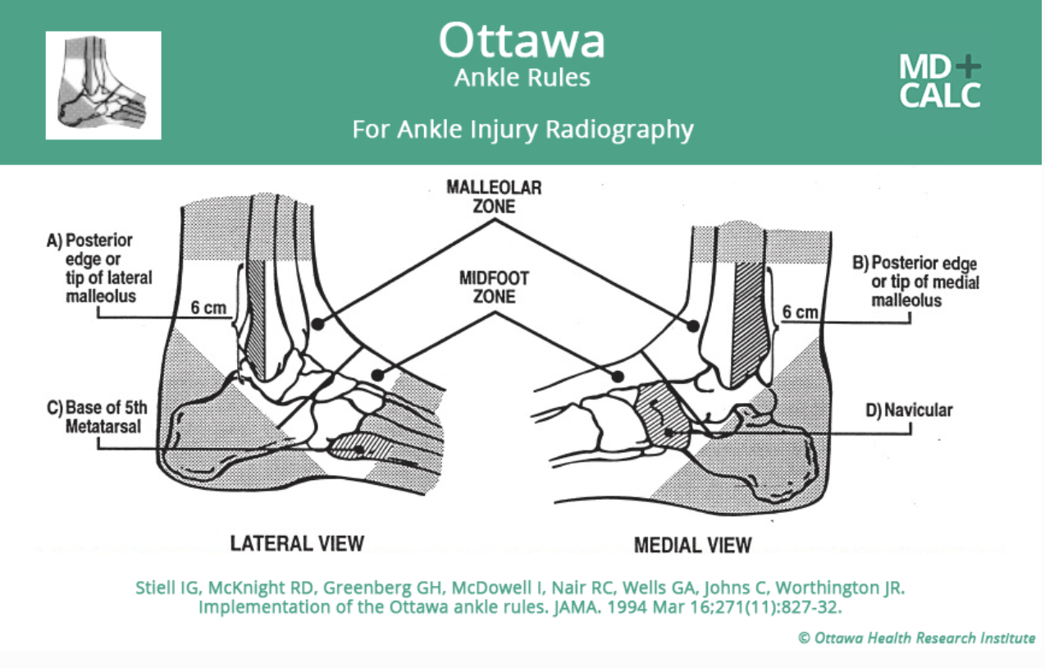
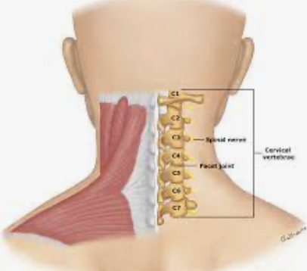
Palpation - Point tenderness

Slide 19
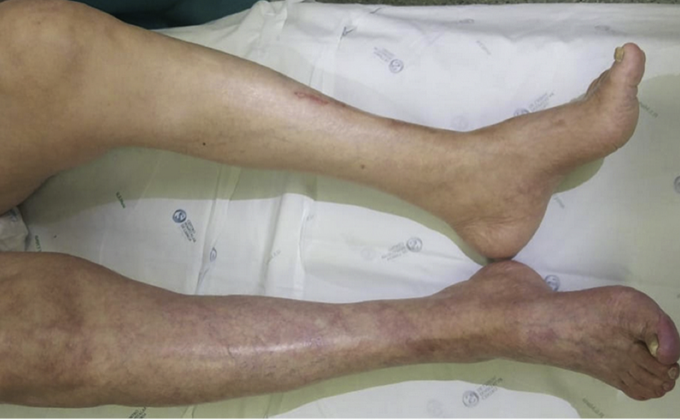
Pallor

Slide 20
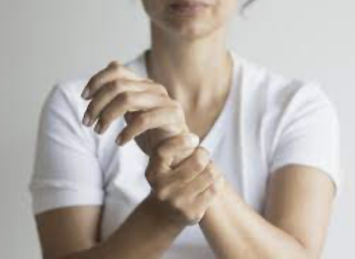
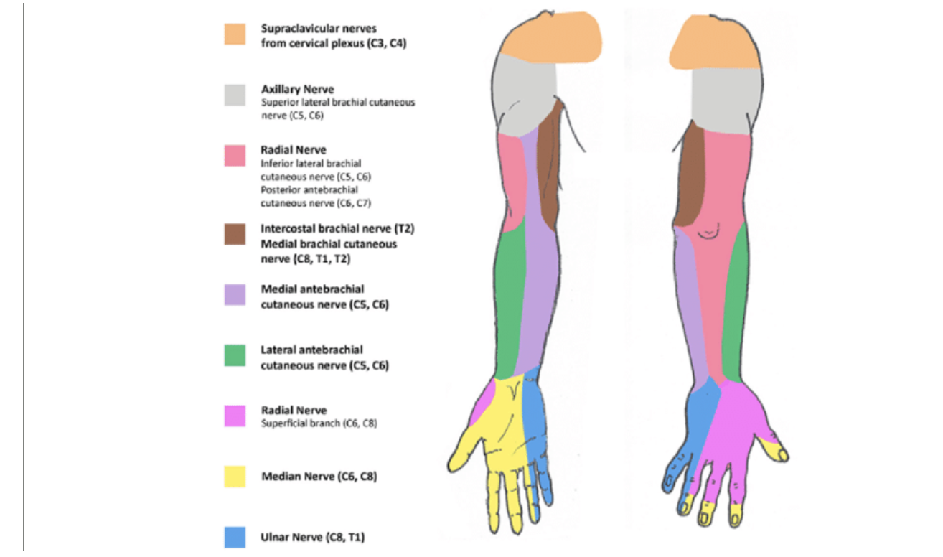
Paresthesia

Slide 21
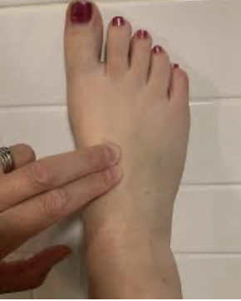
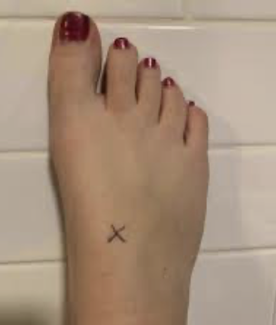
Pulses
Notes:
Assess C/S/M functions in the distal extremity prior to application of the splint. This assessment not only provides a baseline but will also help you identify changes that might occur as a result of the splinting process.
Remove jewelry and cut away clothing before application of a splint. Edema associated with the injury can rapidly turn these items into constricting bands that limit circulation.
Apply a dressing to open wounds prior to splinting. Often the direct pressure of splinting can aid in bleeding control. Clean dressings will also minimize the threat of infection.

Slide 22
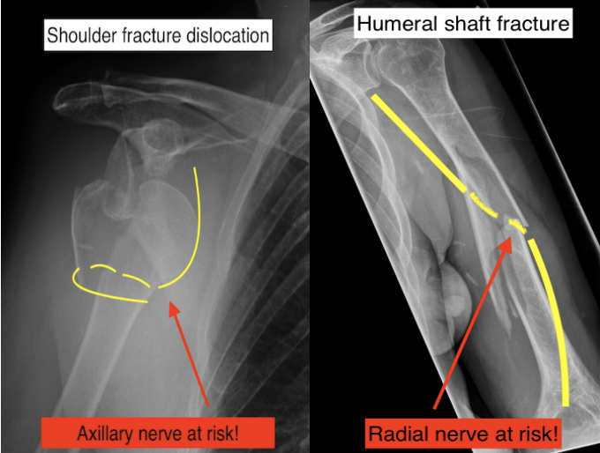
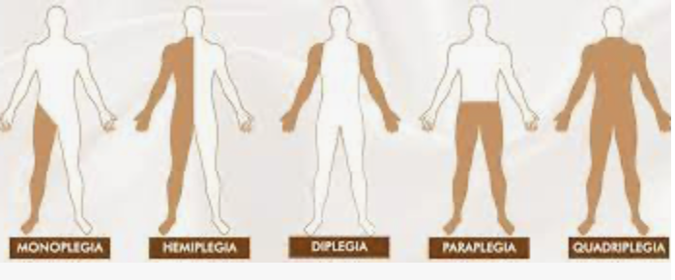
Paralysis

Slide 23
Assessment
1. Pain: Does the patient have pain in the injured area? Is the area sensitive to palpation (pain on palpation), or is the pain increased with movement?
2. Pallor: Is the injured area, or the area distal to the injury, pale, which would indicate compromised circulation?
3. Paresthesia: Does the patient complain of numbness/tingling or pins and needles in the affected extremity? These findings can indicate neurologic compromise.
4. Pulses: Are distal pulses present or lost?
5. Paralysis: Can the patient move the affected extremity?

Slide 24
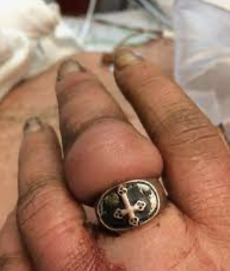
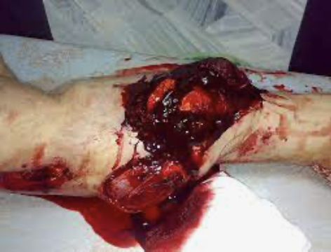
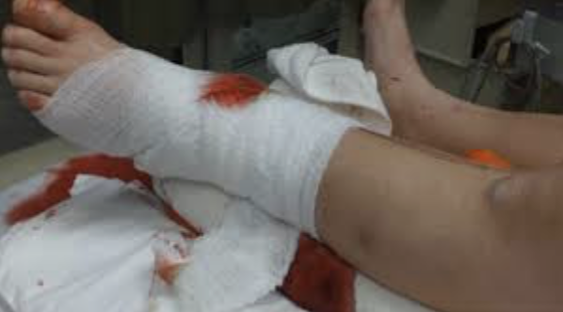
Remove jewelry and wrap wounds prior to splinting!

Slide 25
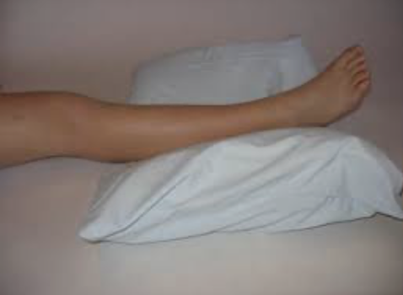
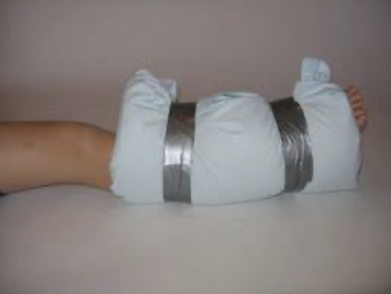
Splinting

Slide 26
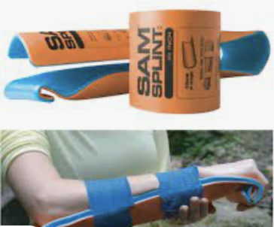
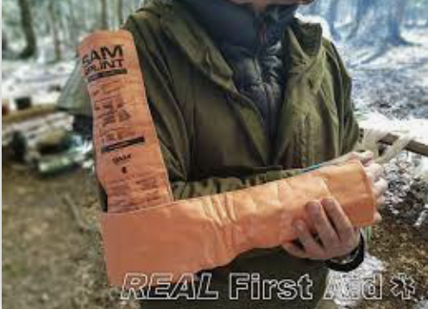
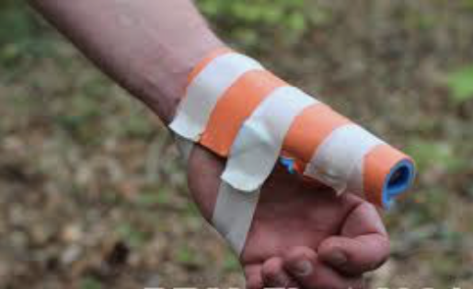
Alumi-form Splinting

Slide 27
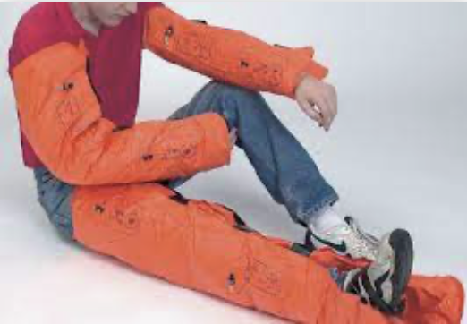
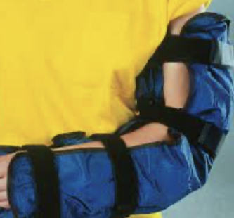
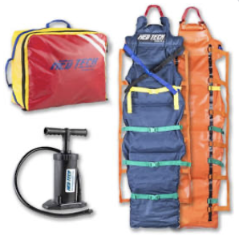
Vacuum Splints

Slide 28
Assessment → Stabilization/Splinting → Re-Assessment

Slide 29
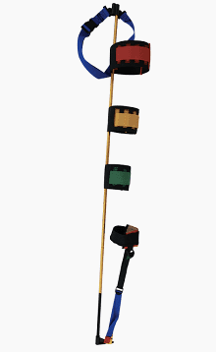
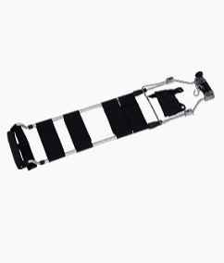
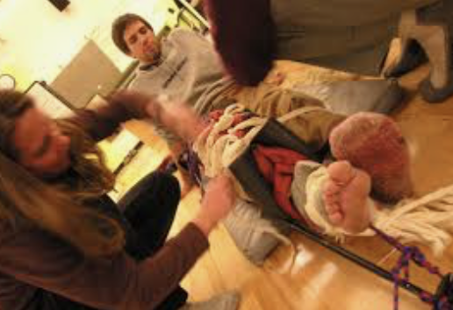
Traction Splint - Femur fractures
Notes:
Femur Fractures: Recall that femur fractures alone can result in serious bleeding. Splinting not only treats the orthopedic injury but also potentially addresses a circulation problem. As a result, splinting such an injury might be a slightly higher priority than treating other isolated musculoskeletal trauma. When protocol allows, consider using a traction splint (see Figure 4) to immobilize the femur. Applying traction pulls displaced bone ends in line and also helps prevent muscle contraction that can lead to increased bleeding.

Slide 30
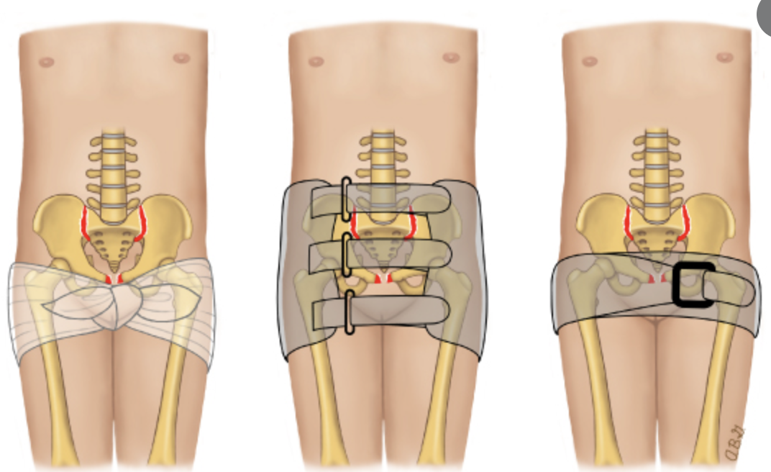
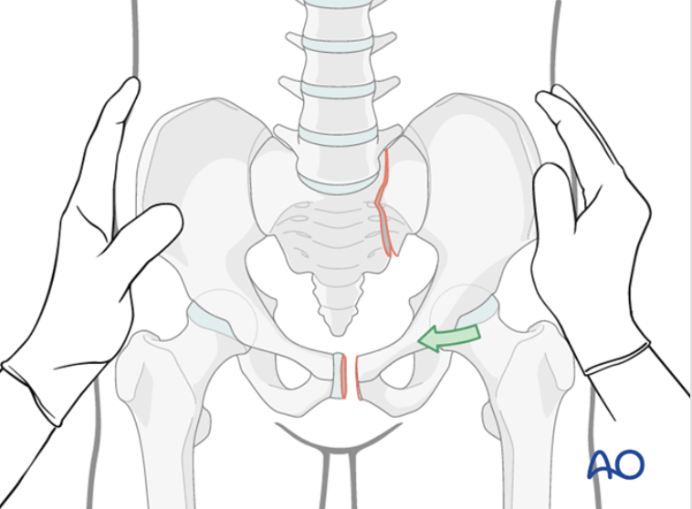
Pelvic Fracture

Slide 31
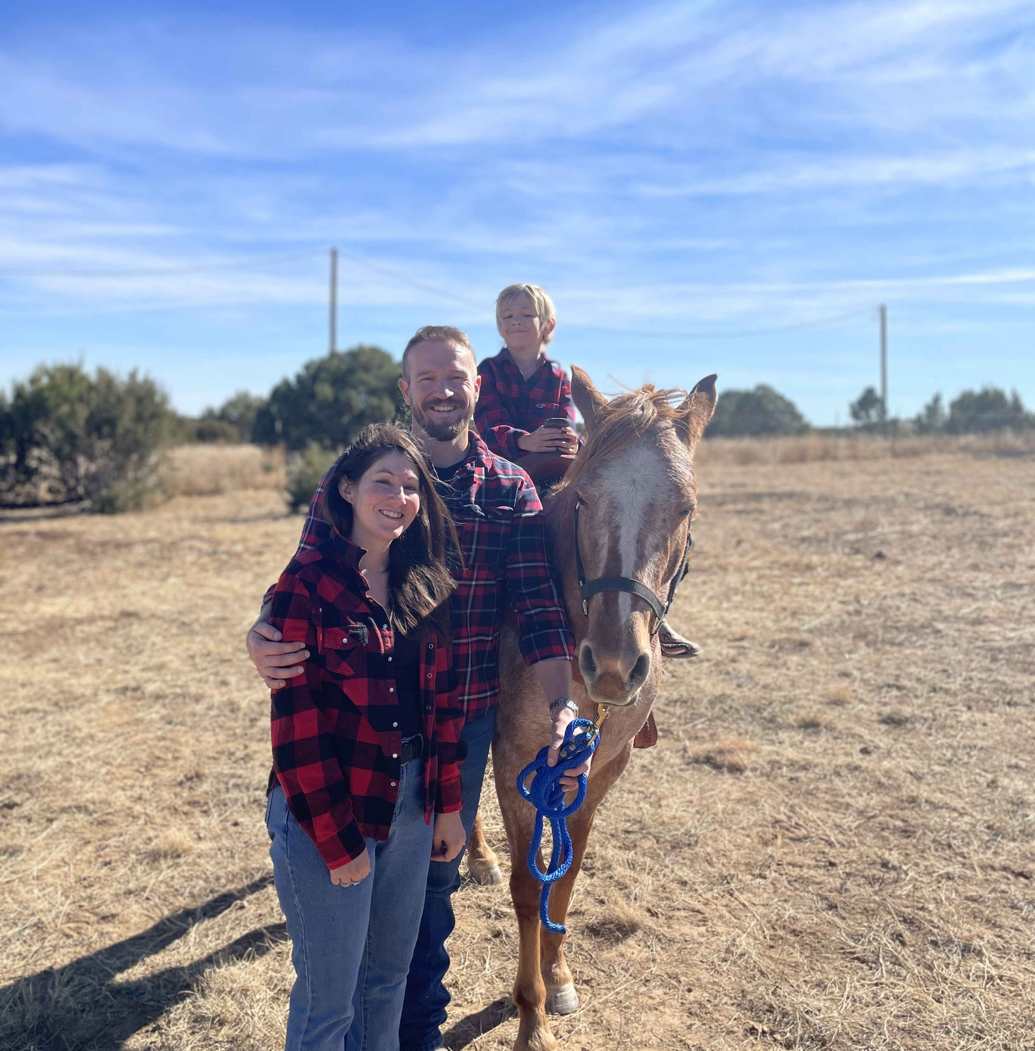
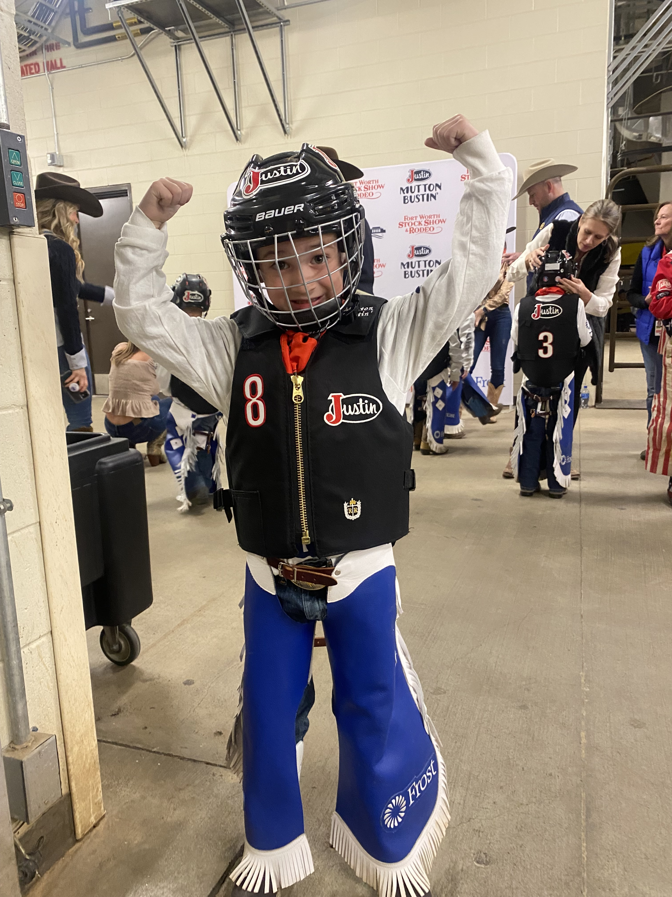
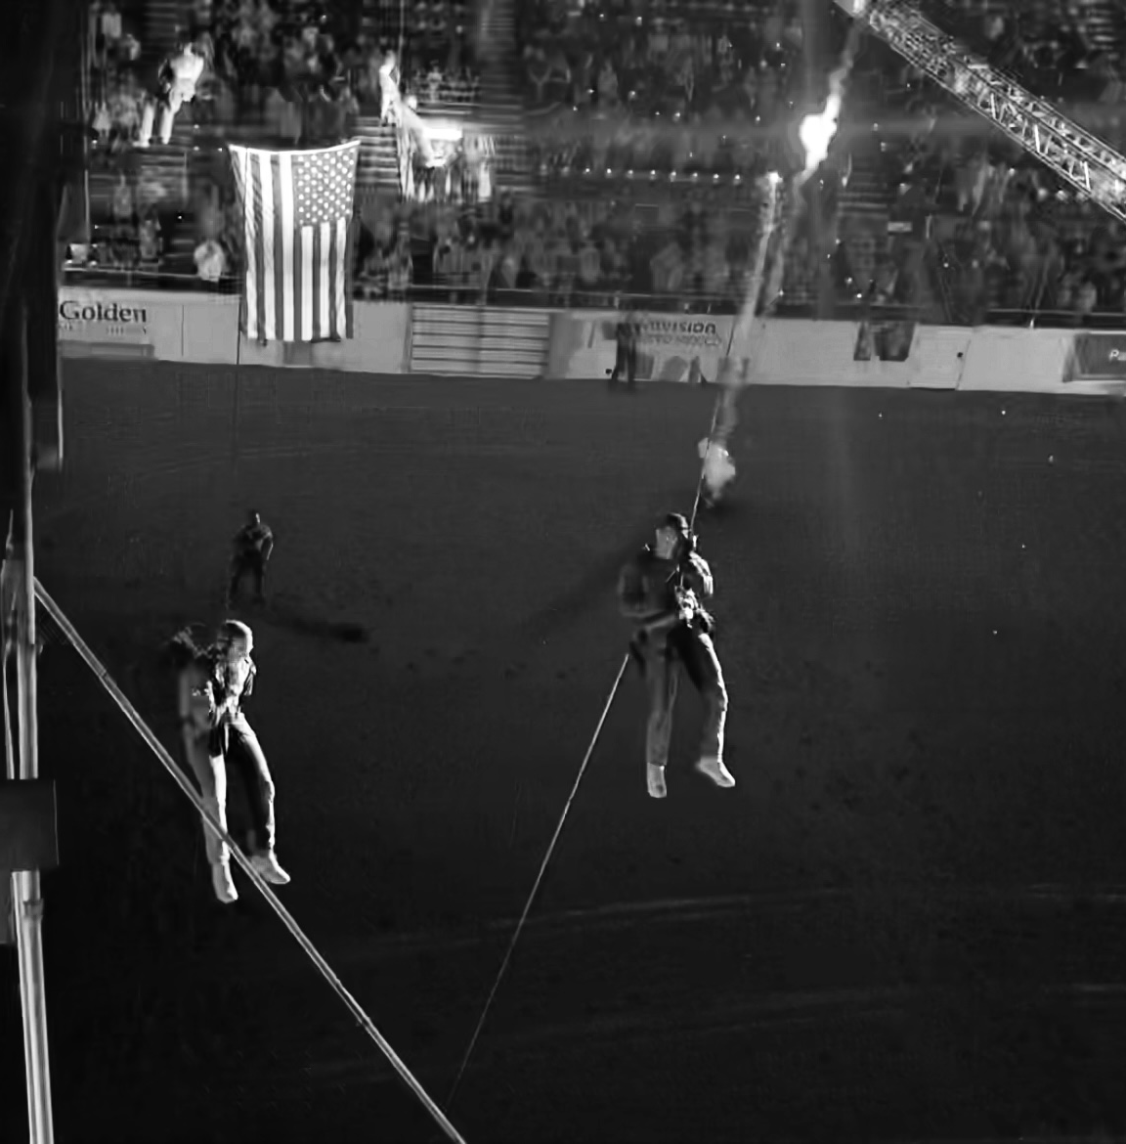
Questions

