Slide 1
ECHO Diabetes
Case Discussion
July 11, 2024

Slide 2
Clinical Question
Patient was previously on Ozempic (semaglutide), but it was discontinued due to concerns with contribution to progression of diabetic retinopathy.
Patient had a history of diabetic retinopathy already - is progression of retinopathy a continued reason to avoid the medication or could we safely retrial?
Why the concern about retinopathy with Ozempic?

Slide 3
Semaglutide (Ozempic) and Worsening Diabetic Retinopathy
The SUSTAIN clinical trial program evaluated the efficacy and safety of semaglutide prior to its FDA approval.
  During Sustain-6 (n engl j med 375;19 November 10, 2016), semaglutide was found to be associated with a significant increase in the risk of diabetic retinopathy (DR) complications vs placebo despite overall improvements in incidents of cardiovascular events and renal complications (1st 16 weeks of the trial)
  Post publication analysis showed that patients who developed diabetic retinopathy complications were characterized by
    a longer diabetes duration
    higher HbA1c levels at baseline
    greater likelihood to have been receiving insulin treatment at trial entry
    proliferative and non-proliferative DR at baseline.
Notes:
https://retinacarecenter.com/wp-content/uploads/2023/06/RCC_Newsletter_JUNE_23_WEB_m1.pdf

Slide 4
Semaglutide (Ozempic) and Worsening Diabetic Retinopathy
The authors felt that much of the DR effect with semaglutide vs placebo was attributable to the magnitude and rapidity of HbA1c reduction during the first 16 weeks of treatment in patients and was balanced out by the benefits of long-term glucose control.
  This paradoxical worsening of DR after a sudden drop in blood glucose is a well-documented phenomenon.
    The landmark DCCT (Diabetes Control and Complications Trial) found an association between better blood glucose control and risk of early worsening of DR.
    Another study looked at patients after intensive insulin treatment, pancreas transplant, or bariatric surgery, and found that 10% to 20% of patients had worsening of DR within three to six months—with twice that much for patients who already had advanced DR at baseline.
“Although the overall number of retinopathy events was low, there was an unexpected higher rate of retinopathy complications (vitreous hemorrhage, blindness, or the need for treatment with an intravitreal agent or photocoagulation) in the semaglutide group.
An association between rapid glucose lowering and worsening of retinopathy has been reported in patients with type 1 diabetes. - The applicability of such an association to our finding is unclear, and a direct effect of semaglutide cannot be ruled out” NEJM 2016
Notes:
https://retinacarecenter.com/wp-content/uploads/2023/06/RCC_Newsletter_JUNE_23_WEB_m1.pdf

Slide 5
Since then, multiple studies – different outcomes
Haq Z, Lum F, Parke DW. Changes in Diabetic Retinopathy After Initiation of Semaglutide. Abstract presented at: American Academy of Ophthalmology Congress. San Francisco, CA. November 3 – 6, 2023.
  Semaglutide Does Not Worsen Diabetic Retinopathy Status
Eleftheriadou, A., Riley, D., Zhao, S.S. et al. Risk of diabetic retinopathy and diabetic macular oedema with sodium–glucose cotransporter 2 inhibitors and glucagon-like peptide 1 receptor agonists in type 2 diabetes: a real-world data study from a global federated database. Diabetologia 67, 1271–1282 (2024).
  In this study, use of SGLT2i with insulin was associated with a lower risk of diabetic macular edema, whereas use of GLP-1 RA was associated with a higher risk of diabetic retinopathy and macular edema.
Douros A, Filion KB, Yin H, et al. Glucagon-like peptide-1 receptor agonists and the risk of incident diabetic retinopathy. Diabetes Care. 2018
  Compared with those taking 2 or more oral drugs, the risk of retinopathy among those taking the GLP-1 class was the same (hazard ratio [HR], 1.00; 95% CI, 0.85-1.17).
  Those taking the GLP-1 class had a 33% reduced risk of retinopathy compared with those taking insulin (HR, 0.67; 95% CI, 0.51-0.90).
Rachitskaya A. Diabetic retinopathy and GLP-1 receptor agonist. Presented at: FLORetina-ICOOR; November 30 – December 3, 2023; Rome, Italy.
  A real-world analysis showed no significant difference in clinical worsening of DR between patients treated with Ozempic vs. a control group.

Slide 6

Very Confusing….

Slide 7

Diabetic Retinopathy (DR)
Most frequent cause of blindness in adults aged 20-74 years
  95-98% of this vision loss is preventable
Most common microvascular complication in people with diabetes - over time almost everyone with diabetes will develop retinopathy
  About 80% of the people who have had diabetes for at least 15 years have some blood vessel damage to their retina.
  Associated conditions:
    Macular edema (Diabetic Macular Edema (DME))
    Glaucoma – neovascular glaucoma
Usually, NO SYMPTOMS until vision loss
  Value of SCREENING
  Treatment interventions can prevent vision loss
    Less effective at restoring lost vision

Slide 8
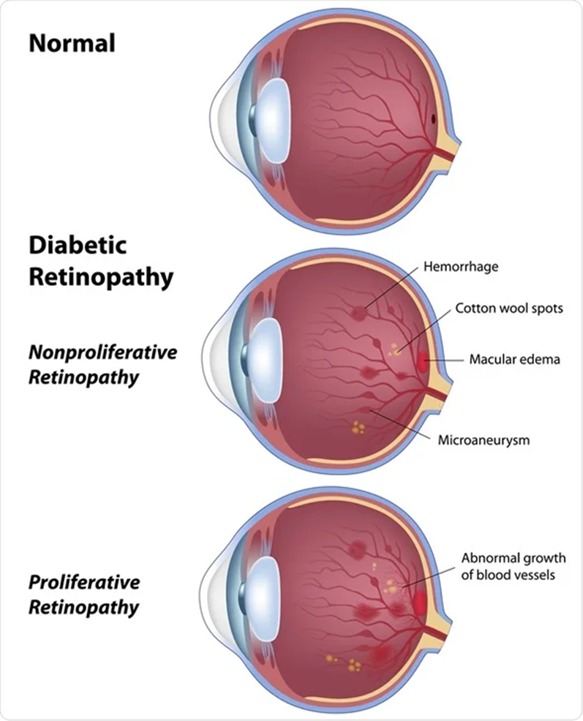
Diabetic Retinopathy
Non-proliferative DR (NPDR)
  Hyperglycemia results in endothelial damage to retinal capillaries resulting in leakage, microaneurysms & hemorrhages and capillary occlusion
Proliferative DR (PDR)
  Ischemia (lack of oxygen) stimulates retinal cells to release pro-angiogenic factors such as VEGF, which stimulate neovascularization (new blood vessels) to bypass damaged retinal blood vessels.
    These new vessels are extremely immature, fragile, permeable and bleed very easily, resulting in severe complications such as vitreous hemorrhage or tractional retinal detachment.
Diabetic Macular Edema (DME)
  Chronic inflammation and endothelial damage lead to increased vascular permeability of blood vessels resulting in fluid leaking into the retina and depositing under the macula.
    Macular edema can occur in NPDR, but it is more common in more severe cases of DR where the increased vascular permeability is more advanced.
Notes:
https://eyewiki.aao.org/Diabetic_Retinopathy_Pathophysiology

Slide 9
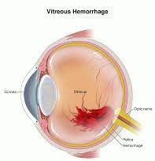
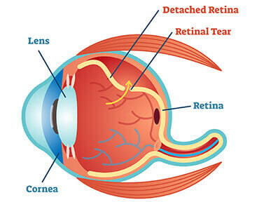
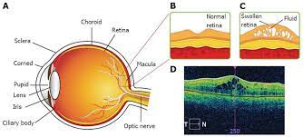
Vision Loss from Diabetic Retinopathy (DR)
In people with T1D, the most common cause of vision loss is PDR
  The new abnormal vessels may
    bleed into the vitreous or
    cause a tractional retinal detachment
In people with T2D, the most common cause of vision loss is DME
Notes:
CDC statistical report on diabetes

Slide 10
2024 ADA Standards of Care – Screening for DR
12.3 Adults with type 1 diabetes should have an initial and comprehensive eye examination by an ophthalmologist or optometrist within 5 years of the onset of diabetes. B
12.4 Patients with type 2 diabetes should have an initial dilated and comprehensive eye examination by an ophthalmologist or optometrist at the time of the diabetes diagnosis. B (~21% of newly diagnosed PWT2D have DR)
12.5 If there is no evidence of retinopathy for one or more annual eye exams and glycemia is well controlled, then screening every 1-2 years may be considered. (AAO indicates annually)
  If any level of diabetic retinopathy is present, subsequent dilated retinal examinations should be repeated at least annually by an ophthalmologist or optometrist.
  If retinopathy is progressing or sigh-threatening, then examinations will be required more frequently. B

Slide 11
Treatment Recommendations (2024 ADA Standards of Care)
12.9 Promptly refer patients with any level of macular edema, severe nonproliferative diabetic retinopathy (a precursor of proliferative retinopathy), or any proliferative retinopathy to an ophthalmologist who is knowledgeable and experienced in the management of diabetic retinopathy. A
  12.10 Panretinal laser photocoagulation therapy, is indicated to reduce risk of vision loss in patients with high-risk proliferative diabetic retinopathy and, in some cases, severe nonproliferative diabetic retinopathy. A
  12.11 Intravitreous injections antivascular endothelial grown factor (anti-VEGF) are a reasonable alternative to panretinal laser photocoagulation for some patients with proliferative diabetic retinopathy and also reduce the risk of vision loss in these patients. A
  12.12 Intravitreous injections antivascular endothelial grown factor (anti-VEGF) are indicated as first line treatment for most eyes with diabetic macular edema that involves the foveal center and impairs vision acuity. A

Slide 12
“Promptly” = “Without Delay”
A delay in treatment for PDR can cause permanent visual impairment.
  A delay in treating PDR by > 30 days can lead to decreased visual outcomes at 1 and 2 years after treatment compared with treatment on the day of diagnosis. Ohlhausen et al
Need a process to ensure the patient with abnormal screening gets to ophthalmology
  Be sure patient understands – don’t just refer
  Send referral vs tell patient to schedule
  Track the referral & outcome of referral (close-the-loop)
  The benefit of the screening is to find & treat abnormalities to
  prevent vision loss – need to ensure that next step occurs if needed
Notes:
Ohlhausen M, Payne C, Greenlee T, et al. Impact and characterization of delayed pan-retinal photocoagulation in proliferative diabetic retinopathy. Am J Ophthalmol. 2021;223:267-274.

Slide 13
Time Course of Vision Changes for Case Patient
Optometry visit
  1/2019 - “severe diabetic retinopathy (DR)” [NPDR]
  4/2019 - “severe DR”
  8/30/2019 – “severe DR”
  7/27/20 – c/o “seeing through a cloud” - macular edema and “severe DR” → referral to ophthalmologist → anti-VEGF injections
  Ongoing f/u & treatment with ophthalmologist
    s/p cataract surgery
    Anti-VEGF injections
6/14/19: A1c 8.4; 9/20/19: A1c 9.6%
11/19/19: A1c 8.9%
2/10/20: A1c 8.6%
3/16/20 Semaglutide started
5/20/20 dose increased to 1 mg/wk
8/4/20: A1c 6.6%
semaglutide stopped due to 7/27/20
optometry report/findings
12/3/20: A1c 8.8%; 7/29/21: 9.3%
3/16/22: 7.4%; 6/21/22: 8.0%;
2/27/23: 9.7%
4/5/24: A1c 9.3%

Slide 14
Diabetic Retinopathy – Reduction of Risk & Progression
2024 American Diabetes Association Standards of Care
Recommendations:
12.1 Implement strategies to help people with diabetes reach glycemic goals to reduce the risk or slow the progression of diabetic retinopathy. A
12.2 Implement strategies to help people with diabetes reach blood pressure and lipid goals to reduce the risk or slow the progression of diabetic retinopathy. A
A = clear evidence from well conducted trials
B = supportive evidence from well conducted trials

Slide 15
Comment from ADA
“On balance, there does not seem to be significant risk of retinopathy with GLP1 treatment.
The issue has largely been related to rapid A1C improvement that is known to worsen active retinopathy (independent of treatment type).”
Bob Gabbay MD FACP Chief Scientific and Medical Officer of the American Diabetes Association

Slide 16
Statement from the American Association of Ophthalmopathy
Consensus in the retina community is that progression of DR is not a reason to keep the patients off these very effective medications.
Whether patients progress in diabetic retinopathy or not, the advantages of overall reduction of cardiovascular disease should likely take priority.
Additionally, many of these patients may have intermittent worsening of retinopathy for the first year or two, but often develop better control of the retinopathy long-term.
The benefits of better glucose control systemically outweigh any local ocular risks.
Primary care physicians should be made aware that this drug might cause DR progression, and ideally all patients should get their routine DR screening prior to initiation of the drug.
Once established with an ophthalmologist, increased screening for any diabetic retinopathy progression compared to normal re-examination timelines is recommended to catch any complications early. If the retina specialist is noting rapid progression on exam, earlier anti-VEGF may mitigate some of these changes.

Slide 17
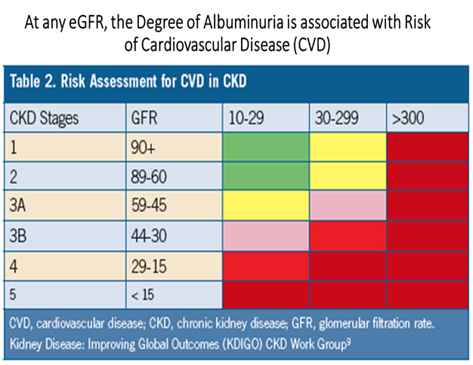
Consider recommendations for helping our case patient
Current meds:
  Metformin SA 500 mg BID
  Alogliptin 12.5 mg QD
  Insulin glargine 70u/day
  Insulin aspart 16-20u/meal
Cr 0.8, UACR 82, eGFR 76.8
  Tried empagliflozin –
    c/o "urticaria & vaginal irritation"
    History of UTIs
  Peripheral neuropathy – History of foot ulcer
Effects of Semaglutide on Chronic Kidney Disease in Patients with Type 2 Diabetes. Vlado Perkovic, M.B., B.S., Ph.D., et al Published May 24, 2024; NEJM (FLOW Study)
  24% reduction progression of renal disease to ESKD
  18% reduction in risk for CV event & 20% reduction in death in PW T2D & CKD

Slide 18
Consider recommendations for helping our case patient
Discuss resumption of Ozempic with her treating ophthalmologist
  May want to monitor more closely
  Offers patient improvement in glycemia, reduced CV & Renal risk, hopefully less complexity
Looks like in past she remained on Basal-Bolus insulin when Ozempic was added with A1c going from 8.6 to 6.6% over 6 months
  Recommend using CGM to help guide – hopefully can stop mealtime insulin (or reduce to one meal/day)
  Can often reduce basal insulin dose as well
Consider exploring Diabetes Distress and/or misperceptions with patient
  “No matter what I do, I am doomed by the diabetes.”
  “Forgetting” meds is usually a cover for “I don’t want to take the meds for some reason.”
Consider the impact of vision impairment on the patient’s life
  ? Vision Rehabilitation

Slide 19
The FOCUS trial
the first trial to evaluate the long-term effects of semaglutide on DR in patients with type 2 diabetes.
This clinical trial will measure the presence of early treatment diabetic retinopathy level progression in 1500 patients with an A1c between 7% and 10%.
Patients will be randomized to receive either placebo or semaglutide in addition to their diabetes medications, with the
  primary outcome of progression of DR
  secondary outcomes of the incidence of treatment with anti-VEGF injections, laser photocoagulation, or vitrectomy.
The study is estimated to conclude in 2026-2027.

Slide 20
Possible link of Semaglutide to a form of Optic Neuropathy that can Cause Blindness
Over a mean follow-up of nearly 3 years, patients with diabetes on semaglutide had more than a fourfold higher risk for developing nonarteritic anterior ischemic optic neuropathy (NAION) compared with patients not on a GLP-1 agonist (HR 4.28, 95% CI 1.62-11.29, P<0.001),
  reported Joseph Rizzo III, MD, of Massachusetts Eye and Ear and Harvard Medical School in Boston, and colleagues.
Association with optic neuropathy in observational data needs further study to assess causality

Slide 22
SUSTAIN 6
Diabetic retinopathy complications occurred in
  50 patients (3.0%) in the semaglutide group and
  29 (1.8%) in the placebo group (hazard ratio, 1.76; 95% CI, 1.11 to 2.78; P=0.02)
  The treatment difference between groups was first seen very early in the trial.
The number who required retinal photocoagulation were
  38 (2.3%) in the semaglutide group
  20 (1.2%) in the placebo group,
the number who required the use of an intravitreal agent were
  16 (1.0%) versus
  13 (0.8%), the placebo group
The numbers who had a vitreous hemorrhage were 16 (1.0%) versus 7 (0.4%)
The numbers who had an onset of diabetes-related blindness were 5 (0.3%) vs 1 (0.1%)
Of the 79 patients with retinopathy complications, 66 (83.5%) had preexisting retinopathy at baseline
  42 of 50 [84.0%] in the semaglutide group
  24 of 29 [82.8%] in the placebo group).

