Slide 1
ECHO Diabetes Screening for Diabetes Distress
Carol Greenlee MD
June 2024

Slide 2
Pre-Question (pick one answer that is most correct)
Diabetes Distress
Is usually associated with insulin use & thus is more common in people with type 1 diabetes.
Is very responsive to treatment with antidepressant medication.
Is less common than clinical depression in people with diabetes.
Is a common aspect of living with diabetes that can impact self-care, outcomes & quality of life

Slide 3


What is Diabetes Distress ?

Slide 4
Diabetes “Overwhelmus” – the Care Team Experience
Foot Exams
Ketones
A1c
Lipids
UACR
Hypoglycemia
Eye Exams
Pills
eGFR
Noncompliant patients
Blood Pressure
Prior
Authorization
Injections
Ejection
Fraction
Denial
Meters
CGM
Sleep
Apnea
BMI
Test Strips
CVD
Lancets
MASH

Slide 5
Diabetes Distress – the Patient Experience
Futility
BLAME
SHAME
Misperceptions
GUILT
A1c
FEAR
Hopelessness
Foot exams
Hypoglycemia
UACR
Pills
My life/My story
Eye Exams
Ketones
lipids
eGFR
CGM
Injections
Blood Pressure
Meters
Sleep
Apnea
BMI
Test Strips
Lancets
MASH

Slide 6
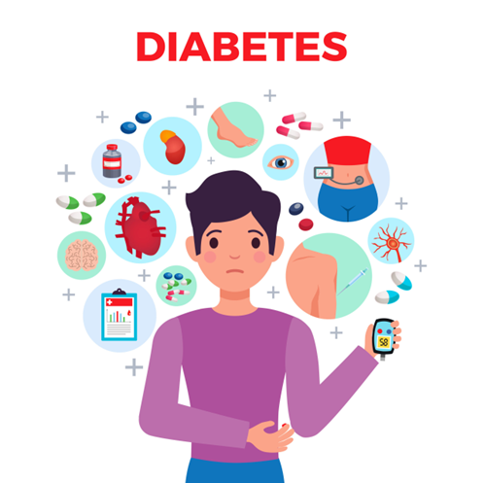
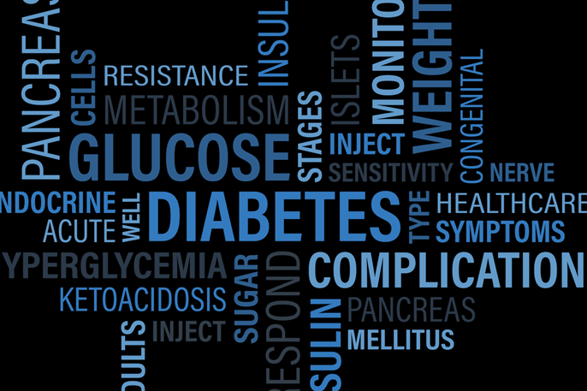
Diabetes Distress (DD)
Diabetes distress is not clinical depression - It is emotional distress that captures
the worries, concerns and fears among individuals struggling with a progressive and demanding chronic disease such as diabetes including
the emotional burden of self-management
threats of complications and potential loss of functioning
is not a co-morbidity or diabetes complication - it is simply the emotional side of having diabetes
Notes:
J Diabetes Complications
. May-Jun 2015;29(4):572-7.
doi: 10.1016/j.jdiacomp.2015.01.012. Epub 2015 Feb 7.
Understanding the sources of diabetes distress in adults with type 1 diabetes
Lawrence Fisher ¹, William H Polonsky ², Danielle M Hessler ³, Umesh Masharani ⁴, Ian Blumer ⁵, Anne L Peters ⁶, Lisa A Strycker ⁷, Vicky Bowyer ³
Affiliations expand
PMID: 25765489
PMCID: PMC4414881
DOI: 10.1016/j.jdiacomp.2015.01.012
Fisher, L., Gonzales, J.S., Polonsky, W.H. The confusing tale of depression and distress in patients with diabetes: A call for greater clarity and precision. Diabetic Medicine, 2014, 31, 764-772.
Diabet Med. Author manuscript; available in PMC 2015 Jul 1.
Diabet Med. Author manuscript; available in PMC 2015 Jul 1.
Published in final edited form as:
Diabet Med. 2014 Jul; 31(7): 764–772.
doi: 10.1111/dme.12428
PMCID: PMC4065190
NIHMSID: NIHMS573631
PMID: 24606397
The confusing tale of depression and distress in patients with diabetes: a call for greater clarity and precision
L. Fisher, J. S. Gonzalez, and W. H. Polonsky

Slide 7
Diabetes Distress vs Depression
Previous studies suggested many people with diabetes (2-3x those without diabetes) have depression.
More recent studies show 3-8% of people with diabetes have depression, about the same as people without diabetes --- but…
People with diabetes score higher on the PHQ9 –
This is picking up something, but it is not always depression, often diabetes distress (DD)
One study suggests ~70% of those with abnormal PHQ9 have DD not clinical depression
Very different solutions
“This distress cannot be treated with depression medications because…it is not depression!
Rather, it requires a greater focus on acknowledging and addressing the emotional and behavioral obstacles associated with diabetes.” W. Polonsky
Notes:
Fisher, Polonsky Fisher L, Gonzalez JS, Polonsky WH. The confusing tale of
depression and distress in patients with diabetes: a call for
greater clarity and precision. Diabet Med 2014;31:764–72.
Bing Videos

Slide 8
Depression vs Diabetes Distress
Depressive Disorder
Diabetes Distress
Hopelessness about life in general
Pervasive & persistent mood problems (most of the day, more days than not)
Interference with functioning across (work, relationships, health)
“I’m a failure. Everything is hopeless.”
Sadness & tough feelings about diabetes
Persistent stressors related to diabetes.
May affect diabetes self-management.
“I am failing at diabetes. My efforts at diabetes are hopeless.”
Diabetes distress is anchored in the day-to-day experience of living with diabetes (it
is an expected reaction to diabetes), whereas depression is the generic feeling of depressed affect, which is not linked to a specific condition or experience.
Notes:
Bing Videos
Diabet. Med. 37, 393–400 (2020)

Slide 9
How Common is Diabetes Distress?
“The rate of diabetes distress is far greater than is often appreciated”
Diabetes Distress is common. Many people experience significant diabetes distress –
about 40% of adults with either type 1 or type 2 diabetes report significant distress at any point in time
over 50% report significant distress during any 12-month period.
In the second Diabetes Attitudes, Wishes, and Needs (DAWN2) study, significant diabetes distress was reported by 45% of the participants
No data on AI/AN individuals
5-15% of people with diabetes overlap with both DD & clinical depression
Notes:
https://diabetesjournals.org/care/article/47/Supplement_1/S77/153949/5-Facilitating-Positive-Health-Behaviors-and-Well
Diabetes Distress: Why It’s Common and What We Can Do About It! (diatribe.org)
Diabetesdistress.com

Slide 10
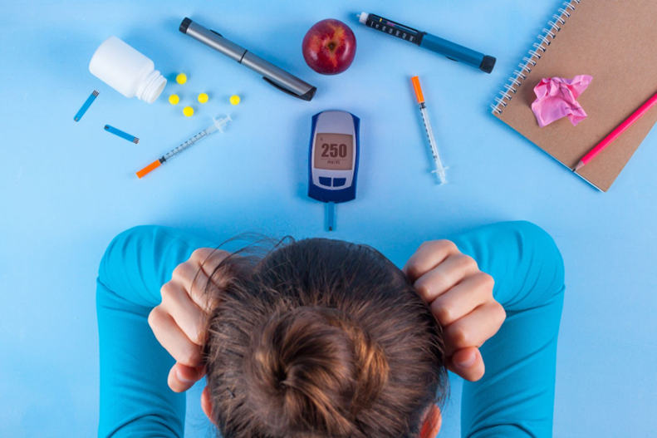
Why is Diabetes Distress Important
Diabetes Distress is of significant clinical concern due its high prevalence and its clinically significant relationship with
disease management
lower self-efficacy
less optimal eating and exercise behaviors
lower medication adherence (problematic medication-taking behaviors)
glycemic control – higher A1c
reduced health-related quality of life
Notes:
https://diabetesjournals.org/care/article/47/Supplement_1/S77/153949/5-Facilitating-Positive-Health-Behaviors-and-Well

Slide 11
ADA 2024 Standards of Care-Diabetes Distress
Recommendation 5.39
Screen people with diabetes for diabetes distress at least annually, and
consider more frequent monitoring
when treatment targets are not met,
at transitional times, and/or
in the presence of diabetes complications.
Health care professionals can address diabetes distress
may consider referral to a qualified behavioral health professional, ideally one with experience in diabetes, for further assessment and treatment if indicated. B
Notes:
https://diabetesjournals.org/care/article/47/Supplement_1/S77/153949/5-Facilitating-Positive-Health-Behaviors-and-Well

Slide 12
How do You Screen for DD?
Be AWARE that people with diabetes may experience diabetes distress (the emotional burden arising from living with and managing diabetes)
Look for signs:
suboptimal A1C or unstable blood glucose levels
missed clinic appointments
reduced engagement in diabetes self-care tasks
ineffective coping strategies
multiple life stressors
chronic stress
impaired relationships (personal or with health professionals)
appearing passive/aggressive during consultations
“Be curious, not furious”
Not responding to
Antidepressant treatment
Notes:
ada_mental_health_toolkit_7as_r2.pdf (diabetes.org)

Slide 13
How do You Screen for DD?
Routinely ASK all people with diabetes about diabetes distress.
Use open-ended questions to explore the impact of diabetes on daily life and well-being
“What is driving you crazy about diabetes?”
“Diabetes can be a lot to deal with, how are you doing with everything?”
“What is the hardest thing for you in dealing with diabetes?”
“What is the most difficult part of living with diabetes for you?”
“How is your diabetes getting in the way of other things in your life right now?”
If diabetes-related concerns are raised through AWARE (signs) and/or ASK →continue to ASSESS.
Notes:
ada_mental_health_toolkit_7as_r2.pdf (diabetes.org)

Slide 14
How do You Screen for DD?
ASSESS for diabetes distress using a validated questionnaire
When to assess:
Annually
If AWARE or ASK indicates possible diabetes distress
Use a validated questionnaire
ADA toolkit(multiple questionnaires ) professional.diabetes.org/sites/default/files/media/ada_mental_health_toolkit_questionnaires.pdf
*BDI: https://diabetesdistress.org/
Provides scoring: subscales/domains
Can download or print results
*Behavioral Diabetes Institute

Slide 15
BDI: Assessment of Diabetes Distress in Type 2 Diabetes:
For adults with type 2 diabetes (regardless of medication regimen) - suggest the T2-Diabetes Distress Assessment System (T2-DDAS) in English or Spanish.
This recently developed system consists of 29 items and yields two sets of scores:
an 8-item CORE DISTRESS SCORE, reflecting overall diabetes-related emotional distress
a 21-item set of seven SOURCE SCORES, reflecting seven different potential sources of distress
How to use the T2-DDAS on This Website (Diabetes Distress Assessment & Resource Center -https://diabetesdistress.org/)
You can download a copy of the T2-DDAS in English or Spanish, along with scoring instructions.
You may also ask patients to complete the T2-DDAS in English or Spanish online.
Online administration will produce a single CORE score, 7 SOURCES scores, and all item scores, which will be computed automatically.
All scores will then be summarized in an accompanying report, available for download or printing.
Notes:
Diabetes Distress Assessment & Resource Center

Slide 16
Instructions for Patients
DIRECTIONS: Living with diabetes can be tough. Listed below are many of the stresses and worries that people with diabetes often experience.
These are issues that can often be tough to acknowledge and to talk about, but please be as open and honest as you can.
Thinking back over the past month, please indicate how much each of the following items were a problem for you by marking the appropriate column.
For example, if an item was not a problem for you over the past month, place a mark in the first column: "Not a Problem" (1). If it was a very tough problem for you, place a mark in the last column: "A Very Serious Problem" (5).

Slide 17
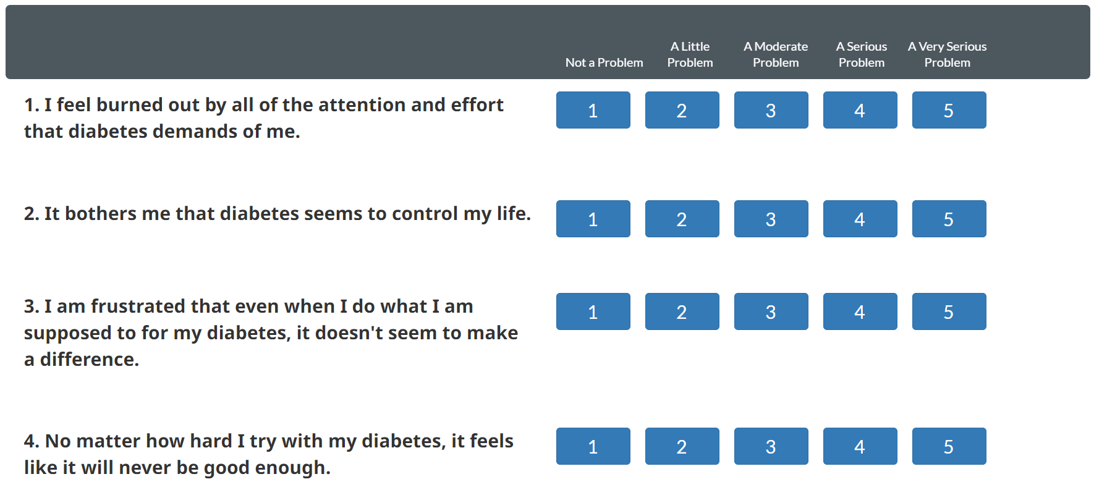
The Online Screening Tool

Slide 18
Interpreting & Using the Screening Scores
How to Use the T2-DDAS
Use the T2-DDAS to identify three levels of specificity of diabetes distress information for use in clinical care:
Use the CORE score to begin a conversation about a patient's overall level of diabetes distress and current general feelings about living with diabetes.
Review each of the 7 SOURCE scores to identify the highest reported source or cause of distress.
Use this subscale to begin a conversation about more focused areas of concern.
Identify the highest rated of the 29 T2-DDAS items. Use these specific items to begin a conversation about particular sources of diabetes distress.
Mean score < 2.0 indicate little or no distress.
Mean score between 2.0 and 2.9 indicate moderate distress.
Mean score > 3.0 indicate high distress
Any subscale score > 2.0 is considered clinically significant

Slide 19

Case Patient - Tony
55-year-old man
Diagnosed with T2D mid-40s – strong family history of T2D & CVD
Works in grocery delivery, in & out of truck & stores all day on workdays
A1c is 8.4% on max doses of metformin, sitagliptin & empagliflozin; rarely uses meter to check BGs
He is on statin with LDL of 62, lisinopril with BP 118/74, UACR 20, eGFR 78
He has had regular diabetic eye exams with mild to moderate cataracts noted bilaterally, no DME or DR
BMI 33; Nonsmoker, occasional alcohol on weekends and social outings
He seems to be reliable at taking his prescribed medications and coming to appointments for follow up of diabetes but had to cancel his last appointment and now is several months overdue when he comes in today.

Slide 20

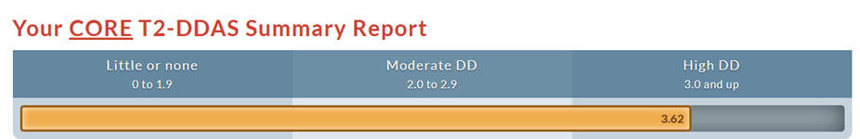
Case Patient - Tony
The Medical Assistant (MA)comments, as she rooms Tony, that she is glad to see him back for follow-up & notes his reply “Thanks, but I am not sure what good it does”
MA: “It sounds like you are discouraged with things or at least with the diabetes?”
Tony: “Just seems like a lot of medications and appointments, gets hard to keep it up, just wondering if it will make a difference.”
MA: “Dr. Brown will be in to see you shortly. While you are waiting, would you be willing to take a survey on how diabetes is impacting you? – it could help us sort things out for you.”
Provides tablet with the T2DDAS open and reviews the directions with him. Asks him to signal her when he is done, and she will take it from there.
She prints the Core & Source Summary Reports (Mean score > 3.0 indicate high distress)

Slide 21
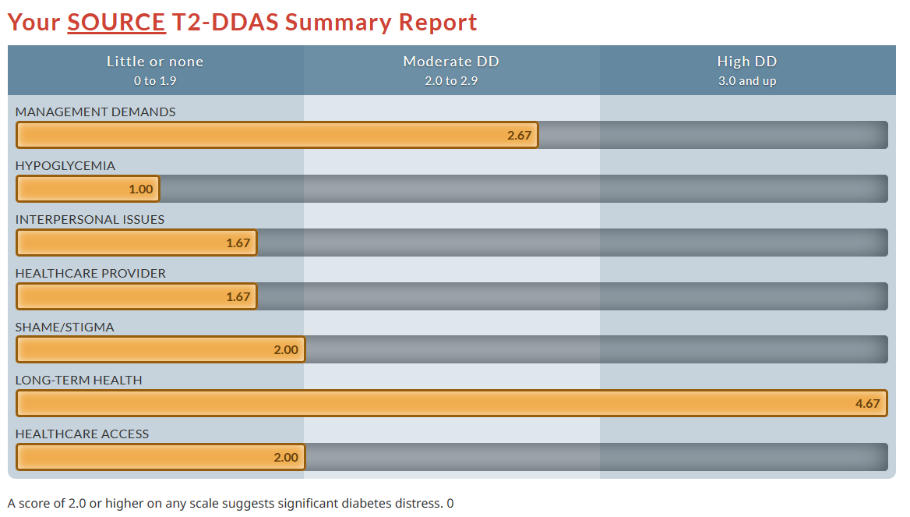
What is the main source of his DD?

Slide 22
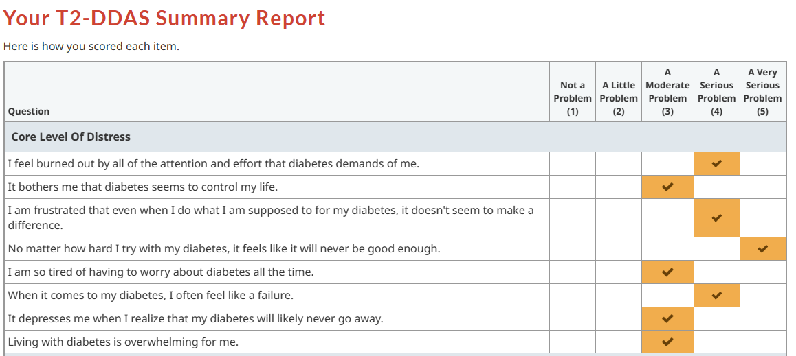
More Detailed Look – at Core Issues
Main message = sense of futility, hopelessness –
No matter what I do, bad things are going to happen
What I do doesn’t make a difference, I am ‘doomed’
I am doing a lot of stuff for nothing (no benefit)

Slide 23
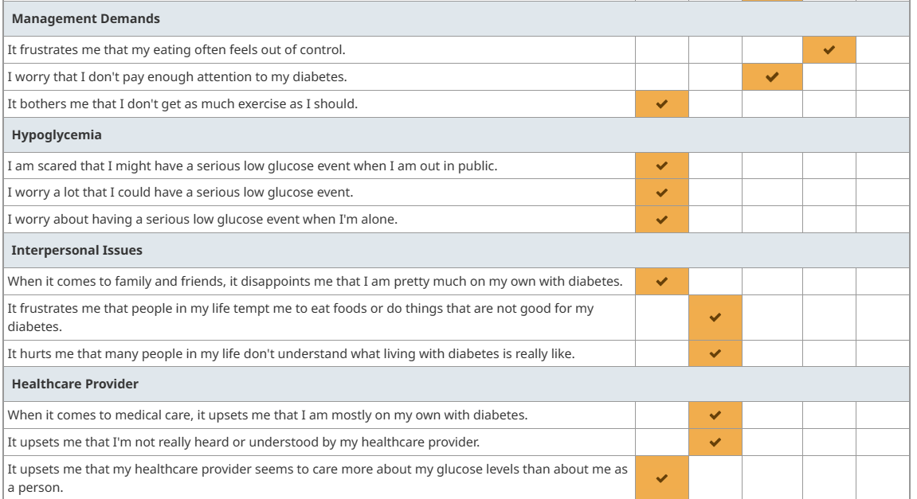
More Details- Sources of Distress
Eating Distress
Maybe some ambivalence
(distress over how much time
diabetes requires & that it
doesn’t make a difference AND
Guilt/distress over not doing more)
Some sense of
“in it all alone”

Slide 24
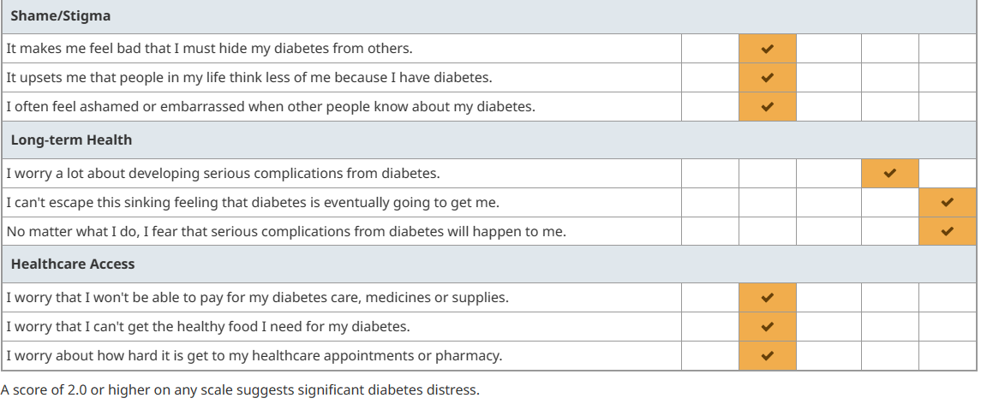

More Details- Sources of Distress
Mild/Moderate
Shame & stigma
The Big One
Futility and
hopelessness
Mild/Moderate
Access Distress

Slide 25
Now What?
What do you do? What can you do?
If diabetes distress is not managed, it can get worse over time. It may lead to “burnout”—this is when a person feels emotionally exhausted and overwhelmed by the demands of their diabetes.
They try to cope with this by giving up on taking care of their diabetes.
For the most part, distress interventions typically do not require the expertise of a mental health professional, which can be costly and, in most cases, unavailable. With planning they can be incorporated into regular diabetes care by well-trained, sensitive diabetes clinicians. Fisher & Polonsky
Good news – just acknowledging DD & talking about it/normalizing it helps reduce it
Improvement seen just by MONITORING DD
Tune in next time for more on addressing/managing diabetes distress …
Notes:
Diabet. Med. 36: 803–812 (2019)

Slide 26
Key Points
Diabetes distress (DD) is very common (40-50% of PWD)
Impacts outcomes & quality of life for PWD
No data on AI/NA populations
DD is distinct from clinical depression – it is the emotional side of diabetes
DD can result in high score on PHQ9 – for PWD ~70% of those with abnormal PHQ9 have DD not clinical depression
Reports indicate ~5-15% of PWD have both DD & depression
Assessment of Diabetes Distress can begin with awareness & asking simple questions.
Formal assessment provides valuable information on specific sources of distress.
Recommend the T2-DDAS – online form provides scoring & can be downloaded or printed
T1-DDAS also available
DD does not respond to treatment with antidepressant medication but is very responsive to acknowledgement & support

Slide 27
Post-Question (pick one answer that is most correct)
Diabetes Distress
Is usually associated with insulin use & thus is more common in people with type 1 diabetes.
Is very responsive to treatment with antidepressant medication.
Is less common than clinical depression in people with diabetes.
Is a common aspect of living with diabetes that can impact self-care, outcomes & quality of life

Slide 28

Questions, Comments, Clarifications, etc.
Diabetes Distress – no data for AI/NA
Any interest in collecting this data for your clinic?
We plan at least 3 sessions on addressing DD
Overview
Diatribe – Diabetes Stigma & Using TIR
Consider tie into cultural connections & community
Intersect with historical & generational trauma

Slide 29
Resources for BH Specialists
https://professional.diabetes.org/professional-development/behavioral-mental-health/MentalHealthWorkbook
https://professional.diabetes.org/journals-resources/behavioral-health-resources
https://www.youtube.com/@BDIviews

Slide 30
References
Lawrence Fisher, William H Polonsky , Danielle M Hessler, Umesh Masharani, Ian Blumer 5, Anne L Peters, Lisa A Strycker, Vicky Bowyer. Understanding the sources of diabetes distress in adults with type 1 diabetes. J Diabetes Complication. May-Jun 2015;29(4):572-7
Fisher, L., Gonzales, J.S., Polonsky, W.H. The confusing tale of depression and distress in patients with diabetes: A call for greater clarity and precision. Diabetic Medicine, 2014, 31, 764-772.
Risk Factors, Mortality, and Cardiovascular Outcomes in Patients with Type 2 Diabetes Swedish National Diabetes Register n engl j med 379;7 August 16, 2018
William Polonsky , Cory Gamble, Neeraj Iyer, Mona Martin, Carol Hamersky. Exploring Why People With Type 2 Diabetes Do or Do Not Persist With Glucagon-Like Peptide-1 Receptor Agonist Therapy: A Qualitative Study. Diabetes Spectr. 2021 May;34(2):175-183.
https://diabetesjournals.org/care/article/47/Supplement_1/S77/153949/5-Facilitating-Positive-Health-Behaviors-and-Well
Diabetes Distress: Why It’s Common and What We Can Do About It! (diatribe.org)
Diabetesdistress.com
Diabet. Med. 36: 803–812 (2019)

Slide 31
References
Emotional Distress Predicts Reduced Type 2 Diabetes Treatment Adherence in the Glycemia Reduction Approaches in Diabetes: A Comparative Effectiveness Study (GRADE). Claire J. Hoogendoorn et al. Diabetes Care 2024;47(4):629–637
Gonzalez JS, Bebu I, Krause-Steinrauf H, et al. Differential Effects of Type 2 Diabetes Treatment Regimens on Diabetes Distress and Depressive Symptoms in the Glycemia Reduction Approaches in Diabetes: A Comparative Effectiveness Study (GRADE). Diabetes Care. 2024;47(4):610619.
T. C. Skinner, L. Joensen and T. Parkin. PSAD Special Issue Paper: Twenty-five years of diabetes distress research. Diabet. Med. 37, 393–400 (2020)
L. Fisher, W. H. Polonsky and D. Hessler. Invited Review: Addressing diabetes distress in clinical care: a practical guide. Diabet. Med. 36: 803–812 (2019)

Slide 32
Diabet. Med. 37, 393–400 (2020)
Diabetes distress is common among people with type 1 and type 2 diabetes, and is associated with lower levels of self-care, general emotional well-being and possibly metabolic outcomes of diabetes care.
There is emerging evidence that the way healthcare professionals communicate with people with diabetes may be exacerbating the distress experienced by people with diabetes, or possibly contributing to its development.
Healthcare professionals need to ensure that the way they communicate with people who have diabetes does not add to the distress that diabetes engenders.
We need to embed the assessment and management of diabetes distress into the routine diabetes care services we offer people with diabetes.

Slide 33
Diabetes distress: understanding the hidden struggles of living with diabetes and exploring intervention strategies Berry E, et al. Postgrad Med J 2015;91:278–283.
…the importance of prompting discussion during appointments to present people with an opportunity to talk about which aspects of diabetes care are the most difficult.
This does not require psychological expertise and does not require providing solutions there and then; indeed, the MIND Study suggests that simply monitoring diabetes distress can have beneficial effects.
It is simply about initiating normal conversation, listening to and showing an understanding and awareness of the psychosocial and emotional issues embedded in diabetes, which often go unnoticed and grow.
Practitioners should encourage patients to acknowledge their emotional difficulties and remind them that they are part of the process of adapting to living with diabetes.
Notes:
Berry E, et al. Postgrad Med J 2015;91:278–283. doi:10.1136/postgradmedj-2014-133017

Slide 34
Diabetes Technol Ther. 2024 Mar 25. doi: 10.1089/dia.2023.0612. The Potential Impact of CGM Use on Diabetes-Related Attitudes and Behaviors in Adults with T2D: A Qualitative Investigation of the Patient Experience Taylor Clark, William Polonsky, Emily Soriano
Conclusions: Participants reported a far-reaching impact of CGM on their daily lives, with many stating that CGM fostered a greater understanding of diabetes and prompted positive behavior changes. The observed attitudinal and behavioral shifts likely contributed synergistically to the significant glycemic benefits observed over the study period.
This study highlights the technology's potential to bring about meaningful attitudinal and behavioral changes. Six primary themes emerged:
1) Making the Invisible Visible, highlighting the newfound awareness of T2D in daily life;
2) Effective Decision Making, emphasizing the use of real-time glucose data for immediate and long-term choices;
3) Enhanced Self-Efficacy, describing a renewed sense of control and motivation;
4) Diabetes-Related Diet Modifications;
5) Changes in Physical Activity; and
6) Changes in Medication Taking.
Notes:
Diabetes Technol Ther. 2024 Mar 25. doi: 10.1089/dia.2023.0612. Online ahead of print.
The Potential Impact of CGM Use on Diabetes-Related Attitudes and Behaviors in Adults with T2D: A Qualitative Investigation of the Patient Experience
Taylor Clark 1, William Polonsky 2 3, Emily Soriano 4

Slide 35
It is important to distinguish diabetes distress from clinical depression or major depressive disorder Diabet. Med. 36: 803–812 (2019)
Most people with diabetes labelled as clinically depressed using common self-report inventories (e.g. Patient Health Questionnaire-9; PHQ-9) do not meet standard psychiatric criteria for major depressive disorder. When well-structured psychiatric interviews are undertaken with most samples of adults with diabetes, however, the prevalence of major depressive disorder distress falls to between 3.8% and 6%, which is similar to rates in the general community (note variation in this rate based on clinical setting and an individual’s characteristics).
Still, individuals with diabetes typically score higher on depression symptom measures than people who do not have diabetes, and although these higher scores may not be indicative of a depressive disorder, they do reflect the experience of significant emotional distress. In recent studies, depressive symptom scores, using the PHQ-9, have been found to correlate quite highly with diabetes distress scores (e.g. r as high as 0.60), pointing to a significant overlap between these two constructs.
Furthermore, in one study, initial analyses indicated significant associations between depressive symptoms with management and HbA1c; but when diabetes distress scores were entered into the same analysis, depressive symptom scores were no longer significantly associated with these outcomes, whereas diabetes distress scores were.
We suggest, therefore, that clinicians should not immediately assume that elevated depression symptom scores obtained from self-report inventories are indicative of a depressive disorder. Instead, it is likely that such scores reflect the emotional distress associated with diabetes. This is not to say that major depressive disorder does not exist in diabetes populations. When it is carefully documented and diagnosed, it needs to be treated accordingly. Fourth, although elevated levels of diabetes
Notes:
Diabet. Med. 36: 803–812 (2019)

Slide 36
Resources
Behavioral Diabetes Institute (BDI) https://behavioraldiabetes.org/
https://behavioraldiabetes.org/resources/health-care-professionals/professional-education-brief-video-series/
DIABETES DISTRESS (From Behavioral Diabetes Institute (BDI) & https://diabetesdistress.org/ )
ADA https://diabetesjournals.org/care/article/47/Supplement_1/S77/153949/5-Facilitating-Positive-Health-Behaviors-and-Well
https://professional.diabetes.org/professional-development/behavioral-mental-health/behavioral-health-toolkit
How to make the diagnosis of type 2 diabetes less difficult (youtube.com)
https://www.youtube.com/watch?v=6qtuO7Hq9WE (evidence-based hope in diabetes)
Bing Videos (diabetes distress vs depression)

Slide 37
ADA - Diabetes Distress in Diabetes
https://www.youtube.com/watch?v=8MTKa4PSp1c
ada_mental_health_toolkit_questionnaires.pdf (diabetes.org)
ada_mental_health_toolkit_handouts_r3.pdf (diabetes.org)
ada_mental_health_toolkit_7as_r2.pdf (diabetes.org)
ADA https://diabetesjournals.org/care/article/47/Supplement_1/S77/153949/5-Facilitating-Positive-Health-Behaviors-and-Well
https://professional.diabetes.org/professional-development/behavioral-mental-health/behavioral-health-toolkit

Slide 38
Diabetes Stigma
Resources – dStigmatize
‘I'm not a druggie, I'm just a diabetic’: a qualitative study of stigma from the perspective of adults with type 1 diabetes | BMJ Open

Slide 39
Diabetes Care. 2016 Dec; 39(12): 2126–2140. Published online 2016 Nov 10. doi: 10.2337/dc16-2053 Psychosocial Care for People With Diabetes: A Position Statement of the American Diabetes Association
DIABETES DISTRESS
Recommendation
Routinely monitor people with diabetes for diabetes distress particularly when treatment targets are not met and/or at the onset of diabetes complications. B
Diabetes distress is very common and is distinct from a psychological disorder (38–40). The constant behavioral demands (medication dosing, frequency, and titration; monitoring blood glucose, food intake and eating patterns, and physical activity) of diabetes self-management and the potential or actuality of disease progression are directly associated with reports of diabetes distress (39). Its prevalence is reported to be 18–45% with an incidence of 38–48% over 18 months (41). High levels of diabetes distress significantly impact medication-taking behaviors and are linked to higher A1C, lower self-efficacy, and poorer dietary and exercise behaviors (39,41,42). It may be helpful to provide counseling regarding expected diabetes-related versus generalized psychological distress at diagnosis and when disease state or treatment changes (43).
About one-third of adolescents with diabetes develop diabetes distress, which may be associated with declines in self-management behaviors and suboptimal blood glucose levels (44). Parents of children with type 1 diabetes are also prone to diabetes distress (45), which could impact their ability to provide psychological and diabetes management support for their child.
Diabetes distress should be routinely monitored (46) using patient-appropriate validated measures (Table 2). If diabetes distress is identified, the person should be referred for diabetes education to address areas of diabetes self-care that are most relevant to the patient and have the most impact on diabetes outcomes. People whose self-care remains impaired after tailored diabetes education should be referred by their care team to a behavioral health provider for evaluation and treatment.
Notes:
https://www.ncbi.nlm.nih.gov/pmc/articles/PMC5127231/

Slide 40
https://diabetesjournals.org/care/article/47/Supplement_1/S77/153949/5-Facilitating-Positive-Health-Behaviors-and-Well
Diabetes distress is very common (391,439–441). While it shares some features with depression, diabetes distress is distinct and has unique relationships with glycemic and other outcomes (440,442). Diabetes distress refers to significant negative psychological reactions related to emotional burdens and worries specific to an individual’s experience in having to manage a severe, complicated, and demanding chronic condition such as diabetes (439,440,443). The constant behavioral demands of diabetes self-management (medication dosing, frequency, and titration as well as monitoring of glucose, food intake, eating patterns, and physical activity) and the potential or actuality of disease progression are directly associated with reports of diabetes distress (439). The prevalence of diabetes distress is reported to be 18–45%, with an incidence of 38–48% over 18 months in people with type 2 diabetes (443). In the second Diabetes Attitudes, Wishes, and Needs (DAWN2) study, significant diabetes distress was reported by 45% of the participants, but only 24% reported that their health care teams asked them how diabetes affected their lives (391).
Notes:
https://diabetesjournals.org/care/article/47/Supplement_1/S77/153949/5-Facilitating-Positive-Health-Behaviors-and-Well

Slide 41
https://diabetesjournals.org/care/article/47/Supplement_1/S77/153949/5-Facilitating-Positive-Health-Behaviors-and-Well

Slide 42
Program ACTIVE II: 6- and 12-month outcomes of a treatment approach for major depressive disorder in adults with type 2 diabetes - ScienceDirect

