Slide 1
ECHO Diabetes
Addressing Diabetes Distress
Carol Greenlee MD
July 11, 2024

Slide 2
Pre-question: Addressing Diabetes Distress
(pick one answer that is most correct)
  Requires referral to a mental health professional
  Requires treatment with antidepressant medication
  Benefits from acknowledgement, normalizing & support
  Does not benefit from monitoring

Slide 3

Recap on Case Patient - Tony
55-year-old man
Diagnosed with T2D mid-40s – strong family history of T2D & CVD
Works in grocery delivery, in & out of truck & stores all day on workdays
A1c is 8.4% on max doses of metformin, sitagliptin & empagliflozin; rarely uses meter to check BGs
He seems to be reliable at taking his prescribed medications and coming to appointments for follow up of diabetes but had to cancel his last appointment and now is several months overdue when he comes in today.
As she rooms Tony, the medical assistant indicates that she is glad to see him back for follow-up & notes his reply “Thanks, but I am not sure what good it does”
MA: “It sounds like you are discouraged with things or at least with the diabetes?”
Tony: “Just seems like a lot of medications and appointments, gets hard to keep it up, just wondering if it will make a difference.”

Slide 4

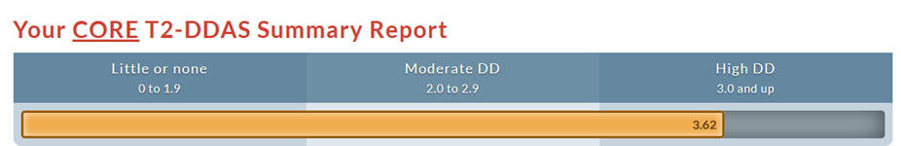
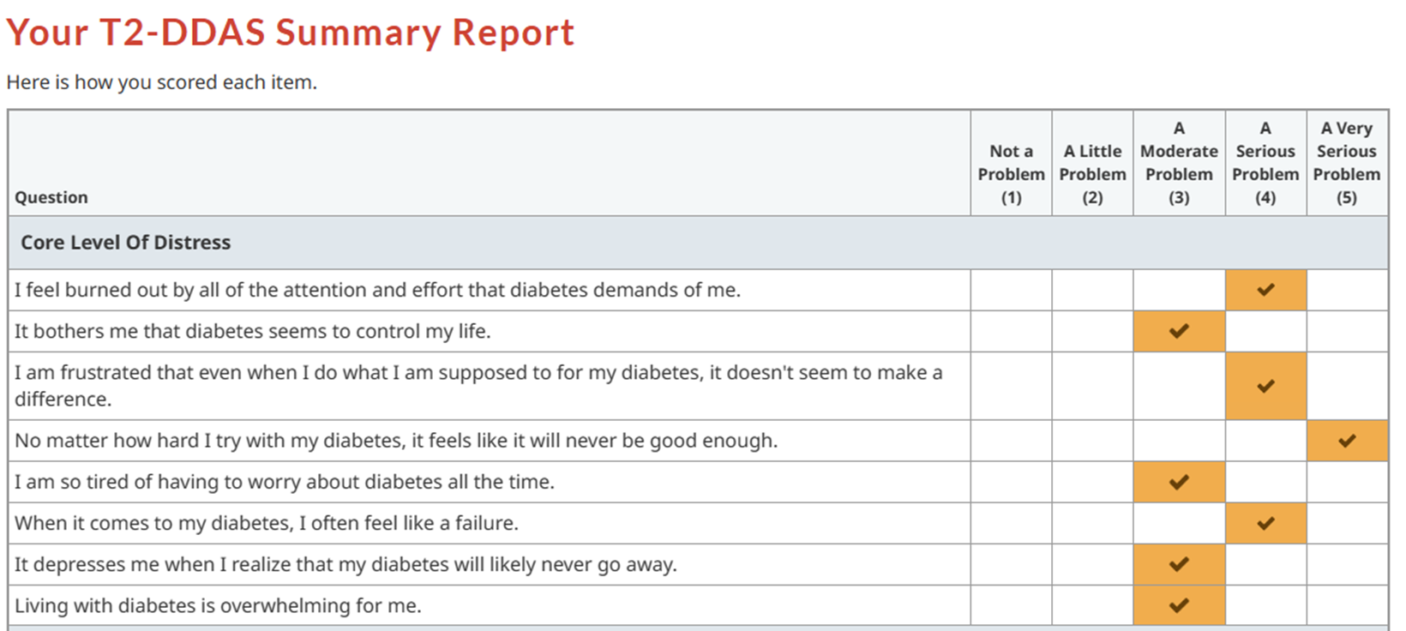

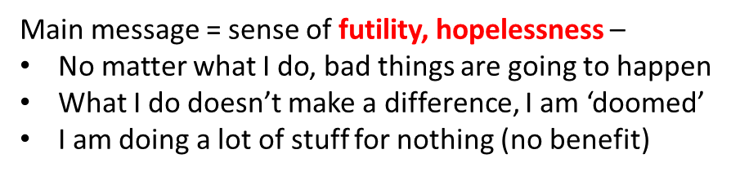
Recap on our patient case - Tony
The Medical Assistant (MA) asked Tony to take the T2-DDAS
She prints the Core & Source Summary Reports (Mean score > 3.0 indicate high distress)

Slide 5
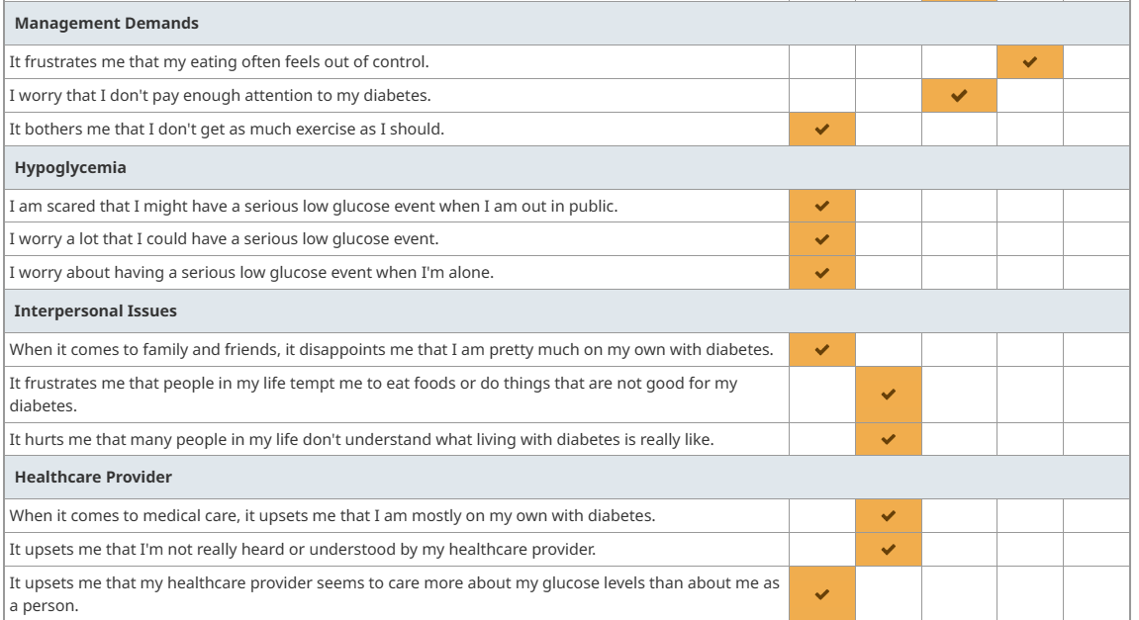
More Details- Sources of Distress
Eating Distress
Maybe some ambivalence
(distress over how much time diabetes requires & that it doesn’t make a difference AND
Guilt/distress over not doing more)
Some sense of
“in it all alone”

Slide 6
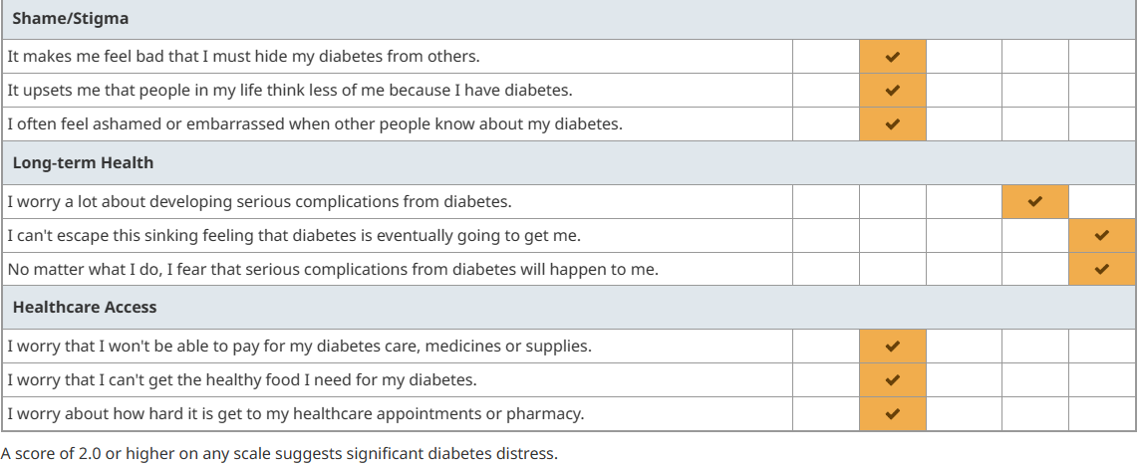

More Details- Sources of Distress
Mild/Moderate
Shame & stigma
The Big One
Futility and
hopelessness
Mild/Moderate
Access Distress

Slide 7
Now What?
What do you do? What can you do?
If diabetes distress is not managed, it can get worse over time. It may lead to “burnout”—this is when a person feels emotionally exhausted and overwhelmed by the demands of their diabetes.
  They try to cope with this by giving up on taking care of their diabetes.
For the most part, distress interventions typically do not require the expertise of a mental health professional, which can be costly and, in most cases, unavailable. With planning they can be incorporated into regular diabetes care by well-trained, sensitive diabetes clinicians. Fisher & Polonsky
Notes:
Diabet. Med. 36: 803–812 (2019)

Slide 8
What can you do to help patients with Diabetes Distress?
Good news – just acknowledging DD & talking about it/normalizing it helps reduce it
  Improvement seen just by MONITORING DD
For some items – diabetes education is helpful
  Most effective to first address emotional distress & then provide the self-management education
  Identifying misperceptions & capacity issues can help address emotional distress – examples:
    Thinking it is necessary to eat “no sugar” – really don’t know what to eat
    Not knowing what BG is normal – e.g., should be 100 all the time
    Not sure how to use pen or use insulin scale, etc.
    Numeracy & literacy issues
Reducing diabetes stigma & shame in the clinic (clinicians & staff) – words matter
Address hopelessness, futility (“no matter what I do, bad things are going to happen”) – provide “Evidence-based Hope”
  Avoid scare tactics – provide strategies – collaboration /partnership
  Share updated research data on outcomes (“not your grandfather’s diabetes”)
  Use “discovery learning” – CGM a great tool
    “what you do does make a difference”
  Being Perfect is not required to improve outcomes & do well with diabetes
Notes:
Diabetesdistress.com
https://diatribe.org/diabetes-distress-why-it%E2%80%99s-common-and-what-we-can-do-about-it

Slide 9
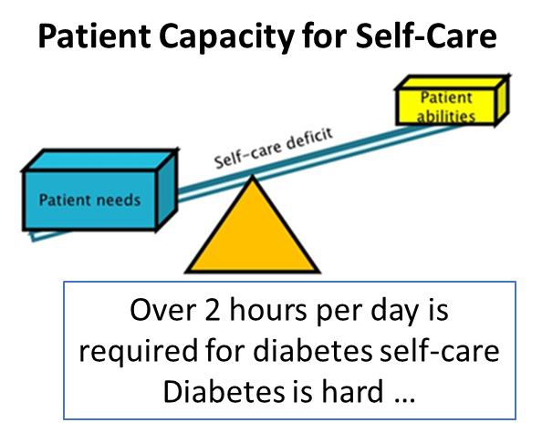
Antidepressants are Not the Answer for DD
The demands of self-management might exceed their capacity
  diabetes adds several hours per day of an unasked-for “job” per day –
    no pay, no vacation – this adds a lot extra to balance with life, especially when there are additional life demands (competing priorities)
    they might not know or understand why or how to do some of the expected self-management
    not everyone has the same capacity for self-management and the necessary skills
“When individuals do not feel able to follow the advice,
recommendations or instructions given, this is likely to
increase distress rather than motivate action.”
Consider patient’s capacity when doing Shared-Decision Making
Notes:
T. C. Skinner, L. Joensen and T. Parkin. PSAD Special Issue Paper: Twenty-five years of diabetes distress research. Diabet. Med. 37, 393–400 (2020)

Slide 10
Diabetes Education can Help
Improve Capacity & Reduce Misperceptions & Self-blame
Ensure necessary skills (how to xxx) – teach back (“show me how you…”)
Assess numeracy skills – make it easier, less intimidating
  “Many people tell me they aren’t good at math, how comfortable are you with math? – how are you with adding, dividing…?”
  “Do you have any questions about what all the numbers mean?”
Explain what is normal
  Normal blood glucose range, fluctuations -
  High BG not always “your fault”
    E.g., Stress hormones make everyone need more insulin/more insulin needed to help fight infection
Explain expectations
  “Diabetes gets worse even if you do everything right” – beta cells “wear out” over time and make less insulin [from inside] (key message – “it is not your fault”)
  Therapeutic heterogeneity – not every treatment works the same for every person – need to find what works for any individual (precision medicine) [the patient didn’t fail]
  For safety need to start with small dose and gradually increase – the starting dose is not the “right” dose that was expected to do the job (you did not fail)
Fear of med side effects
Fear that Insulin therapy
  causes complications
  indicates failure
  indicates “bad” diabetes

Slide 11
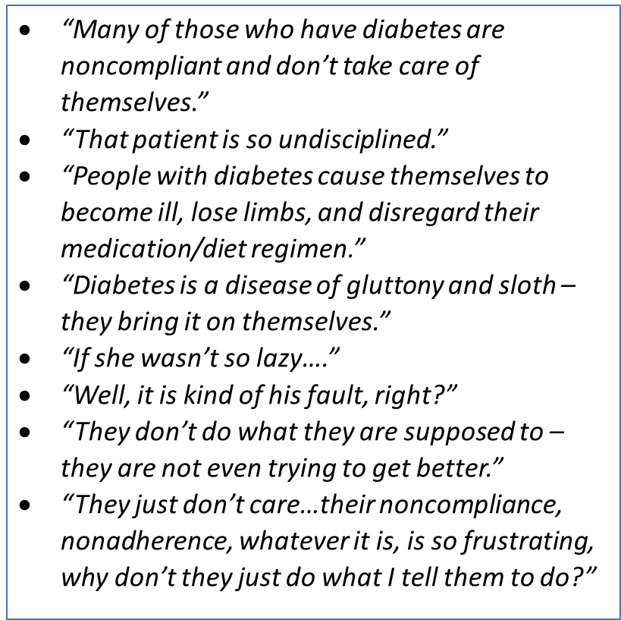
Diabetes Stigma – What is Your Mental Model of Diabetes?
Some Mental Models of Diabetes from HC workers
Assumptions/beliefs that
  people with diabetes are “non-compliant” - don’t do as told
  they don’t care, they aren’t trying
  the diabetes, hyperglycemia & complications are their fault
  treating diabetes is easy, if they would only do it
  they would be fine if they ate right
Many people with diabetes get weight stigma along with diabetes stigma

Slide 12


Words Matter:
Studies shows importance of language choices in diabetes care
“Negative terms” e.g., “nonadherent" or "noncompliant" → negative health outcomes
Blame, Shame, Directives (should, need to vs an option would be_), “Control” (manage, outcomes), “Test” (check, measure) → disengagement, diabetes distress, sub-optimal diabetes self-management
  Use language to support patients' diabetes self-management and psychosocial well-being – on the same side - fighting for, not against (“There are things we can do together to help you stay healthy/prevent complications with diabetes” [or prevent from getting worse])
The effects of being referred to as “a diabetic” vs “a person with diabetes (PWD)”
  Effect on health care professional/staff mindset & approach
Avoid assumptions (“replace cookies with whole grains”) – Replace with curiosity/listening
Carefully chosen language can have a positive effect
https://www.youtube.com/watch?v=6qtuO7Hq9WE
Notes:
A study in Diabetic Medicine
Dickinson J, Guzman SJ, Maryniuk MD, O’Brian CA, Kadohiro JK, Jackson RA, D’Hondt N, Montgomery B,
Close KL, Funnell MM. The use of language in diabetes care and education. Diabetes Care. 2017 Dec;
40(12): 1790-1799 and Diabetes Educ 2017 Dec; 43 (6) 551-564.
Dickinson J, Maryniuk M. Building Therapeutic Relationships: Choosing Words That Put People First.
Clinical Diabetes. 2017 Jan; 35(1)51-54.
Speight J, Conn J, Dunning T, Skinner TC, Diabetes Australia. Diabetes Australia position statement. A
new language for diabetes: improving communications with and about people with diabetes. Diabetes
Res Clin Pract 2012 Sep; 97(3): 425-31.

Slide 13

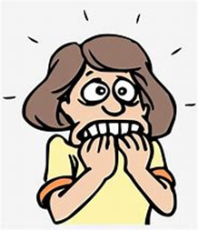
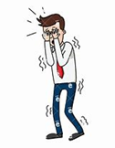
Fear of Complications → large contributor to Diabetes Distress
Words Matter
Scare Tactics Don’t Help & Can Be Harmful
Loss-framing (e.g., "having diabetes is the leading cause of blindness & amputations”) with few if any risk reduction strategies offered (often scare tactics: e.g., "if you don’t do better, you could go blind and lose your feet”) → hopelessness
vs
Gain-framing (“early diagnosis & treatment of diabetic retinopathy can prevent up to 98% of severe vision loss”) plus strategies (“get annual eye exam”) → more effective (evidence-based hope – how to stay healthy)
  Instead of “you need to take care of your feet” (directive, blame) → “I want to be sure you know what we can do to help keep your feet safe” (do foot exam explaining findings to patient, teach self-foot care) [care team activity]
Notes:
Messages in North American and Australasian Diabetes-Specific Media (from American Diabetes Association, Canadian Diabetes Association, etc.)
Linda J. Beeney and Elizabeth J. Fynes-Clinton – Clinical Diabetes 2018
e.g. publications such as Diabetes Forecast; It would be better if we focused with patients on how to stay healthy and using meds, diet etc. to stay healthy – not because they are sick or use as threats to scare them into care – they are already scared – loss framing only pushes them into hopelessness, futility, fatalism – “no matter what I do bad things are going to happen to me”

Slide 14
True or False
Diabetes is the leading cause of adult blindness, amputations and kidney failure.
Poorly Managed Diabetes is the leading cause of adult blindness, amputations and kidney failure.
Well Managed Diabetes is the leading cause of… Nothing.
"The 'leading cause of nothing' doesn't mean 'nothing bad can happen'...[but] research shows that with good care, odds are good that you can live a long and healthy life with diabetes.”
W. Polonsky
“Not only have treatments for diabetes improved, so have treatments for complications.”
FALSE

Slide 15
Risk Factors, Mortality, and Cardiovascular
Outcomes in Patients with Type 2 Diabetes
Swedish National Diabetes Register n engl j med 379;7 August 16, 2018
The following five risk factors were considered:
  the glycated hemoglobin level (cutoff value, ≥7.0%)
  systolic and diastolic blood pressure (cutoff value, ≥140 mm Hg for systolic blood pressure or ≥80 for diastolic blood pressure)
  albuminuria (the presence of microalbuminuria or macroalbuminuria)
  Smoking (being a current smoker at study entry)
  the LDL cholesterol level (cutoff value, 97 mg per deciliter]).

Slide 16
Risk Factors, Mortality, and Cardiovascular
Outcomes in Patients with Type 2 Diabetes
Swedish National Diabetes Register n engl j med 379;7 August 16, 2018
The following five risk factors were considered:
  the glycated hemoglobin level (cutoff value, ≥7.0%)
  systolic and diastolic blood pressure (cutoff value, ≥140 mm Hg for systolic blood pressure or ≥80 for diastolic blood pressure)
  albuminuria (the presence of microalbuminuria or macroalbuminuria)
  Smoking (being a current smoker at study entry)
  the LDL cholesterol level (cutoff value, 97 mg per deciliter]).
Message: “not your grandparents’ diabetes” “What you do does make a difference”
“don’t need to be perfect to see benefits” “not futile, not hopeless”

Slide 17
Establishing Treatment Efficacy
(What you do does make a difference)
Discovery learning
  E.g.: Utilize SBGM/ CGM to “discover” blood glucose effects of
    Exercise / activity
    Meal choices (type or quantity of foods)
    Stress / stress reduction
    Medication changes (increased dose, added medication, change from one med to another, change in timing or injection site)
  Need before & after data
  This is not a test!! (you are not “testing” the patient) – having them help discover what works for them (treatment efficacy) and what doesn’t
  Win-win benefits
    Helps reduce futility
    Helps care team identify efficacy of treatment for that individual (therapeutic heterogeneity)

Slide 18
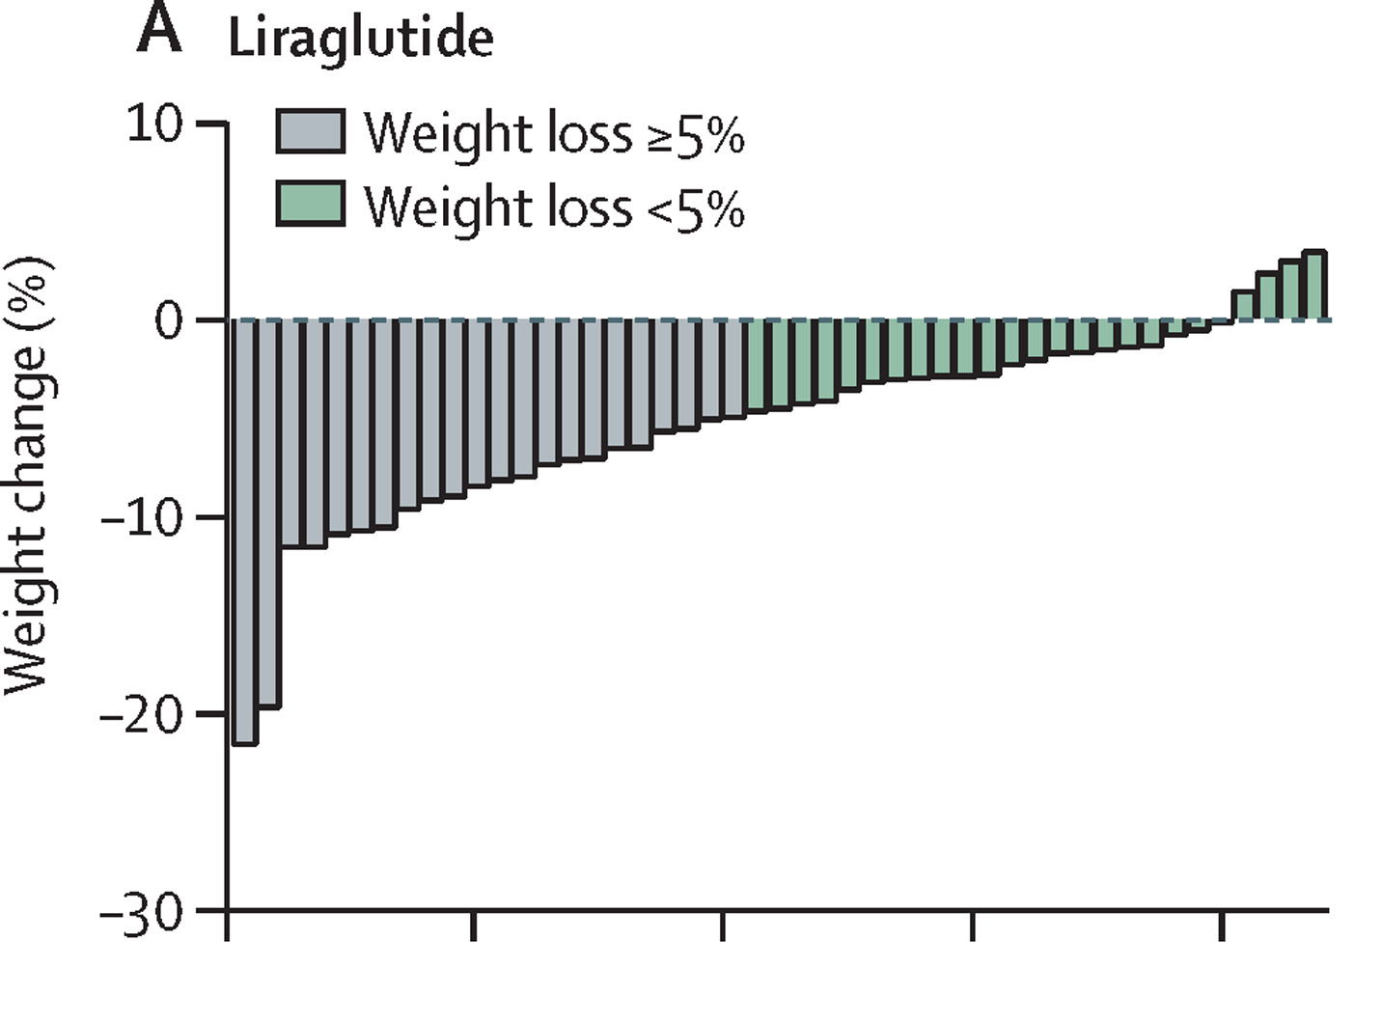
Therapeutic Heterogeneity
(not everyone responds the same)
Based on our individual make-up, some things work better or not as well for some of us- this includes:
  Type of foods/meal plan (low fat, low carb, low glycemic index, intermittent fasting, etc.)
    Glucose lowering
    Weight loss
  Exercise (aerobic, strength training)
    Glucose lowering
    Weight loss
    Fitness
  Medications
    for example, the research reports the average A1c lowering or weight loss with a medication but in the study group of patients, some had a greater than average response and some had less than average or worsening
      E.g., ~10-15% non-responders to weight loss for semaglutide & tirzepatide
Notes:
Sparks LM. Exercise training response heterogeneity: physiological and molecular insights. Diabetologia. 2017;60(12):2329‐2336.

Slide 19
Observations on Diabetes Distress in Glycemic Reduction Approaches; a Comparative Effectiveness Study (GRADE)
4 groups: Metformin + glimepiride or sitagliptin or liraglutide or glargine insulin
Diabetes Distress was associated with reduced medication adherence.
Levels of depressive symptoms and distress decreased over 1 year in all treatment groups:
  The greatest reduction in distress observed in the glargine-treated & liraglutide-treated participants compared with the sitagliptin- and glimepiride-treated participants.
  Given that glargine was the most effective and liraglutide was similarly effective…one interpretation of these data is that when people start a new medication to treat a medical condition, distress decreases when the medication is effective.
Notes:
Emotional Distress Predicts Reduced Type 2 Diabetes Treatment Adherence in the Glycemia Reduction Approaches in Diabetes: A Comparative Effectiveness Study (GRADE). Claire J. Hoogendoorn et al. Diabetes Care 2024;47(4):629–637
Gonzalez JS, Bebu I, Krause-Steinrauf H, et al. Differential Effects of Type 2 Diabetes Treatment Regimens on Diabetes Distress and Depressive Symptoms in the Glycemia Reduction Approaches in Diabetes: A Comparative Effectiveness Study (GRADE). Diabetes Care. 2024;47(4):610619.
https://diabetesjournals.org/care/article/47/4/610/154300/Differential-Effects-of-Type-2-Diabetes-Treatment

Slide 20
Case Patient - Tony
Dr. Brown asks Tony about the results of the survey & his sense of futility – “The survey suggests that you feel like you are doomed by the diabetes – can you tell me more about that?”
“My grandfather and father both had diabetes so it seemed inevitable that I would get it – and that I will end up the same way – strokes & heart attack take us out early, before age 60 –”
“How has that impacted the way you take care of yourself with diabetes?”
“Not sure what I do makes a difference or will change what happens to me – it doesn’t seem like the expensive meds do anything – I hate to pay the higher copay if they aren’t working (the sitagliptin and SGLT2i), so I don’t take them every day. Also, it is /hard to cut out all foods that have sugar in them , especially if it is not going to make a difference, so I know I don’t eat healthy and eat too much.”

Slide 21
So how can we help Tony?
Pick the next best step
  Tell him he needs to eat better, and take his diabetes medicine, or he will indeed end up like his father and grandfather.
  Refer him to see a dietician.
  Add basal insulin.
  Clarify misperceptions, provide some evidence-based hope, and offer a professional CGM as an option to learn what does work for him.

Slide 22
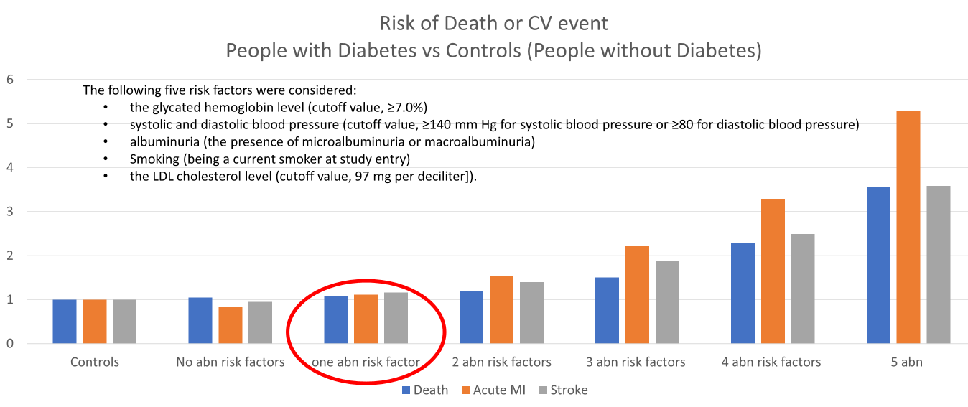
Case Patient - Tony
“I can understand why you might feel like you are doomed, I have also heard that from other PWD.”
“ First, I want assure you that we know more now than when your grandfather or even your father was diagnosed with diabetes - I want to show you some results:
“As you can see, doing those things that we
know help people with diabetes stay healthy
does make a difference! – you are in range
on everything but your A1c, so you have
already greatly reduced your risk of heart attack
and stroke.”
“I also want to assure you that we don’t want you to cut out all sugar – that would be very hard, and it is
not necessary – but what you eat can make a difference on how easy it is to manage the diabetes and on
how healthy you stay.
Also, not all meds work the same for everyone. It sounds like we need more information on what works best
for you. One option would be to get blood glucose readings at specific times using your meter or we have a
device called a continuous glucose monitor (CGM) – we can use this to see what is happening with your BGs
now and what happens when …..”
https://scottsdiabetes.com/2023/01/29/transforming-diabetes-education-with-ah-ha-moments/

Slide 23
How Can You Take Diabetes Distress On?
Avoid worsening “Diabetes Overwhelmus”
Just being aware is good first step
  Asking about it, talking about it, normalizing it, monitoring it
  Avoid scare tactics
  Be on same side as patient
  Reduce stigma/shaming in your practice
  Don’t confuse with depression / avoid polypharmacy (antidepressants “not working”)
    Realize that DD is the cause of abnormal PHQ9 in most people with diabetes
Benefits of structured assessment/scale
  time-efficient
  quantitative
  can be used to monitor change over time
  provides concrete findings that can be shared with people with diabetes
  use of the entire scale helps identify variation in sources of distress among different individuals, as reflected by the various subscales, prompting different kinds of clinical conversations

Slide 24
Suggested Strategies for Approach to DD
First are programs for individuals who are currently experiencing significantly high levels of diabetes distress.
  Group formats especially beneficial
Second, a focus on diabetes distress when critical diabetes events occur may be particularly helpful.
  An increase in medication dose or a transition to insulin or other injectables or devices, the emergence or exacerbation of a complication, the period following a severe hypoglycemic event, or a change in diabetes provider.
  These are times when both rational and irrational fears may increase, self-evaluations may become distorted by self-blame and fault, and worries about the future may abound.
A third strategy is to integrate information about diabetes distress into routine diabetes education seamlessly, both for newly diagnosed individuals and for those receiving a diabetes update or instructions for use of a new device or medication.
Fourth, and perhaps most importantly, are strategies that integrate discussion about the emotional side of diabetes into all clinical encounters.
Notes:
Diabet. Med. 36: 803–812 (2019)

Slide 25
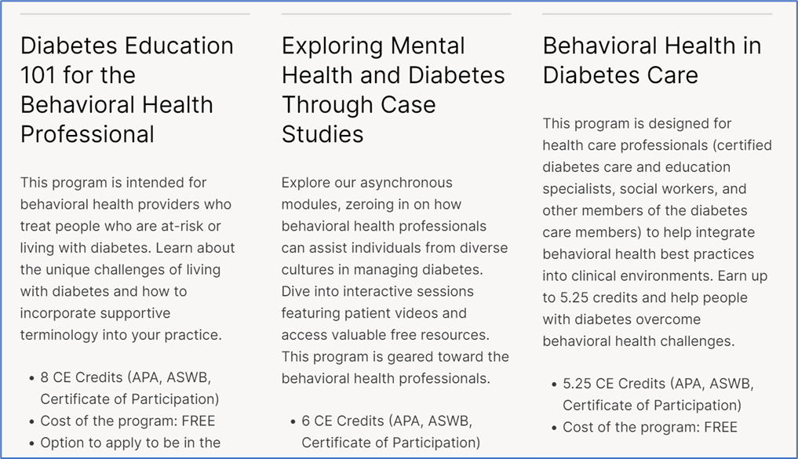
Suggestions for the Behavioral Health Specialist –
Part of the Diabetes Care Team
Enhance your understanding of diabetes & its management requirements
  put yourself in their shoes and think what it would be like for you to manage diabetes 24/7
  https://professional.diabetes.org/journals-resources/behavioral-health-resources
Enhance your understanding of diabetes distress
  Behavioral Diabetes Institute
    www.behavioraldiabetes.org
  Become familiar with the DDAS
    www.diabetesdistress.org
    assessment tools
    the core & subscale distress items

Slide 26
Suggestions for the Behavioral Health Specialist
If Referred a Patient with Diabetes Distress (DD)
Focus on
  Emotional issues (shame, guilt, hopelessness, anger, fear, self-blame, etc.)
  Social support issues
  Communicate & coordinate with medical provider/care team, especially if uncover components of or misperceptions about the diabetes care plan that might be worsening emotional distress
Help with the Explain & Normalize and Explore steps
  Provide resources for the patient on DD ( www.behavioraldiabetes.org)
In patients with severe DD, utilize approaches that have been found effective/successful in diabetes:
  Cognitive behavioral therapy
  Motivational interviewing
  Brief solution-focused therapy
Help sort out if the patient is experiencing DD vs clinical depression, anxiety, or general psychological distress (or other MH issues) or BOTH
  The person may be experiencing other life stressors that are causing general distress and affecting their diabetes self-management and outcomes.
  Also consider DD in patients with diabetes referred with other psychological problems (e.g., depression or anxiety)
    Consider having patient complete a DD assessment survey
Notes:
https://professional.diabetes.org/journals-resources/behavioral-health-resources

Slide 27
BH Specialist can help Explain & Normalize DD
Explaining and normalizing diabetes distress is the first step to addressing it
  Explain what diabetes distress is and that many people with diabetes experience it.
  Explain the signs and consequences of diabetes distress (e.g., the impact on their daily self-management and well-being).
  Acknowledge the significant daily efforts required to manage diabetes—this by itself may reduce the distress.
  “Normalize” negative emotions about diabetes (an expected, normal reaction to diabetes).
  If a person is self-blaming (e.g., “I am useless at ___” or “I can never get it right”), explain that diabetes outcomes are not a reflection of who they are as a person; diabetes is not about being “good” or “bad” or “a failure.”
    Instead remind them that diabetes can be difficult to manage,
    Explore what is going well and in what aspect(s) of diabetes management does the person feel confident?
      Highlight their strengths and skills, which could be applied to address their current problems.
  Offer the person opportunities to ask questions about what you just discussed.
  Make a joint plan about the “next steps” (e.g., what needs to be achieved to reduce diabetes distress and the support they may need).
Notes:
https://professional.diabetes.org/sites/default/files/media/ada_mental_health_workbook_chapter_3.pdf

Slide 28
Explore the most appropriate support for the individual
You can ask about the DD assessment/scores
  “How did you feel about answering these questions?”
  “When looking at your scores, does anything stand out for you?”
Explore further
  “It sounds like you are struggling with several aspects of your diabetes care. Which of these would you most like to talk about today?”
  “You said you feel angry and guilty when you think about your diabetes. Could you tell me what exactly makes you feel this way?”
    Explore whether these feelings are related to
      the self-management tasks or the diabetes outcomes (e.g., high blood glucose levels)
      how diabetes affects other aspects of their life (e.g., feelings of not being a “good” parent because of diabetes, or diabetes interfering with their work or social life).
  “According to your responses, you feel supported in some aspects of your diabetes management but not in others, is that correct? Can you give me an example of this?”
  “You feel that you are not getting support from your partner or family/friends. Is this your overall feeling?”

Slide 29
Help Tailor an Action Plan to Meet
Specific Concerns, Needs & Preferences
Examples: https://professional.diabetes.org/sites/default/files/media/ada_mental_health_workbook_appendix_c.pdf
Explore whether—and how— social support could help in reducing diabetes distress:
  Is there someone they can talk to?
  Would they like to join a peer support group?
Talk about small behavioral changes that could help—such as how to
  remember to do certain tasks (e.g., taking medication or self-monitoring of blood glucose)
  how to reduce the burden (e.g., a reward system).
Acknowledge that well-intended support can often lead to frustration -Advise the person to share with their partner or family/friends:
  how they feel about living with diabetes, and invite the other person to do the same
  what help they would appreciate from their partner or family/friends.
Encourage the person to ask questions or seek clarification (e.g., regarding their medical examination results, general health, or treatment).
Notes:
https://professional.diabetes.org/sites/default/files/media/ada_mental_health_workbook_appendix_c.pdf

Slide 30
Key Points
DD does not respond to treatment with antidepressant medication but is very responsive to acknowledgement, explanation/normalizing & support
A basic approach goes a long way in preventing and reducing DD – includes:
  asking about & normalizing diabetes-related emotional distress
  avoiding scare tactics & directives
  being on the same side as the patient
  identifying & clarifying misperceptions
  providing self-management education / enhancing self-efficacy & capacity
  helping PWD see that their own actions can make a positive difference (“discovery learning”)
  providing “evidence-based hope”
Behavioral Health Specialists can play a valuable role in addressing DD in people with diabetes.

Slide 31
Important Considerations
Entire staff needs to
  be aware of Diabetes Distress as normal & expected part of living with diabetes
  avoid diabetes stigma
  be on same side as patient/avoid scare tactics & punitive or directive approach
Overlap with impact of
  Historical loss
  Intergenerational trauma
  Individual trauma(s)/ PTSD
  Epigenetic effects & learned behaviors
  Role of connection/restoration of culture, community
  Need for holistic approach

Slide 32
Post-question: Addressing Diabetes Distress
(pick one answer that is most correct)
  Requires referral to a mental health professional
  Requires treatment with antidepressant medication
  Benefits from acknowledgement, normalizing & support
  Does not benefit from monitoring

Slide 33

Questions, Comments, Clarifications, etc.

Slide 34
References & Resources

Slide 35
Resources for BH Specialists
https://professional.diabetes.org/professional-development/behavioral-mental-health/MentalHealthWorkbook
https://professional.diabetes.org/journals-resources/behavioral-health-resources
https://www.youtube.com/@BDIviews

Slide 36
References
Emotional Distress Predicts Reduced Type 2 Diabetes Treatment Adherence in the Glycemia Reduction Approaches in Diabetes: A Comparative Effectiveness Study (GRADE). Claire J. Hoogendoorn et al. Diabetes Care 2024;47(4):629–637
Gonzalez JS, Bebu I, Krause-Steinrauf H, et al. Differential Effects of Type 2 Diabetes Treatment Regimens on Diabetes Distress and Depressive Symptoms in the Glycemia Reduction Approaches in Diabetes: A Comparative Effectiveness Study (GRADE). Diabetes Care. 2024;47(4):610619.
T. C. Skinner, L. Joensen and T. Parkin. PSAD Special Issue Paper: Twenty-five years of diabetes distress research. Diabet. Med. 37, 393–400 (2020)
L. Fisher, W. H. Polonsky and D. Hessler. Invited Review: Addressing diabetes distress in clinical care: a practical guide. Diabet. Med. 36: 803–812 (2019)

Slide 37
Diabet. Med. 37, 393–400 (2020)
Diabetes distress is common among people with type 1 and type 2 diabetes, and is associated with lower levels of self-care, general emotional well-being and possibly metabolic outcomes of diabetes care.
There is emerging evidence that the way healthcare professionals communicate with people with diabetes may be exacerbating the distress experienced by people with diabetes, or possibly contributing to its development.
Healthcare professionals need to ensure that the way they communicate with people who have diabetes does not add to the distress that diabetes engenders.
We need to embed the assessment and management of diabetes distress into the routine diabetes care services we offer people with diabetes.

Slide 38
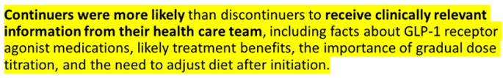
Provide Details on the Medication at time of Prescribing study on Persistence with GLP1 receptor agonist therapy
Continuers
Discontinuers
Perceived treatment efficacy
  Glycemia
  Weight loss
  “The knowledge of the cardiovascular benefit helped me stay on the GLP-1 [receptor agonist].”
Perceived treatment burden
  Cost/insurance coverage
  Ease of use
Relevant information from healthcare team
  explained that GLP-1 receptor agonist therapy would improve my blood glucose control [and other benefits]
  explained the importance of gradual dosage titration
  explained how to manage food volume and fats
    [stop eating when feel full/ satiety – also bland foods, avoid carbonation & fatty or greasy foods]
  my questions were answered by my health care team when I started on GLP-1 receptor agonist therapy.
  I was provided information about GLP-1 receptor agonist medications.
  my physician’s office called to check on my progress and ask if I had any additional questions.
Side Effects (GI, injection site)
Cost
Lack of benefit
  therapeutic heterogeneity: “lack of glycemic improvement, lack of weight loss, and/or intolerability of side effects may simply be an unmodifiable class effect in some participants, which could explain why 25% of discontinuers reported ‘numbers did not improve’ as their primary reason for discontinuation”
Less likely to receive relevant information from healthcare team
Shared Decision Making preferable
Allows ownership
Notes:
Exploring Why People With Type 2 Diabetes Do or Do Not Persist With Glucagon-Like Peptide-1 Receptor Agonist Therapy: A Qualitative Study - PubMed (nih.gov)
Diabetes Spectr. 2021 May;34(2):175-183. doi: 10.2337/ds20-0025. Epub 2021 Feb 2. Exploring Why People With Type 2 Diabetes Do or Do Not Persist With Glucagon-Like Peptide-1 Receptor Agonist Therapy: A Qualitative Study William Polonsky , Cory Gamble, Neeraj Iyer, Mona Martin, Carol Hamersky

Slide 39
Diabetes distress: understanding the hidden struggles of living with diabetes and exploring intervention strategies
Berry E, et al. Postgrad Med J 2015;91:278–283.
…the importance of prompting discussion during appointments to present people with an opportunity to talk about which aspects of diabetes care are the most difficult.
This does not require psychological expertise and does not require providing solutions there and then; indeed, the MIND Study suggests that simply monitoring diabetes distress can have beneficial effects.
It is simply about initiating normal conversation, listening to and showing an understanding and awareness of the psychosocial and emotional issues embedded in diabetes, which often go unnoticed and grow.
Practitioners should encourage patients to acknowledge their emotional difficulties and remind them that they are part of the process of adapting to living with diabetes.
Notes:
Berry E, et al. Postgrad Med J 2015;91:278–283. doi:10.1136/postgradmedj-2014-133017

Slide 40
Diabetes Technol Ther. 2024 Mar 25. doi: 10.1089/dia.2023.0612.
The Potential Impact of CGM Use on Diabetes-Related Attitudes and Behaviors in Adults with T2D: A Qualitative Investigation of the Patient Experience Taylor Clark, William Polonsky, Emily Soriano
Conclusions: Participants reported a far-reaching impact of CGM on their daily lives, with many stating that CGM fostered a greater understanding of diabetes and prompted positive behavior changes. The observed attitudinal and behavioral shifts likely contributed synergistically to the significant glycemic benefits observed over the study period.
This study highlights the technology's potential to bring about meaningful attitudinal and behavioral changes. Six primary themes emerged:
  1) Making the Invisible Visible, highlighting the newfound awareness of T2D in daily life;
  2) Effective Decision Making, emphasizing the use of real-time glucose data for immediate and long-term choices;
  3) Enhanced Self-Efficacy, describing a renewed sense of control and motivation;
  4) Diabetes-Related Diet Modifications;
  5) Changes in Physical Activity; and
  6) Changes in Medication Taking.
Notes:
Diabetes Technol Ther. 2024 Mar 25. doi: 10.1089/dia.2023.0612. Online ahead of print.
The Potential Impact of CGM Use on Diabetes-Related Attitudes and Behaviors in Adults with T2D: A Qualitative Investigation of the Patient Experience
Taylor Clark 1, William Polonsky 2 3, Emily Soriano 4

Slide 41
It is important to distinguish diabetes distress from clinical depression or major depressive disorder
Diabet. Med. 36: 803–812 (2019)
Most people with diabetes labelled as clinically depressed using common self-report inventories (e.g. Patient Health Questionnaire-9; PHQ-9) do not meet standard psychiatric criteria for major depressive disorder. When well-structured psychiatric interviews are undertaken with most samples of adults with diabetes, however, the prevalence of major depressive disorder distress falls to between 3.8% and 6%, which is similar to rates in the general community (note variation in this rate based on clinical setting and an individual’s characteristics).
Still, individuals with diabetes typically score higher on depression symptom measures than people who do not have diabetes, and although these higher scores may not be indicative of a depressive disorder, they do reflect the experience of significant emotional distress. In recent studies, depressive symptom scores, using the PHQ-9, have been found to correlate quite highly with diabetes distress scores (e.g. r as high as 0.60), pointing to a significant overlap between these two constructs.
Furthermore, in one study, initial analyses indicated significant associations between depressive symptoms with management and HbA1c; but when diabetes distress scores were entered into the same analysis, depressive symptom scores were no longer significantly associated with these outcomes, whereas diabetes distress scores were.
We suggest, therefore, that clinicians should not immediately assume that elevated depression symptom scores obtained from self-report inventories are indicative of a depressive disorder. Instead, it is likely that such scores reflect the emotional distress associated with diabetes. This is not to say that major depressive disorder does not exist in diabetes populations. When it is carefully documented and diagnosed, it needs to be treated accordingly. Fourth, although elevated levels of diabetes
Notes:
Diabet. Med. 36: 803–812 (2019)

Slide 42
Resources
Behavioral Diabetes Institute (BDI) https://behavioraldiabetes.org/
  https://behavioraldiabetes.org/resources/health-care-professionals/professional-education-brief-video-series/
DIABETES DISTRESS (From Behavioral Diabetes Institute (BDI) & https://diabetesdistress.org/ )
ADA https://diabetesjournals.org/care/article/47/Supplement_1/S77/153949/5-Facilitating-Positive-Health-Behaviors-and-Well
  https://professional.diabetes.org/professional-development/behavioral-mental-health/behavioral-health-toolkit
How to make the diagnosis of type 2 diabetes less difficult (youtube.com)
https://www.youtube.com/watch?v=6qtuO7Hq9WE (evidence-based hope in diabetes)
Bing Videos (diabetes distress vs depression)

Slide 43
ADA - Diabetes Distress in Diabetes
https://www.youtube.com/watch?v=8MTKa4PSp1c
ada_mental_health_toolkit_questionnaires.pdf (diabetes.org)
ada_mental_health_toolkit_handouts_r3.pdf (diabetes.org)
ada_mental_health_toolkit_7as_r2.pdf (diabetes.org)
ADA https://diabetesjournals.org/care/article/47/Supplement_1/S77/153949/5-Facilitating-Positive-Health-Behaviors-and-Well
  https://professional.diabetes.org/professional-development/behavioral-mental-health/behavioral-health-toolkit

Slide 44
Diabetes Stigma
Resources – dStigmatize
Stigma Makes Managing Diabetes Harder | DiaTribe
‘I'm not a druggie, I'm just a diabetic’: a qualitative study of stigma from the perspective of adults with type 1 diabetes | BMJ Open

Slide 45
Risk Factors, Mortality, and Cardiovascular
Outcomes in Patients with Type 2 Diabetes n engl j med 379;7 August 16, 2018
CONCLUSIONS: Patients with type 2 diabetes who had five risk-factor variables within the target ranges appeared to have little or no excess risk of death, myocardial infarction, or stroke, as compared with the general population.
The following five risk factors were considered:
  the glycated hemoglobin level (cutoff value, ≥7.0%)
  systolic and diastolic blood pressure (cutoff value, ≥140 mm Hg for systolic blood pressure or ≥80 for diastolic blood pressure)
  albuminuria (the presence of microalbuminuria or macroalbuminuria)
  Smoking (being a current smoker at study entry)
  the LDL cholesterol level (cutoff value, 97 mg per deciliter]).

Slide 46
Risk Factors, Mortality, and Cardiovascular
Outcomes in Patients with Type 2 Diabetes n engl j med 379;7 August 16, 2018
The following five risk factors were considered:
  the glycated hemoglobin level (cutoff value, ≥7.0%)
  systolic and diastolic blood pressure (cutoff value, ≥140 mm Hg for systolic blood pressure or ≥80 for diastolic blood pressure)
  albuminuria (the presence of microalbuminuria or macroalbuminuria)
  Smoking (being a current smoker at study entry)
  the LDL cholesterol level (cutoff value, 97 mg per deciliter]).
In the overall cohort, patients with type 2 diabetes who had no risk factor variables outside the target ranges had
  a marginally higher risk of death than the controls (hazard ratio, 1.06; 95% confidence interval [CI], 1.00 to 1.12).
  had a lower risk of acute myocardial infarction than the matched controls (hazard ratio, 0.84; 95% CI, 0.75 to 0.93).
  Had a lower risk of stroke than controls (hazard ratio 0.95; 95% CI, 0.84-1.7)
The results show a stepwise increase in the hazard ratios for each additional variable that was not within the target range among patients with diabetes,

Slide 47
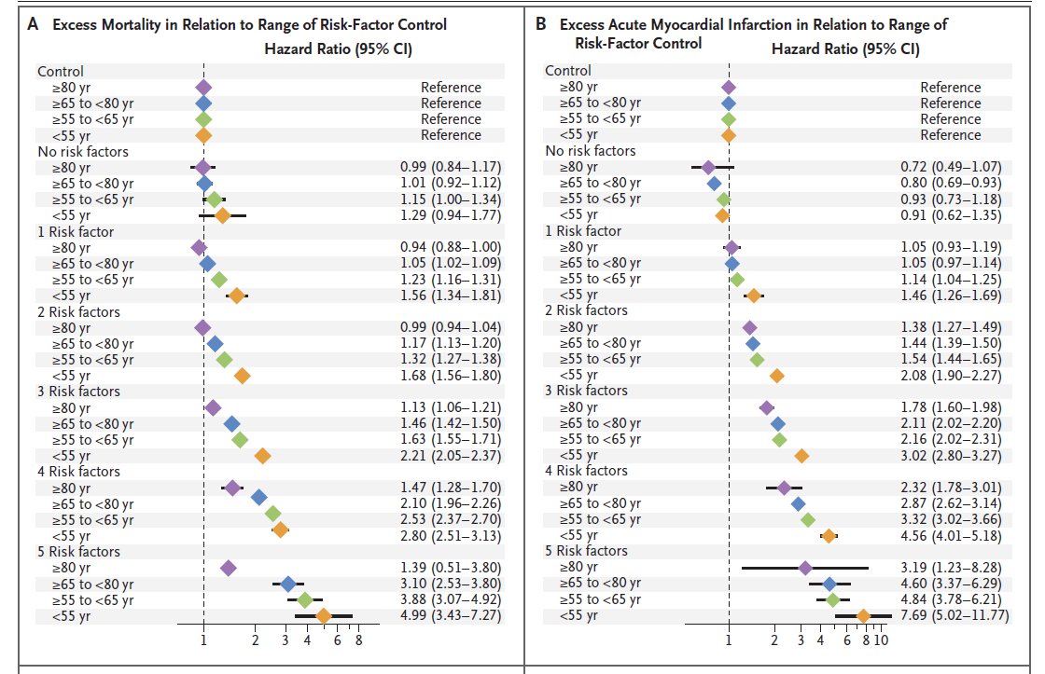
Risk Factors, Mortality, and Cardiovascular
Outcomes in Patients with Type 2 Diabetes n engl j med 379;7 August 16, 2018
Risk based on age group
In the overall cohort, patients with type 2 diabetes who had no risk factor variables outside the target ranges had
a marginally higher risk of death than the controls (hazard ratio, 1.06; 95% confidence interval [CI], 1.00 to 1.12).
had a lower risk of acute myocardial infarction than the matched controls (hazard ratio, 0.84; 95% CI, 0.75 to 0.93).
Had a lower risk of stroke than controls (hazard ratio 0.95; 95% CI, 0.84-1.7)

Slide 48
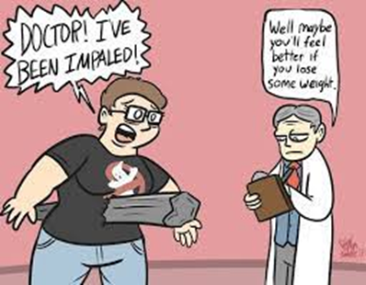
Weight-based discrimination in the HC setting
  Seating, gowns & examination tables
  Lower health care quality
    Often provided with less health information
    Less time spent with them
    View them as undisciplined, annoying, and noncompliant with treatment.
    Reluctance to perform pelvic & other exams
    Automatically assume a patient with obesity is engaging in overeating behaviors
    Believe that pressuring patients about their weight is simply a way of trying to motivate them to be healthier
    Attribute everything to obesity/focus only on their weight & overlook other health issues - missed diagnoses & treatments
Notes:
Weight Stigma | World Obesity Federation

