Slide 1


Buprenorphine
Long-Acting Injections (LAIs)
Notes:
Thank you, today we’ll be discussing long acting buprenorphine injections for the treatment of opioid use disorder

Slide 2
Learning Objectives
Describe available buprenorphine Long-Acting Injectable agents (LAIs).
Compare and Contrast LAIs including dosing and clinical considerations
Discuss the use of LAIs as an approach towards treating OUD.
Notes:
Our objectives for this presentation will be to review what buprenorphine long acting injections exist on the market, review each dosage form individually, and then compare and contrast these agents as well as briefly discuss how long acting agents can be considered for use in practice.

Slide 3
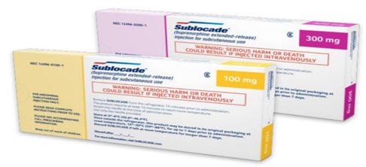
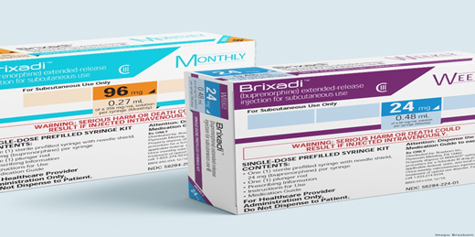
Buprenorphine Long-acting Injections (LAIs)
SUBLOCADE (2017)
BRIXADI (2023)
Notes:
So lets take a look at the long acting agents available.
Sublocade was the first FDA approved once monthly long-acting buprenorphine injection, approved in November of 2017 for adults with moderate to severe opioid use disorder.
Brixadi is the newest FDA approved buprenorphine LAI, being approved in May of 2023. Brixadi is approved in both weekly and monthly long-acting injections, which we will discuss.

Slide 4
Risk Evaluation and Mitigation Strategy
Both LAIs require a REMS through their websites.
Sublocade: Sublocade REMS - Home
Brixadi: Home | Brixadi REMS
Notes:
The first thing you will notice when researching both buprenorphine LAIs is the black box warning and therefore a REMS requirement based on serious harm or death from IV administration.
For this reason, all pharmacies and healthcare settings who wish to procure or administer either LAI must be registered with that products specific REMS program. The basis of the each REMS program is similar, and that is to ensure that patients themselves are not distributed the long acting injection for self administartion and instead must be administered by a health care professional who has been properly trained on how to administer the subcutaneous injection.
Registration takes minutes using the provided links. However, it is critical to ensure training for all staff who will administer the LAI occurs and is documented in case of an audit from the REMS program.

Slide 5
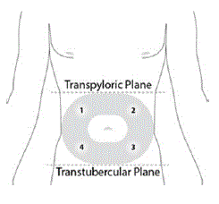
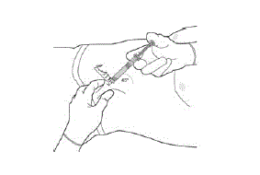
Sublocade Administration
Sterile Technique
Subcutaneous
Abdominal
By a Trained Health Care Staff
Remove from fridge prior to injection
Laying down
With needle provided in packaging
Hold and use Gauze to reduce discharge
Notes:
Looking more specifically with Sublocade, lets look how its administered.
Sublocde should be administered SUBCUTANEOUSLY, in the ABDOMEN, rotating abdominal quadrants with each monthly injection shown here from the package insert. The injection should be separated by 28 days apart, and be received no more frequently than 26 days apart.
As with any medication, use sterile techniques including alcohol pads to clean the site prior to injection. In addition, Sublocade should be removed from the refrigerator at least 15 minutes prior to administration to allow the medication to come to room temperature. Sublocade itself is stable for up to 12 weeks outside of the refrigerator before it is no longer viable.

Slide 6
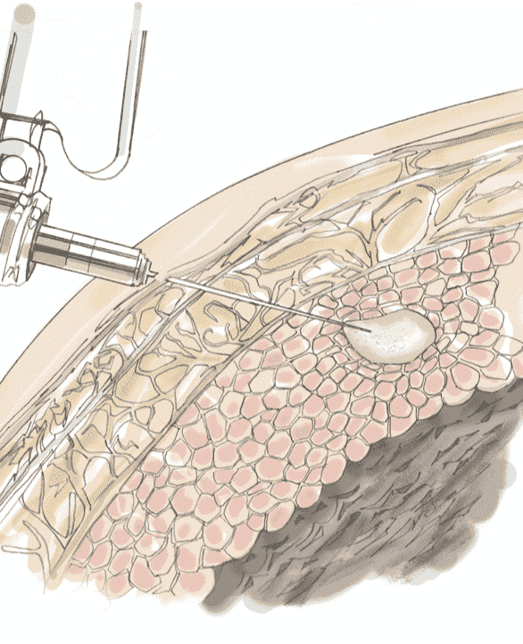
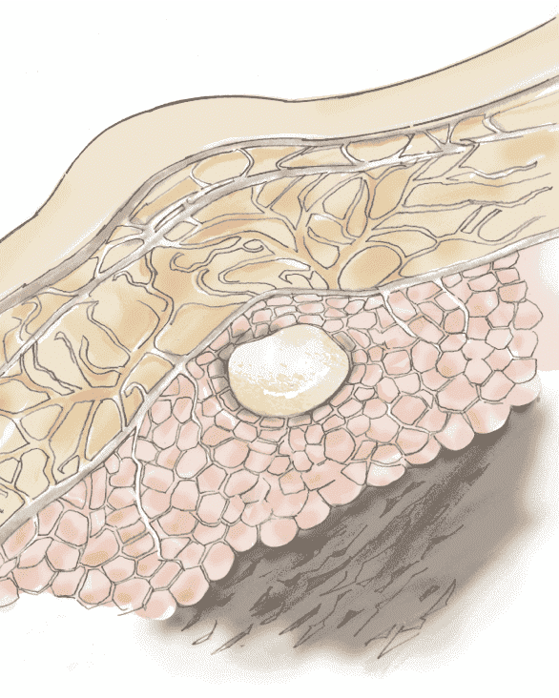
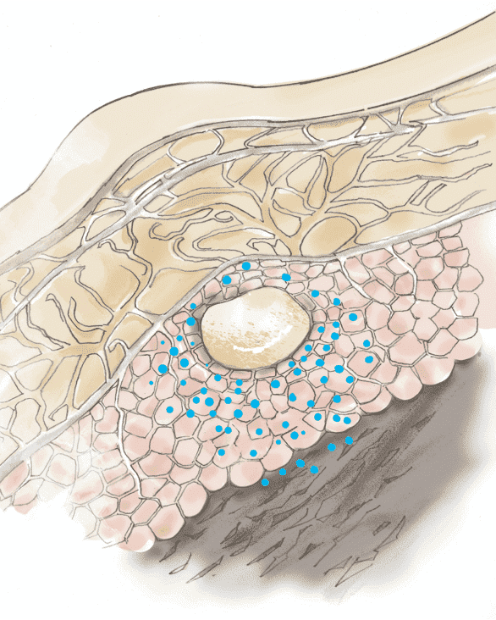
Sublocade Administration
Dosing & Administration | SUBLOCADE® (buprenorphine extended-release) HCP (sublocadehcp.com)
Informational Resources | SUBLOCADE® (buprenorphine extended-release) HCP (sublocadehcp.com)
Notes:
Sublocade uses the ATRIGEL delivery system which WILL create a bump, or “depot”, in the patient's abdomen at the site of injection. Prepare patients to expect this bump, it is not an adverse reaction and is a sign of proper injection technique. To create this depot, the Sublocade liquid is highly viscous and therefore requires a larger gauge needle that is provided in the packaging. Due to the larger size needle, injection site pain can be expected during administration and possibly for several days after. Injection site pain may be reduced by ensuring that sublocade is at room temperature prior to administration. Providers can also consider a local anesthetic such as a lidocaine injection prior to administration.
The link at the bottom of this slide will take the user directly to a 7 minute video that will provide step by step instructions on how to properly administer Sublocade and can be a great training tool.

Slide 7
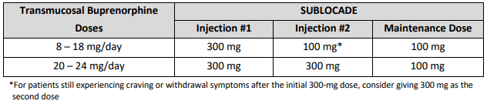
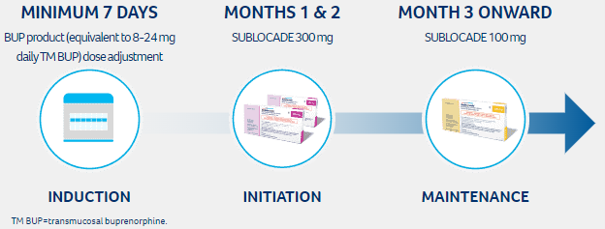
Sublocade Dosing
Dosing & Administration | SUBLOCADE® (buprenorphine extended-release) HCP (sublocadehcp.com)
Notes:
To receive Sublocade according to FDA labeling, patient’s must first be stable on at least 8mg of transmucosal buprenorphine for at least 7 days. Stability on the 8mg dose should include the absence of precipitated withdrawal and over sedation.
You can see here, the recommended initial dose of the LAI is a 300mg injection, followed by an additional 300mg injection or a 100mg injection depending on their induction dose.
(CLICK FOR ANIMATION)
It is important however to notice here, from Sublocade’s Prescribing Information under dosing, that if the patient continues to experience cravings and/or withdrawal symptoms after their initial 300mg injection, providers can consider a second 300mg injection regardless of their initial induction dose.

Slide 8
Sublocade Dosing
Rapid Induction with Sublocade
Off Label
Phase 4 studies exist
  Study Details | SUBLOCADE Rapid Initiation Study | ClinicalTrials.gov
Notes:
That being said, there are several phase-4 studies that have seen a more rapid induction with Sublocade.
One conducted by Indivior (the manufacturer of Sublocade) inducted 24 patients who had been abstinent from full agonist opioids for at least 6-24 hours and were experiencing a COWs score of at least 8. These patients received a single 4mg SL dose of buprenorphine and were followed for signs of precipitated withdrawal and hypersensitivity. If patients did not exhibit these signs or oversedation, they received a 300mg Sublocade injection one hour after the 4mg dose.
Of the 24 patients, none experienced significant withdrawal after the 300mg injection, however 2 did experience an increase in their COWS score 1 hour post injection.
20 of the 24 patients reported at least one adverse effect, most commonly being irritability, anxiety, nausea, and pain, all of which were reported as moderate to mild, and are all side effects that can be reported from even from on label induction of Sublocade.
None of the participants experienced clinically significant oversedation.
Many practice sites in the community and correctional settings practice with a more rapid induction based on limited guarantee of continuity of care, such as the emergency department, or correctional environment prior to release to the community, or hold of jails with short durations in custody. Several practices exist who have inducted 100mg or even 300mg after a single dose of 4 or 8mg of transmucosal buprenorphine.
However, this is considered off label and risk vs benefits must be discussed with the patient regarding the risk of precipitating withdrawal in those in active misuse without moderate-severe COWS scores, or over sedation in those with minimal tolerance.

Slide 9
Sublocade Dosing
Dosing & Administration | SUBLOCADE® (buprenorphine extended-release) HCP (sublocadehcp.com)
300mg as a maintenance dose is still an FDA approved safe and effective dose.
Notes:
As part of on label dosing, utilizing the 300mg injection as a monthly maintenance dose is an FDA approved dose and can be considered in those who tolerate the 100mg injection, but are unable to achieve clinical goals such as reduced cravings, absence of withdrawal, or continued misuse.

Slide 10
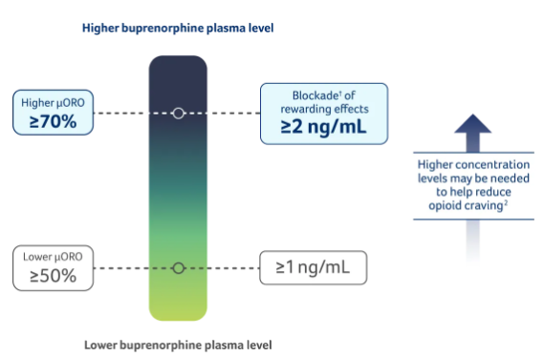
Pharmacokinetics
Mu-Opioid Receptor Occupancy (uORO) is associated with addressing OUD symptoms
Notes:
To fully understand the dosing of buprenorphine, regardless of the dosage form, we should understand the concepts of mu receptor occupancy.
Data from buprenorphine studies indicates that plasma concentrations of >/ 2ng/ml is associated with at least 70% mu-opioid receptor occupancy. This saturation and blocking of the mu-receptor is what provides the proposed mechanism of action for buprenorphine to reduce risk of overdose from other opioids, and reduce the “drug liking” or perceived positive effects from continued opioid misuse.
Of note, 2ng/ml is NOT a defined treatment goal in any published guidelines, but does provide a target level for providers to ensure treatment goals can be met, including reduced risk of overdose.
In the era of fentanyl, a higher potency opioid, 4ng/ml is a more likely targeted goal in to minimize overdose risk.
Again, 2ng/ml is not a published treatment goal, and the dose of buprenorphine should never be pushed to achieve a specific serum concentration at the cost of intolerable side effects or over sedation.

Slide 11
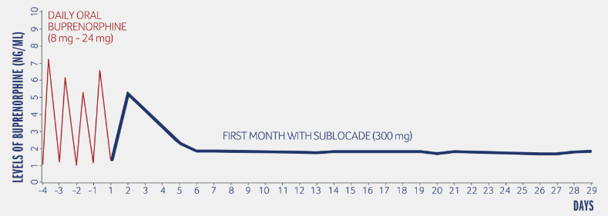
Sublocade Pharmacokinetics
Notes:
So now that we have that 2ng/ml data in mind, lets look at the specific transition from transmucosal buprenorphine to Sublocade.
Here is a kinetic graph for patients transitioning from transmucosal buprenorphine to their first 300mg injection of Sublocade.
Notice the variability in plasma concentration levels with transmucosal buprenorphine, with larger and more rapid fluctuations of serum buprenorphine both above and even dropping below the 2ng/ml concentration between doses. Keep in mind that this graph displays once daily SL buprenorphine dosing. Peaks and troughs of this significance could be avoided by splitting the SL dose over multiple times a day.
With that, one of the clear differences we can see when discussing long-acting injections vs transmucosal buprenorphine is that a long-acting injection will likely have a much smoother and reliable concentration level over its duration. Sublocade avoids the peaks and troughs seen with transmucosal buprenorphine and is eliminated slowly from the body resulting in minimal to no withdrawal after delayed or missed injections. In fact, after achieving steady state with Sublocade, delays in receiving the injection by up to two weeks have not been shown to be clinically significant. As well, plasma concentrations of buprenorphine may still be detectable for several months even after discontinuation. This should also be discussed with the patient if they choose to discontinue treatment.

Slide 12
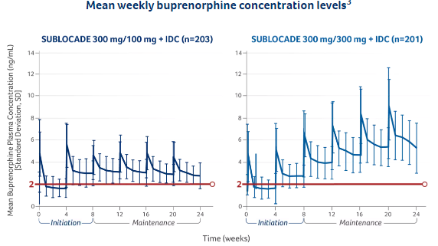
Sublocade Pharmacokinetics
Notes:
The previous graph was after a single injection, this graph shows the same serum concentration plots, but over 6 injections.
Based on the long half-life of Sublocade (43-60 days), it will take anywhere between 4-6 months to reach steady state with most long-acting monthly injections (both Sublocade and monthly Brixadi which we will talk about next). This is important to inform our patients as well as understand as prescribers. It may take several injections for the medication to achieve its full, lasting effects, so we should make sure patient expectations are realistic from the start.
We can see here that both dosing strategies, using the 100mg as a maintenance dose on the LEFT, and using the 300mg as a maintenance dose on the RIGHT both achieve that pseudo goal of 2ng/ml when at steady state, indicated by the bolded red line on both graphs. Obviously, using the 300mg as the monthly maintenance dose will result in a much high average serum concentration compared to the 100mg.
[pause for time to look at graph and explain what we see]

Slide 13
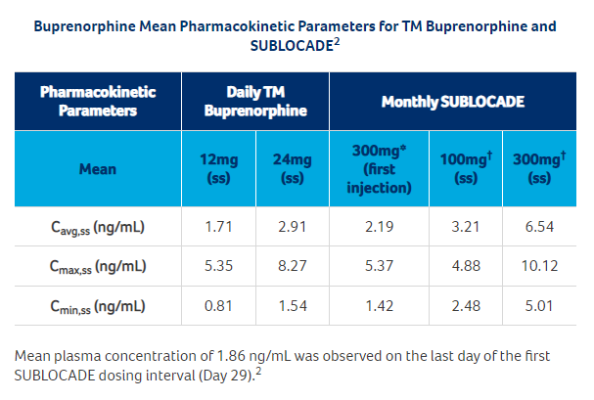
Sublocade Pharmacokinetics
Notes:
Here is another way to display the previous two graphs. The numbers here are those serum plasma concentrations of buprenorphine in nanograms per ml. We see on the left these doses are the concentrations found at steady state after 6 months of Sublocade doses, the concentrations are the average, the maximum, and the minimum recorded levels with each treatment strategy listed across the top.
CLICK FOR ANIMATION
For oral transmucosal buprenorphine. The average concentrations of 12mg and 24mg daily doses are 1.71 and 2.91 respectively.
CLICK FOR ANIMATION
Moving into Sublocade we see the concentrations after the first 300mg injection range from a minimum of 1.42 to 5.37 with an average of 2.19.
What’s important for our patients to understand are the last two columns.
CLICK FOR ANIMATION
We see that after 6 months of injections; a 300mg loading doses followed by 100mg monthly injections, the average, minimum, and maximum concentration are all above 2ng/ml with the minimum being 2.48. What’s important to gain from this graph is that it may take several months to achieve steady state of 2ng/ml and there may be times early in treatment where the patient will still feel cravings and/or may even have use of illicit substances while moving towards steady state, but even after our first injection, patient’s should begin to accomplish treatment goals as they achieve the 2ng/ml concentration.
It is also important to note the plasma concentrations when monthly 300mg injections are utilized instead of 100mg. You can see the concentrations are much higher than the 2ng/ml mark. Again, 300mg monthly injections are an FDA approved dose, but as with all medications, with higher doses comes additional risks of side effects, over sedation, and drug-drug interactions and this should be reviewed with patients prior to increasing the dose.

Slide 14
Sublocade Side Effects
Similar to SL buprenorphine apart from injection site reactions:
Common (>5%)
  Constipation
  Headaches
  Nausea/Vomiting
  Increased hepatic enzymes
Injection Site related
  Pruritis
  Pain
Notes:
During phase 3 studies comparing transmucousal buprenorphine to Sublocade, side effects profiles of each were found to be similar, with the exception of injection site reactions being obviously specific to Sublocade. Otherwise, side effects of Sublcoade can be expected to be the same as patients taking SL buprenorphine.
This includes the most common side effects of opioid induced constipation, which can be treated using a bowel regimen, headaches, nausea, vomiting, which may be reduced by slowing the induction titration to allow for tolerance or avoiding taking on an empty stomach, and staying well hydrated while on treatment.
Regarding increased hepatic enzymes, there hasn’t been any data or studies to indicate that buprenorphine itself is hepatotoxic in nature and elevated hepatic enzymes is often times a baseline feature of those enrolling in OUD trials or starting OUD treatment based on possible comorbidities such as hepatitis. It remains important however to be aware of this potential risk and monitor hepatic profiles accordingly during OUD treatment with any buprenorphine dosage forms.
Injection site specific reactions including redness, pruritis, pain, and bruising were all common, around 5-10%.

Slide 15
Sublocade
Contraindications:
Precautions
  Allergies to components
  GI Obstruction (Paralytic ileus)
  Significant Respiratory Depression
  CNS Depression
  Serotonin Syndrome
  Hepatic Dysfunction
  Adrenocortical Insufficiency
  Respiratory Diseases
  Seizure Disorders
  Older Adults
Notes:
Contraindications to buprenorphine and therefore Sublocade would be allergies to any of its components.
Active GI obstruction due to the reduction in GI motility commonly seen with chronic opioid treatment.
And uncontrolled respiratory depression due to the respiratory risks from opioids.
Otherwise, precautions, that should be considered with buprenorphine are the use of other CNS depressive agents such as benzodiazepines, antidepressants, or antipsychotic treatment. Other medications that are metabolized by the liver, specifically the CYP3A4 enzymes should also be reviewed prior to initiation of any buprenorphine based treatment.
Although Hepatic Dysfunction is listed as a precaution, it should be noted that having hepatitis itself is not a contraindication to Sublocade. Additional monitoring of hepatic function should occur in these patients and if dysfunction is moderate-severe, Sublocade should be avoided and low dose SL buprenorphine should be considered.
Adrenal Insufficiency has been associated with buprenorphine use, particularly after 1 month of treatment. Use with caution in patients with Addison’s Disease or Osteoporosis as buprenorphine may worsen these conditions.
As stated with contraindications, any respiratory diseases pose a precaution for any opioid use based on the etiology of opioid overdose. Similar, older adults should also receive closer monitoring for oversedation similar with other CNS agents.

Slide 16
Buprenorphine Long-acting Injections (LAIs)
BRIXADI (2023)
Notes:
Lets shift gears a bit to our second buprenorphine long acting injection, which is are more recently FDA approved agent, Brixadi.

Slide 17
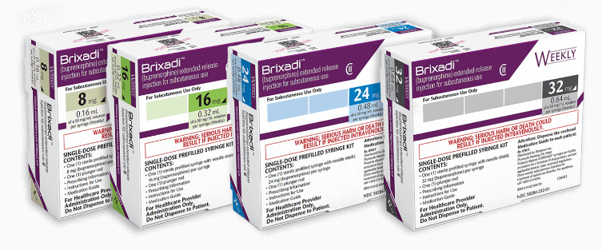
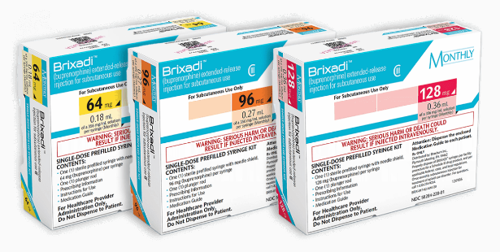
BRIXADI
Weekly
Monthly
Dosing & Administration | BRIXADI® (buprenorphine) extended-release injection for subcutaneous use (CIII) (brixadihcp.com)
Notes:
Lets shift gears a bit to our second buprenorphine long acting injection, which is are more recently FDA approved agent, Brixadi.
The first and one of the most obvious differences between Sublocade and Brixadi, is that Brixadi is available as both weekly and monthly formulations.

Slide 18
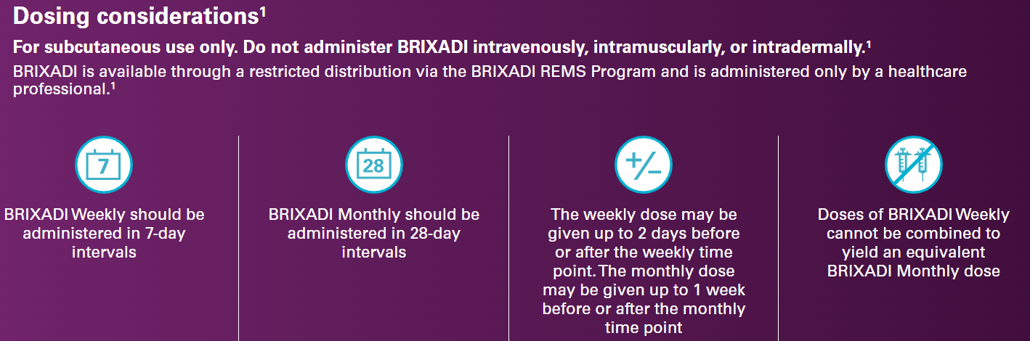
BRIXADI Dosing
Dosing & Administration | BRIXADI® (buprenorphine) extended-release injection for subcutaneous use (CIII) (brixadihcp.com)
Notes:
Weekly Brxadi is administered every 7 days, and its monthly counter part is similar to Sublcoade in that it should be administered every 28 days.

Slide 19
BRIXADI Dosing
Dosing & Administration | BRIXADI® (buprenorphine) extended-release injection for subcutaneous use (CIII) (brixadihcp.com)
Notes:
The weekly Brixadi can be given up to 2 days earlier (or as early as 5 days after the last injection) or two days later (or as late as 9 days).
The monthly dose on the other hand can be given as early as one week (or day 21) and as late as one week (day 35). This provides a little more flexibility on the labelled dosing period compared to Sublocade which if you’ll recall was every 28 days, but as early as 26 days.
It is important to keep weekly and monthly dosing strategies separated. Weekly Brixadi doses CANNOT be combined to yield an equivalent monthly dose and be expected to last 28 days.

Slide 20
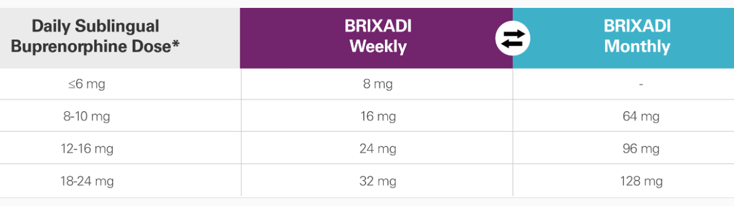
BRIXADI Dosing
Dosing & Administration | BRIXADI® (buprenorphine) extended-release injection for subcutaneous use (CIII) (brixadihcp.com)
Notes:
For patients already established on transmucosal buprenorphine, a conversion chart is available on the Brixadi website that was developed based on serum plasma concentrations achieved at perspective doses.
Contrasting from Sublocade’s FDA label, which requires a minimum transmucosal dose of 8mg for at least 7 days. Brixadi allows transition into a weekly dose with as little as a single 4mg tolerated dose for those with opioid tolerance (not opioid naïve).

Slide 21
BRIXADI Induction Dosing
For those not currently on buprenorphine but who have opioid tolerance:
  Administer a 4mg “test dose” to rule out precipitated withdrawal
  If tolerated, administer 16mg Weekly dose followed by 8mg weekly within 3 days
  Continue with 24mg weekly dosing one week after the 16mg dose was administered and continue with 24mg weekly dosing thereafter.
  Titrate dose as needed to include transition to monthly dosing
Notes:
Lets take a look at that dose induction specifically.
For those who are not already established on buprenorphine, but have established opioid tolerance due to active misuse of opioids, a 4mg sublingual test dose can be provided when objective signs of mild to moderate withdrawal appear (as with most buprenorphine SL induction strategies).
If the 4mg dose is tolerated, the patient can proceed forward with a 16mg weekly dose. The Brixadi dosing and administration guide then goes on to suggest an additional 8mg weekly dose 3 days later therefore achieve and continuing with a 24mg weekly dose from there.
It is important to note that this dosing strategy does NOT apply to those with minimal to no opioid tolerance (or opioid naïve). For those patients, such as those in the correctional or other controlled settings. More careful dose titrations should occur and transition to the equivalent weekly or monthly long acting injection should be considered once the patient is stable at the appropriate dose range referring back to this illustration.

Slide 22
BRIXADI Dosing
Dosing & Administration | BRIXADI® (buprenorphine) extended-release injection for subcutaneous use (CIII) (brixadihcp.com)
Notes:
It is important to note that this dosing strategy does NOT apply to those with minimal to no opioid tolerance (or opioid naïve).
For those patients, such as perhaps those in a correctional or other controlled settings. More careful dose titrations should occur and transitioned to the equivalent weekly or monthly long acting dose once the patient is stable at the equivalent dose range, referring back to this illustration. Initiating treatment with BRIXADI as the first buprenorphine product has not been studied

Slide 23
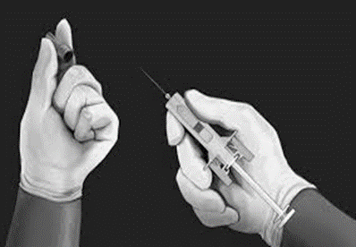
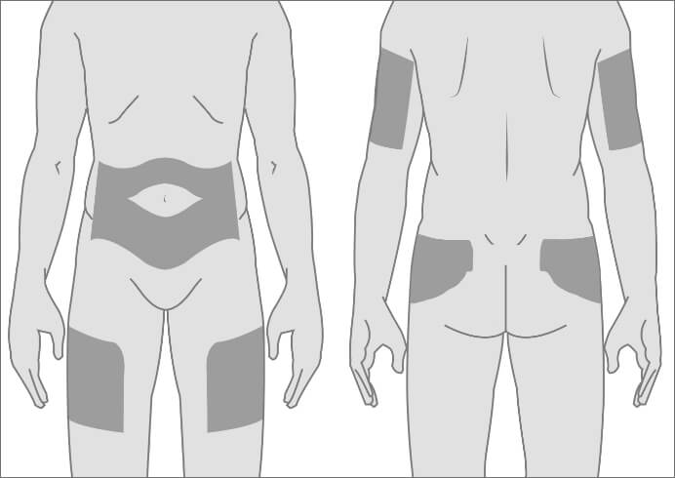
BRIXADI Administration
Dosing & Administration | BRIXADI® (buprenorphine) extended-release injection for subcutaneous use (CIII) (brixadihcp.com)
Notes:
So the dosing can perhaps be more complex with Brixadi, but in contrast to Sublocade, there are more dosing options.
How about the administration of Brixadi. Again, the most noticeable difference is, more options.
Where Sublocade is only FDA approved to be administered subcutaneously in the abdomen, Brixadi is approved for subcutaneous administration on the abdomen, but also the thigh and buttock, as well as the upper arm once steady state has been achieved.
Additionally, Brixadi does NOT require refrigeration, and therefore does not have to come to room temperature prior to administration.
Similar to how was provided in the previous Sublocade slide, the link located here will take any user to a 7 minute video on how to properly administer Brixadi, which is excellent for education.

Slide 24
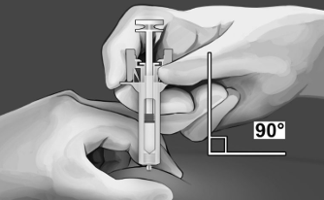
Brixadi Administration
23 gauge ½ inch
Brixadi Weekly
Dosage Strength | Dosage Volume
8mg | 0.16ml
16mg | 0.32ml
24mg | 0.48ml
32mg | 0.64ml
Brixadi Monthly
Dosage Strength | Dosage Volume
64mg | 0.18ml
96mg | 0.27ml
128mg | 0.36ml
Notes:
Along with the locations for administration, the needle, dosage volume, and injection technique differ from our previously discussed long acting injection.
The needle boasts a much larger (and therefore thinner) gauge as well as smaller length, with only ½ an inch. Due to the shorter needle, the administration technique to achieve subcutaneous administration recommends a 90 degree insertion.
Additionally, the dosage volume with Brixadi is, in most circumstances, smaller than that of Sublocade, with all but one dose (both weekly and monthly) being less than a ½ ml volume. Because of this smaller volume, Brixadi is not expected to produce as large of a “depot”, if at all, compared to Sublocade.

Slide 25
Sublocade Administration
19 Gauge, 5/8 inch
Sublocade
Dosage Strength | Dosage Volume
100mg | 0.5ml
300mg | 1.5ml
Notes:
As a quick refresher comparison,
Sublocadue utilizes a larger, 19 gauge, 5/8 inch needle, uses a 45 degree angle for administration, and has larger dosage volumes with 0.5ml and 1.5ml for the 100 and 300mg doses respectively.

Slide 26
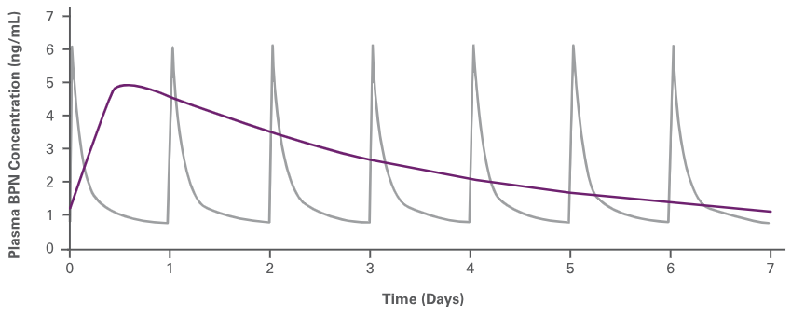

Brixadi Pharmacokinetics
24mg Weekly
Notes:
Here is a similar kinetic graph that we observed when discussing Sublocade. This time we see the buprenorphine serum concentrations of each Transmucousal and Brixadi weekly superimposed. The purple line is our weekly long acting injection, again providing a more steady, reliable concentration over the dosage period.

Slide 27
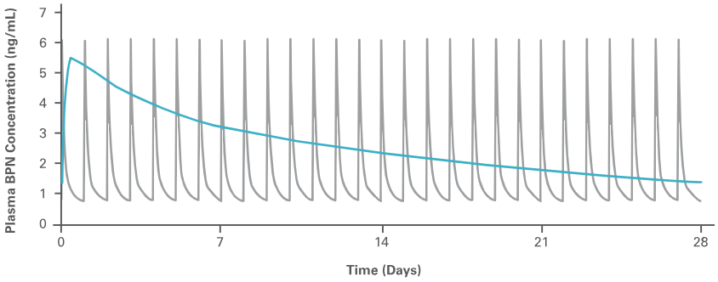

Brixadi Pharmacokinetics
96mg Monthly
Notes:
And in comparison, here is the 96mg monthly dose vs the serum concentrations of a 16mg transmucosal dose.

Slide 28
Brixadi Pharmacokinetics
Pharmacokinetic Parameters | Daily TM |  | Weekly |  |  | Monthly
Mean (SS) | 12mg | 24mg | 16mg | 24mg | 32mg | 64mg | 96mg | 128mg
Cavg,ss (ng/mL) | 1.71 | 2.91 | 2.1 | 2.9 | 4.2 | 2.0 | 2.9 | 3.9
Cmax,ss (ng/mL) | 5.35 | 8.27 | 4.7 | 5.5 | 6.9 | 4.0 | 6.0 | 11.1
Cmin,ss (ng/mL) | 0.81 | 1.54 | 0.8 | 1.4 | 2.6 | 1.3 | 2.0 | 2.1
Notes:
Looking at the kinetics to Brixadi similar to how we viewed Sublocade, lets again compare each weekly and monthly dose to that of transmucousal steady state serum concentrations.
We see that the average concentration at steady state of all brixadi doses is at or above the 2ng/ml concentration.

Slide 29
Brixadi Pharmacokinetics
Pharmacokinetic Parameters | Brxadi Weekly |  |  | Brixadi Monthly |  |  | Sublocade
Mean (SS) | 16mg | 24mg | 32mg | 64mg | 96mg | 128mg | 100mg | 300mg
Cavg,ss (ng/mL) | 2.1 | 2.9 | 4.2 | 2.0 | 2.9 | 3.9 | 3.21 | 6.54
Cmax,ss (ng/mL) | 4.7 | 5.5 | 6.9 | 4.0 | 6.0 | 11.1 | 4.88 | 10.12
Cmin,ss (ng/mL) | 0.8 | 1.4 | 2.6 | 1.3 | 2.0 | 2.1 | 2.48 | 5.01
Notes:
Comparing specifically between the two long acting injections, we can see that the largest average serum concentration is achieved by 300mg Sublocade monthly dosing, with the largest max concentration was 128mg of monthly Brixadi.
Of note, these concentrations were not compared over the same population size or study, this chart was developed using study data across both manufacturers data. Brixadi and Sublocade have never been compared in a study.

Slide 30
Brixadi Side Effects
Similar to SL buprenorphine apart from injection site reactions:
Common (>5%)
  Constipation
  Headaches
  Nausea/Vomiting
  Increased hepatic enzymes
Injection Site related
  Pruritis
  Pain
Notes:
Side effects during phase 2 and 3 studies were again similar compared to that of sublingual buprenorphine, and were therefore similar to Sublocade.

Slide 31
Brixadi
Contraindications:
Precautions
  Allergies to components
  GI Obstruction (Paralytic ileus)
  Significant Respiratory Depression
  CNS Depression
  Serotonin Syndrome
  Hepatic Dysfunction
  Adrenocortical Insufficiency
  Respiratory Diseases
  Seizure Disorders
  Older Adults
Notes:
As was the case with Sublocade, Brixadi shares similar contraindications and precautions than that of all buprenorphine products.

Slide 32
Brixadi vs Sublocade
Medication | SUBLOCADE | BRIXADI (weekly) | BRIXADI (monthly)
Storage Requirement | Refrigerated | No Refrigeration
Strength/Volume | 100 mg / 0.5 mL 300 mg / 1.5 mL | 8 mg / 0.16 mL 16 mg / 0.32 mL 24 mg / 0.48 mL 32 mg / 0.64 mL | ​64 mg / 0.18 mL 96 mg / 0.27 mL 128 mg / 0.36 mL
Needle Size | 19-gauge 5/8 inch | 23-gauge ½ inch
Injection angle | 45° | 90°
Injection Sites | Abdomen | Abdomen, Thigh, Buttock, Arm
Notes:
As a final comparison, here is a lot of what we observed in one, hopefully helpful, table comparing the storage requirements, strengths, volumes, needle size, injection technique, and injection sites.

Slide 33
Factors to Consider
Patients in transition; incarceration, ED, rehabilitation
Concerns with adherence
Providers with concerns of misuse
Patient Preference/Convenience
Notes:
As a final thought, lets leave with some considerations when using Long Acting Buprenorphine Injections.
Long acting injections aren’t for everyone, and each patient may tolerate or experience various injections and strengths differently.
With that, long acting injection may be ideal for patients in the following circumstances.
Where follow up care is unknown or unlikely, LAI are a great way to ensure compliance for a given duration.
Similarly, for providers or patients who have concerns with misuse or remember to take their SL doses of buprenorphine, long acting injections are a great solution to these concerns.
As well, the more steady serum concentration and long half life seen with long acting injections can lead to more steady tolerability and minimal withdrawal during missed or unexpected discontinuation of treatment.

Slide 34


Questions?
Notes:
I hope everyone found this presentation insightful.
What questions or additional thoughts do we have?

