Slide 1

Reactive Airway Diseases:
Asthma, COPD, Anaphylaxis (-ish)
Michael T. Mozer, DO
UNM EMS Fellow
3/5/2024

Slide 2



Presenter Biography
Medical school in Maine
Completed residency in Phoenix, AZ
ER Physician/EMS Fellow at University of New Mexico
Professional interest in austere/rural emergency care, medical education, and delivery of high quality emergency care.

Slide 3

Disclosures
No financial disclosures

Slide 4


I’ve got this!

Slide 5


Slide 6

Outline
Anatomy Review
Respiratory Assessment
Review of Pathophysiology/Treatment
  Asthma
  COPD
  Anaphylaxis
Summary

Slide 7
Outline
Anatomy Review
Respiratory Assessment
Review of Pathophysiology/Treatment
  Asthma
  COPD
  Anaphylaxis
Summary

Slide 8
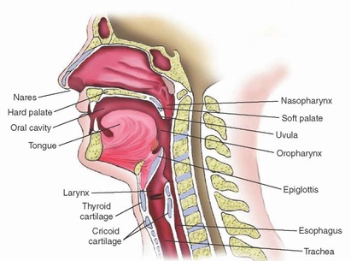

Slide 9
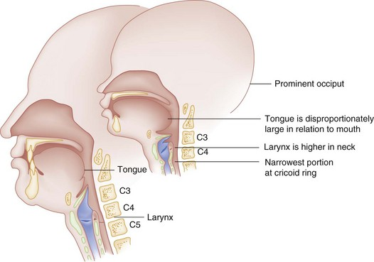
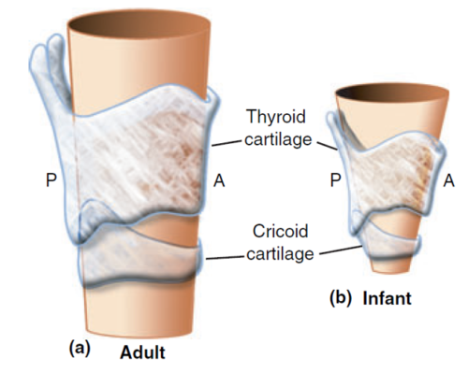
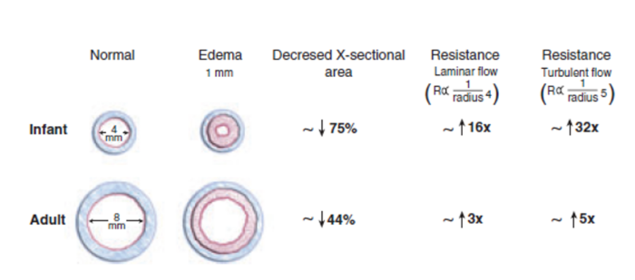

Slide 10
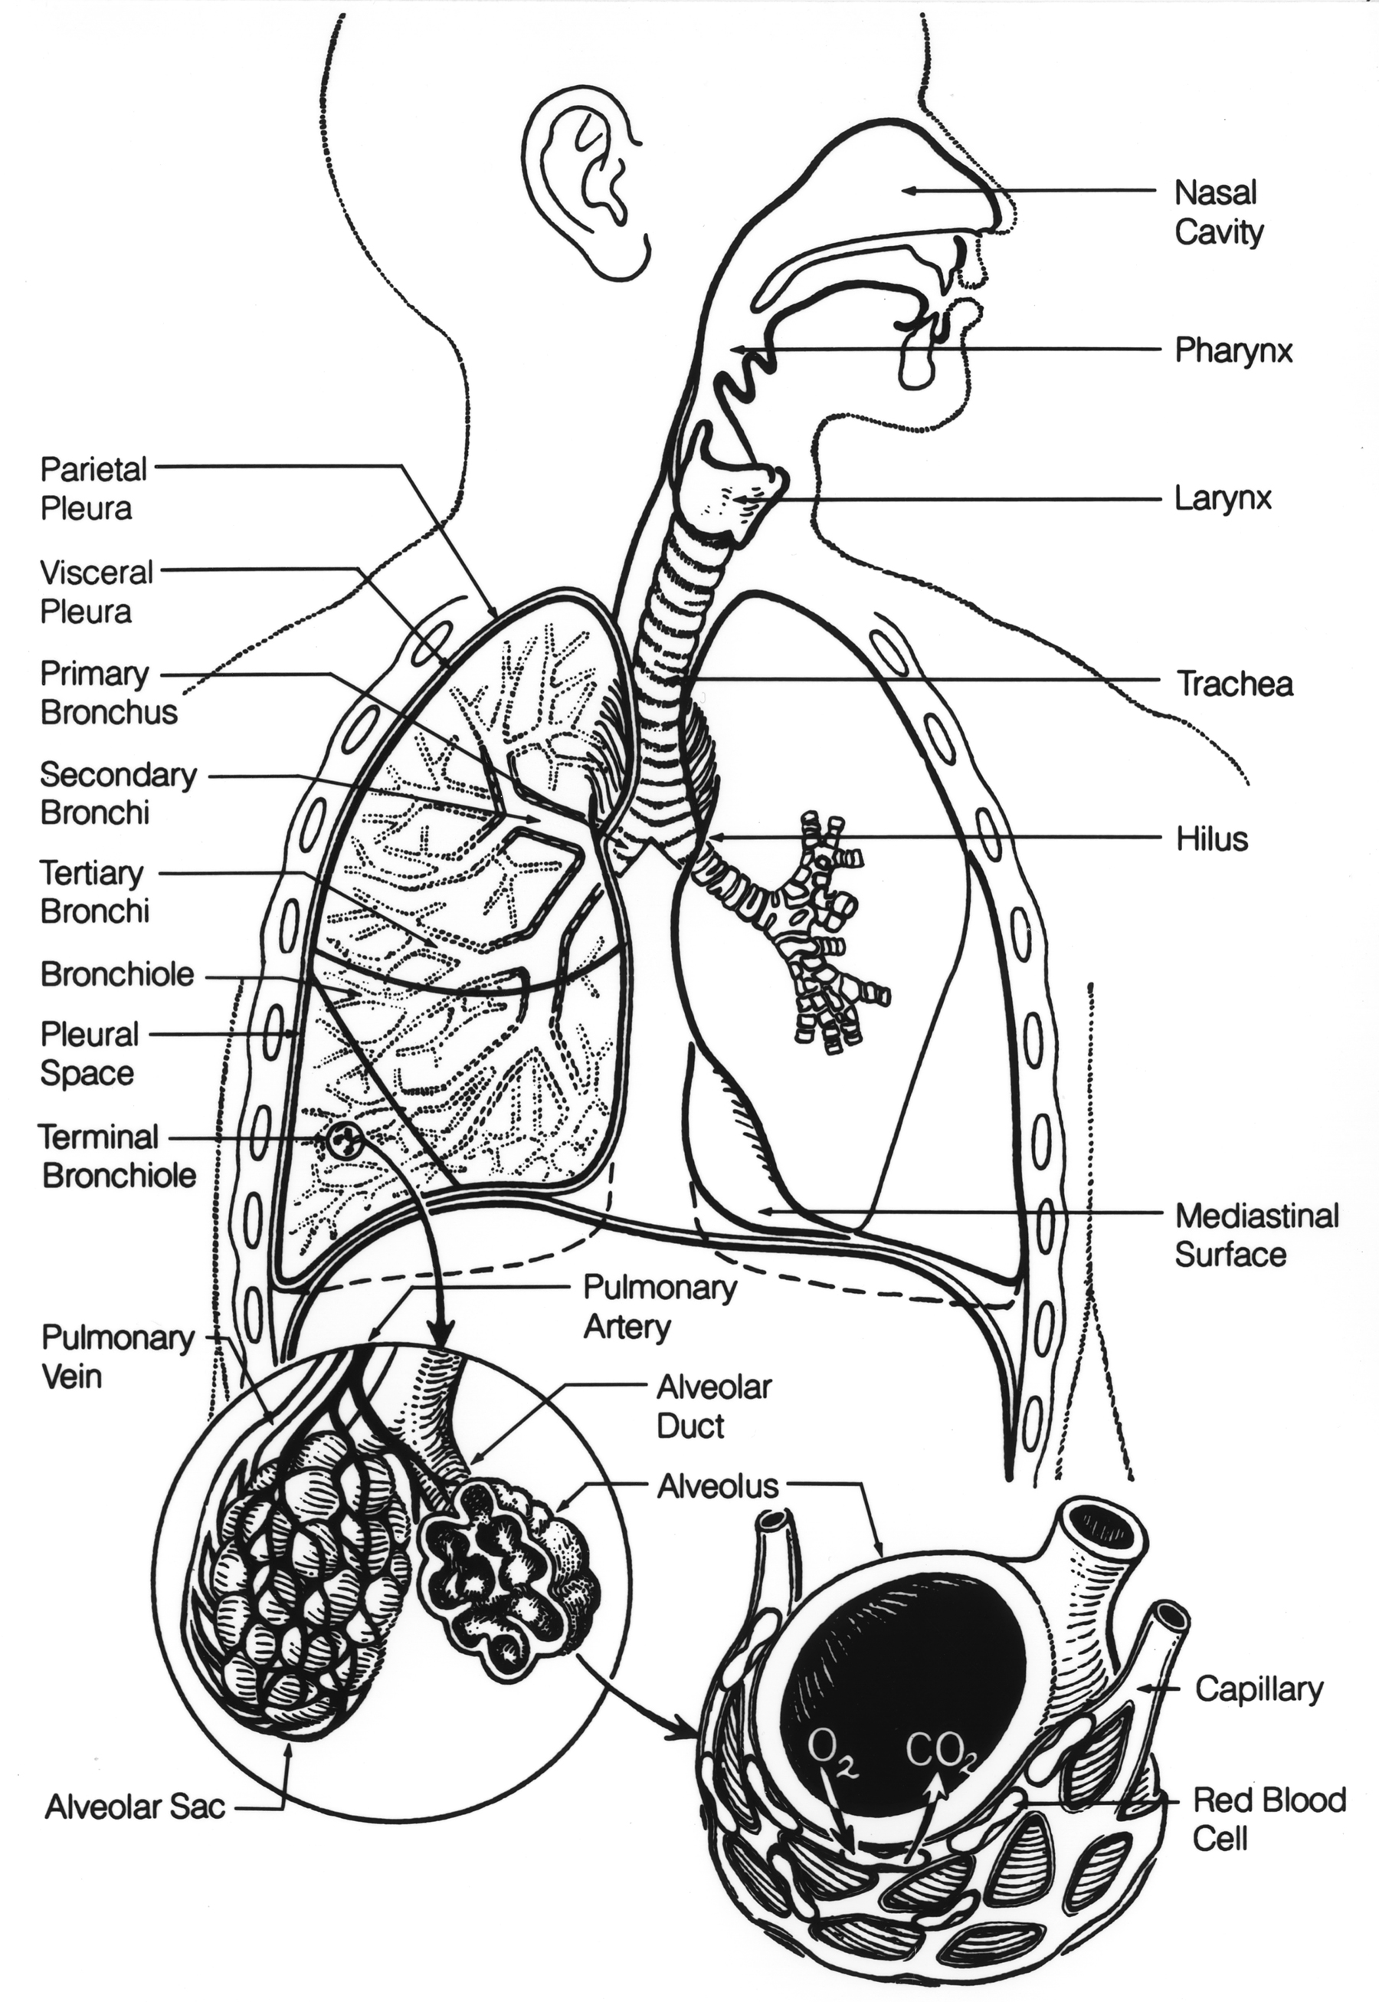

Slide 11
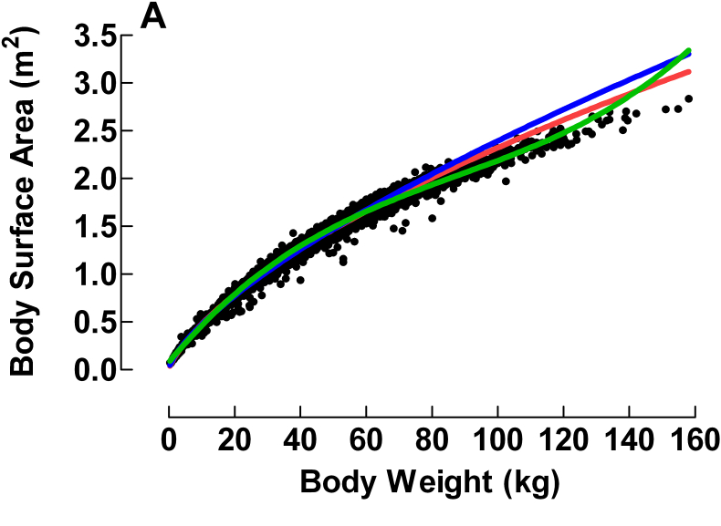
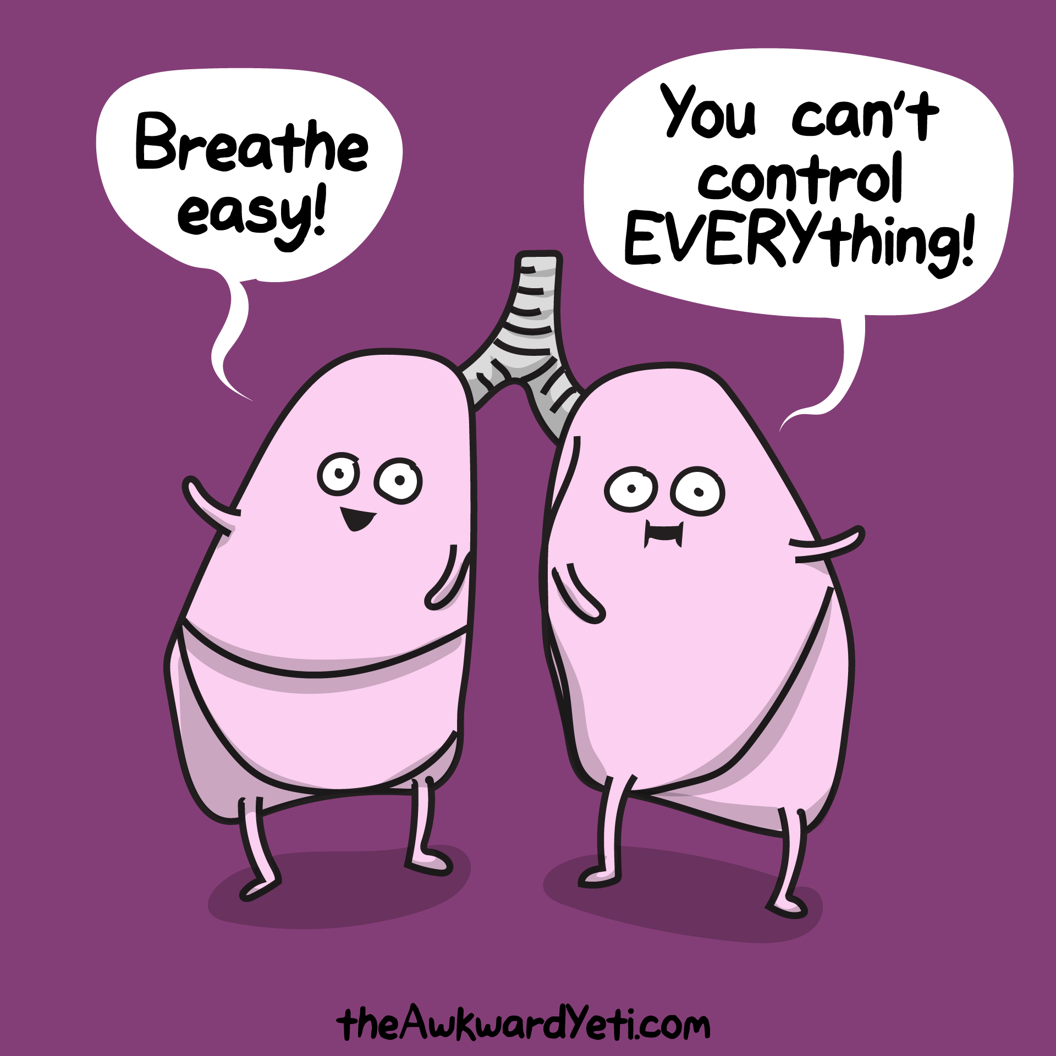
Anatomy Variability – Body Surface Area
Notes:
Variability in shape, size, and response to inflammation
Higher risk of obstruction , particularly below vocal cords
Lung volumes significantly different (estimated physiologic volume = 5-8 mL/kg IBW)
Pediatric Airway -> softer, more flexible cartilage, large occiput, large tongue (more likely to have transient obstruction), small nares
Akkawi El Edelbi R, Lindemalm S, Nydert P, Eksborg S. Estimation of body surface area in neonates, infants, and children using body weight alone. Int J Pediatr Adolesc Med. 2021 Dec;8(4):221-228. doi: 10.1016/j.ijpam.2020.09.003. Epub 2020 Sep 19. PMID: 34401446; PMCID: PMC8356100.

Slide 12
Age Appropriate Vital Signs
Age (yr) | RR (Br/min) | HR (bpm) | SBP (mmHg)
Newborn | 30-60 | 85-200 | 60-90
<1 | 30-60 | 100-160 | 87-105
1-2 | 24-40 | 90-150 | 95-105
2-5 | 22-34 | 80-140 | 95-110
6-12 | 18-30 | 70-120 | 97-112
> 12 | 12-16 | 60-100 | 112-128
Estimated Hypotension (1-10 y/o): < 70 + 2(age in years)
Notes:
Because of pediatric patient’s size and lung volume, they have much higher respiratory rates to maintain SpO2
They also have a larger proportion of deadspace for each breath they take (lungs are not as big or developed)

Slide 13
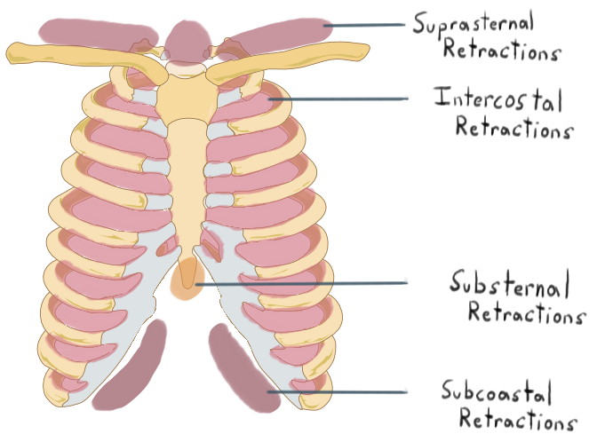
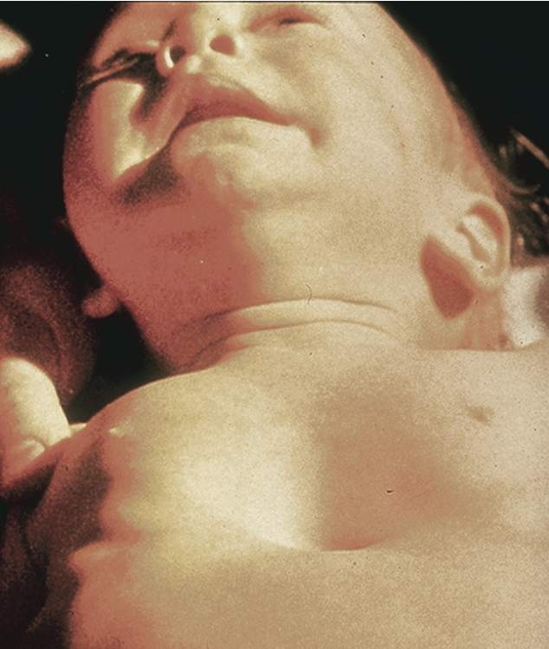
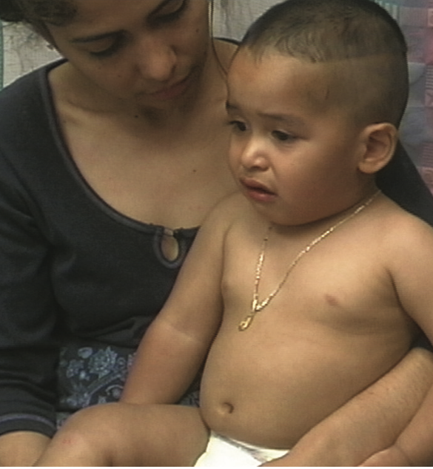
Work of breathing
Notes:
Assess from distance if possible as difficult to interpret in crying child
Signs of increased WOB
Sniffing position
Tripoding
Retractions, grunting
Head-bobbing
Seasaw respirations
Slowing respirations can be an ominous sign of fatigue/failure
Tachypnea without an apparent respiratory cause can be one of the first indications of increased metabolic demand (e.g. sepsis), shock state, metabolic disease (DKA)
Baseline tachypnea is never normal

Slide 14
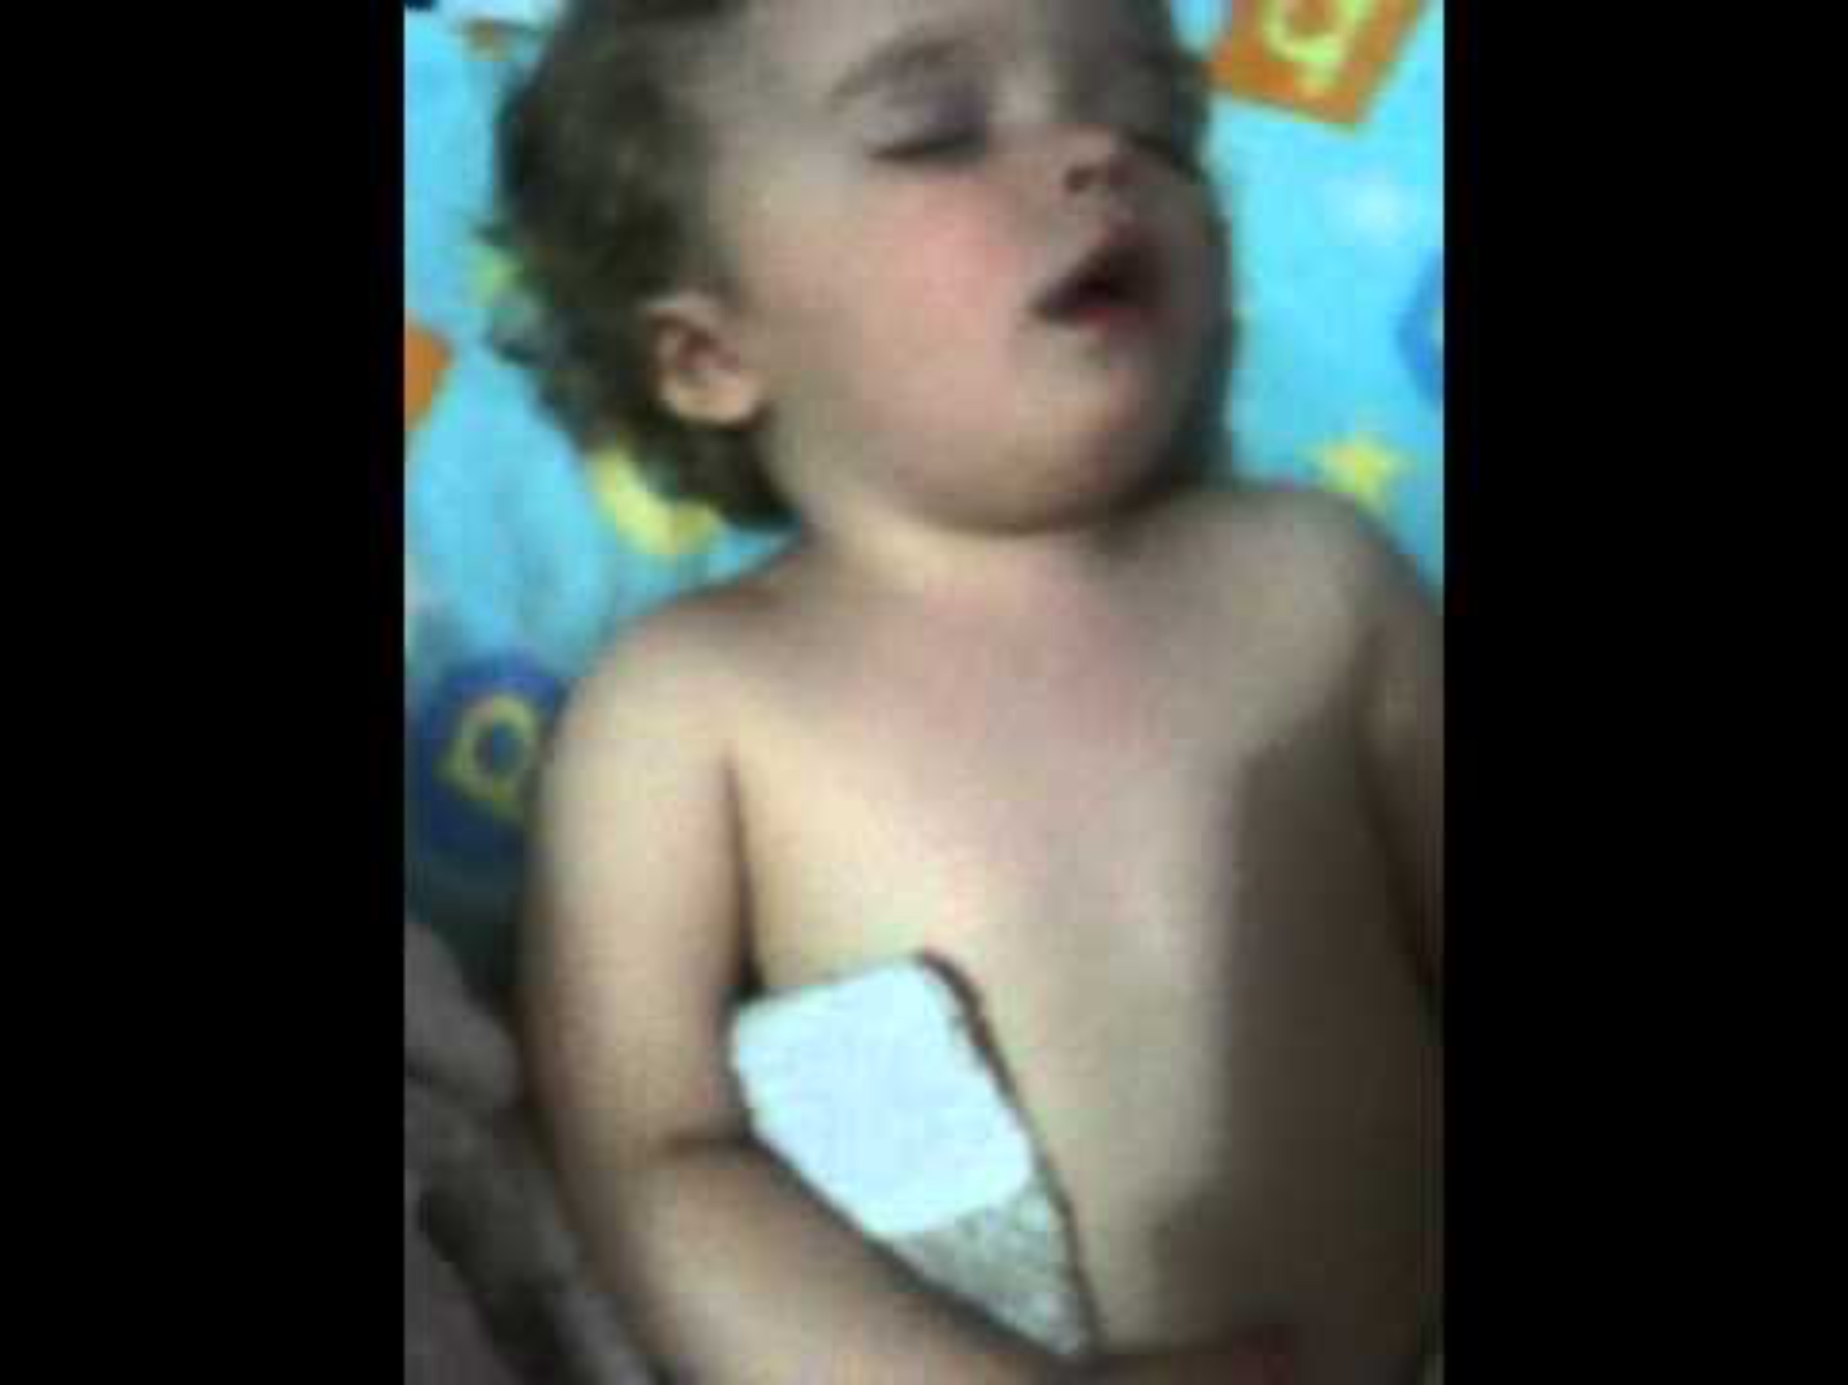
Respiratory Distress

Slide 15
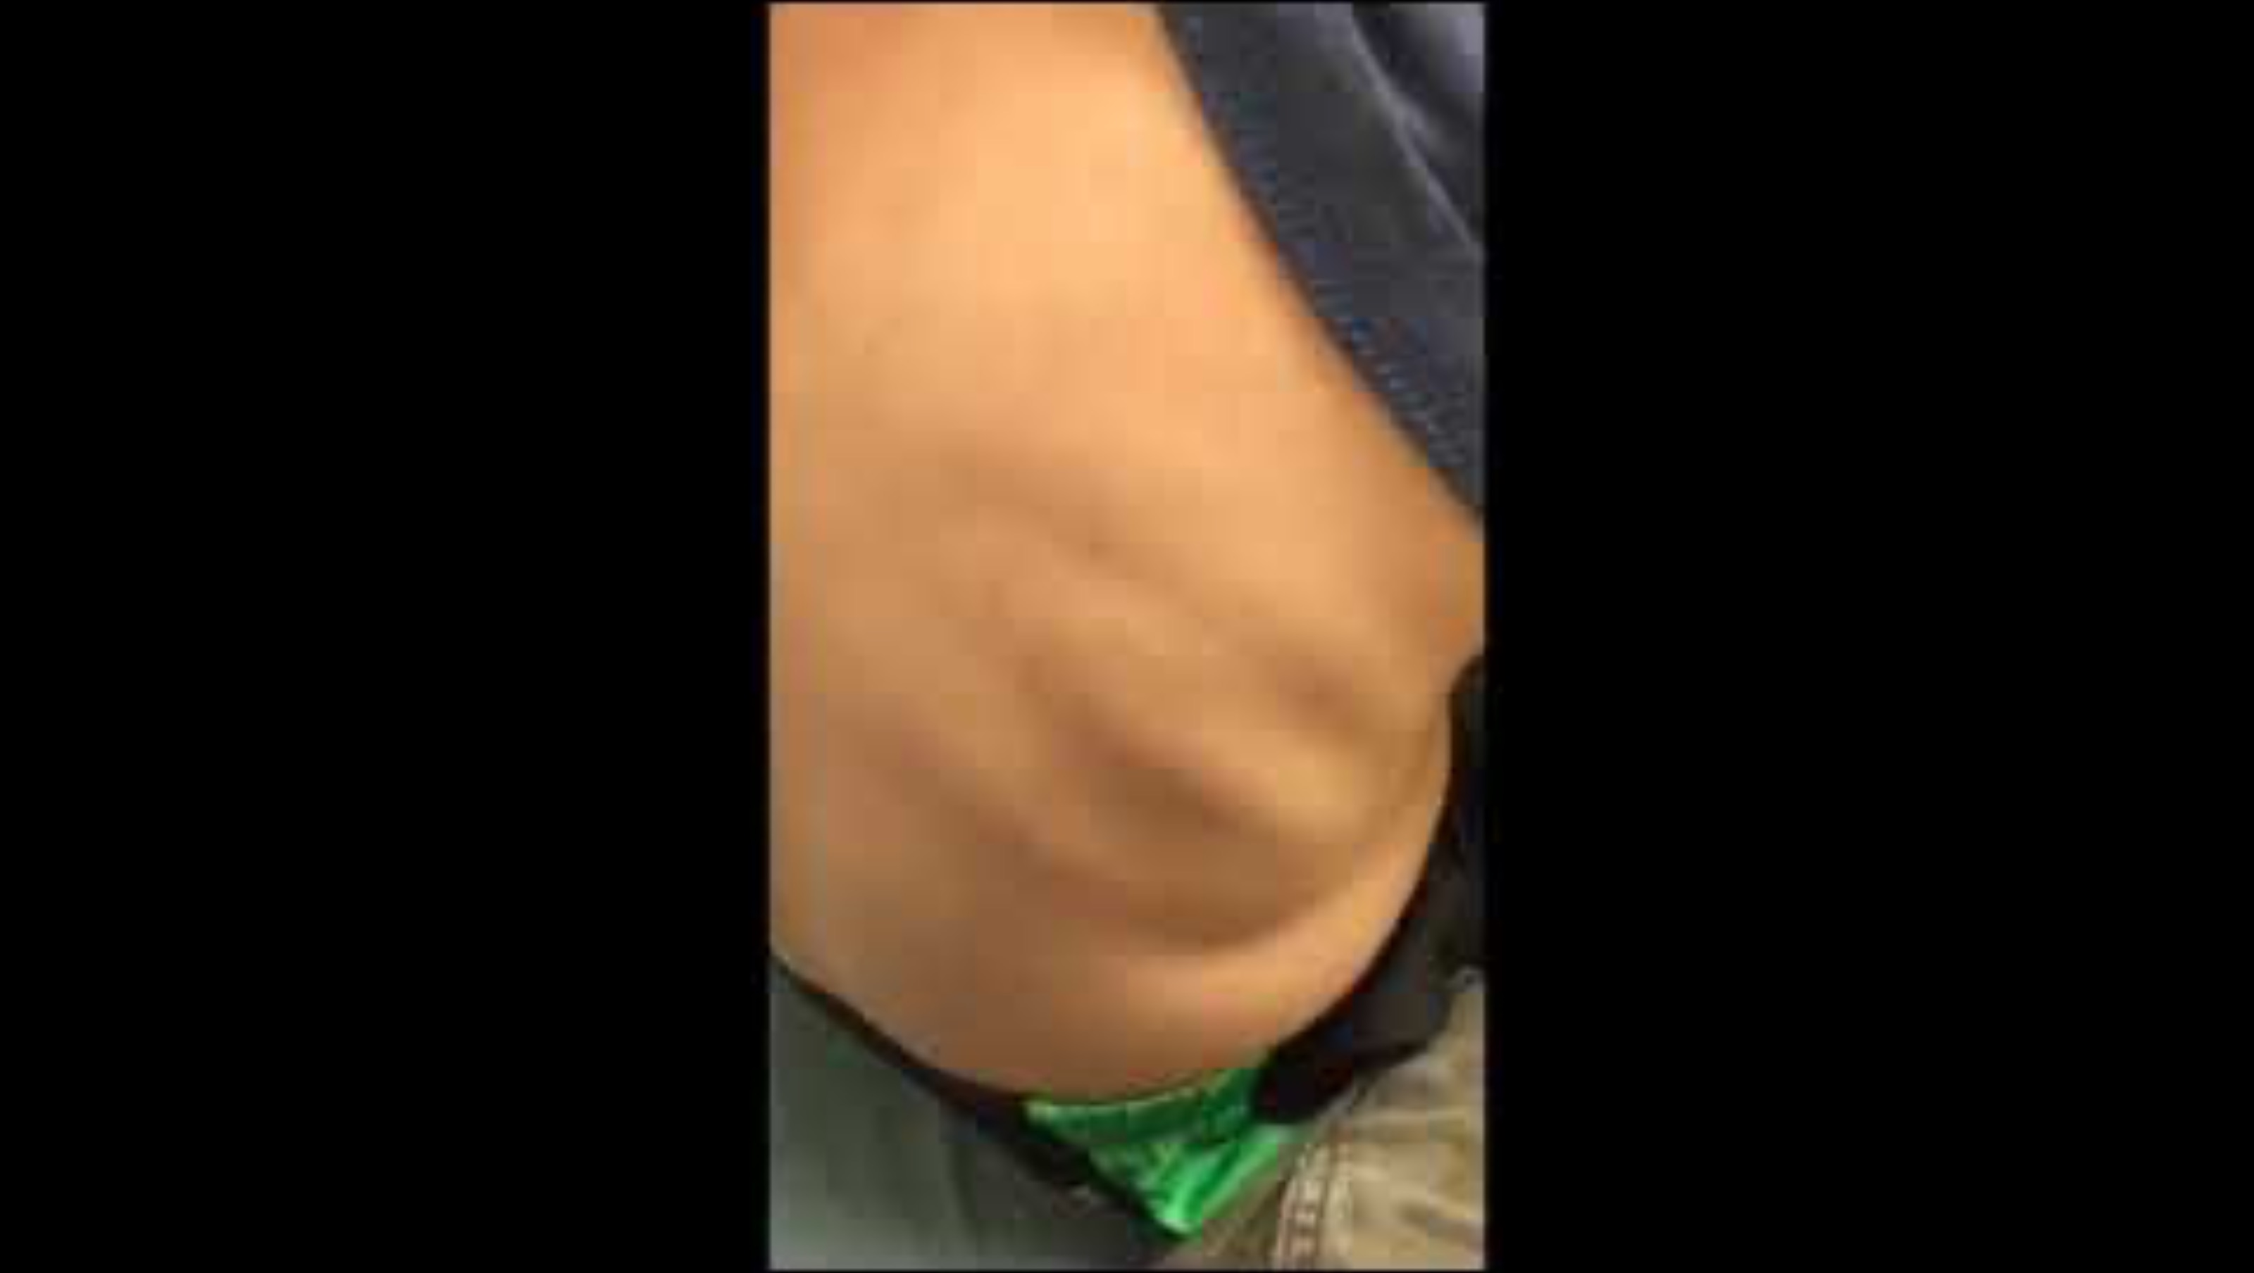
Intercostal Retractions

Slide 16
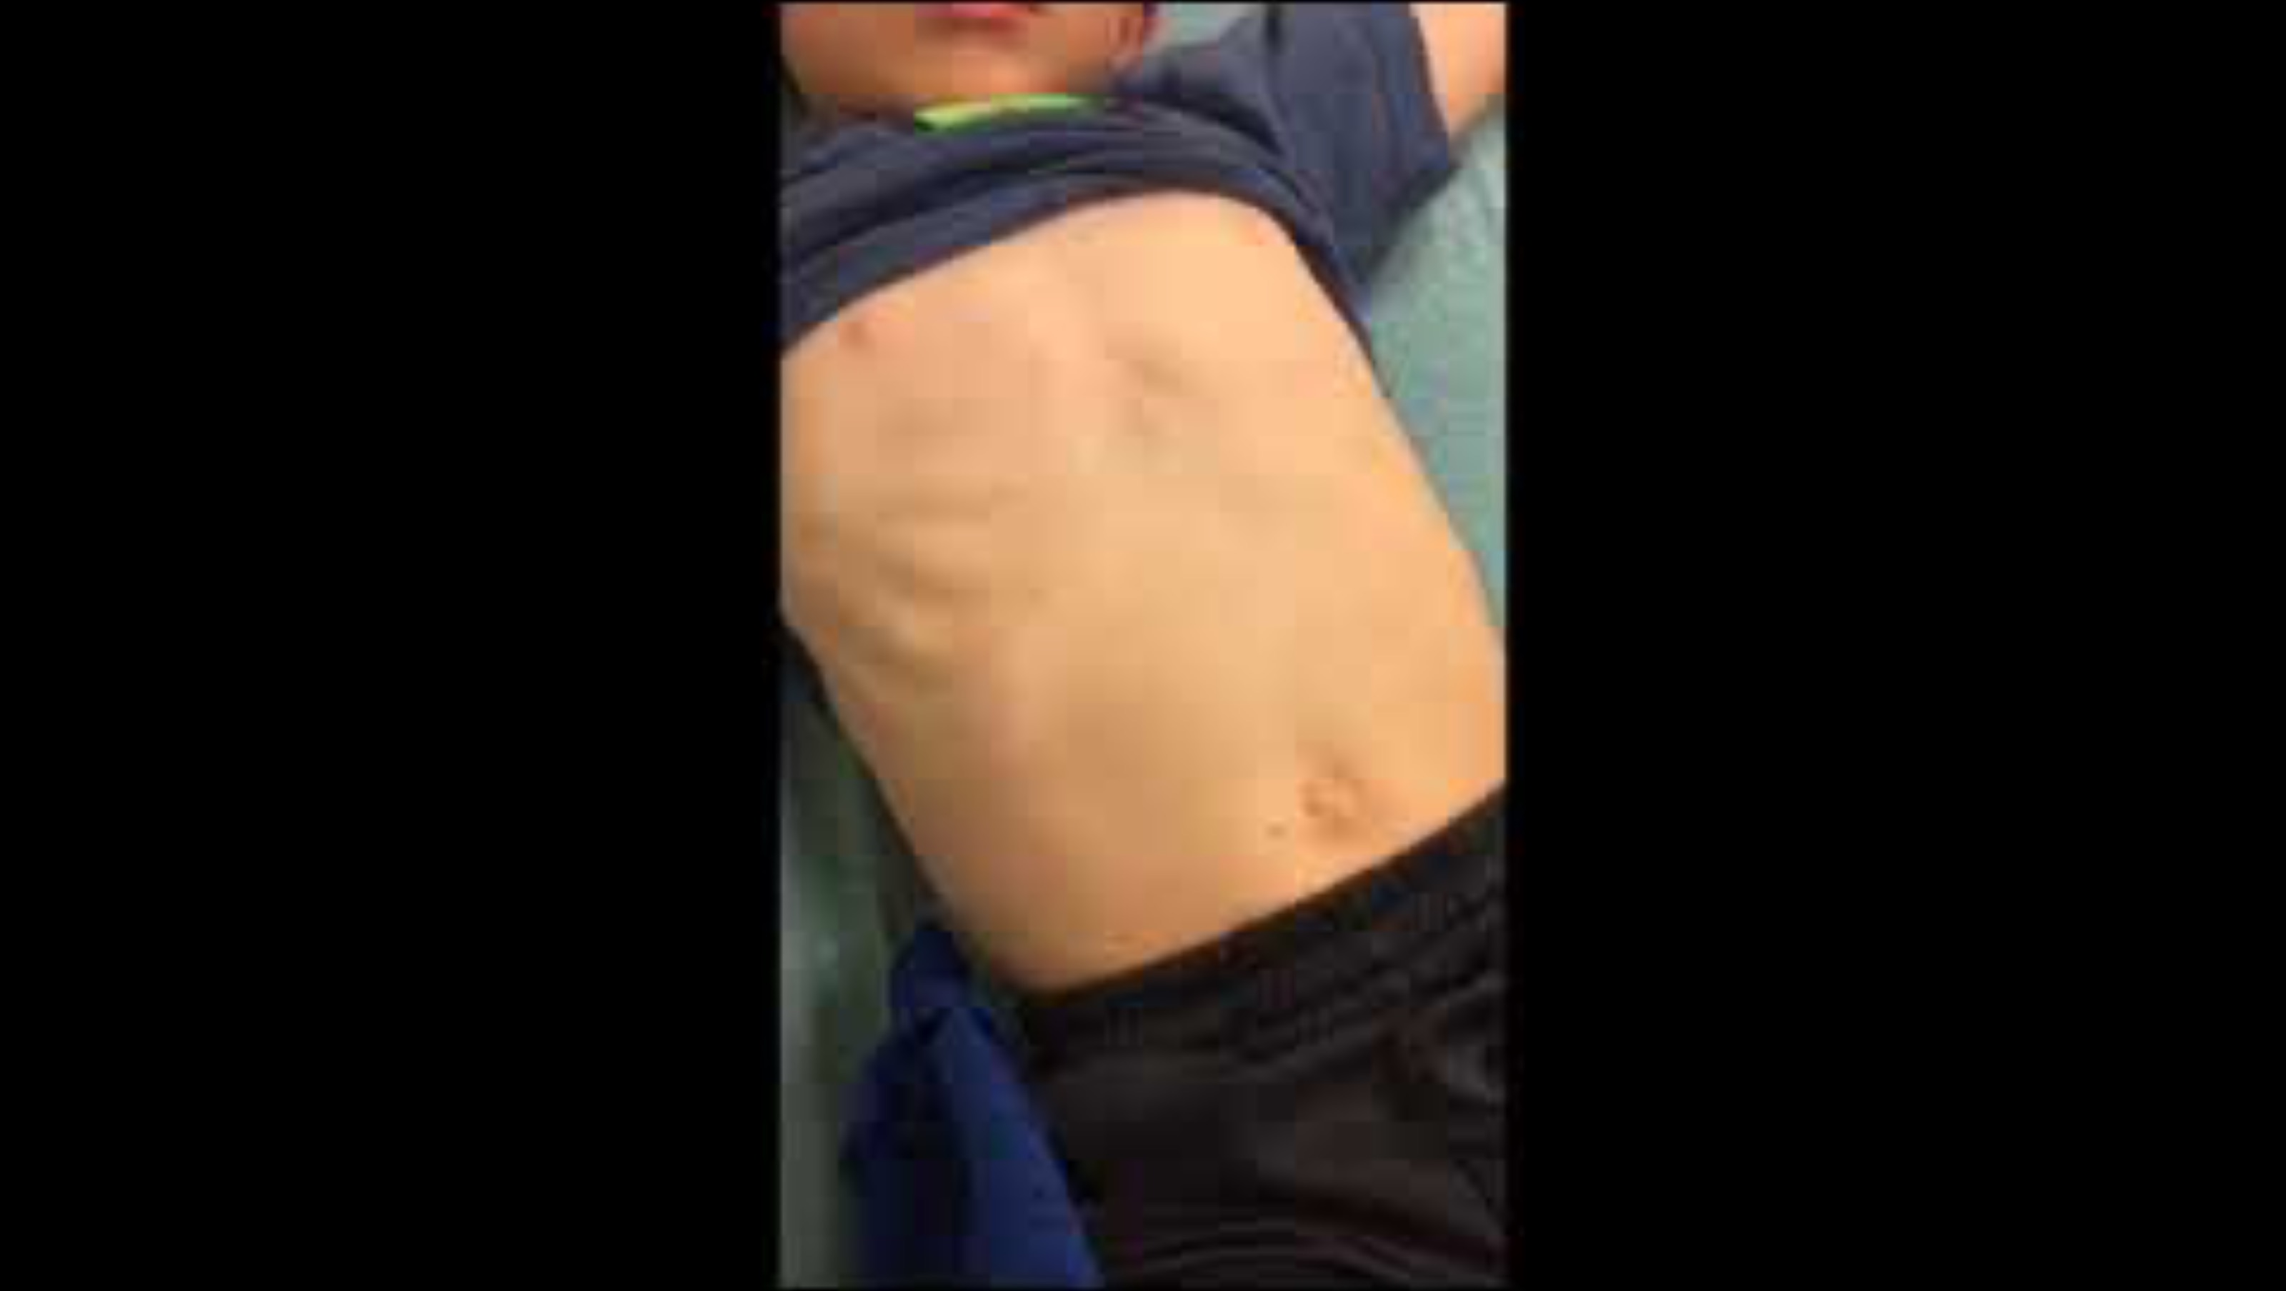
Subcostal Retractions

Slide 17
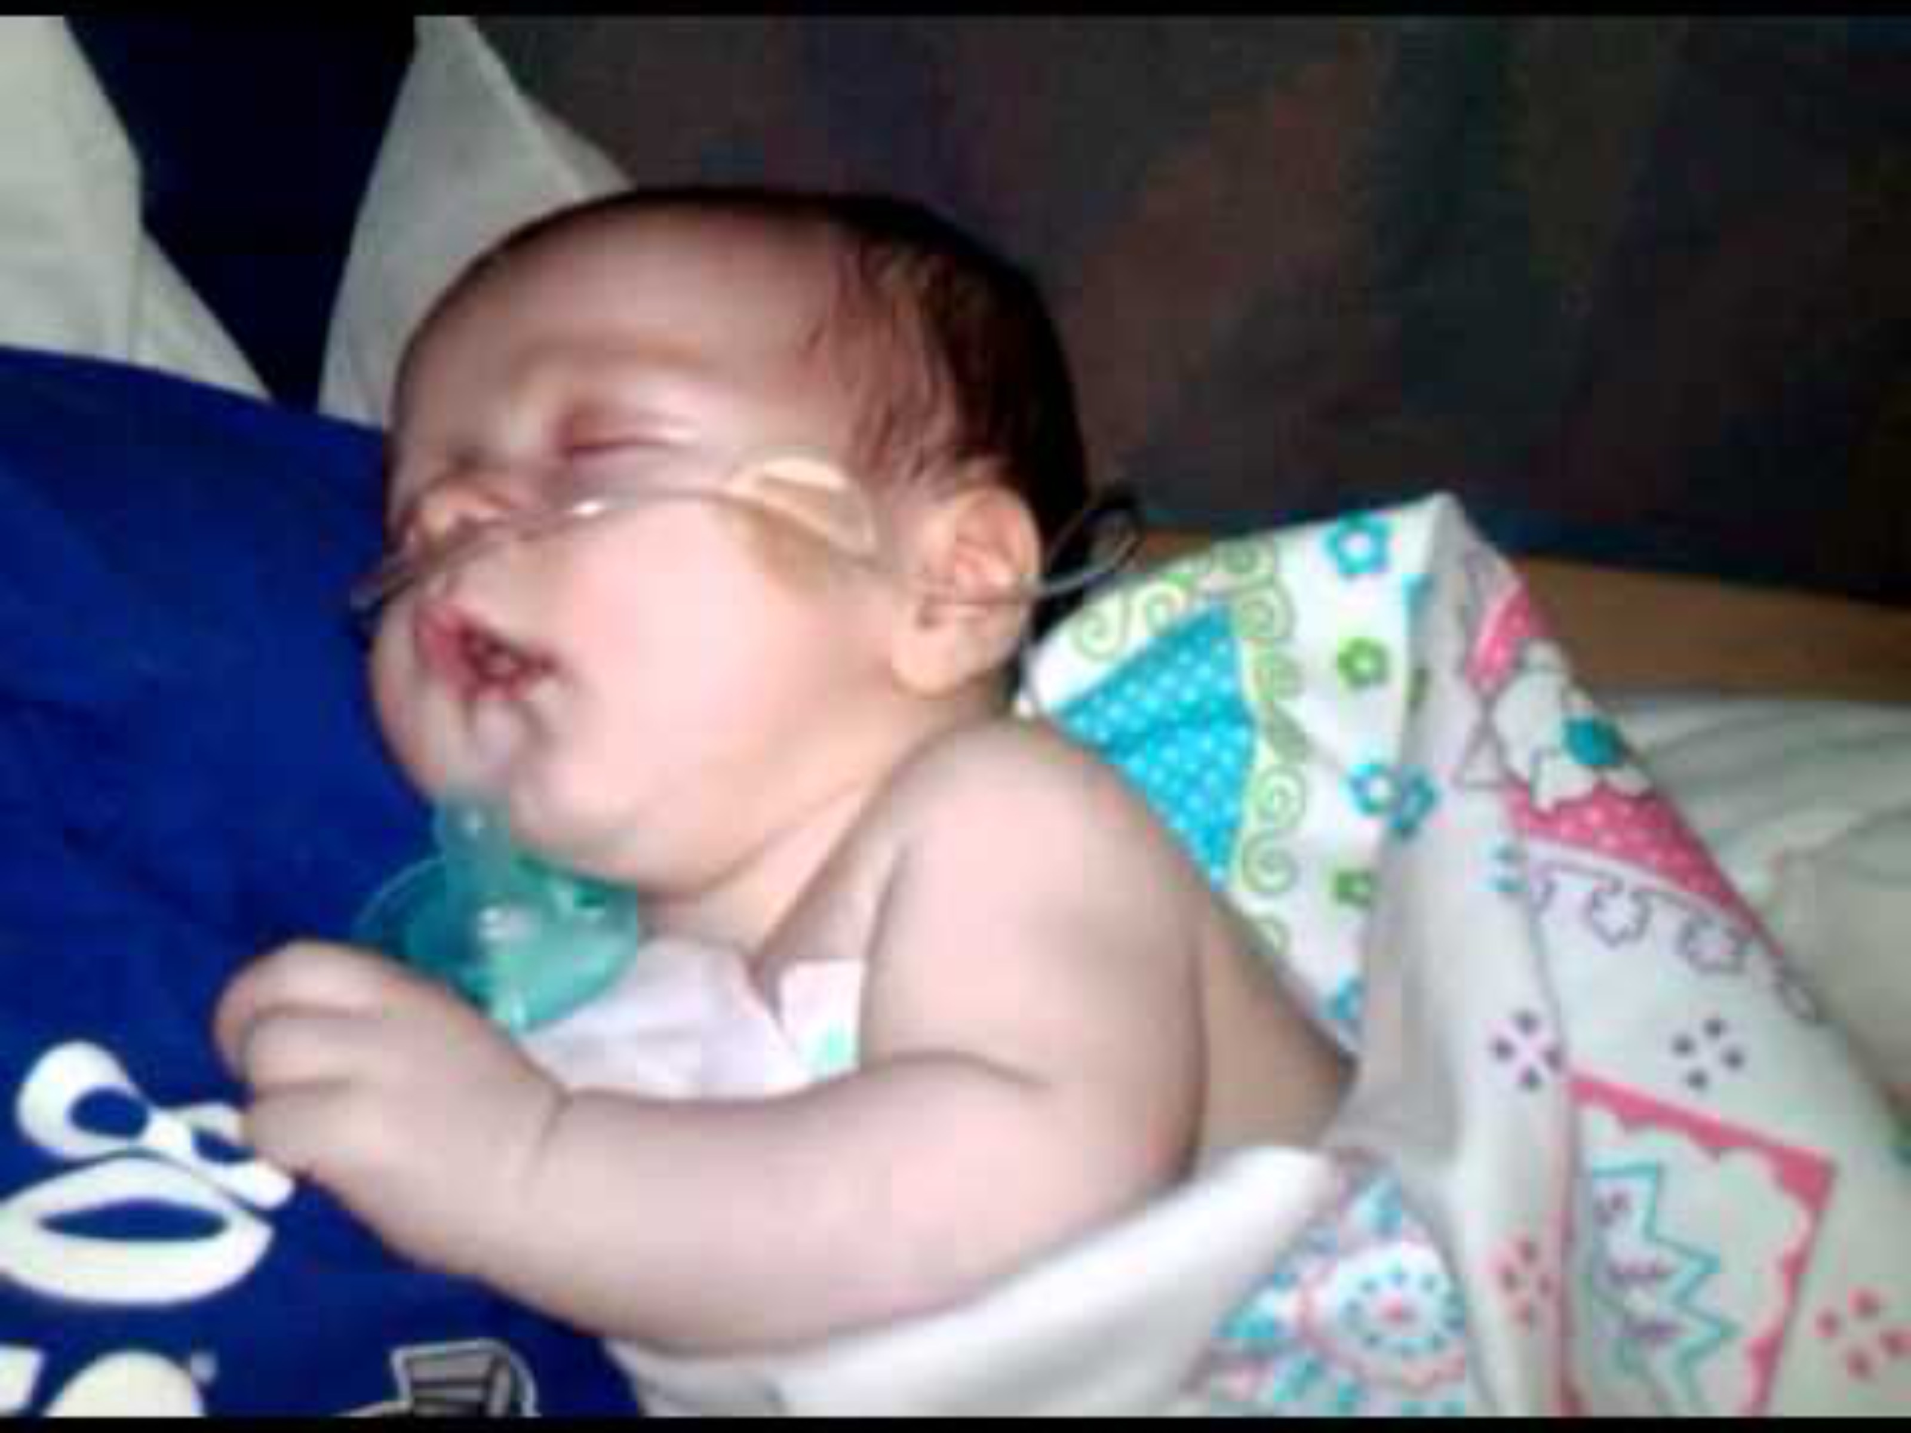
Head Bobbing

Slide 18
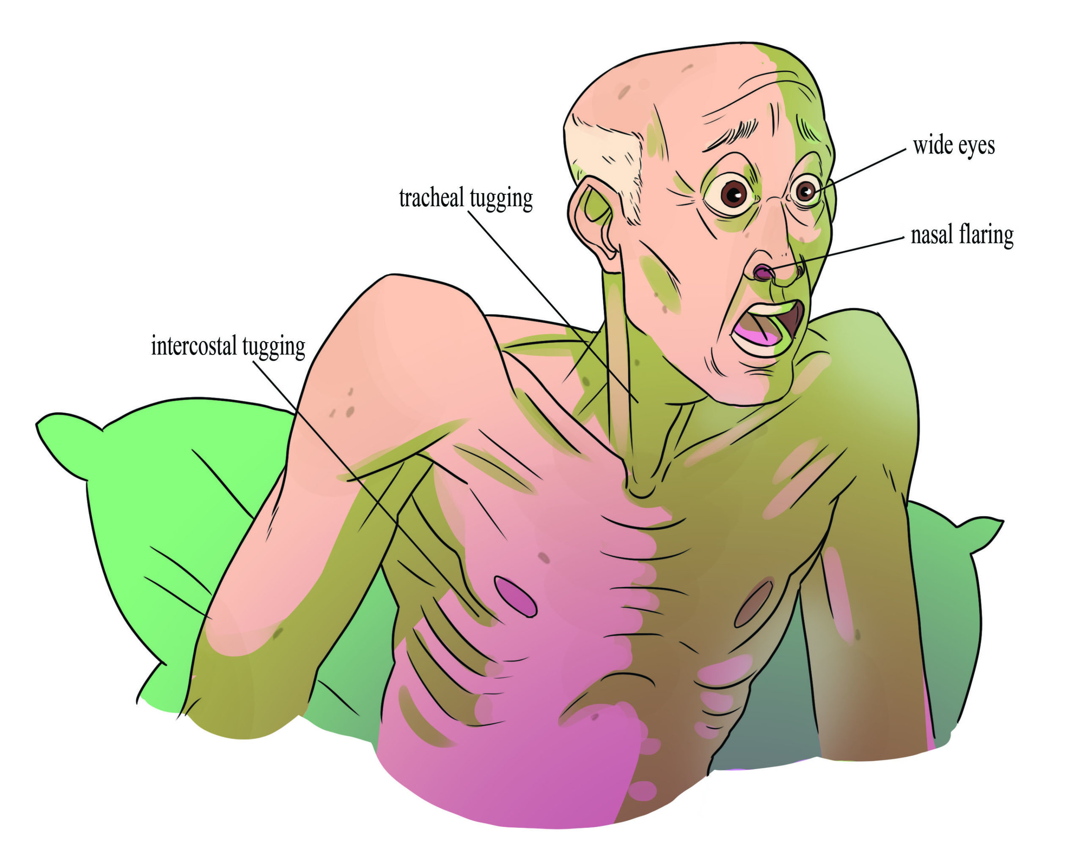
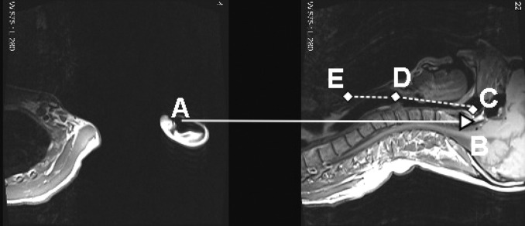
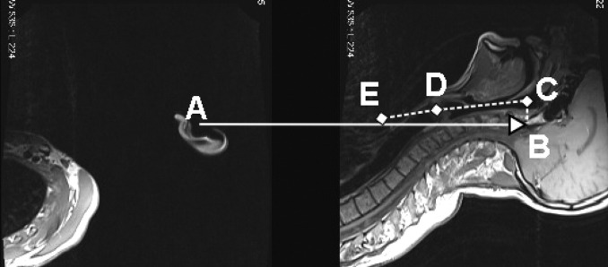
Adult Respiratory Distress
https://opentextbc.ca/vitalsignmeasurement/chapter/respiration/
Image credit – Paige Jones
Greenland KB, Edwards MJ, Hutton NJ. External auditory meatus-sternal notch relationship in adults in the sniffing position: a magnetic resonance imaging study. Br J Anaesth. 2010 Feb;104(2):268-9. doi: 10.1093/bja/aep390. PMID: 20086071.
Notes:
Greenland et al in the British journal of Anesthesia – 2010
Top – neutral position
Bottom – sniffing position

Slide 19
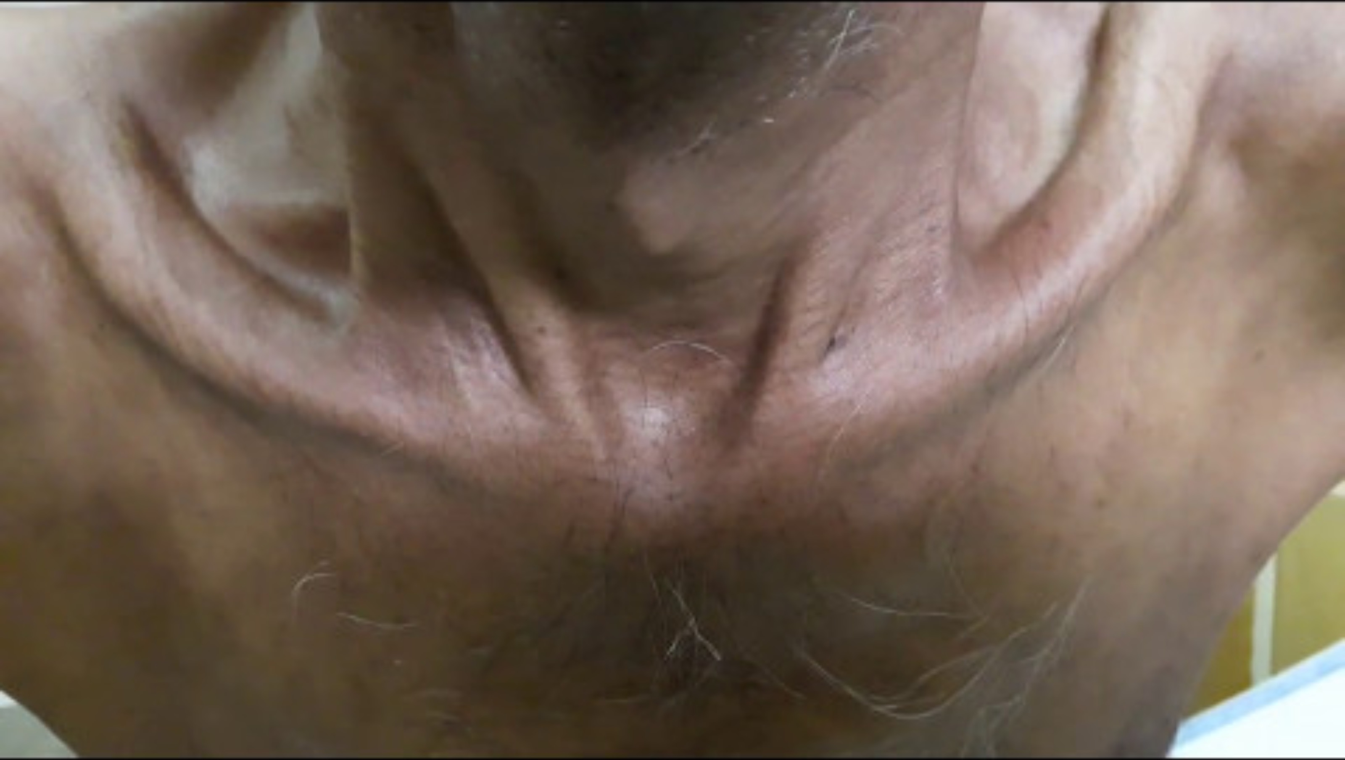

Slide 20
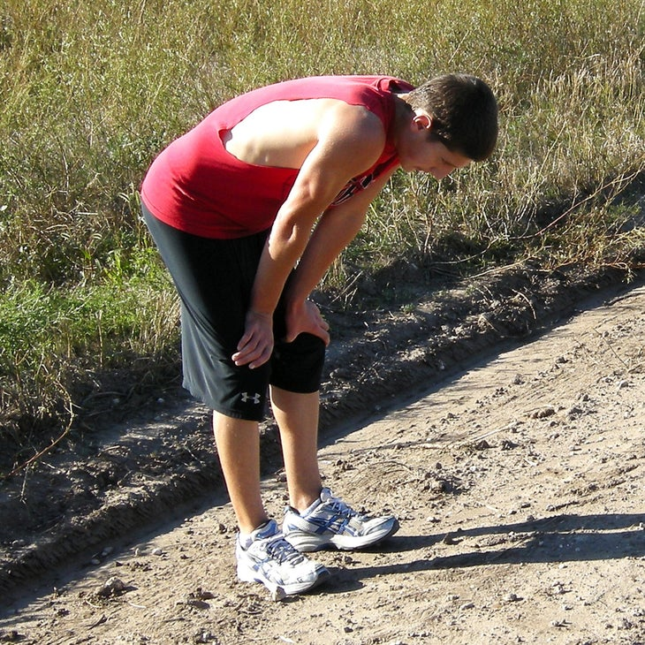
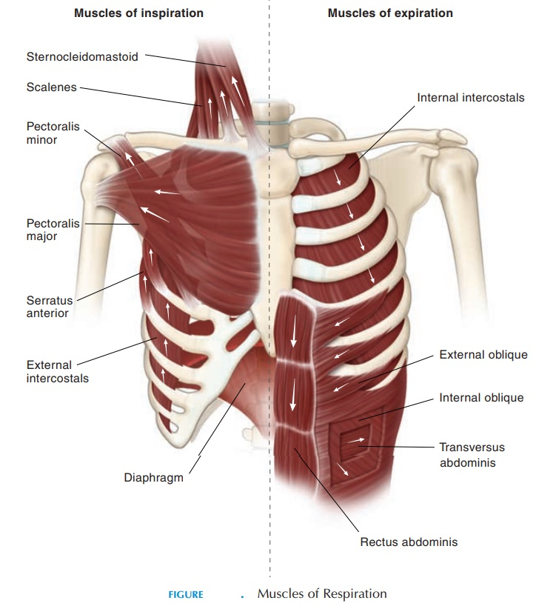
Adult Respiratory Distress

Slide 21
Outline
Anatomy Review
Respiratory Assessment
Review of Pathophysiology/Treatment
  Asthma
  COPD
  Anaphylaxis
Summary

Slide 22
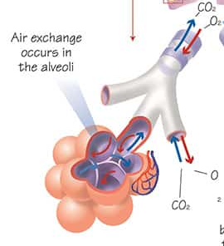
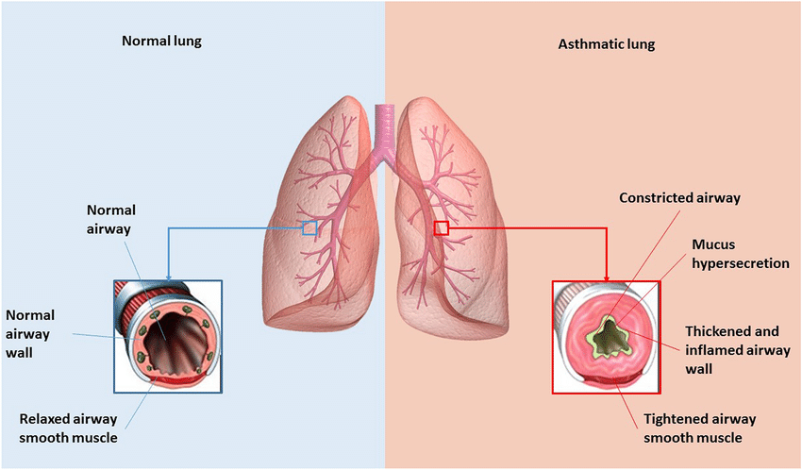
Asthma
Shrastri et al. 2021, Inflammopharmacology
Notes:
Shastri, Madhur & Chong, Wai Chin & Peterson, Gregory & Patel, Rahul & Mahmood, Malik & Kumar Chellappan, Dinesh & Hansbro, Nicole & Shukla, Shakti & Hansbro, Philip & Dua, Kamal. (2021). Emerging concepts and directed therapeutics for the management of asthma: regulating the regulators. Inflammopharmacology. 29. 10.1007/s10787-020-00770-y.
https://emcrit.org/ibcc/asthma/

Slide 23
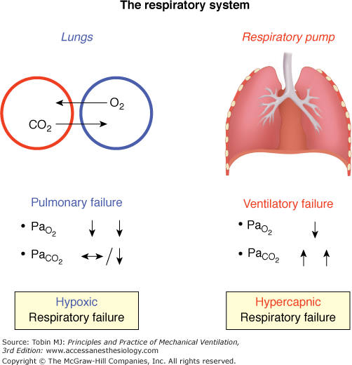
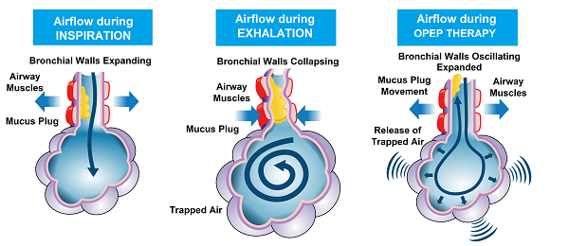
What is the primary problem in Asthma?
https://airphysioaustralia.com.au/smoke-doesnt-cause-asthma-attacks-it-causes-respiratory-attacks/
Notes:
Is it ventilation or oxygenation?
A component of both, but ultimately VENTILATION is the primary problem, with patients unable to move air in and out of the lungs
Moving air in and out (Ventilation)
Air is trapped after inspiration
CO2 remains in the lungs, O2 cannot get in

Slide 24

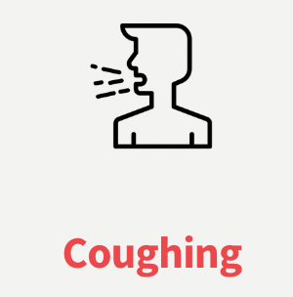
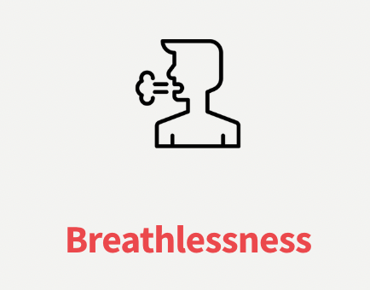
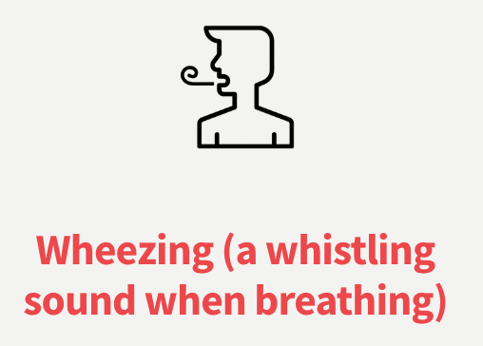




Signs and Symptoms of Asthma Exacerbation
In Severe Distress
Notes:
Wheezing
Sometimes no movement
Tachypnea, pursed lips
Dry cough
Long expiratory phase, short inspiratory phase
Agitation/Anxiety -> first signs of cerebral hypoxia
In severe distress
Diaphoresis
Altered mental status
“Silent” chest

Slide 25

Asthma Presentation
Notes:
Note the short inspiration with long exhalation phase
Note the subcostal/intercostal retractions

Slide 26
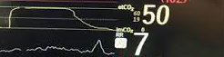

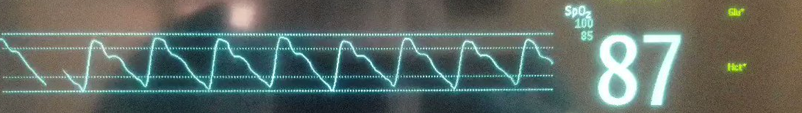
Asthma - Decompensation
Notes:
Decreasing respiratory rate
Worsening altered mental status
Increasing EtCO2
Persistent Hypoxia
Bradycardia (late and BAD finding

Slide 27
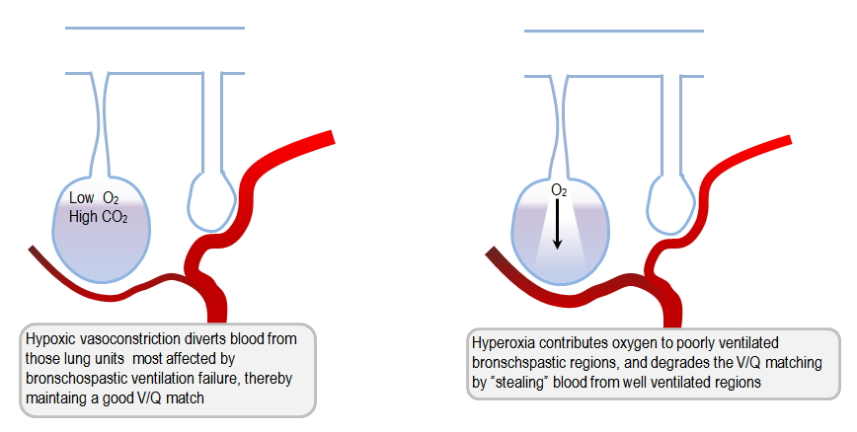
Treatment approach – Target the problem
Airway
Suctioning (as needed)
Adjuncts
  NPA/OPA
Breathing
Monitor SpO2/EtCO2
Consider CPAP
Consider BVM
Oxygenation?
  Target ~94% SpO2 (normoxia)*
  Hyperoxia can worsen respiratory status!
Notes:
This is a BLS (non-intubation) approach
Reference:
https://derangedphysiology.com/main/required-reading/respiratory-medicine-and-ventilation/Chapter%20611/ventilation-strategies-status-asthmaticus-0

Slide 28
Oxygen Therapy
System | Flow Range | Oxygen Delivered (normal breathing)
Nasal Cannula | 1/8 - 4 L | 24 - 40%
Blow by Oxygen | 15 L | 24%
Simple Facemask | 5 - 15 L | 40 - 60%
Non-rebreather | 10 - 15 L | 80 - 90%

Slide 29
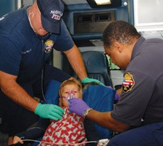

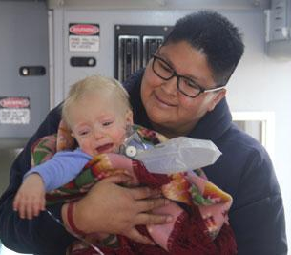
Peds note - Aggressively Treat Hypoxia
Respiratory failure is the leading cause of arrest in pediatric patients
Don’t just treat a number
Treat the work of breathing

Slide 30
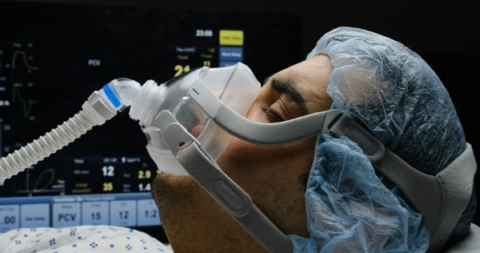
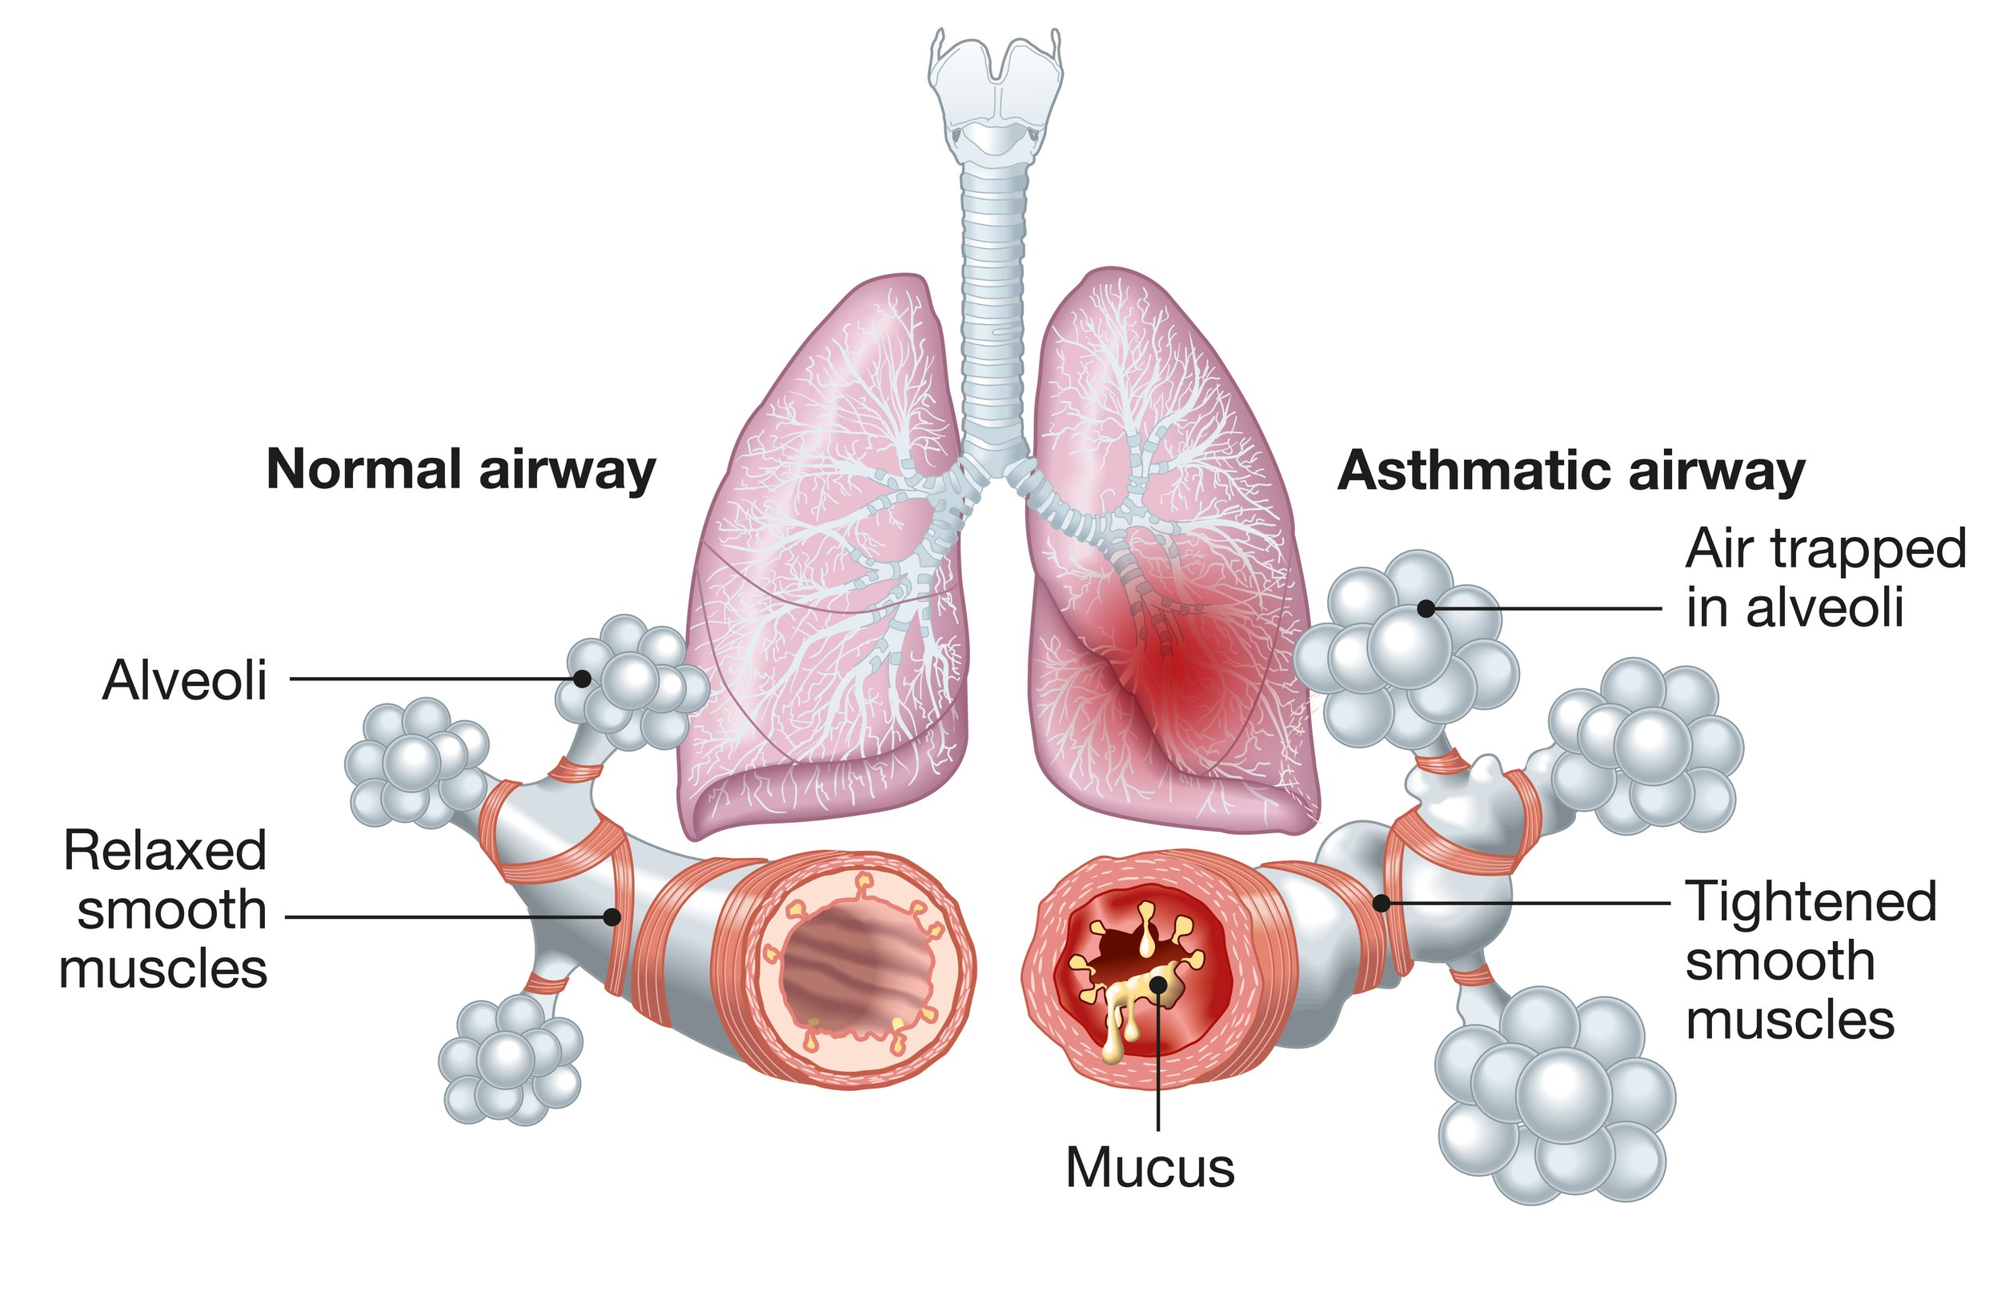
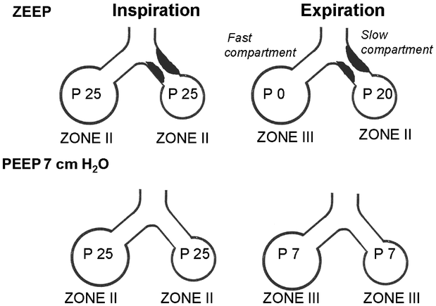
Respiratory Support - CPAP
Notes:
PEEP is in the bottom panes
Demonstrates the balance of pressure in the alveoli by maintaining patent airways that have been narrowed by inflammation, further exacerbated by forced exhalation (pursed lips, thoracic muscle use etc.)
Picture:
https://www.canbreathe.org.nz/about-asthma
https://www.emra.org/emresident/article/device-series-nppv
Figure:
Jardin, F., Vieillard-Baron, A. Right ventricular function and positive pressure ventilation in clinical practice: from hemodynamic subsets to respirator settings. Intensive Care Med 29, 1426–1434 (2003). https://doi.org/10.1007/s00134-003-1873-1

Slide 31
CPAP - Considerations
Contraindications?
  No respiratory drive
  Hypotension
  Head or facial trauma (severe)
  Unable to protect airway (N/V)
  Severe gastric distention
  Pneumothorax/penetrating chest trauma
  Equipment failures (poor fit)
Notes:
SBP <90 for adults or peds adjusted for age (1-10y/o) (<70 + Age in years x2)
Coaching the patient as you are applying the mask will help with compliance and comfort! You don’t always needs meds to calm someone down
Their anxiety/agitation is their brain’s response to hypoxia or hypercarbia (or both!) be patient

Slide 32
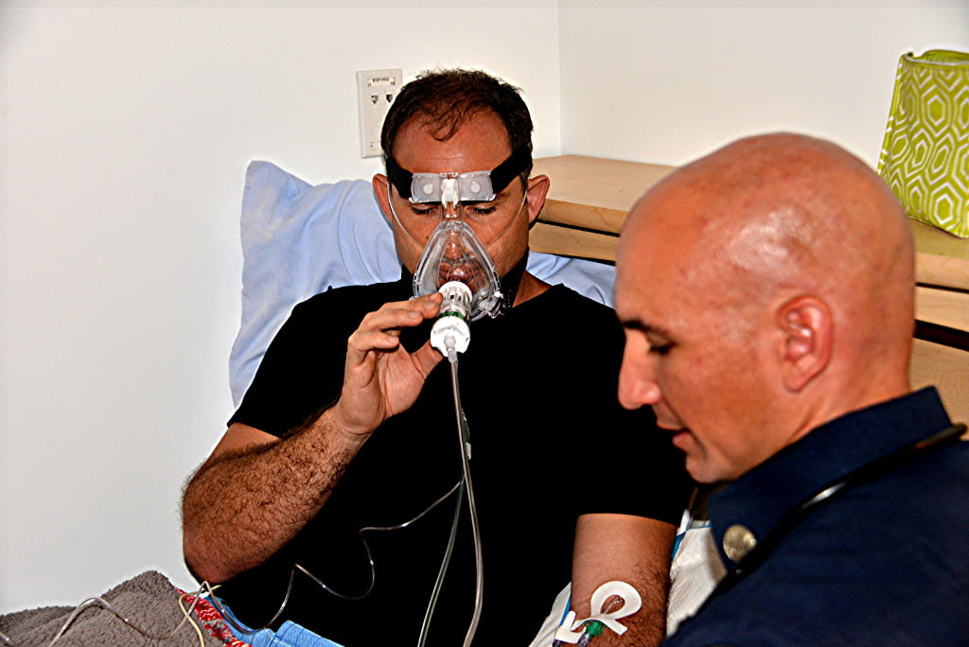
CPAP – Troubleshooting tips
Mask Leak
  Beards: use petroleum jelly/lubricant to help create mask seal
  Try a size up/down
  Tegaderm over facial hair
Remove if:
Patient vomits
Respiratory arrest/Cardiac arrest
Notes:
Patient anxiety
Coach, have patient hold/apply mask at first
Position of comfort (sit upright)
https://emsairway.com/2021/07/12/training-tips-for-cpap-and-bipap/#gref

Slide 33
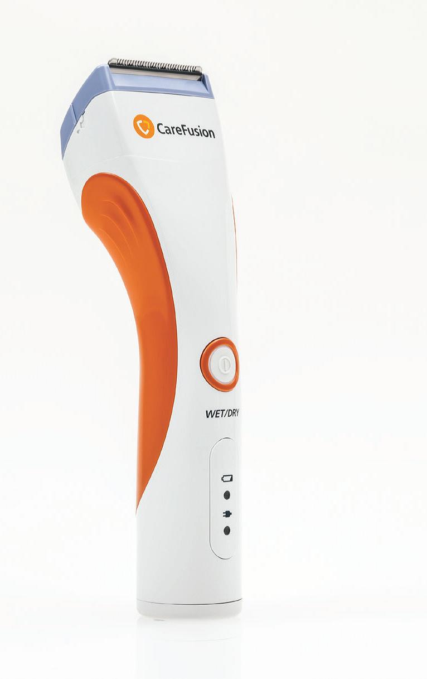
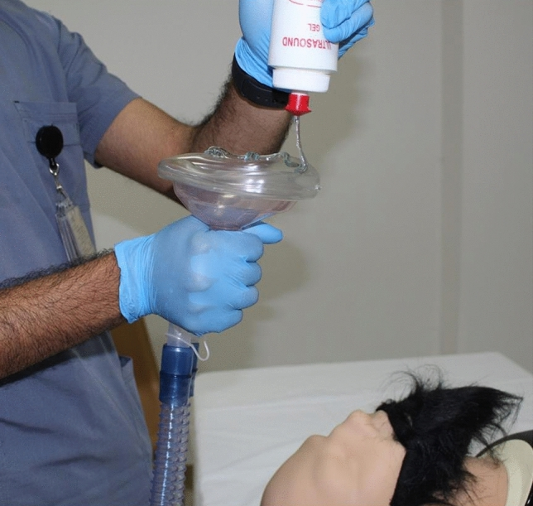

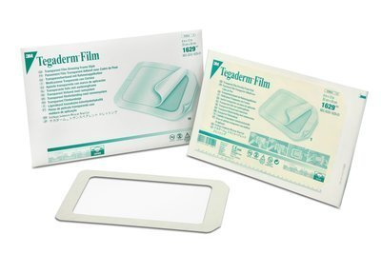
Beards and Seals
Notes:
Althunayyan SM, Mubarak AM, Alotaibi RN, Alharthi MZ, Aljanoubi MA, Alshabanat S, Mobrad AM. Using gel for difficult mask ventilation on the bearded patients: a simulation-based study. Intern Emerg Med. 2021 Jun;16(4):1043-1049. doi: 10.1007/s11739-020-02547-1. Epub 2020 Nov 6. PMID: 33159283; PMCID: PMC7646717.
67% improvement in delivered ventilations with gel application in their simulation study

Slide 34
CPAP Mask Fit
CPAP is only effective with a good seal
Make sure the mask fits

Slide 35
Treatment approach - Pharmacology
Nebulized albuterol
“Duo-Neb”
  Ipratropium Bromide + albuterol
Ipratropium = anticholinergic
  Primarily muscarinic type receptors
  Smooth muscle relaxation
Albuterol = Beta-agonist
  Smooth muscle relaxation in airways
  Mild increase in HR
  Decreased Mast-Cell inflammatory marker release
Notes:
StatPearls for ref:
Ipratropium:
Patel P, Saab H, Aboeed A. Ipratropium. [Updated 2023 May 26]. In: StatPearls [Internet]. Treasure Island (FL): StatPearls Publishing; 2024 Jan-. Available from: https://www.ncbi.nlm.nih.gov/books/NBK544261/
Albuterol:
Johnson DB, Merrell BJ, Bounds CG. Albuterol. [Updated 2024 Jan 10]. In: StatPearls [Internet]. Treasure Island (FL): StatPearls Publishing; 2024 Jan-. Available from: https://www.ncbi.nlm.nih.gov/books/NBK482272/

Slide 36
Chronic Obstructive Pulmonary Disease
Usually effects older patients
Chronic inflammation/Scarring
Baseline of inflammation with periodic exacerbation
  More persistent and chronic than Asthma
Unlike Asthma, often underlying alveolar injury
  Decreased gas exchange in lungs
  More persistent expansion/air trapping
  Less functional ventilation
Notes:
Inflammation/Scarring of lungs usually from smoking, but also autoimmune disease, occupational exposure
COPD usually develops after ~40> pack-years of smoking
https://emcrit.org/ibcc/aecopd/

Slide 37
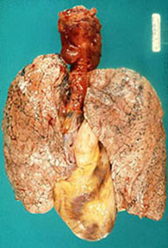
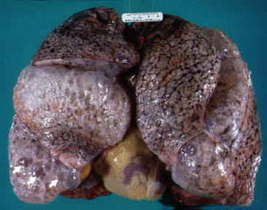
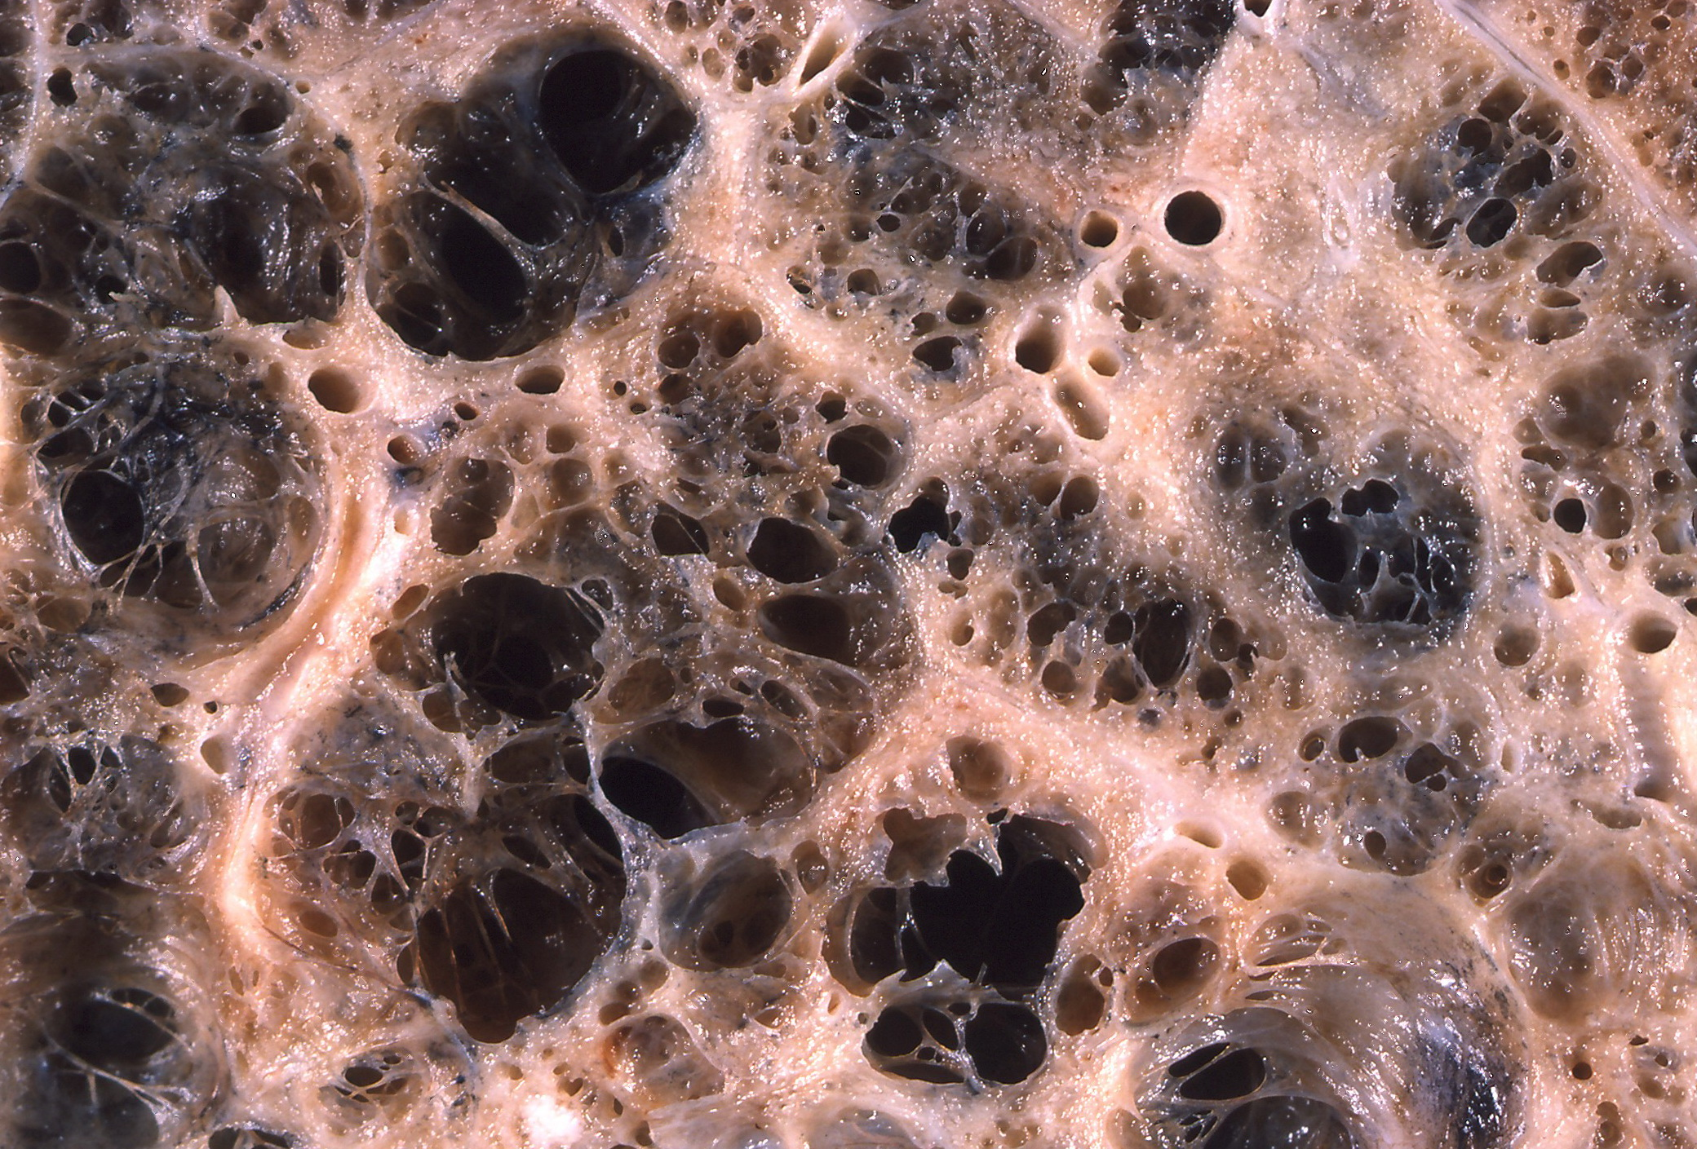
COPD – Tissue Damage
Notes:
https://www.stritch.luc.edu/lumen/meded/radio/curriculum/medicine/emphysema.htm

Slide 38
COPD Exacerbation Presentation
Wheezing
Tachypnea/bradypnea
Cough
Hypoxia

Slide 39
Treatment - Respiratory support
Top priority
Deliver supplement O2 (SpO2 goal 88-92% in COPD)
  But undifferentiated prehospital, so shoot for >94%
Poor VENTILATION is the problem
  2nd is diaphragmatic fatigue
If alert with respiratory drive:
  CPAP
  BiPAP if within scope
If somnolent with poor respiratory drive (RR <10)
  BVM w/ PEEP valve probable better choice
Notes:
Poor ventilation will likely not deliver nebulized medications to the lungs
Epinephrine (IM dose, anaphylaxis) will help improve ventilation until the patient is more alert and can tolerate nebulized medications

Slide 40
Treatment
Nebulized Rx (NRB, BVM or CPAP)
  Albuterol – 5mg
    Per protocol, but usually okay to continue to give continuously until hospital
  Ipratropium
    Usually 0.5mg with 1st or 2nd dose of albuterol
Notes:
Although bronchodilators are important, bronchospasm is not as large of a component in the treatment of COPD exacerbations vs. Asthma

Slide 41
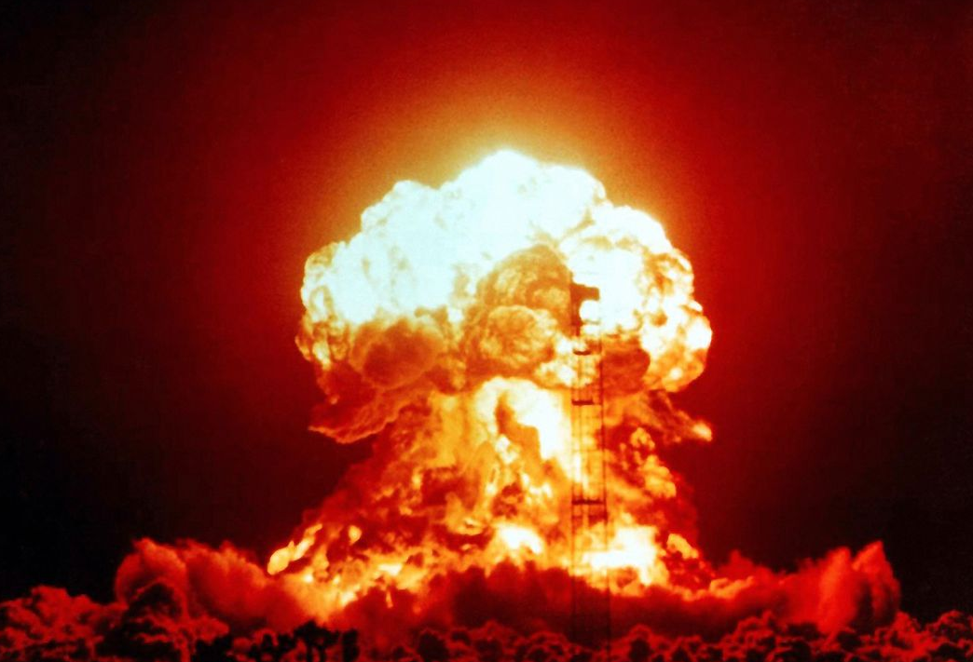
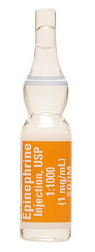
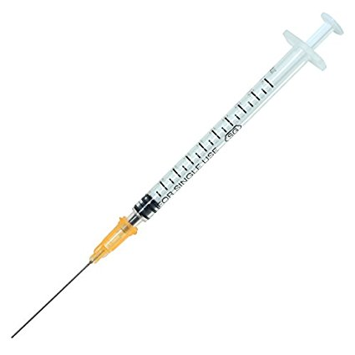
Epinephrine – Respiratory Failure
Consider Use In Impending Respiratory Arrest
Adult: 0.3mg of 1:1,000 IM
Pediatric: 0.01 mg/kg of 1:1,000 IM
Notes:
Use a pre-measured dose (anaphylaxis dose = 0.3mg IM)
0.15mg IM for pediatric patients
Can repeat q 3-5 minutes as needed

Slide 42
Anaphylaxis – Quick Notes
Acute, severe allergic response
Defined by multiple system involvement (>1):
  Respiratory
  Gastrointestinal
  Skin/Mucous membranes
  Cardiovascular (hypotension)
Can seem like asthma…
  BUT will have secondary system involvement!

Slide 43
Anaphylaxis – Rx and support
Epinephrine is the best medicine!
  This is often your “Airway” treatment
  Remember repeat doses
Breathing
  Supplemental O2
  NRB

Slide 44
Summary/Takeaways
Reactive airway diseases lead to obstruction and primary problems with ventilation
Treatment to relieve the obstruction will improve ventilation AND oxygenation
Consider positive pressure support (BVM/CPAP) in severe disease
CPAP will NOT WORK in patients that are not breathing on their own
Provide O2 and nebulizer therapy
Consider epinephrine as an adjunct in severe respiratory distress

