Slide 1
Managing the Emergency Difficult Airway at GIMC
CAPT David Good, CRNA

Slide 2
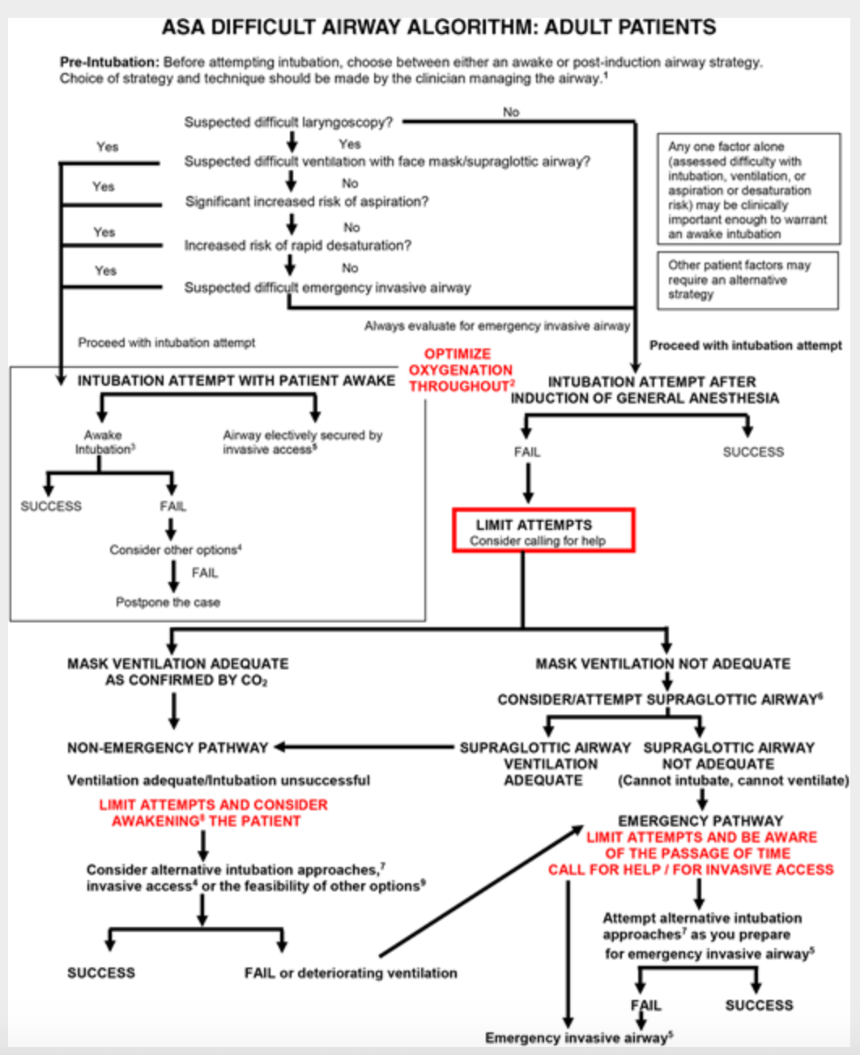

Slide 3
LEMON
Assess Difficult Intubation
    Look- external features (deformities, overbite, etc.)
    Evaluate- 3-3-2 (interincisor distance, thyromental distance, distance from hyoid to mandible)
    Mallampati- I, II, III, or IV
    Obstruction- obesity, trauma, foreign body, etc.
    Neck Mobility- range of motion

Slide 4
ROMAN
Assess Difficult Mask Ventilation
    Restriction/Radiation
    Obstruction/Obesity/OSA
    Mask seal/Male/Mallampati
    Aged
    No teeth
Notes:
.

Slide 5
SMART
Assess Difficult Surgical Airway
    Surgery
    Mass
    Access/Anatomy
    Radiation
    Tumor

Slide 7
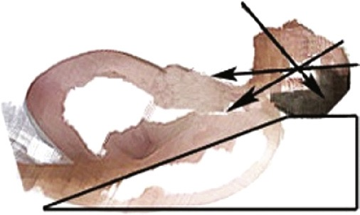
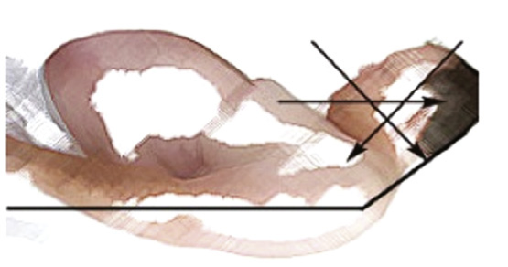
Airway Positioning

Slide 8
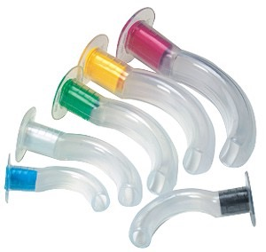
Airway Preparation
SOAPME
Suction
Oxygen
Airway equipment
Pharmacologic agents
Monitors
Equipment

Slide 9
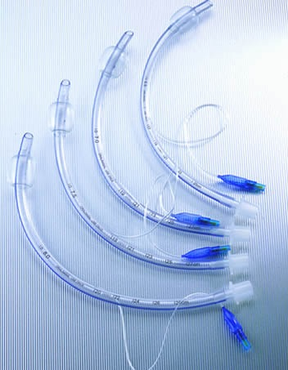
Endotracheal Tubes
Adult Sizing
  Female 6.5 - 7.0
  Male 7.5 - 8.0
Pediatric Sizing
  (Age / 4) + 3.5

Slide 10
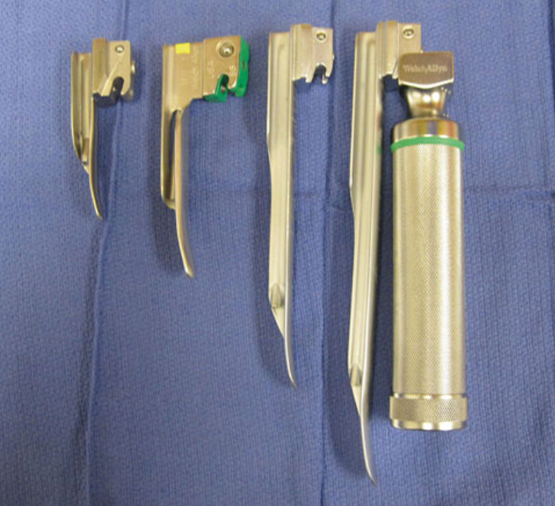
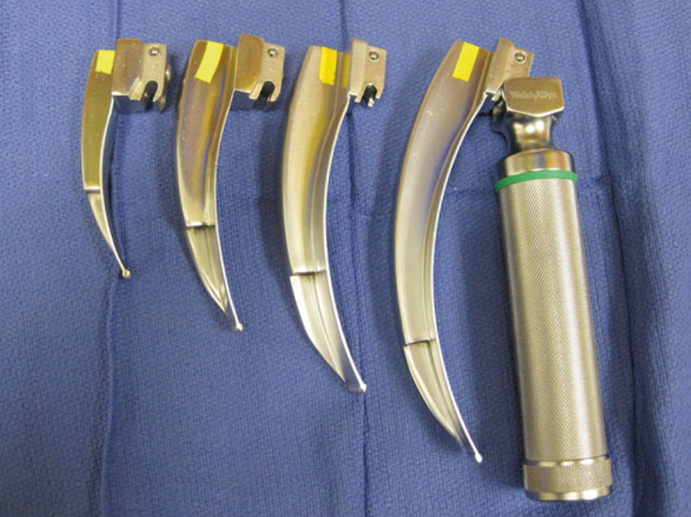
Laryngoscopes
Miller
Macintosh

Slide 11
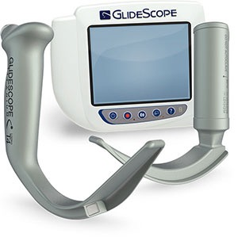
Alternative Equipment
Glidescope
Bougie
LMA
Fiberoptic Bronchoscope

Slide 12
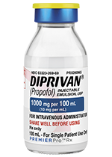
Induction Agents and Muscle Relaxants
Sedative Hypnotics:
  Propofol
  Ketamine
  Etomidate
Muscle Relaxants:
  Succinylcholine
  Rocuronium
  Cisatricurium
Reversals:
  Sugamadex

Slide 13
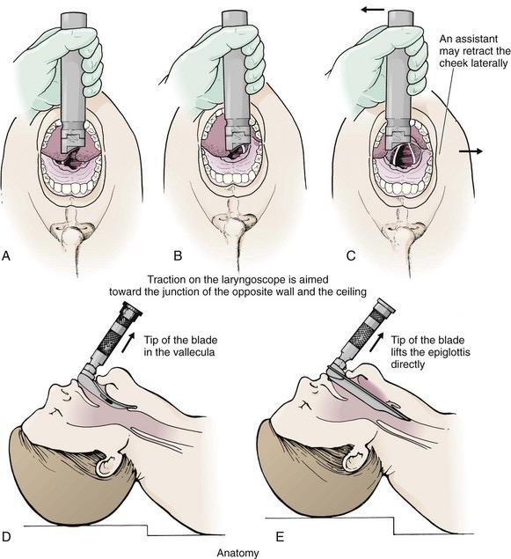
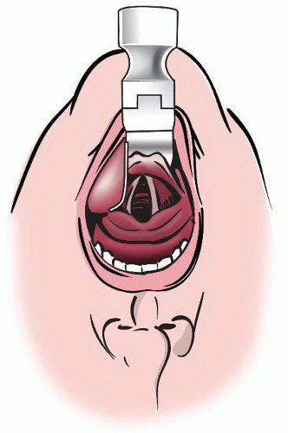

Slide 15
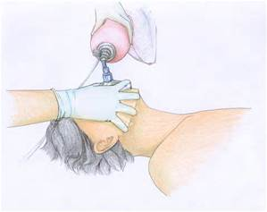
Mask Ventilation

Slide 17
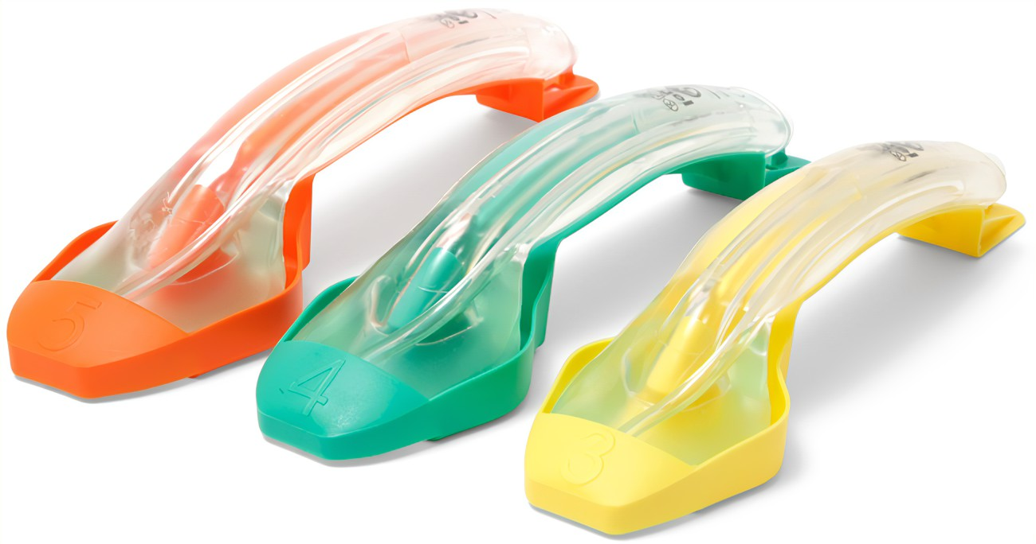
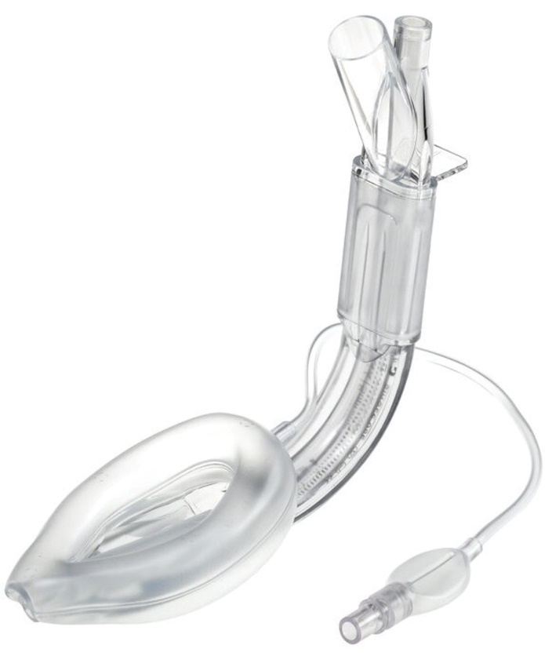
Supraglottic Airway
iGel- size 3, 4, or 5
Supreme- size 3, 4, or 5

Slide 19
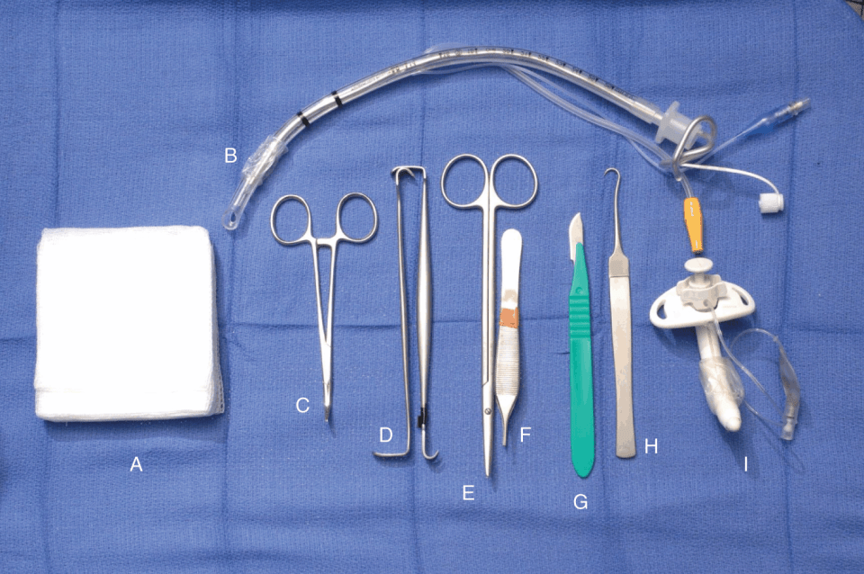
Cricothyrotomy

Slide 20
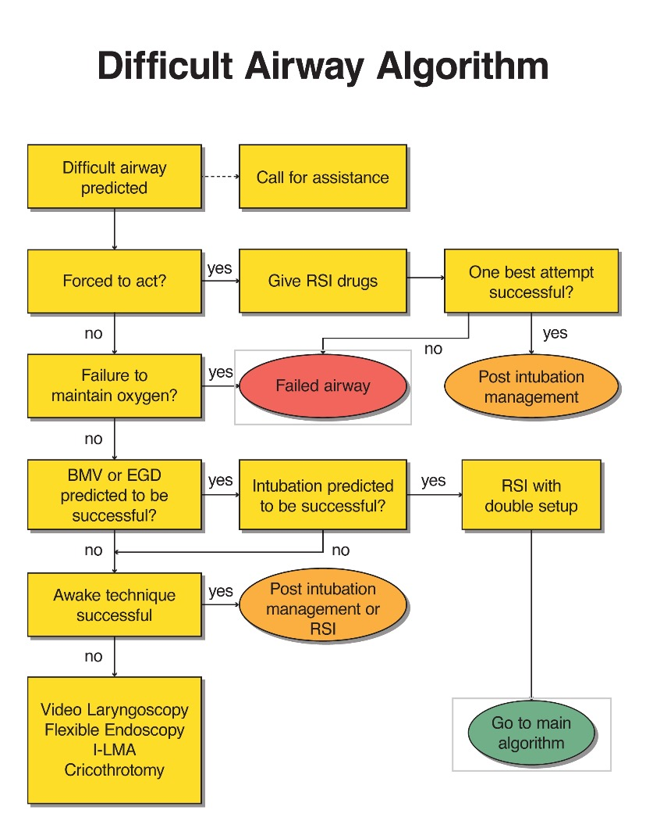
ED Algorithm
Anesthesia Consult: Predicted Difficult Airway

Slide 21
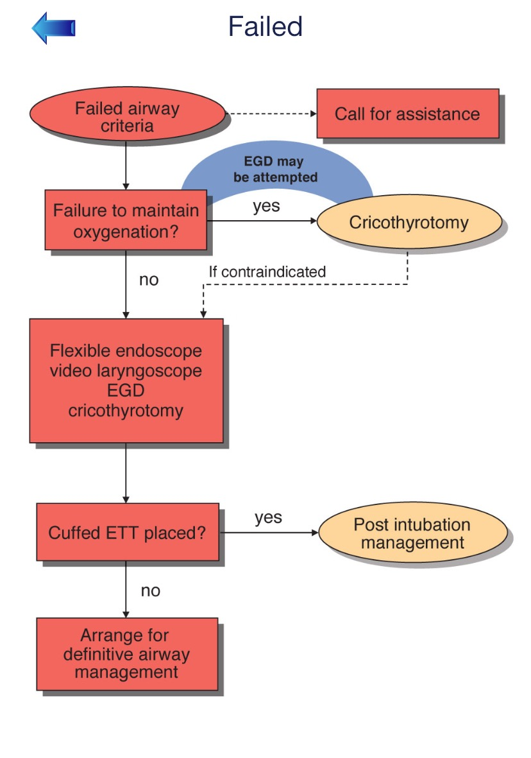
ED Algorithm
Anesthesia Help Called: Failed Intubation

Slide 22
Case Scenario #1
45 YEAR OLD MALE
ARRIVES TO THE ED WITH TACHYPNEA AND SHORTNESS OF BREATH
PMH:
Obesity, diabetes, HTN.
HPI:
Respiratory infection with progressively worsening symptoms over the last week. Symptoms became much worse last night and this morning.
Physical Assessment:
Vital signs: HR-98, RR-34, BP- 172/95, Sat- 82% on RA (90% with 10L/min non-rebreather), Temp- 102
Airway assessment: Interincisor and thyromental distance of 2 finger breaths, large tongue, short neck with limited range of motion, bearded, and Mallampati III.
Chest X-Ray: Pneumonia with severe and diffuse infiltrates

Slide 23
Case Scenario #2
25 YEAR OLD MALE
ARRIVES TO THE ED WITH SEVERE MAXIOFACIAL TRAUMA
PMH:
Asthma
HPI:
Patient was involved in a physical altercation. Was struck multiple times in the face with a blunt object. Patent became unconscious after transfer to ED bed. Airway is full of blood and patient is actively aspirating. ED provider determines this is a forced to act scenario and immediately moves to an RSI with intubation. Due to copious amounts of blood, even with continuous suctioning, the first attempt was unsuccessful.
Physical Assessment:
Vital signs: HR-120, RR-28, BP- 145/95, Sat- 72%, Temp- 98
Airway assessment: Unable to assess. Copious amounts of blood noted.

