Slide 1


Management of agitation in the ED 2024
Michael Wilson, MD PhD FAAEM FACEP
Emergency Medicine/Addiction Medicine
Associate Professor, Departments of Emergency Medicine and Psychiatry
University of Arkansas for Medical Sciences

Slide 2
Objectives
Define agitation
  (we’ll use a real ED case but applies to clinics as well)
Etiology of agitation
Treatment principles
  Basic pharmacology

Slide 3
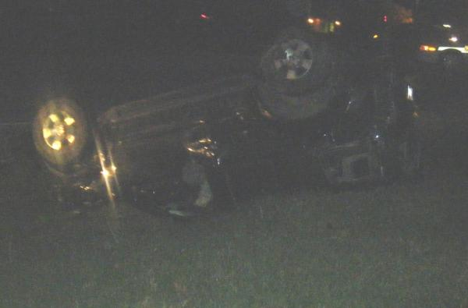
Somewhere in the western USA…
There are no
financial relationships
with any drug
mentioned in this talk.
(not our actual patient)

Slide 4
As documented in the medical records….
21:55 Brought to trauma center after high-speed chase with extrication
  Initial GCS 13 (mostly for odd answers)
23:01 Cleared from backboard
  Left in c-collar
  Attending notes no trauma, but acutely psychotic
23:19
  urine drug screen is negative

Slide 5
00:05 cooperative on way to CT scan, but convinced he is married to Christina Applegate
00:07 Jumps off CT scan table, lands on bottom, kicks tech
00:10 IV Versed 5mg
  Physician ordered but did not see the patient
00:10 IV diphenhydramine 50mg
  Physician ordered but did not see the patient
00:15 Security arrives, handcuffed

Slide 6
00:25 Still restrained in prone position, lifted to CT gurney for CT scans
00:25 IV diazepam 5mg
  Physician ordered but did not see patient
00:41 Restraints removed urgently, CPR started
00:44 Noted to be in PEA

Slide 7
What if anything went wrong in this case?
What if anything would you have done differently in diagnosing the cause of agitation?
What if anything would you have done differently in treating this patient’s agitation?
What if anything would you have done differently in restraining this patient?
Would you have monitored this patient?

Slide 8
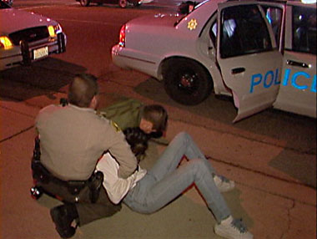
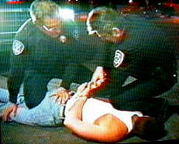
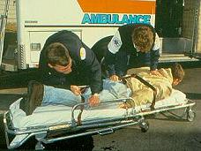
Agitation in the ED is commonplace
Older data:
1.7 million episodes/year
Sachs GS. A review of agitation in mental illness: burden of illness and underlying pathology. J Clin Psychiatry. 2006;67 Suppl 10(Suppl 10):5-12.

Slide 9
Most frequent users are not mental health patients
Brennan JJ, Chan TC, Hsia RY, Wilson MP, Castillo EM. Emergency department utilization among frequent users with psychiatric visits. Acad Emerg Med. 2014; 21:1015-1022.

Slide 10

Question 1: What woud you have done differently in diagnosing the cause of agitation?

Slide 11
Nordstrom K, Zun LS, Wilson MP, et al. Medical evaluation and triage of the agitated patient: Consensus Statement of the American Association for Emergency Psychiatry Project BETA Medical Evaluation Workgroup. West JEM. 2012; 13(1):3-10.
Notes:
There are some findings which although rarely missed by the time seen by psychiatry, do require prompt return & referral to the ED.

Slide 12
Nordstrom K, Zun LS, Wilson MP, et al. Medical evaluation and triage of the agitated patient: Consensus Statement of the American Association for Emergency Psychiatry Project BETA Medical Evaluation Workgroup. West JEM. 2012; 13(1):3-10.
Notes:
There are some findings which although rarely missed by the time seen by psychiatry, do require prompt return & referral to the ED.

Slide 13
Clues to distinguish medical from psychiatric cause
Medical
Psychiatric
<12 or >40 years of age
Sudden onset
Fluctuating course
Disorientation
Visual hallucinations
Abnormal vital signs
Gradual onset
Continuous course
Awake and alert
Auditory hallucinations
Normal physical exam
Williams ER, Shepherd SM. Medical clearance of psychiatric patients. Emerg Med Clin N Am. 2000; 18(2):185-198
Notes:
Gradual onset
Continuous course
Awake and alert
Auditory hallucinations
Normal physical exam findings

Slide 14
Question 1: What would you have done differently in diagnosing the agitation?
Poor documentation of medical examination in psych patients
  298 psych admissions from ED reviewed in 1991
  45% did not have cranial nerve exam
  38% did not document motor function
  20% did not have mental status exam
  4% required medical treatment within 24h of psychiatric admission
  Term “medically clear” documented in 80%
Tintinalli, JE, Peacock, FW, Wright, MA: Emergency medical evaluation of psychiatric patients. Ann Emerg Med. 1994; 23:859-862.

Slide 15
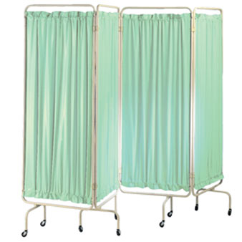
So, what is a medical screen anyway?
Primary Purpose
  To determine whether a medical illness is causing or exacerbating the psychiatric condition
Secondary Purpose
  To identify medical or surgical conditions incidental to the psychiatric problem that may need treatment

Slide 16
Nazarian DJ, Broder JS, Thiessen ME, Wilson MP,
Zun LS, et al. Clinical Policy: Critical Issues in the
Diagnosis and Management of the Adult Psychiatric
Patient in the Emergency Department. Ann Emerg
Med. 2017;69(4):480-98.

Slide 17
How well are physical exams actually performed?
Complete vitals 52%
Pulse ox 28%
Glucose 5%
Neurologic system 36%
Respiratory system 54%
Cardiovascular 52%
Behavior exam 76%
Szpakowicz, Herd A. “Medically cleared”: How well are patients with psychiatric
presentations examined by emergency physicians? J Emerg Med. 2008; 35(4):369-372.

Slide 18
Wilson MP, Nordstrom K, Anderson EL, Ng AT,
Zun LS, Peltzer-Jones JM, et al. American
Association for Emergency Psychiatry Task Force
on Medical Clearance of Adult Psychiatric Patients.
Part II: Controversies over Medical Assessment,
and Consensus Recommendations. West J Emerg
Med. 2017;18(4):640-6.

Slide 19

Question 2: What if anything would you have done differently in treating this agitation?

Slide 20
Verbal de-escalation
Richmond JS, Berlin JS, Fishkind AB, Holloman GH, Jr., Zeller SL, Wilson MP, et al. Verbal De-escalation of the Agitated Patient: Consensus
Statement of the American Association for Emergency Psychiatry Project BETA De-escalation Workgroup. West J Emerg Med. 2012;13(1):17-25.

Slide 21
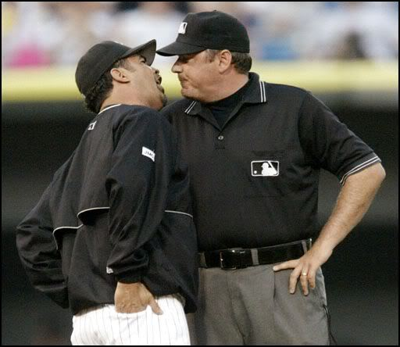
X

Slide 22
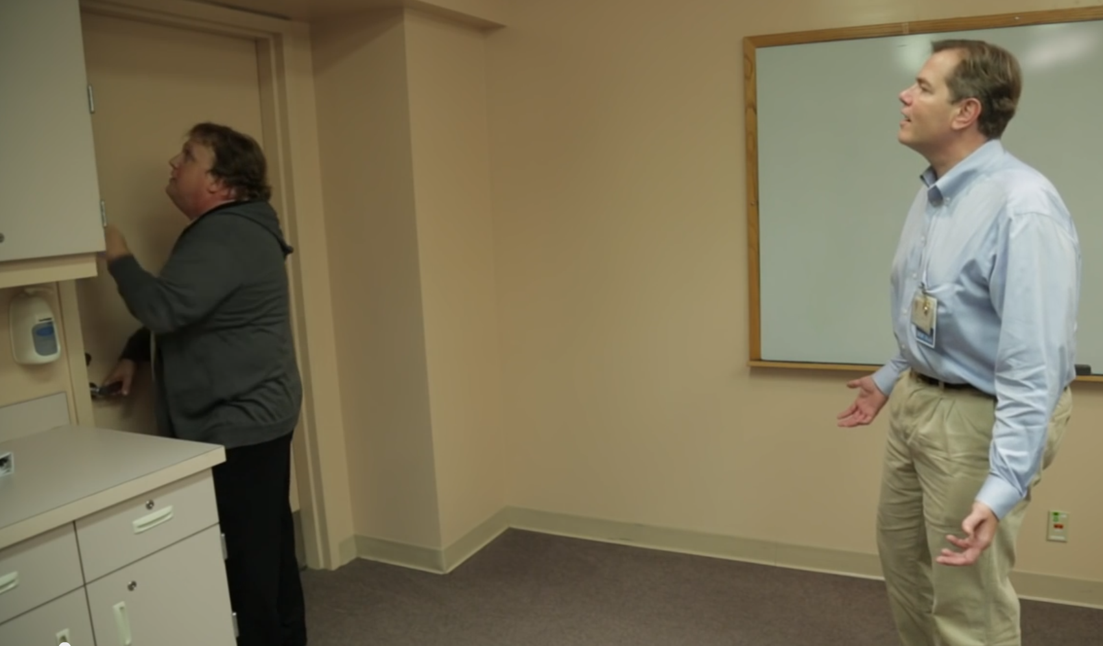
Courtesy of Scott Zeller, MD

Slide 23


Especially useful in patients to
whom you can’t (or shouldn’t) give medication

Slide 24
Pharmacology: Haloperidol benefits
Less effects on vitals
  such as hypotension
Relatively low risk of oversedation
No anticholinergic activity
Not associated with respiratory suppression, even at high doses
Battaglia J. Pharmacologic management of acute agitation. Drugs. 2005;65(9):1207-22.

Slide 25
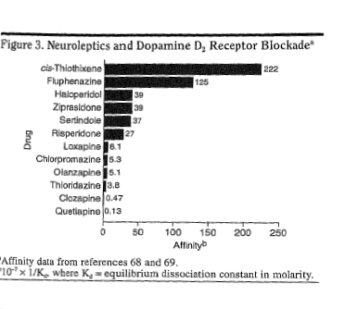
Relative affinity for D2 receptors
Richelson E. Receptor pharmacology of neuroleptics: relation to clinical effects. J Clin Psychiatry. 1999;60(suppl 10):5-14.

Slide 26
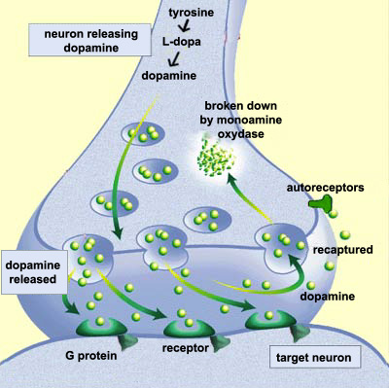
FGA risks
may induce movement disorders (ie, extrapyramidal symptoms)
dysphoria
prolong QT intervals, risk of sudden death
Neuroleptic malignant syndrome
Diagram courtesy of http://thebrain.mcgill.ca

Slide 27
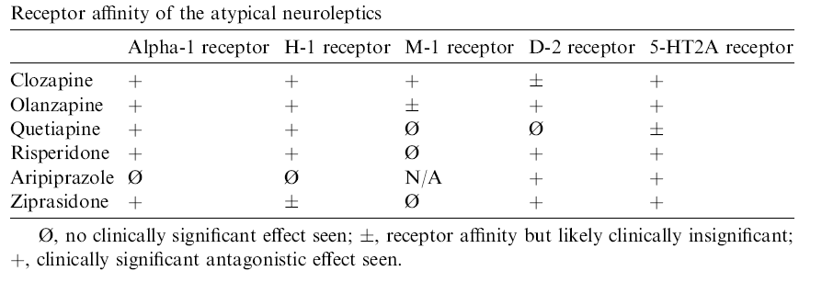
Second-generation antipsychotics
Reilly TH, Kirk MA. Atypical antipsychotics and newer antidepressants. Emerg Med Clin North Am. 2007;25(2):477-97.
Baldwin CM, Scott LJ. Quetiapine extended release: in schizophrenia. CNS Drugs. 2009;23(3):261-9.

Slide 28
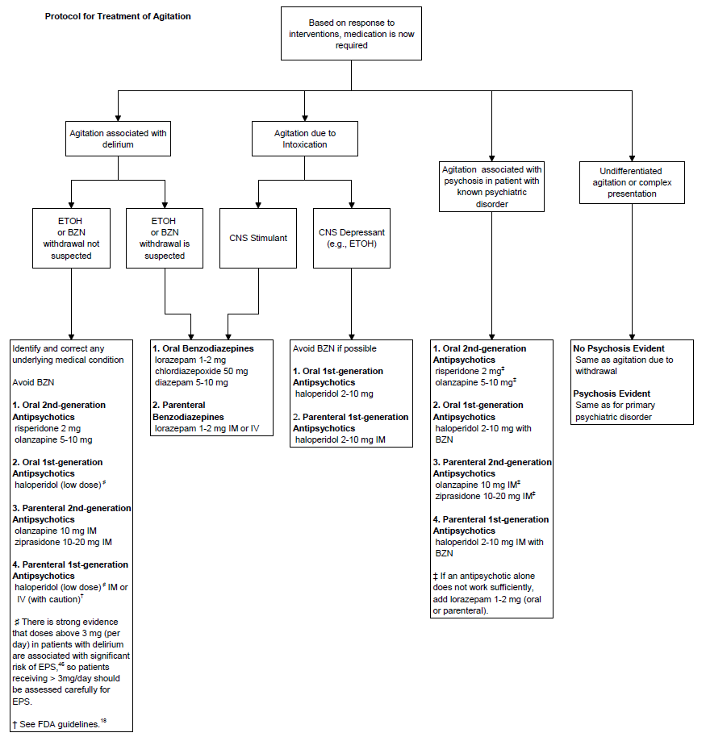
Wilson MP, Pepper D, Currier GW, Holloman GH, Feifel D.
The psychopharmacology of agitation: Consensus statement of the
American Association for Emergency Psychiatry Project BETA
Psychopharmacology Workgroup. West JEM. 2012; XIII(1):26-34.
Notes:
This slide may be useful to convert to a full-page handout for the audience.

Slide 29
Should you use haloperidol?
Ostinelli EG, Brooke-Powney MJ, Li X, Adams CE. Haloperidol for psychosis-induced aggression
or agitation (rapid tranquillisation). Cochrane Database Syst Rev. 2017;7:CD009377.

Slide 32
Question 2: Appropriate medication
Calming not sleeping
Use oral over IM/IV where possible
Try not to mix & match medications
  Makes it harder to calculate total dose

Slide 33
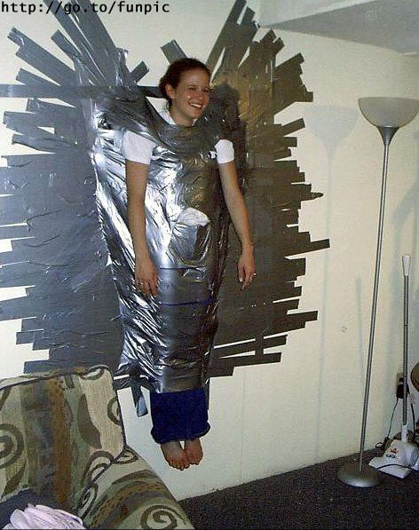
Question 3: What if anything would you have done differently in restraining this patient?

Slide 34
“In this qualitative study, participants described a desire
for compassion and therapeutic engagement, even after
they experienced coercion and physical restraint during
their visits that created lasting negative consequences.”
Wong AH, Ray JM, Rosenberg A, et al. Experiences of Individuals Who Were Physically
Restrained in the Emergency Department. JAMA Netw Open. 2020;3(1):e1919381.

Slide 35
Restraints
Most mental health advocacy groups have called for little or no restraint use
    American Psychiatric Association
    American Psychiatric Nurses Association
    American Academy of National Alliance for the Mentally Ill
    Mental Health America
    the American Association of Community Psychiatrists
    the National Association of State Mental Health Program Directors
Notes:
Major media focus on untoward outcomes and deaths of restrained patients in the late 1990s led to a new regulatory and survey focus on restraint and seclusion use. Organizations like the Joint Commission, CMS and NAMI advocate for minimal use of restraints and strict criteria for their use. Yet many facilities still use restraints and involuntary medications far too often.

Slide 36
ACEP
“The American College of Emergency Physicians (ACEP) supports the careful and appropriate use of patient restraints or seclusion.”

Slide 37
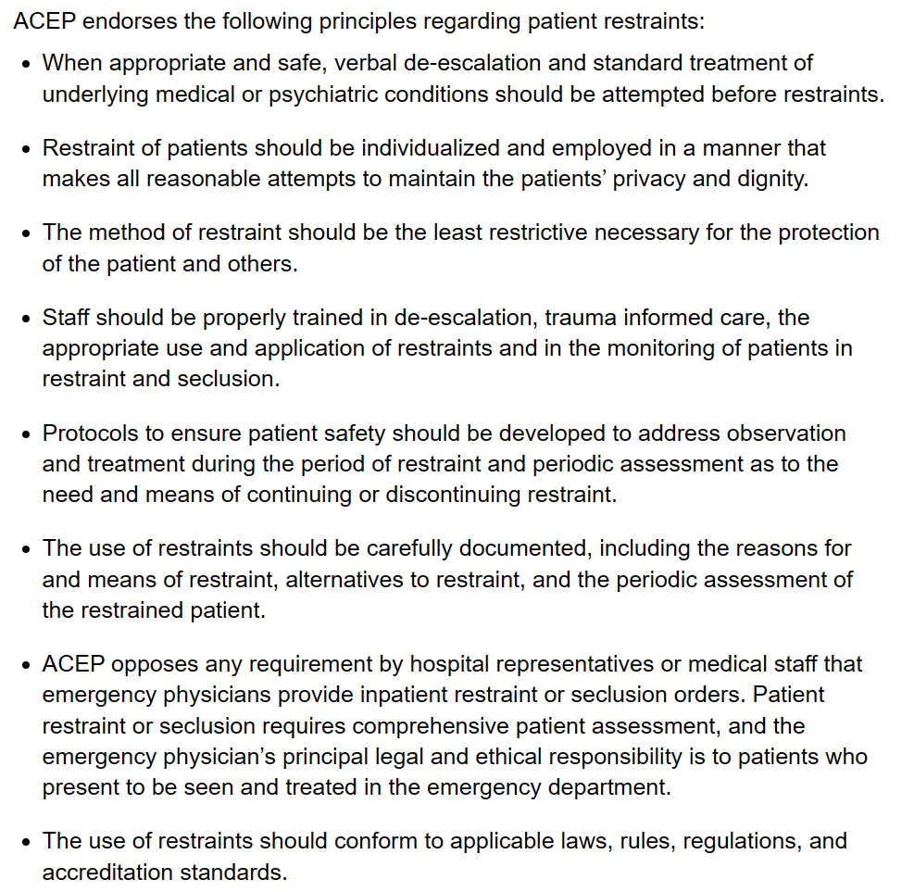
ACEP
policy
on
restraints

Slide 38
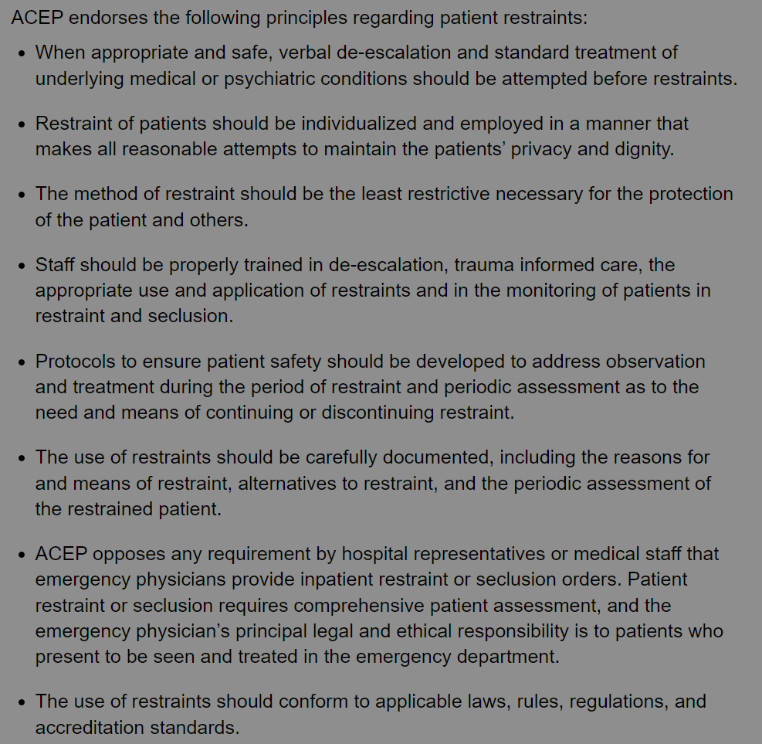
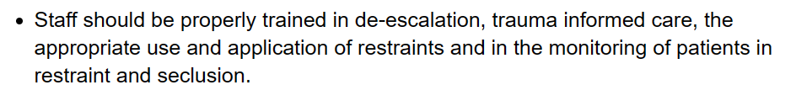
(i.e., not prone)
ACEP
policy
on
restraints

Slide 39
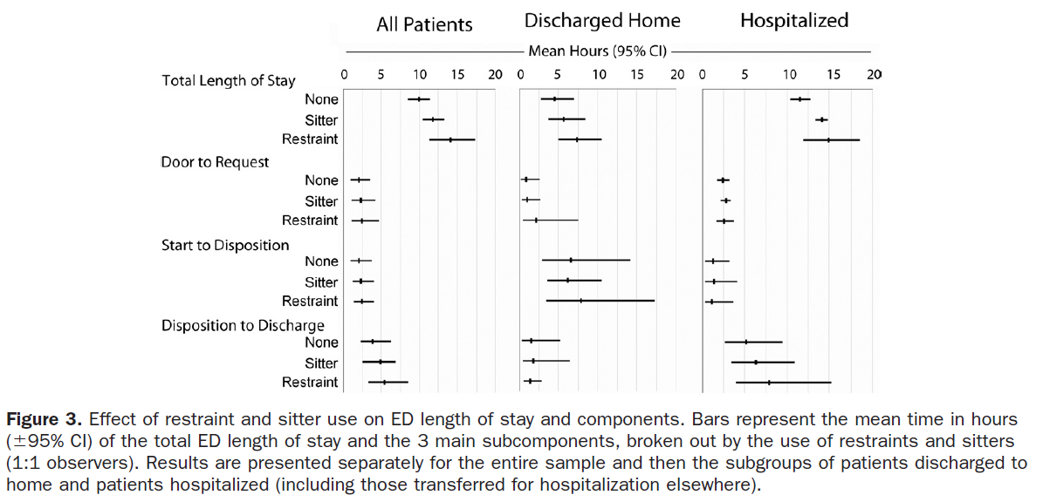
Restrained patients stay longer
Weiss AP, et al. Patient and practice-related determinants of emergency department
length of stay for patients with psychiatric illness. Ann Emerg Med. 2012; 60(2):162-171.

Slide 40
Currier GW, et al. Physical
restraints and attendance at
subsequent outpatient
Psychiatric treatment.
J Psychiatr Pract.
2011; 17(6):387-393.

Slide 41
Question 4: Would you monitor this patient?

Slide 42
Summary:
How do I manage a patient with agitation?
X

Slide 43
Pitfall 1: Diagnose the cause
Make the ED do a good exam & history
  Have them document what they did
Don’t believe the term “medically clear”
Be suspicious of medical causes
  in new-onset psychosis
  in children or adults >40-45
  In immunosuppressed patients
  who have something different than their typical psychiatric presentation

Slide 44
Pitfall 2: Careful medication
Use oral (SGAs) over IM where possible
  Caution with injectable SGAs in alcohol use
Don’t write “chemical restraints”
Don’t mix & match medications
  This makes it harder to calculate total dose

Slide 45
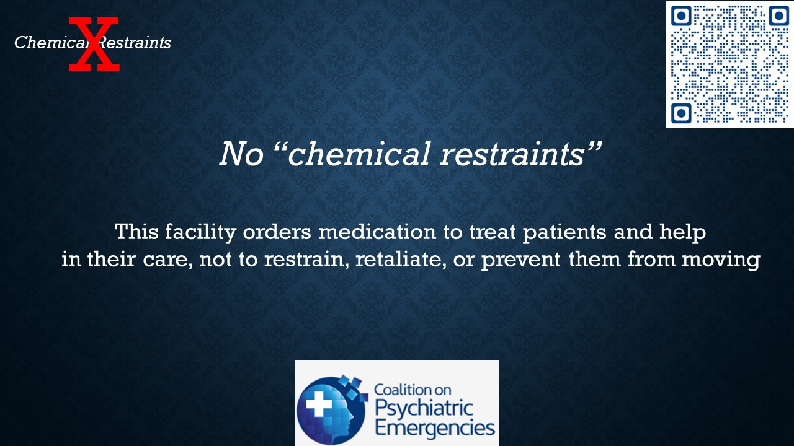
Join this campaign: coalitiononpsychiatricemergencies.org

Slide 46
Pitfall 3: Restraints
Reduce or eliminate restraints
  Most mental health organizations say stop
  Restrained patients stay longer/use more resources
  Less likely to follow up outpatient
  Likely suffer psychological trauma
  If forced to restrain, do it properly
    Don’t restrict head movement
    Don’t stand on the patient
    Don’t block their mouth

Slide 47
Pitfall 4: Monitoring
(my view) medicated & restrained patients should be monitored as soon as possible

Slide 48
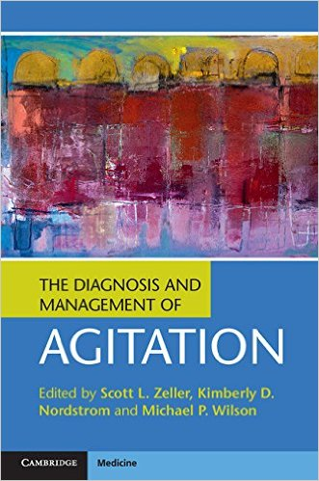

Need more info?
coalitiononpsychiatricemergencies.org

Slide 49

Questions?
mpwilso1@outlook.com

