Slide 1
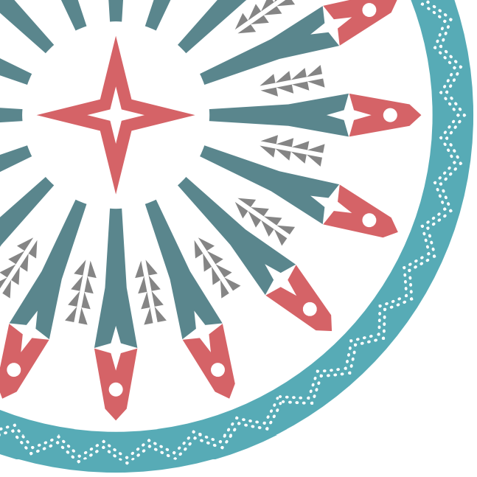

Syphilis
Jorge Mera, MD

Slide 2
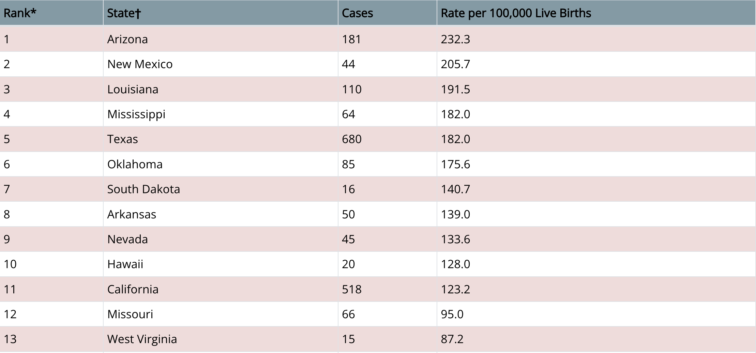
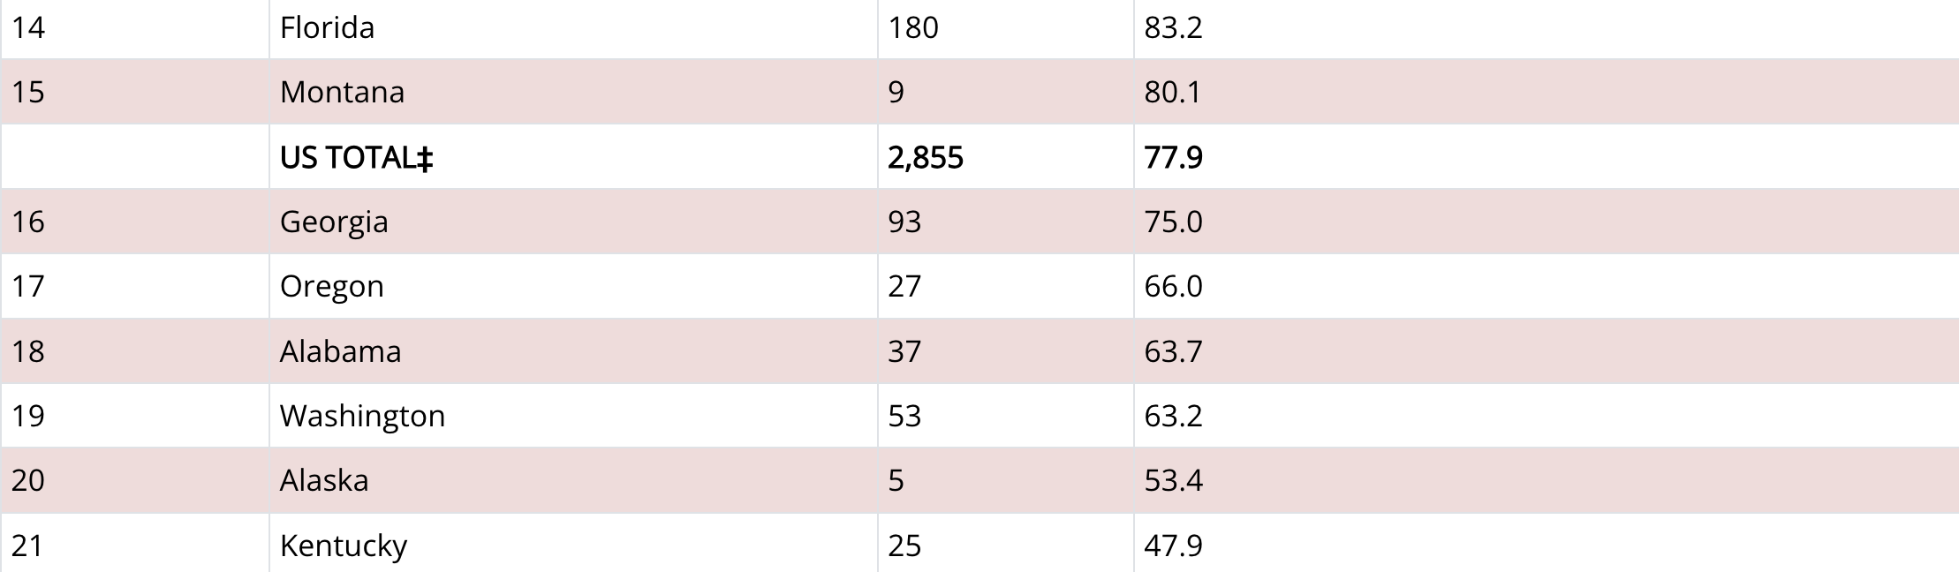
Congenital Syphilis — Reported Cases and Rates of Reported Cases by State, Ranked by Rates, United States, 2021
Notes:
Oklahoma ranks 6th in the nation (by state) in reported congenital syphilis cases, over double the nation’s average. Regional as well with border states.
Sexually Transmitted Disease Surveillance, 2021 (cdc.gov)

Slide 3
Congenital Syphilis Transmission
How
  Transplacental during maternal spirochetemia
  Direct contact with an infectious lesion during birth
  Not transferred into breast milk
When during gestation?
  At any time during gestation with increasing frequency as gestation advances.
Transmission according to syphilis stage:
  Primary or secondary syphilis: 60% to 90%
  Early latent: 40%
  Late latent syphilis: 10% (2% after four years)

Slide 4

Questions that We Need to be Answer
to Evaluate A positive RPR in a Newborn
Was the mother properly diagnosed, staged and treated for syphilis during pregnancy?
Was the treatment initiated 30 days before delivery?
What is the neonates RPR titer?
Was the neonate's physical exam normal?
Does the neonate need any further workup such as LP, imaging, etc.?
Is it > 4-fold compared to the mothers RPR (obtained at delivery)?

Slide 5
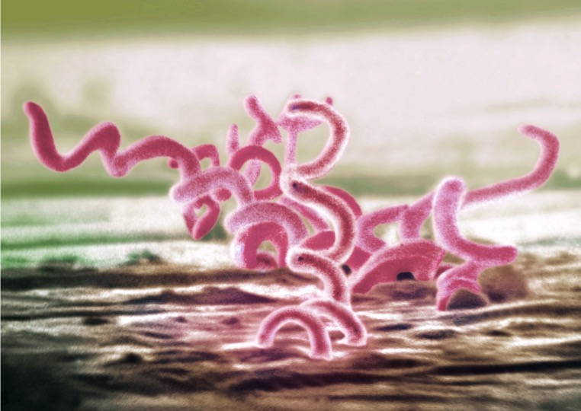
Syphilis
Treponema pallidum
Sexual, vertical, and horizontal transmission
Curable with penicillin
4 stages
Primary
Secondary
Early (non-primary, non-secondary)
Unknown duration or late

Slide 6
Syphilis
Stages start with primary, then may not progress linearly.
Characterized by episodes of active disease interrupted by periods of latency.
Signs/symptoms and transmission risks vary by stage.

Slide 7

Case Definitions: Primary Syphilis
Clinical Description
Characterized by one or more ulcerative lesions (e.g. chancre), which might differ in clinical appearance.
Classic Presentation
Single painless ulcer or chancre at the site of infection
Atypical Presentation
Multiple, atypical, or painful lesions at the site of infection
Vaginal
Tongue
Penile
https://www.cdc.gov/std/syphilis/images.htm and https://www.cdc.gov/std/statistics/2019/case-definitions.htm

Slide 8
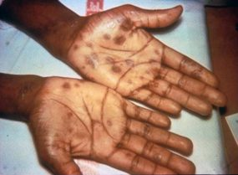
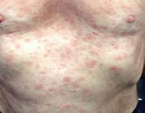
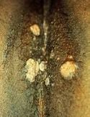
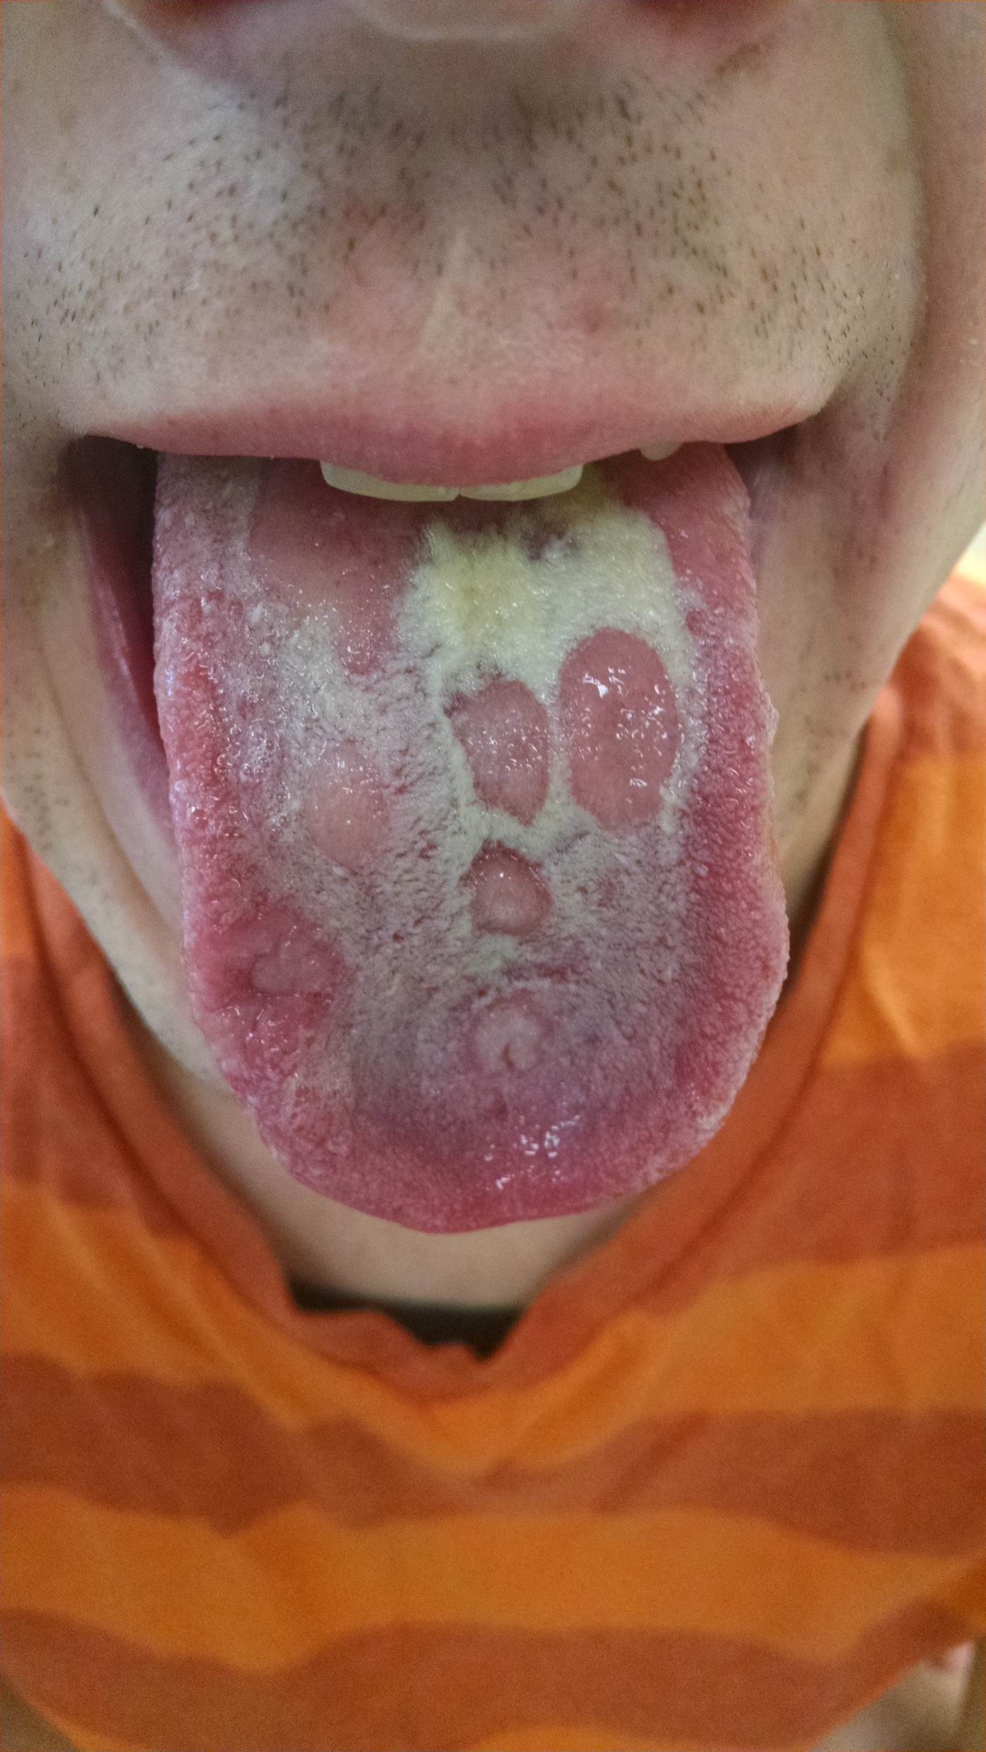
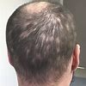
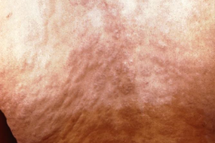
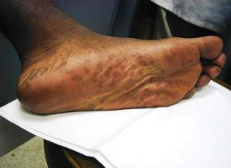
Case Definitions: Secondary Syphilis
Clinical Description
Characterized by localized or diffuse mucocutaneous lesions (e.g., rash – such as non-pruritic macular, maculopapular, papular, or pustular lesions), often with generalized lymphadenopathy. Other signs can include mucous patches, condyloma lata, and alopecia. The primary ulcerative lesion may still be present.
Torso/back rash
Palmar/plantar rash
Condyloma lata
Alopecia
Mucous patches
https://www.cdc.gov/std/syphilis/images.htm
https://www.cdc.gov/std/statistics/2019/case-definitions.htm

Slide 9
Natural History of Untreated Syphilis
The Diagnosis, Management and Prevention of Syphilis An Update and Review. New York City Department of Health and Mental Hygiene Bureau of
Sexually Transmitted Infections and the New York City STD Prevention Training Center . May 2019. https://www.nycptc.org/x/Syphilis_Monograph_2019_NYC_PTC_NYC_DOHMH.pdf

Slide 10
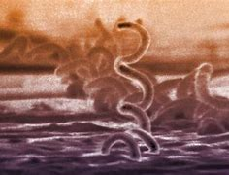
Case Definitions: Early Latent
(non-primary non-secondary)
Clinical Description
Stage of infection caused by T. pallidum in which initial infection has occurred within the previous 12 months, but there are no current signs or symptoms of primary or secondary syphilis.
Less than 12 months duration by
Interval from prior negative syphilis test (or 4-fold titer increase)
OR
Report of symptoms consistent with syphilis within prior 12 months
OR
Sexual contact with a known case (or sexual debut) within prior 12 months
https://www.cdc.gov/std/statistics/2019/case-definitions.htm)

Slide 11
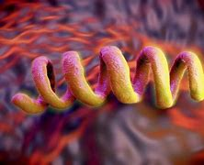
Case Definitions: Late Latent or Unknown
Clinical Description
Stage of infection caused by T. pallidum in which initial infection has occurred >12 months previously or in which there is insufficient evidence to conclude that infections was acquired during the previous 12 months.
Unknown or greater than 12 months duration by:
Interval from prior negative syphilis test (or 4-fold titer increase)
OR
(2) Report of symptoms consistent with syphilis occurring > 12 months ago
OR
Sexual contact with a known case > 12 months ago
OR
Neurologic, ocular, otic signs without evidence of acquiring infection in prior 12 months.
https://www.cdc.gov/std/statistics/2019/case-definitions.htm)

Slide 12
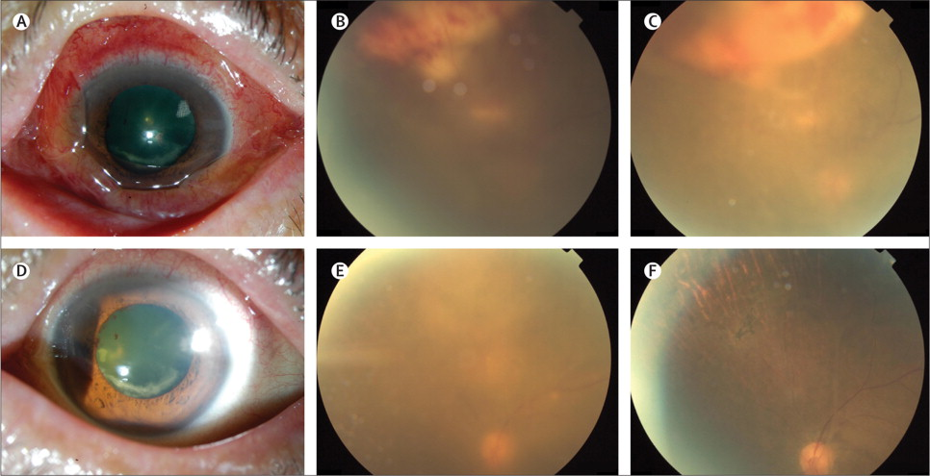
Neurologic Manifestations can occur at any stage
Neurosyphilis | Ocular syphilis | Otosyphilis
Infection of the central nervous system with T. pallidum, as evidenced by manifestations including: Syphilitic meningitis, Meningovascular syphilis, General paresis, Dementia, Tabes dorsalis | Infection of any eye structure with T. pallidum. Manifestations can involve any structure in the anterior and posterior segment of the eye including: Conjunctivitis Anterior uveitis Posterior uveitis Panuveitis Posterior interstitial keratitis Optic neuropathy Retinal vasculitis Ocular syphilis may lead to decreased visual acuity including permanent blindness. | Infection of the cochleovestibular system with T. pallidum, as evidenced by manifestations including sensorineural hearing loss, tinnitus, and vertigo. Typically presents with cochleo-vestibular symptoms including Tinnitus Vertigo Sensorineural hearing loss Unilateral/Bilateral Have a sudden onset Progress Rapidly Otic syphilis can result in permanent hearing loss
https://www.thelancet.com/journals/laninf/article/PIIS1473-3099(13)70198-1/fulltext
https://www.cdc.gov/std/statistics/2019/case-definitions.htm)

Slide 13

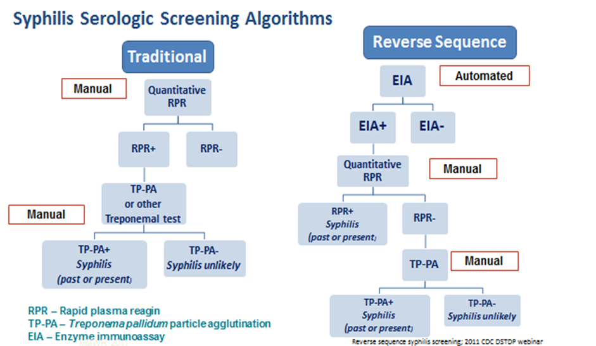
Serologic Diagnosis of Syphilis

Slide 14
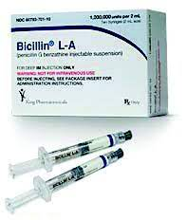
Treatment of syphilis with Penicillin
Stage
Primary | Secondary | Early non-primary, non secondary | Late Latent/ or Unknown Duration | Neurosyphilis, ocular syphilis and otic syphilis
Benzathine penicillin 2.4 million units IM in a single dose | Benzathine penicillin 2.4 million units IM in a single dose | Benzathine penicillin 2.4 million units IM in a single dose | Benzathine penicillin 2.4 million units total administered as 3 doses of 2.4 million units IM each at 1-week intervals | Aqueous crystalline penicillin G 18-24 million units per day, administered as 3-4 million units by IV every 4 hours or continuous infusion for 10-14 days Alternative: procaine penicillin G 2.4 million units IM 1x/day PLUS probenecid 500 mg orally 4x/day, both for 10-14 days
https://www.cdc.gov/std/treatment-guidelines/default.htm

Slide 15
Penicillin Allergy
Patients often are incorrectly labeled as allergic to penicillin
  Evaluate what symptoms were experienced by patients with reported penicillin allergy
Penicillin allergy causing anaphylaxis is rare
  In studies that have incorporated penicillin skin testing and graded oral challenge among persons with reported penicillin allergy, the true rates of allergy are low, ranging from 1.5% to 6.1%.
Allergies wane over time:
  Approximately 80% of patients with a true IgE-mediated allergic reaction to penicillin have lost the sensitivity after 10 years
Desensitization is recommended for pregnant women diagnosed with syphilis followed by treatment with penicillin.
https://www.cdc.gov/std/treatment-guidelines/STI-Guidelines-2021.pdf

Slide 16
Syphilis Penicillin Shortage:
Pregnant persons and HIV infected persons with syphilis as well as infants with congenital syphilis should receive priority for treatment with Benzathine penicillin G.
  Benzathine penicillin G (Bicillin L-A®) is the only recommended treatment for pregnant people infected or exposed to syphilis.
If Benzathine penicillin G supplies are inadequate to cover patients other than the ones listed above, treat early syphilis (primary, secondary, early latent) with doxycycline 100 mg po bid for 14 days and late latent syphilis or latent syphilis of uncertain duration with doxycycline 100 mg po bid for 28 days.

Slide 17
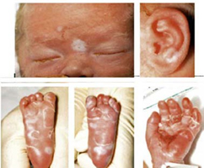
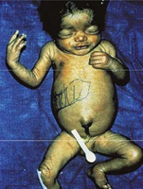
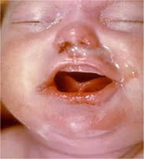
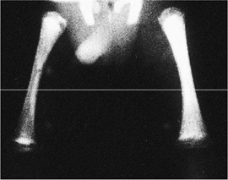
Clinical Manifestations of Congenital Syphilis (CS)
https://www.cdc.gov/ncbddd/birthdefects/surveillancemanual/quick-reference-handbook/congenital-syphilis.html

Slide 18
Scenario 1: Confirmed, proven or highly probable congenital syphilis
Neonate with: A physical exam consistent with CS: Hepatomegaly, Jaundice, Nasal discharge ("snuffles"), Rash, Generalized lymphadenopathy, Skeletal abnormalities A serum quantitative nontreponemal serology 4-fold greater than mother’s or A positive darkfield or PCR test of placenta, body fluids or positive silver stain of placenta or cord
Evaluation: CSF with VDRL, cell ct, protein, CBC/diff, long bone radiographs, neurologic eval (eye, auditory, imaging)
Treatment: Aqueous crystalline penicillin G 100,000–150,000 units/kg/body wt./day, administered as 50,000 units/kg body wt./dose IV q 12 hours during the first 7 days of life and q 8 hours thereafter for a total of 10 days OR Procaine penicillin G 50,000 units/kg body weight/dose IM in a single daily dose for 10 days
https://www.cdc.gov/std/treatment-guidelines/default.htm
Notes:
60-90 % are asymptomatic

Slide 19
Scenario 2: Possible congenital syphilis
Neonate with a normal physical exam and a serum quantitative nontreponemal serologic titer equal to or < 4-fold of the maternal titer at delivery and one of the following: • The mother was not treated, was inadequately treated, or has no documentation of treatment. • The mother was treated with erythromycin, or a regimen not recommended in these guidelines • The mother received recommended regimen, but treatment was initiated <30 days before delivery.
CSF analysis for VDRL, cell count, and protein** CBC, differential, long-bone radiographs
Treatment: Aqueous crystalline penicillin G 100,000–150,000 units/kg/body wt./day, administered as 50,000 units/kg body wt./dose IV q 12 hours during the first 7 days of life and q 8 hours thereafter for a total of 10 days OR Procaine penicillin G 50,000 units/kg body weight/dose IM in a single daily dose for 10 days OR Benzathine penicillin 50,000 units/kg body wt. single IM injection
https://www.cdc.gov/std/treatment-guidelines/default.htm

Slide 20
Scenario 3: Congenital syphilis less likely
Neonate with a normal physical examination and a serum quantitative nontreponemal serologic titer equal or <4-fold of the maternal titer at delivery and both of the following are true: • The mother was treated during pregnancy, treatment was appropriate for the infection stage, and the treatment regimen was initiated ≥30 days before delivery. • The mother has no evidence of reinfection or relapse
No evaluation is recommended
Treatment: Benzathine penicillin G 50,000 units/kg body weight/dose IM in a single dose * Another approach involves not treating the newborn if follow-up is certain but providing close serologic follow-up every 2–3 months for 6 months for infants whose mothers’ nontreponemal titers decreased at least fourfold after therapy for early syphilis or remained stable for low titer, latent syphilis (VDRL <1:2 or RPR <1:4).
https://www.cdc.gov/std/treatment-guidelines/default.htm

Slide 21
Scenario 4: Congenital syphilis unlikely
Neonate with: a normal physical exam serum quantitative nontreponemal serology equal to or less than 4-fold mother at delivery and Mother’s treatment was adequate before pregnancy Mother’s nontreponemal titer remained low and stable before and during pregnancy and at delivery
No evaluation is recommended
No treatment recommended Benzathine penicillin 50,000 units/kg body weight as a single IM injection might be considered, if follow-up is uncertain and the neonate has a reactive nontreponemal test. Neonates should be followed serologically to ensure the nontreponemal test returns to negative
https://www.cdc.gov/std/treatment-guidelines/default.htm

Slide 22

Provider Education Resources
CDC STD Treatment Guidelines: https://www.cdc.gov/std/treatment-guidelines/default.htm
Indian Country Infectious Disease ECHO: www.IndianCountryECHO.org
CDC STD Prevention Training Centers: https://www.cdc.gov/std/training/default.htm
University of Washington STD CME sessions: https://www.std.uw.edu/
California Prevention Training Center Online: https://www.stdhivtraining.org/online_courses.html
Johns Hopkins STD Prevention Training: https://www.stdpreventiontraining.com/
New York City STD/HIV Prevention Training Center: https://www.nycptc.org/
CDC STD Surveillance: https://www.cdc.gov/std/statistics/2019/default.htm
CDC STD Hotline: https://www.usa.gov/federal-agencies/cdc-national-std-hotline

Slide 23

Follow-up
Please email the following contact with any questions, concerns, or interest in having a follow-up discussion to learn more about how we can best support your efforts:
Jorge Mera, MD
He/him
ECHO Clinic Medical Director
Northwest Portland Area Indian Health Board
jmera@salud.unm.edu

