Slide 1
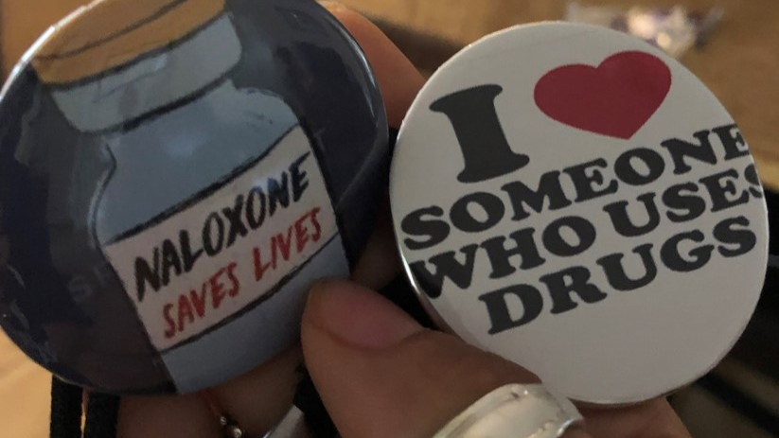
Naloxone
Harm Reduction ECHO
February 2, 2024

Slide 2
Why it is important to keep talking about naloxone?
How naloxone works
Overdose recognition, response steps and support
Good Samaritan Laws
Taking care of yourself
Questions

Slide 3
Background
Synthetic opioids and stimulants continue to drive overdose increases across rural and urban communities.
In Oregon, as with much of the US, overdose deaths are not spread evenly across demographic groups. Black and American Indian/Alaska Native individuals experience the highest rates of fatal overdose.
Synthetic opioids, such as fentanyl, can cause breathing to slow to dangerous levels and/or stop rapidly making community member overdose response critically important.
People who use substances and who have naloxone save lives.

Slide 4
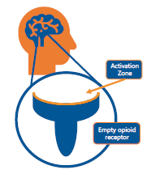
Naloxone…
is a safe, short-acting opioid antagonist medication.
rapidly reverses an opioid overdose.
attaches to opioid receptors, reversing and blocking the effects of opioids.
can restore breathing to a person whose breathing has stopped or slowed to dangerous levels because of an opioid overdose.
only works to reverse the effects of opioids.
will work when alcohol or other drugs are present.
has NO effect on a person who does not have opioids in their system.

Slide 5
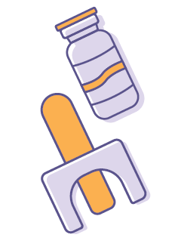
Types of Naloxone Commonly Used by Community Members
Injectable naloxone
Pre-filled nasal spray
There are different brands and strengths.
Agencies may distribute different types of naloxone.
Community members may have different experiences or preferences.
There has been many community discussions about the different types, brands and strengths.
The goal when administering naloxone is to restore BREATHING.

Slide 6
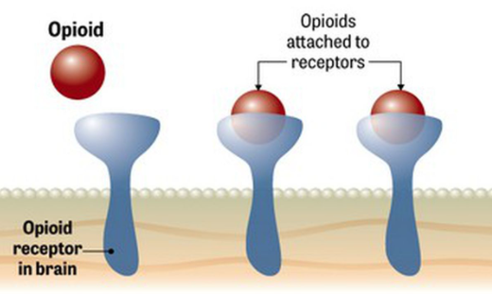
What is an opioid overdose?
There are many opioid receptors in the body
Opioid medications (prescription and illicit) fill the opioid receptors
Some of the opioid receptors located in the brain slow down breathing
If there are too many opioids, breathing can slow to dangerous levels and stop
Without oxygen brain damage will occur
1 minute brain cells begin to die
3 minutes serious brain damage can occur
10 minutes recovery chances lower

Slide 7
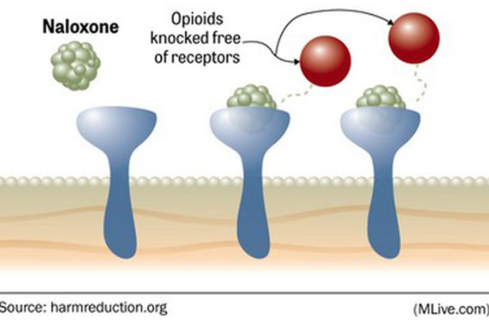
How Naloxone Works
Opioid antagonist
Naloxone has a stronger affinity to the receptors than opioids (think “magnet”)
[Reversing] effects can take 2-3 minutes
Breathing returns
Naloxone effect lasts for 30-90 minutes
Only works for opioids
Causes no harm if not overdosing

Slide 8
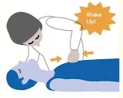
Overdose Recognition
Does not respond to yelling or stimulation,
Sternum rub - rubbing your knuckles up and down the sternum (flat chest bone)
Slow, shallow, or no breathing
Snoring, gurgling or choking sounds
Pulse is slow, erratic or not there
Discolored skin blue or gray ( lips and fingernails)
Body limp
Vomiting

Slide 9
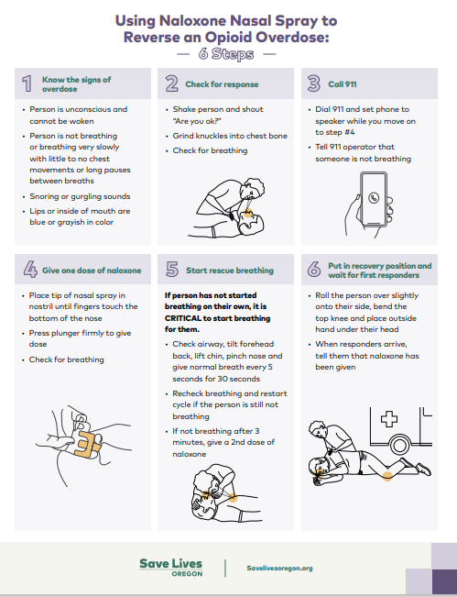
Opioid Overdose Response
Know the signs of overdose
Check for Response
Call 911
Give ONE dose of naloxone
Start Rescue Breathing
If the person has not started breathing on their own, it is CRITICAL to start breathing for them
Put person in recovery position and wait for first responders
https://www.savelivesoregon.org/wp-content/uploads/2023/06/SLO_Naloxone_HowToUse_Nasal.pdf

Slide 10

Good Samaritan Laws
Most states have “Good Samaritan Laws”
US Government Accountability Office 2021 Report “Most States Have Good Samaritan Laws and Research Indicates They May Have Positive Effects” https://www.gao.gov/products/gao-21-248
Oregon State Law - Immunity from drug-related offenses for emergency medical assistance (ORS 475.898)
Washington State Law (RCW 69.50.315)
Alaska State Law (Enrolled HB 369)

Slide 11
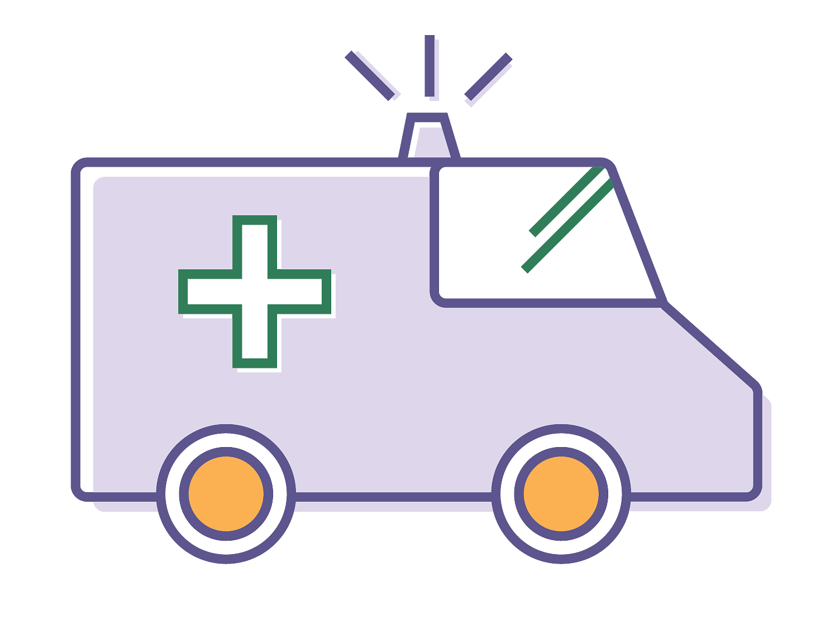
Oregon’s Good Samaritan Law
If someone is experiencing an overdose and you seek medical help for them, neither of you can be arrested or prosecuted for:
1. Possessing drugs or drug paraphernalia
2. Being in a place where drugs are used
3. Violating probation or parole because of #1 or #2 above
4. Outstanding warrants related to #1 or #2 above
If someone is overdosing and you seek medical assistance, both of you are protected from being charged with drug possession.
The Good Samaritan Law does not protect you from:
1. Crimes that are not listed above (Including drug dealing, weapons possession, DUI, and others)
2. Outstanding federal warrants, or warrants from other states besides Oregon

Slide 12
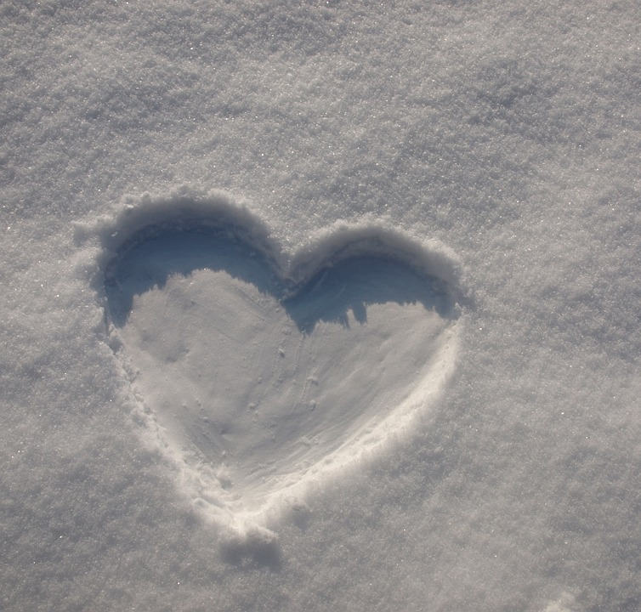
Caring for Yourself After
Responding when a person experiences an overdose is stressful and can be traumatizing
Talk with someone who can listen deeply, attentively and without judgement
Go easy on yourself.
Explore support groups
Do something that is healthy for you.

