Slide 1
Delirium vs Dementia: the double Ds of Geriatrics
Blythe S. Winchester, MD, MPH
5/22/13 1/11/24

Slide 2
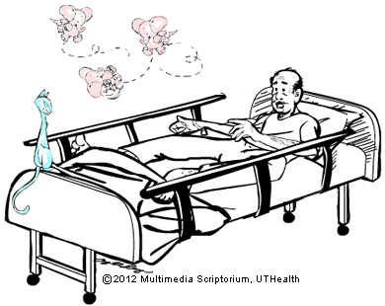
Objectives
Key features, risk factors, diagnosis
Prevention
Treatment
Differences between Dementia, Delirium, and Depression
Cases

Slide 3
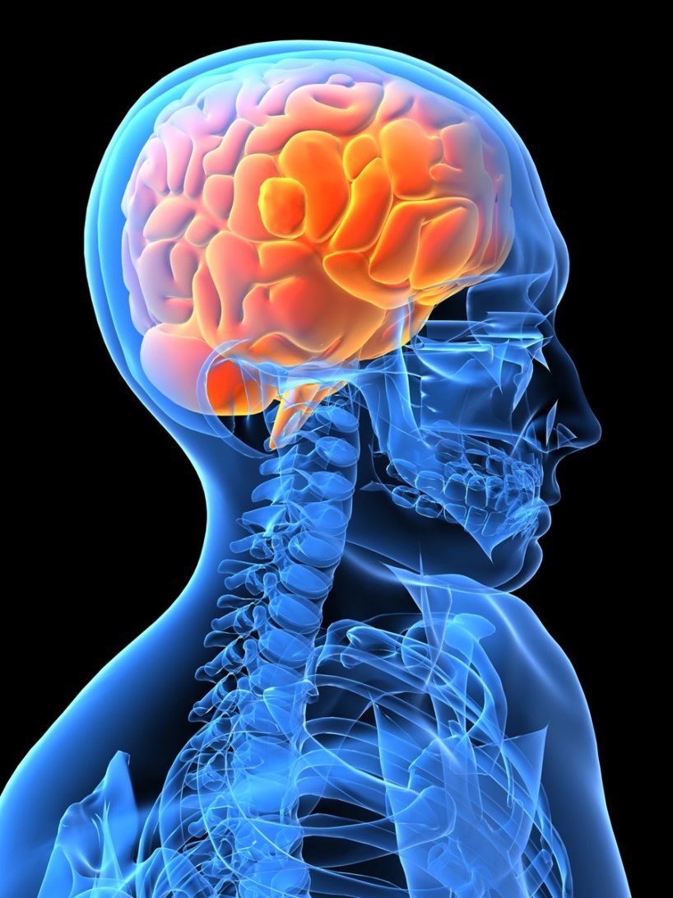
Delirium acute confusional state, metabolic encephalopathy
Notes:
word delirium derives from the Latin deliro-delirare (de-lira, to go out of
the furrow) – hence, to deviate from a straight line, to be crazy, deranged, out
of one’s wits, to be silly, to dote, to rave (Lewis, Short and Andrews, 1879).
During the medieval period a remarkably accurate description of Delirium
was given by the historian Procopius (History of the Wars, II.xxii–xxxiii) who
described an epidemic of a possible bubonic disease in Constantinople in
AD 542 (cited in Bury, 1958). He described hallucinations occasionally
462 HISTORY OF PSYCHIATRY 18(4)
preceding the disease. Some victims became violent with insomnia, excitement,
shouting, rushing off in fl ight (perhaps resembling the modern
concept of hyperactive delirium), while others drifted into coma, forgetting
all those familiar to them, and seeming to sleep constantly, and they could
die from lack of food or water if nobody cared for them (perhaps resembling
hypoactive delirium).

Slide 4
Delirium key features
1. Disturbance of consciousness
2. Change in cognition that is not better accounted for by a pre- existing/established/evolving dementia
3. Disturbance develops over a short time period (hours to days) and tends to fluctuate during the course of the day
4. A medical condition, substance intoxication, or medication side-effect is usually involved
Notes:
Hypoactive v hyperactive
disruptions in thinking and behavior, including changes in perception, attention, mood and activity level
Contrast with “Sundowning”, which is behavioral deterioration, seen in evening, in demented institutionalized patients. Assume to be delirium if new. Patients with established sundowning and no acute medical illness are likely responding to a factor in the institutional environment that has changed (noise, staffing).

Slide 5
Risk Factors
1. Dementia #s 1-3 present in nearly ½ of patients with delirium
2. Stroke
3. Parkinson’s Disease
4. Advanced age
5. Sensory impairment (hearing and vision loss)
6. Polypharmacy
7. Infection

Slide 6

Risk Factors
8. Dehydration
9. Immobility
10. Malnutrition
11. Bladder catheters- or other “tethers”
12. ICU
13. Absence of clock, watch, reading glasses
14. Frequent room changes
15. Inadequate pain control

Slide 7
Diagnosis
Confusion Assessment Method for the diagnosis of Delirium
  Looks at 4 features
    Feature 1: Acute Onset or Fluctuating Course
    Feature 2: Inattention
    Feature 3: Disorganized thinking
    Feature 4: Altered Level of consciousness
Notes:
The diagnosis of delirium by CAM requires the presence of features 1 and 2 and either 3 or 4.
In medical/surgical settings, Sensitivity 94-100%, specificity 90-95%

Slide 8
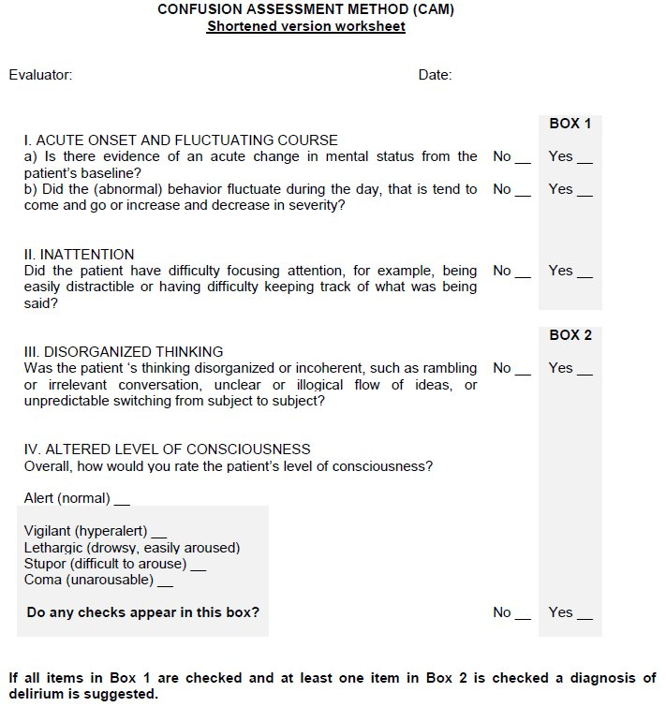
CAM
Notes:
Other tests for attention- days of the week or months of year backwards

Slide 9
Diagnosis, continued
Basic labs
CT rarely indicated

Slide 10
Prevention-outpatient
Avoid illness
Avoid alcohol
Exercise caution with medication
Eliminate or reduce the use of the following medications:
Antihistamines (e.g., diphenhydramine)
Bladder relaxants
Intestinal antispasmodic
Centrally-acting blood pressure medicines (e.g., clonidine, methyldopa)
Muscle relaxants
Anticholinergics (drugs with atropine-like effects)
Opioids (e.g., codeine, hydrocodone, morphine)
Anti-nausea medication
Benzodiazepine type sedatives

Slide 11
Prevention- inpatient
1. Orientation protocol and cognitive stimulation for patients with cognitive impairment
2. Environmental modification and nonpharmacologic sleep aids for patients with insomnia
3. Early mobilization and minimizing use of physical restraints for patients with limited mobility
4. Visual and hearing aids for patients with these impairments
5. Early volume repletion for patients with dehydration
6. Manage pain
*No medication has evidence-based support for prophylaxis of delirium at this time-

Slide 12

Treatment- always address underlying condition!
Interdisciplinary Team!
Supportive Care:
a. Maintain hydration, nutrition, mobility
b. Treat pain
c. Avoid skin breakdown, aspiration pneumonitis
d. Assess caregivers’ ability to provide extended care
What is the unmet need??

Slide 13
Managing Behaviors
Prevent wandering/falls: obs better than than restraints
Meds are only necessary for safety-
Haldol 0.5 - 1.0 mg: IV=30 minute onset, IM=60 minute onset, Oral >60 minute onset
  QT prolongation, caution in parkinsonism
Lorazepam 0.5 to 1.0 mg IM or IV (five minute onset) for drug withdrawal. May cause confusion/sedation. Can use if antipsychotics are contraindicated or delirium is from drug withdrawal

Slide 14
DEMENTIA | DELIRIUM | DEPRESSION
Mental decline slow | Mental decline rapid | Mental decline rapid
Disoriented, confused; gets lost | Waxes/wanes | oriented
Trouble with short-term memory | Trouble with attention/concentration | Difficulty concentrating
Writing, speaking, motor skills impaired | Writing, speaking, motor skills may be impaired | Language/motor skills slow, but normal
Doesn’t notice memory problems or seem to care | Doesn’t notice memory problems | Notices or worries about memory problems

Slide 15
Case
88yo WM admitted with worse balance, falls, confusion
h/o CABG, HF, pulm HTN, h/o CVA, depression, chronic hyponatremia, anemia, dextroscoliosis, DJD, debility, Parkinson’s
Functional: lives in AL, refuses increased level of care unless there is catastrophic event

Slide 16
Case
Lives with wife who has dementia
He also has reported h/o mild dementia
Family reports decreased appetite, requires help with getting to toilet/transfers, overall increase in weakness that is progressive.

Slide 17
Case
Meds:
  ASA
  Imdur
  Statin
  Levothyroxine
  Sinemet 25/100 2 tabs 5x/day
  Cholecalciferol
  Celexa
  Dronabinol
  Senna
  Miralax
  Ferrous sulfate
Notes:
Dronabinol- recently started by pcp- supposedly to help with appetite. Not so great in person with h/o depression, confusion?

Slide 18
Case
PE: very frail, cachectic, orthostatic
  Lethargic. Had not received parkinson’s meds on schedule and had panic attacks/anxiety. Received ativan, then trazodone to sleep.
  Confused
  CT head small v disease, mild volume loss, encephalomalacia.
  AAS- constipation
  Anemic- declined scope
Notes:
Overall decline- had parkinson’s for years. Hd declined over months, recent hospitalizations. Hypoactive delirium. Likely related to anemia, dehydration/orthostasis. Fluids, decreased meds. Improved. But needed palliative care- discussions with family

Slide 19
Prognosis
Delirium is an independent marker for mortality after hospitalization
Protracted delirium (symptoms for over 6 months) also higher mortality regardless of dementia
Notes:
Signs of delirium may persist for 12 months or longer, particularly in those with underlying dementia [118].
One long-term follow-up study found that after two years, only one-third of patients who had experienced delirium still lived independently in the community [119]. Another prospective study of 225 patients after heart surgery found that those who experienced delirium were more likely to have a persistent drop in Mini-Mental State Examination (MMSE) scores over baseline at six months compared with those who did not suffer delirium (40 versus 24 percent); at 12 months the differences were not quite statistically significant (31 versus 20 percent, p = 0.055) [120]. In a study of 821 patients admitted to medical or surgical intensive care, the duration of delirium was associated with worse cognitive function at 3 and 12 months. While only 6 percent had cognitive impairment at baseline, at 12 months, 34 percent had deficits that were similar to patients with moderate traumatic brain injury [121]. Other studies have found that patients with delirium are more likely to have long-term cognitive problems than hospitalized patients who did not suffer from delirium [122]. Thus, although delirium is considered potentially reversible, impairments may be prolonged and perhaps permanent, particularly in frail, older patients.

Slide 20

Questions?
Fong, T.G., Inouye, S.K. The inter-relationship between delirium and dementia: the importance of delirium prevention. Nat Rev Neurol 18, 579–596 (2022). https://doi.org/10.1038/s41582-022-00698-7
O'Mahony R, Murthy L, Akunne A, et al. Synopsis of the National Institute for Health and Clinical Excellence guideline for prevention of delirium. Ann Intern Med 2011; 154:746.
Hshieh TT, Yue J, Oh E, et al. Effectiveness of multicomponent nonpharmacological delirium interventions: a meta-analysis. JAMA Intern Med 2015; 175:512.
Francis J.Delirium and acute confusional states: Prevention, treatment, and prognosis. UptoDate Literature review current through: Dec 2023.
This topic last updated: May 22, 2019. accessed 1/5/24.

