Slide 1


Slide 2
Recovery Capital: Assets, Not Abstinence
Dr. Alex Elswick
Assistant Professor, University of Kentucky
Co-Founder, Voices of Hope

Slide 3
Disclosure
I am a Co-founder and Board Member of Voices of Hope-Lexington Inc.

Slide 4
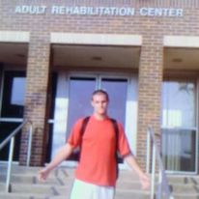
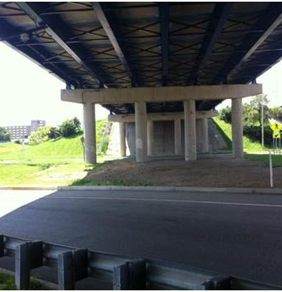
Notes:
Alex’s story

Slide 5
Recovery
“A process of change through which individuals improve their health and wellness, live a self-directed life, and strive to reach their full potential” (SAMHSA, 2012)

Slide 6
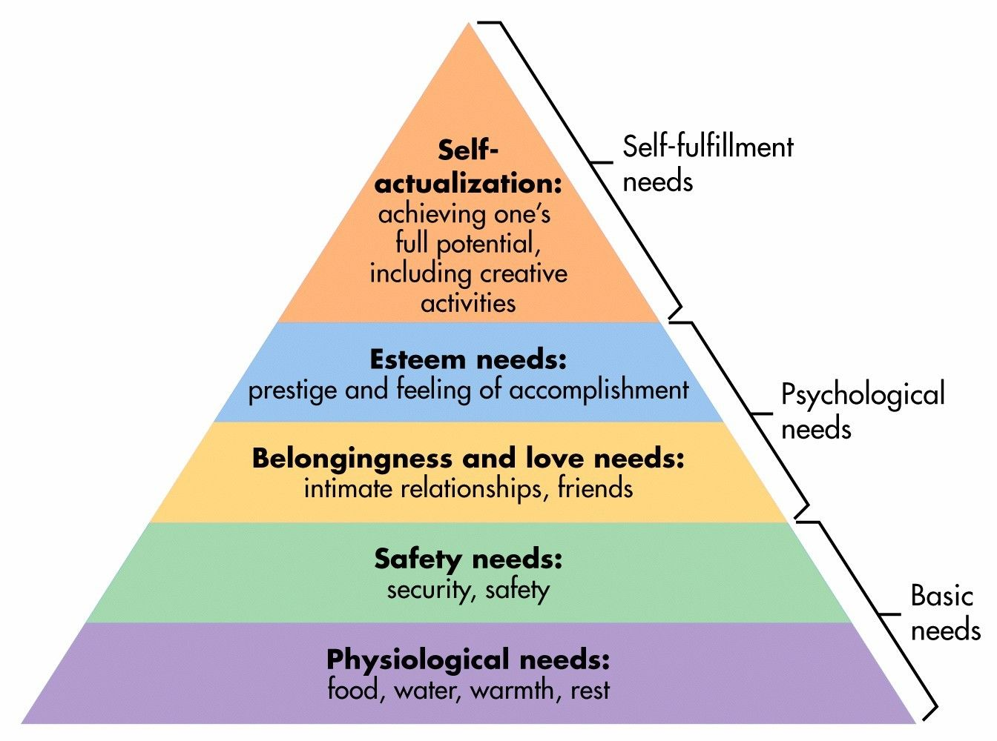
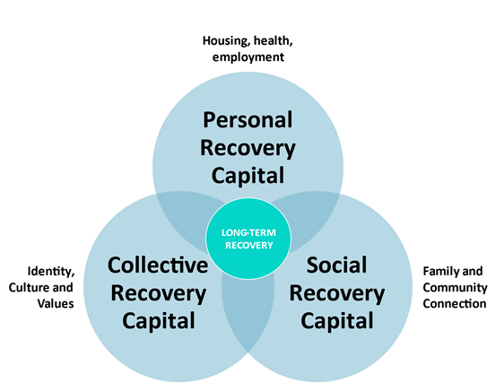
Adapted from Maslow (1943)
Adapted from Cloud & Granfield (2008)
Notes:
Alex had the recovery capital he needed, including housing from crossroads

Slide 7

Which comes first, Abstinence or Recovery Capital?
Housing (Pauly et al., 2013)
Social services (Rigaud, 2019)
Caregiving (Patton, Best, & Brown, 2022)
Mental health services
Continued treatment (White, 2005)
Acceptance in the recovery community (von Greiff, & Skogens, 2021)

Slide 8
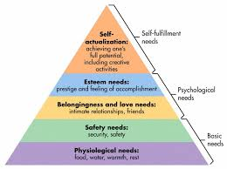
Rock Bottom

Slide 9
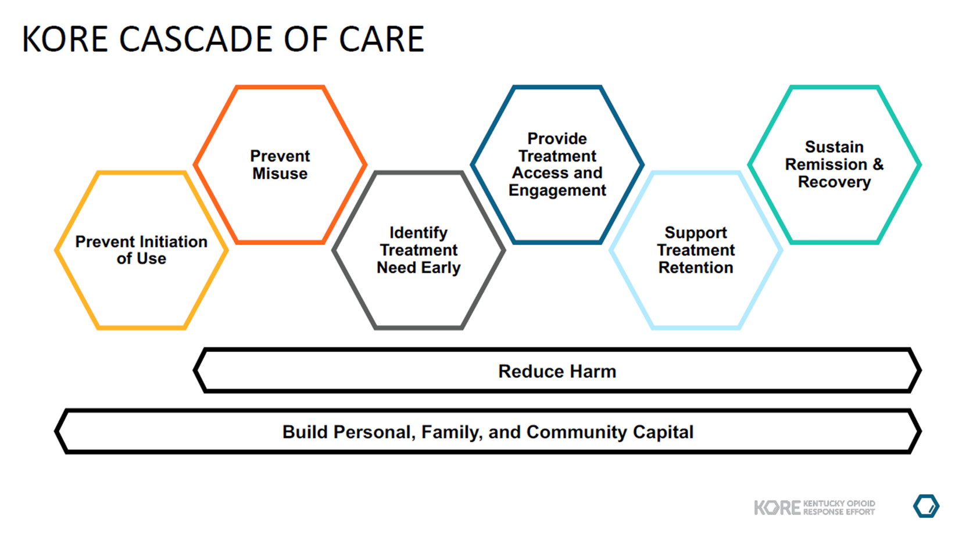

Slide 10
Why is Recovery Capital so important?
Recovery Capital is conceptually linked to Natural Recovery (Granfield & Cloud, 1996)
Natural Recovery (also called unassisted recovery or spontaneous remission)
  50% of people with SUDs (Kelly, Bergman, Hoeppner, Vilsaint, & White, 2017)
  75% of people with AUDs (Tucker, Chandler, & Witkiewitz, 2020)

Slide 11
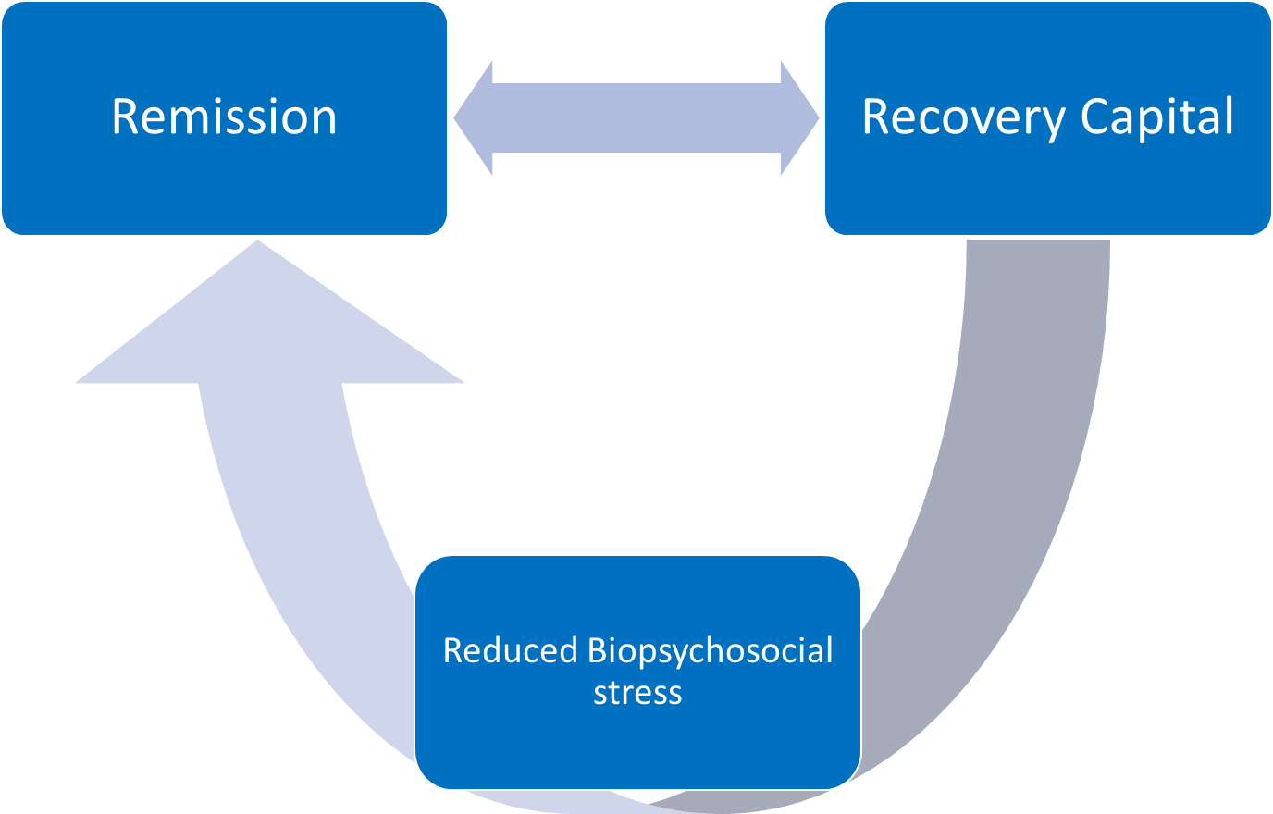
Recovery Capital and Natural Recovery
Adapted from Kelly and Hoepner (2015)

Slide 13
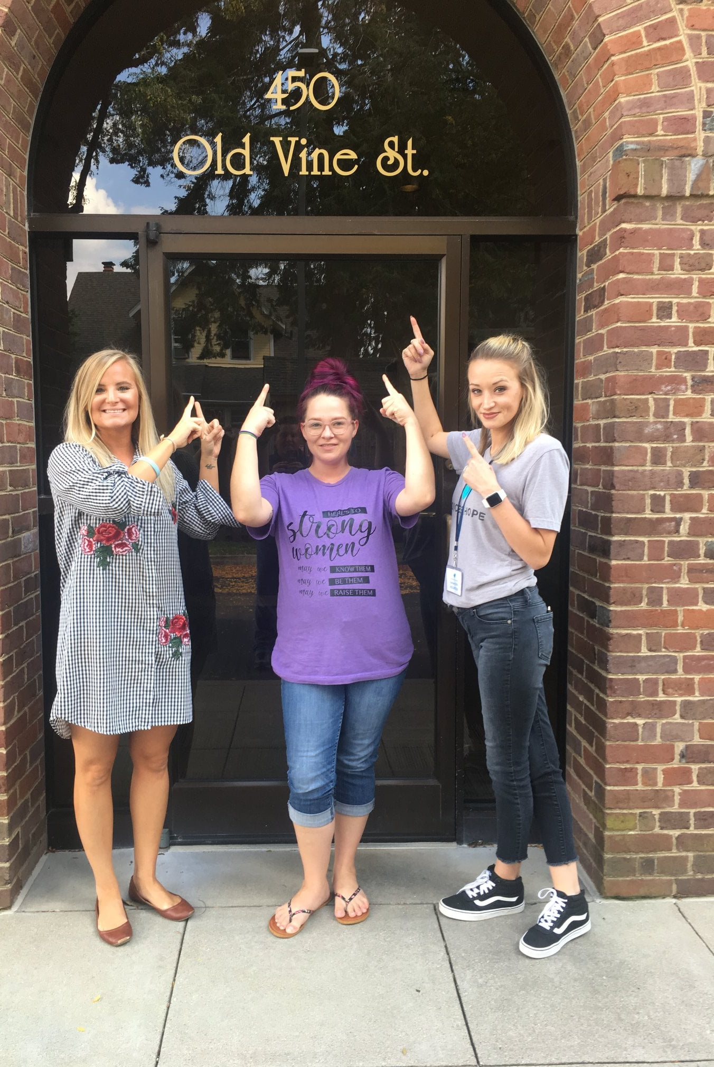
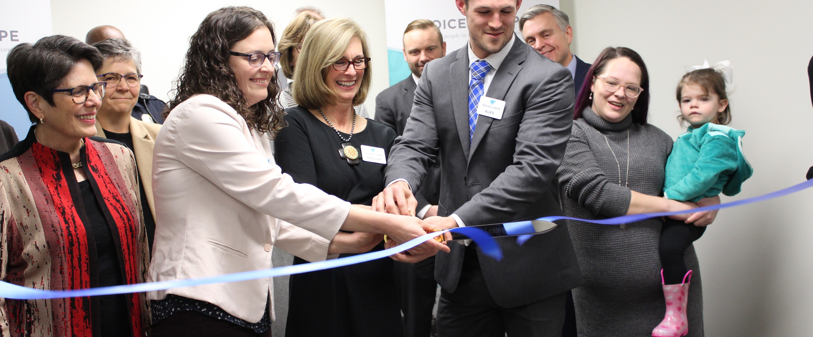
2018:
5 Staff in Recovery
Notes:
We created a recovery community center

Slide 14
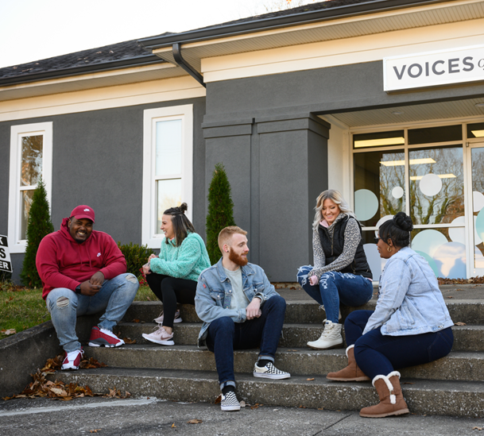
Today:
55 Staff in Recovery
2023:
85 Staff in Recovery
Notes:
And this is what these folks do…

Slide 15
Asset-Building at Voices of Hope
Recovery Community Center
Recovery Coaching
Telephone Recovery Support
Mutual Aid Meetings
Community Outreach
Mobile Outreach Recovery Engagement (MORE)

Slide 16

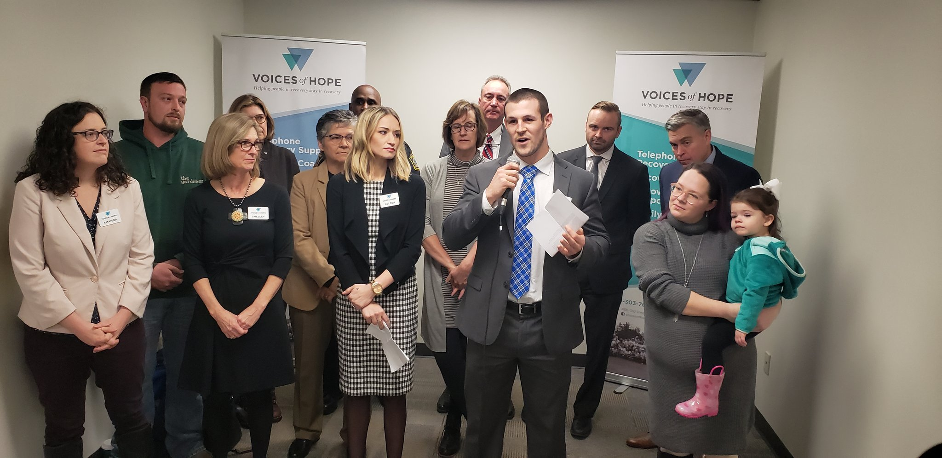
Voices of Hope Recovery Community Center (RCC)
What we offer:
Recovery Coaching: 468
Laundry: 291
Public Computers: 93
Social activities: 186
Other: 653
Year-to-Date:
1,694 RCC participants
An average of 169 RCC participants per month
Notes:
And this is what these folks do…

Slide 17
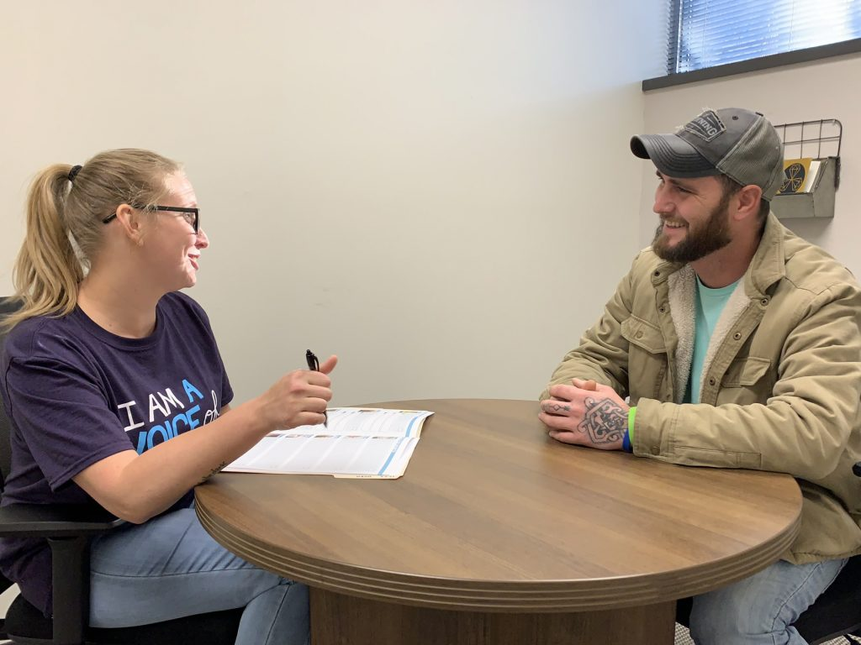
What we offer:
Housing assistance
Employment readiness
Barrier relief
Warm handoffs
Recovery Coaching
Year-to-Date:
Monthly average of 195 new coaching participants
Currently 426 active participants
Notes:
And this is what these folks do…

Slide 18

What we offer:
Regularly scheduled support phone calls
Targeted support
Referrals
Connection
Telephone Recovery Support
Year-to-Date:
5,330 TRS calls
129 participants per month
Notes:
And this is what these folks do…

Slide 19
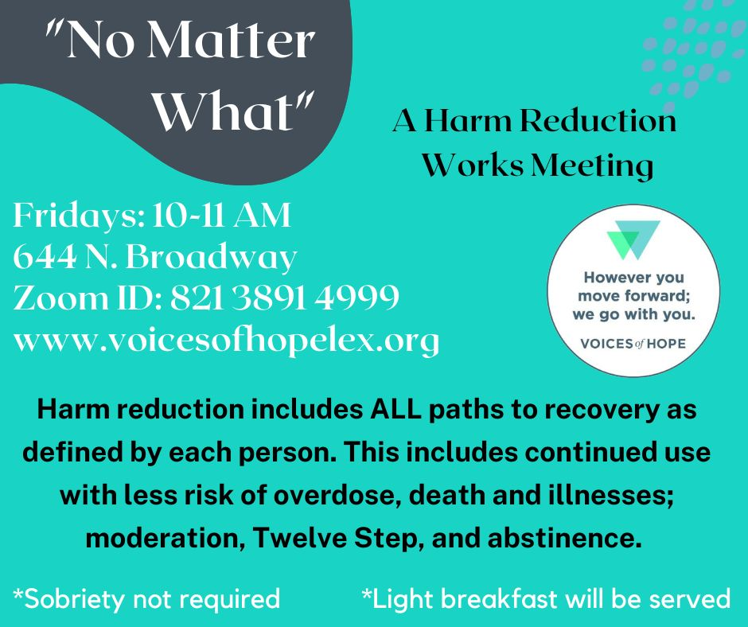
What we offer:
Alcoholics Anonymous
Narcotics Anonymous
Harm Reduction Works
Medication Assisted Recovery Anonymous
And Many More!
Mutual Aid Meetings
Year-to-Date:
13,767 attendees
1,377 per month
Notes:
And this is what these folks do…

Slide 20
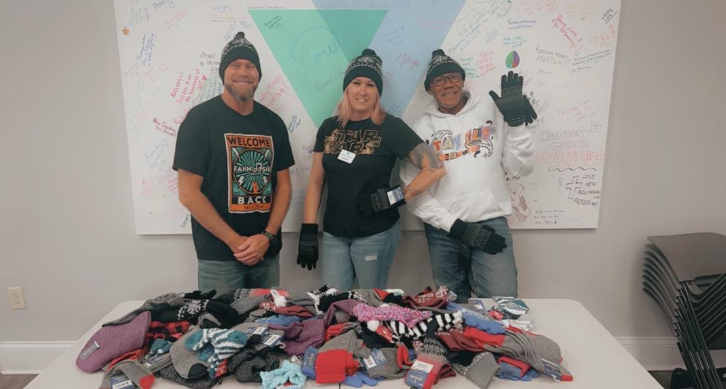
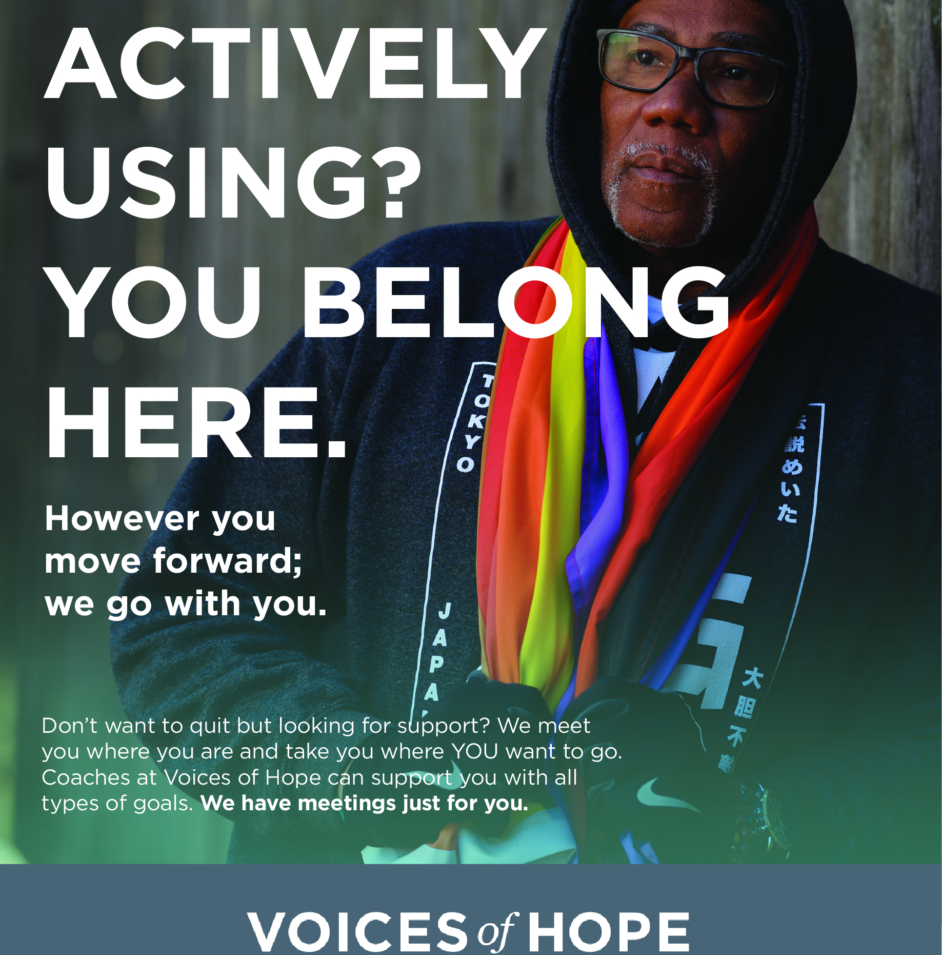
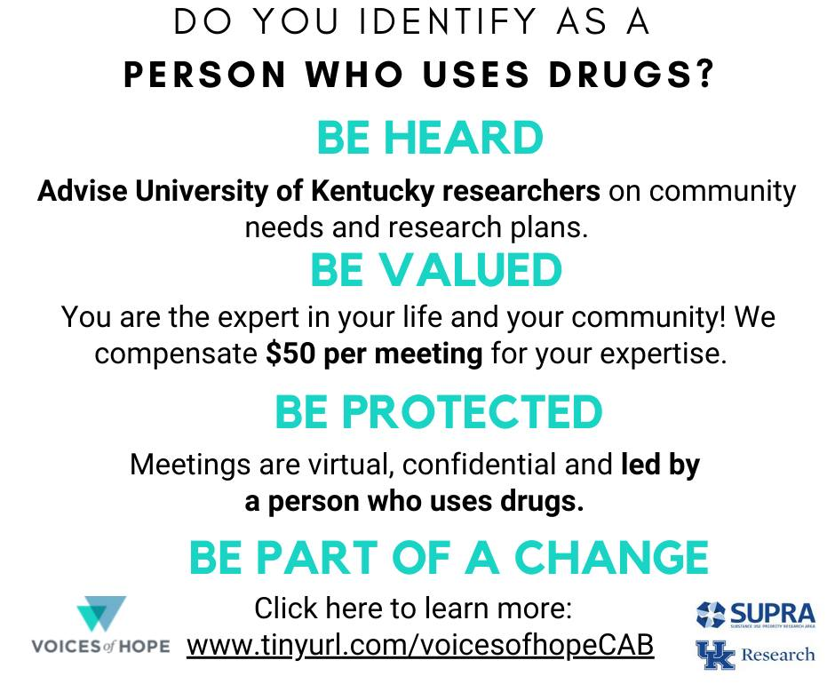
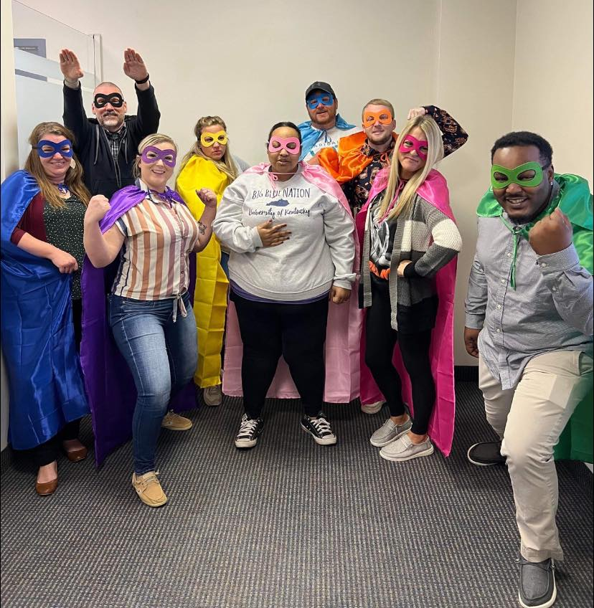
What we offer:
Community Advisory Board (CAB)
Monthly meals
Sober social events
Community Outreach
Year-to-Date:
Trick-or-treat: 129 kiddos
Monthly meals: 50 individuals
Notes:
And this is what these folks do…

Slide 21
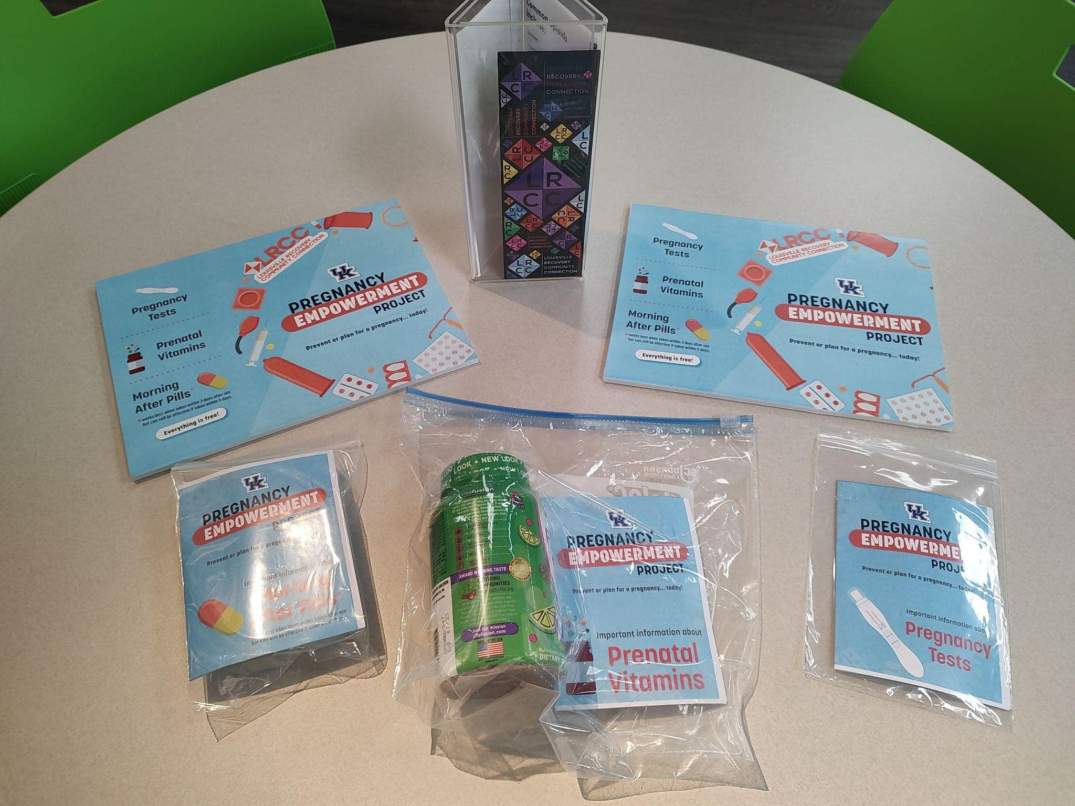
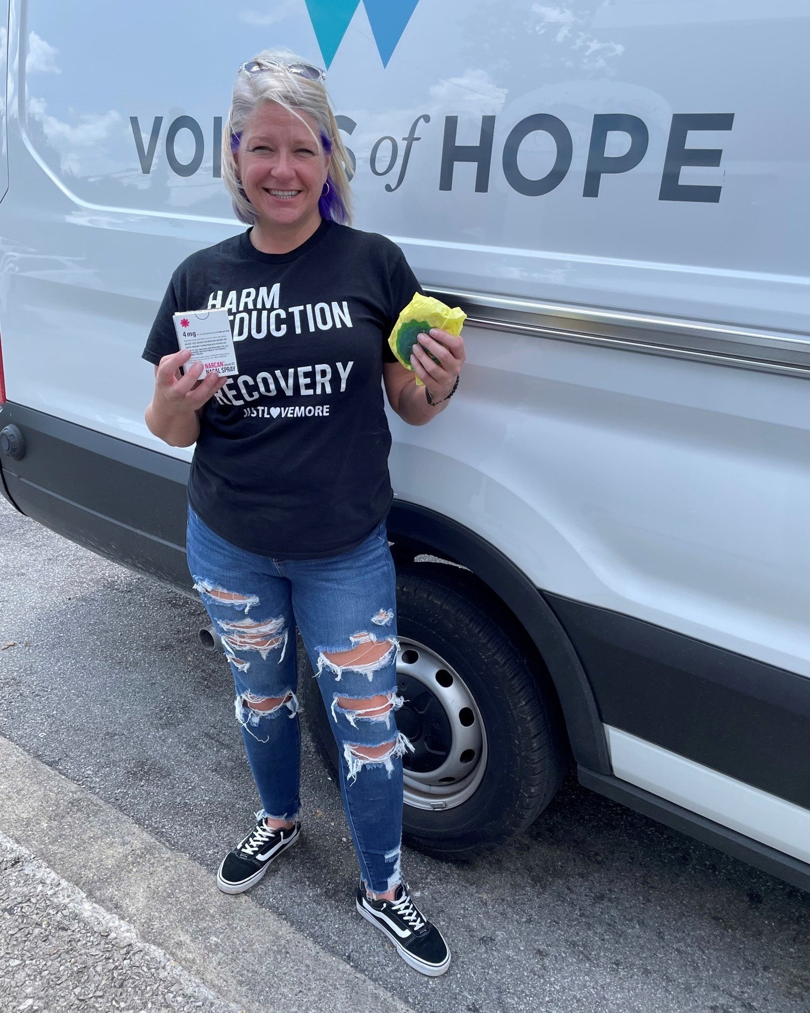
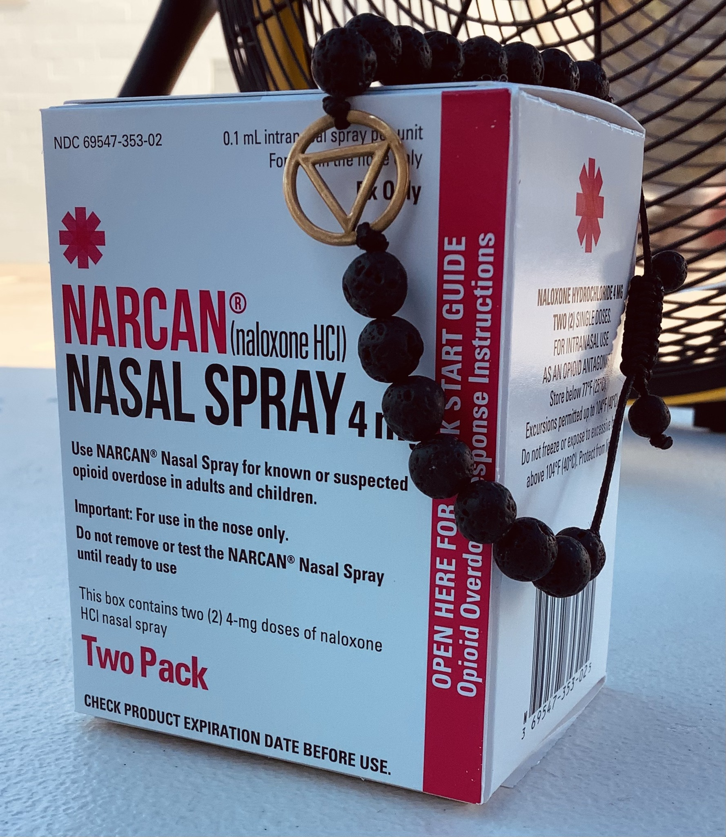
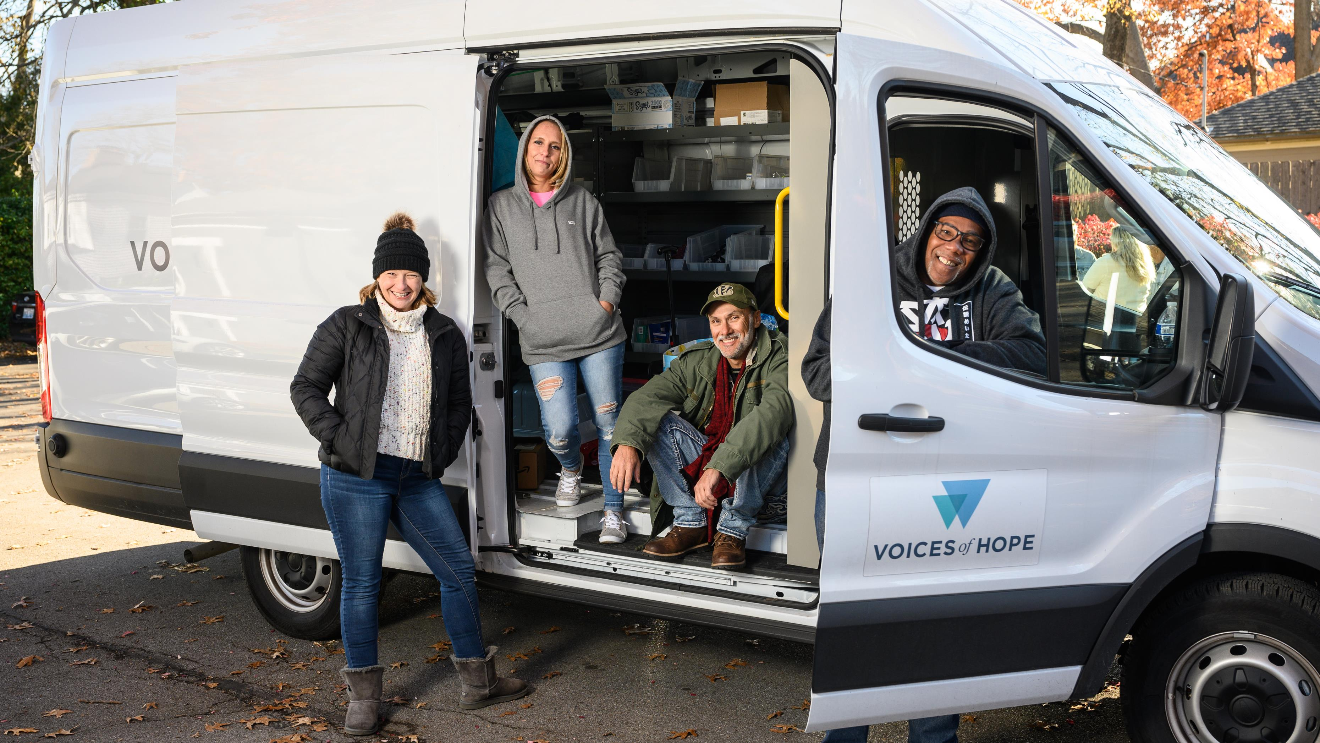
What we offer:
On-Site Coaching
Narcan & Overdose Response Training
Safer using kits
Pregnancy Empowerment Kits
Food
Blankets
And more!
Mobile Outreach Recovery Engagement (MORE)
Year-to-Date:
2,757 units of Narcan
611 reported OD reversals
3,000 fentanyl test strips
346 reported FTS uses
7,405 snacks
2,912 meals
Notes:
And this is what these folks do…

Slide 22
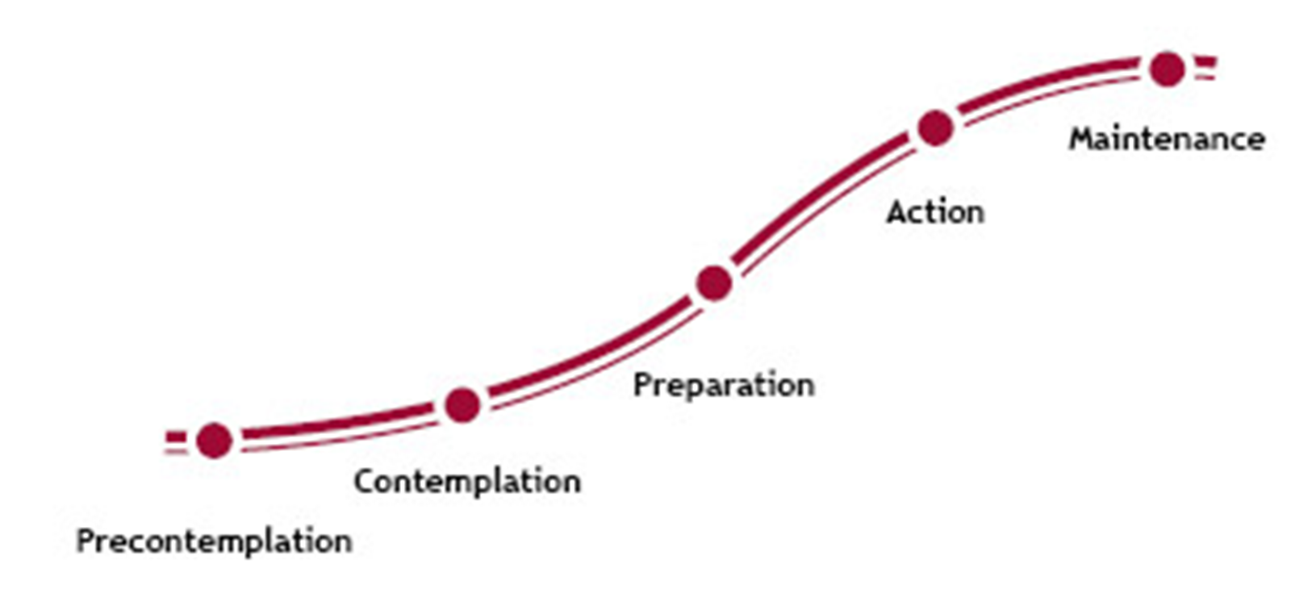
Why Focus on Harm Reduction and Asset Building Rather than Abstinence?
Adapted from Prochaska & DiClemente (1977)
Treatment (Abstinence only)
Harm Reduction, Recovery Support Services, etc.

Slide 23
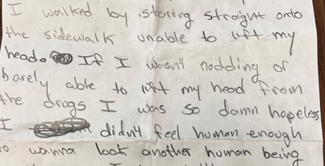
Notes:
"As I look out this window on North Broadway, I watch folks walking by and I recall the many times I walked by staring straight into this window unable to lift my head. I was so hopeless. I didn't feel human enough to wanna look another human being in the eyes. A month ago I heard that I could wash my laundry in this place with no strings attached - I just needed to sign up for recovery coaching. I thought to myself that was a small price to pay to do laundry. I stumbled in feeling defeated and beneath everyone. I had accepted that I'd die out here and fade from everyone's memory.
“Now, I'm staring out this window waiting for a ride back to treatment. I feel completely opposite of how I felt when I first came here. Thanks to Voices of Hope I know I am worthy of recovery and can live a meaningful life. I've received encouragement and have been able to talk to others that know exactly how I feel and what I've been through.

Slide 24
References
Cloud, W., & Granfield, R. (2008). Conceptualizing Recovery Capital: Expansion of a Theoretical Construct. Substance Use & Misuse, 43(12/13), 1971–1986.
Granfield, R., & Cloud, W. (1996). The Elephant That No One Sees: Natural Recovery among Middle-Class Addicts. Journal of Drug Issues, 26(1), 45–61
Joseph, R. (2019). Legislative malpractice in drug-testing welfare policies: A cross-sectional analysis of the National Survey on Drug Use and Health data. Journal of Evidence-Based Social Work, 16(3), 294–310.
Kelly, J. F., Bergman, B., Hoeppner, B. B., Vilsaint, C., & White, W. L. (2017). Prevalence and pathways of recovery from drug and alcohol problems in the United States population: Implications for practice, research, and policy. Drug and Alcohol Dependence, 181, 162–169.
Kelly, J. F., & Hoeppner, B. (2015). A biaxial formulation of the recovery construct. Addiction Research & Theory, 23(1), 5–9.
Patton, D., Best, D., & Brown, L. (2022). Overcoming the pains of recovery: the management of negative recovery capital during addiction recovery pathways. Addiction Research & Theory, 30(5), 340–350.
Pauly, B., Reist, D., Belle-Isle, L., & Schactman, C. (2013). Housing and harm reduction: What is the role of harm reduction in addressing homelessness? International Journal of Drug Policy, 24(4), 284-290.
Tucker, J. A., Chandler, S. D., & Witkiewitz, K. (2020). Epidemiology of Recovery from Alcohol Use Disorder. Alcohol Research: Current Reviews, 40(3), 1–12.
von Greiff, N., & Skogens, L. (2021). Recovery and identity: a five-year follow-up of persons treated in 12-step-related programs. Drugs: Education, Prevention & Policy, 28(5), 465–474.
White, W., Scott, C., Dennis, M. & Boyle, M. (2005). It’s time to stop kicking people out of addiction treatment. Counselor, 6(2), 12-25.

