Slide 1
Shock
C. Mateo Garcia, MD

Slide 2
MEdications
Tranexamic Acid
Dobutamine (Dobutrex)
Dopamine (Inotropin)
Norepinephrine (Levophed)
Milrinone (Primacor)
Phenylephrine

Slide 3
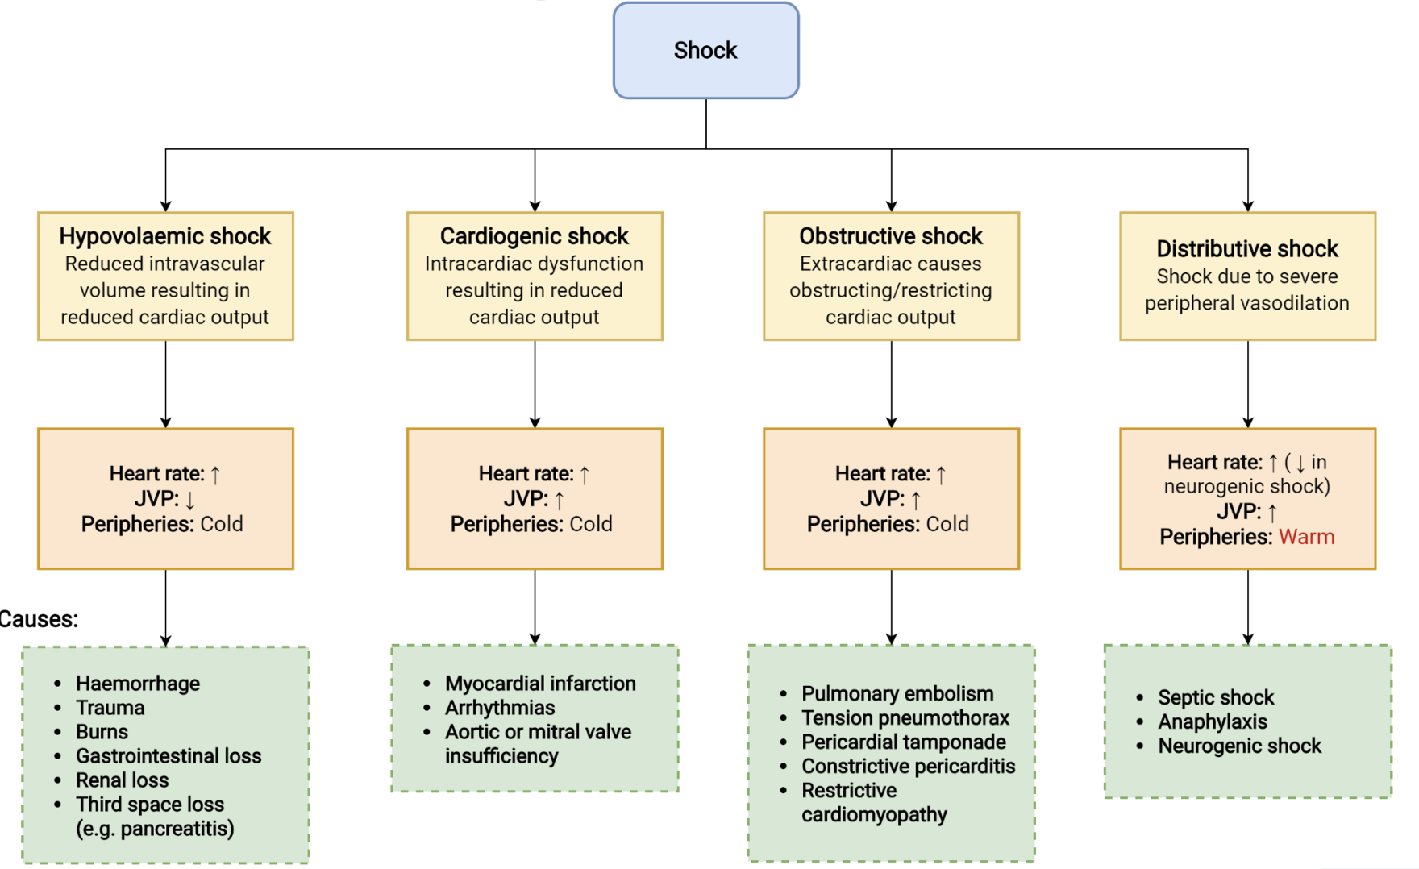
Shock
Abnormality of the circulatory system resulting in inadequate tissue perfusion.
Compensated vs Decompensated.

Slide 4
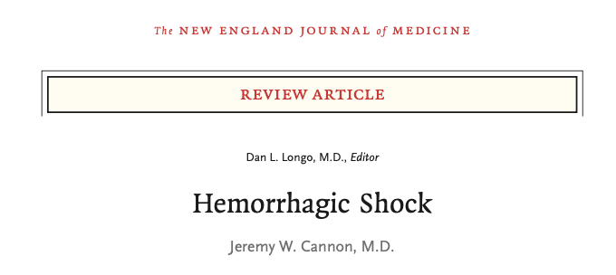
2018 NEJM review article on hemorrhagic shock

Slide 5
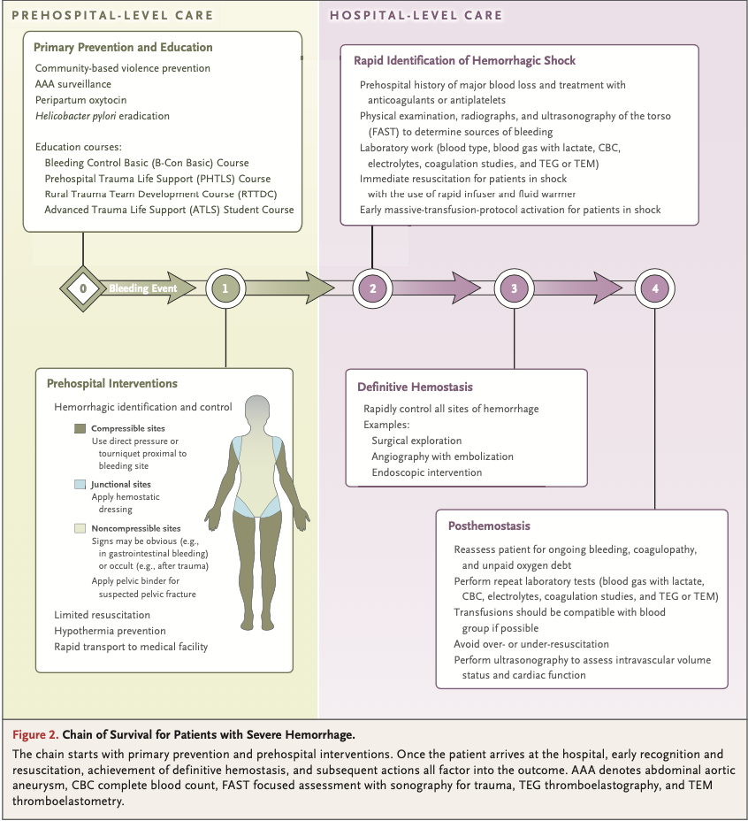
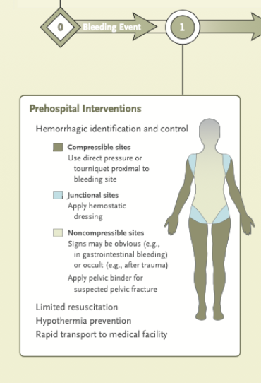

Slide 6
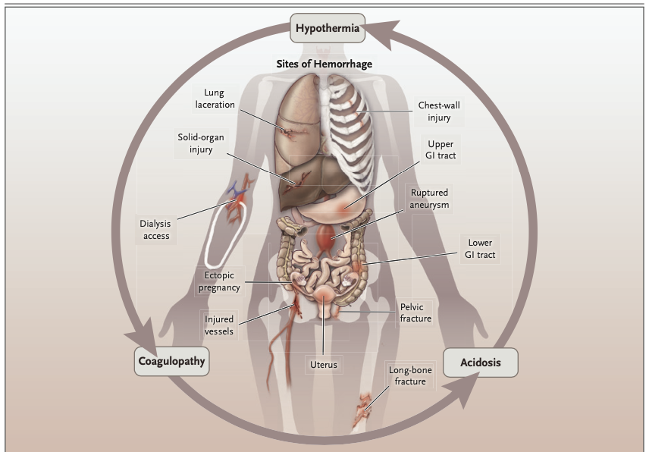

Slide 7
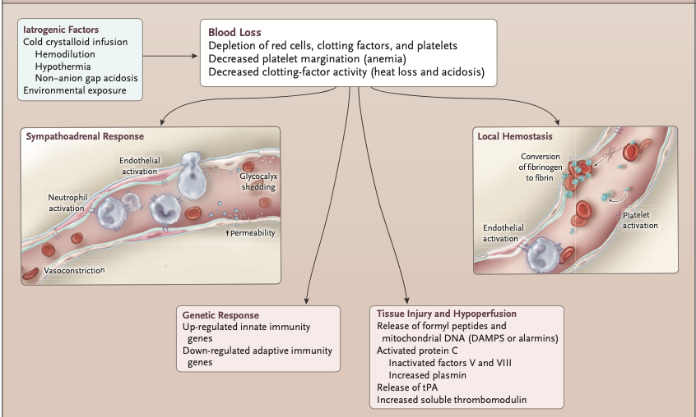

Slide 8
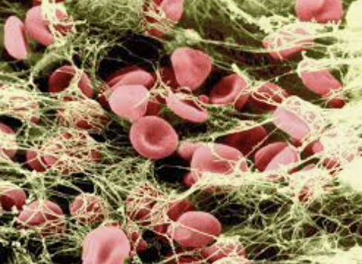
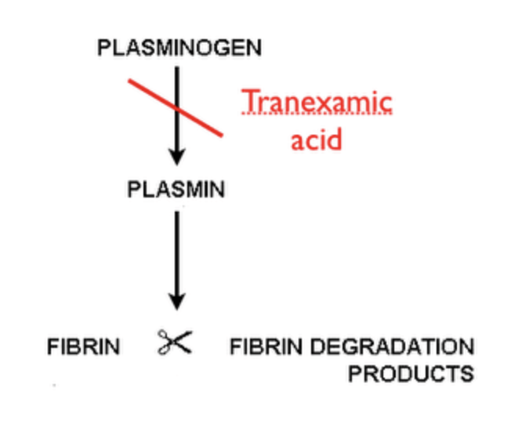
Tranexamic acid
Class: antifibrinolytic, hemostatic agent.
MOA: inhibits intrinsic fibrinolysis, promoting blood clot formation.
Indication: severe traumatic hemorrhage, surgical hemorrhage, Postpartum hemorrhage severe menstrual bleeding.
Adverse Effects:
Contraindications: thromboembolism

Slide 9
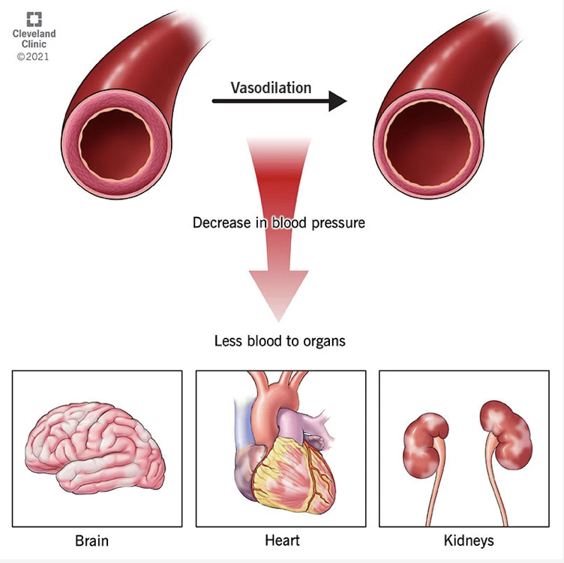
Distributive Shock
Septic shock - Norepi
Neurogenic shock - Norepi
Anaphylactic shock - Epi

Slide 10
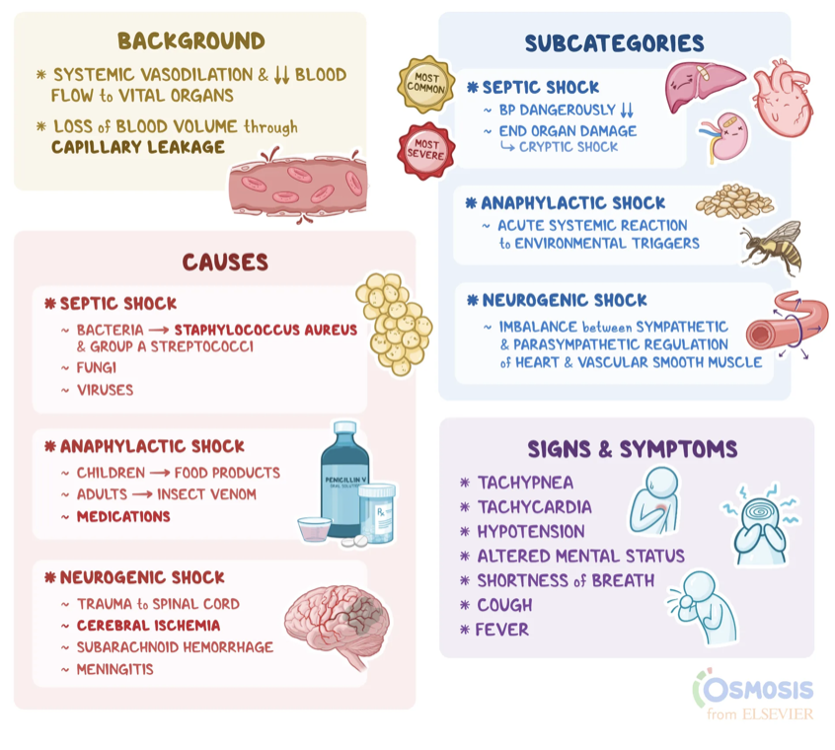
Distributive Shock

Slide 11
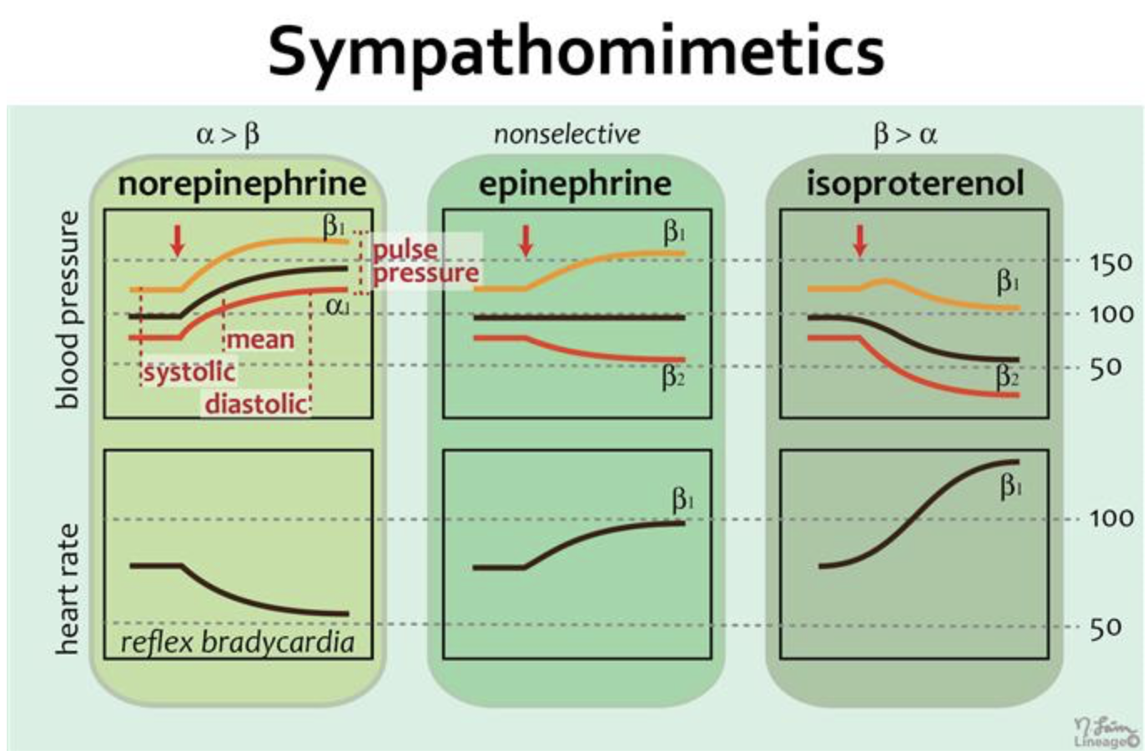
Norepinephrine
Class: adrenergic receptor agonist, inotropic, vasopressor.
Action: Norepinephrine is alpha and Beta agonist, (much stronger alpha predilection).
Indications: cardiogenic shock, septic shock, severe hypotension.
Adverse effects: Dizziness, anxiety, cardiac arrhythmias, dyspnea, exacerbation of asthma.
Contraindications: patients taking MAOI’s.

Slide 12
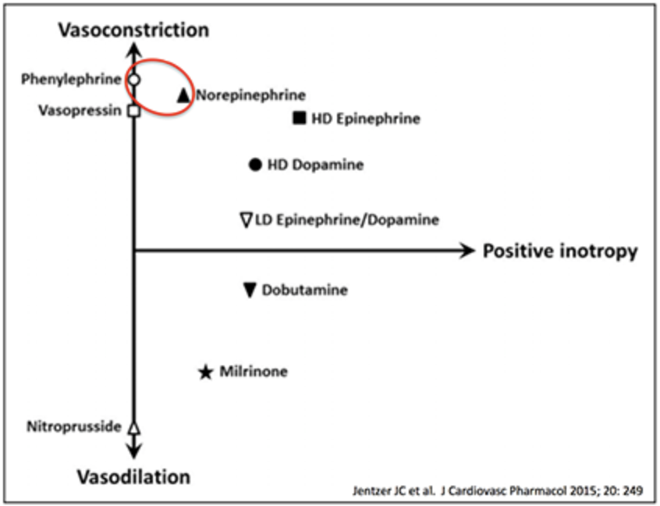
Phenylephrine
Class:adrenergic agonist
Action: stimulate alpha receptors, causing vasoconstriction, which results in increased blood pressure
Indications: neurogenic shock, spinal shock, drug induced hypotension.
Adverse effects: Dizziness, anxiety, cardiac arrhythmias, dyspnea
Contraindications: acute MI, Angina, cardiac arrhythmias, severe hypertension, CAD, pheochromocytoma, MAOI’s

Slide 13
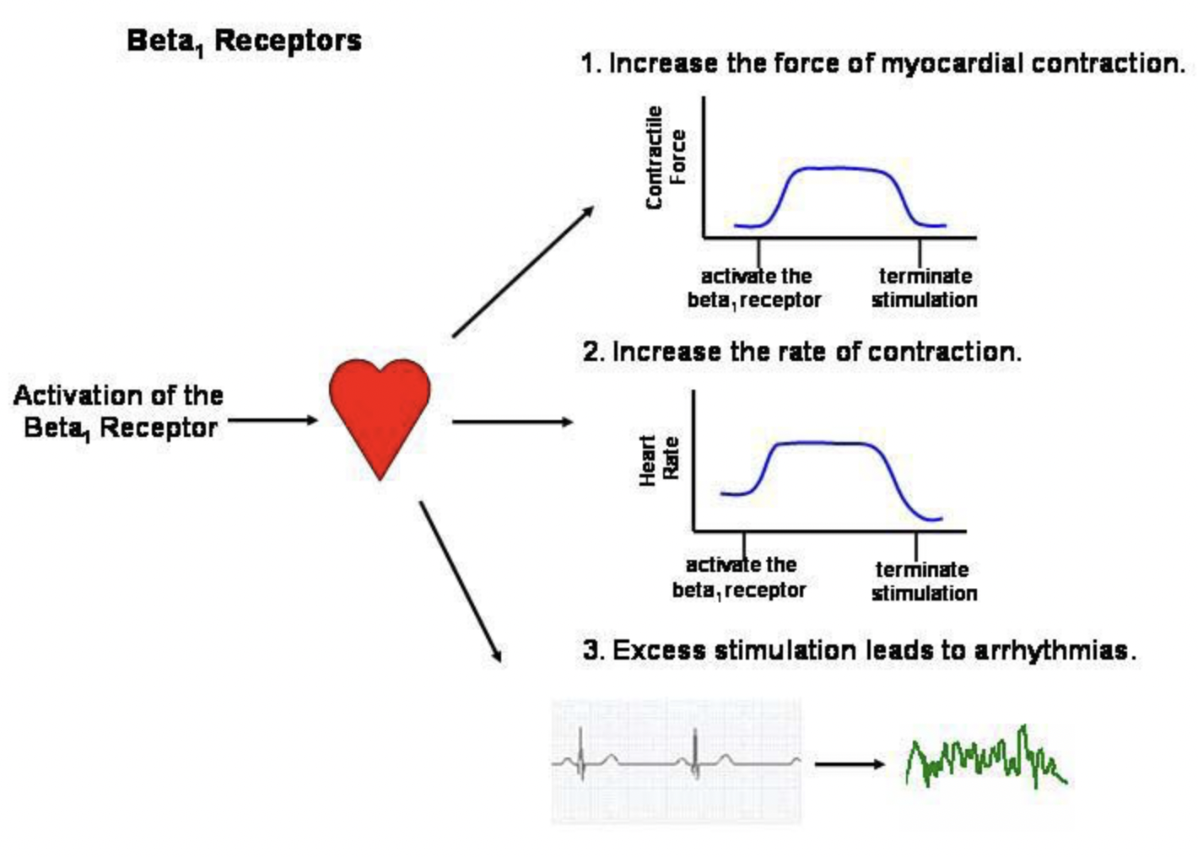
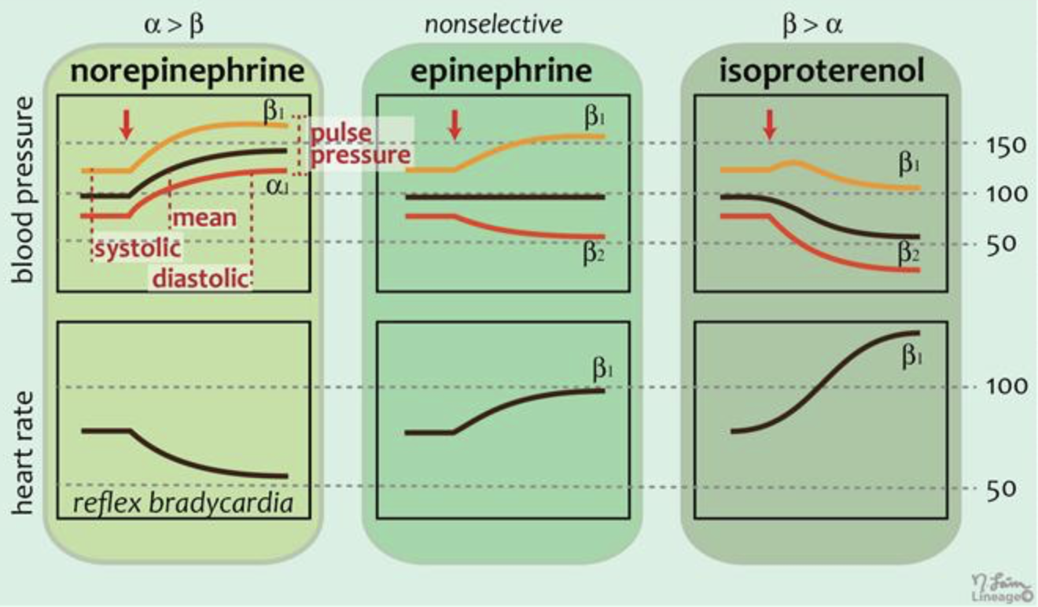
Epinephrine
Adrenergic agonist
Binds w/ high affinity to alpha and Beta receptors producing increased blood pressure increased heart rate and bronchodilation.
Adverse effects: anxiety, headache, cardiac arrhythmias, htn, nausea/vomiting.
Contraindications: arrhythmias other than VF, pregnant females in active labor.

Slide 14
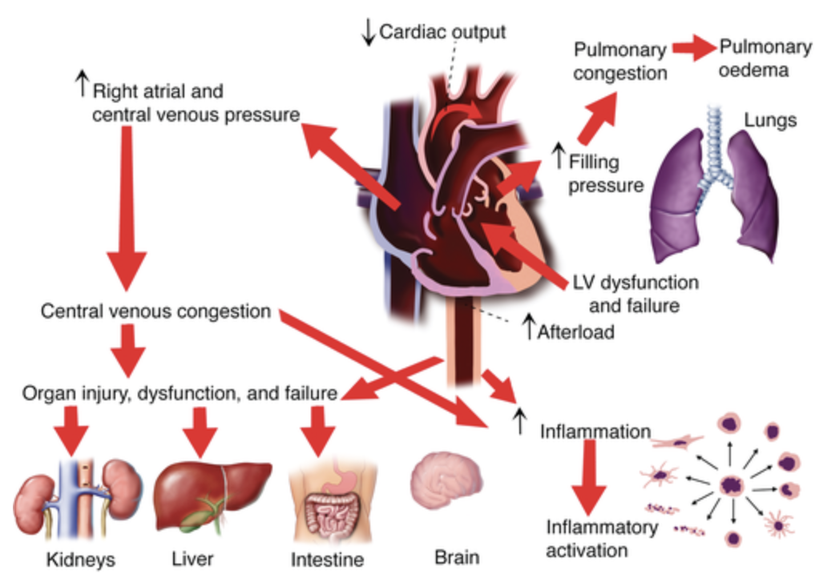
Cardiogenic shock

Slide 15
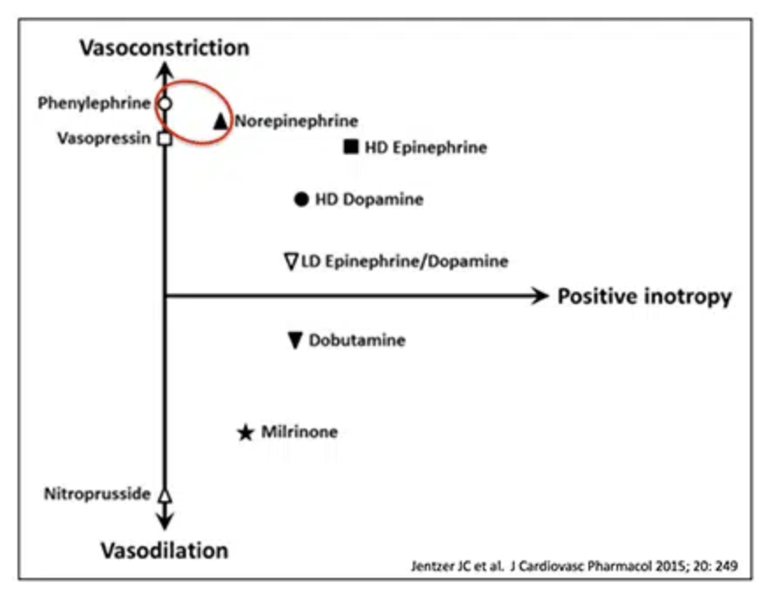
Dopamine
Adrenergic agonist, inotrope, vasopressor
Stimulates alpha and beta
Indications hypotension and low cardiac output/ cardiogenic shock. Hypotension after ROSC.
Short half life, 2min.
Pregnancy class C.
Contraindications:pheochromocytoma, VF, VT or other ventricular arrhythmias.

Slide 16
Norepinephrine
Class: adrenergic receptor agonist, inotropic, vasopressor.
Action: Norepinephrine is alpha and Beta agonist, (much stronger alpha predilection).
Indications: cardiogenic shock, septic shock, severe hypotension.
Adverse effects: Dizziness, anxiety, cardiac arrhythmias, dyspnea, exacerbation of asthma.
Contraindications: patients taking MAOIs.

Slide 17
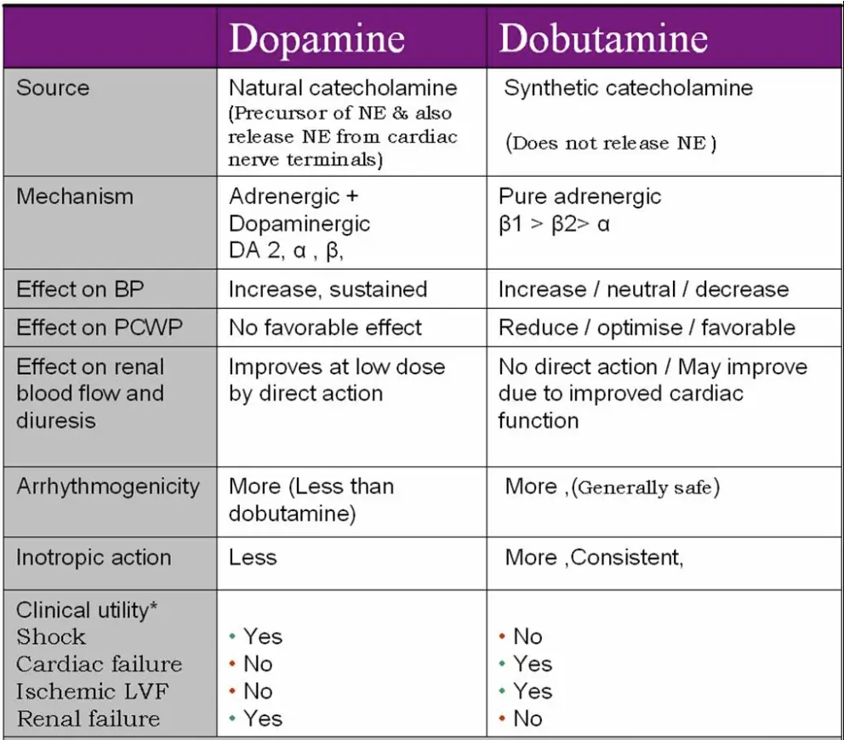
Dobutamine
Class: adrenergic Agonist, inotrope
MOA: Beta agonist, increases myocardial contraction and stroke volume with minor effect in chronotropy all resulting in increased CO
Indications: heart failure, cardiogenic shock
Contraindications: suspected drug induced shock, systolic blood pressure <100, subaortic stenosis.

Slide 18
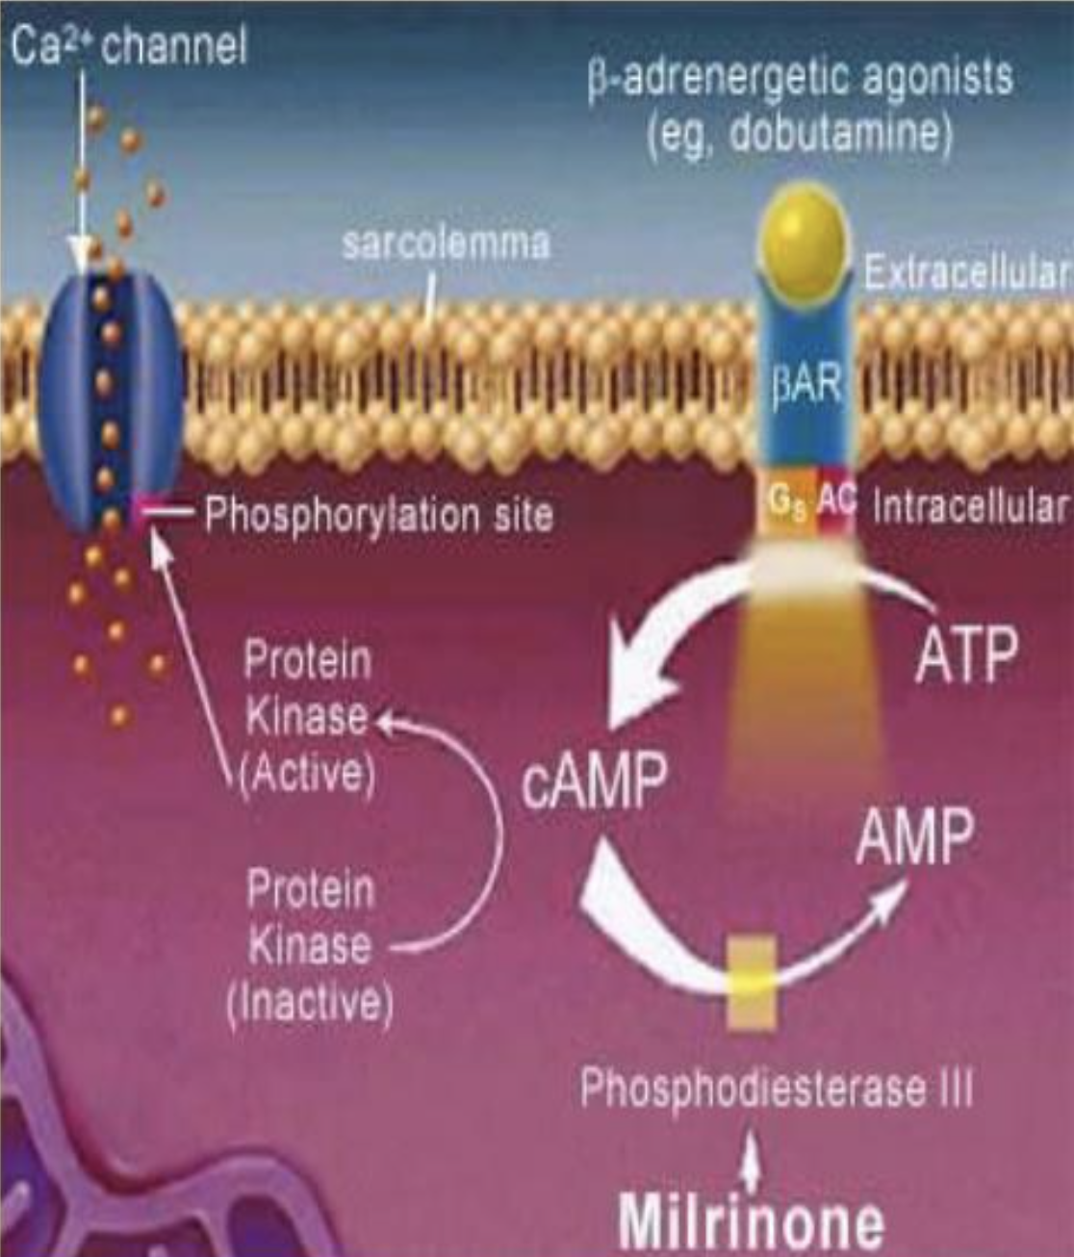
Milrinone
Class: Inotropic
MOA: cAMP phosphodiesterase inhibitor resulting in increased calcium concentration in myocytes and increased diastolic function and myocardial contractility.
Indication: Cardiogenic Shock, heart failure.
Adverse effects: arrhythmogenic
Contraindications: Valvular heart disease

Slide 19
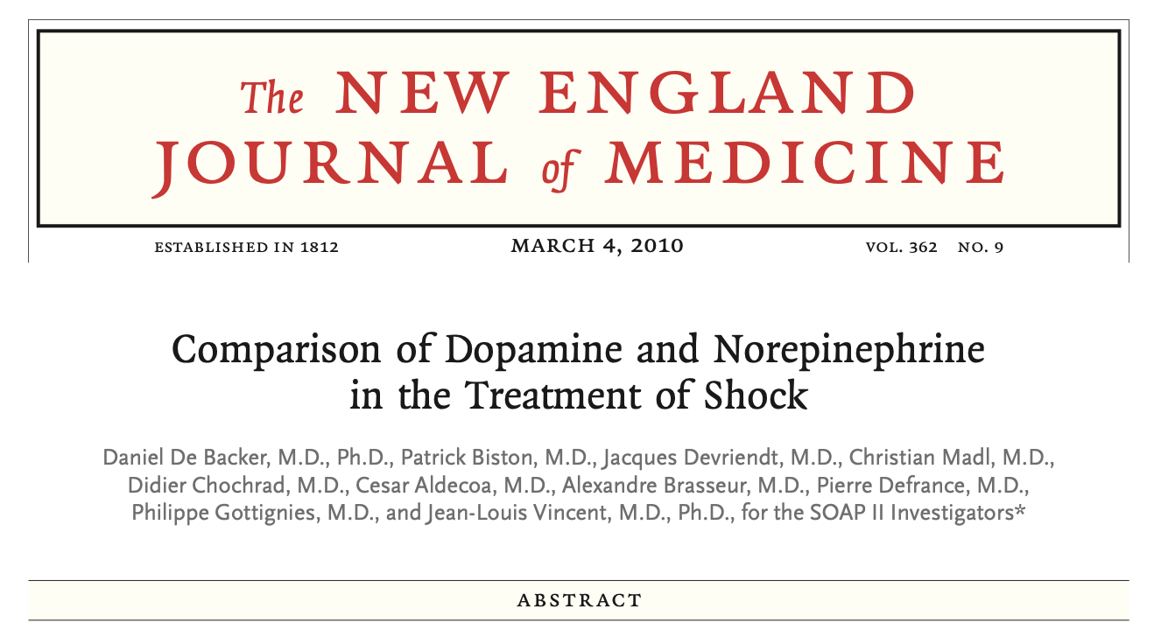

Slide 20
Dopamine vs Norepinephrine
Shock due to any cause
NE = Dop (Cochrane review, May 11 2011)
Septic shock - NE > Dop
No significant mortality difference, Greater adverse effects due to Dopamine.(N Engl J Med. 2010 Mar 4:362/91:779-89)
Mortality higher for dopamine (1) J Intensive Care Med. 2012 May-Jun;27(3):172-8 (2) Crit Care Med 2012; 40:725-730)
Cardiogenic shock - NE > Dop
Mortality as well as arrhythmias higher for Dopamine (N Engl J Med. 2010 Mar 4;362(9):779-89)
AHA 2009 /ESC 2012/HFSA 2010 guidelines do not comment on superiority/ priority of any single inotrope.... Dobutamine generally accepted as 1st inotrope of choice for heart
failure.

Slide 21
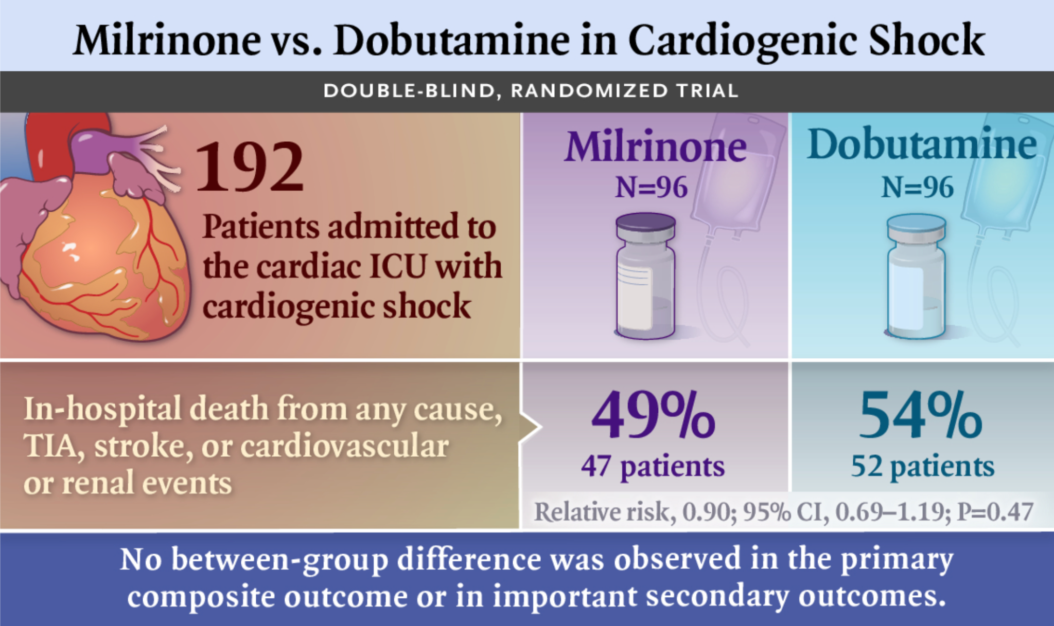

Slide 22
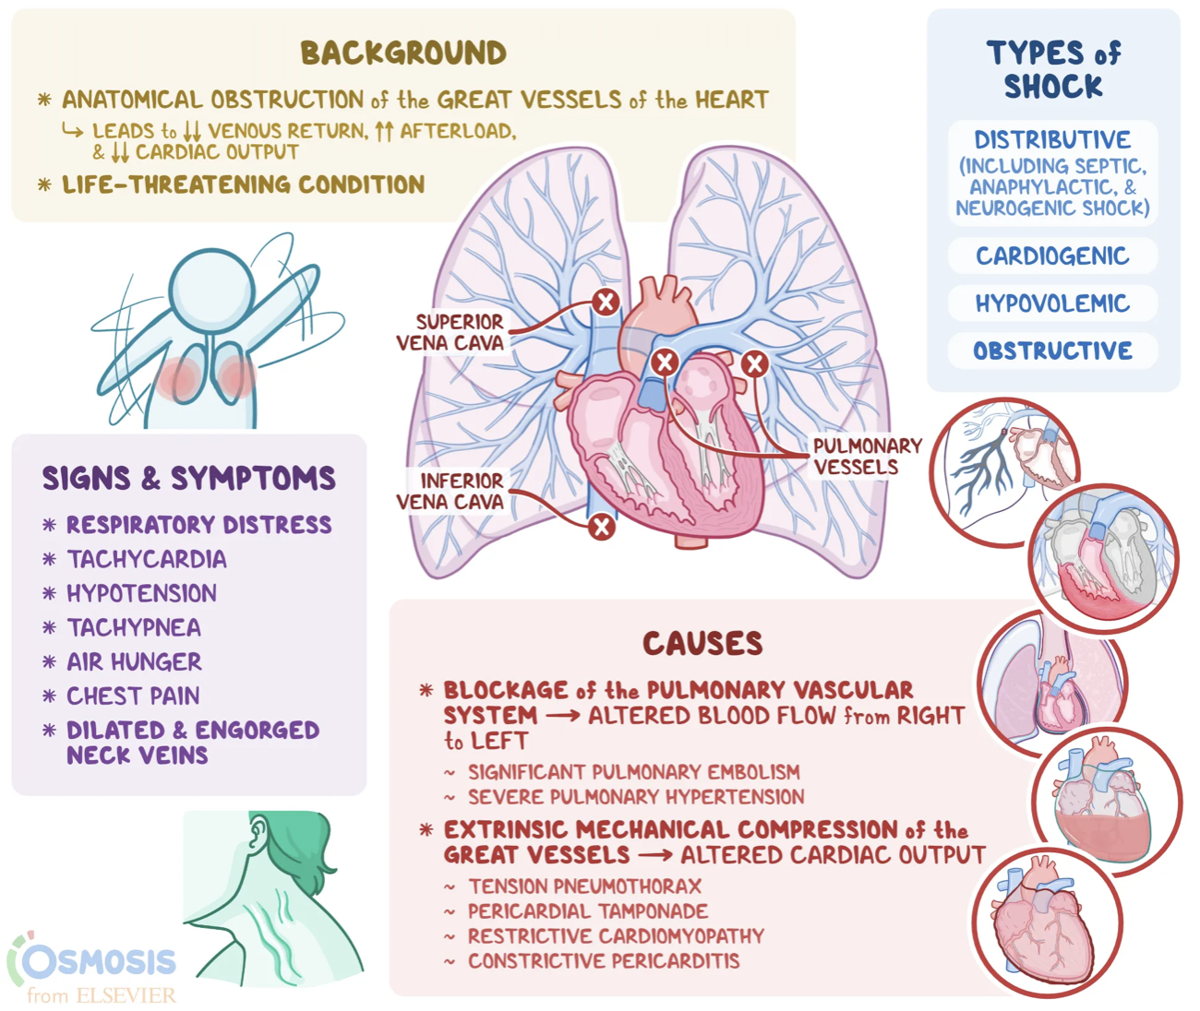
Obstructive shock

